Slide 1

Notes:
Welcome to Gospel Friday

Slide 2

Notes:
Welcome to regulars and newcomers.

Slide 3

Notes:
Prayer: Let’s open our meeting in prayer.

Slide 4
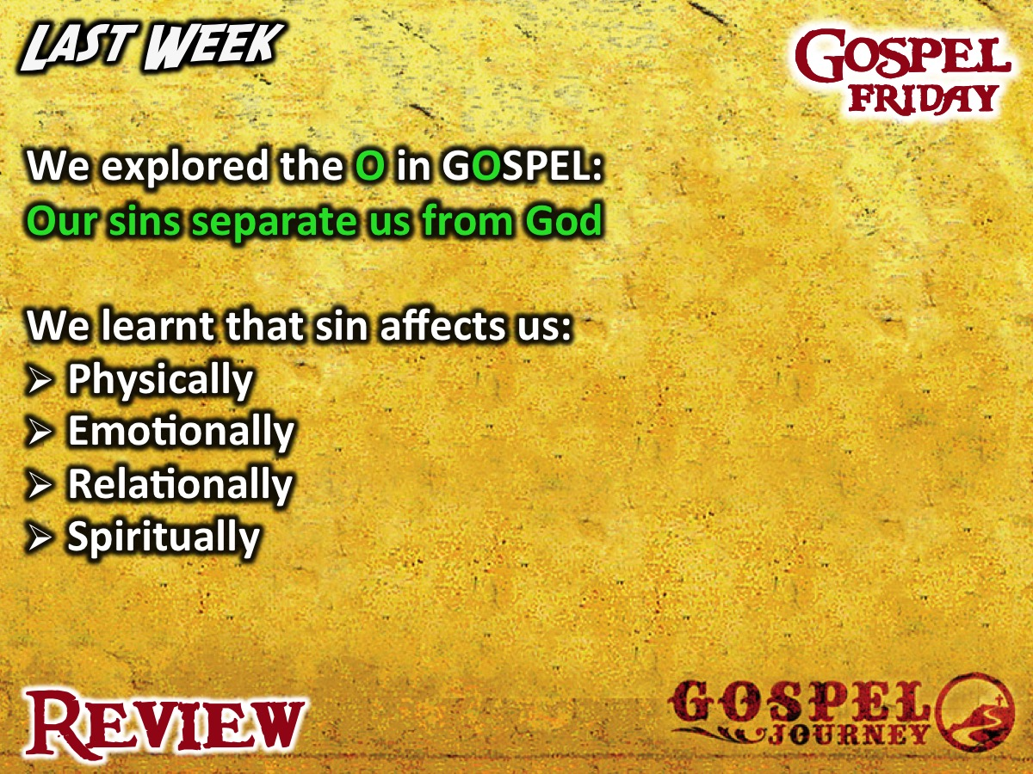
Notes:
Review: We explored the O in GOSPEL: Our sins separate us from God. We learnt that sin affects us Physically, Emotionally, Relationally and Spiritually.

Slide 5
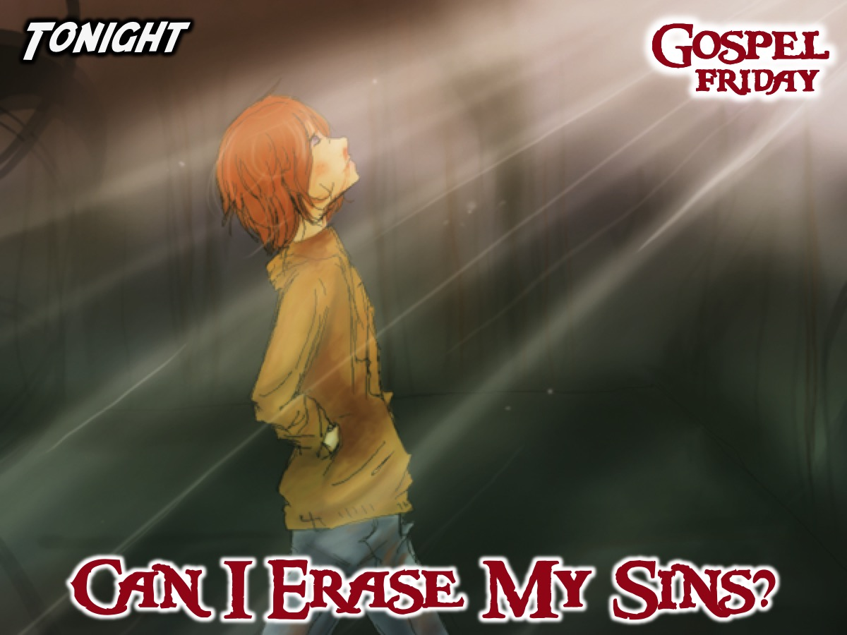
Notes:
Tonight we answer the question: Can I Erase My Sins?

Slide 6
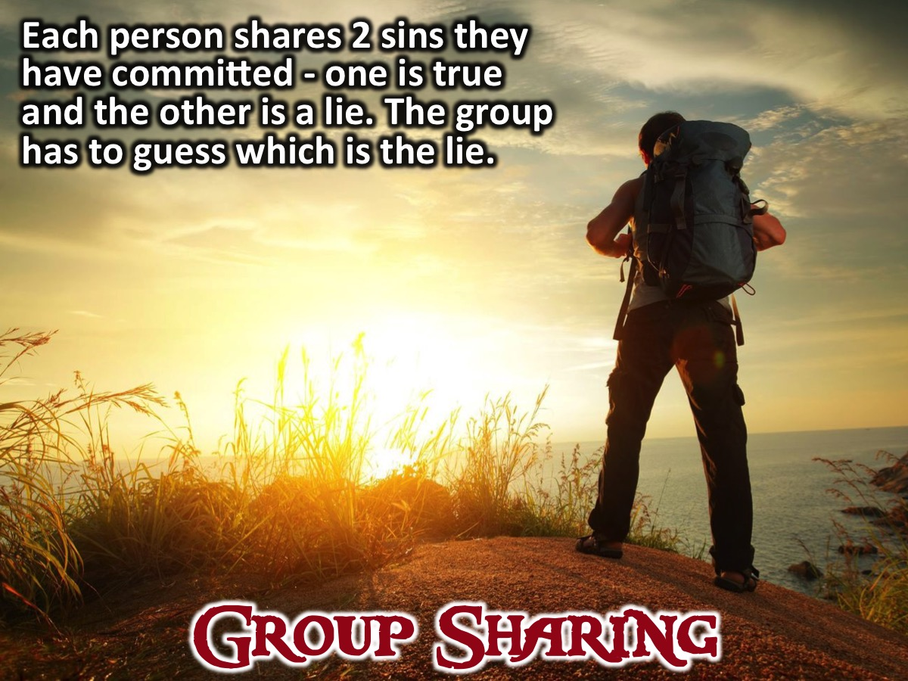
Notes:
Group Task: Each person shares 2 sins they have committed - one is true and the other is a lie. The group has to guess which is the lie.

Slide 7

Notes:
Intro: Tonight we’re going to be watching the fourth episode of the GOSPEL Journey series. In this episode we will find out how sin cannot be removed by good deeds.

Slide 8
Notes:
Video: Session 4 of the Gospel Journey DVD series. Length: 26 minutes.

Slide 9
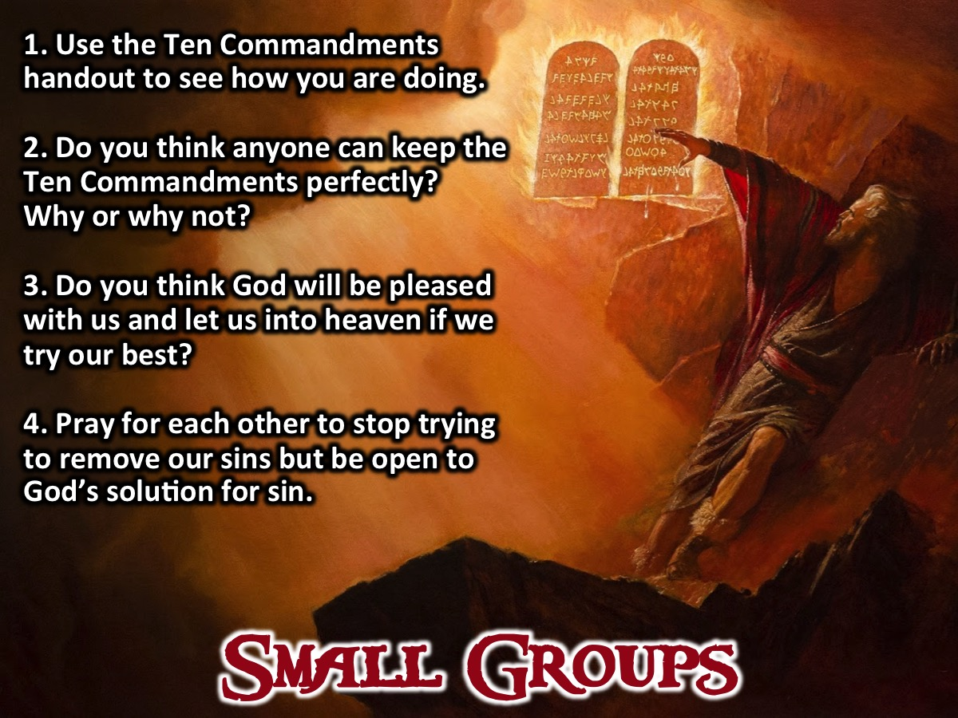
Notes:
Small Groups: Here are the small group question for this week: (1) Use the Ten Commandments handout to see how you are doing. (2) Do you think anyone can keep the Ten Commandments perfectly? Why or why not? (3) Do you think God will be pleased with us and let us into heaven if we try our best? (4) Pray for each other to stop trying to remove our sins but be open to God’s solution for sin.

Slide 10
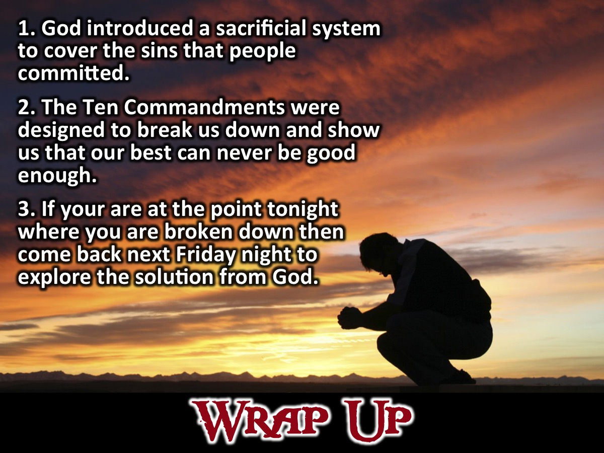
Notes:
Wrap Up: (1) God introduced a sacrificial system to cover the sins that people committed. (2) The Ten Commandments were designed to break us down and show us that our best can never be good enough. (3) If your are at the point tonight where you are broken down then come back next Friday night to explore the solution from God.

Slide 11

Notes:
Announcements: On Sunday mornings we are presenting The Shine Series.

Slide 12
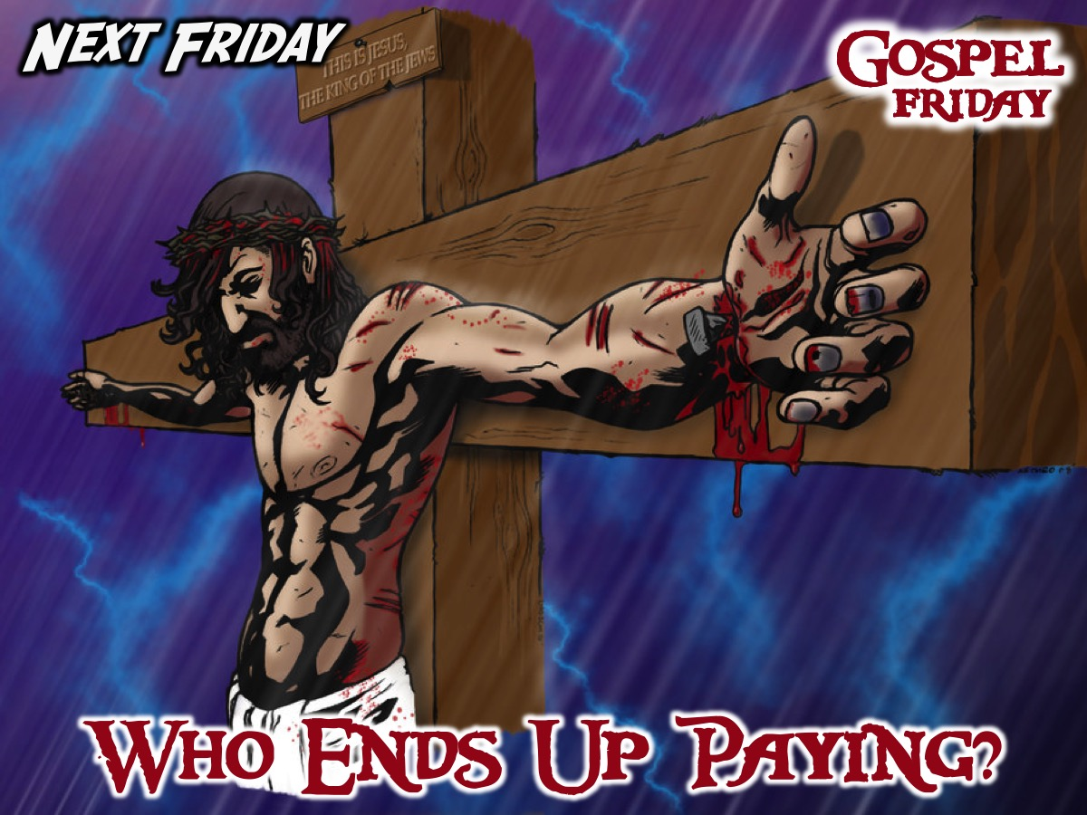
Notes:
Announcements: Next Friday night we answer the question: Who Ends Up Paying?

Slide 13

Notes:
Refreshments: It is time for refreshments.

