Slide 1

Notes:
Welcome to Gospel Friday

Slide 2

Notes:
Welcome to regulars and newcomers.

Slide 3

Notes:
Prayer: Let’s open our meeting in prayer.

Slide 4
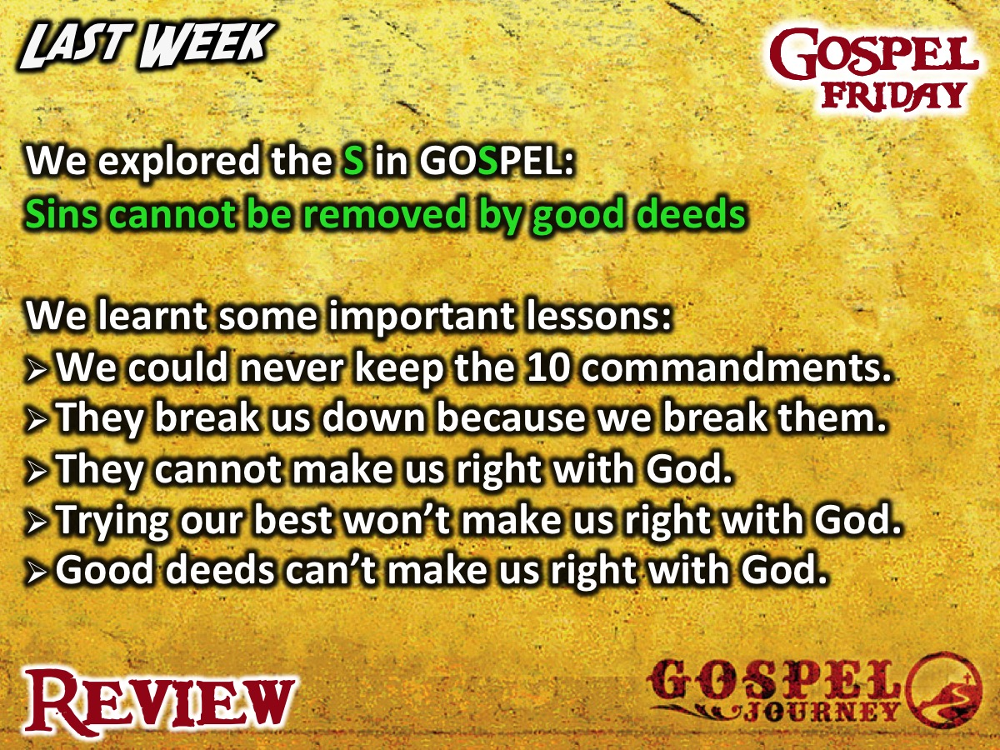
Notes:
Review: Last week we explored the S in GOSPEL: Sins cannot be removed by good deeds. We learnt some important lessons: (1) We could never keep the 10 commandments. (2) They break us down because we break them. (3) They cannot make us right with God. (4) Trying our best won’t make us right with God. (5) Good deeds can’t make us right with God.

Slide 5
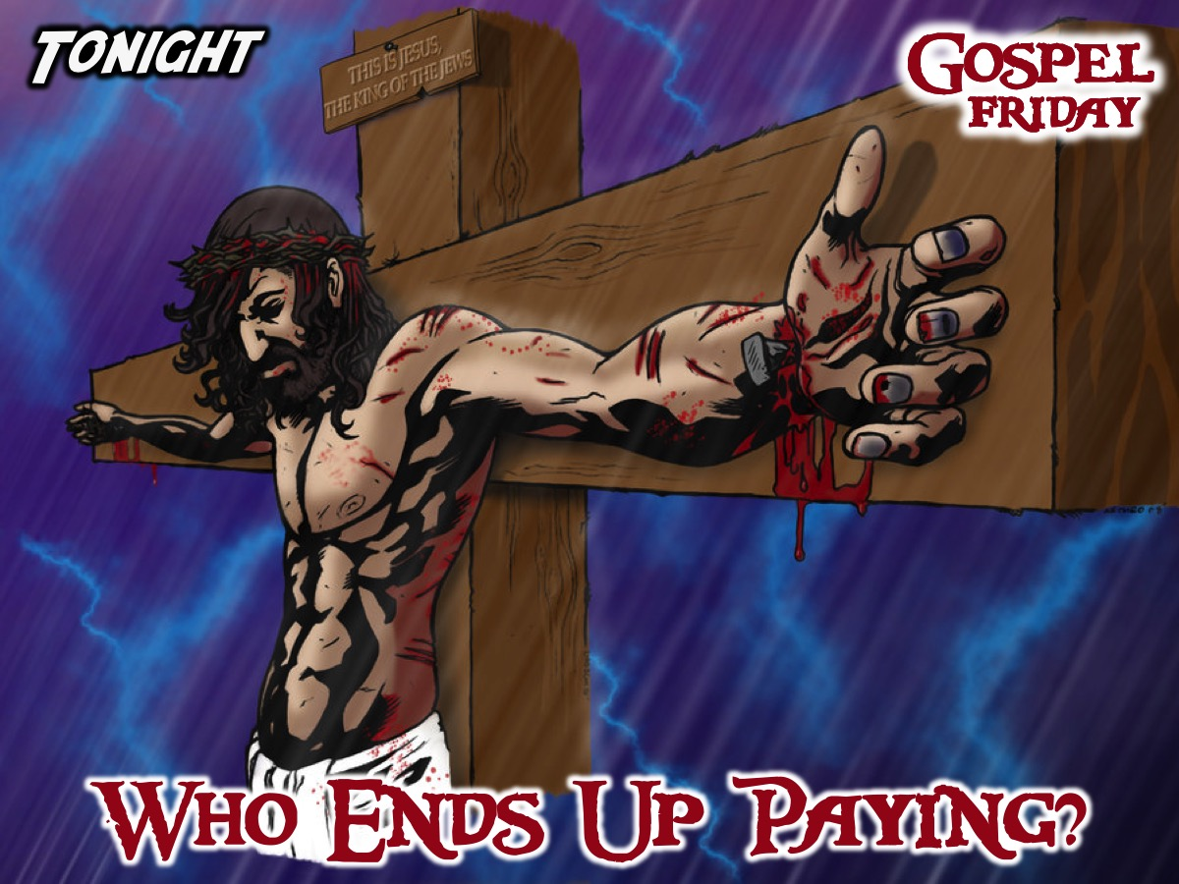
Notes:
Tonight we answer the question: Who Ends Up Paying?

Slide 6

Notes:
Group Task: What sacrifice have you made in your life and what impact has it had on your life?

Slide 7

Notes:
Intro: Tonight we’re going to be watching the fifth episode of the GOSPEL Journey series. In this episode we will find out how paying the price for sin, Jesus died and rose again.

Slide 8
Notes:
Video: Session 5 of the Gospel Journey DVD series. Length: 23 minutes.

Slide 9

Notes:
Small Groups: Here are the small group question for this week: (1) What do these verses say about what Jesus did on the cross for you? “He personally carried our sins in his body on the cross so that we can be dead to sin and live for what is right. Christ suffered for our sins once for all time. He never sinned, but he died for sinners to bring you safely home to God. He suffered physical death, but he was raised to life in the Spirit.” (1 Peter 2:24; 3:18). (2) Write down some sins you are ashamed of on a piece of paper. Then tear it up into little pieces and throw them away knowing that Jesus paid the price for your sins. (3) Thank God for making a way for your sins to be forgiven.

Slide 10
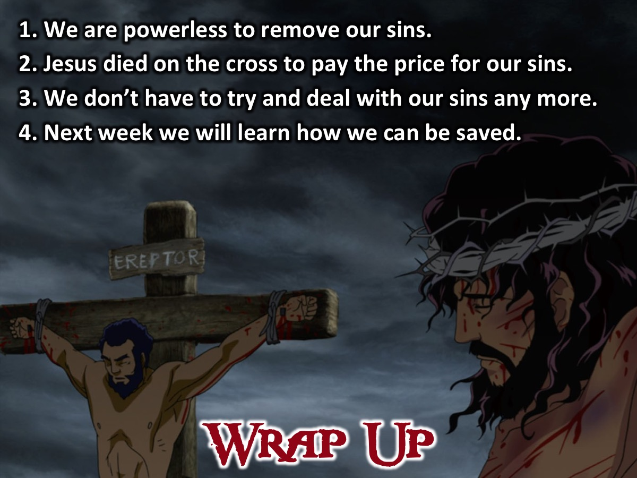
Notes:
Wrap Up: (1) We are powerless to remove our sins. (2) Jesus died on the cross to pay the price for our sins. (3) We don’t have to try and deal with our sins any more. (4) Next week we will learn how we can be saved.

Slide 11

Notes:
Announcements: On Sunday mornings we are presenting The Shine Series.

Slide 12
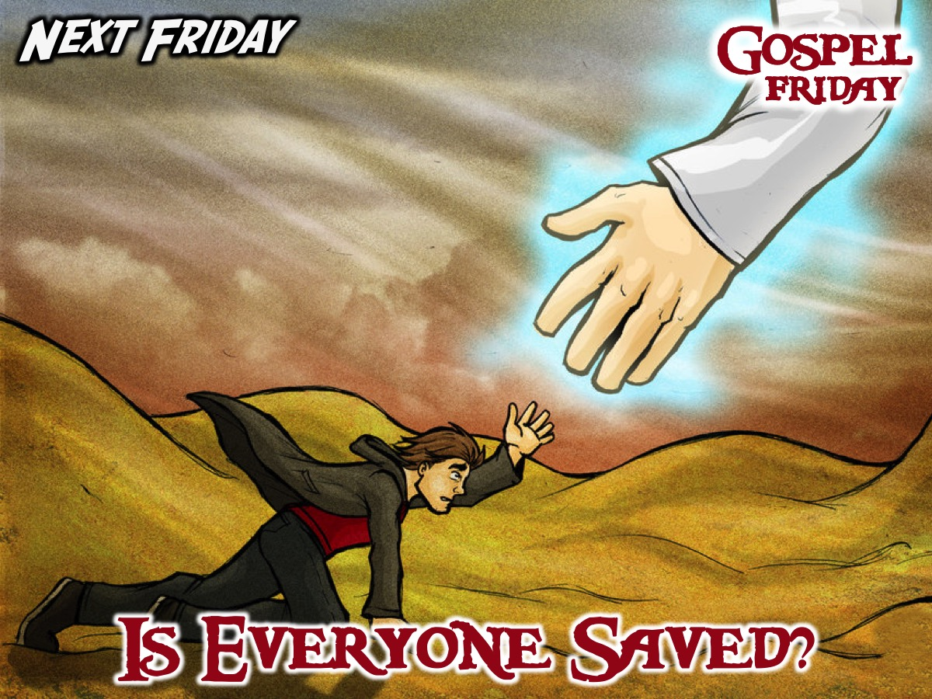
Notes:
Announcements: Next Friday night we answer the question: Is Everyone Saved?

Slide 13
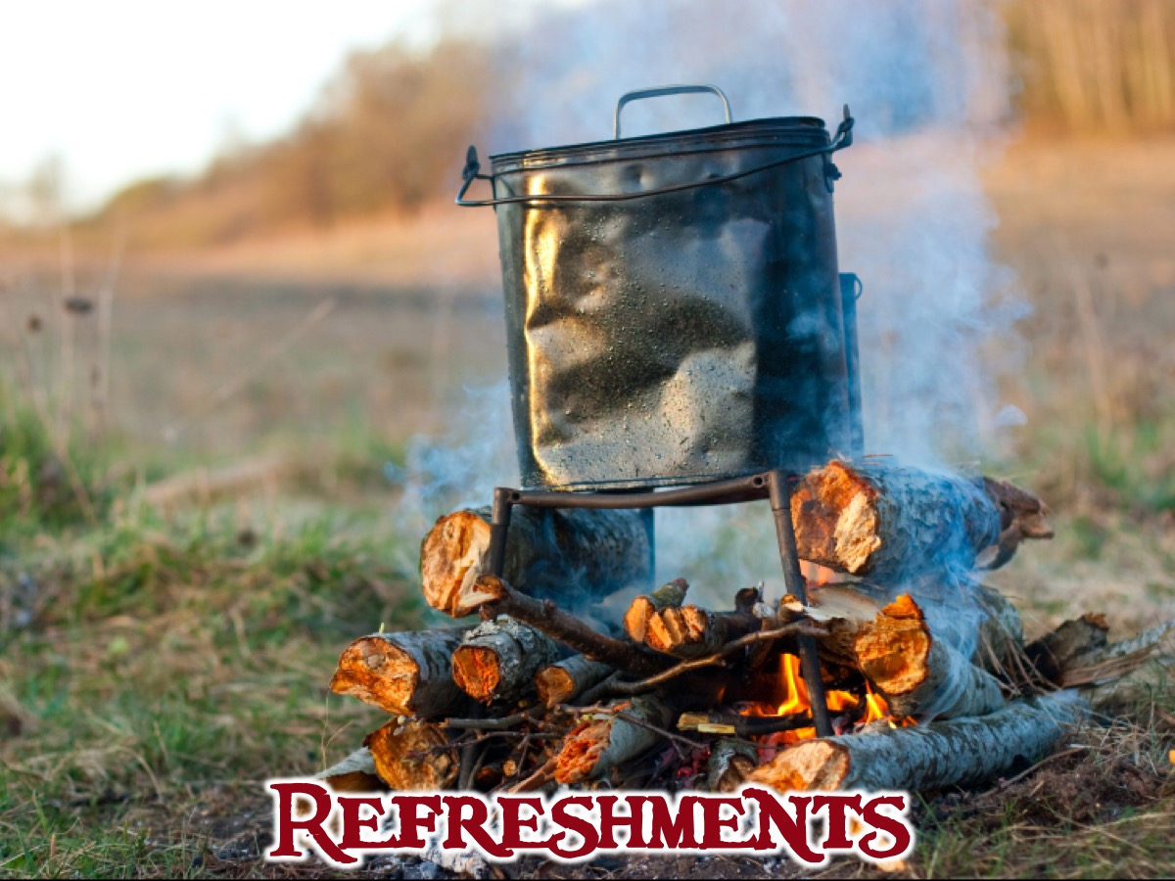
Notes:
Refreshments: It is time for refreshments.

