Slide 1

Notes:
Welcome to Gospel Friday

Slide 2

Notes:
Welcome to regulars and newcomers.

Slide 3

Notes:
Prayer: Let’s open our meeting in prayer.

Slide 4
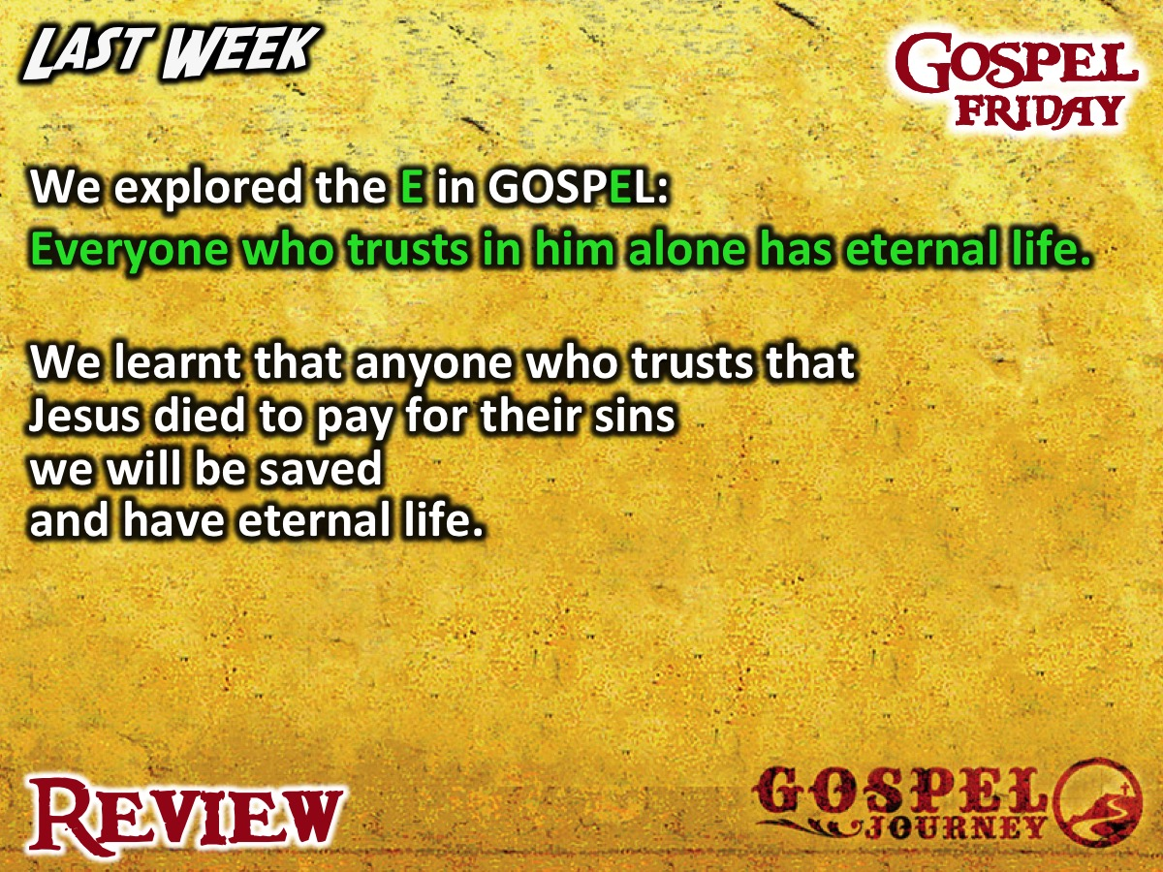
Notes:
Review: Last week we explored the E in GOSPEL: Everyone who trusts in him alone has eternal life. We learnt that anyone who trusts that Jesus died to pay for their sins we will be saved and have eternal life.

Slide 5
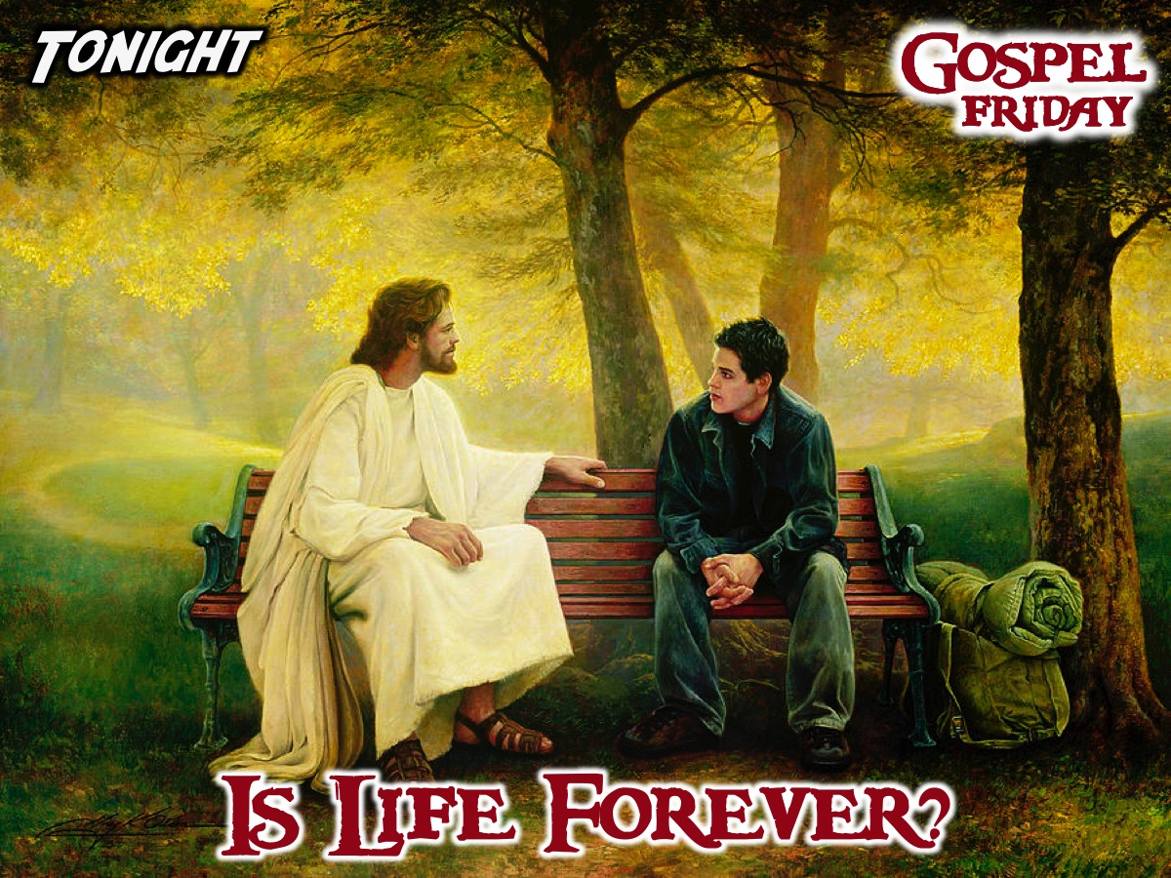
Notes:
Tonight we answer the question: Is Life Forever?

Slide 6

Notes:
Group Sharing: What close encounter have you had with death?

Slide 7

Notes:
Tonight we’re going to be watching the seventh episode of the GOSPEL Journey series. In this episode we will find out that life with Jesus starts now and lasts forever.

Slide 8
Notes:
Video: Session 7 of the Gospel Journey DVD series. Length: 16 minutes.

Slide 9
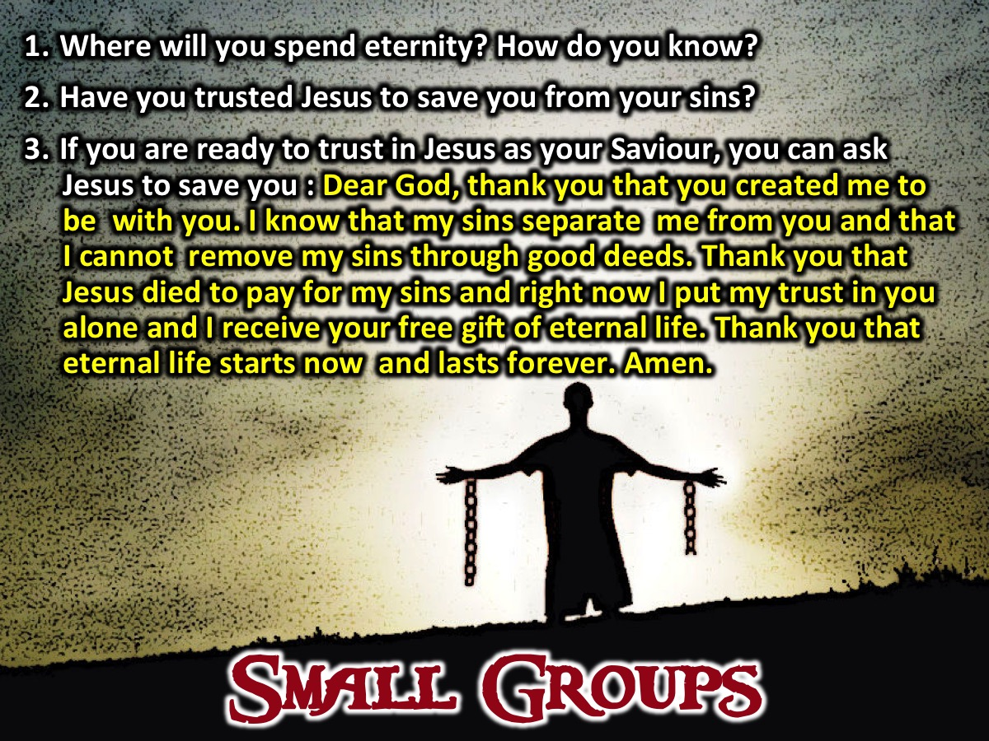
Notes:
Small Groups: Here are the small group question for this week: (1) Where will you spend eternity? How do you know? (2) Have you trusted Jesus to save you from your sins? (3) If you are ready to trust in Jesus as your Saviour, you can ask Jesus to save you: Dear God, thank you that you created me to be with you. I know that my sins separate me from you and that I cannot remove my sins through good deeds. Thank you that Jesus died to pay for my sins and right now I put my trust in you alone and I receive your free gift of eternal life. Thank you that eternal life starts now and lasts forever. Amen.
:

Slide 10

Notes:
Wrap Up: (1) Eternal life is about quality (an awesome kind of life) and quantity (an unending life). (2) We only have it when we believe that Jesus died for our sins and we ask him to save us. (3) If this series has been a watershed moment in your life, then stand so we can ask God to help you on your journey.

Slide 11

Notes:
Announcements: On Sunday mornings we are presenting The Shine Series.

Slide 12
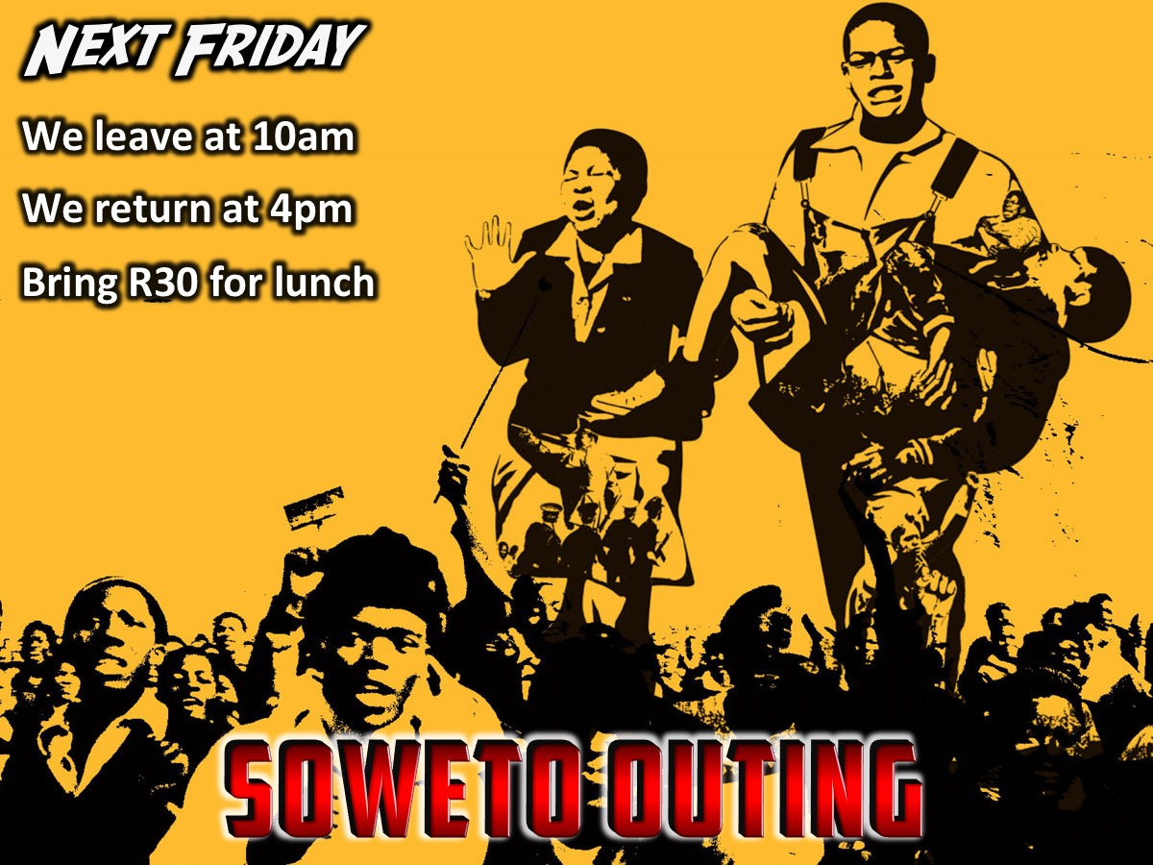
Notes:
Announcements: Next Friday we are going to Soweto for Youth day. Meet at church at 10am and we will end around 4pm back at church. Bring R30 for a Korta and a Coke.

Slide 13
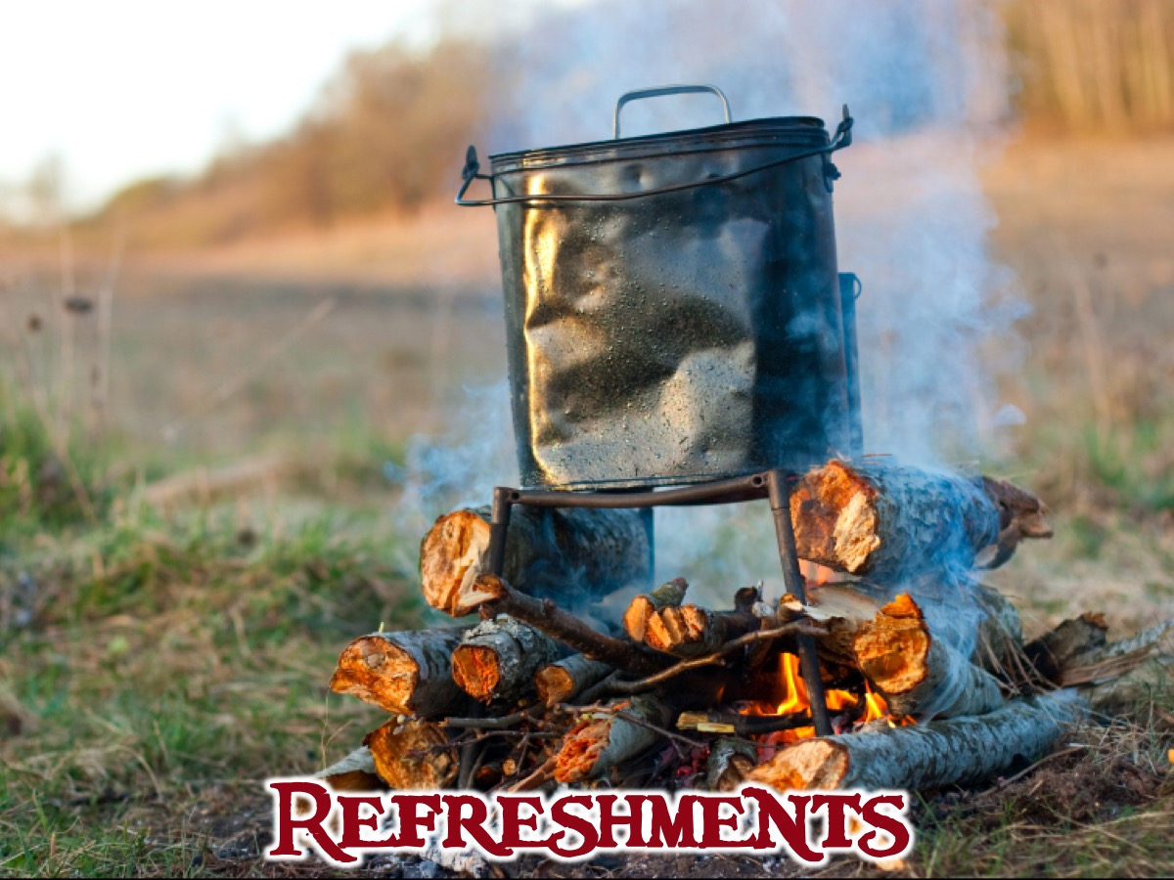
Notes:
Refreshments: It is time for refreshments.

