Slide 1

Notes:
Welcome to Uno & Friends Night

Slide 2

Notes:
Welcome to regulars and newcomers

Slide 3

Notes:
Prayer: Let’s open our meeting in prayer.

Slide 4
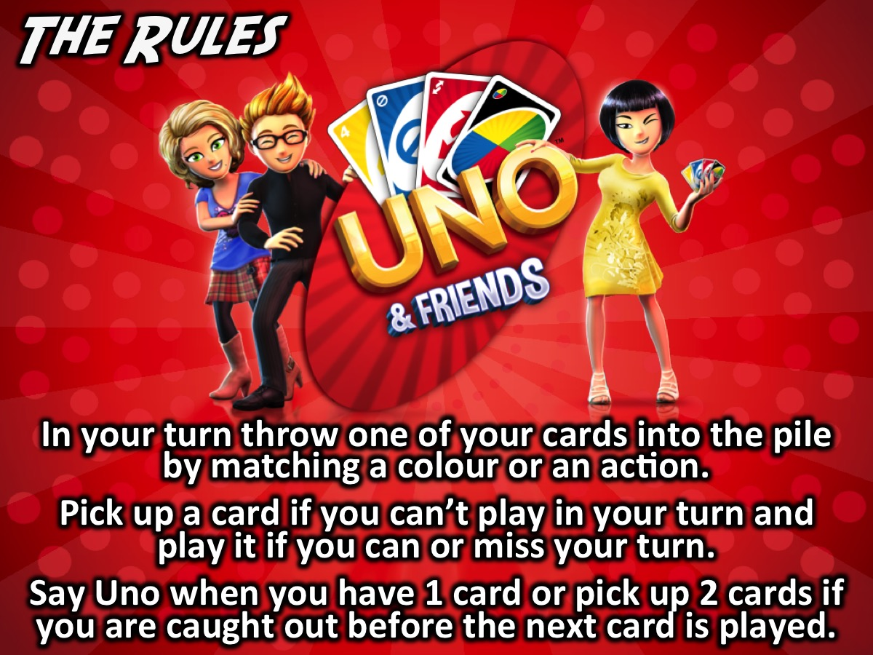
Notes:
The Rules: (1) In your turn throw one of your cards into the pile by matching a colour or an action. (2) Pick up a card if you can’t play in your turn and play it if you can or miss your turn. (3) Say Uno when you have 1 card or pick up 2 cards if you are caught out before the next card is played.

Slide 5
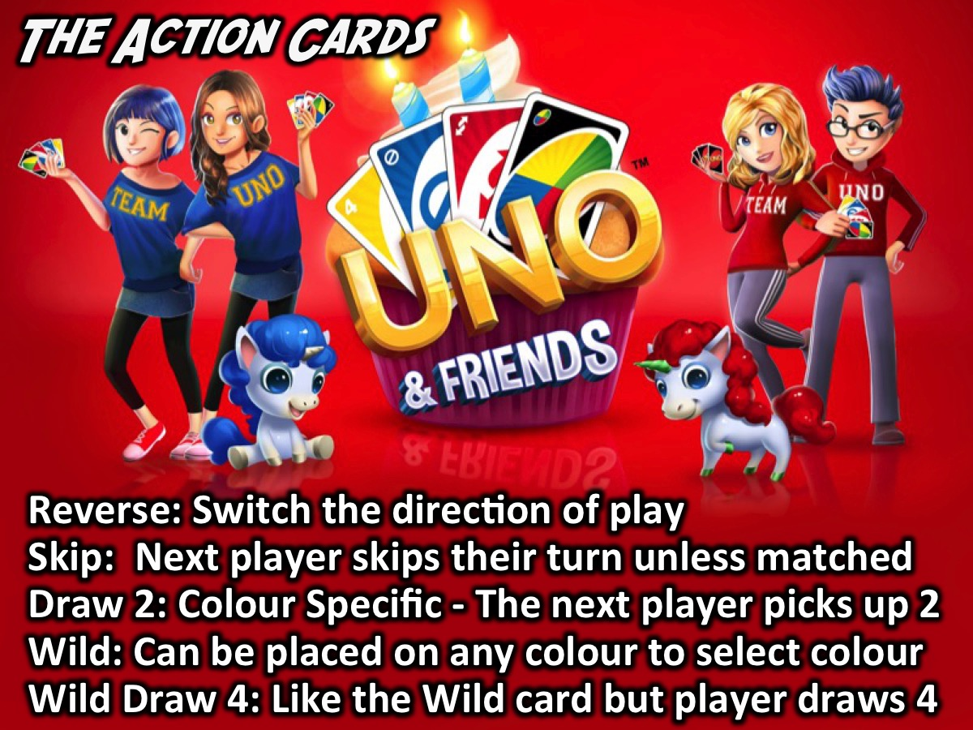
Notes:
The Action Cards: There are Action cards that help mix up the game: (1) Reverse: If going clockwise, switch to counterclockwise or vice versa. (2) Skip: When this card is played, the next player has to skip their turn. (3) Draw Two: When a person places this card, the next player will have to pick up two cards and miss their turn. (4) Wild: This card represents all four colors, and can be placed on any card. The player has to state which color it will represent for the next player. (5) Wild Draw Four: This acts just like the wild card except that the next player also has to draw four cards.

Slide 6
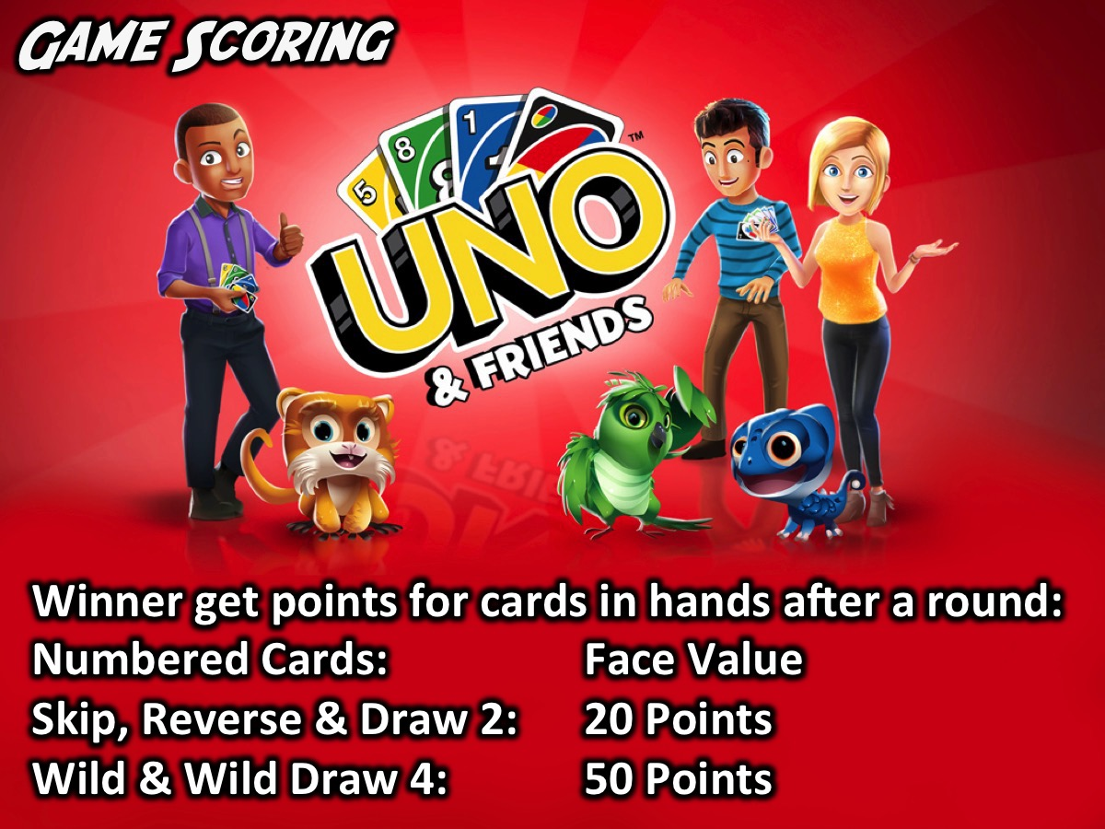
Notes:
Game Scoring: The winner get the points for all cards left in all the other players hands after each round: (1) Numbered Cards score their Face Value (0-9). (2) Skip, Reverse & Draw 2 are 20 Points each. (3) Wild & Wild Draw 4 are 50 Points each.

Slide 7

Notes:
Let’s Play Uno!

Slide 8

Notes:
Prizes: The champion UNO player from each table receives a prize.

Slide 9
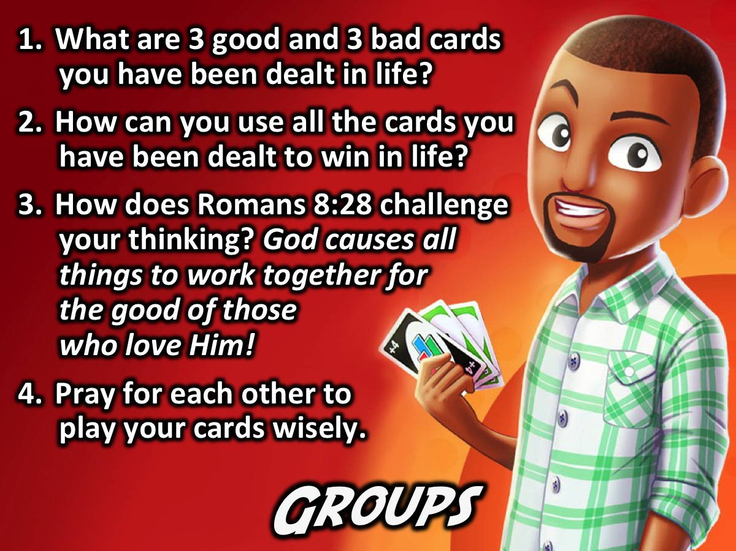
Notes:
Small Groups: Here are the small group questions for this Friday night: (1) What are 3 good and 3 bad cards you have been dealt in life? (2) How can you use all the cards you have been dealt to win in life? (3) How does Romans 8:28 challenge your thinking? “God causes all things to work together for the good of those who love Him!” (4) Pray for each other to play your cards wisely.

Slide 10

Notes:
Announcements: On Sunday mornings we are presenting The Shine Series.

Slide 11

Notes:
Announcements: Next Friday it is our last Friday night for the term - it is time to Party!

Slide 12

Notes:
Refreshments: It is time for refreshments.

