Slide 1

Notes:
Here are some do’s and don’ts for leaders at His Youth.

Slide 2

Notes:
Don’t climb onto the roof

Slide 3

Notes:
And don’t jump off the roof!

Slide 4
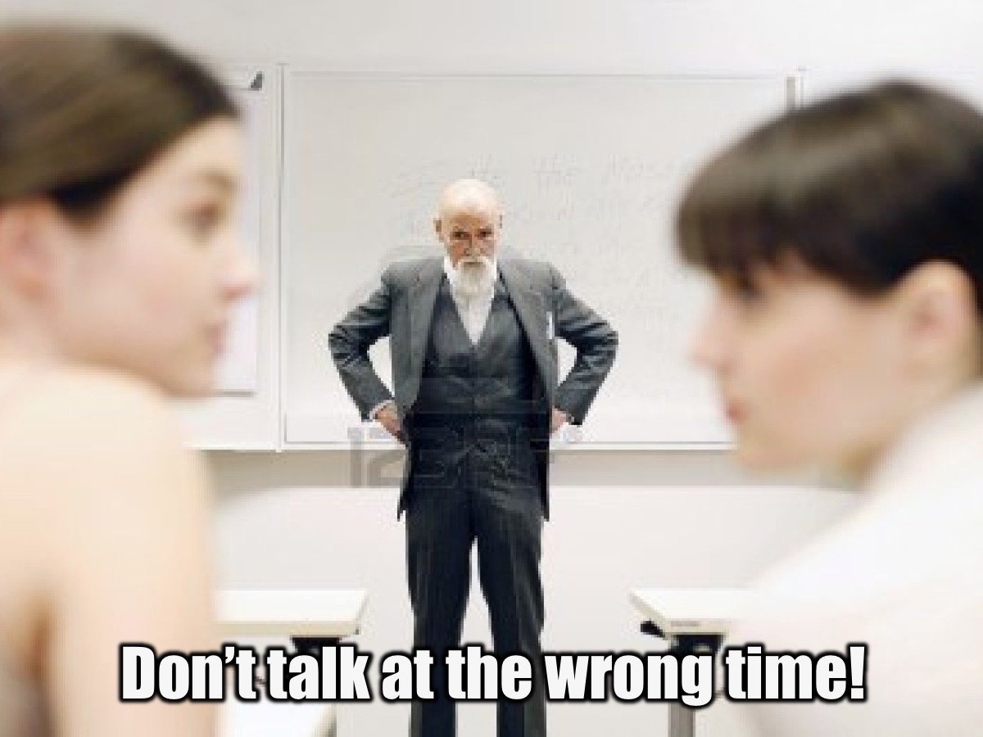
Notes:
Don’t talk at the wrong time! If you talk while the program is on you are disturbing others!

Slide 5
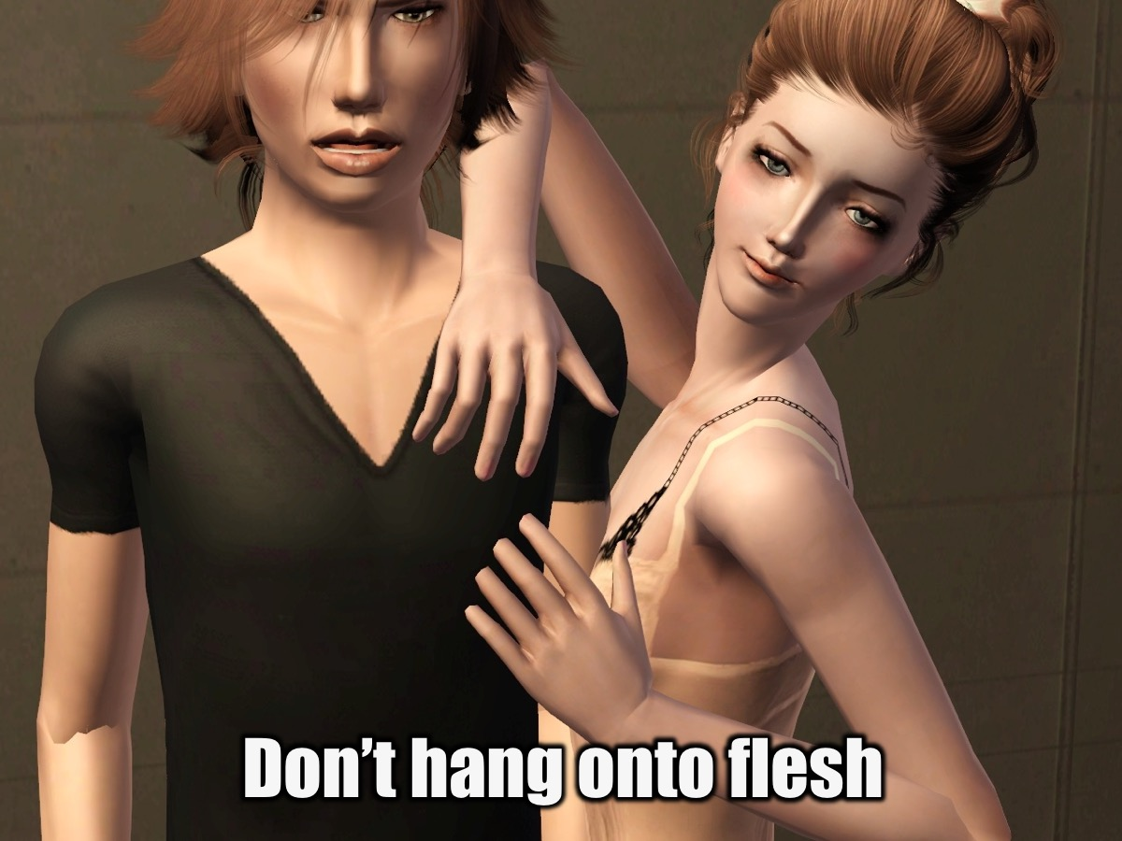
Notes:
Don’t hang onto flesh! Engaging in excessive physical contact is not setting a good ecample!

Slide 6
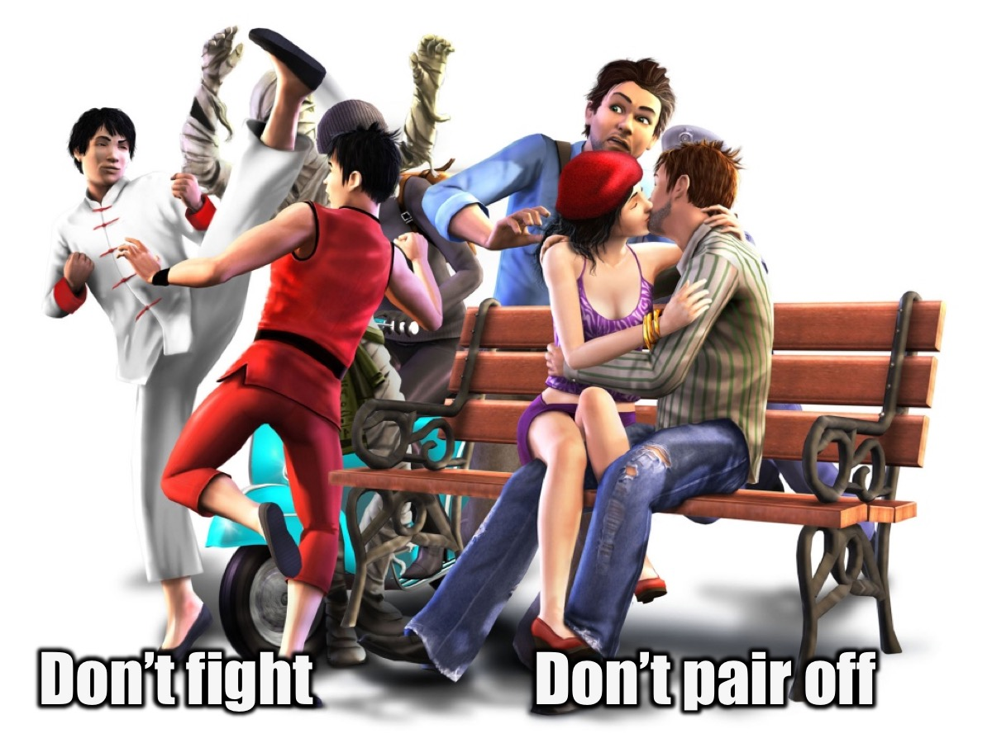
Notes:
Don’t fight and don’t pair off - in other words, avoid Kissing and Fighting!

Slide 7
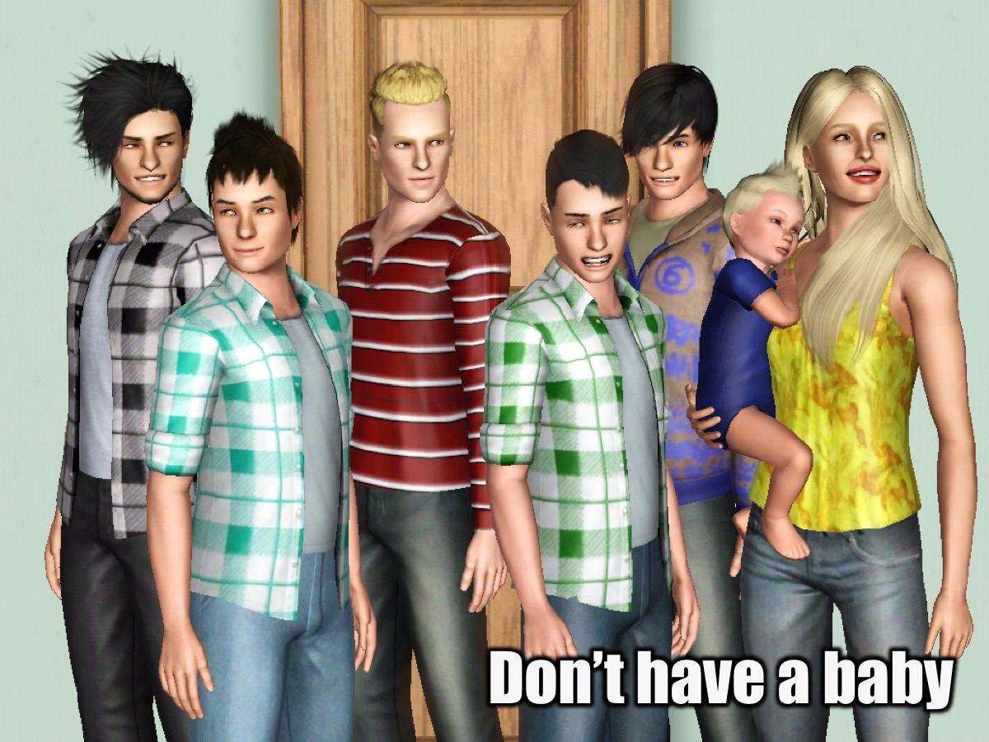
Notes:
Don’t have a baby! Unless you are married of course!

Slide 8
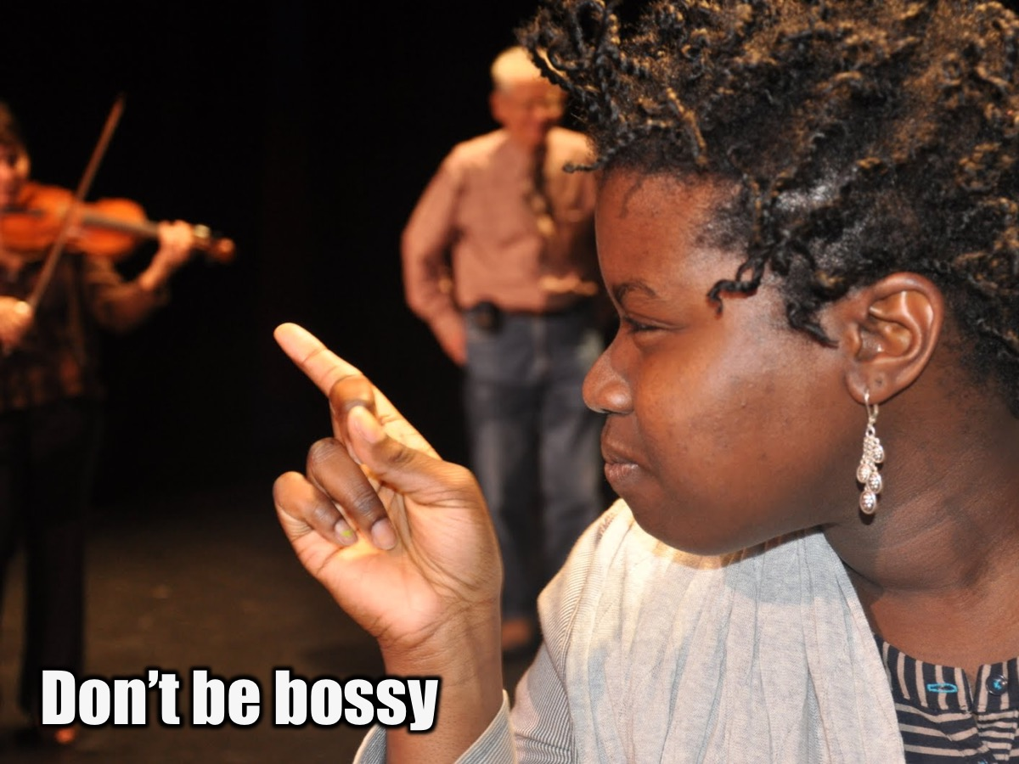
Notes:
Don’t be bossy! You are not a School prefect!

Slide 9

Notes:
Don’t panic! Remain calm and figure out what to do in each situation!

Slide 10

Notes:
Don’t over-react! It does not help to get hysterical and get dramatic about stuff that happens!

Slide 11

Notes:
So, instead of doing all those negative things… Do this – not that…

Slide 12

Notes:
Be helpful - Ask if you can do anything.

Slide 13

Notes:
Be fun.

Slide 14

Notes:
Come to serve.

Slide 15
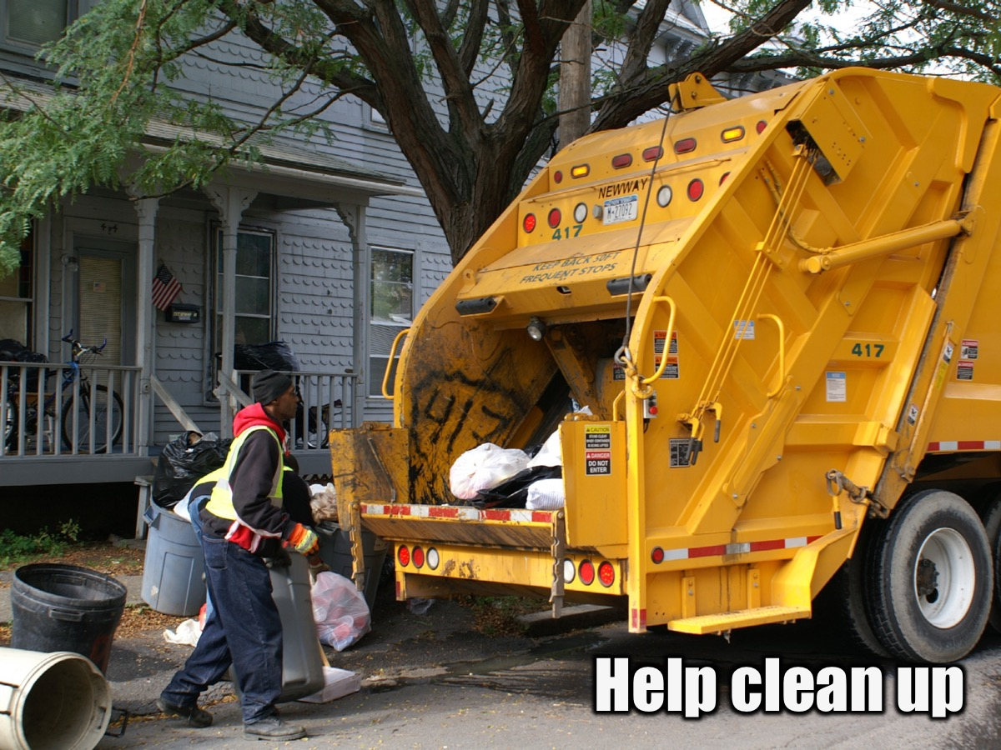
Notes:
Help clean up.

Slide 16
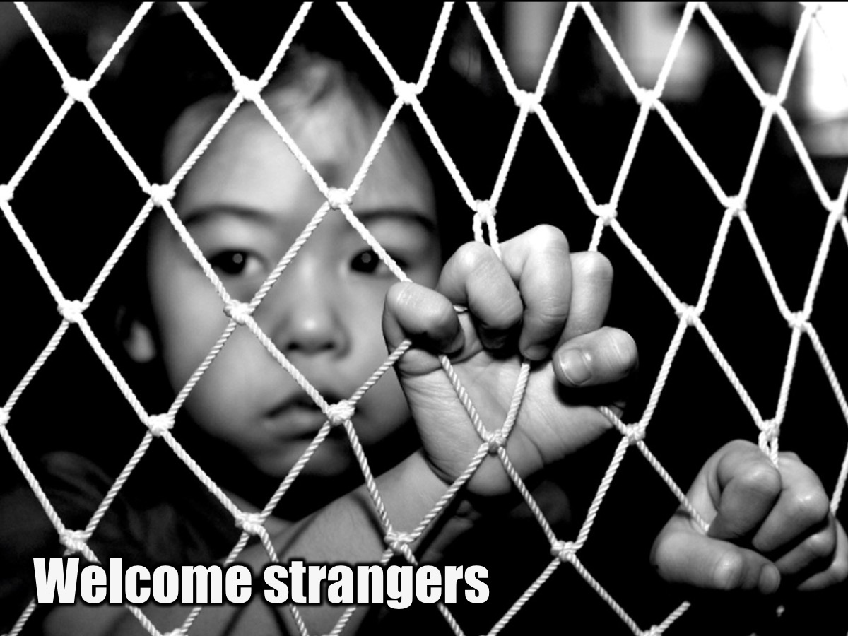
Notes:
Look out for outsiders and welcome them into the group.

Slide 17
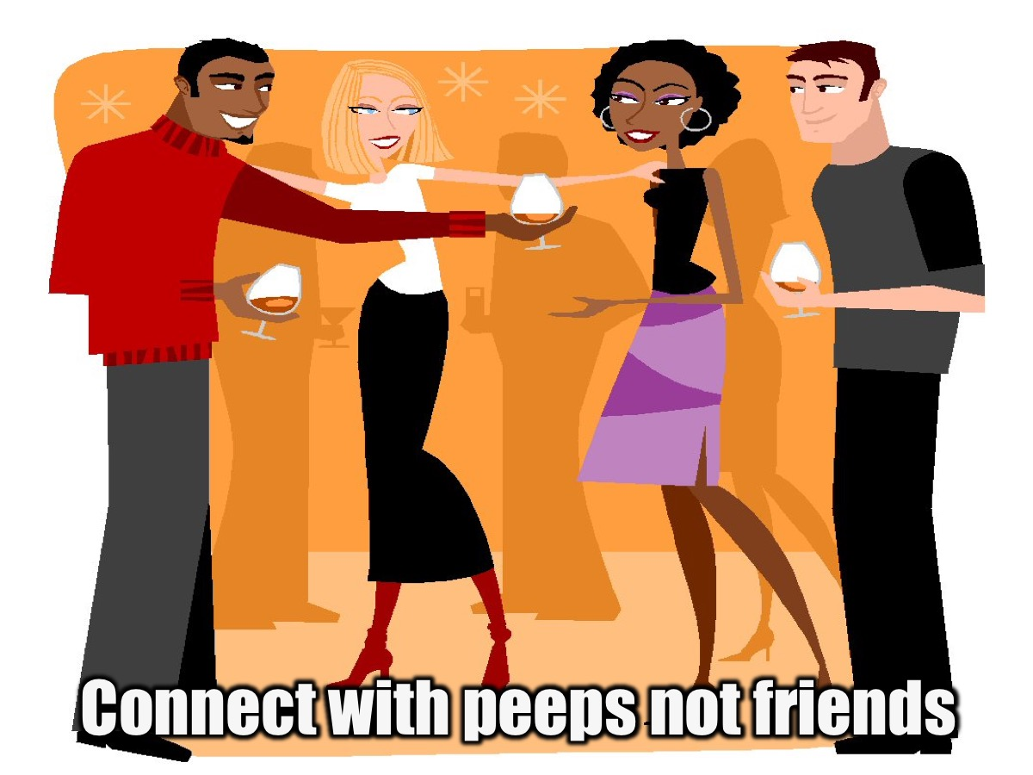
Notes:
Communicate with newcomers rather than your own friends.

Slide 18

Notes:
Connect via social media.

Slide 19

Notes:
Use your initiative – don’t wait to be told to do something.

Slide 20

Notes:
Be approachable.

Slide 21

Notes:
Minister to people who are in need.

Slide 22

Notes:
Add value to the team and the ministry.

Slide 23
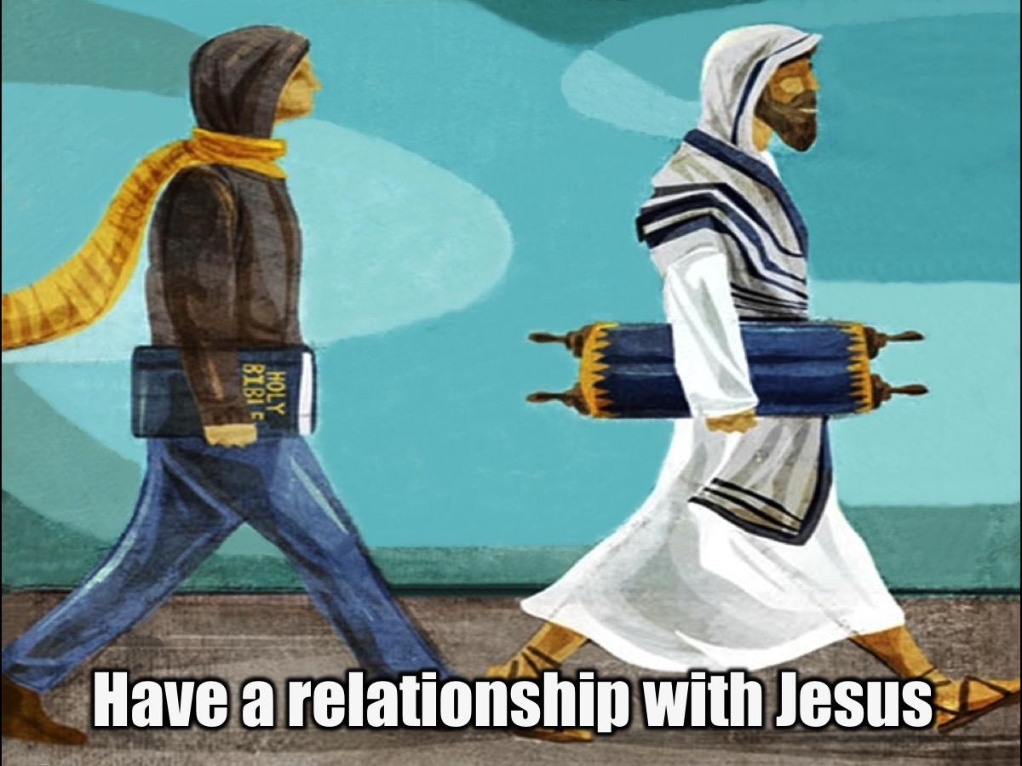
Notes:
Have a genuine relationship with the Lord.

Slide 24

Notes:
Love God, Love People and do something about it.

