Slide 1

Notes:
The First Part of Our Planning Session was PRAY:
We started our time with guided devotions and prayer using these five lessons we learnt from Nehemiah in chapter 1:
(1) Get The Facts (Nehemiah 1:1-3) - we spent time in prayer reflecting on the state of our lives, ministries and organisation.
(2) Go to God (Nehemiah 1:4-6a) - we spent time giving God the praise He deserves deserves for who he is and all he does.
(3) Confess your Sins (Nehemiah 1:6b-7) - we spent time confessing any personal or corporate sins that God brought to our attention.
(4) Remember the Past (Nehemiah 1:8-10) - we spent time remembering all that God has done in the past in and through us or your ministries.
(5) Ask for Help (Nehemiah 1:11) - we spent time asking God help us experience success and favour in the coming months.

Slide 2

Notes:
The Second Part of our Planning Session was SURVEY:​
Using the example of Nehemiah who went out to survey the situation (Nehemiah 2:11-16) we went on a prayer journey for 30 minutes where leaders listened to what God was saying to them about the organisation as they contemplated the following things: Buildings, Grass, Trees, Mountains, Sky and anything else they encountered. All the insights were captured on a flipchart and then each delegate reflected on the top three insights they received and they were used to create a list of key insights from the group.

Slide 3

Notes:
The Third Part of our Planning Session was Build
Nehemiah 3 describes the building process that was started and we were guided by the Patrick Lencioni book, The Advantage, that describes 4 disciples of a healthy organisation.

Slide 4

Notes:
Four Disciplines of a Healthy Organisation.

Slide 5

Notes:
The Advantage by Patrick Lencioni. In The Advantage, Patrick Lencioni identifies Four Disciples of a Healthy Organisation. But first, a video…

Slide 6
Notes:
Video: Honda Clarity Advert. Get it on YouTube at: https://www.youtube.com/watch?v=ncN8MfkQaCA

Slide 7
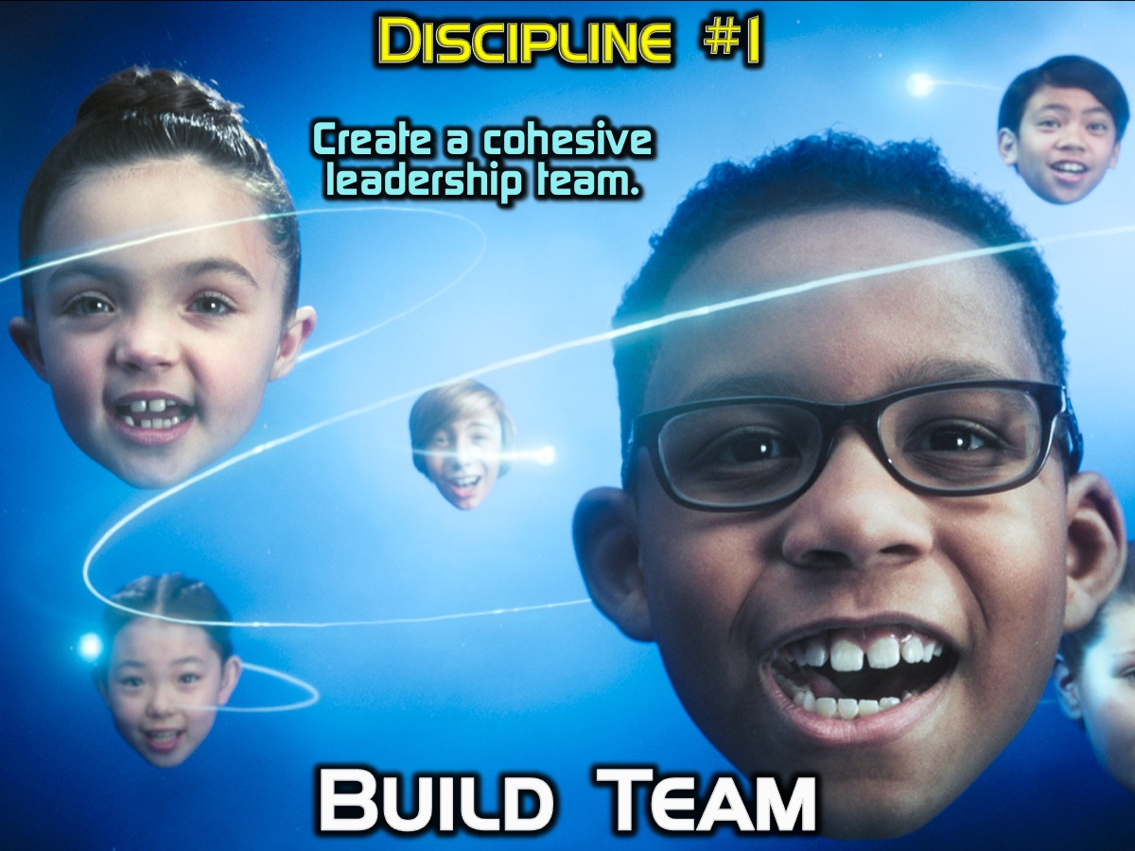
Notes:
Discipline #1: Build Team: The first and most critical step towards a healthy organization is creating a cohesive leadership team. Without an aligned team at the top of an organization, it will never come near to reaching its full potential.

Slide 8
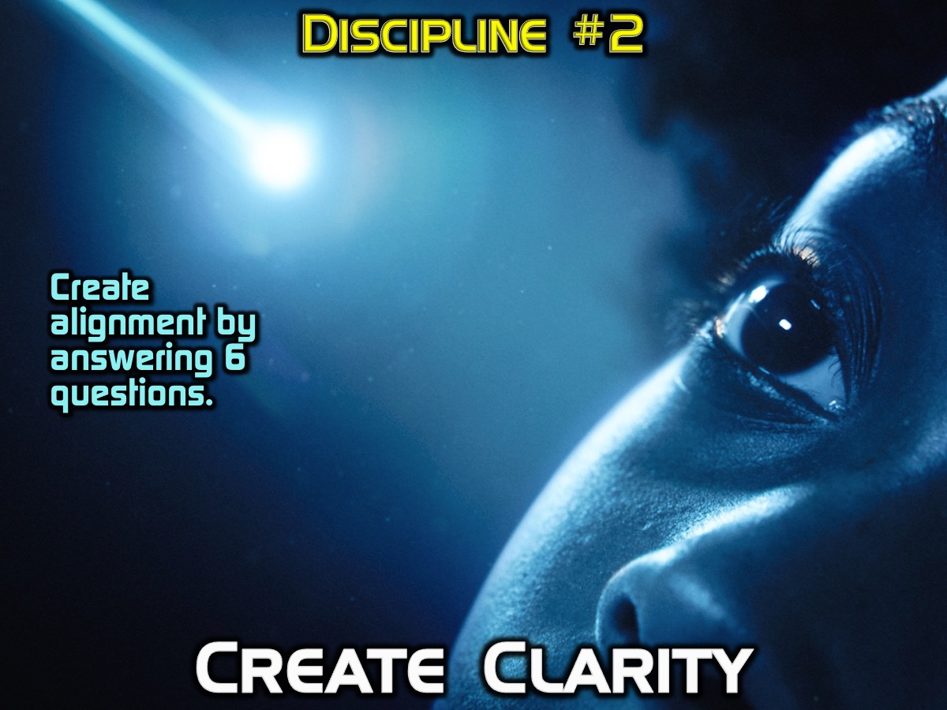
Notes:
Discipline #2: Create Clarity: Creating alignment at the executive level is essential to building and maintaining a healthy organization. There is probably no greater frustration for employees than having to navigate the politics and confusion caused by leaders who are misaligned. Even the slightest bit of daylight between executive team members can cause an overwhelming effect on employees below. There are six simple but critical questions that need to be answered, eliminating all discrepancies among team members.

Slide 9
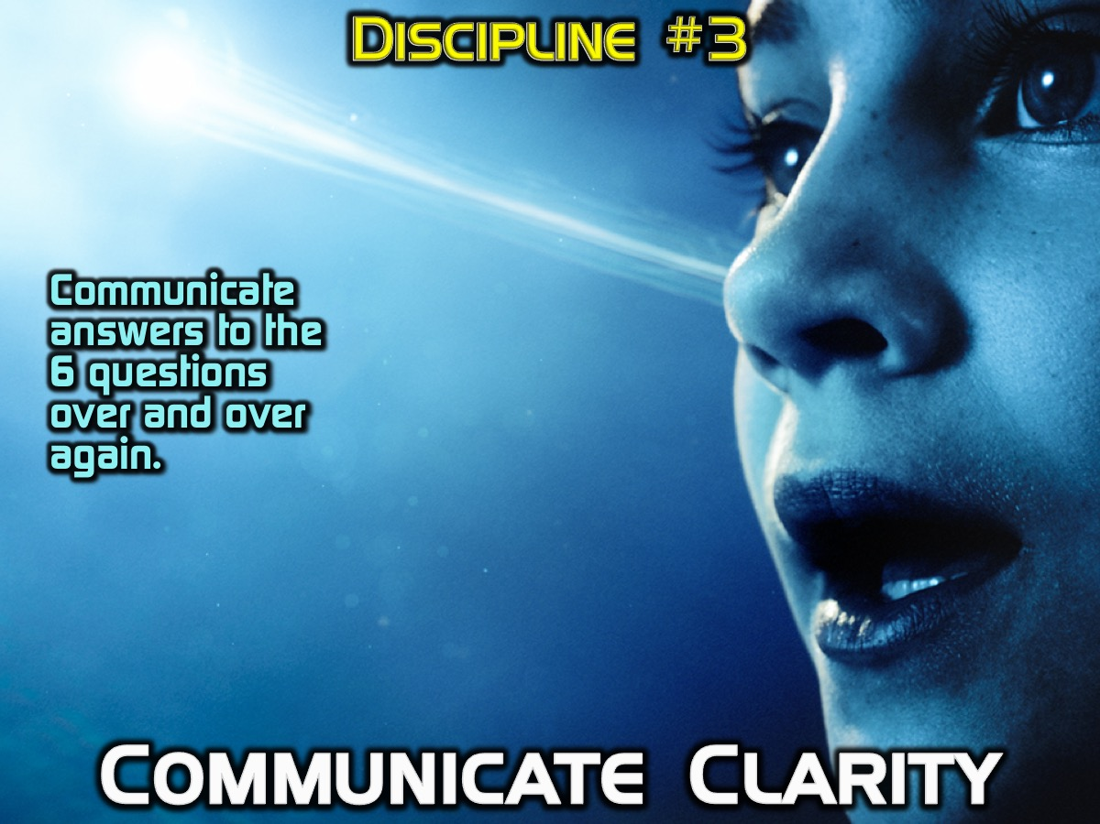
Notes:
Discipline #3: Communicate Clarity: Once a leadership team has become cohesive and established clarity around the six critical questions, they need to communicate the answers to employees over and over and over and over and over and over and over again. Apparently, employees won’t believe a leader’s message until they’ve heard it seven times.

Slide 10
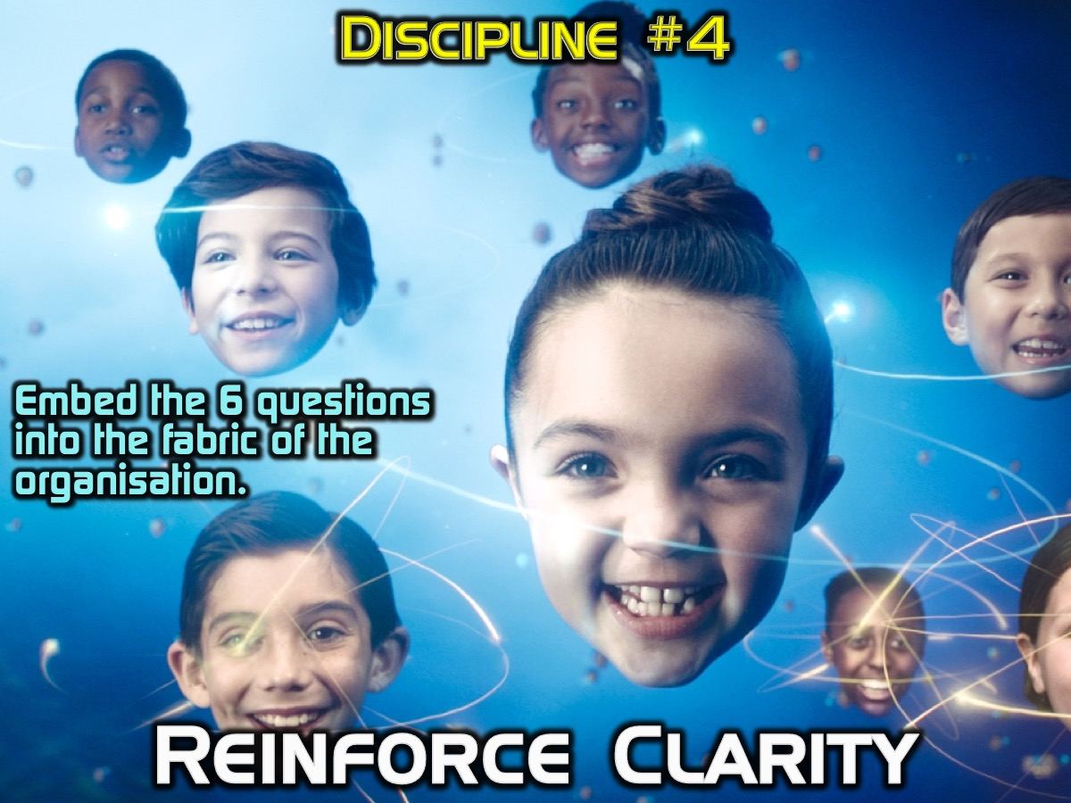
Notes:
Discipline #4: Reinforce Clarity: For an organization to be healthy, organizational clarity (the six critical questions) must become embedded into the fabric of the organization. All human systems must reinforce the answers to the six critical questions in order to keep them alive and ingrained in the organization.

Slide 11
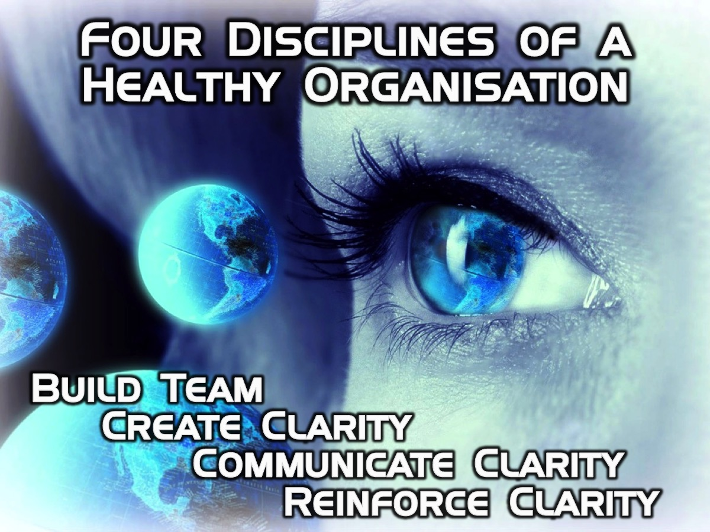
Notes:
So, according to Patrick Lencioni in The Advantage there are Four Disciples of a Healthy Organisation: (1) Build Team, (2) Create Clarity, (3) Communicate Clarity and (4) Reinforce Clarity.

Slide 12
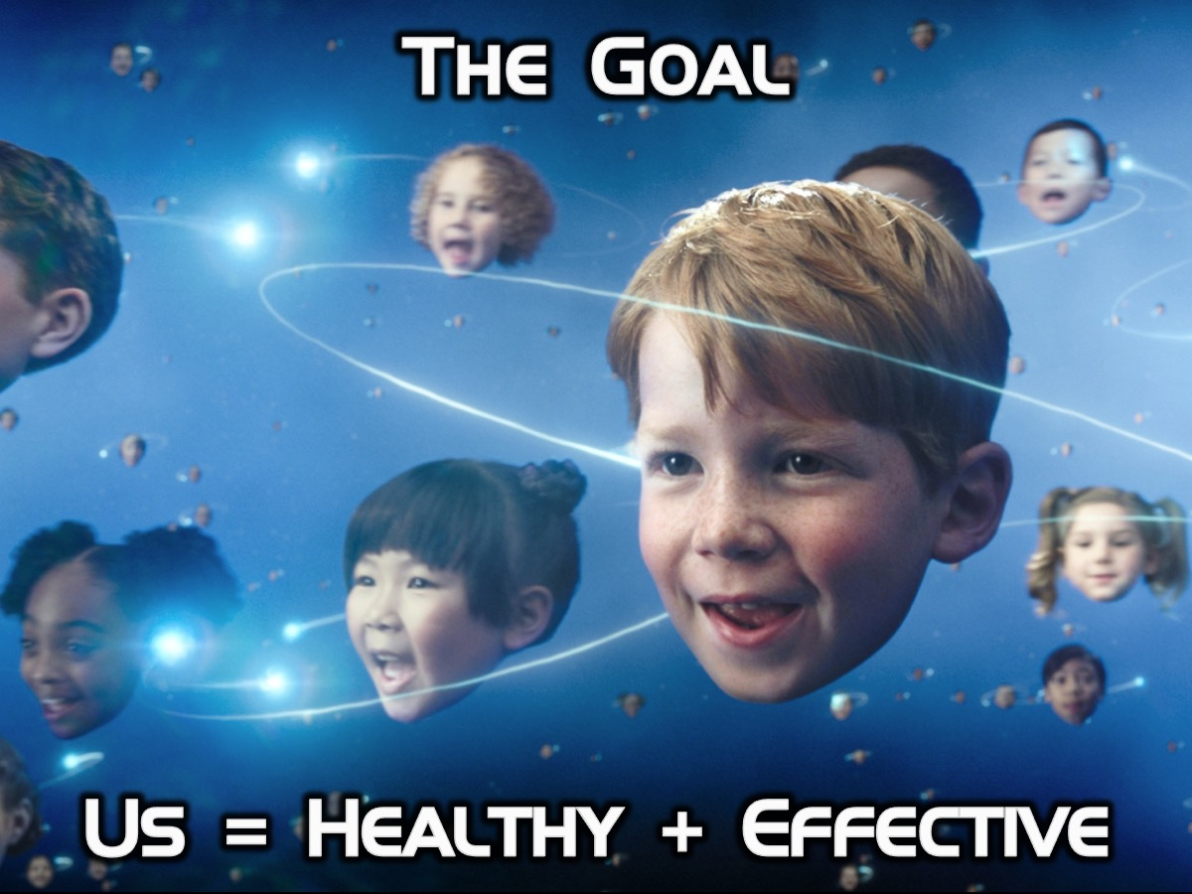
Notes:
Here is a formula that we are aiming for: Us = Healthy + Effective

Slide 13
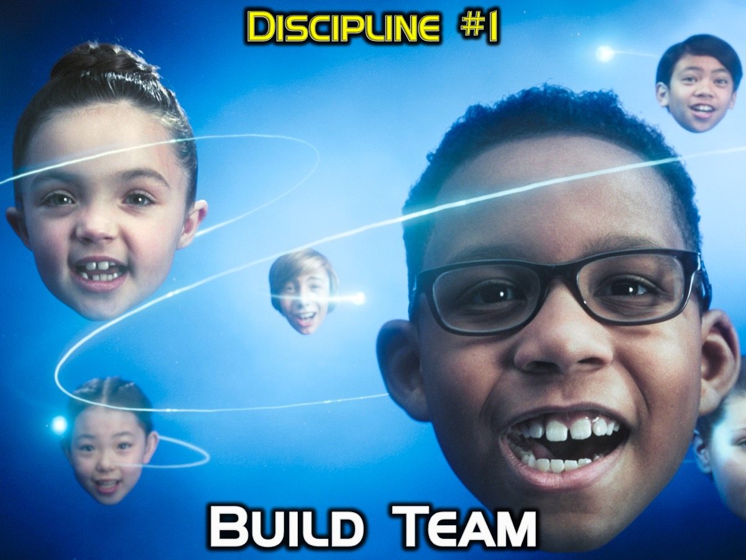
Notes:
Discipline #1: Build Team

Slide 14

Notes:
In the not-too-distant future, our planet has come under attack from a malevolent race of aliens known as the Formics. Incredibly, fearless International Fleet Commander Mazer Rackham (Ben Kingsley) sent them fleeing back into the stars, becoming a living legend in the process. But decorated Colonel Hyrum Graff (Harrison Ford) knows that the Formics will soon return even stronger than they were before, and he's determined to find a new hero who can meet them head on. Enter Ender Wiggin (Asa Butterfield), a modest young man with vast untapped potential. Upon being recruited into Battle School, Ender partakes in a grueling series of simulations, effortlessly mastering every challenge presented to him. Celebrated by his peers and respected by his superiors, Ender is quickly promoted to Command School, where the one and only Mazer Rackham provides him with the knowledge and tools needed to save mankind from certain extinction. As the final battle approaches, Ender prepares to embrace his destiny as one of the greatest heroes in the history of planet Earth.

Slide 15
Notes:
Video: Ender’s Game Trailer 1 2013. Get it on YouTube at: https://www.youtube.com/watch?v=2SRizeR4MmU

Slide 16
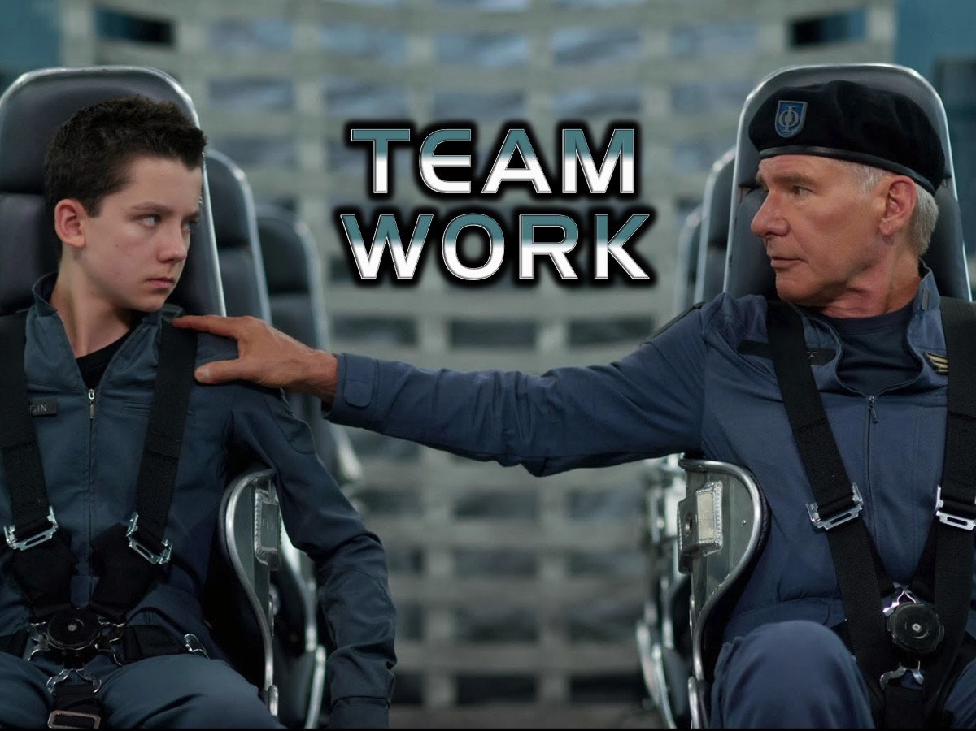
Notes:
Teamwork!

Slide 17
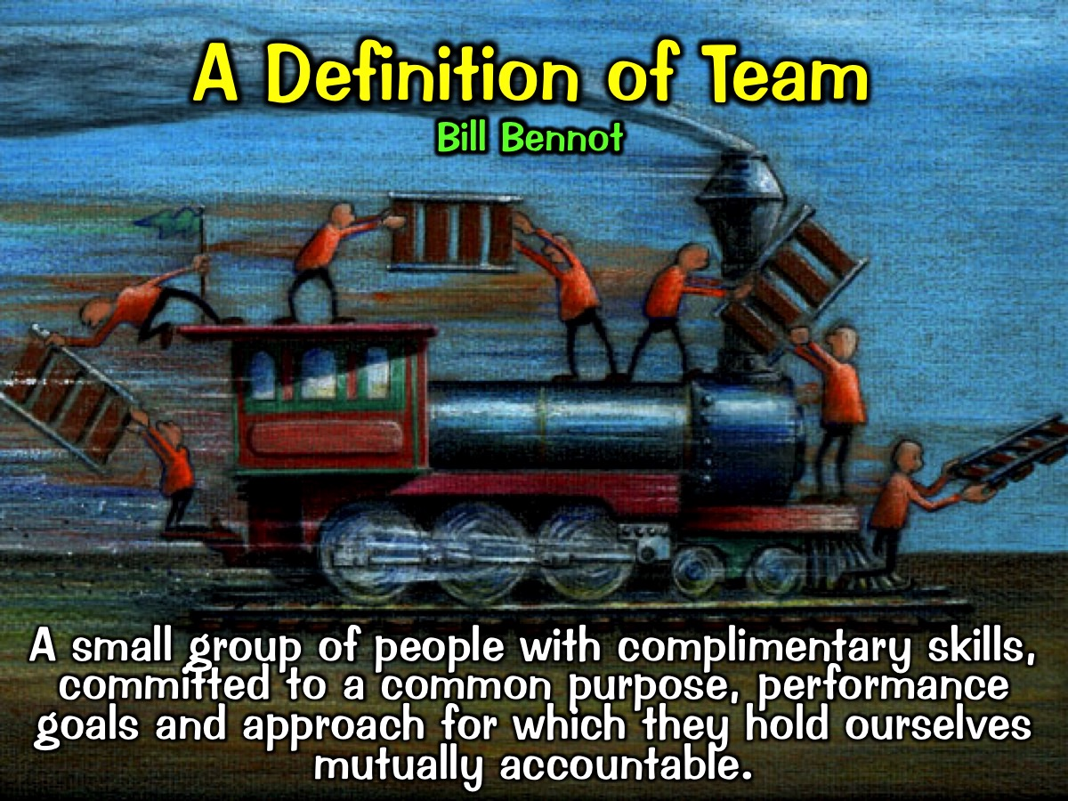
Notes:
A Definition of Team: A team is a small group of people with complimentary skills committed to a common purpose, performance goals and approach for which they hold themselves mutually accountable. (Bill Bennot, Founder of His People Johannesburg).

Slide 18
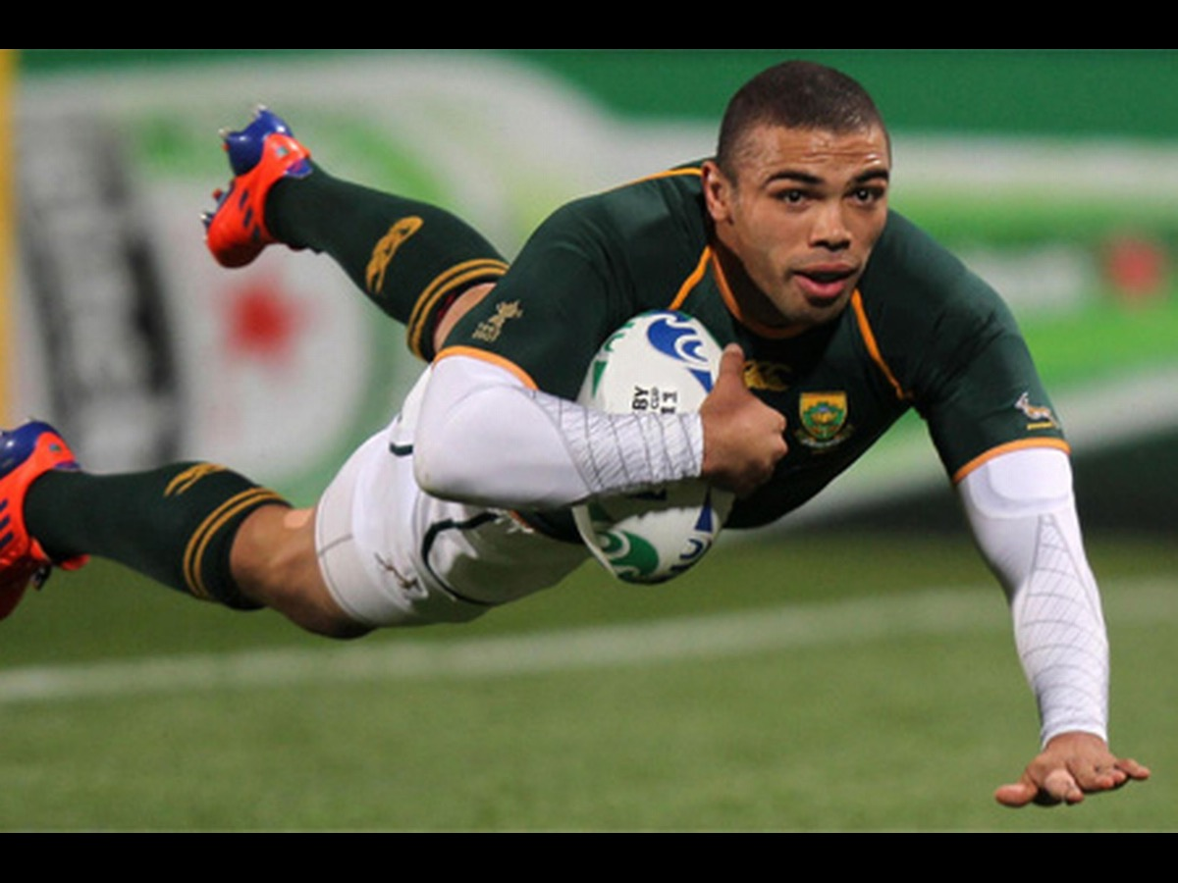
Notes:
There is nothing like watching Brian Habana flying over the try line to score for the Springboks.

Slide 19
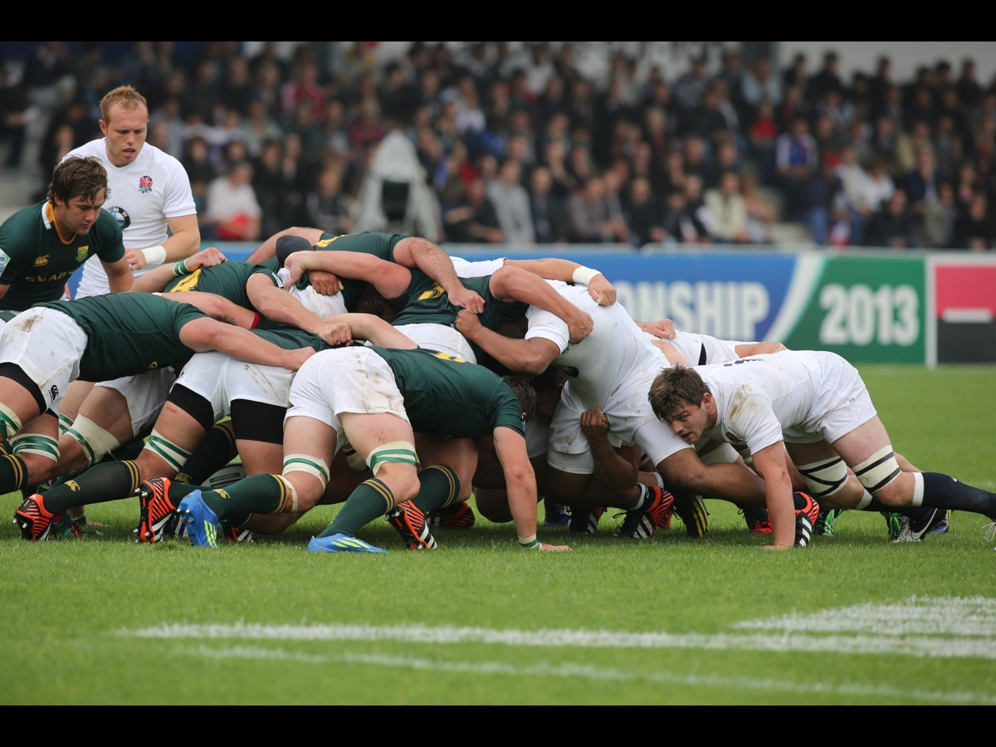
Notes:
But invariably it is a team effort that led to the try being scored. In the scrums.

Slide 20
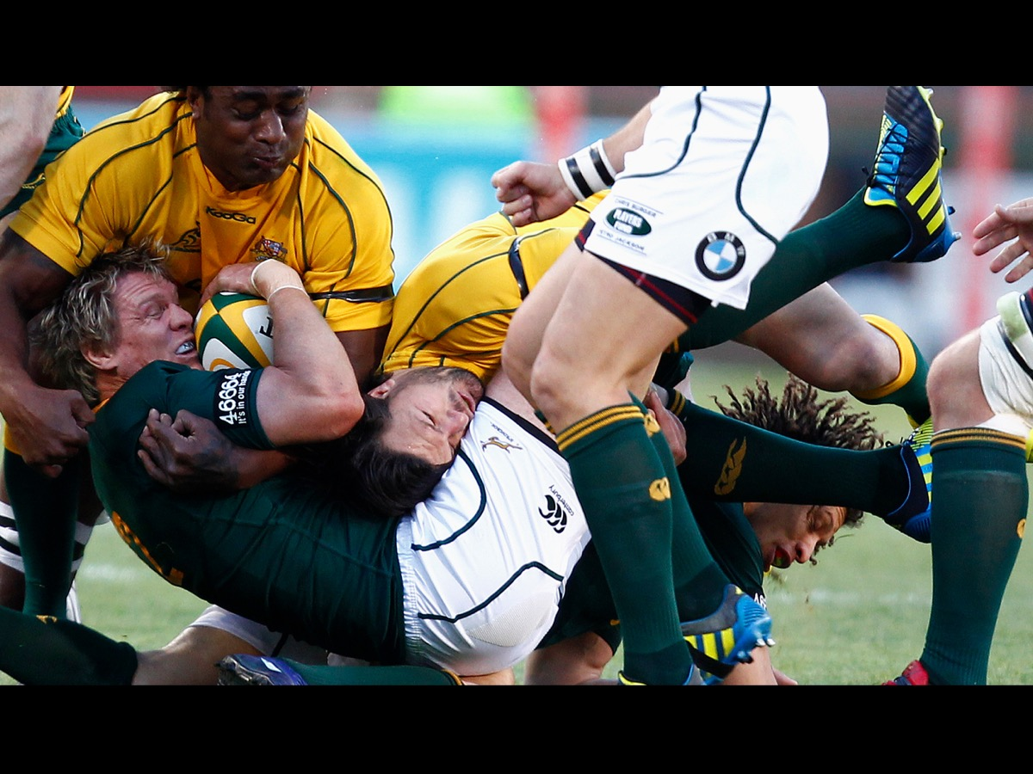
Notes:
In the loose play.

Slide 21
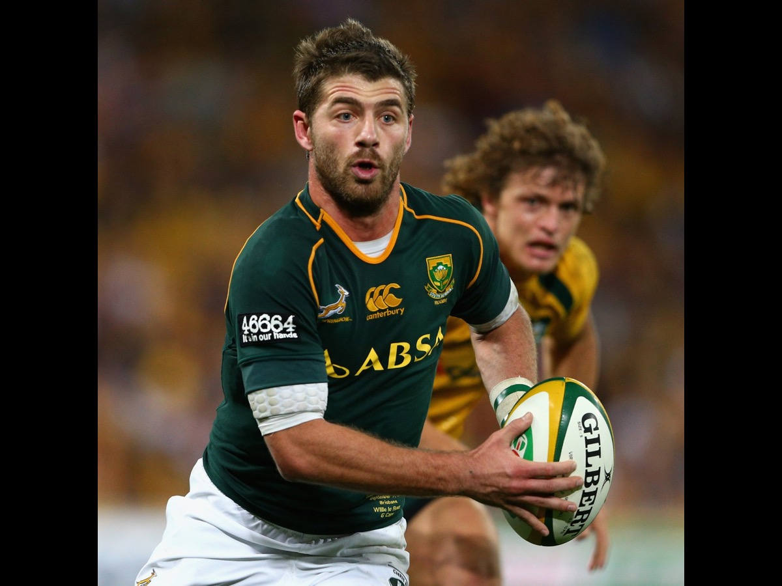
Notes:
In the running and passing.

Slide 22
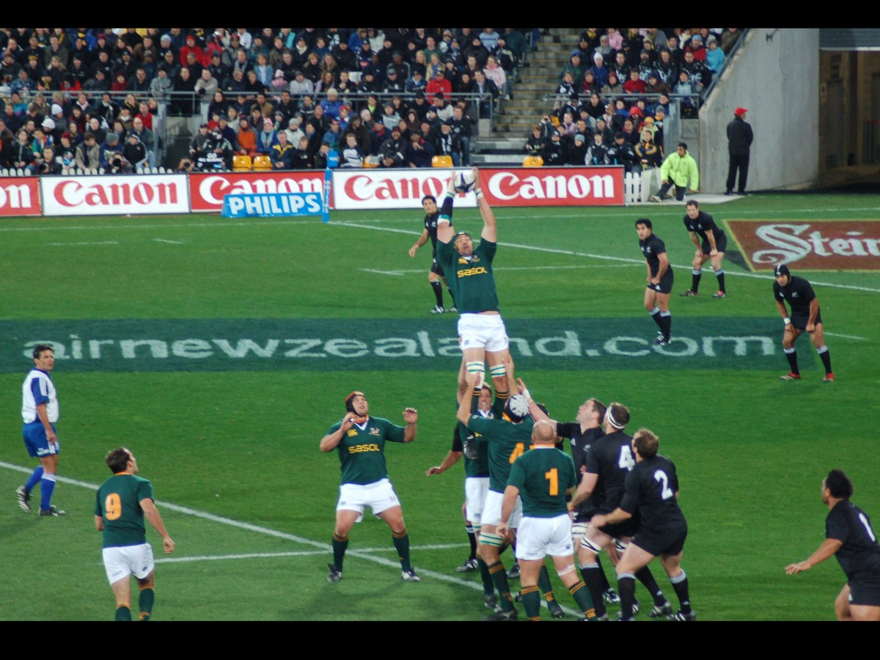
Notes:
In the line outs.

Slide 23
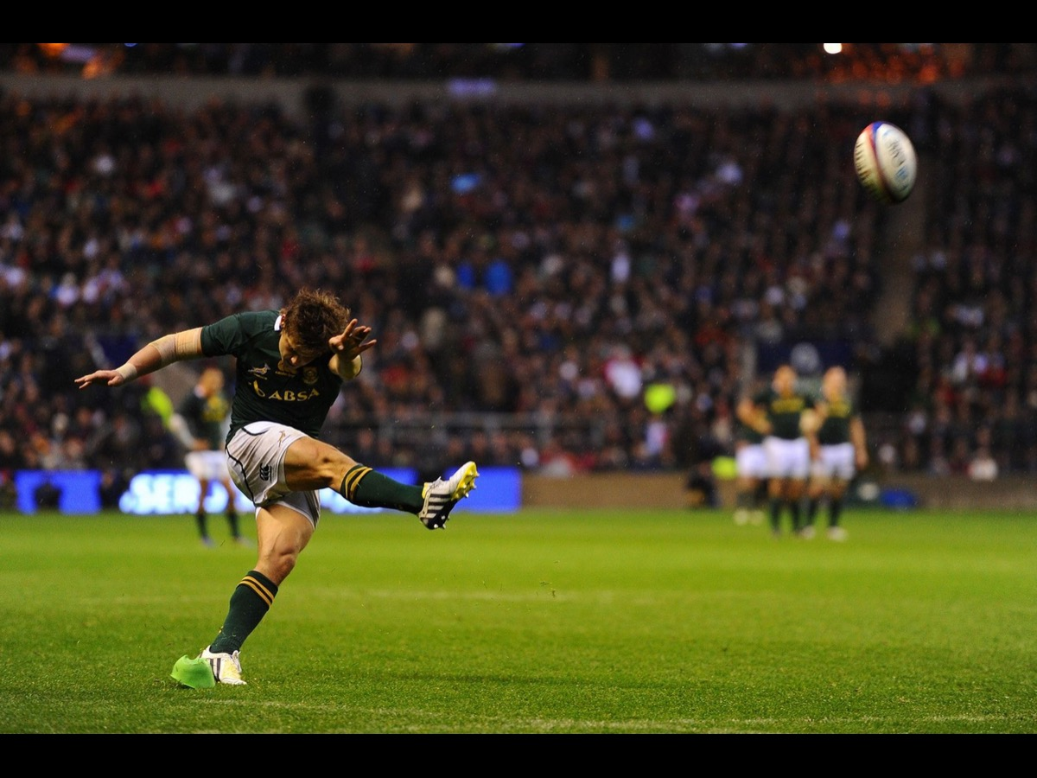
Notes:
And the kicking.

Slide 24
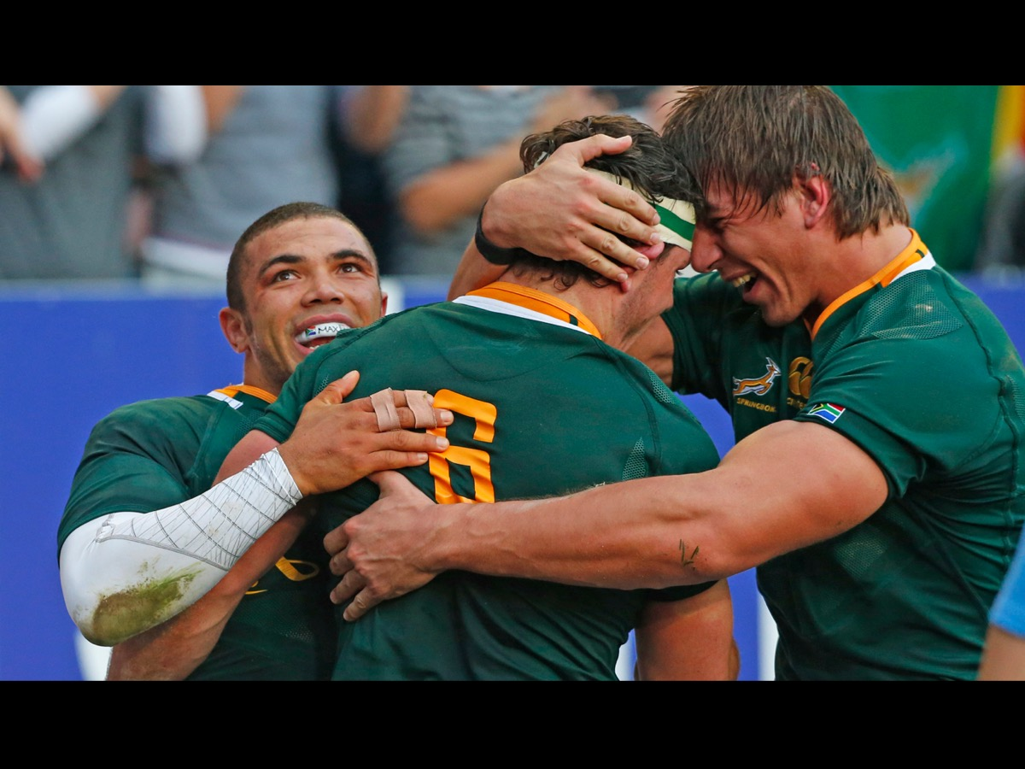
Notes:
Soon people are congratulating each other on the win

Slide 25
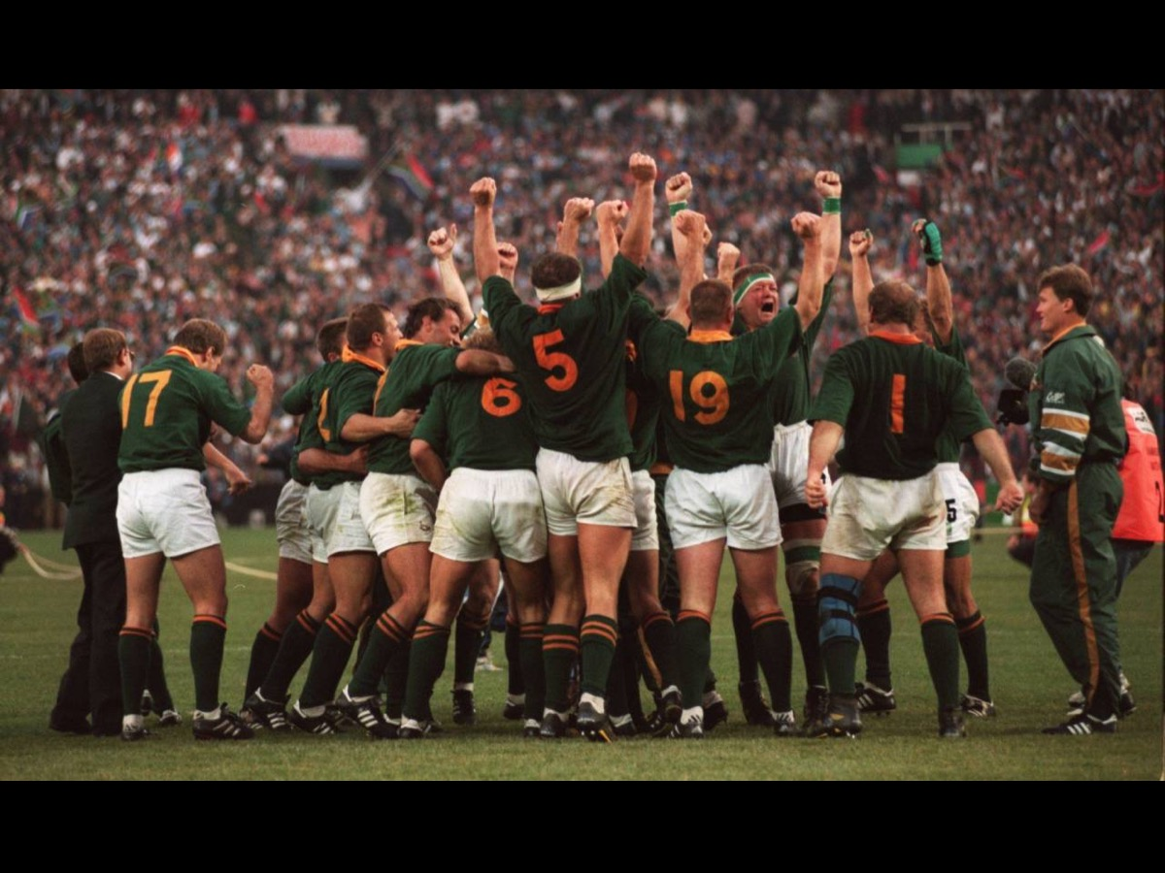
Notes:
Ultimately it is the team effort that is remembered!

Slide 26
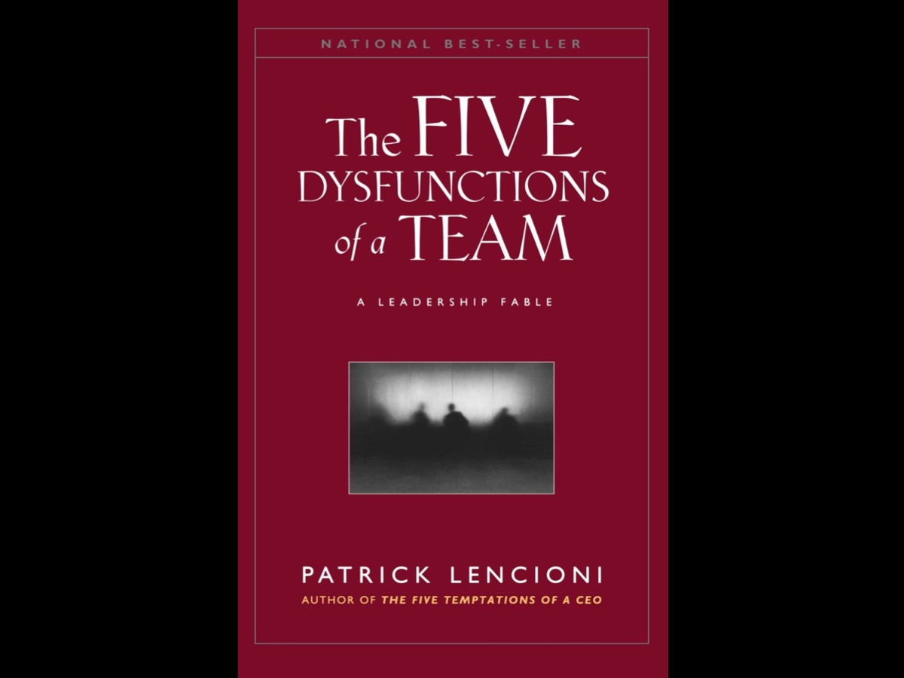
Notes:
This section is based on a book by Patrick Lencioni: The Five Dysfunctions of a Team.

Slide 27
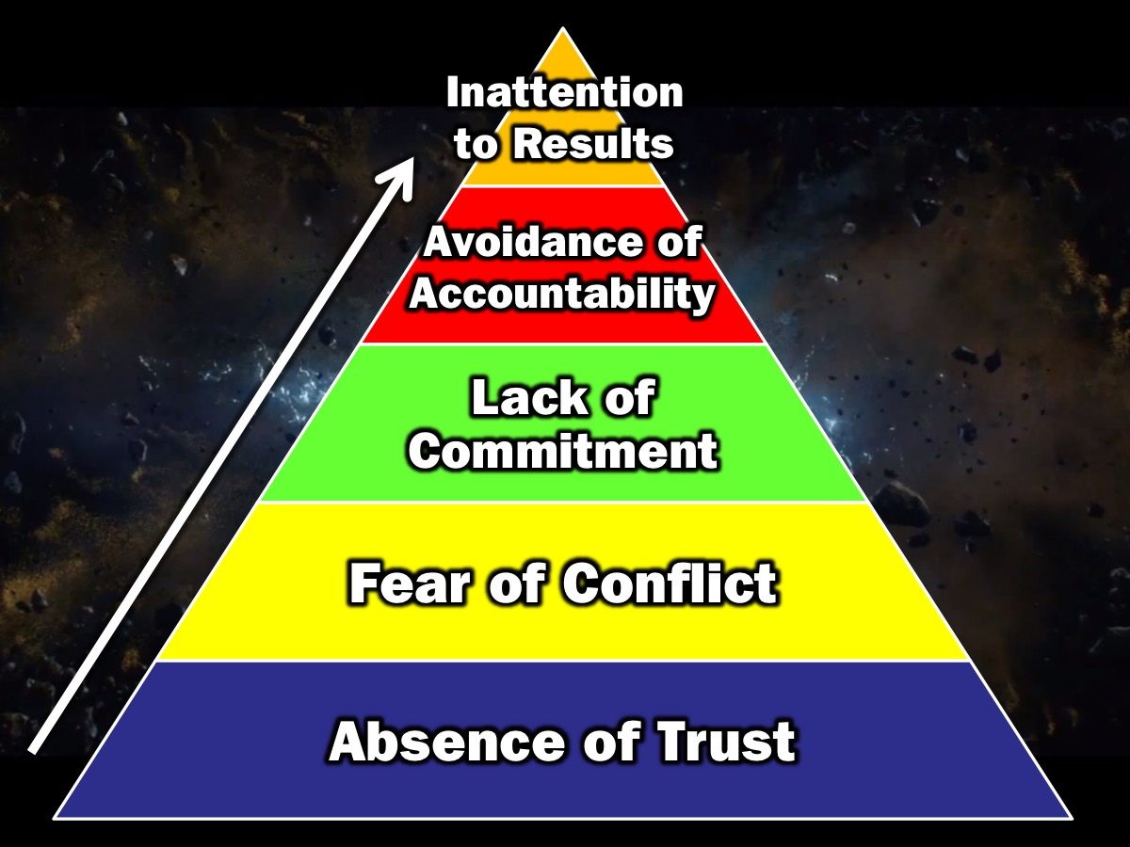
Notes:
The 5 Dysfunctions Pyramid. A journey from the Absence of Trust to Inattention to Results. (1) The first dysfunction is the absence of trust among team members. Essentially this stems from their unwillingness to be vulnerable within the group. Team members who are not genuinely open with one another about their mistakes and weaknesses make it impossible to build a foundation for trust. (2) This failure to build trust is damaging because it sets the tone for the second dysfunction: fear of conflict. Teams that lack trust are incapable of engaging in unfiltered and passionate debate of ideas. Instead, they resort to veiled discussions and guarded comments. (3) A lack of healthy conflict is a problem because it creates the third dysfunction of a team: lack of commitment. Without having aired their opinions in the course of passionate and open debate, team members rarely, if ever, buy in and commit to decisions, though they may agree in meetings. (4) Because of this lack of real commitment and buy in, team members develop the fourth dysfunction: avoidance of accountability. Without committing to a clear plan of action, even the most focussed and driven people are often hesitant to call their peers on actions and behaviours that seem counterproductive to the good of the team. (5) Failure to hold one another acountable creates an environment where the fifth dysfunction thrives: Inattention to results. It occurs when team members put their personal needs (such as ego, career development, or recognition) or even the needs of their department about the collective goals of the team.

Slide 28
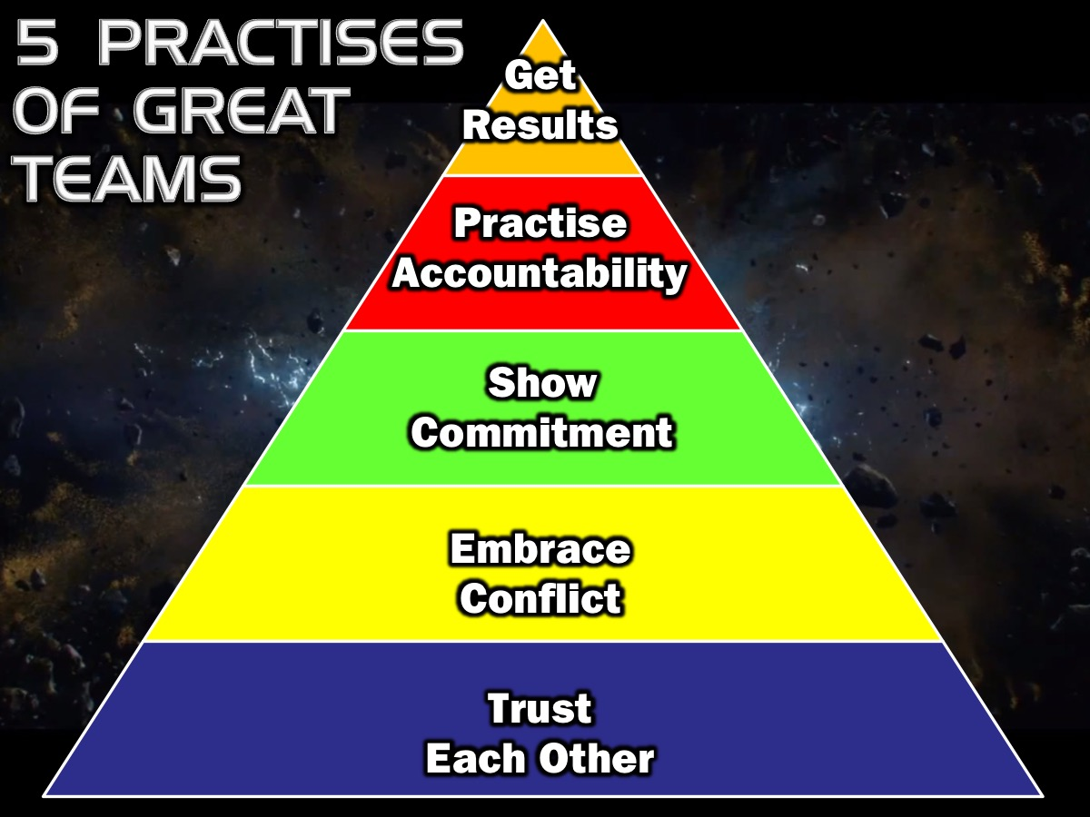
Notes:
Another way to understand the model is to take the opposite approach – a positive one – and imagine how members of truly cohesive teams behave. Here are the 5 Practises of Great Teams: (1) They trust Each Other. (2) They Embrace Conflict. (3) They Display Commitment. (4) They Practise Accountability. (5) They Get Results.

Slide 29
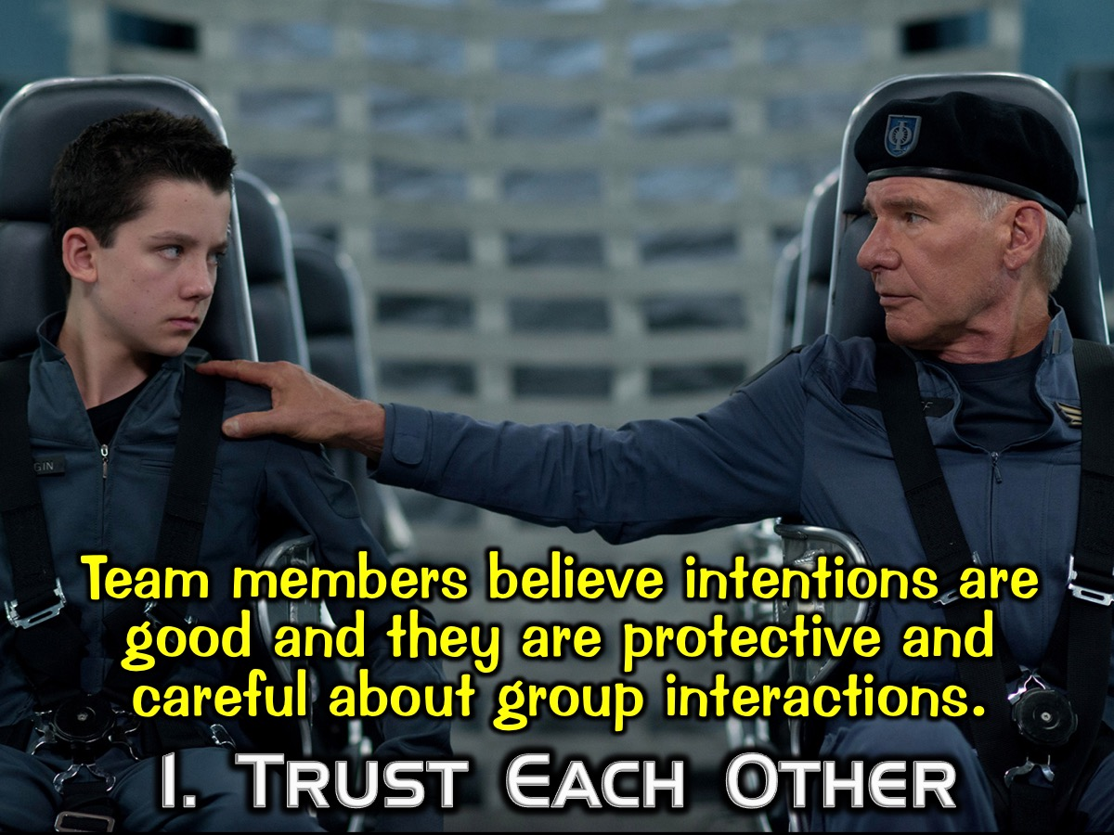
Notes:
1. They Trust Each other: Team members believe their peer’s intentions are good and they are protective and careful about group interactions.

Slide 30
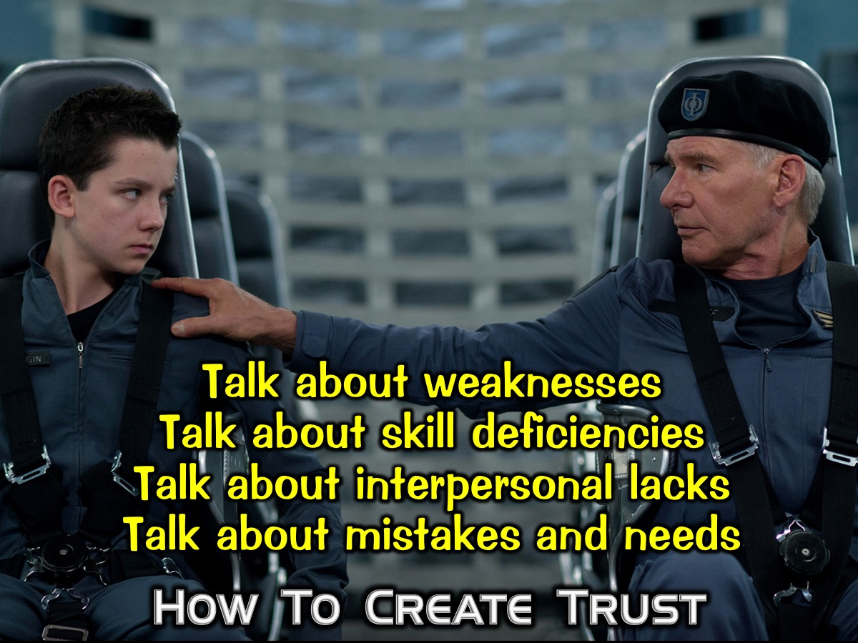
Notes:
How To Create Trust: (1) Get people to talk about weaknesses; (2) Talk about skill deficiencies; (3) Talk about interpersonal lacks; and (4) Talk about mistakes and needs.

Slide 31
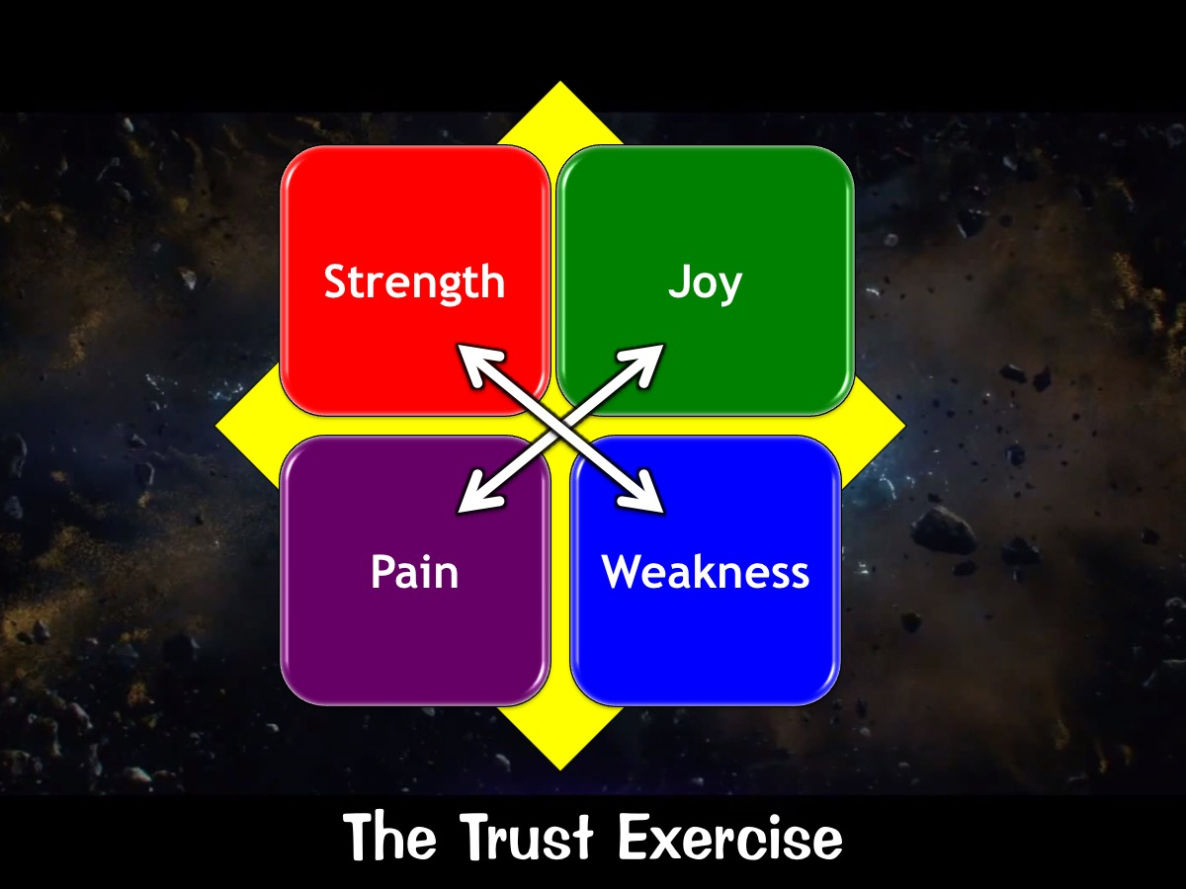
Notes:
The Trust Exercise: Share a strength and a weakness, a joy and a pain with each other.

Slide 32
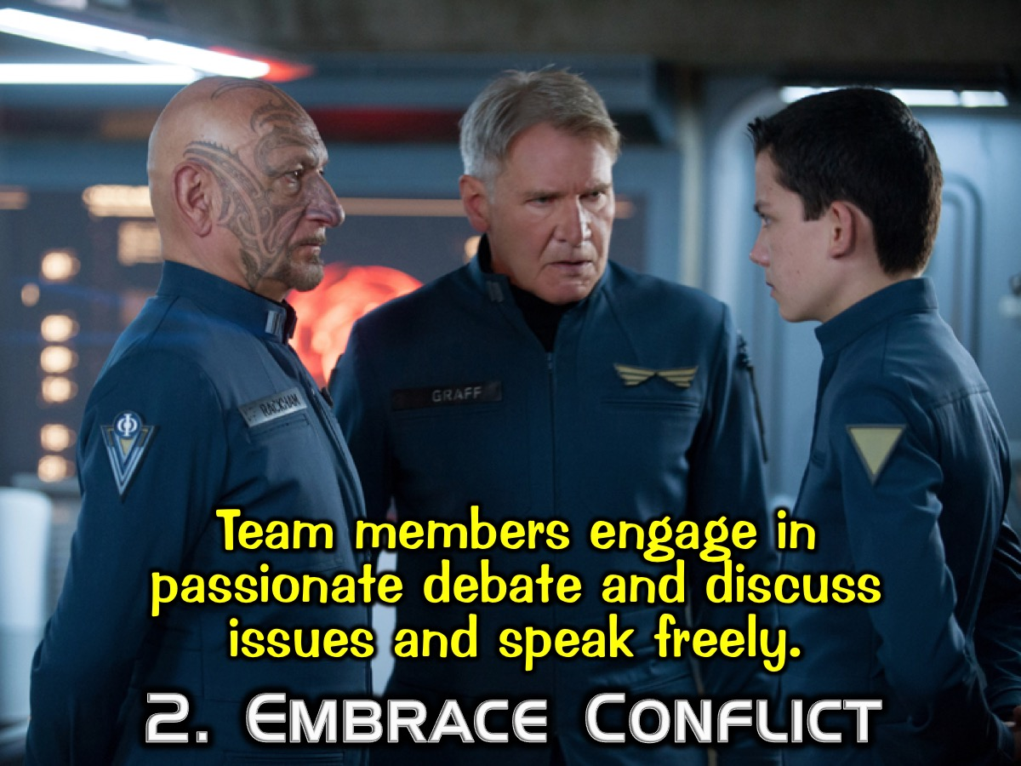
Notes:
2. They Embrace Conflict. Team members engage in passionate debate and discuss issues and speak freely.

Slide 33
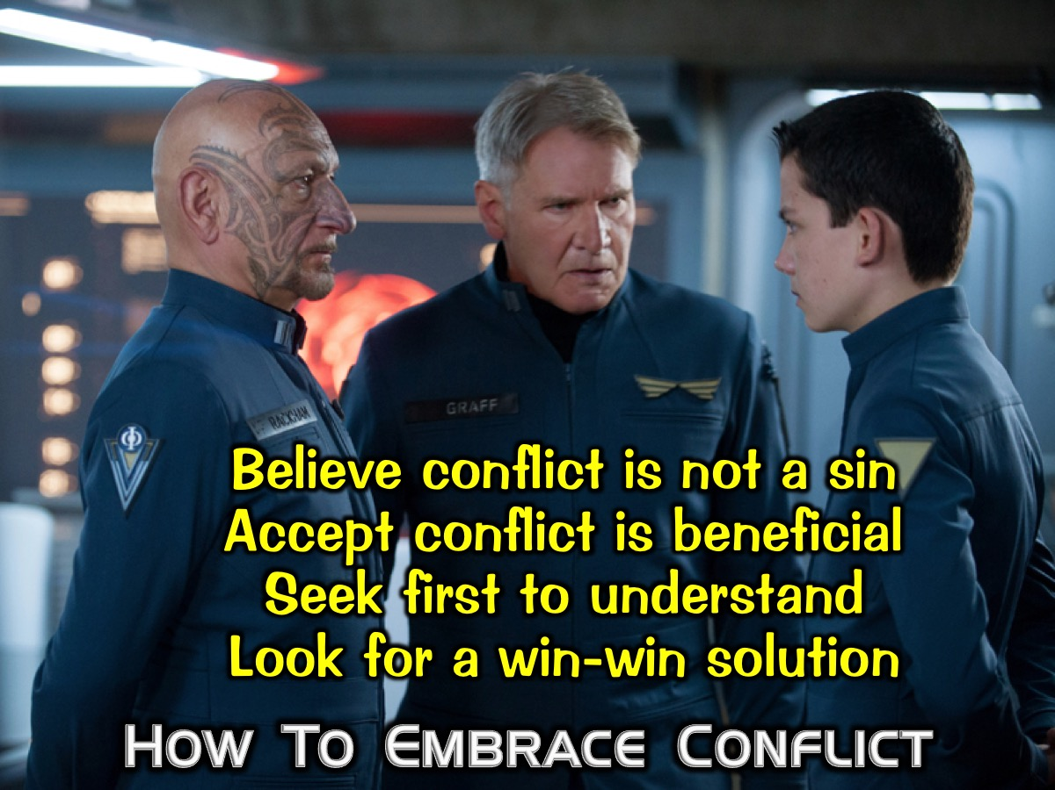
Notes:
How To Embrace Conflict: (1) Believe conflict is not a sin; (2) Accept conflict is beneficial; (3) Seek first to understand; (4) Look for a win-win solution.

Slide 34
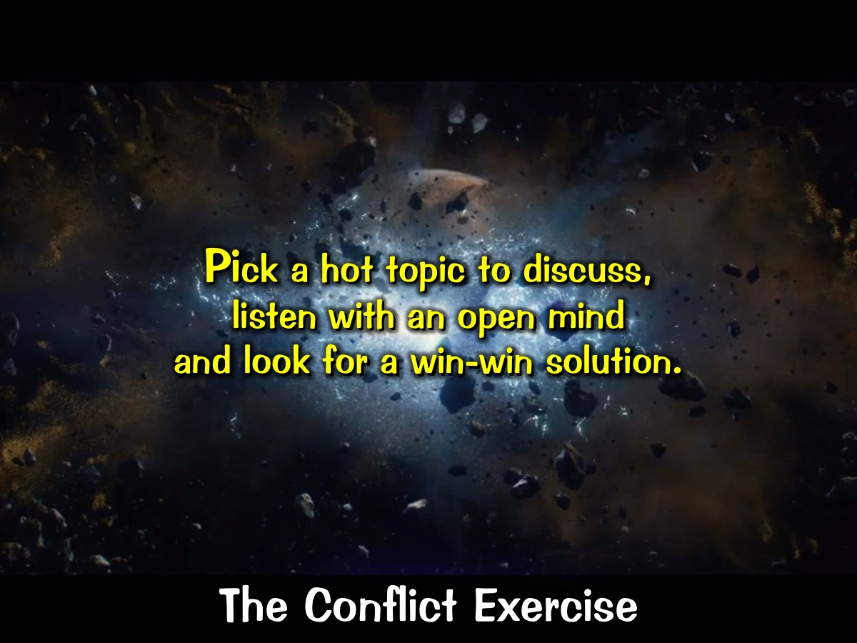
Notes:
The Conflict Exercise: Pick a hot topic to discuss, listen with an open mind and look for a win-win solution.

Slide 35
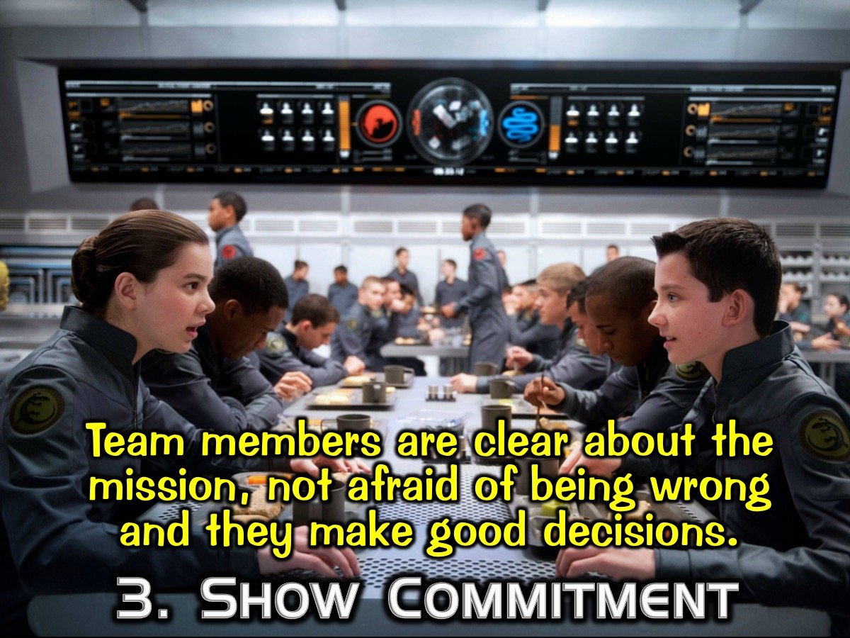
Notes:
3. They Show Commitment: They Commit to Plans. Team members are clear about the mission, not afraid of being wrong and they make timely and definitive decisions.

Slide 36
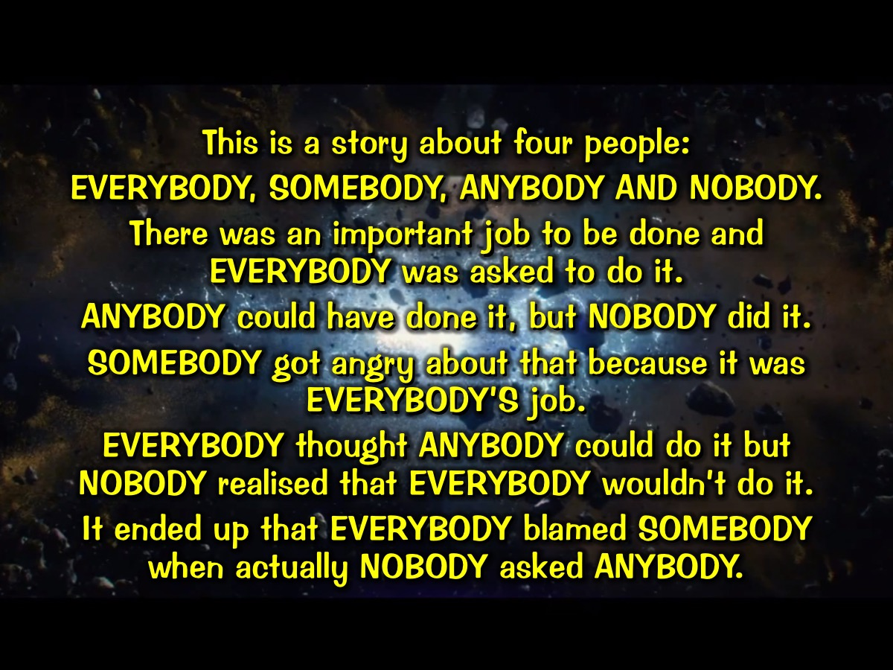
Notes:
This is a story about four people EVERYBODY, SOMEBODY, ANYBODY AND NOBODY. There was an important job to be done and EVERYBODY was asked to do it. ANYBODY could have done it, but NOBODY did it. SOMEBODY got angry about that because it was EVERYBODY’S job. EVERYBODY thought ANYBODY could do it but NOBODY realised that EVERYBODY wouldn’t do it. It ended up that EVERYBODY blamed SOMEBODY when actually NOBODY asked ANYBODY.

Slide 37
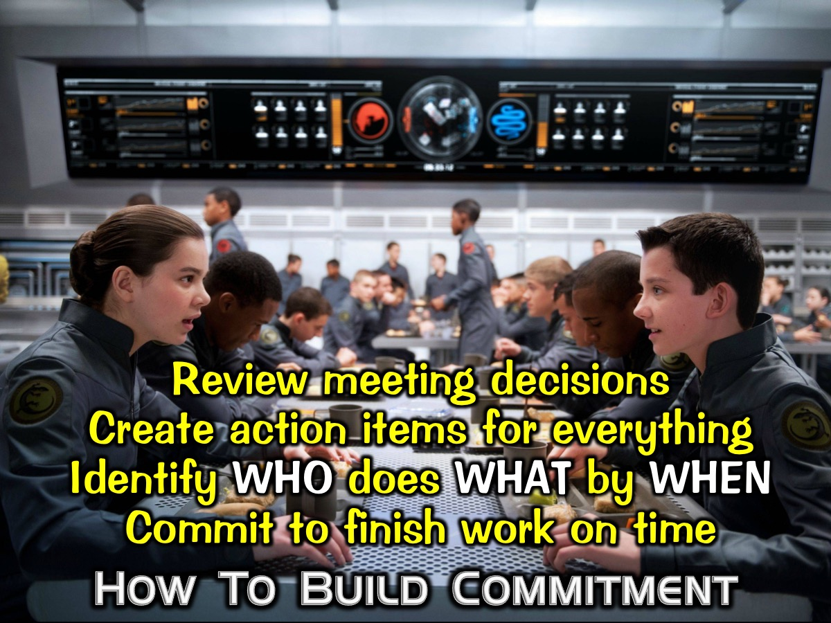
Notes:
How To Build Commitment: (1) Review meeting decisions; (2) Create action items for everything; (3) Identify who does what by when; and (4) Commit to finish work on time.

Slide 38
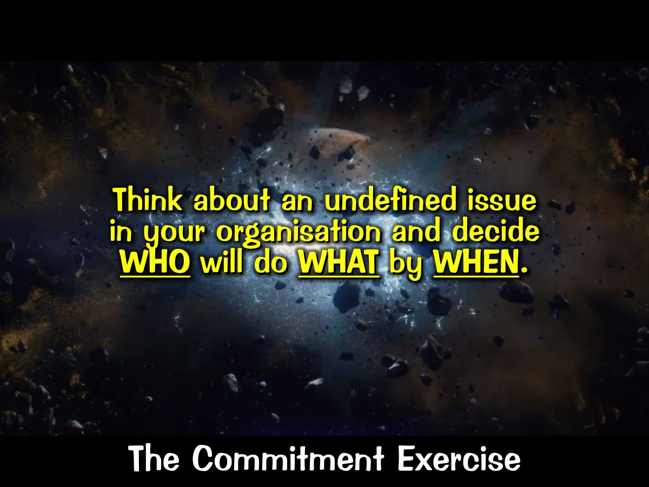
Notes:
The Commitment Exercise: Think about an undefined issue in your organisation and decide who will do what by when.

Slide 39
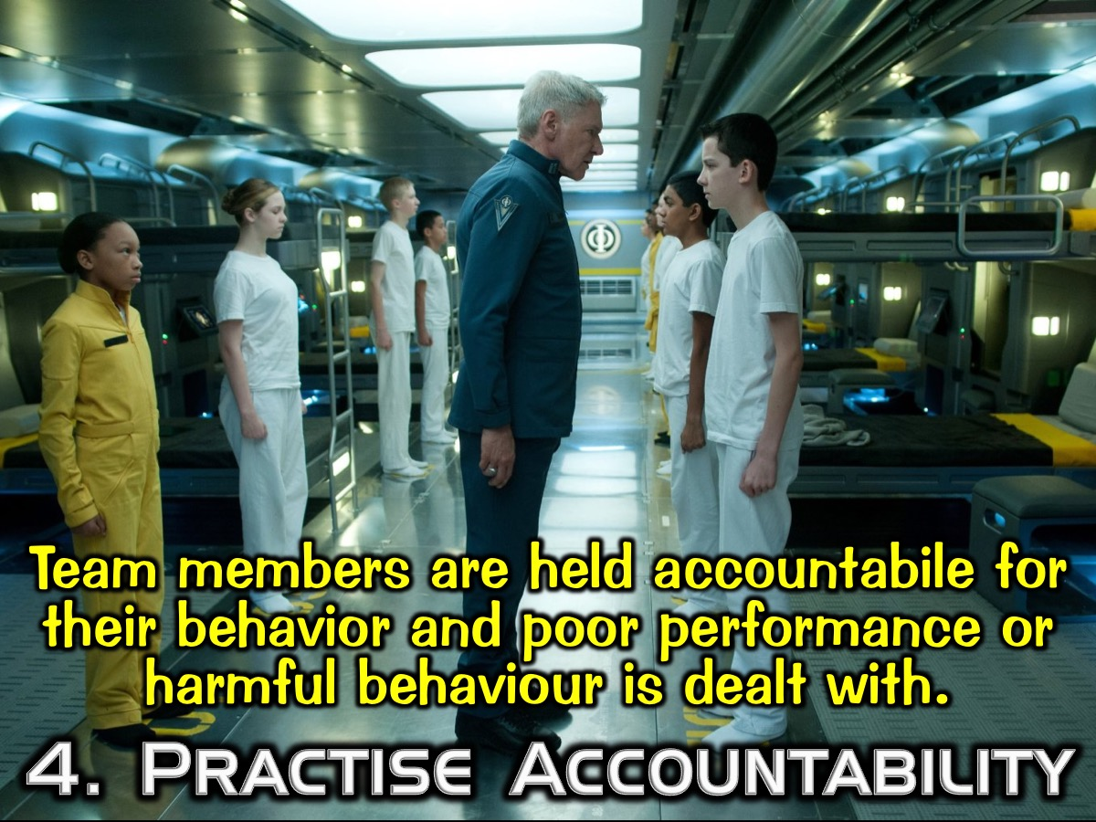
Notes:
4. They Practise Accountability: Team members are held accountabile for their behavior and poor performance or harmful behaviour is dealt with.

Slide 40
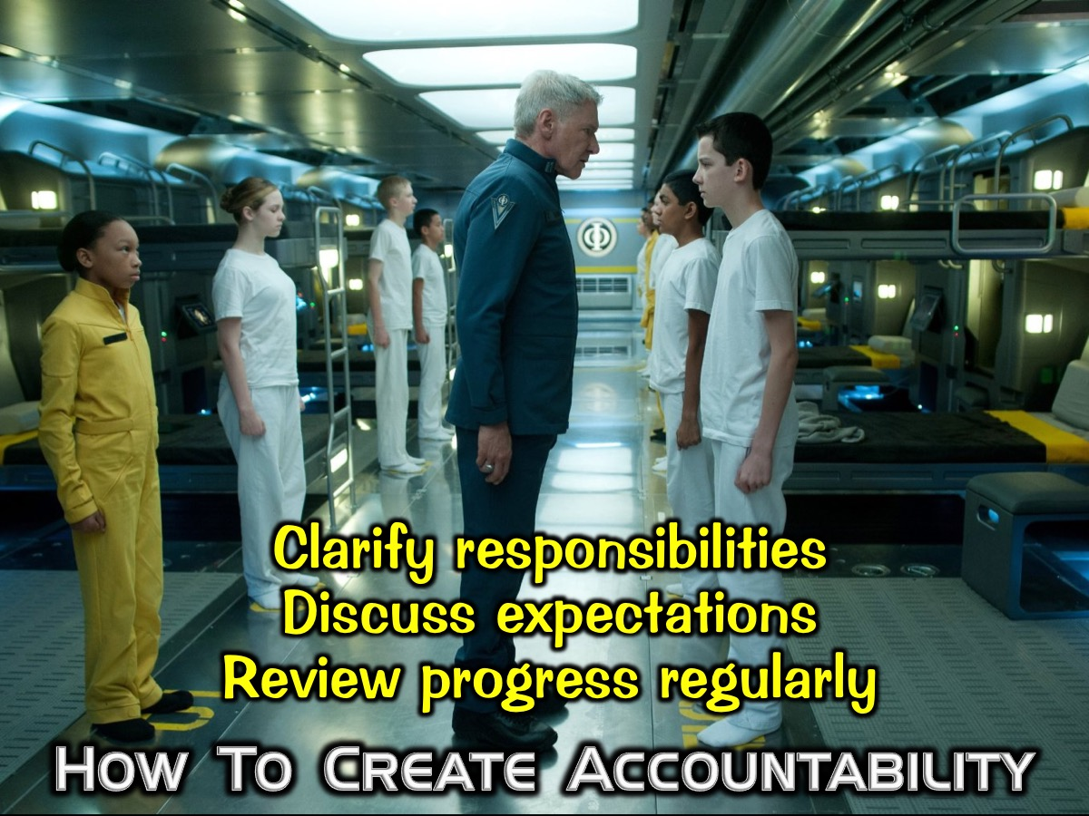
Notes:
How to Create Accountability: Clarify responsibilities; Discuss expectations; Review progress regularly.

Slide 41
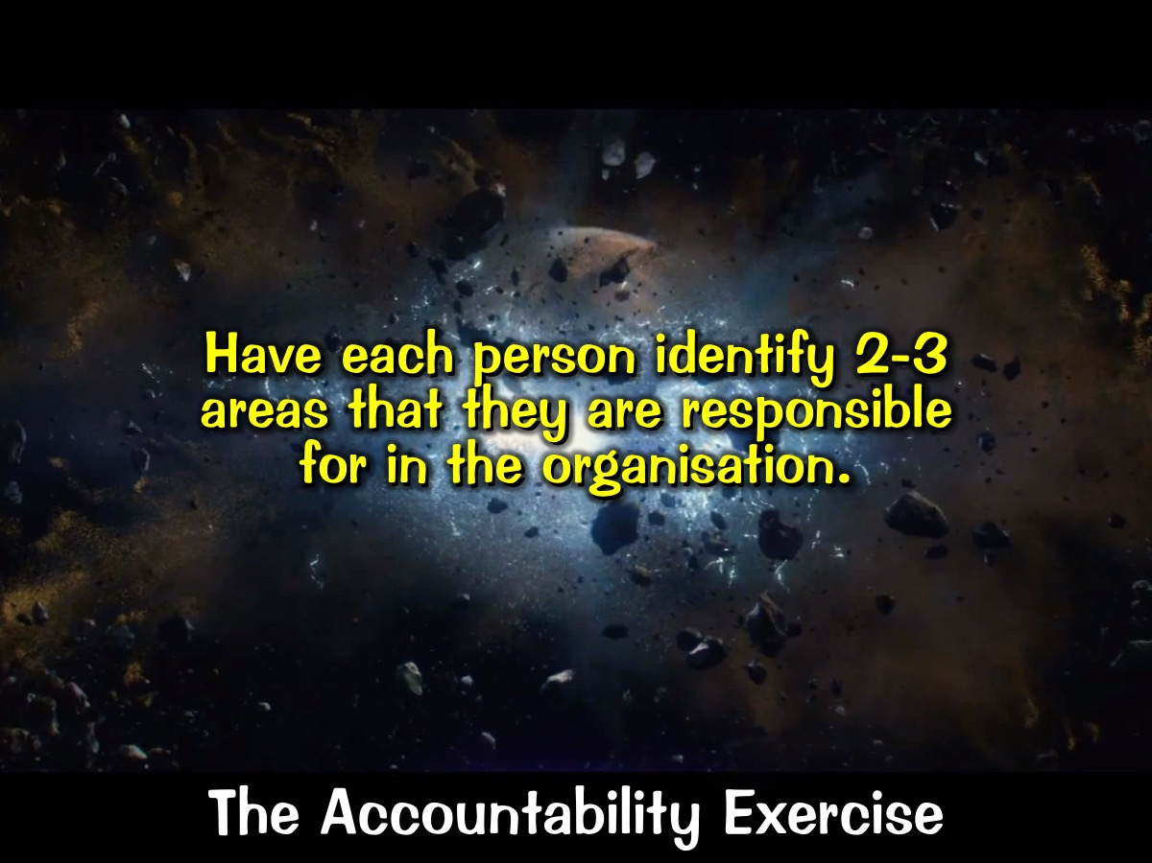
Notes:
The Accountability Exercise: Have each person identify 2-3 areas that they are responsible for in the organisation.

Slide 42
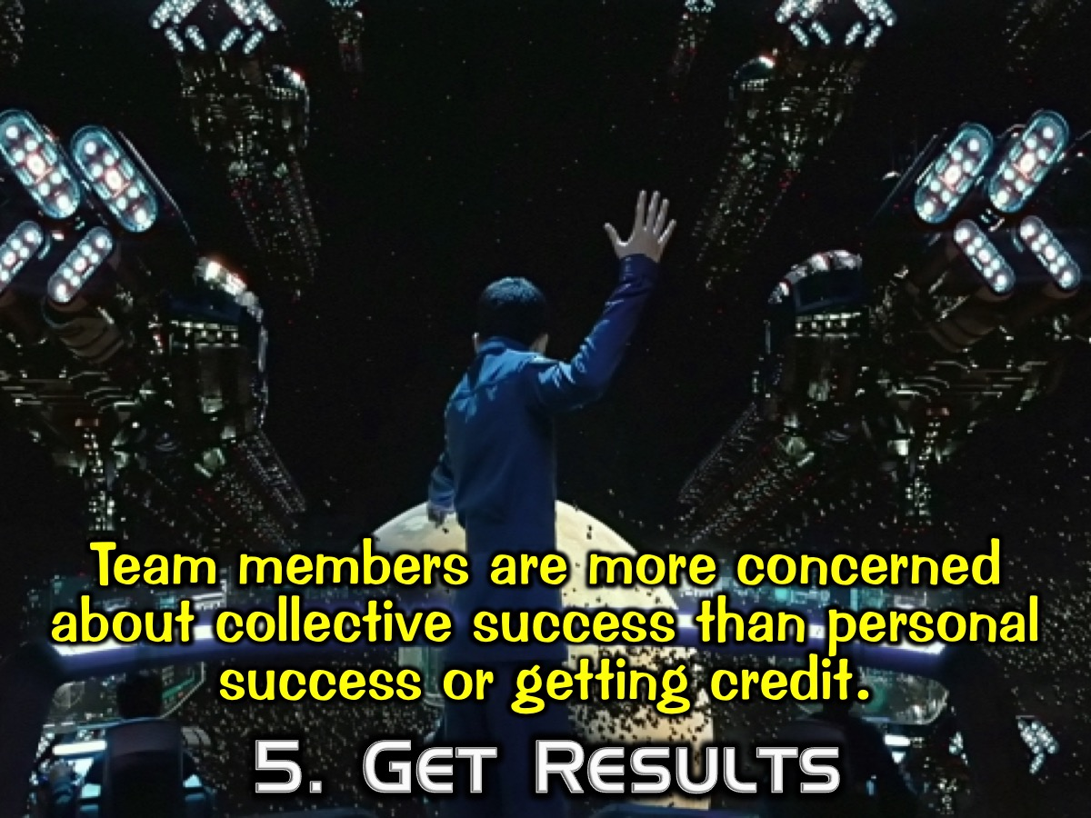
Notes:
5. They Get Results: Team members are more concerned about collective success than personal success or getting credit.

Slide 43
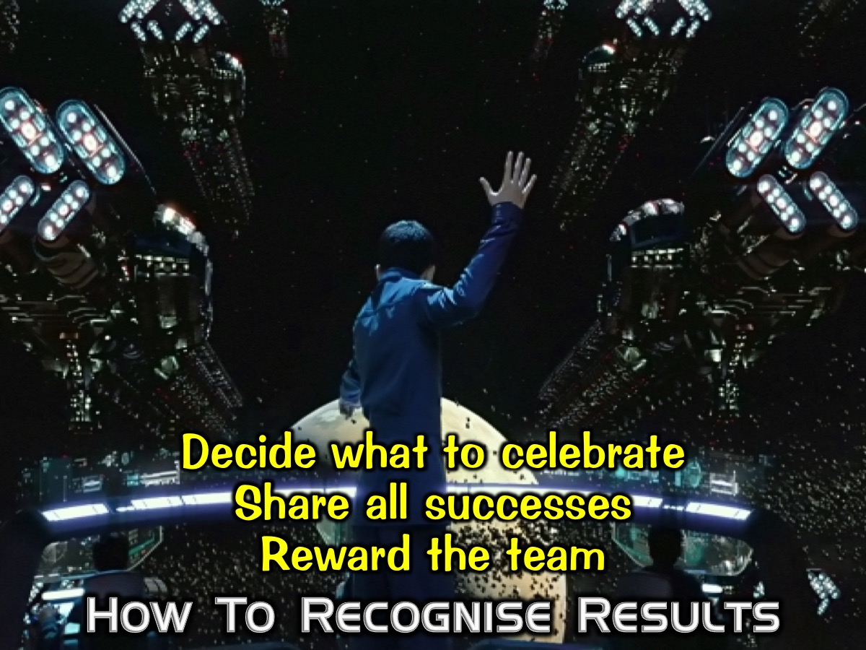
Notes:
How to Recognise Results: (1) Decide what to celebrate. (2) Share all successes. (3) Reward the team.

Slide 44
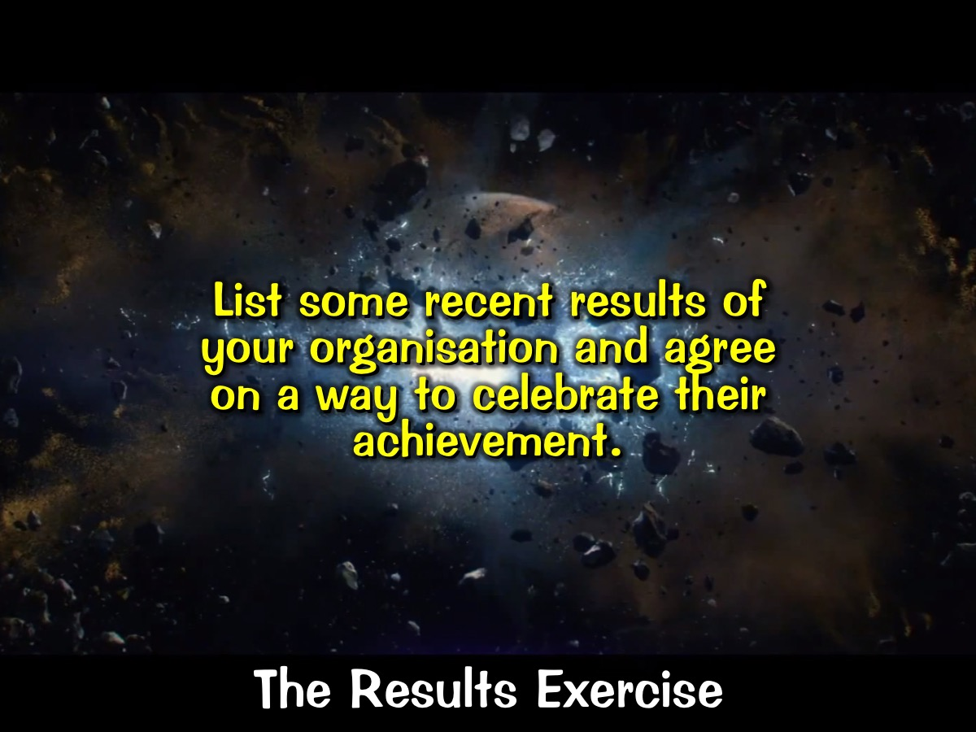
Notes:
The Results Exercise: List some recent results of your ministry and agree on a way to celebrate their achievement.

Slide 45
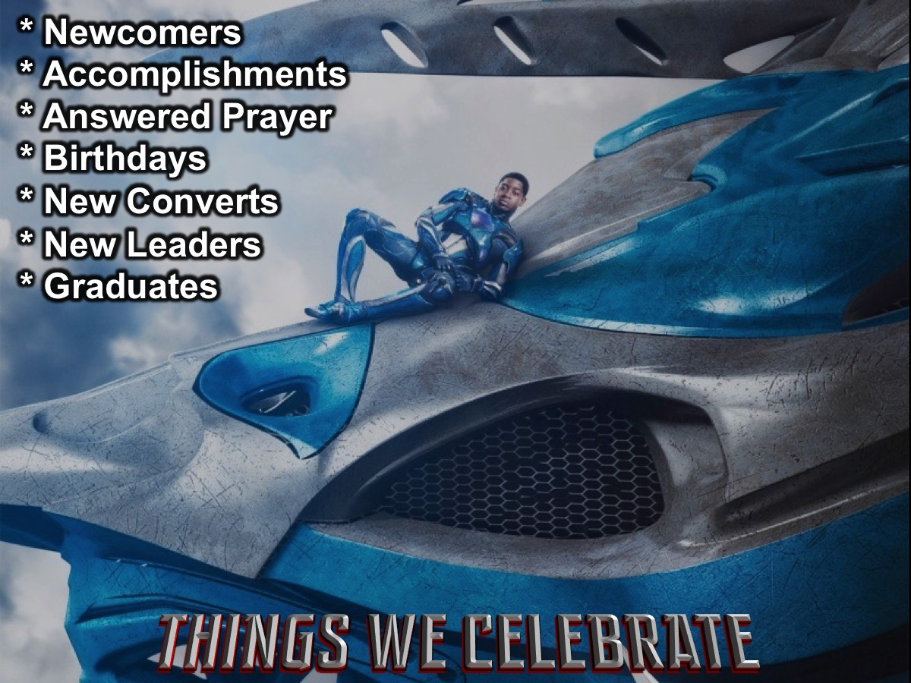
Notes:
Here are some of the things that we currently celebrate at Youth.
* Newcomers
* Something someone has done
* Answered prayers - Have a praise report - Miracle wall ticks
* Someone did something in her school
* Birthdays - birthdays during services?
* Praising God for something happening in our lives
* New converts
* Appointment of new teen/adult leaders
* Leaders who graduate - like matrics or other transitions

Slide 46

Notes:
Here is a summary of what we have explored so far:

Slide 47
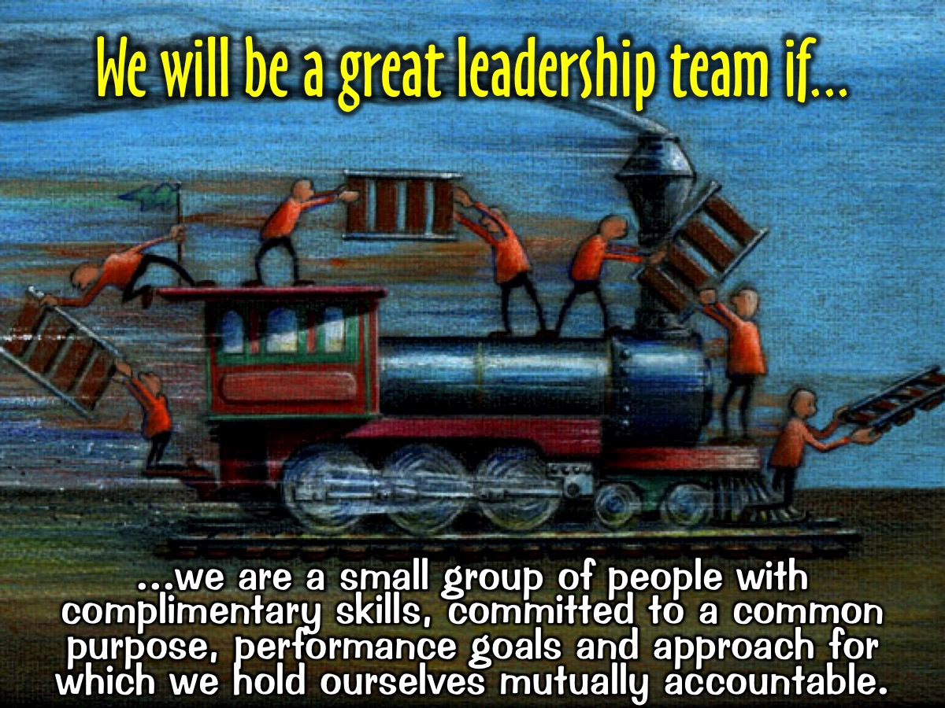
Notes:
We will be a great leadership team if we are a small group of people with complimentary skills, committed to a common purpose, performance goals and approach for which we hold ourselves mutually accountable.

Slide 48
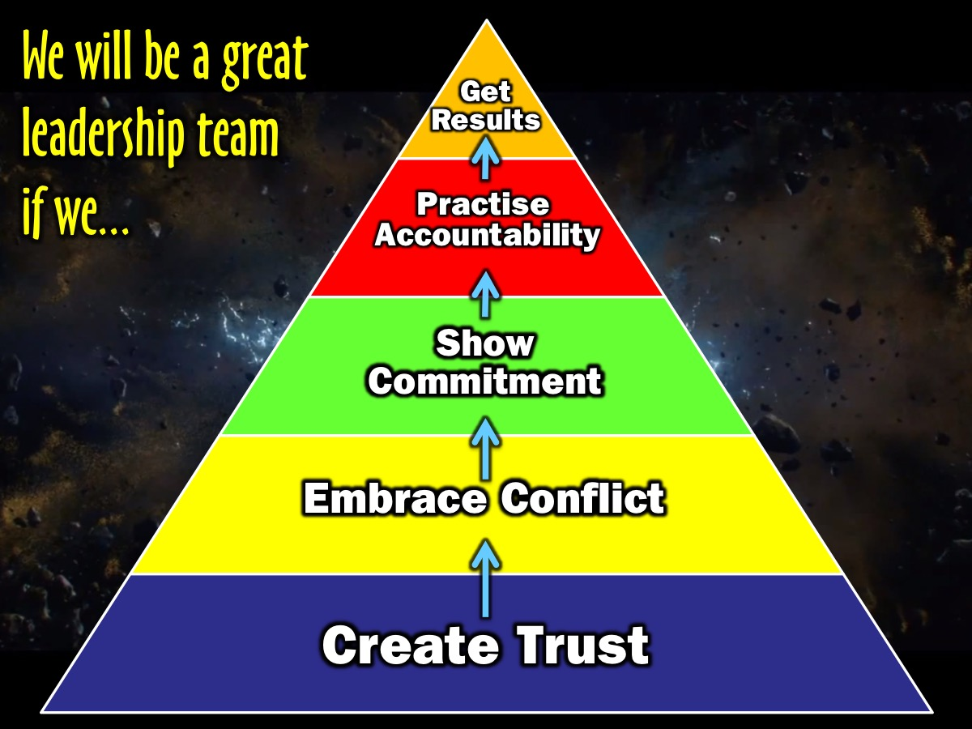
Notes:
We will be a great leadership team if we create trust, embrace conflict, show commitment, practise accountability and get results.

Slide 49
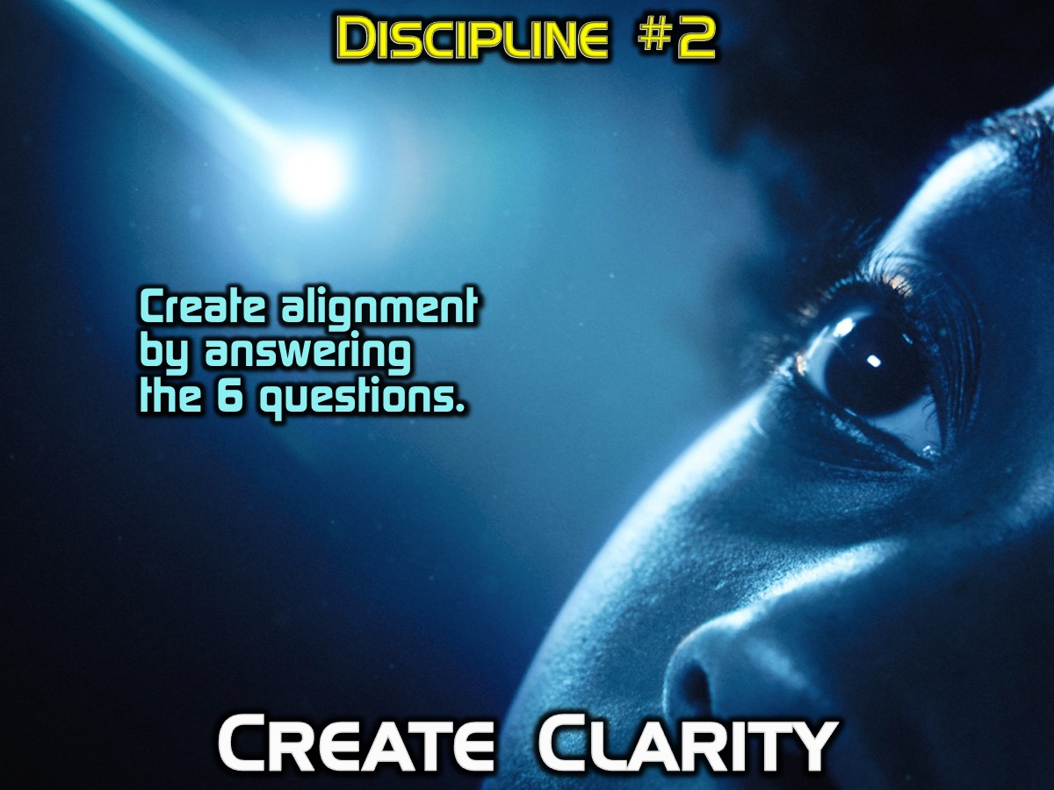
Notes:
Discipline #2: Create Clarity: We create alignment by answering the 6 questions.

Slide 50

Notes:
1. Why do we exist? The answer to this question will yield a core purpose, or the fundamental reason the organisation is operating.

Slide 51
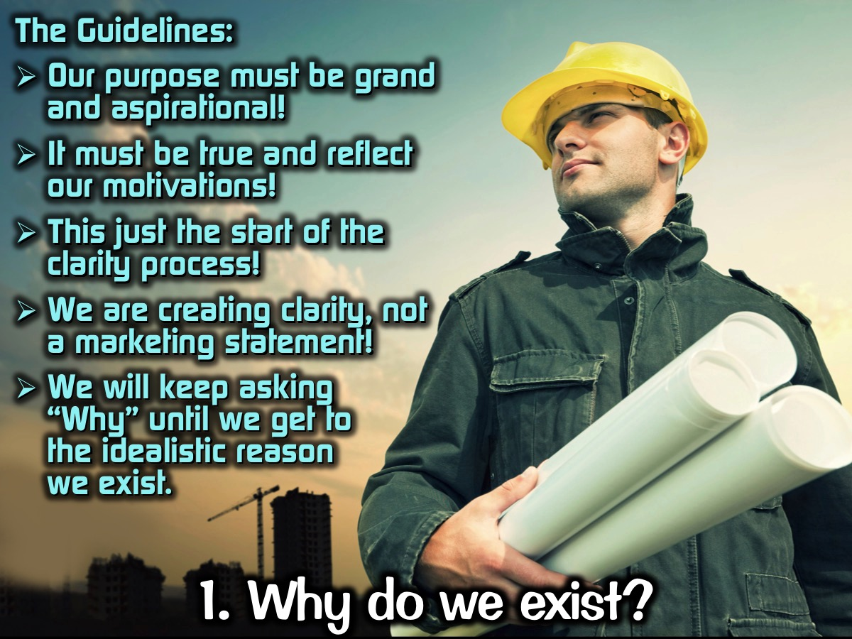
Notes:
The Guidelines: (1) Our purpose must be grand and aspirational. (2) It must be true and reflect our motivations. (3) This just the start of the clarity process. (4) We are creating clarity and not writing a marketing statement. (5) We must keep asking “Why” until we get to the idealistic reason we exist.

Slide 52
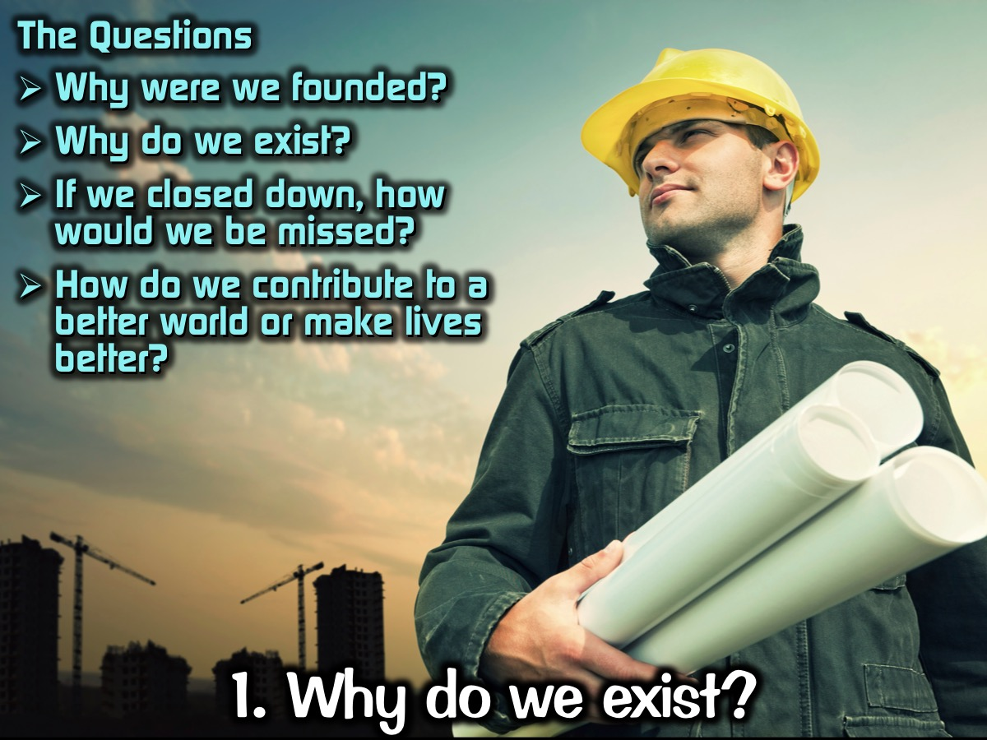
Notes:
The Questions: (1) Why were we founded? (2) Why do we exist? (3) If we closed down, how would we be missed? (4) How do we contribute to a better world or make lives better?

Slide 53
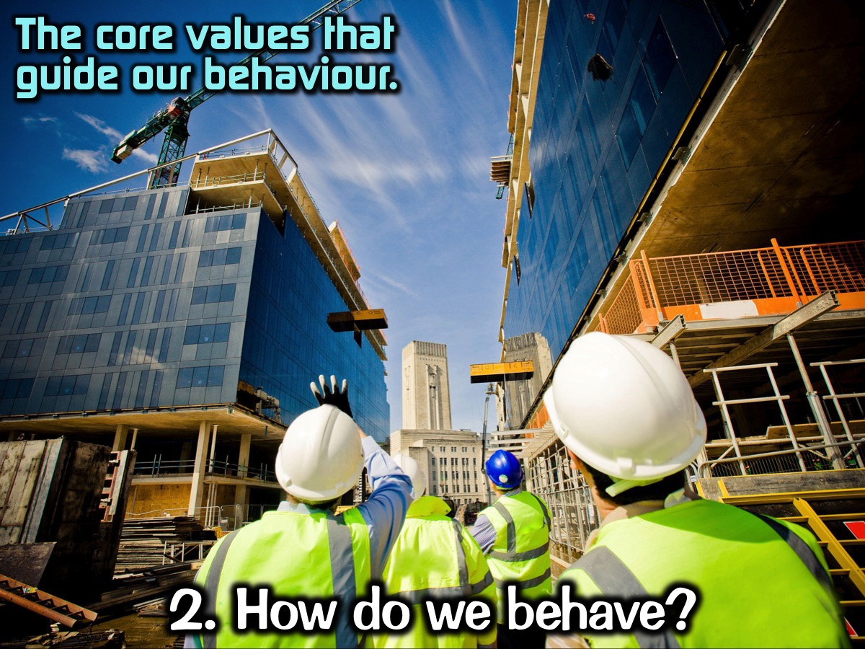
Notes:
2. How do we behave? This question examines behaviors and values required for success. It helps us to identity core values that will guide our behaviour.

Slide 54
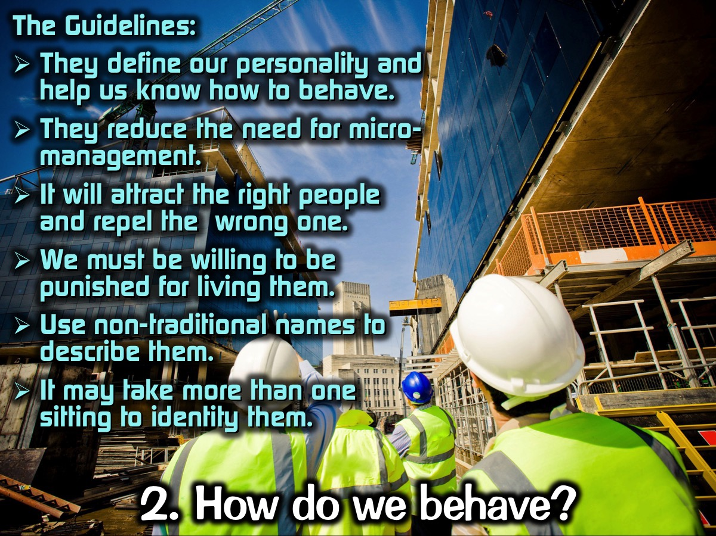
Notes:
The Guidelines: (1) They define our personality and help us know how to behave. (2) They reduce the need for micro-management. (3) It will attract the right people and repel the wrong one. (4) We must be willing to be punished for living them. (5) Use non-traditional names to describe them. (6) It may take more than one sitting to identity them.

Slide 55
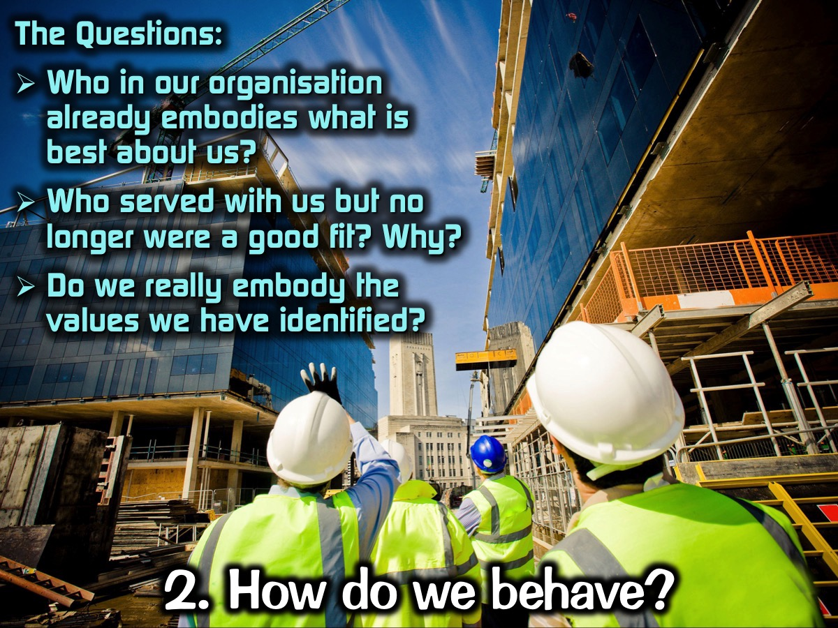
Notes:
The Questions: (1) Who in our organisation already embodies what is best about us? (2) Who served with us but no longer were a good fit? Why? (3) Do we really embody the values we have identified?

Slide 56
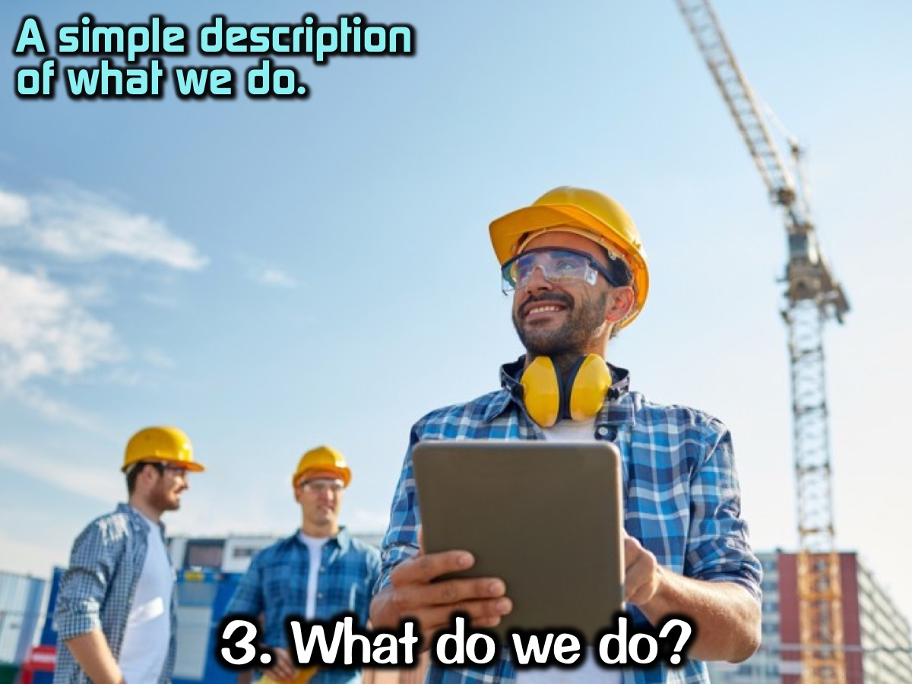
Notes:
3. What do we do? This answer provides a simple description of what we do.

Slide 57
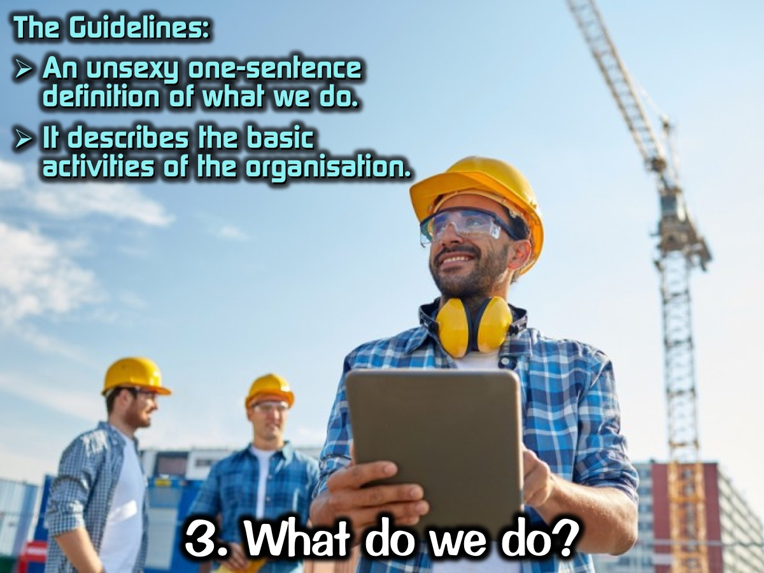
Notes:
The Guidelines: (1) An unsexy one-sentence definition of what we do. (2) It describes the basic activities of the organisation.

Slide 58
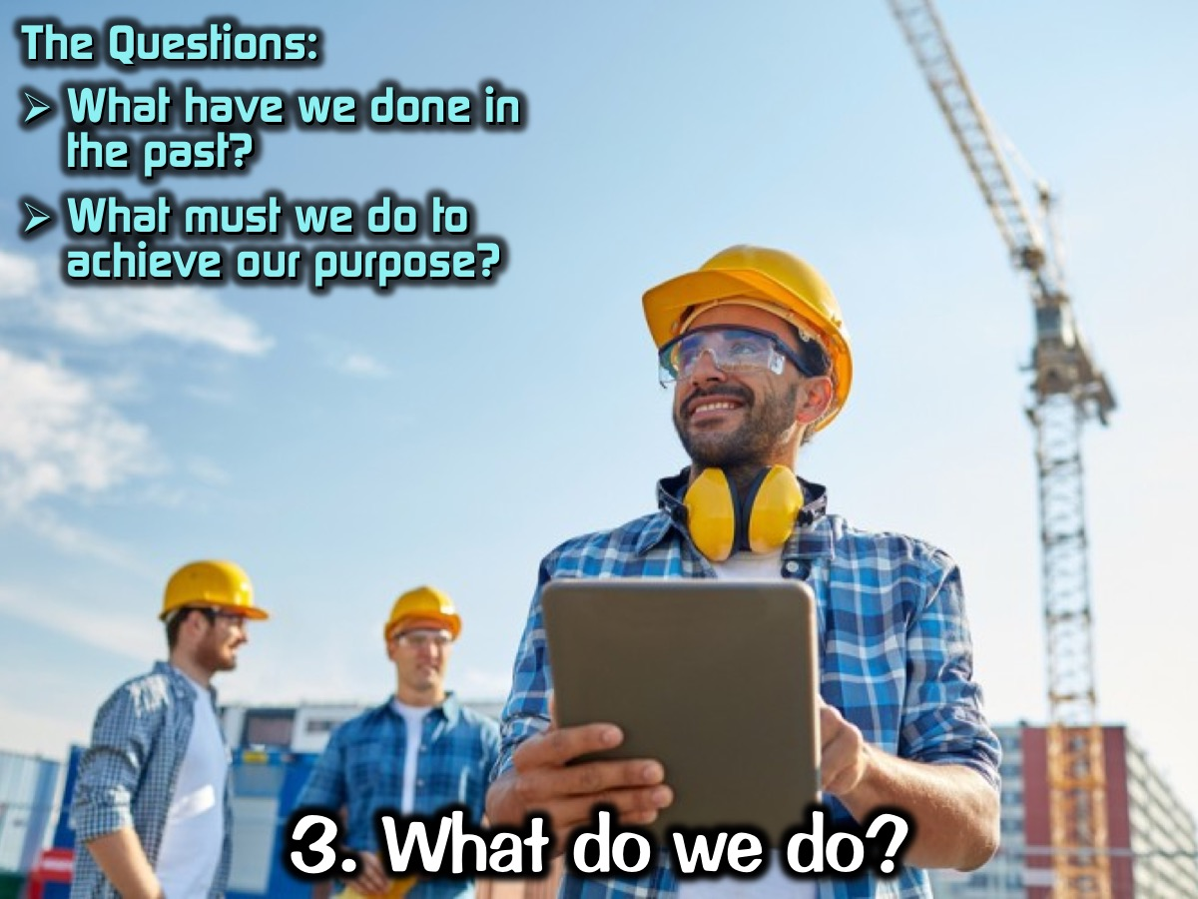
Notes:
The Questions: (1) What have we done in the past? (2) What must we do to achieve our purpose?

Slide 59
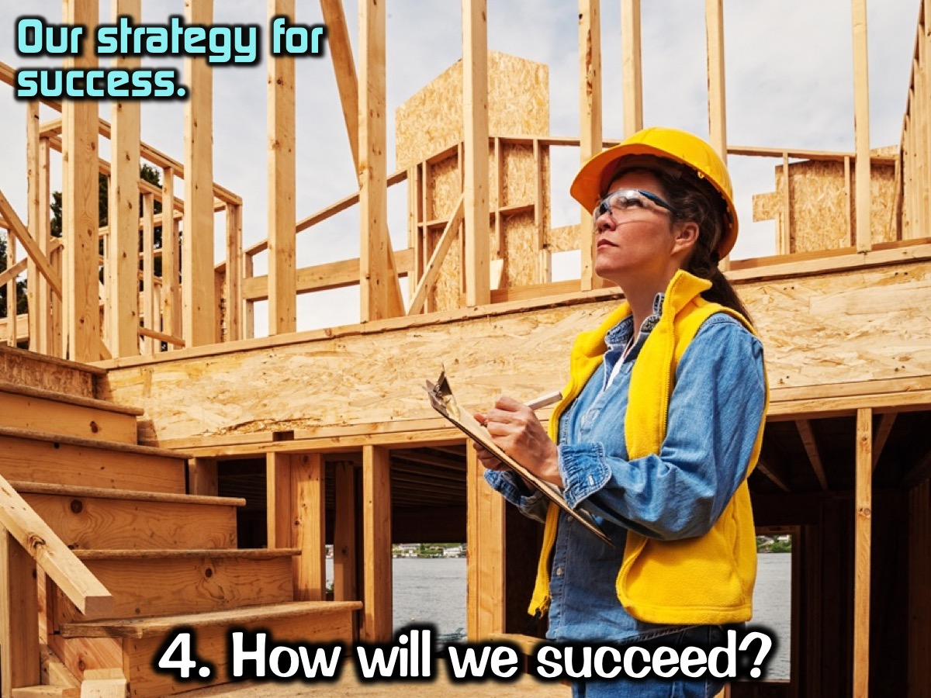
Notes:
4. How will we succeed? This question requires the team members to develop a strategy.

Slide 60
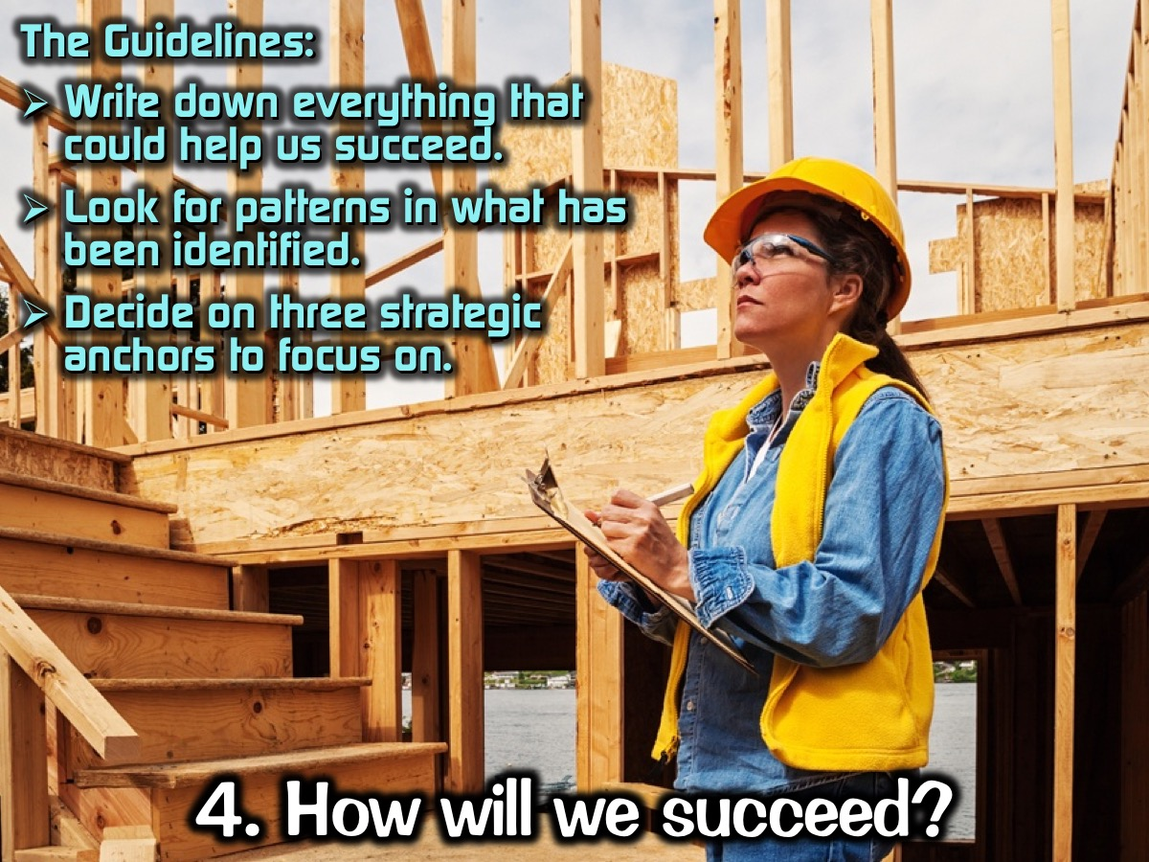
Notes:
The Guidelines: (1) Write down everything that could help us succeed. (2) Look for patterns in what has been identified. (3) Decide on three strategic anchors to focus on.

Slide 61

Notes:
The Questions: (1) What can we do to achieve our purpose? (2) How can we group the activities together? (3) What are three strategic anchors we must focus on!

Slide 62

Notes:
5. What is most important, right now? The answer to this question is the establishment of a short-term action plan - also called a thematic goal.

Slide 63

Notes:
The Guidelines: (1) It is one thing - a rallying cry. (2) It is qualitative. (3) It is temporary (3-12mths). (4) It is a shared responsibility. (5) It is not shared right away nor does it involve everyone.

Slide 64

Notes:
The Questions: (1) If we accomplish only one thing during the next x months, what would it be? (2) What must be true x months from now for us to say it was a good period? (3) What objectives will make it happen?

Slide 65

Notes:
6. Who must do what? This question addresses the roles and responsibilities of the various members in the organisation.

Slide 66

Notes:
The Guidelines: (1) This is a division of the labour. (2) We identify what each person will do.

Slide 67

Notes:
The Question: What will each of us do in the coming months?

Slide 68

Notes:
The Playbook: Capture the answers to the 6 questions in a concise, actionable way.
1. Why do we exist?
2. How do we behave?
3. What will be do?
4. How will we succeed?
5. What is most important, now?
6. Who must do what?

Slide 69

Notes:
Discipline #3: Communicate Clarity: Once a leadership team has become cohesive and established clarity around the six critical questions, they need to communicate the answers to employees over and over and over and over and over and over and over again.

Slide 70

Notes:
The Guidelines: (1) Repeat the message at least 7 times for it to stick. (2) Repeat it in difference situations. (3) Repeat it through different people. (4) Repeat it through different mediums. (5) Word of mouth is the most effective means.

Slide 71

Notes:
The Methods: (1) Cascading Communication - roll the message down though the organisation. End meetings by asking: What are we going to go back and tell our people. Share the message face-to-face to groups if possible. (2) Top-Down Communication - use various means to share the message through the organisation. (3) Upward Communication - give people a chance to communicate up the organisation as well. (4) Lateral Communication - encourage people to communicate across departments in the organisation.

Slide 72

Notes:
“If your people cannot do a good impression of you when you’re gone, you’re not communicating enough.” (Patrick Lencioni)

Slide 73

Notes:
Discipline #4: Reinforce Clarity: For an organization to be healthy, organizational clarity (the six critical questions) must become embedded into the fabric of the organization. All human systems must reinforce the answers to the six critical questions in order to keep them alive and ingrained in the organization. Systems in the following areas need to tie to the six questions: Recruiting and hiring, managing performance, compensation and rewards, and real-time recognition.

Slide 74

Notes:
The Guideline: The answers to the 6 questions must be reinforced through the structure of the organisation.

Slide 75

Notes:
The Methods: (1) Recruiting and Hiring (bring the right people into the organisation and keep the wrong people out by focusing on the behavioural values and develop a quality orientation process). (2) Managing Performance. (3) Compensation and Rewards. (4) Real-time Recognition. (5) Firing (add by subtracting)

Slide 76
Notes:
Remember the goal is that we will become Healthy and Effective!

