Slide 1

Notes:
Welcome to The Hearing God Series. This is a four-week mini-series designed to help you hear God.

Slide 2

Notes:
Last week we learnt that God speaks!

Slide 3
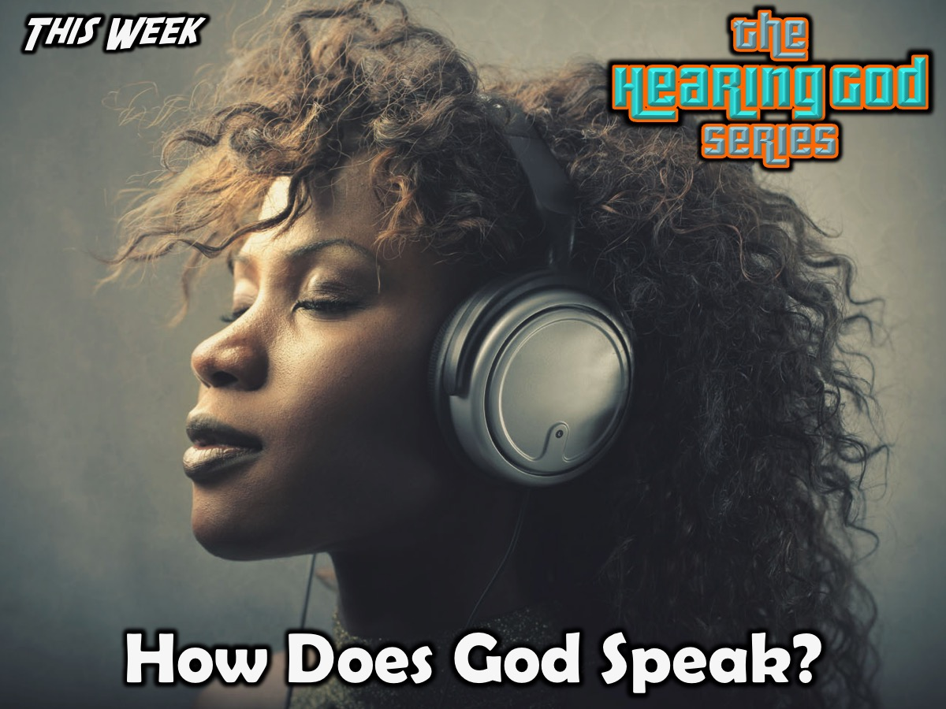
Notes:
This week are are going to look at the ways in which God speaks.

Slide 4

Notes:
Activity: The Memory Game. There are matching cards on the table, they are all upside down, and one person turns one over and then turns it back over again (everyone should watch closely to see what they have turned over). The next person goes and if they can match one they turned over to one that was previously turned over they get to keep the two cards and play again. Each time someone matches a pair of cards someone will read out what the symbol stands for (each pair of symbols is one of the ways in which God speaks).

Slide 5
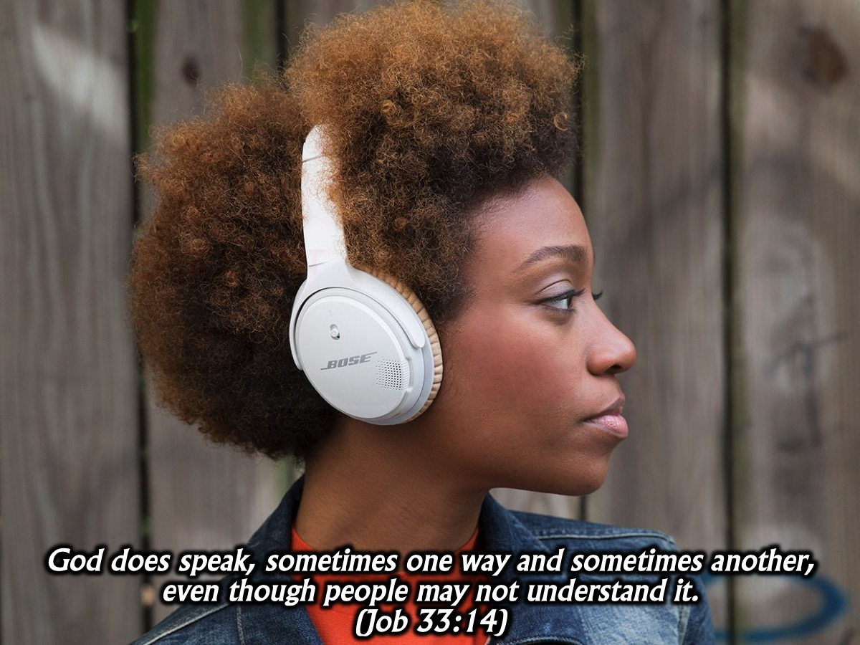
Notes:
“God does speak — sometimes one way and sometimes another — even though people may not understand it.” (Job 33:14).

Slide 6
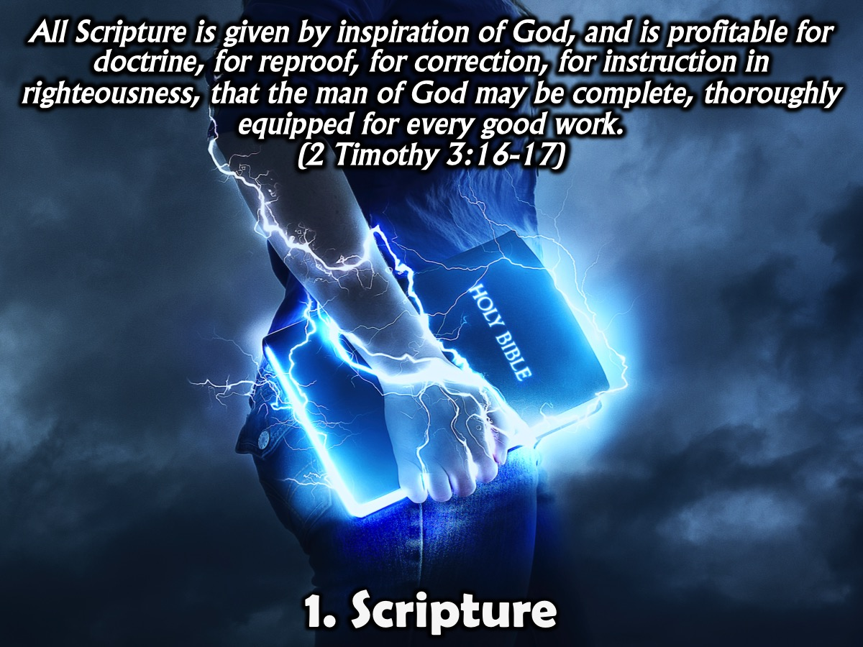
Notes:
1. Scripture. "All Scripture is given by inspiration of God, and is profitable for doctrine, for reproof, for correction, for instruction in righteousness, that the man of God may be complete, thoroughly equipped for every good work" (2 Timothy 3:16-17). God speaks to us through the Bible and whatever he says to us will be consistent with what he has said in the Bible. It is the Word of God - everything in it, was written by humans, but is inspired by God. All Scripture is “God-breathed” and His Word sometimes gives us a warning, a word of encouragement, or a lesson for life. It is able to equip us for every good work. God can speak specifically to us through the Bible, by drawing a particular passage to our attention, because the Word of God is living and active (Hebrews 4:12).

Slide 7
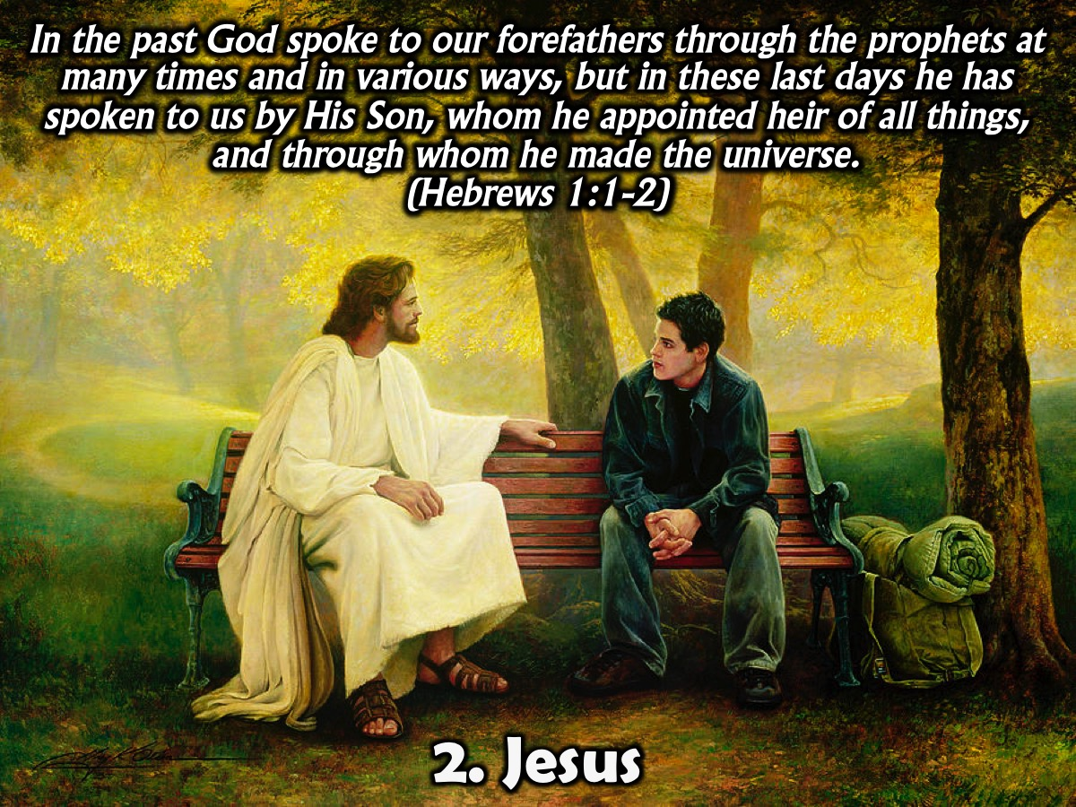
Notes:
2. Jesus. “In the past God spoke to our forefathers through the prophets at many times and in various ways, but in these last days he has spoken to us by His Son, whom he appointed heir of all things, and through whom he made the universe.” (Hebrews 1:1-2). As we read the words of Jesus in the Bible we hear God’s heart and God’s voice and know what God is like. Jesus said in John 10:27: “My sheep hear my voice, and I know them, and they follow me.” He is our shepherd and as His sheep we know who he is - we belong to him and we recognise Him by the sound of His voice. Through his words he lovingly lead us on the right path.

Slide 8
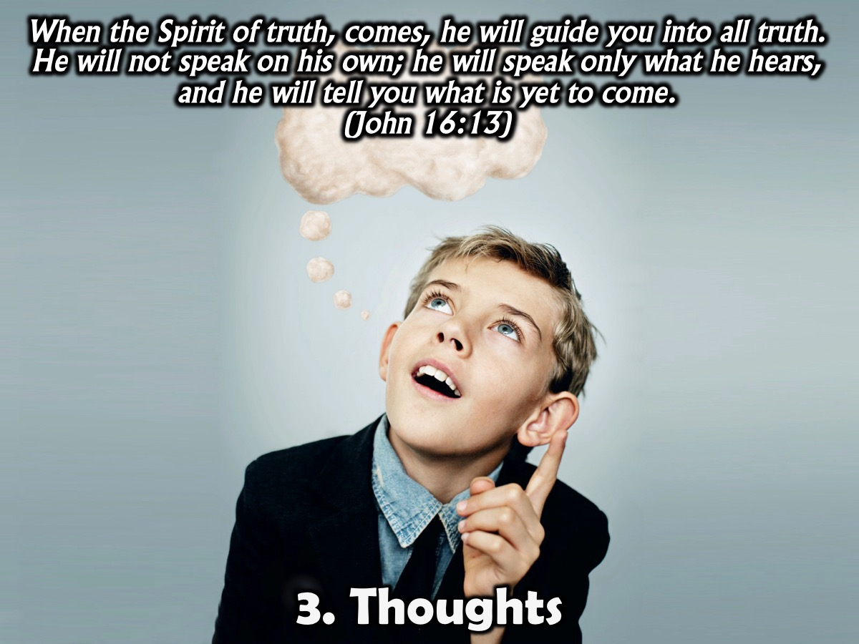
Notes:
3. Thoughts. “When the Spirit of truth, comes, he will guide you into all truth. He will not speak on his own; he will speak only what he hears, and he will tell you what is yet to come.” (John 16:13). God speaks to us by his Spirit by giving us impressions in our mind and heart. John calls these Spirit impressions an “anointing” and encourages us to learn to place confidence in the Spirit as our inner teacher (1 John 2:27). God’s Spirit speaks to us through our conscience, helping to make the right decision. When we’re tempted, that same Spirit warns and nudges us to do the right thing. Amos 4:13 says that God makes known His ways to us through our thoughts.

Slide 9
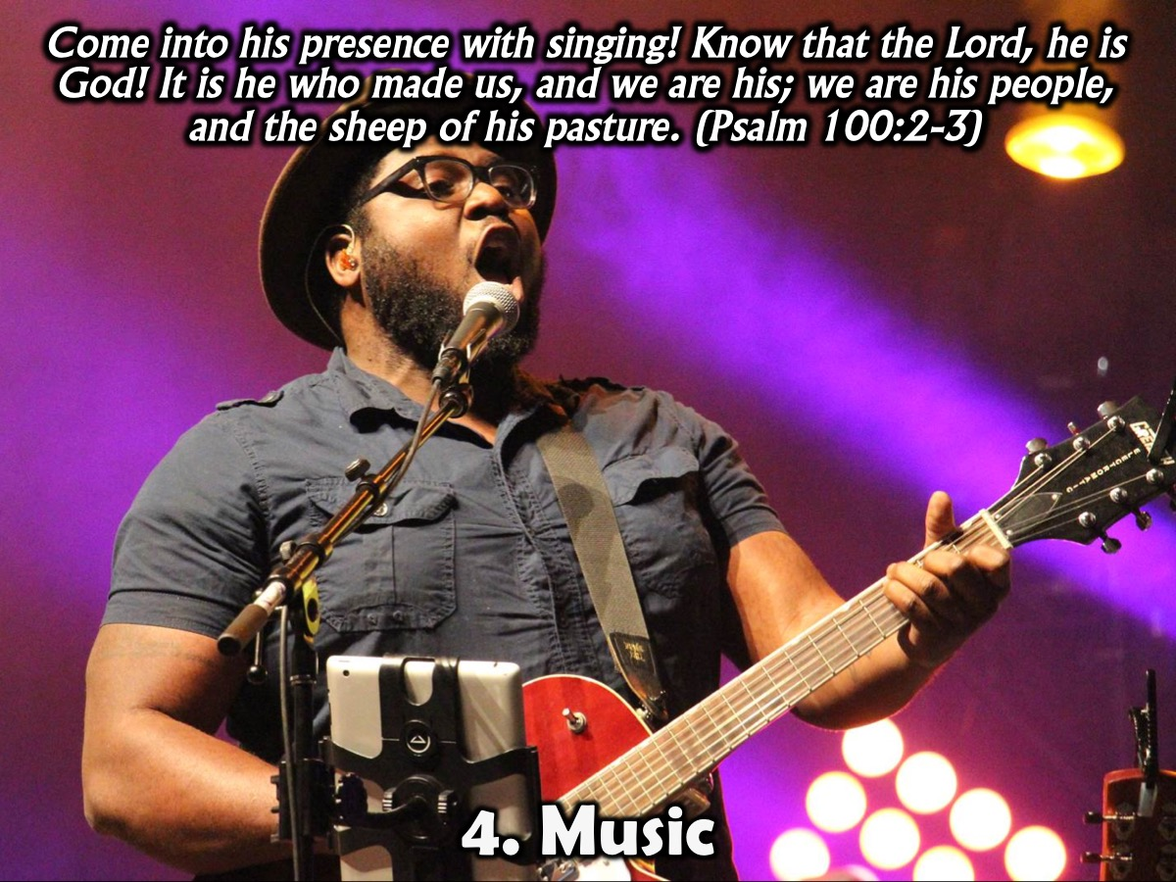
Notes:
4. Music. “Come into his presence with singing! Know that the Lord, he is God! It is he who made us, and we are his; we are his people, and the sheep of his pasture.” (Psalm 100:2-3)
One of most common ways that we sense God’s presence and hear His voice the best is when we praise Him through music. The words and the notes bring a soothing comfort, excitement, and passion that open our ears and heart and lift our spirits. In 2 Chronicles 20, King Jehoshaphat faced a huge army of enemies who could have easily destroyed His people, but he did a strange thing. With a declaration that his eyes were on God, he sent in a choir of praise singers: “Jehoshaphat appointed men to sing to the LORD and to praise him for the splendor of his holiness as they went out at the head of the army, saying: ‘Give thanks to the LORD, for his love endures forever’” (2 Chronicles 20:21). God “spoke” clearly. He released His power, and Jehoshaphat’s army defeated their enemies!

Slide 10
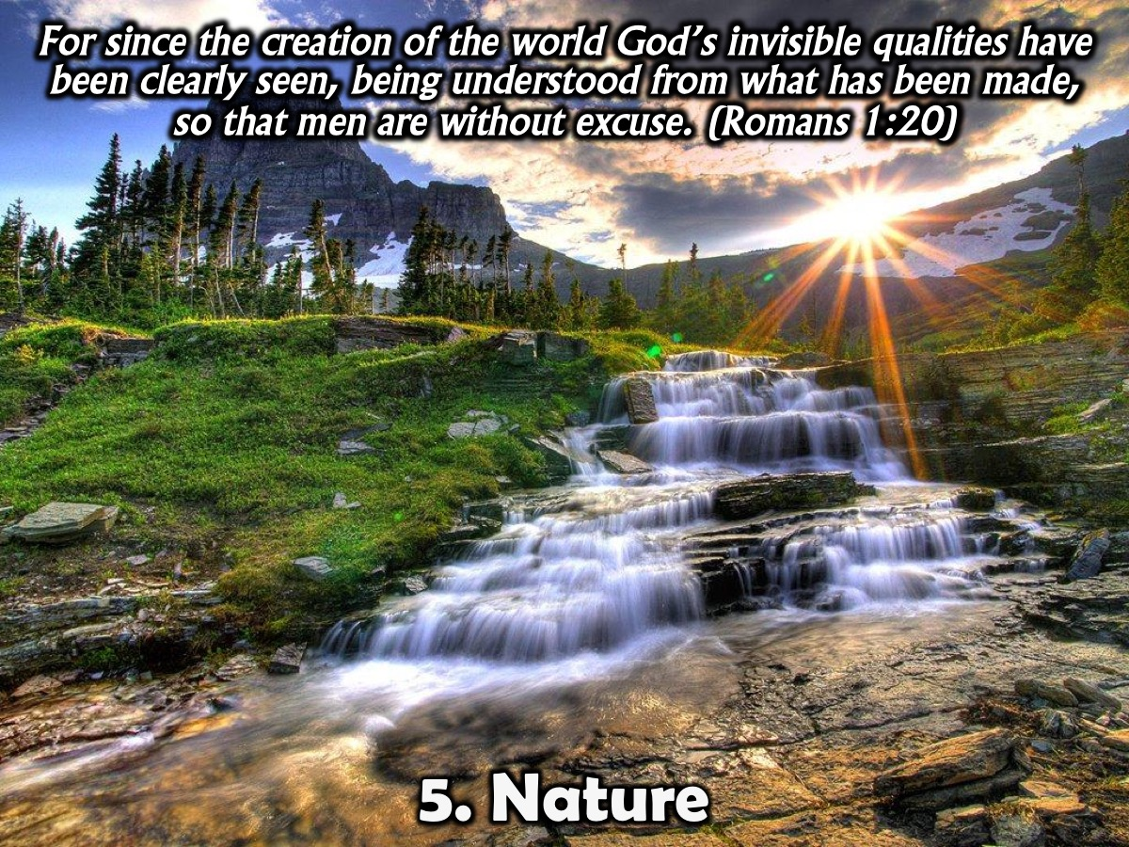
Notes:
5. Nature. “For since the creation of the world God’s invisible qualities–his eternal power and divine nature–have been clearly seen, being understood from what has been made, so that men are without excuse.” (Romans 1:20). Through the magnificent beauty of God’s creation we can hear His voice. How? By observing the ant’s strength to store up food all summer long, we learn about wisdom and industriousness. By studying the heavens, we understand more of God’s greatness. And through planting and growing a garden, we “hear” about miracles of death and rebirth. God speaks to us through nature, through practical situations and through our every day surroundings. Proverbs 24:30-34 is a great example of how we can hear God through nature. God spoke to Solomon through an experience. It wasn't a still, small voice or a supernatural encounter. He was just passing by the field of a lazy man and he prophetically received a powerful bit of wisdom from God. If you keep a listening ear, you'll discover that God will speak to you through and about many things just as you go about your everyday life.

Slide 11
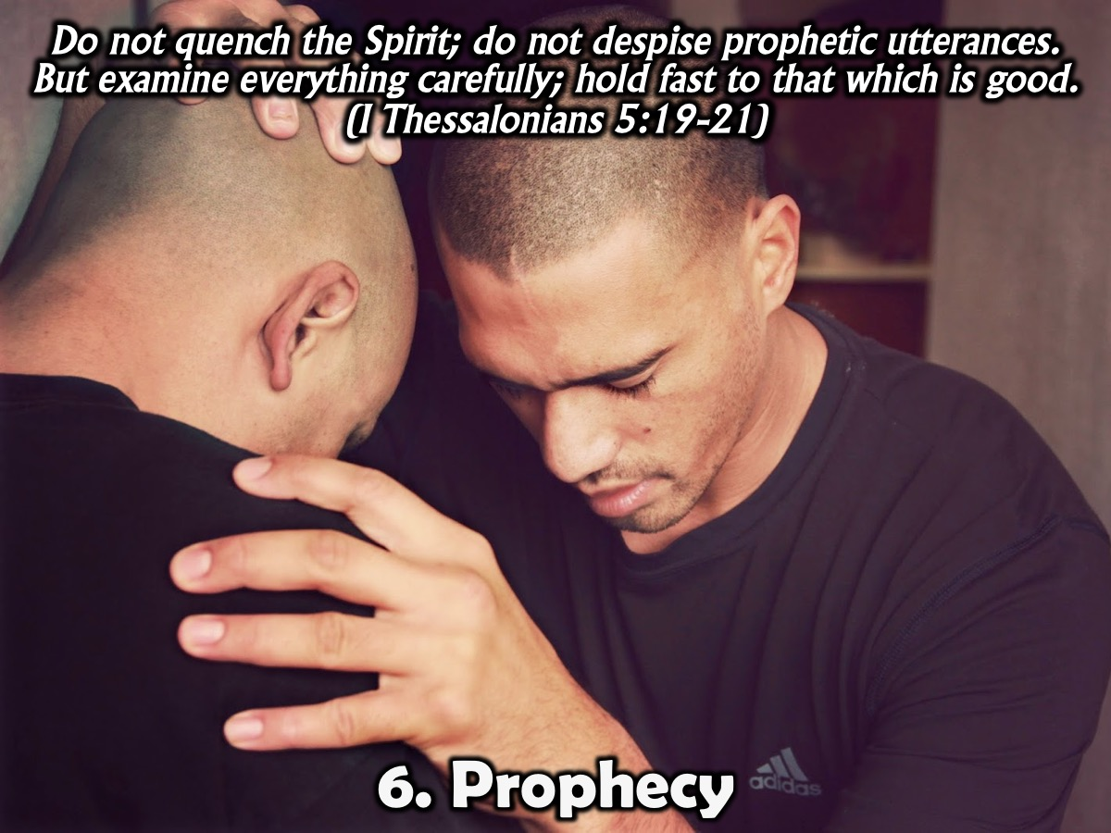
Notes:
6. Prophecy. "Do not quench the Spirit; do not despise prophetic utterances. But examine everything carefully; hold fast to that which is good" (I Thessalonians 5:19-21). God often speaks to us through spiritual gifts like a word of knowledge or word of wisdom or through a personal prophecy that someone speaks over our lives.

Slide 12

Notes:
7. People. “Without good direction, people lose their way; the more wise counsel you follow, the better your chances.” (Proverbs 11:14). God speaks to us through people or preachers that come across our path. Sometimes we feel like a preacher is speaking just to us and we know that it is a word from God for us. God says that he uses His people as ‘instruments for noble purposes’ (2 Timothy 2:21). These instruments may be in the form of people through books, podcasts, radio, TV programs, sermons or complete strangers on the street, but when it comes and is precisely what we need to hear we know it is God speaking to us. We learn throughout the book of Proverbs that when we seek godly counsel we can hear the voice of God.

Slide 13

Notes:
8. Prayer. “The Spirit helps us in our weakness. We do not know what we ought to pray for, but the Spirit himself intercedes for us through wordless groans.” (Romans 8:26). God often speaks to us through His Spirit, through prayer. We may not know how to pray, but God’s Word tells us His spirit makes intercession for us. Often as we fast and pray our minds become clear and our hearts become more sensitive to God. We may not hear God’s audible voice, but His Spirit confirms a certain direction or answer for us. Sometimes while praying, God’s Spirit will remind us of a Scripture or a truth in His Word that we can directly apply to the situation.

Slide 14
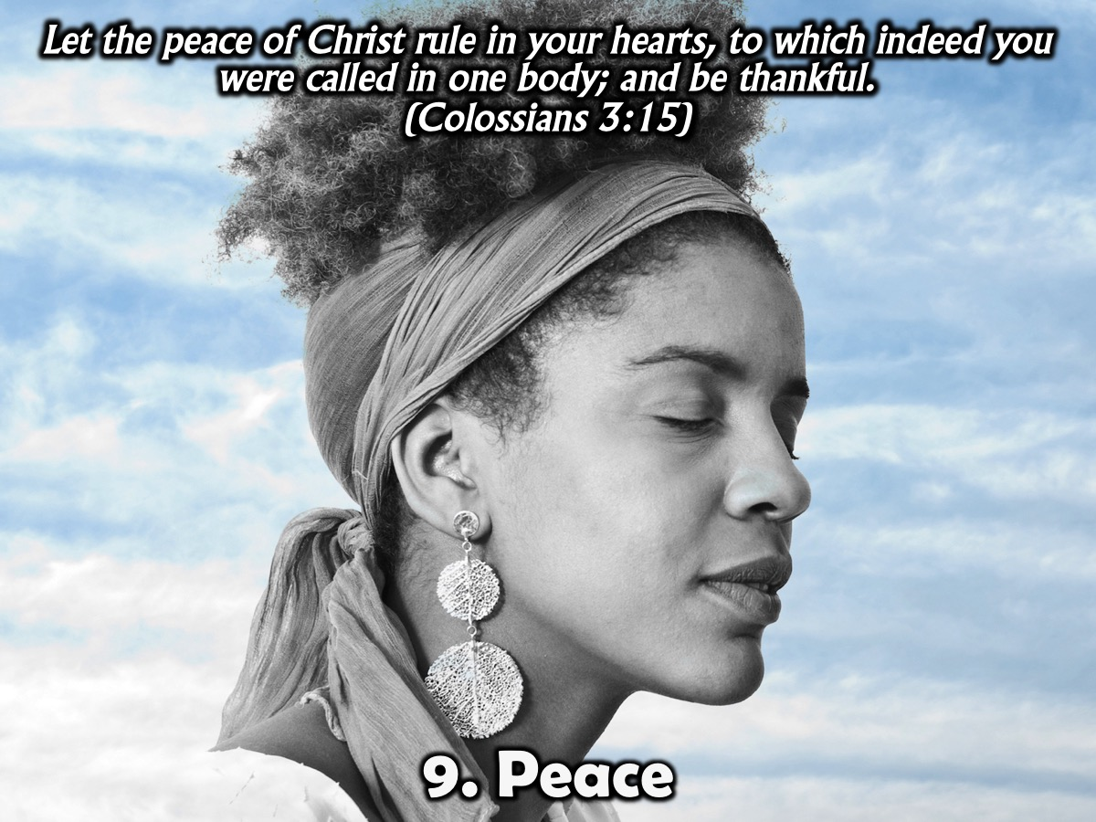
Notes:
9. Peace. "Let the peace of Christ rule in your hearts, to which indeed you were called in one body; and be thankful" (Colossians 3:15). God’s peace can rule in our hearts. The word rule means to reign or to be a deciding factor. If we don’t have peace about a decision, then it isn’t from the Lord. Don’t move forward unless you have peace. Jesus said that the Holy Spirit will lead us and guide us into all truth (see John 16:13). One of the ways He leads us into that truth is through peace. The Amplified translation of Colossians 3:15 says, "Let the peace (soul harmony which comes) from Christ rule (act as umpire continually) in your hearts [deciding and settling with finality all questions that arise in your minds, in that peaceful state] ... .”

Slide 15

Notes:
10. Events. “And we know that in all things God works for the good of those who love him, who have been called according to his purpose.” (Romans 8:28). God is the sovereign Lord who uses events or circumstances in our lives to open and close doors for us. God often uses the ordinary to communicate His extraordinary love. Lose a job? The Apostle Paul says, “And we know that in all things God works for the good of those who love him, who have been called according to his purpose” (Romans 8:28). Through Moses, God used circumstances (plagues) to convince Egypt’s leader to release God’s people from slavery. But Pharaoh wouldn’t listen. God spoke to Jonah first with His voice, but Jonah didn’t heed God’s voice. So God spoke to Jonah through events - first, being swallowed by a great fish, and second when a vine grew up to shade Jonah, and then the vine withered (Jonah 1–4). We need to examine our circumstances and ask if we are hearing the Lord through these events. Ask yourself two questions: What’s happening in my life right now? What is the Lord telling me through these events?

Slide 16
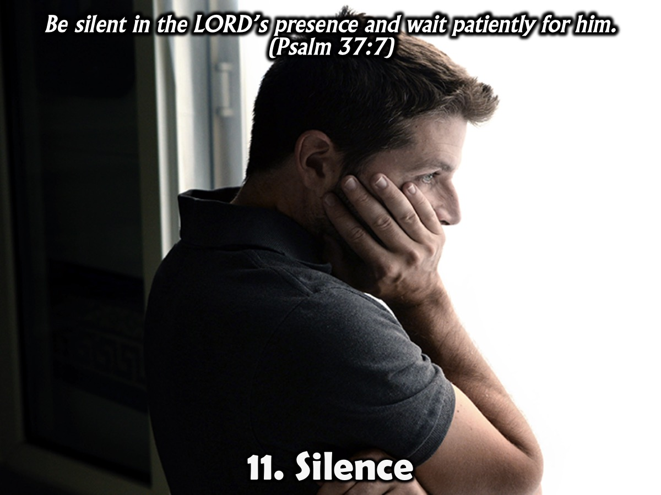
Notes:
11. Silence. “Be silent in the LORD’s presence and wait patiently for him.” (Psalm 37:7). As Jesus went to the Garden of Gethsemane and asked God to change his circumstances, only to receive silence in response. Jesus accepted this silence as temporary. He knew God was there and would take him through the trial. Matthew 26:39 says, “My Father, if it is possible, may this cup be taken from me. Yet not as I will, but as you will.” There are many reasons for God’s silence: maybe he spoke in the past and we did not pay attention, maybe he wants us to follow a difficult path without easing the load to gain strength and stamina or maybe He is teaching us that we have to trust Him even if we are facing the death of a loved one.

Slide 17

Notes:
12. Dreams. “God speaks again and again, in dreams, in visions of the night when deep sleep falls on men as they lie on their beds.” (Job 33:14-15). There are several placed in the Bible where God says he will speak to us through visions and dreams (Joel 2:28, Acts 2:17, Daniel 7:1). Whether it is a dream while you are sleeping, or a vivid image that comes to mind while praying, God does use visuals to speak to us and gives us the wisdom to interpret what He is saying. Dreams and visions weren't just an Old Testament phenomenon. Peter fell into a trance (see Acts 10:10), Paul had supernatural encounters (2 Cor. 12:13) ad John wrote the book of Revelation based on a supernatural vision. How do you know if a dream is from God? There are three general guidelines: (1) It won't contradict the Word; (2) God will give you an immediate interpretation; (3) You just can't shake it - t stays with you so you are compelled to pray about it, ask God what it means or ask spiritual leaders to help you interpret it.

Slide 18

Notes:
13. Wonders. The angel of the LORD appeared to him as a blazing fire in a bush. Moses was amazed because the bush was engulfed in flames, but it didn't burn up. When the LORD saw that he had caught Moses' attention, God called to him from the bush, "Moses! Moses!” (Exodus 3:1-4). God also speaks to us through miracles, supernatural manifestations or signs. God spoke to Moses through a burning bush (Exodus 3:1–4). He spoke to Gideon through a fleece (Judges 6:37–40). He spoke to Saul on the Damascus road through a bright light (Acts 9:1–5). He even spoke to Balaam through a donkey (Numbers 22:1–35).

Slide 19
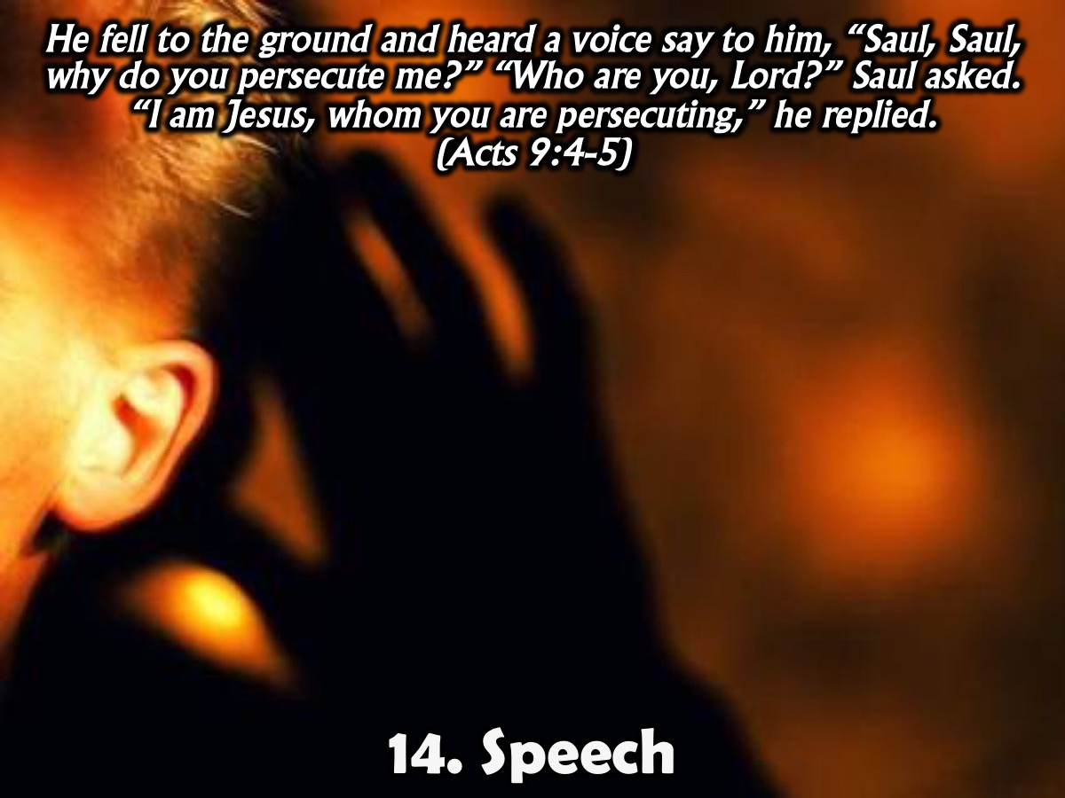
Notes:
14. Speech. “He fell to the ground and heard a voice say to him, “Saul, Saul, why do you persecute me?” “Who are you, Lord?” Saul asked. “I am Jesus, whom you are persecuting,” he replied.“ (Acts 9:4-5). Hearing the audible voice of God is rare. It happened throughout the Bible so there is no reason for us to believe that it could not happen to us today.

Slide 20
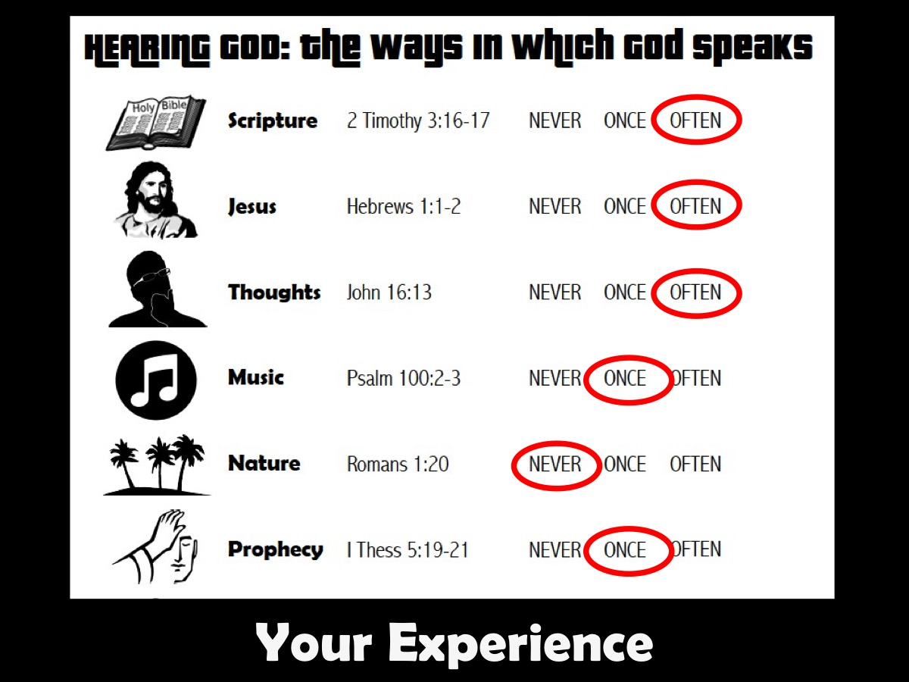
Notes:
Your Experience: So what experience of hearing God’s voice have you had in your life. Take a few moments to work through the handout - cirle one of the three words next to each of the 14 ways that God speaks: Never, Once or Often. Then spend a few moments asking God to speak to you in new ways in the coming weeks.
God speaks in many different ways. We need to pay close attention and establish a pattern of how He speaks to us most often. Monitor the track record with success in this with these different ways. If you are consistently on target with one of these, then you can be confident in that area. If you are consistently off target with one of these areas, then you don't need to be prophesying to people or making decisions on those ways.

Slide 21

Notes:
Wrap Up: (1) You Are Unique: Does God speak to all of us the same way? No, we are all unique. Are these the only ways God speaks today? No. He’s a creative God. He speaks so many ways. In other countries where Christianity is taboo, God is also revealing Himself repeatedly through dreams. Report after report confirms that an unbeliever who has never heard of Jesus dreams of Him – but doesn’t know who the “man” is–or what the dream means. Then a messenger comes, shows a film about Jesus’ death and resurrection, and the one who has dreamed recognizes the man in his dream: It’s Jesus, the Son of God! (2) No matter how God chooses to reveal Himself or “speak” to us today, we must remember that He will never contradict His Word, and the message He gives will always bring glory to God. (3) If we are going to hear God’s voice, then we need to listen to Him. We need to tune in to the frequency of heaven and hear the voice of God. Note the warning held out in Jeremiah 7:13: “While you have been sinning, I have been trying to talk to you, but you refuse to listen”. Essentially, God is saying to the Israelites that they did any number of wicked things, and He was speaking and speaking to them repeatedly about it, but they did not listen to Him.

Slide 22
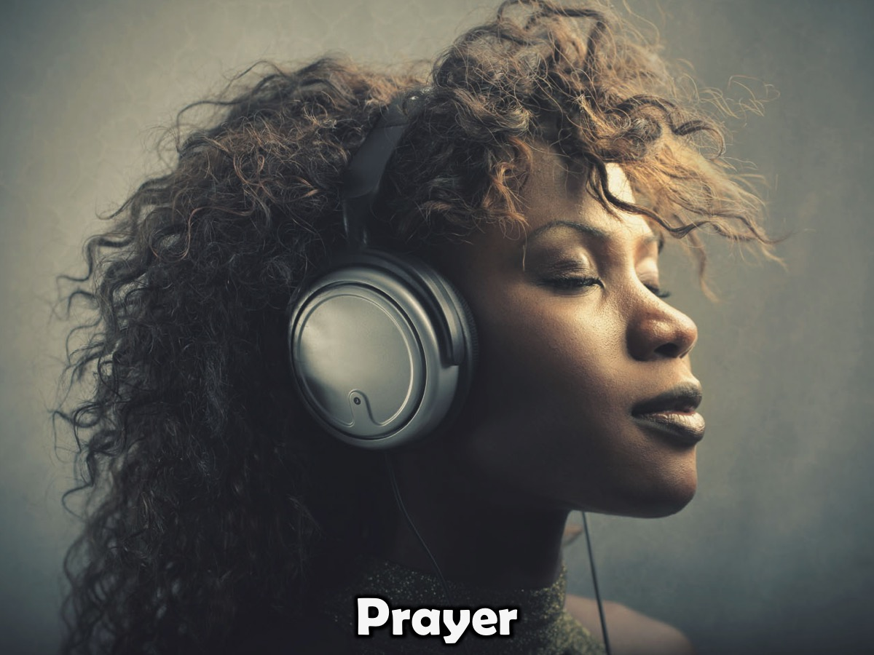
Notes:
Prayer

Slide 23

Notes:
Next week we are going to look at Part 1 of how we can hear God!

