Slide 1

Notes:
Welcome to The Hearing God Series. This is a four-week mini-series designed to help you hear God.

Slide 2

Notes:
In week 1 we learnt that God speaks to us today!

Slide 3

Notes:
In week 2 we learnt that God speaks in different ways.

Slide 4

Notes:
In week 3 we learnt that God speaks through visions our thoughts.

Slide 5

Notes:
This week we are going to learn that God speaks through the Bible.

Slide 6
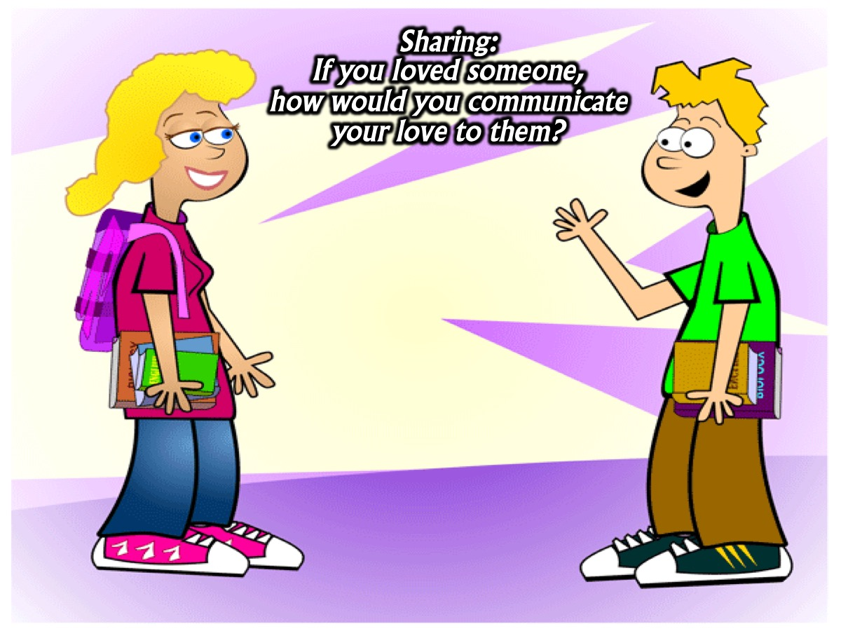
Notes:
Sharing: If you loved someone, how would you communicate your love to them?

Slide 7
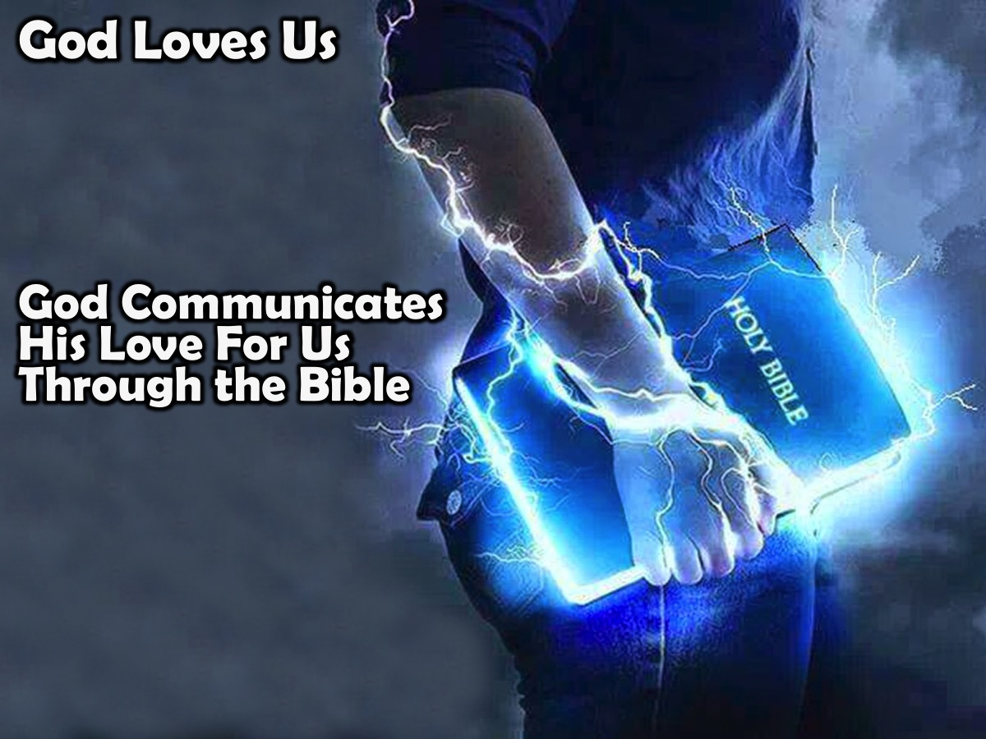
Notes:
God loves us and one of the ways he communicates his love for us through the Bible.

Slide 8
Notes:
Video: Did you know that God speaks to us through the Bible? Get it at: https://www.youtube.com/watch?v=EMFeuSK0mrQ

Slide 9

Notes:
Here are some passages from the Bible that speak about The Bible is a tool God uses to communicate with us:

Slide 10
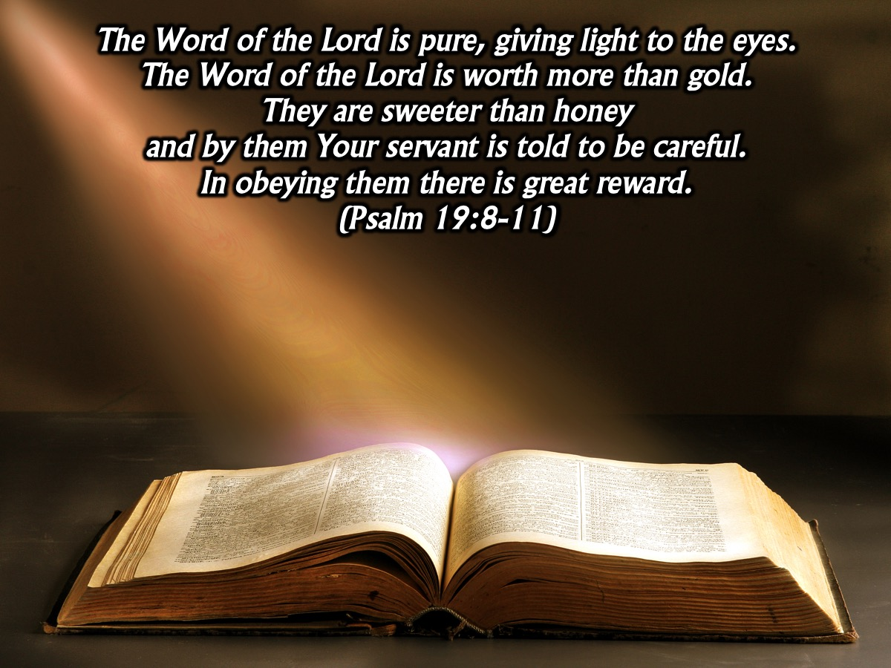
Notes:
The Word of the Lord is pure, giving light to the eyes. The Word of the Lord is worth more than gold. They are sweeter than honey and by them Your servant is told to be careful. In obeying them there is great reward. (Psalm 19:8-11)

Slide 11
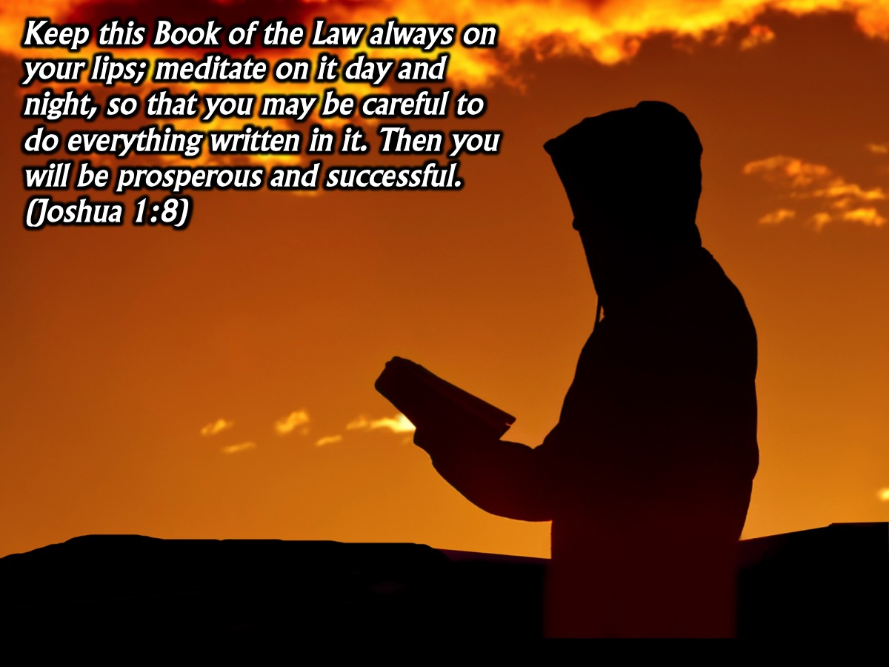
Notes:
Keep this Book of the Law always on your lips; meditate on it day and night, so that you may be careful to do everything written in it. Then you will be prosperous and successful. (Joshua 1:8)

Slide 12
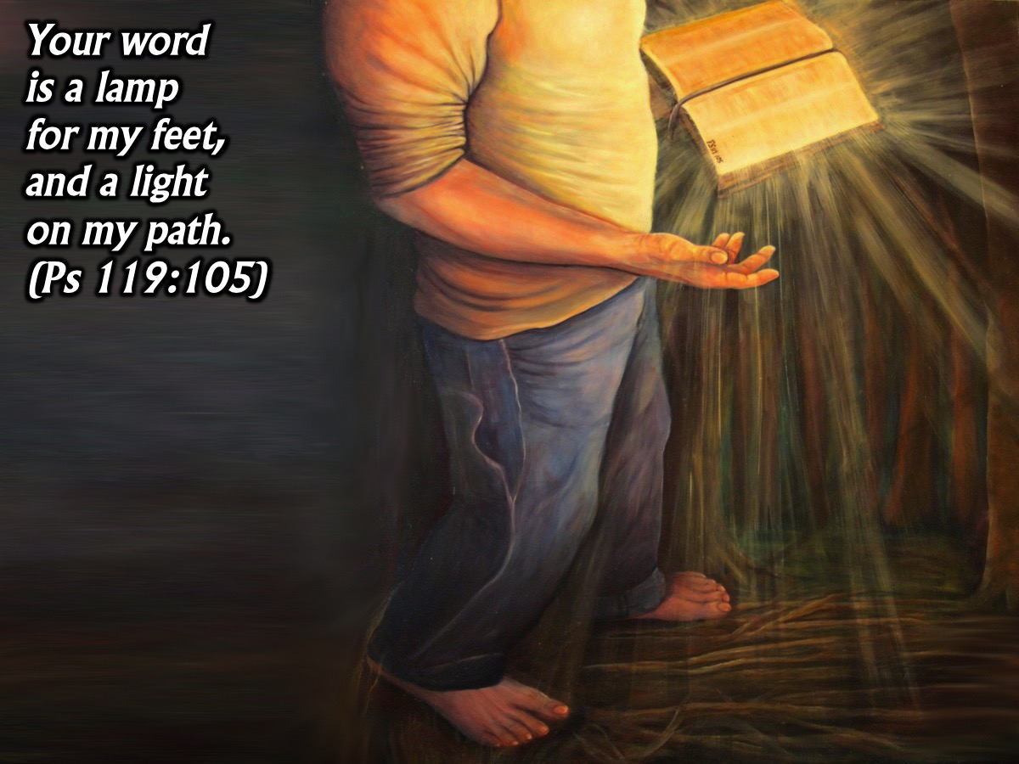
Notes:
“Your word is a lamp for my feet, a light on my path.” (Psalm 119:105)

Slide 13

Notes:
The Holy Scriptures are able to make you wise for salvation through faith in Christ Jesus. All Scripture is God-breathed and is useful for teaching, rebuking, correcting and training in righteousness, so that the servant of God may be thoroughly equipped for every good work. (2 Timothy 3:15-17)

Slide 14
Notes:
Video: David Bowden "I Believe in Scripture" Spoken Word. https://www.youtube.com/watch?v=EZdzjf5uuv4

Slide 15

Notes:
Challenge: (1) God speaks to us. (2) God speaks to us through the Bible. (3) We can hear God speak. (4) We need to read God’s love letter

Slide 16

Notes:
Activation #1: Read Until God Speaks
Read the Bible until God speaks to you. Start reading a chapter of a book and keep reading until you believe that God is speaking to you. Read slowly and listen as you read for what God is saying to you. It won’t be long until God speaks!
1. Choose a chapter or a book of the Bible.
2. Ask God to speak to you as you read.
3. Start reading and stop when God speaks.
4. Write down the thoughts you get.
5. Thank God for speaking to you.
Feedback: Have teens share what God said to them.

Slide 17
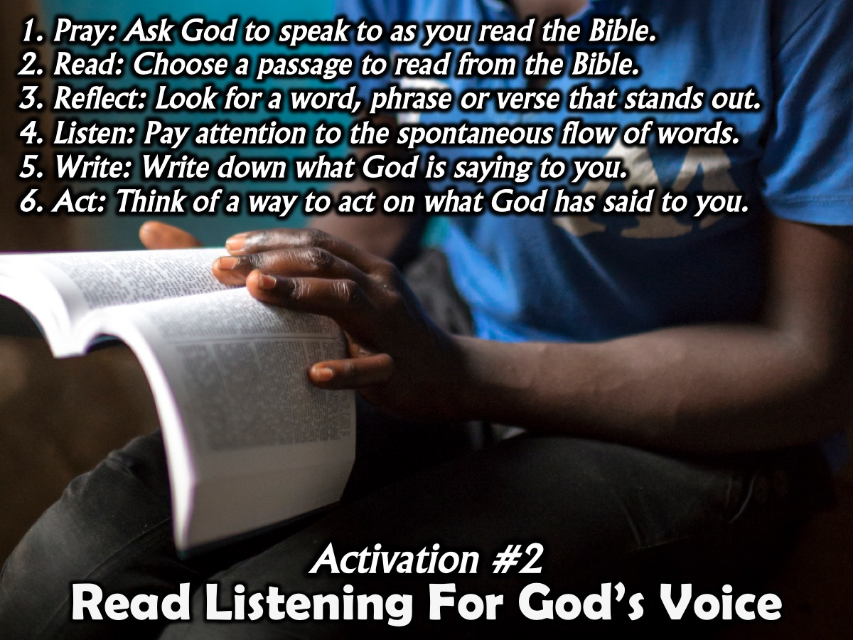
Notes:
Activation #2: Read Listening For God’s Voice
1. Pray: Ask God to speak to as you read the Bible.
2. Read: Choose a passage to read from the Bible (a Psalm, a chapter from the Gospels, etc).
3. Reflect: Look for a word, phrase or verse that stands out to you (underline it or write it out).
4. Listen: Pay attention to the spontaneous flow of words that come to mind.
5. Write: Write down what God is saying to you.
6. Act: Think of a way to act on what God has said to you.
Feedback: Have teens share what God said to them.

Slide 18

Notes:
Wrap Up: Take 10 minutes every day in the coming week to practice hearing God speak to you through the Bible.

Slide 19
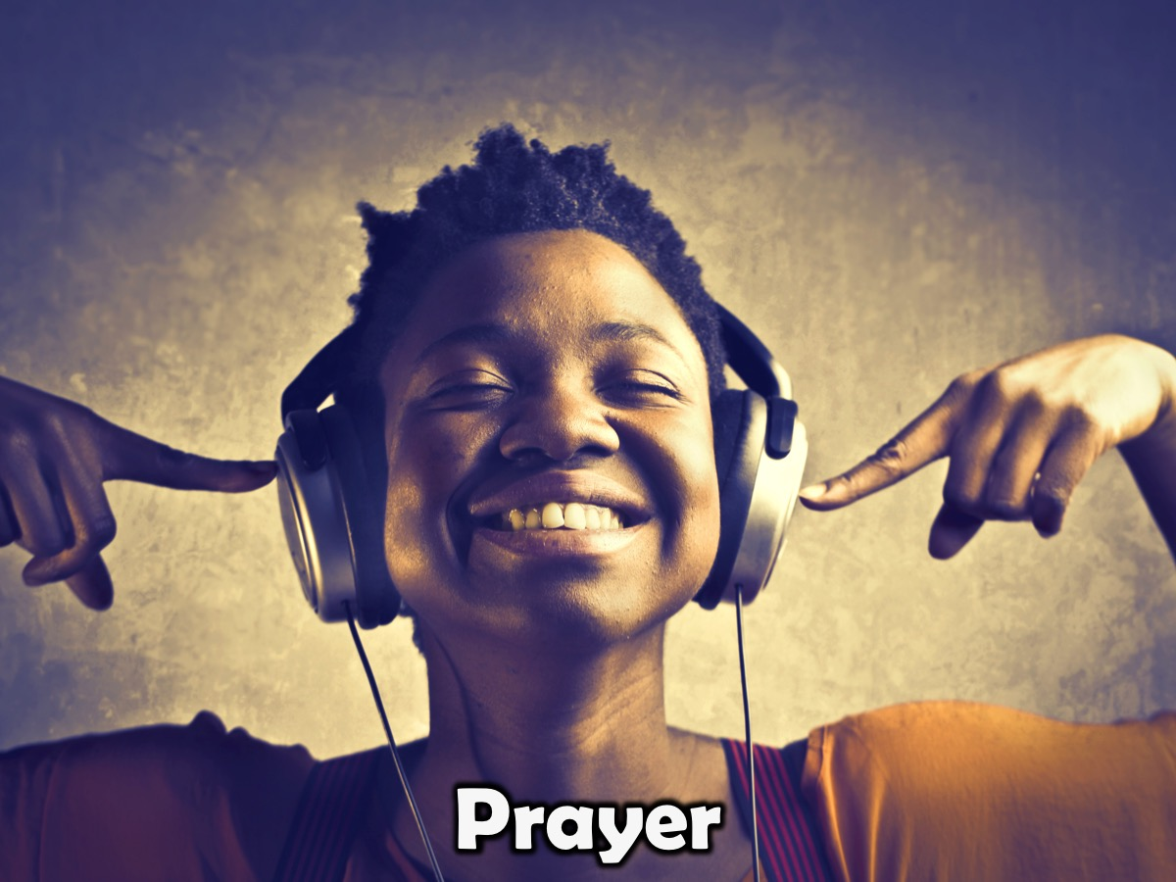
Notes:
Prayer

Slide 20

Notes:
From next week until schools go back in January, we will stay in the Sanctuary after worship each week.

