Slide 1
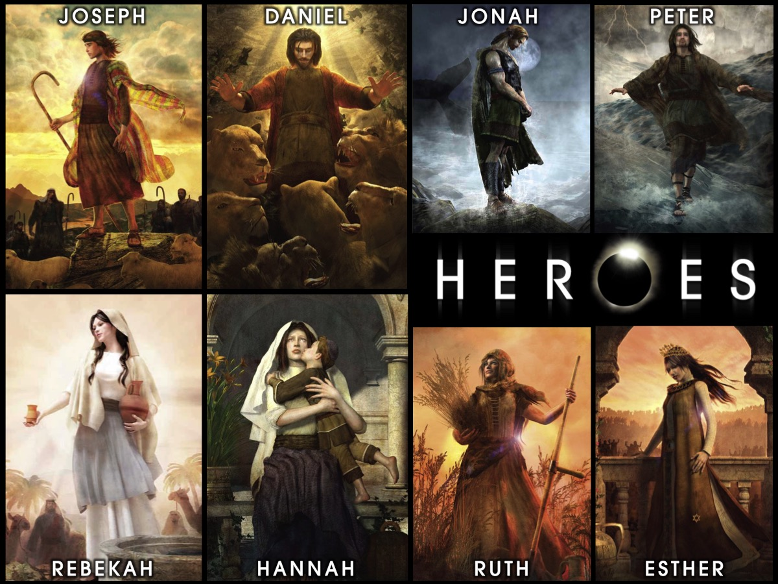
Notes:
Welcome to our Heroes Series on Sunday mornings at His Youth.

Slide 2
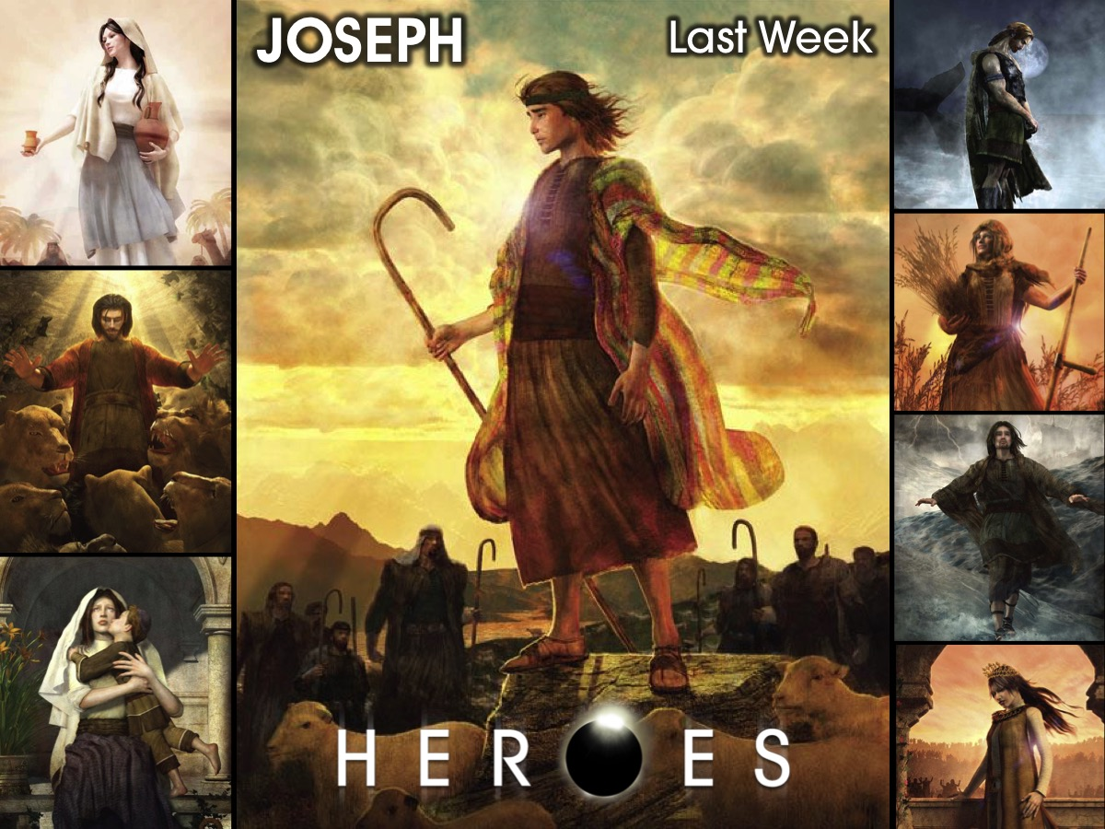
Notes:
Last Sunday we looked at the life of Joseph and learnt so much about how to live as followers of Jesus.

Slide 3
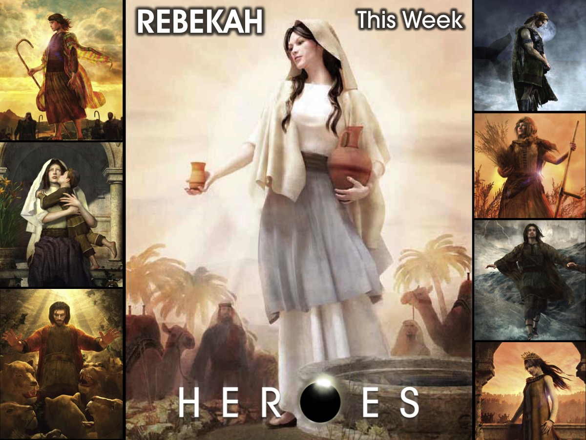
Notes:
This week we are going to enter into the story of Rebekah

Slide 4
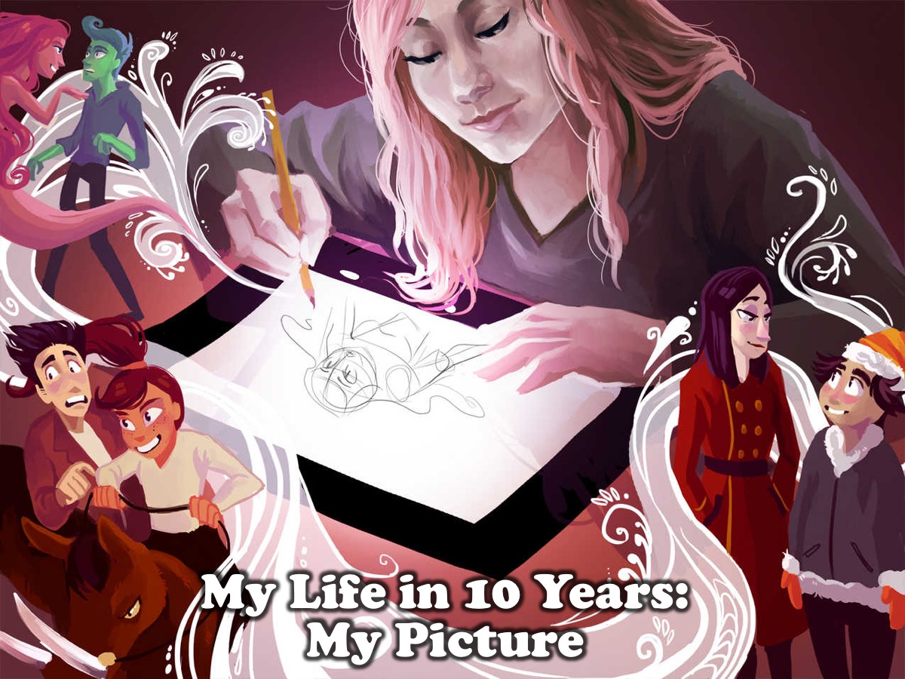
Notes:
I want you to fast forward your life by 10 years and draw a picture of what you think your life is going to look like.

Slide 5

Notes:
Now, turn that page over and do the drawing again, but this time do it from what you think God would draw of your life in ten years time.

Slide 6
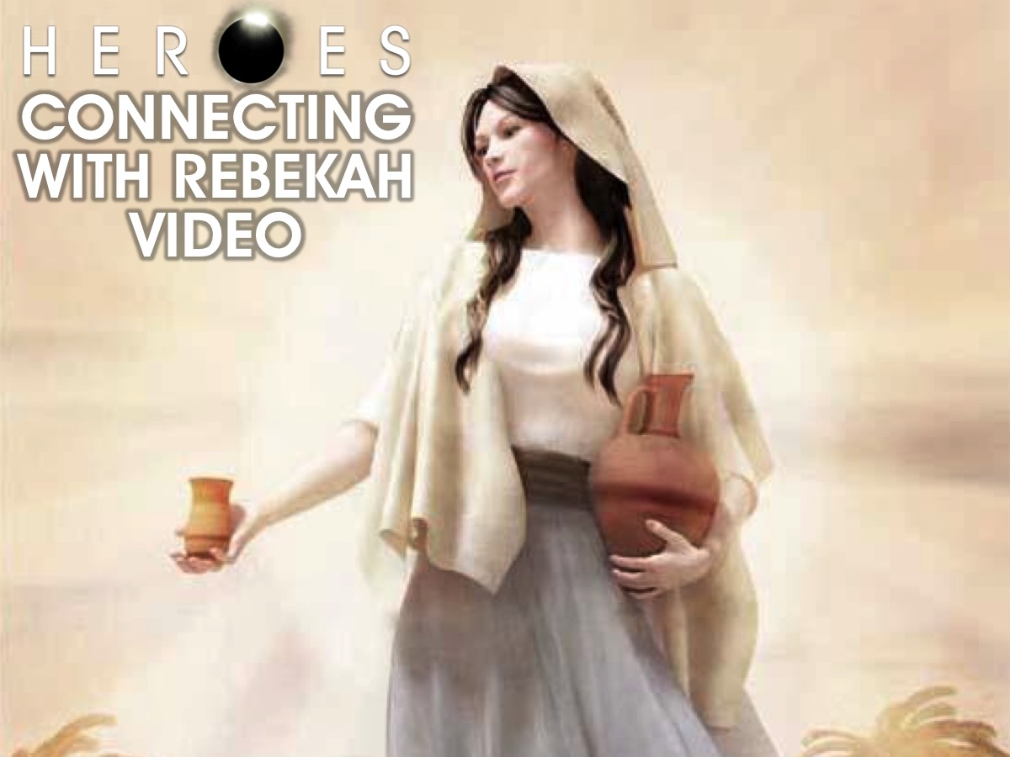
Notes:
Connecting with Rebekah: We are going to watch a video about the story of Rebekah.

Slide 7
Notes:
Video: Isaac and Rebekah. Get it on YouTube at: https://www.youtube.com/watch?v=-RP7qFGvBz8

Slide 8

Notes:
We are going to get into small groups to check out a Manga version of the story of Rebekah. Taken from the Action Bible.

Slide 9
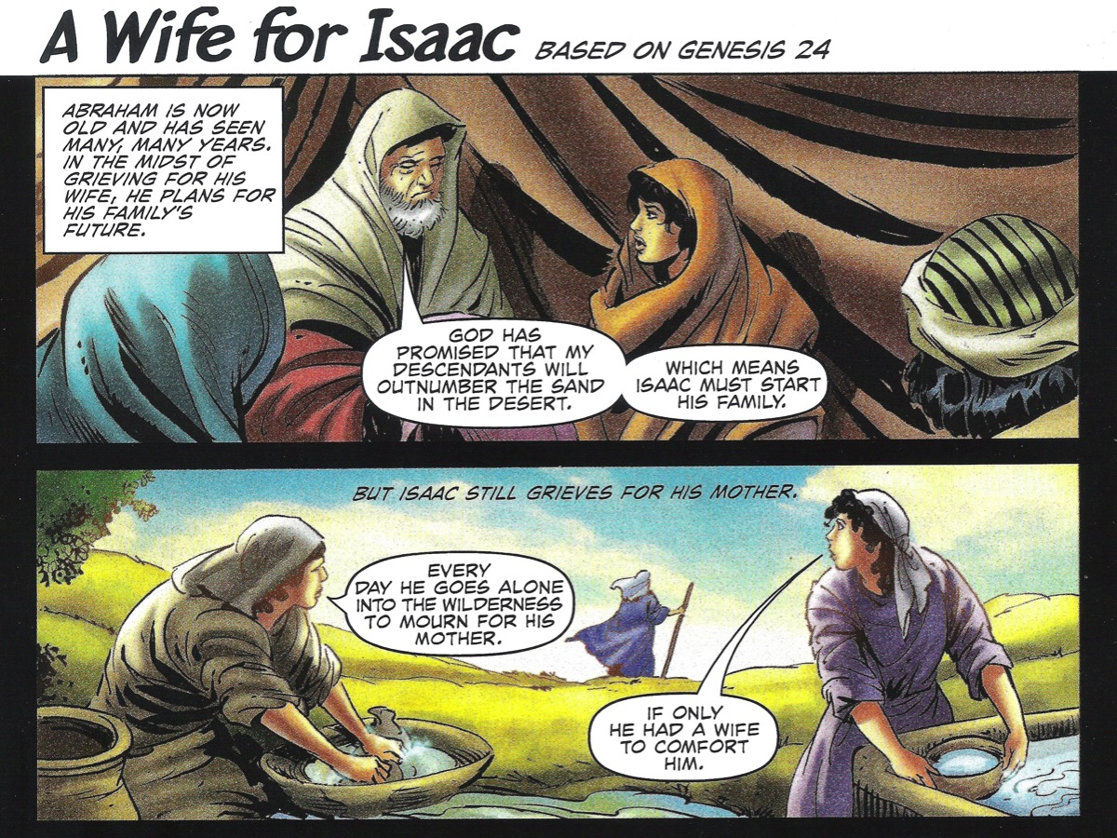
Notes:
Small groups – begin by having one person read the account of how Rebekah came into Isaac’s life.

Slide 10
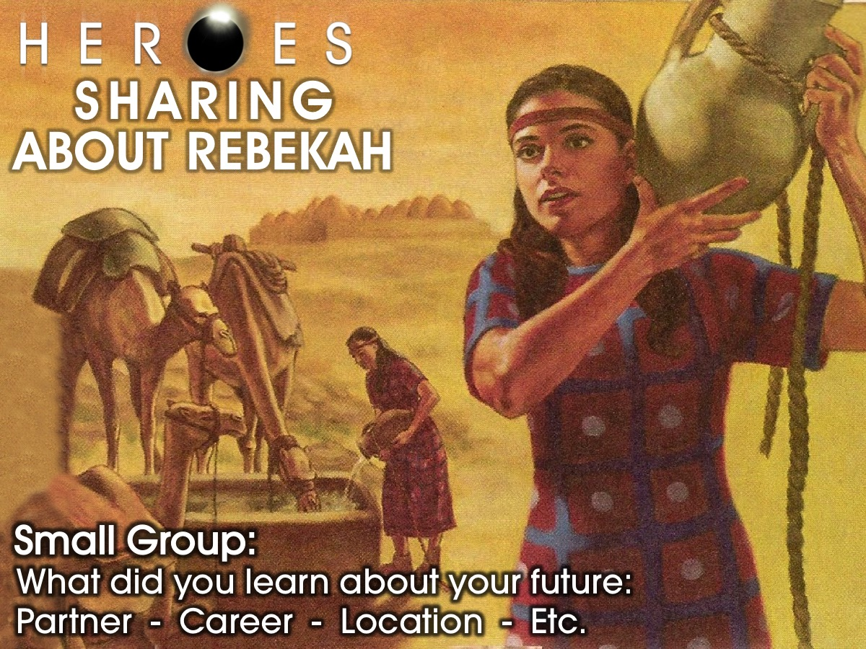
Notes:
Sharing About Rebekah. In small groups share with each other what you can learn from the story of Rebekah about your future: Partner, Career, Location, etc.

Slide 11
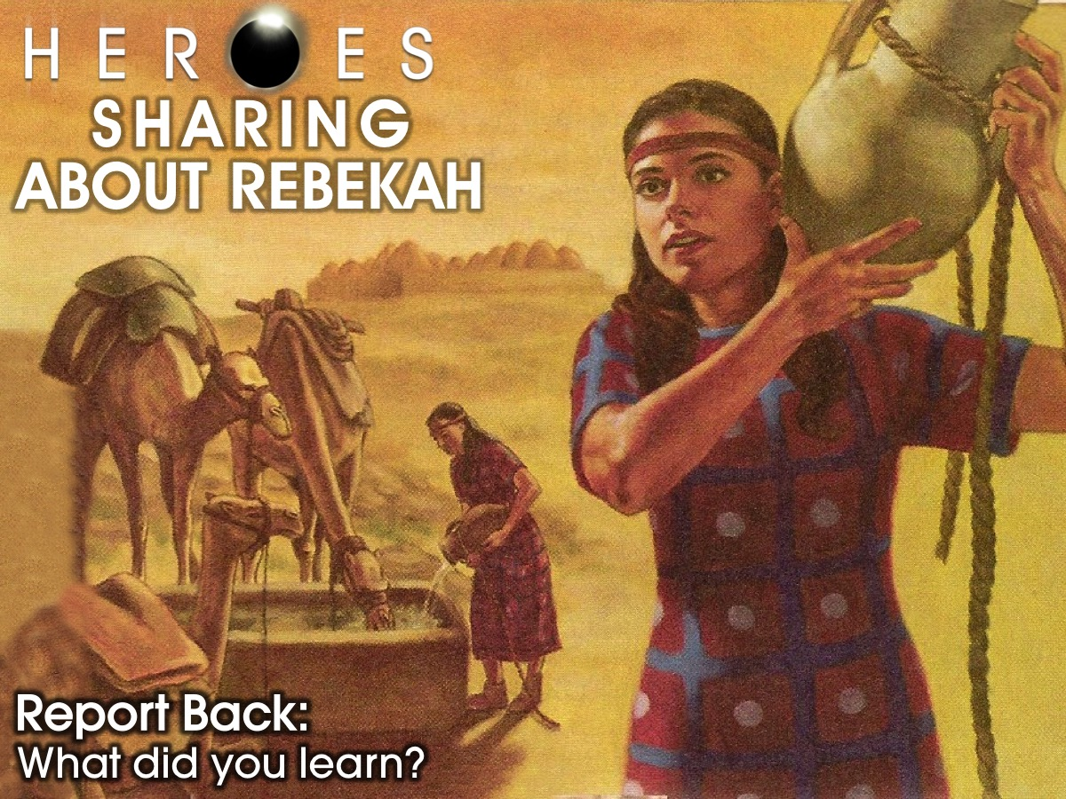
Notes:
Each group sends a leader to share one insight they learned with the wider group.

Slide 12
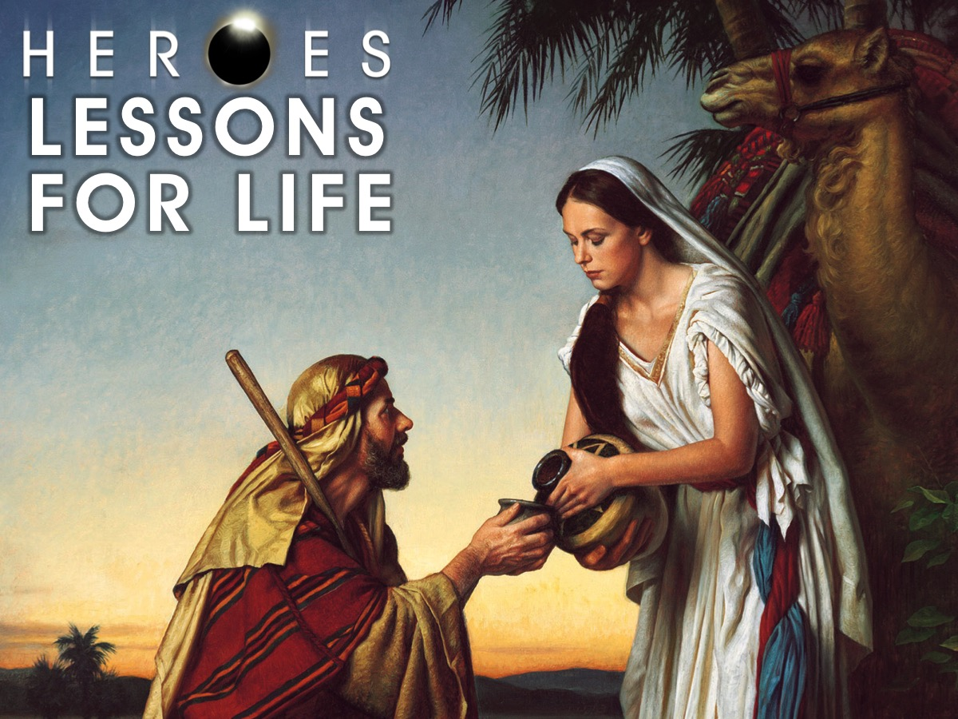
Notes:
Lessons for life from Rebekah.

Slide 13
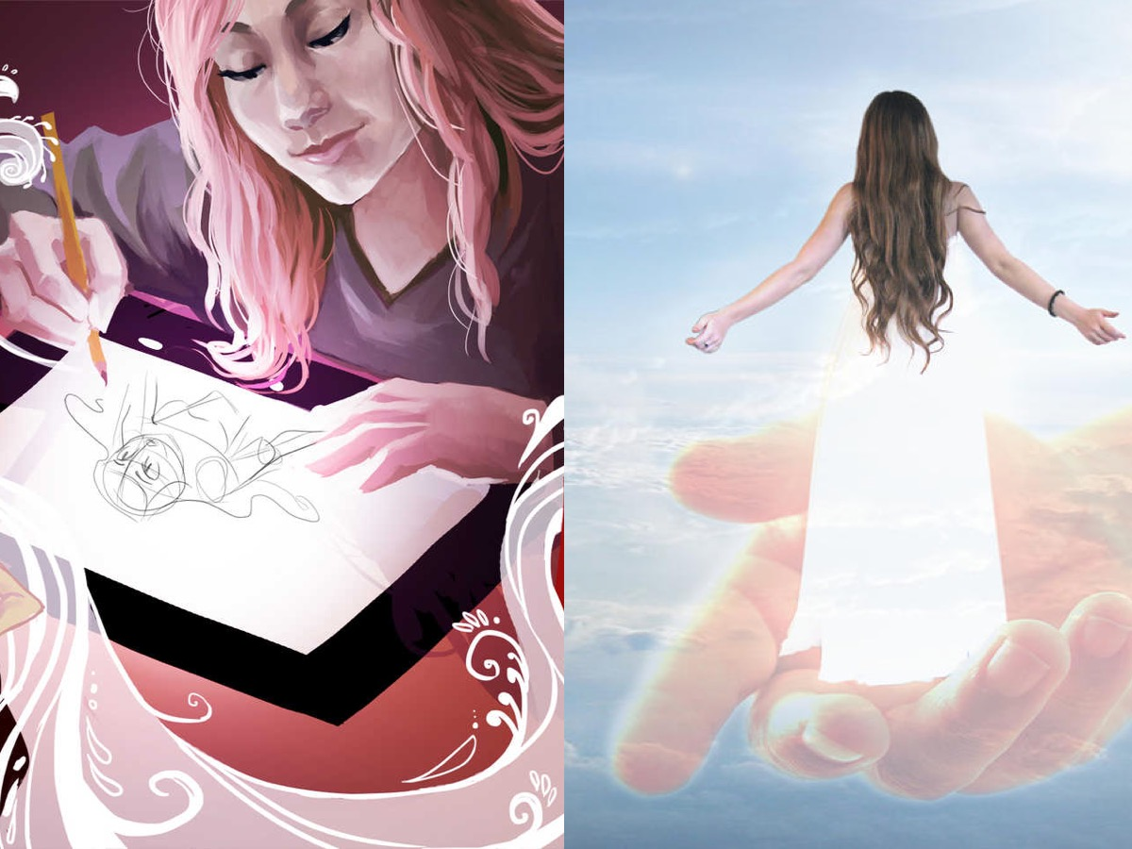
Notes:
How do I trust God for my future and make sure that my picture and his picture are similar?

Slide 14
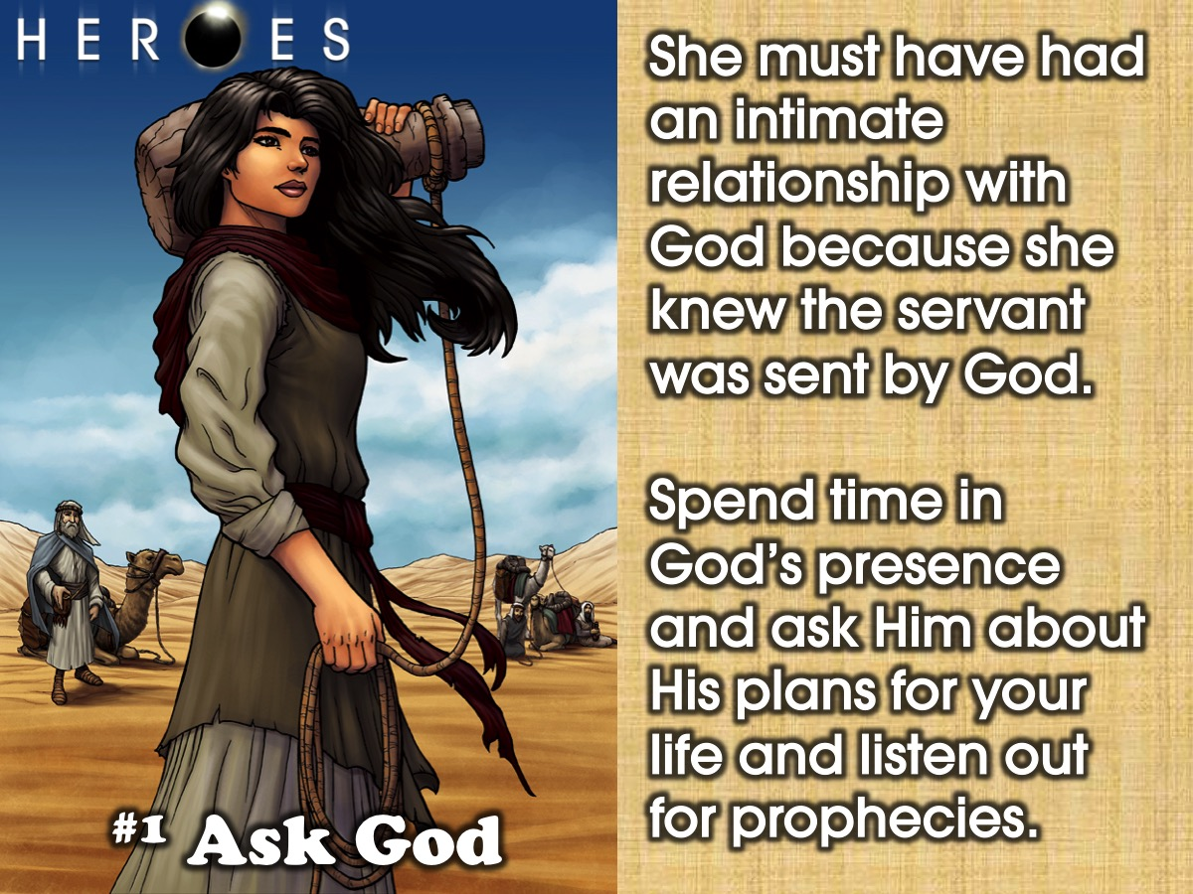
Notes:
1. Ask God. Rebecca must have had an intimate relationship with God because when the servant came she knew he was sent by God. Do you spend time in God’s presence asking Him what His plans for my life are? There have been prophetic words spoken over your life. You need to trust them. When the servant was telling her why he was there she believed him. She didn’t know him.

Slide 15
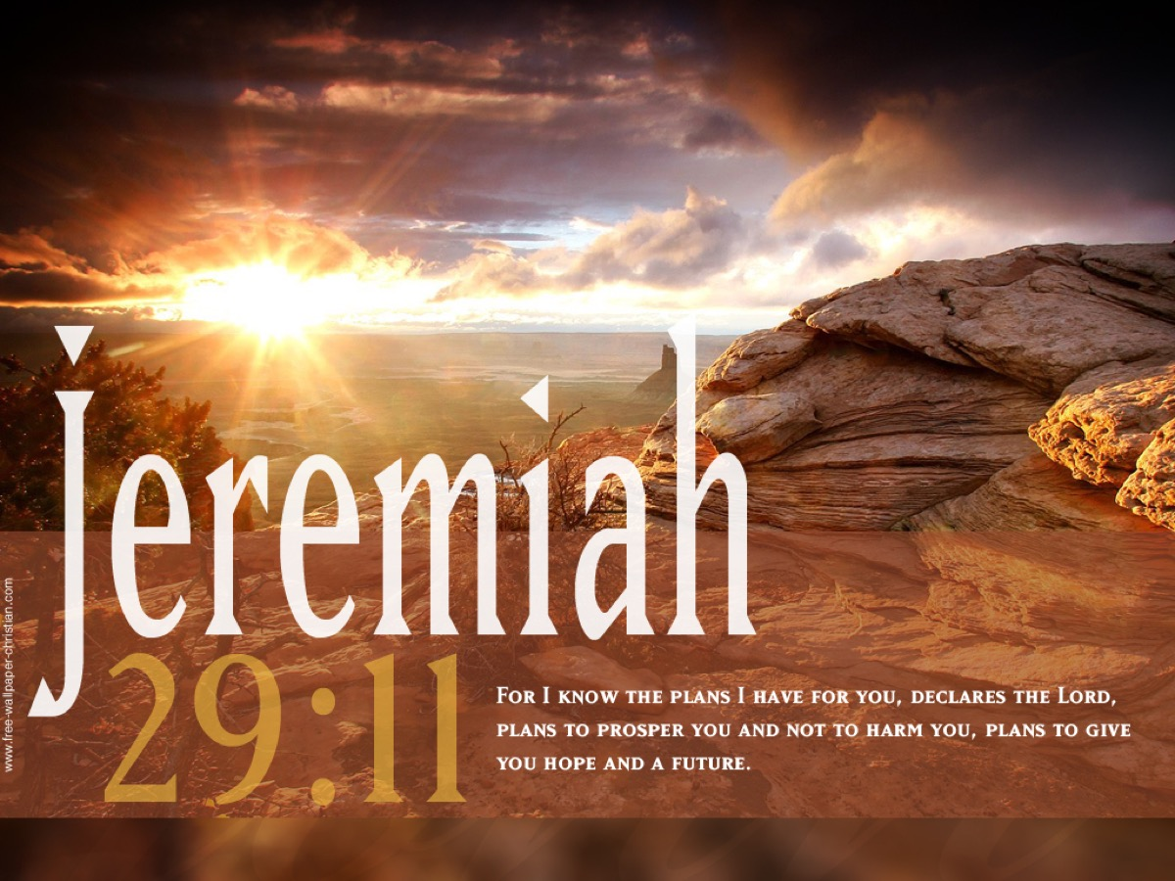
Notes:
Jeremiah 29:11 tells us that God has plans for our lives – plans to give us a hope and a future.

Slide 16
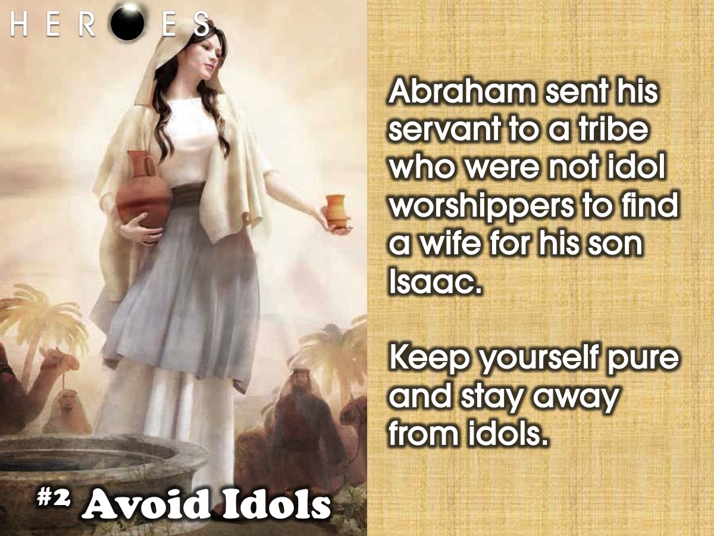
Notes:
2. Avoid Idol. Abraham sent his servant to a tribe who were not idol worshippers to find a wife for his son Isaac. Stay pure and stay away from idols.

Slide 17
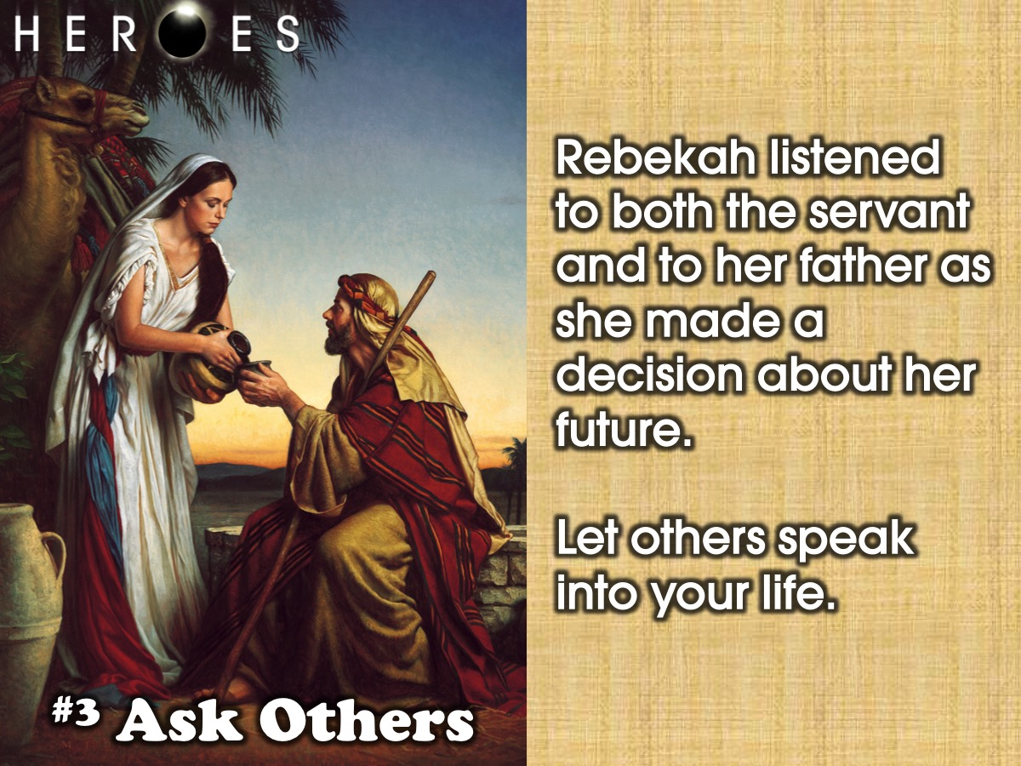
Notes:
3. Ask Others. She listened to what the servant said and then what her father said and made a decision according to that information. Let others speak into your life.

Slide 18
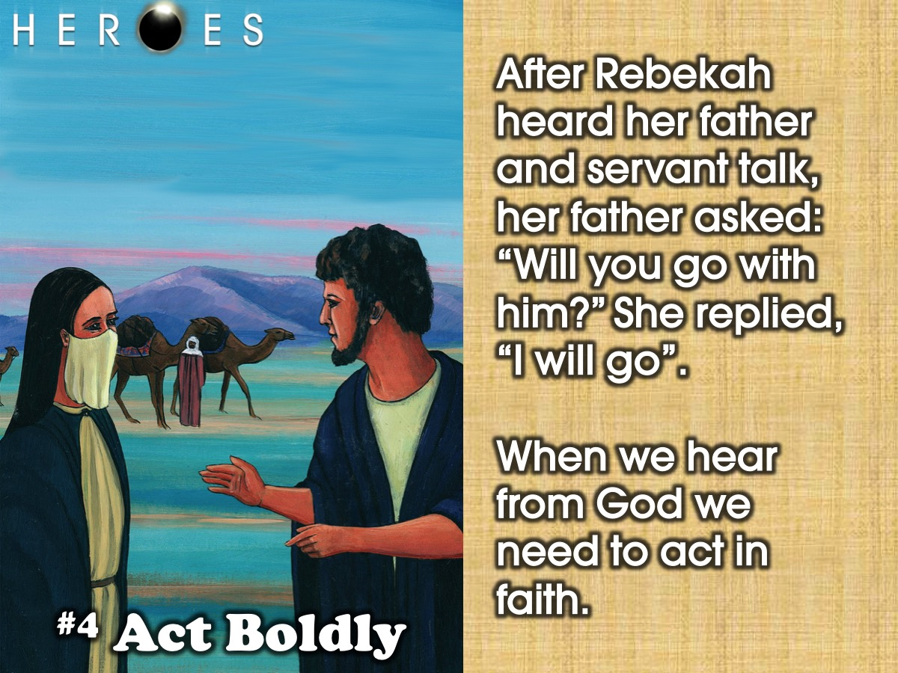
Notes:
4. Act Boldly. After Rebekah heard her father and servant talk, her father asked her “Will you go with him?” She replied, “I will go”. When we hear from God we need to act in faith.

Slide 19
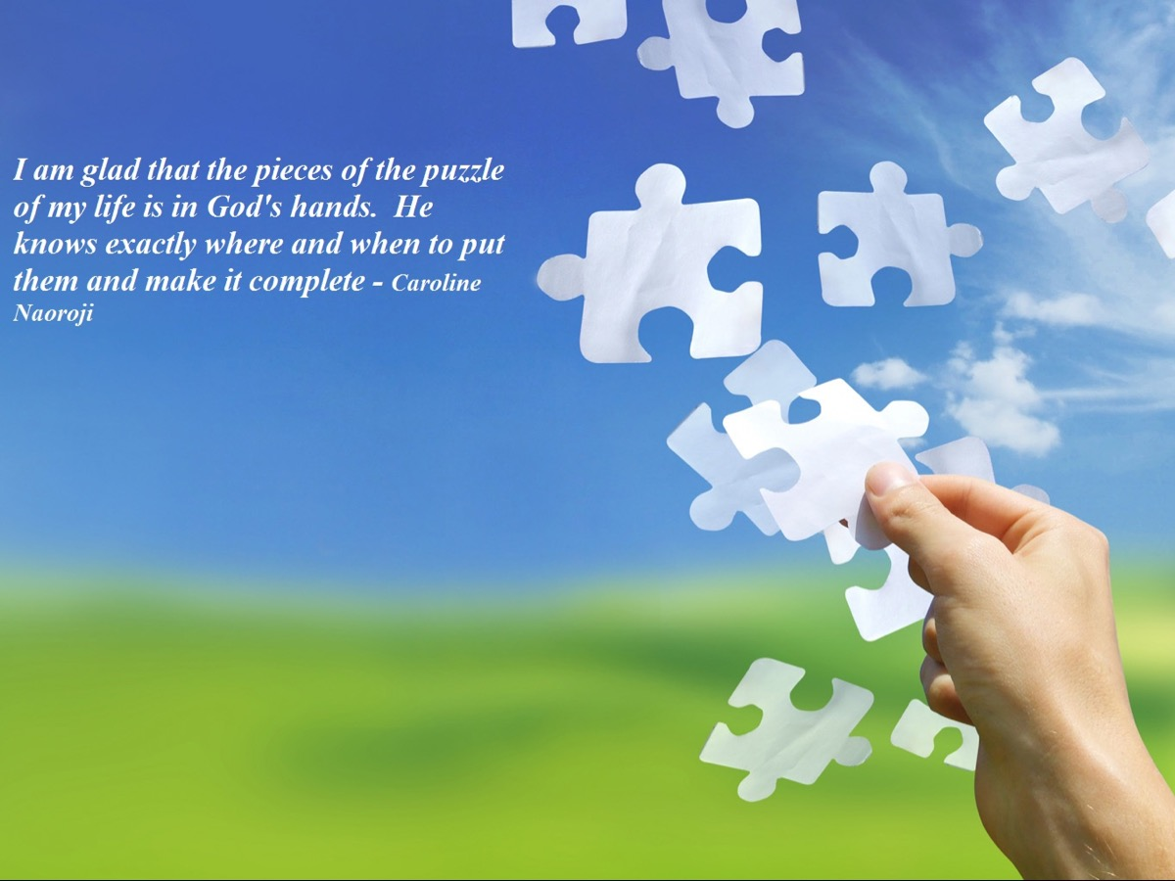
Notes:
I am glad that the pieces of the puzzle of my life is in God’s hands. He knows exactly where and when to put them and make it complete. (Caroline Naoroji)

Slide 20
Notes:
Video: Our God by Chris Tomlin. Get it on YouTube at: https://www.youtube.com/watch?v=OnTf4sMIKtw
This is the God into whose hands we are trusting our future.

Slide 21
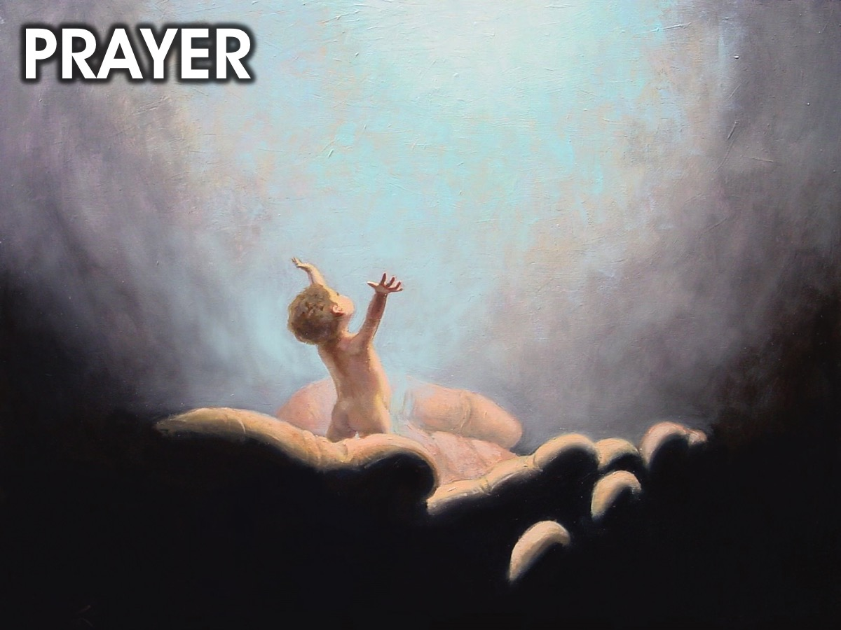
Notes:
Closing Prayer. I’d like you to stand if you are saying to God today, “Father I am going to trust you with my future, my career and my future partner.”

Slide 22
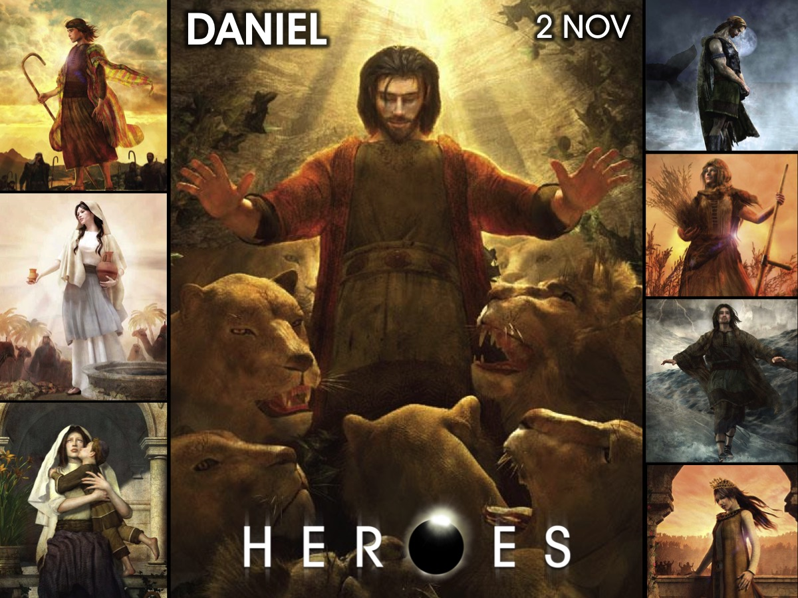
Notes:
Next Sunday we are going to look at the life of Daniel.

