Slide 1
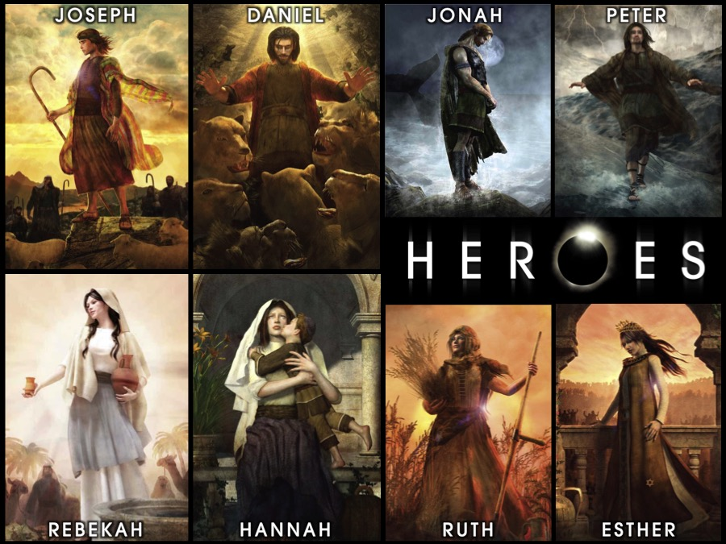
Notes:
Welcome to our Heroes Series on Sunday mornings at His Youth.

Slide 2
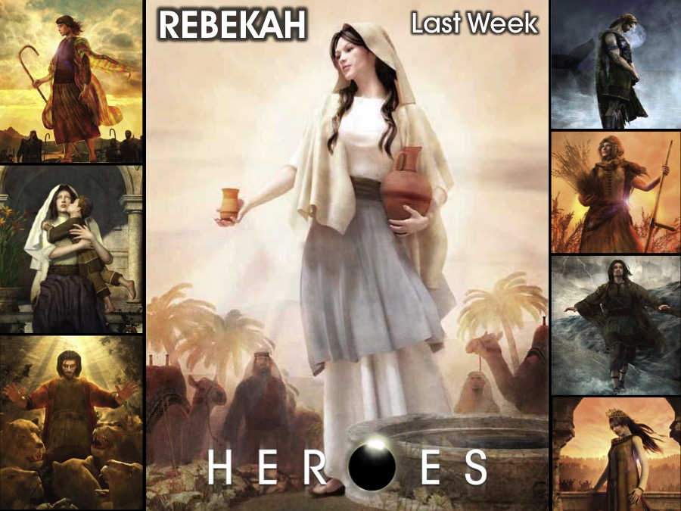
Notes:
Last week we looked at the story of Rebekah.

Slide 3
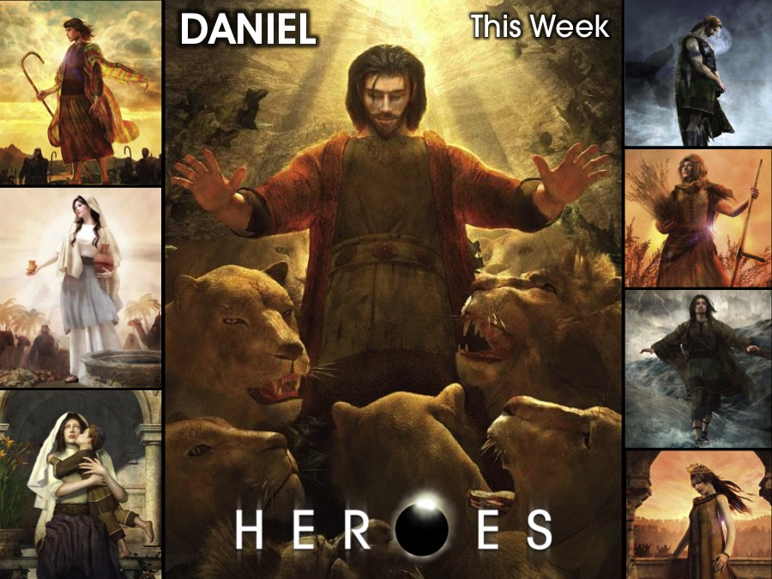
Notes:
This week we are going to enter into the story of Daniel.

Slide 4
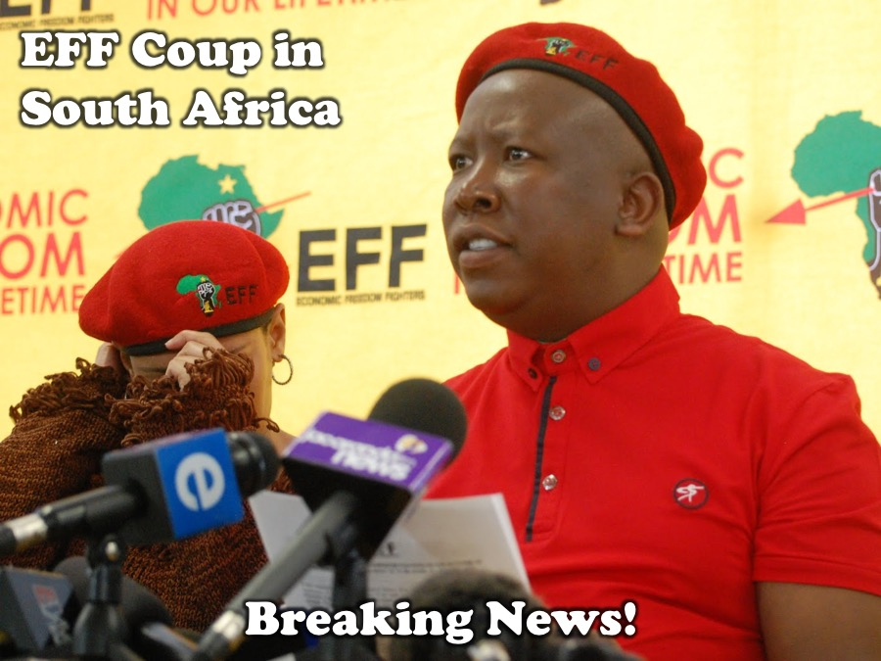
Notes:
Breaking News! Have you heard the news – early this morning the EFF (Economic Freedom Fighters) staged a coup in South Africa…

Slide 5
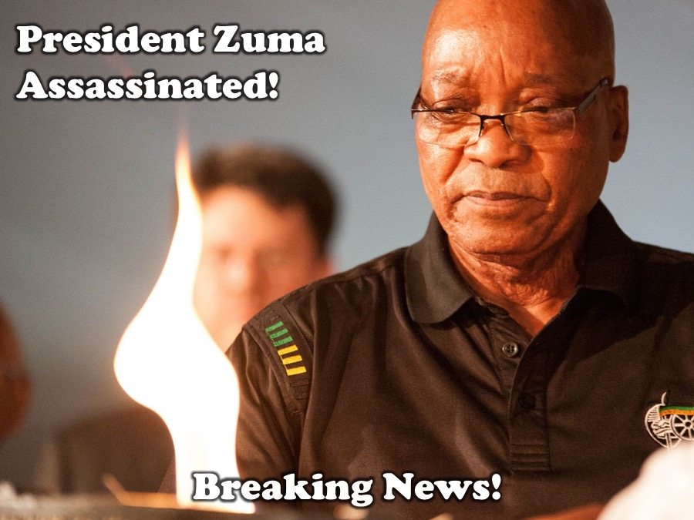
Notes:
President Jacob Zuma has been assassinated.

Slide 6
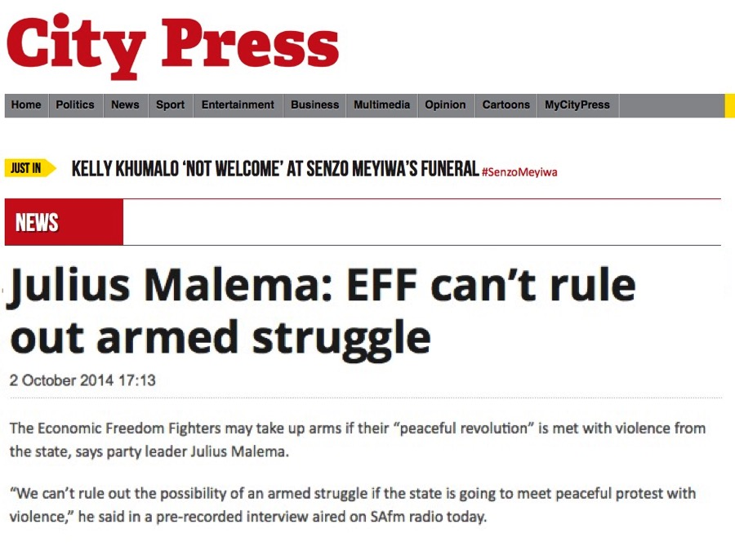
Notes:
While we may be shocked at these developments but it was reported on the 2nd October in the City Press that Julius that the EFF could not rule out armed struggle in South Africa.

Slide 7
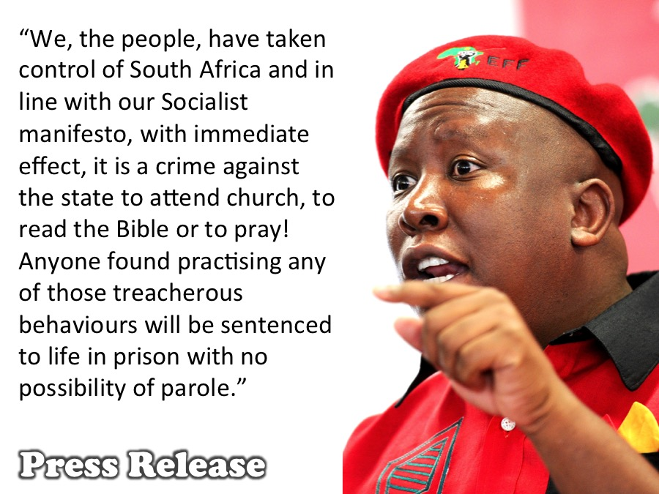
Notes:
The leader of the EFF, Julius Malema, appeared on SABC3 at 7am and issued the following statement: “We, the people, have taken control of the country and because of our Socialist manifesto, with immediate effect, it is a crime against the state to attend church, to read your Bible or to pray! Anyone found practising any of those treacherous behaviours will be sentenced to life in prison with no possibility of parole.”

Slide 8
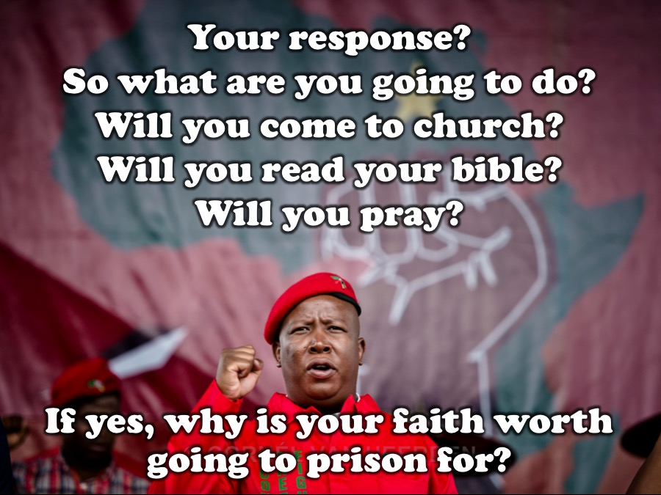
Notes:
Sharing: Your response? So what are you going to do? Will you come to church? Will you read your bible? Will you pray? If you answer yes to any of these question, why is your faith worth going to prison for?

Slide 9
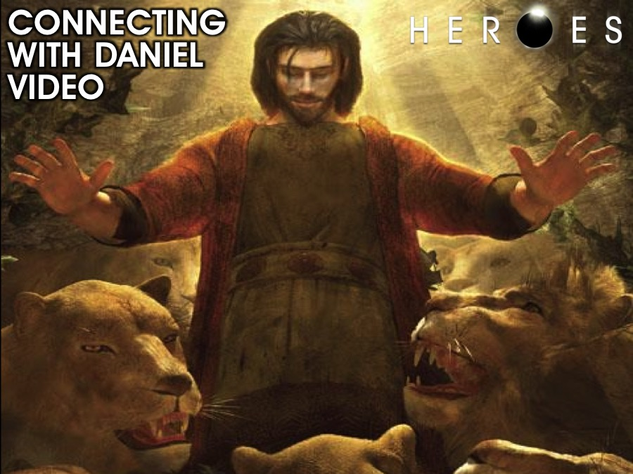
Notes:
Connecting with Daniel. We are going to watch a video about the story of Daniel.

Slide 10
Notes:
Video: Daniel from the Bible Series – get it from Disc 2 in the series.

Slide 11
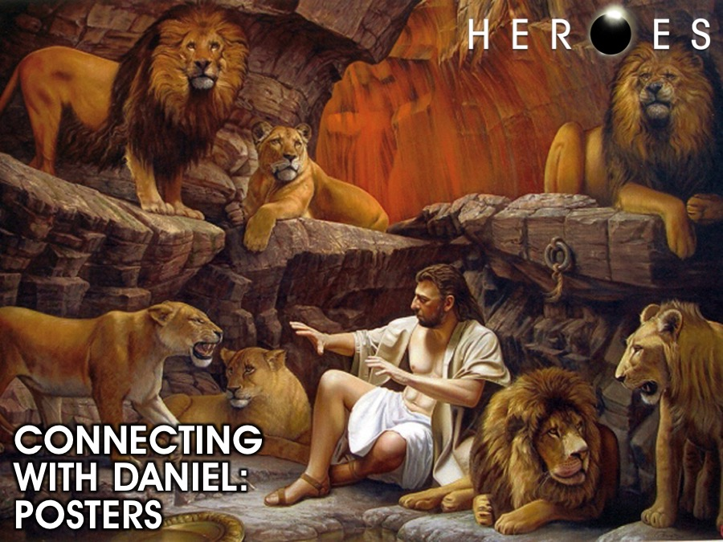
Notes:
You have a few minutes to move around the room and stand in front of a few posters and ask God to reveal something to you from the poster about the story and your life.

Slide 12
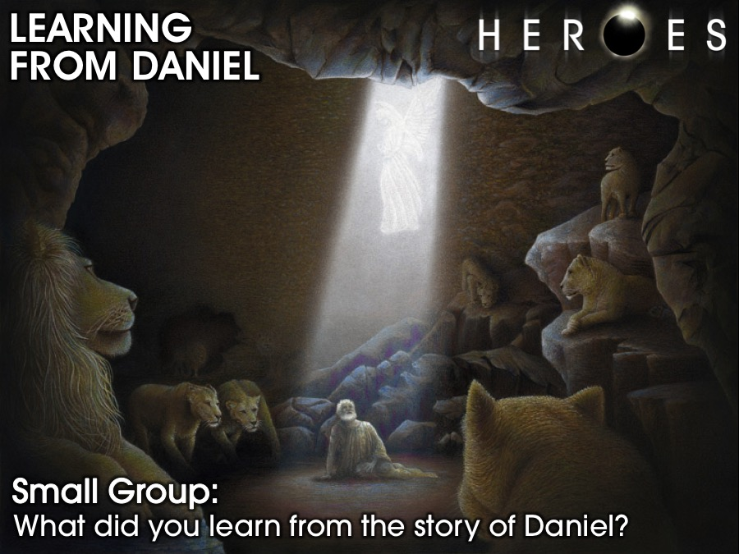
Notes:
Learning from Daniel. In small groups share with each what you can learn from the story of Daniel through the video and the posters.

Slide 13
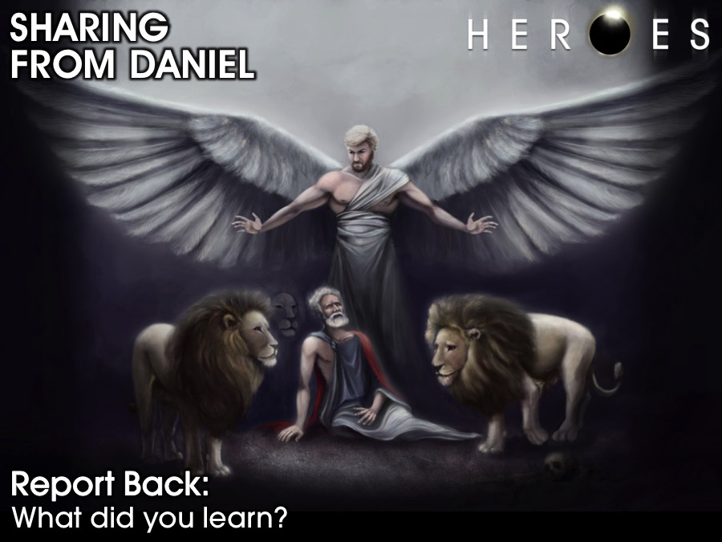
Notes:
Each group sends a leader to share one insight they learned with the wider group.

Slide 14
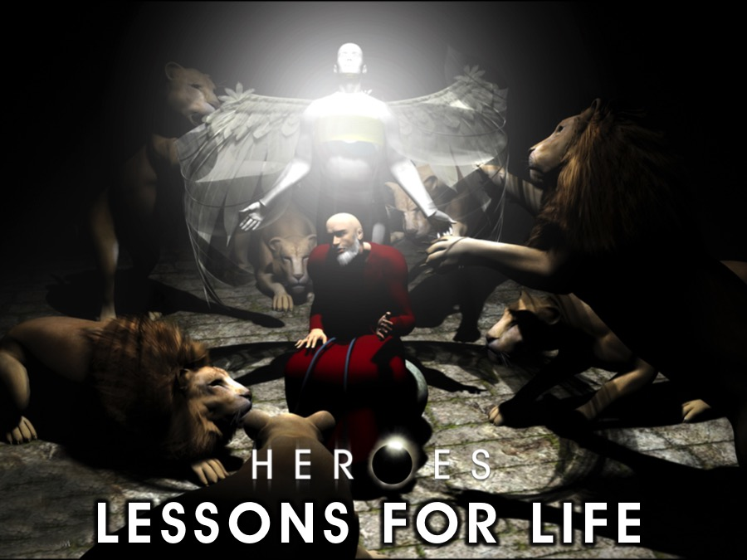
Notes:
Lessons for life from Daniel.

Slide 15
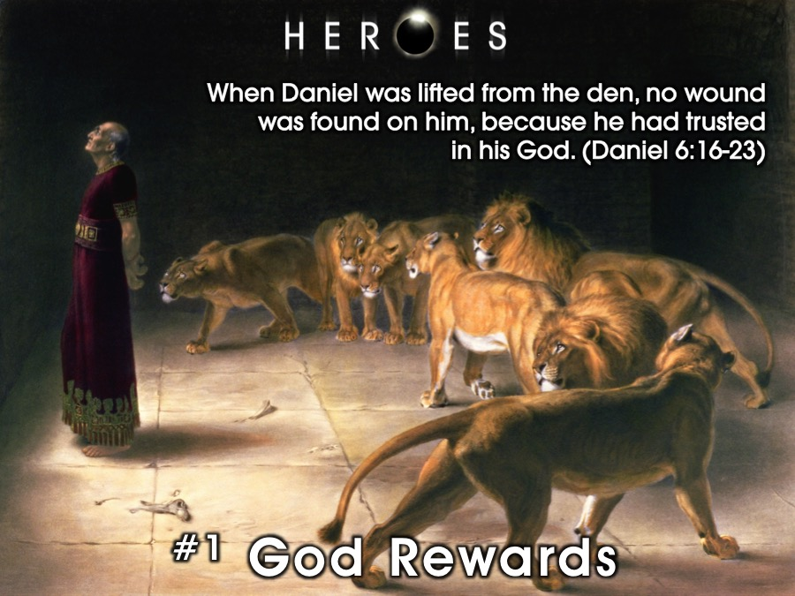
Notes:
1. God Rewards. “When Daniel was lifted from the den, no wound was found on him, because he had trusted in his God”. (Daniel 6:16-23). God, like a good parent, loves to reward his children when they please him.

Slide 16
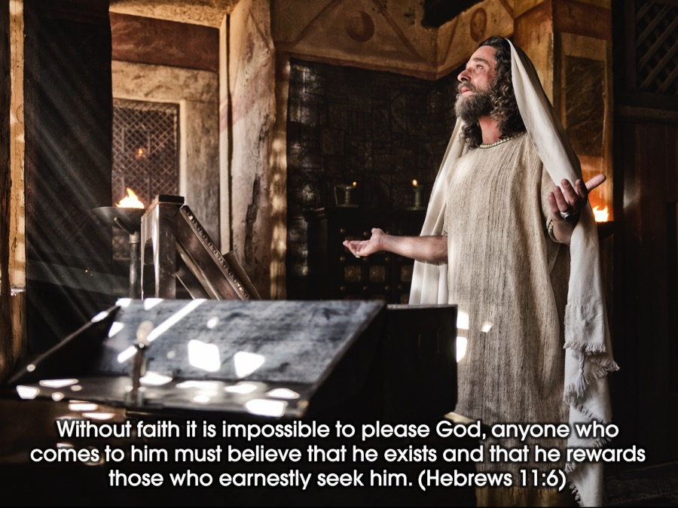
Notes:
Without faith it is impossible to please God, because anyone who comes to him must believe that he exists and that he rewards those who earnestly seek him. (Hebrews 11:6)

Slide 17
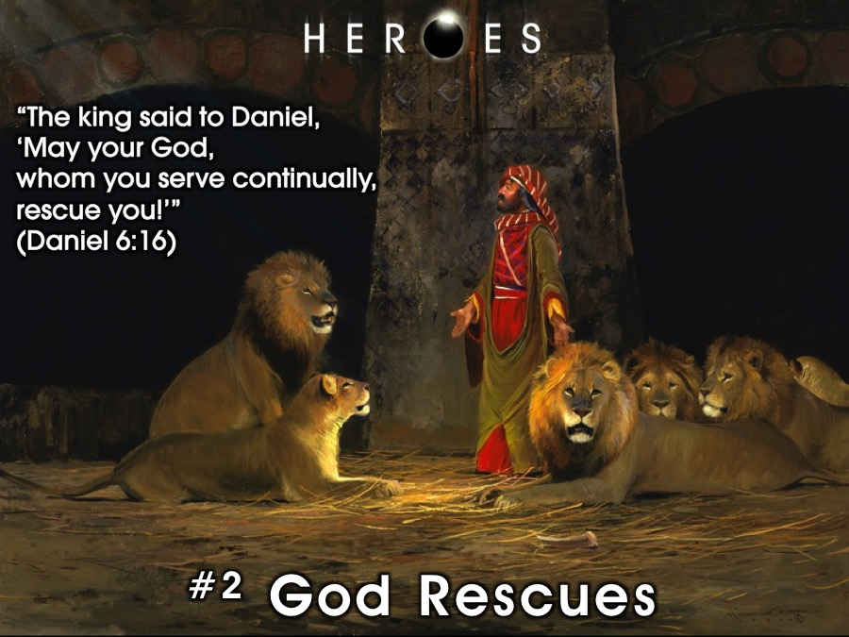
Notes:
2. God Rescues. So the king gave the order, and they brought Daniel and threw him into the lions’ den. The king said to Daniel, “May your God, whom you serve continually, rescue you. (Daniel 6:16)
No matter what type of pit the enemy has thrown you into, your God is well able to rescue you. It may not be immediate, you may have to spend a night in a pit, but in the morning you will be set free.

Slide 18
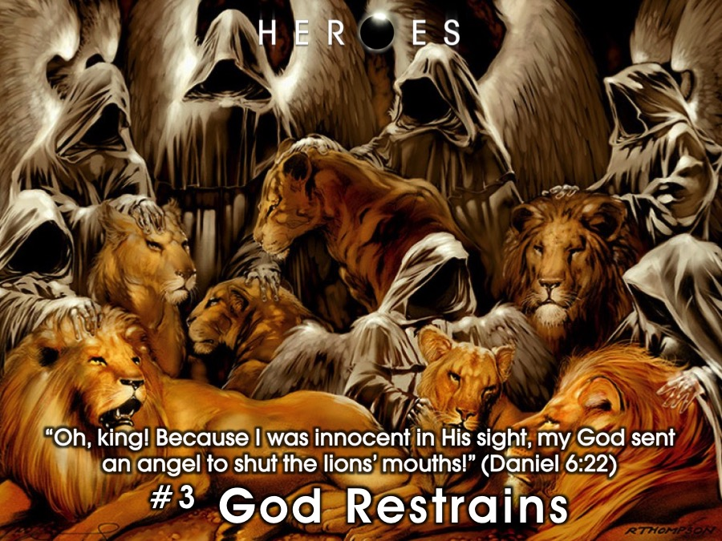
Notes:
3. God Restrains. “Oh, king!” Daniel answered. “Because I was innocent in His sight, my God sent an angel to shut the lions’ mouths!” (Daniel 6:22)
No matter what type of spiritual lion is threatening to consume you today, God can shut its mouth. God is powerful – Satan had to get permission from God to mess with Job!

Slide 19
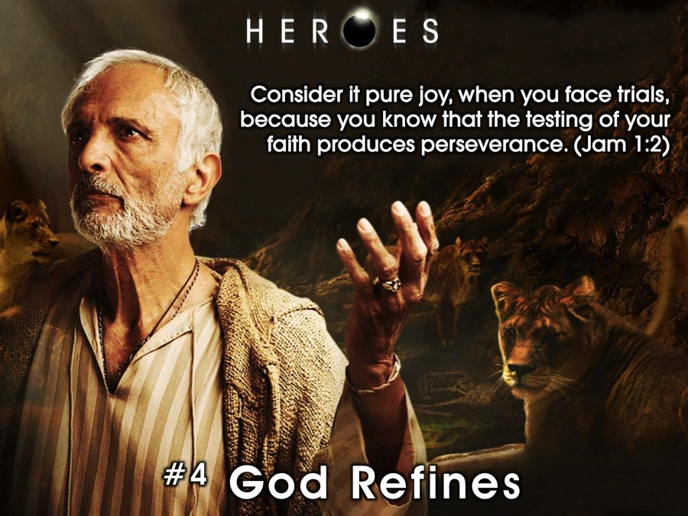
Notes:
4. God Refines. God allows his people to face these trials to test their faith to that it will be refined and grow stronger. Consider it pure joy, my brothers and sisters, whenever you face trials of many kinds, because you know that the testing of your faith produces perseverance. Let perseverance finish its work so that you may be mature and complete, not lacking anything. (James 1:2-4)

Slide 20
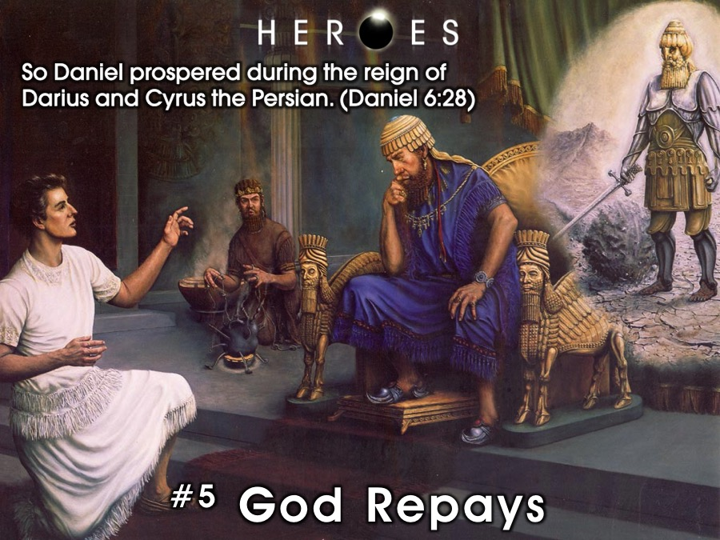
Notes:
5. God Repays. So Daniel prospered during the reign of Darius and the reign of Cyrus the Persian. (Daniel 6:28). God is no man’s debtor – he repays people for what they have lost when they serve him with all their heart!

Slide 21
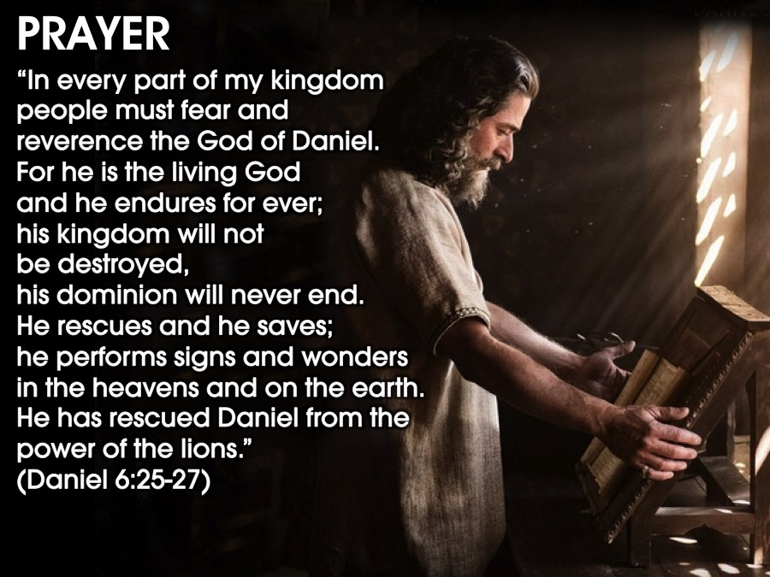
Notes:
Closing Prayer. Let’s reflect on the decree that King Darius wrote after God rescued Daniel from the Lion’s den! Then King Darius wrote to all the nations and peoples of every language in all the earth: “May you prosper greatly! I issue a decree that in every part of my kingdom people must fear and reverence the God of Daniel. For he is the living God and he endures for ever; his kingdom will not be destroyed, his dominion will never end. He rescues and he saves; he performs signs and wonders in the heavens and on the earth. He has rescued Daniel from the power of the lions.’

Slide 22
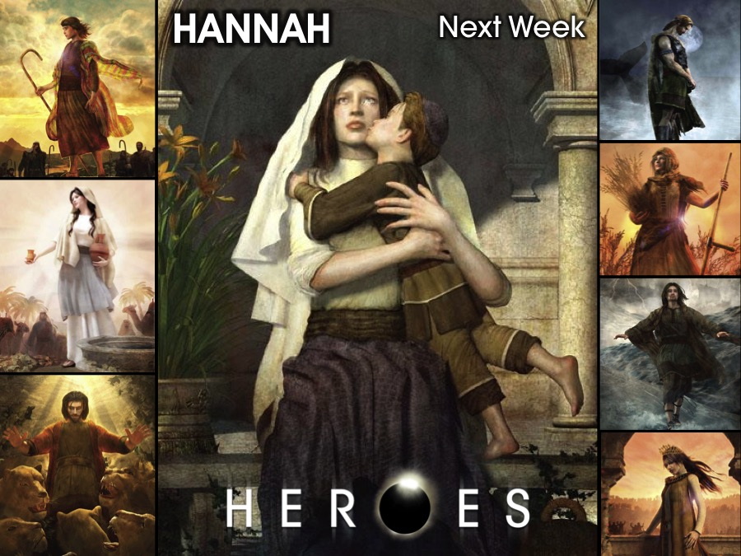
Notes:
Next week we will look at the life of Hannah.

