Slide 1
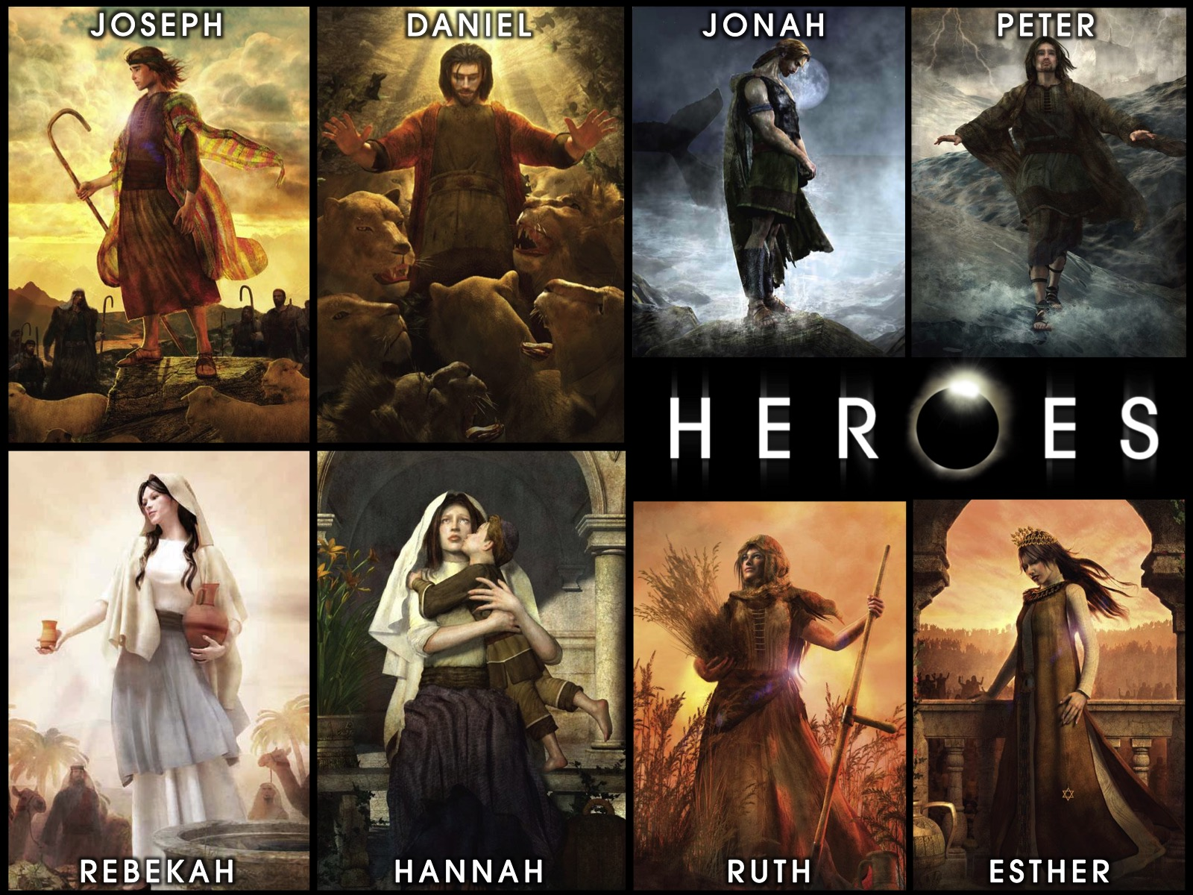
Notes:
Welcome to our Heroes Series on Sunday mornings at His Youth.

Slide 2
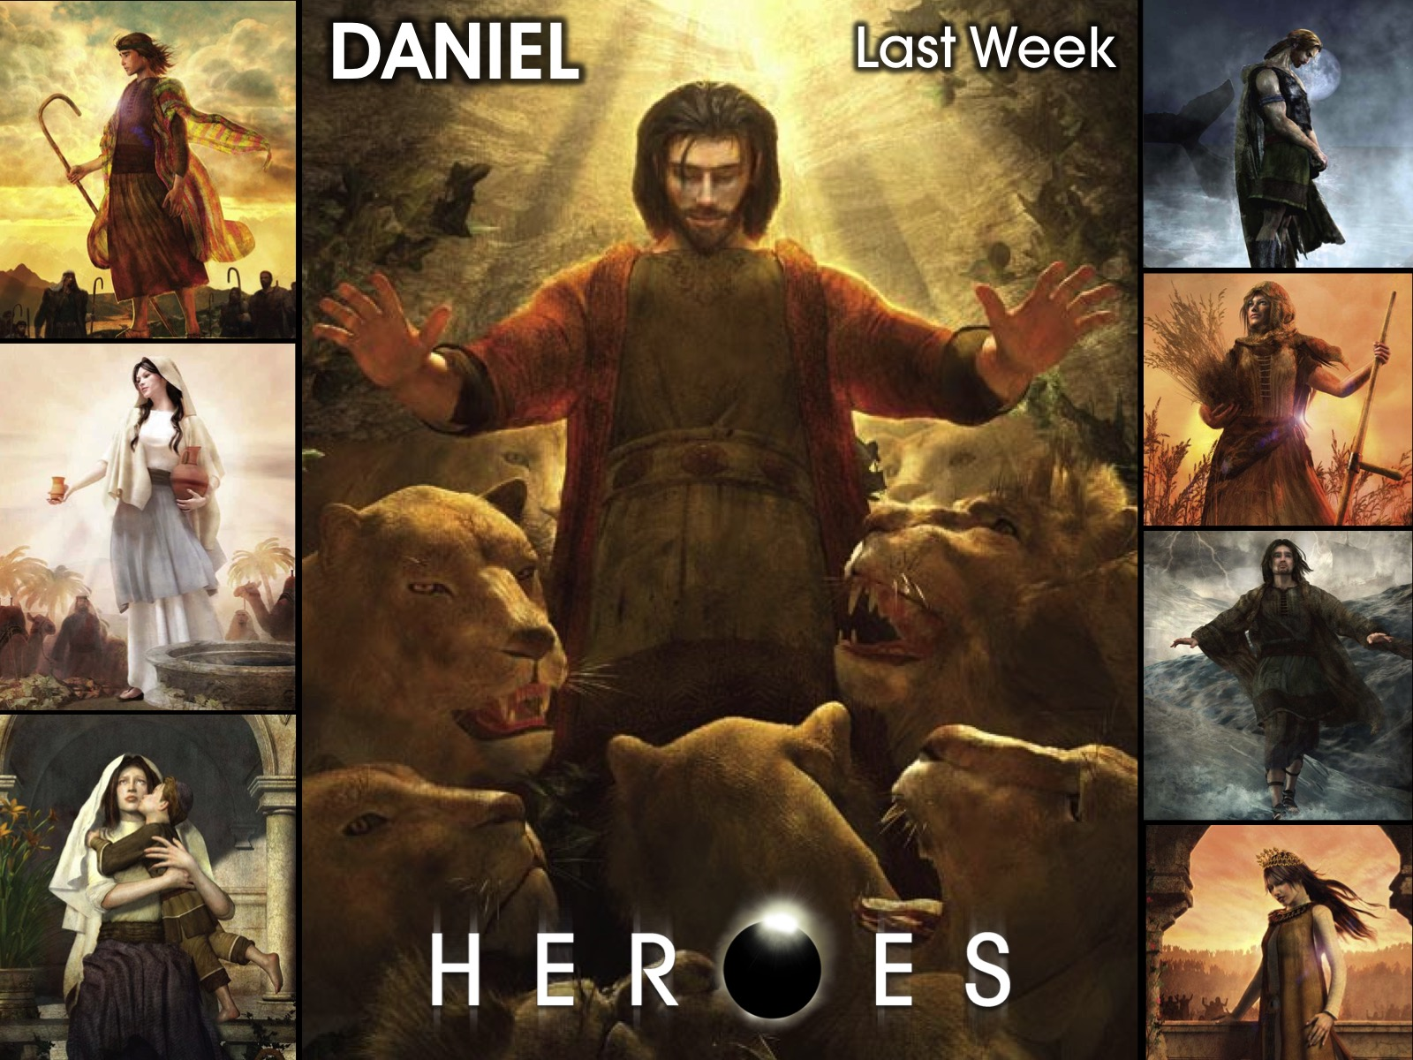
Notes:
Last week we looked at the story of Daniel.

Slide 3
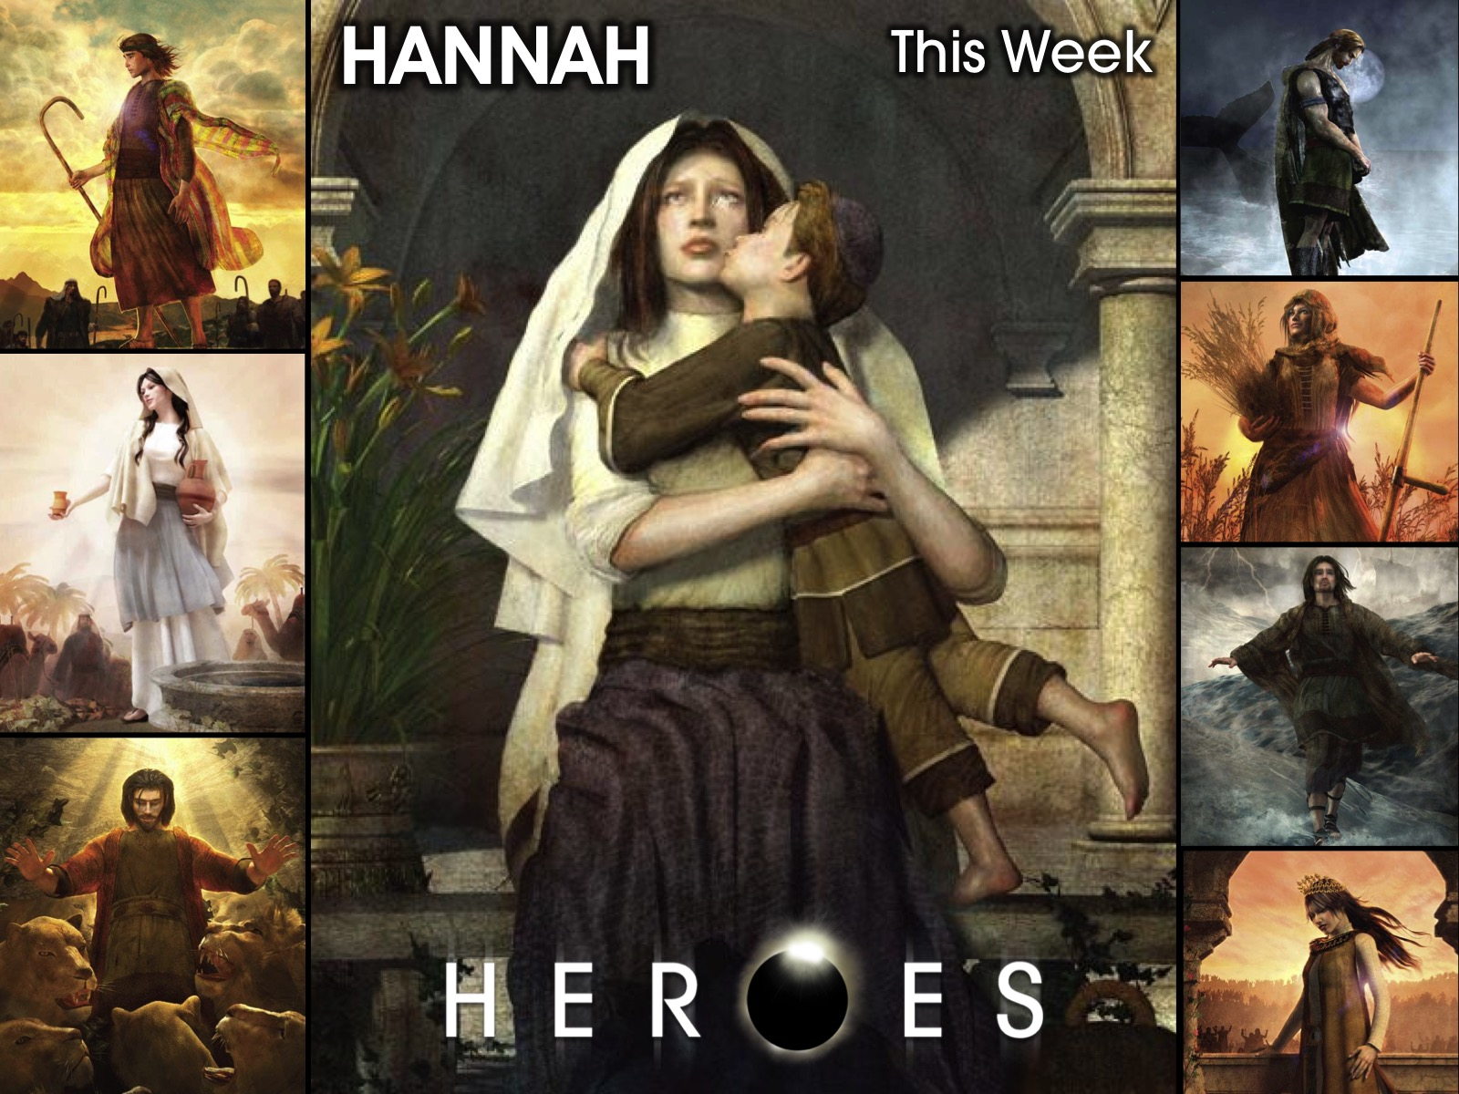
Notes:
This week we are going to look at the story of Hannah.

Slide 4
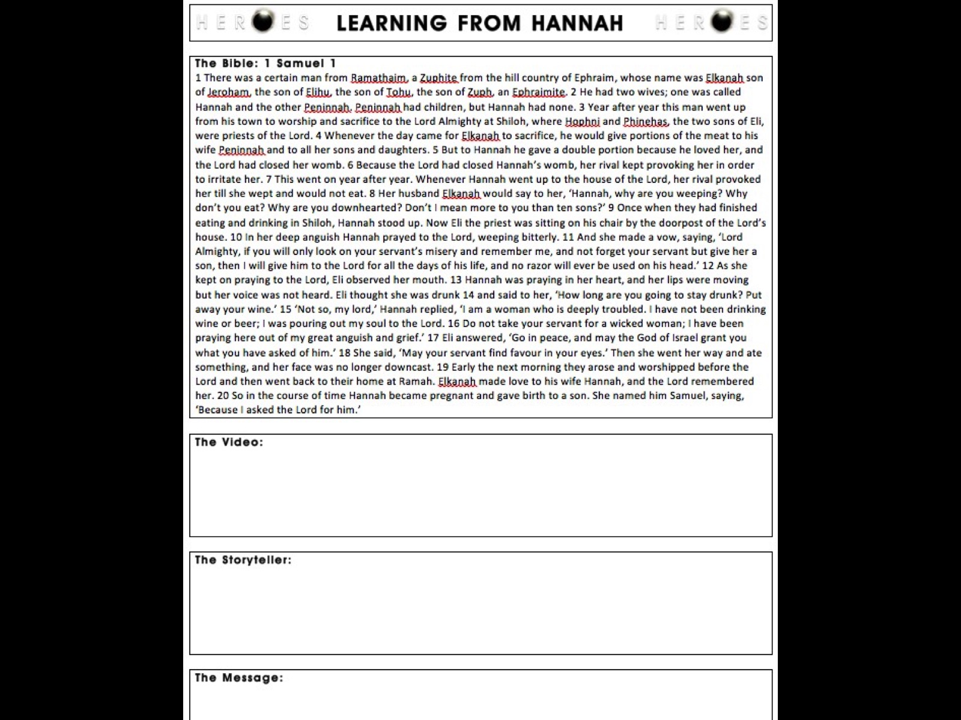
Notes:
Each of you is getting a worksheet – that contains the bible passage of the story of Hannah, space to write down some thoughts are you connect with the story of Hannah in different ways this morning.

Slide 5
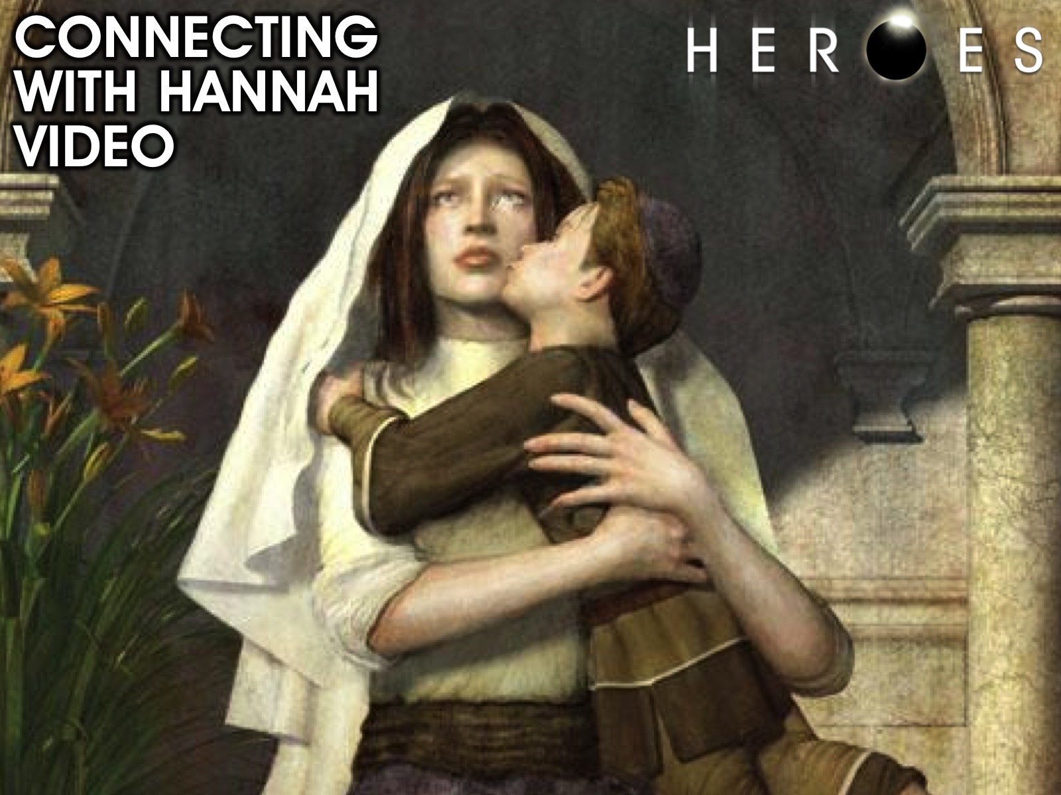
Notes:
Connecting with Hannah. We are going to watch a video about the story of Hannah.

Slide 6
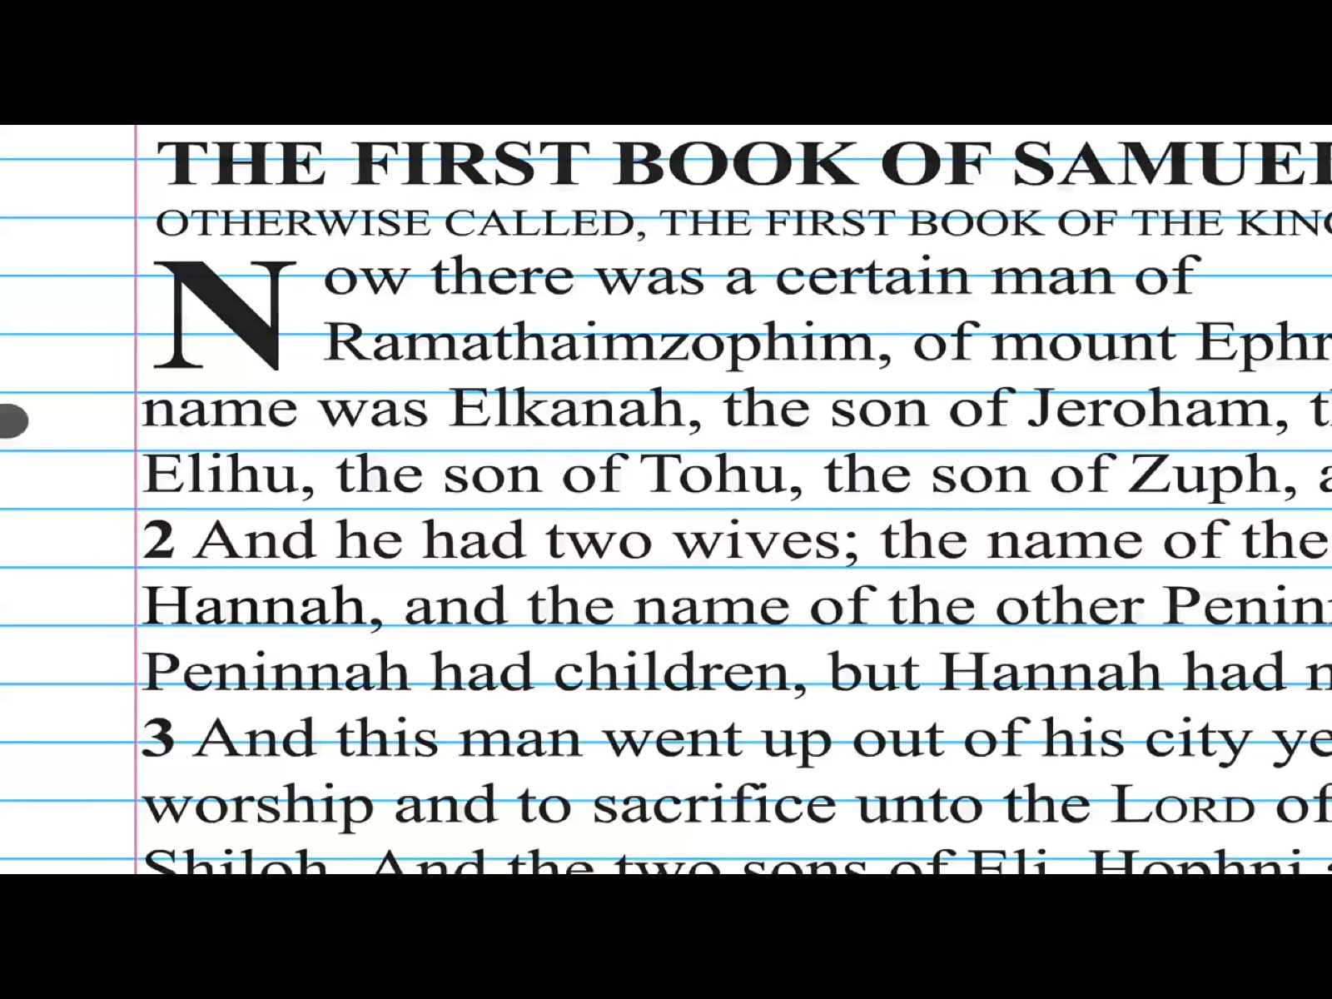
Notes:
Video: The Story of Hannah Sketch Version. Get it on YouTube at: https://www.youtube.com/watch?v=a7SouU3ECpU

Slide 7
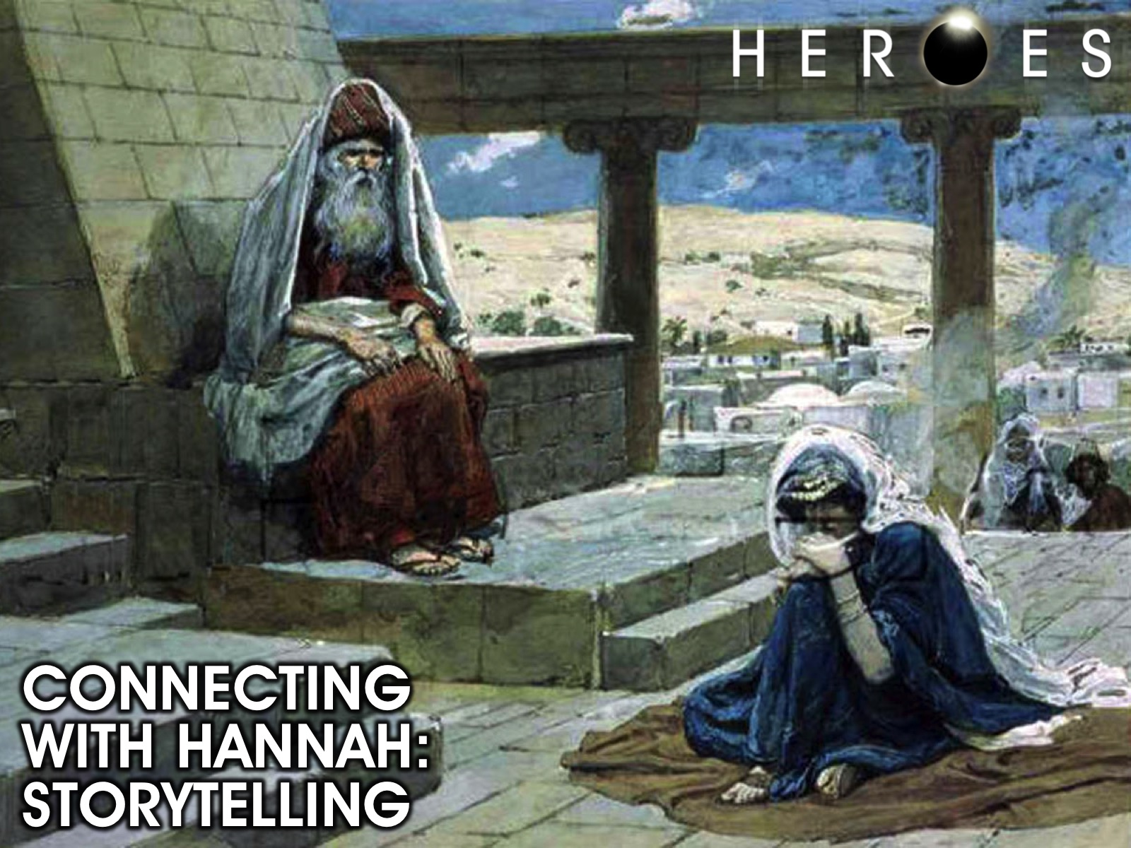
Notes:
Connecting with Hannah. We are going to get into small groups where a Hannah is going to tell you her story. “Hi my name is Hannah. I am married, and my husband has two wives. The name of my husband's other wife is Peninnah. She has sons and daughters. I know that I'm my husband's favorite, but I am very troubled. I am not happy about my life. Reason being that I cannot have children, and Peninnah reminds me of that every chance she gets. Her insults just never stop. I pray to God all the time, actually I've been praying for years and have never stopped praying. One day I felt like I could not take it any more. I decided to go to the temple and pray. I cried out to God, I poured my soul out to him. The priest thought I was drunk. I told him my troubles, and he assured me that God had heard my prayer. Time went by, and I found out that I was pregnant. The Joy I felt was amazing. Then I remembered the promise I made to God. I told God that if He gave me a child, I would give the child back to Him. After a couple of years of having my child, his name was Samuel, I took him back to God. I took him to the temple to grow up there. It wasn't easy, but I know that this child was a miracle and that God had everything to do with this miracle. Finally I had peace, and joy in my heart for the first time after a long time. I thank God everyday for my little Samuel.”

Slide 8
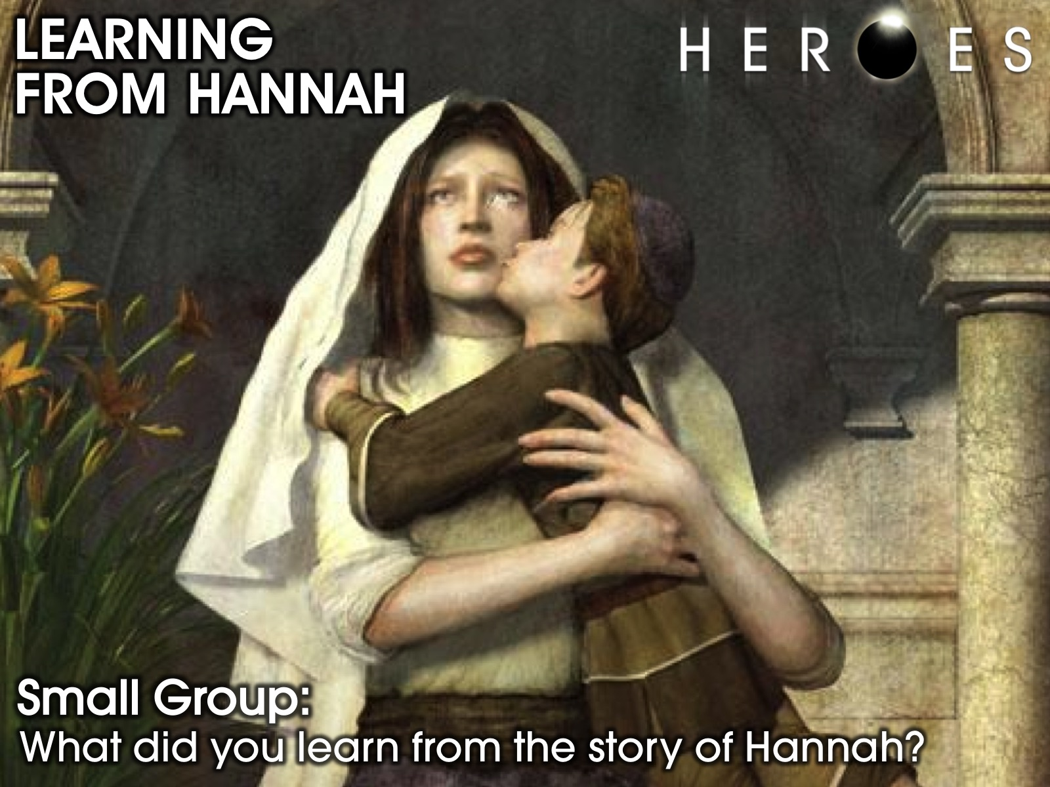
Notes:
Learning from Hannah. In small groups share with each other what you have learnt from the story of Hannah through the video and the storytelling.

Slide 9
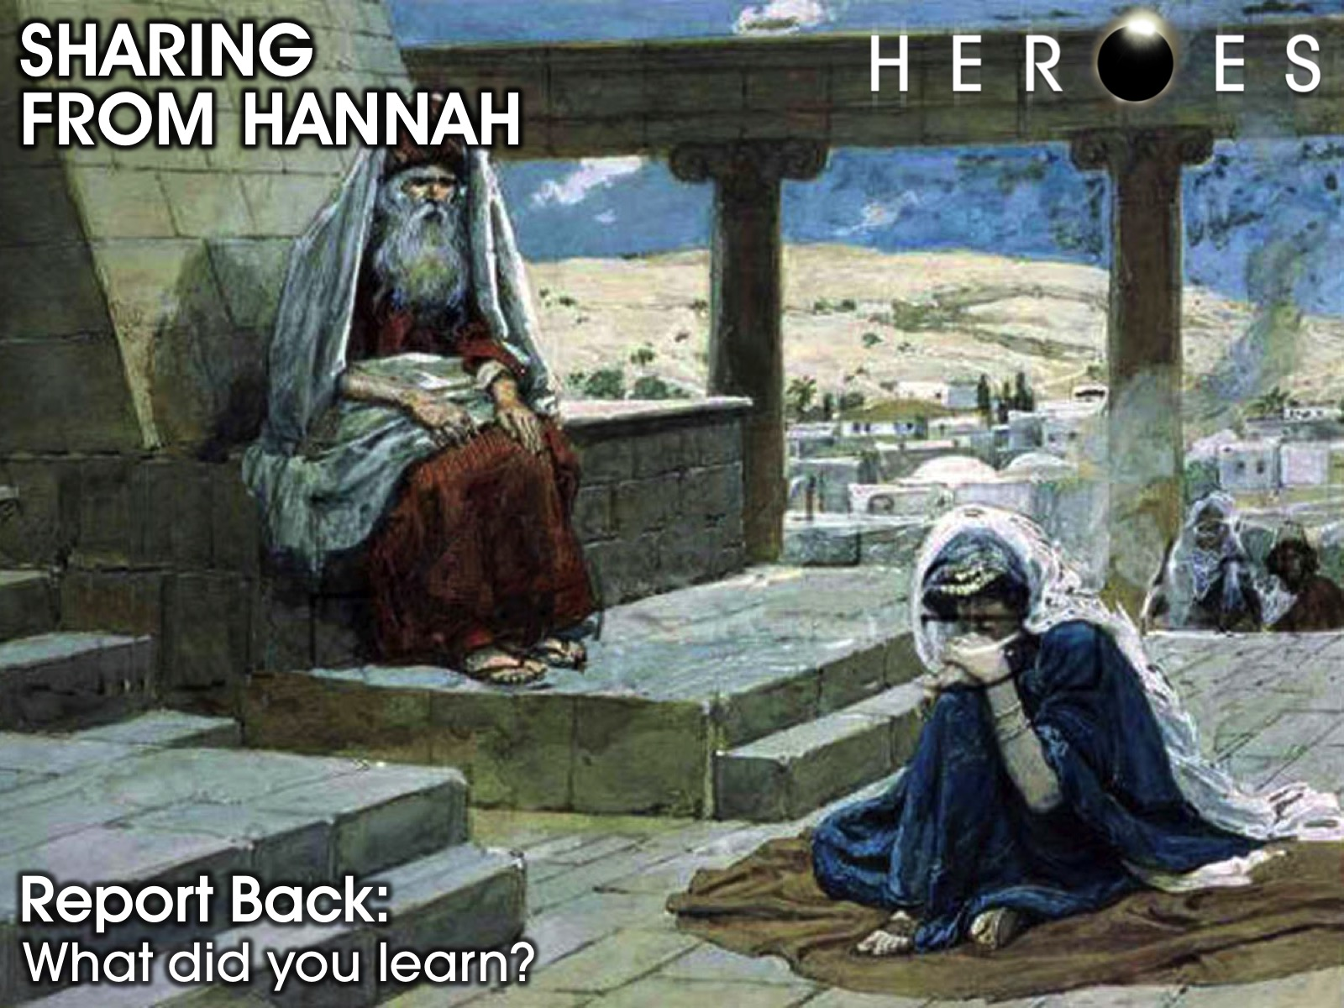
Notes:
Each group sends a leader to share one insight they learned with the wider group.

Slide 10
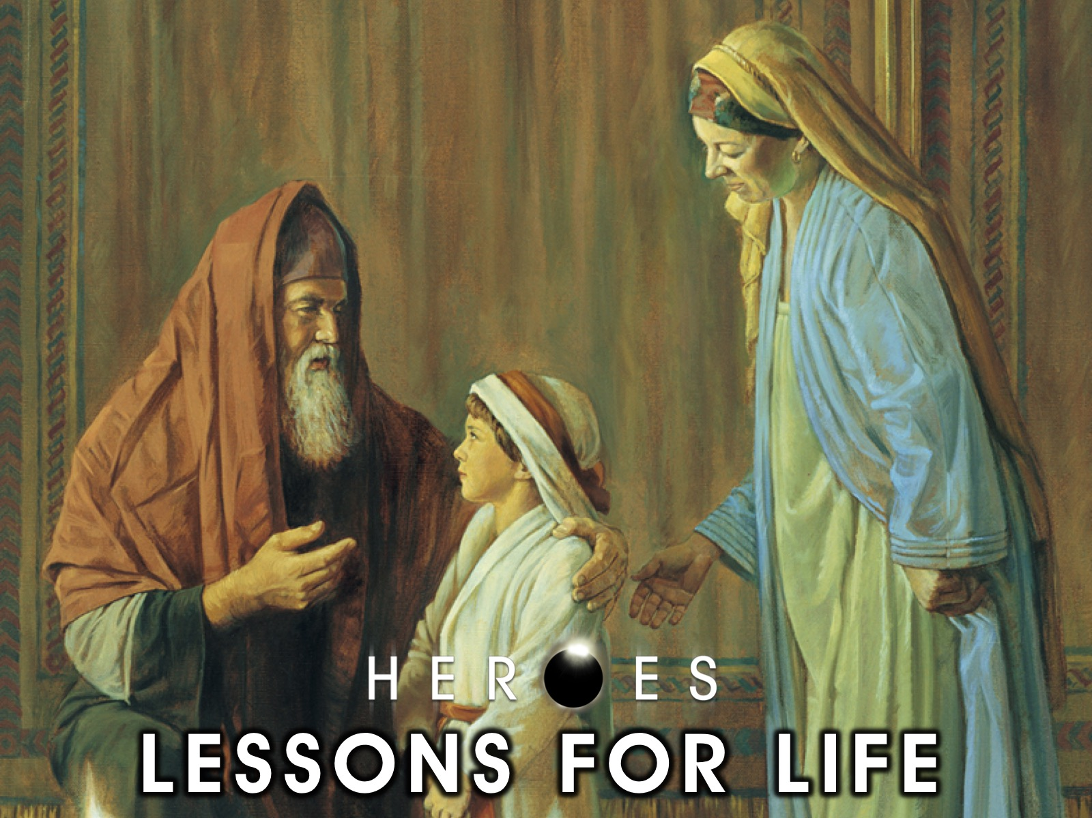
Notes:
Lessons for life from Hannah.

Slide 11
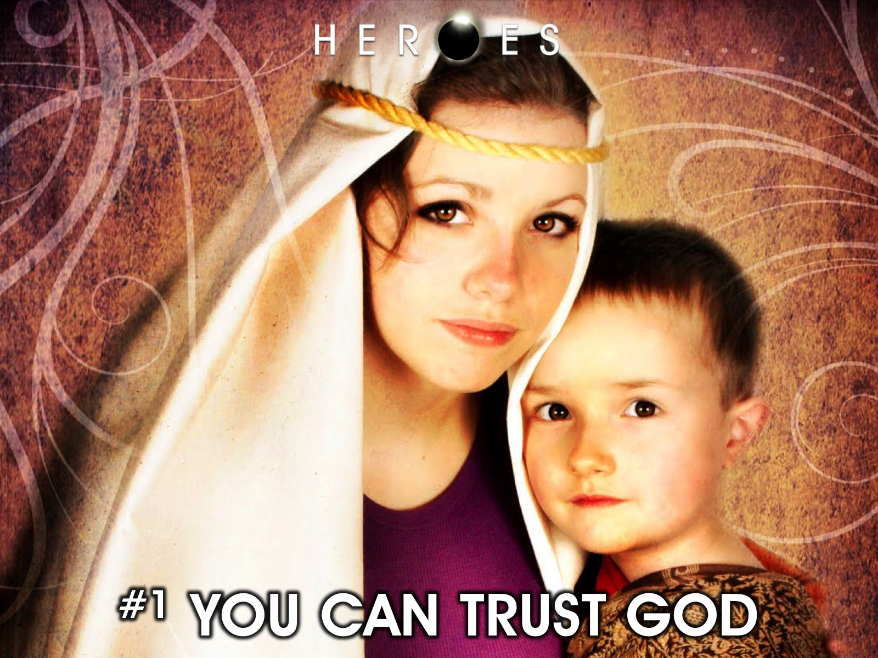
Notes:
#1 YOU CAN TRUST GOD. Here are some things that Hannah knew in her heart – that we should also know…

Slide 12
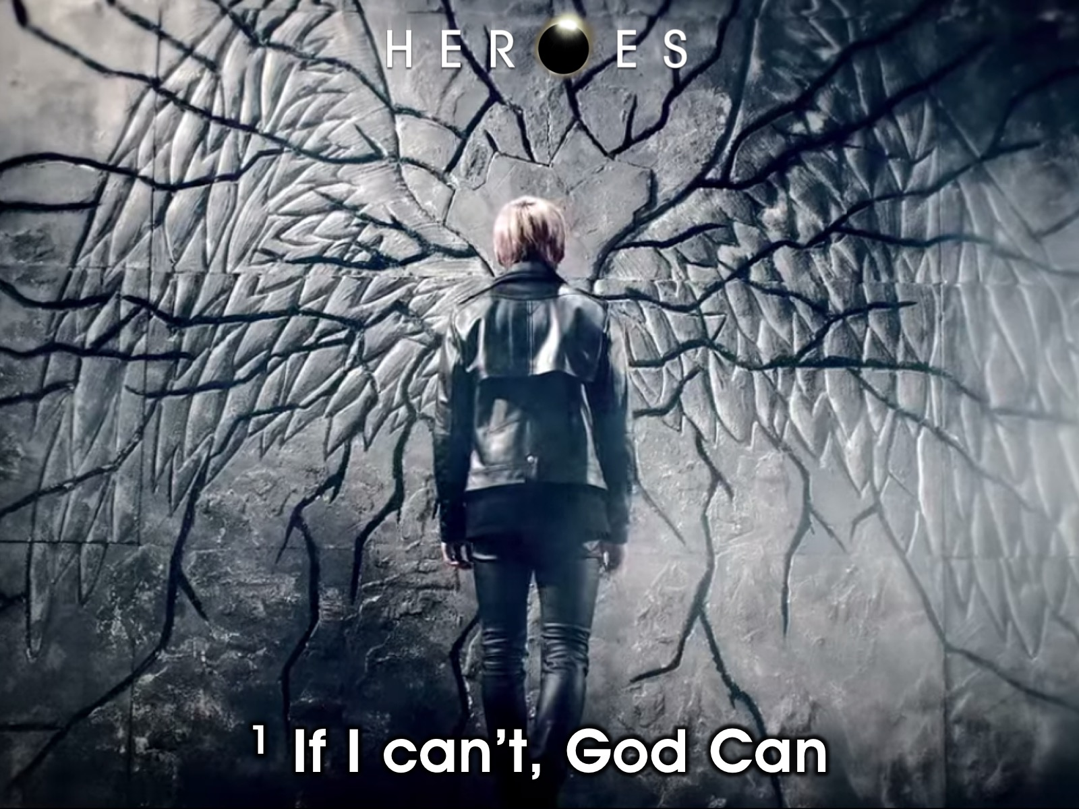
Notes:
1. If I can't God can.

Slide 13
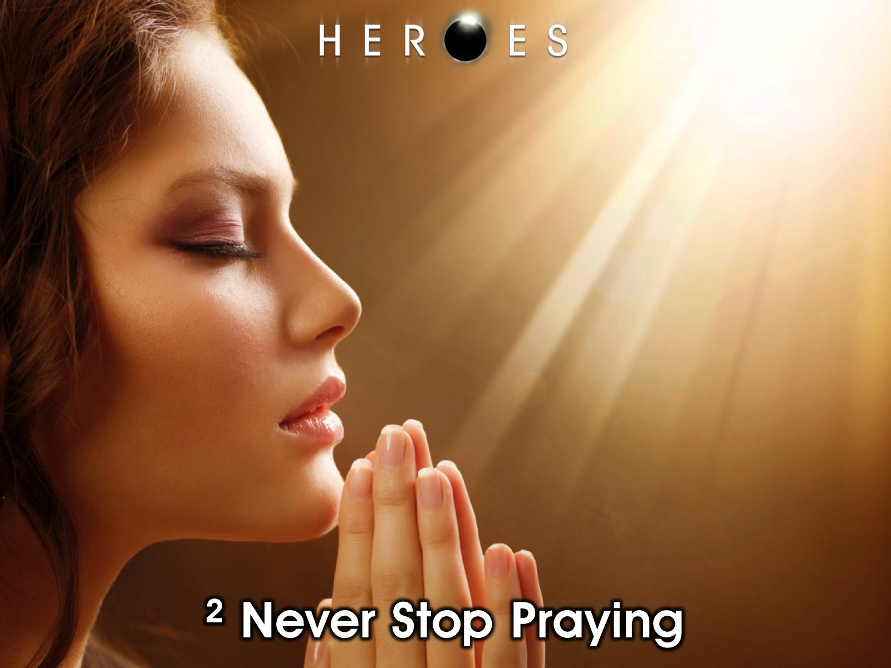
Notes:
2. Never stop praying. Spend time with God and give him all your troubles.

Slide 14

Notes:
3. God hears and answers prayers.

Slide 15

Notes:
4. God's time is the right time.

Slide 16
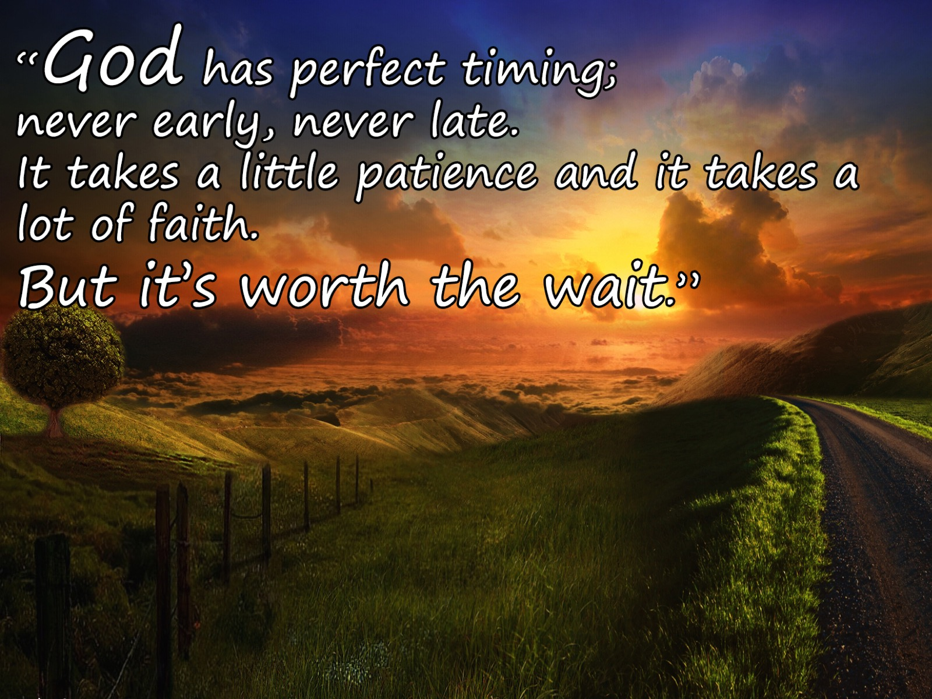
Notes:
Someone has said: “God has perfect timing; never early, never late. It takes a little patience and it takes a lot of faith. But it’s worth the wait.”

Slide 17
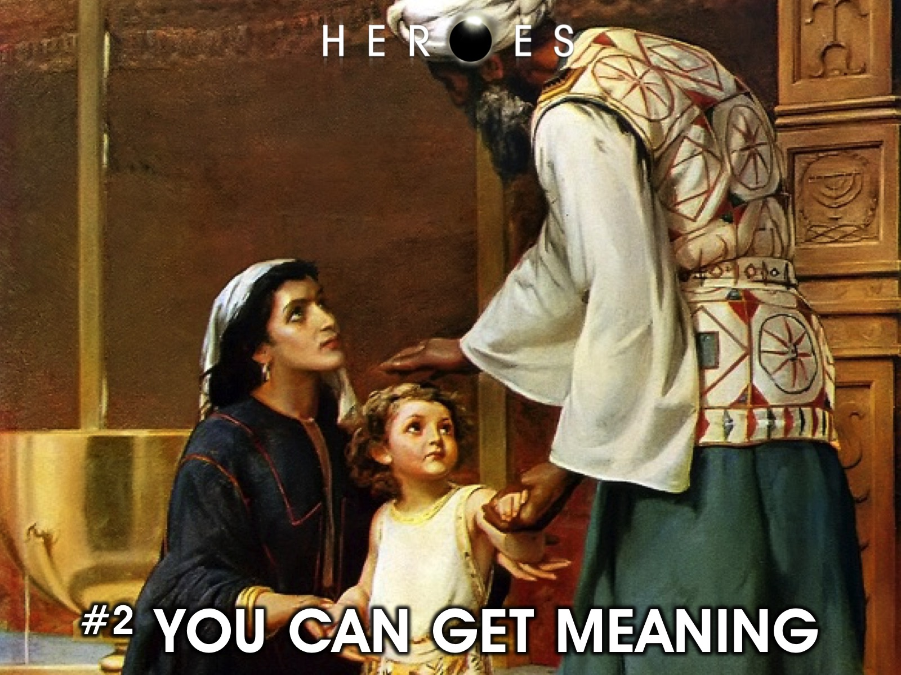
Notes:
#2 YOU CAN GET MEANING

Slide 18
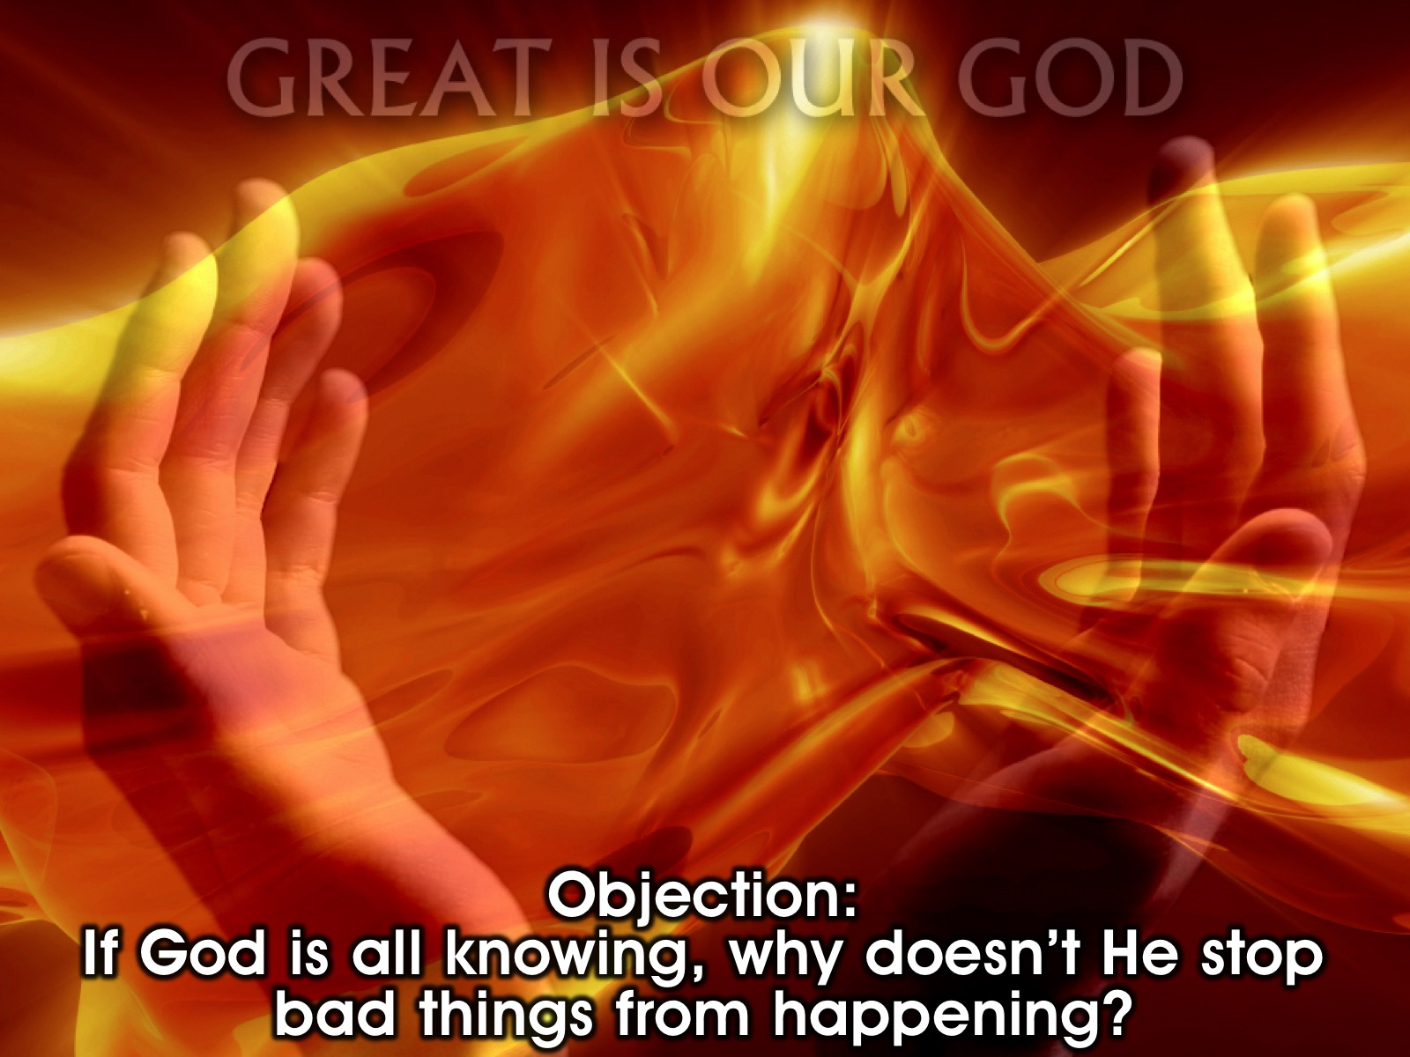
Notes:
Objection: You can ask yourself a question that if god is all knowing then why doesn't he stop bad things from happening? Why am I going through what I'm going through?

Slide 19

Notes:
1. God wants your life to be a testimony, so that other people can get to know him through your story.

Slide 20

Notes:
2. God wants us to depend on him completely and for us to learn how to be closer to him. If life was smooth we wouldn't think that we need God. Imagine if you had everything you ever wanted, and you know that you got it all by yourself, would you still pray to God?

Slide 21
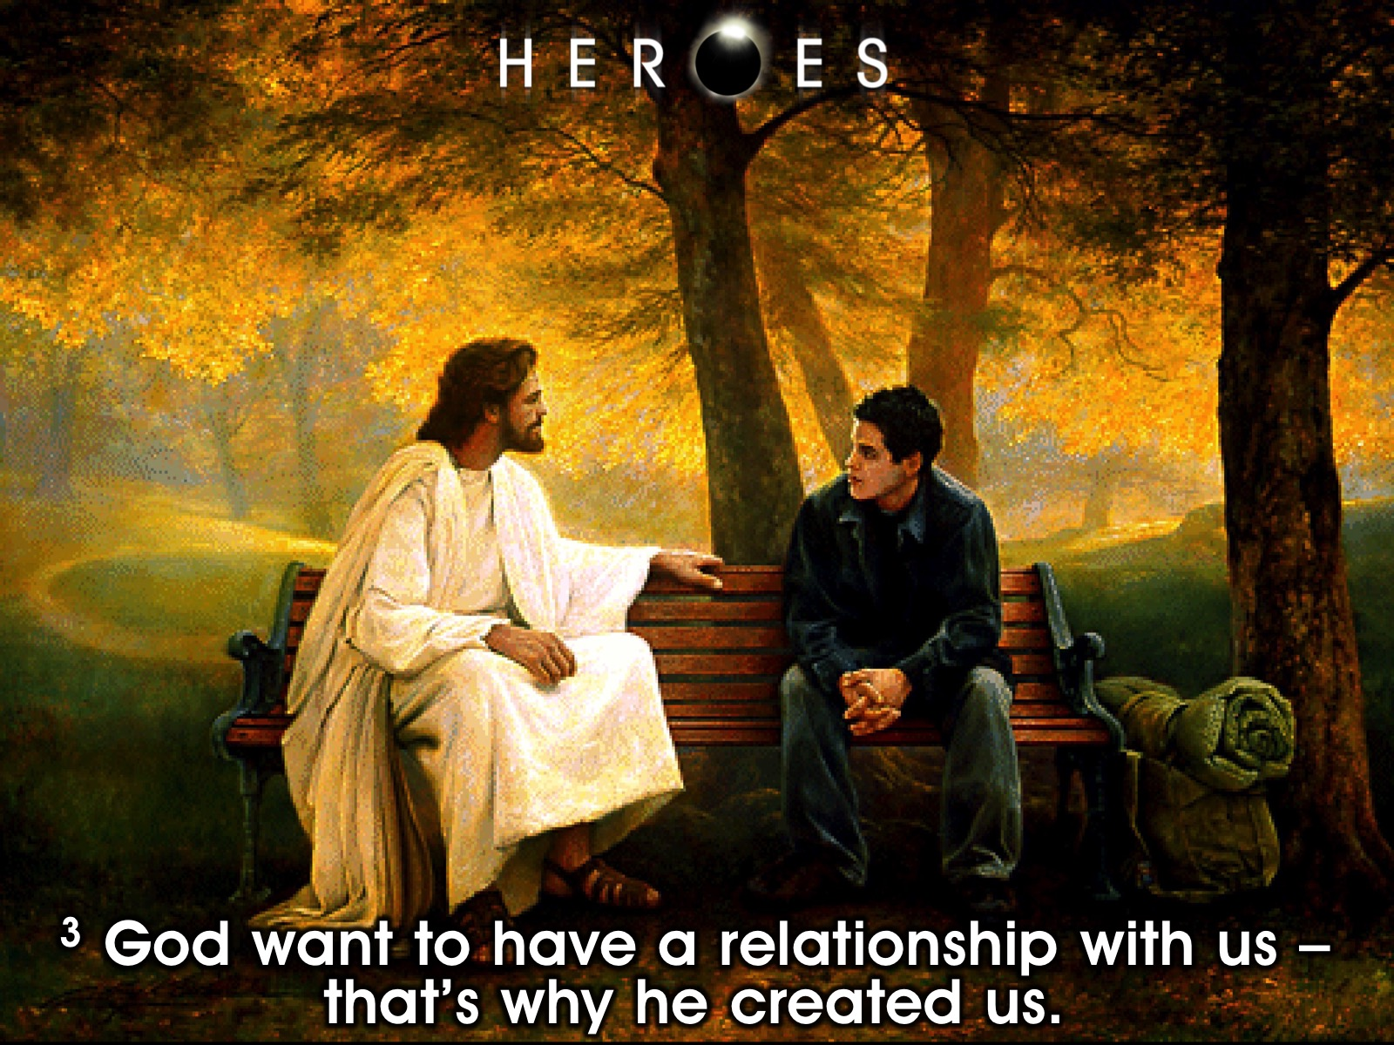
Notes:
3. God want to have a relationship with us. That's why he created us.

Slide 22
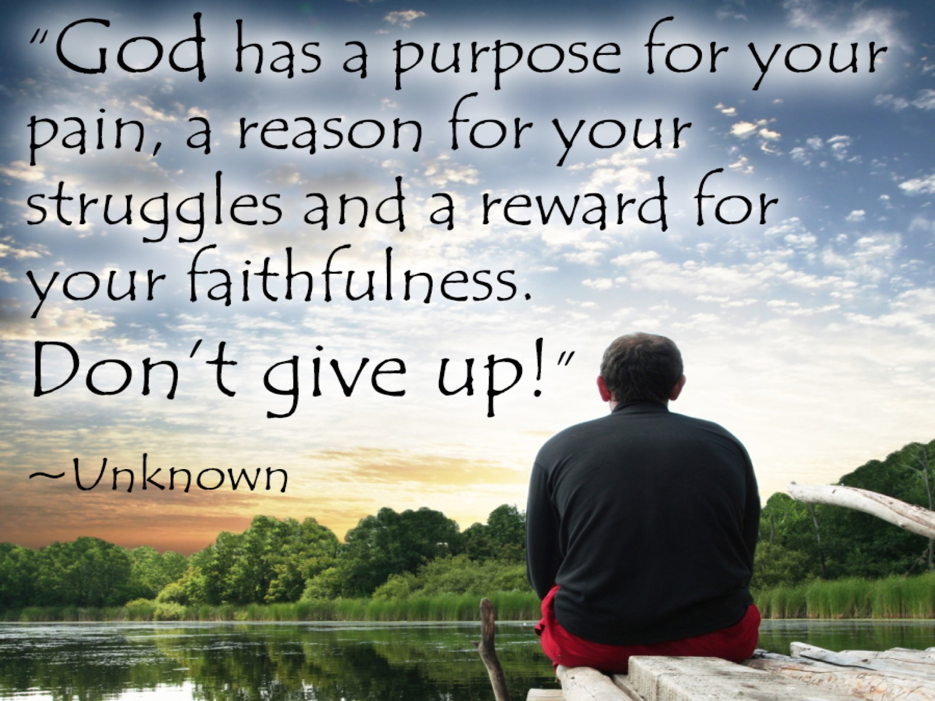
Notes:
Someone said: “God has a purpose for your pain, a reason for your struggles and a reward for your faithfulness. Don’t give up!"

Slide 23
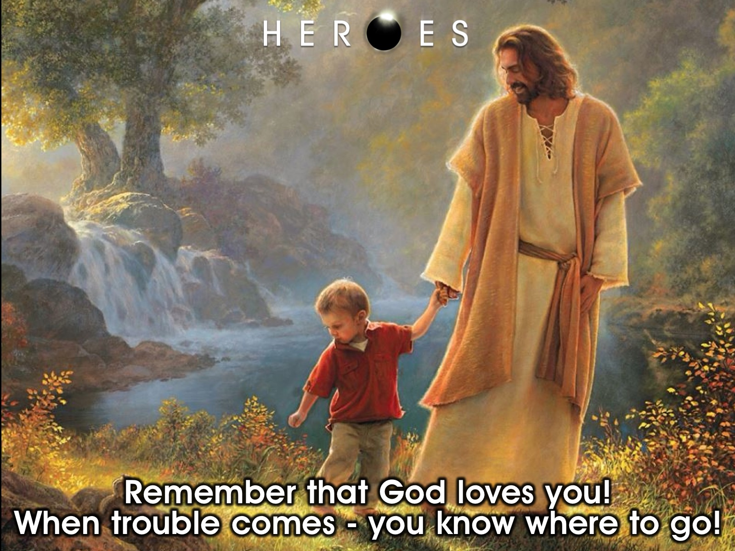
Notes:
Remember that God love us. When trouble comes we know where to go.

Slide 24
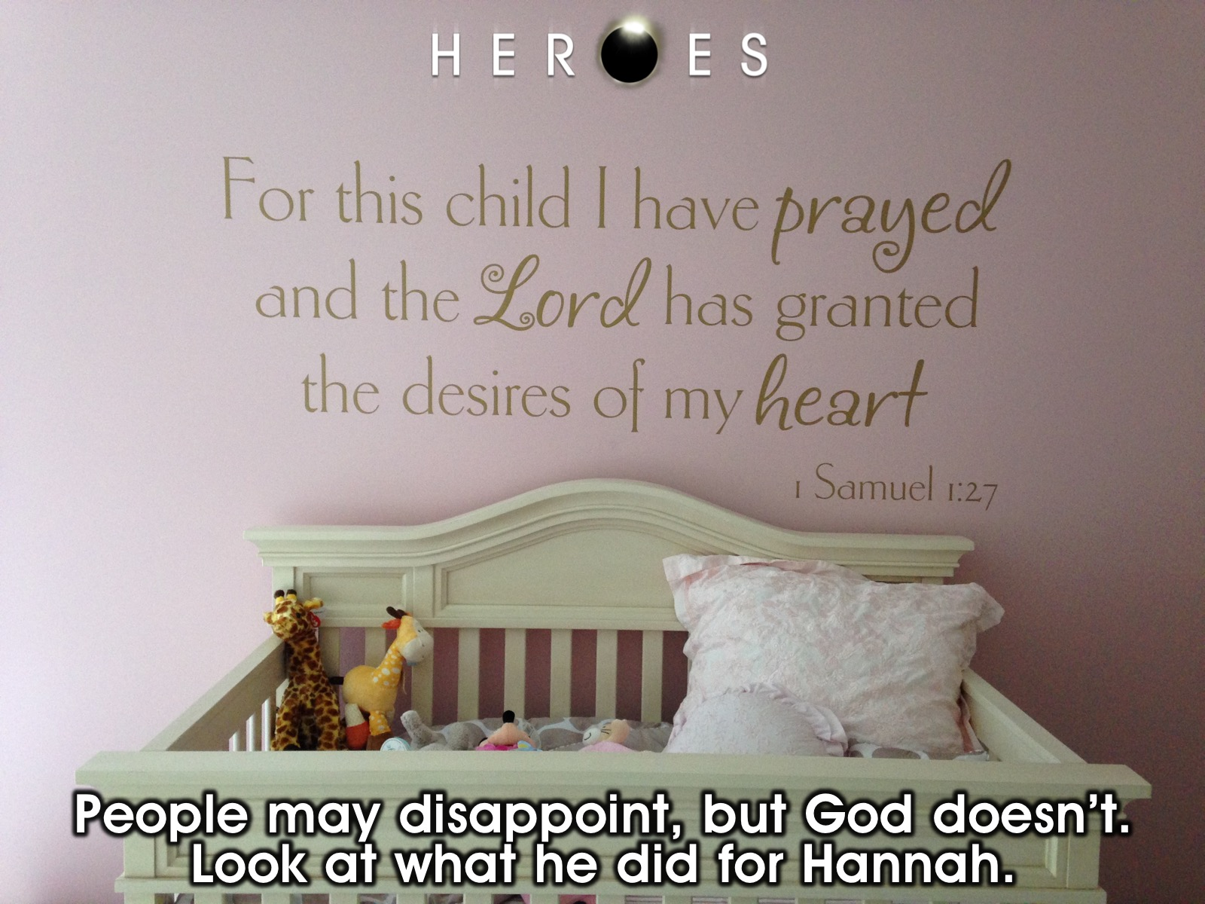
Notes:
People may disappoint, but God doesn't. Look at what he did for Hannah.

Slide 25
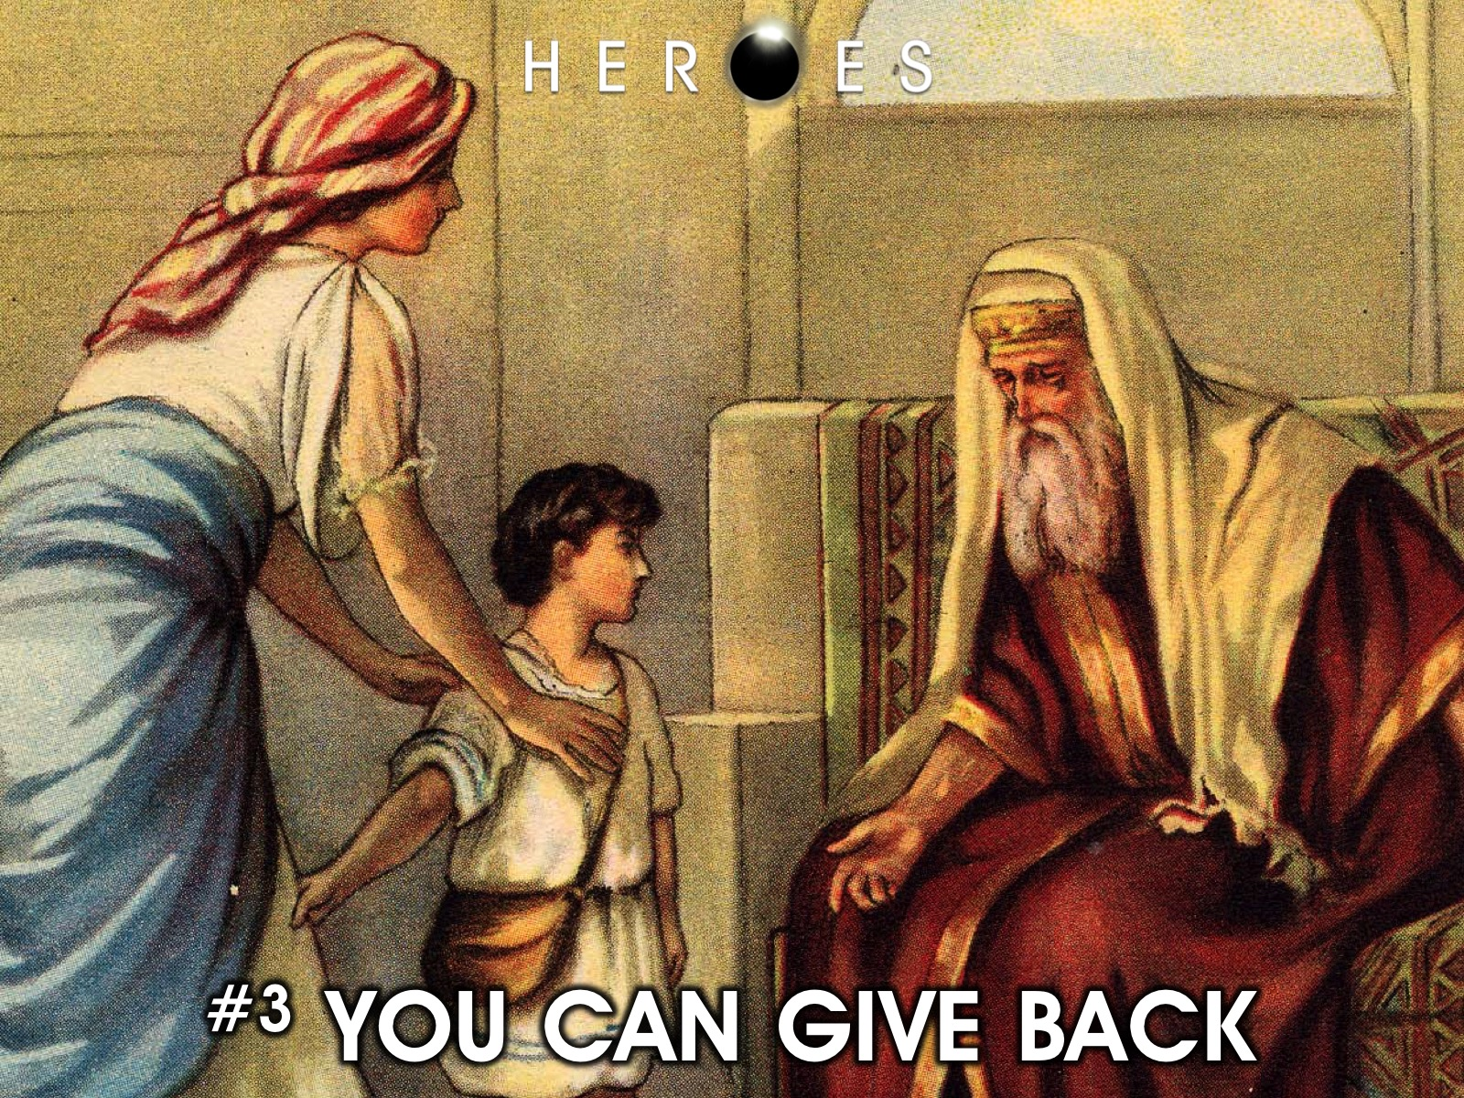
Notes:
#3 YOU CAN GIVE BACK

Slide 26

Notes:
Hannah knew that everything we have belongs to God. She gave the very thing she wanted back to God. We need to learn to give back to God. We may not give to God directly like Hannah did, but we can help others by seeing a need and responding to it.

Slide 27
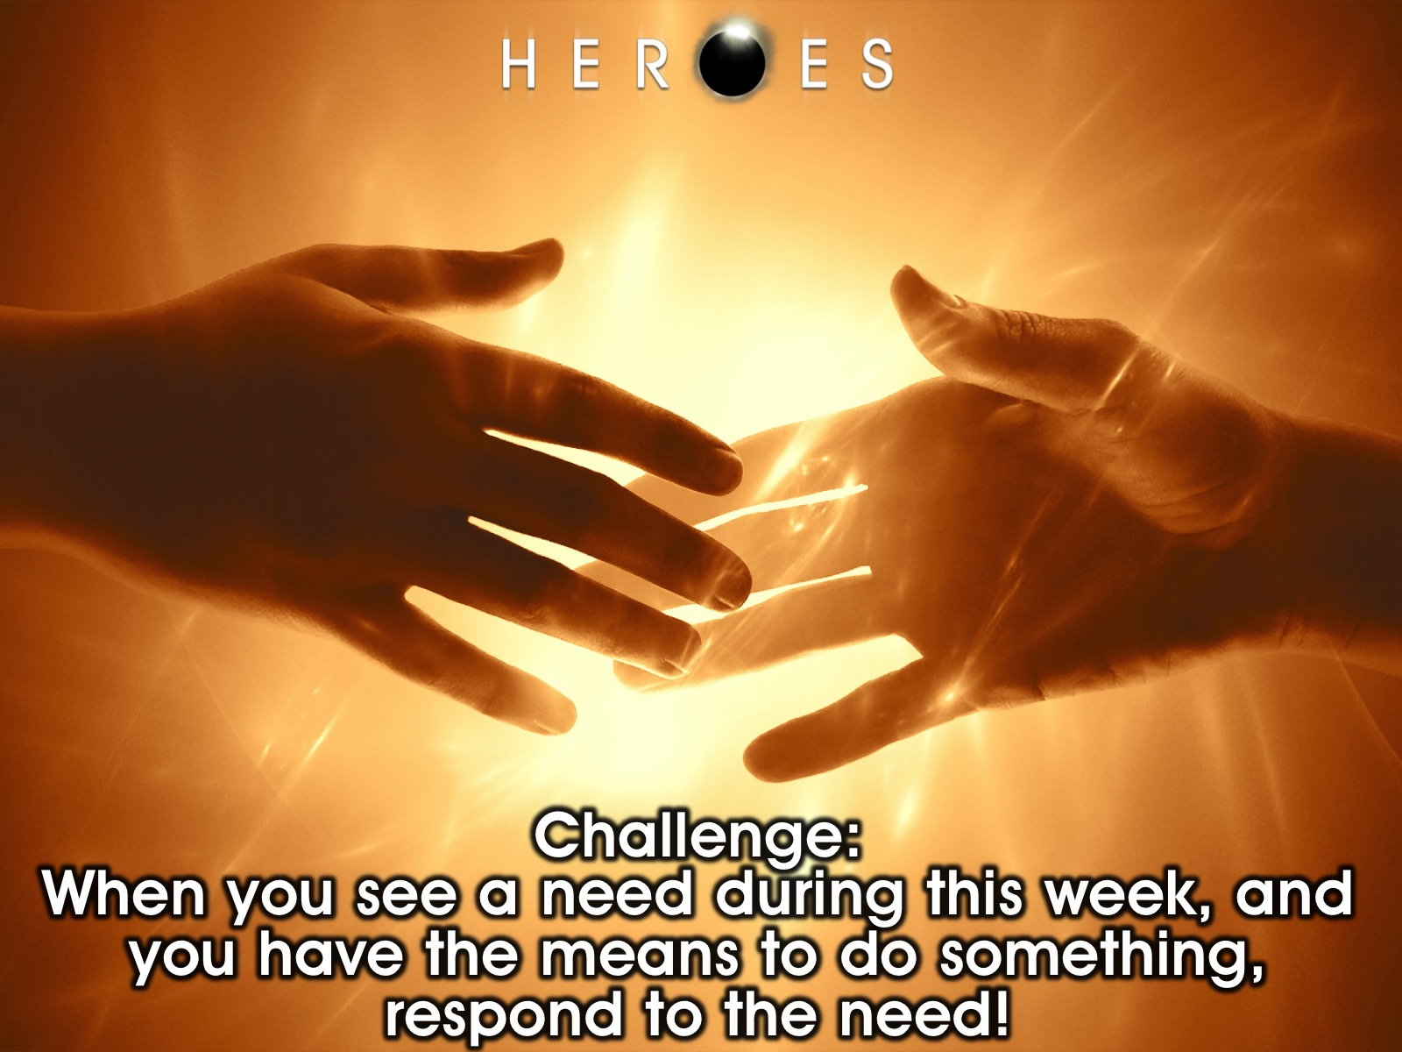
Notes:
Challenge: When ever you see a need during this week, and you have the means to do something, respond to it.

Slide 28
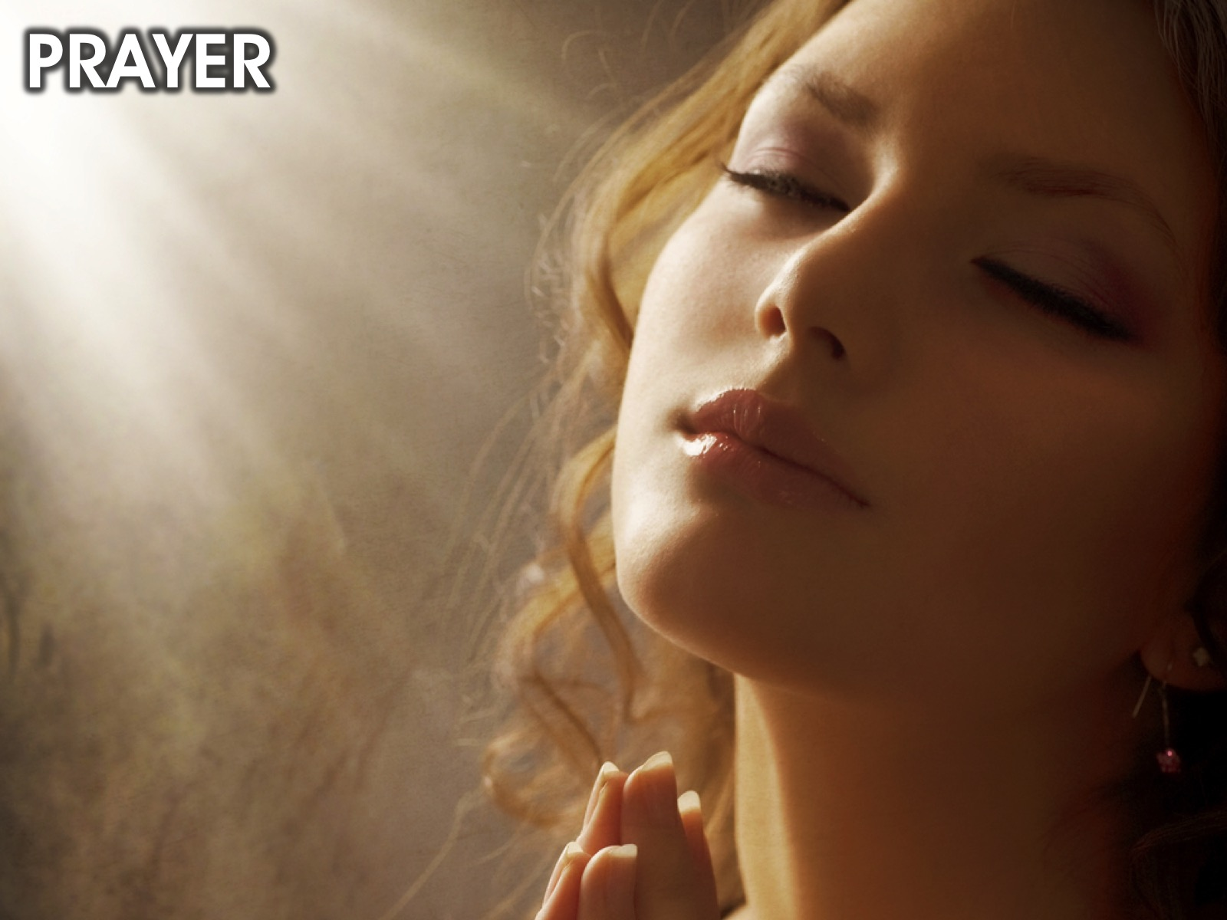
Notes:
Closing Prayer

Slide 29
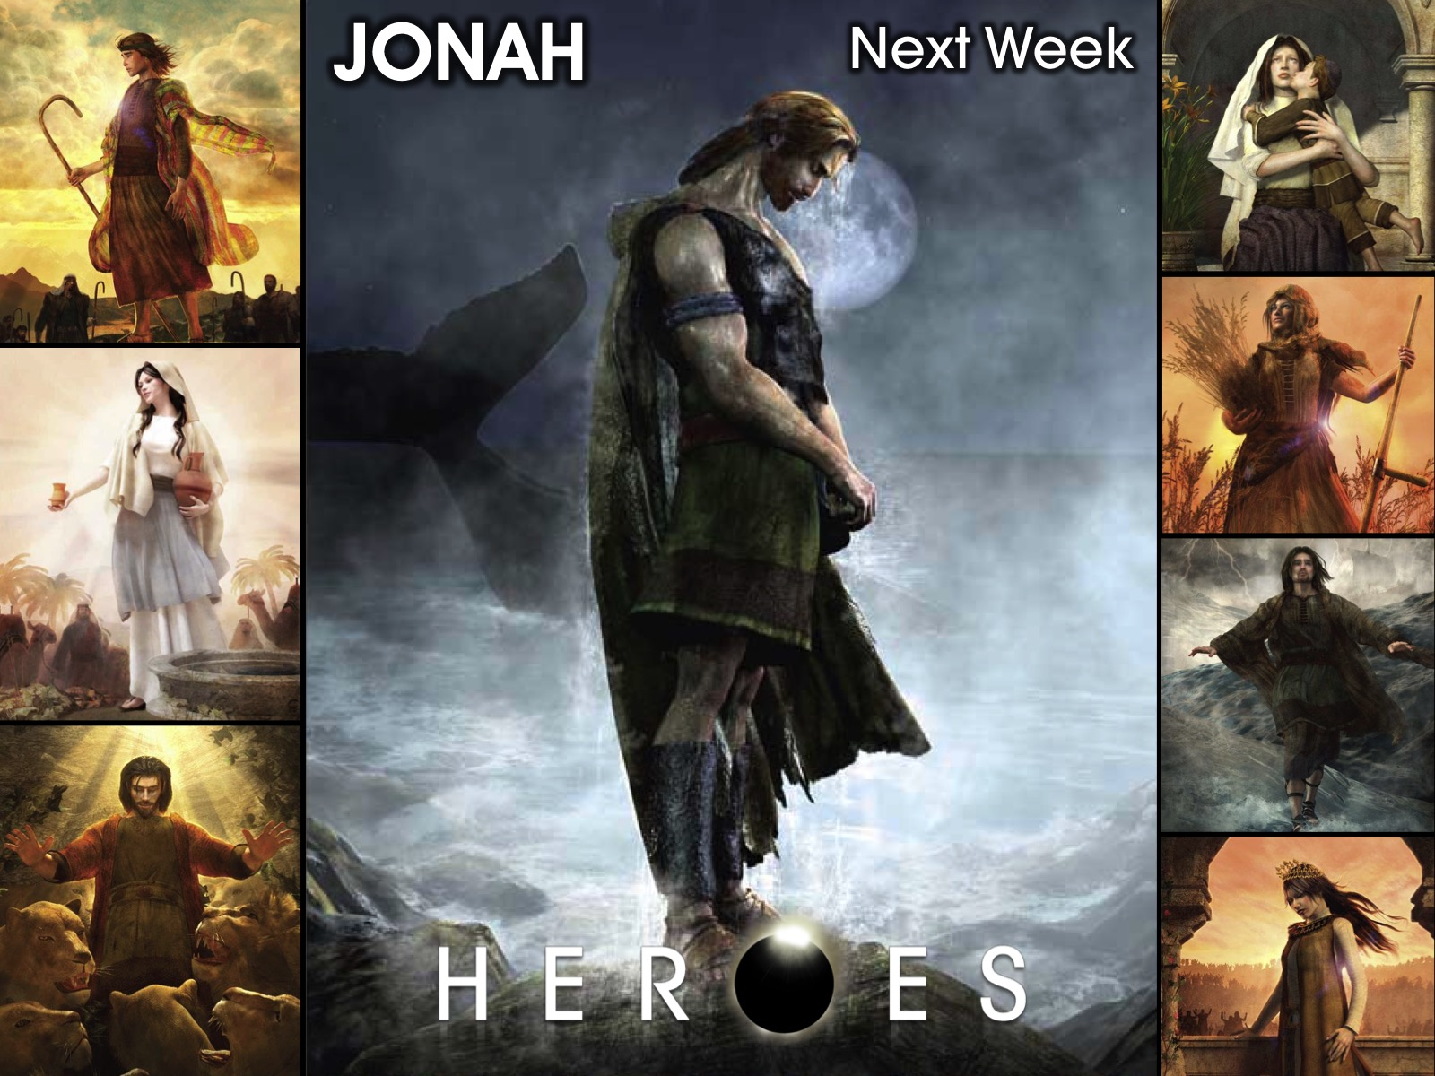
Notes:
Next week we will look at the life of Jonah.

