Slide 1
Notes:
This week we are going to explore the life of Ruth.

Slide 2
Notes:
Connecting with Ruth: Drama. Each of you has been given a piece of paper with a reading from either Ruth chapter 1 or 2 or 3 or 4. You need to find the rest of the members of your Chapter. Then read through the chapter together and then you have to re-enact the chapter on the stage. You can use dramatic reading with different people playing different characters or your can actually act out your chapter.

Slide 3
Notes:
The team with Ruth chapter 1 gets to enact their chapter.

Slide 4
Notes:
The team with Ruth chapter 2 gets to enact their chapter.

Slide 5
Notes:
The team with Ruth chapter 3 gets to enact their chapter.

Slide 6
Notes:
The team with Ruth chapter 4 gets to enact their chapter.

Slide 7
Notes:
Connecting with Ruth Through Video. So in case you missed the story of Ruth – here is a puppet version…

Slide 8
Notes:
Video: Ruth. Get it on YouTube at: https://www.youtube.com/watch?v=5Kt0geKYNs4

Slide 9
Notes:
Connecting with Ruth: Key Verses. Which verses in the book of Ruth stood out to you?

Slide 10
Notes:
Here are some of the verses that jumped out at me:
1. But Ruth replied, "Don't urge me to leave you or to turn back from you. Where you go I will go, and where you stay I will stay. Your people will be my people and your God my God. Where you die I will die, and there I will be buried. May the LORD deal with me, be it ever so severely, if even death separates you and me.” (Ruth 1:16-17)

Slide 11
Notes:
2. Boaz replied, "I've been told all about what you have done for your mother-in-law since the death of your husband--how you left your father and mother and your homeland and came to live with a people you did not know before. May the LORD repay you for what you have done. May you be richly rewarded by the LORD, the God of Israel, under whose wings you have come to take refuge.” (Ruth 2:11-12)

Slide 12
Notes:
3. Then Boaz announced to the elders and all the people, "Today you are witnesses that I have bought from Naomi all the property of Elimelek, Kilion and Mahlon. I have also acquired Ruth the Moabite, Mahlon's widow, as my wife, in order to maintain the name of the dead with his property, so that his name will not disappear from among his family or from his hometown. Today you are witnesses!” (Ruth 4:9-10)

Slide 13
Notes:
4. Then Naomi took the child in her arms and cared for him. The women living there said, "Naomi has a son!" And they named him Obed. He was the father of Jesse, the father of David. (Ruth 4:16-17)

Slide 14
Notes:
Connecting with Ruth: Themes. What themes do you think are in the book?

Slide 15
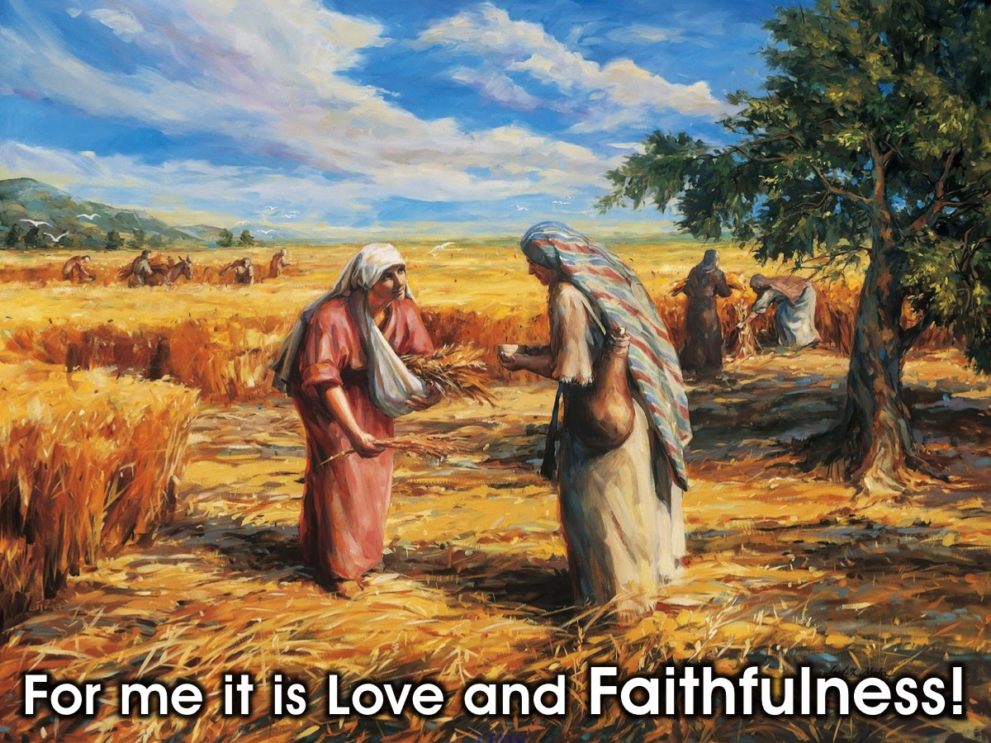
Notes:
For me two main themes stick out: Love and Faithfulness. But for me Faithfulness is the main theme.

Slide 16
Notes:
Faithfulness is…adhering firmly and devotedly, to a person, cause, or idea; loyal.
Ruth replied, "Don't urge me to leave you or to turn back from you. Where you go I will go, and where you stay I will stay. Your people will be my people and your God my God. Where you die I will die, and there I will be buried. May the LORD deal with me, be it ever so severely, if even death separates you and me.” (Ruth 1:16-17)
Naomi pleads with both her daughter in laws, to start a new life without her and does so with her blessing. You can see that Naomi loves her daughter in laws and they love her. Orpah loves Naomi she does not just leave her, it is a hard process for her to leave. But Ruth is shows a character of unconditional love which is faithfulness.

Slide 17
Notes:
Connecting with Ruth: Small Groups: How can we show faithfulness to God and people? Do you have a testimony of faithfulness to share with us?
Report Back: Share an example of faithfulness and a testimony

Slide 18
Notes:
Connecting with Ruth: My Story - After all the groups share, Gen will share a testimony of faithfulness.

Slide 19
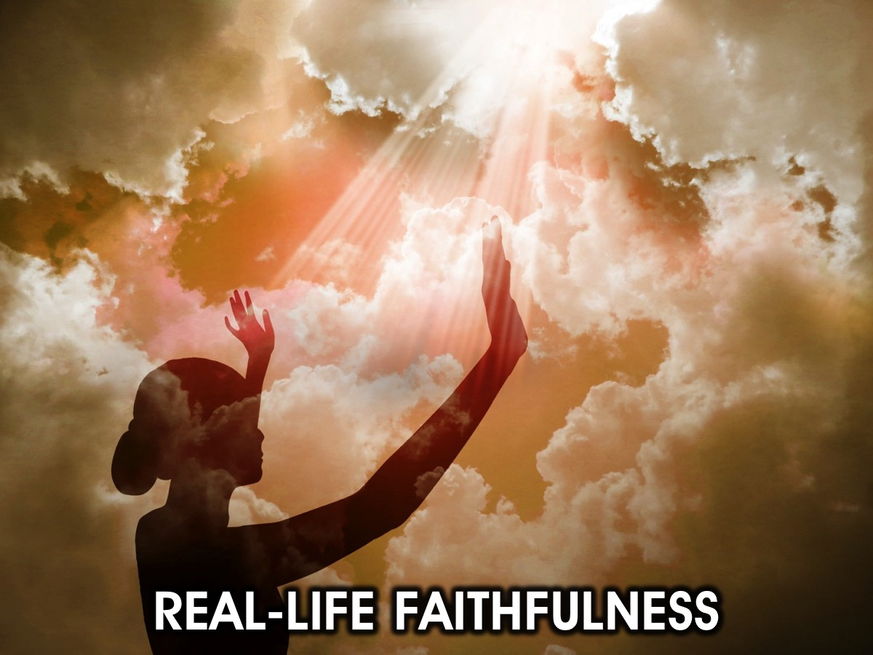
Notes:
Real-Life Faithfulness: Here are some practical ways to show faithfulness as we close this morning:

Slide 20
Notes:
Keeping the confidence of your friend

Slide 21
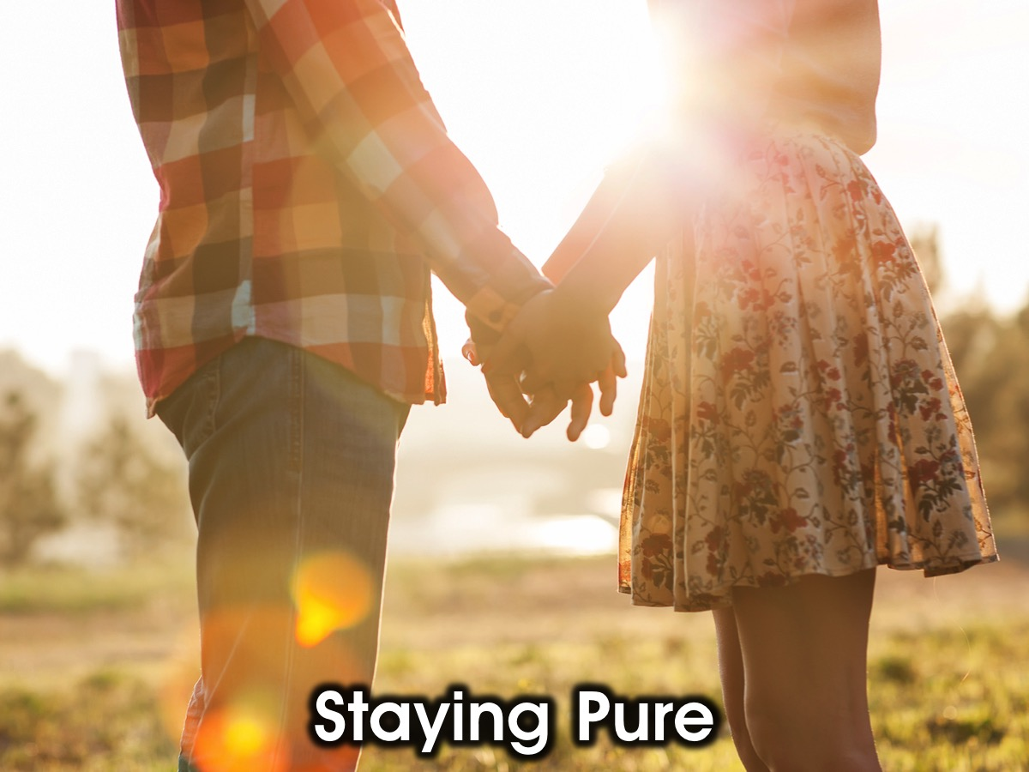
Notes:
Staying pure till you get married. Faithfulness does not start when you are alone with your boo and things get hot .... Faithfulness starts with your thoughts ... making a conscious effort to stay pure in your mind .

Slide 22
Notes:
Being obedient to your parents. Faithfulness is staying home and not sneaking out, even though its the party of the century and you have VIP tickets .... because mom said No, I don't have a good feeling!

Slide 23
Notes:
Doing what God has whispered in your heart. Like Jonah when God has told you to go to Nineveh but you don't want to. Faithfulness is going to Nineveh anyway, even its just because God said so!

Slide 24
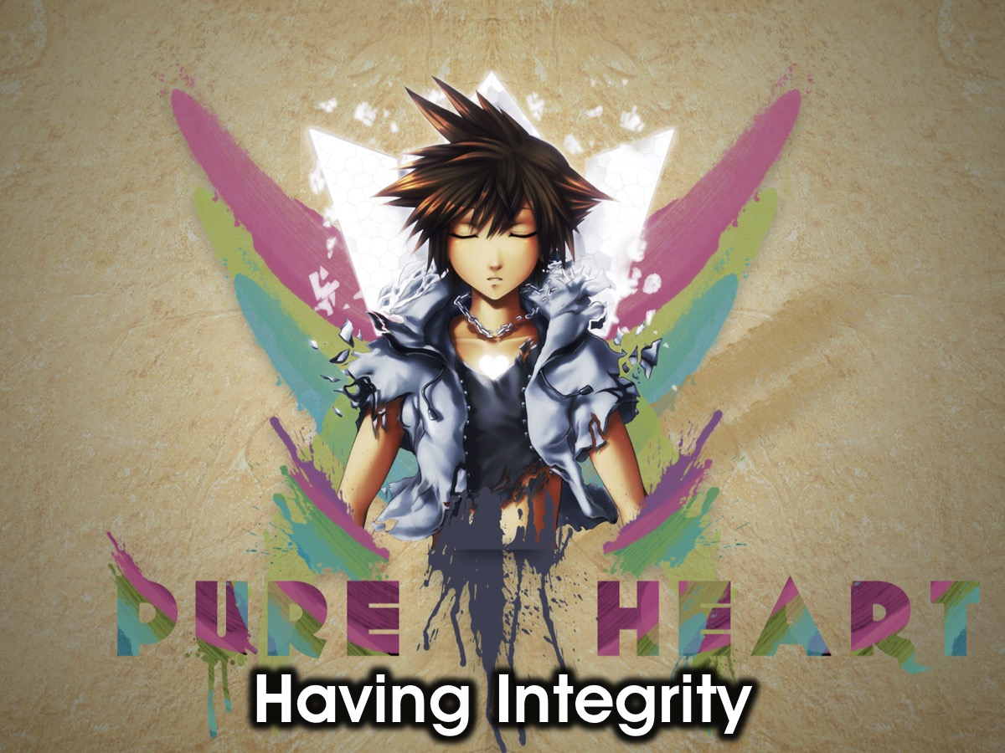
Notes:
Having integrity. When you get the R100 change from a R50 at the shop. Faithfulness is going in and telling the teller you gave me the wrong change.

Slide 25
Notes:
Giving tithes. When you get your first paying job and you wage is just enough for those new shoes you had your eye on. Faithfulness is giving your tithes and not using the your tithes towards buying the shoes.

Slide 26
Notes:
Because of Ruth’s faithfulness to God and Naomi, God rewarded her and her generations to follow by allowing her linage to be that of King David and our Messiah, Jesus Christ.

Slide 27
Notes:
God is Gracious and Forgiving
“For all have sinned and fall short of the glory of God.” (Romans 3:23)
God loves and he forgives us of ALL our transgressions.
The bible says a righteous man falls seven times but gets back up again.
But God is also Principled
And He rewards and blessed those who follow His principles. The story of Ruth shows that if we are faithful, God will reward us. He will not only reward you but your generations to come.
Lets pray for anyone who needs help to be faithful.

Slide 28
Notes:
Next week we are going to look at the life of Peter.

