Slide 1
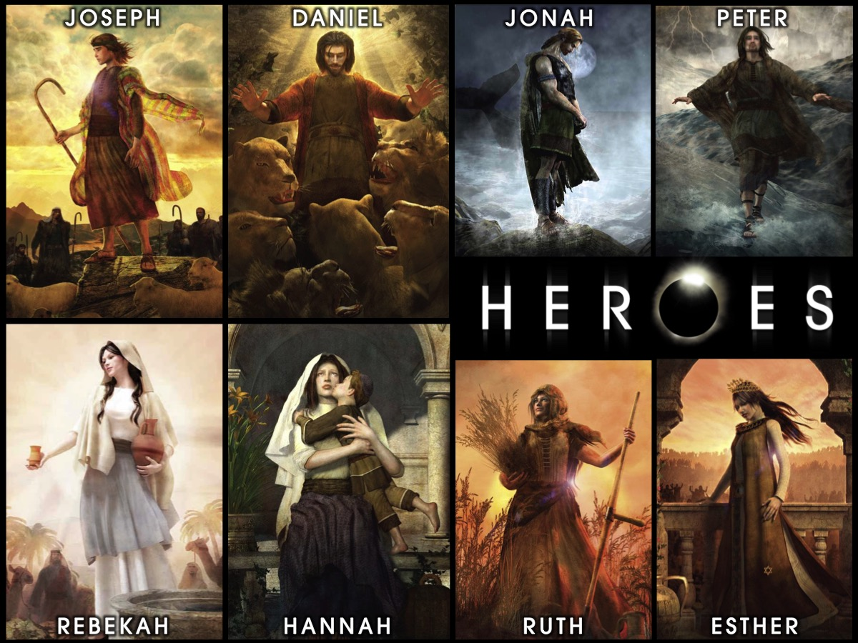
Notes:
Welcome to our Heroes Series on Sunday mornings at His Youth.

Slide 2
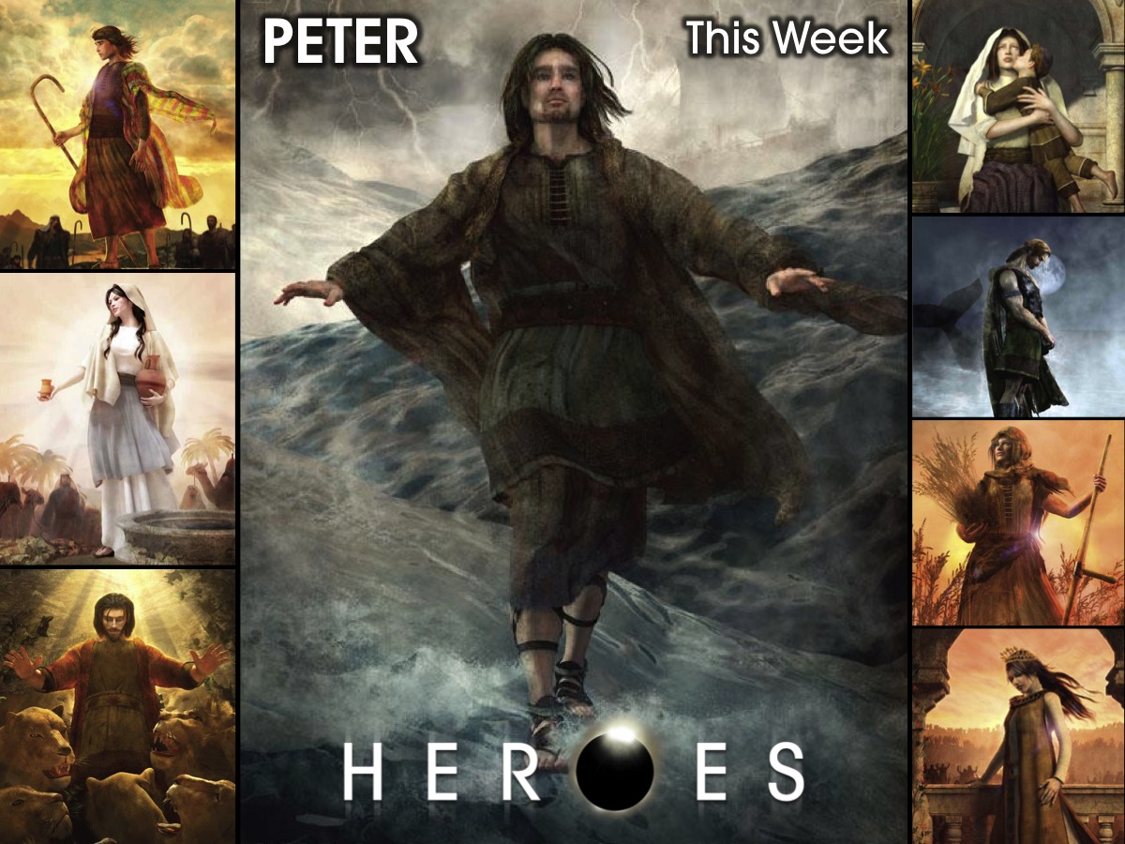
Notes:
This week we are going to explore the life of Peter.

Slide 3
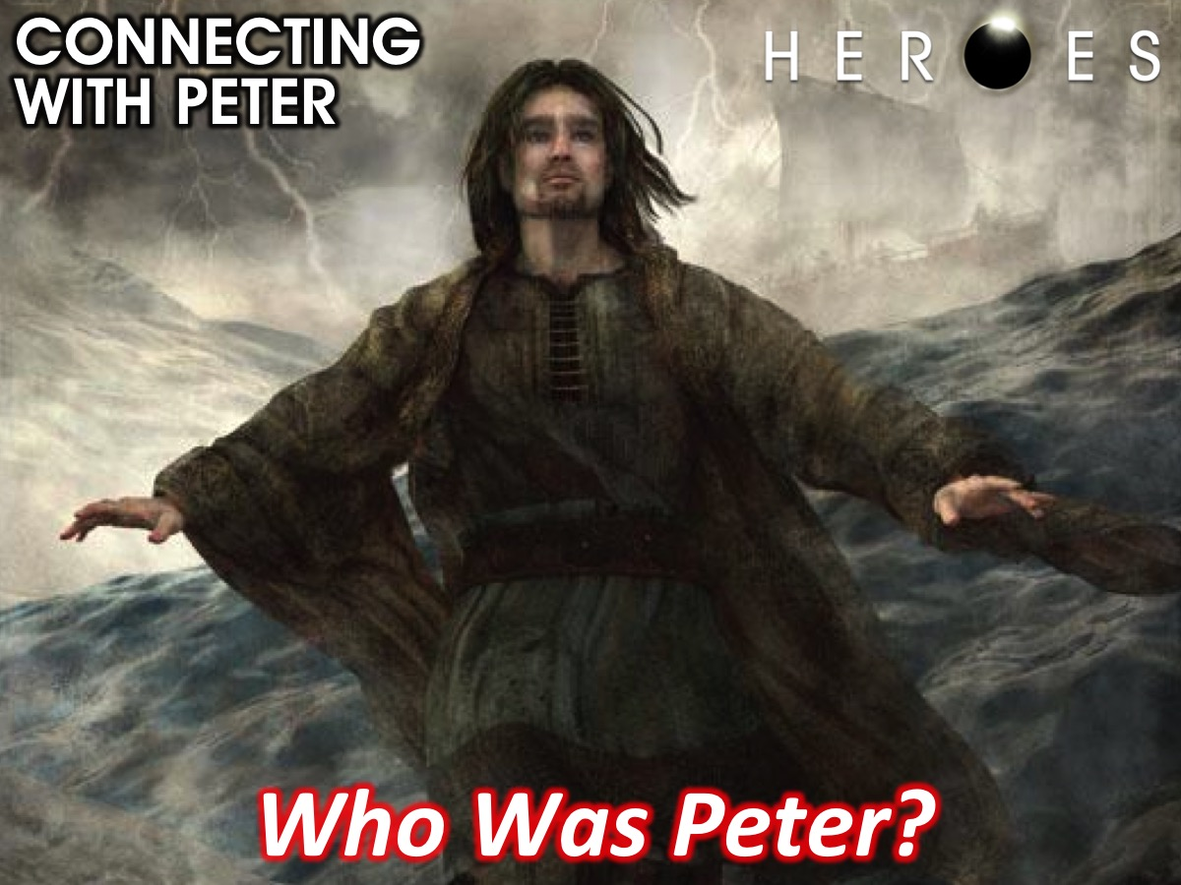
Notes:
Connecting with Peter: Who Was Peter?

Slide 4
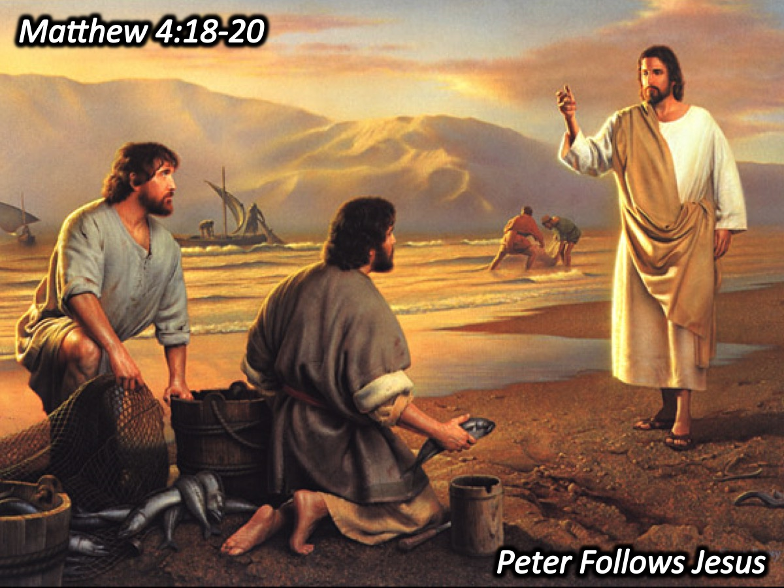
Notes:
1. Peter Follows Jesus. As Jesus was walking beside the Sea of Galilee, he saw two brothers, Simon called Peter and his brother Andrew. They were casting a net into the lake, for they were fishermen." "Come, follow me," Jesus said, "and I will make you fishers of men." At once they left their nets and followed him. (Matthew 4:18-20)

Slide 5
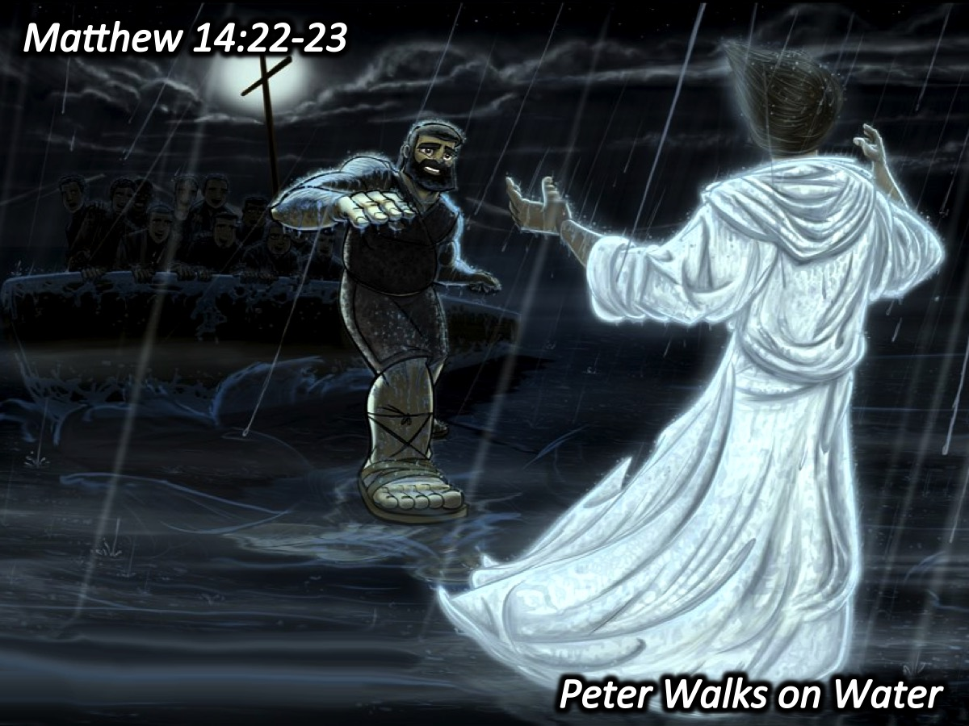
Notes:
2. Peter Walks on Water. During the fourth watch of the night Jesus went out to them, walking on the lake. When the disciples saw him walking on the lake, they were terrified. "It's a ghost," they said, and cried out in fear. But Jesus immediately said to them: "Take courage! It is I. Don't be afraid." "Lord, if it's you," Peter replied, "tell me to come to you on the water." "Come," he said. Then Peter got down out of the boat, walked on the water and came toward Jesus. But when he saw the wind, he was afraid and, beginning to sink, cried out, "Lord, save me!" Immediately Jesus reached out his hand and caught him. "You of little faith," he said, "why did you doubt?" And when they climbed into the boat, the wind died down. Then those who were in the boat worshiped him, saying, "Truly you are the Son of God.“ (Matthew 14:22‑33)

Slide 6
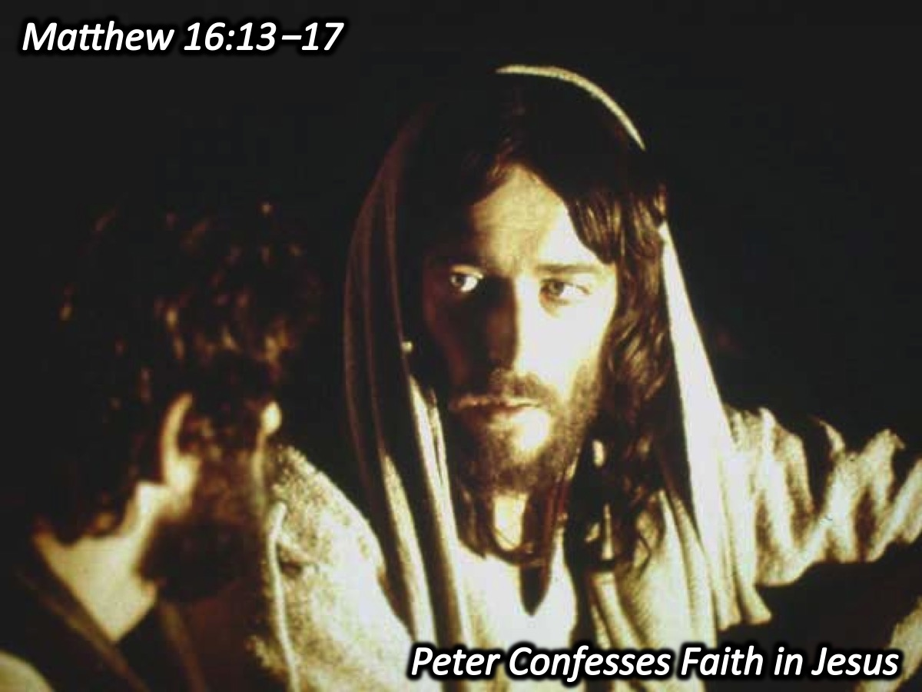
Notes:
3. Peter Confesses Faith in Jesus. When Jesus came to the region of Caesarea Philippi, he asked his disciples, "Who do people say the Son of Man is?" They replied, "Some say John the Baptist; others say Elijah; and still others, Jeremiah or one of the prophets." "But what about you?" he asked. "Who do you say I am?" Simon Peter answered, "You are the Christ, the Son of the living God." Jesus replied, "Blessed are you, Simon son of Jonah, for this was not revealed to you by man, but by my Father in heaven." (Matthew 16:13‑17)

Slide 7
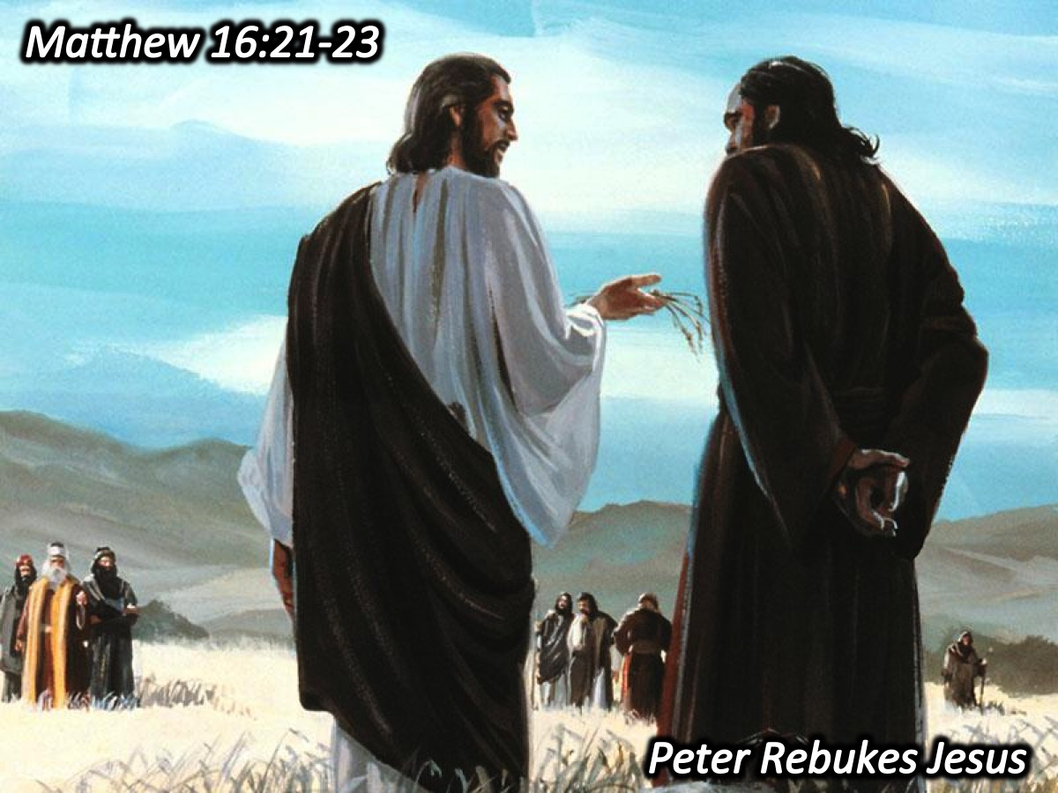
Notes:
4. Peter Rebukes Jesus. From that time on Jesus began to explain to his disciples that he must go to Jerusalem and suffer many things at the hands of the elders, chief priests and teachers of the law, and that he must be killed and on the third day be raised to life. "Peter took him aside and began to rebuke him. "Never, Lord!" he said. "This shall never happen to you!" Jesus turned and said to Peter, "Get behind me, Satan! You are a stumbling block to me; you do not have in mind the things of God, but the things of men." (Matthew 16:21-23)

Slide 8
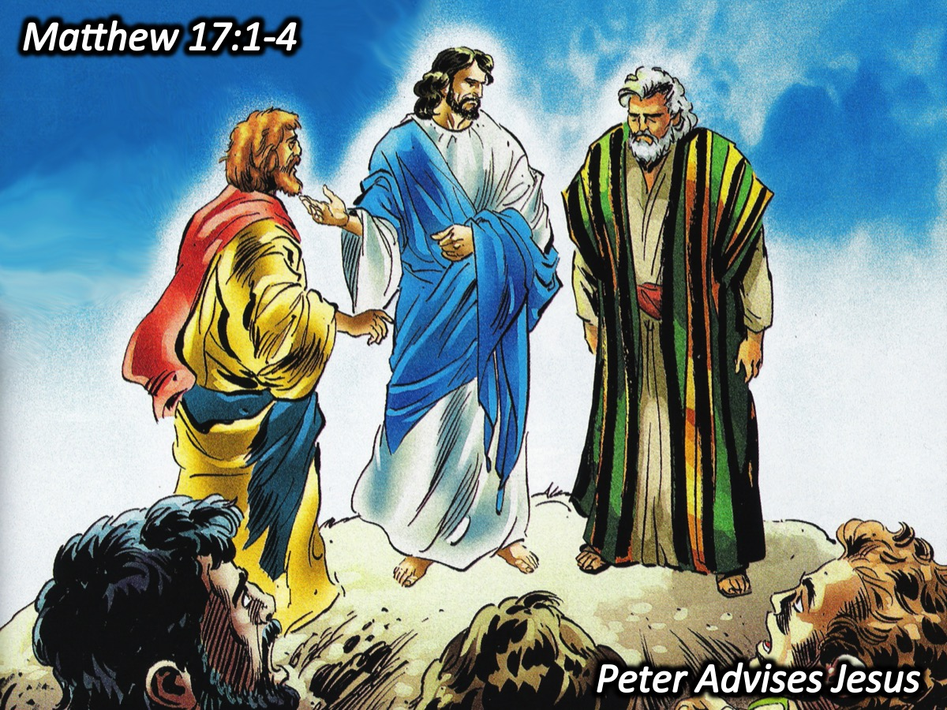
Notes:
5. Peter Advises Jesus. After six days Jesus took with him Peter, James and John the brother of James, and led them up a high mountain by themselves. There he was transfigured before them. His face shone like the sun, and his clothes became as white as the light. Just then there appeared before them Moses and Elijah, talking with Jesus. Peter said to Jesus, "Lord, it is good for us to be here. If you wish, I will put up three shelters one for you, one for Moses and one for Elijah.” (Matthew 17:1-4)

Slide 9
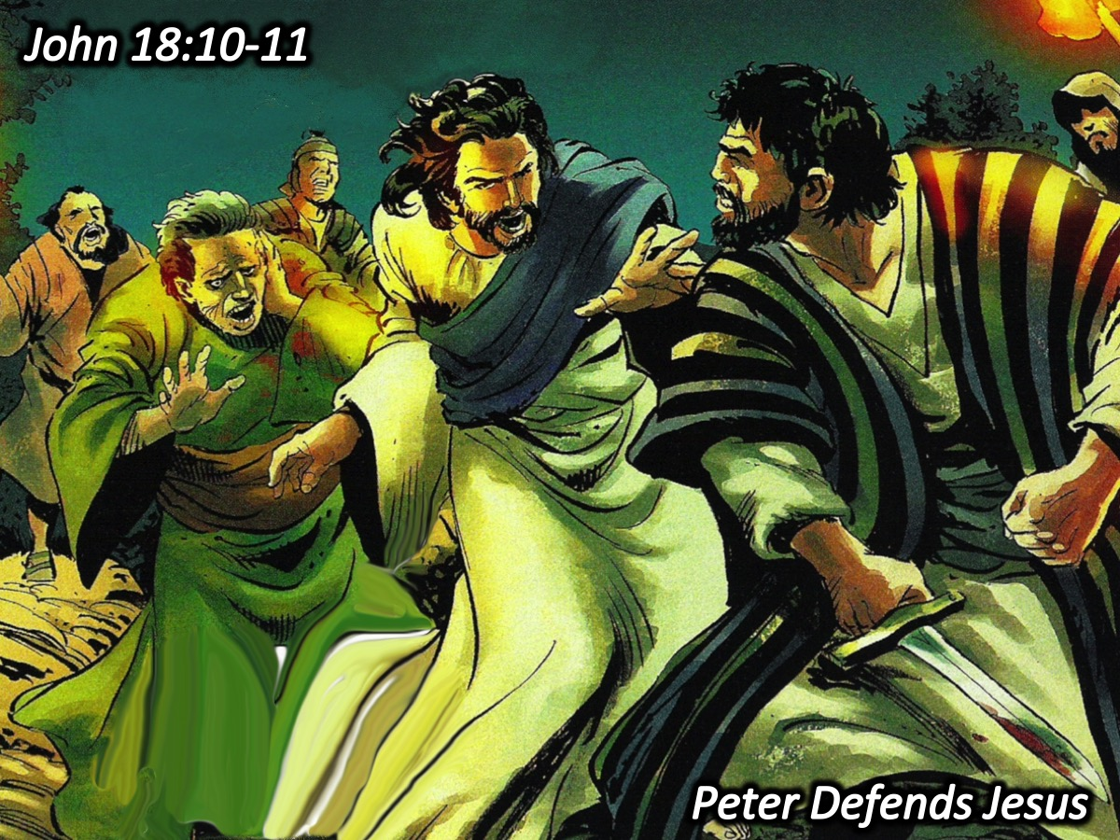
Notes:
6. Peter Defends Jesus. Then Simon Peter, who had a sword, drew it and struck the high priest's servant, cutting off his right ear. (The servant's name was Malchus.) Jesus commanded Peter, "Put your sword away! Shall I not drink the cup the Father has given me?" (John 18:10‑11)

Slide 10
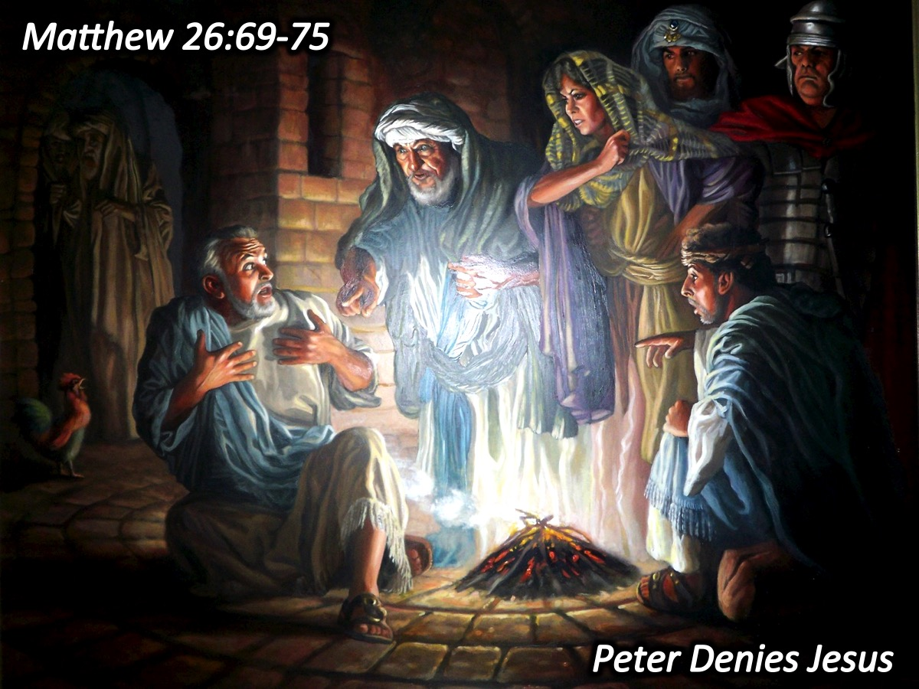
Notes:
7. Peter Denies Jesus. Now Peter was sitting out in the courtyard, and a servant girl came to him." You also were with Jesus of Galilee," she said. But he denied it before them all. "I don't know what you're talking about," he said. Then he went out to the gateway, where another girl saw him and said to the people there, "This fellow was with Jesus of Nazareth." He denied it again, with an oath: "I don't know the man!" After a little while, those standing there went up to Peter and said, "Surely you are one of them, for your accent gives you away." Then he began to call down curses on himself and he swore to them, "I don't know the man!" Immediately a rooster crowed. Then Peter remembered the word Jesus had spoken: "Before the rooster crows, you will disown me three times." And he went outside and wept bitterly. (Matthew 26:69-75)

Slide 11
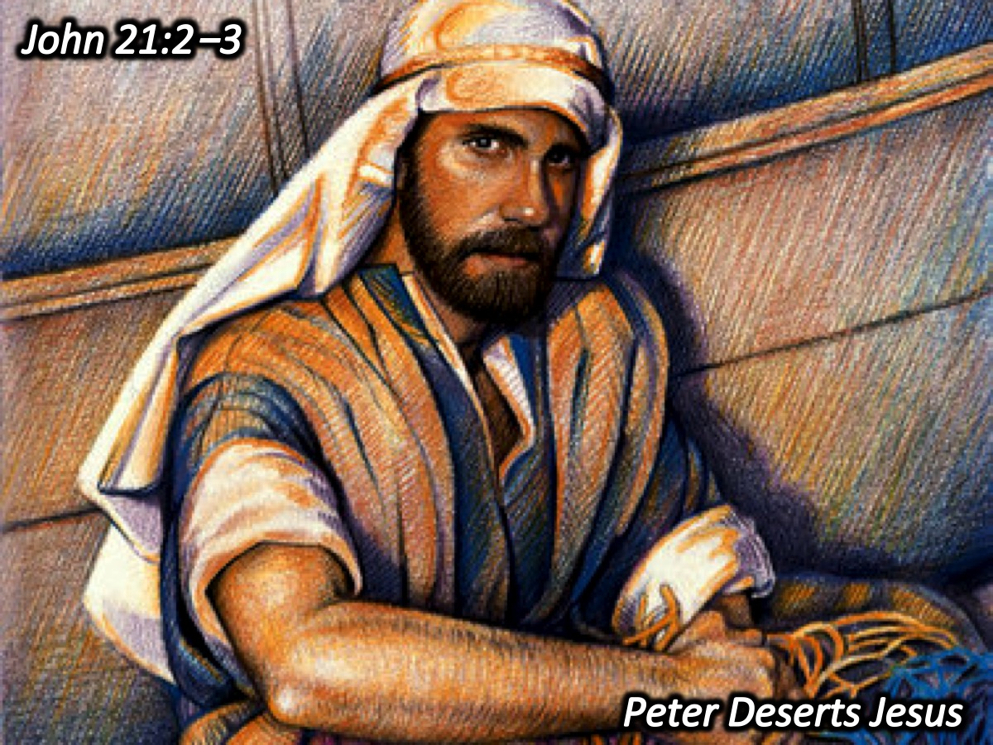
Notes:
8. Peter Deserts Jesus. "Simon Peter, Thomas, Nathanael, the sons of Zebedee, and two other disciples were together. "I'm going out to fish," Simon Peter told them, and they said, "We'll go with you." So they went out and got into the boat, but that night they caught nothing." (John 21:2‑3)

Slide 12
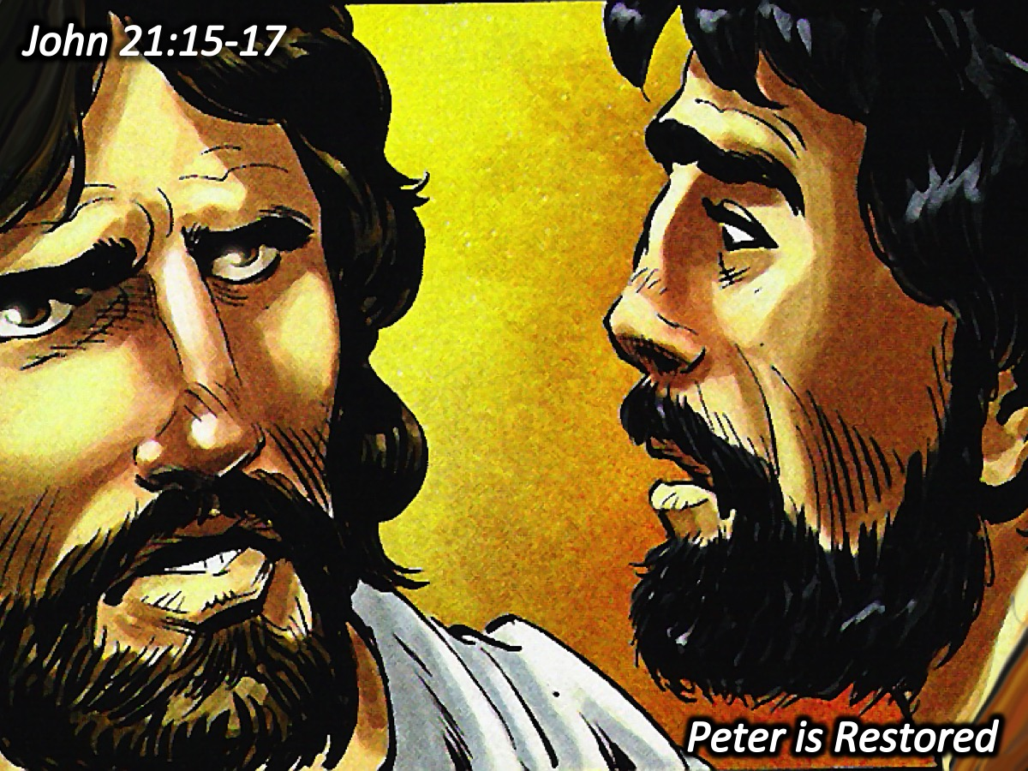
Notes:
9. Peter is Restored. When they had finished eating, Jesus said to Simon Peter, "Simon son of John, do you truly love me more than these?" "Yes, Lord," he said, "you know that I love you." Jesus said, "Feed my lambs." Again Jesus said, "Simon son of John, do you truly love me?" He answered, "Yes, Lord, you know that I love you." Jesus said, "Take care of my sheep." The third time he said to him, "Simon son of John, do you love me?" Peter was hurt because Jesus asked him the third time, "Do you love me?" He said, "Lord, you know all things; you know that I love you." Jesus said, "Feed my sheep." (John 21:15-17)

Slide 13
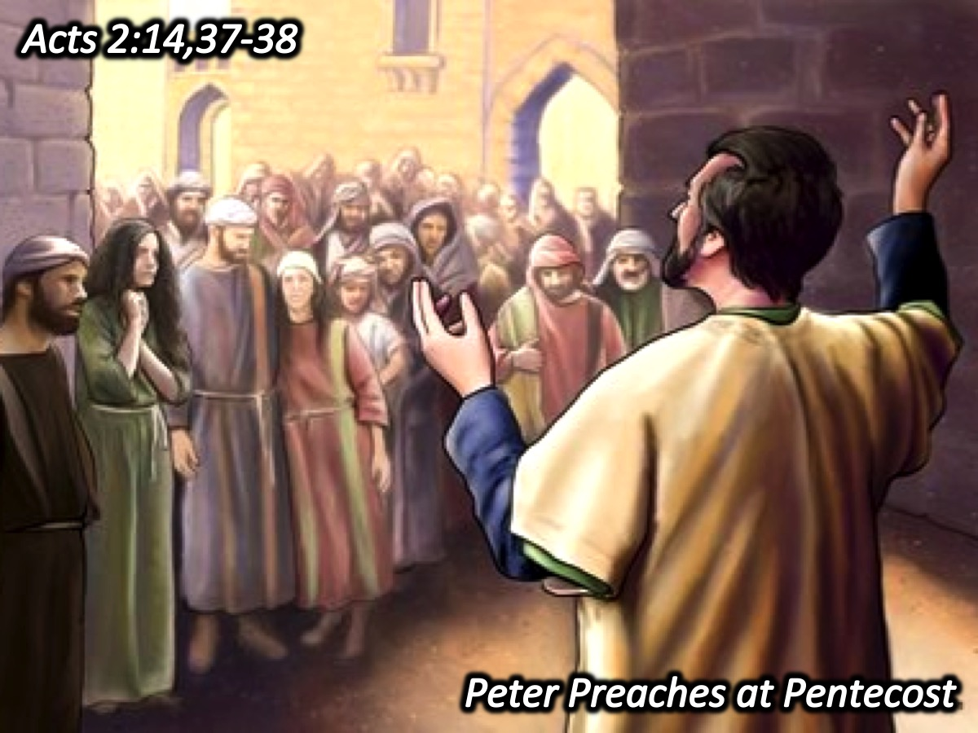
Notes:
10. Peter Preaches at Pentecost. Then Peter stood up with the Eleven, raised his voice and addressed the crowd: "Fellow Jews and all of you who live in Jerusalem, let me explain this to you; listen carefully to what I say."..."When the people heard this, they were cut to the heart and said to Peter and the other apostles, "Brothers, what shall we do?" Peter replied, "Repent and be baptized, every one of you, in the name of Jesus Christ for the forgiveness of your sins. And you will receive the gift of the Holy Spirit." (Acts 2:14, 37-38)

Slide 14
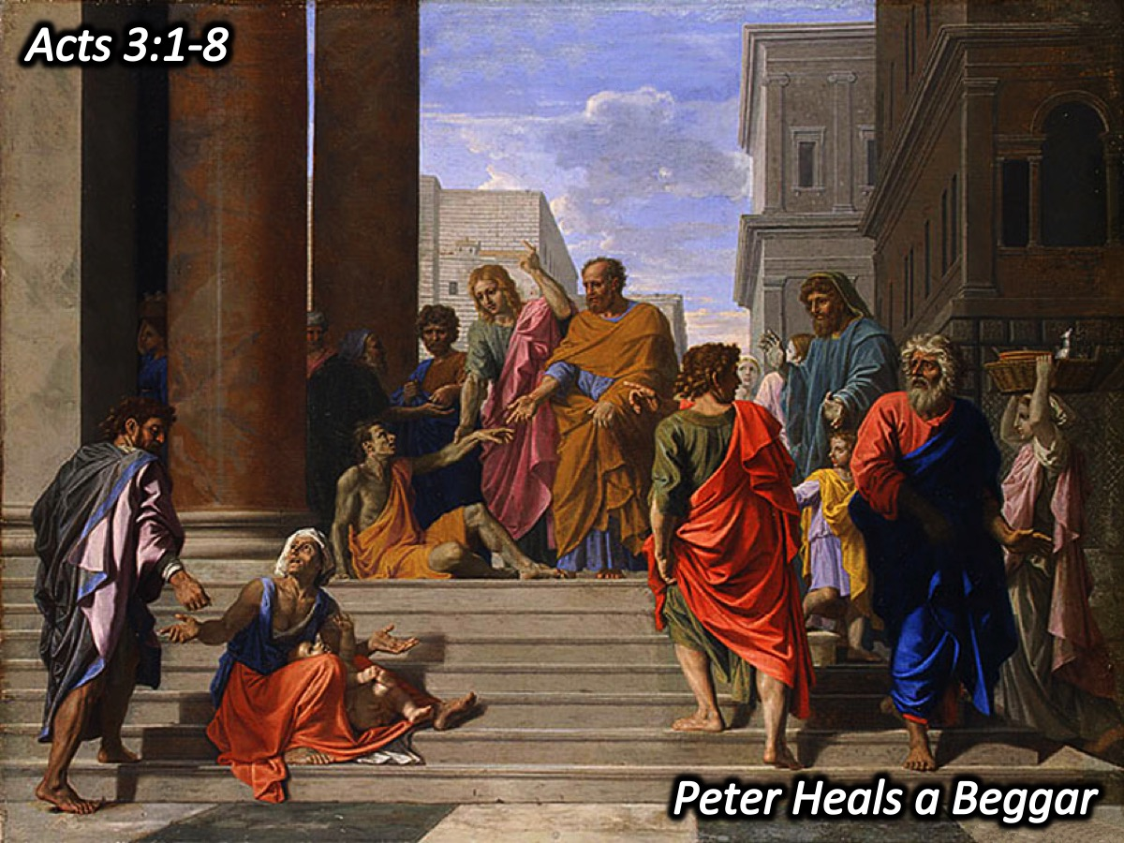
Notes:
11. Peter Heals a Beggar. One day Peter and John were going up to the temple at the time of prayer at three in the afternoon. Now a man crippled from birth was being carried to the temple gate called Beautiful, where he was put every day to beg from those going into the temple courts. When he saw Peter and John about to enter, he asked them for money. Peter looked straight at him, as did John. Then Peter said, "Look at us!" So the man gave them his attention, expecting to get something from them. Then Peter said, "Silver or gold I do not have, but what I have I give you. In the name of Jesus Christ of Nazareth, walk." Taking him by the right hand, he helped him up, and instantly the man's feet and ankles became strong. He jumped to his feet and began to walk. Then he went with them into the temple courts, walking and jumping, and praising God. (Acts 3:1-8)

Slide 15
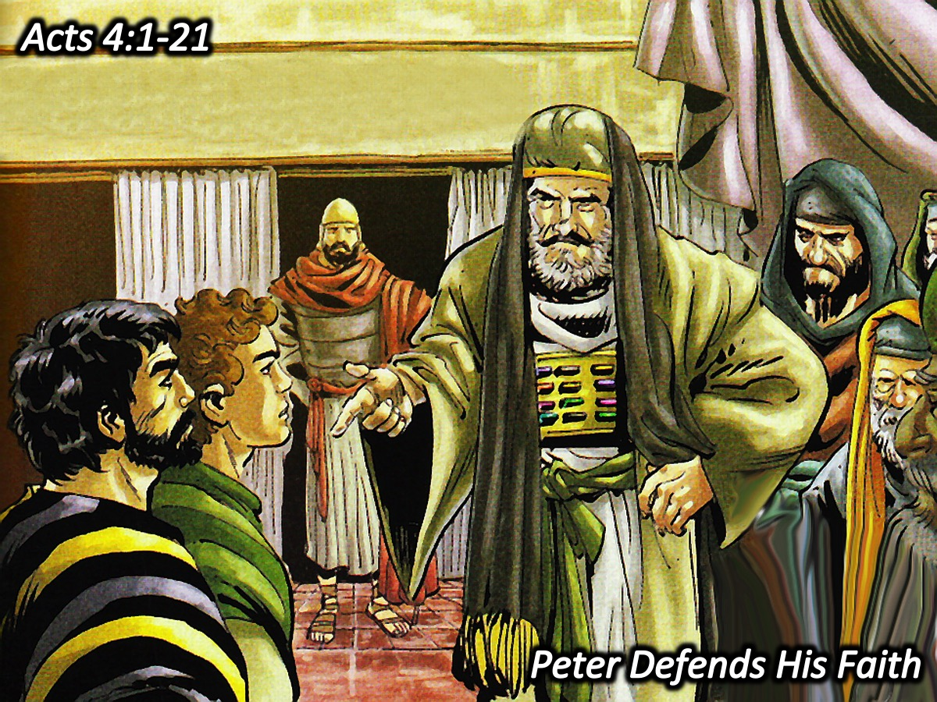
Notes:
12. Peter Defends His Faith. The priests and the captain of the temple guard and the Sadducees came up to Peter and John while they were speaking to the people. They were greatly disturbed because the apostles were teaching the people and proclaiming in Jesus the resurrection of the dead. They seized Peter and John, and because it was evening, they put them in jail until the next day. But many who heard the message believed, and the number of men grew to about five thousand. The next day the rulers, elders and teachers of the law met in Jerusalem. Annas the high priest was there, and so were Caiaphas, John, Alexander and the other men of the high priest's family. They had Peter and John brought before them and began to question them: "By what power or what name did you do this?" Then Peter, filled with the Holy Spirit, said to them: "Rulers and elders of the people! If we are being called to account today for an act of kindness shown to a cripple and are asked how he was healed, then know this, you and all the people of Israel: It is by the name of Jesus Christ of Nazareth, whom you crucified but whom God raised from the dead, that this man stands before you healed. He is "'the stone you builders rejected, which has become the capstone.' Salvation is found in no one else, for there is no other name under heaven given to men by which we must be saved." When they saw the courage of Peter and John and realized that they were unschooled, ordinary men, they were astonished and they took note that these men had been with Jesus. But since they could see the man who had been healed standing there with them, there was nothing they could say. So they ordered them to withdraw from the Sanhedrin and then conferred together. "What are we going to do with these men?" they asked. "Everybody living in Jerusalem knows they have done an outstanding miracle, and we cannot deny it. But to stop this thing from spreading any further among the people, we must warn these men to speak no longer to anyone in this name." Then they called them in again and commanded them not to speak or teach at all in the name of Jesus. But Peter and John replied, "Judge for yourselves whether it is right in God's sight to obey you rather than God. For we cannot help speaking about what we have seen and heard." After further threats they let them go. They could not decide how to punish them, because all the people were praising God for what had happened." (Acts 4:1-21)

Slide 16
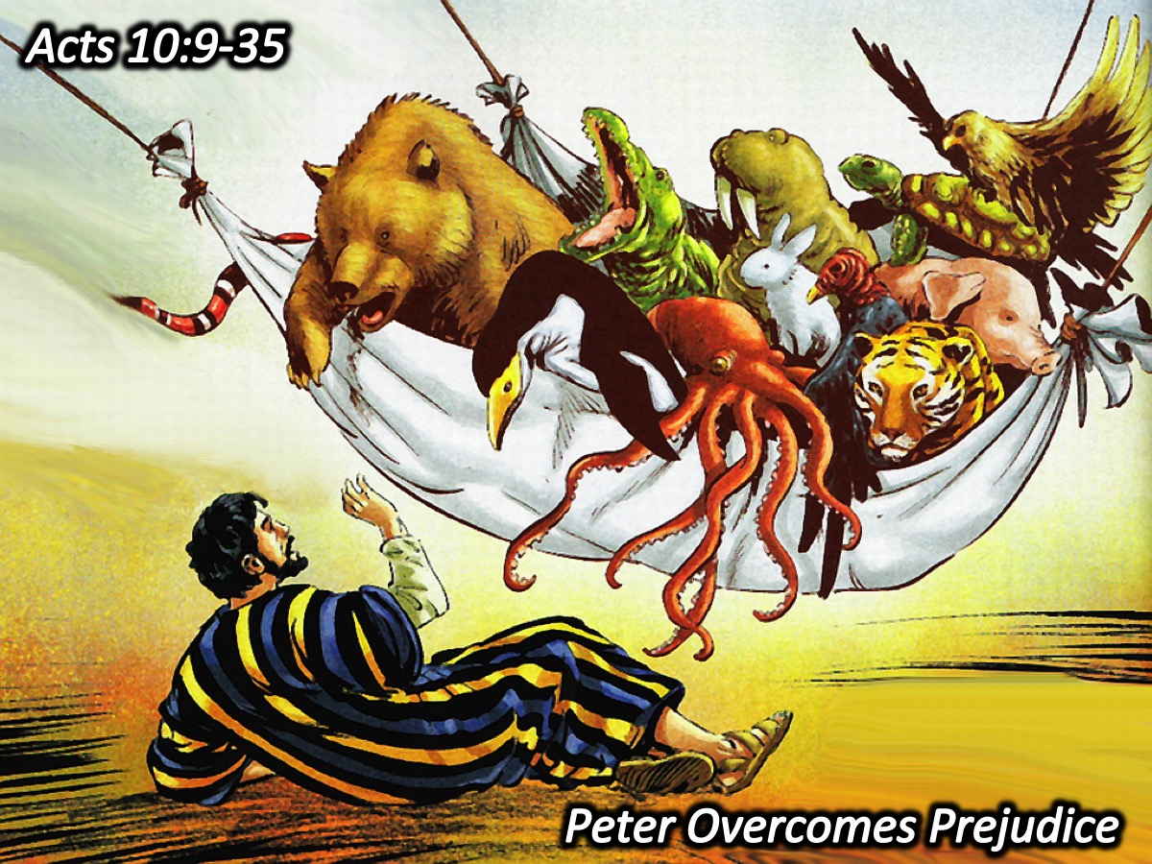
Notes:
13. Peter Overcomes Prejudices. About noon the following day as they were on their journey and approaching the city, Peter went up on the roof to pray. He became hungry and wanted something to eat, and while the meal was being prepared, he fell into a trance. He saw heaven opened and something like a large sheet being let down to earth by its four corners. It contained all kinds of four footed animals, as well as reptiles of the earth and birds of the air. Then a voice told him, "Get up, Peter. Kill and eat." "Surely not, Lord!" Peter replied. "I have never eaten anything impure or unclean." The voice spoke to him a second time, "Do not call anything impure that God has made clean." This happened three times, and immediately the sheet was taken back to heaven. While Peter was wondering about the meaning of the vision, the men sent by Cornelius found out where Simon's house was and stopped at the gate. They called out, asking if Simon who was known as Peter was staying there. While Peter was still thinking about the vision, the Spirit said to him, "Simon, three men are looking for you. So get up and go downstairs. Do not hesitate to go with them, for I have sent them." Peter went down and said to the men, "I'm the one you're looking for. Why have you come?" The men replied, "We have come from Cornelius the centurion. He is a righteous and God fearing man, who is respected by all the Jewish people. A holy angel told him to have you come to his house so that he could hear what you have to say." Then Peter invited the men into the house to be his guests. The next day Peter started out with them, and some of the brothers from Joppa went along. The following day he arrived in Caesarea. Cornelius was expecting them and had called together his relatives and close friends. As Peter entered the house, Cornelius met him and fell at his feet in reverence. But Peter made him get up. "Stand up," he said, "I am only a man myself." Talking with him, Peter went inside and found a large gathering of people. He said to them: "You are well aware that it is against our law for a Jew to associate with a Gentile or visit him. But God has shown me that I should not call any man impure or unclean. So when I was sent for, I came without raising any objection. May I ask why you sent for me?" Cornelius answered: "Four days ago I was in my house praying at this hour, at three in the afternoon. Suddenly a man in shining clothes stood before me and said, 'Cornelius, God has heard your prayer and remembered your gifts to the poor. Send to Joppa for Simon who is called Peter. He is a guest in the home of Simon the tanner, who lives by the sea.' So I sent for you immediately, and it was good of you to come. Now we are all here in the presence of God to listen to everything the Lord has commanded you to tell us." Then Peter began to speak: "I now realize how true it is that God does not show favoritism but accepts men from every nation who fear him and do what is right." (Acts 10:9-35)

Slide 17
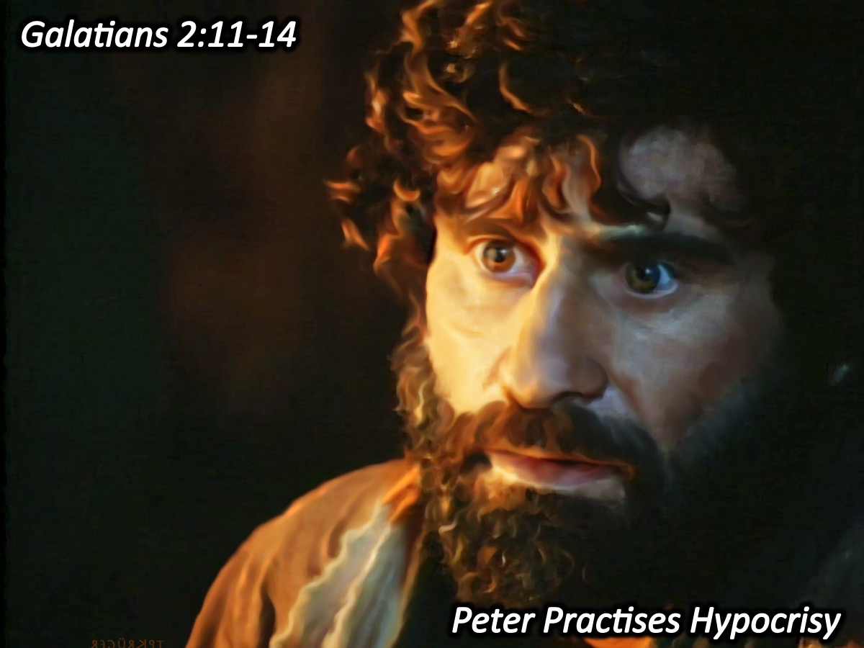
Notes:
14. Peter Practises Hypocrisy. "When Peter came to Antioch, I opposed him to his face, because he was clearly in the wrong. Before certain men came from James, he used to eat with the Gentiles. But when they arrived, he began to draw back and separate himself from the Gentiles because he was afraid of those who belonged to the circumcision group. The other Jews joined him in his hypocrisy, so that by their hypocrisy even Barnabas was led astray. When I saw that they were not acting in line with the truth of the gospel, I said to Peter in front of them all, "You are a Jew, yet you live like a Gentile and not like a Jew. How is it, then, that you force Gentiles to follow Jewish customs?“ (Galatians 2:11-14)

Slide 18
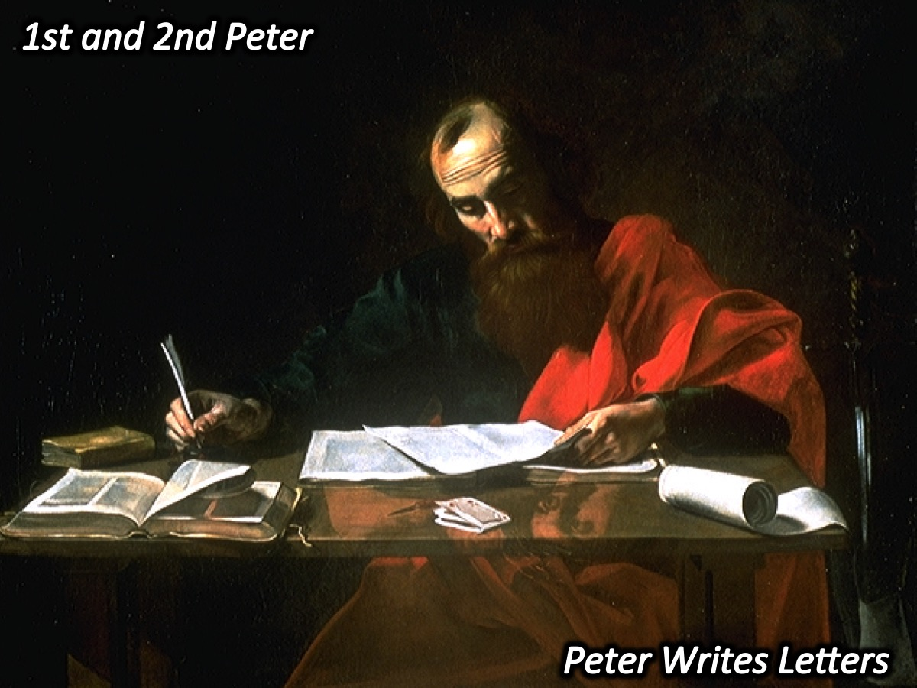
Notes:
15. Peter Writes Letters (1 & 2 Peter)

Slide 19
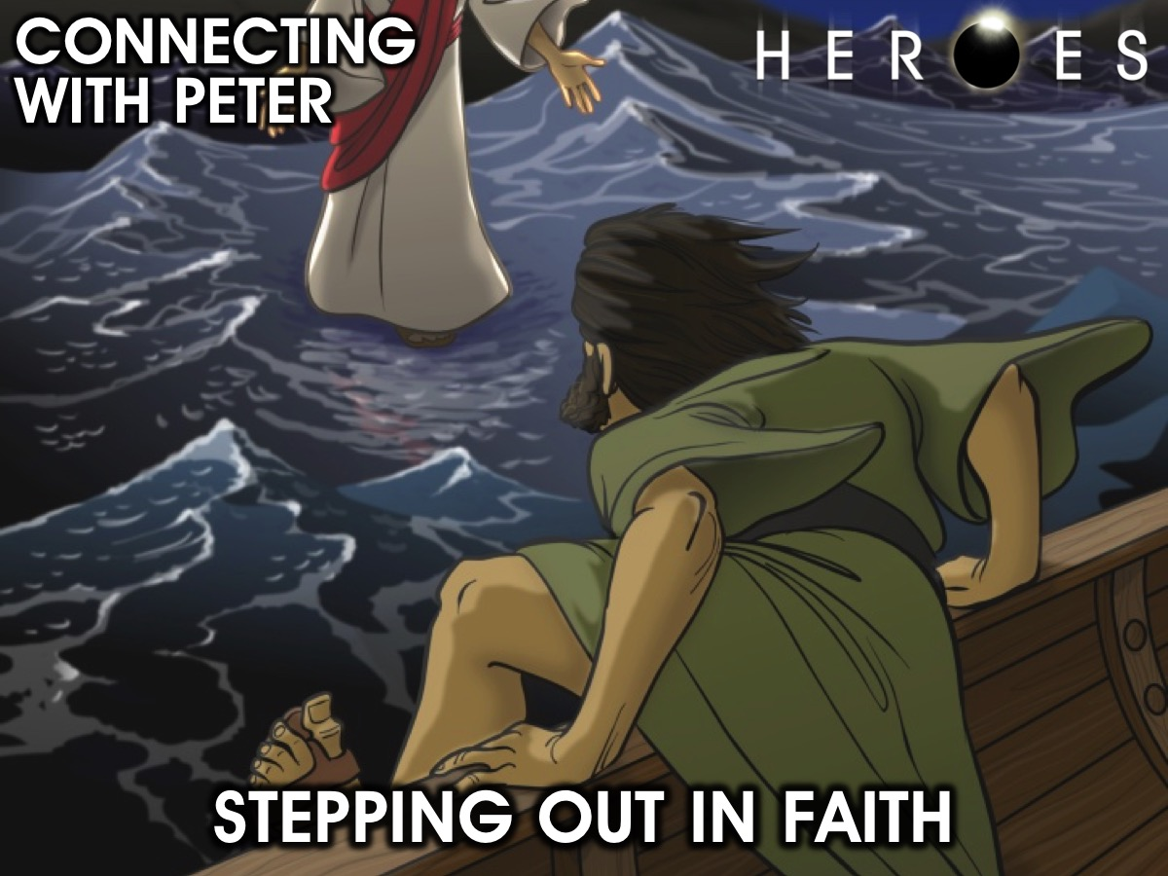
Notes:
Connecting with Peter: Stepping Out in Faith

Slide 20
Notes:
Video: Walking on Water from the Son of God movie. Get it on YouTube at: https://www.youtube.com/watch?v=ONeM2X309I8

Slide 21
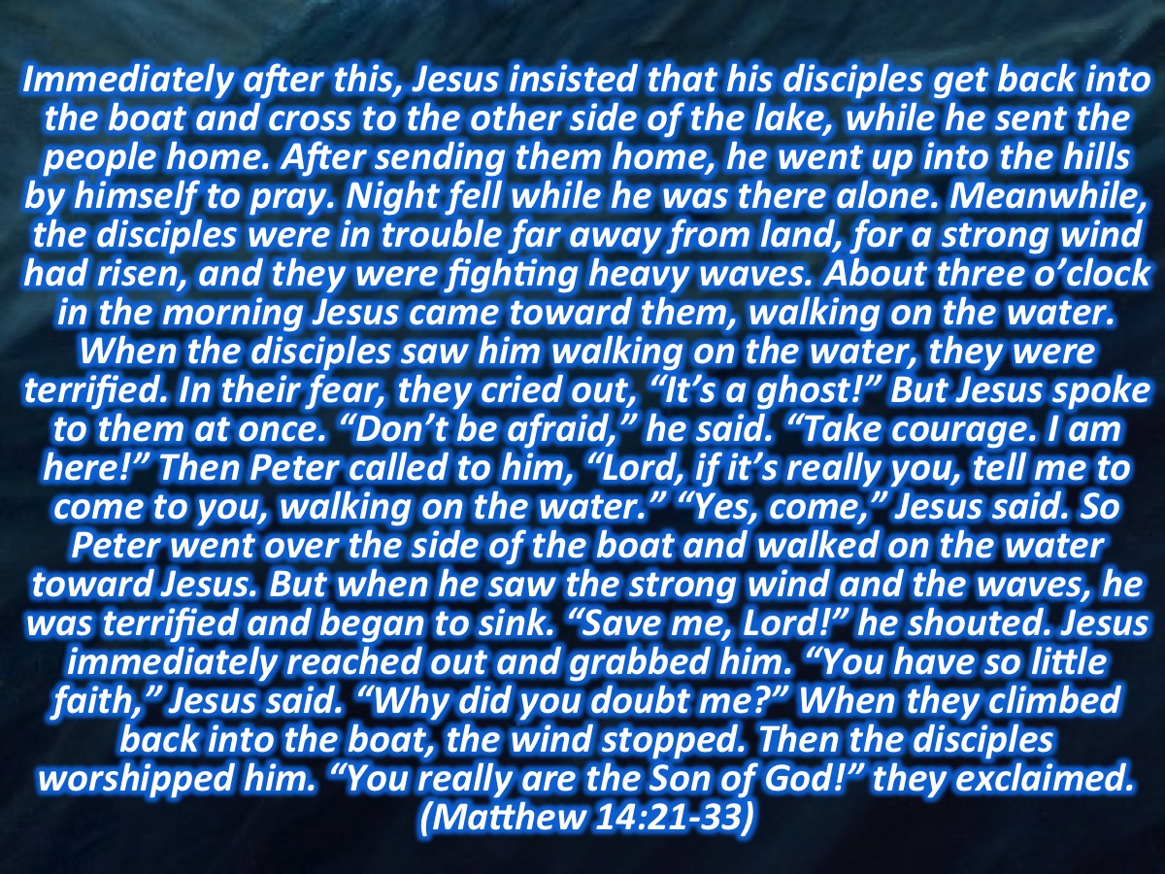
Notes:
Scripture: Immediately after this, Jesus insisted that his disciples get back into the boat and cross to the other side of the lake, while he sent the people home. After sending them home, he went up into the hills by himself to pray. Night fell while he was there alone. Meanwhile, the disciples were in trouble far away from land, for a strong wind had risen, and they were fighting heavy waves. About three o’clock in the morning Jesus came toward them, walking on the water. When the disciples saw him walking on the water, they were terrified. In their fear, they cried out, “It’s a ghost!” But Jesus spoke to them at once. “Don’t be afraid,” he said. “Take courage. I am here!” Then Peter called to him, “Lord, if it’s really you, tell me to come to you, walking on the water.” “Yes, come,” Jesus said. So Peter went over the side of the boat and walked on the water toward Jesus. But when he saw the strong wind and the waves, he was terrified and began to sink. “Save me, Lord!” he shouted. Jesus immediately reached out and grabbed him. “You have so little faith,” Jesus said. “Why did you doubt me?” When they climbed back into the boat, the wind stopped. Then the disciples worshipped him. “You really are the Son of God!” they exclaimed. (Matthew 14:21-33)

Slide 22
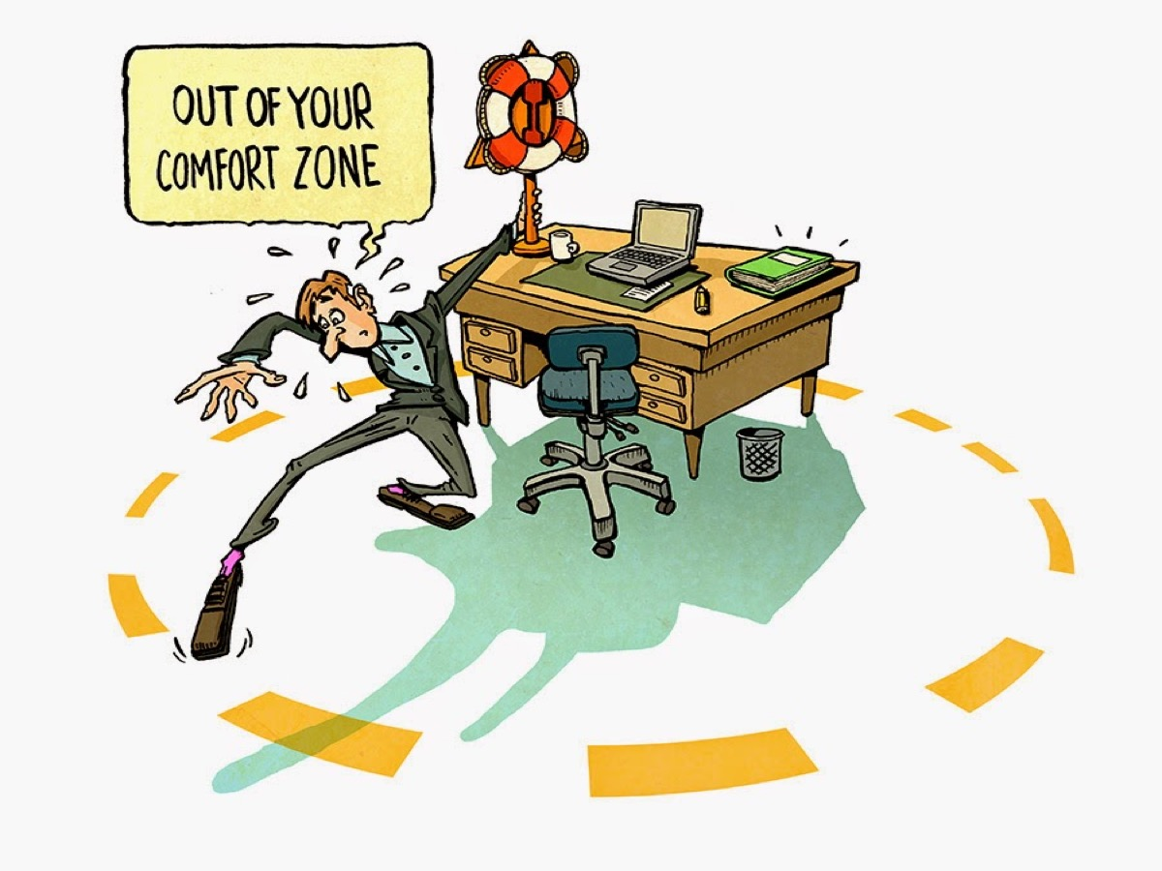
Notes:
Stepping out of your comfort zone.

Slide 23
Notes:
Video: Too Much Planning - Step Out In Faith. Get it on YouTube at: http://www.youtube.com/watch?v=IPqkHpg-ZJo

Slide 24
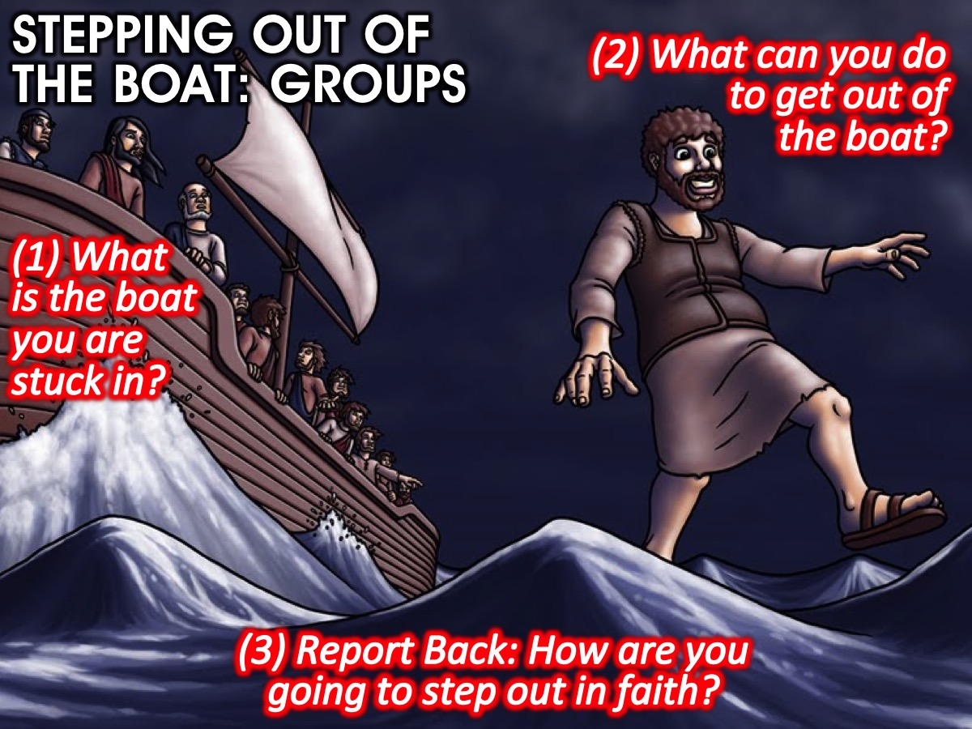
Notes:
Interactive Activity: Stepping out of the boat. Get into groups. In your group identify the boat that you're stuck in. It may be comfort, fear, or addiction, etc. Perhaps it's something that is not explicitly bad like media or your friends? Share with your group what you're planning to do to get out of this boat. After the group discussions get one brave person from each group to come up and share with everyone what they're planning to do to step out in faith.

Slide 25
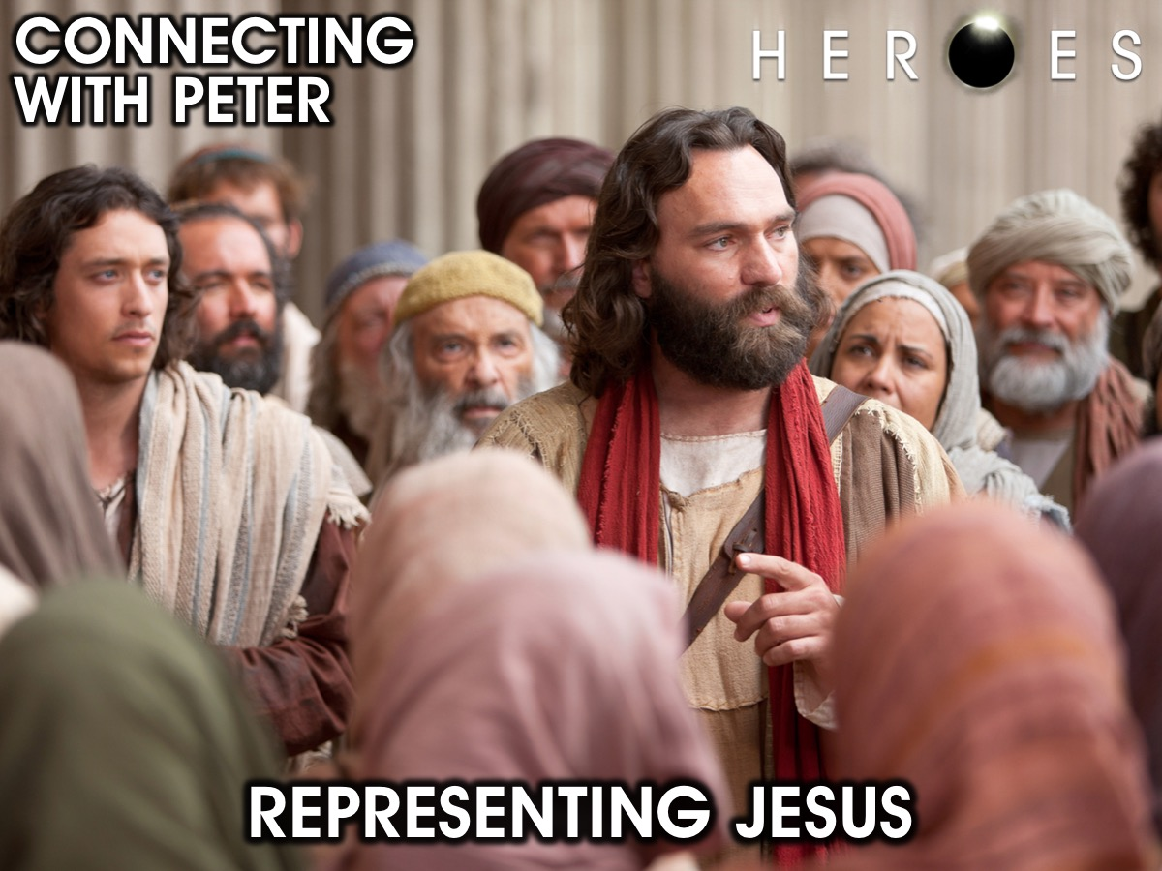
Notes:
Representing Jesus (Kenan)

Slide 26
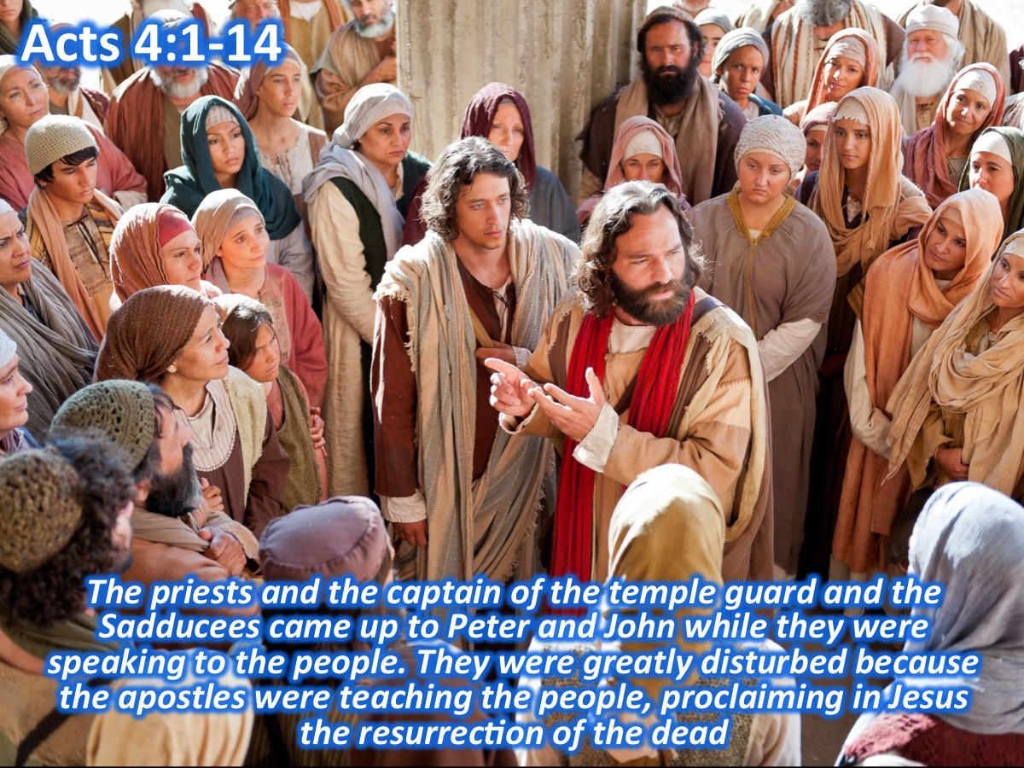
Notes:
Scripture: The priests and the captain of the temple guard and the Sadducees came up to Peter and John while they were speaking to the people. They were greatly disturbed because the apostles were teaching the people, proclaiming in Jesus the resurrection of the dead.

Slide 27
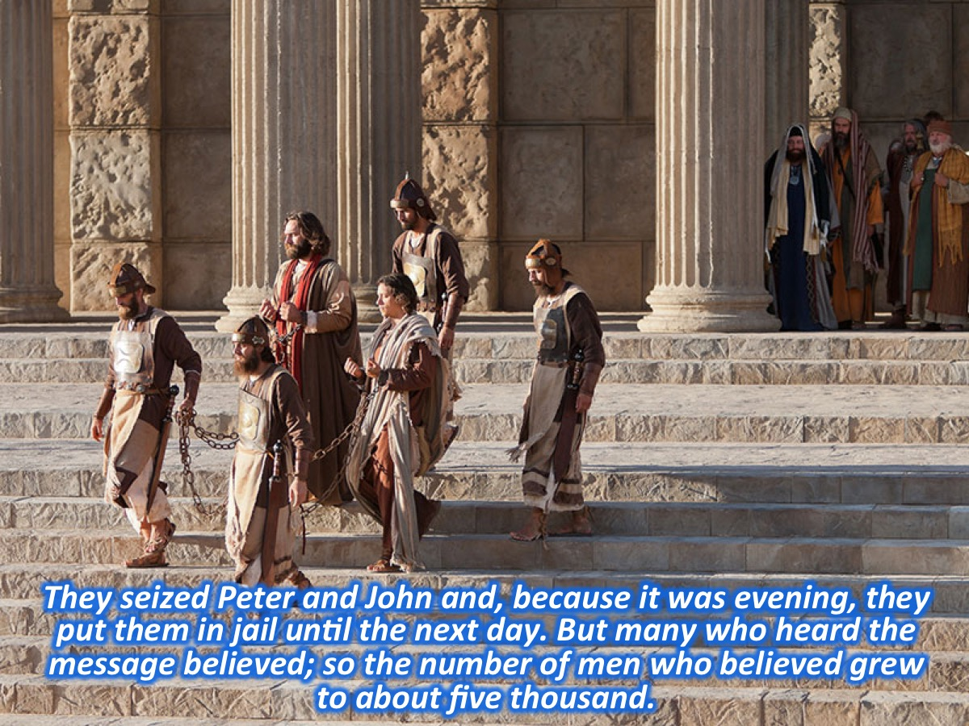
Notes:
They seized Peter and John and, because it was evening, they put them in jail until the next day. But many who heard the message believed; so the number of men who believed grew to about five thousand.

Slide 28
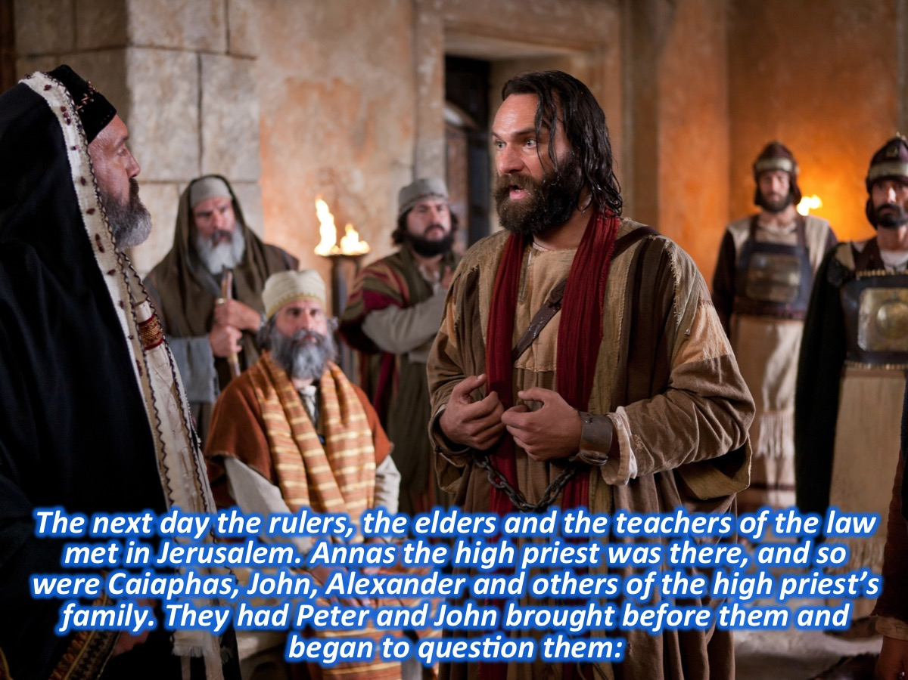
Notes:
The next day the rulers, the elders and the teachers of the law met in Jerusalem. Annas the high priest was there, and so were Caiaphas, John, Alexander and others of the high priest’s family. They had Peter and John brought before them and began to question them:

Slide 29
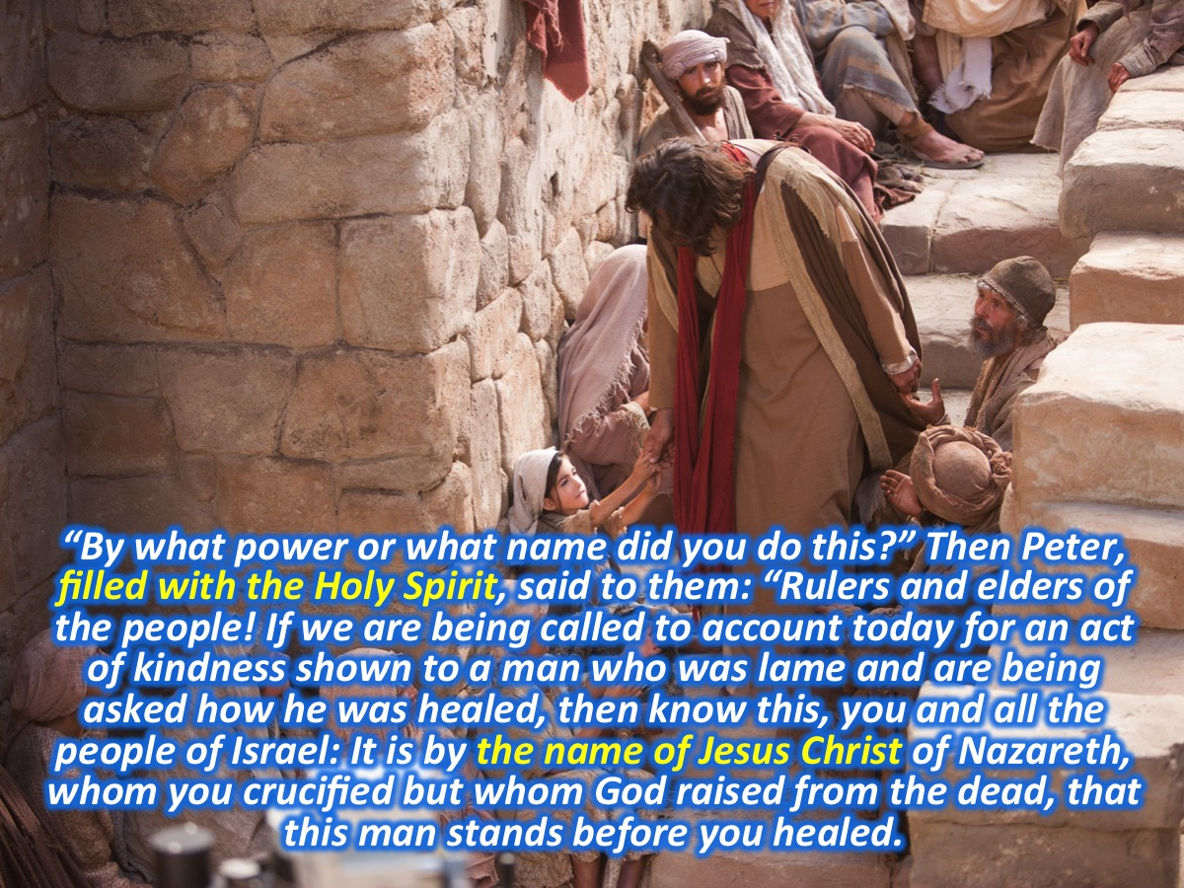
Notes:
“By what power or what name did you do this?” Then Peter, filled with the Holy Spirit, said to them: “Rulers and elders of the people! If we are being called to account today for an act of kindness shown to a man who was lame and are being asked how he was healed, then know this, you and all the people of Israel: It is by the name of Jesus Christ of Nazareth, whom you crucified but whom God raised from the dead, that this man stands before you healed.

Slide 30
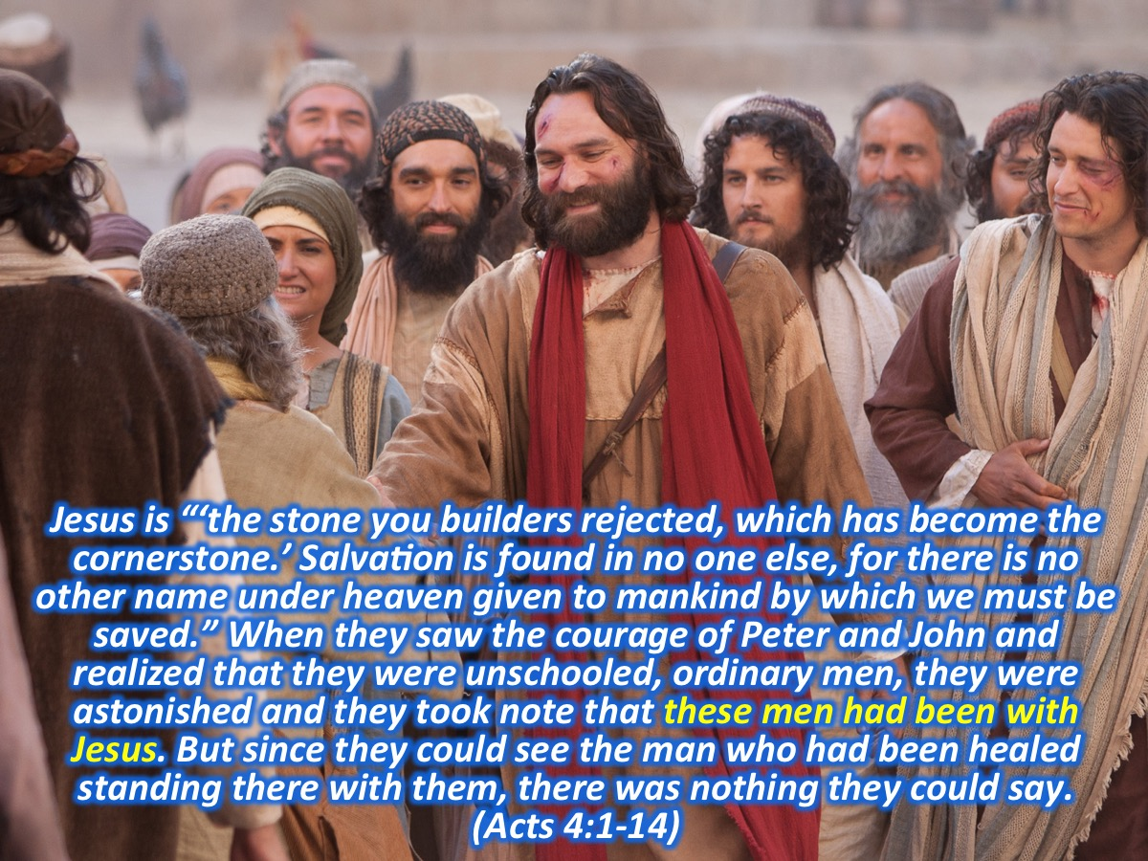
Notes:
Jesus is “‘the stone you builders rejected, which has become the cornerstone.’ Salvation is found in no one else, for there is no other name under heaven given to mankind by which we must be saved.” When they saw the courage of Peter and John and realized that they were unschooled, ordinary men, they were astonished and they took note that these men had been with Jesus. But since they could see the man who had been healed standing there with them, there was nothing they could say. (Acts 4:1-14)

Slide 31
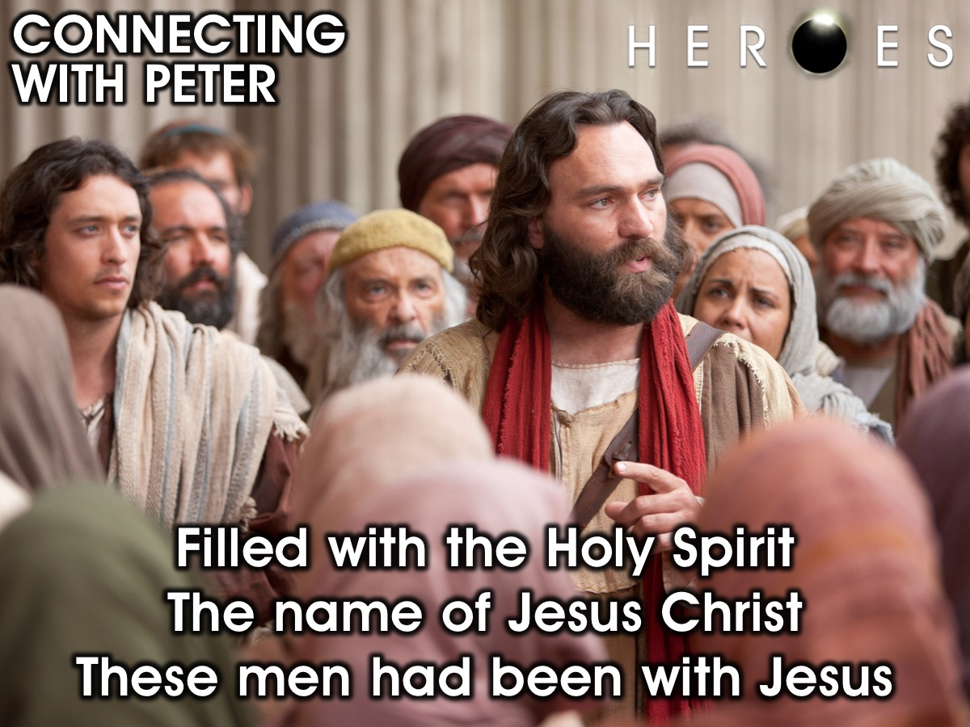
Notes:
So how does this passage apply to our lives in the 21st Century? Let’s look again at three key phrases in the passage: (1) Filled with the Holy Spirit: God empowered Peter to stand against the elders to represent Jesus. The Holy Spirit gives us boldness! We need to be filled with the spirit. He makes us zealous and passionate. (2) The name of Jesus Christ – Peter used the name of Jesus. He gave Jesus all the credit. It takes courage to do this and not be politically correct. He did not filter his faith down. There is power and authority in Jesus. Things change and mountains move when we speak the name of Jesus. (3) These men had been with Jesus - Peter and John spent time with Jesus. They were able to represent Jesus because they knew him and had spent time with him. Get into the word and we will find courage. Don't neglect time spent in his presence. We must have a relationship with Jesus. Challenge: What are we doing to represent Jesus in our city or schools? We must bring Jesus to people who need to be fixed!

Slide 32
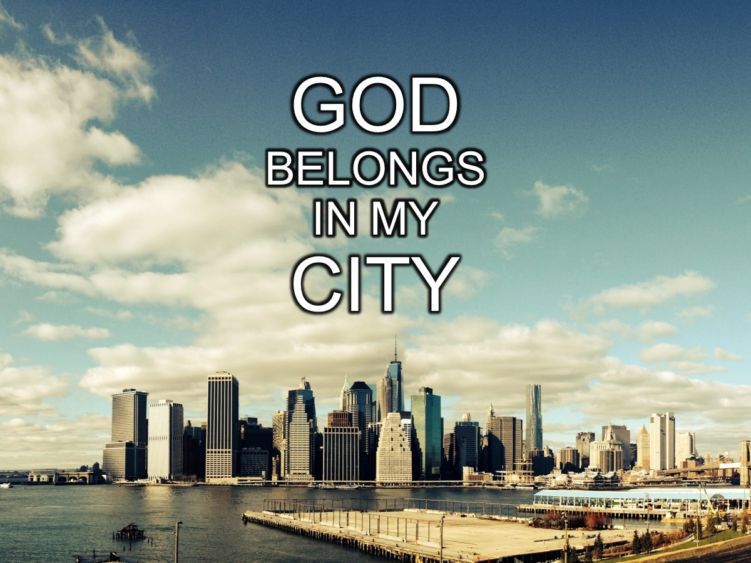
Notes:
The “God Belongs in My City” Movement

Slide 33
Notes:
Video: God Belongs in My City (GBIMC NYC PROMO 2014). Get it on YouTube at: https://www.youtube.com/watch?v=v98pDRIniaY

Slide 34
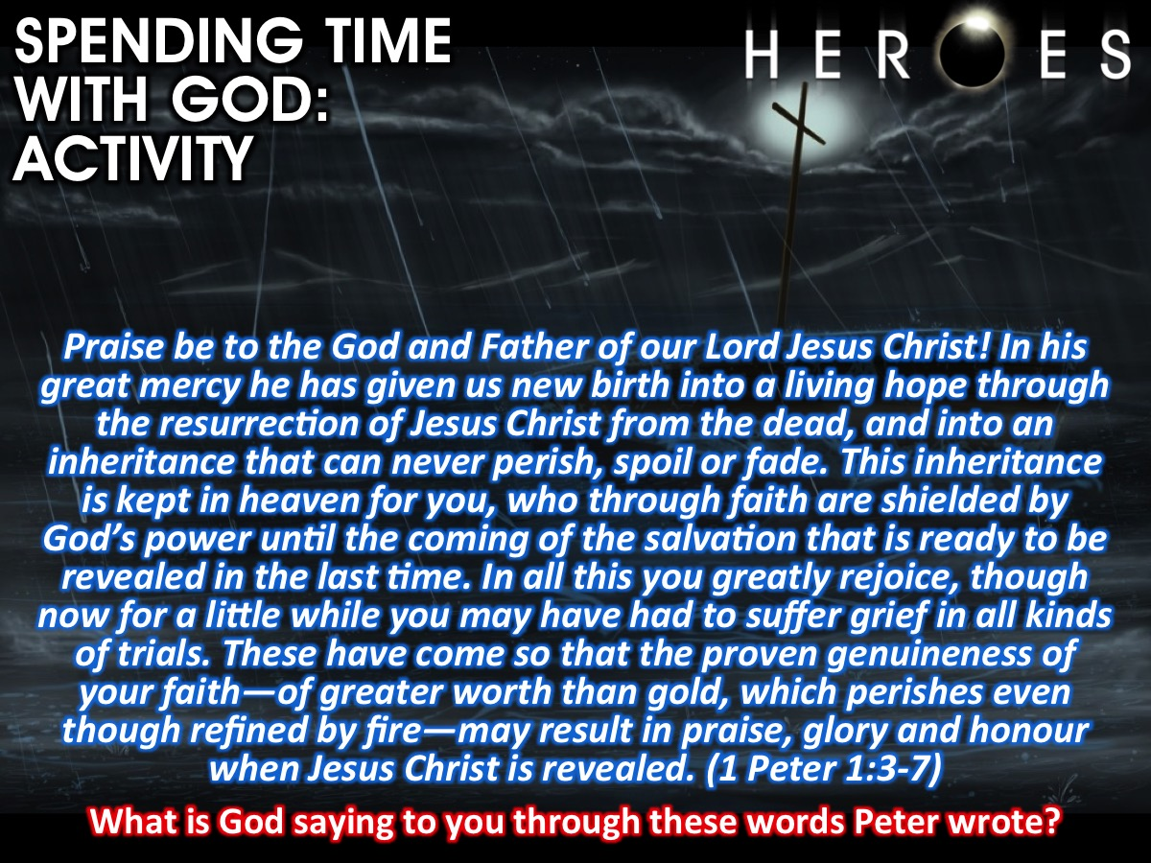
Notes:
Interactive Activity: Spending time with God. (1) Read this Scripture: Praise be to the God and Father of our Lord Jesus Christ! In his great mercy he has given us new birth into a living hope through the resurrection of Jesus Christ from the dead, and into an inheritance that can never perish, spoil or fade. This inheritance is kept in heaven for you, who through faith are shielded by God’s power until the coming of the salvation that is ready to be revealed in the last time. In all this you greatly rejoice, though now for a little while you may have had to suffer grief in all kinds of trials. These have come so that the proven genuineness of your faith—of greater worth than gold, which perishes even though refined by fire—may result in praise, glory and honour when Jesus Christ is revealed. (1 Peter 1:3-7)
(2) Answer this Question: What is God saying to you through these words Peter wrote?
Note: Each person is given a handout.

Slide 35
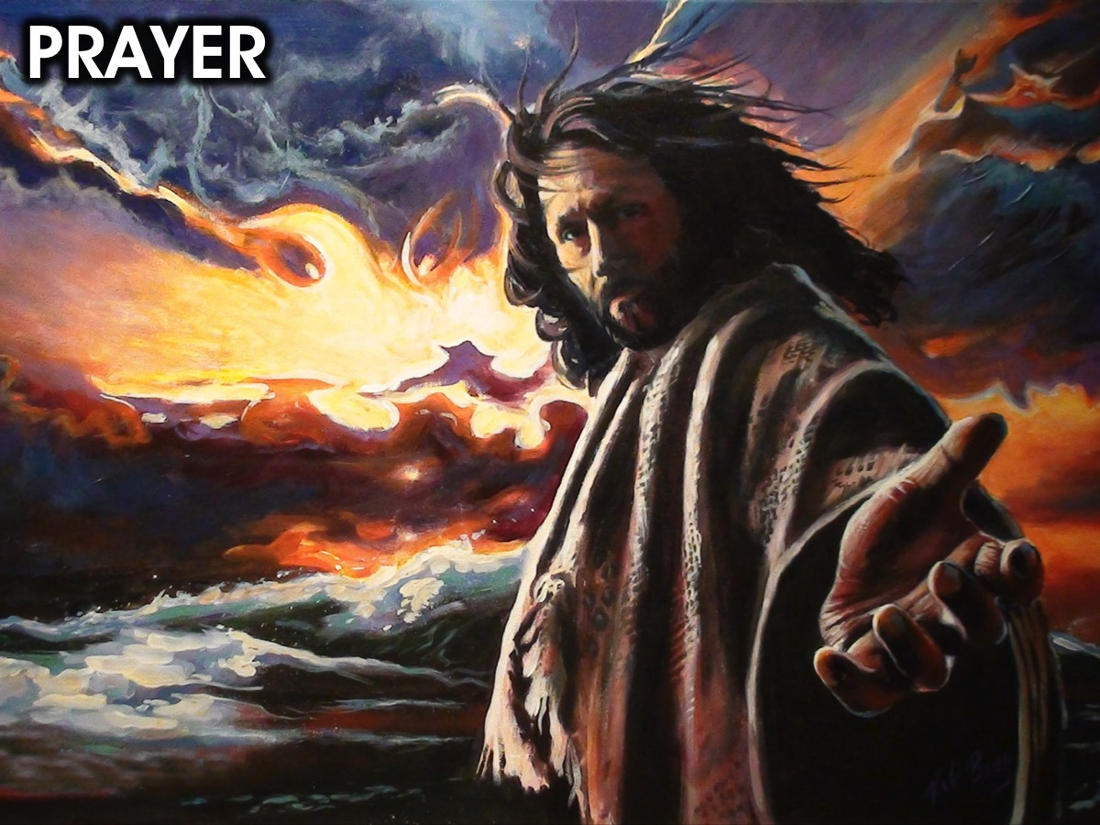
Notes:
Prayer

Slide 36
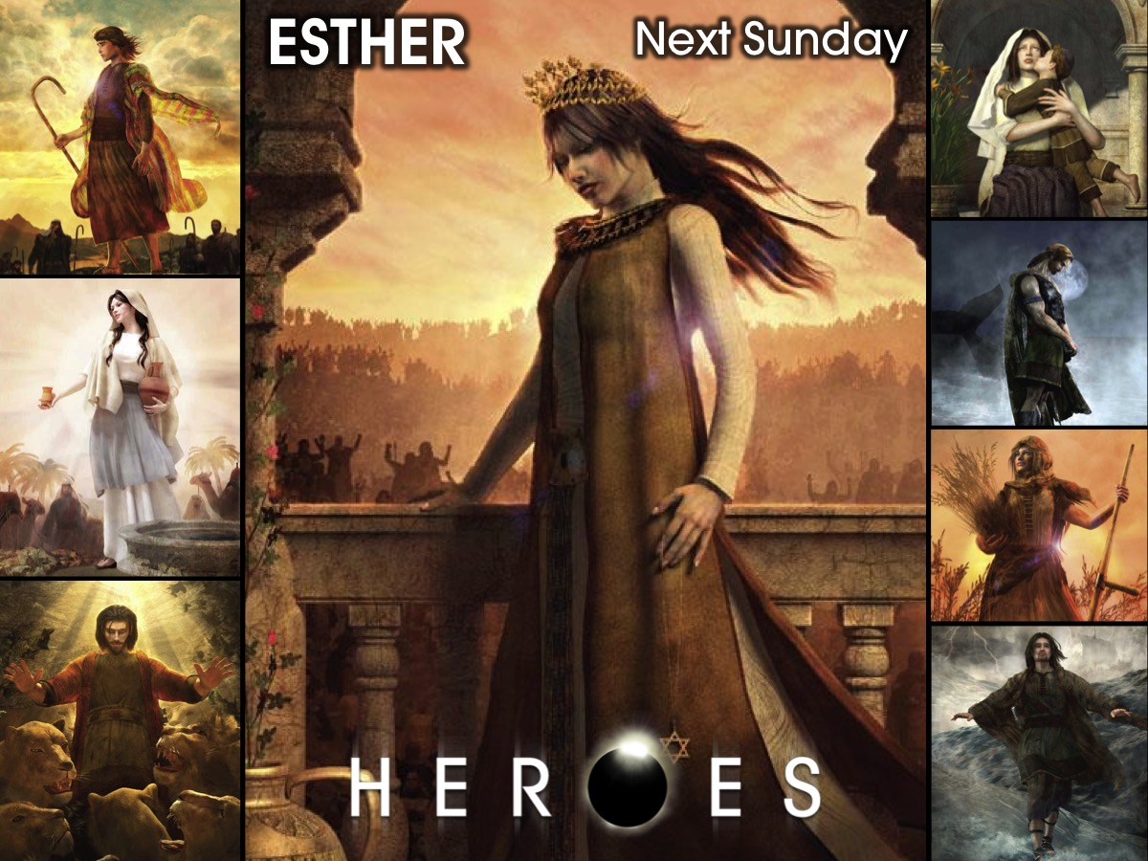
Notes:
Next week we are going to look at the life of Esther.

