Slide 1
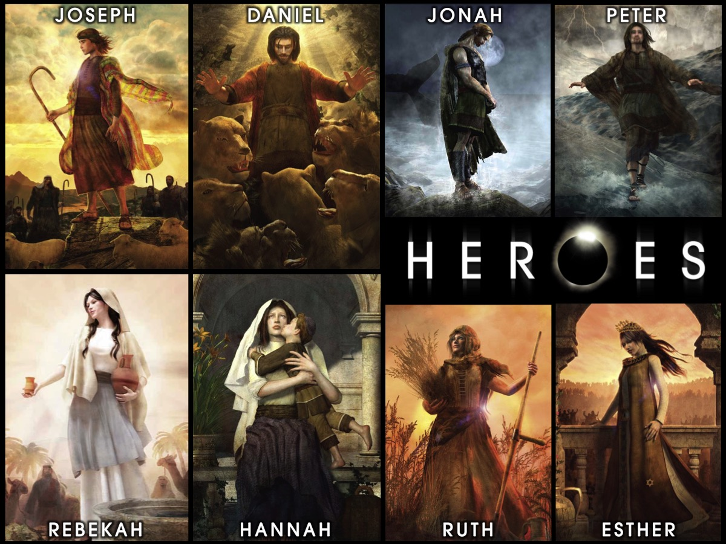
Notes:
Welcome to our Heroes Series on Sunday mornings at His Youth.

Slide 2
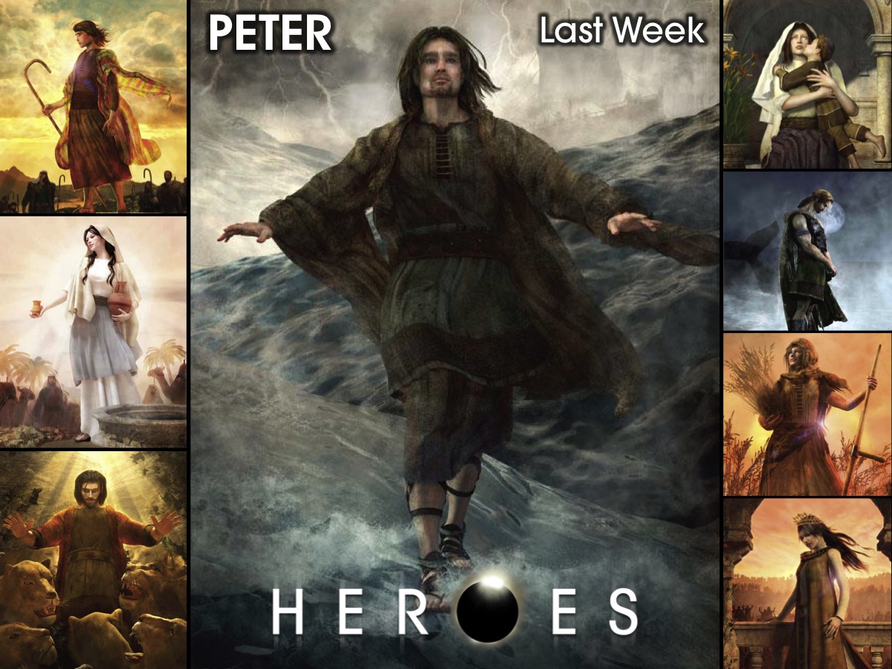
Notes:
Last week we looked at the life of Peter.

Slide 3
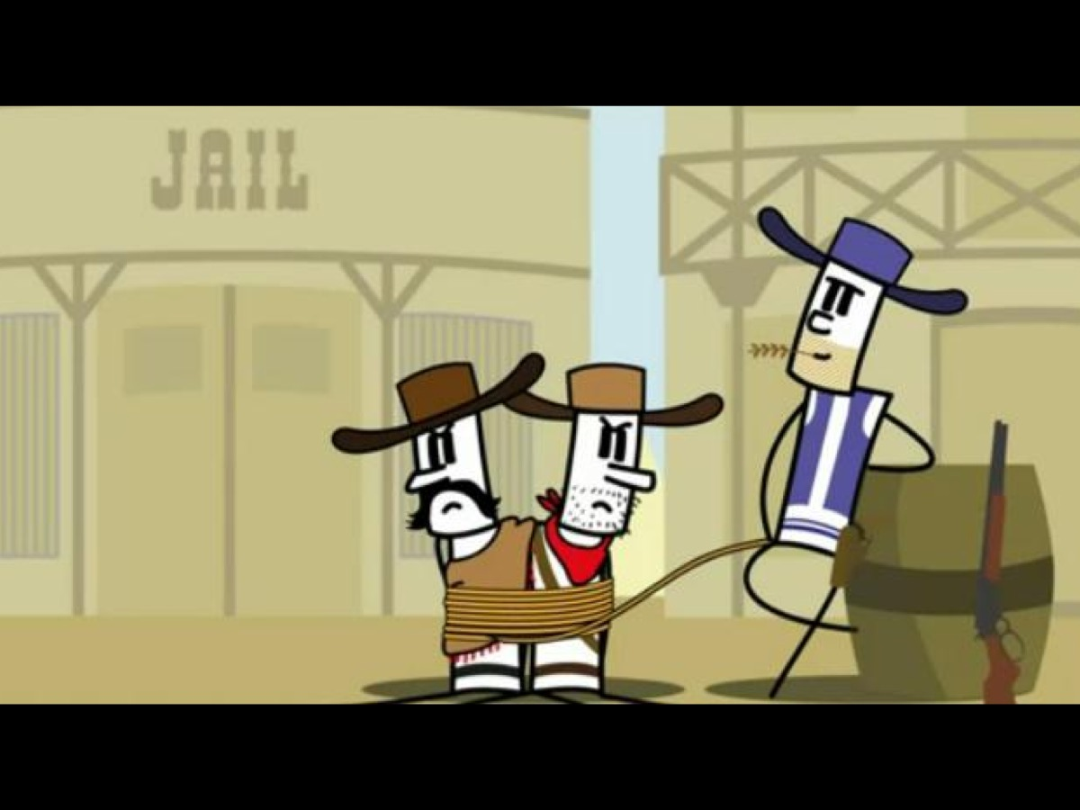
Notes:
But first a little movie – a Western!

Slide 4
Notes:
Video: The Book of Esther Goes Western. Get it on YouTube at: https://www.youtube.com/watch?v=UMIEFlwzj5s

Slide 5
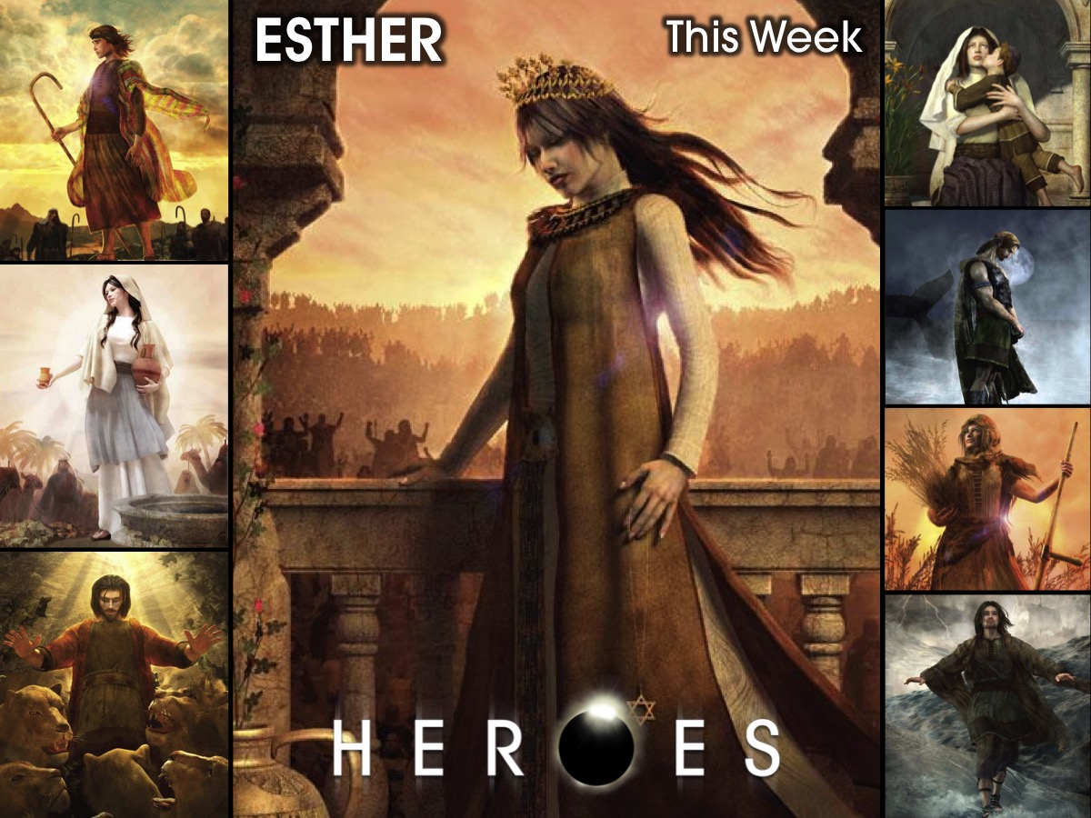
Notes:
This week we are going to look at the life of Esther.

Slide 6
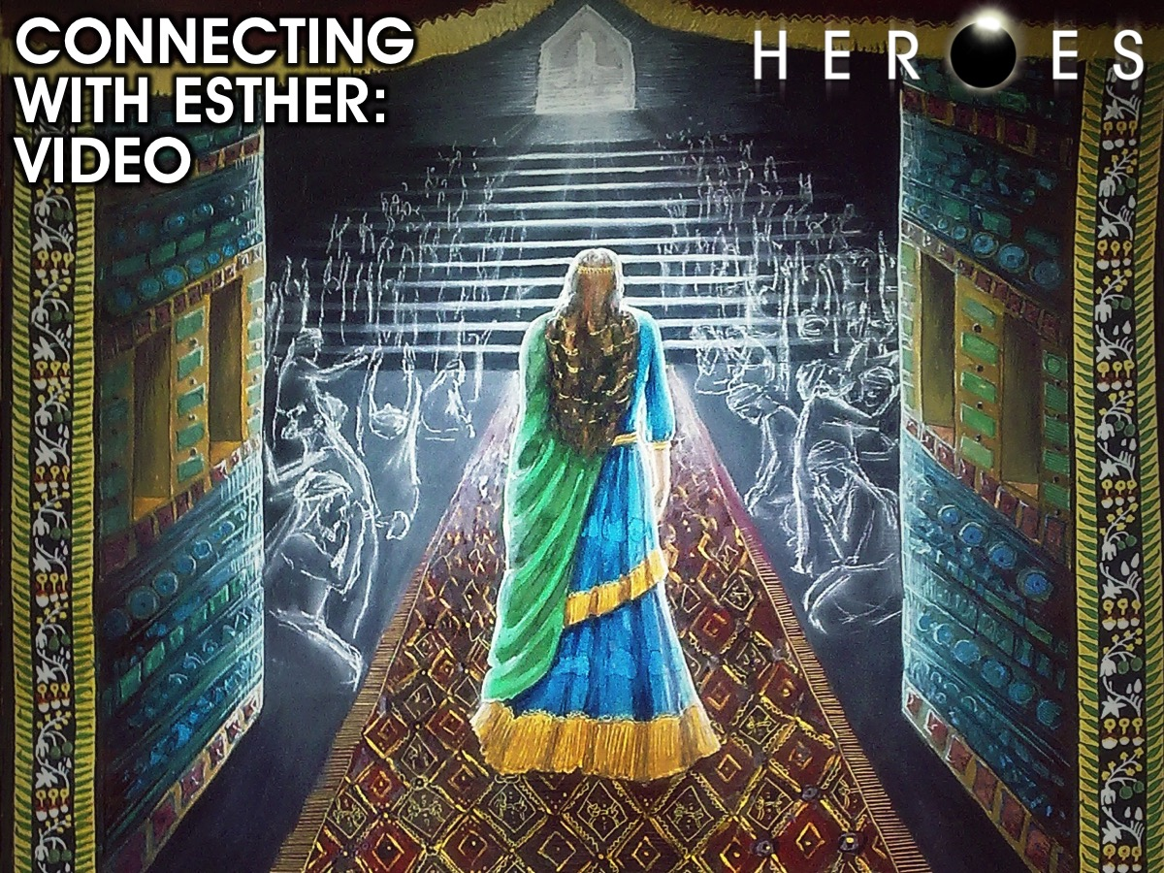
Notes:
Connecting with Esther: Video

Slide 7
Notes:
Video: Esther Bible Story. Get it on YouTube at: https://www.youtube.com/watch?v=QOPgxCeg0ow

Slide 8
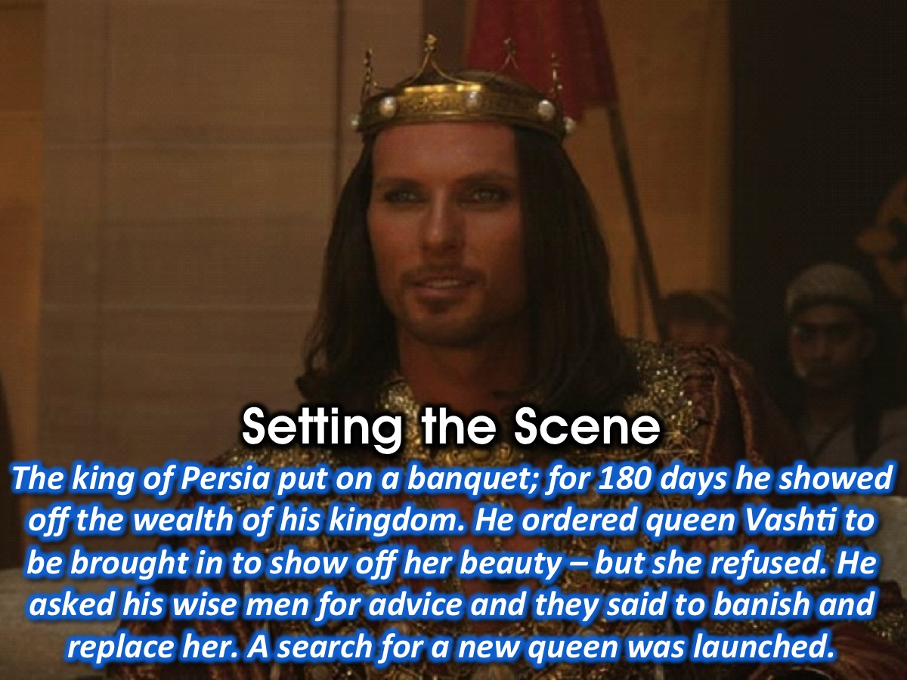
Notes:
Setting the Scene: The king of Persia, Xerxes, in the third year of his reign put on a banquet for his nobles and officials. For 180 days he showed off the wealth and splendour of his kingdom. After this he had a more private banquet for people in the citadel. On the 7th day he ordered his queen, Vashti, to be brought in to show off her beauty – but she refused and the king was furious. He asked his wise men what he should do and they advised him to banish her from his presence and to find a new queen. The king’s attendants proposed that a search should be made for beautiful young virgins for the king – so the equivalent of the Nokia Face of Africa competition was launched in the kingdom. The likely candidates would be given beauty treatments and the girl who most pleased the king would be made queen instead of Vashti.

Slide 9
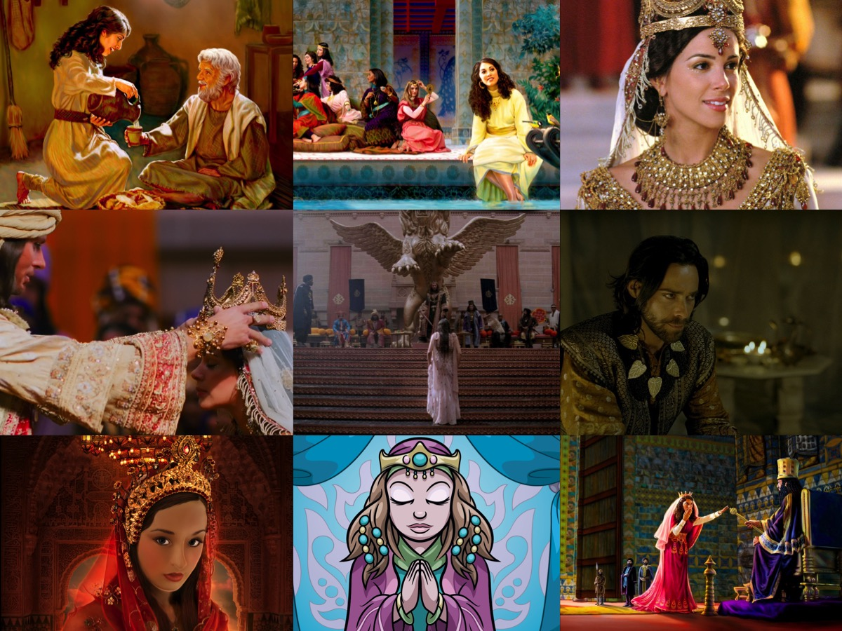
Notes:
So around the room there are 9 different images that reflect key scenes in the story.

Slide 10
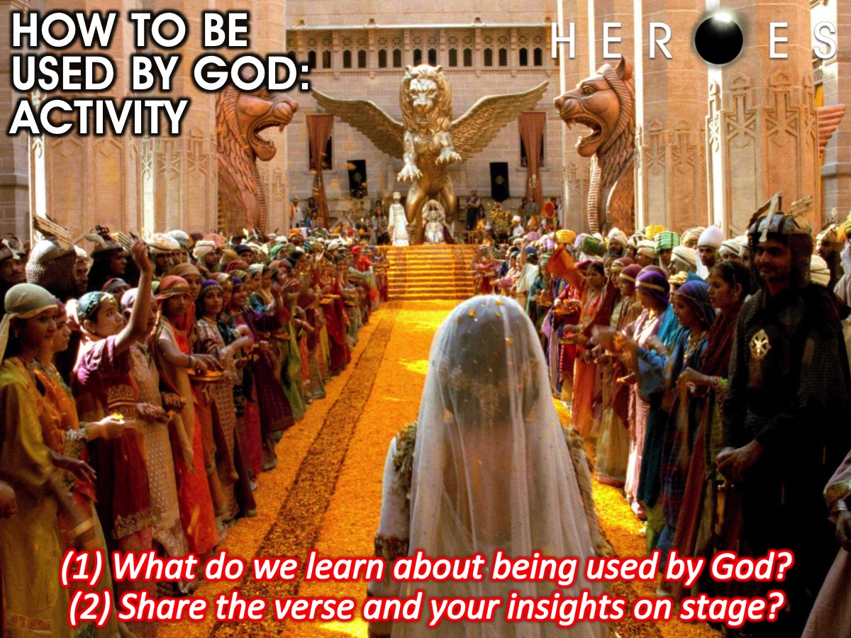
Notes:
How to be used by God: Activity. You are going to divide up into small groups and each group will look at one of the pictures on the wall and read the Scriptures and the notes that go with it – to and figure out what we need to do to be used by God. You will then discuss it in you group and send one person to share what you discovered with the big group.

Slide 11
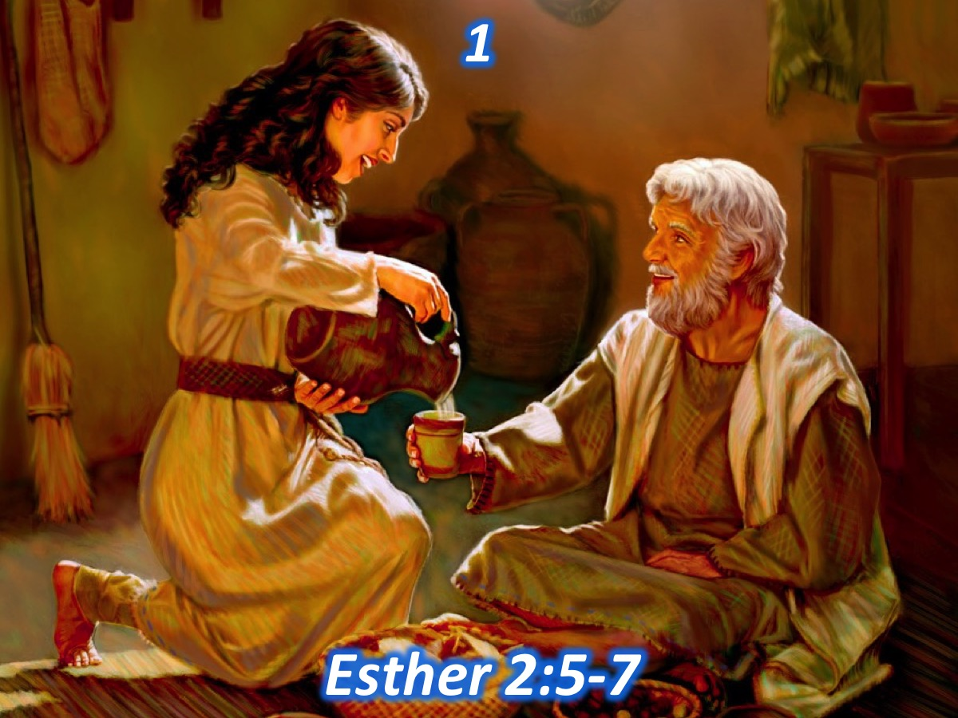
Notes:
Pic #1: Esther was an orphan, a Jew and living in exile in a foreign land. “Now there was in the citadel of Susa a Jew of the tribe of Benjamin, named Mordecai, who had been carried into exile from Jerusalem by Nebuchadnezzar king of Babylon. Mordecai had a cousin named Hadassah, whom he had brought up because she had neither father nor mother. This young woman, who was also known as Esther, had a lovely figure and was beautiful. Mordecai had taken her as his own daughter when her father and mother died.” (Esther 2:5-7)

Slide 12
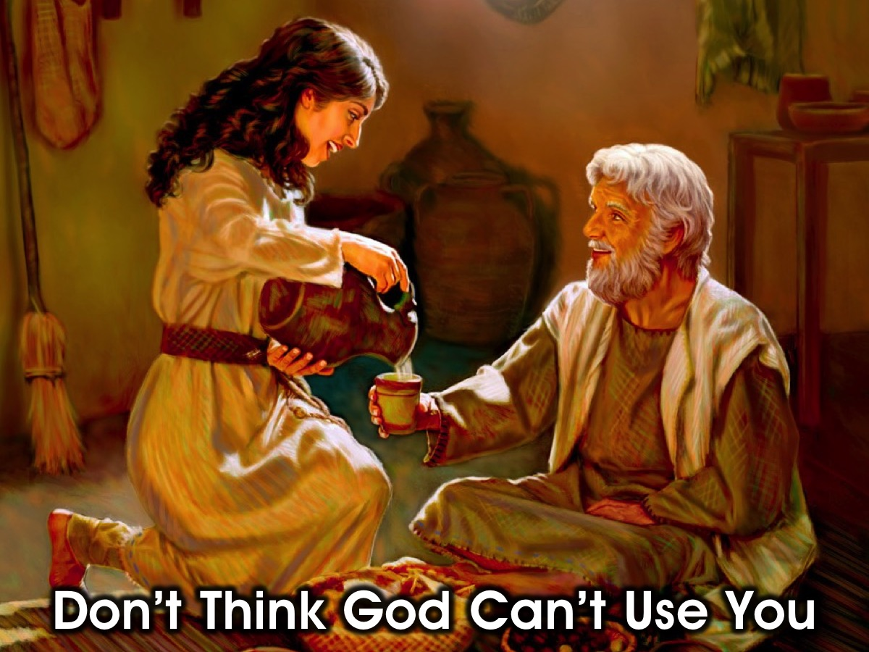
Notes:
1. Don’t Think God Can’t Use You (Look Past Your Inabilities and Failings: Esther was an orphan, a Jew and living in exile in a foreign land)

Slide 13
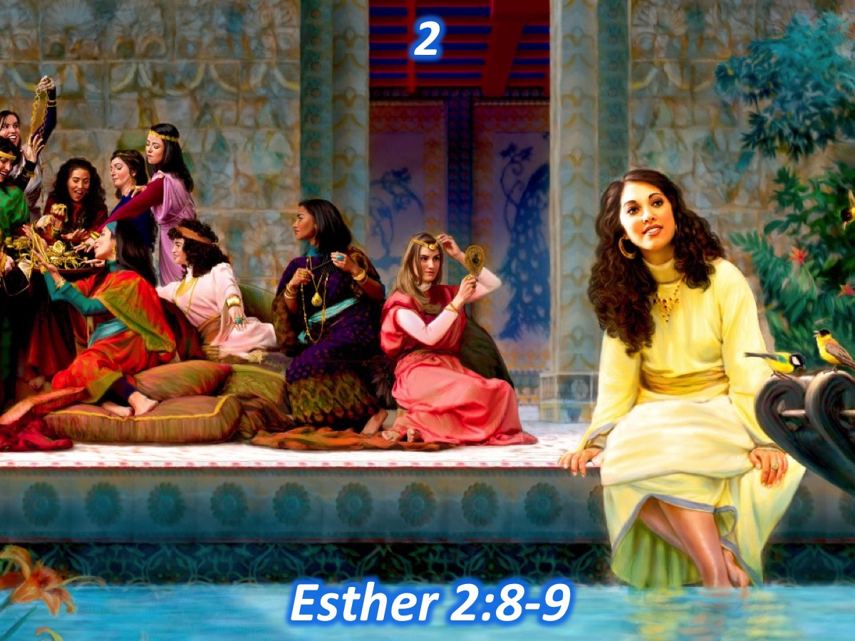
Notes:
Pic #2: Esther spent a year preparing – it was a time of personal transformation. “Many young women were brought to the citadel of Susa. Esther also was taken to the king’s palace and entrusted to Hegai, who had charge of the harem. She pleased him and won his favour. Immediately he provided her with her beauty treatments and special food. He assigned to her seven female attendants selected from the king’s palace and moved her and her attendants into the best place in the harem.” (Esther 2:8-9)

Slide 14
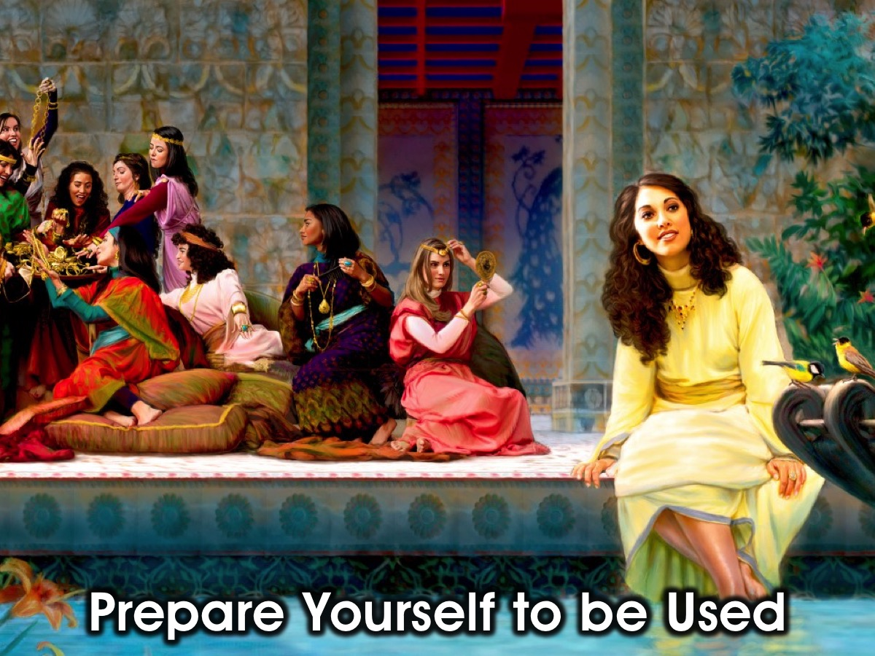
Notes:
2. Prepare Yourself to be Used by God (Embrace a Period of Preparation: Esther spent a year preparing – it was a time of personal transformation)

Slide 15
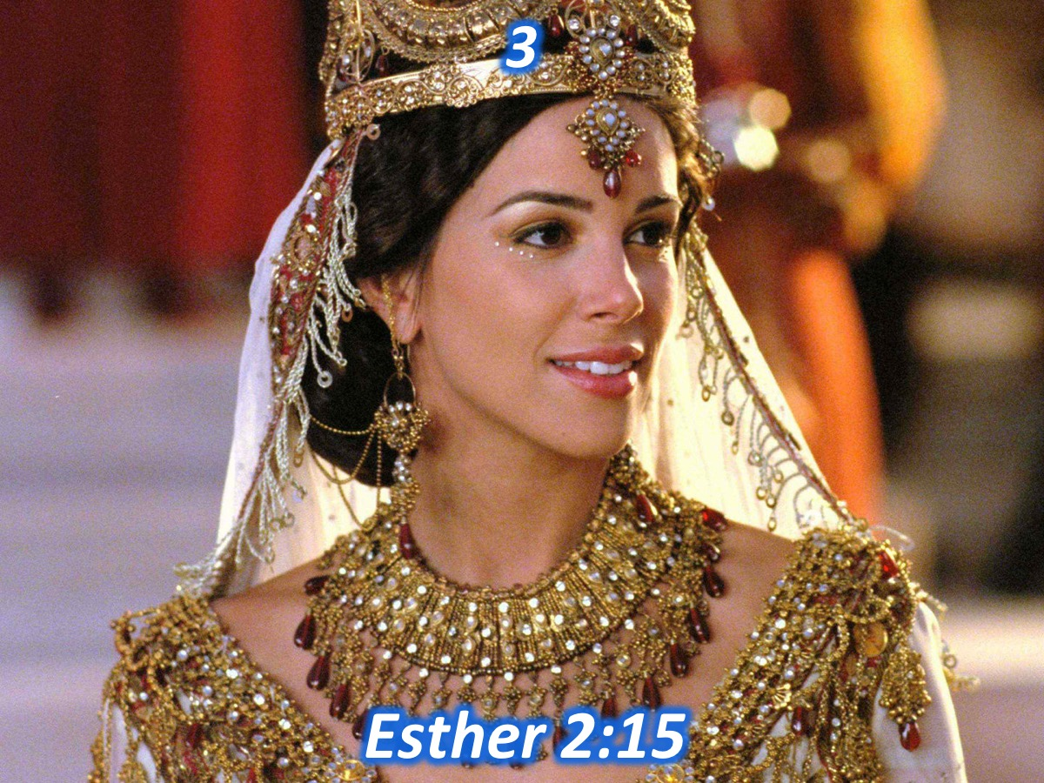
Notes:
Pic #3: Esther wanted the king’s presence more than his presents. “When the turn came for Esther to go to the king, she asked for nothing other than what Hegai, the king’s eunuch who was in charge of the harem, suggested. And Esther won the favour of everyone who saw her.” (Esther 2:15)

Slide 16
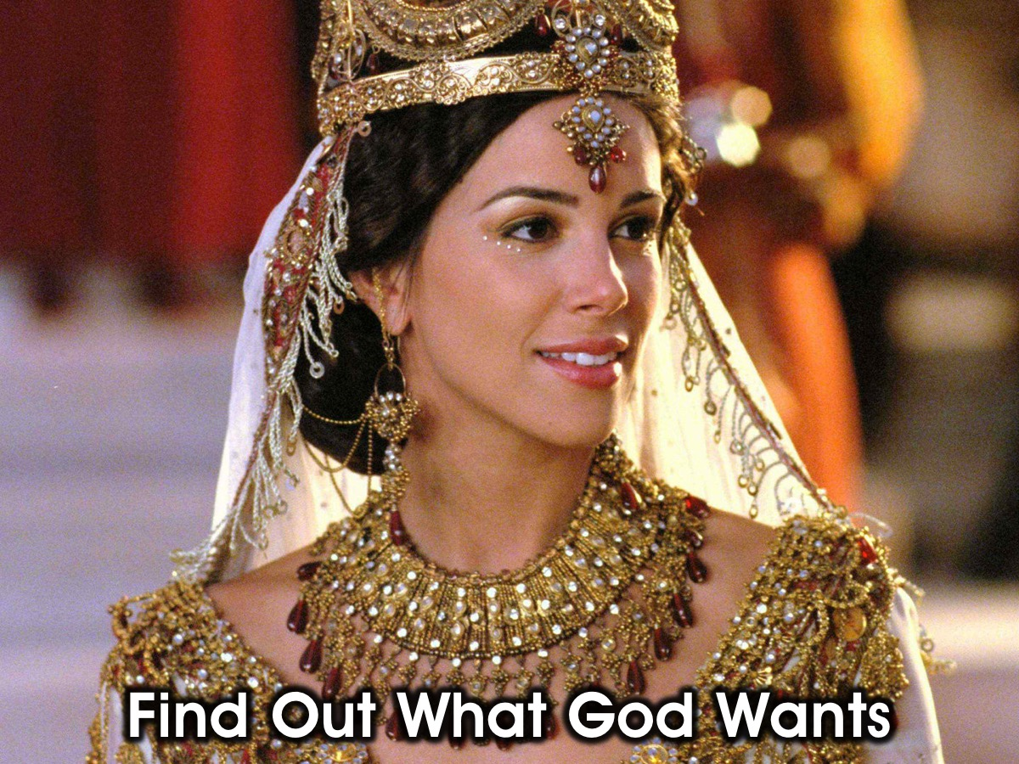
Notes:
3. Find Our What God Wants (Make sure you are wanting to be used by God and not get God to serve or bless you: Esther wanted the king’s presence more than his presents)

Slide 17
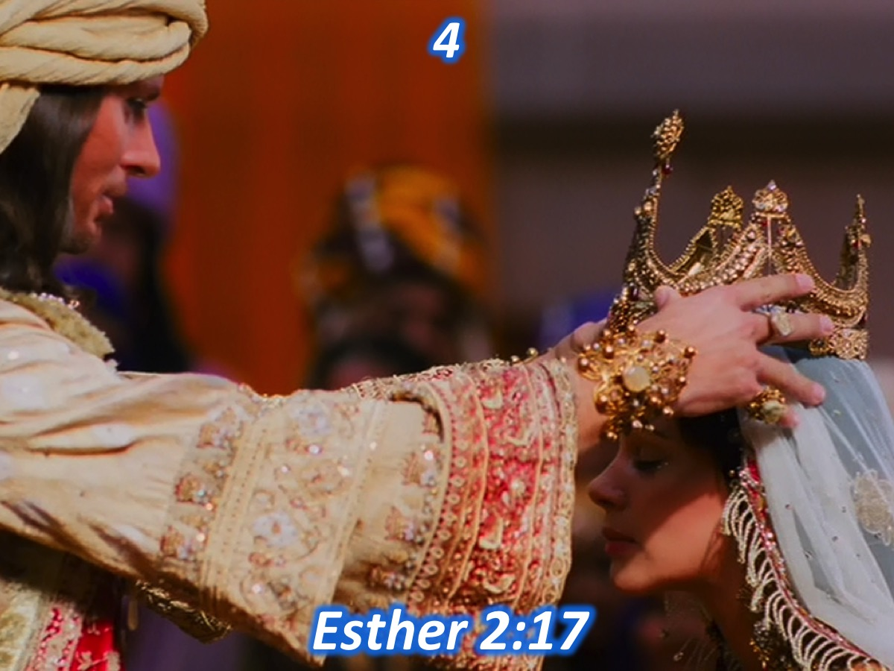
Notes:
Pic #4: Esther’s influence flowed from intimacy and her access came from her relationship with the king. “Now the king was attracted to Esther more than to any of the other women, and she won his favour and approval more than any of the other virgins. So he set a royal crown on her head and made her queen instead of Vashti.” (Esther 2:17)

Slide 18
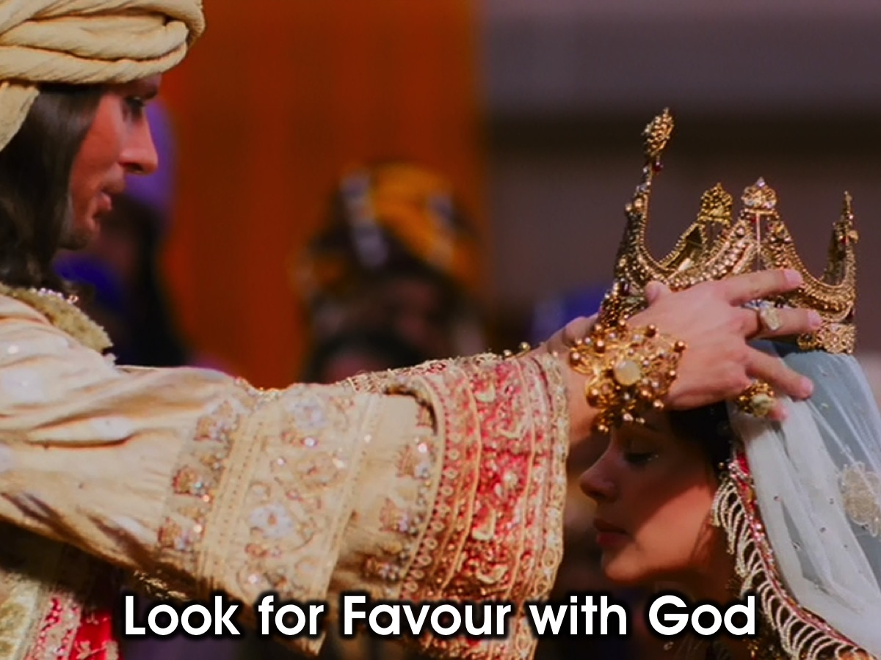
Notes:
4. Look for Favour with God (Esther’s influence flowed from intimacy and her access came from her relationship with the king)

Slide 19
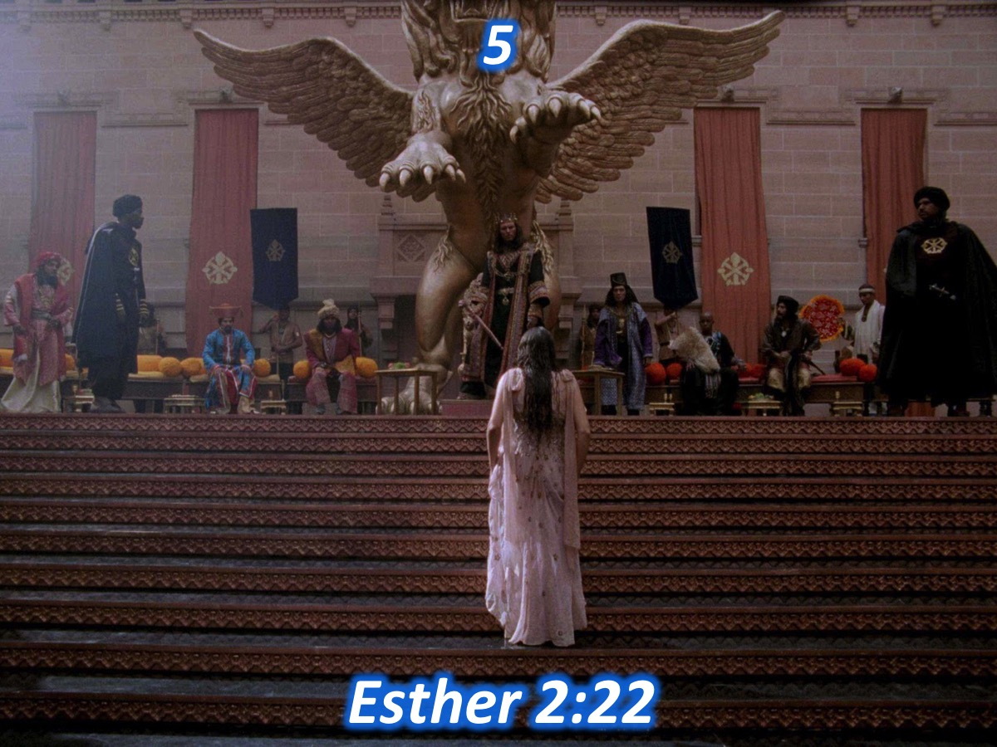
Notes:
Pic #5: Esther’s reliability and motives were tested when she dealt with the assassination plot. “During the time Mordecai was sitting at the king’s gate, two of the king’s officers who guarded the doorway, became angry and conspired to assassinate King Xerxes. But Mordecai found out about the plot and told Queen Esther, who in turn reported it to the king, giving credit to Mordecai.” (Esther 2:22)

Slide 20
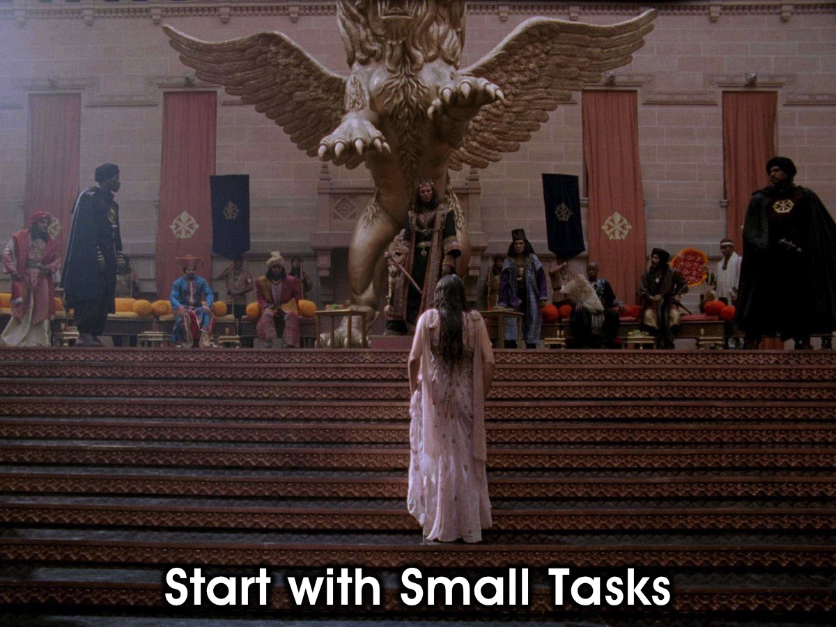
Notes:
5. Be Willing to Start with Small Tasks

Slide 21
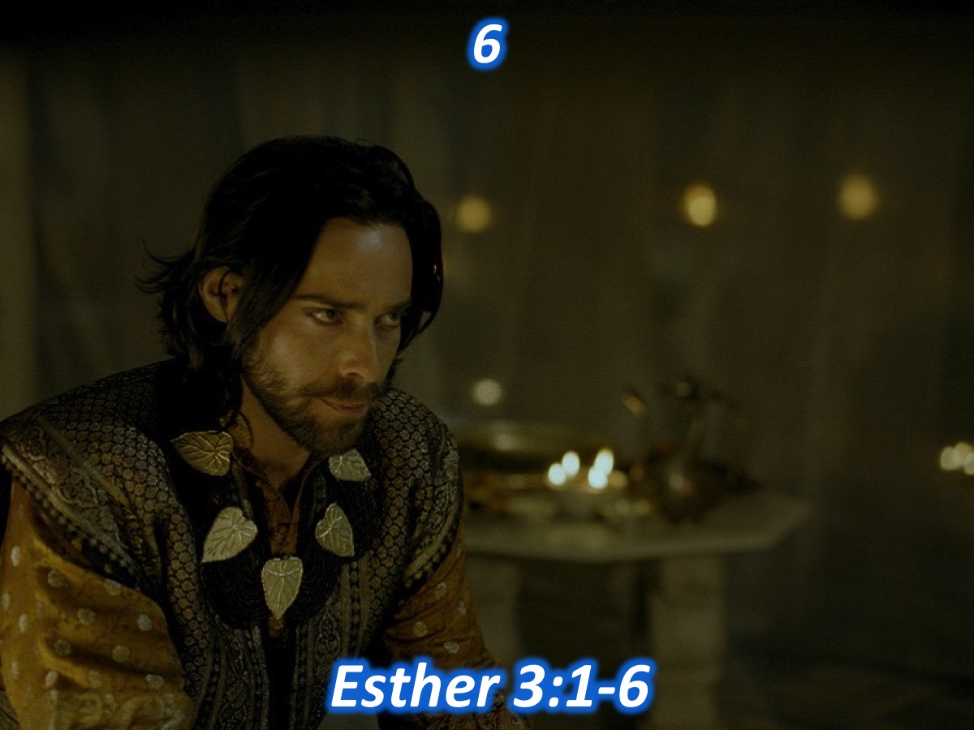
Notes:
Pic #6: As Esther got ready to be used by God she would soon meet Haman, an enemy of the Jews. “King Xerxes honoured Haman and all the royal officials at the king’s gate were commanded to honour him by kneeling down in his presence. But Mordecai refused to do it. When Haman saw that Mordecai would not kneel down before him, he was enraged. Yet having learned who Mordecai’s people were, he looked for a way to destroy all the Jews in the kingdom of Xerxes and not just Mordecai.” (Esther 3:1-6)

Slide 22
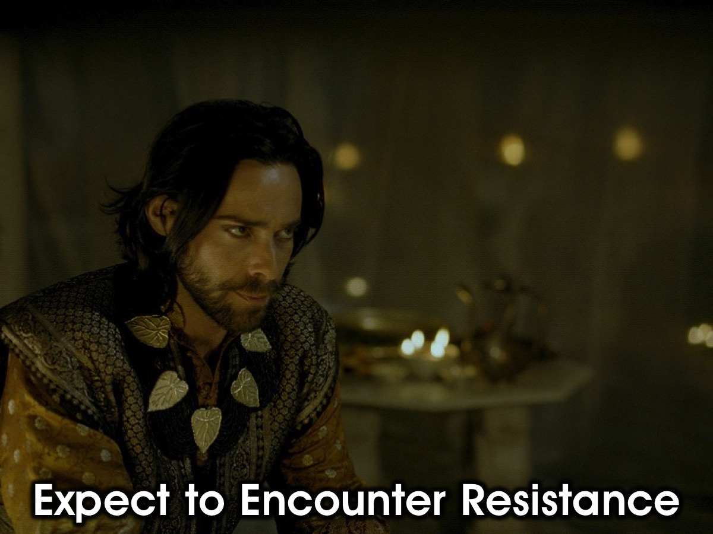
Notes:
6. Expect to Encounter Resistance (As Esther got ready to be used by God she would soon meet Haman, an enemy of the Jews.)

Slide 23
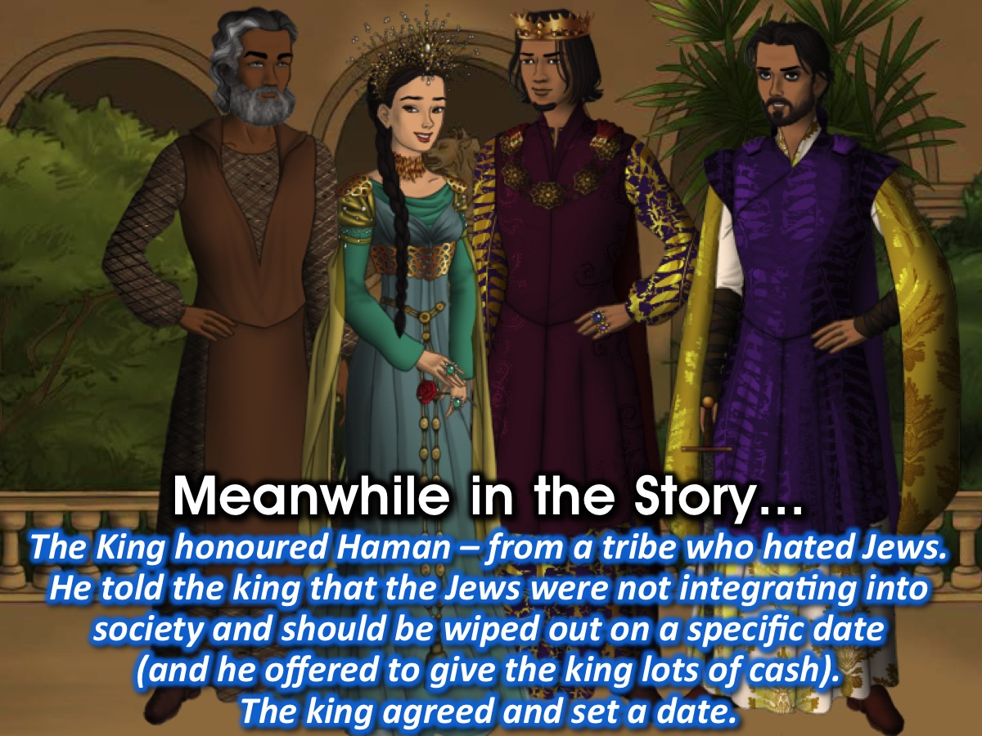
Notes:
King Xerxes honoured Haman and everyone owed down to him except Mordecai – Haman was a descendant of the Agagites who were bitter enemies of the Jews and when he found out that Mordecai was not honouring him, he looked for a way to get rid of all the Jews, and not just Mordecai. Haman came up with a plan to get the king to issue a decree to have the Jews eliminated for failure to integrate into society – and he promised to pay a large amount of money into the state coffers if the king agreed to his plan. The king agreed and a day was set aside on which the massacre would take place.

Slide 24
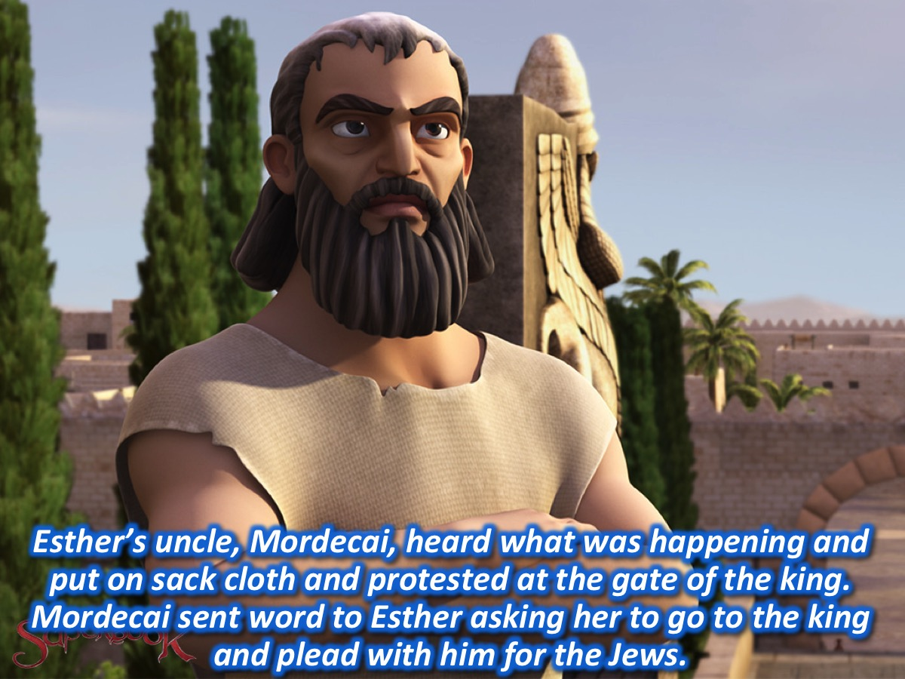
Notes:
When Mordecai heard of what was about to happen he put on sack cloth and went to the gate of the king to express his protest. Esther heard about Mordecai’s actions from her maids and she sent one the king’s eunuchs to find out what it was all about. Mordecai sent word through the eunuch and urged Esther to go into the presence of the king to plead with him for her people. But she knew that anyone who approached the king, who had not been invited, would be put to death – unless the king extended his golden sceptre towards the person. Mordecai challenged Esther to take action, suggesting that perhaps God had brought her into this “royal position for such a time as this” (14). Her reply what that all the people in the city needed to fast for three days with her and after that she would go into the king’s presence even if it meant being killed. Mordecai went away and carried out all her instructions.

Slide 25
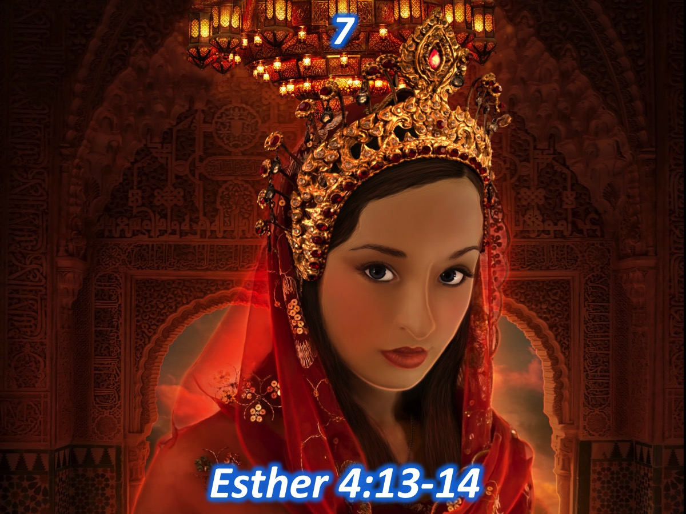
Notes:
Pic #7: Esther knew she was divinely positioned to serve – to ask the king to save her people. “Mordecai sent this reply to Esther: “Don’t think for a moment that because you’re in the palace you will escape when all other Jews are killed. If you keep quiet at a time like this, deliverance and relief for the Jews will arise from some other place, but you and your relatives will die. Who knows if perhaps you were made queen for just such a time as this?” (Esther 4:13-14)

Slide 26
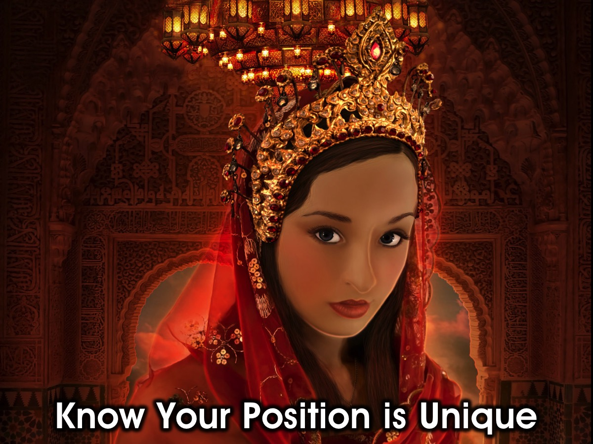
Notes:
7. Know your position is unique (God has put you in a specific place in time to make a difference in the world around you!)

Slide 27
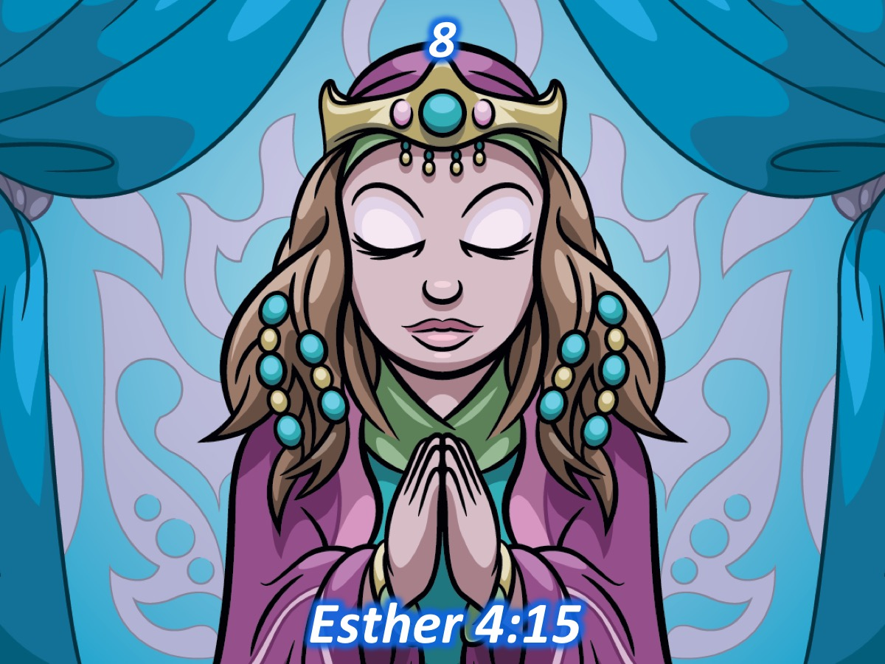
Notes:
Pic #8 Esther decided to take action because she cared about her people and she knew that God could help. “Then Esther sent this reply to Mordecai: “Go and gather together all the Jews of Susa and fast for me. Do not eat or drink for three days, night or day. My maids and I will do the same. And then, though it is against the law, I will go in to see the king.” (Esther 4:15)

Slide 28
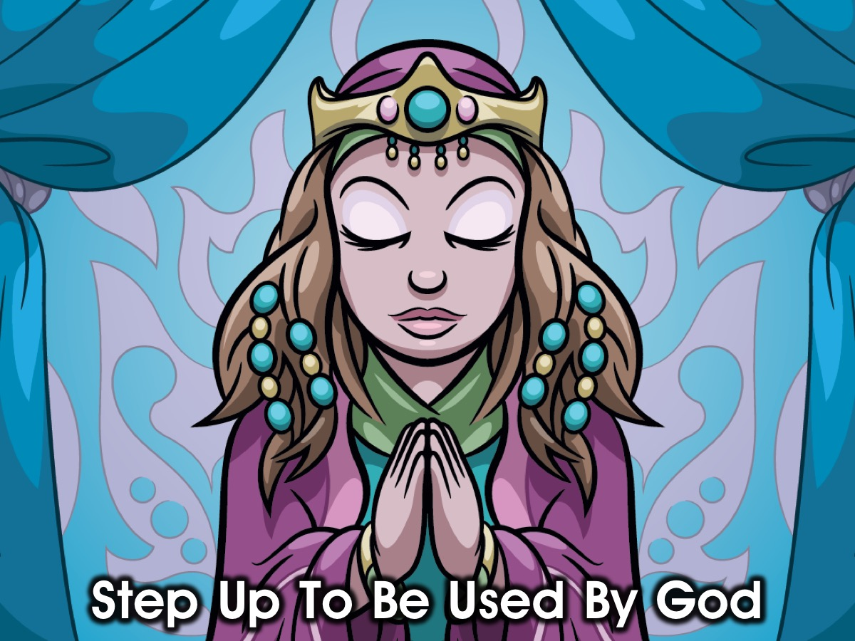
Notes:
8. Step Up To Be Used By God. Esther cared about her people, she knew that God could help, she was the one who could be used by God.

Slide 29
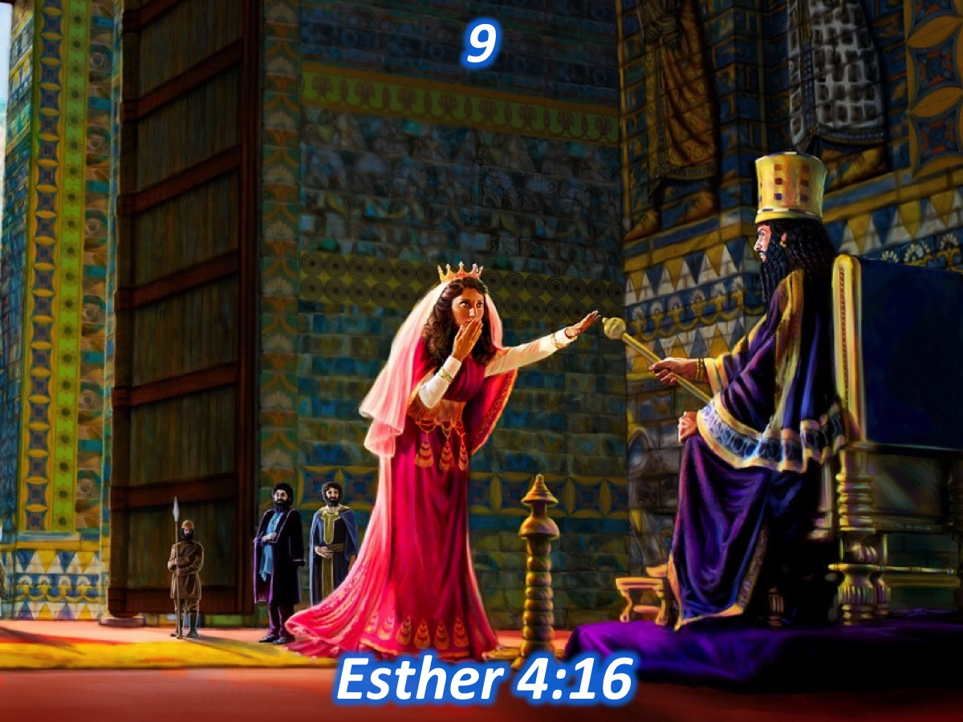
Notes:
Pic #9: Esther knew that she could be killed for seeing the king without an invitation. But it was a price she was willing to pay. “Esther said: “And then, though it is against the law, I will go in to see the king. If I must die, I must die.” (Esther 4:16)

Slide 30
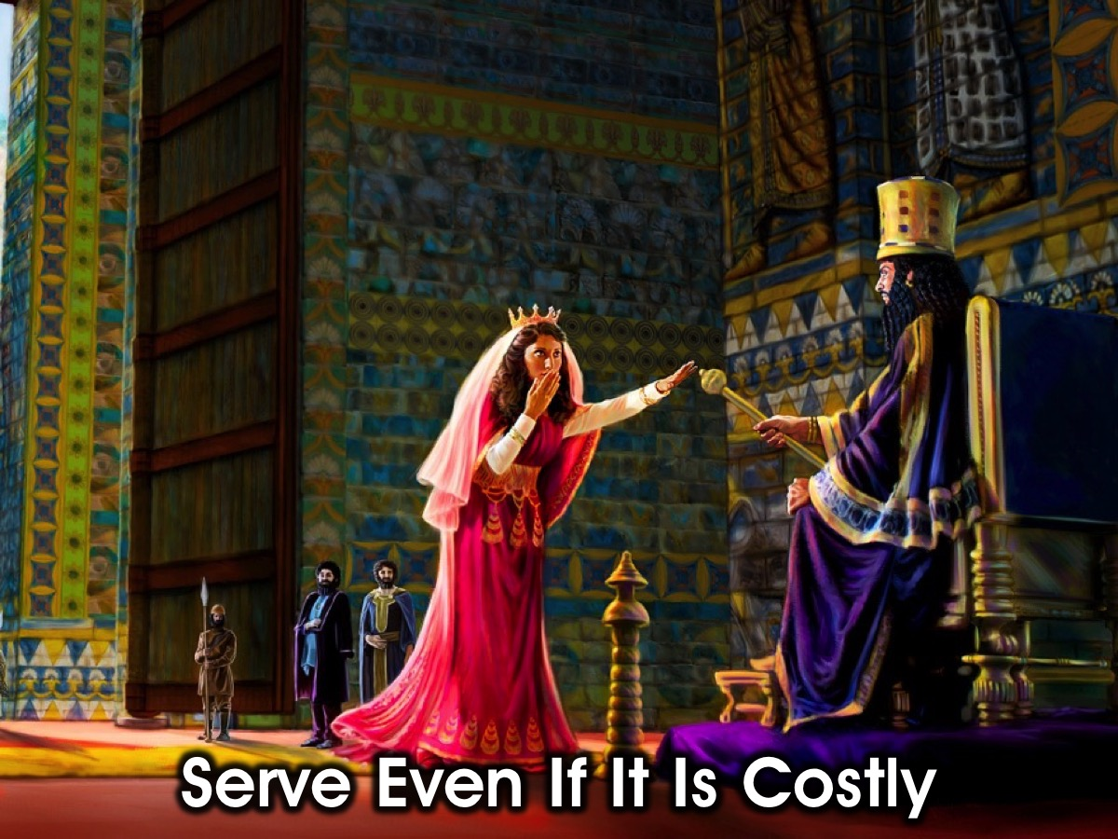
Notes:
9. Be Willing to Serve Even if it is costly. Esther knew that she could be killed for seeing the king without an invitation. But it was a price she was willing to pay.

Slide 31
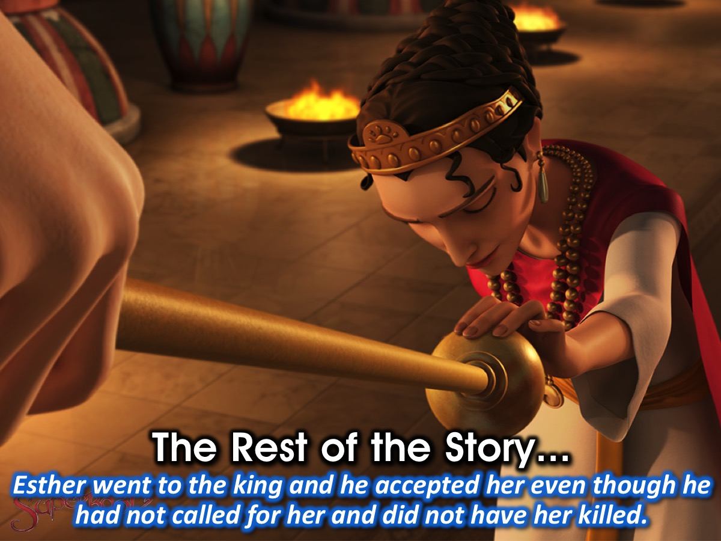
Notes:
And the Rest of the Story: On the third day, Esther went into the inner court of the palace and stood in the door way – when the kind saw her he was pleased with her and he held out the gold scepter to her – so she approached him and touched the top of the scepter.

Slide 32
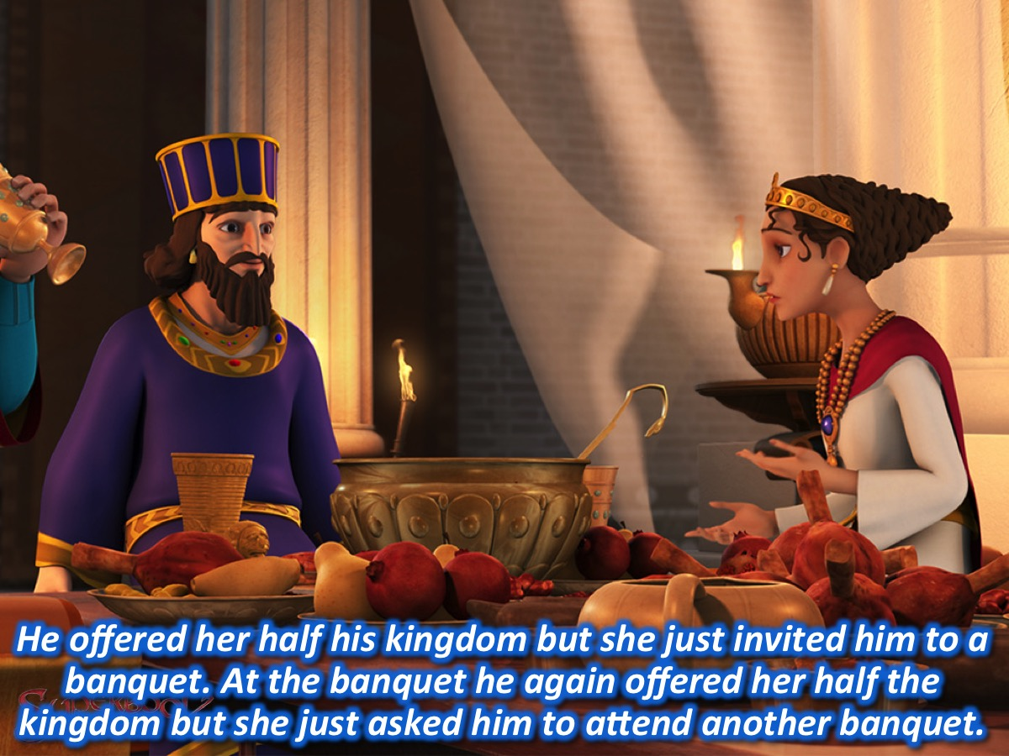
Notes:
He offered her up to half of his kingdom but all she asked for was that the king and Haman would attend a banquet that she was putting on. The king agreed and went to the banquet with Haman. During the banquet the king again offered her anything she wanted, up to half of the kingdom. She simply asked that they would attend another banquet that she was preparing.

Slide 33
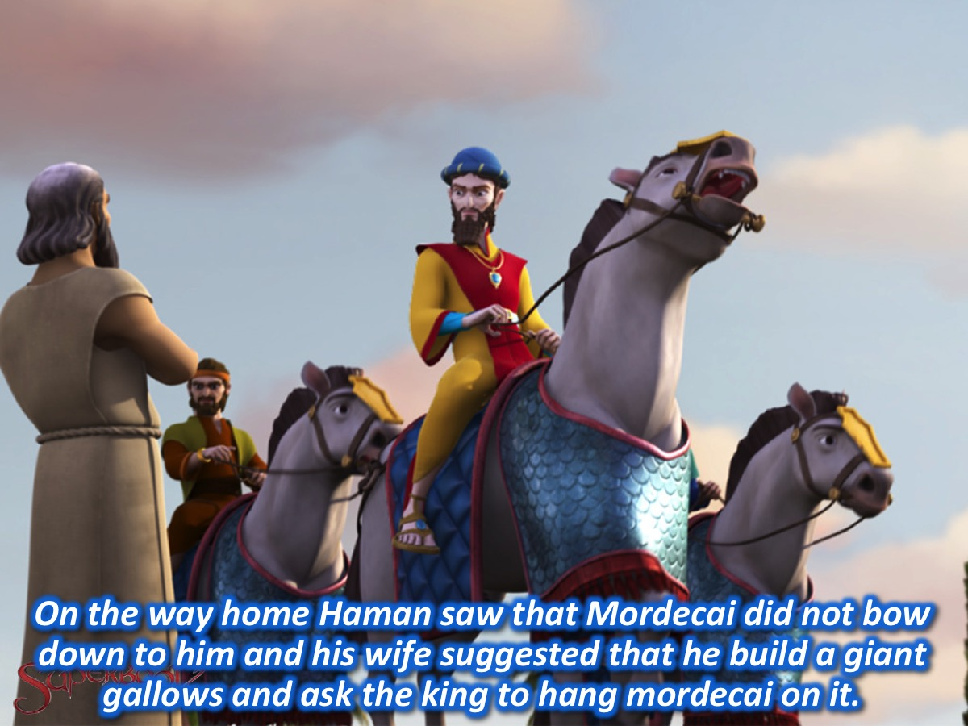
Notes:
Haman saw Mordecai on the way home at the city gate and was furious that he did not bow before him and when he complained to his wife Zeresh she suggested that he erect a giant gallows and at the banquet ask the king to hang Mordecai on it.

Slide 34
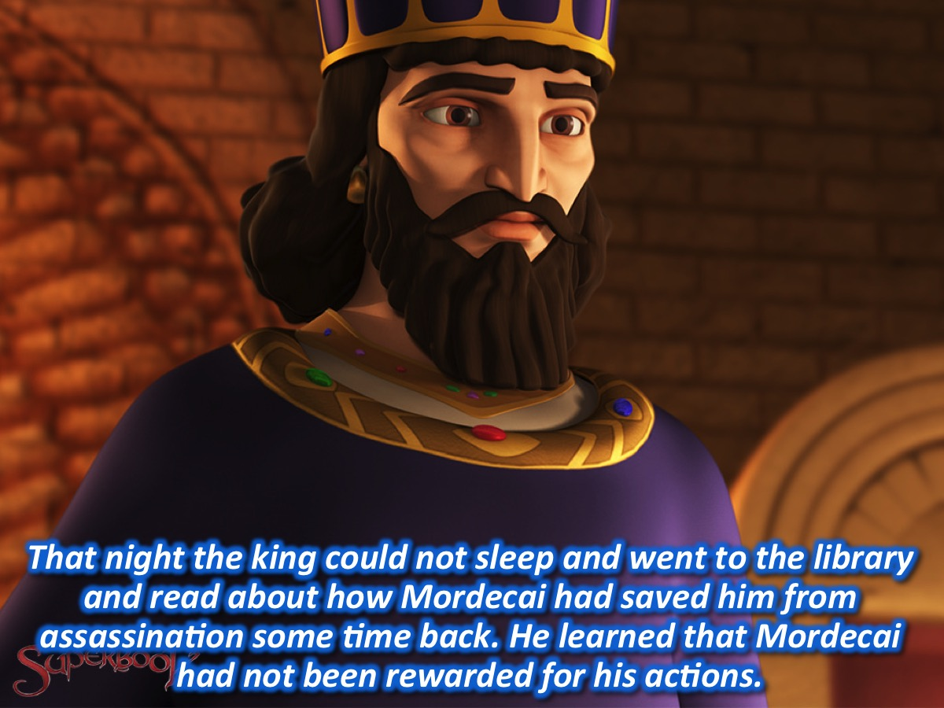
Notes:
During the night the king could not sleep and he decided to read through the records of his reign – and he came across the story of how Mordecai had saved him from the assassination attempt. He asked what recognition Mordecai has received for this and discovered that nothing had been done.

Slide 35
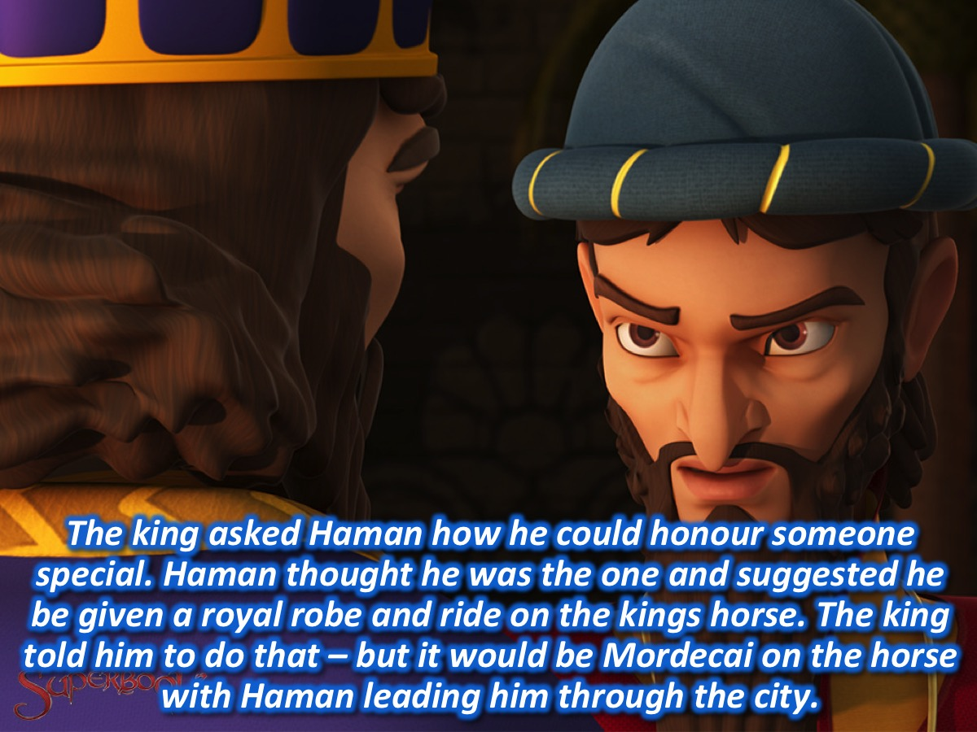
Notes:
Then the king saw that someone was in the outer court of the palace and discovered that it was Haman who had come to speak to the king about hanging Mordecai on the gallows. The king had Haman brought to him and asked him what he should do to the person he wanted to honour. Haman thought the king was talking about him and suggested that he should be given a royal robe and allowed to ride on one of the kings own horses. The king commanded Haman to do what he had suggested – but to do it for Mordecai the Jew. And Haman had to lead Mordecai through the city on the horse with the king’s robe. Afterwards, Mordecai returned to the king’s gate and Haman returned home and complained to his wife. Suddenly officials came and took Haman off to the banquet that Esther had prepared.

Slide 36
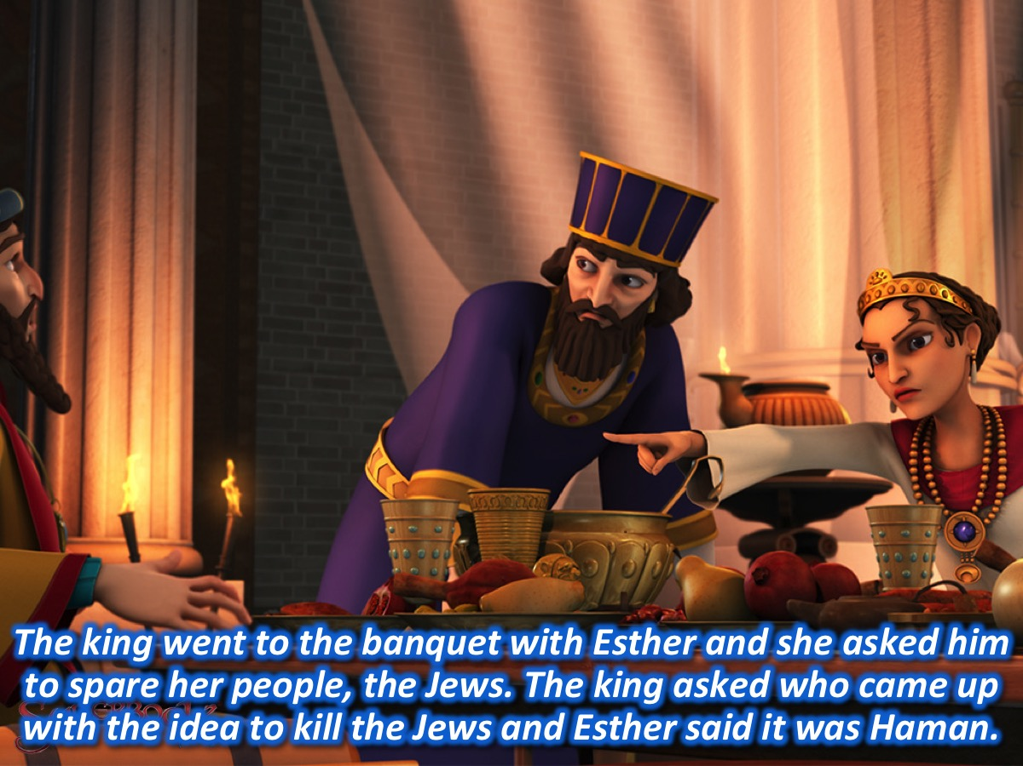
Notes:
The king and Haman went to dinner with Esther and the king again asked what she wanted – and she asked for her life to be spared and that of her people, the Jews (3-4). The king asked who had dared to issue a decree to kill Esther’s people and Esther told him that it was Haman.

Slide 37
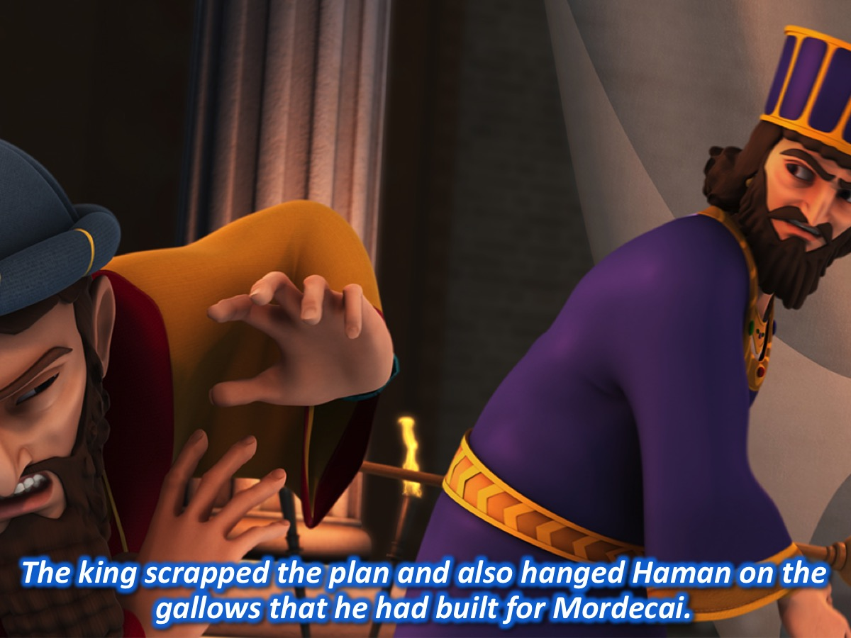
Notes:
The king got up in a rage and went to cool off in the garden – when he came back he saw Haman falling on the couch where Esther was sitting (he had been pleading with her for his life). The king went ballistic and when he heard that Haman had built the giant gallows for Mordecai he commanded that Haman should be hanged on it instead. When it was done, the king calmed down.

Slide 38
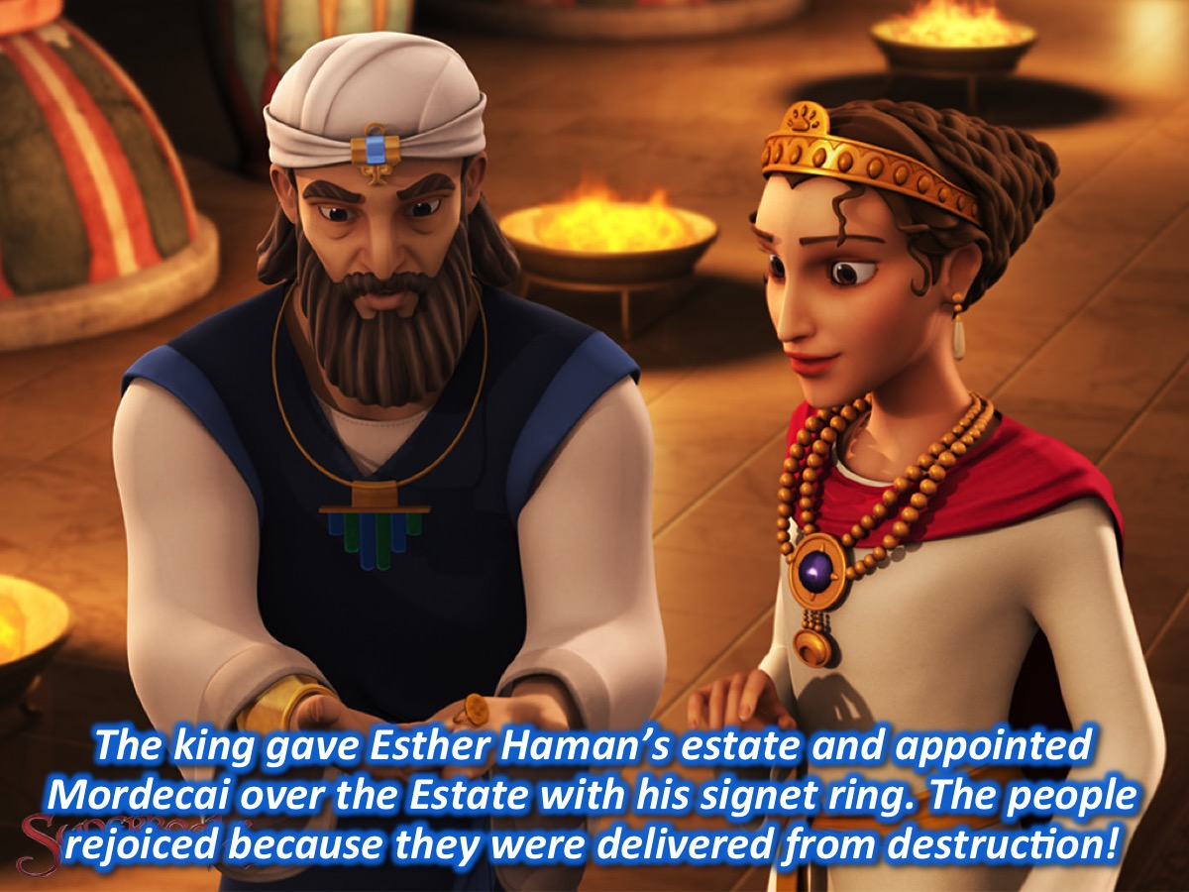
Notes:
The king gave Esther Haman’s whole estate and brought Mordecai into his presence – he gave him his signet ring and Esther appointed him over the Haman estate. Esther again approached the king and asked him to write an edict that would protect the Jews from the scheme that Haman had devised to have them all killed. He allowed Mordecai to write the edict giving protection to the Jews. And there was great joy and gladness throughout the kingdom with feasting and celebrating – and people from other nations converted to Judaism because they were afraid of the Jews. The Jews rose up and killed everyone who was out to destroy them and Esther asked the king for an extension of the time for the retribution to be carried out and also that Haman’s ten sons would be killed. The Jews killed all those who were out to harm them, but they did not engage in any plundering! Mordecai and Esther wrote a new law to institute an annual day of joy and festival to celebrate how the Jews were delivered. The fame of the king spread throughout the kingdom, together with a report of all that Mordecai had done – he was second in rank only to king Xerxes. He was held in high esteem by all the Jews because he worked for their good and spoke up for the welfare of all the Jews.

Slide 39
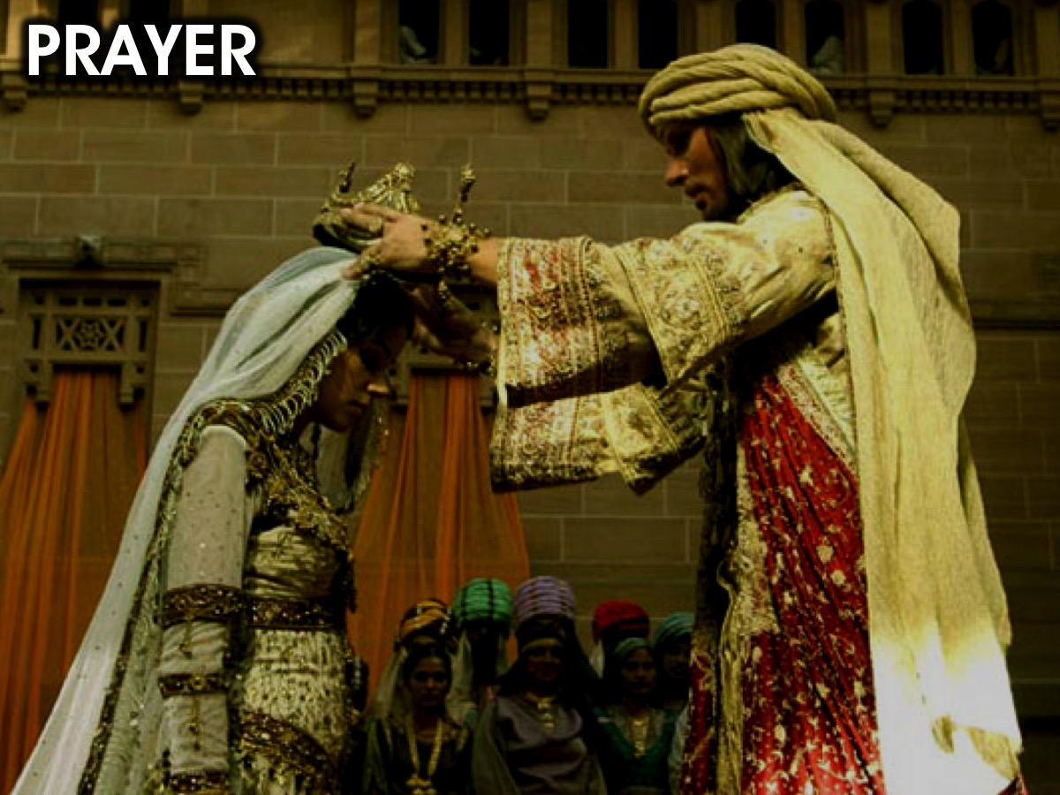
Notes:
Prayer

Slide 40

Notes:
Next term we are launching a brand new series on Sunday mornings – called the Revolution series!

