Slide 1
Notes:
How t Get Things Done

Slide 2
Notes:
1. Get Things Off Your Mind: Keep nothing in your head. Do regular downloads. Write things down! Type Things up!

Slide 3
Notes:
David Allen says that “the brain is better at having thoughts than holding them” So you should HAVE thoughts more than HOLD them and you should think ABOUT things more than think OF them.

Slide 4
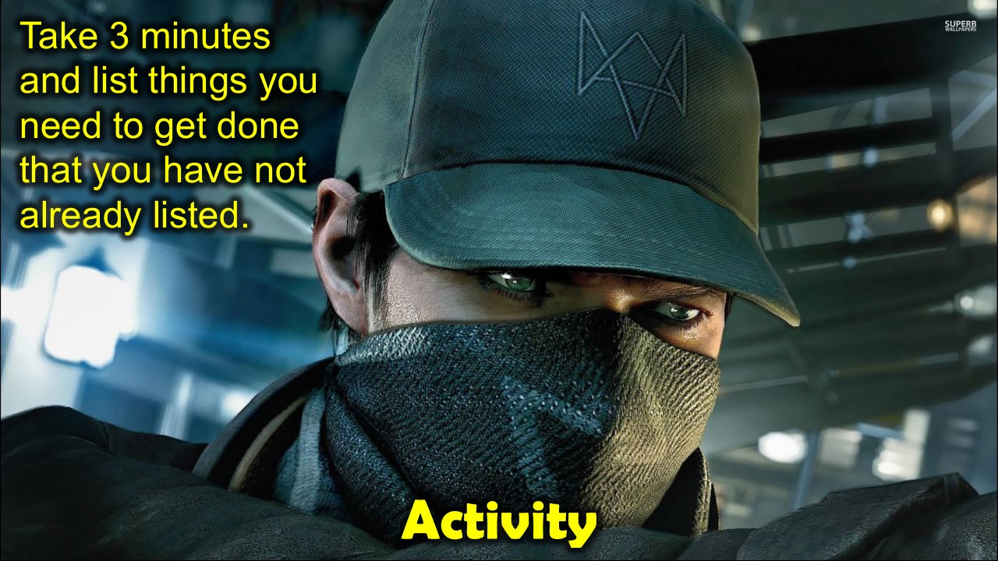
Notes:
Activity: Take 3 minutes and list things you need to get done that you have not already listed.

Slide 5
Notes:
2. Identify the Next Action: Identify the very Next Action to be taken for anything you need to get done.

Slide 6
Notes:
Activity: Look at your list and identify the Next Action for 3 of the things you need to get done.

Slide 7
Notes:
3. Give Contexts To Actions: Select a Context that is relevant for each Action: Such as: Calls, Email, Read, Download, Errands, Meetings, Home, Office, Someday, Waiting, etc.

Slide 8
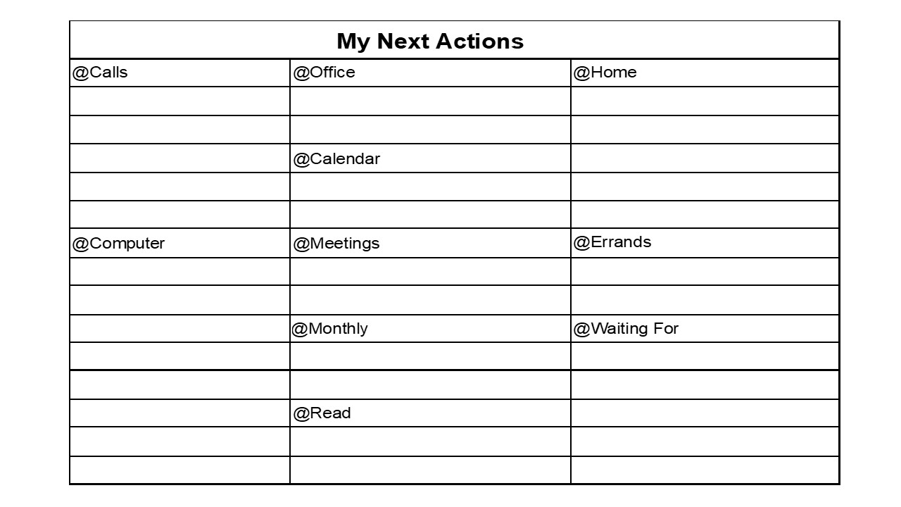
Notes:
Here is a simple table to track your next actions in Contexts.

Slide 9
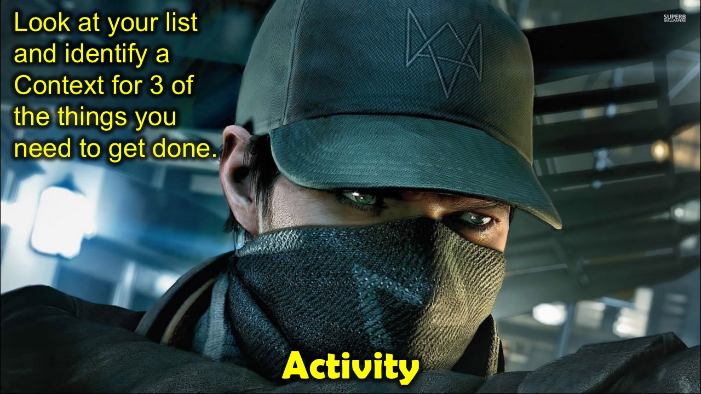
Notes:
Activity: Take 3 minutes and list things you need to get done that you have not already listed.

Slide 10
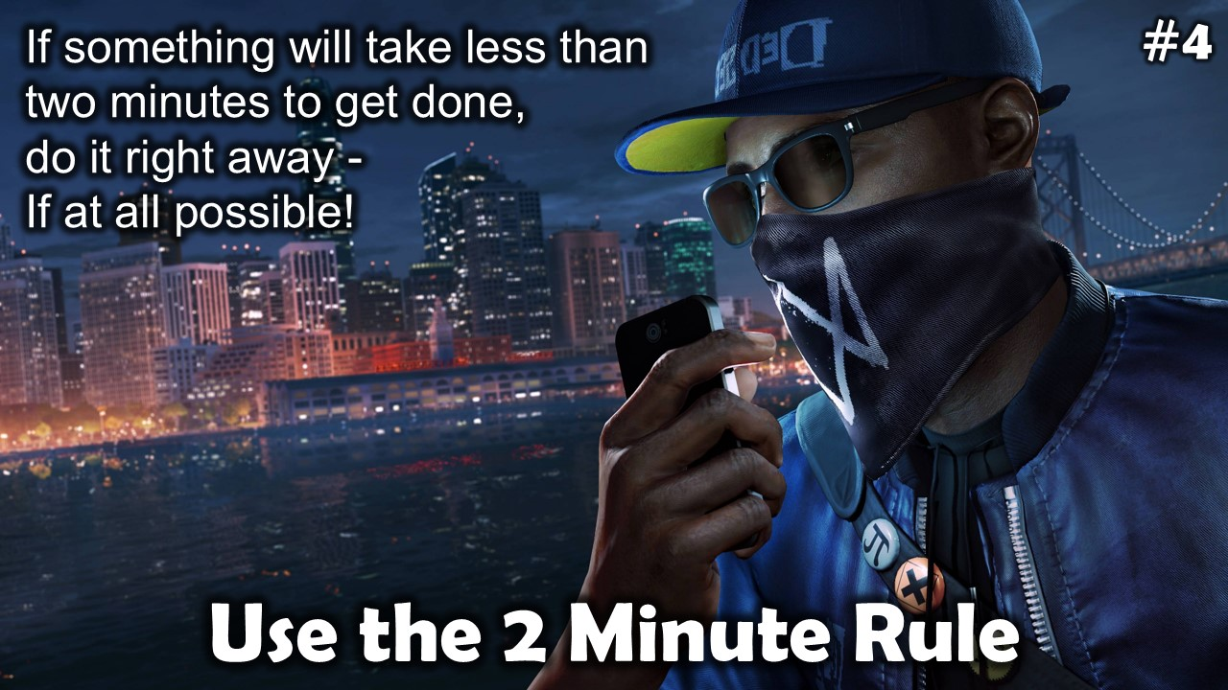
Notes:
4. Use the 2 Minute Rule: If something will take less than two minutes to get done, do it right away - If at all possible!

Slide 11
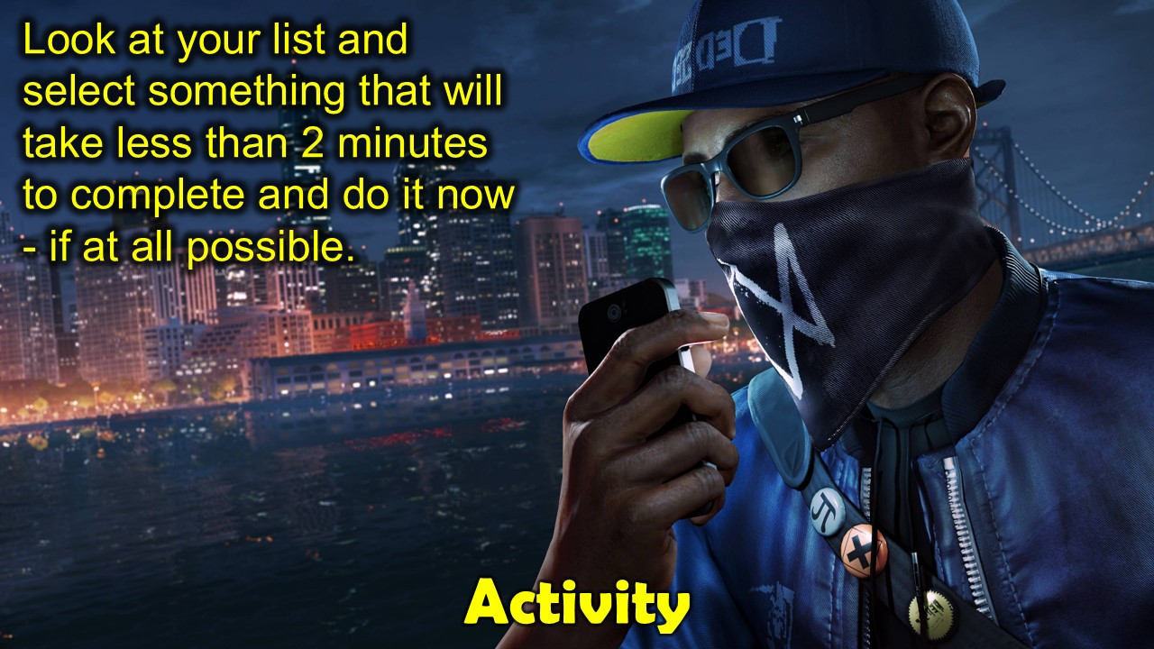
Notes:
Activity: Look at your list and select something that will take less than 2 minutes to complete and do it now - if at all possible.

Slide 12
Notes:
5. Mark Actions As Done: Use lists sorted by Category to tick off Actions as you complete them.

Slide 13
Notes:
Activity: Look at your list and tick off the thing that you just completed.

Slide 14
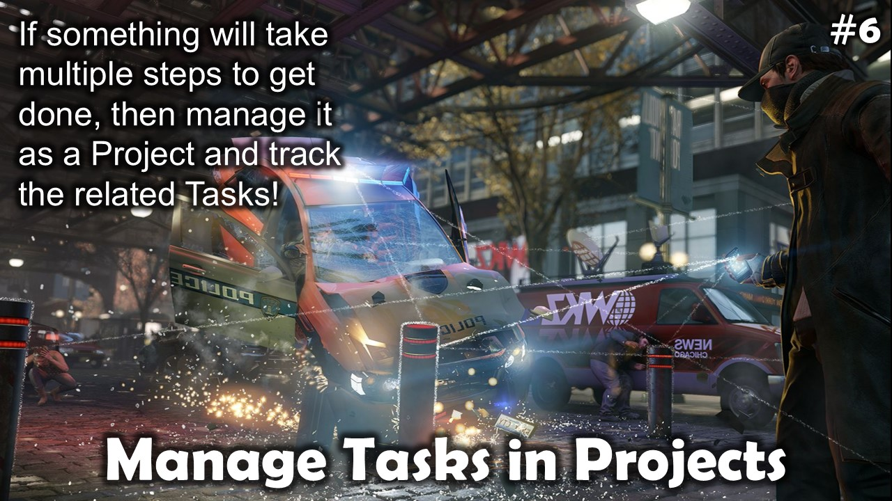
Notes:
6. Manage Tasks in Projects: If something will take multiple steps to get done, then manage it as a Project and track the related Tasks!

Slide 15
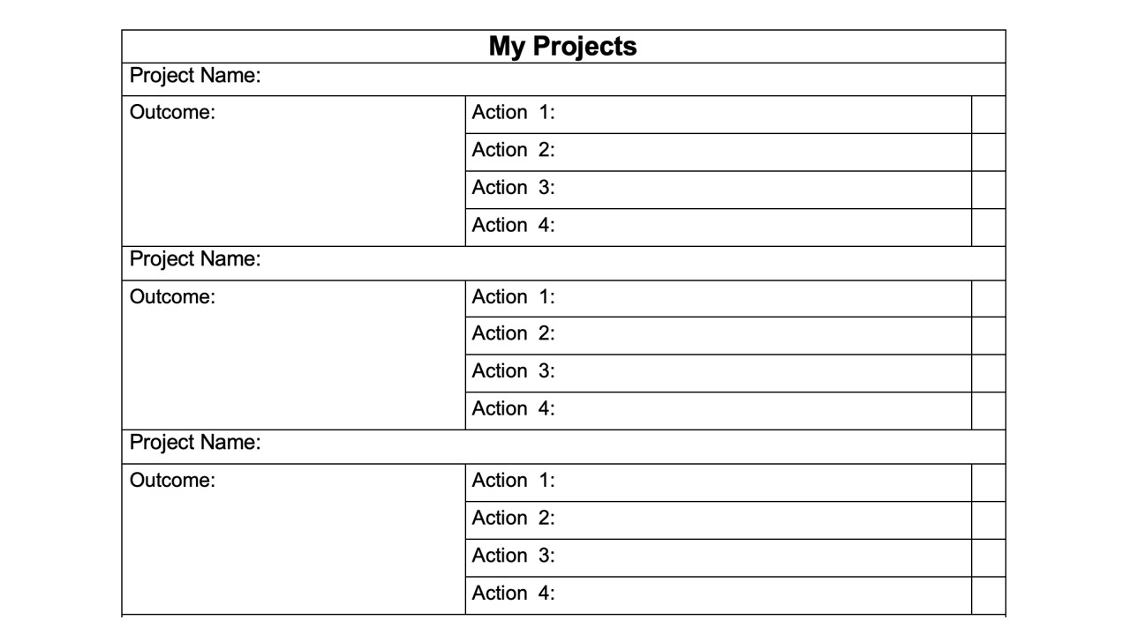
Notes:
There is a Projects list you can to manage anything that will take more than 1 action to complete – ie, Projects.

Slide 16
Notes:
Activity: Look at your list and circle items that are Projects and not just single Tasks.

Slide 17
Notes:
7. Review Everything Often. Review everything you need to get done as often as necessary: Daily, Weekly, Monthly and Yearly. Check apps, inboxes, notebook, etc.

Slide 18
Notes:
Activity: Make calendar entries to remind yourself to do a Review at the end of each day, week, month and year.

Slide 19
Notes:
Preview: 7 Secrets to Getting Things Done: (1) Get Things off Your Mind. (2) Identify Next Actions. (3) Give Contexts To Actions, (4) Use the 2 Minute Rule. (5) Mark Actions As Done. (6) Manage Tasks in Projects. (7) Review Everything Often.

Slide 20
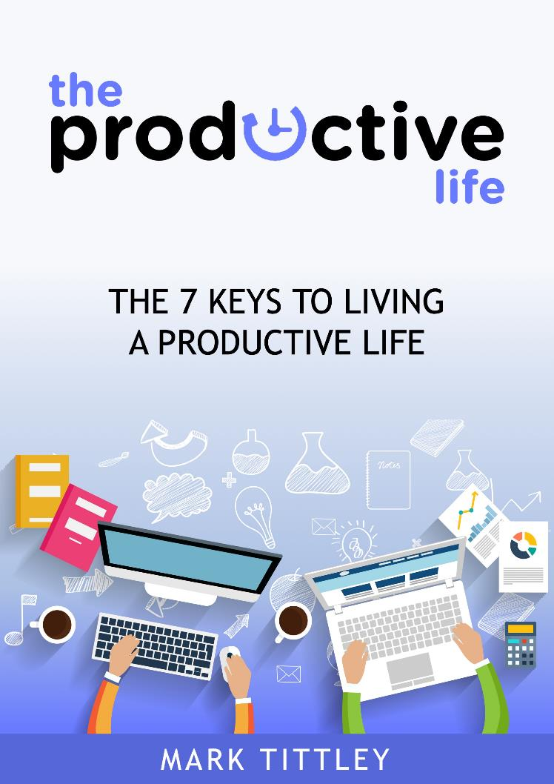
Notes:
What we explored today is from my book The Productive Life.

Slide 21
Coaching
Notes:
A Coaching Journey through the 7 Keys to Living a Productive Life is launching soon. Let me know if you would like to hear more and sign up. There is no cost and you will receive a free copy of the book. You will need to attend an hour long session each week online during your work day and put in at least one more hour to apply what you learn to your life.

