Slide 1
Notes:
Program Overview: Tonight’s Hunger Games event will involve twelve Districts battling it out to be the winning district. There will be three Hunger Games with tributes reaped for the first and then volunteers will take their places for each subsequent games. Members of the Capitol will give gifts that will help selected tributes in each of the three Hunger Games. Districts will win prizes for each time they win a round and at the end of the event the winning District as chosen by the members of the Capitol will receive a special prize of decadent cup cakes.

Slide 2
Notes:
Pre-Event Video: Catching Fire Let It Burn. Get it on YouTube at: https://www.youtube.com/watch?v=f6pGwTIslGk
Length: 1:21

Slide 3
Notes:
Pre-Event Video: Ellie Golding Burn. Get it on YouTube at: https://www.youtube.com/watch?v=CGyEd0aKWZE
Length: 4:00

Slide 4
Notes:
Pre-Event Video: Fall Boys Light Em Up. Get it on YouTube at: https://www.youtube.com/watch?v=Rd95IAkHdn8
Length: 2:00

Slide 5
Notes:
Welcome to The Hunger Games night. Are there any newcomers here tonight?

Slide 6
Notes:
Are you ready to compete in the arena?

Slide 7
Notes:
The Rules: (1) One person will be reaped from each district. (2) The districts will design a shirt for their tributes. (3) The tributes will be introduced to the Capitol. (4) The tributes will compete in 3 Hunger Games. (5) Volunteers will swop places in each Hunger Games. (6) Districts will win prizes for winning each Games. (7) The best district overall will be greatly rewarded.

Slide 8
Notes:
The Big Prize – the winning district will be treated to decadent cupcakes.

Slide 9
Notes:
The Capitol: Firstly tonight we are especially honoured to have members from the Capitol of Panem seated on stage. A warm round of applause everybody for these most valuable members of society! You may want to do everything in your power to please these special gifts as they will have the power to help you in the arena – more about that later on!

Slide 10
Notes:
The Districts: There are 12 districts in Panem seated around the arena. A member of the Capitol will say words of welcome to each of the 12 districts…

Slide 11
Notes:
Welcome to District 1. The citizens of the Capitol are forever grateful to the Luxury District – it is your luxury goods that decorate and beautify our great Capitol. Your excellent taste and craftsmanship keep Capitol residents bedazzled all year-round. What would we be without the diamonds, emeralds and sapphires that are fashioned in your district? Even our hairstyles have been inspired by your stylists! We can't wait for the parade because your costumes in the chariot rides have always been the best.

Slide 12
Notes:
Welcome to District 2. We are delighted to have the members of the Masonry District with us today - our nation would be nothing without your superb stonework. You have built and fortified our cities and your citizens are known for their strength. We will never forget the way in which you were loyal to the Capitol during the first rebellion so we rewarded you with better living conditions. Thank you too for supplying us with the peacekeepers that ensure the stability of our nation.

Slide 13
Notes:
Welcome to District 3. Brothers and sisters of the Technology District, we salute your kind efforts to contribute to the technological world of our great nation. The highly intelligent minds of District 3 are behind some of Panem’s most advanced achievements, and for that, we thank you. We in the Capitol strive to create a secure, harmonious environment, and your infinite contributions enable us to make that goal a reality. The codes you write, the wires you unravel and the gadgets you invent all contribute to the well-being of your District, and in turn, the greater good of Panem.

Slide 14
Notes:
Welcome to District 4. We salute you, the hardworking citizens of the Fishing District, for your invaluable contributions to society. As the seasons change and the tides turn, you continue to feed the beating heart of the Capitol. Remember the value of your actions because they grow and unify the country as a whole: Every fish you spear, every knot you tie, and every ocean swell you conquer further helps maintain the steady current of our elegant system, and strengthens the bond between Panem and its people. No contribution is too small, and every impact is crucial.

Slide 15
Notes:
Welcome to District 5. Today we stand as one to applaud the members of the Power District who harnesses the energy of the earth and the sky in order to power our great nation. Without your energy - electric, solar, and nuclear – we would be plunged into darkness like those poor citizens of that far away land called South Africa. Keep a watch out for those rebels who are always looking to sabotage your dams and coal storage facilities. Keep our lights on and we will forever be in your debt!

Slide 16
Notes:
Welcome to District 6. The Capitol honors your tenacious efforts to make outstanding strides in the world of transit. We praise the everyday heroes of the Transportation District and cherish a community that strives for excellence, progress and harmony! We appreciate the love and commitment every citizen rolls into his or her work. From the young minds absorbing the culture and history of our great nation, to the men and women working day in and day out to protect our elegant system, every job is essential to the growth of Panem.

Slide 17
Notes:
Welcome to District 7. Brothers and sisters in the Lumber District; Let us come together in celebration of your fervent efforts to make Panem a truly wonderful nation! As you tend to the finest forests and provide your fellow brethren with the most beautiful and flawless lumber, remember that the Capitol treasures your dedication to society. Embrace the challenges of strenuous labor, and remember the instrumental role you play in the preservation of our country. We in admire your strength and commend your loyalty. We must all stand as tall as the mighty oaks you fell, and work together to build and preserve a better future.

Slide 18
Notes:
Welcome to District 8. As you look upon the splendor of the outfits worn by citizens of the Capitol you know why we are so grateful to the Textiles District. All of the amazing fabrics in the Capitol are the work of your hands. When you design Avant-garde patterns, mix unique colours and source new materials - just remember that we are forever grateful to each and every one of you. It is your factories that create the material that adorn our Peacekeepers – but we warn you not to start another war like you did in the second rebellion or you will be on the wrong side of the Peacekeeper uniforms!

Slide 19
Notes:
Welcome to District 9. The Capitol gives high praise to the citizens of its Grain District! From the minute the sun graces the skies with its radiance to the moment it quietly slips away and into the night, you embrace your duties with the utmost care. The time, love and commitment your pour into your work enables our industrious nation to take one step further into becoming the nation it was always meant to be. Help us keep every seed in its rightful place, help us plow through any obstacle that comes our way and above all, help us nourish Panem in our quest for peace and unity.

Slide 20
Notes:
Welcome to District 10. The Capitol celebrates the spirit of the Livestock District. We honor the everyday heroes of District 10 as they breed the finest meat, shear the softest wool, and embrace the shining Capitol sun in their ongoing endeavors. Work as one to become shining examples of greatness we know this country is capable of producing. Work as one to become the model citizens we know this country has raised. Work as one to ratify the solidarity within our system. We are forever grateful to the citizens who make countless contributions to society.

Slide 21
Notes:
Welcome to District 11. As we enjoy fresh fruit juice this evening we give praise to the Agriculture District – your bountiful orchards keep our taste buds in ecstasy – no wonder you are all so well tanned from all the hours spent working among rustling fruit trees and huge farms. As you plant, reap and sow your crops for the good of all Panem – remember that you are contributing to a beautiful society.

Slide 22
Notes:
Welcome to District 12. To our brothers and sisters of the Mining District we say: “Bravo!” Your honorable work ethic and perseverance has not gone unnoticed, and the Capitol appreciates your commitment to serving our great nation. Now more than ever you must remember the importance of our system and the greater good it creates. Embrace the sweat on your brow and the sores on your fingers. Allow the soot to settle along your feet. You are the light that shines in the coal mines you venture. Take pride in your scars of labor, for they are labors of love for your country.

Slide 23
Notes:
The Dressing: Use the black marker to make the Tribute Shirt reflect your District. Your number must be clearly visible on the front and the back of the t-shirt!

Slide 24
Notes:
The Reaping: Write your name on a piece of paper and place it in the bowl. A Capitol citizen will come around and reap the Tribute from each of the 12 Districts!
Music from the Catching Fire Soundtrack was played here.

Slide 25
Notes:
The Introduction of Tributes: We welcome the Tributes to the Capitol so they can introduce themselves to the esteemed citizens of Panem.

Slide 26
Notes:
The Parade: Tributes, you will parade around the arena so the other districts can get a closer look at you!
Music from the Catching Fire Soundtrack was played here.

Slide 27
Notes:
The 1st Hunger Games: Tributes, please take your position in the marked area in front of your district

Slide 28
Notes:
The rules of PEG WAR: (1) You place 2 pegs on your shirt. (2) You protect your pegs but can’t touch them. (3) You must knock other tributes pegs off. (4) The last tribute wearing a peg wins.

Slide 29
Notes:
Canon Sound: A canon will signify the death of a tribute who will immediately leave the arena.

Slide 30
Notes:
Capitol’s Gift: But before we start, members of the Capitol have pegs that they are going to give to tributes of their choice.

Slide 31
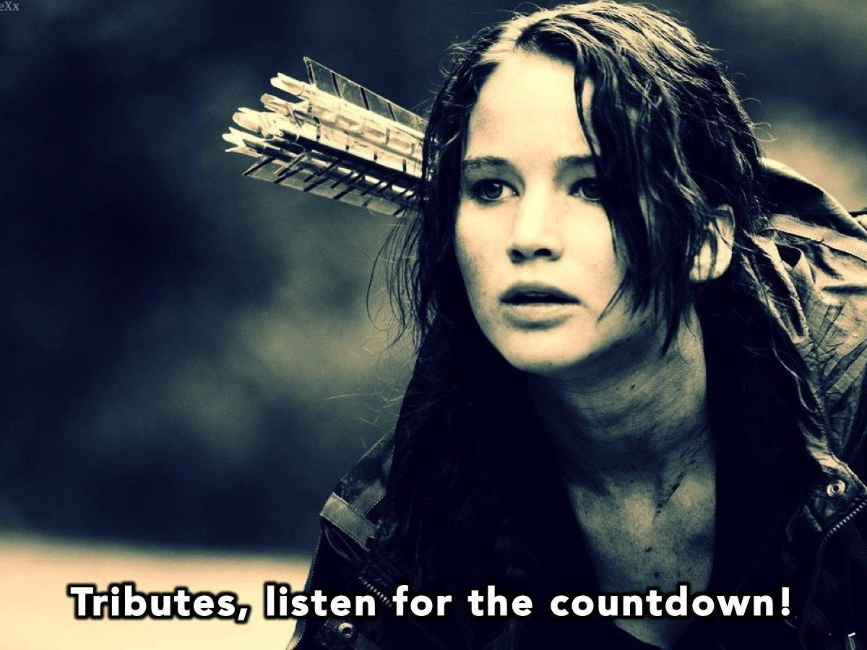
Notes:
Tributes, listen for the countdown!

Slide 32
Notes:
Video: HG Countdown 1. Get it on YouTube at: https://www.youtube.com/watch?v=gJstfFRLqCw

Slide 33
Notes:
Play the Peg Wars. The canon sound was taken from: Get it on YouTube at: https://www.youtube.com/watch?v=9mE162kNOB8. We played songs from The MockinJay Part 1 movie while the districts competed in the games.

Slide 34
Notes:
The Prizes: Winners of the 1st Hunger Games receive a prize for their District.

Slide 35
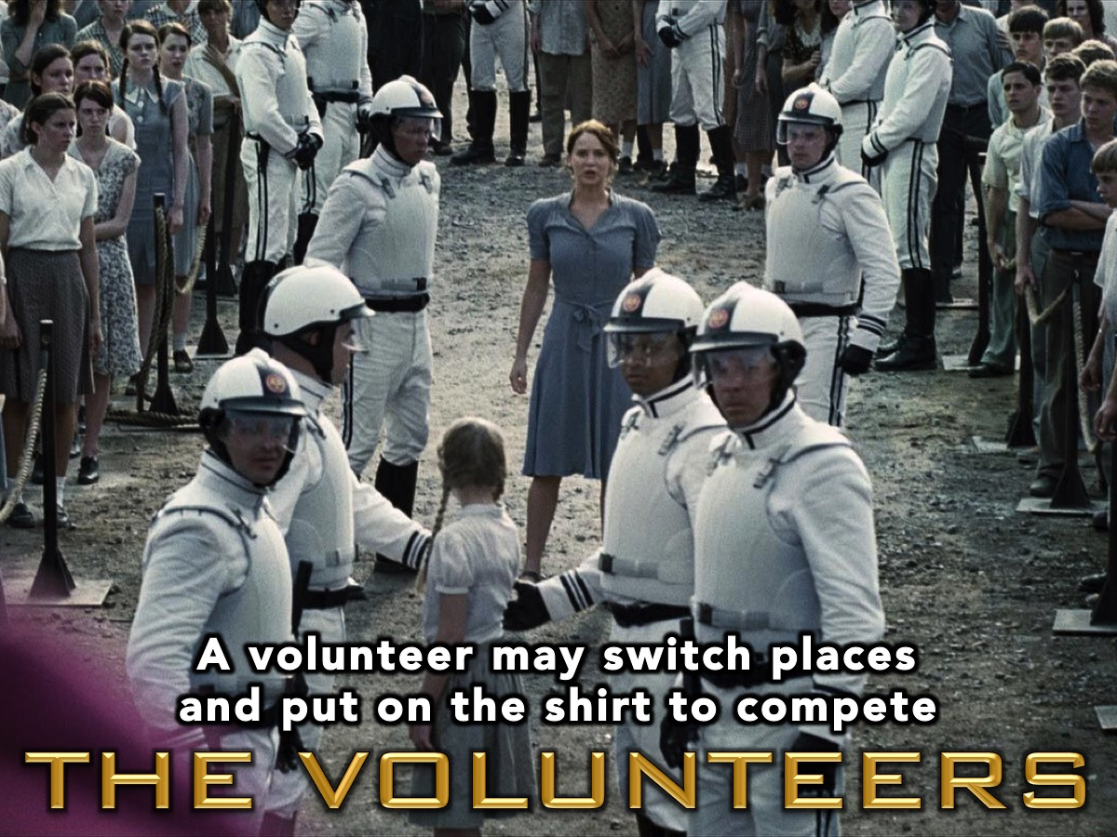
Notes:
The Volunteers: Each District must have a volunteer switch out with the tribute for the next round of the games.

Slide 36
Notes:
The 2nd Hunger Games: Tributes, please take your position in the marked area in front of your district!

Slide 37
Notes:
The rules of GRENADE WARS: (1) Each tributes has 2 grenades. (2) Each tribute will draw a district. (3) They have to kill that district first before killing other tributes. (4) The last tribute alive wins the Games.

Slide 38
Notes:
The Capitol’s Gift: Members of the Capitol have grenades and shields to give to selected tributes.

Slide 39
Notes:
Tributes, listen for the countdown!

Slide 40
Notes:
Video: HG Countdown 2. Get it on YouTube at: https://www.youtube.com/watch?v=CO3NlavHbcM

Slide 41
Notes:
Play the Grenade Wars game. The canon sound was taken from: Get it on YouTube at: https://www.youtube.com/watch?v=9mE162kNOB8. We played songs from The MockinJay Part 1 movie while the districts competed in the games.

Slide 42
Notes:
The Prizes: Winners of the 2nd Hunger Games receive a prize for their District.

Slide 43
Notes:
The Volunteers: Each District must have a volunteer switch out with the tribute for the next round of the games.

Slide 44
Notes:
The 3rd Hunger Games: Tributes, please take your position in the marked area in front of your district!

Slide 45
Notes:
The rules of STICKER WARS. In the Hunger Games if you get stung by the too many Tracker Jackers you will die. (1) You have a strip of stings. (2) You sting by putting stickers on shirts. (3) You must avoid getting stung. (4) You can’t remove stings. (5) If you get stung 5 times you’re out.

Slide 46
Notes:
The Capitol’s Gift: Members of the Capitol will place gifts in the middle of the arena that you can keep even if you get eliminated. You can retrieve the gift and place it in your triangle.

Slide 47
Notes:
Tributes, listen for the countdown!

Slide 48
Notes:
Video: HG Countdown 3. Get it on YouTube at: https://www.youtube.com/watch?v=ndViBlMn0V0

Slide 49
Notes:
Play the Sticker Wars game. The canon sound was taken from: Get it on YouTube at: https://www.youtube.com/watch?v=9mE162kNOB8. We played songs from The MockinJay Part 1 movie while the districts competed in the games.

Slide 50
Notes:
The Prizes: Winners of the 3rd Hunger Games receive a prize for their District.

Slide 51
Notes:
Congratulations to our winning District! Come up to the stage for your prizes and a photo!

Slide 52
Notes:
Small Groups: Here are the questions for our small group time: (1) What was the best moment of tonight’s Hunger Games experience for you? (2) In real life, when would you consider volunteering to take someone’s place so they avoid death? (3) What do you know about God stepping into time and space to volunteer to get you out of danger? (4) How have you responded to Jesus’ dying in your place to give you the gift of eternal life? (5) Can we pray for you to accept the gift of eternal life or be sure that you are already saved?

Slide 53
Notes:
Refreshments

