Slide 1
Notes:
Welcome to the Productive Life journey. In this series you will explore seven keys to living a productive life.

Slide 2
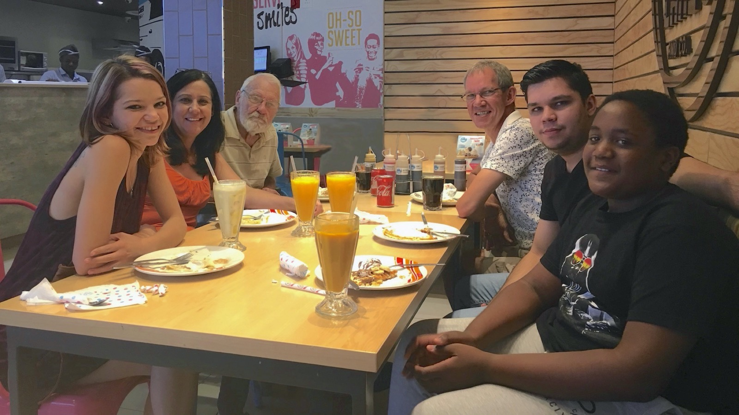
Notes:
Let me begin by introducing myself. I am married to Debbie and am the proud father of three “kids”: Keegan, Ashley and Drew.

Slide 3
Notes:
I am on staff at Every Nation Rosebank where I'm tasked with the responsibility of ensuring there's a leadership development pipeline.

Slide 4
Notes:
After years of having people ask me to help them get organised I got around to putting everything I know about into a book – and out popped this little book – hmmh, or rather let me say that I birthed it over the last 3 decades. It is available on Amazon or Takealot but more about it later.

Slide 5
Notes:
Here is an overview of the 7 keys to living a productive life that I explore in my book…

Slide 6
Notes:
When you struggle to find meaning in life... Key #1 will help you Live Your Mission.

Slide 7
Notes:
When you forget to do important things... Key #2 is Manage Your Actions

Slide 8
Notes:
When you battle to break or keep habits... Key #3 will help you Build Your Habits.

Slide 9
Notes:
When you neglect important areas... Key #4 will help you Plan Your Time.

Slide 10
Notes:
When you get easily distracted... Key #5 will help you Focus Your Mind.

Slide 11
Notes:
When you fight to be productive... Key #6 will help you Know Your Self.

Slide 12
Notes:
When you run on empty... Key #7 will help you Renew Your Energy.

Slide 13
Notes:
So those are the 7 keys to living a productive life that we are going to explore in the coming sessions.

Slide 14
Notes:
Understanding Productivity
For me, the Productive Life is all about being excellent and doing great things through your whole life and not just in your work life. Just imagine what your life would be like if you invested significant time and energy in the pursuit of productive rest, play, hobbies, spirituality, work life, family life, friendships, etc.

Slide 15
Notes:
I have a section in the weekly review page where each week you think of one thing you can do to grow in the following key life areas: Spirituality, Health, Partner, Family, Friends, Work, Finance, Hobbies; Community and Giving.

Slide 16
Notes:
You may have seen an image like this before – how much can you fill this bucket? The lowest point is the highest! In life it does not really count if you are excellent in a few areas are a disaster in others! The Bible calls us to excel in every area of our lives! “Since you excel in everything – in faith, in speech, in knowledge, in complete earnestness and in the love we have kindled in you – see that you also excel in this grace of giving”. (2 Corinthians 8:7)

Slide 17
Notes:
Do you ever feel like this? Like you are spinning plates and some are in danger of falling!

Slide 18
Notes:
I learnt about the importance of living a productive life the hard way: I will never forget the day I came home from work and found my wife in tears having made a decision to leave with the kids. She actually said: “Why should we stick around when you are never around?” It took weeks of counselling and significant changes to my approach to life and work to rescue my marriage. Thankfully the situation was turned around and after 33 years of marriage we are still together and I can honestly say that I have never allowed myself to get back into a place where one area of my life takes over like it did back then!

Slide 19
Notes:
This online workshop is all about leading and managing your life. Your WHOLE life!!! And the starting point is to Live Your Mission which is the first of seven keys to Living a Productive Life.

Slide 20
Notes:
To discover your mission and put it into action – instead of worrying on the sidelines – is to find peace of mind and a heart full of love. Scilla Elworthy

Slide 21
Notes:
The one book you should read for this Productivity Key is: The Seven Habits of High Effective People by Stephen R. Covey.

Slide 22
Notes:
Preview: There are four steps to live your mission:
(1) Define Your Mission
(2) Identify Your Roles
(3) Create Your Goals
(4) Plan Your Week

Slide 23
Notes:
Step #1: Define Your Mission
The first step to live your mission is to define your mission. It is critical that you figure out what you want to achieve with your life.

Slide 24
Notes:
Reflection: Have you ever created a mission statement for your life? If No, “Why not?” If Yes, “So what?”

Slide 25
Notes:
What is Mission? Here are some definitions to help you understand what I mean by “mission”:

Slide 26
Notes:
Peter Senge, a business leader once wrote: “Mission is what you want to create of yourself and the world around you.”

Slide 27
Notes:
George Barna says that: “Mission is a clear mental picture of a preferable future imparted by God to His chosen servants based upon an accurate understanding of God, self and circumstances."

Slide 28
Notes:
“Mission is what you want to be and do to others to impact them positively during your life-time.”

Slide 29
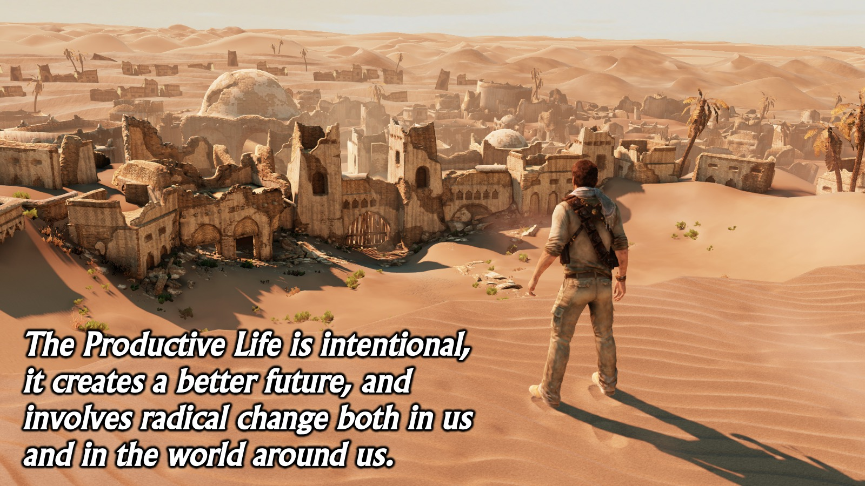
Notes:
These authors are describing a life that is intentional, that creates a better future, that involves radical change both inside of us and in the world around us – this is a Productive Life.

Slide 30
Notes:
Creating that kind of a life starts by writing a personal mission statement that describes the kind of life we want to live and the difference we want to make in the world in which we live.

Slide 31
Notes:
How do you write a Mission Statement?
During my training of leaders across the continent of Africa, I adopted a four-step process to writing a mission statement based on answers to four questions.

Slide 32
Notes:
It will be helpful to see where we are going with this process – here are the four sections of the mission statement that we will work through step by step. As I explain each section you will start to craft your mission statement!

Slide 33
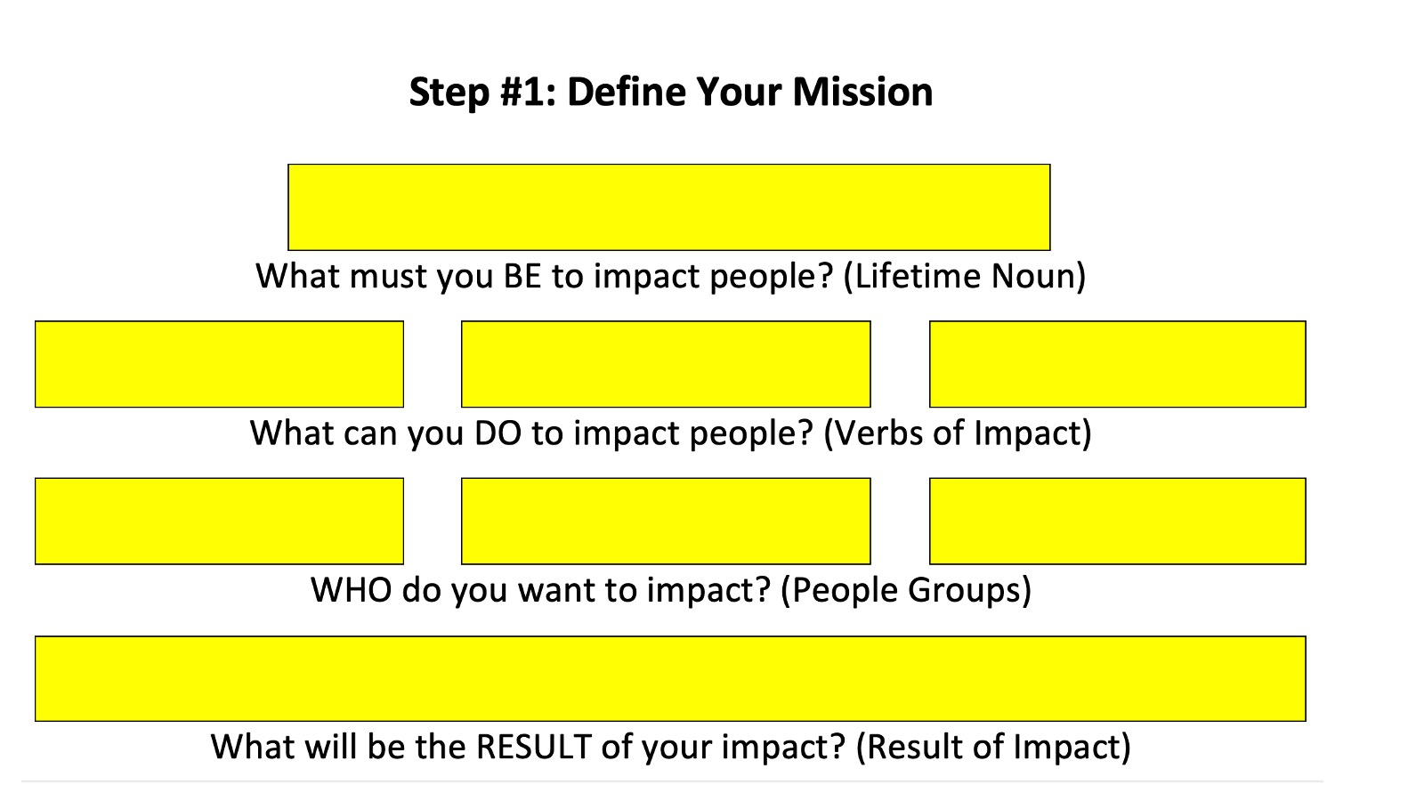
Notes:
Find this section in your workbook and use it to craft your mission statement as we take the next four steps!

Slide 34
Notes:
Question #1: What must you BE to impact people?
The first question forces you to start with your “being” rather than your “doing”. As you answer this question, think about the kind of person you want to be. Choose a noun that reflects what you want to be throughout your life. Imagine the best version of yourself. Write down what you believe you were meant to be! Your lifetime noun is not a job title or a profession. It should not need to change even when you change your job or near the end of your life. Keep it as short as possible – use a single word, or a hyphenated phrase or, at most, three or four words.

Slide 35
Notes:
Question #2: What can you DO to impact people?
The second question focusses on what you will do when you are living out the lifetime noun you chose in the first question. Write down three ways in which you will impact the people in your sphere of influence to bring change in the world using verbs – i.e. action or doing words.

Slide 36
Notes:
Question #3: WHO do you want to impact?
The third question is all about the different groups of people in your sphere of influence that you will impact as you live your mission. Make sure that it is as broad as possible and does not just refer to your work environment. Include your friends and family in the groups and if at all possible, try and end up with 3 groupings of people that cover your whole network of relationships.

Slide 37
Notes:
Question #4: What will be the RESULT of your impact?
The final question deals with what you believe your impact will accomplish in the lives of the people groups or the world in general. This is a statement about the ultimate outcome of your engagements with people.

Slide 38
Notes:
By now you should have all your key words for your Mission Statement…

Slide 39
Notes:
Write out your mission statement, using as few words as possible, in a single sentence! Now you are ready to write your mission statement in one sentence, memorise it and connect with it every day as you live through each experience.

Slide 40
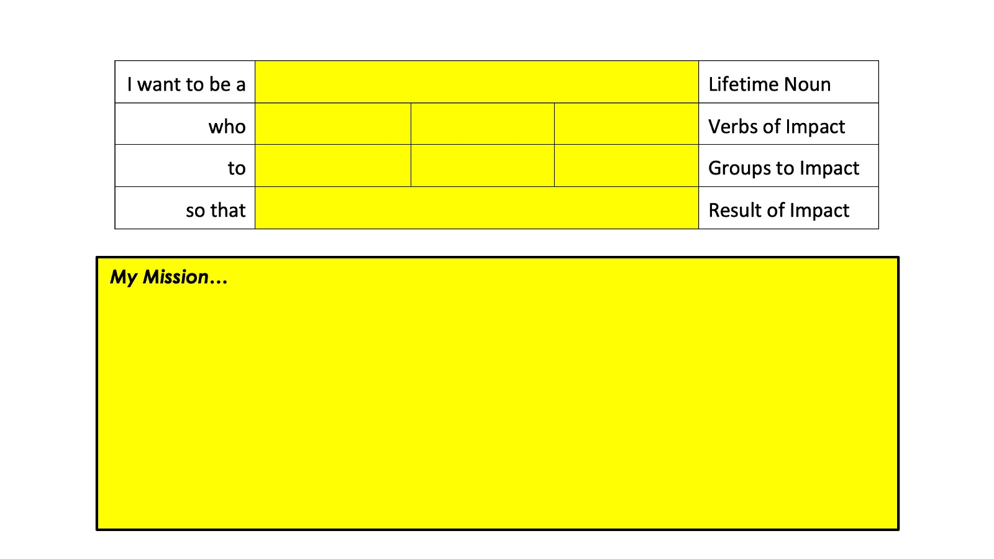
Notes:
Move to the next section in your workbook and use it to write your Mission Statement out in one sentence.

Slide 41
Notes:
Here is an example of my mission statement: My mission is to be a Christ-follower who equips family, friends and next generation leaders to be disciplemakers. Notice how it covers all of my life and the diverse groups of people I want to impact and also speaks of an ongoing end result. This is a significant step towards me living a Productive Life!

Slide 42
Notes:
Here is an example of a temporary mission statement that I am using for this Lockdown period: “I am a Value-Adder who trains, coaches and mentors family, friends and followers to be productive at life and work.”

Slide 43
Notes:
Many people write mission statements but they often get filed away or don’t actually result in significant life change or impact. To avoid this happening to you, it is critical that you take the next three steps to live your mission.

Slide 44
Notes:
Step #2: Identify Your Roles. Roles are the contexts in which you live out your mission.
The second step to live your mission is to identify your roles. Your mission must be lived through your whole life and one way to ensure that happens is to identify the roles you play in life. These are the contexts in which you live out your mission. The roles that I am currently tracking are: Disciple, Husband, Father, Pastor, Coach and Author.

Slide 45
Notes:
There are 3 steps to identifying your roles:
1. List all the roles you play in life: Brainstorm all the possible roles you play in life. Think of every “hat” you wear, every different way in which you show up in life. Keep going until you have identified at least 10 to 15 roles.
2. Group the roles into categories: You may be feeling a little overwhelmed with that long list of roles but don’t give up just yet because the next two steps will help you as to group related roles and reduce them to categories.
3. Select five or six roles to work with: If you choose more than six roles you will struggle to actually lead and manage your life.

Slide 46
Notes:
Move to the next section in your workbook and use it to identify all the Roles you have in life…

Slide 47
Notes:
Move to the next section in your workbook and use it to group all the Roles into categories…

Slide 48
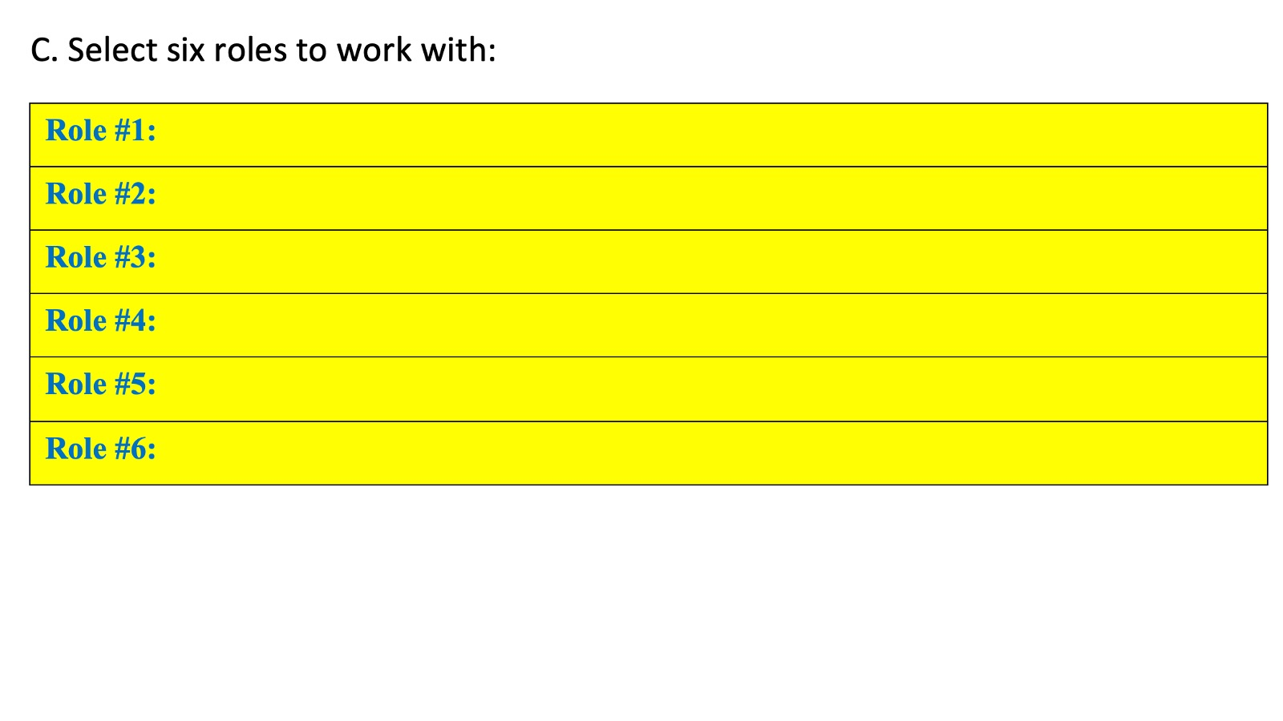
Notes:
Move to the next section in your workbook and use it to select six Roles to work with…

Slide 49
Notes:
Step #3: Create Your Goals. Goals are a key to helping you achieve your mission.
The third step to live your mission life is to create your goals.

Slide 50
Notes:
Now that you have defined the roles you play in life you need to create goals for each role. You could use the SMART goal approach where you ensure that your goals are Specific, Measurable, Attainable, Realistic and Timely, or the DUMB goal approach where you create goals that are: Dream-driven; Uplifting; Method-friendly and Behavior-driven (http://bit.ly/Productive_DUMB). Create 2 or 3 goals for each of your roles. Make them SMART: Specific, Measurable, Attainable, Realistic and Timely. You can create goals by asking yourself: “What is the most important thing I could do this week to have the greatest positive impact on this role.” While many goals may come to mind, you should limit yourself to just a few important goals for each role. Use the worksheet or a sheet of paper and, with your mission statement in mind, list each of your 6 roles and create three goals for each role.

Slide 51
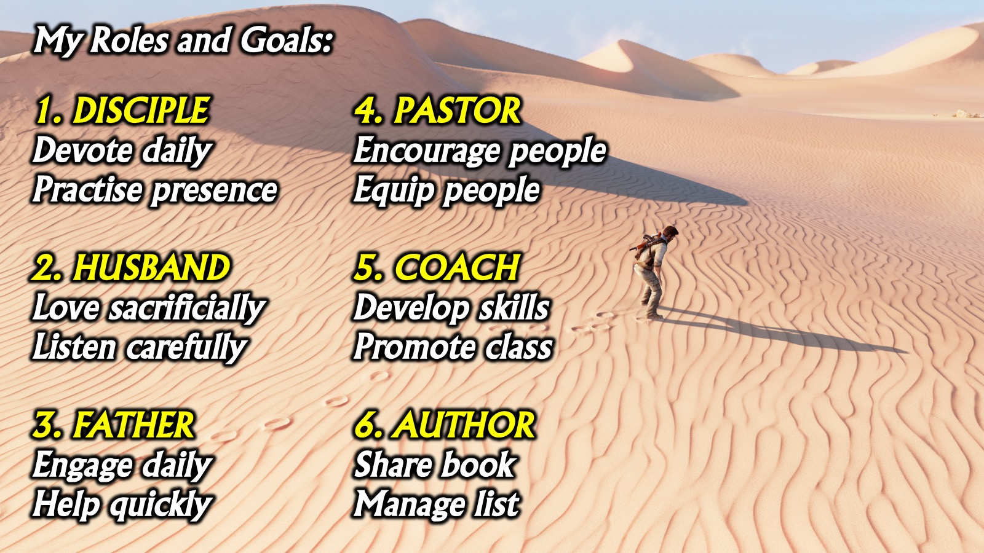
Notes:
Here is an example of my Roles and Goals: (1) DISCIPLE: Devote daily. Practise presence. (2) HUSBAND: Love sacrificially, Listen carefully. (3) FATHER: Engage daily, Help quickly. (4) PASTOR: Encourage people, Equip people. (5) COACH: Develop skills, Promote class. (6) AUTHOR: Share book, Manage list.

Slide 52
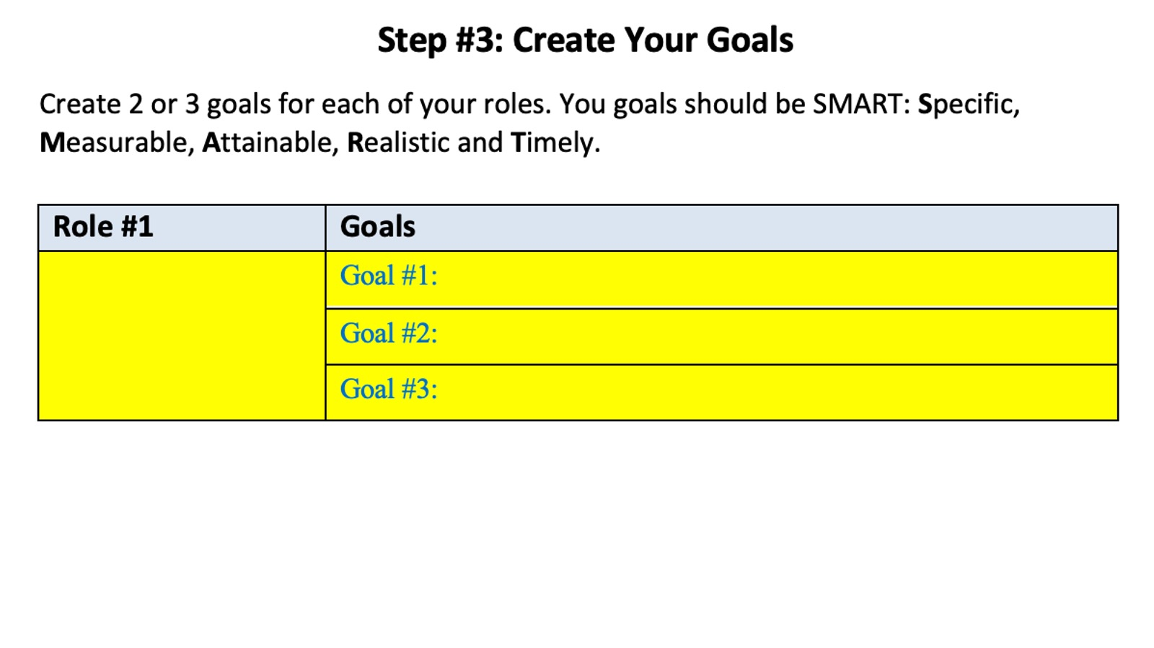
Notes:
Move to the next section in your workbook and use it to create 2 or 3 Goals for each of your Roles…

Slide 53
Notes:
Step #4: Plan Your Week
The fourth step to live your mission is to plan your week. So far to help you manage your life, you have defined your mission, identified your roles and created goals for each role. The next step is to actually live your mission during your week.

Slide 54
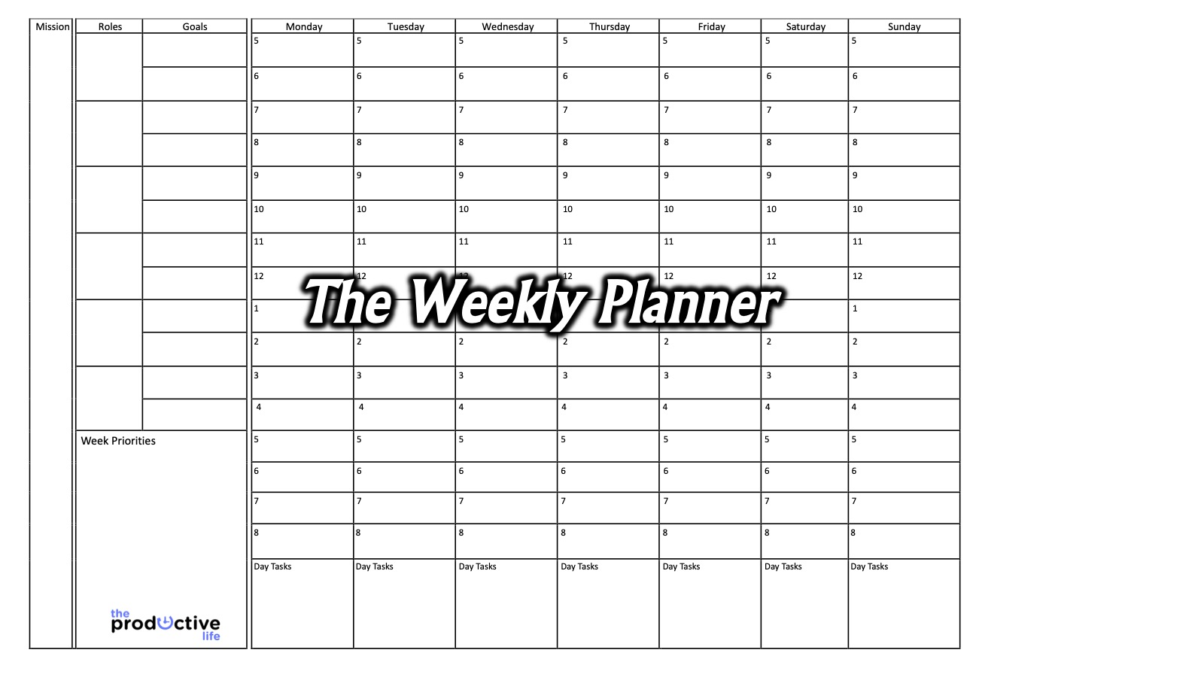
Notes:
The Weekly Planner: Stephen Covey in First Things First explored the idea of a weekly planner. Get your copy of the weekly planner and fill it in as we go. You may not get to finish it as it takes about 30 minutes to complete and should be done at the start of each week.

Slide 55
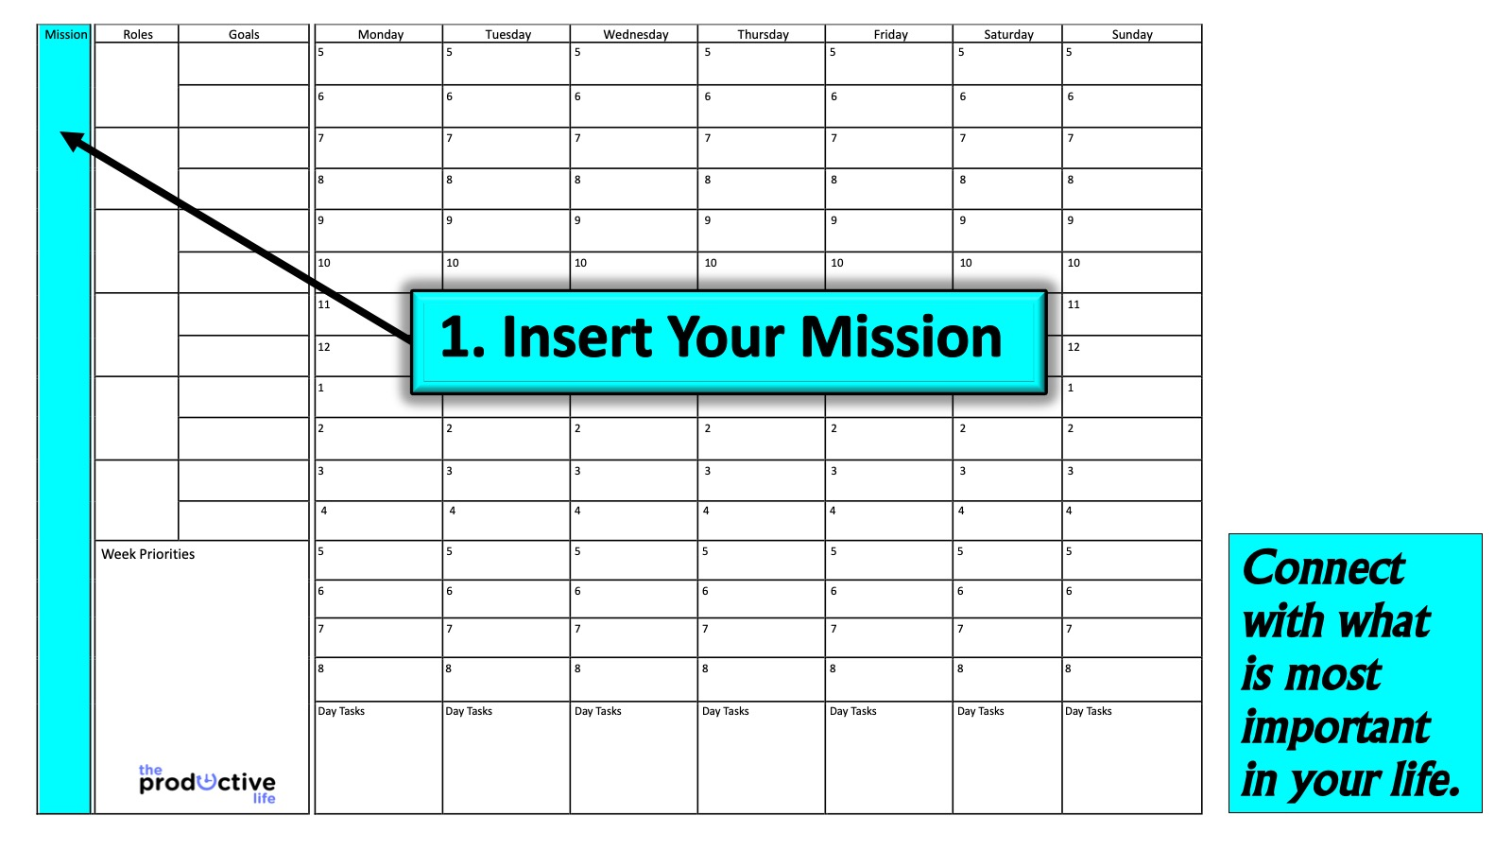
Notes:
1. Insert Your Mission: The first step in planning for the coming week is to connect with what is most important in your life. You do this by reading your mission statement to remind you of what is most important in your life. This process will help you schedule important activities into your week to move you closer to living your mission.

Slide 56
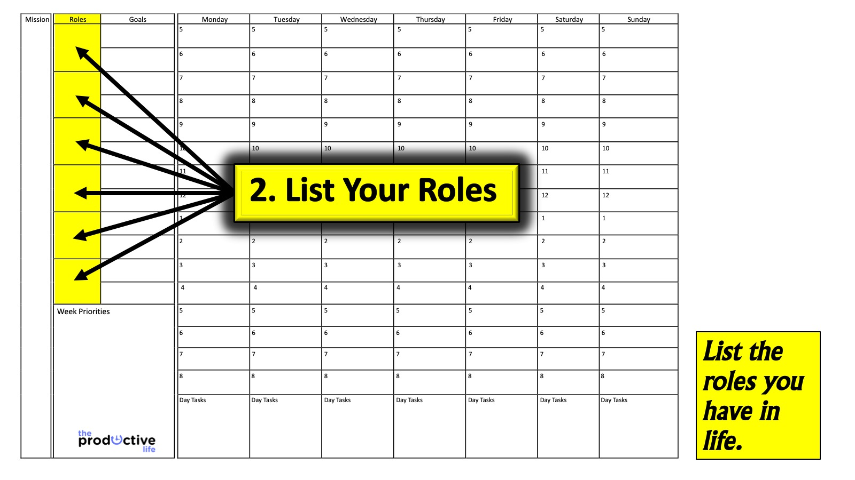
Notes:
2. List Your Roles: Connect with the roles that you have in life and set an intention to live your mission through each of them during your day.

Slide 57
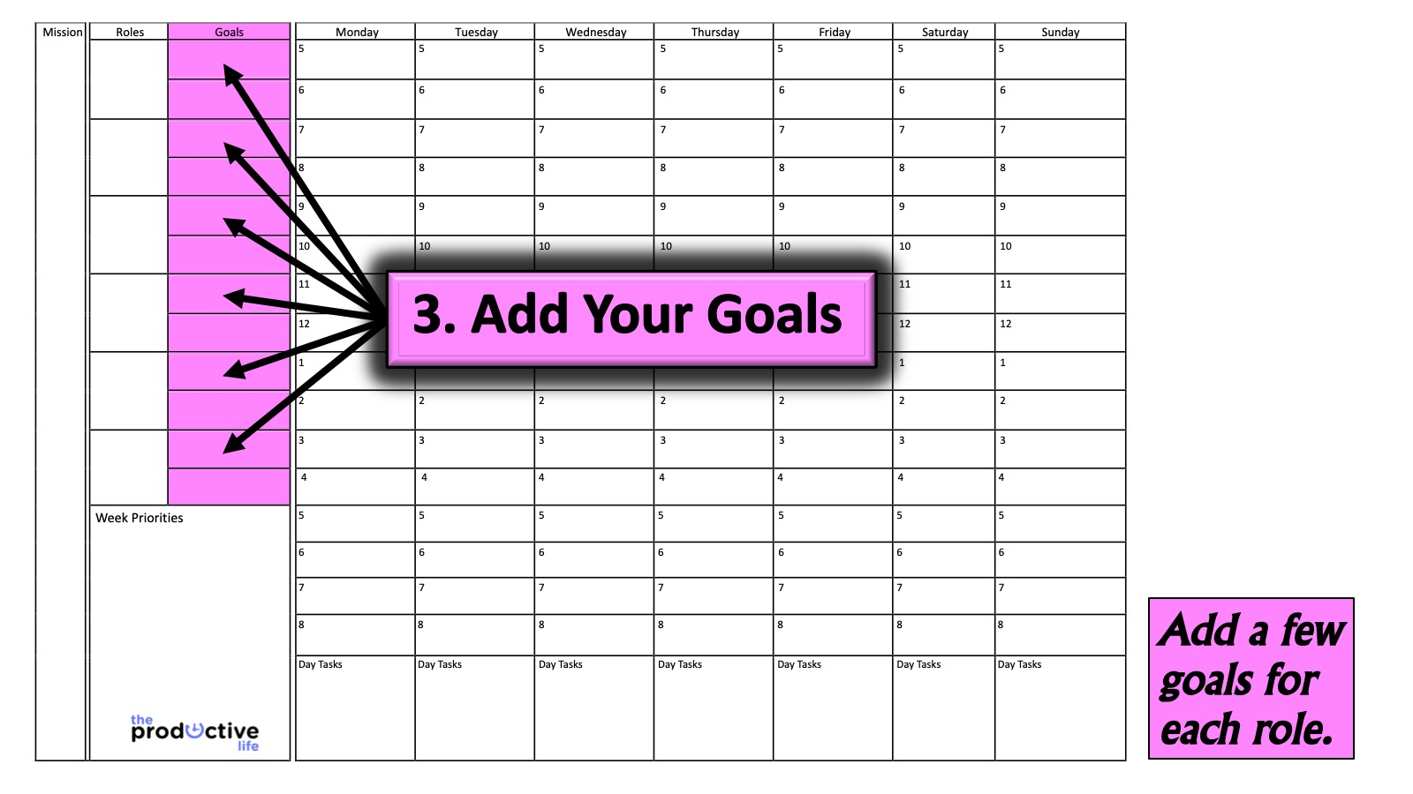
Notes:
3. Add Your Goals: Write down the goals that you have chosen for each of the roles you identified.

Slide 58
Notes:
Video: Stephen Covey and the Big Rocks at:
Source: bit.ly/TPL_Rocks

Slide 59
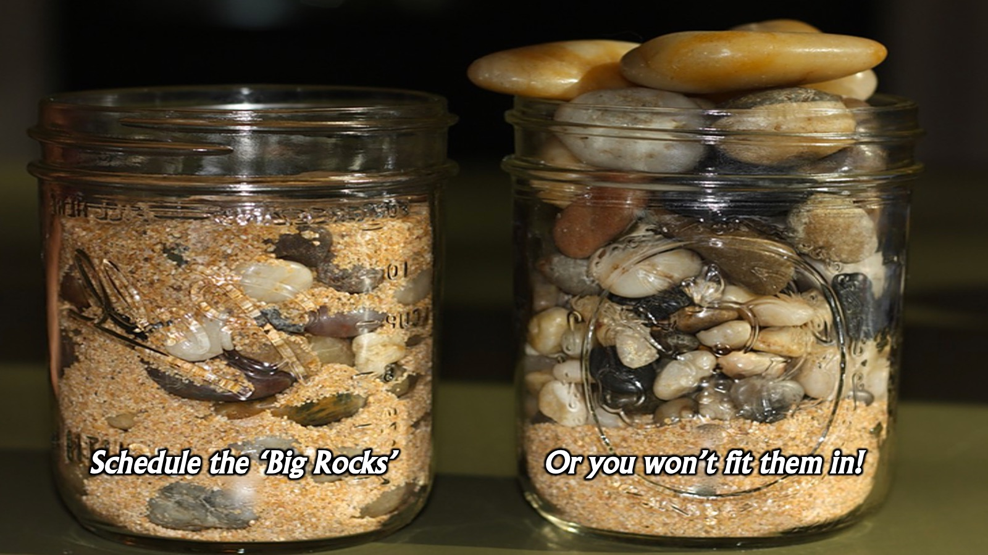
Notes:
In the video Stephen Covey showed how you can place big rocks in a jar and you can still add stones and sand but you can’t do it in opposite order. We have to schedule the most important things into our lives or they will be crowded out with things of lesser importance.

Slide 60
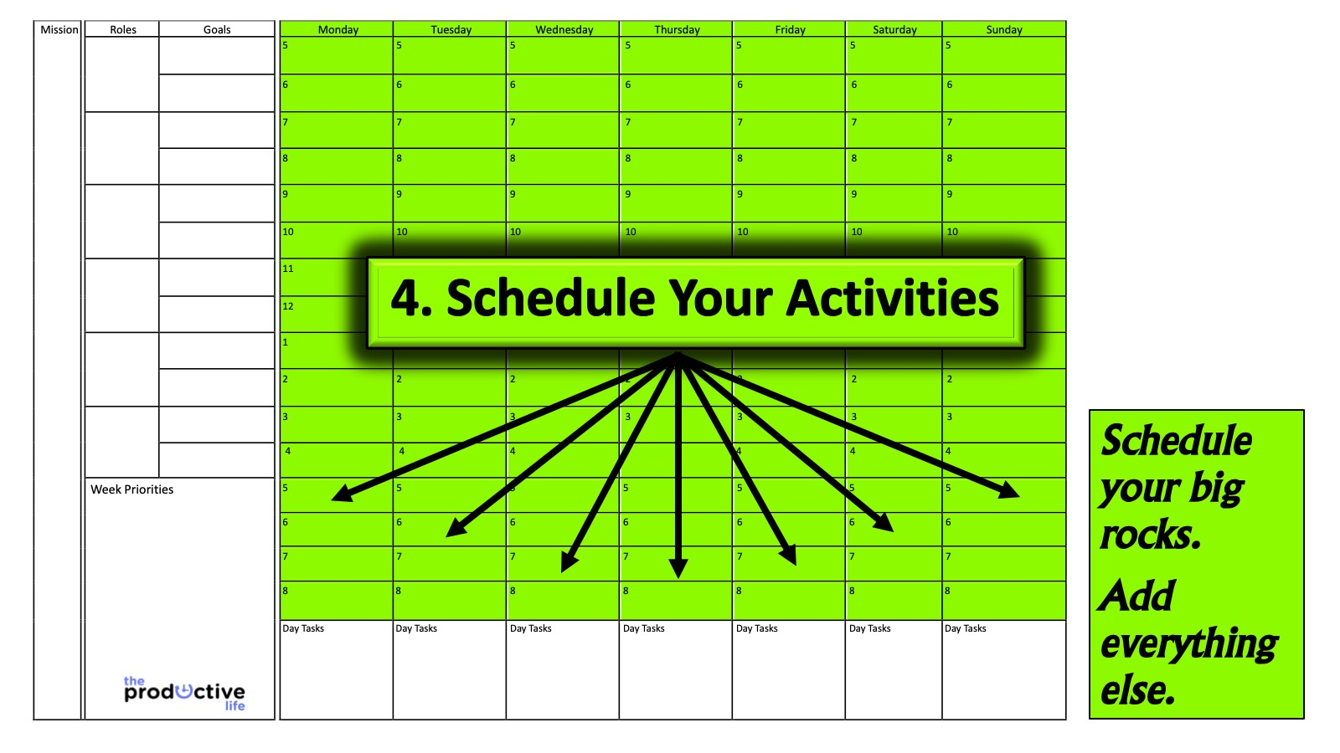
Notes:
4. Schedule Your Activities: Schedule important activities in your calendar before the week starts. Next you need to add everything else: Now you can fill in the little to-dos, daily tasks and appointments. You may like to record upcoming events and activities as well.

Slide 61
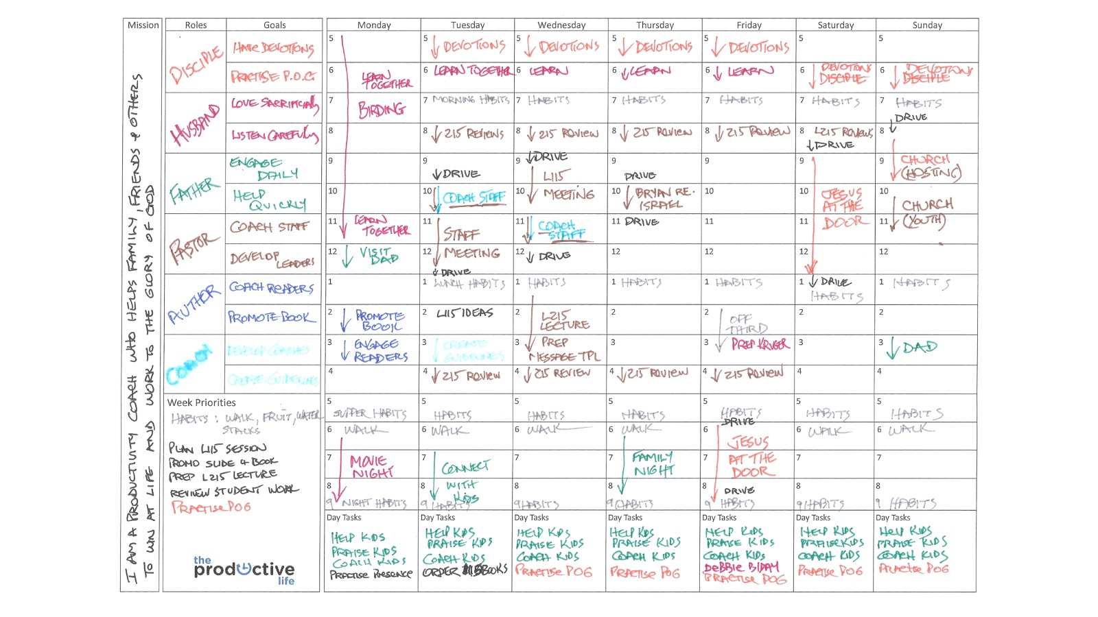
Notes:
Here is an example of a completed weekly planner - using colour coding for each of the 6 Roles and related Goals and activities..

Slide 62
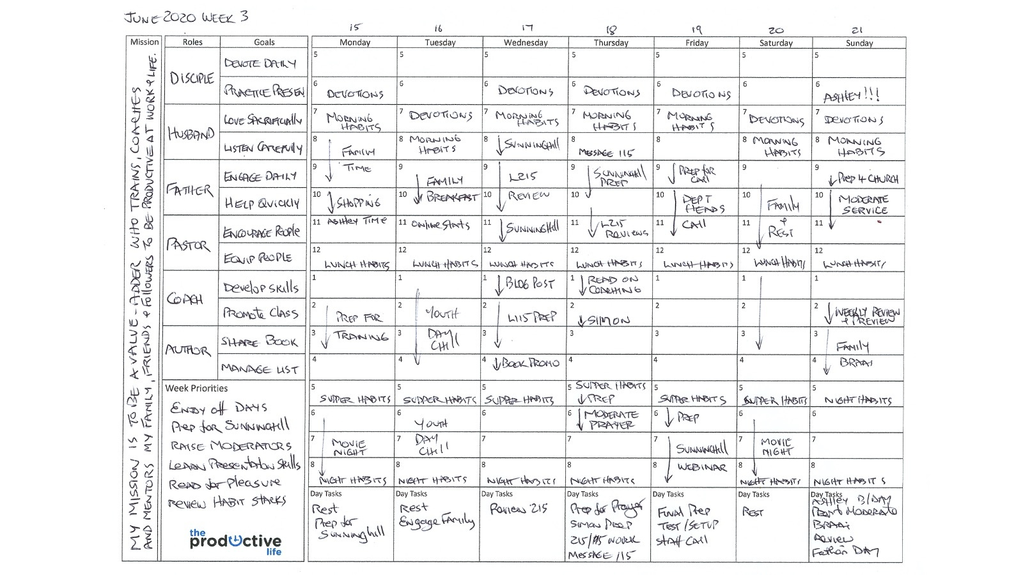
Notes:
Here is an example of a completed weekly planner - this is a lockdown version and is orientated around my rallying cry for this season which is to add value to people!

Slide 63
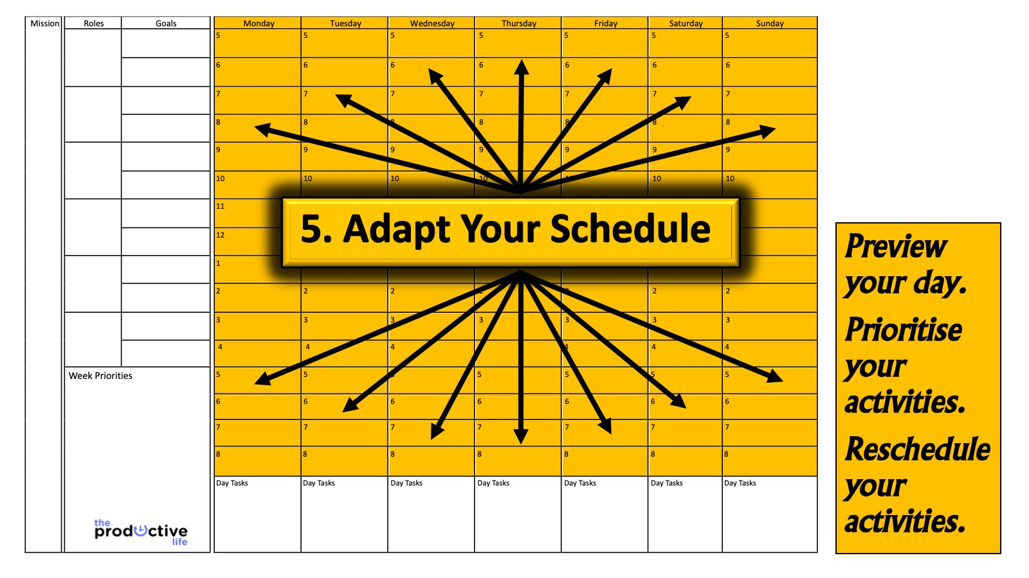
Notes:
5. Adapt Your Schedule: As you move through your day you will deal with unexpected opportunities and challenges that arise. Planning is never a waste of time, even if you have to move things around in the moment. Knowing what needs to be done and having a system to actually get things done won’t stop stuff happening to mess with your schedule but it will allow you to recover more quickly and still live your mission.

Slide 64
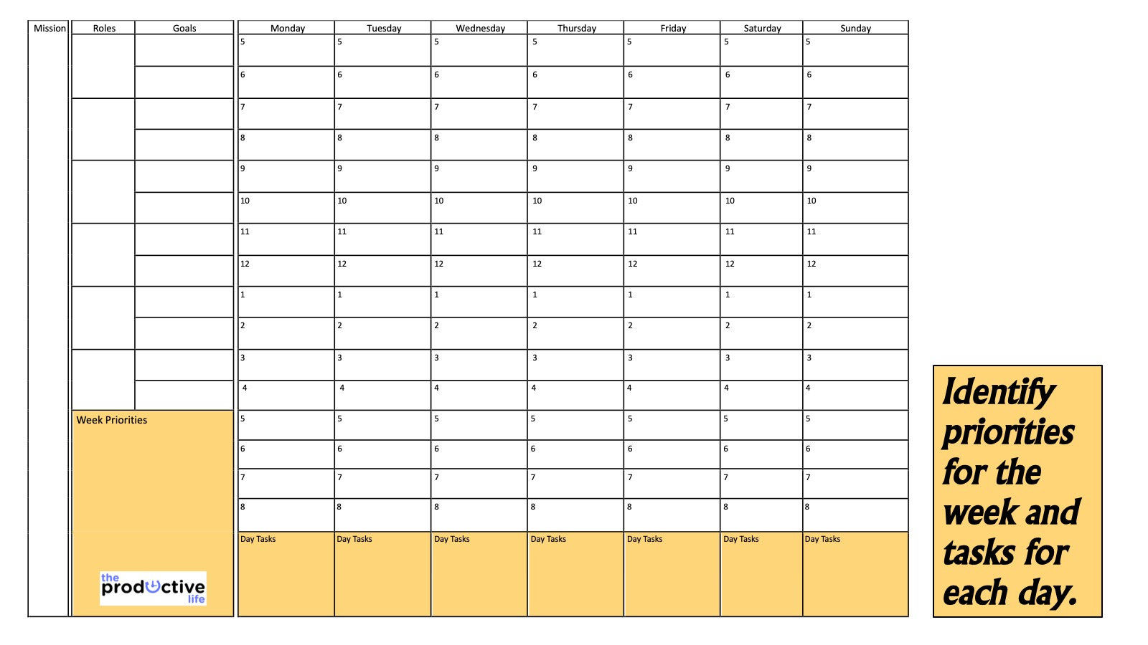
Notes:
Identify priorities for the week and tasks for each day: There is a space for you to identify the key priorities you must focus on for the coming week and also the tasks that you absolutely must completed each day!

Slide 65
Notes:
6. Evaluate Your Progress: Make time at the end of each day, week, month and year to look back on what happened, what you accomplished, what you learnt and what you need to do better going forward.

Slide 66
Notes:
Review: We have explored four steps to Live Your Mission: (1) Define your Mission; (2) Identify your Roles; (3) Create your Goals and (4) Plan your Week.

Slide 67
Notes:
The Bonus Step: Here is a bonus step to live your mission:

Slide 68
Notes:
Step 5: Control Your Time
The fifth step to live your mission is to control your time. During the past decades I have come up with a list of guidelines which have allowed me to take control of my time to actually live a Productive Life:

Slide 69
Notes:
1. Balance Your Whole Life: Make sure your productivity system covers the whole of your life and not just your work. Your personal life, your family, your work and your hobbies are all important and need to be kept in balance. Make sure all these areas are reflected in your planner.

Slide 70
Notes:
2. Empower People and Delegate Effectively: Don’t do everything yourself – give things to others to do. I heard Andy Stanley in a Podcast say: “Only do what only you can do!”

Slide 71
Notes:
3. Get Organised: Develop a filing system and keep your working or living spaces tidy.

Slide 72
Notes:
Here are some best practices for filing: (1) Create Your System: It should work for you and allow you to retrieve a document in the quickest amount of time possible. (2) Identify Your Categories: List the categories you could file items under and create a folder or hanging file for each item. (3) Clear Your Backlog: Work though everything on your desk or shelves by picking it up and asking: (a) What is it? (b) Do I need to act on it? (c) Can I file it? (4) Manage Your Filing: Set aside time regularly to file material so you don’t end up with a huge pile of items to file.

Slide 73
Notes:
4. Schedule Think Time in Your Week: Create a weekly appointment with yourself in your calendar where you can think about what is going on in your life, plan ahead and get on top of your workload.

Slide 74
Notes:
5. Take Time to Give Time: Don’t accept invitations or requests for your time too quickly. Think about the amount of preparation time you will need to invest if you accept an invitation. Ask the person to give you some time to respond to their request.

Slide 75
Notes:
6. Work Two Thirds of the Day: Work morning and afternoon or morning and evening or afternoon and evening but don’t work all three parts of the day. There can be exceptions to this rule but don’t let it become a regular habit or other areas of your life will suffer!

Slide 76
Notes:
7. Handle a Piece of Paper Once: Don’t pick up stuff and then put it aside for later - deal with it once! This applies to handling digital material too. David Allen speaks about the 2 Minute Rule where if you can get something done in less than 2 minutes you do it rather than schedule it for later action.

Slide 77
Notes:
8. Always Have Something to Do: Carry something with you that you can do if you are left waiting. It could be a book or an article to read, a project to plan, an email to send, a call to make, etc. Of course, you could choose to spend time thinking or meditating when you are left waiting so that is also an option.

Slide 78
Notes:
9. Keep Information at Your Fingertips: Develop a good system to keep track of phone numbers, addresses, key information, etc. Reduce the amount of time you spend looking for stuff by getting organised and staying organised.

Slide 79
Notes:
10. Work with Task Check Lists: Keep a list of everything you need to get done and cross off tasks when you complete them. We will explore best practices for this area in the next chapter.

Slide 80
Notes:
11. Automate Regular Tasks: Don’t start working from scratch each time you repeat a task. Create templates for tasks you do regularly so you can save time and get things done more efficiently.

Slide 81
Notes:
12. Confirm Appointments: Before you leave for a meeting check that the person you are supposed to be meeting is still available to meet. This will often save you from wasting time if they are not available. I am seldom left waiting because I check in to confirm appointments an hour before a meeting and reschedule the appointment if necessary.

Slide 82
Notes:
13. Deal with Interruptions.

Slide 83
Notes:
Here are some ways to handle interruptions so you remain productive and honour people who interrupt you: (1) Realize that not every interruption is an interruption. Life is about responding to the needs of people around you. Some interruptions are actually significant opportunities for engagement. (2) Give people the information they need so they don’t need to interrupt you. Think ahead about information people may need or questions they may ask and be proactive with what you give them. (3) Set up meeting times. If people want to meet with you, then suggest a time when you are available to meet with them that is convenient for both of you. (4) Evaluate your interruptions. Keep a list of your interruptions for two weeks. You will probably discover that 80% of your interruptions are caused by three or four people. Take them aside and have a conversation with them about respecting times when you do not want to be interrupted and find a suitable time to meet. (5) Stand up when interrupted in your office. Most people will feel too uncomfortable to sit down if you remain standing while they're in your office. If you sense that the interruption is really significant then you can sit down and invite them to take a seat. Otherwise, remain standing and schedule a time to meet once you have assessed their immediate concerns. (6) Schedule your interruptions. Schedule an “open” time when you are most available for meetings, questions or phone calls. Let everyone know that this is the best time you can be reached. And of course, make sure you are available during those times!

Slide 84
Notes:
Review: In the first key to living a Productive Life you explored five steps to live your mission: (1) Define your Mission; (2) Identify your Roles; (3) Create your Goals; (4) Plan your Week and (5) Control your Time.

Slide 85
Notes:
Podcast: The podcast for this Productivity Key is: Craig Groeschel Leadership Podcast. You should specifically look out for the following episodes: It's About Time and 6 Steps to Your Best Year of Leadership.

Slide 86
Notes:
Challenge: Find your mission in life and live it out through all your roles using goals with activities that you track in your weekly planner.

Slide 87
Notes:
So this is my book…

Slide 88
Notes:
Here is the link to my book on Amazon (bit.ly/TPL_BOOK) and a print version is also available on Takealot (bit.ly/TPL_Takealot).

Slide 89
Notes:
Here are links to the eBook version on Amazon (bit.ly/TPL_BOOK) and a print version on Takealot (bit.ly/TPL_Takealot).

Slide 90
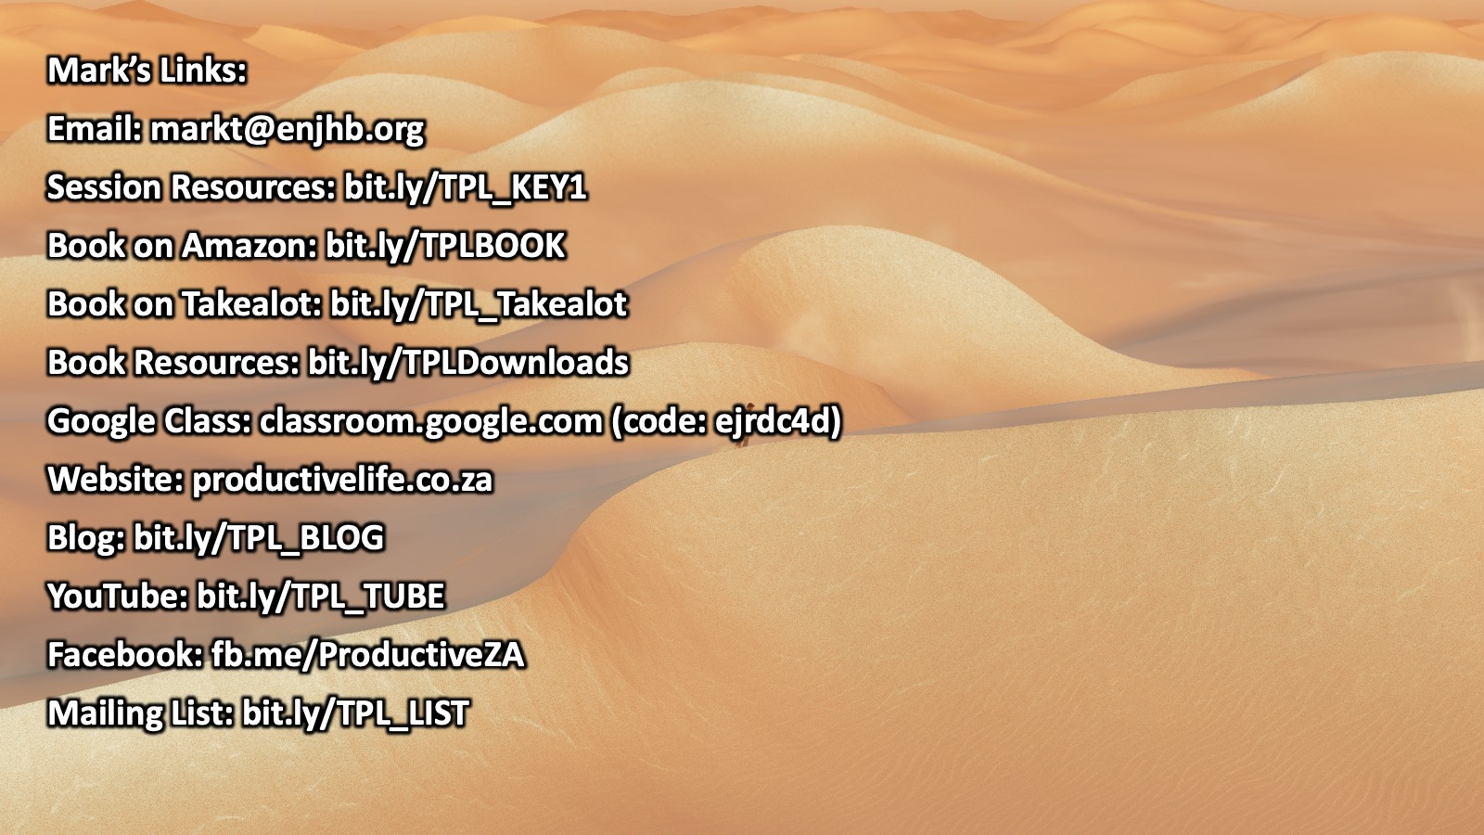
Notes:
Here are all the links you will need to contact me or to access my work:
Email: markt@enjhb.org
Session Resources: bit.ly/TPL_KEY1
Book on Amazon: bit.ly/TPLBOOK
Book on Takealot: bit.ly/TPL_Takealot
Book Resources: bit.ly/TPLDownloads
Google Class: classroom.google.com (code: ejrdc4d)
Website: productivelife.co.za
Blog: bit.ly/TPL_BLOG
YouTube: bit.ly/TPL_TUBE
Facebook: fb.me/ProductiveZA
Mailing List: bit.ly/TPL_LIST

Slide 91
Notes:
The Resources Folder: I have created a folder of resources on Google Drive for you to access material from our session – including the PowerPoint and my notes. Here is the link to the folder: bit.ly/TPL_KEY1

Slide 92
Notes:
Here is an overview of the 7 keys to living a productive life that I explore in my book…
Key #1: Live Your Mission (we covered this today)
Key #2: Manage Your Actions
Key #3: Build Your Habits
Key #4: Plan Your Time
Key #5: Focus Your Mind
Key #6: Know Your Self
Key #7: Renew Your Energy

Slide 93
Notes:
Preview: In the second key to living a Productive Life you will learn how to Manage Your Actions.

