Slide 1
Notes:
Are there lessons to be learnt for leadership in a hobby like birding? Well, I have been doing some serious bird photography since the beginning of 2010 – the upgrade to a bigger zoom lens made it possible for me to get that much closer to birds! There are 953 bird species in Southern Africa and my goal is to photograph each one. I recently realised that my hobby is teaching me a great deal about life and leadership. Recently I got to share devotions with the 60 or so leaders of the church where I serve as youth pastor. I spoke about lessons for life that birding has taught me. fore unprepared. As a soldier in the military I was trained to be not just on time, but early to be prepared for anything unexpected. So get there early so that you can lead the meeting effectively.

Slide 2
Notes:
Hey, Jesus did the same thing when we said to his followers: Consider the crows. They don’t plant or harvest. They don’t even have a storeroom or a barn. Yet, God feeds them. You are worth much more than birds. (Luke 12:24). So, here are some lessons that I have learnt while doing bird photography:

Slide 3
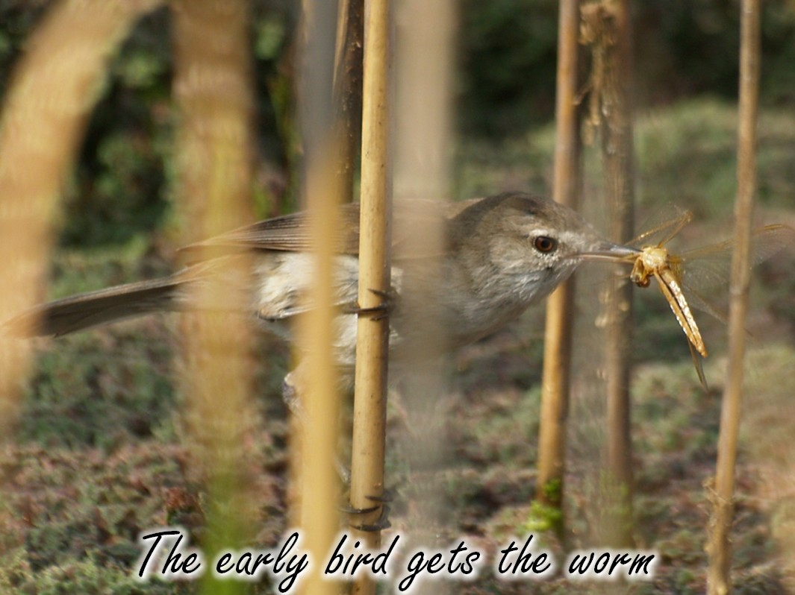
Notes:
There is a great parable that says: The early bird gets the worm. Here are some pics I have taken where the bird clearly has gotten it’s worm…

Slide 4
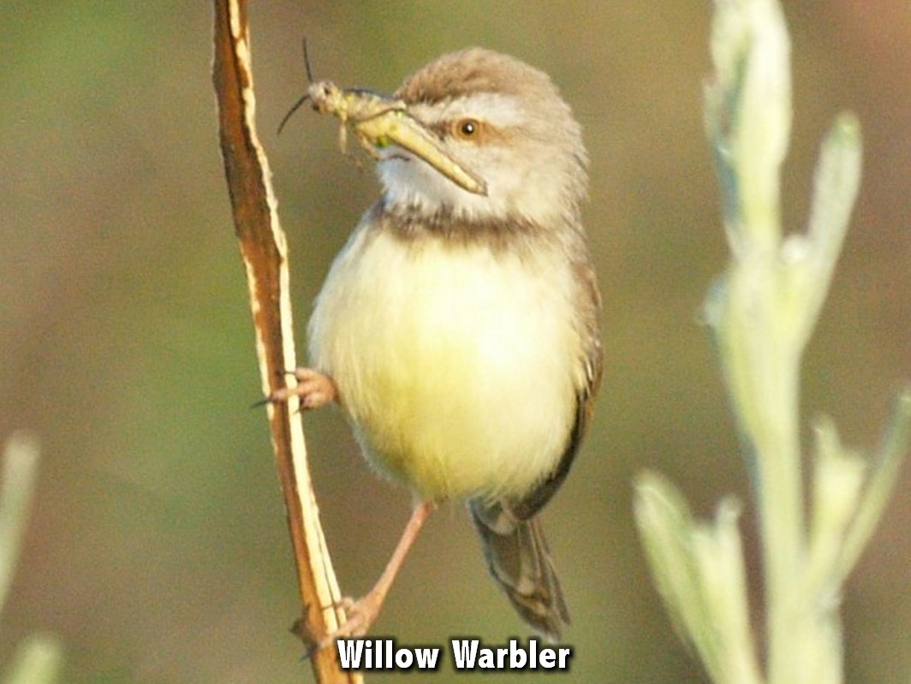

Slide 5
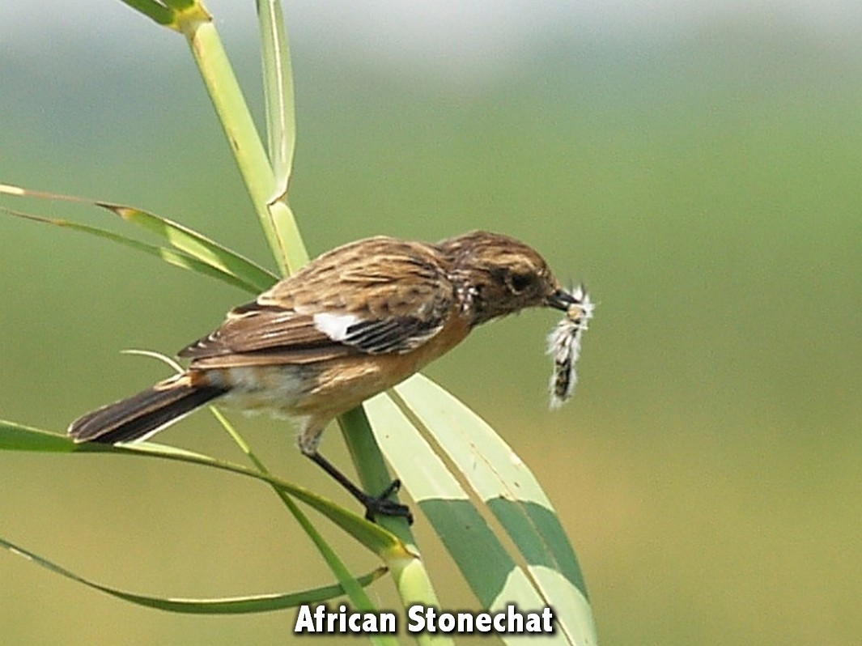

Slide 6
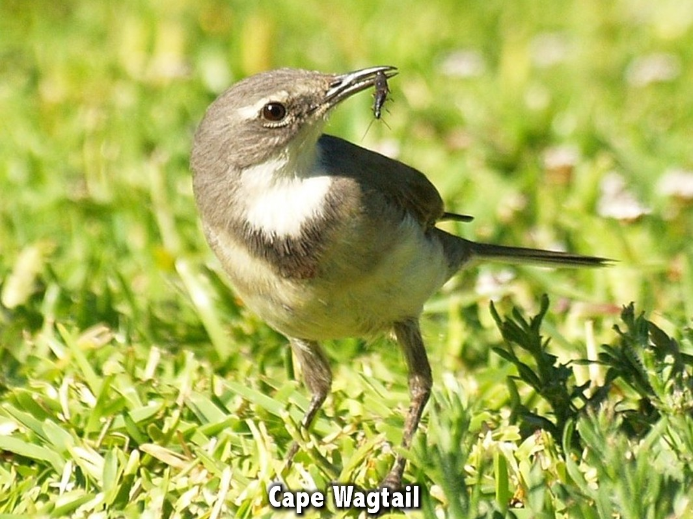

Slide 7
Notes:
Lesson 1: Be Early. It is true, birds feed early in the morning and as a photographer I know that I have to be up and about early in the morning to get the best shots while the sun is rising!

Slide 8
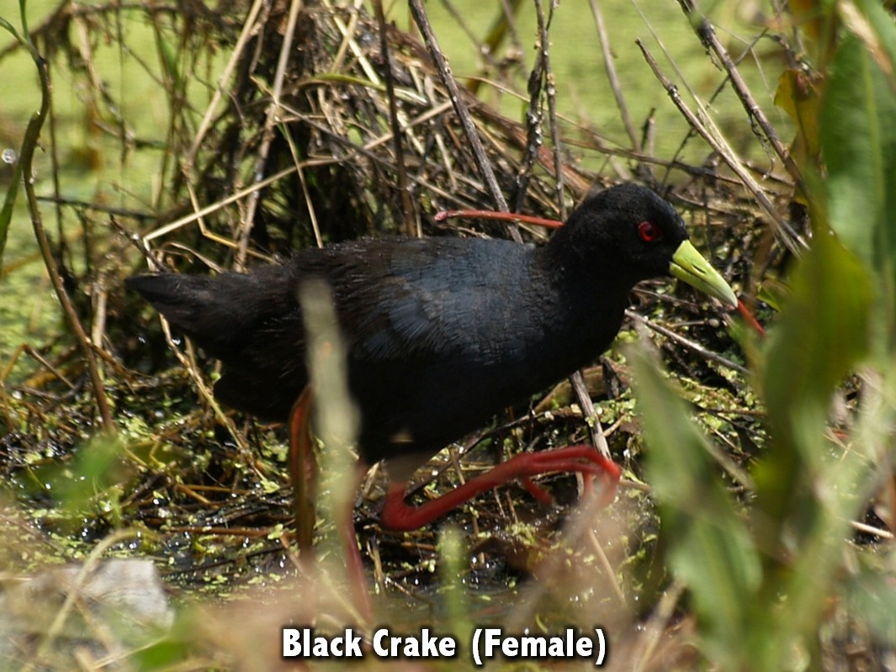
Notes:
Here are some pics that took me getting into place early and waiting for this special birds to appear…

Slide 9
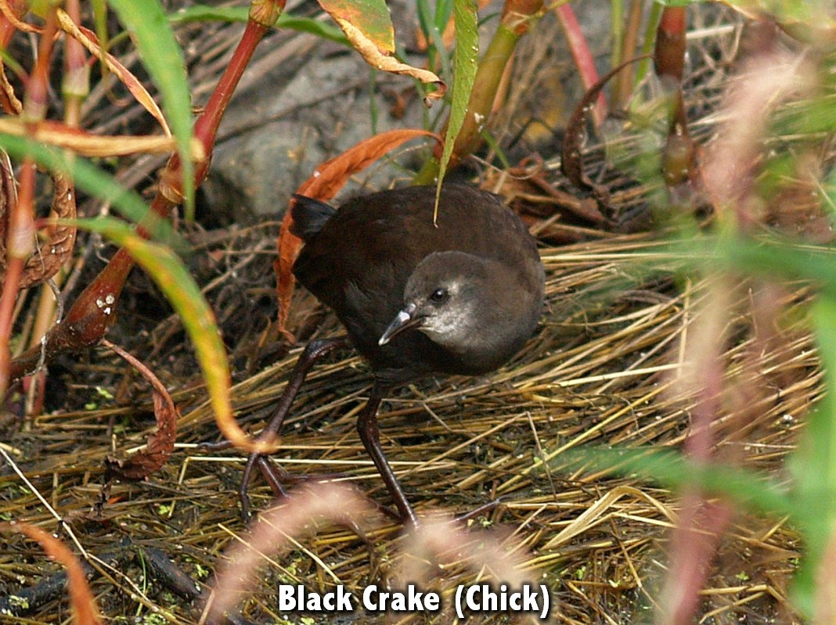

Slide 11
Notes:
The Message translation of 2 Corinthians 6:3 says: Don’t put it off, don’t frustrate God’s work by showing up late, throwing a question mark over everything we’re doing. When we arrive late for meetings with people we communicate that they are not important and we arrive stressed and therefore unprepared. As a soldier in the military I was trained to be not just on time, but early to be prepared for anything unexpected. So get there early so that you can lead the meeting effectively.

Slide 12
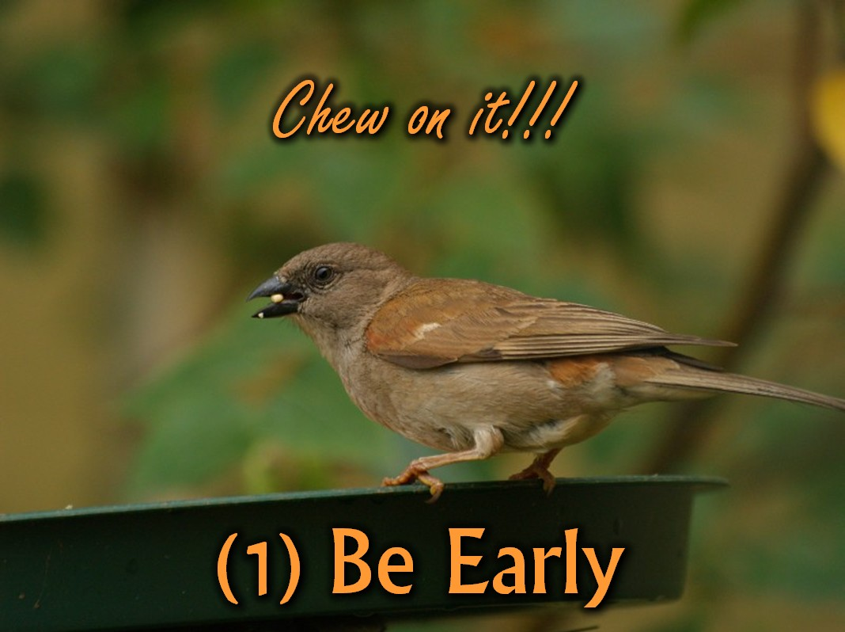
Notes:
Consider the Birds: How are you doing in terms of being punctual? What do you need to do to improve in this area?

Slide 13
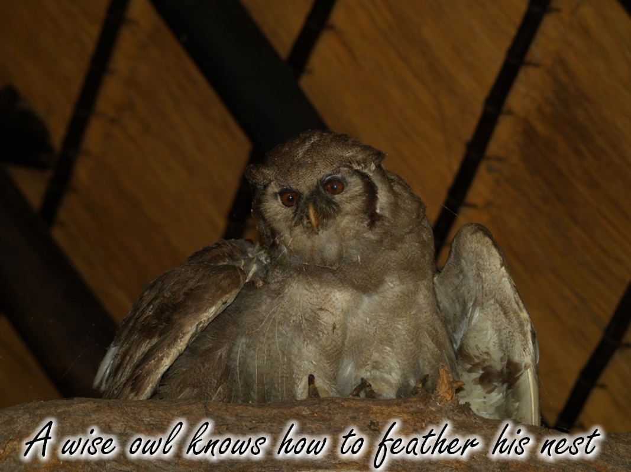
Notes:
There is a parable that says: A wise owl knows how to feather his nest.

Slide 14
Notes:
Lesson 2: Be Prepared. The wise owl spends time preparing the nest so that when the egg is hatched it is well protected and the chicklet will grow into an owlet. As a bird photographer I had to be prepared at all times. If I have a full-memory card or flat camera battery or the wrong camera lens is on my camera, I will miss the shot. A leader must always be prepared.

Slide 15
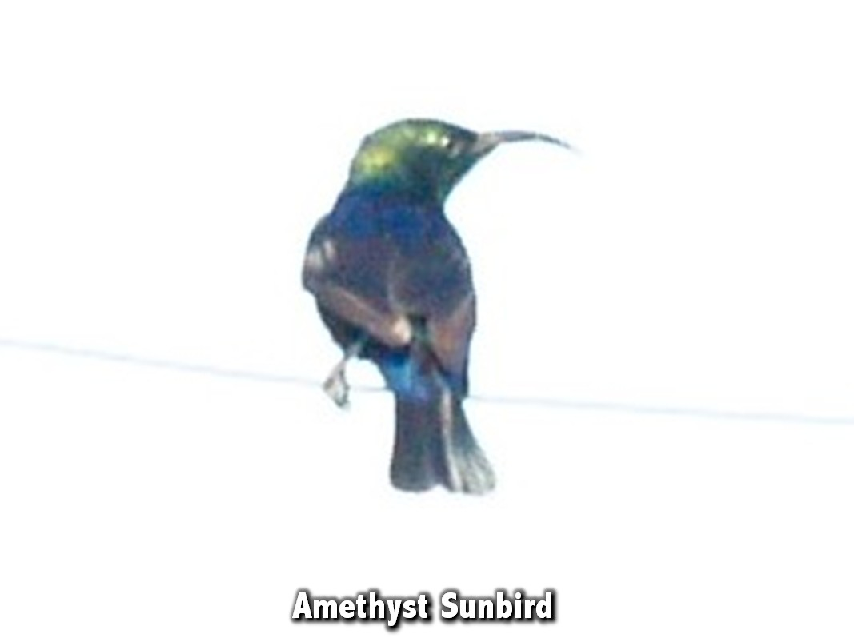
Notes:
A good example of not being prepared for a shot - I had probably being taking a photo of a bird in the shade, saw this Sunbird on the wire in broad daylight and snapped away without stopping to adjust my settings. As a result the shot is pretty much useless except as a lesson about being prepared!

Slide 16
Notes:
Here is a better example of a shot that is properly exposed and even has the background blurred out to not distract from the pair of Cormorants sunning themselves on the branches in the foreground.

Slide 17
Notes:
This shot of a goose coming in to land would have been really great if the shutter speed had been set much higher before the shot was taken.

Slide 18
Notes:
The Message translation of Ephesians 6:13 says: “Be prepared. You’re up against far more than you can handle on your own. Take all the help you can get, every weapon God has issued, so that when it’s all over but the shouting you’ll still be on your feet.” Great leaders don’t wait until the last minute to get things done. They think everything through twice and cover all the bases. A bit of thinking and preparation beforehand will ensure that we do not suffer later.

Slide 19
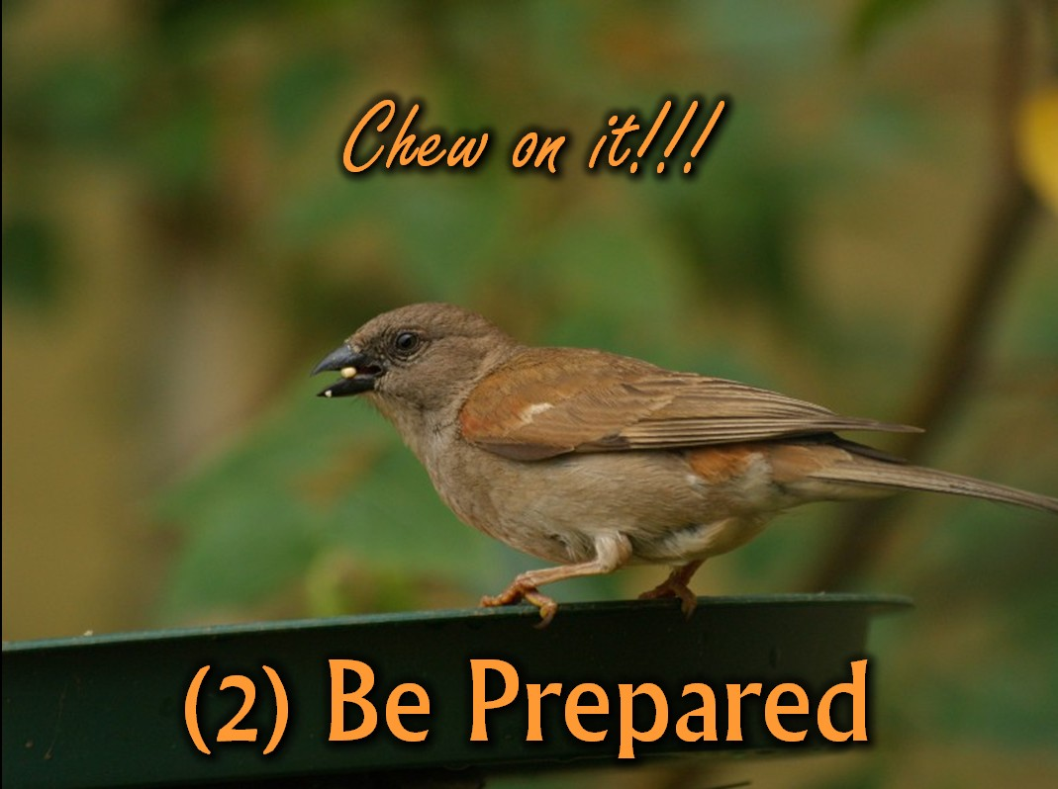
Notes:
Consider the Birds: How are you doing in terms of being prepared? What is getting in your way?

Slide 20
Notes:
There is a great parable: Don’t run around like a chicken without a head.

Slide 21
Notes:
Lesson 3: Be Patient. My best pictures are ones that required me to wait for just the right moment before I could get the shot. When I go running around the bush trying to cover a large amount of ground, the birds hear me coming and disappear into the thickets. When I settle down and wait for them to appear and come to me, I get the shots that I need. In life it is true that good things come to those who wait.

Slide 22
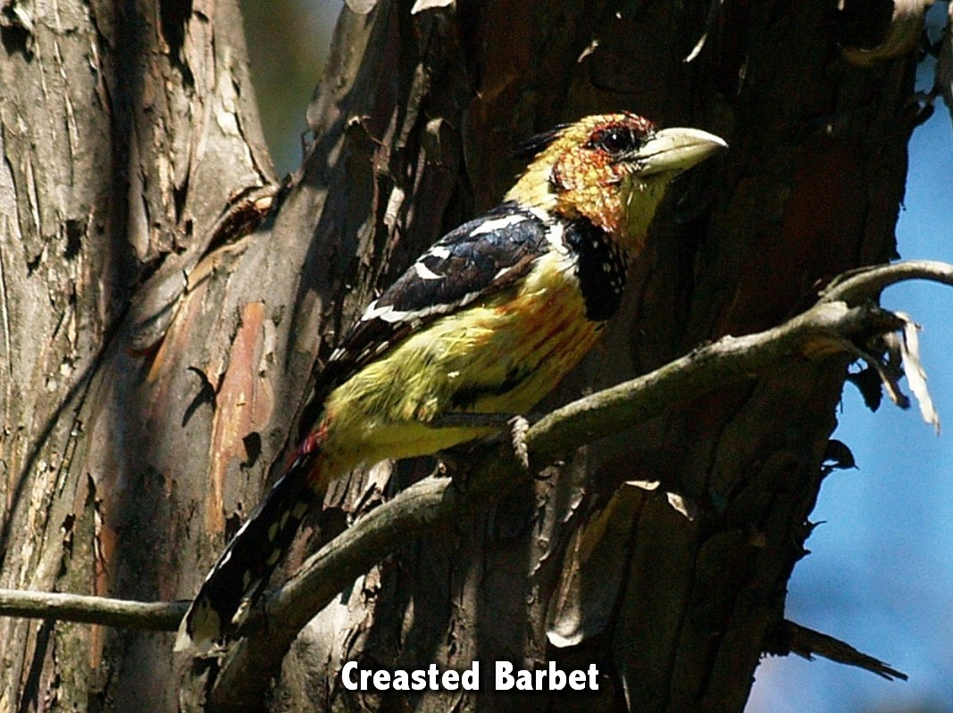
Notes:
The following shots have one thing in common - all of them took a lot of patience on my part to be able to capture and ensure everything was correct for a decent shot!

Slide 23
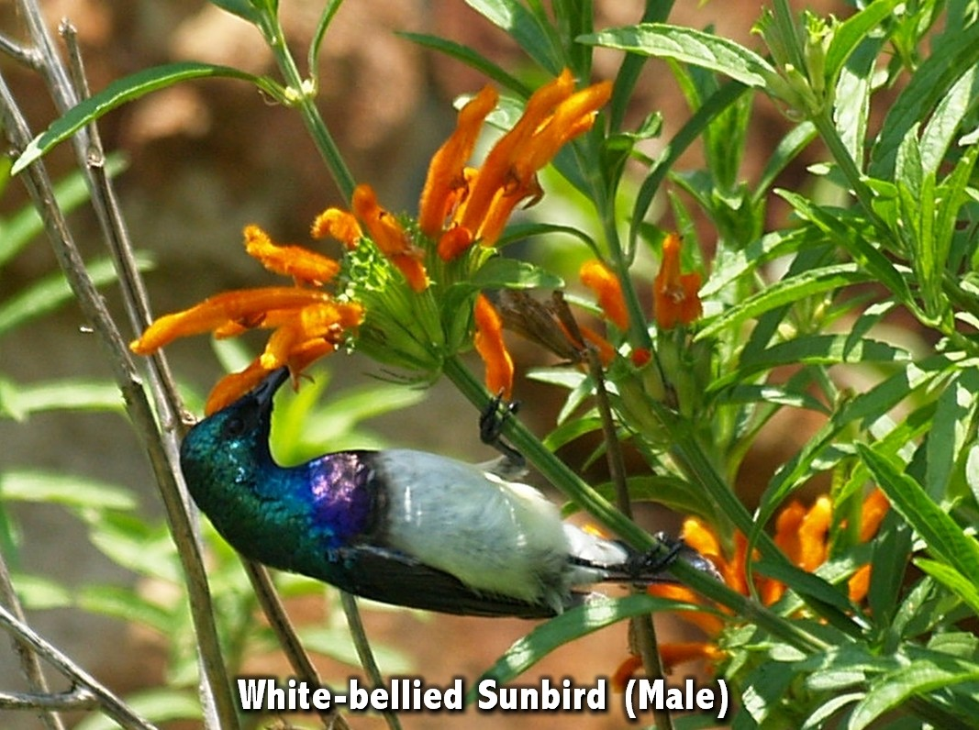

Slide 26
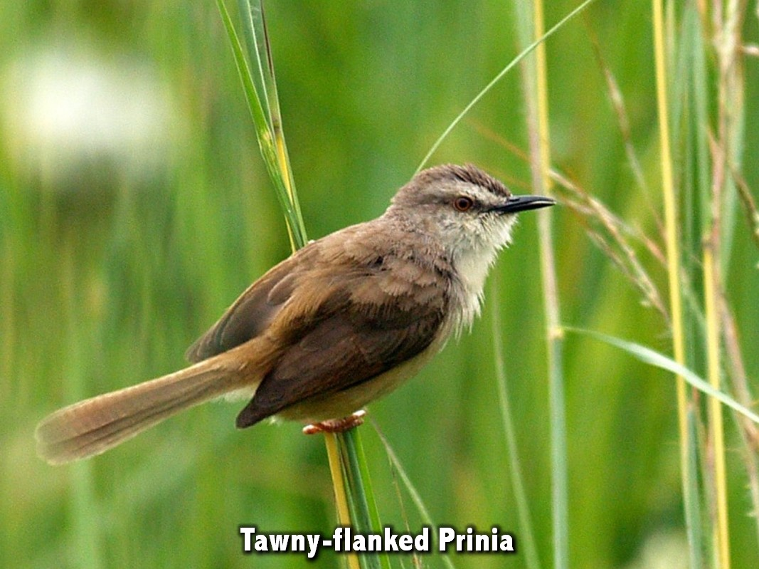

Slide 27
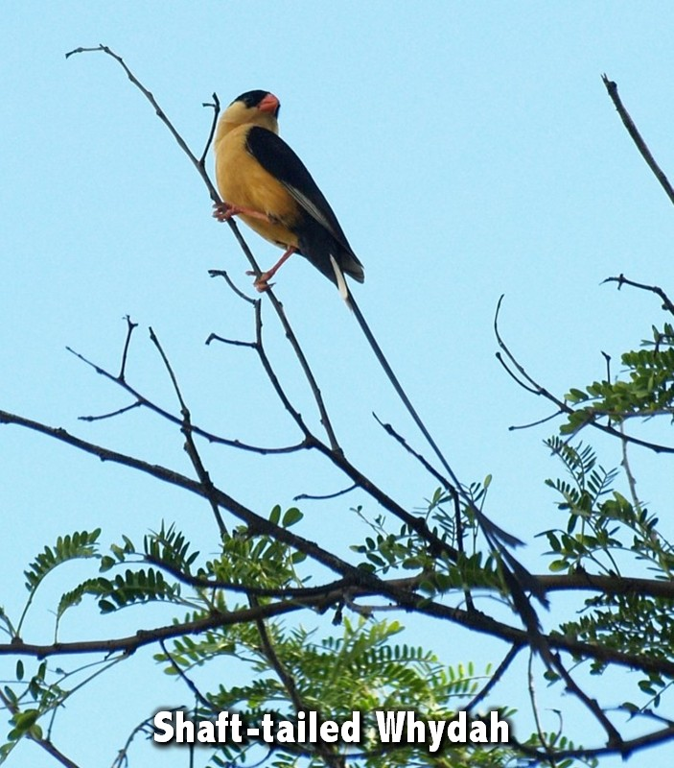

Slide 28
Notes:
The Message translation of Romans 5:4 says: We continue to shout our praise even when we’re hemmed in with troubles, because we know how troubles can develop passionate patience in us, and how that patience in turn forges the tempered steel of virtue, keeping us alert for whatever God will do next. God will work in our life, but it takes time and I have to surrender to what He is doing in my life. As a leader I have to be patient with people and not force their development.

Slide 29
Notes:
Consider the Birds: How are you doing in terms of being patient? How can you be more patient with people?

Slide 30
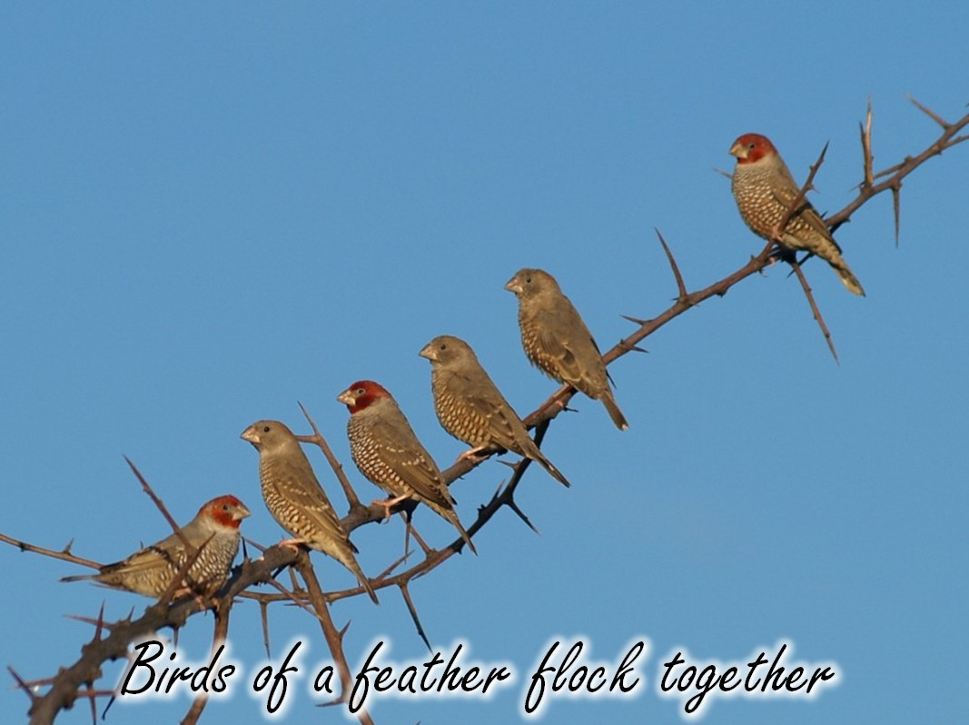
Notes:
There is a parable that says: Birds of a feather flock together.

Slide 31
Notes:
Lesson 4: Be Relational. I have gained immense value in learning how to identify birds by interacting with others birders in online forums where we are able to post pictures to have bird identities confirmed. I also post my pictures online so that others can benefit from what I am doing.

Slide 32
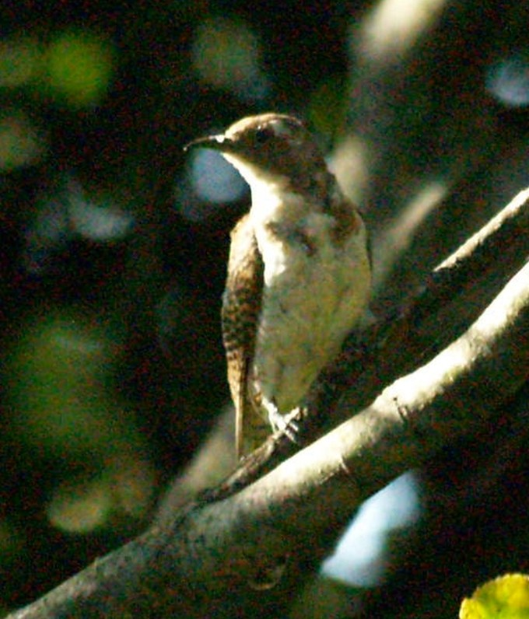
Notes:
This bird was one that I had to ask others to help me identify and with their help I was able to conclude that it is a Klaas’s Cuckoo.

Slide 33
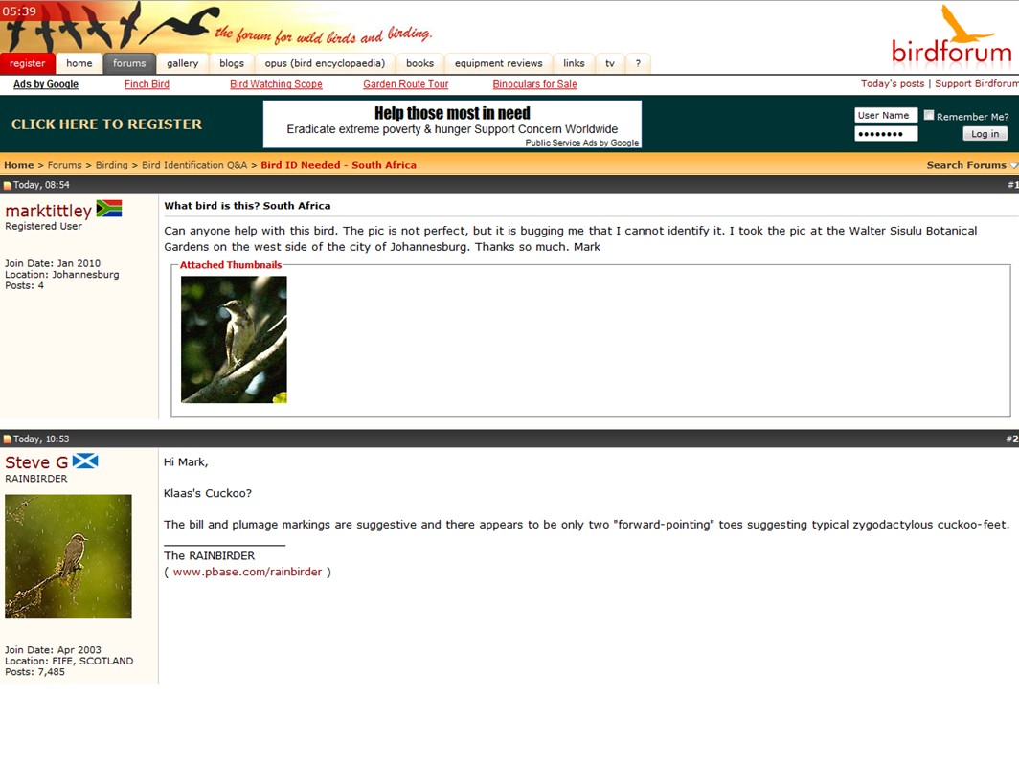
Notes:
Here are some sites that I have used to connect with others in the bird watching community.

Slide 34
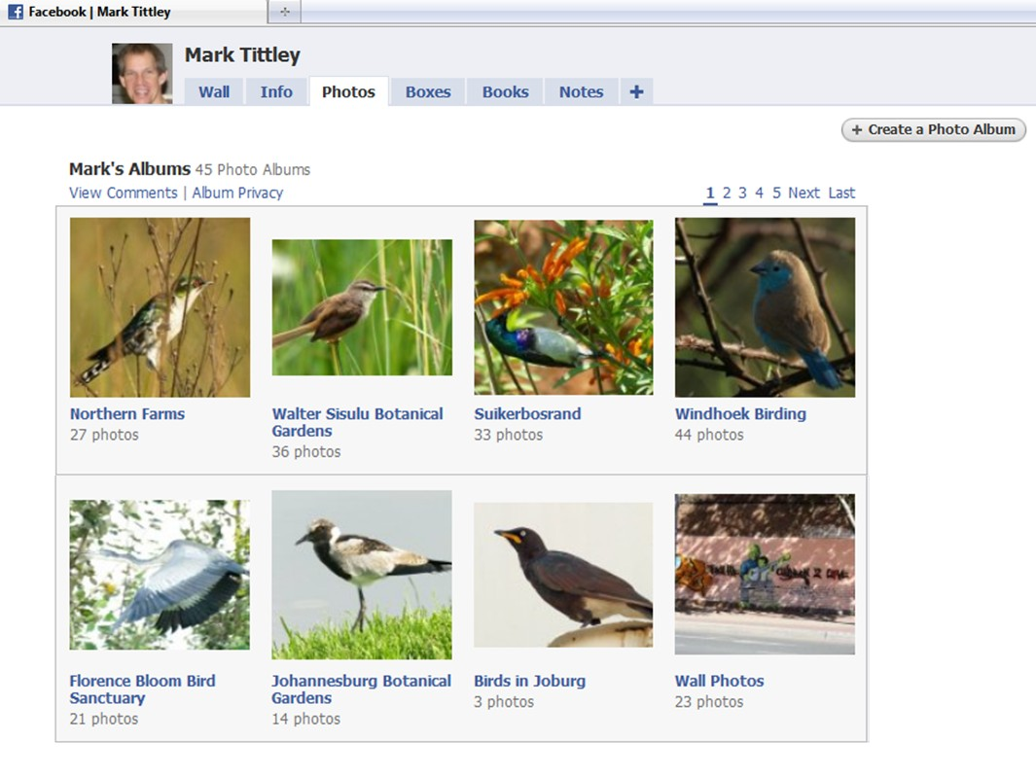

Slide 35
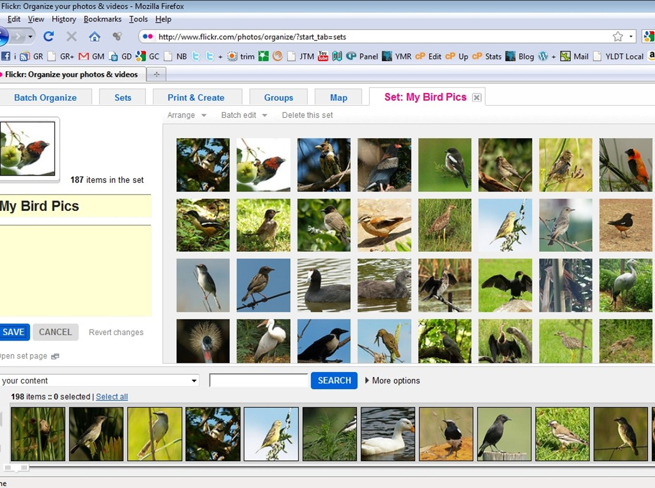

Slide 36
Notes:
The Message translation of Hebrews 13:16 says: Make sure you don’t take things for granted and go slack in working for the common good; share what you have with others. Great leaders are those who freely share what they create with other leaders. It frustrates me immensely to see leaders who just work in their own area and never share what they create with others. We have so much to share with our peers. Each month I get together with other youth pastors in our community and we spend time catching up about our lives and sharing what we create with one another.

Slide 37
Notes:
Consider the Birds: How are you doing in terms of being relational? Do you intentionally hang out with, and share with, other leaders in your area?

Slide 38
Notes:
There is parable that says: Walk proud like a peacock.

Slide 39
Notes:
Lesson 5: Look Good. Obviously God does not want us to be proud, but there is nothing wrong with looking our best and striving to be the best that we can be in every area of our lives.

Slide 40
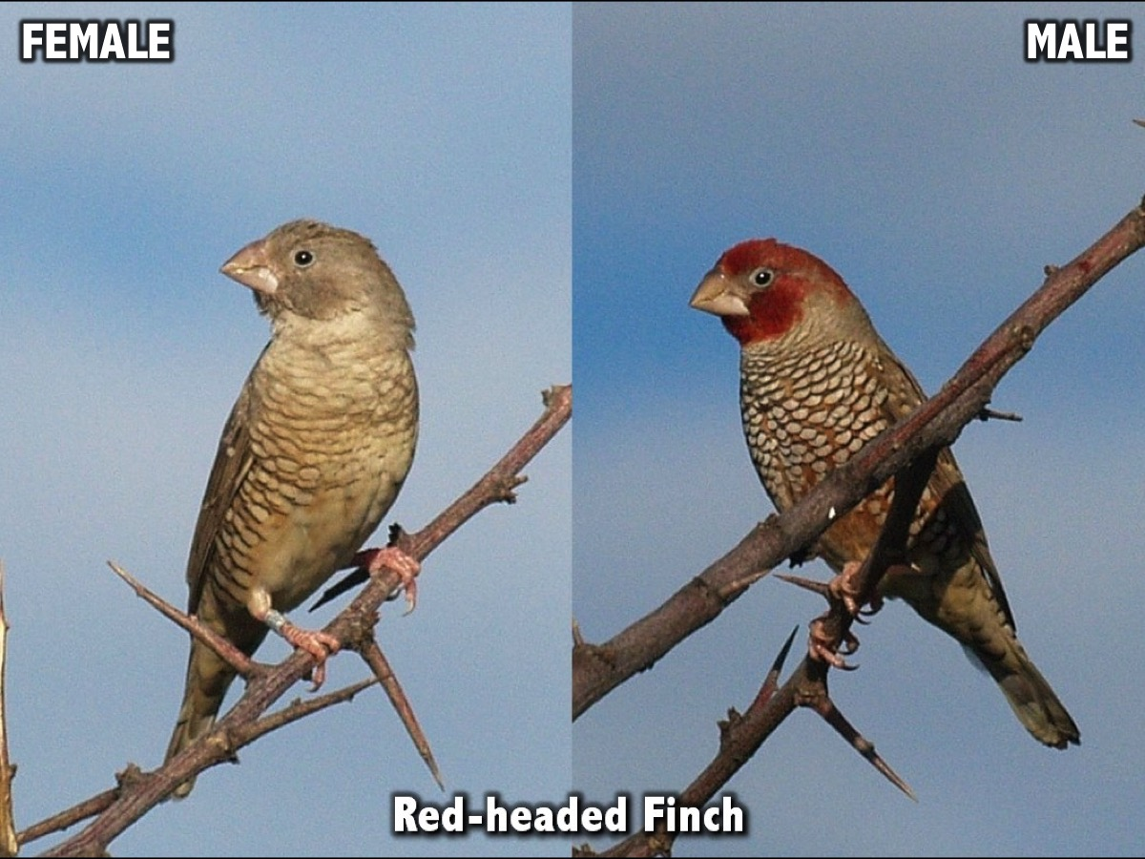
Notes:
Look at these birds - notice how the male in each case is so much more colourful than the female - they work hard at looking good…

Slide 41
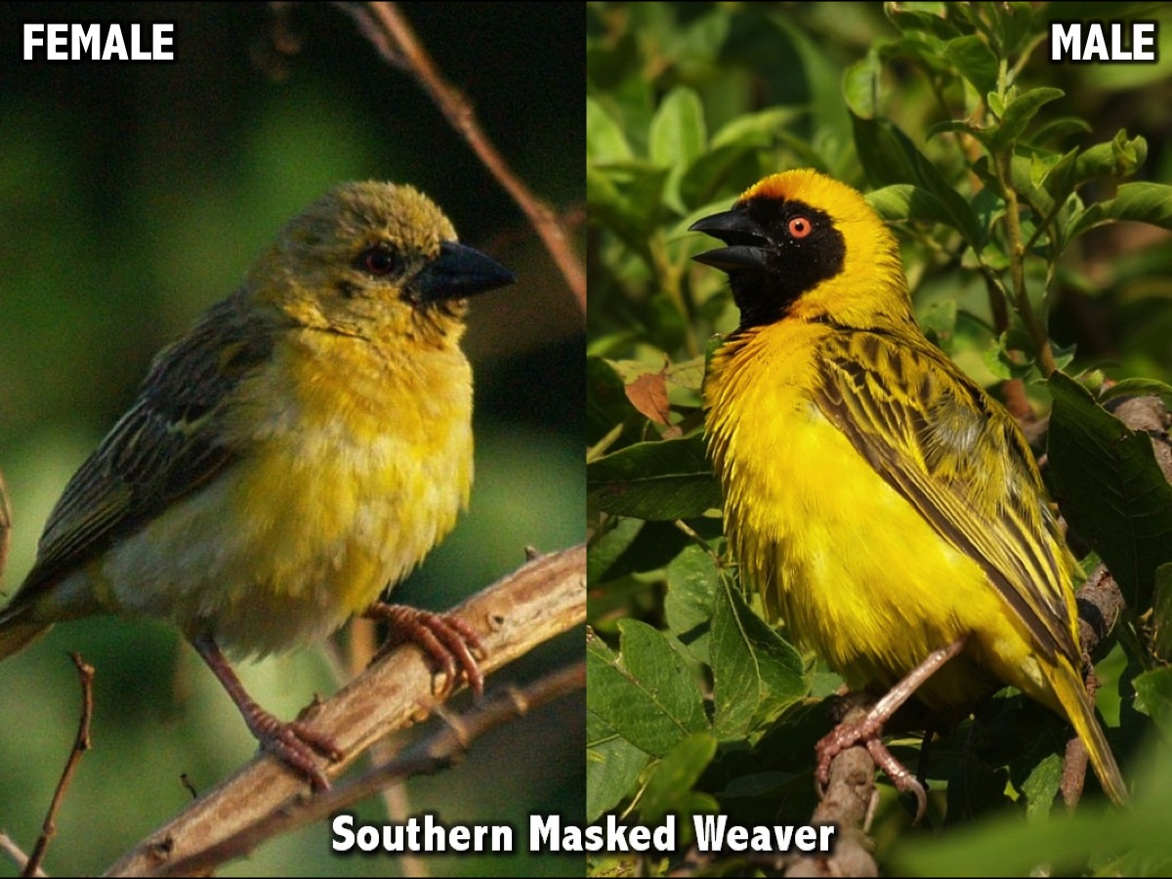

Slide 42
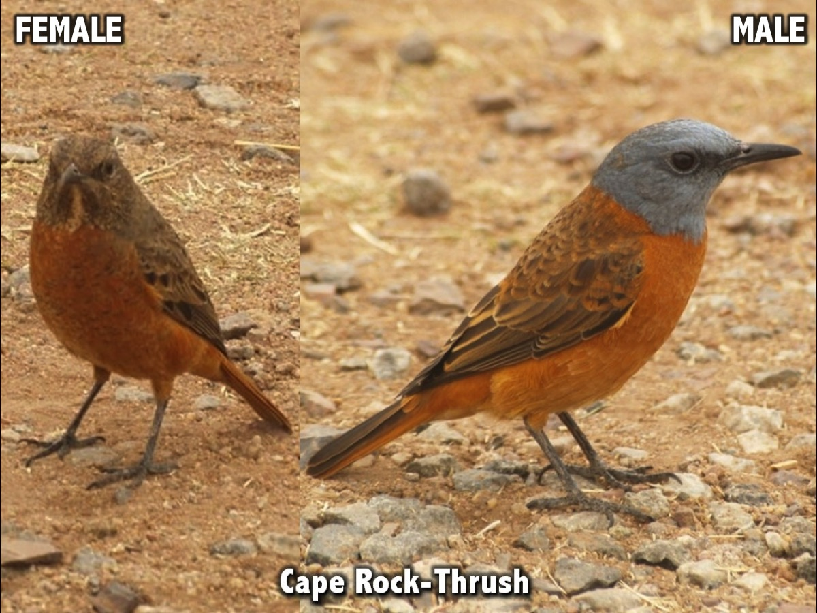

Slide 43
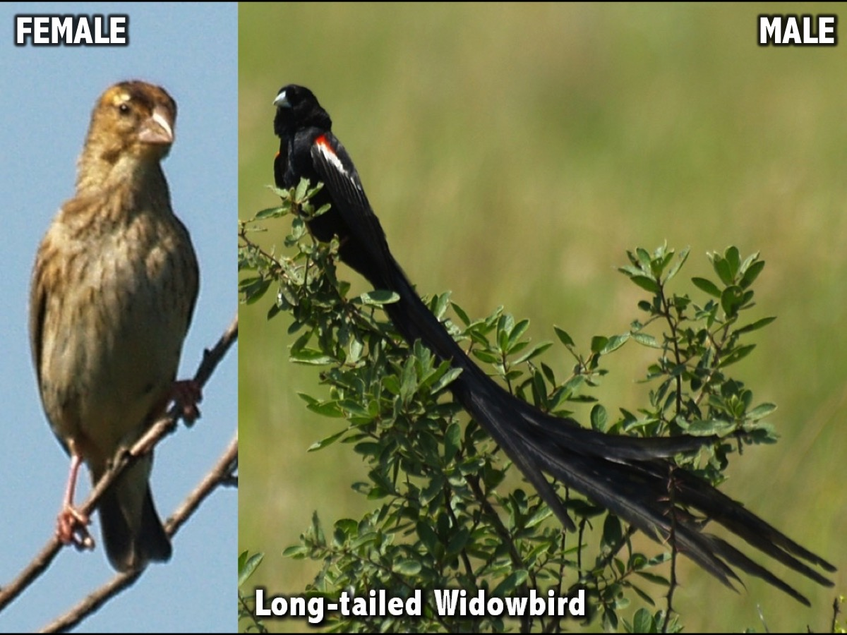

Slide 44
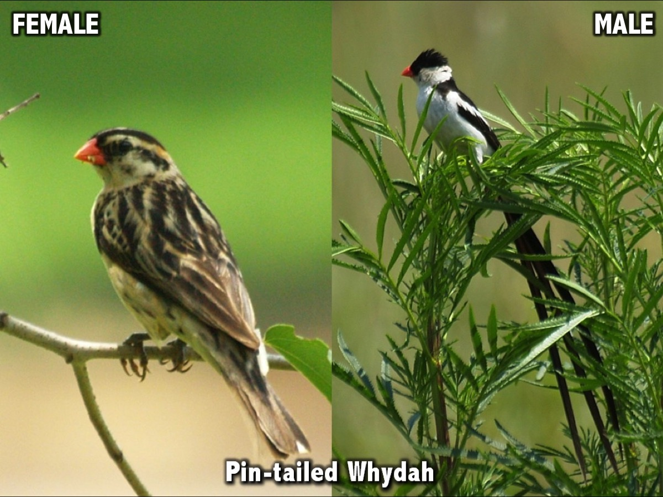

Slide 46
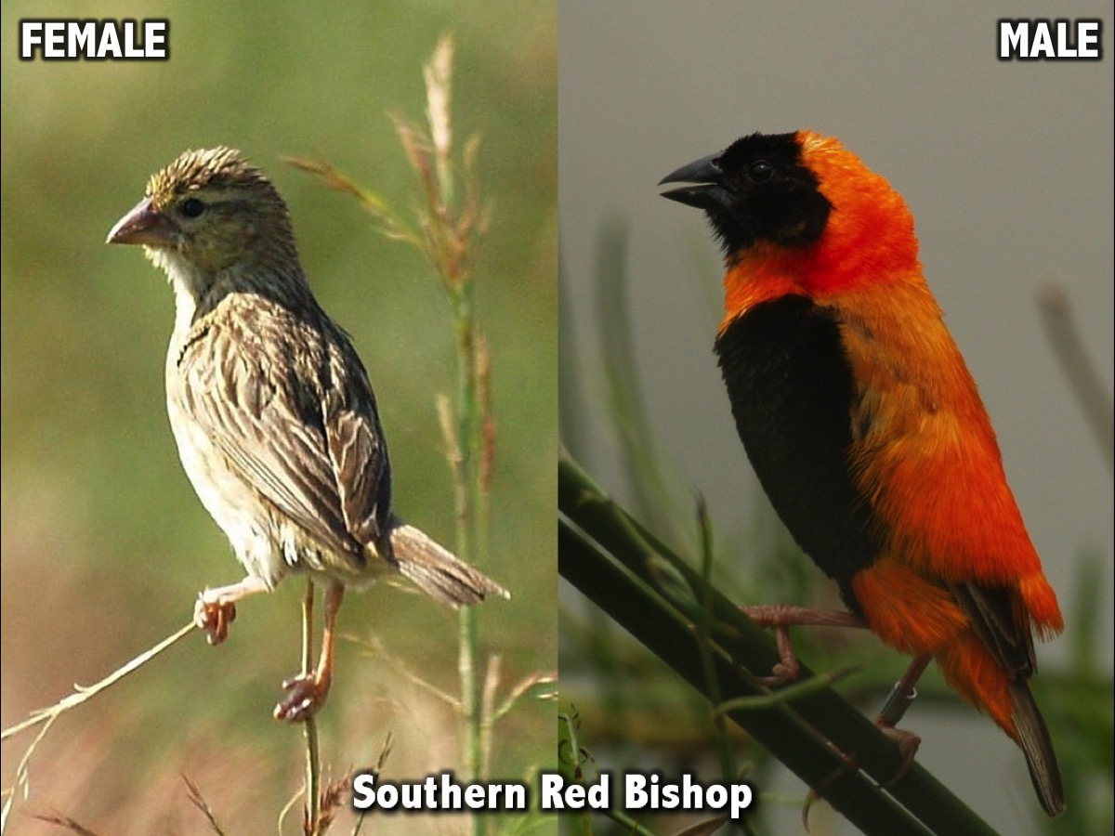

Slide 47
Notes:
The Message translation of Colossians 3:12 says: So, chosen by God for this new life of love, dress in the wardrobe God picked out for you: compassion, kindness, humility, quiet strength, discipline. We must clothe ourselves with the fruit of the Spirit! After all, we represent the King of Kings and the Lord of Lords.

Slide 48
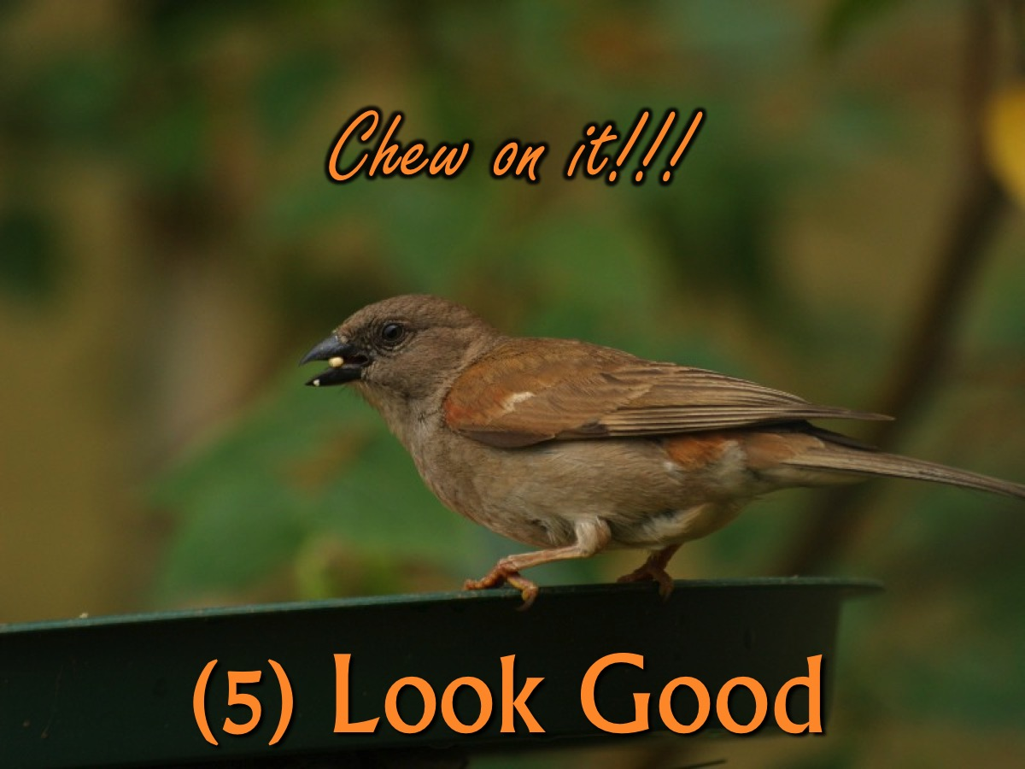
Notes:
Consider the Birds: How are you doing in terms of looking good? What fruit of the Spirit do you need to work on?

