Slide 1
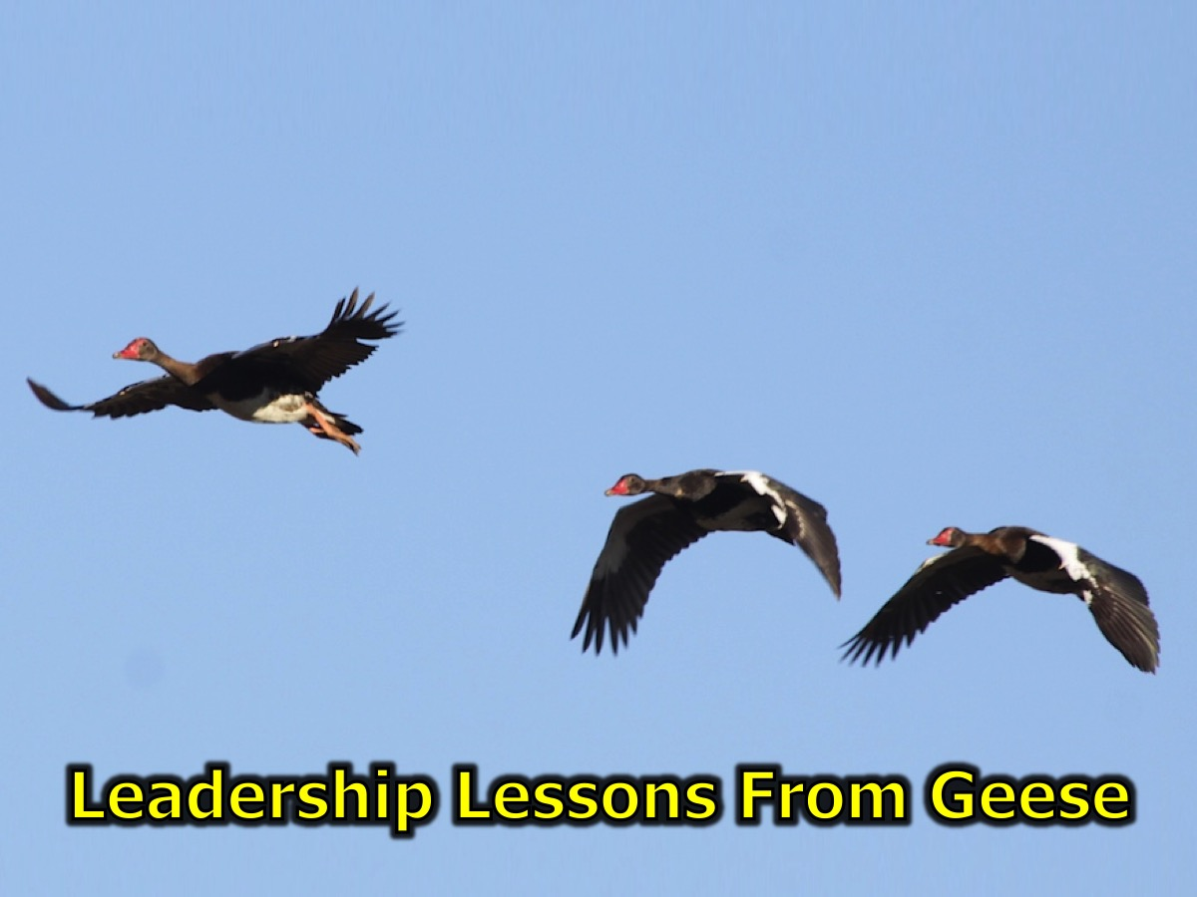
Notes:
Leadership Lesson from Geese: What can Geese teach us about leadership?

Slide 2
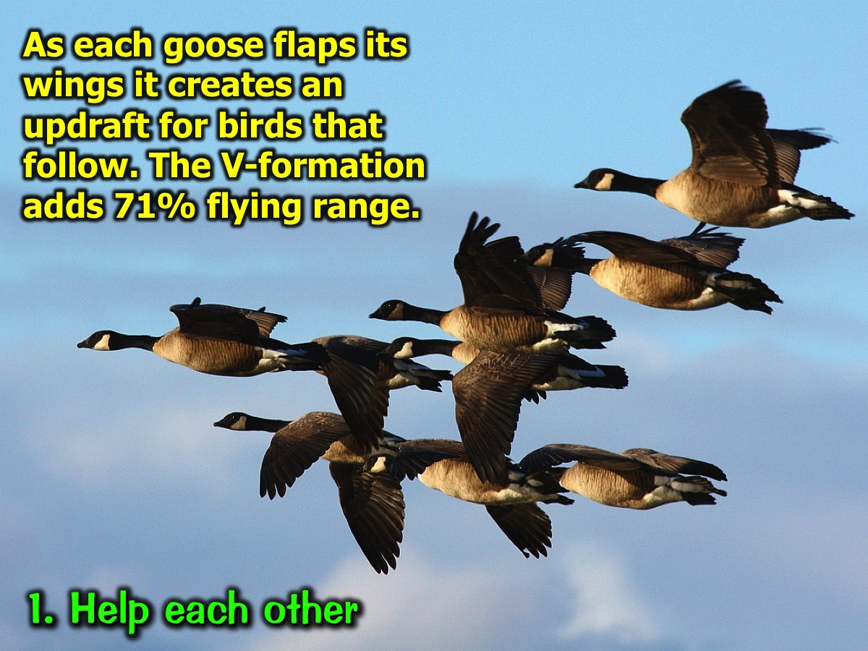
Notes:
1. Help each other: As each goose flaps its wings it creates an updraft for birds that follow. The V-formation adds 71% flying range.

Slide 3
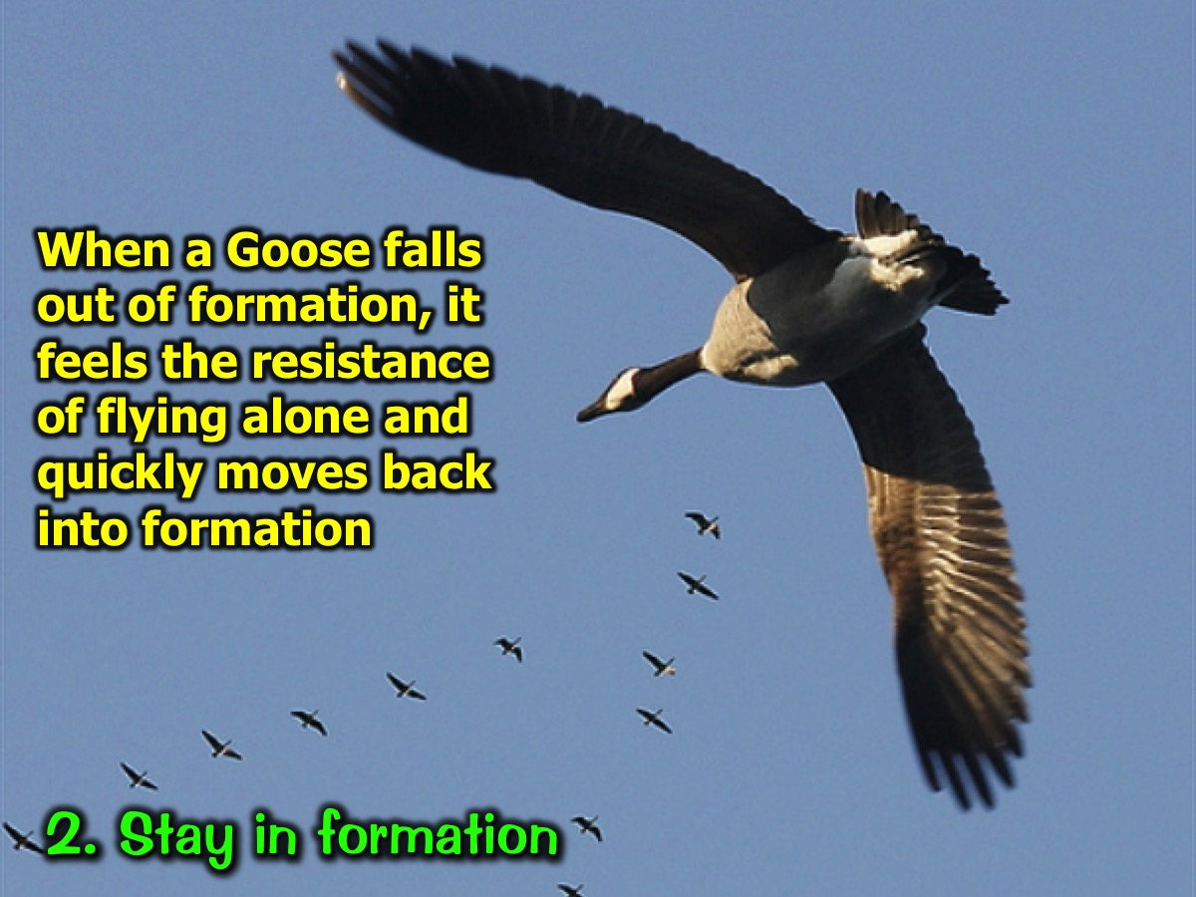
Notes:
2. Stay in formation: When a Goose falls out of formation, it feels the resistance of flying alone and quickly moves back into formation.

Slide 4
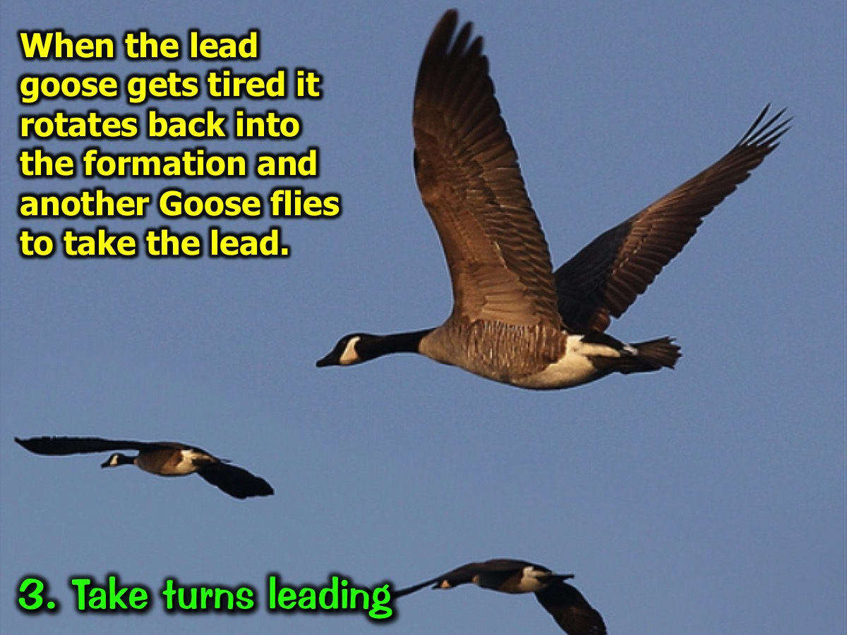
Notes:
3. Take turns leading: When the lead goose gets tired it rotates back into the formation and another Goose flies to take the lead.

Slide 5
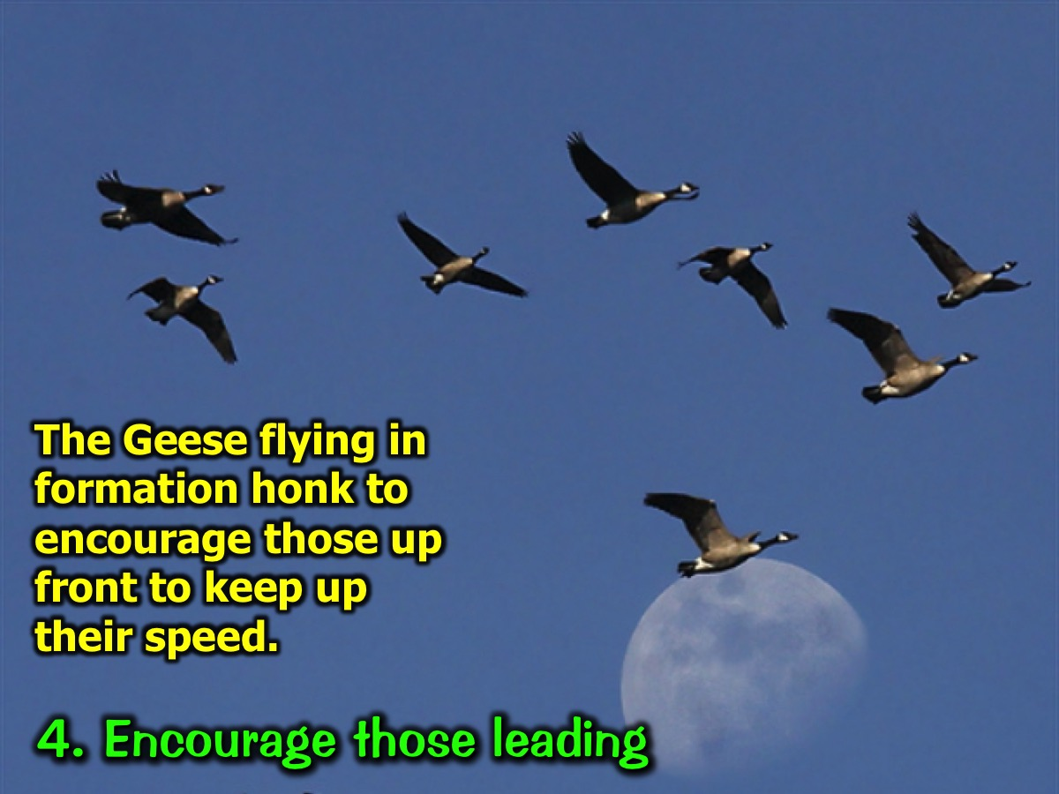
Notes:
4. Encourage those leading: The Geese flying in formation honk to encourage those up front to keep up their speed.

Slide 6
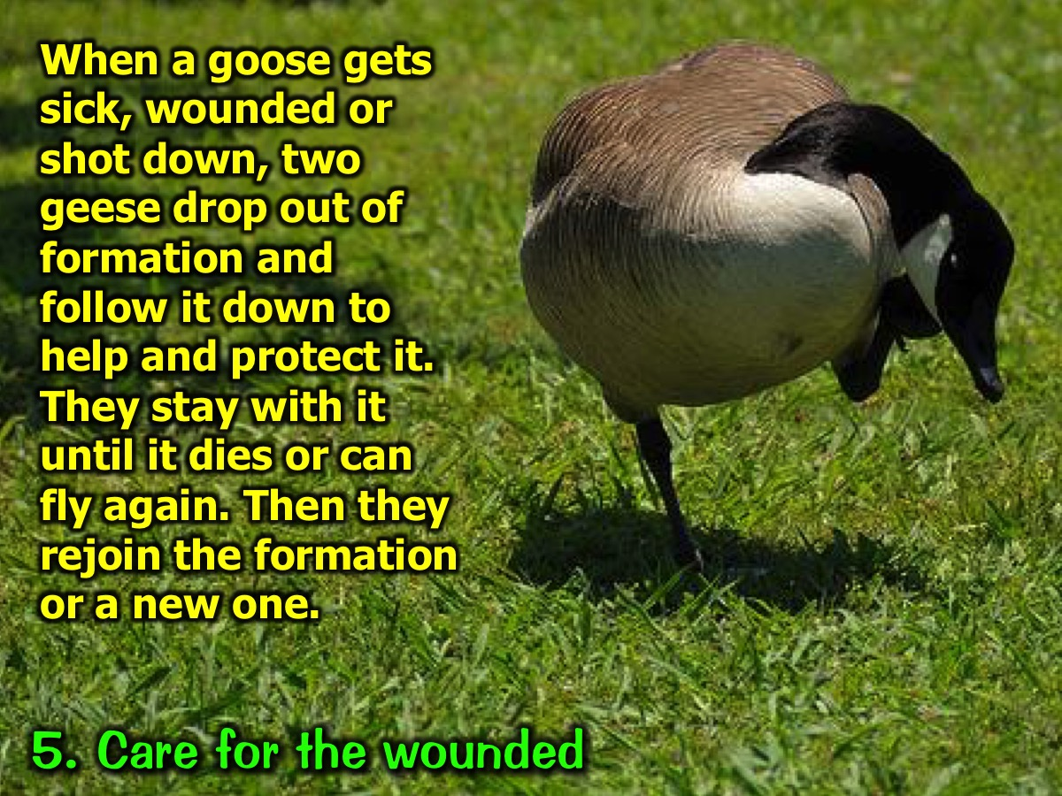
Notes:
5. Care for the wounded: When a goose gets sick, wounded or shot down, two geese drop out of formation and follow it down to help and protect it. They stay with it until it dies or can fly again. Then they rejoin the formation or a new one.

