Slide 1

Notes:
This is the presentation used on Sunday afternoon at our leaders training session to help our teen leaders improve their skills in running small groups on Friday nights at youth.

Slide 2

Notes:
1. Get your guys - as soon as the teens who are in your small group are allocated to you, try and get them into a huddle as soon as possible.

Slide 3
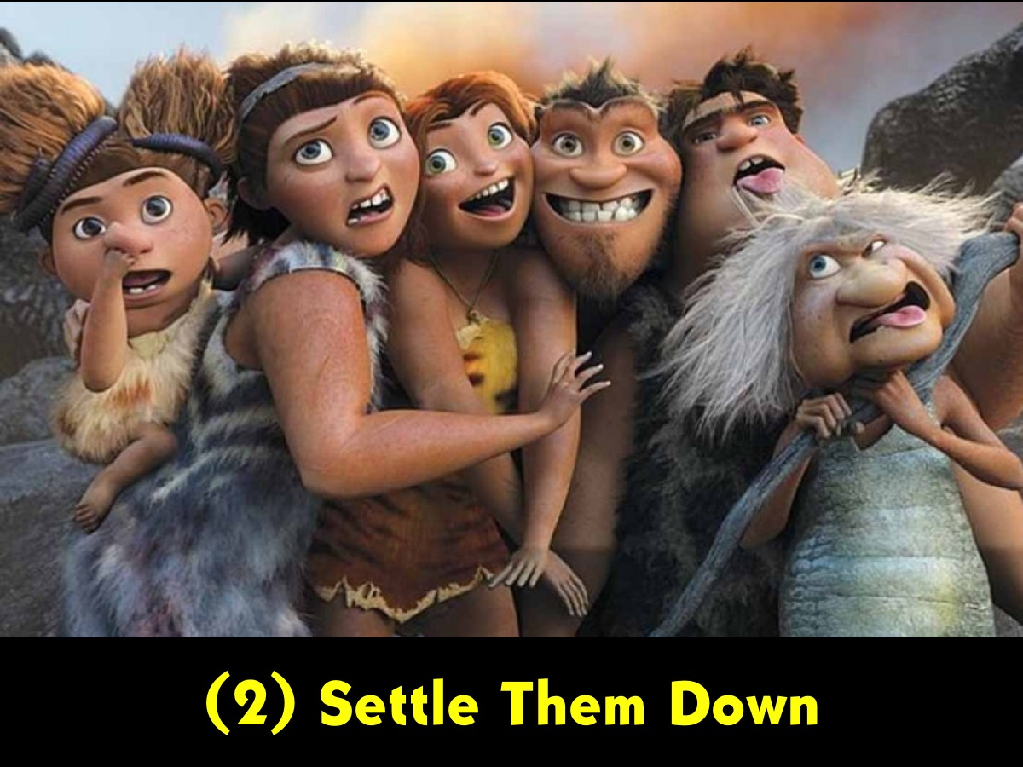
Notes:
2. Settle them down - it is the leaders responsibility to encourage their group members to sit down and get ready for the group time.

Slide 4
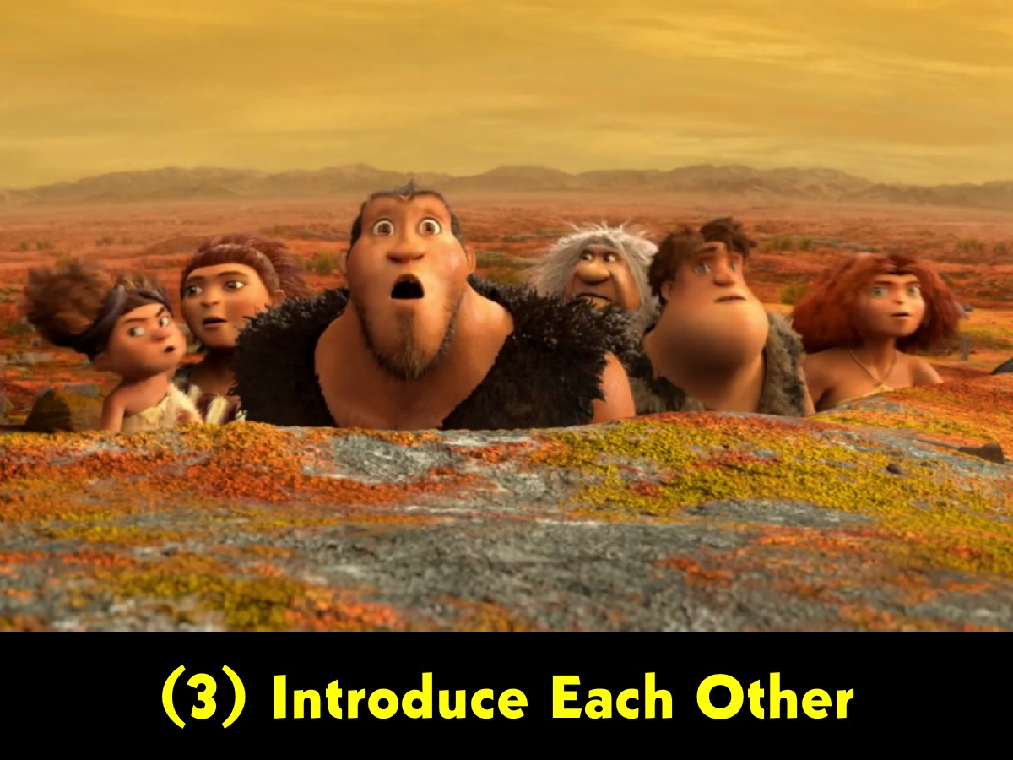
Notes:
3. Introduce each other - As leaders are given different teens each Friday night it is necessary to make sure that the teens know each other - so it is necessary to have each person share their names and if necessary a little about themselves.

Slide 5
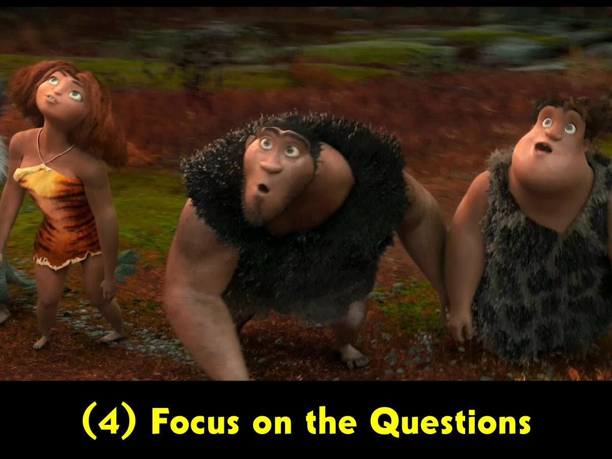
Notes:
4. Focus on the questions - it is the leader's responsibility to keep their small group focused on the questions and this is something that will take effort and guidance along the way.

Slide 6

Notes:
5. Handle Different Characters – today we are going to explore different group member characters to empower you to handle them in your small group.

Slide 7

Notes:
A. The Newcomer

Slide 8
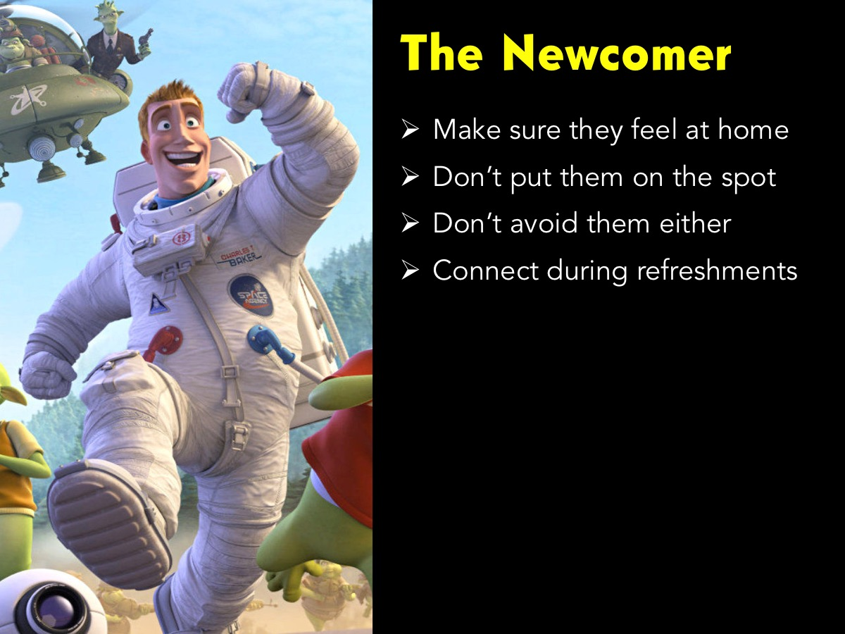
Notes:
The newcomer is new to the group and will be hesitant to speak until they feel comfortable. Some tips: (1) Make sure they feel at home. (2) Don’t put them on the spot. (3) Don’t avoid them either. (4) Connect during refreshments.

Slide 9
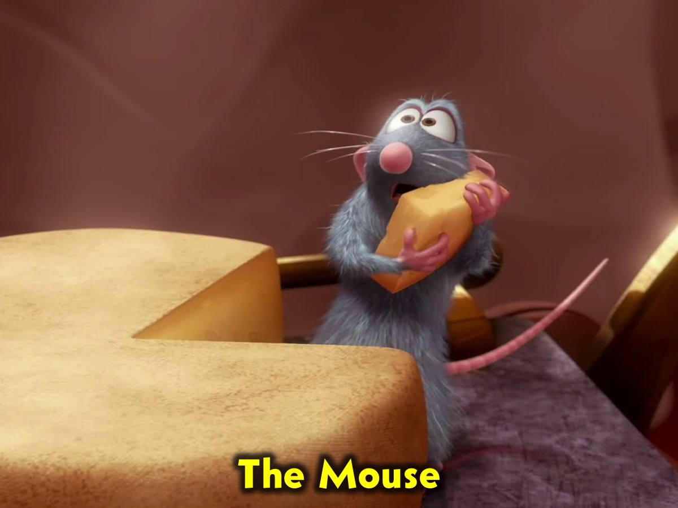
Notes:
B. The Mouse

Slide 10
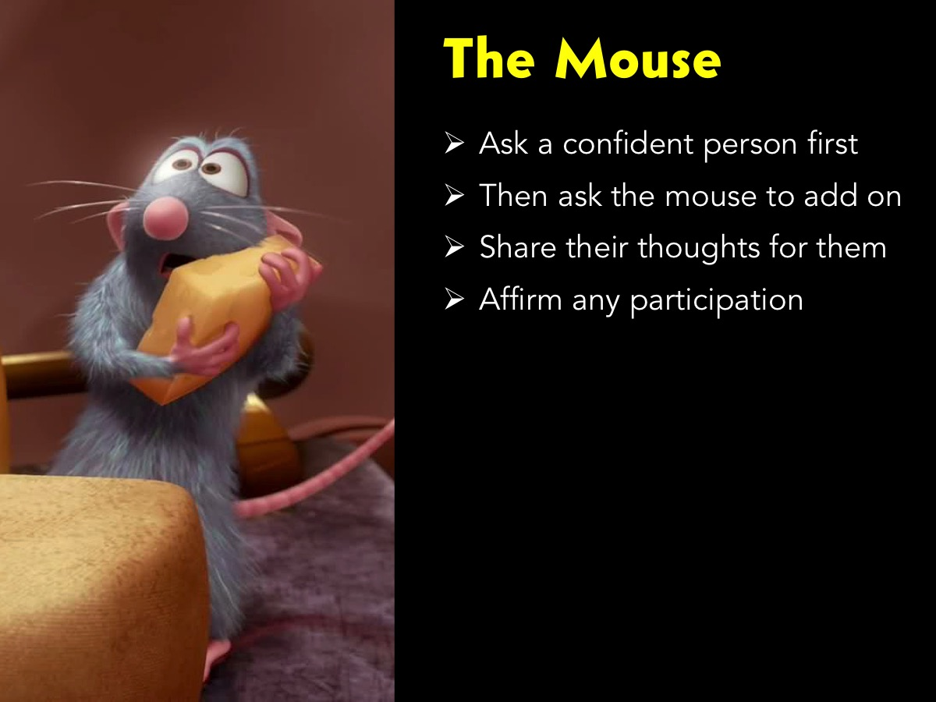
Notes:
This person, also called the ‘wallflower’ talks too little or not at all. The leader should encourage them to participate by asking a confident person a question and then asking the wallflower to respond. It is also useful to overhear what they say in a small group context and then reinforce their comments to the whole group. The leader could also engage in one‑on‑one conversation during fellowship time with them and reinforce private comments so they will want to talk to the bigger group at a later stage.

Slide 11
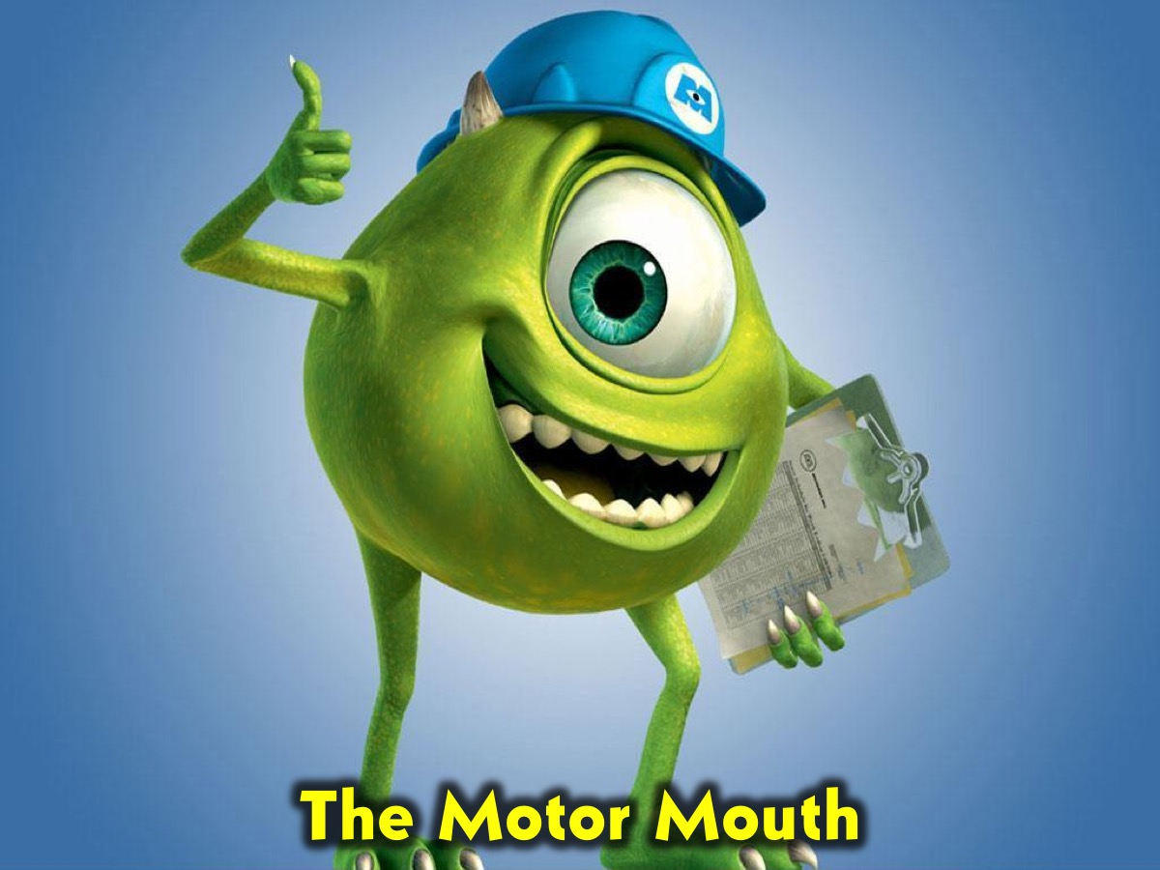
Notes:
C. The Motor Mouth

Slide 12
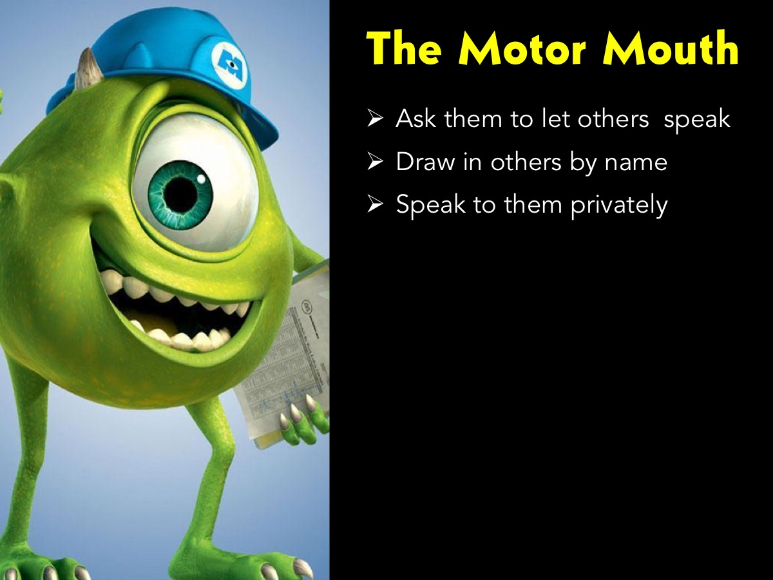
Notes:
Some people talk a great deal and consume valuable time and distract other learners with irrelevant ideas. While there is a general rule, “never interrupt a talking student,” the case of the over‑talker may be one exception. The leader should limit the ‘motor mouth’ by being direct or suggesting that he talk with you after the lesson. Where possible such counsel should happen privately, unless this fails to help.

Slide 13
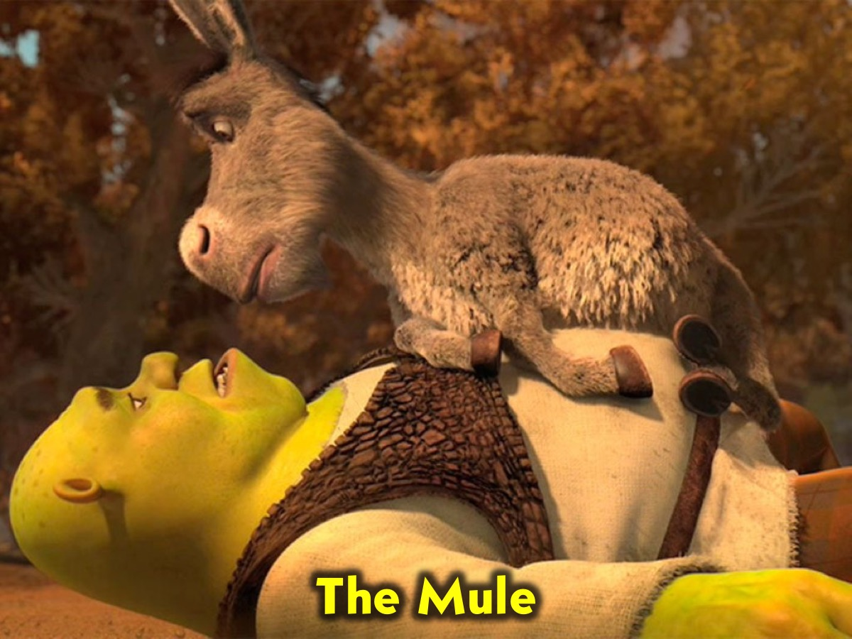
Notes:
D. The Mule

Slide 14
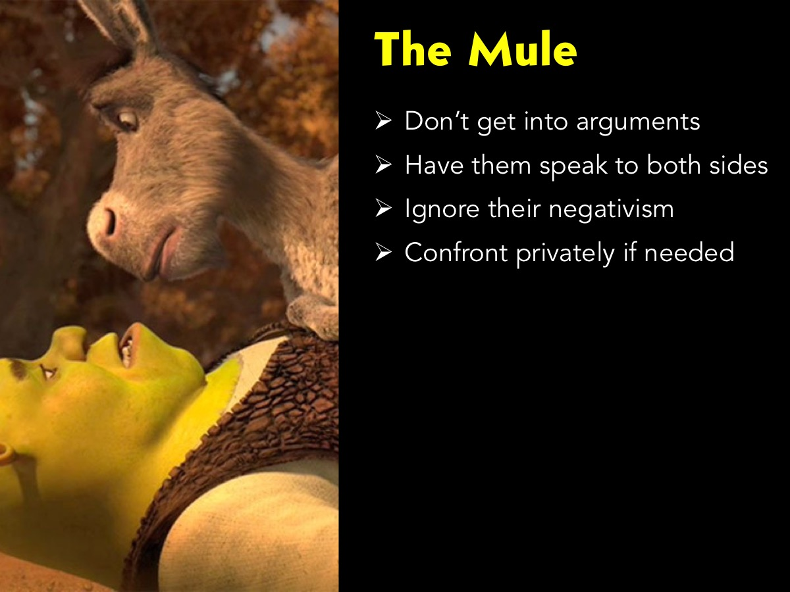
Notes:
The ‘mule’ who takes exception to everything said by the leader or anyone else. They tend to be stubborn and argumentative. Get the ‘mule’ to contribute to both sides of an argument and affirm them for both sides of their analysis. Pay little attention to their negativism. Direct confrontation may be less effective as they will perceive it as positive reinforcement. If confrontation is necessary, it should be done privately and should focus on the negative behaviour and not the issue that was raised.

Slide 15

Notes:
E. The Joker

Slide 16
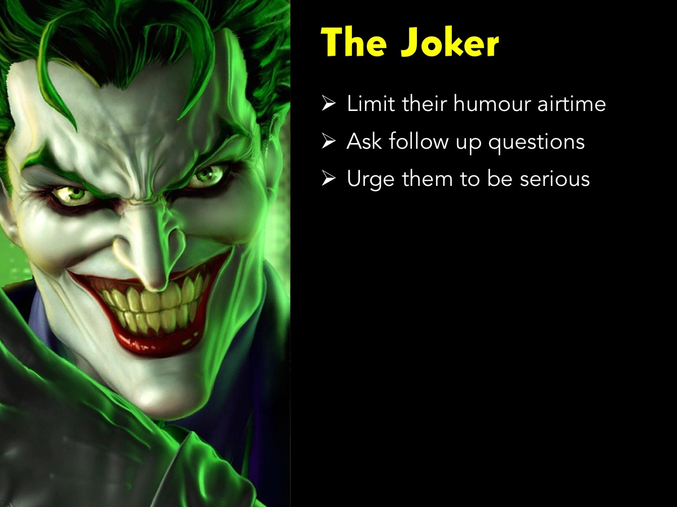
Notes:
The Joker seldom says anything deep or serious – choosing rather to play the role of the clown. If you ask a few follow up questions of the Joker you will find that they actually have some valuable insights to add to the group discussion.

Slide 17
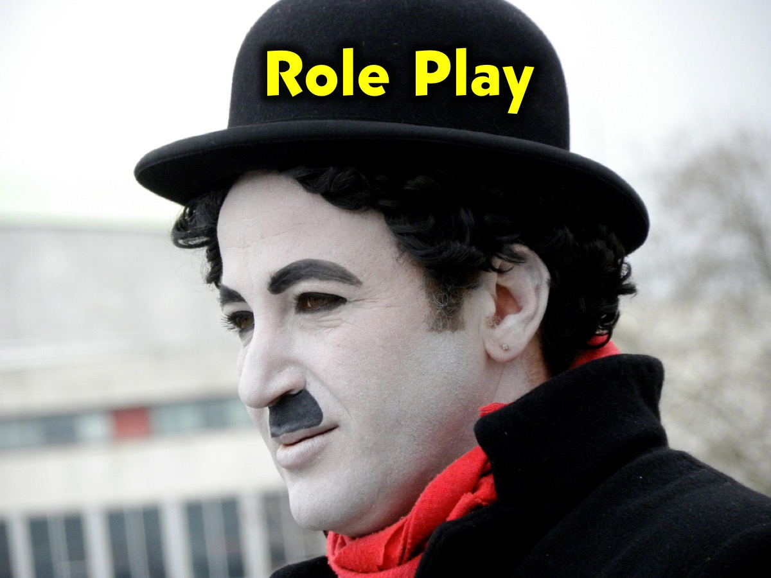
Notes:
Role Play: To make this session practical - tell your leaders that you are going to do some role plays focusing on each of the characters they may encounter in their small groups:

Slide 18

Notes:
Firstly, the Newcomer. Start a mock small group time by appointing someone to play the role of a Newcomer to the group (they should make it obviously that they don’t know what is going on and don’t understand what a small group is all about) and then ask this question: “What giant are you facing in your life?” Tell the group members to apply the guidelines on the screen to handling the Newcomer.

Slide 19
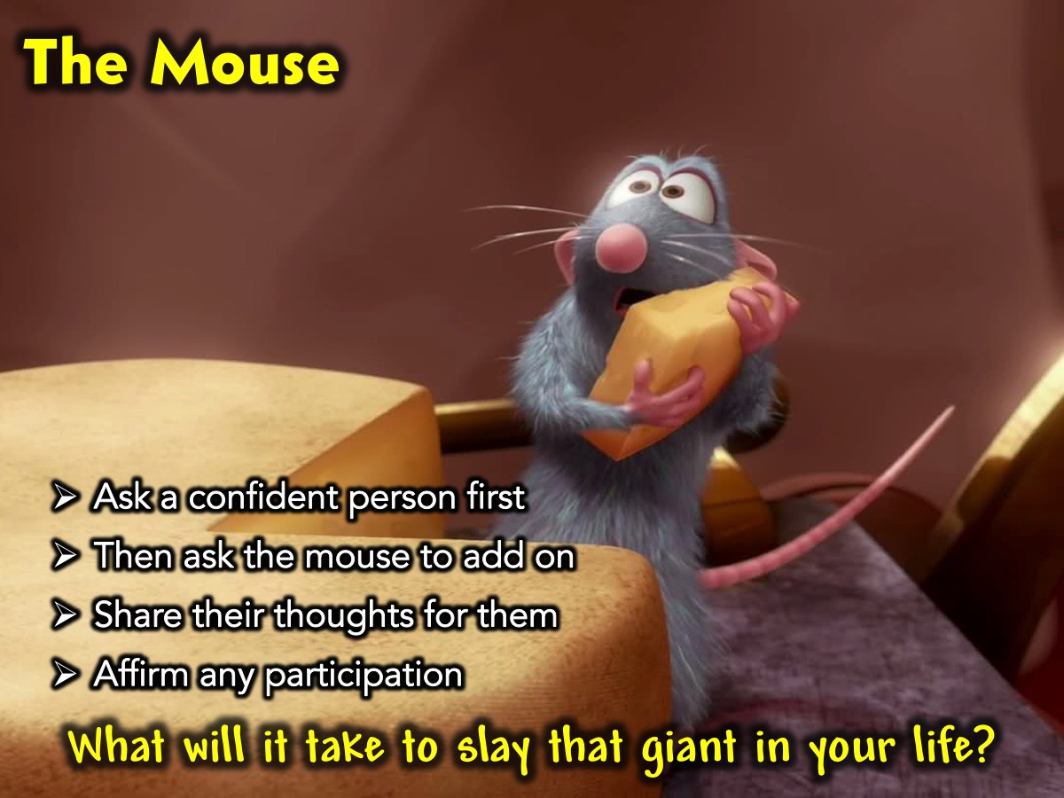
Notes:
Secondly, the Mouse. Start a mock small group time by appointing someone to play the role of a Mouse in the group (they not talk much or at all and come across really shy) and then ask this question: “What will it take to slay that giant in your life?” Tell the group members to apply the guidelines on the screen to handling the Mouse.

Slide 20
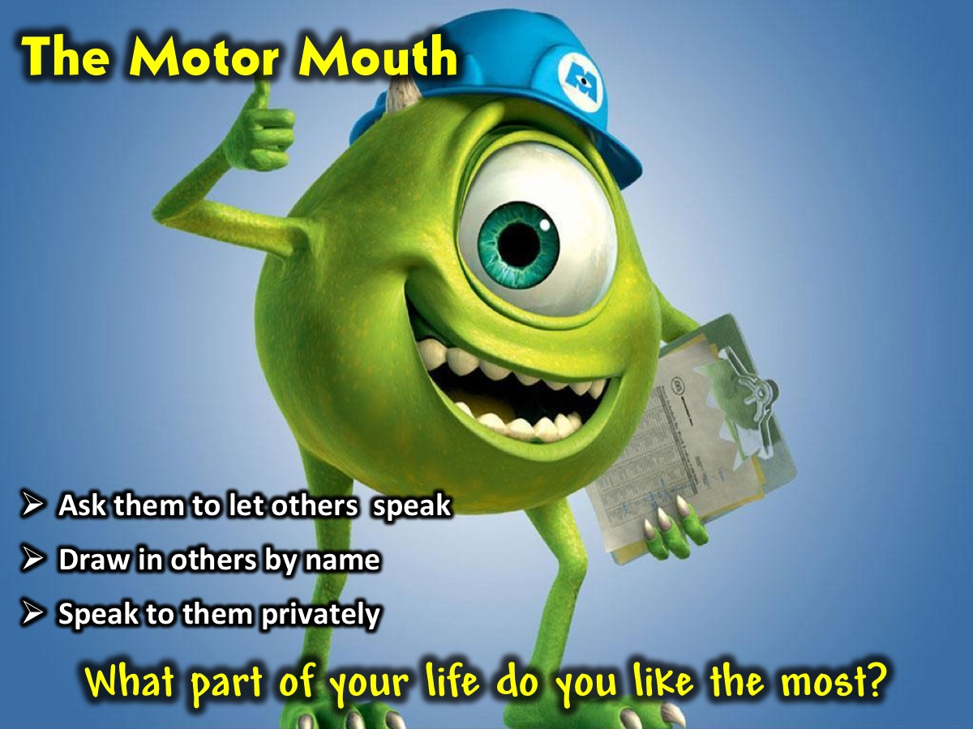
Notes:
Thirdly, the Motor Mouth. Start a mock small group time by appointing someone to play the role of a Motor Mouth in the group (ask them to talk a great deal and consume valuable time and distract people with irrelevant ideas) and then ask this question: “What part of your life do you like the most?” Tell the group members to apply the guidelines on the screen to handling the Motor Mouth.

Slide 21
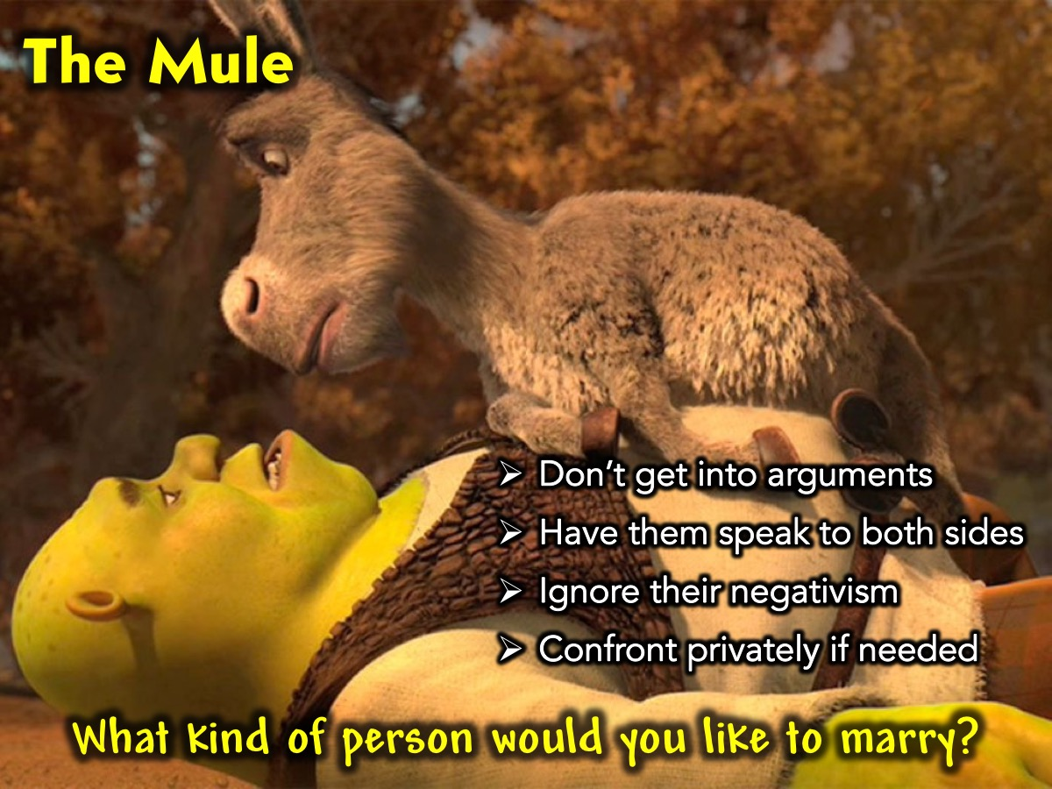
Notes:
Fourthly, the Mule. Start a mock small group time by appointing someone to play the role of a Mule in the group (ask them to be stubborn and argumentative) and then ask this question: “What kind of person would you like to marry?”. Tell the group members to apply the guidelines on the screen to handling the Mule.

Slide 22

Notes:
Fifthly, the Joker. Start a mock small group time by appointing someone to play the role of a Joker in the group (ask them to makes jokes and not take things seriously) and then ask this question: “Who is your favourite superhero and why?”. Tell the group members to apply the guidelines on the screen to handling the Joker.

Slide 23
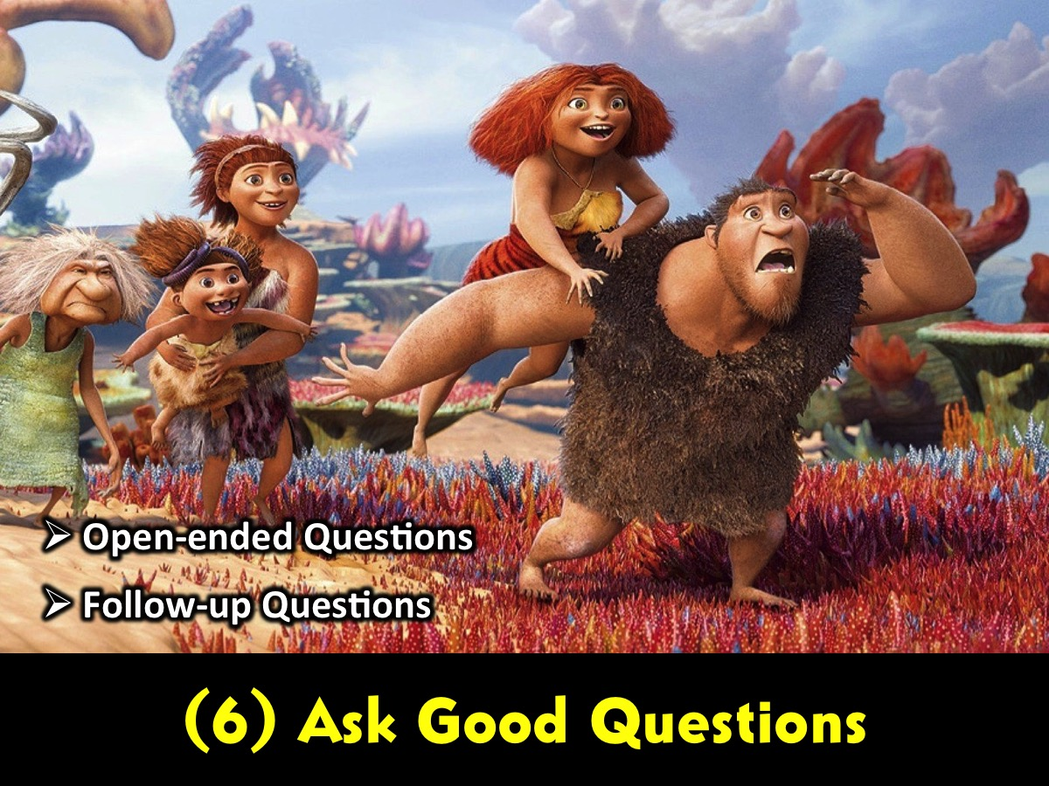
Notes:
6. Ask Good Questions - One of the most important skills in small-group facilitation is not having all of the right answers, but asking the right questions. Here are a few secrets to good question-asking:
A. Ask open-ended questions. Avoid the yes/no, true/false, multiple-choice questions—"Is Jesus the sheep or the shepherd in this parable?" Similarly, avoid questions that let people off the hook with a simple Sunday-school answer—"Why did Jesus die on the cross?" You want to ask questions that require people to share some actual thoughts and feelings.
B. Ask follow-up questions. Many people default to staying pretty surface-level with their answers to your questions, so get in the habit of not letting them off the hook. Ask more questions that follow up on their response. Here are some examples of good follow-up questions for the short/simple answers that people often give:
What makes you say that?
How do you feel about that?
How do you think that would've affected you if you had been living in the time of Jesus?
How would you explain your answer to a non-Christian friend or neighbor?
The idea is to get at the core of what people are really trying to say.

