Slide 1

Notes:
Have you heard of the movie: Tomorrowland?

Slide 2
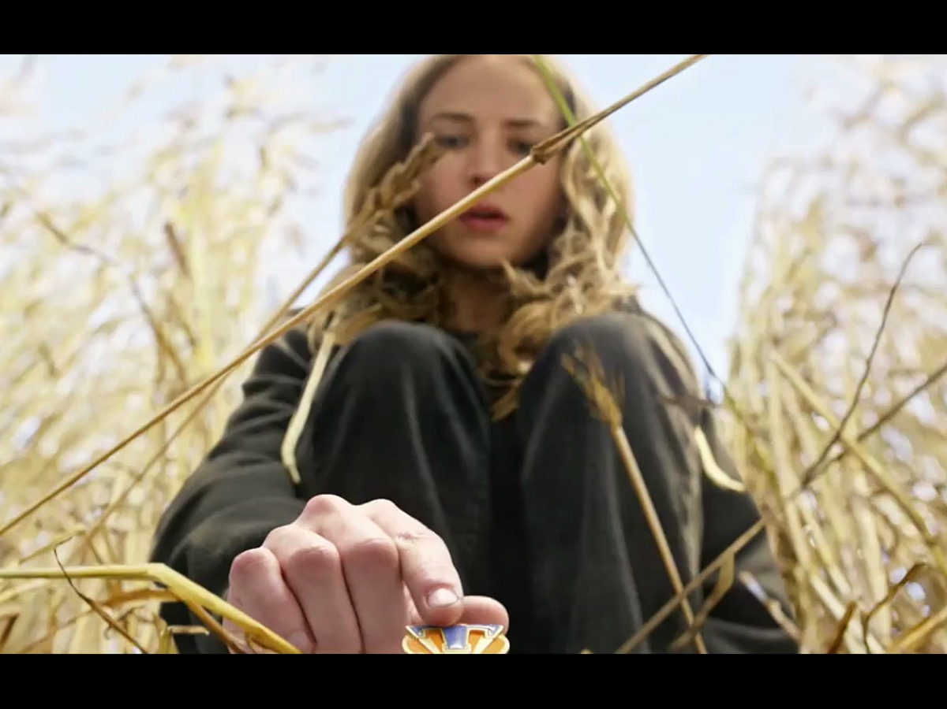
Notes:
A young girl named Casey Newton with a checkered past is released from detainment and is gifted with a small, circular pin with a T emblazoned on it. When she touches the pin, she sees glimpses of a futuristic society, featuring glittery towers and men on jet packs.

Slide 3
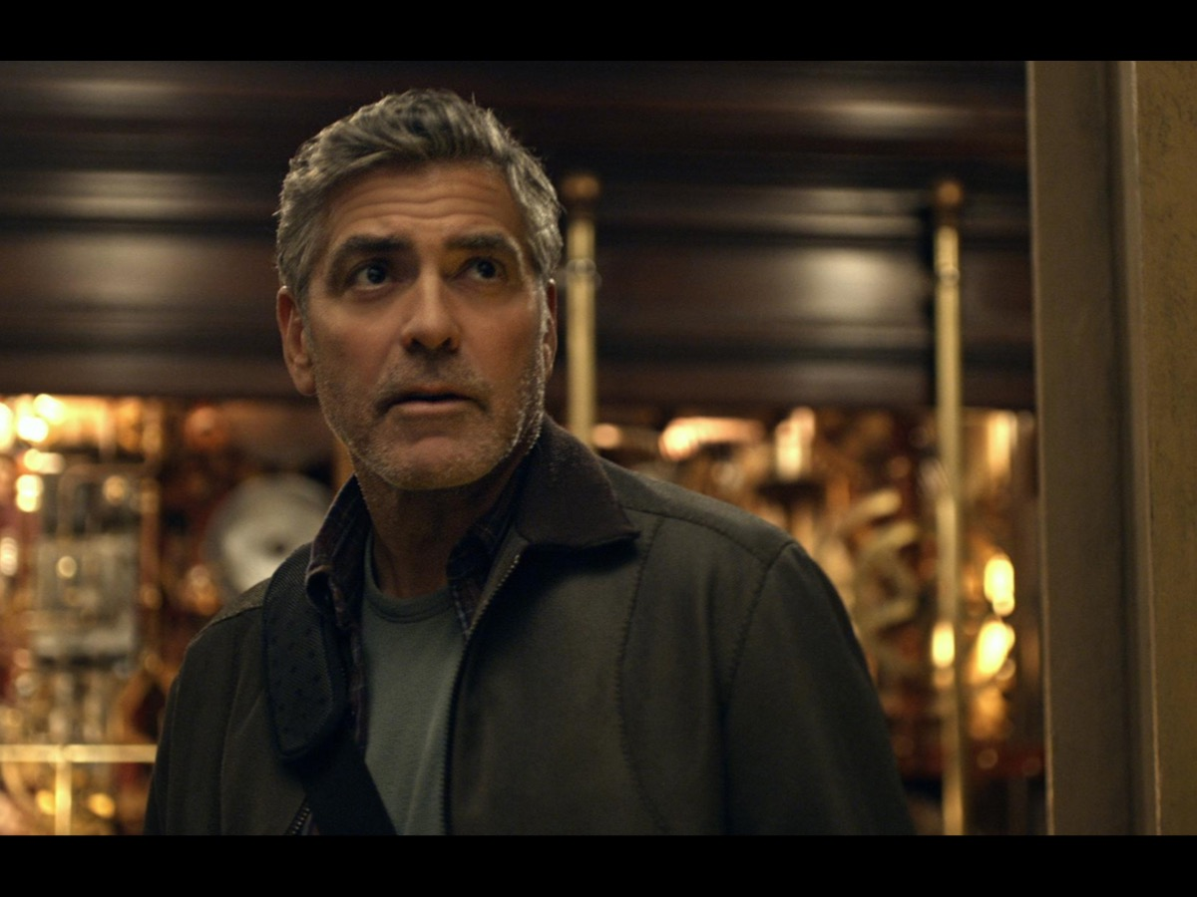
Notes:
She tracks down a reclusive inventor named Frank Walker, demanding that she escort him to this world that she's seen.

Slide 4

Notes:
He refuses but when robotic villains invade their home he changes his mind and the adventure begins.

Slide 5

Notes:
He helps her make the transition from her world to the world of Tomorrowland - a place where imagination and technology have run wild for the better.

Slide 6

Notes:
Tomorrowland: a place of untapped potential, unfettered dreams, and childlike imagination. It's where wishes go to take flight, where the things you only think about are brought to life.

Slide 7

Notes:
There are all sorts of dangers in the phases of transition both into high school ministry and out of high school ministry.

Slide 8
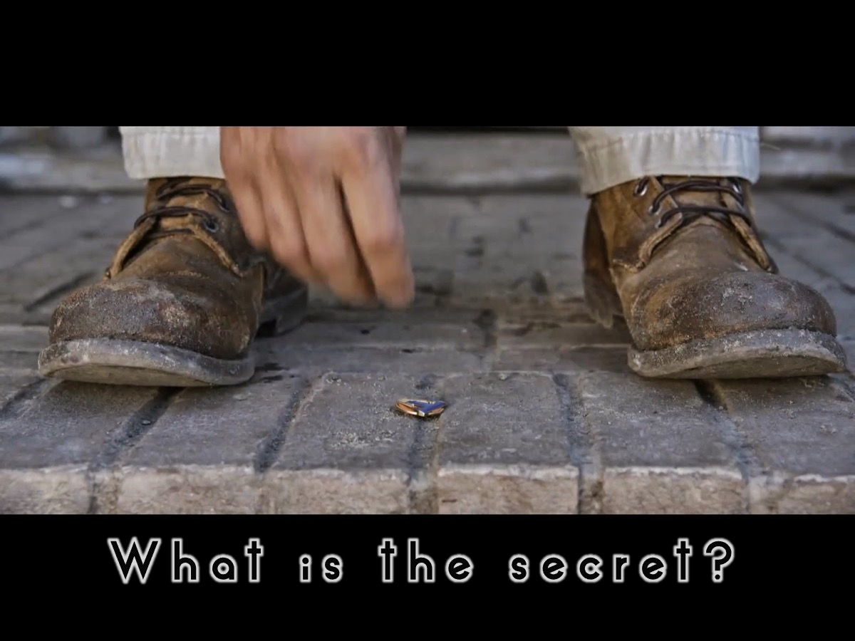
Notes:
What if the secret “pin” to ensure that people make positive transitions into and out of youth ministry?

Slide 9

Notes:
How do we manage transitions into high school ministry from kids ministry and from high school ministry into the wider church or campus and careers?

Slide 10
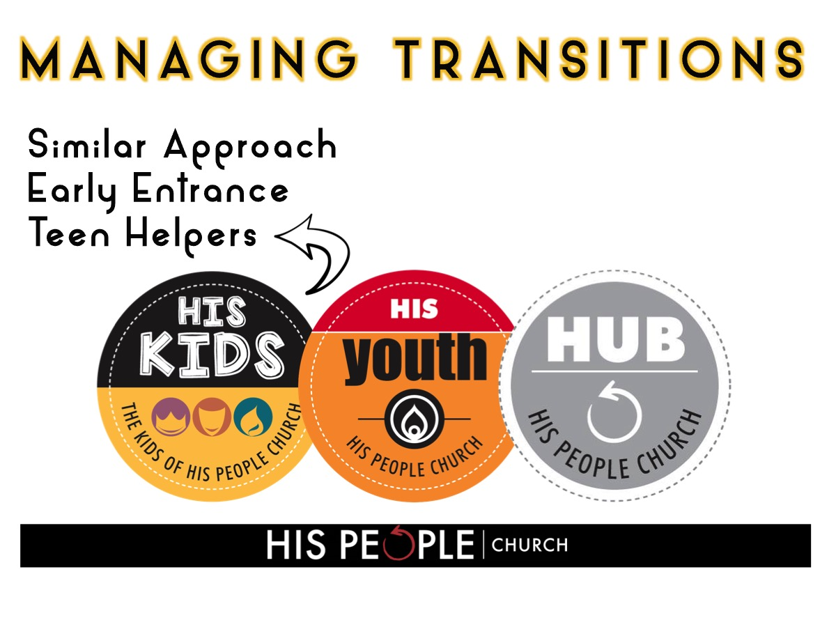
Notes:
For the transition into High School ministry we do the following: (1) Similar Approach - we ensure that we work closely with the kids ministry to ensure that the approach to disciplemaking we both use has common elements so that the kids coming into the group have a sense of familiarity even though it is a transition. Even our choice of branding ourselves as His Youth has helped with the transition from His Tots to His Kids to His Diz to His Youth. (2) Early Entrance - we have moved the entrance to high school ministry earlier so pre-teens in their final year at primary school have already made the transition before they have the added challenge of going to a new school - High School. We have two intakes in the year: June and November - and we let the kids, their families and the leaders in the Kids ministry make the decision about when they are ready to transition. The welcome service includes an official handing over of the kids who are incoming by the children’s pastor and a receiving by the youth pastor. They are introduced by name to the high school group and their photos are taken at the end of the service and displayed on the wall with all the others teens by the following Sunday. (3) Teen Helpers - another factor ensuring a smooth transition is the number of teens who volunteer as workers in the children’s ministry - this ensures that there are people in the group that the kids known when they get there!

Slide 11
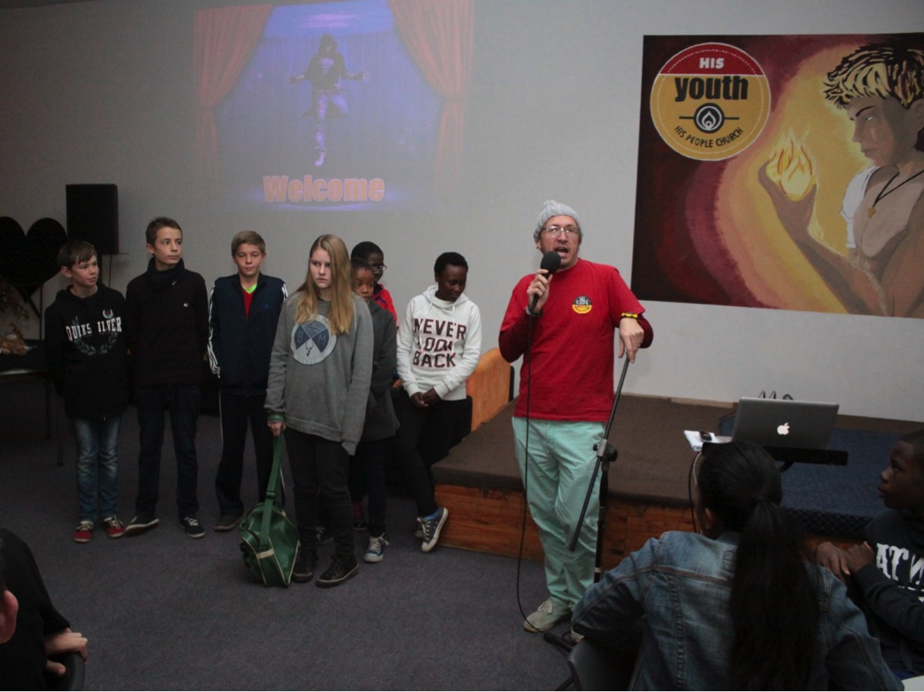
Notes:
Welcome Sunday - the first service kids making the transition into His Youth

Slide 12
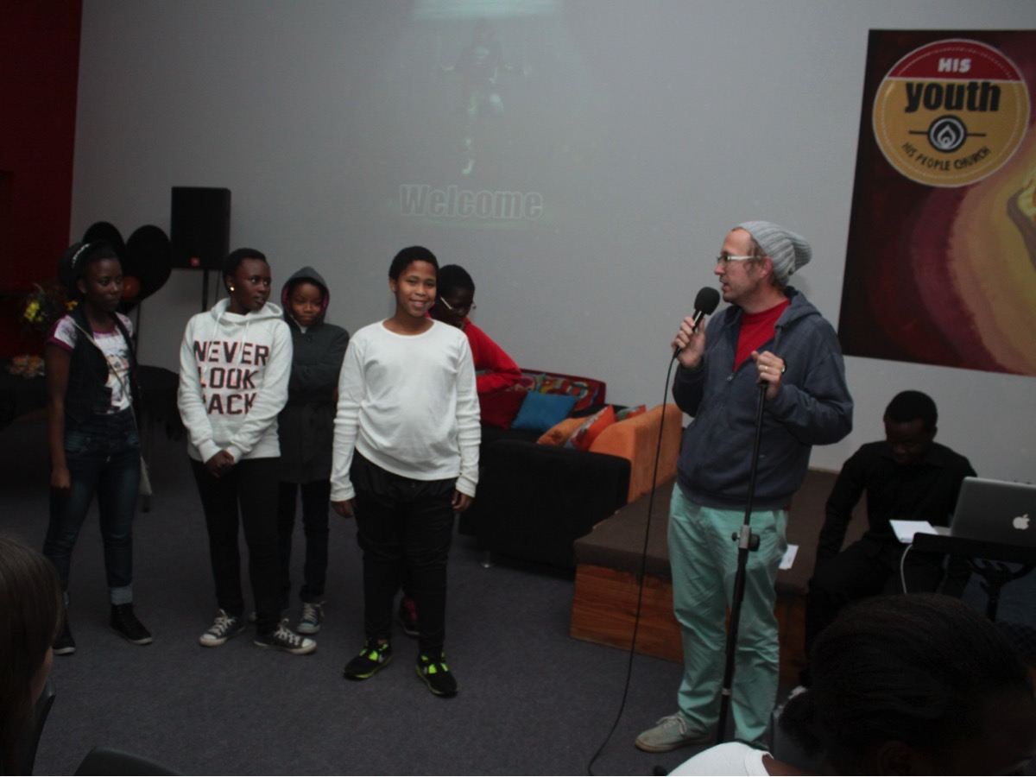
Notes:
Welcome Sunday - the second service kids making the transition into His Youth

Slide 13
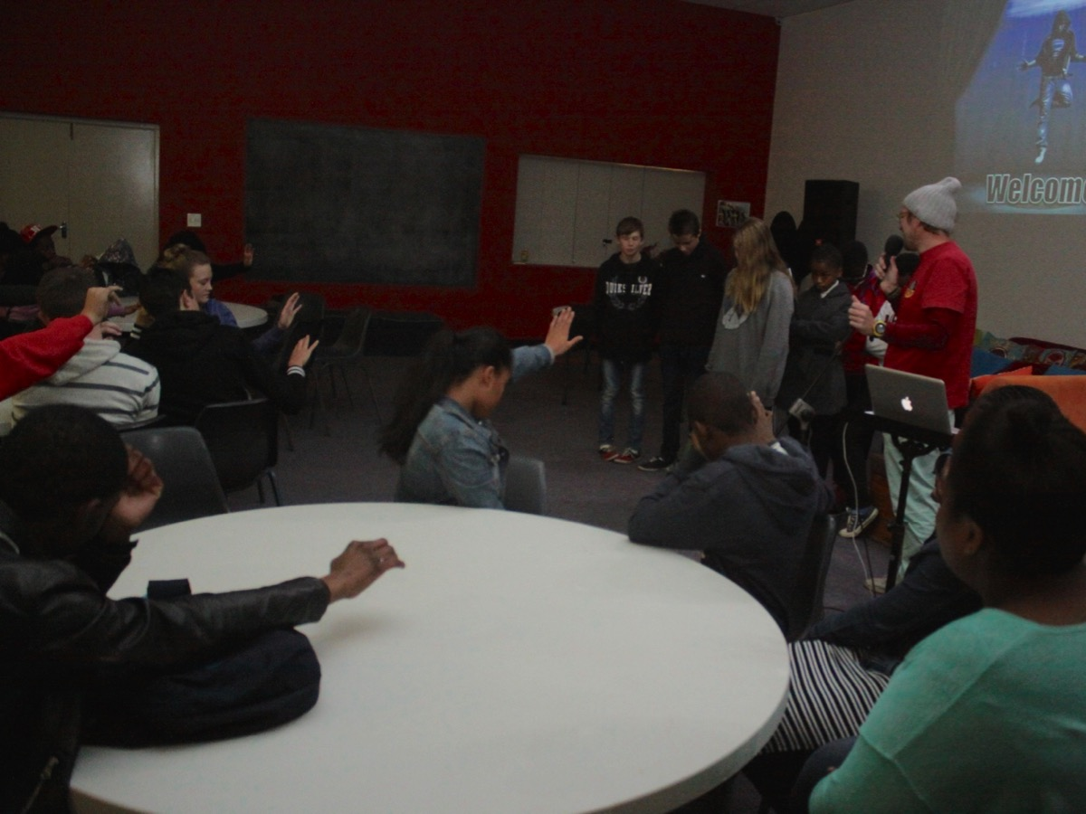
Notes:
Our teens praying for the incoming Kids.

Slide 14
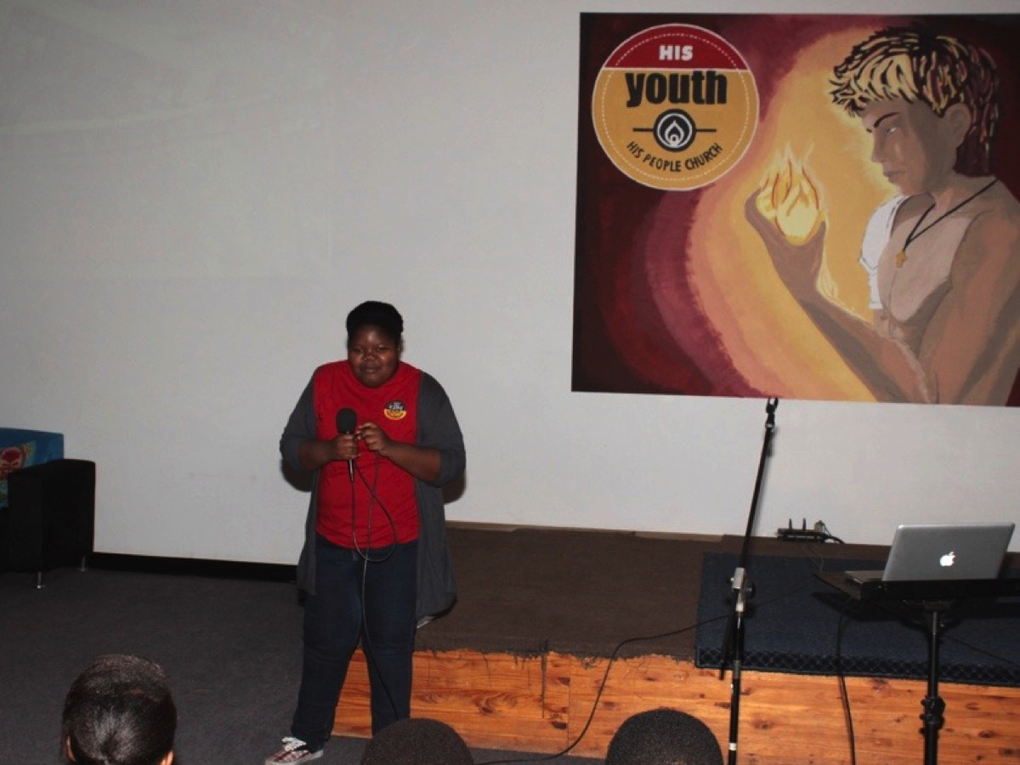
Notes:
One of our teens who serves at His Kids in her worker T-Shirt.

Slide 15
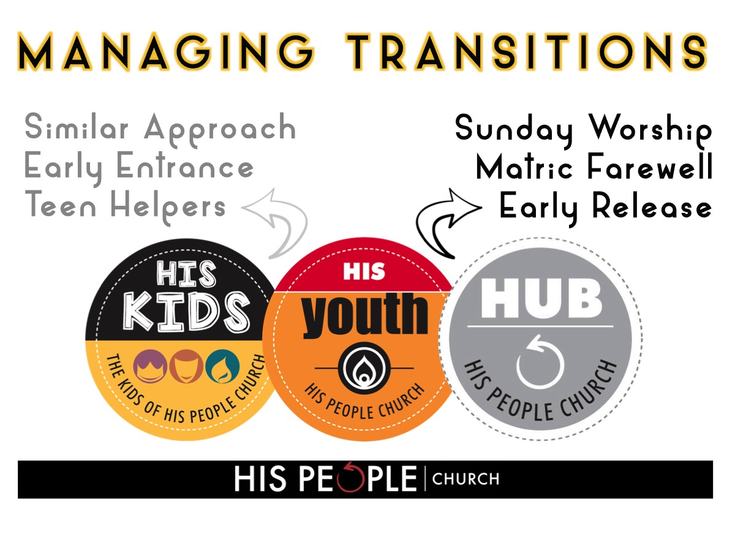
Notes:
For the transition from High School ministry we do the following: (1) Sunday Worship - our current approach of choosing to worship together with the adult congregation in church on Sunday mornings is helping teens to identify with the wider church family and this is a part of smoothing the way for them to make the transition. We look for ways to have senior teens involved in the church service - like opening the service in prayer of doing the offering message, or serving as door greeters, ushers or offering takers. (2) Matric Farewell - in the third term we have a farewell event for our Matrics which helps them with the realisation that within a few months they will have exited our ministry. Having church leaders or campus ministry leaders at this event is also a key to the transition. Last year we had our senior pastoral couple, Roger and Nicola Pearce at the dinner. (3) Early Release - we also ensure that in the first term the leaders on our teams who are in matric are aware that they are in a transition year. They continue as leaders in the first term, and in the second term are paired up with a young teen they help to mentor into a leadership position and then in the third term they are released from all program responsibility and removed from our social media lists so they can focus on their studies and exams. A further help with the transition was a paintball event planned in 2015 just for Matriculants to attend - it was run by our Sunday night congregation which would be one option for Matriculants to transition into.

Slide 16
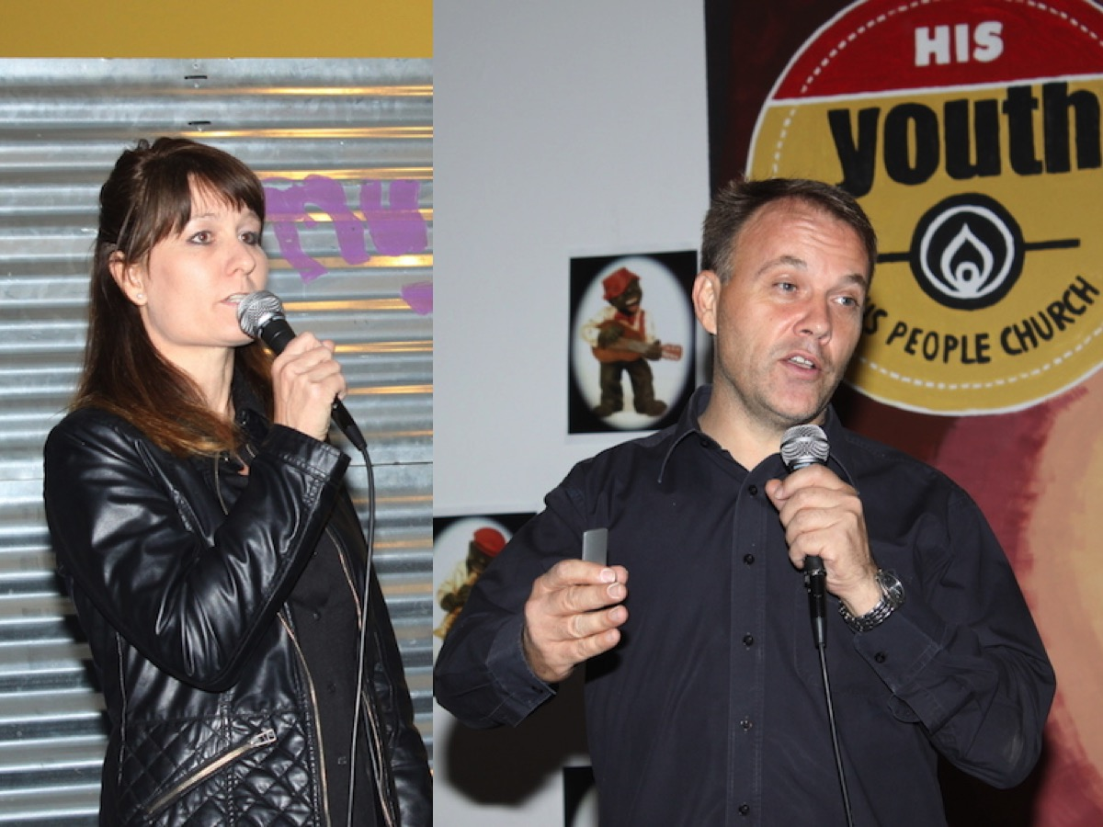
Notes:
Our senior leaders, Nicola and Roger Pearce, participated at our farewell dinner to welcome the Matrics into the life of the church.

Slide 17
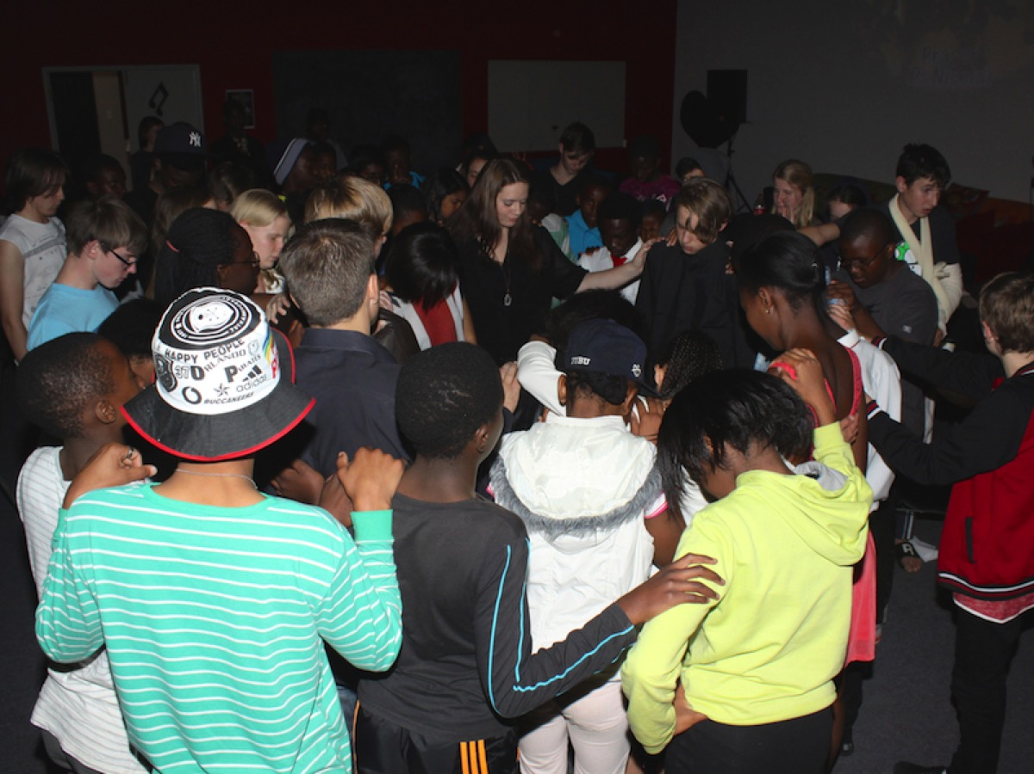
Notes:
Teens praying for the Matriculants.

Slide 18
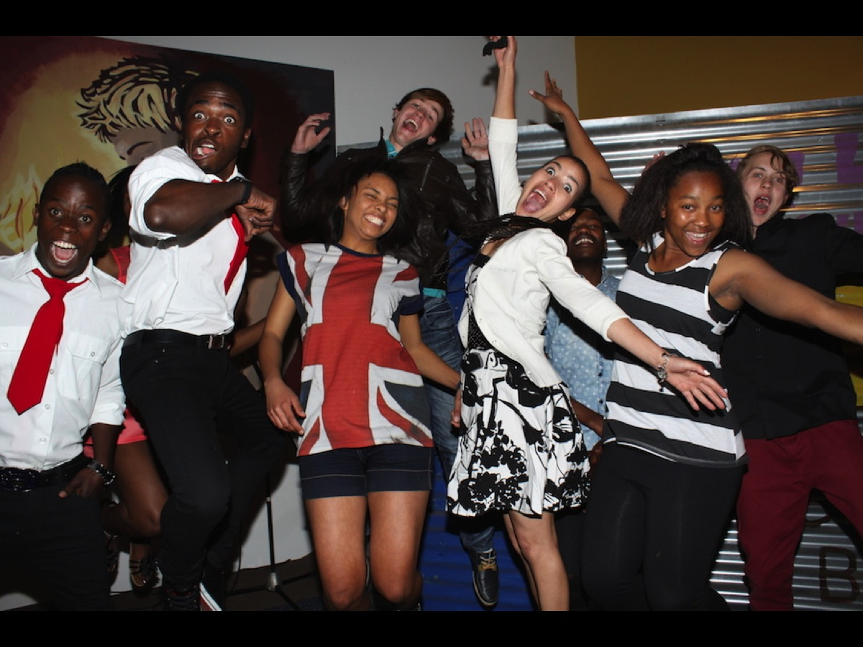
Notes:
The Matriculants of 2014.

Slide 19
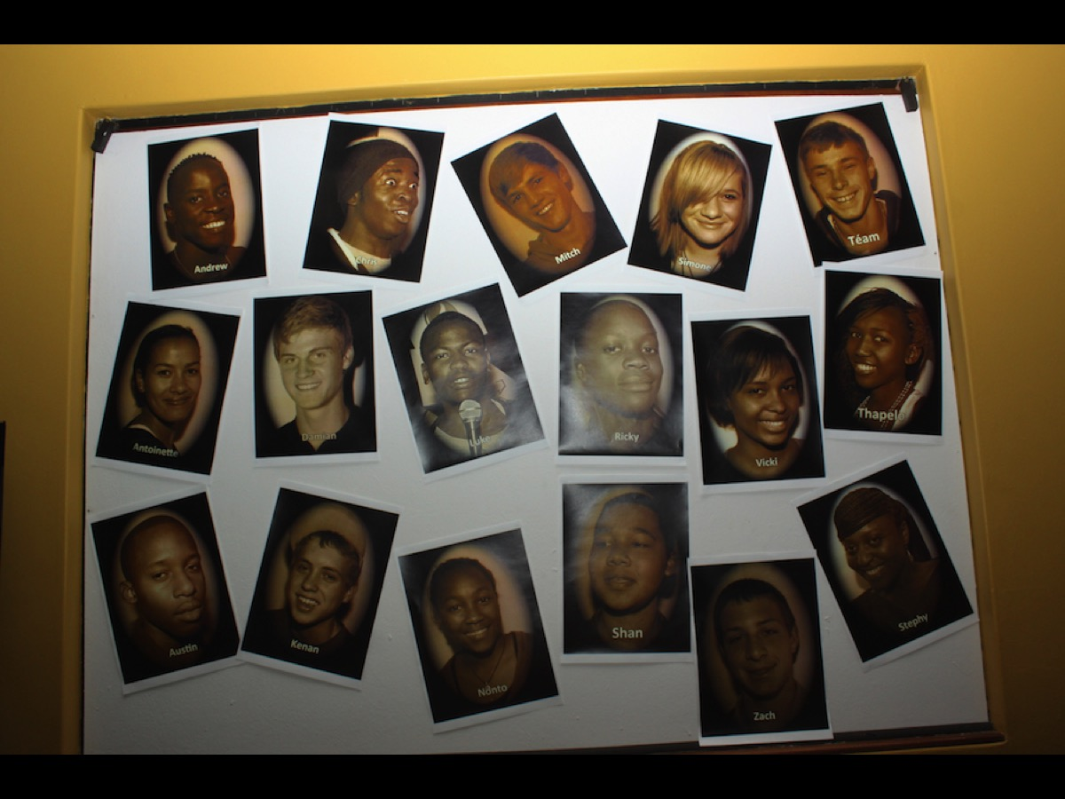
Notes:
A photo wall we created of our Matriculants in 2014.

Slide 20

Notes:
A Paintball event help in 2015 to integrate Matriculants into our Sunday evening service.

Slide 21
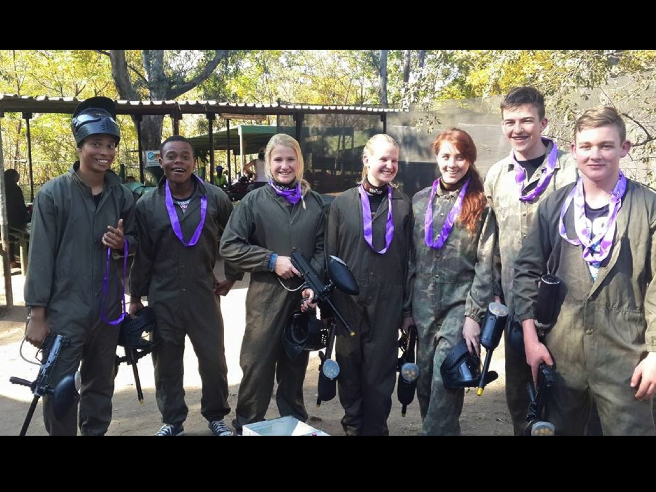
Notes:
The teens who participated in the Paintball experience in 2015.

