Slide 1
Notes:
Managing Your Life and Time.

Slide 2
Notes:
We are going to explore 6 steps to managing our life and time.

Slide 3
Notes:
1. Define Your Mission
Some definitions of mission: Mission is what you want to create of yourself and the world around you. (Peter Senge). Mission is what you want to be, do, feel, think, own, associate with and impact by some date in the future. (Dr. Linda Phillips-Jones). Mission is a clear mental picture of a preferable future imparted by God to His chosen servants based upon an accurate understanding of God, self and circumstances. (George Barna). Writing a personal mission statement is a key to successfully life and management!
(1) What Do You Want to Be? What noun best reflects what you will ‘be’ for a lifetime?
(2) How Can You Become This? What verbs best describe the impact you want to make?
(3) Who Do You Want To Impact? What people groups do you want to impact?
(4) Why Do You Want To Live This Kind Of Life? What is the end product of your life?
verbs of impact
people groups to impact
end-product of impact
lifetime noun
My Mission is…

Slide 4
Notes:
Sharing: Have you ever created a mission statement for your life? If No, “Why not?” If Yes, “So what?”

Slide 5
Notes:
What is Mission?

Slide 6
Notes:
Peter Senge, a business leader once wrote: “Mission is what you want to create of yourself and the world around you.”

Slide 7
Notes:
Today we will define mission like this: “Mission is what you want to be and do to others to impact them positively during your life-time.”

Slide 8
Notes:
Who had a mission? Here are some examples of people who lived with a clearly defined mission for their lives.

Slide 9
Notes:
Adam and Eve had a mission to be fruitful, to multiply and have dominion over the earth.

Slide 10
Notes:
Jesus had a mission to seek and to save the Lost.

Slide 11
Notes:
Martin Luther King Jr. had a mission to see equality and racial harmony existing among all people.

Slide 12
Notes:
Nelson Mandela had a mission to see a democratic and free society where people live in harmony.

Slide 13
Notes:
Why should you write a Mission statement?

Slide 14
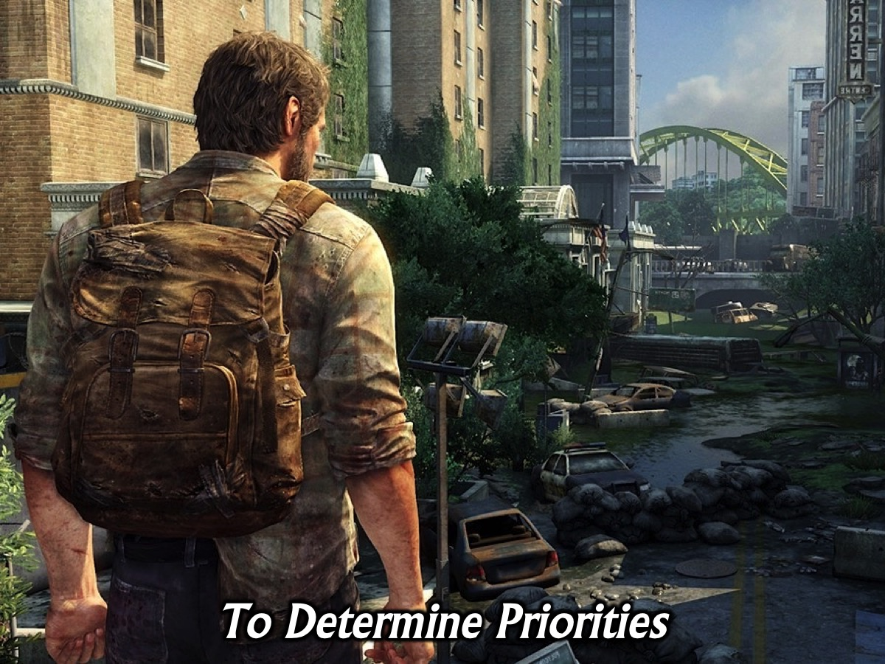
Notes:
(1) To Determine Priorities - Helps you focus on what is important.

Slide 15
Notes:
(2) To Inspire Progress - Keeps you moving forward when the going gets tough.

Slide 16
Notes:
(3) To Limit Distractions – it helps you say no to things that will get in the way of you living your mission.

Slide 17
Notes:
How do you write a Mission Statement?

Slide 18
Notes:
Here is the template we are going to use to craft our mission statements. There are four parts to the mission statement: (1) A Lifetime Noun; (2) Verbs of Impact; (3) Groups to Impact and (4) Result of Impact.

Slide 19
Notes:
Here is an example – not to be copied of course – of my mission statement that uses this format.

Slide 20
Notes:
Okay, so grab your handout and let’s start working on our mission statements – one line at a time.

Slide 21
Notes:
1. What must you BE to impact people? As you write down what you want to be for a lifetime think about the kind of person you want to be – choose a noun that reflects what you want to be throughout your life – this is like the best version of yourself – what God meant you to be!

Slide 22
Notes:
2. What can you DO to impact people? Write down three ways in which you will impact lives – these are verbs and not nouns – i.e. doing or action words.

Slide 23
Notes:
3. Who do you want to impact? So think about three different groups of people in your sphere of influence that you will impact through your mission. Make sure that it is as board as possible and does not just refer to your work environment.

Slide 24
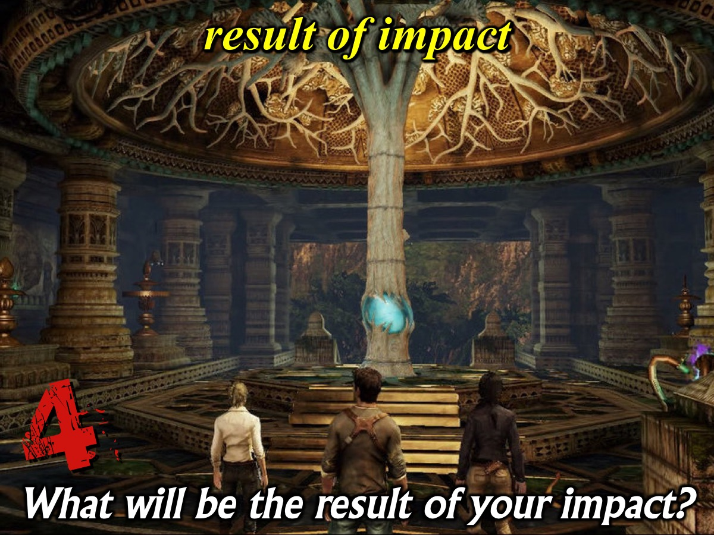
Notes:
4. What will be the result of your impact? Write down what you believe your impact will accomplish in the lives of the people groups or in the world in general.

Slide 26
Notes:
Now you can put key words into the various blocks on your handout.

Slide 27
Notes:
Write out your missions statement, using as few words as possible, in a single sentence!

Slide 28
Notes:
Share your mission with someone next to you.

Slide 29
Notes:
Now it is up to you to live your mission: (1) Ask others to help you live your mission. (2) Allocate time, energy and resources to it. (3) Act in line with your mission.

Slide 30
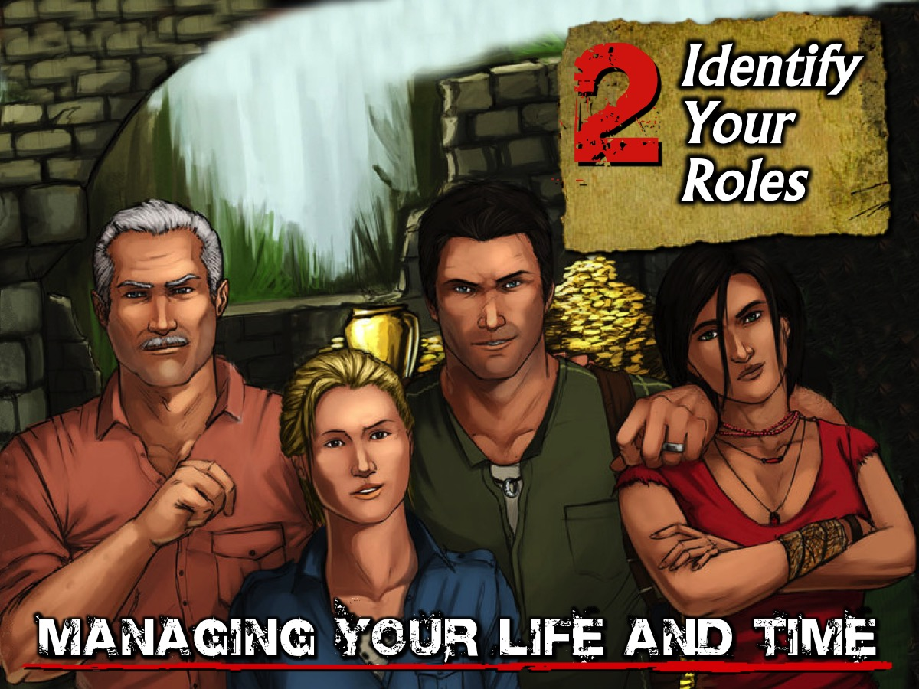
Notes:
2. Identify Your Roles. These are the contexts in which you will live out your mission.

Slide 31
Notes:
There are 3 steps to identifying your roles: (1) List all the roles you have in life. (2) Group the roles into categories. (3) Select five or six roles to work with.

Slide 32
Notes:
3. Create Your Goals. To improve in each of your roles you have to set goals for each of them.

Slide 33
Notes:
Create 2 or 3 goals for each of your roles. Make them SMART: Specific, Measurable, Attainable, Realistic and Timely.

Slide 34
Notes:
4. Plan Your Week. There are six steps that will help you turn your mission into reality. You should consider using a weekly planner. A daily planner is so ‘close up’ that you end up focussing on what is right in front of you and urgency and efficiency can take the place of importance and effectiveness. Using a weekly planner is a better tool as it helps you focus on fulfilling your mission.
(1) Review your Mission. The first step in programming for the coming week is to connect with what is most important in your life. The key to this connection is referring to your mission statement that reminds you of what is most important in your life and that which gives your life meaning. This process will also help you to schedule into your week a significant number of important activities.
(2) Identify your Roles. Now you make a list of all the roles you fulfil in life. The total number of roles must not exceed six as it is difficult to mentally manage too many. If you have more roles, you could combine some of them (i.e. family - for husband, father and brother).
(3) Create your Goals. Next, you should think important results to accomplish in each role during the next seven days. You can create goals by asking yourself: “What is the most important thing I could do this week to have the greatest positive impact.” While many goals may come to mind, you should limit yourself to one or two important goals for each role.
(4) Schedule your Activities. Most people are always trying to find time for important activities in their busy lives. They move, delegate, cancel or postpone things - trying to find time to do important things, but the secret is not get the most important items into your week as oon as possible and then use the remaining time for things that come up. You also need to create time zones - these are big chunks of time that are set aside for important activities. Here is how to go about scheduling your activities: (a) Identify Your Big Rocks: Look ahead through the week and make a list of all the things you must accomplish that week. Another key is to think through your roles in life and think of one or two important things you need to get done for each of your roles. (b) Schedule Your Big Rocks: Get to your weekly planner and allocate time for the important things before you week gets filled up with little, lesser important things. (c) Schedule Everything Else: Now you can fill in the little to-dos, daily tasks and appointments. You may like to record upcoming events and activities as well.
(d) Be Flexible When Necessary: You may need to rearrange things during the week. Don’t feel that having a weekly planner means that everything is set in concrete.
(5) Adapt your Schedule. Once your important goals have been entered onto the weekly planner, the daily task is to keep a focus on priorities as you deal with unexpected opportunities and challenges that arise. There are three keys to effectiveness: (a) Preview your day - look at the day in the context of the week. (b) Prioritise your activities - mark activities using a numbering system. (c) Reschedule your activities – list timed and non-timed activities separately so you know which activities you can juggle.
(6) Evaluate your Progress. Evaluation should be done weekly and monthly: (a) Weekly evaluation - at the end of the week ask questions like: What goals did I achieve? What goals did I miss? What kept me from accomplishing my goals? What challenges did I encounter? Did I protect my priorities when I made decisions? How much time did I spend on important activities? What can I learn from this week as a whole? (b) Monthly evaluation - at the end of each month or quarter, ask yourself questions like: What patterns of success or failure do I see in setting and achieving my goals? Am I setting realistic but challenging goals? What keeps me from accomplishing my goals?

Slide 35
Notes:
(1) Review your Mission. The first step in programming for the coming week is to connect with what is most important in your life. The key to this connection is referring to your mission statement that reminds you of what is most important in your life and that which gives your life meaning. This process will also help you to schedule into your week a significant number of important activities.

Slide 36
Notes:
(2) Identify your Roles. Now you make a list of all the roles you fulfil in life. The total number of roles must not exceed six as it is difficult to mentally manage too many. If you have more roles, you could combine some of them (i.e. family - for husband, father and brother).

Slide 37
Notes:
(3) Create your Goals. Next, you should think important results to accomplish in each role during the next seven days. You can create goals by asking yourself: “What is the most important thing I could do this week to have the greatest positive impact.” While many goals may come to mind, you should limit yourself to one or two important goals for each role.

Slide 38
Notes:
(4) Schedule your Activitie. Most people are always trying to find time for important activities in their busy lives. They move, delegate, cancel or postpone things - trying to find time to do important things, but the secret is not get the most important items into your week as oon as possible and then use the remaining time for things that come up. You also need to create time zones - these are big chunks of time that are set aside for important activities. Here is how to go about scheduling your activities: (a) Identify Your Big Rocks: Look ahead through the week and make a list of all the things you must accomplish that week. Another key is to think through your roles in life and think of one or two important things you need to get done for each of your roles.(b) Schedule Your Big Rocks: Get to your weekly planner and allocate time for the important things before you week gets filled up with little, lesser important things.

Slide 39
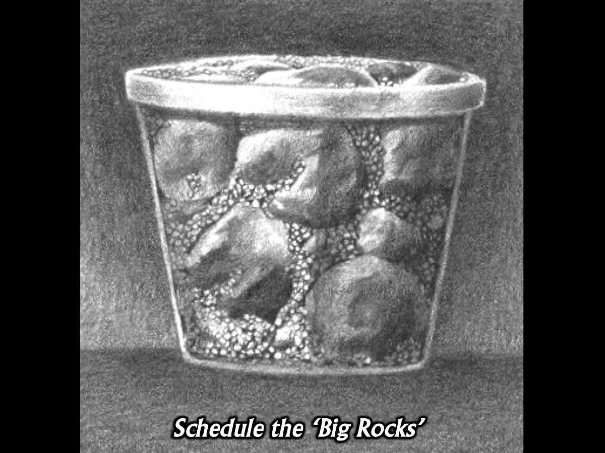
Notes:
You have to schedule you your big rocks - the important things in your life

Slide 40
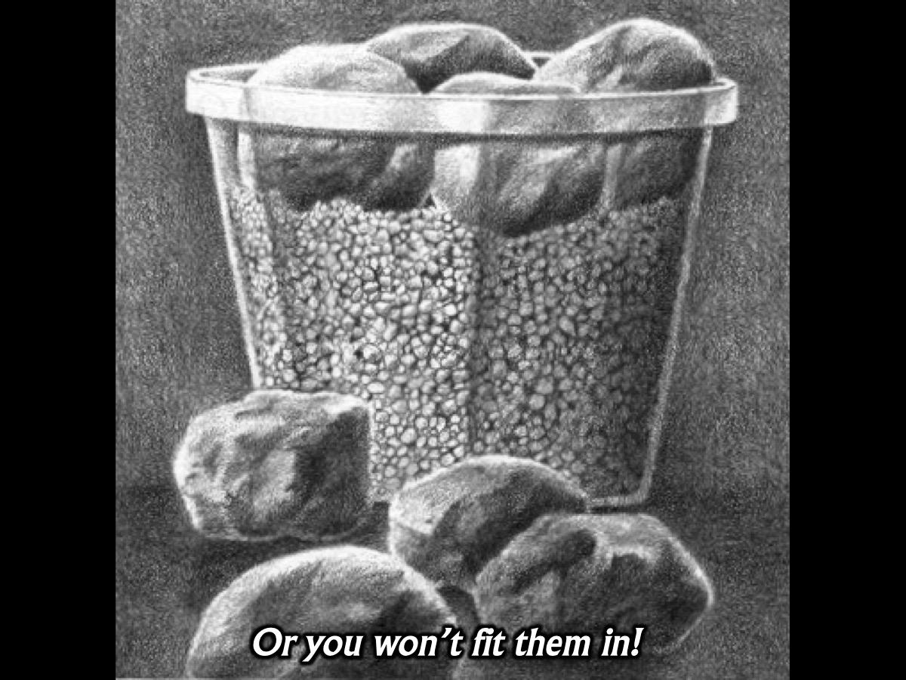
Notes:
Or you won’t fit them in.

Slide 41
Notes:
(c) Schedule Everything Else: Now you can fill in the little to-dos, daily tasks and appointments. You may like to record upcoming events and activities as well. (d) Be Flexible When Necessary: You may need to rearrange things during the week. Don’t feel that having a weekly planner means that everything is set in concrete.

Slide 42
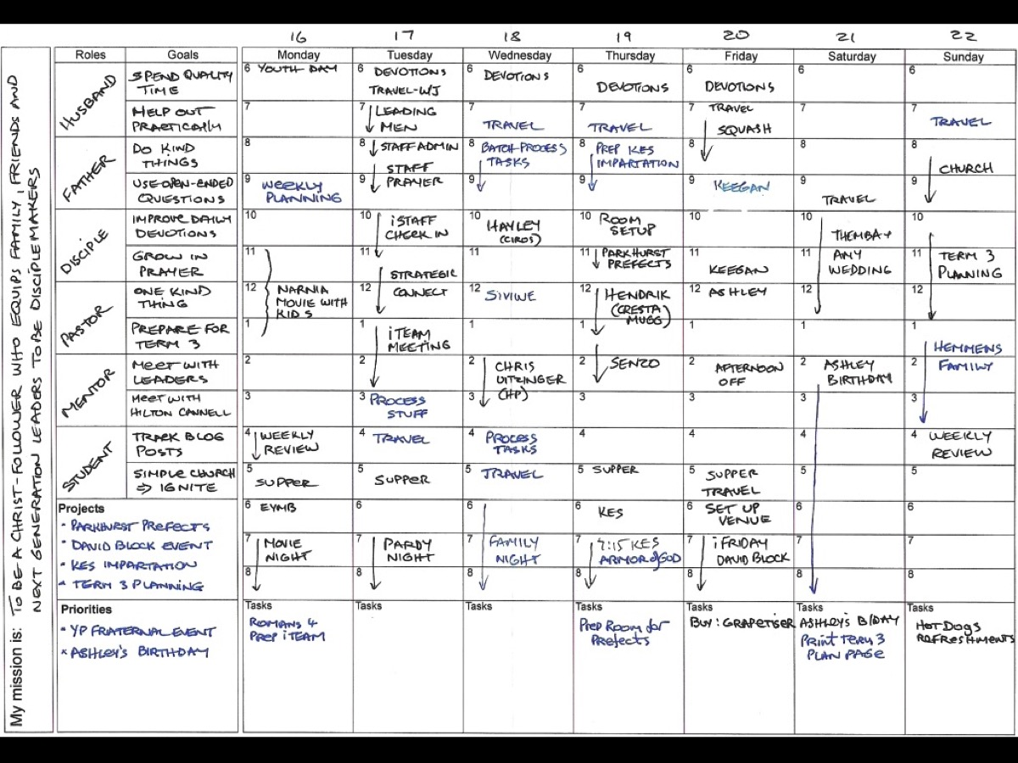
Notes:
Here is an example of a completed weekly planner.

Slide 43
Notes:
(5) Adapt your Schedule. Once your important goals have been entered onto the weekly planner, the daily task is to keep a focus on priorities as you deal with unexpected opportunities and challenges that arise. There are three keys to effectiveness: (a) Preview your day - look at the day in the context of the week. (b) Prioritise your activities - mark activities using a numbering system. (c) Reschedule your activities – list timed and non-timed activities separately so you know which activities you can juggle.

Slide 44
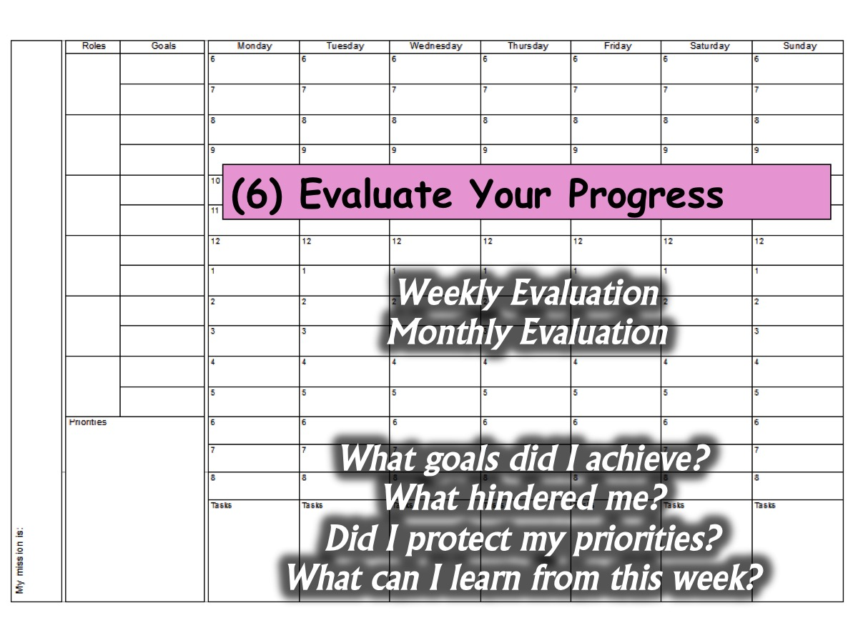
Notes:
(6) Evaluate your Progress. Evaluation should be done weekly and monthly: (a) Weekly evaluation - at the end of the week ask questions like: What goals did I achieve? What goals did I miss? What kept me from accomplishing my goals? What challenges did I encounter? Did I protect my priorities when I made decisions? How much time did I spend on important activities? What can I learn from this week as a whole? (b) Monthly evaluation - at the end of each month or quarter, ask yourself questions like: What patterns of success or failure do I see in setting and achieving my goals? Am I setting realistic but challenging goals? What keeps me from accomplishing my goals?

Slide 45
Notes:
5. Manage Your Week

Slide 46
Notes:
1. Balance Your Whole Life: Make sure your system covers the whole of your life and not just your work. Your personal life, your family, your work and your hobbies are all important and need to be kept in balance.

Slide 47
Notes:
2. Learn to Empower People and Delegate Effectively: Don’t do everything yourself – give stuff to others.

Slide 48
Notes:
3. Get Organised: Develop a filing system (file don’t pile) and keep your office and workspace tidy. Here are some best practises for filing:
Create Your System: One that works for you and will allow you to retrieve a document in the quickest amount of time possible.
Identify Your Categories: List the categories you could file items under and create a folder or hanging file for each item.
Clear Your Backlog: Work though everything on your desk or in shelves by picking it up and asking: (i) What is it? (ii) Do I need to act on it? (iii) Can I file it?
Manage Your Filing: Set aside time regularly to file material so you don’t end up with a huge pile of items to file.

Slide 49
Notes:
3. Get Organised: Develop a filing system (file don’t pile) and keep your office and workspace tidy. Here are some best practises for filing:
Create Your System: One that works for you and will allow you to retrieve a document in the quickest amount of time possible.
Identify Your Categories: List the categories you could file items under and create a folder or hanging file for each item.
Clear Your Backlog: Work though everything on your desk or in shelves by picking it up and asking: (i) What is it? (ii) Do I need to act on it? (iii) Can I file it?
Manage Your Filing: Set aside time regularly to file material so you don’t end up with a huge pile of items to file.

Slide 50
Notes:
4. Schedule Think Time in Your Week: Create a weekly appointment where you can think about stuff.

Slide 51
Notes:
5. Take Time to Give Time: Don’t accept invitations too quickly. Think about preparation time needed.

Slide 52
Notes:
6. Work Two Thirds of the Day: Morning and Afternoon or Morning and Evening but not all three.

Slide 53
Notes:
7. Handle a Piece of Paper Once: Don’t pick up stuff and then put it aside for later - deal with it once!

Slide 54
Notes:
8. Always Have Something to Do: A book to read, an article to read, a project to plan, etc.

Slide 55
Notes:
9. Keep Information at your Fingertips: Have system to keep track of phone numbers, addresses, etc.

Slide 56
Notes:
10. Work with Task Check Lists: Cross off completed tasks when they are done.

Slide 57
Notes:
11. Automate Regular Tasks: Don’t start tasks from scratch each time you repeat it. Create templates.

Slide 58
Notes:
12. Confirm Appointments Before You Leave For the Meeting Venue: Check the person is available.

Slide 59
Notes:
13. Deal with Interruptions.

Slide 60
Notes:
Here are some guidelines for handling interuptions:
(a) Realize that not every interruption is an interruption. You’re both paid and called to focus on others. Some of what may strike you as inconvenient could actually be significant appointment.
(b) Realize that most interruptions are your fault. When you design a program that revolves around you, don’t be surprised when everything revolves around you.
(c) Give people the information they need before they interrupt you. Think ahead about questions you’re likely to be asked, include them in a newsletter, or set up a phone hot line.
(d) Set up office hours. If people want you, then steer them toward times that make sense to you.
(e) Evaluate your interruptions. Keep a log of your interruptions for two weeks. 80 percent of your interruptions are caused by about four people, so take them aside and say, “I’m really trying to protect my study time. Could you help me out by not interrupting me between 9am and lunch?”
(f) Stand up when interrupted in your office. Most people will feel too uncomfortable to sit down if you remain standing while they're in your office. If the person has come for a worthwhile interruption, sit down and offer the person a seat. Otherwise, remain standing.
(g) Schedule your interruptions. Schedule an “open” time when you are most available for questions and phone calls. Let everyone know that this is the best time you can be reached then make sure you're available.

Slide 61
Notes:
6. Manage Your Actions.

Slide 62
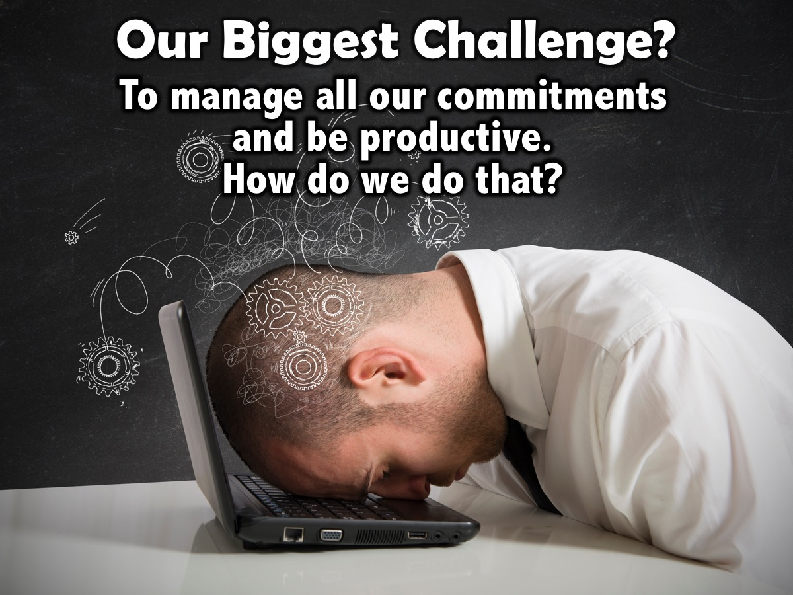
Notes:
Our biggest challenge is to manage all the commitments that we have and ensure that we exist in a state of productivity.

Slide 63
Notes:
(1) Capture all the things that need to get done into a logical and trusted system outside of your head and off your mind. This will ensure that you think about tasks and not of them.

Slide 64
Notes:
(2) Clarify what your commitment to each responsibility is and what you need to do to make progress towards fulfilling it.

Slide 65
Notes:
(3) Keep reminders of all the actions you need to take in a system that you review regularly.

Slide 66
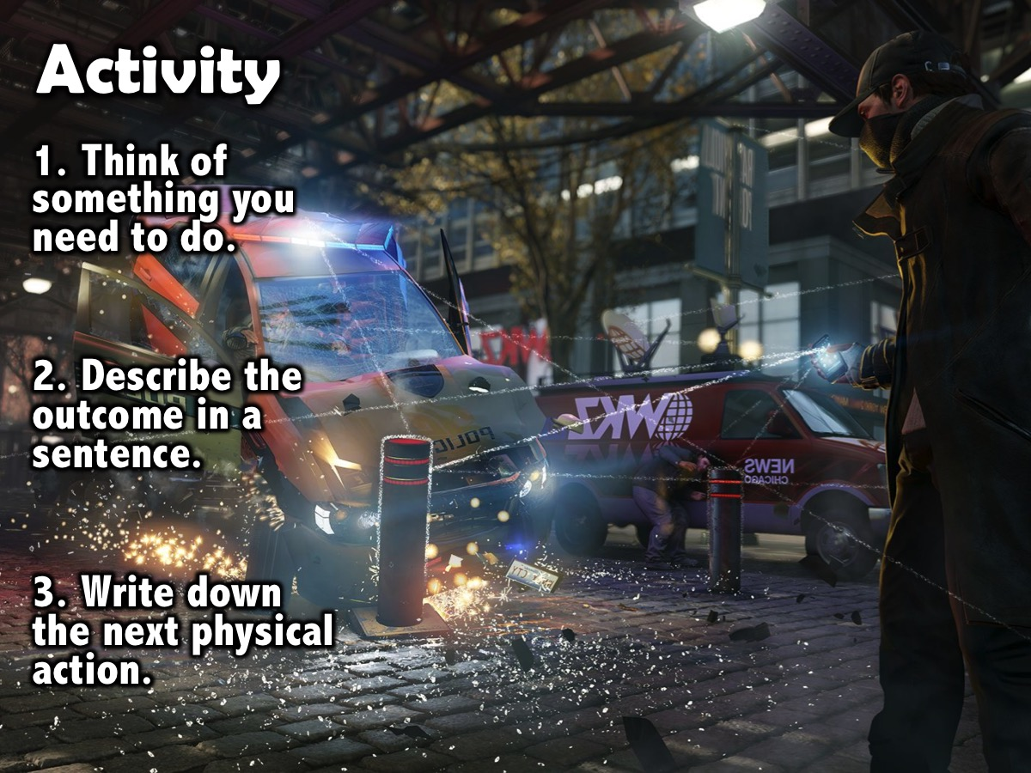
Notes:
Here is an activity to get you started: (1) Think of something that you need to do. (2) Describe in a single sentence the intended successful outcome for the problem or situation. (3) Write down the very next physical action required to move the situation forward.

Slide 67
Notes:
The 5 Stages of Mastering Workflow: (1) Collect things that command our attention. (2) Process what they mean and what to do about them. (3) Organise the results. (4) Review everything on a weekly basis. (5) Do what needs to

Slide 68
Notes:
A. Collect. You must collect things that have your attention (anything personal or professional, big or little, that you think should be different than it currently is and that you have any level of internal commitment to changing). Here are 3 principles: (a) Get it all out of your head – nothing should be left in your mind. (b) Minimize your collection buckets – these could be physical in-baskets; writing paper and pads; electronic note taking; recording devices (answering machines, voicemail, dictating equipment); email and high-tech devices (computers or phones). (c) Empty the buckets regularly – you must process the stuff you collect.

Slide 69
Notes:
Activity: Do a mind dump - where you take a sheet of paper and write down anything that you need to do - get everything out of your mind and onto the paper.

Slide 70
Notes:
B. Process. This involves identifying what each item means and what you need to do about them. To get the collection bucket emptied you must process each item. You can ask the following questions:
What is it? We must identify what each item is, where it comes from and what our responsibility is.
(2) Is it actionable? There are two possible answers to whether an item is actionable: YES or NO!
If the answer is No, you have three options: (a) Trash – throw it away! (b) Incubate – schedule it for future attention using a someday/maybe list or month file system. (c) File (reference should be information that can be easily referred to when needed) – this could be filed in an A-Z filing system or a category system.
If the answer is Yes, you must ask two follow up questions: (a) What project or outcome have you committed to? Any item that requires more than one step to accomplish the desired outcome is a project and must be tracked using a ‘Projects’ list and reviewed each week to check for follow up actions that must be completed. (b) What is the next action? The next action is the next physical, visible activity that need to be engaged in, in order to move the current reality toward completion. Once you have know the next action, you have three choices: (i) Do it – if the action will take less than two minutes then do it right away. (ii) Delegate it – if it will take more than two minutes consider giving it to someone else to do. (iii) Defer it – if it will take more than two minutes and you are the person who must do it, then decide when you need to act on it.

Slide 71
Notes:
C. Organize. The results of your collecting and processing must be organised. For non-actionable items the possible categories are trash, incubation tools and reference storage. For actionable items you will need a list of projects (these are things that require more than one action step), storage or files for project plans and materials, a calendar (time specific actions, day specific actions, day specific information), a list of reminders of next actions and a list of reminders of things you're waiting for (only review as often as they have to be in order to stop wondering about them).

Slide 72
Notes:
Activity: Customise your Next Actions list. Think about the contexts that you work in.

Slide 73
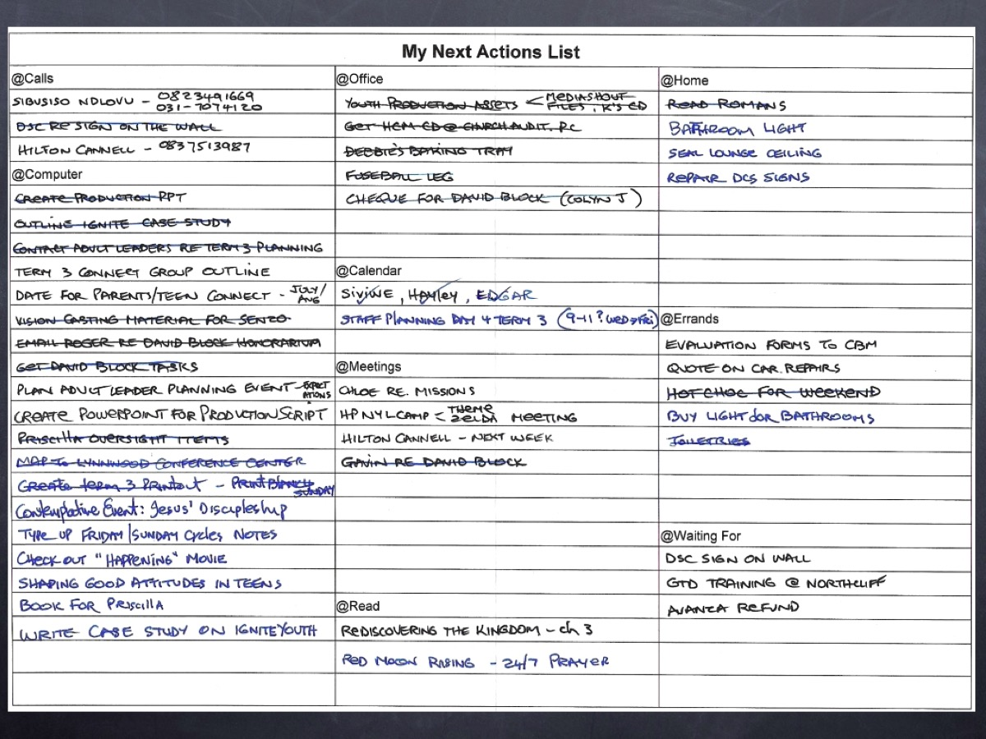
Notes:
Here is a sample of one of my Next Action Lists.

Slide 74
Notes:
D. Review. You must be able to review the whole picture of your life and work at appropriate intervals and appropriate levels. This involves being able to scan all the defined actions and options before you – to increase the effectiveness of the choices you make about what you are doing at any point in time. So what should you review and when? Firstly, your project list, your next action list, your calendar and waiting for list should be reviewed. Secondly, a weekly review must be done - this is where you gather and process all your stuff, review your system, update your lists, and get clean, clear, current and complete.

Slide 75
Notes:
Activity: Think of a time when you can do a weekly review. Put it in your diary.

Slide 76
Notes:
E. Do. The whole purpose of managing your work is to help you make good choices about what you are doing at any point in time. So how do we decide what to do? There are four criteria: (1) Context – some projects can be done anywhere but many need a specific location – so manage your to do list based on different contents like: @Calls, @Errands, @Office, @Meetings, @Computer, @Home, etc. (2) Time – the amount of time you have will determine what you can do. (3) Energy – the amount of energy you have will determine what you can do. (4) Priority – what is the most important thing to do given the context, time and energy you have?

Slide 77
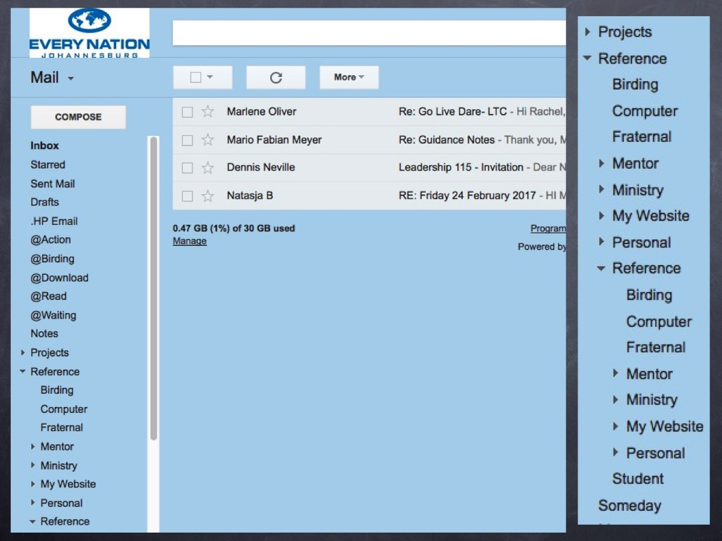
Notes:
Finally, in order to administer your life you need to create an email system that will ensure that you are on top of all the demands that come your way through email. The goal is to get your inbox to Zero by process each email and assigning it to an action folder that you process and don’t forget about. My email system in Gmail uses the following folders to help me deal with emails and get them out of my inbox:
@Action – this is a folder for emails that I need to act on as soon as I get a chance.
@Downloads – this is a folder for emails that contain web links that I need to visit.
@Read – this is a folder for emails that contain information I need to read.
@Waiting For – this is a folder for emails that I cannot act on until I get a response.
Projects – this is a folder with sub-folders for each of the current projects I am tracking.
Reference – this is a folder with sub-folders for groups of emails that need to be archived.

Slide 79
Notes:
Here are the 6 steps we have explored to managing your life and your time.

