Slide 1

Notes:
Tonight is out Matric Farewell. The theme is “Up, Up and Away!”

Slide 2

Notes:
Welcome to regulars and newcomers!

Slide 3

Notes:
Prayer: Let’s open our meeting in prayer.

Slide 4

Notes:
Announcements: Please Listen up to the following announcement.

Slide 5
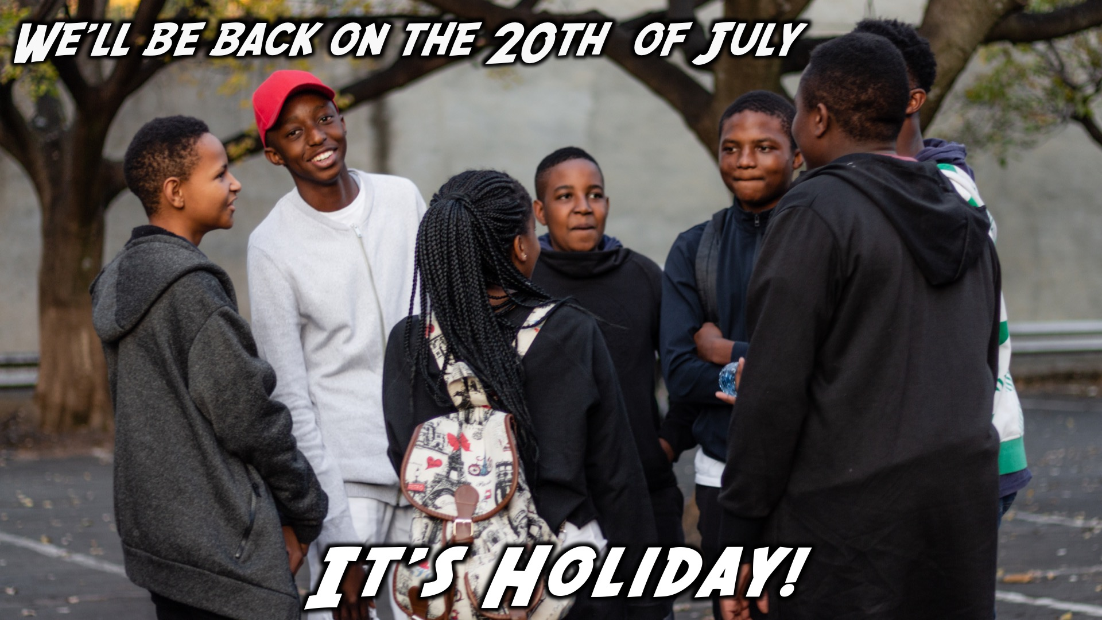
Notes:
Next week Friday is our Matric Farewell!

Slide 6

Notes:
It’s the Alpha Series!

Slide 7

Notes:
Announcements: Follow us on Instagram! @EncounterYouth_Rosebank

Slide 8

Notes:
Announcements: Join our Friday Night WhatsApp group!

Slide 9

Notes:
Tonight is our Matric Farewell

Slide 10
Notes:
A video clip introducing our Matriculants.

Slide 11
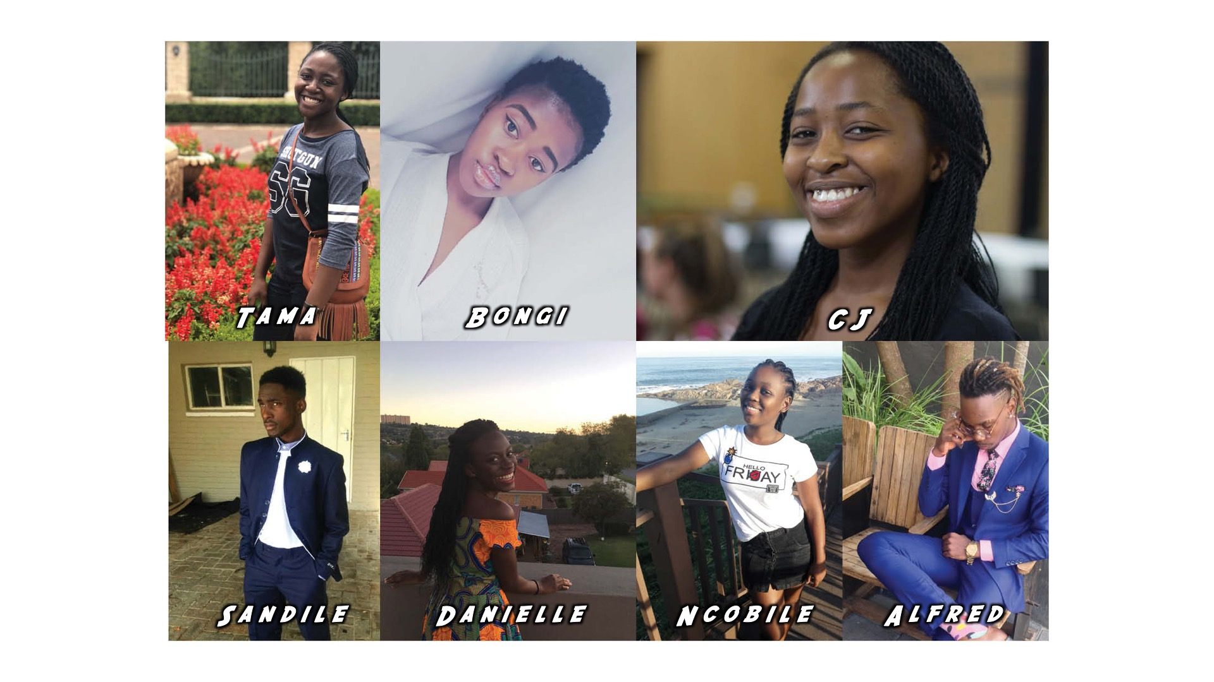
Notes:
Our Matriculants

Slide 12
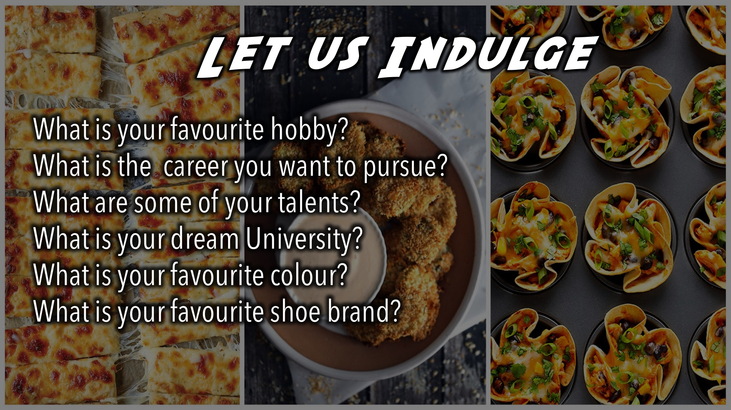
Notes:
Dinner Time - While dinner is taking place, answer the following questions: (1) What is your favourite hobby? (2) What is the career you want to pursue? (3) What are some of your talents? (4) What is your dream University? (5) What is your favourite colour? (6) What is your favourite shoe brand?

Slide 13

Notes:
Photo Booth – There is a photo booth with props! Bring your squad and get a photo taken.

Slide 14

Notes:
Amazing Race. Find the theme song here: https://www.youtube.com/watch?v=ReHIpD7SUzA

Slide 15
Notes:
Amazing Race Intro Video. Find the video on YouTube: https://www.youtube.com/watch?v=4yQ9Du7_-P0

Slide 16

Notes:
Amazing Race Challenges: As groups (your table), you will have to compete in the following challenges: (1) Country Challenge (2) Donut Challenge (3) Who knows their Matriculant best (4) Jenga/ timber (5) Ping pong challenge (6) Code breaking

Slide 17

Notes:
Grab a cupcake and take seat!

Slide 18

Notes:
Release Balloons: Matrics to come to the front to receive their helium balloons.

Slide 19
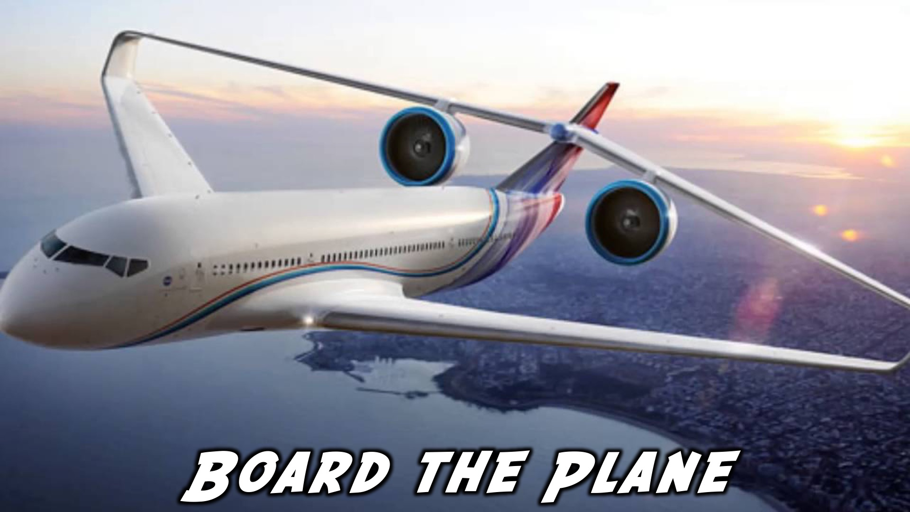
Notes:
Board The Plane: Pastor Simon will Receive the Matriculants.

Slide 20
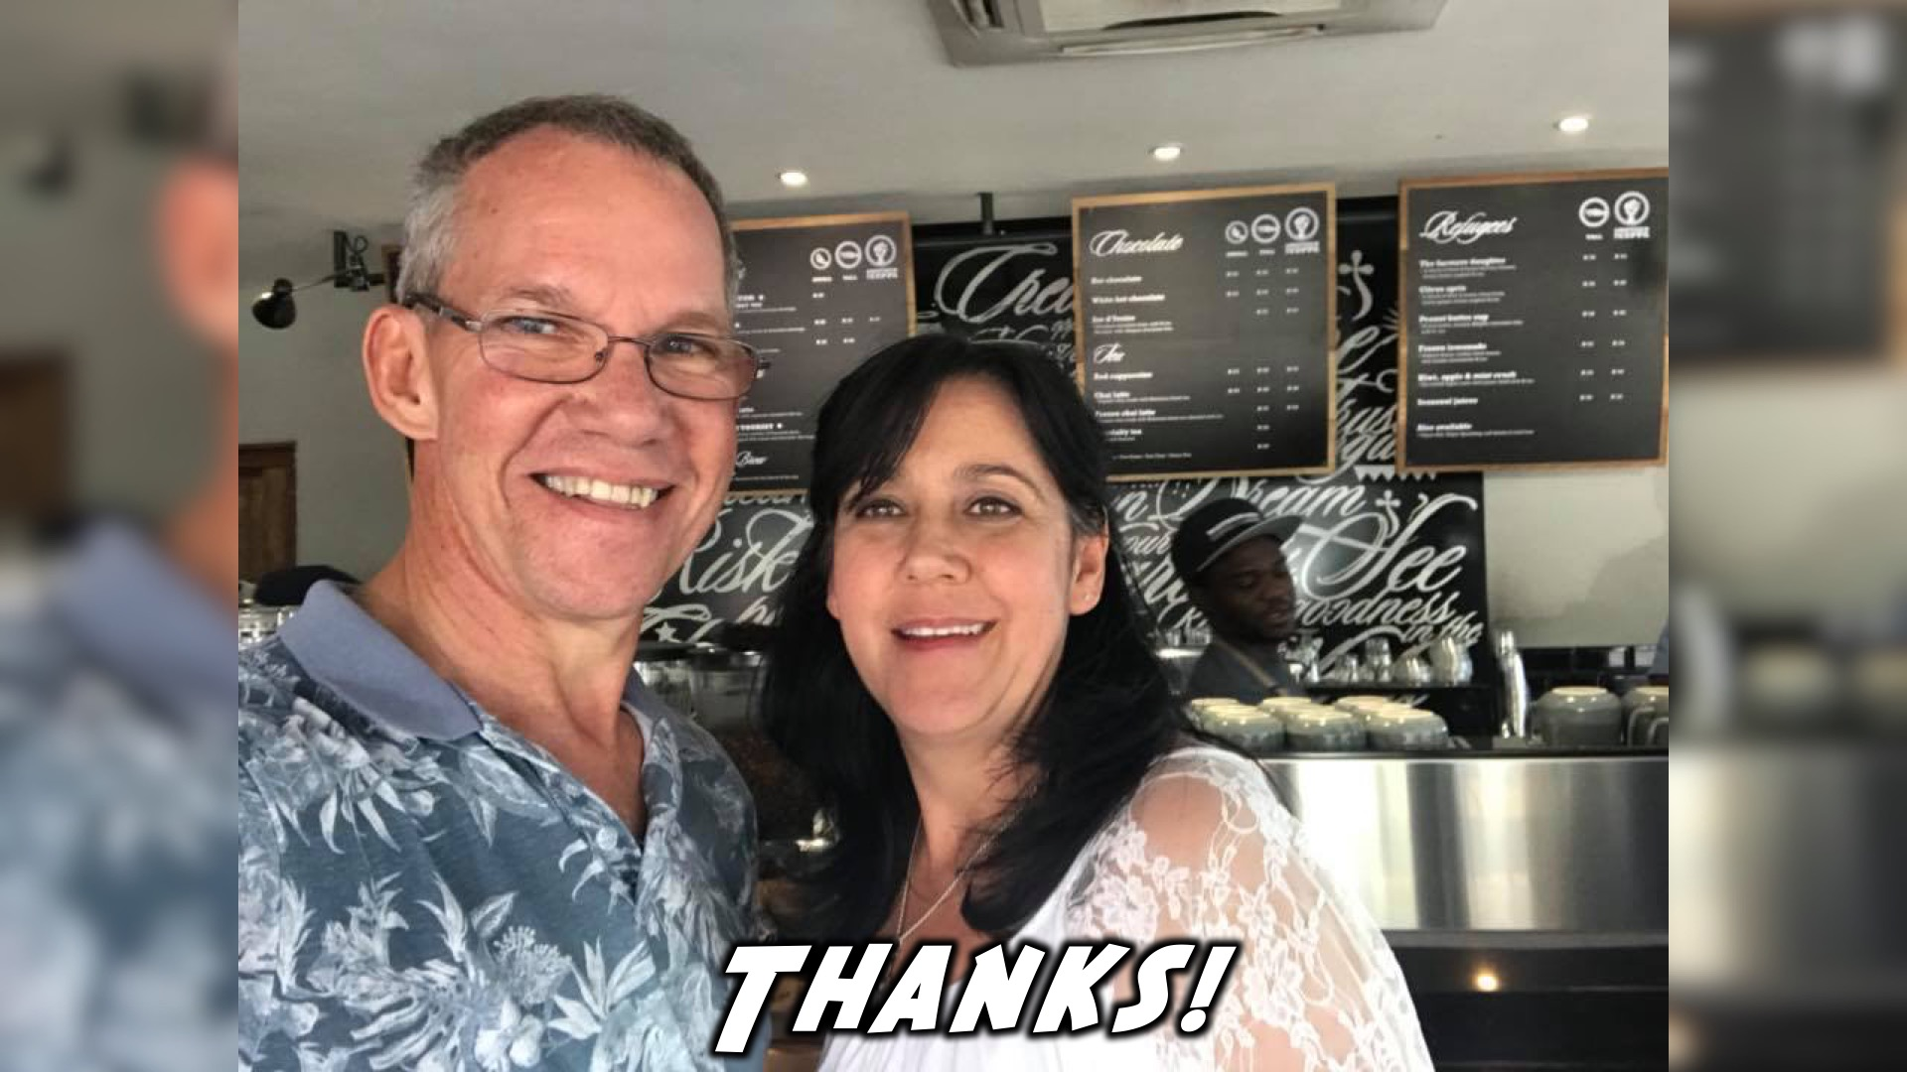
Notes:
A vote of thanks from Pastor Mark and Debbie

Slide 21
Notes:
Chris Pratt Award Speech. Find it on YouTube: https://www.youtube.com/watch?v=EihqXHqxri0

Slide 22
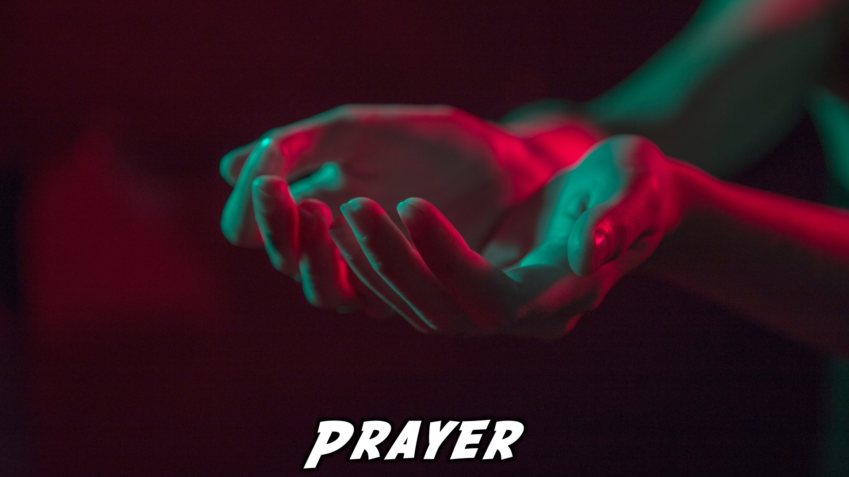
Notes:
Close in Prayer

Slide 23

Notes:
Thanks for coming – See you next term!

Slide 24


