Slide 1
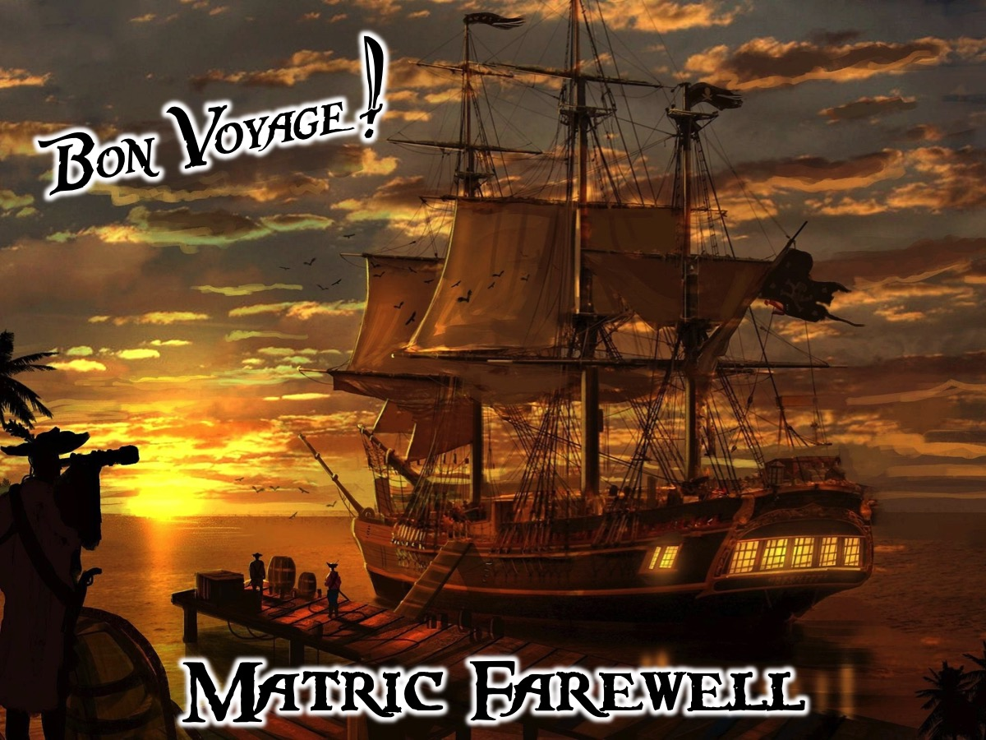
Notes:
Matric Farewell: Tonight we say Bon Voyage to the Matrics of 2016.
Table decorations: A captains hat and an eye patch and a sword. The skull and cross bones will be cutout on white cardboard and placed on black table cloths.
Music to play: Check out this playlist on YouTube: https://www.youtube.com/watch?v=meb_4cEriyw&list=PL263677A4D1B673E4&index=1
Needed:
* Chocolates for the Dice Game (10 small chocolates in a bowl for each table)
* Food for the Captains Loot table: Whispers, sour worms and other nautical themes snacks.
* Chocolate coins for the captains contest
* Chocolate coins for the dice game
* 24 Dice
* Pirates hats for the captains
* Eye patches and swords for the captains

Slide 2
Notes:
Video: Pirates of the Caribbean - The Curse of the Black Pearl - Jack's Entrance. Get it on YouTube at: https://www.youtube.com/watch?v=LkWQvzrv6gI

Slide 3

Notes:
Welcome me Harties: Welcome to regulars and newcomers and especially our Matrics.

Slide 4
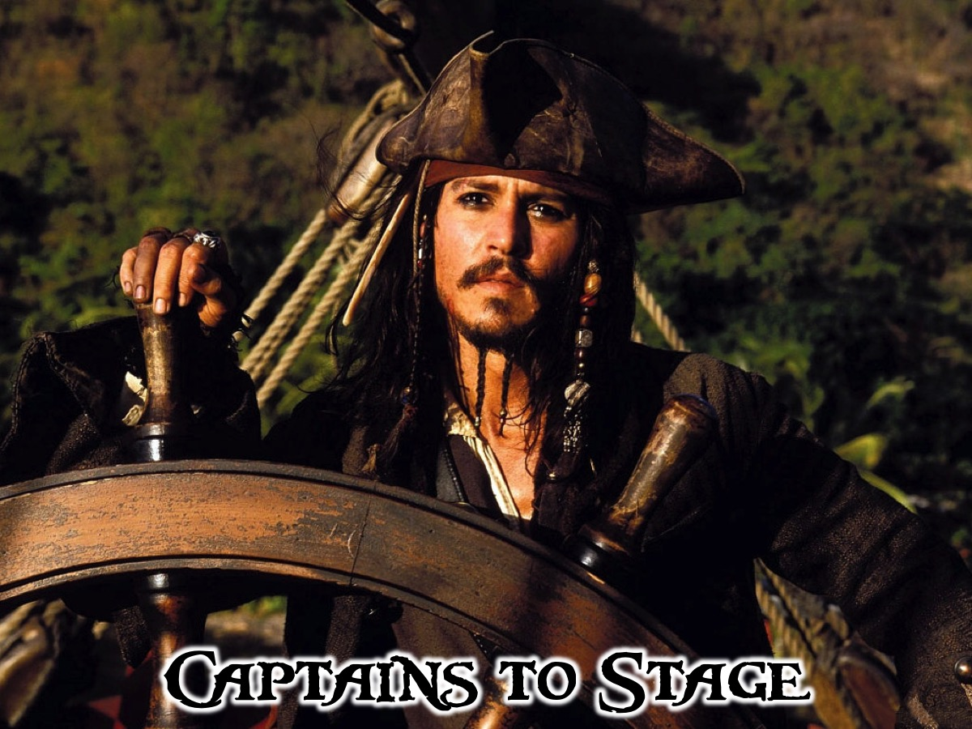
Notes:
Captains to Stage: Would all the Matriculants of 2016 please join me on stage?
Music: An extract from Pirates of the Caribbean Barbossa Is Hungry. Get it on YouTube at: https://www.youtube.com/watch?v=fi6tvcDInVY.

Slide 5

Notes:
Pirates to Ships: Teens are invited to take their place at the tables - leaving one or two seats open for Captains (Matrics) who be seated there shortly.
Music: An extract from Pirates of the Caribbean Barbossa Is Hungry. Get it on YouTube at: https://www.youtube.com/watch?v=fi6tvcDInVY.
[Some seats are marked: Reserved for Captains]

Slide 6
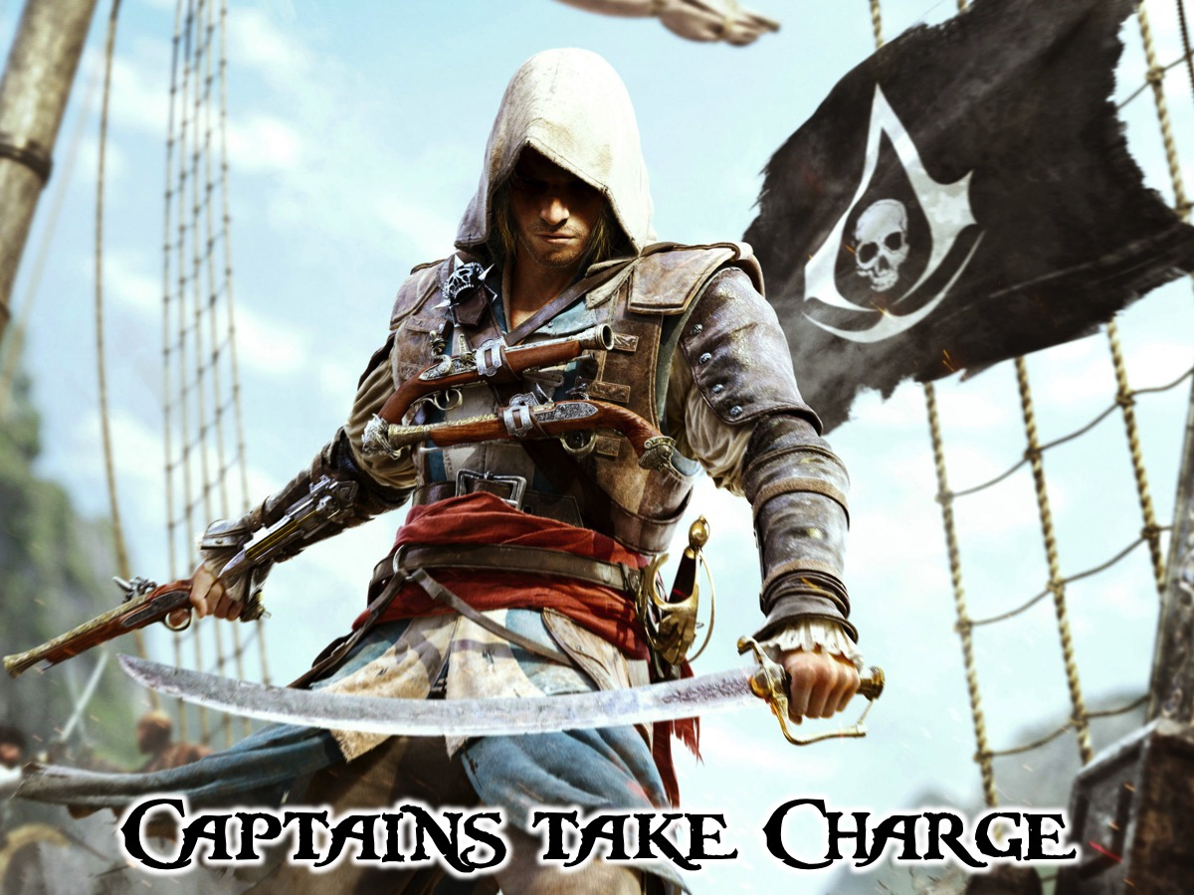
Notes:
Captains Take Charge: The Matriculants (our Captains) are going to take charge of the tables by finding a seat for the night.
[The Captains (our matrics) are each assigned to a table (a ship that they capture for the night - some ships will have more than one captains as there are 6 tables).
Music: An extract from Pirates of the Caribbean Barbossa Is Hungry. Get it on YouTube at: https://www.youtube.com/watch?v=fi6tvcDInVY.

Slide 7
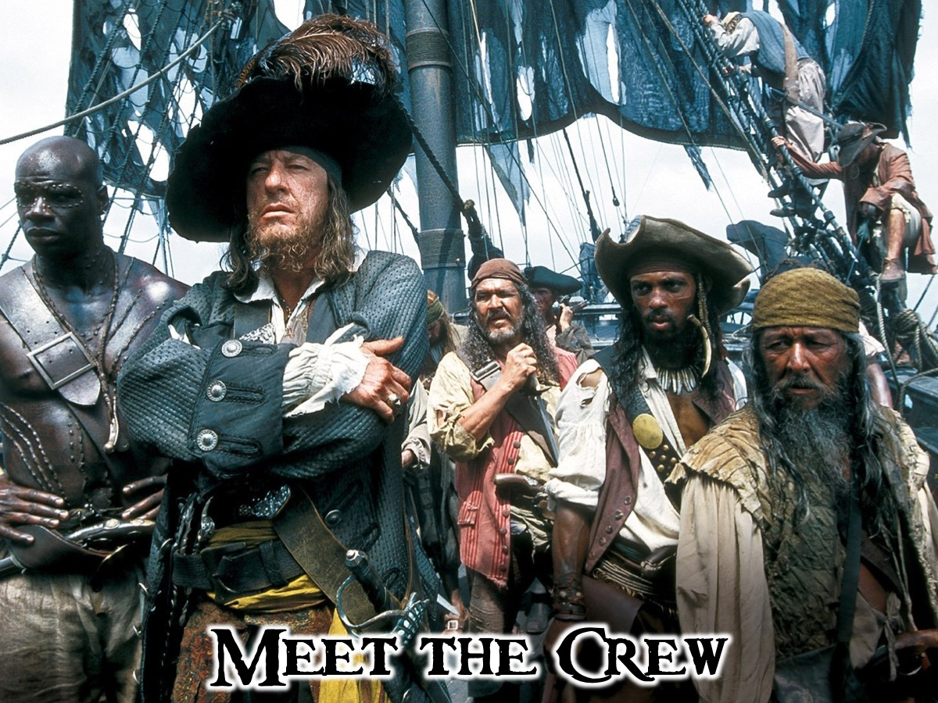
Notes:
Meet the Crew: You have a few minutes to introduce yourselves to each other.
Music: Pirates of the Caribbean Fog Bound. Get it on YouTube at: https://www.youtube.com/watch?v=meb_4cEriyw

Slide 8
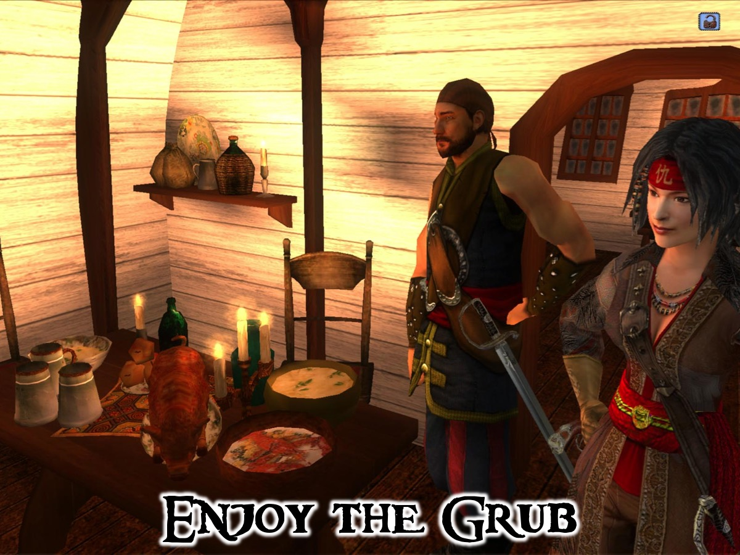
Notes:
Enjoy the Grub: Serve the Main Course.
Music: Pirates of the Caribbean 2 Dinner is Served. Get it on YouTube at: https://www.youtube.com/watch?v=qifgc6UZ2VQ

Slide 9
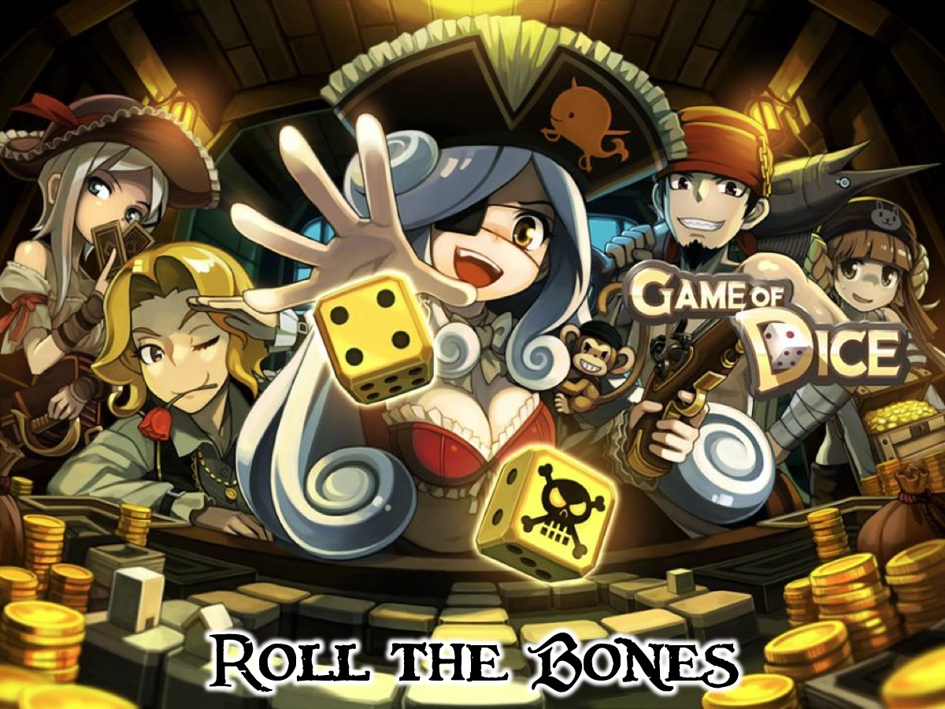
Notes:
Roll the Bones: We are going to play a few rounds of rolling the bones. You will each roll 4 dice and the pirate who rolls the highest score in the round take a chocolate from the center of the table. Play until time is called.
Music: Pirates of the Caribbean The Black Pearl. https://www.youtube.com/watch?v=mP-BeFi58tQ

Slide 10
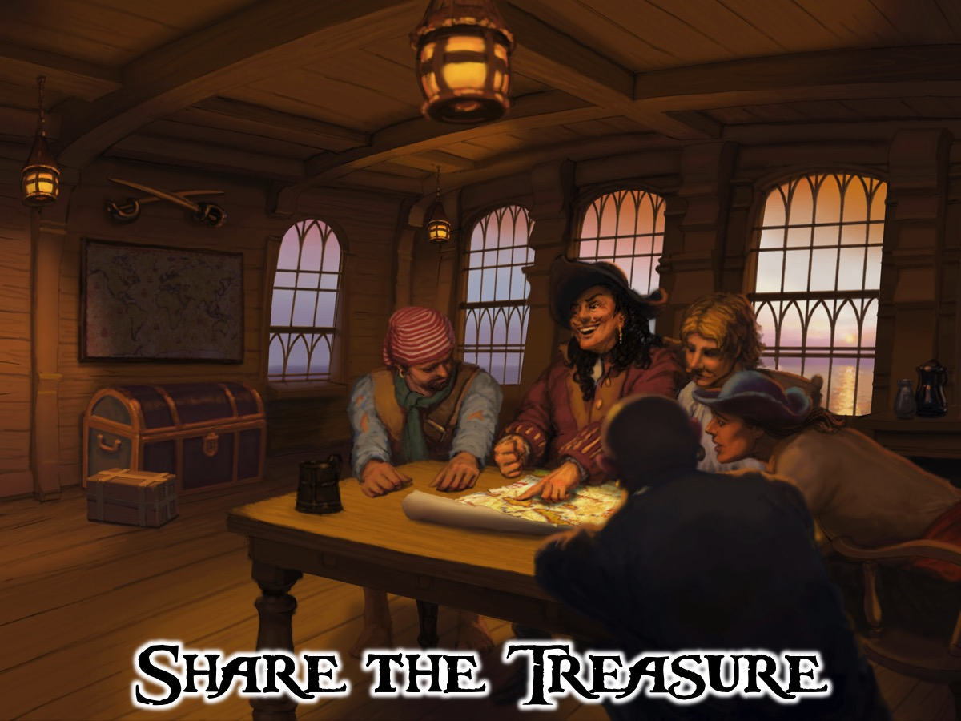
Notes:
Share the Treasure: Captains dig into the treasure chest on the table to retrieve a piece of treasure. Depending on what item they retrieve they have to share with their table a life lesson based on that object - to leave some wisdom with the rest of the group. Treasures could be images of the following items printed and laminated standing and standing among the squidgys: Sword, Ship, Anchor, Ships Wheel, Oar, Spyglass, etc.
Music: Pirates of the Caribbean I See Dead People. Get it on YouTube at: https://www.youtube.com/watch?v=9TMq9pZOzZE

Slide 11
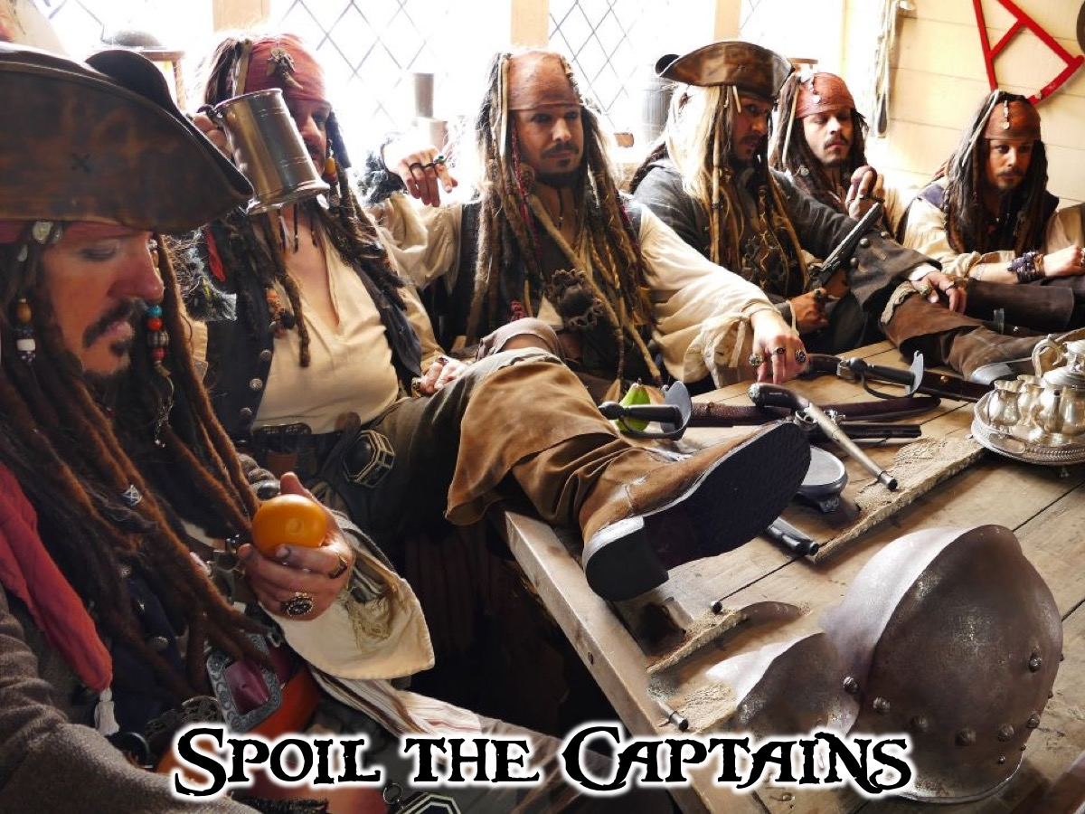
Notes:
Spoils for Captains: It is time to spoil the Captains - would all the Captains please take a seat at the Captains table on the stage (setup on the stage with chairs and a map and other pirate items on the table and place drinks and some snacks for the Captains to enjoy while the Message in a Bottle activity takes place at the tables).
Spoils on the Table: Canonballs: A jar of whispers or chocolate Maltesers; Fish and Chips: A bowl of crisps and fish shaped snacks; Fish Bait: A Jar of sour worms; um: Glasses of Grape Juice; etc.

Slide 12
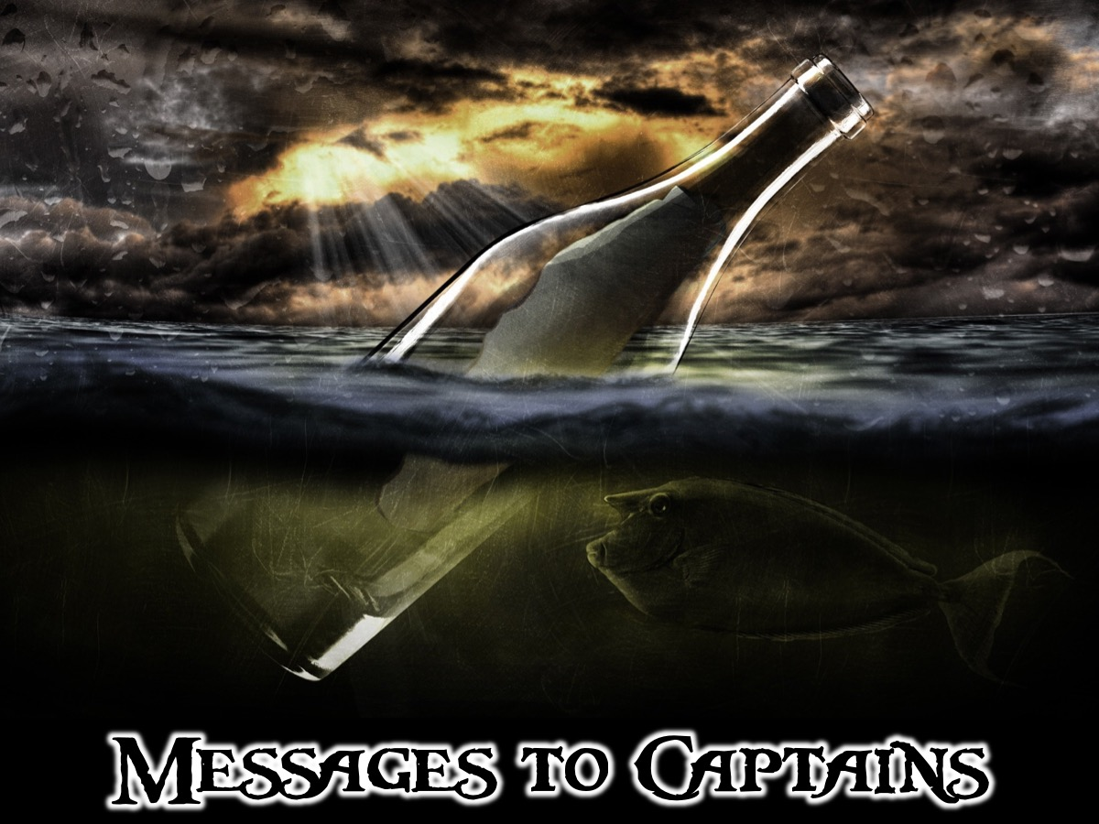
Notes:
Messages to Captains: On your ships each Pirate is going to write a brief message to their Captain on the piece of paper provided - it could be a wish, a dream for them or a word of encouragement - when you are finished the last Pirate will put the message in the bottle and give it to your Captain. They can read their messages while pudding is served.
Music: Pirates of the Caribbean I See Dead People. Get it on YouTube at: https://www.youtube.com/watch?v=9TMq9pZOzZE

Slide 13
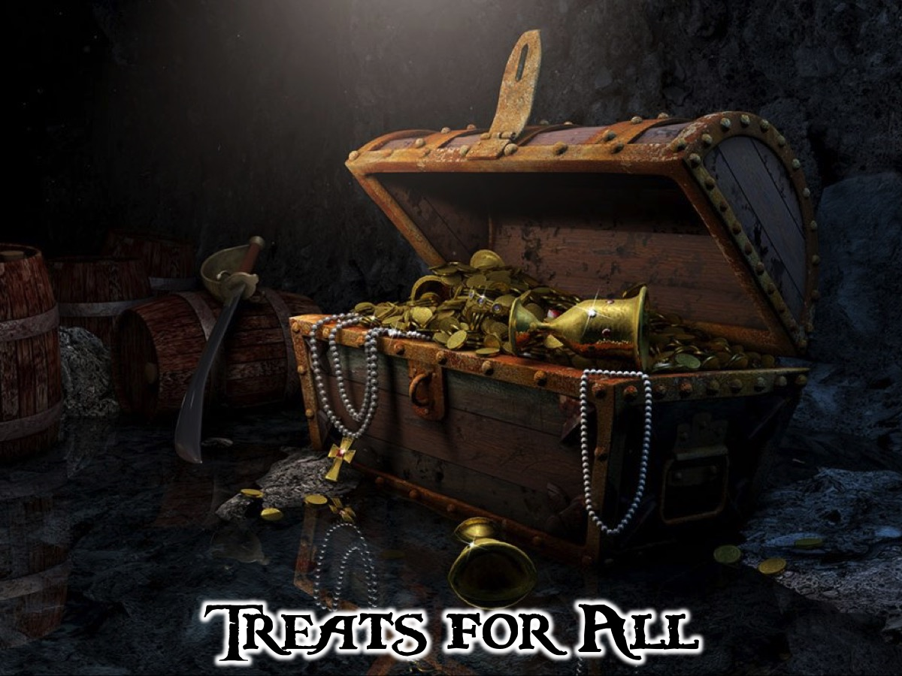
Notes:
Treats for All: Pudding is served
Music: Pirates of the Caribbean A Family Affair. Get it on YouTube at: https://www.youtube.com/watch?v=chWrhd4IlO8

Slide 14
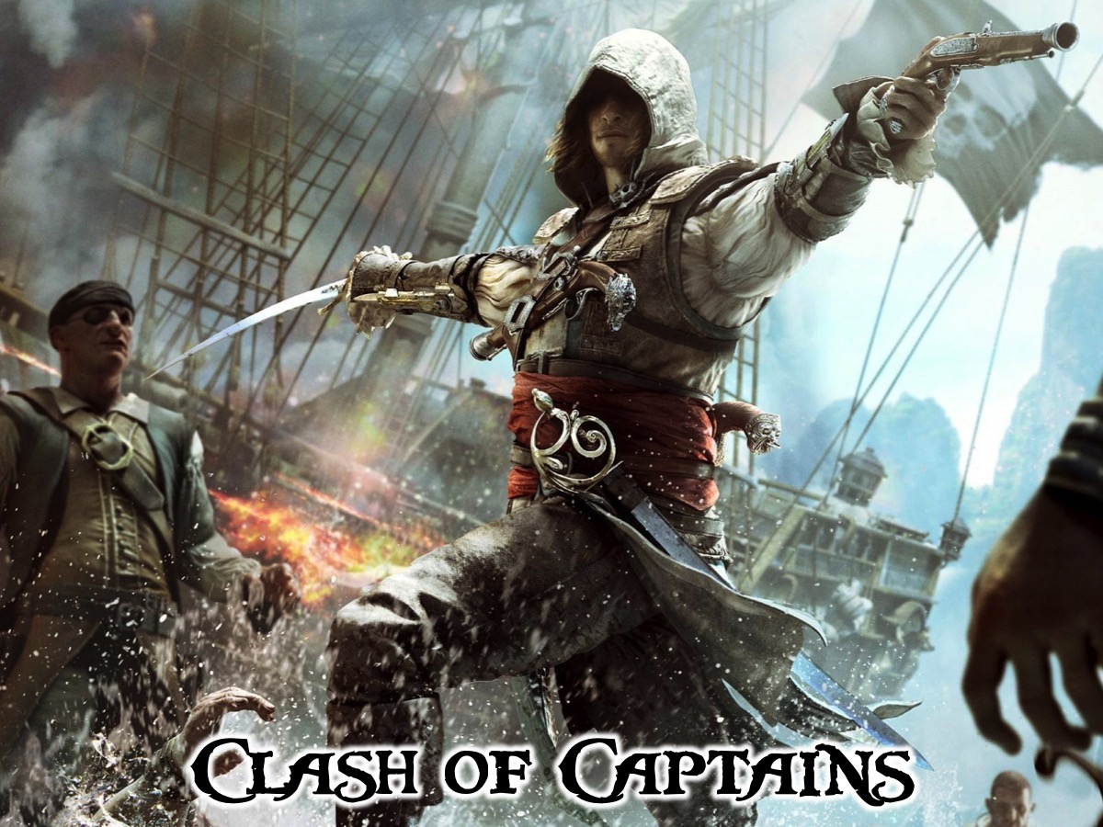
Notes:
Clash of Captains: Captains compete against each other in a sword fighting game - each captain uses the sword from their table and the first person to make contact with the other captains chest with their sword moves on to the next round. Continue until there is a final winner - who received a treasure chest filled with chocolate coins (prominently displayed while the Clash takes place). The winner also received a certificate of their achievement.
Music: Pirates of the Caribbean - Soundtr 05 - Swords Crossed. Get it on YouTube at: https://www.youtube.com/watch?v=C3PfF-Huv2g

Slide 15
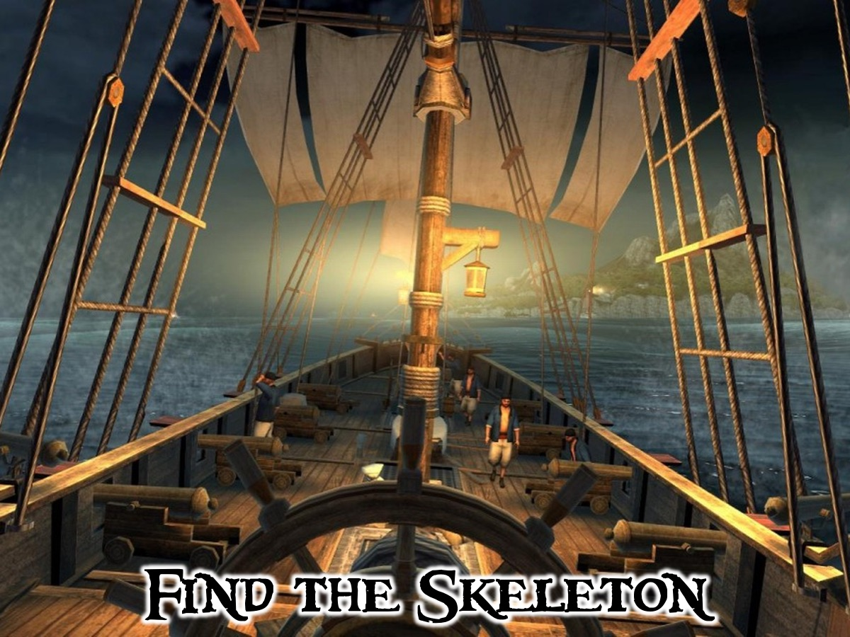
Notes:
Find the Skeleton: Each captain must write down - on a piece of cardboard cutout of a skeleton - what they are happy to leave behind as they make the transition from high school. While they are doing this - refreshments are served!

Slide 16
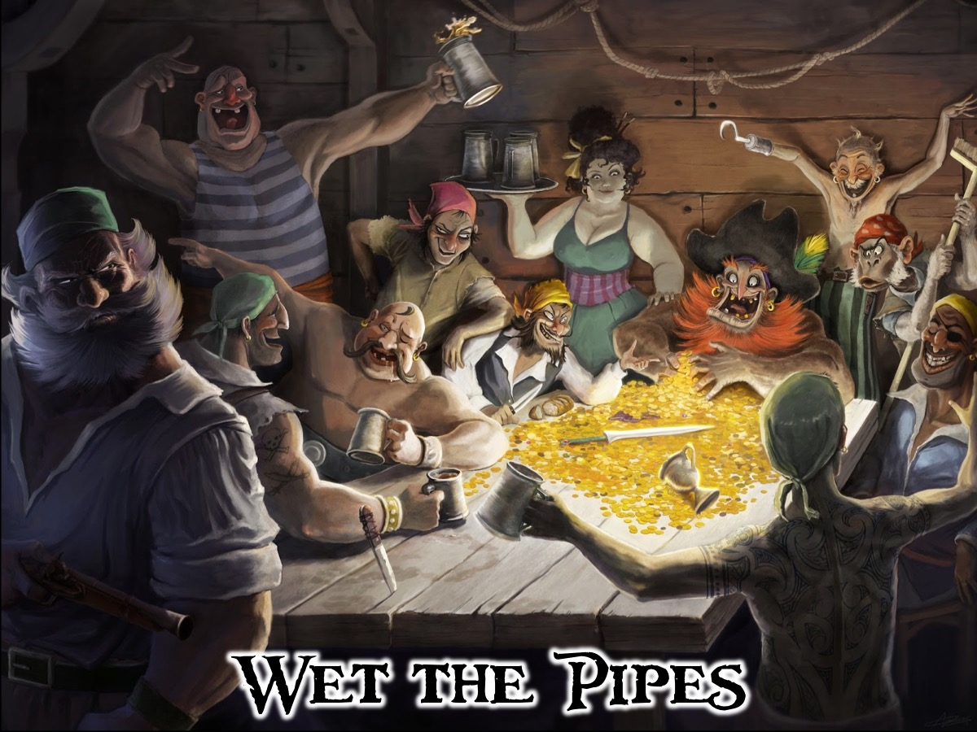
Notes:
Wet the Pipes: Refreshments are served.
Music: Pirates of the Caribbean Drink Up Me Hearties. Get it on YouTube at: https://www.youtube.com/watch?v=AnHXRyabx2A

Slide 17
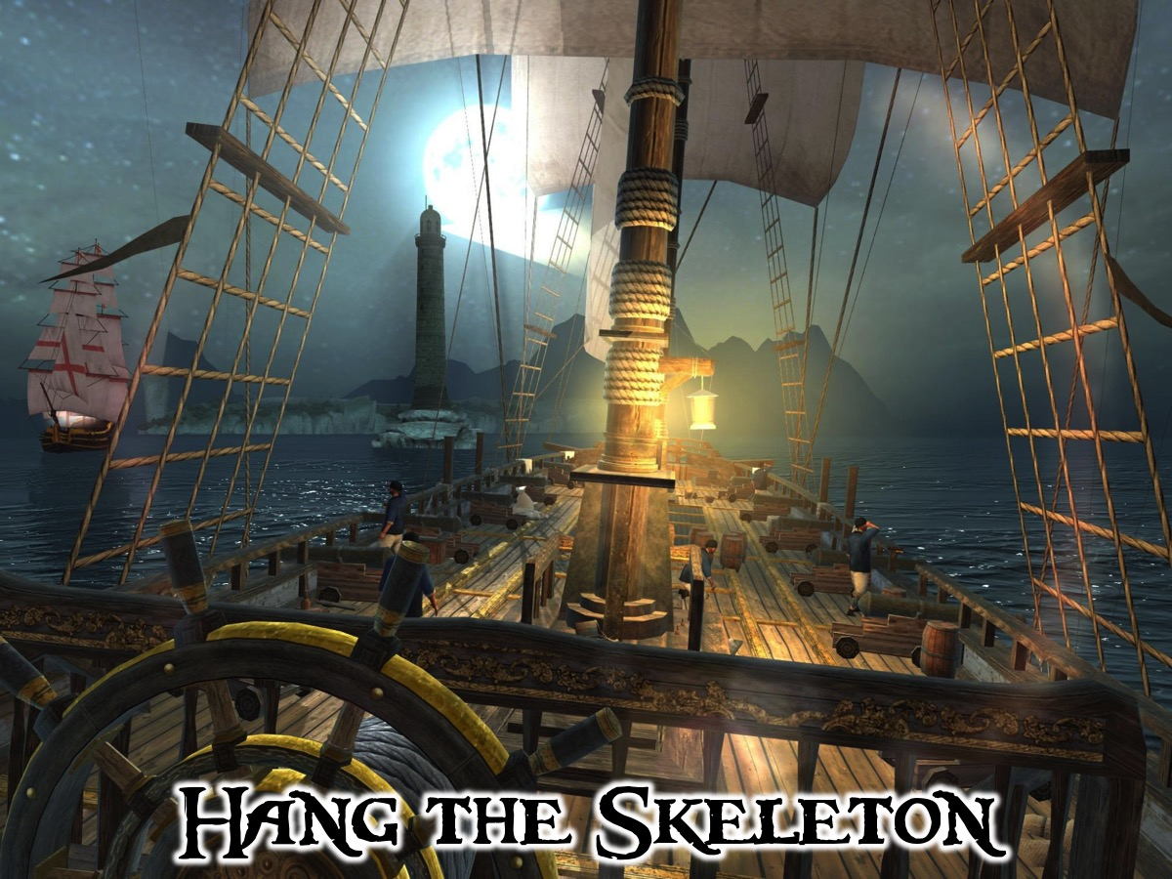
Notes:
Hang the Skeleton: Each captain moves to the stage and shares the thing they are leaving behind and then hangs their skeleton on the rope using the hooks provided.
[Note: Captains stay on stage after they have shared!]
Music: Pirates of the Caribbean Underwater March. Get it on YouTube at: https://www.youtube.com/watch?v=bh_h-6cnD1M

Slide 18
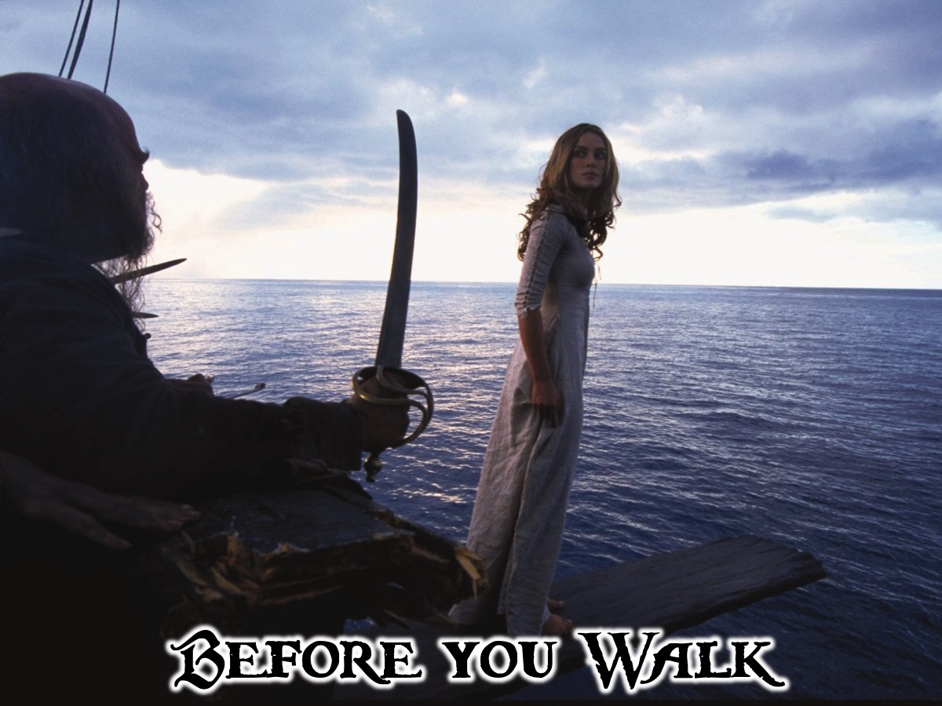
Notes:
Before You Walk: Very soon you are going to be forced to walk the plank… but before that, Pastor Mark has some words of farewell to share with you!

Slide 19
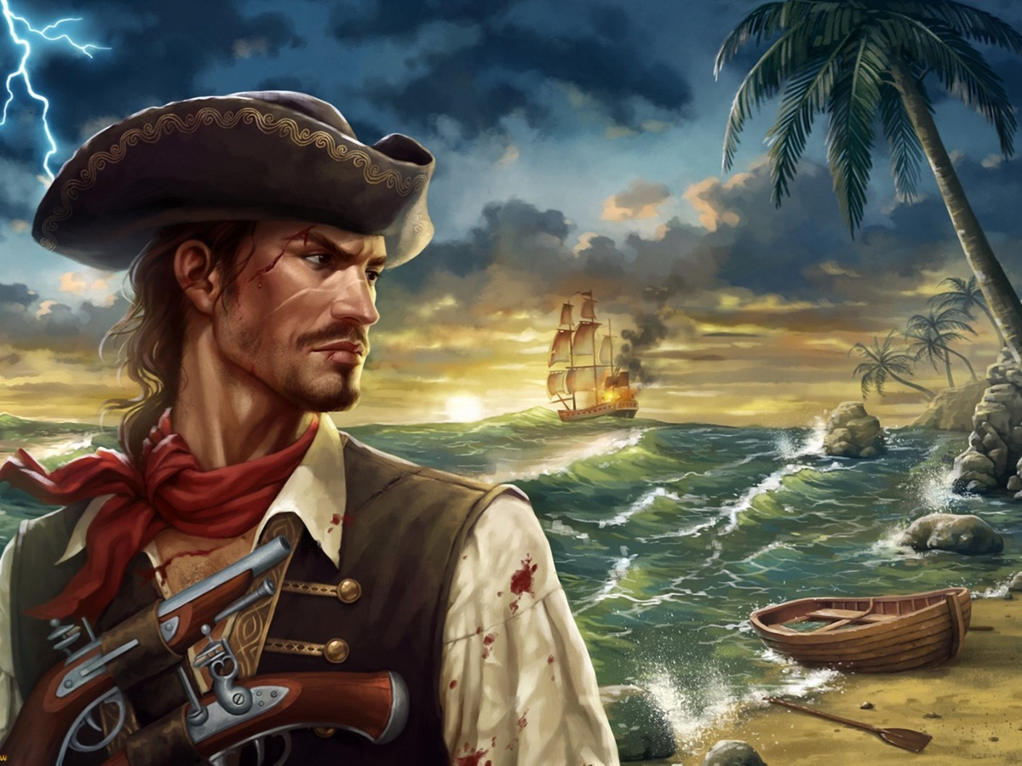
Notes:
Message from Youth Pastor: Wow - seems like yesterday that some of you walked into His Youth in grade 7 and since then each of you have found your way into our hearts. In a few minutes, I am going to share a few words to encourage you on your journey using phrases that I have borrowed from the world of pirates:

Slide 20
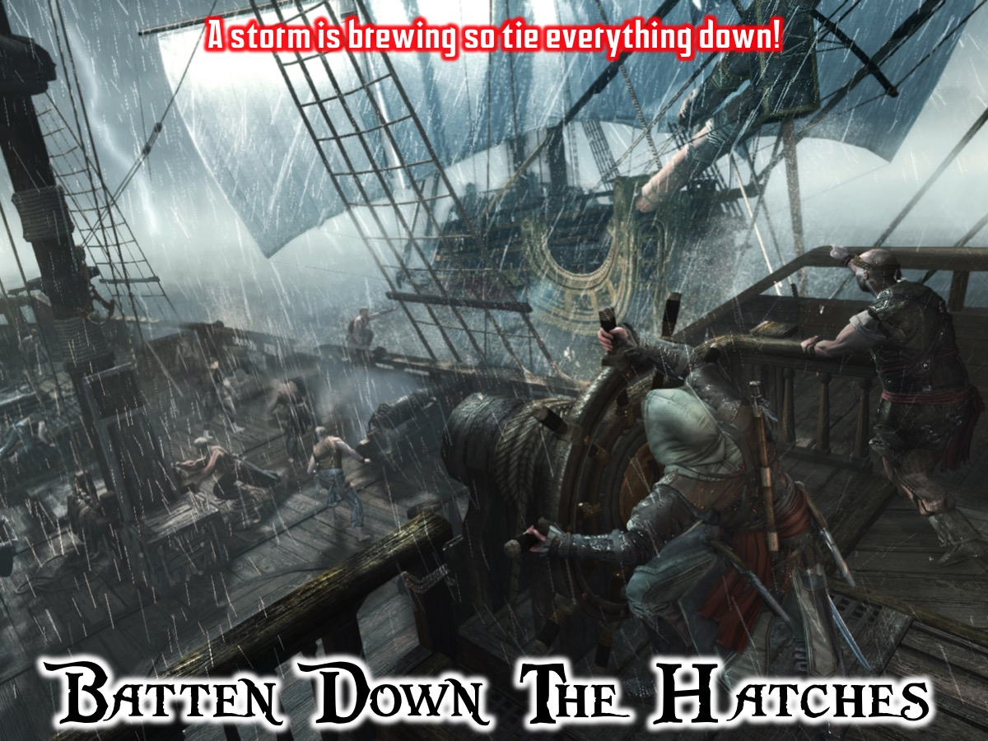
Notes:
1. Batten down the hatches: Put everything away on the ship and tie everything down because a storm is brewing - expect difficult conditions ahead!

Slide 21
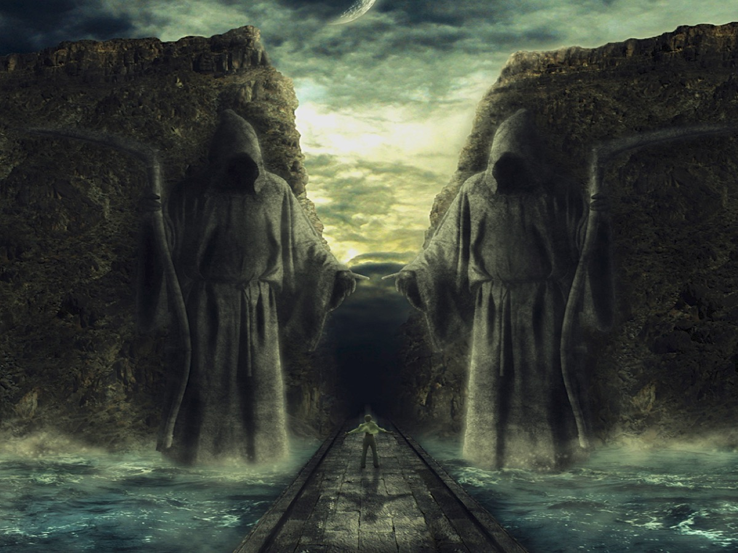
Notes:
Even though you may walk through the valley of the shadow of death - you do not need to be afraid because God is with you! (Psalm 23)

Slide 22
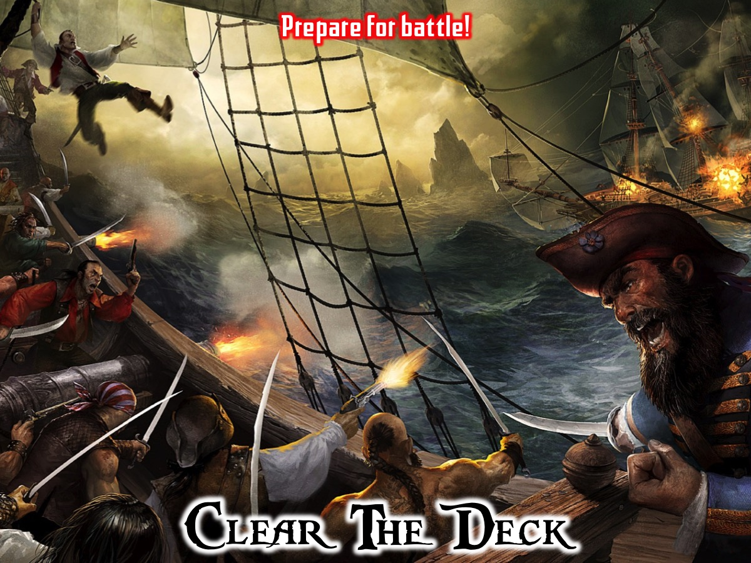
Notes:
2. Clear the deck: Prepare for battle!

Slide 23
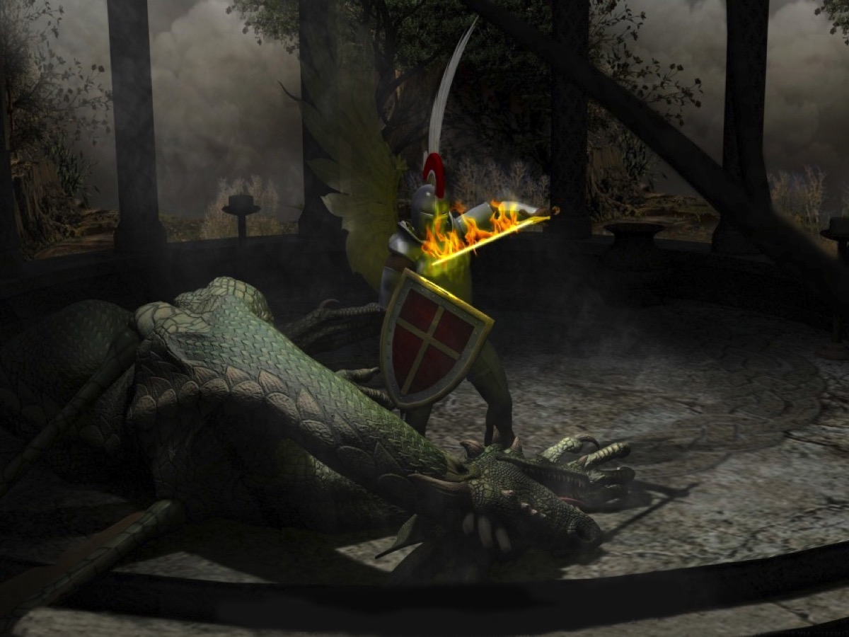
Notes:
Never forget that as followers of Jesus you are involved in spiritual warfare! Through Jesus you have already won the the victory!

Slide 24
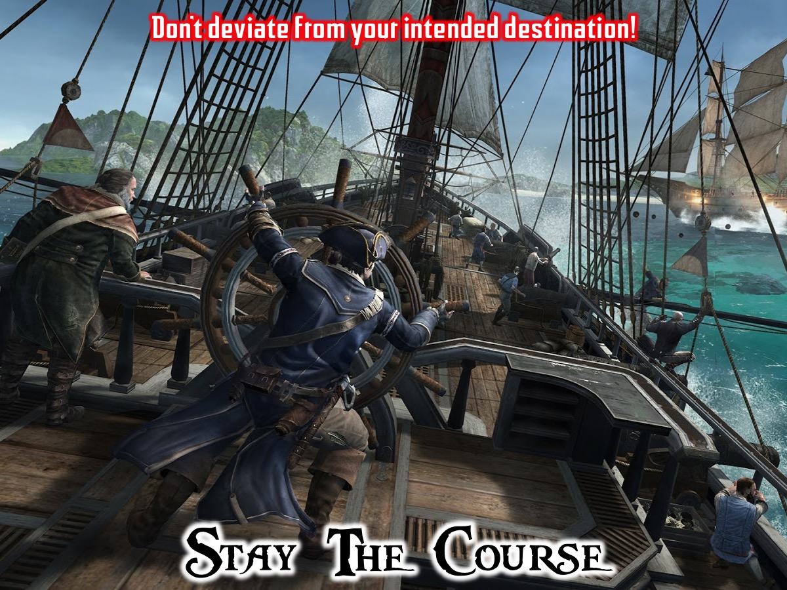
Notes:
3. Stay the course: Do not deviate from your intended destination.

Slide 25
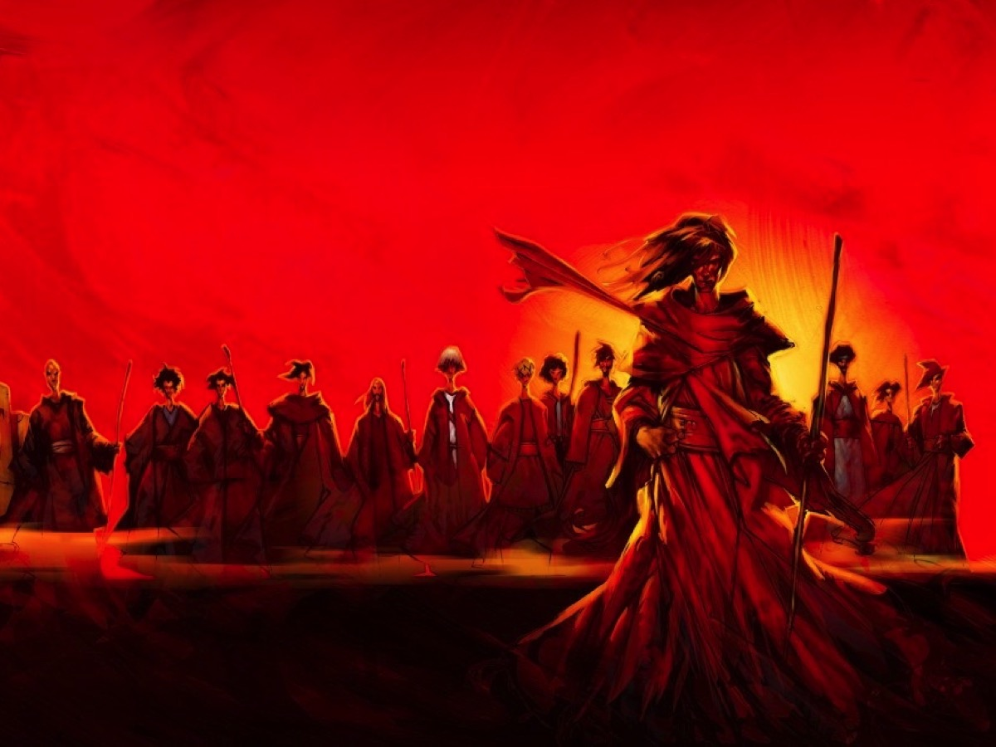
Notes:
Keep on following Jesus! Make it your aim to be like him and do what he would do if he were living your life!

Slide 26
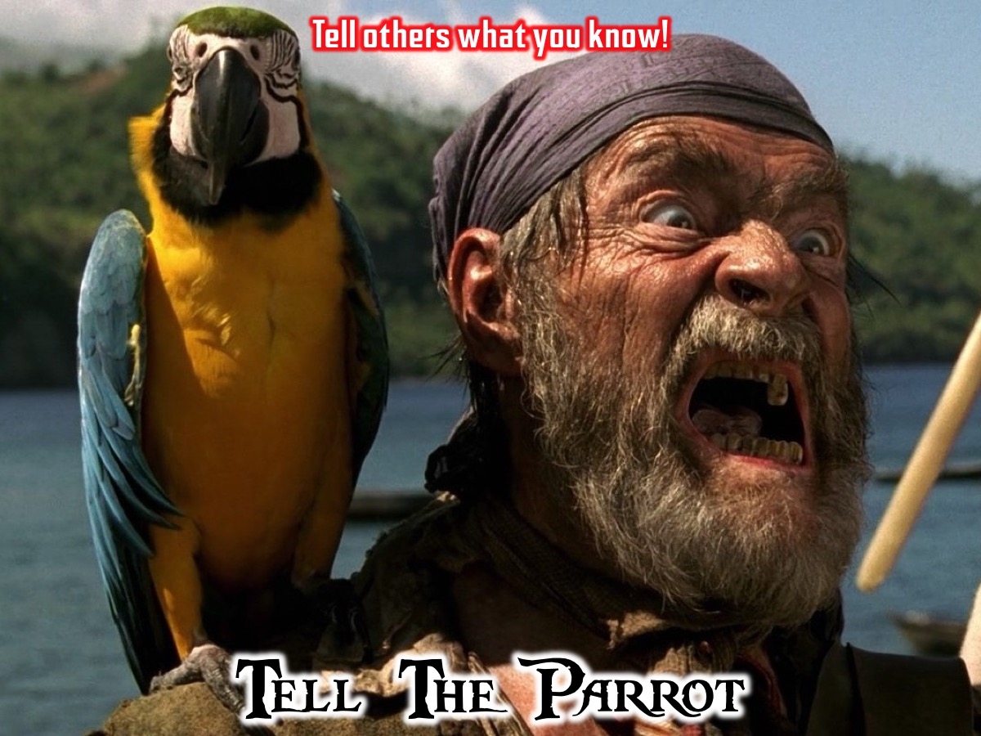
Notes:
4. Tell the parrot: To gossip or tell everyone about something you know!

Slide 27
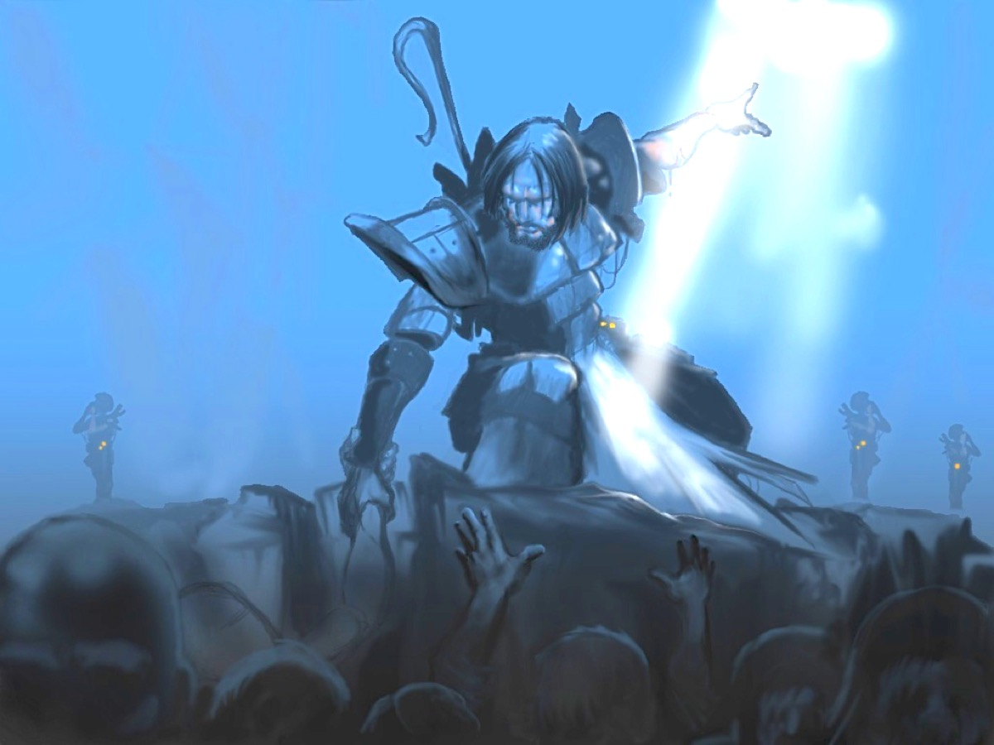
Notes:
We have taught you how to replicate yourself into other – so tell others about Jesus and make disciples wherever you do!

Slide 28
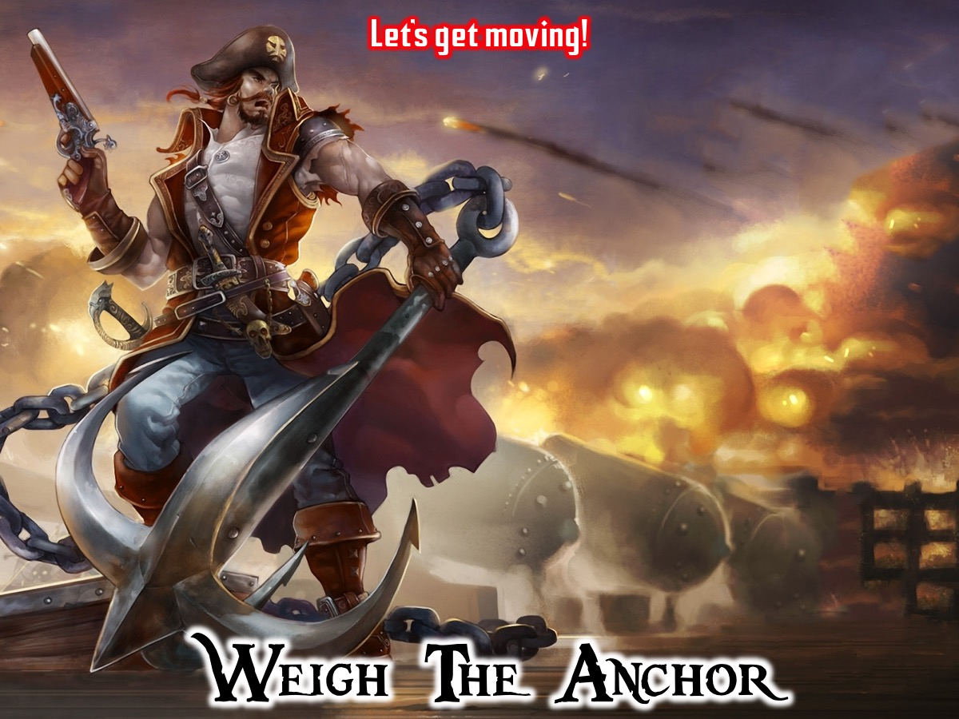
Notes:
5. Weigh the anchor: Pull up the anchor and the sail and let's get going!

Slide 29
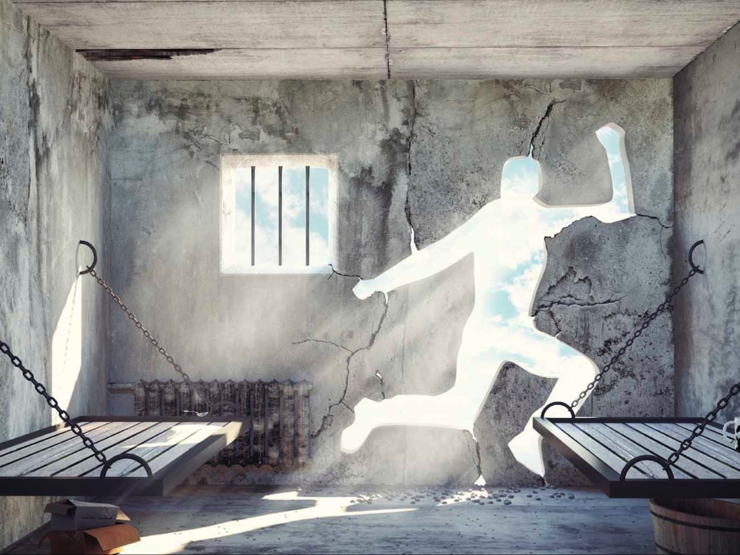
Notes:
Don’t let anything hold you back as you move forward as a world changer!

Slide 30
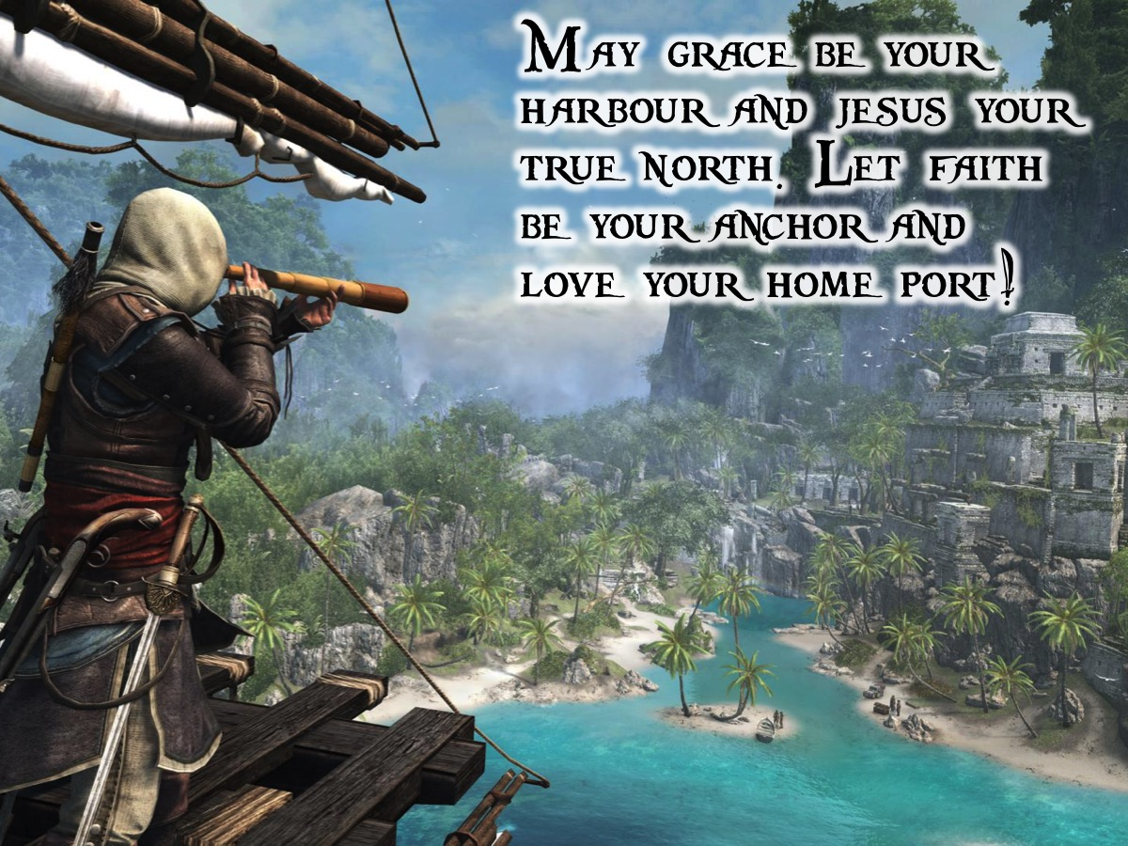
Notes:
Prayer: I trust that you will leave His Youth and find fantastic new adventures in the next season of your life! Let me pray for you before you are made to walk the plank!
Here is an extract from The Pirates Prayer: “May grace be your harbour, and Jesus your true north, let faith be your anchor and love your home port!”

Slide 31
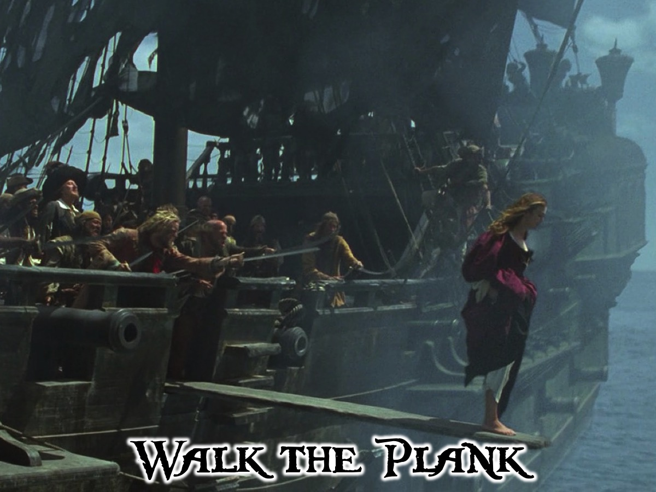
Notes:
Walk the Plank: Each Captain is made to walk the plank as they leave the stage.
Music: Pirates of the Caribbean - Walk the Plank. Get it on YouTube at: https://www.youtube.com/watch?v=lCvzkd_Nsg0

Slide 32
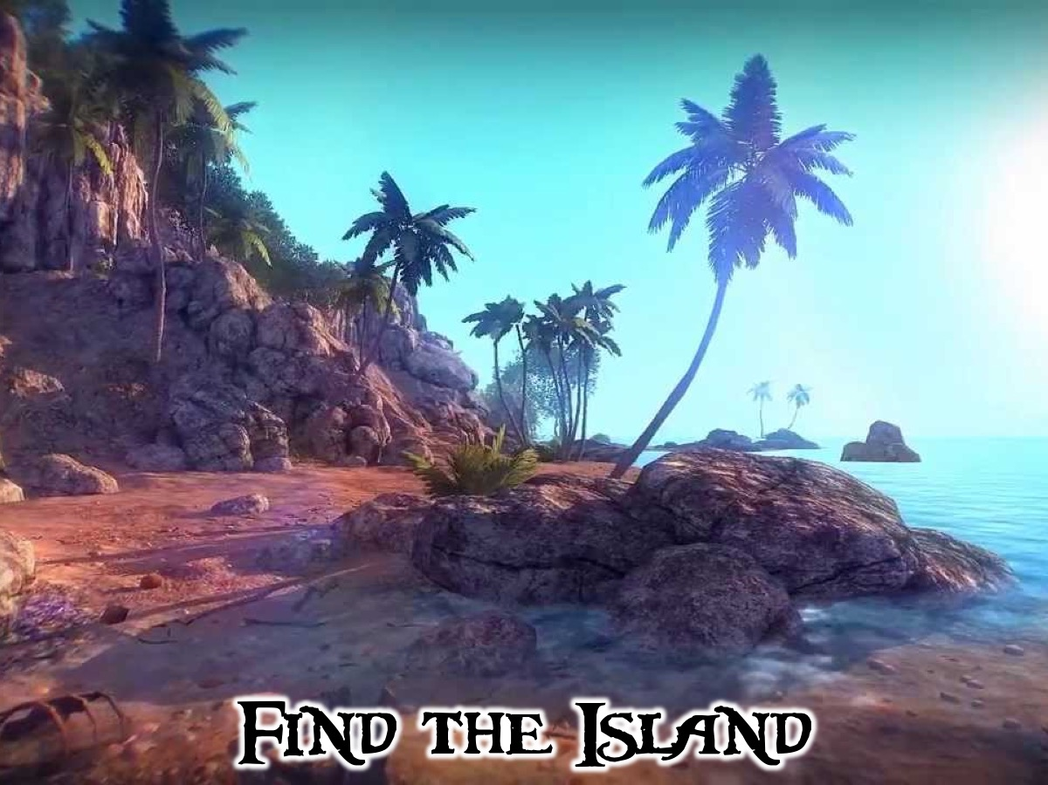
Notes:
Find the Island: Matrics make their way to the Island where they are welcomed by a church leader and given a challenge and are prayed for.

Slide 33
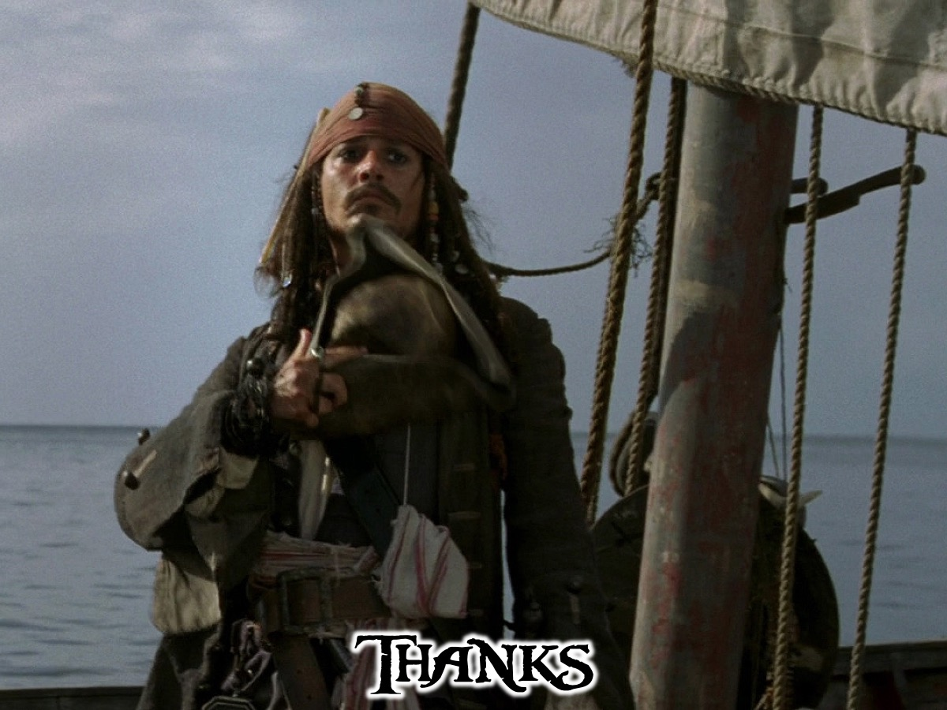
Notes:
Thanks: Thanks to everyone who helped to make tonight a great success; Debbie and Ashley, leaders and teens who helped on the night, to the Matriculants; to the church leader; etc.

Slide 34
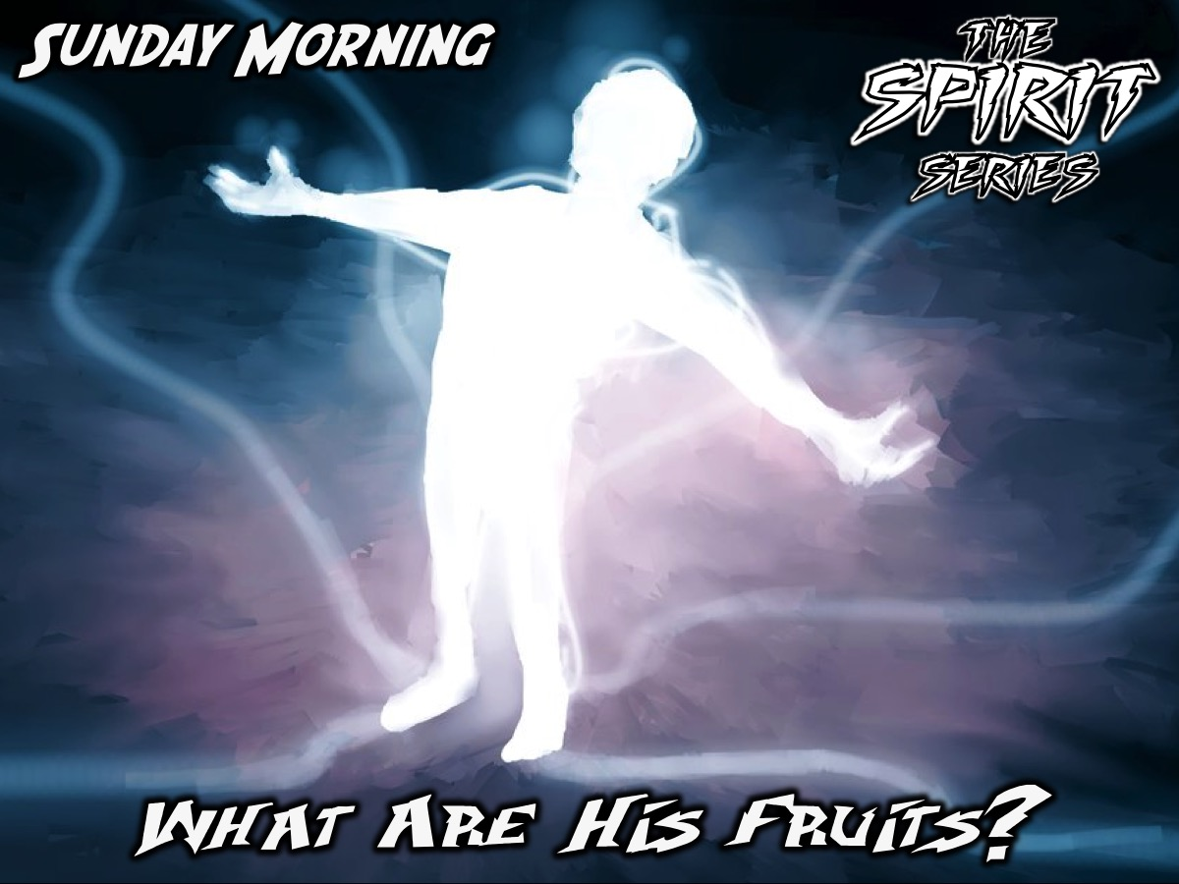
Notes:
Announcements: On Sunday morning it is week 2 of our Spirit Series - Genevieve will be preaching on the Fruits of the Holy Spirit.

Slide 35
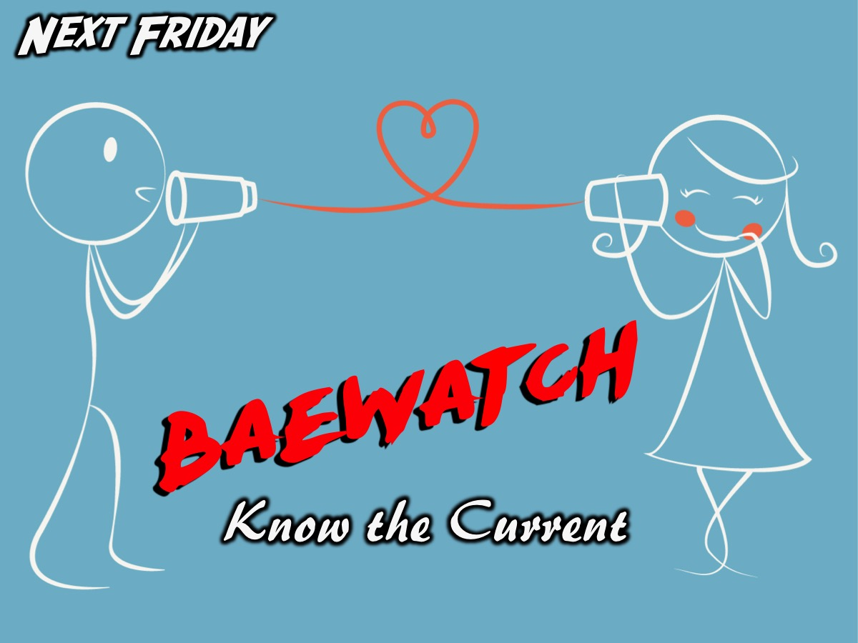
Notes:
Next Friday night is the launch of our Baewatch series.

Slide 36

Notes:
Once again we wish the Matrics of 2016 well on their journey!
Music: Pirates of the Caribbean Pirates Montage. https://www.youtube.com/watch?v=uQrYEEfgbG8

