Slide 1
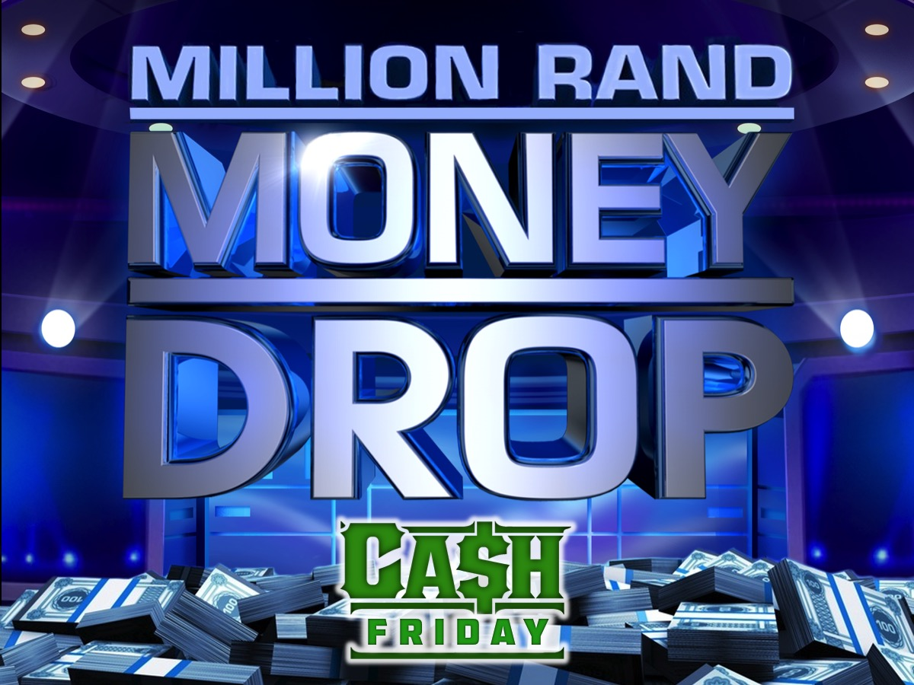
Notes:
Million Rand Money Drop Night
Event Notes:
1. After trying different ideas this week for how we will do the dropping we decided on a simplified version: We have three boxes that will sit on top of a table and there will be two see through container plus one that is filled with 48 Bar One mini-chocolates. Each pair comes forward and they have to place all the chocolates into either one or two of the containers. At least one box will not have a container placed on top of it. When the wrong answers are revealed the presenter (or preferably a helper) will take any containers from the wrong answer boxes and empty those chocolates into a spare box and the next round will continue.
2. To ensure participation - we suggest that we place five pairs of chairs in rows on one side of the table and the same on the other side of the table. We are guessing there will be about 10 people in a team. Two people step forward to compete in question 1 from the first row of chairs and when the question is over they sit on the seats on the other side and the next two team members get up to compete - Etc Etc until the team is finished their 5 questions. Seating the team like this will stop any delay in selecting who is next. They just take their seat on the rows of chairs and come forward row by row. Not sure if we do it on the stage or on the ground in front of the stage.
3. Also, we have printed on A4 paper in colour the sets of answers for each of the questions. The show does this where the answers appear on the drop boxes (they have the budget to use digital screens). The helper will place the answers on the three boxes as the question is read and before the team starts to place their chocolates. They will have to do it quickly as time is limited.

Slide 2
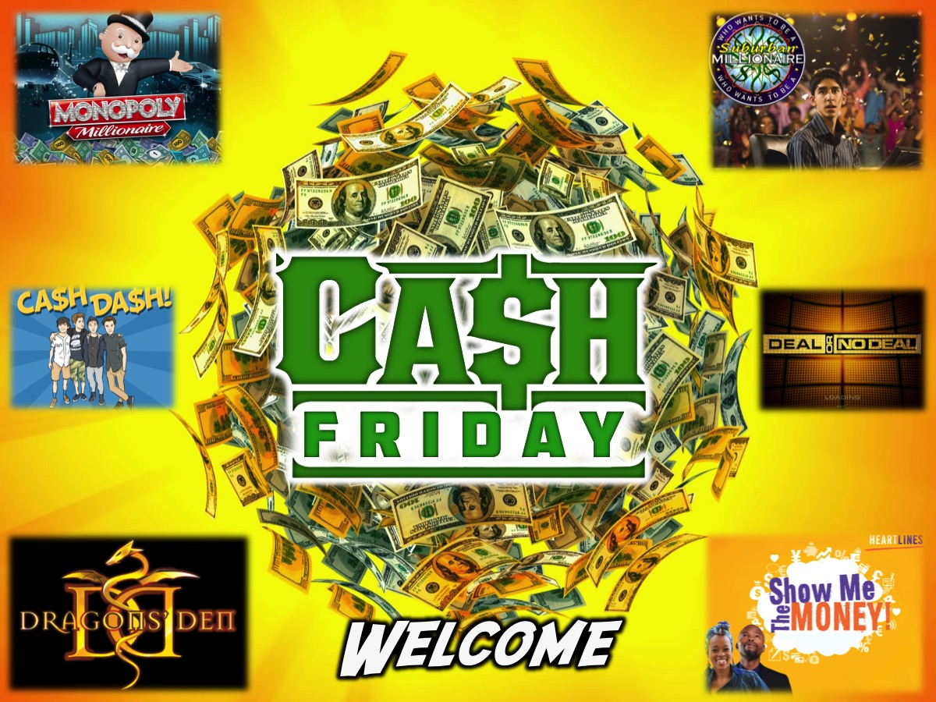
Notes:
Welcome: Welcome to Cash Friday - welcome to our regulars and if there are any newcomers please come up onto stage so we can welcome you!

Slide 3

Notes:
Next Week is Dragon’s Den Night.

Slide 4

Notes:
Tonight is Million Rand Money Drop Night

Slide 5
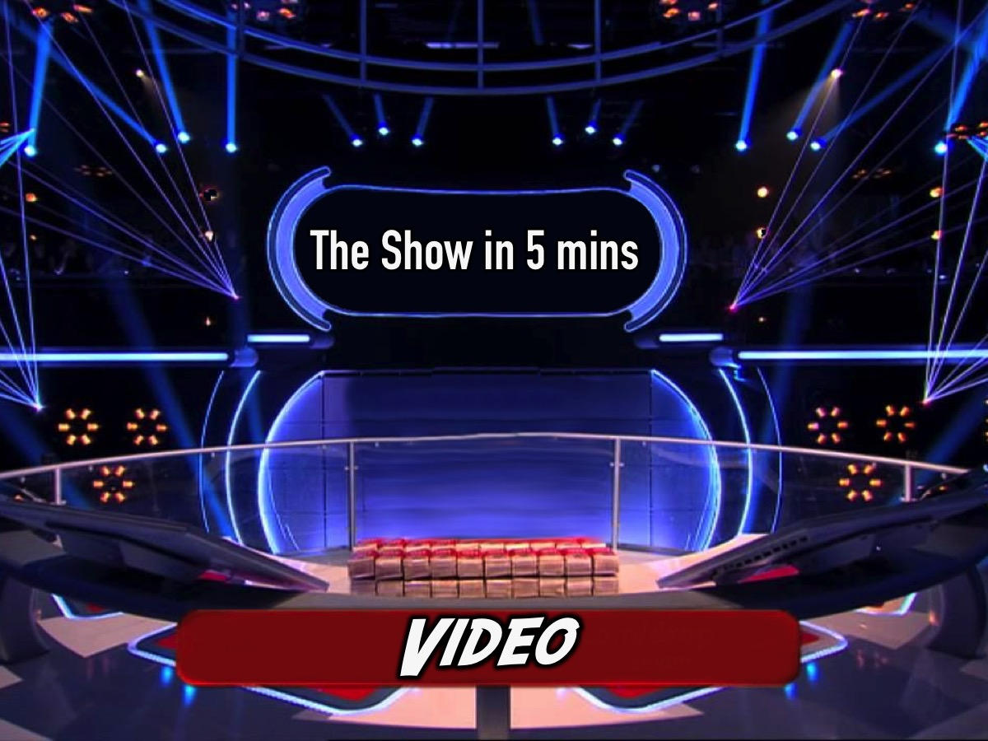
Notes:
But first a video to give you an idea of how the game show works.

Slide 6
Notes:
Video: Money Drop - Full Episode in 5min. Get it on YouTube at: https://www.youtube.com/watch?v=5FtRiNNFhmI

Slide 7
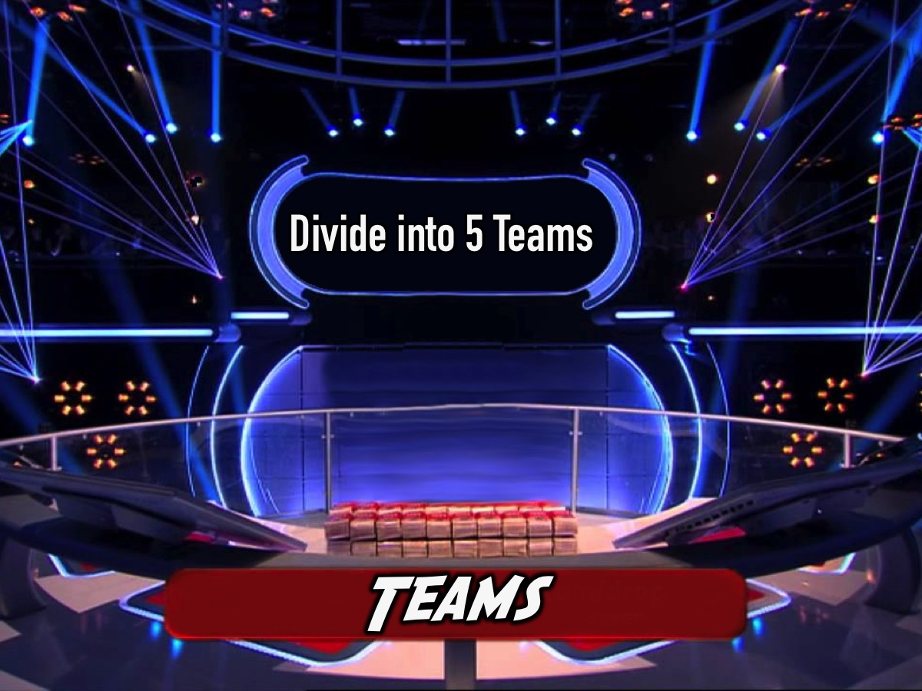
Notes:
Teams: You are going to divide up into 5 teams.

Slide 8
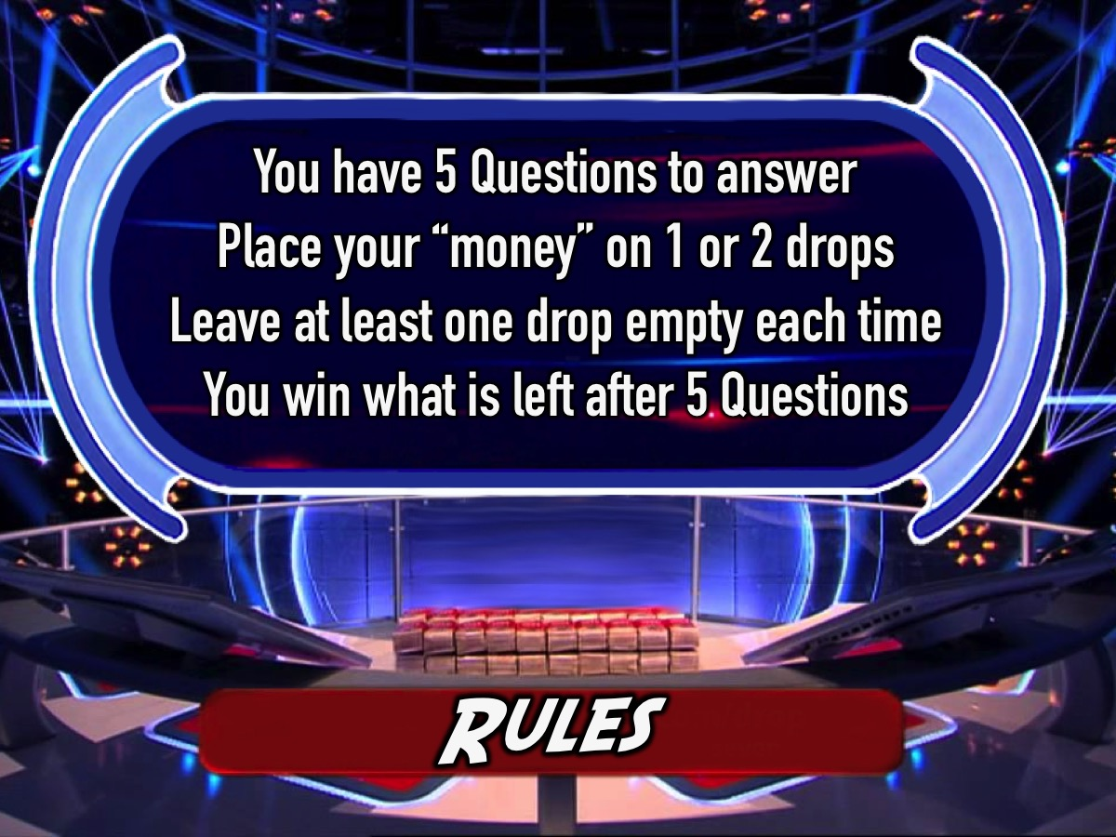
Notes:
Rules: Listen carefully to the following rules or you will have no chance of winning the Million! (1) You have 5 Questions to answer. (2) Place your money on the drops. (3) Leave one drop open each time. (4) You keep what is left after 5 Questions.

Slide 9

Notes:
Let’s play: Milliona Rand Money Drop

Slide 10
Notes:
Video: A His Youth personalised intro video. Get part of it online at: https://www.youtube.com/watch?v=5fY7LOGJF2o

Slide 11

Notes:
Team 1 it is your turn to play Million Rand Money Drop!

Slide 12
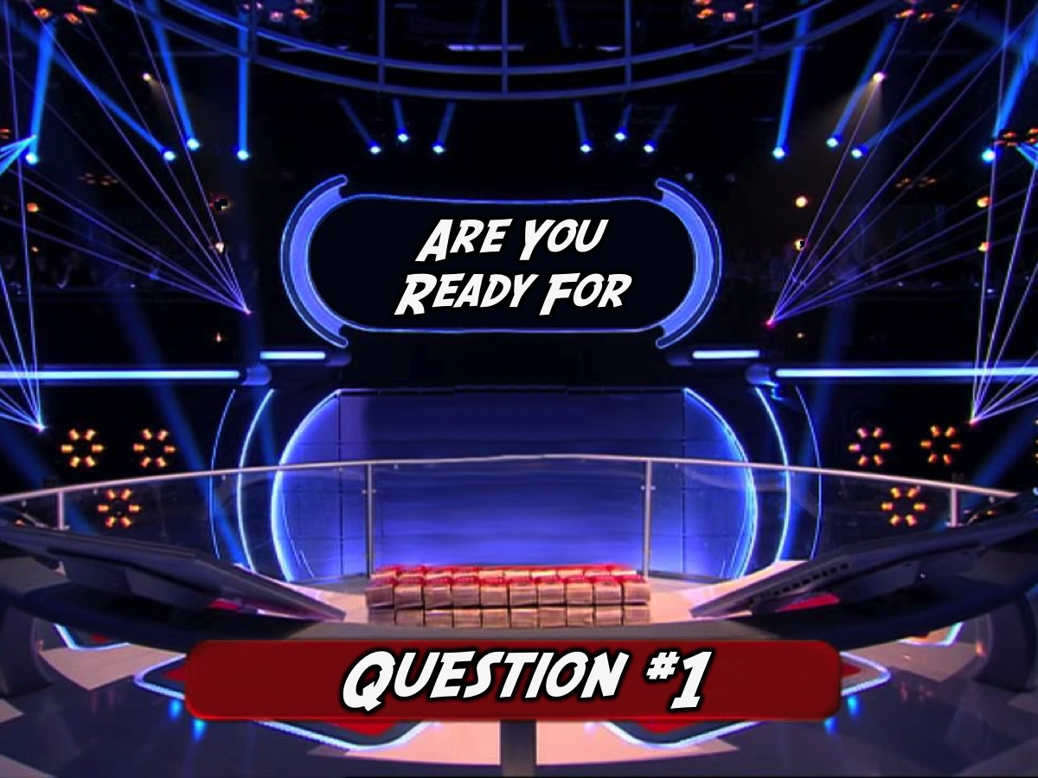
Notes:
Get ready for Question #1
Download the sound clip from: http://www.ymresourcer/documents/Money_Drop_3_The_Question.mp3

Slide 13
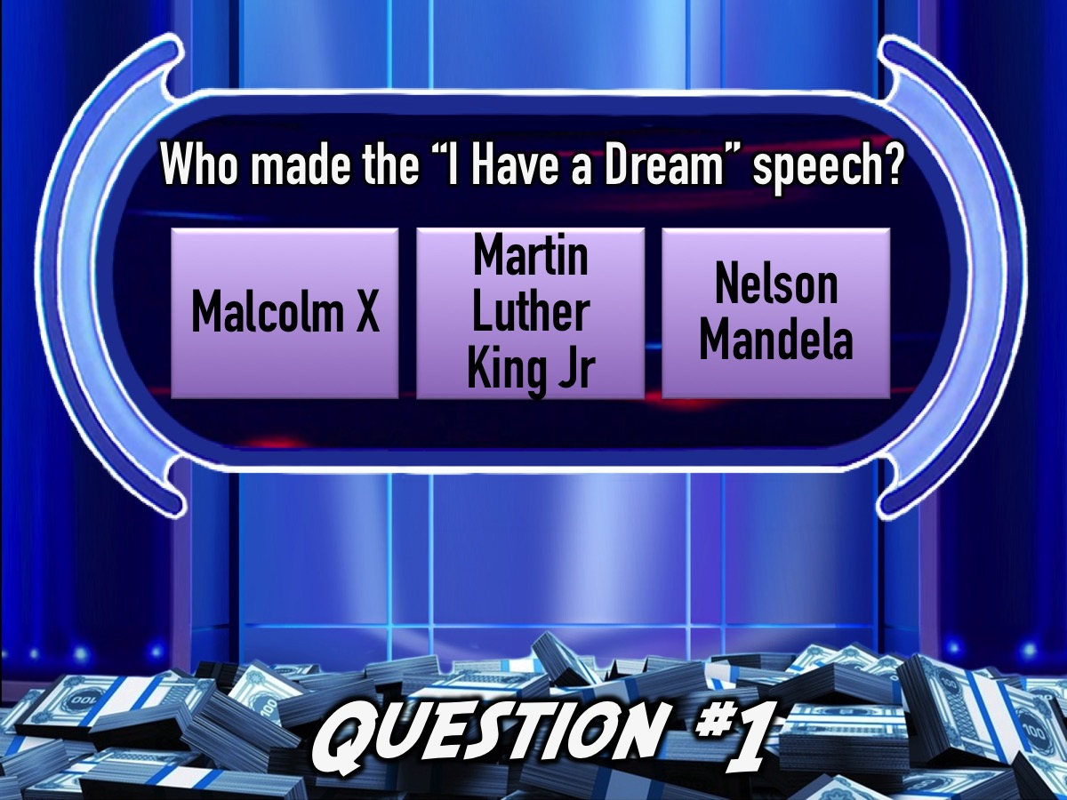
Notes:
Question #1: Who made the “I Have a Dream” speech?
(a) Malcolm X (b) Martin Luther King Jr (c) Nelson Mandela
Download the sound clip from: http://www.ymresourcer/documents/Money_Drop_2_The_Answers.mp3

Slide 14
Notes:
Question #1: Who made the “I Have a Dream” speech?
Malcolm (b) Nelson Mandela (c) Jacob Zuma

Slide 15
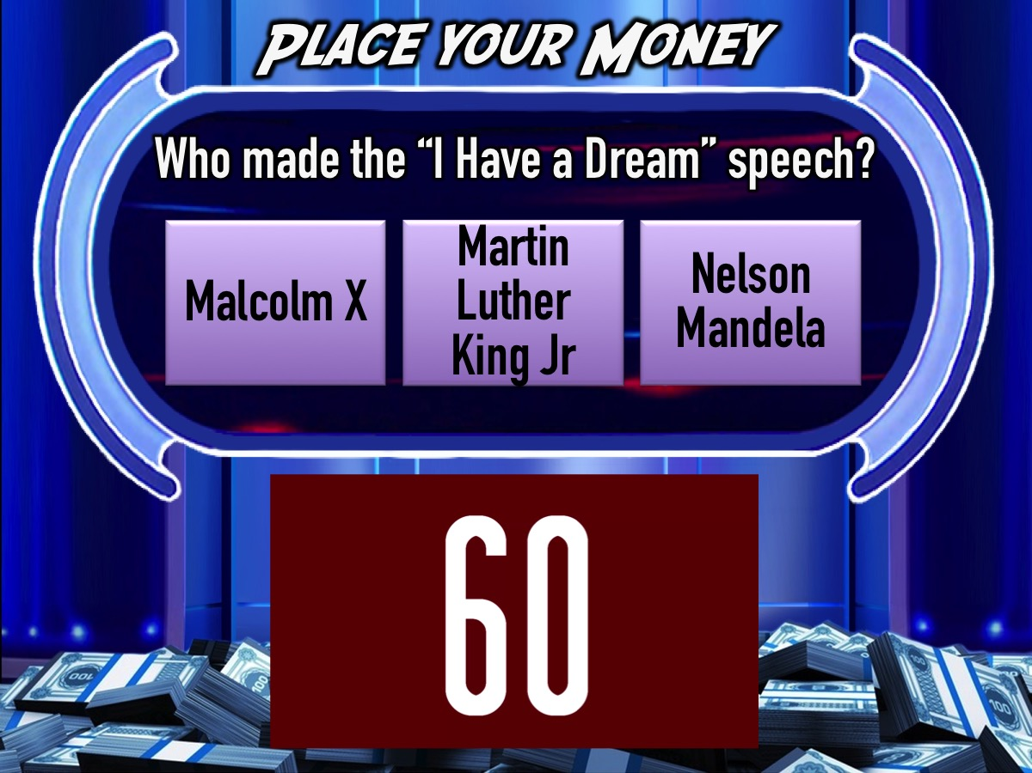
Notes:
You have 60 seconds to place your money.
Video: 1 Minute Countdown. Get it on YouTube: https://www.youtube.com/watch?v=gfYQ2ncAerM

Slide 16
Notes:
Question #1: Who made the “I Have a Dream” speech?
Malcolm (b) Nelson Mandela (c) Jacob Zuma

Slide 17
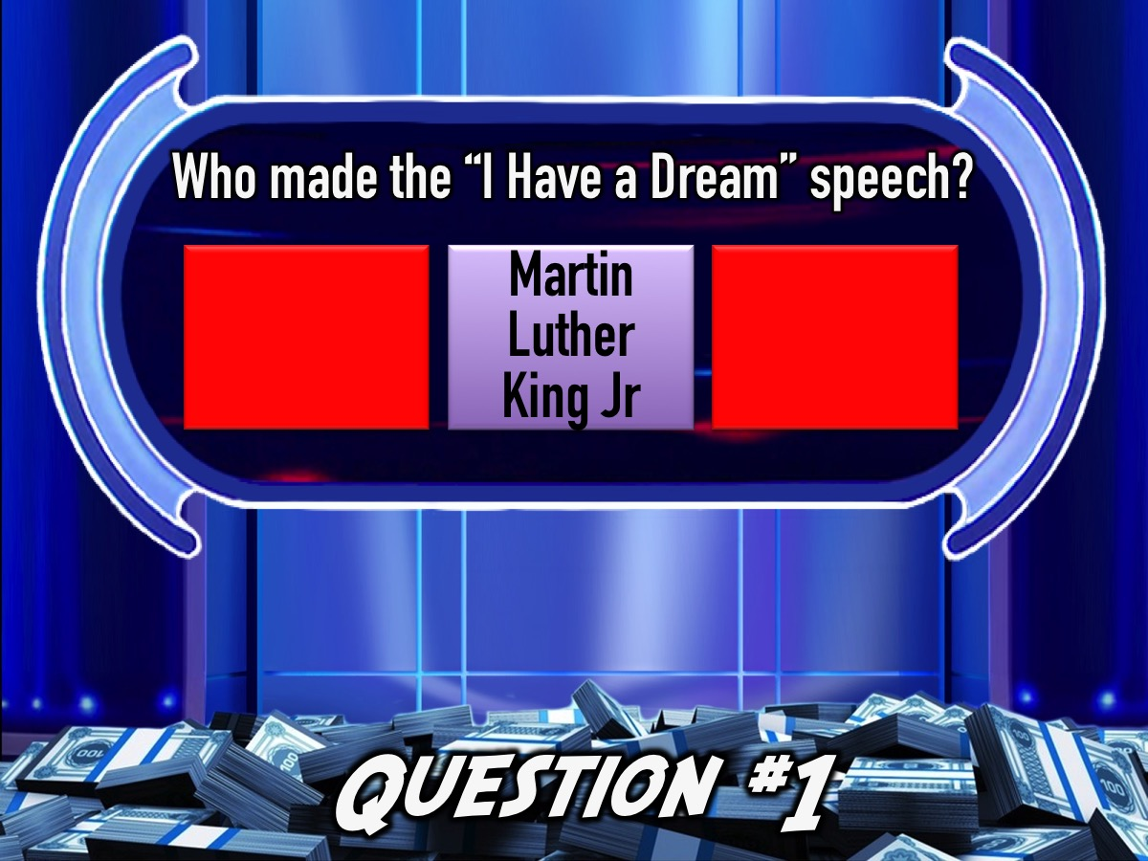
Notes:
Answer: (b) Martin Luther King Jr
Download the sound clip from: http://www.ymresourcer/documents/Money_Drop_4_Wrong_Answers.mp3

Slide 18
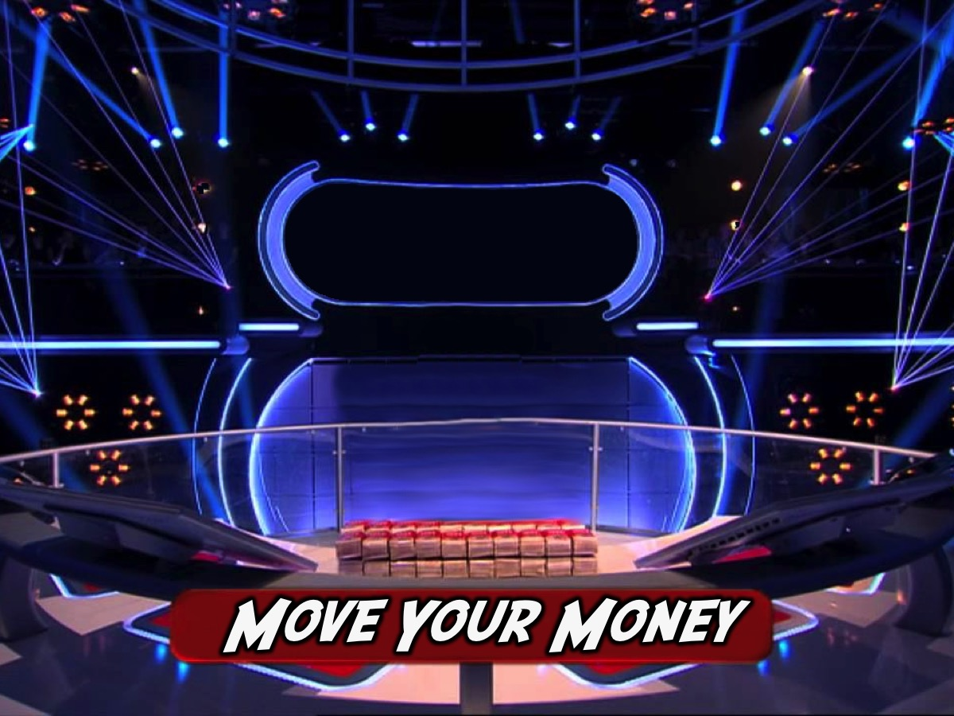
Notes:
Move your money back…

Slide 19
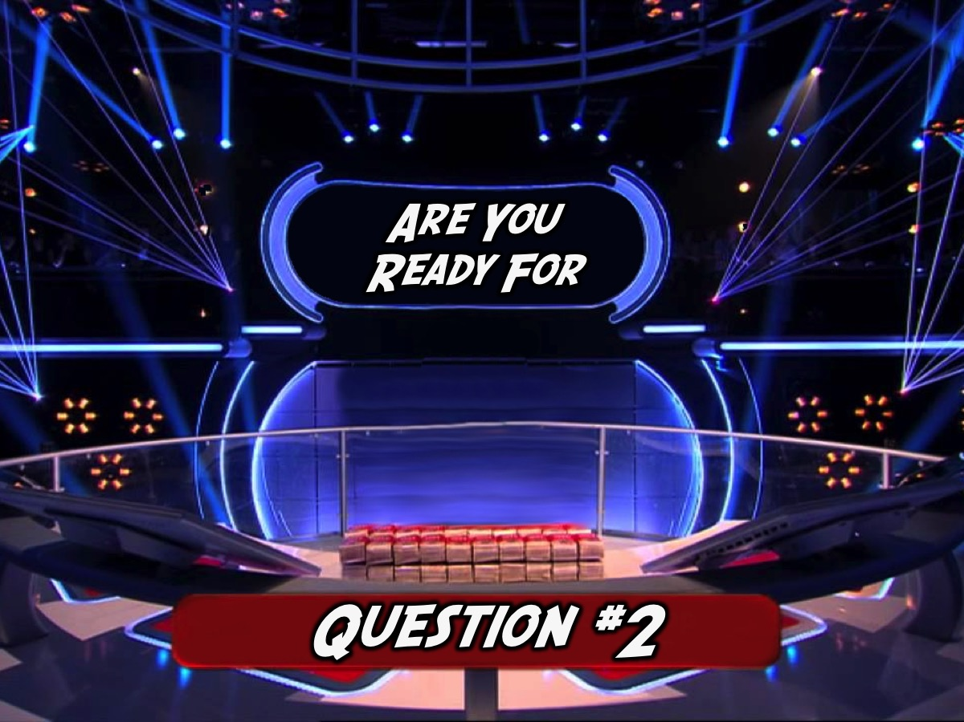
Notes:
Get ready for Question #2

Slide 20
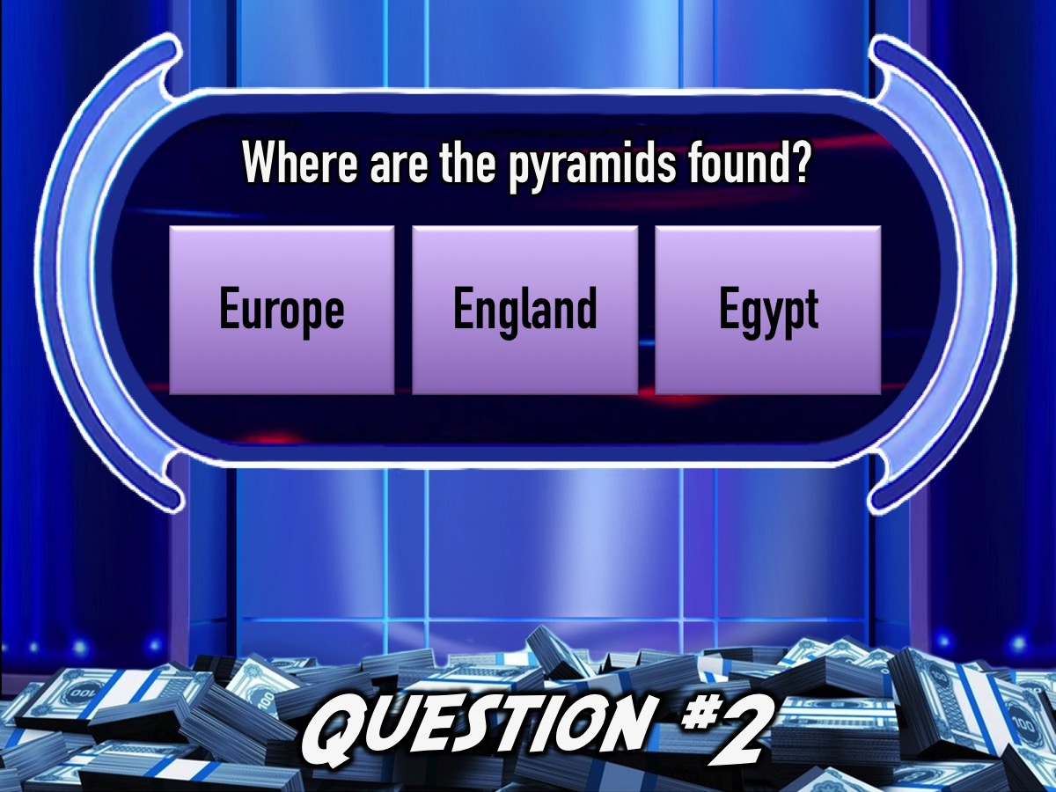
Notes:
Question #2: Where are the pyramids found?
(a) Europe (b) England (c) Egypt

Slide 21
Notes:
Question #2: Where are the pyramids found?
(a) Europe (b) England (c) Egypt

Slide 22
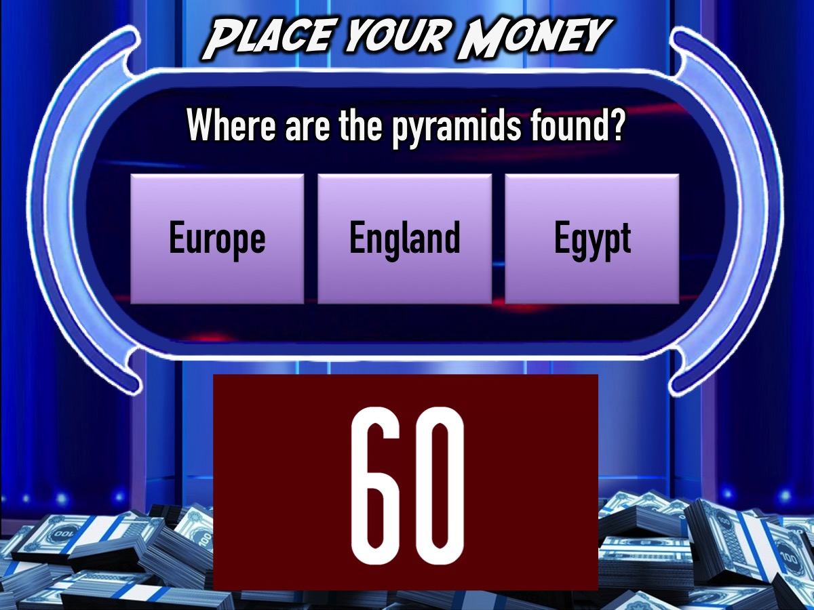
Notes:
You have 60 seconds…
Video: 1 Minute Countdown. Get it on YouTube: https://www.youtube.com/watch?v=gfYQ2ncAerM

Slide 23
Notes:
Question #2: Where are the pyramids found?
(a) Europe (b) England (c) Egypt

Slide 24
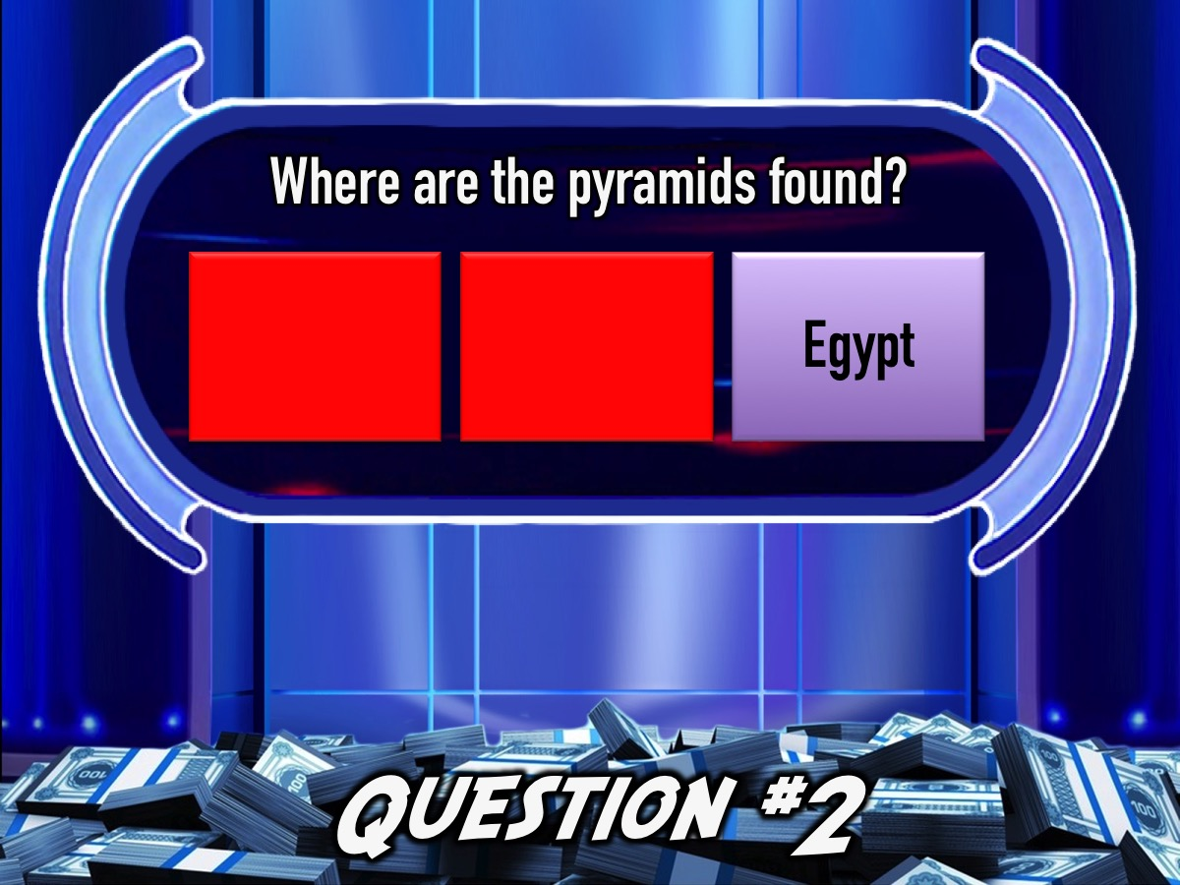
Notes:
Answer: (c) Egypy

Slide 25
Notes:
Move your money back…

Slide 26
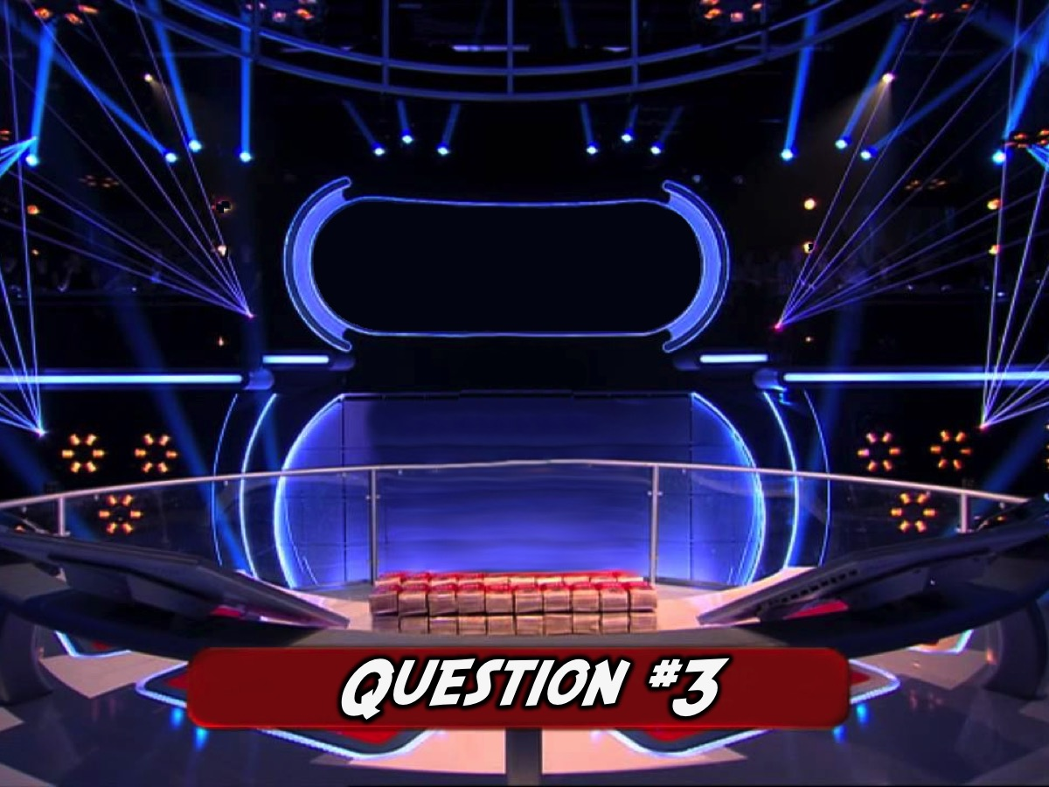
Notes:
Get ready for Question #3

Slide 27
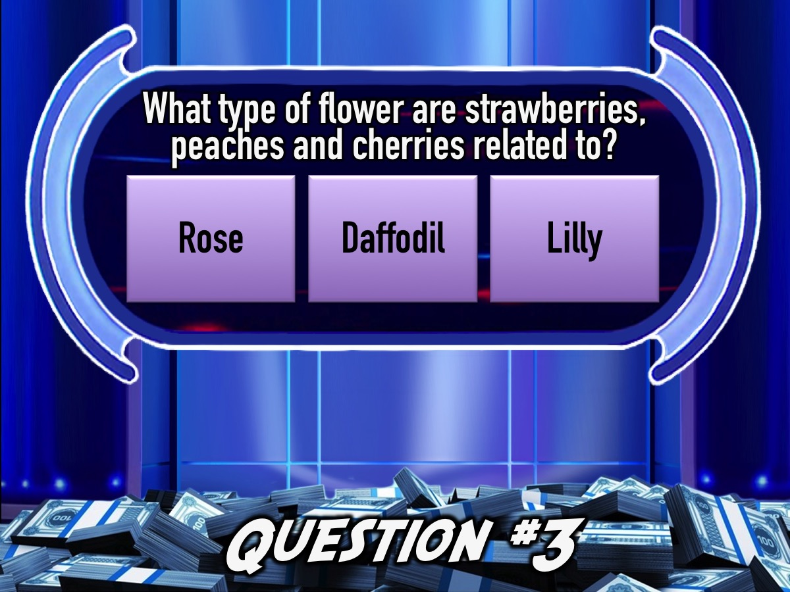
Notes:
Question #3. What type of flower are strawberries, peaches and cherries related to?
(a) Rose (b) Daffodil (c) Lily

Slide 28
Notes:
Question #3. What type of flower are strawberries, peaches and cherries related to?
(a) Rose (b) Daffodil (c) Lily

Slide 29
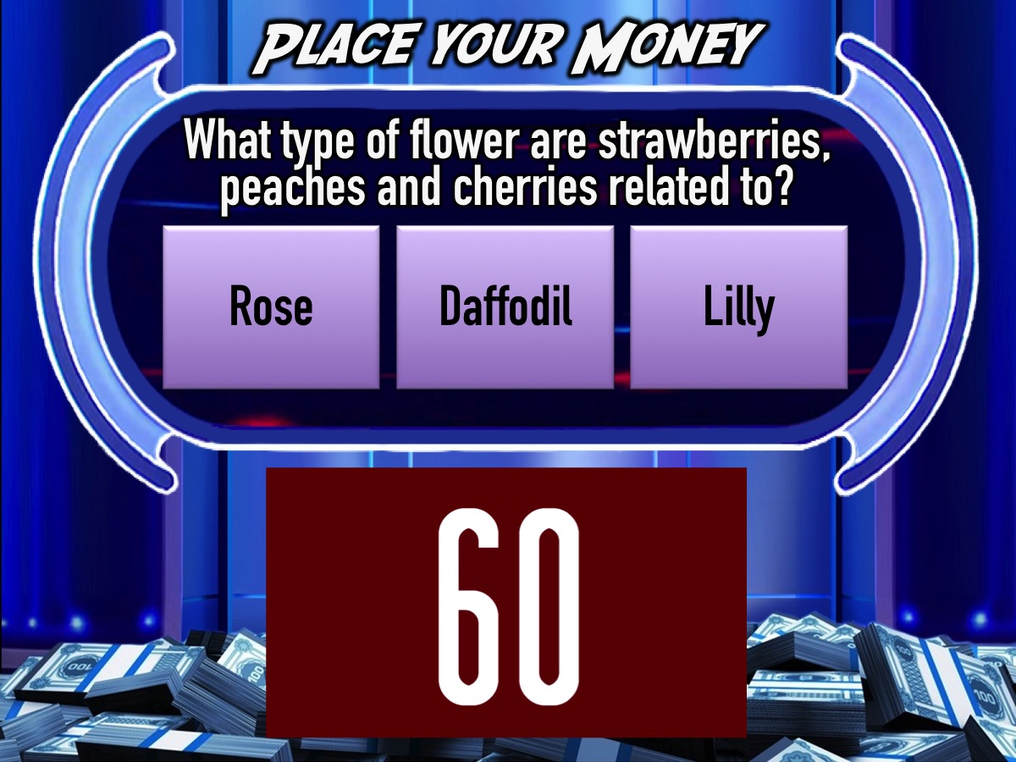
Notes:
You have 60 seconds…
Video: 1 Minute Countdown. Get it on YouTube: https://www.youtube.com/watch?v=gfYQ2ncAerM

Slide 30
Notes:
Question #3. What type of flower are strawberries, peaches and cherries related to?
(a) Rose (b) Daffodil (c) Lily

Slide 31
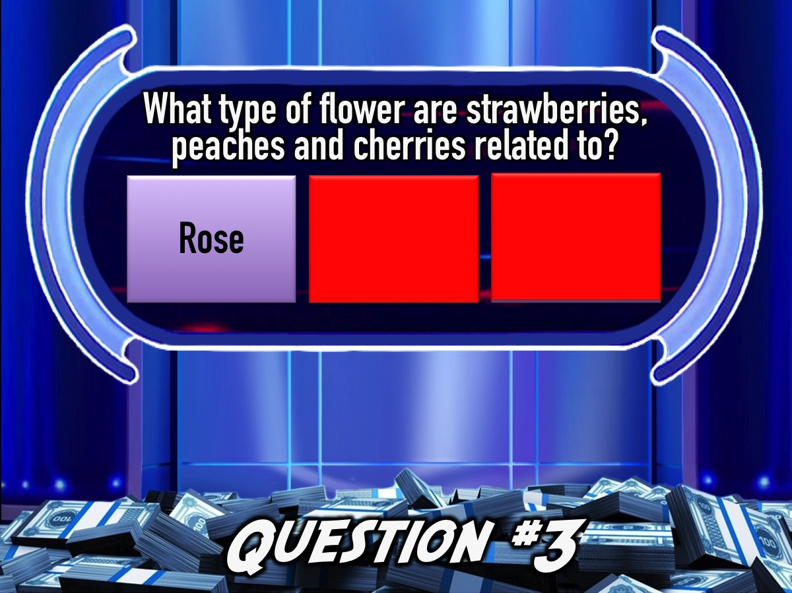
Notes:
Answer: (a) Rose. A surprising number of your favourite edible fruits are in the 'rose family’ including apples, apricots, plums and pears.

Slide 32
Notes:
Move your money back…

Slide 33

Notes:
Get ready for Question #4

Slide 34
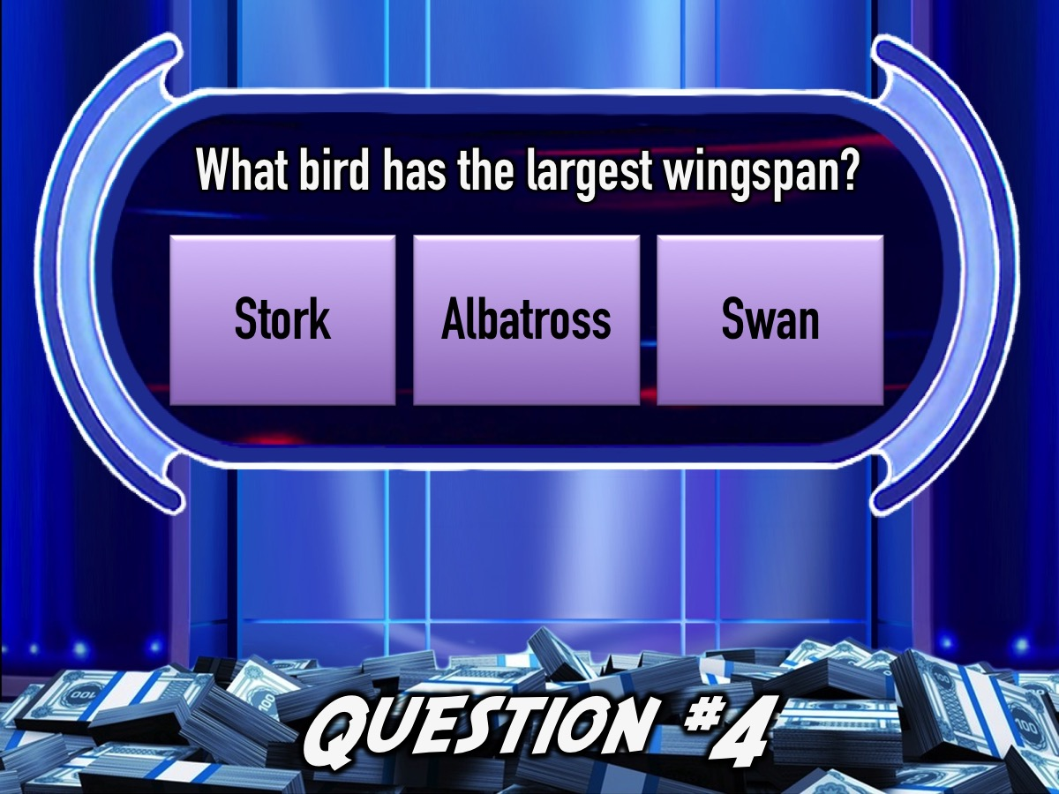
Notes:
Question #4. What bird has the largest wingspan?
(a) Stork (b) Albatross (c) Swan

Slide 35
Notes:
Question #4. What bird has the largest wingspan?
(a) Stork (b) Albatross (c) Swan

Slide 36
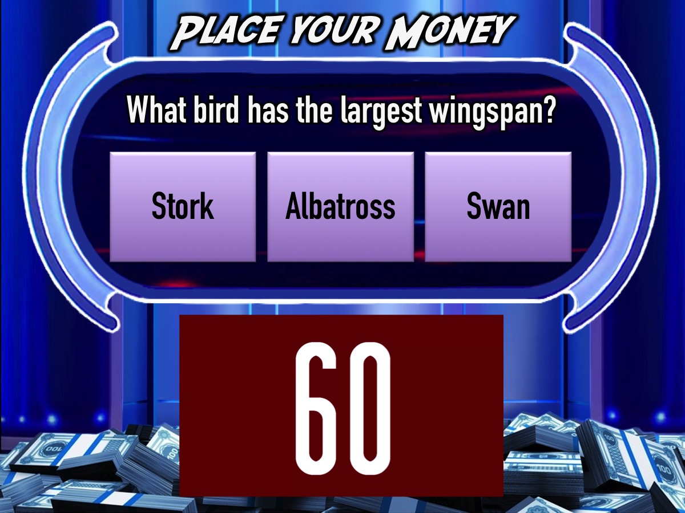
Notes:
You have 60 seconds…
Video: 1 Minute Countdown. Get it on YouTube: https://www.youtube.com/watch?v=gfYQ2ncAerM

Slide 37
Notes:
Question #4. What bird has the largest wingspan?
(a) Stork (b) Albatross (c) Swan

Slide 38
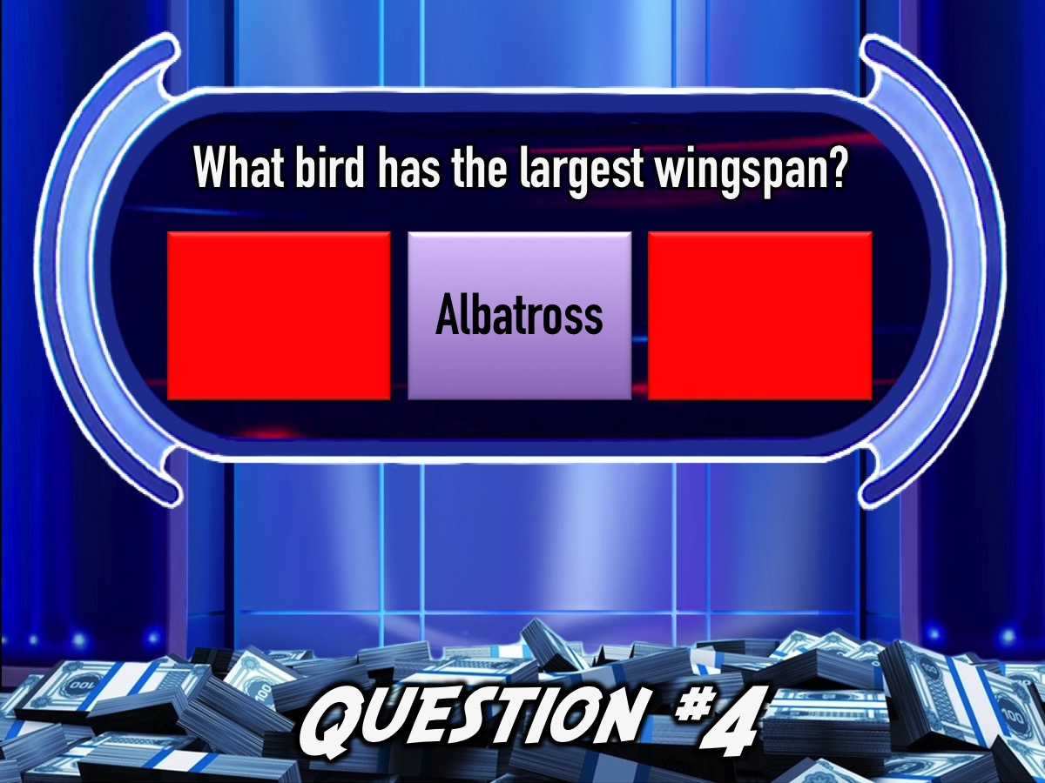
Notes:
Answer: (b) The Wandering Albatross has a wingspan that ranges from 8 to 11.5 feet.

Slide 39
Notes:
Move your money back…

Slide 40
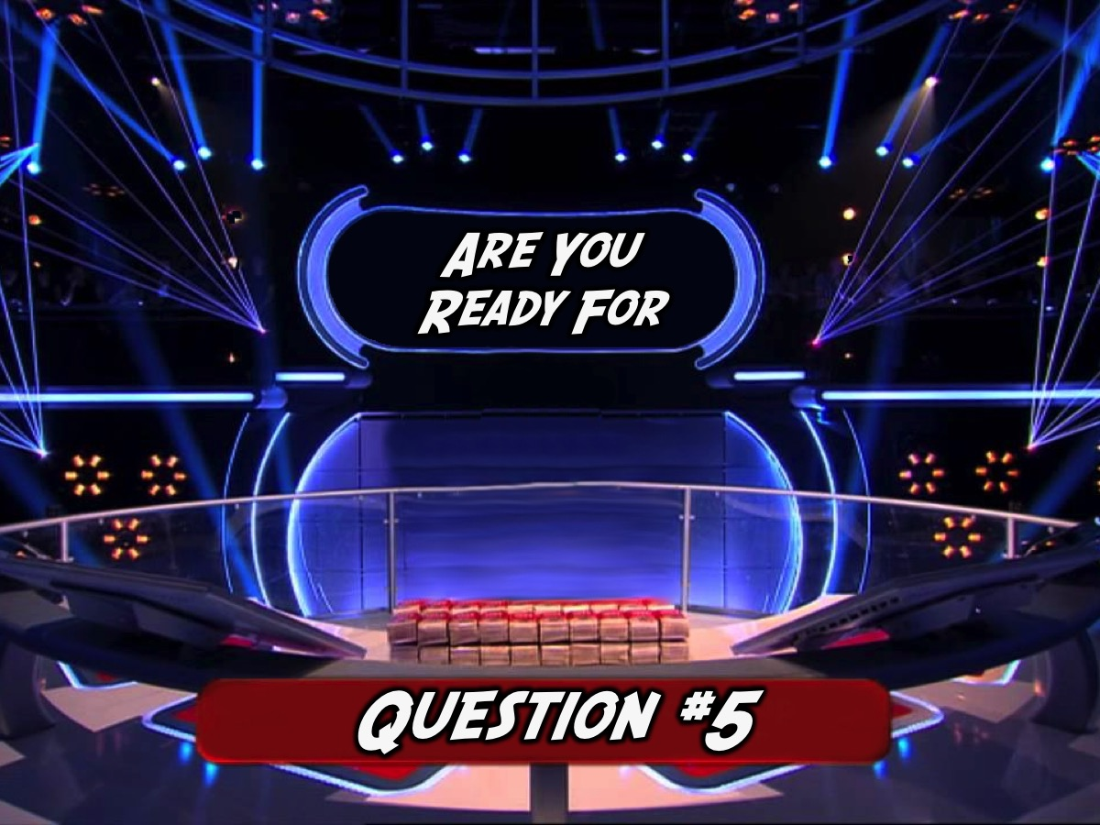
Notes:
Get ready for Question #5

Slide 41
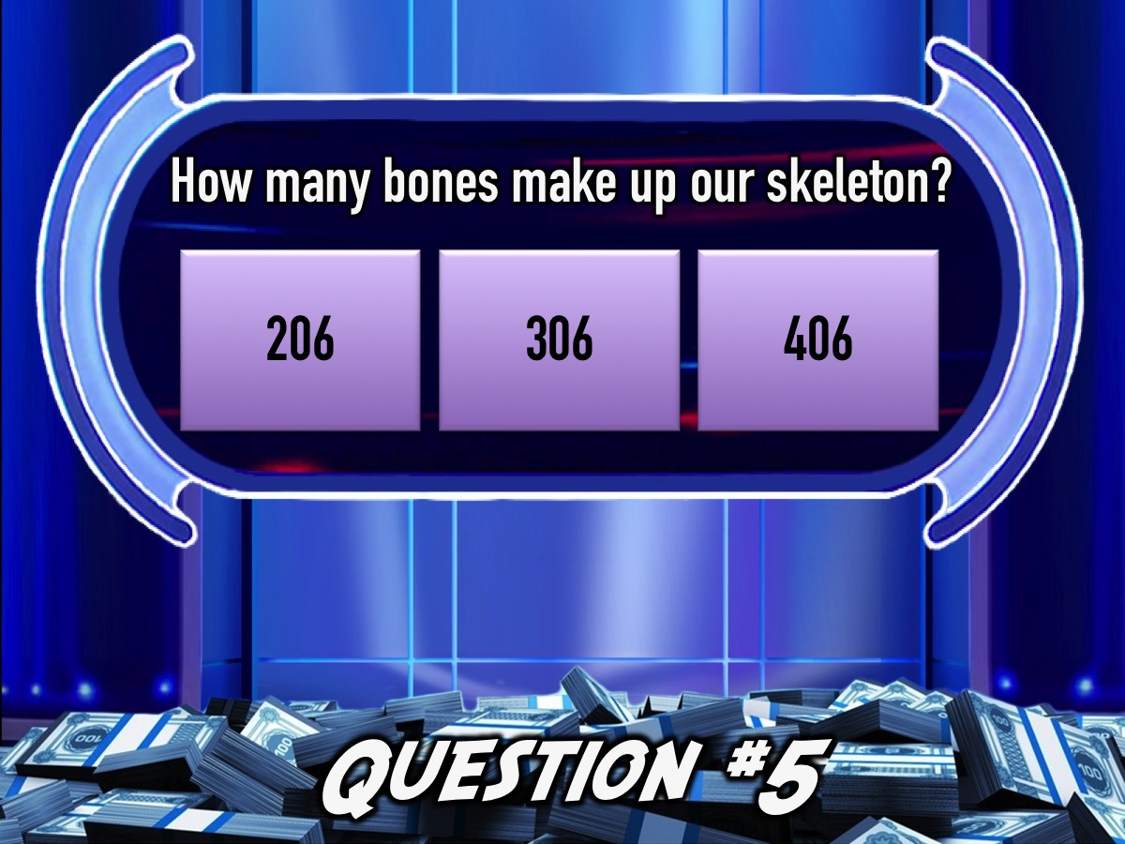
Notes:
Question #5. How many bones make up our skeleton?
(a) 206 (b) 306 (c) 406

Slide 42
Notes:
Question #5. How many bones make up our skeleton?
(a) 206 (b) 306 (c) 406

Slide 43
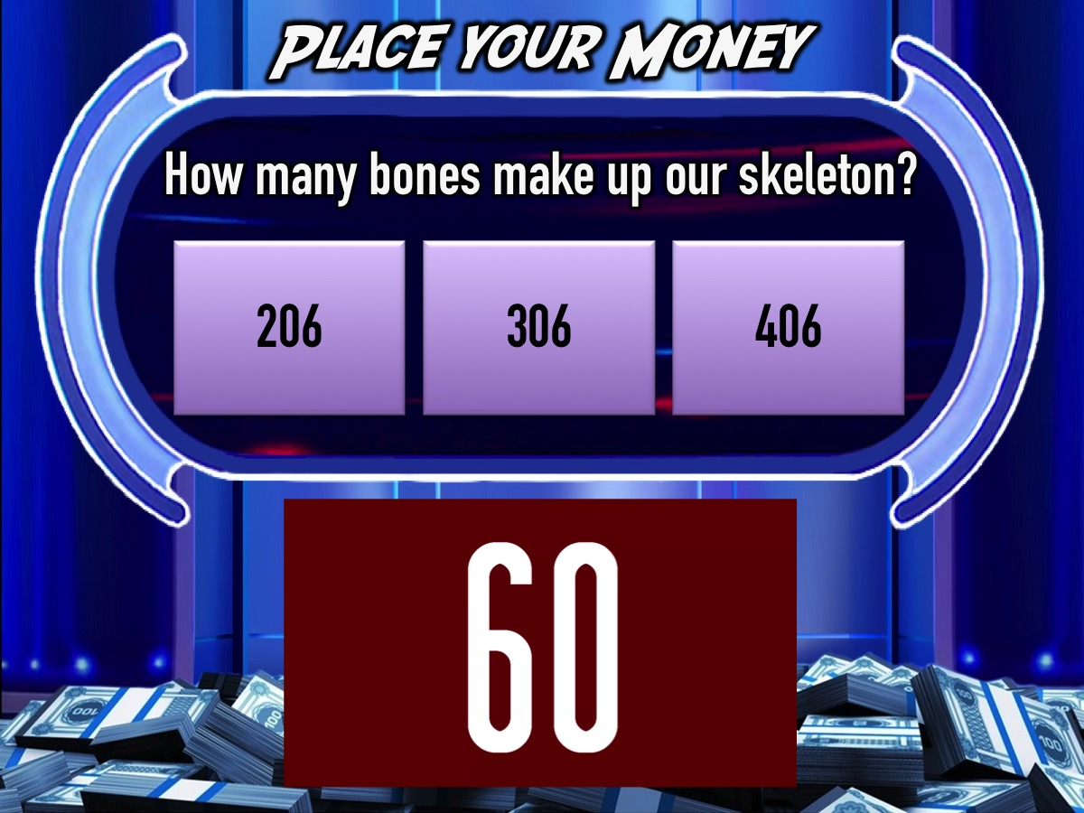
Notes:
You have 60 seconds…
Video: 1 Minute Countdown. Get it on YouTube: https://www.youtube.com/watch?v=gfYQ2ncAerM

Slide 44
Notes:
Question #5. How many bones make up our skeleton?
(a) 206 (b) 306 (c) 406

Slide 45
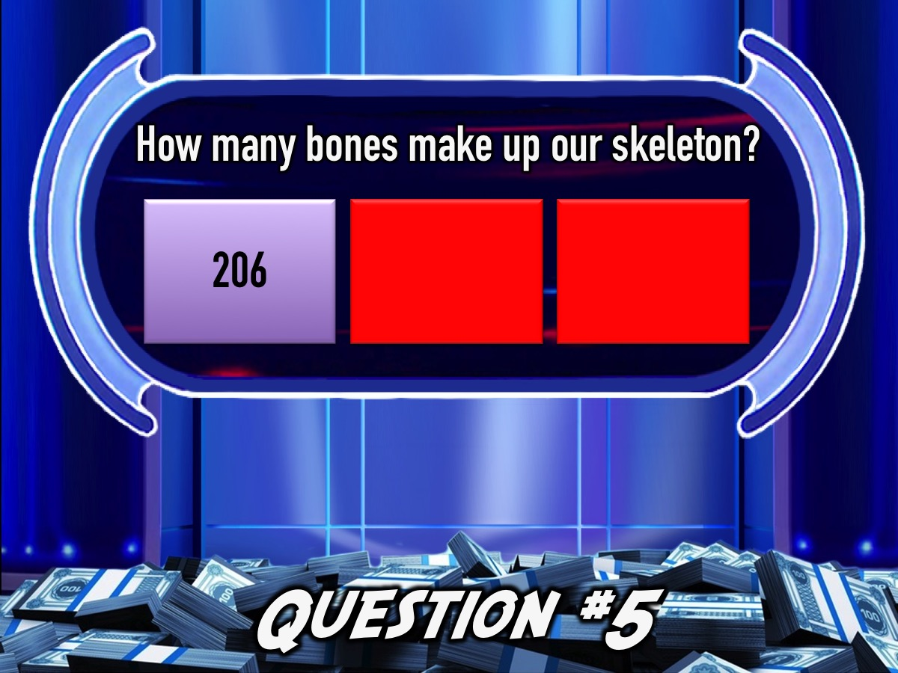
Notes:
Answer: (a) 206. Over 100 of those 206 bones are found just in our feet and hands.

Slide 46

Notes:
Team 2 it is your turn to play Million Rand Money Drop!

Slide 47
Notes:
Get ready for Question #1

Slide 48
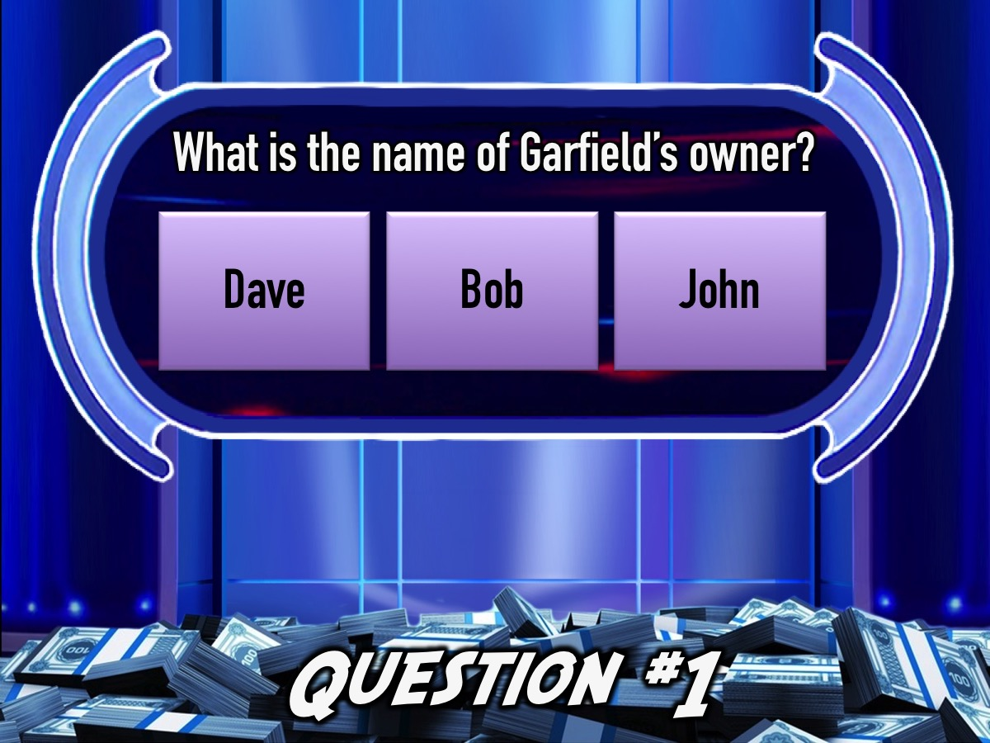
Notes:
Question #1: What is the name of Garfield’’s owner?
(a) Dave (b) Bob (c) John

Slide 49
Notes:
Question #1: What is the name of Garfield the cat’s owner?
(a) Dave (b) Bob (c) John

Slide 50
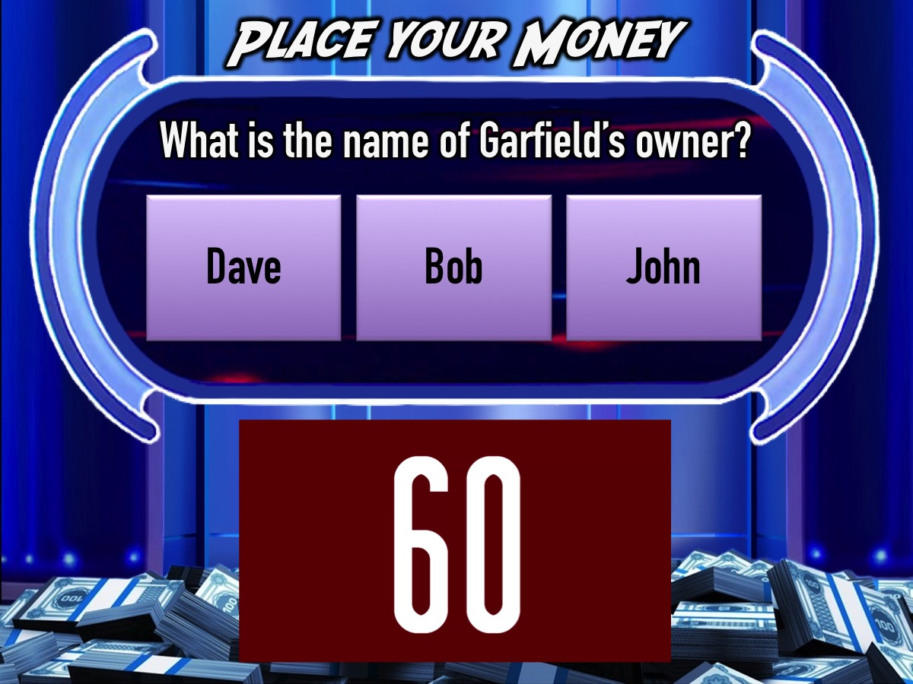
Notes:
You have 60 seconds…
Video: 1 Minute Countdown. Get it on YouTube: https://www.youtube.com/watch?v=gfYQ2ncAerM

Slide 51
Notes:
Question #1: What is the name of Garfield the cat’s owner?
(a) Dave (b) Bob (c) John

Slide 52
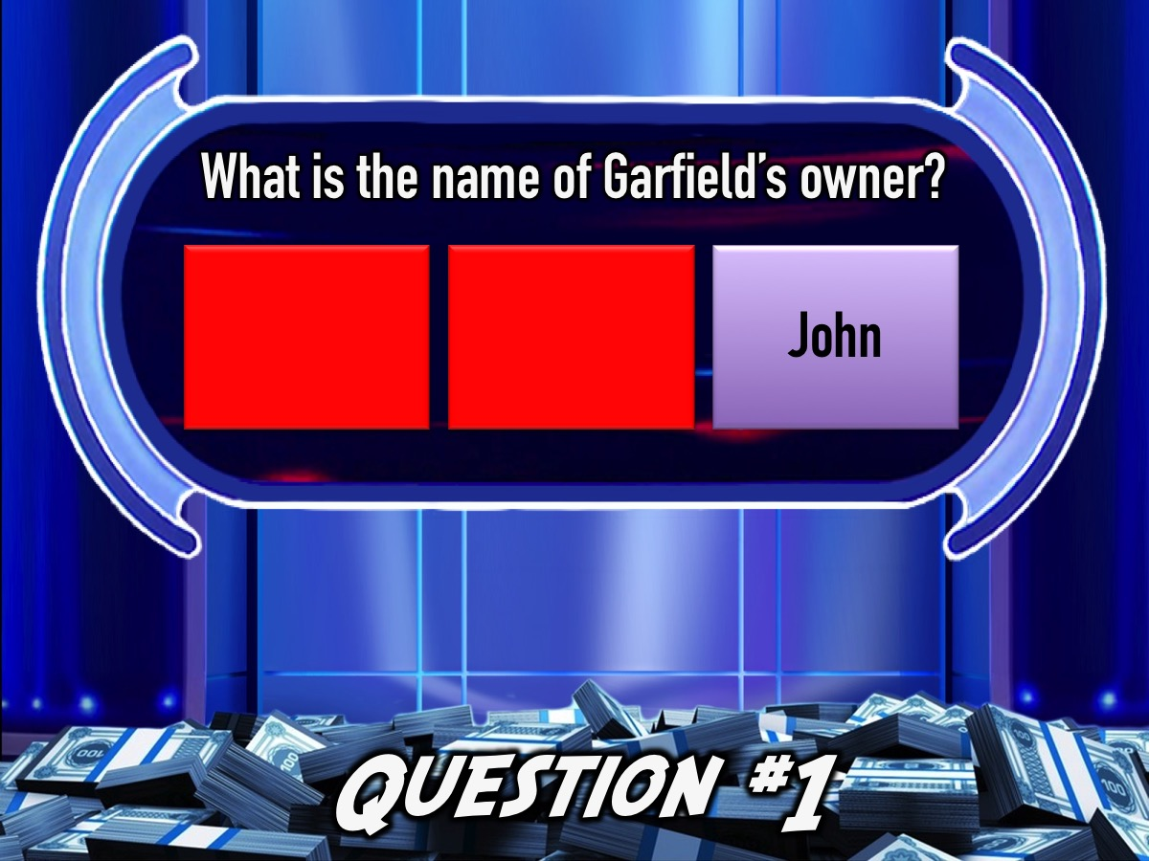
Notes:
Answer: (c) John

Slide 53
Notes:
Move your money back…

Slide 54
Notes:
Get ready for Question #2

Slide 55
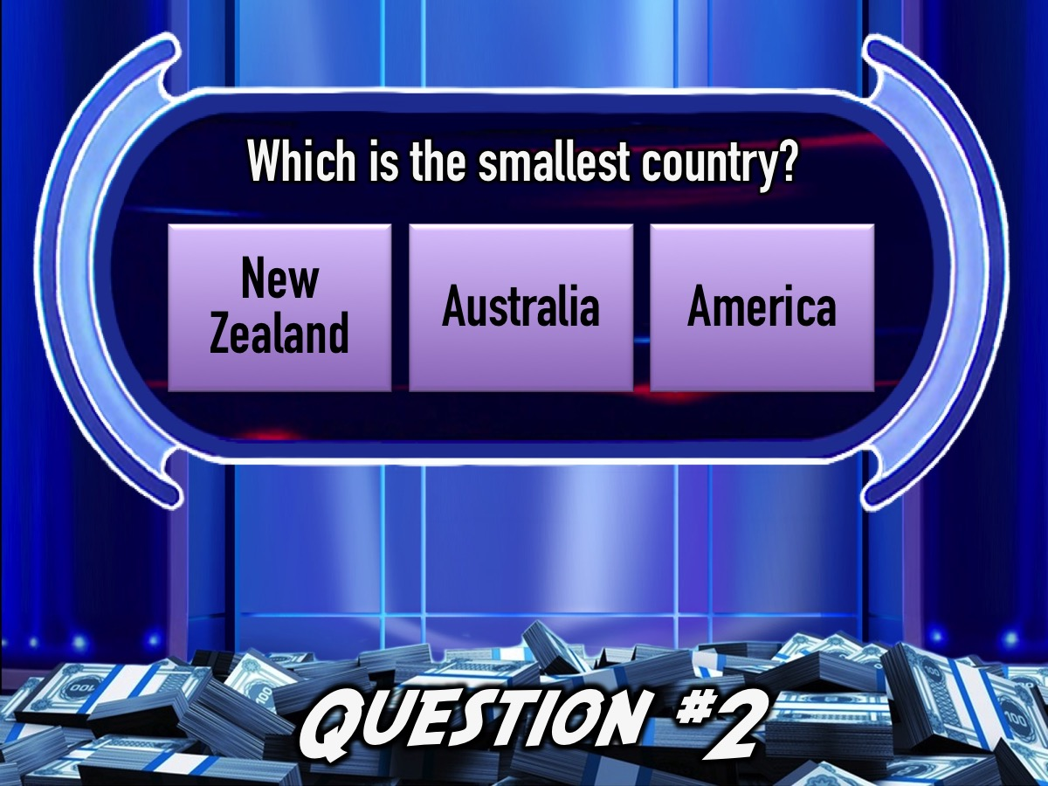
Notes:
Question #2: Which is the smallest country?
(a) New Zealand (b) Australia (c) America

Slide 56
Notes:
Question #2: Which is the smallest country?
(a) New Zealand (b) Australia (c) America

Slide 57
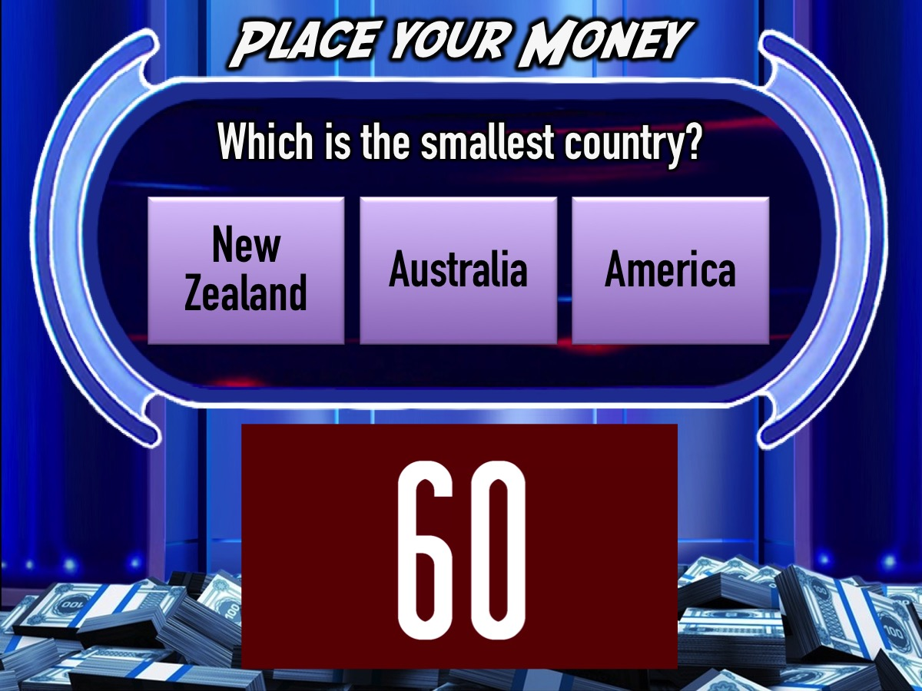
Notes:
You have 60 seconds…
Video: 1 Minute Countdown. Get it on YouTube: https://www.youtube.com/watch?v=gfYQ2ncAerM

Slide 58
Notes:
Question #2: Which is the smallest country?
(a) New Zealand (b) Australia (c) America

Slide 59
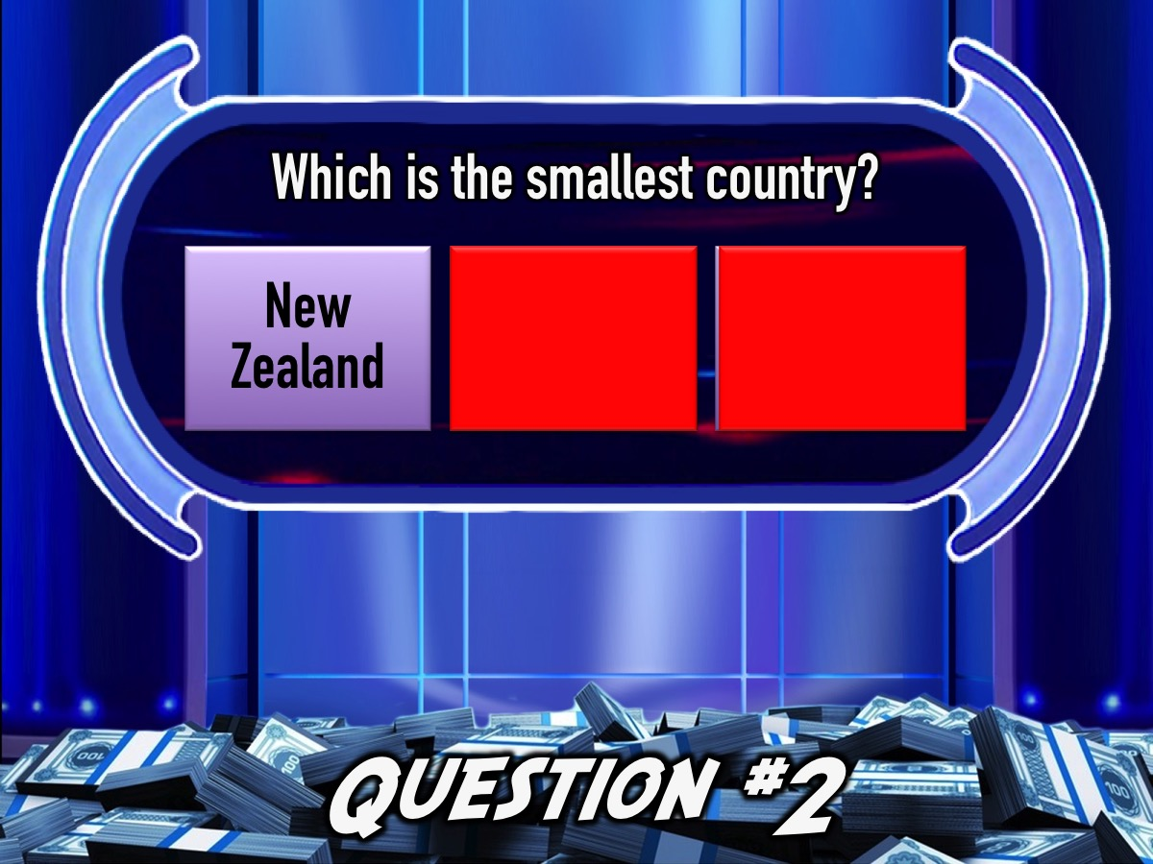
Notes:
Answer: (a) New Zealand

Slide 60
Notes:
Move your money back…

Slide 61
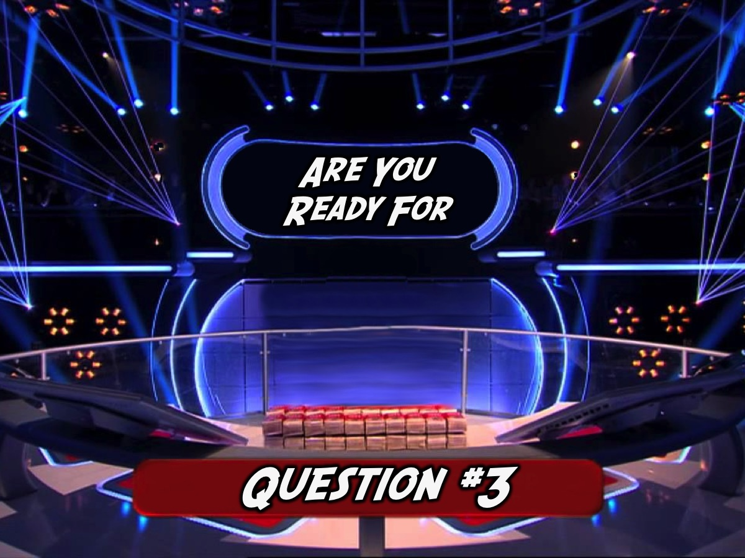
Notes:
Get ready for Question #3

Slide 62
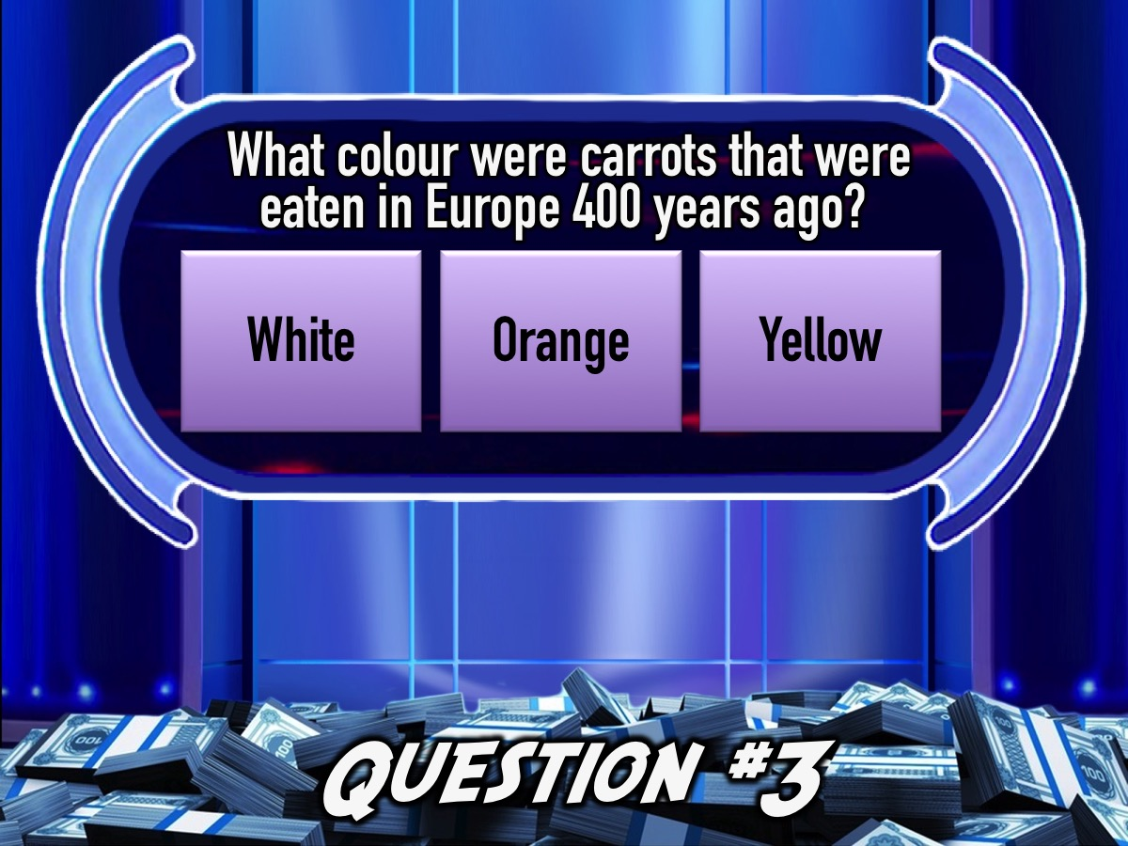
Notes:
Question #3. What colour were carrots that were eaten in Europe 400 years ago?
(a) White (b) Orange (c) Yellow

Slide 63
Notes:
Question #3. What colour were carrots that were eaten in Europe 400 years ago?
(a) White (b) Orange (c) Yellow

Slide 64

Notes:
You have 60 seconds…
Video: 1 Minute Countdown. Get it on YouTube: https://www.youtube.com/watch?v=gfYQ2ncAerM

Slide 65
Notes:
Question #3. What colour were carrots that were eaten in Europe 400 years ago?
(a) White (b) Orange (c) Yellow

Slide 66
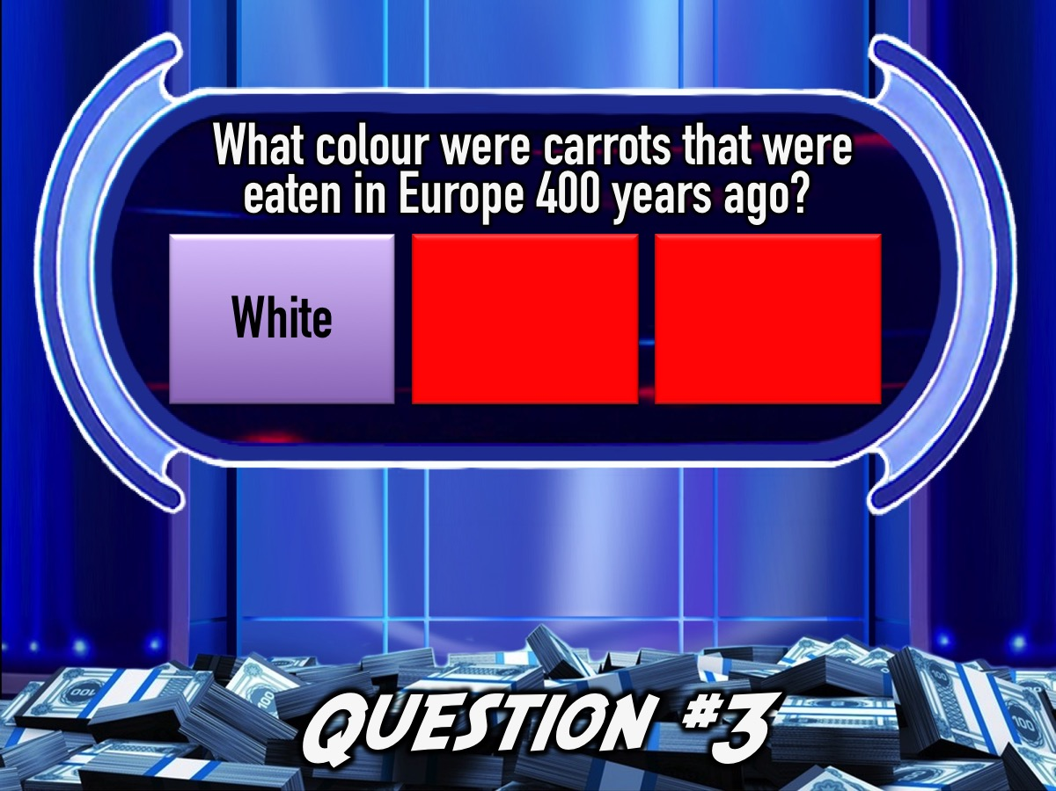
Notes:
Answer: (b) White. Actually, carrots have been all kinds of colours through history including purple, black, red and yellow. Carrot colours still vary around the world today (especially wild ones).

Slide 67
Notes:
Move your money back…

Slide 68

Notes:
Get ready for Question #4

Slide 69

Notes:
Question #4. Which of the following animals sleep standing up?
(a) Gorillas (b) Flamingos (c) Camels

Slide 70
Notes:
Question #4. Which of the following animals sleep standing up?
(a) Gorillas (b) Flamingos (c) Camels

Slide 71
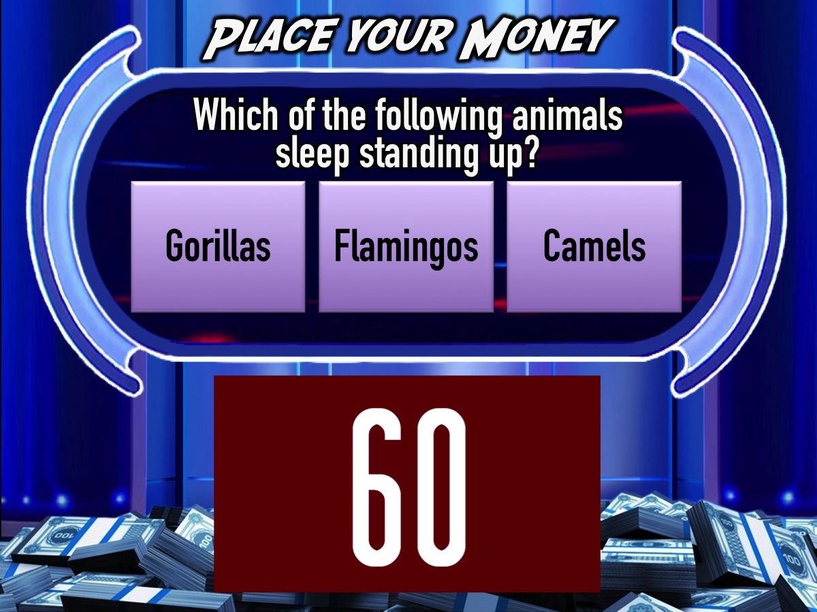
Notes:
You have 60 seconds…
Video: 1 Minute Countdown. Get it on YouTube: https://www.youtube.com/watch?v=gfYQ2ncAerM

Slide 72
Notes:
Question #4. Which of the following animals sleep standing up?
(a) Gorillas (b) Flamingos (c) Camels

Slide 73
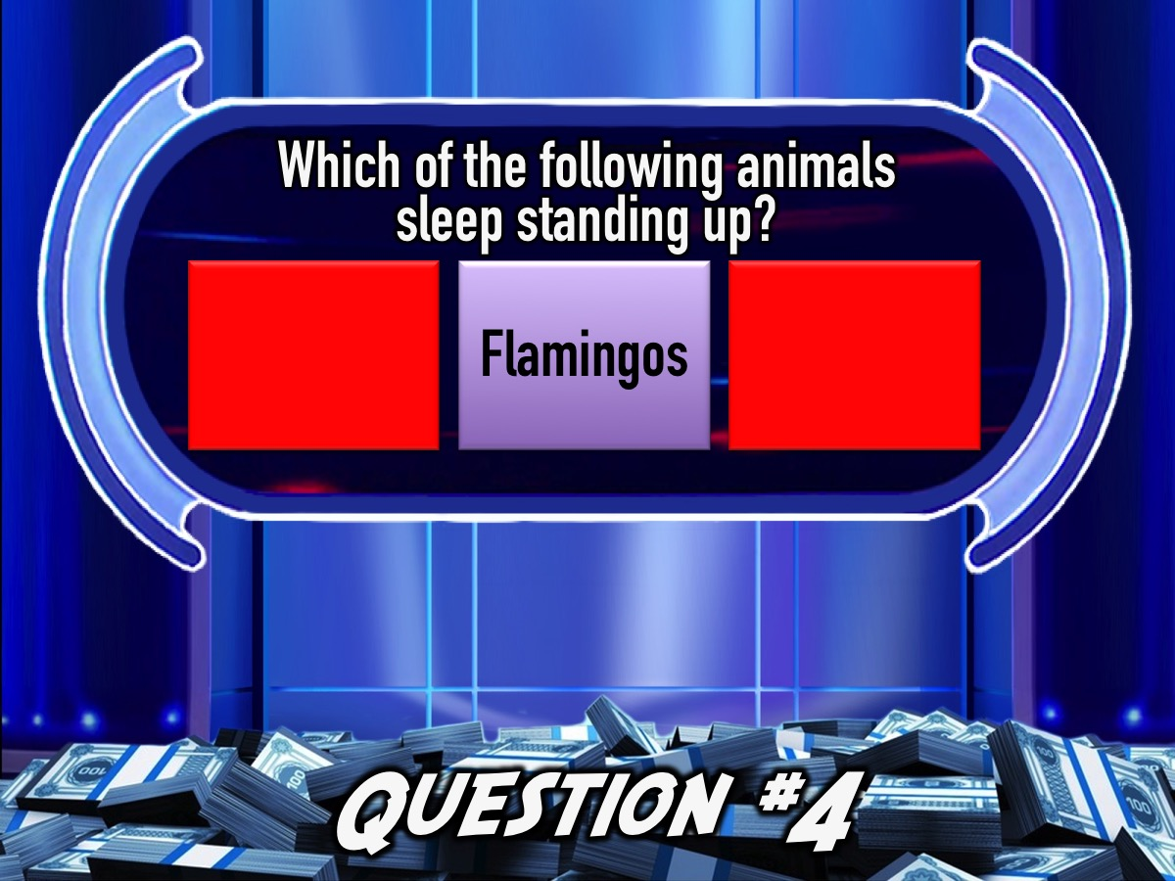
Notes:
Answer: (b) Flamingos sleep standing up because the salt flats they live on are too caustic to sit down in.

Slide 74
Notes:
Move your money back…

Slide 75
Notes:
Get ready for Question #5

Slide 76
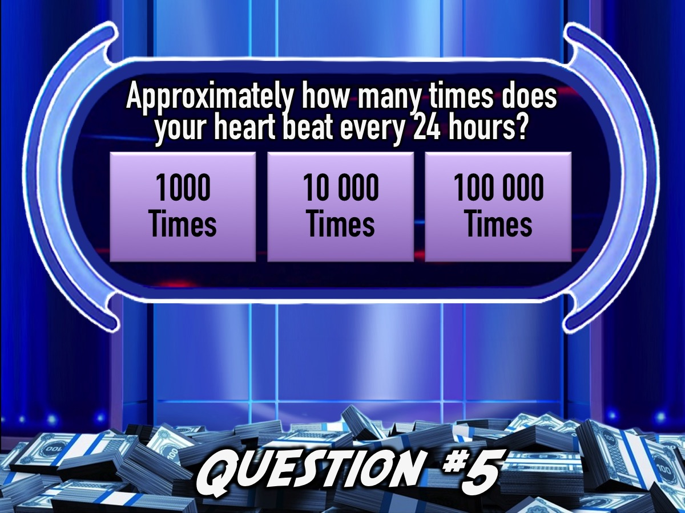
Notes:
Question #5. Approximately how many times does your heart beat every 24 hours?
(a) 1000 times (b) 10,000 times (c) 100,000 times

Slide 77
Notes:
Question #5. Approximately how many times does your heart beat every 24 hours?
(a) 1000 times (b) 10,000 times (c) 100,000 times

Slide 78
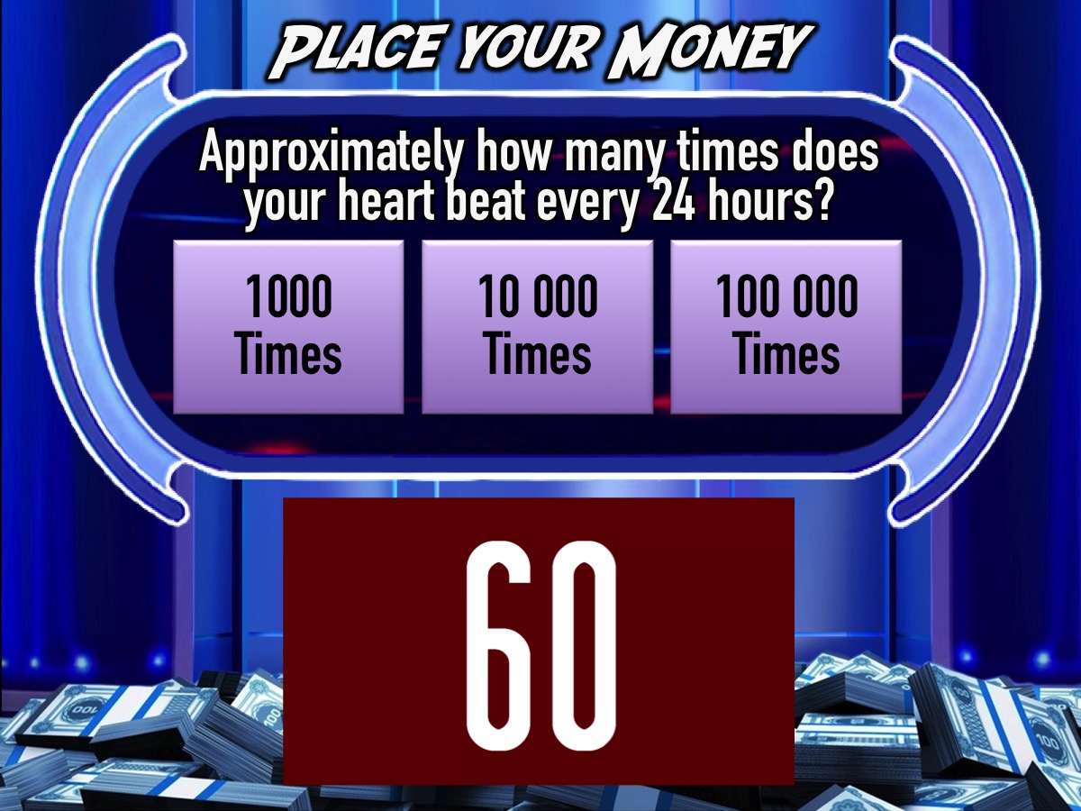
Notes:
You have 60 seconds…
Video: 1 Minute Countdown. Get it on YouTube: https://www.youtube.com/watch?v=gfYQ2ncAerM

Slide 79
Notes:
Question #5. Approximately how many times does your heart beat every 24 hours?
(a) 1000 times (b) 10,000 times (c) 100,000 times

Slide 80
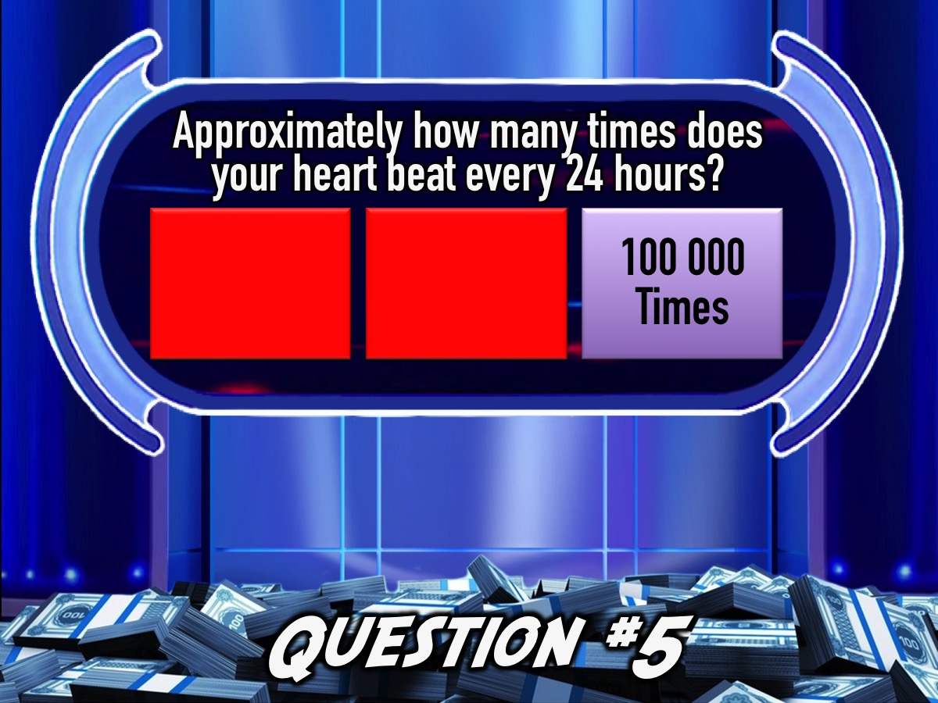
Notes:
Answer: (c) 100,000 times. Everybody's resting heartbeat is different and it depends on your age too. For example, children under 10 years old will have a heartbeat of around 70-130 beats per minute .... whereas older children and adults will average around 60 - 100 beats per minute. When you exercise it gets a lot faster.

Slide 81

Notes:
Team 3 it is your turn to play Million Rand Money Drop!

Slide 82
Notes:
Get ready for Question #1

Slide 83

Notes:
Question #1: What was Elvis’ surname?
(a) Johnson (b) Smith (c) Presley

Slide 84
Notes:
Question #1: What was Elvis’ surname?
(a) Johnson (b) Smith (c) Presley

Slide 85
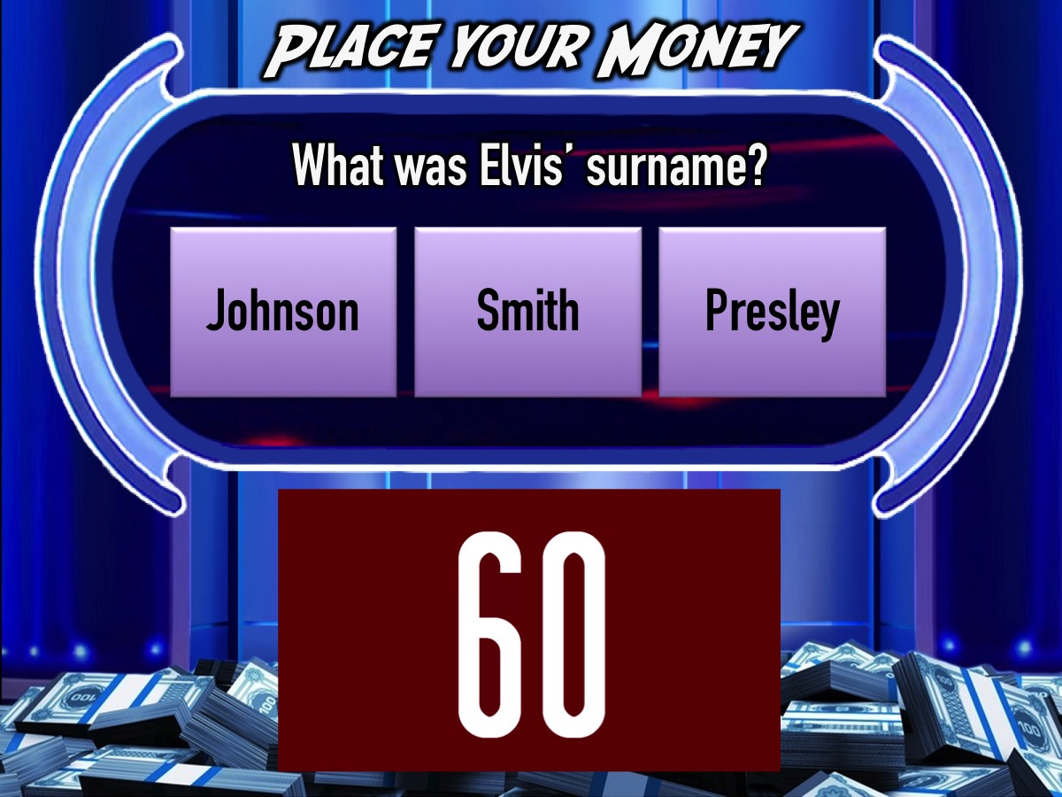
Notes:
You have 60 seconds…
Video: 1 Minute Countdown. Get it on YouTube: https://www.youtube.com/watch?v=gfYQ2ncAerM

Slide 86
Notes:
Question #1: What was Elvis’ surname?
(a) Johnson (b) Smith (c) Presley

Slide 87
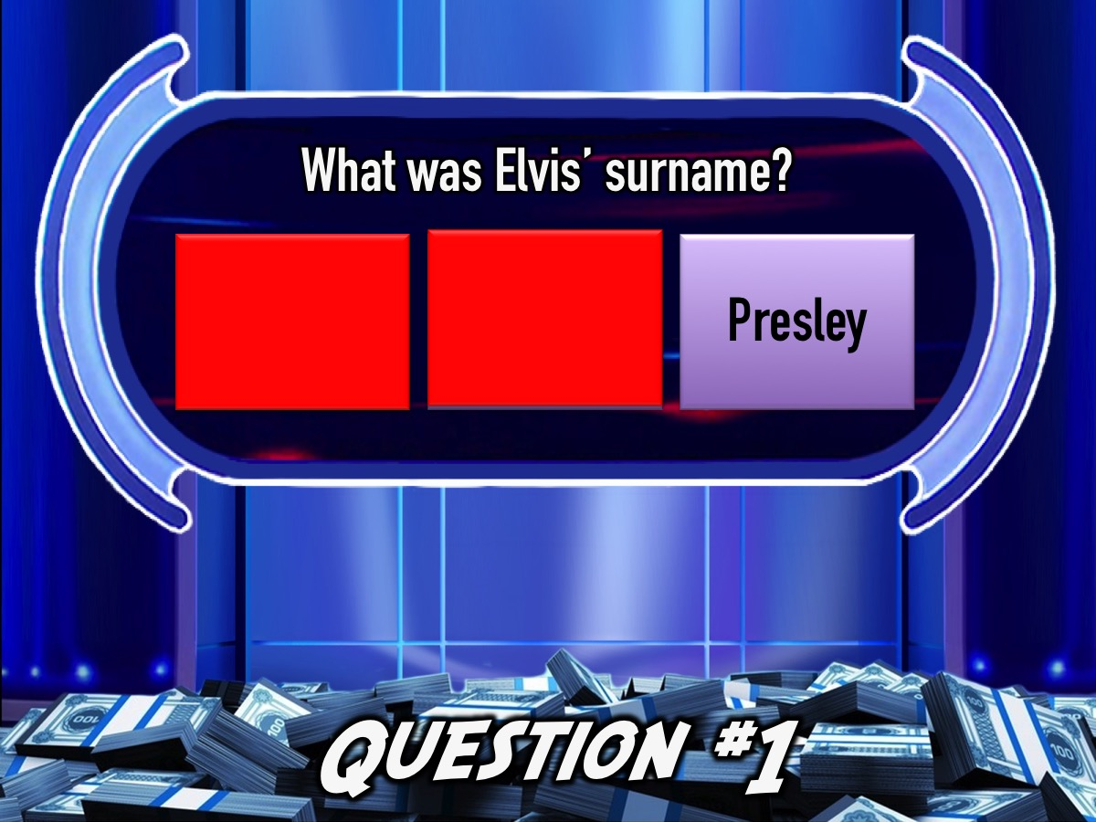
Notes:
Answer: (c) Presley

Slide 88
Notes:
Move your money back…

Slide 89
Notes:
Get ready for Question #2

Slide 90
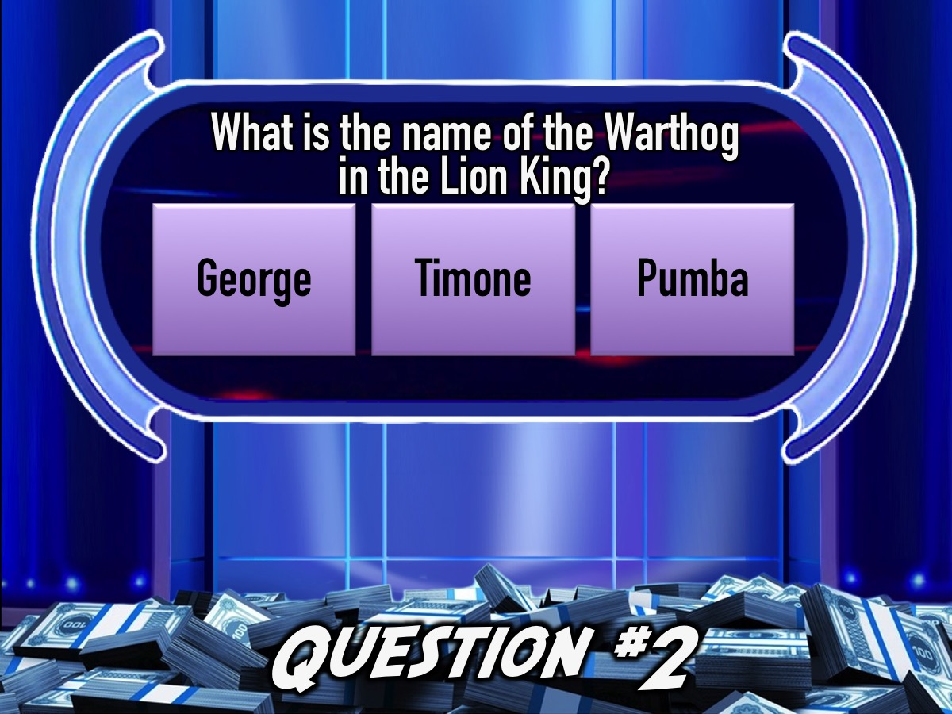
Notes:
Question #2: What is the name of the Warthog in the Lion King?
(a) George (b) Timone (c) Pumba

Slide 91
Notes:
Question #2: What is the name of the Warthog in the Lion King?
(a) George (b) Timone (c) Pumba

Slide 92
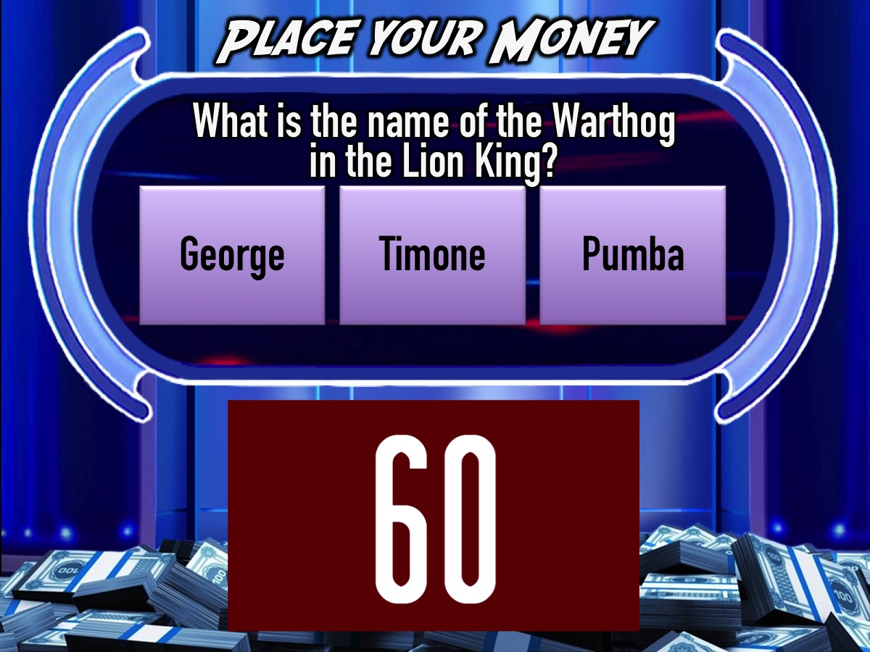
Notes:
You have 60 seconds…
Video: 1 Minute Countdown. Get it on YouTube: https://www.youtube.com/watch?v=gfYQ2ncAerM

Slide 93
Notes:
Question #2: What is the name of the Warthog in the Lion King?
(a) George (b) Timone (c) Pumba

Slide 94

Notes:
Answer: (c) Pumba

Slide 95
Notes:
Move your money back…

Slide 96
Notes:
Get ready for Question #3

Slide 97
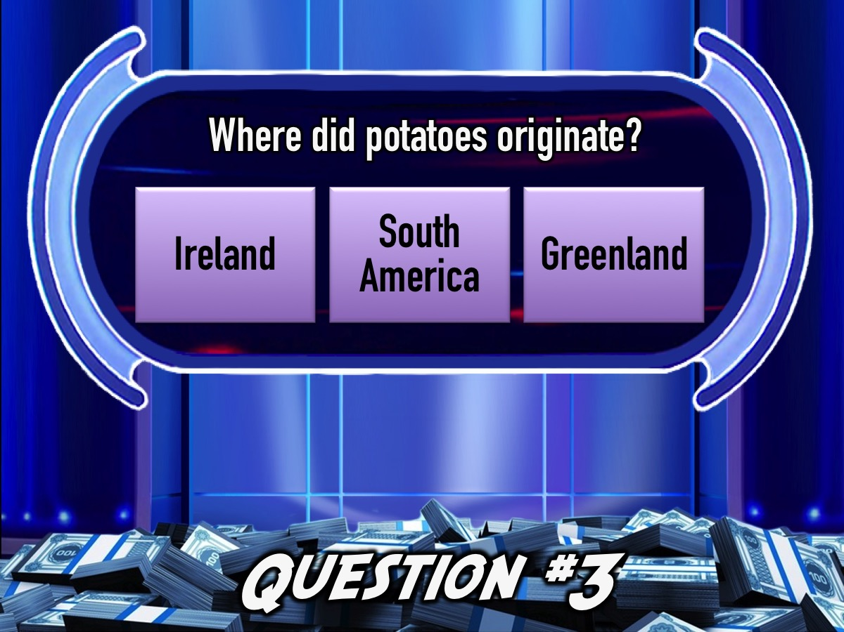
Notes:
Question #3. Where did potatoes originate?
(a) Ireland (b) South America (c) Greenland

Slide 98
Notes:
Question #3. Where did potatoes originate?
(a) Ireland (b) South America (c) Greenland

Slide 99
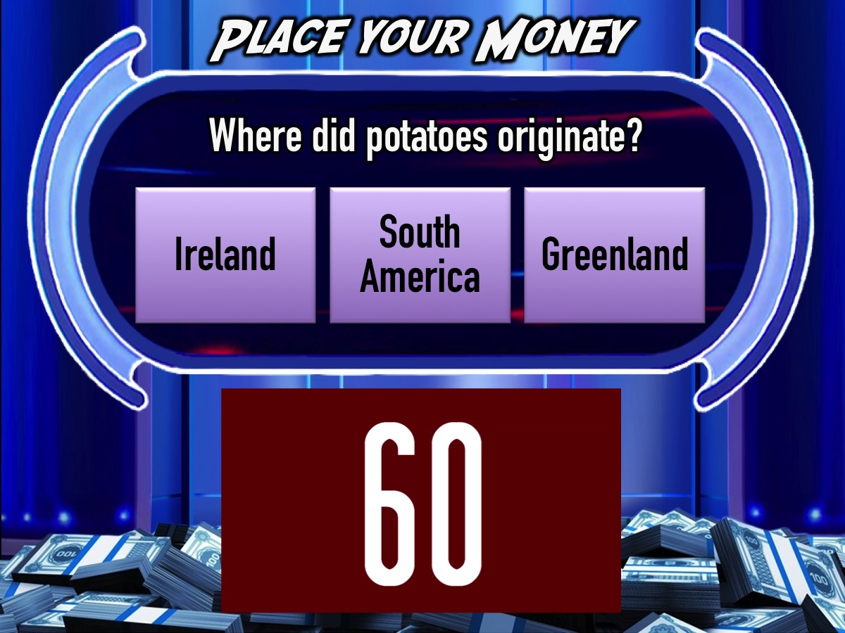
Notes:
You have 60 seconds…
Video: 1 Minute Countdown. Get it on YouTube: https://www.youtube.com/watch?v=gfYQ2ncAerM

Slide 100
Notes:
Question #3. Where did potatoes originate?
(a) Ireland (b) South America (c) Greenland

Slide 101
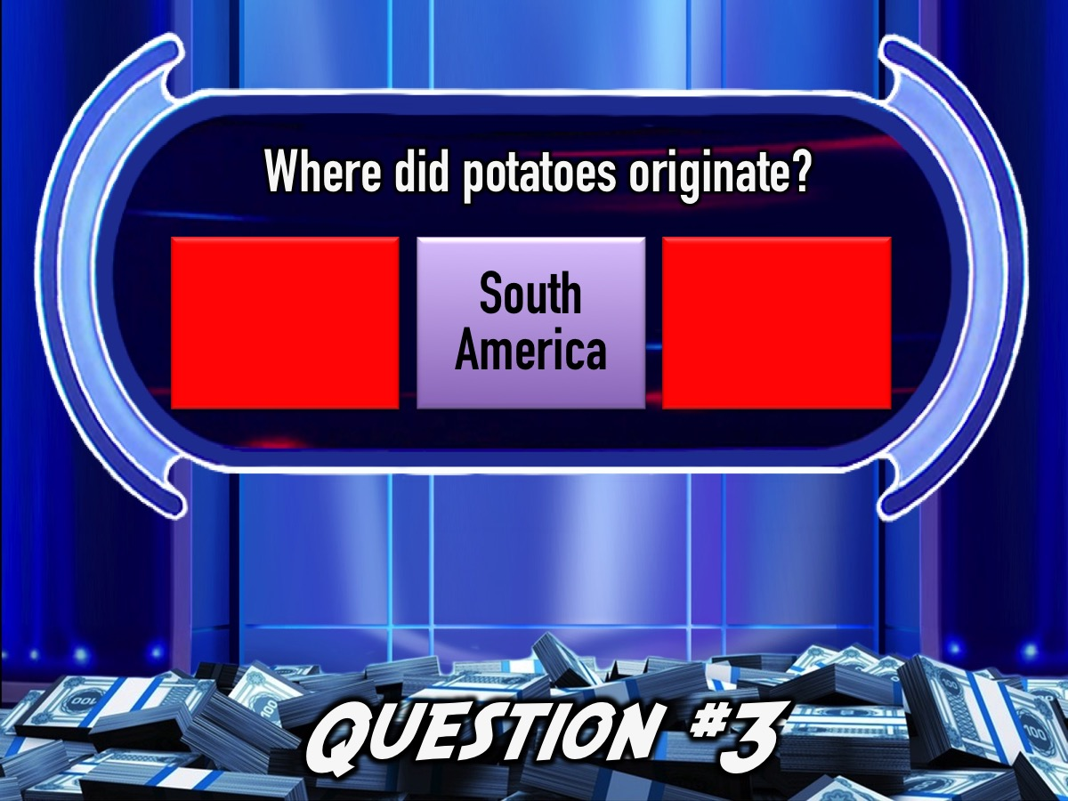
Notes:
Answer: (b) South America. The potato was first cultivated there around 3000-7000 years ago, and it had probably grown wild there for many thousands of years more.

Slide 102
Notes:
Move your money back…

Slide 103
Notes:
Get ready for Question #4

Slide 104

Notes:
Question #4. What is the fastest water animal?
(a) Porpoise (b) Sailfish (c) Flying Fish

Slide 105
Notes:
Question #4. What is the fastest water animal?
(a) Porpoise (b) Sailfish (c) Flying Fish

Slide 106

Notes:
You have 60 seconds…
Video: 1 Minute Countdown. Get it on YouTube: https://www.youtube.com/watch?v=gfYQ2ncAerM

Slide 107
Notes:
Question #4. What is the fastest water animal?
(a) Porpoise (b) Sailfish (c) Flying Fish

Slide 108

Notes:
Answer: (b) The Sailfish is the fastest water animal, reaching speed up to 110 kilometers per hour.

Slide 109
Notes:
Move your money back…

Slide 110
Notes:
Get ready for Question #5

Slide 111

Notes:
Question #5. How many taste buds do you have on your tongue?
(a) About 5000 (b) About 50,000 (c) About 500,000

Slide 112
Notes:
Question #5. How many taste buds do you have on your tongue?
(a) About 5000 (b) About 50,000 (c) About 500,000

Slide 113

Notes:
You have 60 seconds…
Video: 1 Minute Countdown. Get it on YouTube: https://www.youtube.com/watch?v=gfYQ2ncAerM

Slide 114
Notes:
Question #5. How many taste buds do you have on your tongue?
(a) About 5000 (b) About 50,000 (c) About 500,000

Slide 115
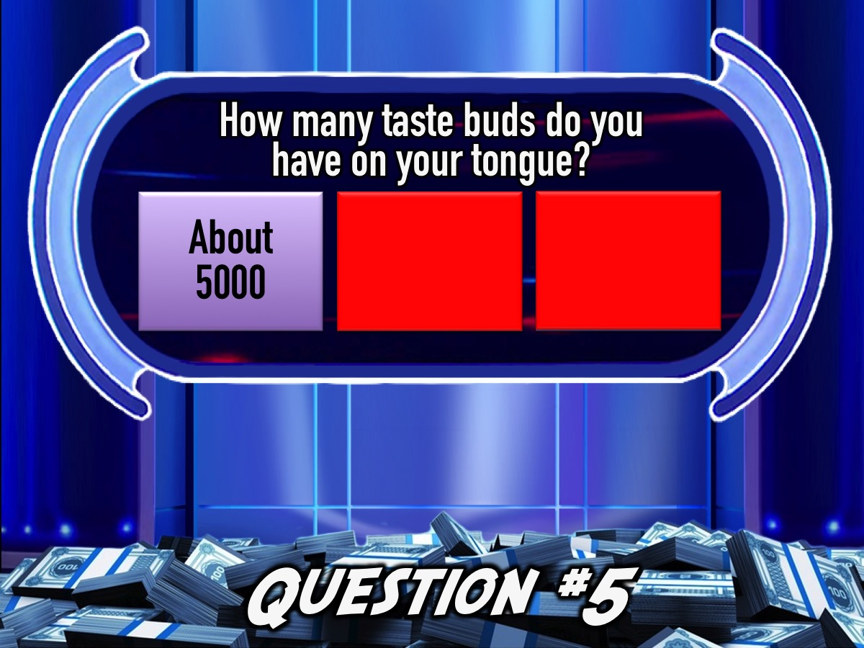
Notes:
Answer: (a) About 5000. Humans have between 2,000 and 8,000 taste buds on their tongues.

Slide 116

Notes:
Team 4 it is your turn to play Million Rand Money Drop!

Slide 117
Notes:
Get ready for Question #1

Slide 118

Notes:
Question #1: What do Oxygen and Hydrogen make?
(a) Gold (b) Water (c) Oil

Slide 119
Notes:
Question #1: What do Oxygen and Hydrogen make?
(a) Gold (b) Water (c) Oil

Slide 120

Notes:
You have 60 seconds…
Video: 1 Minute Countdown. Get it on YouTube: https://www.youtube.com/watch?v=gfYQ2ncAerM

Slide 121
Notes:
Question #1: What do Oxygen and Hydrogen make?
(a) Gold (b) Water (c) Oil

Slide 122

Notes:
Answer: (b) Water

Slide 123
Notes:
Move your money back…

Slide 124
Notes:
Get ready for Question #2

Slide 125

Notes:
Question #2: Where is the Eiffel Tower?
(a) London (b) Paris (c) Barcelona

Slide 126
Notes:
Question #2: Where is the Eiffel Tower?
(a) London (b) Paris (c) Barcelona

Slide 127

Notes:
You have 60 seconds…
Video: 1 Minute Countdown. Get it on YouTube: https://www.youtube.com/watch?v=gfYQ2ncAerM

Slide 128
Notes:
Question #2: Where is the Eiffel Tower?
(a) London (b) Paris (c) Barcelona

Slide 129
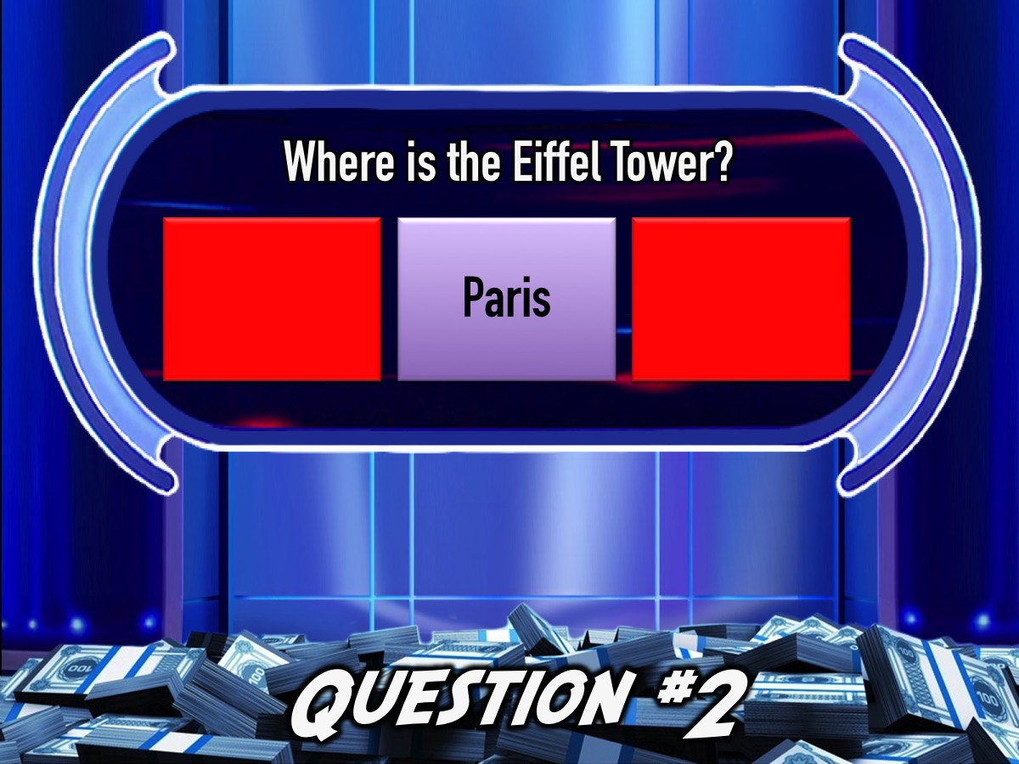
Notes:
Answer: (b) Paris

Slide 130
Notes:
Move your money back…

Slide 131
Notes:
Get ready for Question #3

Slide 132

Notes:
Question #3. The word 'coconut' is from a Portuguese word 'cocos' meaning .....?
(a) Angry Face (b) Weeping Face (c) Grinnning Face

Slide 133

Notes:
Question #3. The word 'coconut' is from a Portuguese word 'cocos' meaning .....?
(a) Angry Face (b) Weeping Face (c) Grinnning Face

Slide 134
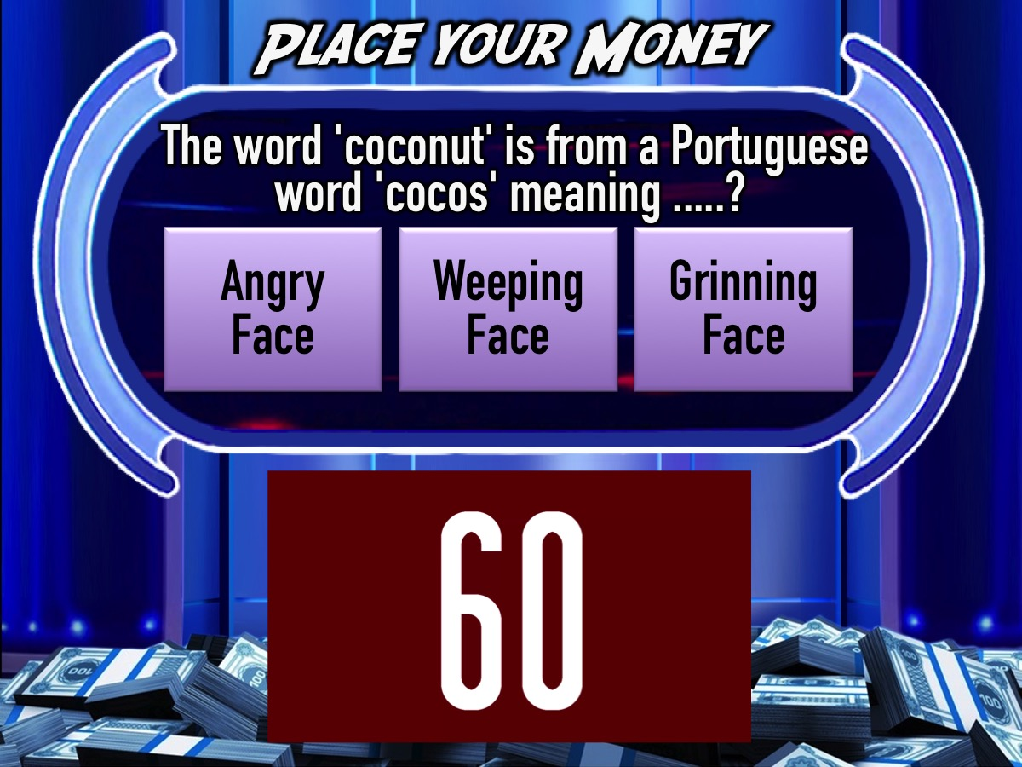
Notes:
You have 60 seconds…
Video: 1 Minute Countdown. Get it on YouTube: https://www.youtube.com/watch?v=gfYQ2ncAerM

Slide 135
Notes:
Question #3. The word 'coconut' is from a Portuguese word 'cocos' meaning .....?
(a) Angry Face (b) Weeping Face (c) Grinnning Face

Slide 136
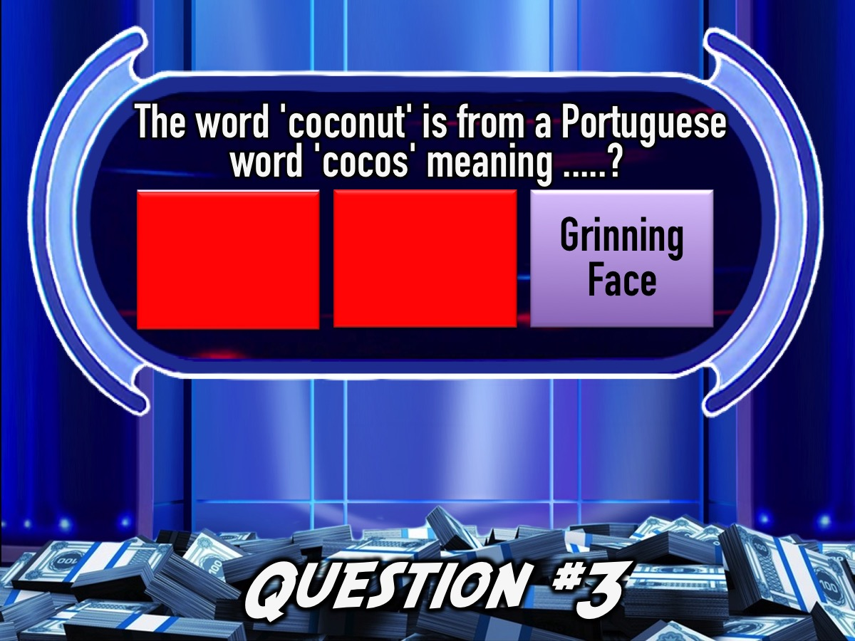
Notes:
Answer: (c) Grinnning Face (from the three holes on the shell that look a bit like a human face).

Slide 137
Notes:
Move your money back…

Slide 138
Notes:
Get ready for Question #4

Slide 139

Notes:
Question #4. What animal lives the longest?
(a) Ocean Quahog (b) Red Sea Urchin (c) Galapagos Tortois

Slide 140
Notes:
Question #4. What animal lives the longest?
(a) Ocean Quahog (b) Red Sea Urchin (c) Galapagos Tortois

Slide 141

Notes:
You have 60 seconds…
Video: 1 Minute Countdown. Get it on YouTube: https://www.youtube.com/watch?v=gfYQ2ncAerM

Slide 142
Notes:
Question #4. What animal lives the longest?
(a) Ocean Quahog (b) Red Sea Urchin (c) Galapagos Tortois

Slide 143

Notes:
Answer: (a) The Ocean Quahog lives up to 400 years versus the Galapagos tortoise that lives only 177 years.

Slide 144
Notes:
Move your money back…

Slide 145
Notes:
Get ready for Question #5

Slide 146

Notes:
Question #5. How many hairs does the average person have on their head?
(a) About 25,000 (b) About 125,000 (c) About 1,125,000

Slide 147
Notes:
Question #5. How many hairs does the average person have on their head?
(a) About 25,000 (b) About 125,000 (c) About 1,125,000

Slide 148

Notes:
You have 60 seconds…
Video: 1 Minute Countdown. Get it on YouTube: https://www.youtube.com/watch?v=gfYQ2ncAerM

Slide 149
Notes:
Question #5. How many hairs does the average person have on their head?
(a) About 25,000 (b) About 125,000 (c) About 1,125,000

Slide 150

Notes:
Answer: (b) Approximately 125,000. It's estimated that we humans average around 100,000 to 150,000 hairs on our head.

Slide 151

Notes:
Team 5 it is your turn to play Million Rand Money Drop!

Slide 152
Notes:
Get ready for Question #1

Slide 153

Notes:
Question #1: Who had a hit with the song: Roar?
(a) Katy Perry (b) Adele (c) Beyonce’

Slide 154
Notes:
Question #1: Who had a hit with the song: Roar?
(a) Katy Perry (b) Adele (c) Beyonce’

Slide 155

Notes:
You have 60 seconds…
Video: 1 Minute Countdown. Get it on YouTube: https://www.youtube.com/watch?v=gfYQ2ncAerM

Slide 156
Notes:
Question #1: Who had a hit with the song: Roar?
(a) Katy Perry (b) Adele (c) Beyonce’

Slide 157

Notes:
Answer: (a) Katy Perry

Slide 158
Notes:
Move your money back…

Slide 159
Notes:
Get ready for Question #2

Slide 160

Notes:
Question #2: Which is the most popular Facebook Game?
(a) Farmville (b) Candy Crush (c) Criminal Case

Slide 161
Notes:
Question #2: Which is the most popular Facebook Game?
(a) Farmville (b) Candy Crush (c) Criminal Case

Slide 162

Notes:
You have 60 seconds…
Video: 1 Minute Countdown. Get it on YouTube: https://www.youtube.com/watch?v=gfYQ2ncAerM

Slide 163
Notes:
Question #2: Which is the most popular Facebook Game?
(a) Farmville (b) Candy Crush (c) Criminal Case

Slide 164

Notes:
Answer: (b) Candy Crush

Slide 165
Notes:
Move your money back…

Slide 166
Notes:
Get ready for Question #3

Slide 167

Notes:
Question #3. A calzone is a type of ..... ?
(a) Potato (b) Peach (c) Pizza

Slide 168
Notes:
Question #3. A calzone is a type of ..... ?
(a) Potato (b) Peach (c) Pizza

Slide 169

Notes:
You have 60 seconds…
Video: 1 Minute Countdown. Get it on YouTube: https://www.youtube.com/watch?v=gfYQ2ncAerM

Slide 170
Notes:
Question #3. A calzone is a type of ..... ?
(a) Potato (b) Peach (c) Pizza

Slide 171

Notes:
Answer: (c) Pizza. A calzone is basically a folded-over pizza (to make a half-moon shape) which is usually filled with pizza toppings like cheese and tomato

Slide 172
Notes:
Move your money back…

Slide 173

Notes:
Get ready for Question #4

Slide 174

Notes:
Question #4. Which of these is the smallest dog?
(a) Dachshund (b) Pomeranian (c) Chihuahua

Slide 175
Notes:
Question #4. Which of these is the smallest dog?
(a) Dachshund (b) Pomeranian (c) Chihuahua

Slide 176

Notes:
You have 60 seconds…
Video: 1 Minute Countdown. Get it on YouTube: https://www.youtube.com/watch?v=gfYQ2ncAerM

Slide 177
Notes:
Question #4. Which of these is the smallest dog?
(a) Dachshund (b) Pomeranian (c) Chihuahua

Slide 178

Notes:
Answer: (c) The smallest dog breed is the Chihuhua, who cannot weigh more than six pounds according to the American Kennel Club.

Slide 179
Notes:
Move your money back…

Slide 180
Notes:
Get ready for Question #5

Slide 181

Notes:
Question #5. How many functions does the liver perform to keep you fit and healthy?
(a) Around 5 (b) Around 50 (c) Around 500

Slide 182
Notes:
Question #5. How many functions does the liver perform to keep you fit and healthy?
(a) Around 5 (b) Around 50 (c) Around 500

Slide 183

Notes:
You have 60 seconds…
Video: 1 Minute Countdown. Get it on YouTube: https://www.youtube.com/watch?v=gfYQ2ncAerM

Slide 184
Notes:
Question #5. How many functions does the liver perform to keep you fit and healthy?
(a) Around 5 (b) Around 50 (c) Around 500

Slide 185

Notes:
Answer: (c) Around 500 functions. Two of the most important functions of your liver are to break down food, and also to remove waste products from your blood.

Slide 186

Notes:
Small Groups. Here are the questions for our small group time: (1) What did you love/hate about the game show? (2) Where in life are you been tempted to gamble? (3) What do you think God thinks about gambling? “Money wrongly gotten will disappear bit by bit; money earned little by little will grow and grow.” (Pr 13:11). (4) Is your eternal destiny secure or is it a gamble? “To those who believed in his name, he gave the right to become children of God.” (John 1:12)

Slide 187

Notes:
Refreshments: It is time for Hot Chocolate and biscuits.

Slide 188
Notes:
Next Week is Dragon’s Den Night.

