Slide 1

Notes:
Overview of the Night:
The group is divided into three equal sized groups. Each group has a table in front of them and chairs behind the table where the members of the group sit in between challenges. A number of team challenges will be staged where groups have to compete against each other to win points and the team with the most points at the end of the night wins a prize for the team. One person has been allocated to be a Mole in each group and it is the Mole’s responsibility to stop their team from winning the challenges or the prize at the end of the night. The mole in the winning team does not win a prize. The Mole in the team who finishes in last place will win a prize for his role in sabotaging the success of the team. After the challenges – before the final scores are announced, each team member will write down who they think the mole is in their team. The Moles whose identities are not guessed by a majority of the team members will win a prize.
Pre-Event Videos: For this event we used trailers from upcoming movies as pre-event videos.

Slide 2

Notes:
The Welcome: Welcome to The Mole Night – are there any newcomers?

Slide 3

Notes:
The Host: My name is Shaun Pearce, and I am your reality show host this evening.

Slide 4
Notes:
Video: The Mole Intro. Edited from a video on YouTube: https://www.youtube.com/watch?v=6ZLZSkteEaw

Slide 5
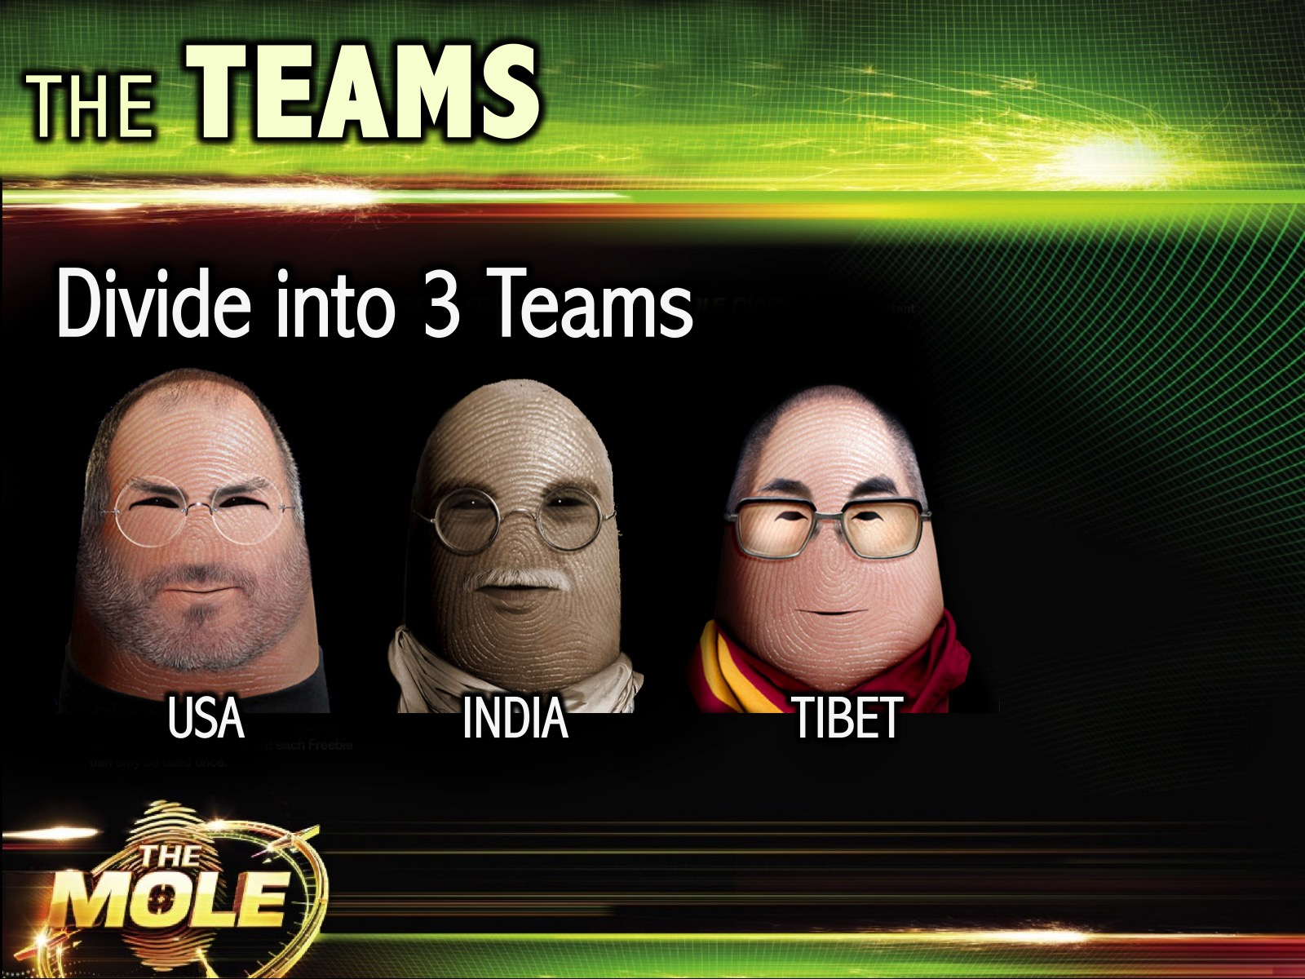
Notes:
The Teams: The big group is going to divide into three equal sized smaller groups for our Mole night. The team names are USA (with the Steve Jobs icon), INDIA (with the Gandhi icon) and Tibet (with the Dalai Lama icon).

Slide 6
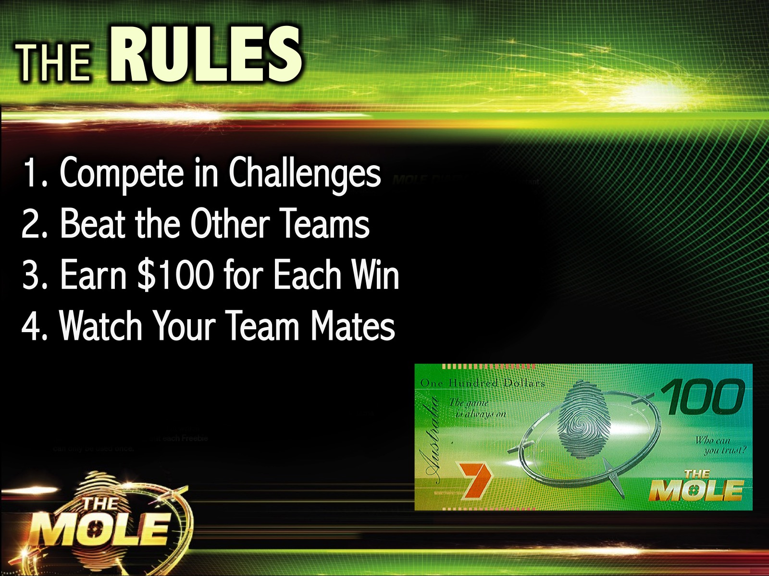
Notes:
The Rules: (1) You will compete in challenges against each other team. (2) Your goal is to beat the other teams. (3) You will earn $100 for each win. (4) Along the way be sure to watch your team mates closely!

Slide 7
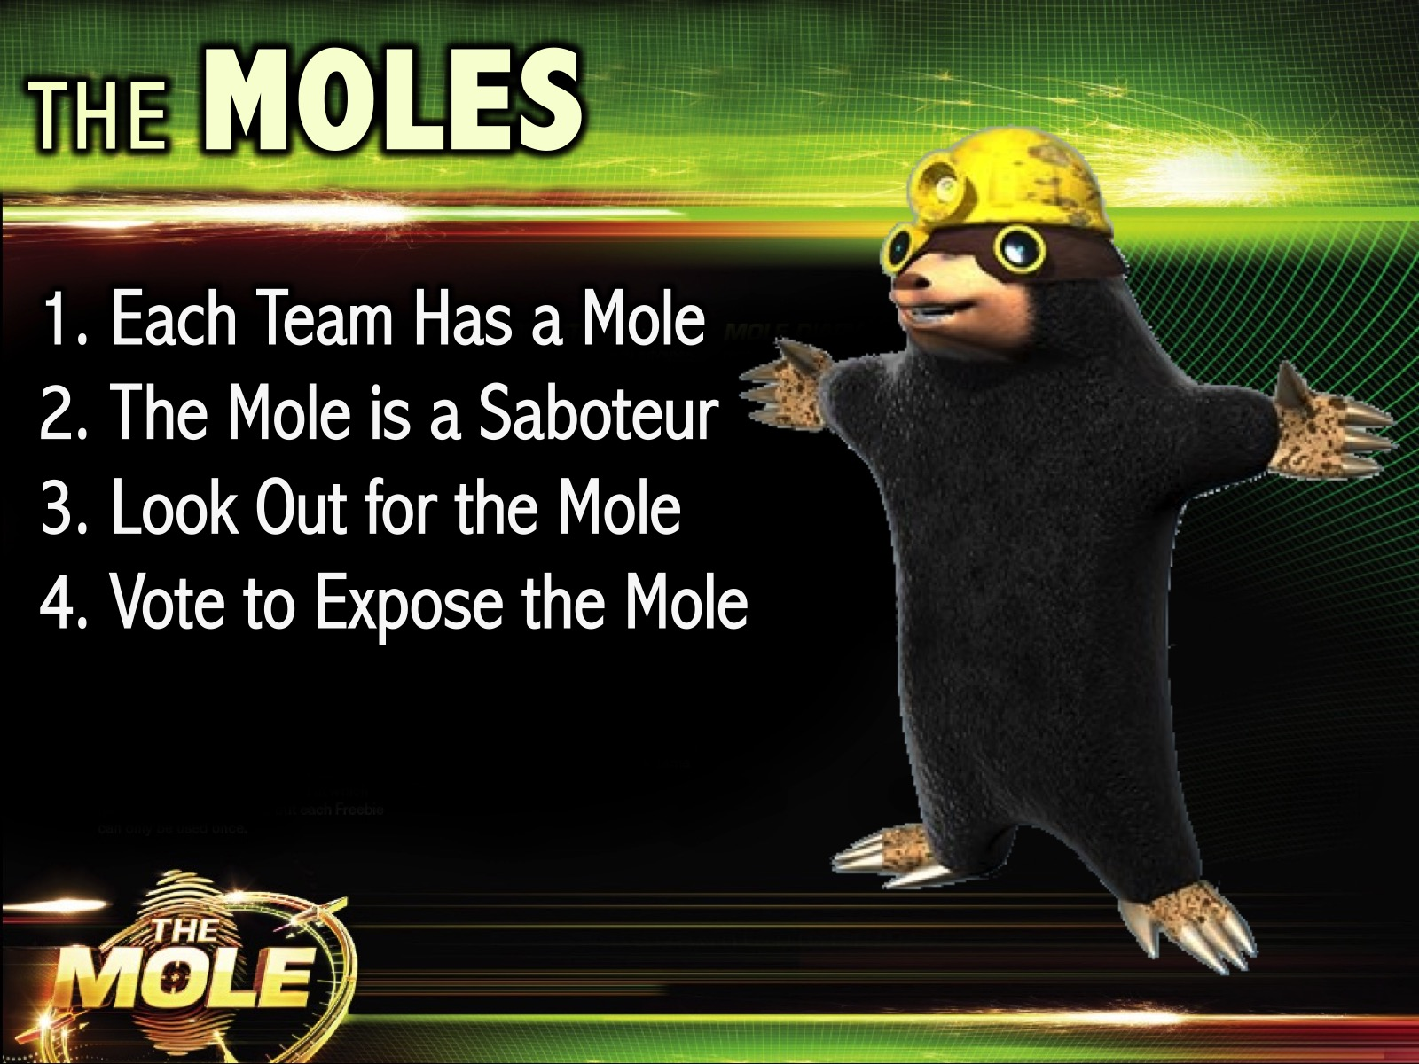
Notes:
The Moles: (1) Each team has a mole in the team. (2) The Mole is a Saboteur (their role is to sabotage your efforts and stop you winning). (3) Look out for the mole as you compete. (4) At the end of the night you will vote to expose the mole in your team. Here is a video of the mole in action…

Slide 8
Notes:
Video: The Mole Australia NEW Promo. The Mole in Action. Get it on YouTube: https://www.youtube.com/watch?v=TKPoCt31Yu8

Slide 9
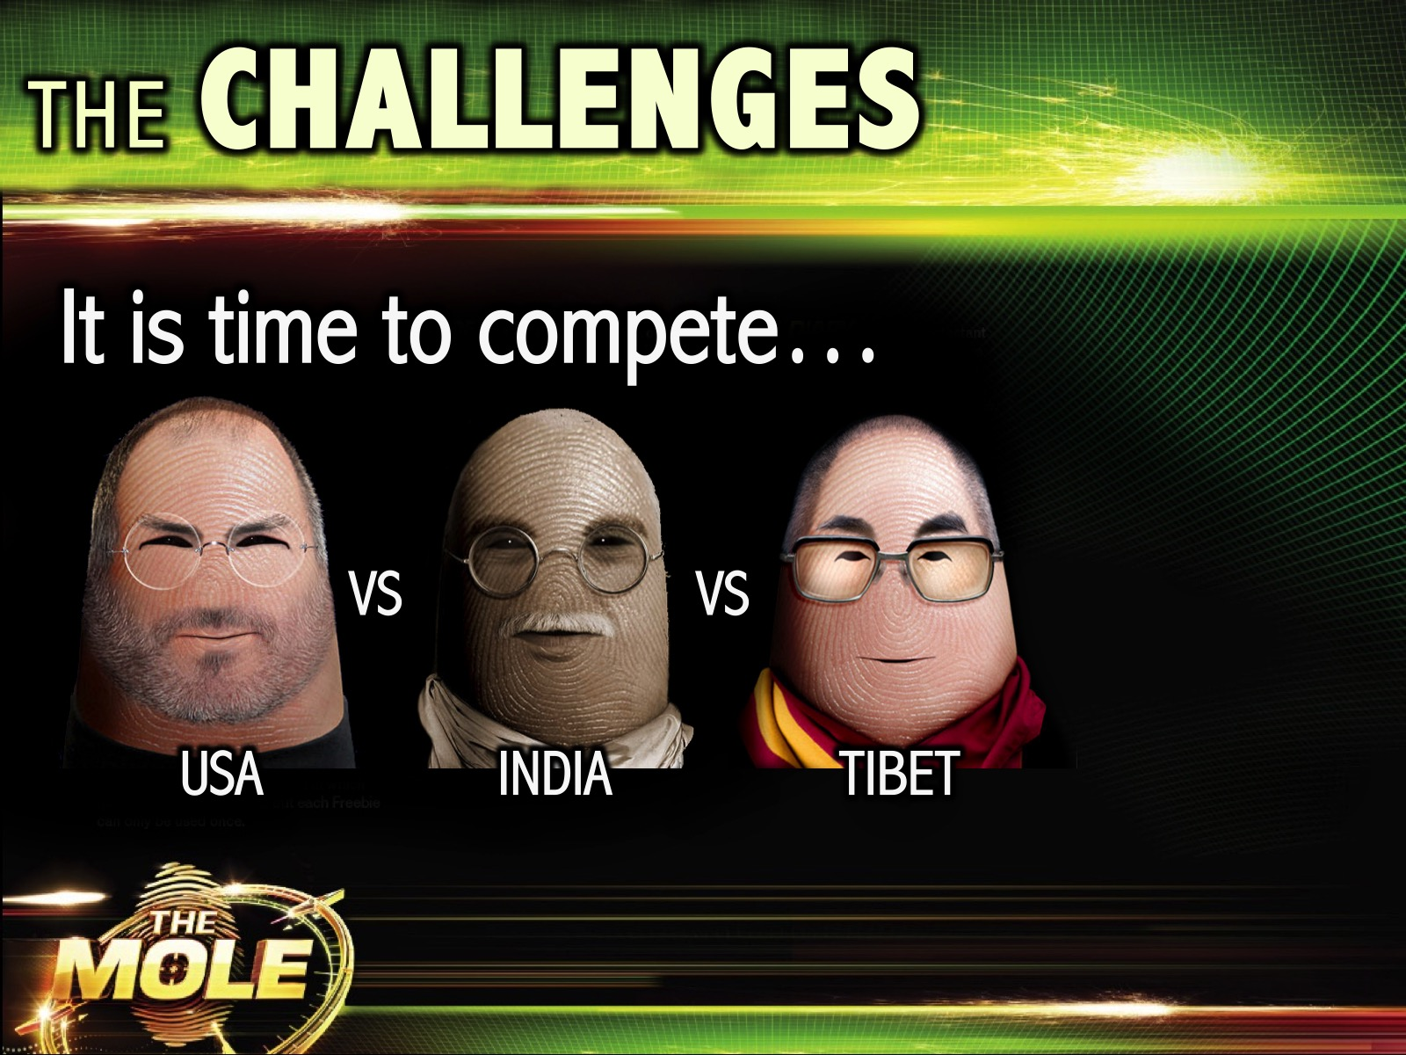
Notes:
The Challenges: It is time for the three groups to compete against each other. There are five different challenges with prizes for the winners!

Slide 10
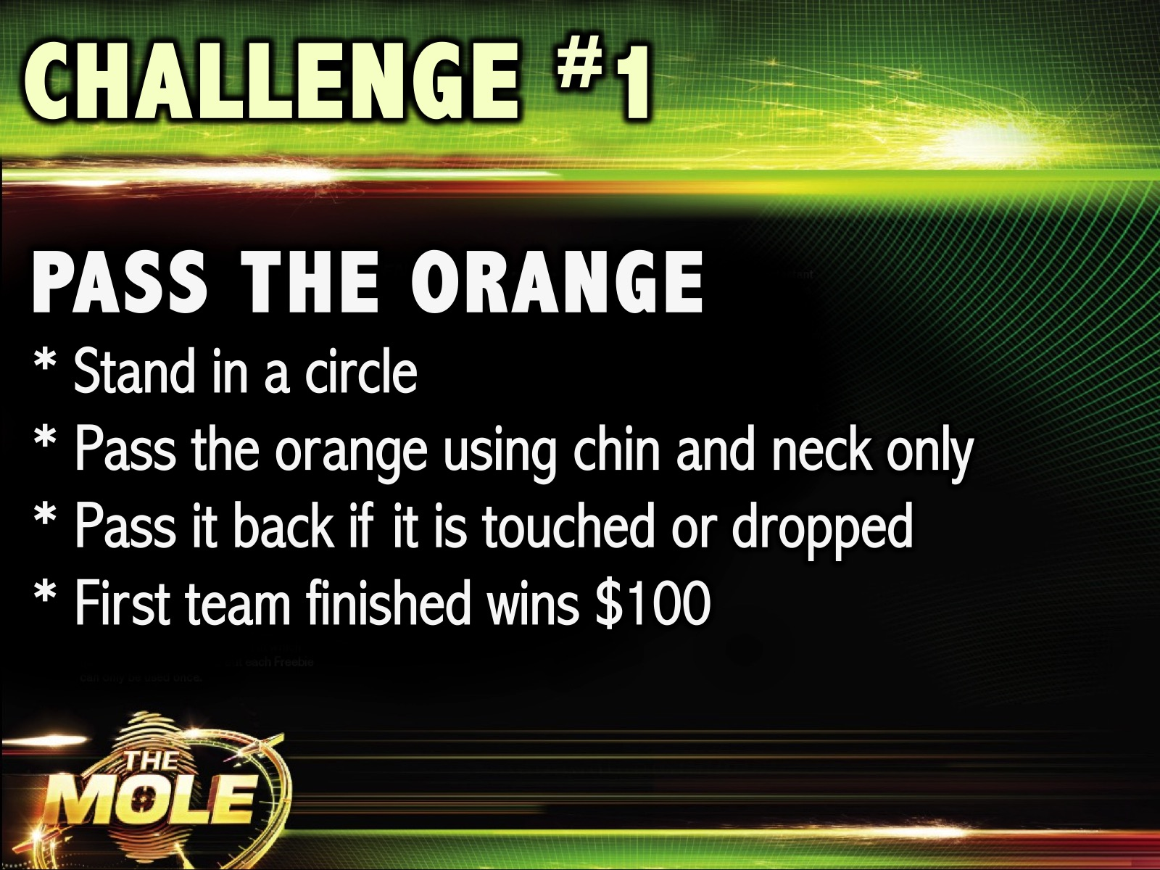
Notes:
Challenge #1: Pass the Orange. Each team stands in a line and has to transfer an orange from the first person to the last person using only their necks and their chins. If the orange falls or if someone touches the orange the orange is returned to the person who is passing it to you. The first team to finish wins $100.

Slide 11
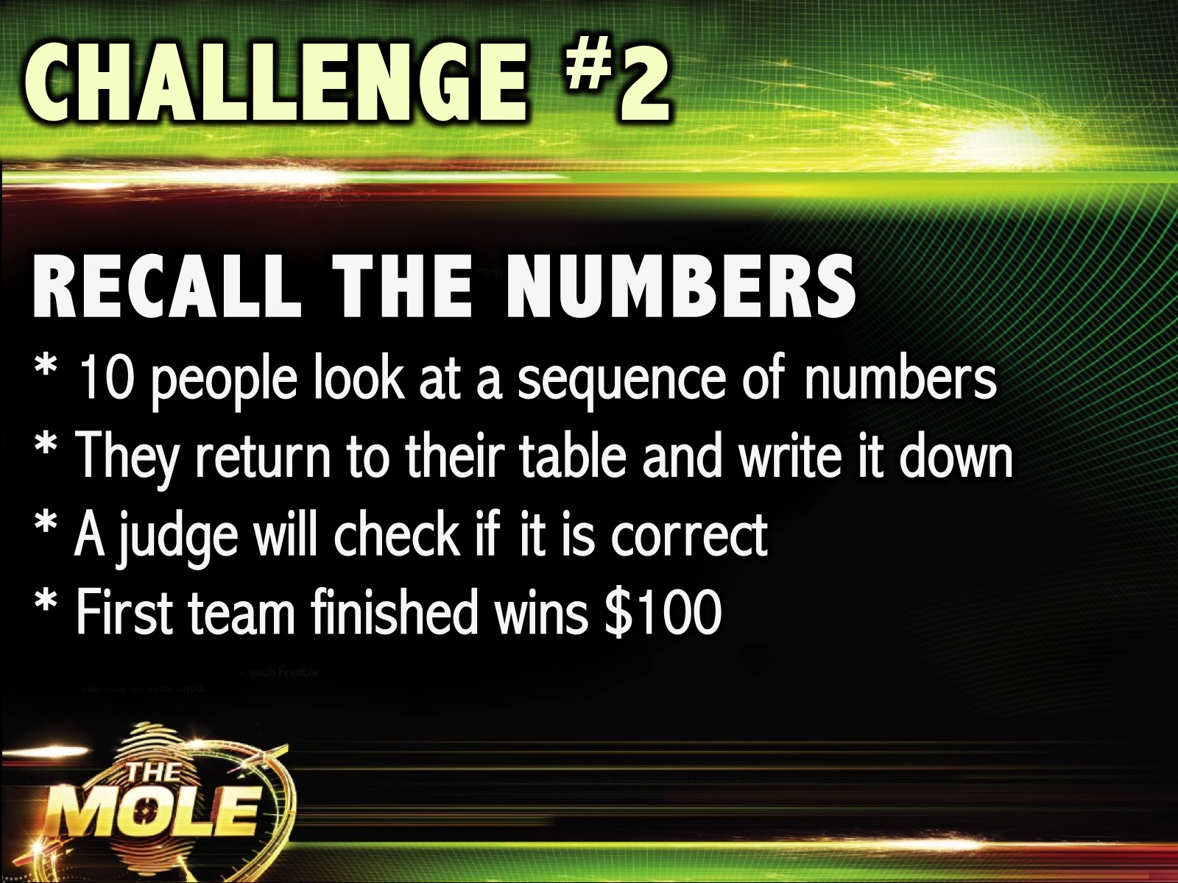
Notes:
Challenge #2: Recall the Numbers. 10 people (from each team) look at a sequence of numbers. They return to their table and have to recall it and write it down. A judge will check if it is correct. First team finished wins $100.

Slide 12
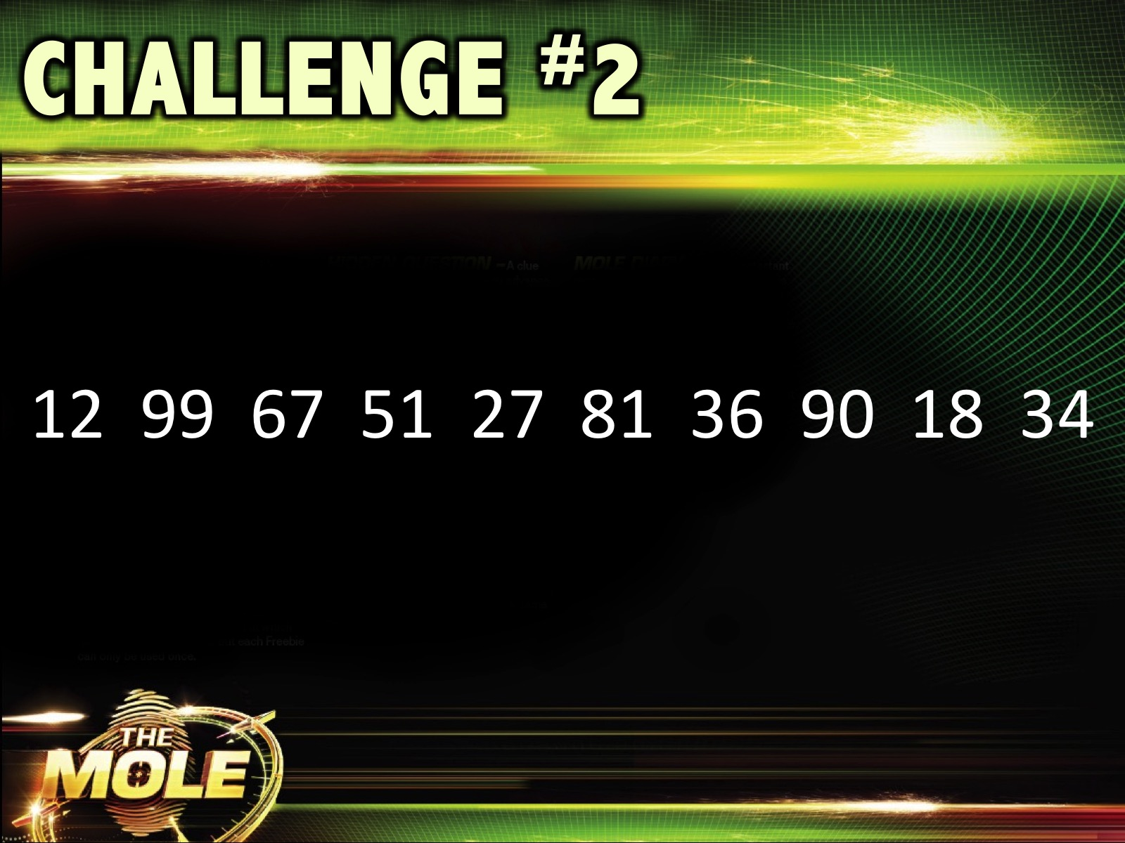
Notes:
Challenge #2: Recall the Numbers. The SOLUTION!

Slide 13
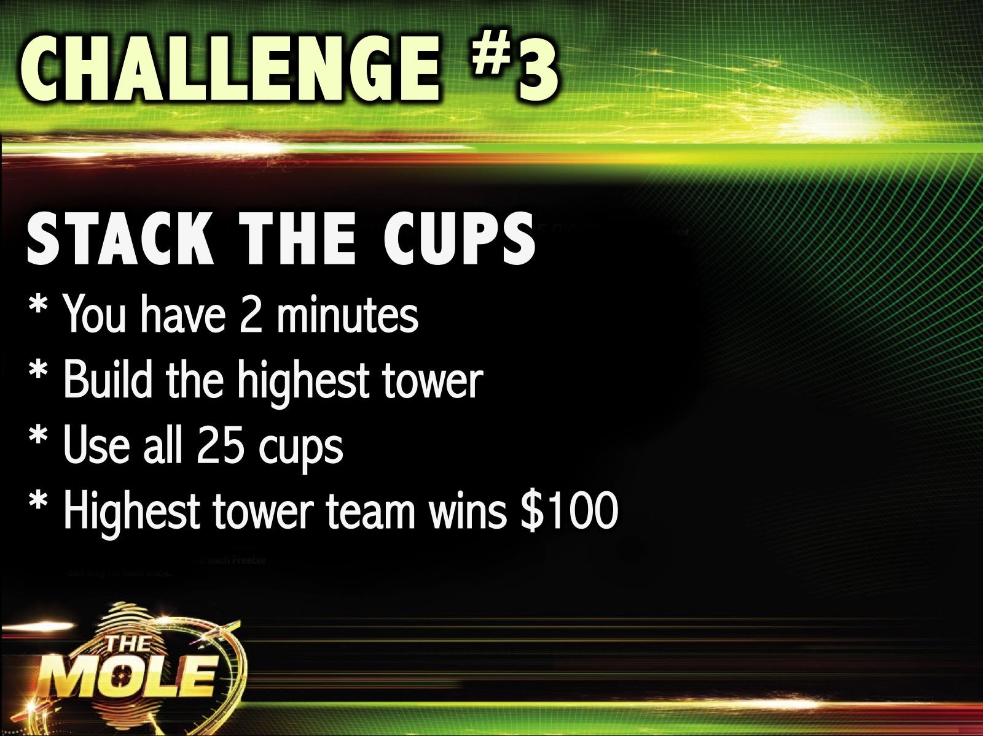
Notes:
Challenge #3: Stack the Cups. Each team is given a pack of 25 polystyrene cups and has 2 minutes to build the highest tower. The team with the highest tower wins $100.

Slide 14
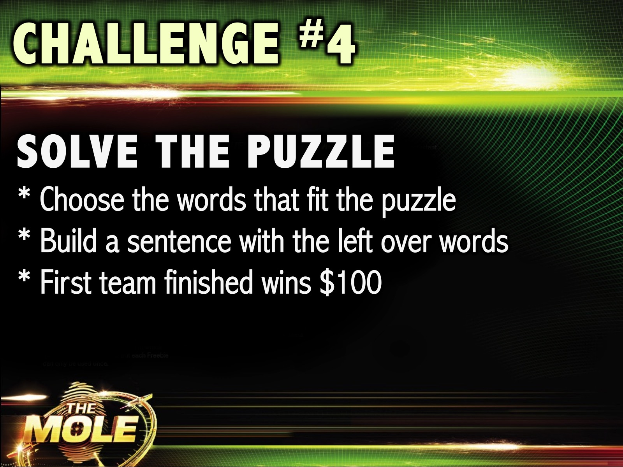
Notes:
Challenge #4: Solve the Puzzle. Each team has to solve a word puzzle (they are given the framework and words to use) – they have to make a sentence with the leftover words. The first team finished with the correct words filled in and the correct sentence wins $100.

Slide 15
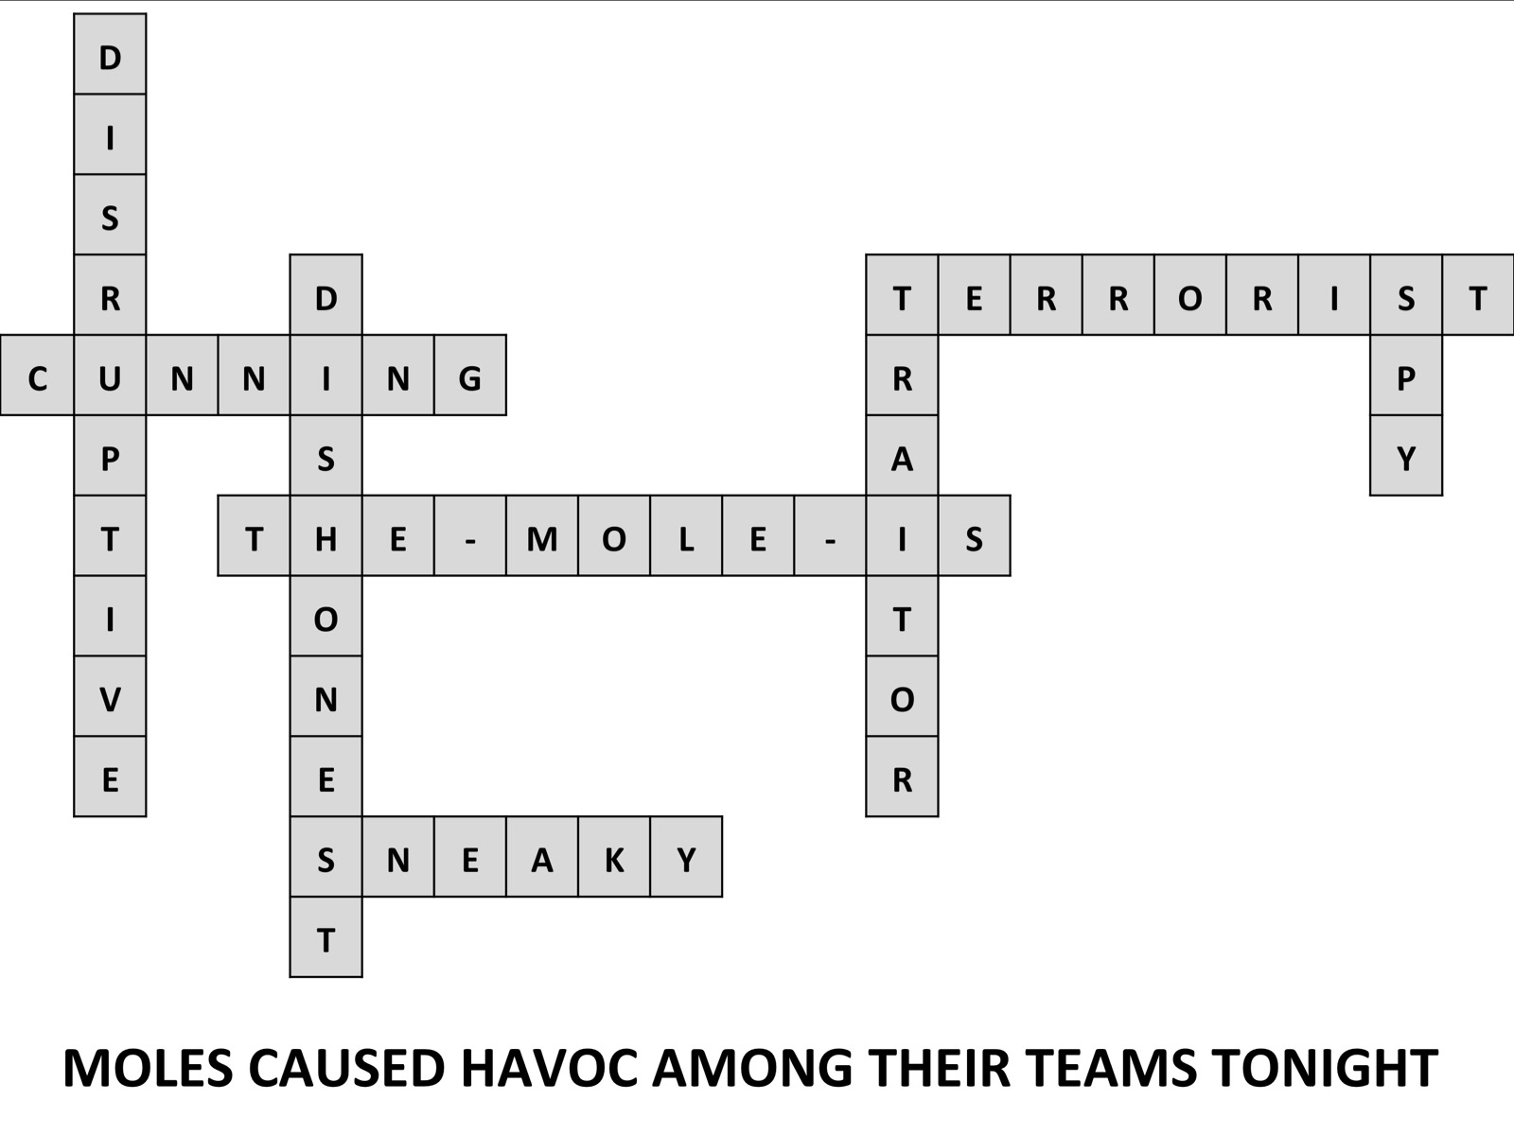
Notes:
Challenge #4: Solve the Puzzle. Each team has to solve a word puzzle (they are given the framework and words to use) – they have to make a sentence with the leftover words. The first team finished with the correct words filled in and the correct sentence wins $100.

Slide 16
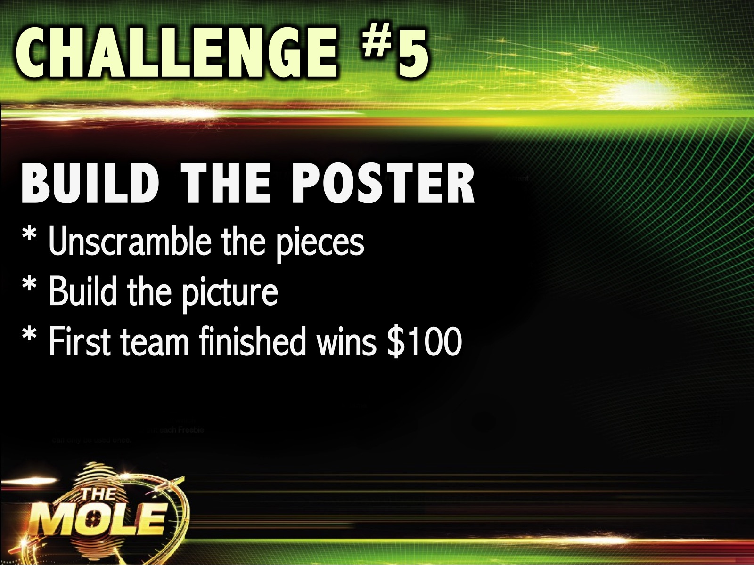
Notes:
Challenge #5: Build the Poster. Each team is given a printed poster that has been cut into strips and they have to build the puzzle the quickest. The first team finished wins $100.

Slide 17
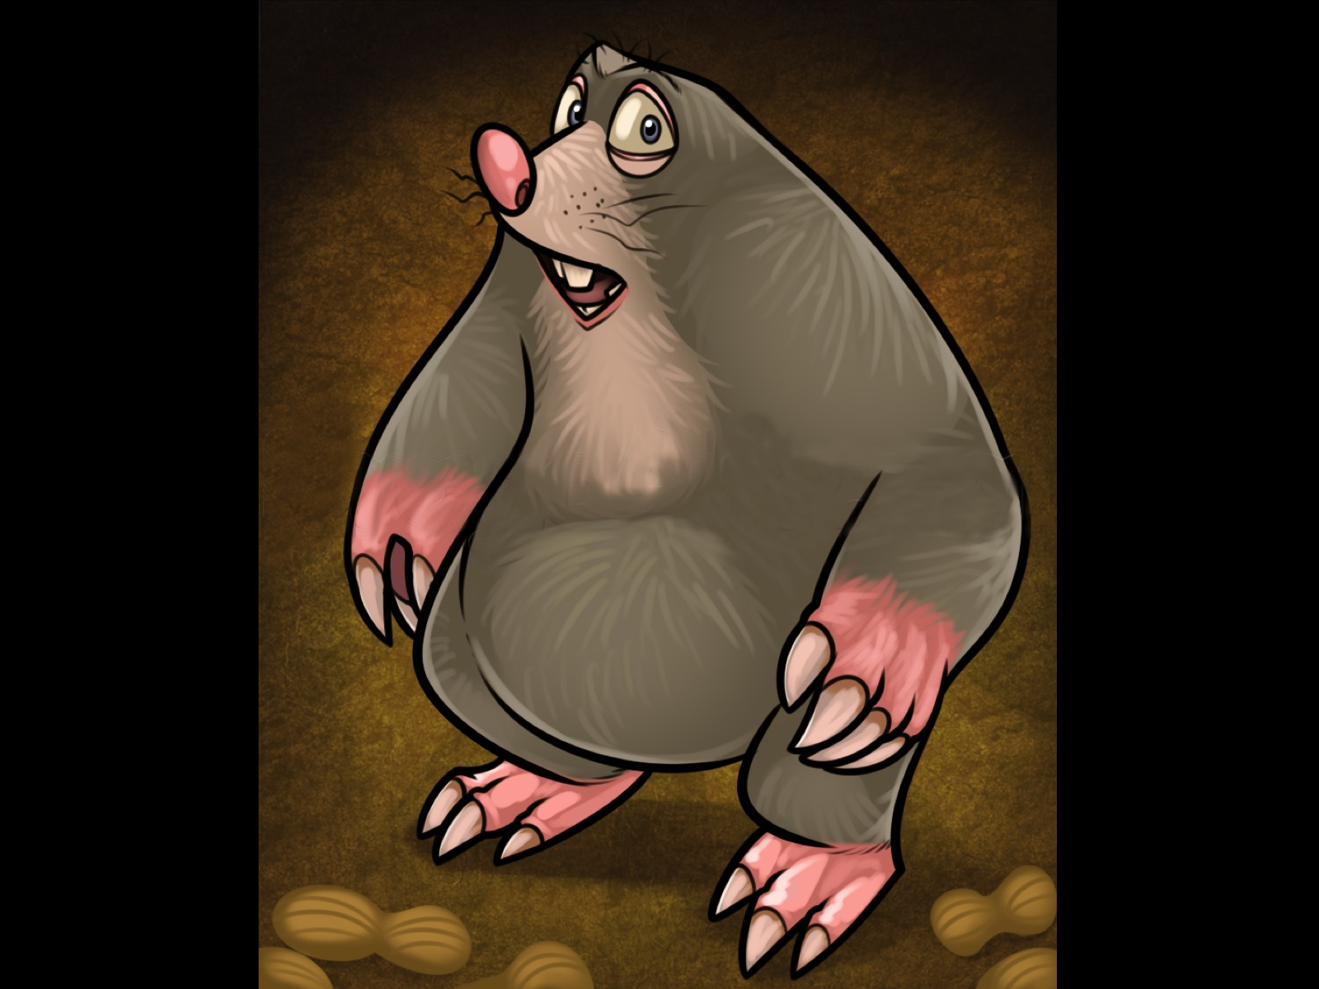
Notes:
Challenge #5: Build the Poster. SOLUTION

Slide 18
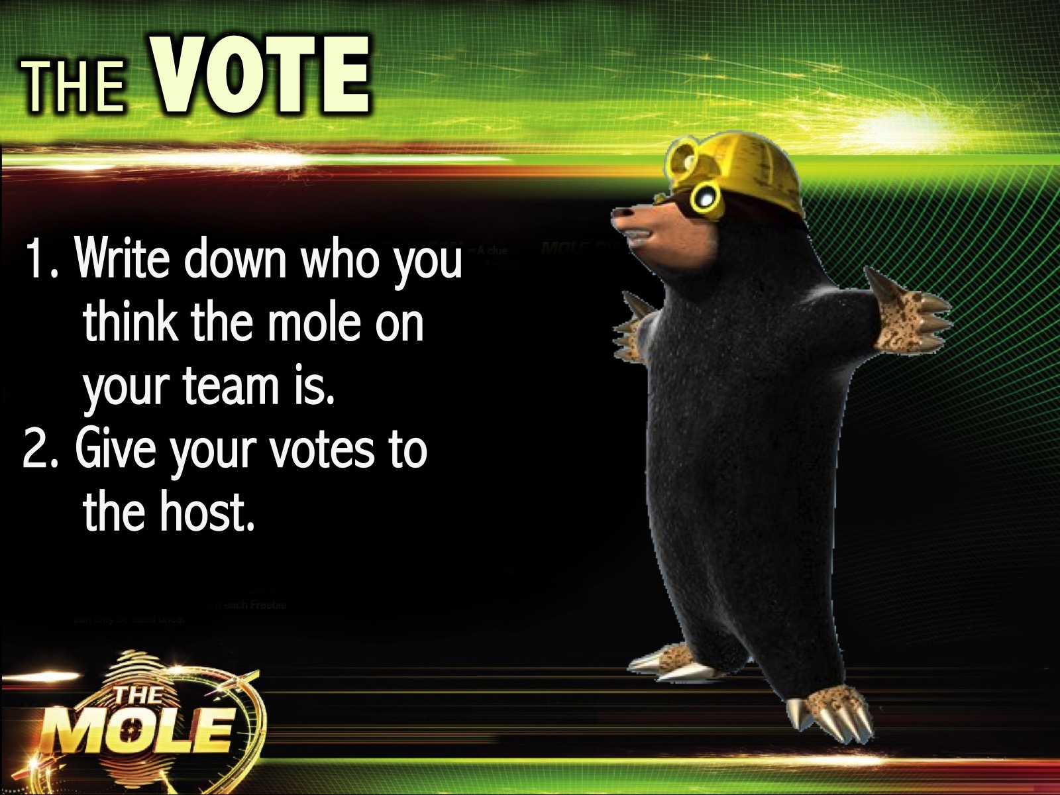
Notes:
The Vote: Before we announce the winning team you are each going to vote in your team to try and expose the mole. Each team member will write down who they think the mole is on their team. The Moles whose identities are not guessed by a majority of the team members will win a prize. So you are trying to stop the mole winning tonight!
During the voting the sound track played is from The Mole series. Get it on YouTube at: https://www.youtube.com/watch?v=jLchbBgcK_c

Slide 19
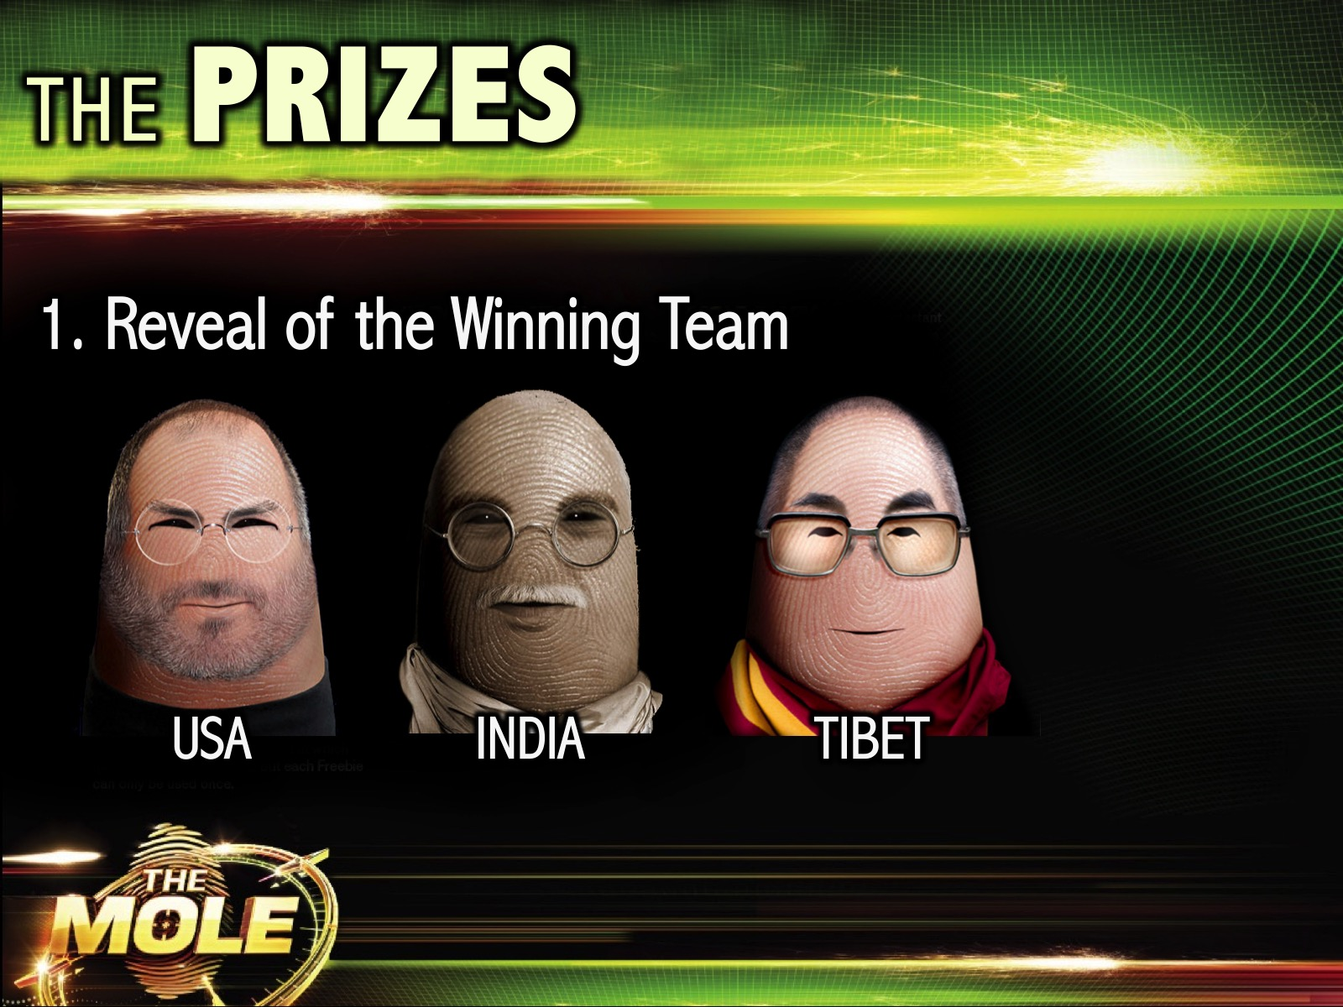
Notes:
The Prizes: (1) Reveal of the Winning Team. The winning team gets a prize. The music to be played before the reveal is from this clip on YouTube: https://www.youtube.com/watch?v=uJy8KTiMkbI

Slide 20

Notes:
(2) Reveal of the Three Moles. This is to reveal the moles hidden on each of the three teams. The moles step forward and stand in front of their groups when revealed.

Slide 21
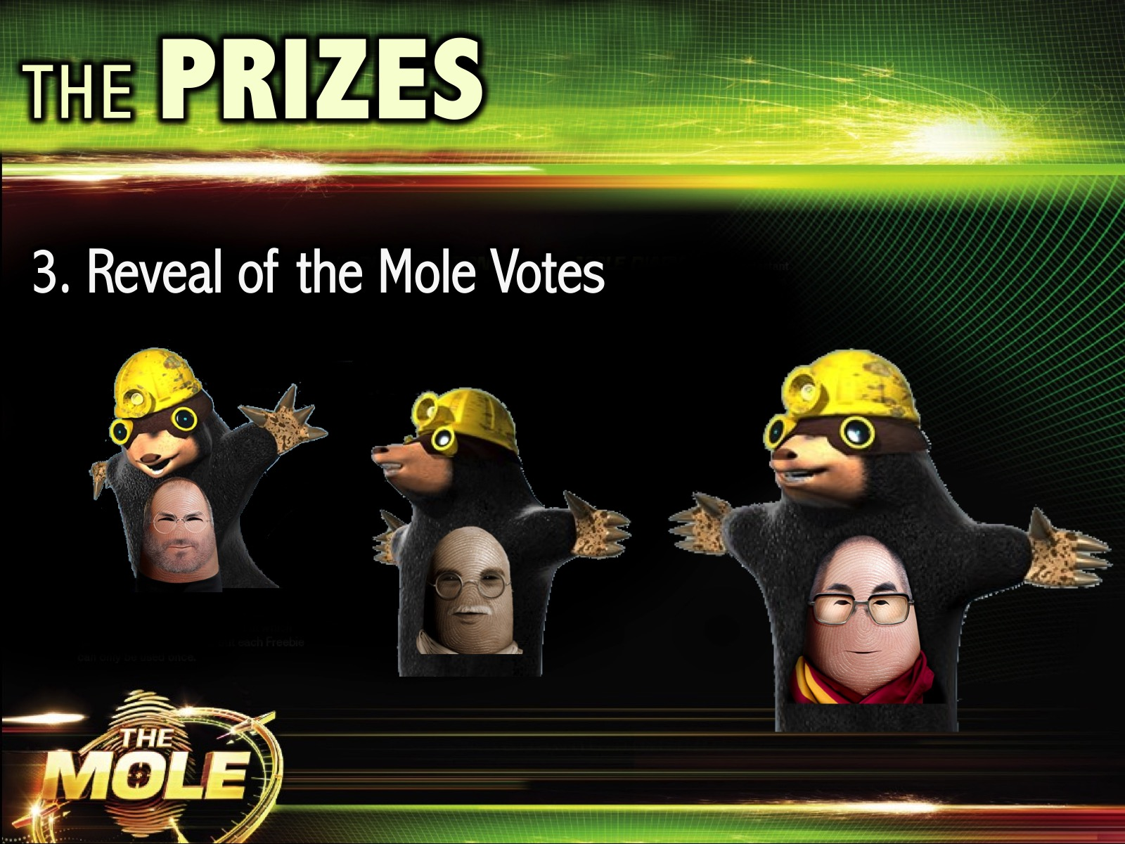
Notes:
(3) Reveal of the Mole Votes. This will reveal which of the Moles were able to keep their identity secret. Those that were not detected will receive a prize. The music to be played before the reveal is from this clip on YouTube: https://www.youtube.com/watch?v=uJy8KTiMkbI

Slide 22
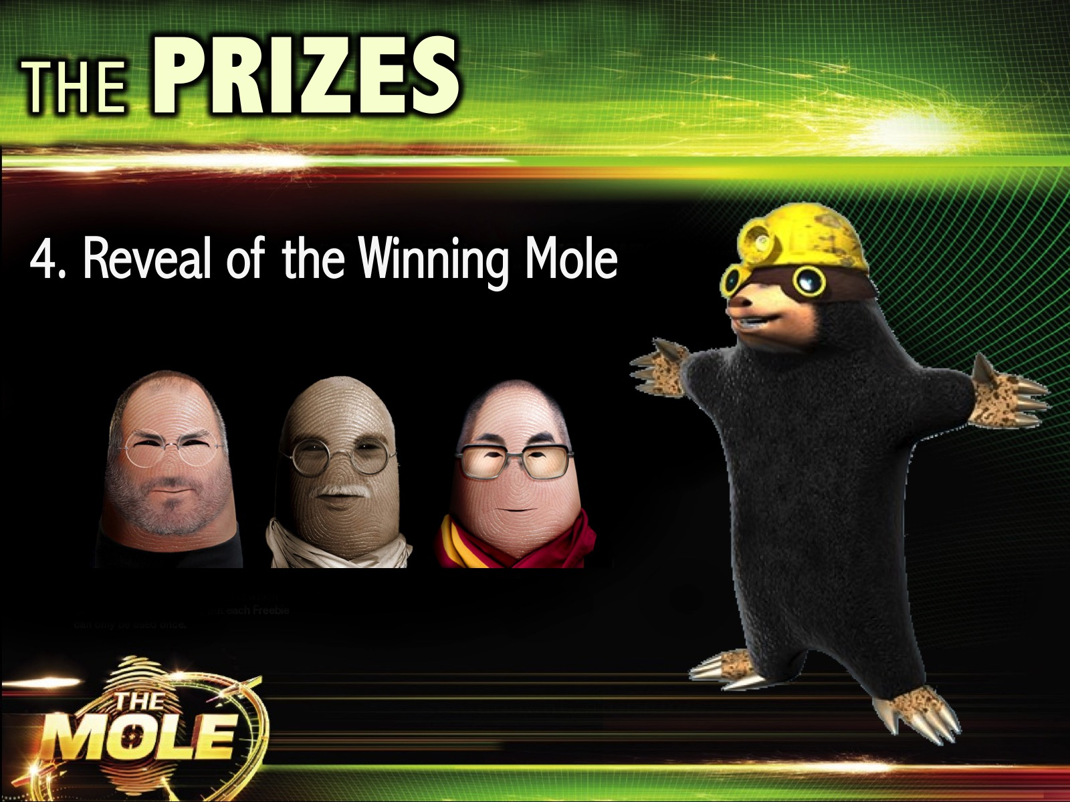
Notes:
(4) Reveal of the Winning Mole. The mole in the team that comes in last place wins the grand prize. The music to be played before the reveal is from this clip on YouTube: https://www.youtube.com/watch?v=uJy8KTiMkbI

Slide 23
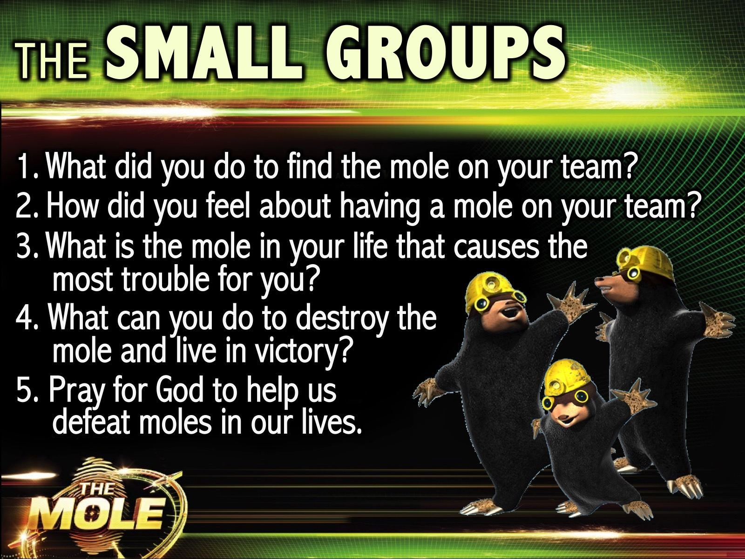
Notes:
The Small Groups: Here are the questions for our small group time: (1) What did you do to find the mole on your team? (2) How did you feel about having a mole on your team? (3) What is the mole in your life that causes the most trouble for you? (4) What can you do to destroy the mole and live in victory? (5) Pray for God to help us defeat moles in our moles.

Slide 24

Notes:
The Announcements: Next Friday night is Project Runway Night.
* Dress up in props or different accessories in groups, take group pics in different posses
* Draw a creative design as a group
* Design outfits in groups: girls design a guy's outfit, guys design girls outfit, Pimp up or make different items look great: PJs, Karate Outfit, overalls, School uniform, etc model on a runway - use Feathers, Beads, pieces of cloth, etc (Use recyclable material to create an outfit)
Awards for different items - most confident walk, most creative idea, etc

Slide 25
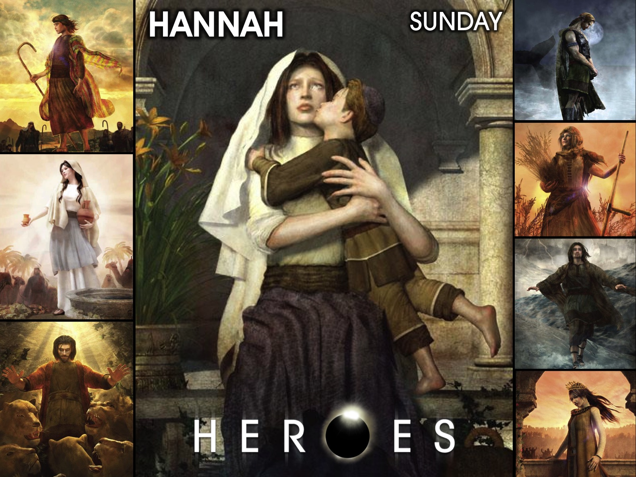
Notes:
On Sunday morning it is the Heroes Series and we will be looking at the life of Hannah.

Slide 26
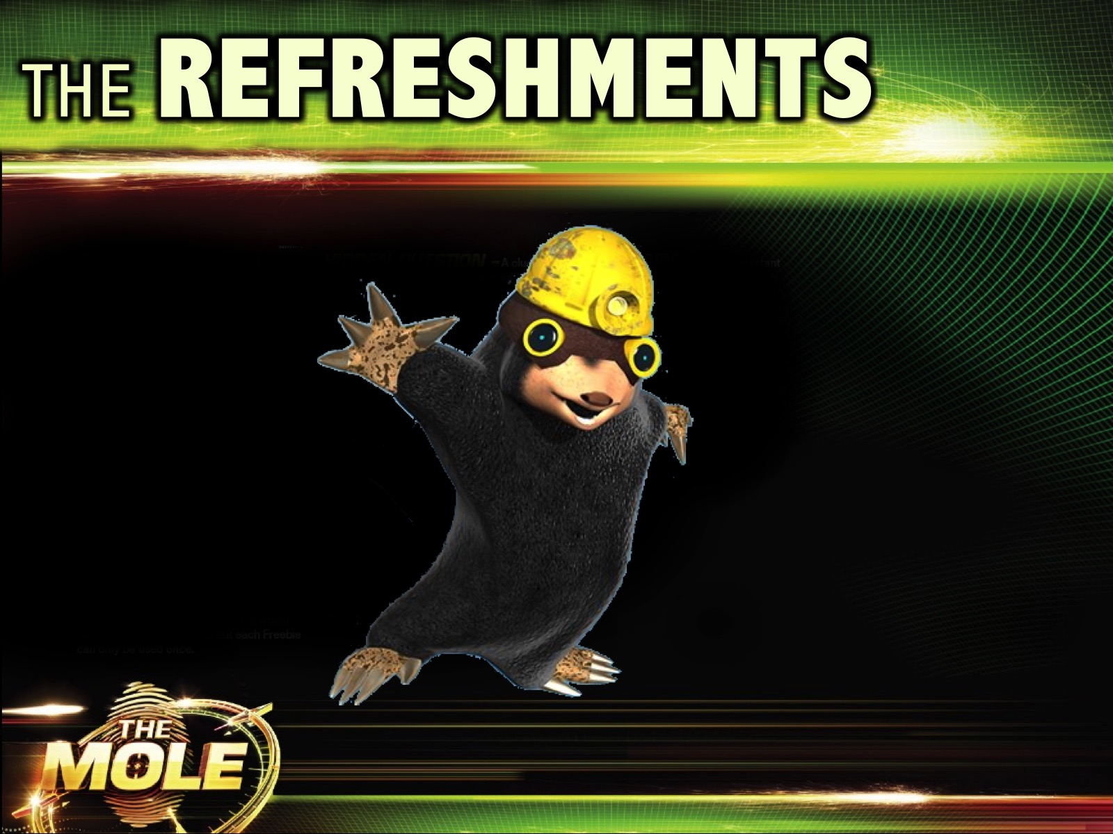
Notes:
The Refreshments.

