Slide 1
Notes:
Monopoly Millionaire Night
Time: 7:40-7:50 - Welcome, Announcements and Instructions
Setting the stage:
The Tokens (1 teen from each group will be dressed up in a blazer and top hats of different colours).
There is a banker who should be dressed up aw well. He will be given a runner to hand out the money.
And maybe we need a jailer who will fetch those who are meant to spend a round in jail.
We need two big dice - constructed out of boxes Houses printed onto paper and stuck onto cardboard triangles.
To start:
6 teams choose a property out of an envelope - maybe one or two more expensive and the others cheaper.
They get given the money they need to start playing - 2,200.
To make the game more exciting we thought to put more "Go to jail" cards. So there will be more action on the board. We stop play when the 40 min is up and the team with the most money wins. We want the game to have South African properties on the board. The prizes could be a slab of chocolate for the winning team.
To end the night we will do Hot chocolate and biscuits.
UPDATE: To help with the flow of the game we found that it would be best to make the board each time a team gets or buys a property - write the colour of the team in black koki on the colour bar on the top of the board on the ground. This will help organisers know who owns a property - whether it is availableto buy, or whether rent must be paid.

Slide 2
Notes:
Pre-Event Video: Travie McCoy Billionaire ft. Bruno Mars (LIVE ACOUSTIC). Get it on YouTube at: https://www.youtube.com/watch?v=Ryt2SuHYhW0

Slide 3
Notes:
Welcome to all our regulars and if there are any newcomers – please come up onto stage so we can welcome you!

Slide 4
Notes:
So tonight is Monopoly Millionaire Night

Slide 5
Notes:
Video: Monopoly Streets Trailer. Get it on YouTube at: https://www.youtube.com/watch?v=KEVaOGb8Du8

Slide 6
Notes:
Teams: It is time to get into 6 equal-sized teams.

Slide 7
Notes:
Cash: Each team starts with 2200.
1x500 = 500
10x100 = 1000
10x50 = 500
10x20 = 200

Slide 8
Notes:
Choose a Player: Each team must choose 1 person to be their token on the board and they must get a hat to wear.

Slide 9
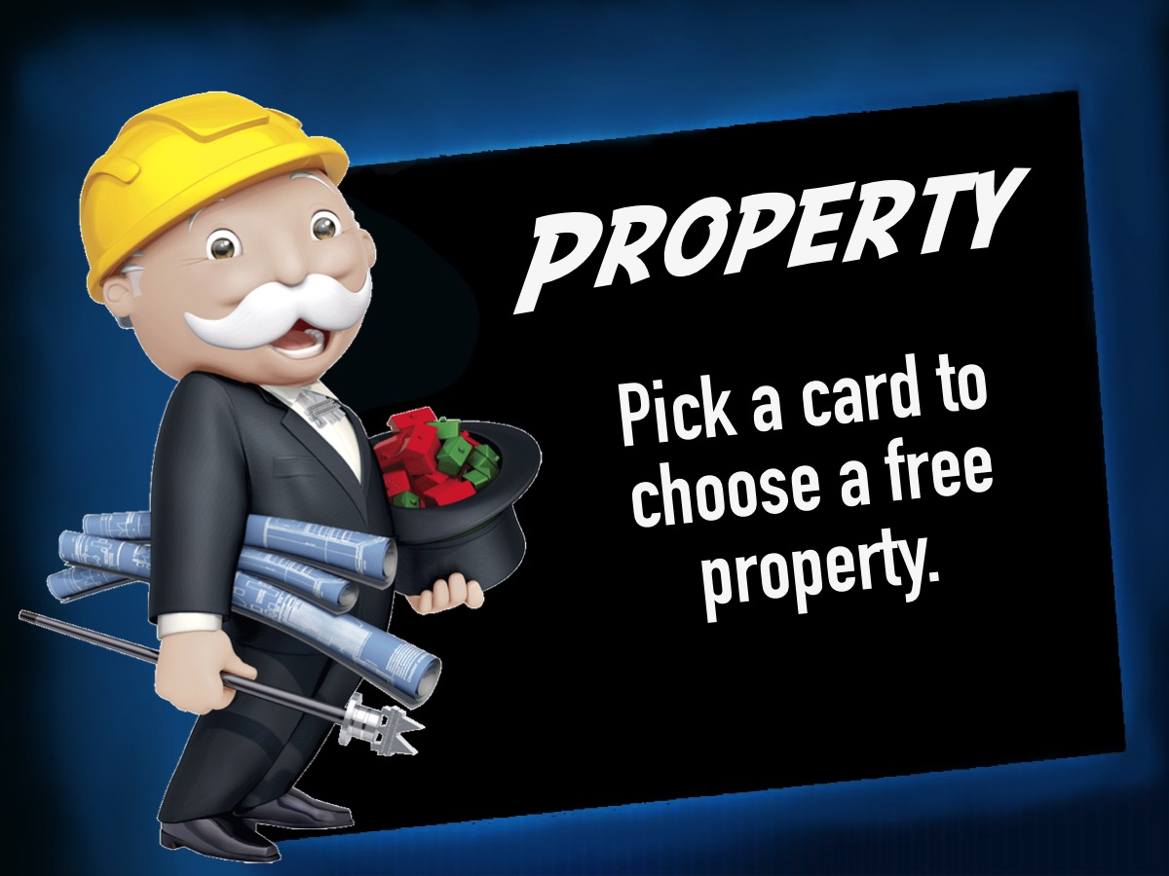
Notes:
Property: Each team will pick a card to choose a free property.

Slide 10
Notes:
Team Up: It is time to get into 6 equal-sized teams.

Slide 11
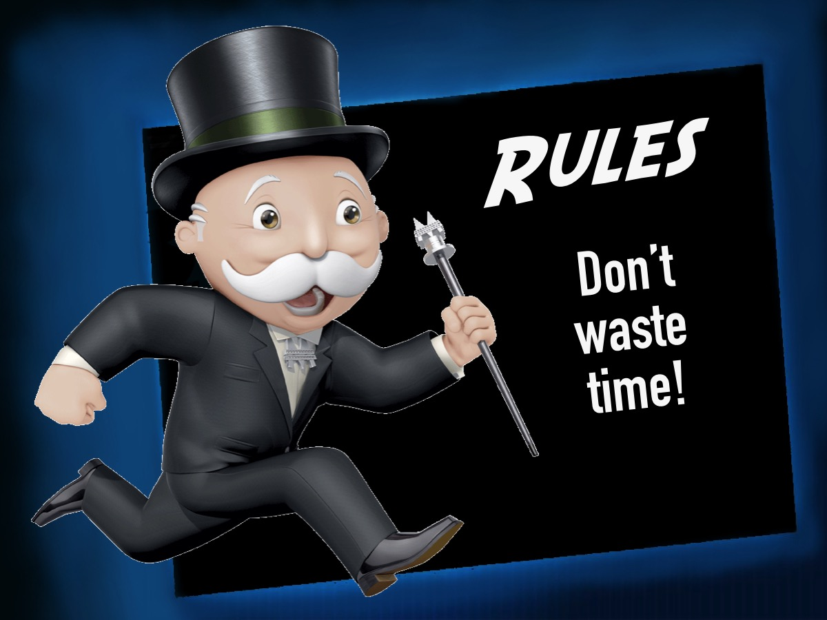
Notes:
Team Up: It is time to get into 6 equal-sized teams.

Slide 12
Notes:
Rules: On your next turn to get out of jail you must throw a double, use a Get Out Of Jail Card or pay R50.

Slide 13
Notes:
Rules: Respect the banker: He handles the cash. He also has a runner who assists him.

Slide 14
Notes:
Let’s play: Monopoly Millionaire!

Slide 15
Notes:
Prizes: And the winning team is…

Slide 16
Notes:
Small Groups. Here are the questions for our small group time: (1) How bad did you want to win the game? (2) How is life like the game of Monopoly? (3) How does God want you to live? What does the Lord require of you? To do justice, love kindness, and walk humbly with your God? (Micah 6:8). (4) What one thing can you do to live in a way that pleases God? (5) Pray for each other to live in a way that pleases God.

Slide 17
Notes:
Refreshments: It is time for Hot Chocolate and biscuits.

Slide 18
Notes:
Next Week is Suburban Millionaire Night

