Slide 2
Notes:
The Continuum: Get youth to stand on a continuum as they answer this question of how satisfied they are and also how close they want to get to God: (1) How satisfied are you with your relationship with God? (1 is unsatisfied and 10 is fully satisfied).

Slide 3
Notes:
(2) How close are you to God?

Slide 4
Notes:
(3) How close do you want to get to God?

Slide 5
Notes:
(4) How close does the devil want you to get to God?

Slide 6
Notes:
(5) How close does Jesus want you to get to Father God?

Slide 7
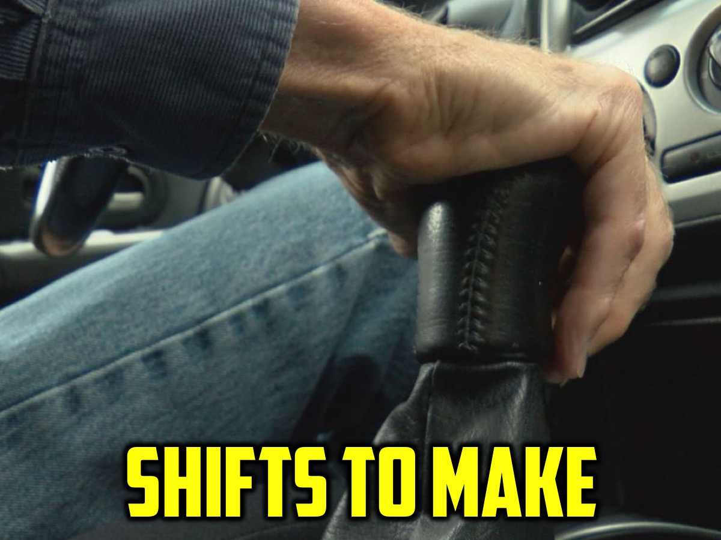
Notes:
Challenge:
In the coming weeks we are going to explore 6 shifts that need to take place for us to experience more of God in our lives:
1. Living for God: From Inside to Outside
2. Living with God: From There to Here
3. Engaging the Word: From Head to Heart
4. Engaging with Others: From Closed to Open
5. Loving like God: From Full to Empty
6. Loving the Movement: From Next to Now

Slide 8
Notes:
Shift 1: From Inside to Outside
Do you live in a box? Many of us live in a small box called the Kingdom of Me. It’s a place where we are fully in charge and control everything that happens. It feels safe and secure and gives us the illusion of protection. We convince ourselves that as long as we stay in the box everything will be fine. Jesus wants us to live a life of more and so He calls us to live outside of the box. There is no life in the Kingdom of Me – we have to enter God’s Kingdom to receive lie.
We cannot simply ask God to help us with our own lives – we have to die to our lives and begin living God’s life.
Matthew 10:39 – Whoever finds their life will lose it, and whoever loses their life for my sake will find it.
Leaving the box is losing your life for Jesus sake and it is the only way to come out of the box and find real life. We really want to bring God into the box and have Him fix it up for us – but this will never satisfy us as it is just trying to control Him. We have to move our thinking from inside the box to outside the box and the only we we can do that is to be fully consumed by Love himself. Intimate relationship with the King is the abundant life Jesus talks about. Leaving the box is the only way we can foster this relationship. God is and has everything we need.
The Gift of Freedom
Trusting God enough to get out of the box of our own kingdom and live in the wide open space of God’s kingdom, brings us the gift of freedom. All our striving to provide for and protect ourselves is actually based in Fear – fear rules in the Kingdom of Me. We are worried we will loose what we have worked so hard to acquire – money, power, relationship, control. We must be willing to abandon our own kingdoms so that there will be only one kingdom under one King and that His will, will be done on earth (in our lives) as it is in Heaven.
Instead of consuming God to meet our own needs in the box, we leave the box and become consumed by Him. His thoughts become our thoughts and we are able to demonstrate His love for others through us. To leave the box we must die to the idea of being in charge. The key to this is being willing to submit, over and over again until we let go of every piece of the Kingdom of me we are holding.
We find it difficult to submit because, when we try to do it we discover exactly where we are drawing our identity from in the box. Affirmation that comes from our ability to do things – gifts, talents, strengths, skills, training, learning etc – that gives us more of a sense of worth and significance than simply knowing we are loved by God will keep us living in the box. We must allow Christ to continually remind us that apart from Him we are nothing, but with Him we are everything.
Surrender to Love
Practically, leaving the box, means living in Gods Kingdom and that means surrendering our lives. We think of surrender as defeat, as being crushed by a powerful foe, and so we live in fear and resist surrender. Fear is driven by our self-reliance – I feel fear and anxiety when I am not in control. The antidote to fear is faith, and faith means being fully grounded in the reality that there is very little that I actually control.
God is King! If I believe that I have nothing to fear – I can surrender, not in defeat, but n faith! This kind of surrender feels more like falling in love – its risky but its exhilarating and ultimately the only way to find joy. This requires us to trust – When we don’t trust we go picking through the garbage heap to try and provide and fend for ourselves. We forget that in God’s kingdom there is more than enough to go around. God keeps calling us, with love and tenderness, back out of our little kingdoms, and into His where there is always plenty.
As we surrender we move from wanting our own lives to wanting God’s life, to simply wanting God. We realise that if we have God we have everything we need.
Shift in Action
One of the core actions that strengthens this daily decision to get out of the box, and builds deep intimacy with God is the simple action of saying to God “I’m Sorry” when we make choices that hurt others or God himself. When we honestly confess that we are not trusting God or that we went our own way instead of His, intimacy is restored. He knows what you did before you tell Him, but He wants us to trust him enough to believe He’s really got your back so that you never think of hiding anything from Him.
Romans 8 38 – 39 (Nothing can separate us from His love).
Taking time for a bit of brief examination and honest conversation with God helps us see the ways in which we are living in the box. Regular confession is like checking our GPS and seeing where we have gotten off track.
Saying you are sorry builds trust through conversation.
Small Group Questions:
1. Where are you living now in your relationship with God?
2. In the next week, what practical steps can you take to live outside the box?
Challenge 1:
Jesus wants us to live a life of more and so He calls us to live outside the box. There is no life inside the box. We have to enter God's Kingdom to receive life. Leaving the box is losing your life for Jesus sake and is the only way to find real life. Instead of consuming God to meet our own needs in the box, we must leave the box and become consumed by Him.
Challenge 2:
Leaving the box means living in God's Kingdom and that means surrendering our lives. We think of surrender as defeat, so we live in fear and resist surrender. Fear is driven by our self-reliance. We feel fear and anxiety when we are not in control. The antidote to fear is faith, and faith means being fully grounded in the reality that there is very little that I actually control. God is King! If I believe I have nothing to fear, I can surrender, not in defeat but in faith. This kind of surrender feels more like falling in love - it's risky but it's exhilarating and ultimately the only way to find joy!

Slide 9
Notes:
Question: In the next week, what practical steps can you take to live outside the box?

Slide 10
Notes:
Shift 2: From There to Here (Me to We) – Be Still and Know
Leaving your box can be scary. And finding God can be even more of a challenge. Where is God? Is he up in heaven? Is he on standby to rush to help us like an armed response guy?
The Bible says God is closer than a brother (Proverbs 18:24); he is with us (Matthew 28:20) and even more: God is inside us! He wants to fill us up with more of himself! To help experience this as a relating we have to take make a Shift: The Shift from Me to We.
We often say: I am going to do this, or I am going to go here, or I have this homework to do, or I have a difficult challenge to face. Maybe we even say: I have to read the Bible, go to church, pray, tell other about Jesus, etc. We need to start using We instead of Me: We are going to school today, We are going to love someone today, We are going to face this challenge together.
We stop asking God to be with us, or to help us with something, but remind ourselves that God is already with us by including him in whatever we do and engage in a conversation with him.
God won’t force himself on us – he waits for us to give him permission to fill us.
God wants to completely consume us so his thoughts are our thoughts, so his desires are our desires.
We must tear down any barriers we have erected between us and God by inviting God to fully invade our lives.
The secret is to “Be Still and Know” (Psalm 46:10). We should regularly quieten ourselves down and simply know that God is with us and that he loves us. Find quiet moments in the day to remind yourself that God is with you and ask him to fill you and then live you know aware that he is with you and that you do things together – a shift from Me to We.
As we slow down and are still with God, we spend time in His presence and we ask ourselves: Where is God right now? Is he close or far away? If he seems far off, we invite God to show us if there are any barriers that have been erected between us and Him and ask him to remove the barriers.
He is closer than a brother – we don’t need to ask him to travel from heaven to get to us – we need to be aware he is inside us and wants to live life in and through us!
Small Group Questions:
1. What stops you from taking time to stop and just be with God?
2. What can you do this week to be still and know that God is with you?
Challenge:
Each day, find time to be still, even if it is only for five minutes. Remember that God is here with you, not out there. Pay attention to when you think “me” (or “I”) and mentally replace it with “we.”
Reflect on this verse: My heart has heard you say: “Come and talk with me.” And my heart responds: “Lord, I am coming.” (Psalm 27:8, NLT)

Slide 11
Notes:
Question: What can you do this week to be still and know that God is with you?

Slide 12
Notes:
Shift 3: From Head to Heart
As we get out of our box and become more aware that God is not just nearby but is in us we face a challenge: we love experiencing intimacy with God as we think of "we" instead of me, but we tend to drift. We don’t do what we want to do and we do what we don’t want to do. (Romans 7:15)
What shift needs to happen to keep us from drifting?
The secret is engaging with the Bible. People who are closest to God interact with the Bible every day. They read it, study it, reflect on it and memorize it. They are hungry for God and they see the Bible just as essential to their lives as food. It is not just an intellectual pursuit but a deep hungering love.
Jesus told us not to live on bread alone but on God's words and truth. (Matthew 4:4).
The Bible in 90 Days reading plan can revolutionize our lives as we read twelve pages of the Bible every day. You immerse yourself in the story and get an overview of God's plan for His people and their redemption. It would take about 45 minutes a day. Some people move on to a yearly bible memory plan where every 15 days you memorize a verse.
Although reading the Bible is an intellectual exercise, Bible engagement causes a shift - moving our relationship with God from our heads to our hearts. The goal is falling in love with God's Word and engaging with Scripture. We stop seeing the Bible as a guide to help me provide for myself or to protect myself as I live in my box, and we shift to see it as a guide that will help us engage with others outside of our box - in the world. We see the Bible as a map for living outside of the box!
As we fall in love with the Bible we begin to experience more of God! When we shift from our heads (thinking about the Bible) to our hearts (falling in love with the Bible) that we move closer to living a life of more.
The key is to Eat Something Good Everyday! We should see the Bible like we see food - not just a habit but something we cannot do without or we will die. The Bible is a feast for our soul - a love letter not just a rule book. The goal is not to snack on it but consume it like we would consume a seven course meal. Jesus said if we hunger and thirst for righteousness we would be filled (Matthew 5:6). God will fill us as we immerse ourselves in the Word.
When we read and reflect on the Bible regularly it gives us strength like a healthy meal, strength to battle the distractions that can injure our relationship with God, and strength to choose to live in God’s kingdom rather than our own. Imagine if we were as connected to our Bibles as we are to our cell phones and messages from social media.
We need both quantity and quality time engaging with the Bible. We should read big parts of the Bible every day and also spend time thinking and meditating on what we read. Here are some principles to follow:
1. Read through the entire Bible - from beginning to end. Take a year or try the 90-day experience.
2. Read everyday - try eating something good everyday by setting aside some time everyday to read the Bible unrushed and uninterrupted.
3. Reflect on what you read - we need to slow down and savor what we read - it is not fast-food. We should read, meditate, pray and contemplate. Ask yourself, What did I like about the words I just consumed? And ask God, What do you want me to know?
4. Memorise Scripture - especially verses or passages that are especially inspiring or encouraging to you.
To pursue intimacy with God you need to spend time digging into the scripture yourself. Attending church won’t do this for you!
If you long for more in your life, if you want a deeper sense of God’s presence and peace, if you want the fullness of a relationship with Him, you will find these when you feast on His Word. When you cross the line and develop a passionate love affair with the Bible you will gain a holy longing in which you desire more and more time with God.
Questions:
1. What experience have you had reading the Bible on your own?
2. What can you do to start getting into the Bible every day?
Challenge:
Decide right now what next step you need to take to engage with the Bible (with your heart and not just your mind). Maybe it is to read a chapter every day, or read it through in 90 days or memorise a verse every two weeks. Doing nothing is not an option. You will starve!
Challenge 2:
So we heard many of you struggle to connect with the Bible so we thought it would be fun to help get you into it. So everyday of this week we will read one chapter and I will put out a question to help you engage with the Bible. If you take on the challenge by the end of this week you would have read through one whole book of the Bible!!! Grab a piece of paper and pen, as you read Ephesians 1 in your Bible ask yourself "Who does God say I am?" Write down your thoughts. End with a word of prayer thank God for who you are in Him!

Slide 13
Notes:
Question: What can you do to start getting into the Bible every day?

Slide 14
Notes:
Shift 4: From Closed to Open
So far we have gotten out of our box (from Inside to Outside by learning to say sorry to surrender control of our whole lives to God), we became aware that God is in us and not somewhere out there (From There to Here by taking time to “be still and know”), and we started reading the Bible everyday to keep us from drifting (from Head to Heard by eating something good everyday). The next shift is from Closed to Open where we realize that life is meant to be lived in community and not isolation.
God intended us to live in relationship with himself and with other people. Those who live a life of more intimacy with God do not do it alone! We have to open up our lives to others in community to experience greater intimacy with God. The key here is to Build a Web.
In Genesis God declared everything was good except man’s aloneness. (Genesis 2:18). So God made a helper for him. From the beginning with were designed to do life together, to be open to truth from others, to be held accountable, to encourage and be encouraged – to experience life with others.
Sadly, from the beginning we started to build walls between us and other people but we need to start taking down the walls to experience community with other people.
The only thing that will last from life in the end is people. Jesus said that “where two or three gather in my name, there am I with them.” (Matthew 18:20). And John said: “If we love one another God lives in us and his love is made complete in us.” (1 John 4:12). In Ephesians 4:15-16 Paul speaks of how we are designed to be interdependent – interconnected into a network of relationships.
Why should we build a web of relationships?
1. It is the way to experience life as it is supposed to be lived.
2. Because God asks us to do so.
Jesus had a web of relationships around his life. Some close friends, a group of disciples and even others beyond his 12.
Like Jesus, there are three kinds of relationships we all need in life:
1. Small Groups – a safe place where we can process the issues of life, to talk about God, make sense of the world and figure out how to live in God’s kingdom. It is a place to speak the truth in love. We learn how to listen to each other in small groups and also speak into each others lives so we can grow spiritually.
2. Spiritual Friendships – these are friends that we can speak about our spiritual lives with. It is a two way relationships in which we give and receive love and encouragement.
3. Mentoring Relationships – we also need relationships with people who know more than we do and we need to offer our help to those who know less than we do. We need to have mentors and we need to be mentors. People who live a life of more intimacy with God seek our mentors and coaches.
Reflect:
You are all children of the light and children of the day. We do not belong to the night or to the darkness. Therefore encourage one another and build each other up, just as in fact you are doing. (1 Thessalonians 5:5,11)
Therefore confess your sins to each other and pray for each other so that you may be healed. The prayer of a righteous person is powerful and effective. (James 5:16)
Questions:
1. How easy is it for you to let others into your life?
2. Does the thought of it completely overwhelm you or excite you?
Challenge:
Every day decide to open yourself up to the people in your life, looking for those who can become part of your relational web. You need them and they need you.

Slide 15
Notes:
Question: What do you need to do to let others into your life?

Slide 16
Notes:
Shift 5: From Full to Empty
Once we have chosen to let God be King, to get out of our box and live in God’s kingdom, we’re kind of out of a job. We are no longer kings of our lives responsible for protecting our little kingdoms. We are unemployed. But God has a new job for us – our job in God’s kingdom is to love people. John 13:34 says: “So now I am giving you a new commandment: Love each other. Just as I have loved you, you should love each other.” But this does not have much to do with warm fuzzy feelings, rather it has to do with serving people.
When we follow Jesus we are called to die – to die to our own desires and needs. What if we were to put to rest that part of us that wants our own way and really surrender every part of our life to God? What if I lived as though I was dead? Dead people don’t need anything – they don’t argue whether they are right or wrong – they don’t worry about being late or doing their own thing – they have lots of time of their hands and don’t have to rush.
When someone asks for something for us we should not hesitate to stop and serve them – asking God to show us what he wants to give to them through us. We are dead so don’t have much to give them, but God has lots to give to them through us. People around us need a word, a touch, or a look from God!
So our job is to love, which means to serve, which means to die.
The shift is from full to empty. When God fills us with his love and blessings we often keep it all for ourselves to stay full but God is calling us to give it all away to others and trust that He will fill us up again! We must be willing to empty ourselves every day rather than hoarding the love that God gives us!
To love what is important to God, we have to be willing to lose what is important to us. People who live a life of more move from living with the love of God stored up in their box to living outside the box where they give away God’s love every day!
People matter so much that Jesus gave his life for them: John 3:16. And we ought to also lay down out lives for our brothers: 1 John 3:16. Jesus said: “There is no greater love than to lay down one’s life for one’s friends.” (John 15:13). We are called to copy Jesus example of becoming a servant: Philippians 2:5-8. In Galatians 2:20 we read: “My old self has been crucified with Christ.[a] It is no longer I who live, but Christ lives in me. So I live in this earthly body by trusting in the Son of God, who loved me and gave himself for me.” When I die to myself and have Christ living in me – fully consuming me and intimate with me – I can then love what matters most to God – people!
We often give a little to others, but not everything. We're unwilling to empty ourselves so there’s nothing left but God loving through us. Maybe it is because we don’t trust God’s abundance, God’s ability to replenish us when we empty ourselves completely. God’s love can only flow through us when we make the shift from full to empty.
Questions:
(1) What do you think about your new job of loving others?
(2) What do the people closest to you need from God today? How is he asking you to meet that need?
Challenge:
Each, day remember your job is to love, which means to serve, which means to die to what you want in order to give people what they need, which is a touch from God. Start close in with those nearest and dearest to you.

Slide 17
Notes:
Question: What do the people closest to you need from God today? How is he asking you to meet that need?

Slide 18
Notes:
Shift 6: From Next to Now
We tend to focus on the future. We worry about what lies ahead of us and this often makes us miss what is happening now – in the present moment.
The shifts we have made so far are: We move from in the box to out (our Kingdom to God’s kingdom) and learn to say we are sorry; we move from there to here (or from me to we) as we learn to be still and know God; we shift from our heads to our hearts as we eat something good from God’s Word every day; we move from closed to open as we build a web of relationships and community; and we move from trying to fill ourselves to emptying ourselves as we love, serve and die. These shifts in our hearts and actions move us towards a life that is truly life.
The essential thing that holds all these shifts together is a new view of time. Everything we do is shaped by our view of time: How we trust God, love others, read God’s Word or serve others.
The next shift is from next to now - a life of more is lived in the moment, trusting God to handle the future. We don’t need to know what is next – we just need to know who is in charge of what’s next and be in relationship with Him.
When we worry about what comes next we stop living in the moment happening now. Our worries and anxieties are the remains of a life in the Kingdom of Me. Our heavenly Father has already figured out all the things that are necessary for our life. We can focus on today because he has everything else covered.
The secret is to: Slow Down to Be With. We slow down so we don’t miss the moment and at a slower pace we engage with and love people.
So how do people live in the now? When the children of Israel travelled to the Promised Land, God led them with a pillar of could by day and a pillar of fire by night. They lived in the now of every day! They often complained or let fear get the better of them and God responded with protection and provision. Today we have the Holy Spirit who lives in us to lead and guide us.
Dallas Willard once said that the secret to being spiritually healthy is to ruthlessly eliminate hurry from our lives. We just have to slow down to be with God and with people. When we hurry we miss the joy that comes from trusting God and seeing Him provide in ways that exceed our expectations.
We must stop pushing. Push kills your life. It destroys the moment. It stops us being with God and people.
Try this exercise: think of your last week or month and ask yourself: What percentage of time did I live fully present in the moment? Do I have any regrets?
When you go to sleep at night, ask yourself: What percentage of my day did I live fully present before God and the people He put in my life? And what percentage did I live thinking about what’s next?
We must live each moment as an encounter that has meaning, believing that God is directing our steps for a purpose. When we are fully present we are able to respond to God’s promptings and to respond to them. Sometimes we miss moments before we rush right past them.
To be with others we must stop seeing them as distractions or interruptions and see them as people that God is using to speak to us. We must be with others, connect with them, listen to their stories, and try to ask God in each of those moments, God what do you want me to do in this moment? How can I extend Your love in this moment? How can I bless this person in this moment?
Jesus told us not to worry about tomorrow (Matthew 6:34). He lived this way. He was never in a rush. He trusted His Father. He was fully present to everybody. He lived moment by moment and responded to the promptings of the Holy Spirit.
James 4:13-15 challenges us to live in the moment: “Look here, you who say, “Today or tomorrow we are going to a certain town and will stay there a year. We will do business there and make a profit.” How do you know what your life will be like tomorrow? Your life is like the morning fog—it’s here a little while, then it’s gone. What you ought to say is, “If the Lord wants us to, we will live and do this or that.”
This does not mean that we become a slacker or ignore our responsibilities. We still need to prepare things in advance. Living in the moment does not mean that we quit looking ahead completely. It is a matter of balance and priorities. Keep everything in God’s perspective. We need to work smarter, not harder.
When we are worried about the future we need to ask: Do I know what to do now? We normally know what we need to do in the moment. If we don’t know the answer, we can connect with God and ask Him what he wants us to do right now and He will guide us by His Holy Spirit.
Remember Jesus said that tomorrow will take care of itself!
When we shift our thoughts from next to now and shift our actions by slowing down and being with God and people we will never miss our life. Instead, we’ll discover the life that is truly life, which God wants to give us right now.
Small group questions:
1. Think about your relationship with speed: Do you life to go fast? Why?
2. What do you think about people who go slow?
3. What can you do to slow down and be with God and people?
Challenge:
Each day, focus on what’s happening right now instead of worrying about what’s next. Slow down to be with God and others. Do not miss your life.

Slide 19
Notes:
Question: What can you do to slow down and be with God and people?

Slide 20
Notes:
Small Group Questions: (1) What can you do this week to move to where you want to be in your relationship with God? (2) What barrier is keeping you from experiencing intimacy with God and what can you do about it?

