Slide 1

Notes:
This week is Movie Night Night.

Slide 2

Notes:
Welcome to Escape Friday.

Slide 3

Notes:
On Sunday morning in our Breakout Series we are dealing with Anger.

Slide 4

Notes:
Next Friday is Heaven or Hell Night.

Slide 5
Notes:
Tonight is our Movie Night.

Slide 6

Notes:
Welcome to newcomers and regulars.

Slide 7
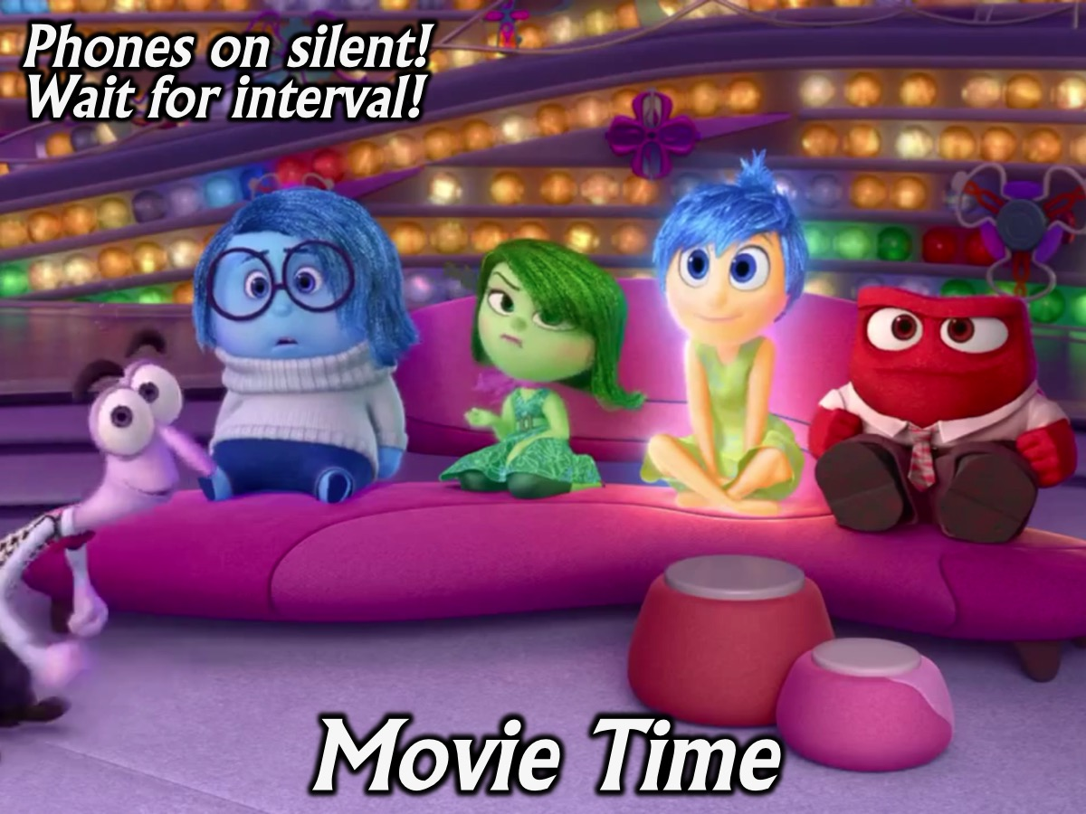
Notes:
It is Movie Time. Please put your phones on silent and wait for the interval half way through the movie. First some trailers for upcoming movies that will be released this year.

Slide 8

Notes:
Video: The Divergent Series Allegiant Official TV Spot – “Damaged”. Get it on YouTube at: https://www.youtube.com/watch?v=1Pd3S_1CHkk

Slide 9

Notes:
Video: X-Men: Apocalypse Official Trailer #1. Get it on YouTube at: https://www.youtube.com/watch?v=N0io2w_6vT8

Slide 10

Notes:
Get ready for our feature movie for tonight: Inside Out by Disney/Pixar!

Slide 11

Notes:
Don’t forget that next Friday is Movie Night - bring a friend.

Slide 12
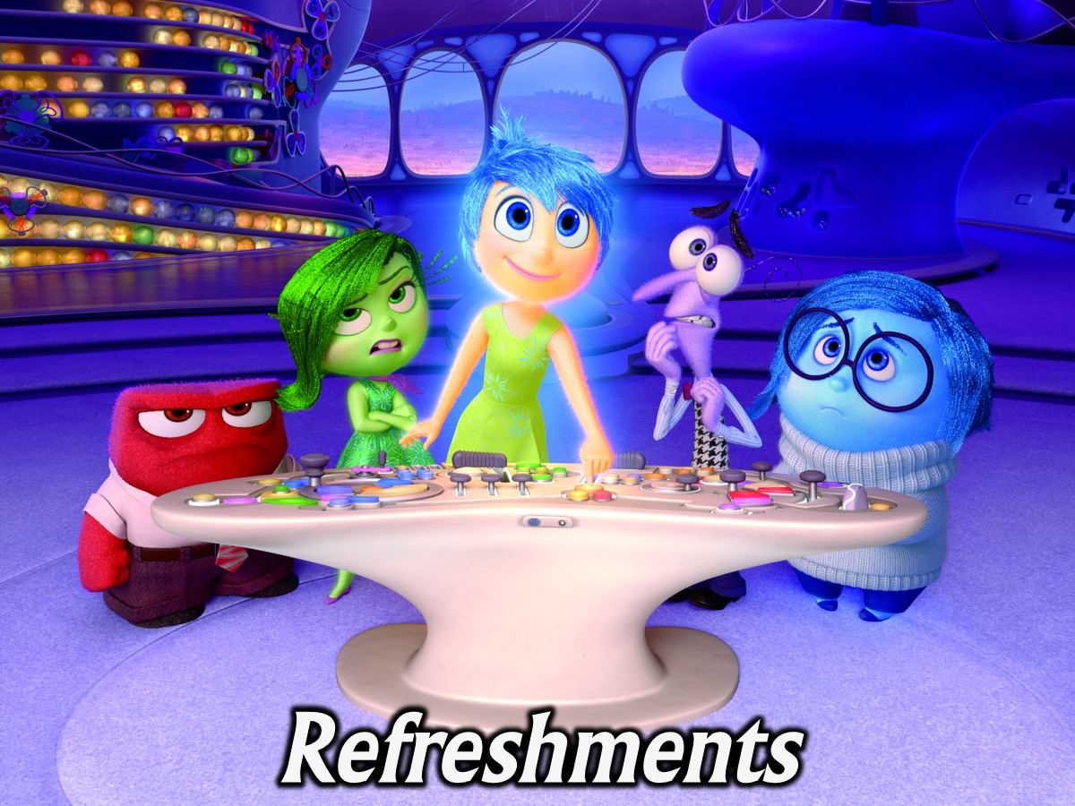
Notes:
Refreshments are served.

Slide 13
Notes:
Don’t forget that next Friday is Movie Night - bring a friend.

