Slide 1

Notes:
My Friends Night

Slide 2

Notes:
Welcome to My Life Friday
Time: 7:40-7:50 - Welcome, Announcements and Instructions

Slide 3
Notes:
Tonight is My School Night

Slide 4

Notes:
Welcome to all our regulars and if there are any newcomers – please come up onto stage so we can welcome you!

Slide 5

Notes:
Announcements: On Sunday morning we have Celebration Sunday to end the term.

Slide 6

Notes:
Next Friday night is PJs Movie Night. We end at 10pm! You have to wear at least 1 item that is related to sleep wear.

Slide 7
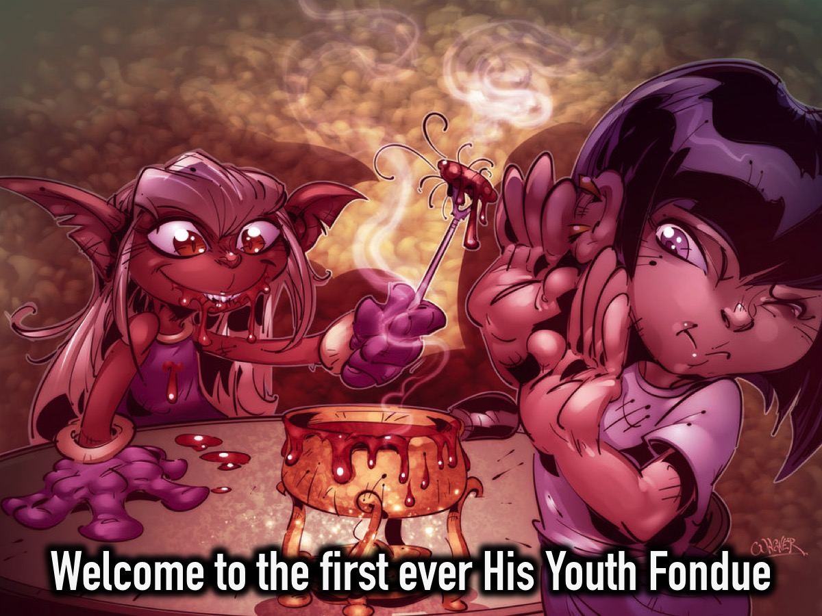
Notes:
Welcome to the first ever His Youth fondue.

Slide 8
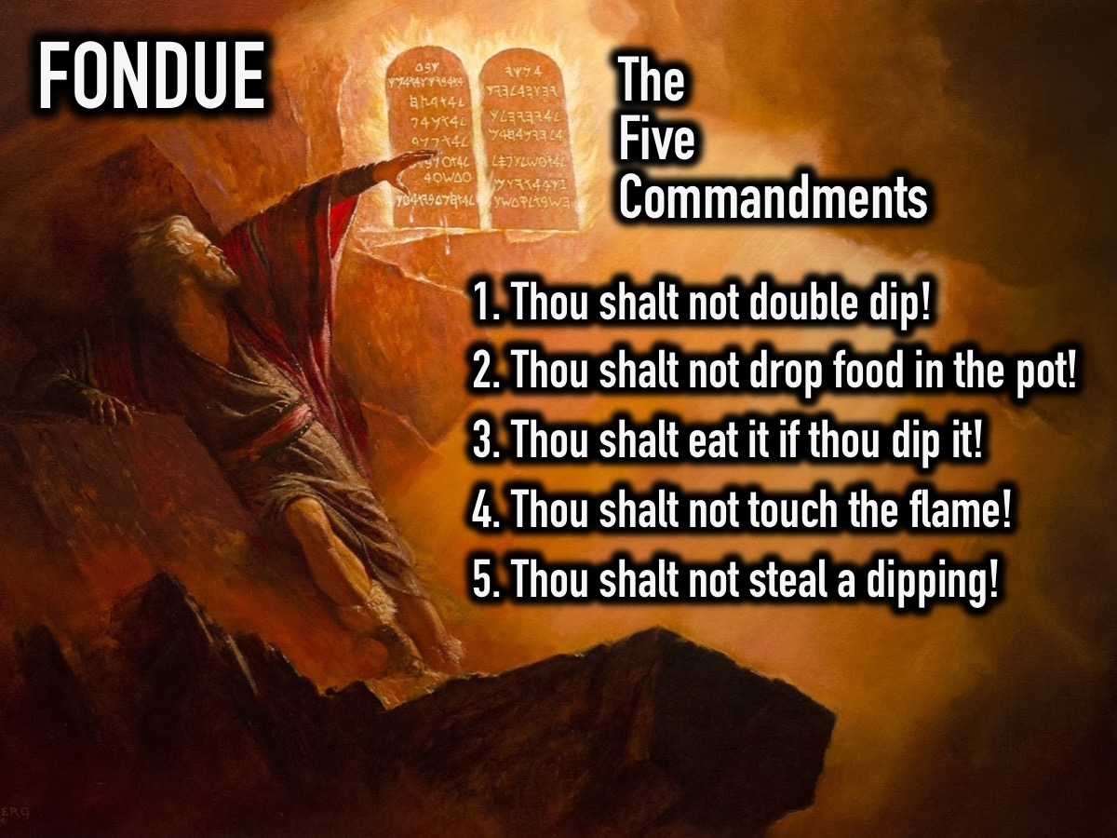
Notes:
Before we start there are 5 commandments that you need to know about the Fondue:
1. Thou shalt not double dip!
2. Thou shalt not drop food in the pot!
3. Thou shalt eat it if thou dip it!
4. Thou shalt not touch the flame!
5. Thou shalt not steal a dipping!

Slide 9
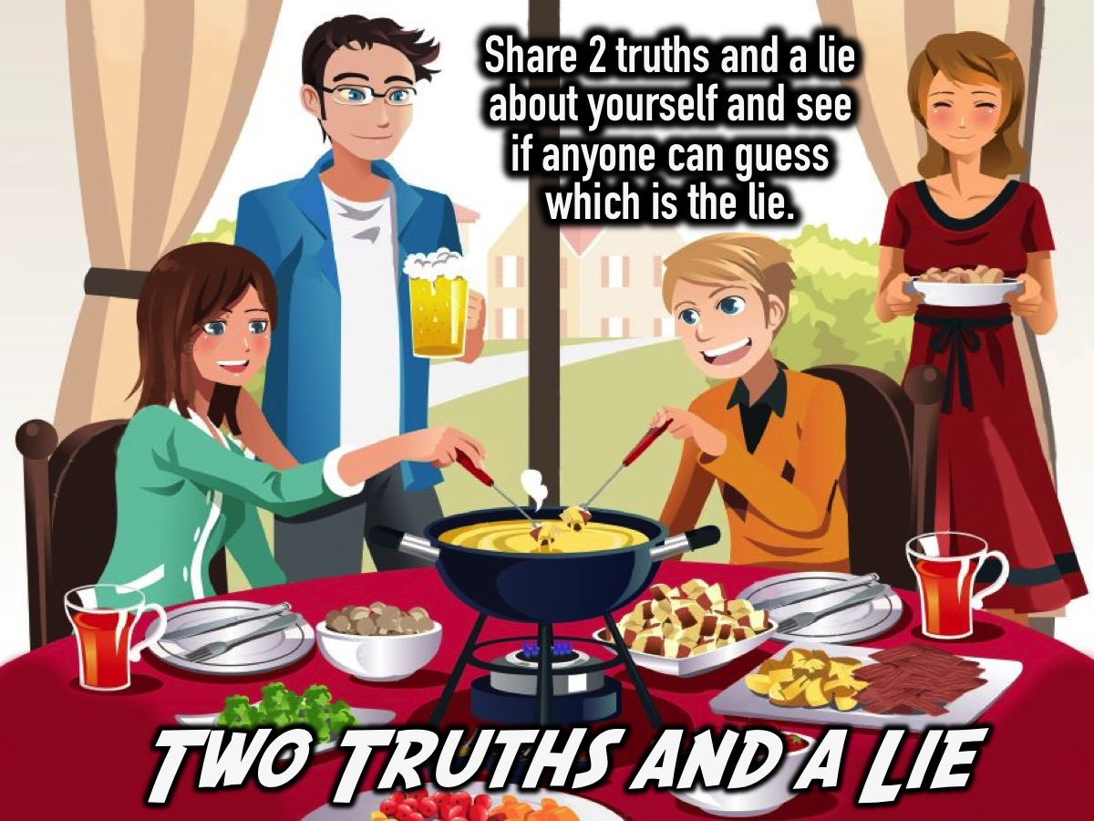
Notes:
1. Two Truths and a Lie. Tell the group that each person will introduce themselves by stating two truths about their life and one lie. The rest of the group has to guess which statement is the lie.

Slide 10
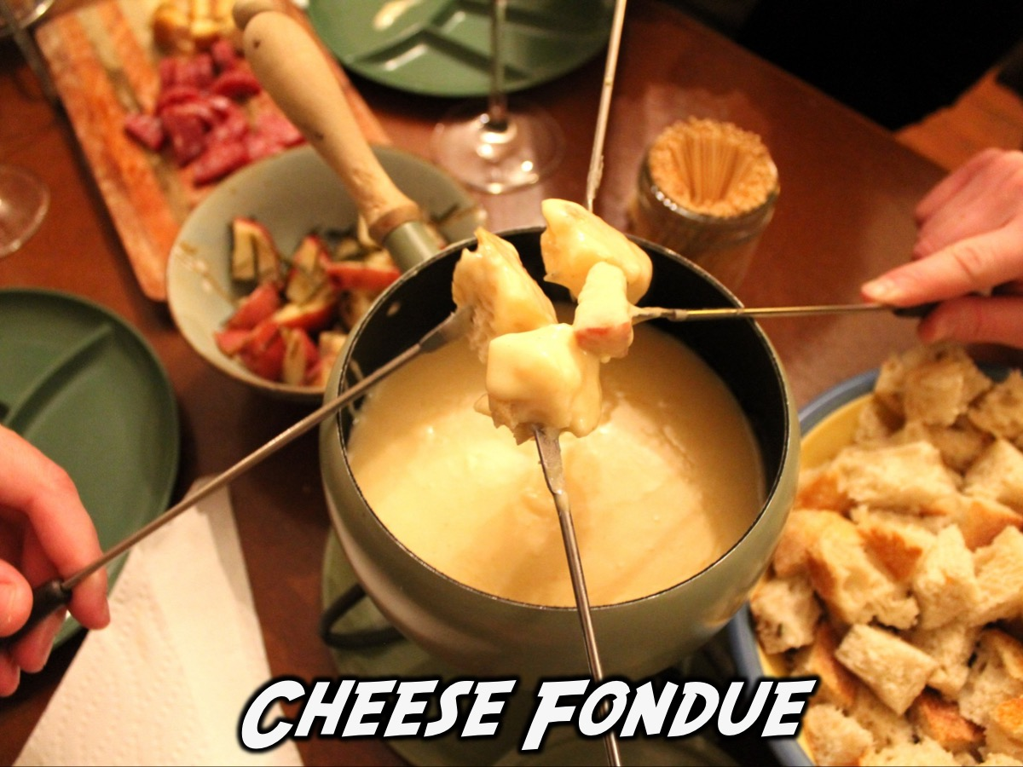
Notes:
Cheese Fondue: Teens dip cubes of bread, savoury sticks, baby carrots, cucumber, viennas into the cheese using fondue forks

Slide 11
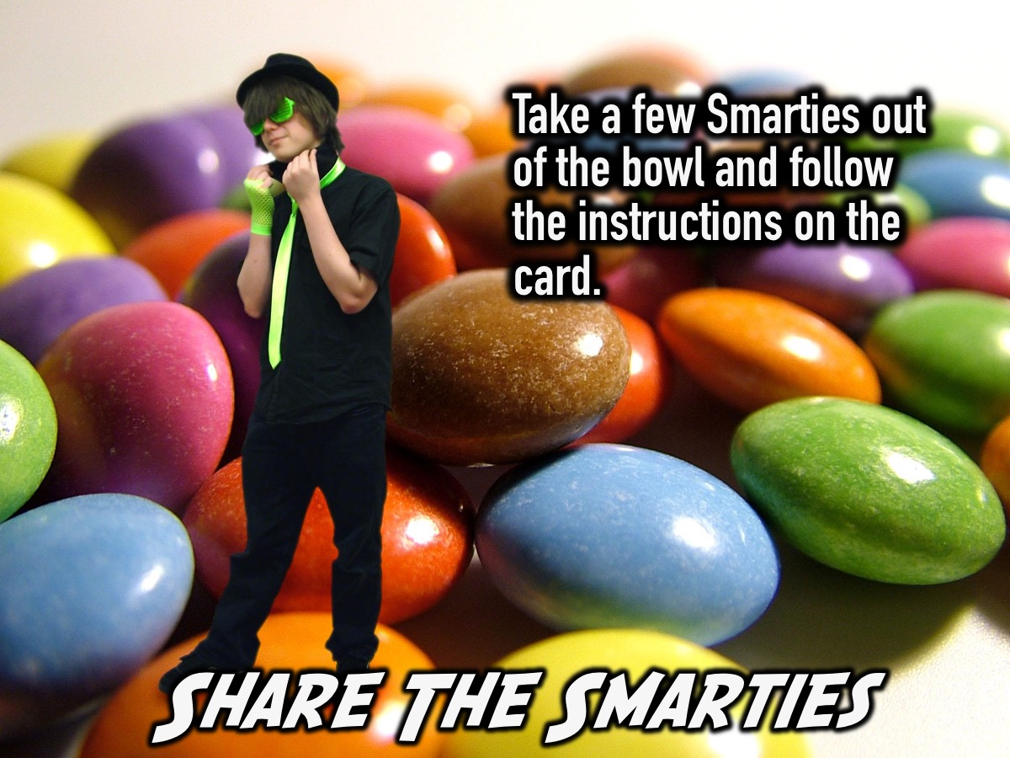
Notes:
2. Share the Smarties. Each table is given a bowl of Smarties (with 6 different solours) on each table. Someone will pass the bowl around and tell each person to take a few sweets. Once everyone has their sweets they are told that they have to share one fact about themselves for every sweet they took (eating them as they go) – and each colour represents a different category to share.
For each Smartie share something…
Violet – you expect in the future
Green – you could not live without
Orange – about your childhood
Yellow – about your family
Pink – you’ve learned at youth
Red – you hate
Blue – that makes you sad

Slide 12
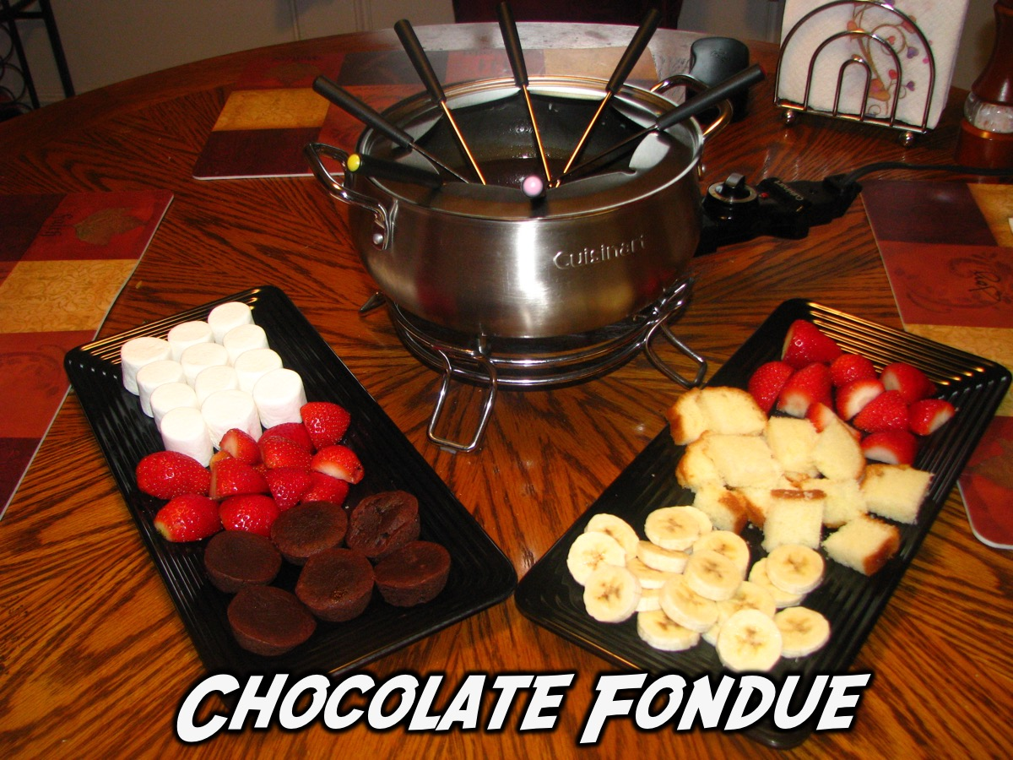
Notes:
Chocolate Fondue: Teens dip cubes of banana, strawberries, mini-marshmallows, pineapple, pretzels, finger biscuits and breads into the chocolate using fondue forks.

Slide 13
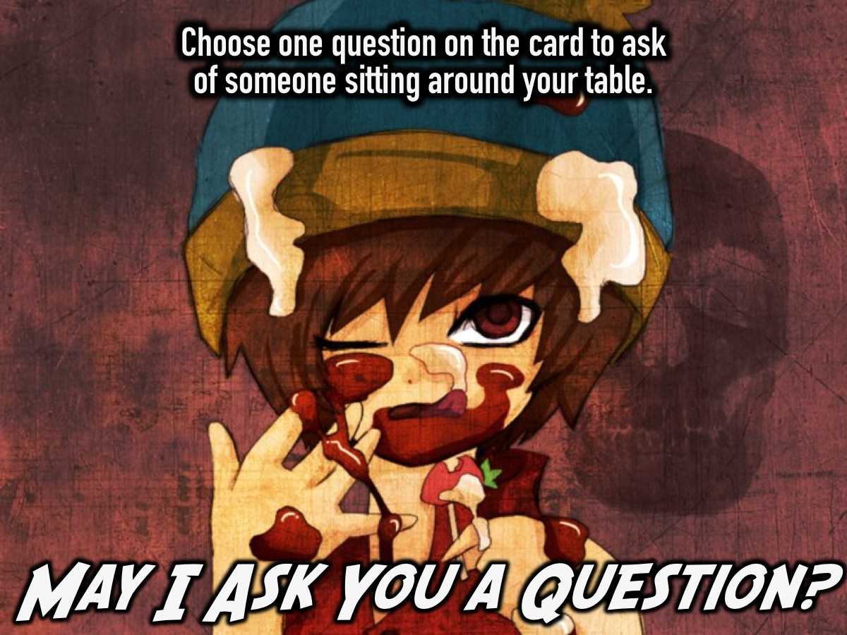
Notes:
3. May I Ask You a Question? Each table will have a card with these 9 questions on it. Someone picks up the card and asks one of the questions of someone sitting around their table. Play until the round is finished or until a certain amount of time has passed.
1. If you were to choose a new name for yourself, what would it be?
2. If you were given an extra R50 in change at Pick n’ Pay, what would you do with it and why?
3. What’s the biggest lesson you’ve learnt from your past relationships?
4. What’s one of your worst habits?
5. What was the best day of the past week for you - why?
6. What are you wearing today which is most reflective of who you are?
7. If you could change one thing about your physical appearance what would it be and why?
8. What was one of your most embarrassing moments?
9. If you were given a million Rand and 24 hours to spend it in, what would you buy?

Slide 14
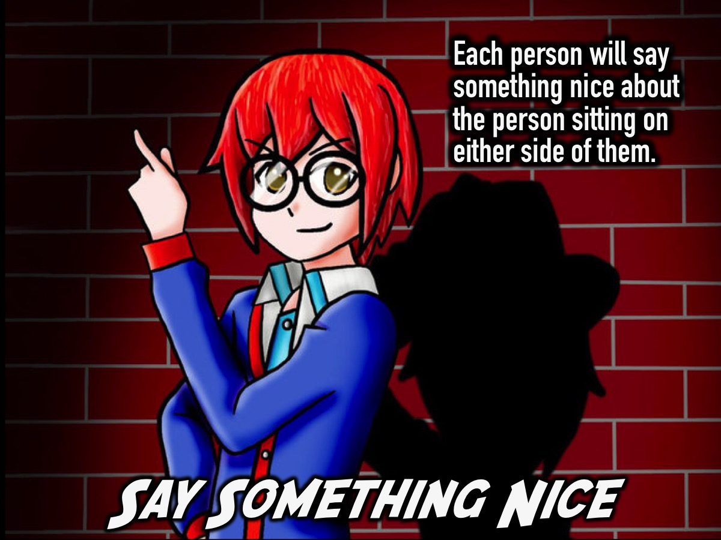
Notes:
4. Say Something Nice. Go around in the circle and each person has to think of something nice to say about person who is sitting on either side of them.

Slide 15

Notes:
Small Groups. Here are the questions for our small group time: (1) How did you feel being separated from your friends tonight? (2) What was it like joining a new group and making friends? (3) What did you learn tonight about how to make new friends? (4) What do you need to do to develop your existing friendships? (5) What do these verses teach you about friendship? "Greater love has no one than this, that he lay down his life for his friends.” (John 15:13). "Do nothing out of selfish ambition or vain conceit, but in humility consider others betters than yourselves. Each of you should look out for the interests of others." (Philippians 2:3-4). “A friend loves at all times.” (Proverbs 17:17). (6) Pray for each other to be and have awesome friends.

Slide 16

Notes:
Refreshments: It is time for Hot Chocolate.

Slide 17
Notes:
Next Friday night is PJs Movie Night. We end at 10pm! You have to wear at least 1 item that is related to sleep wear.

