Slide 1

Notes:
My Friends Night

Slide 2
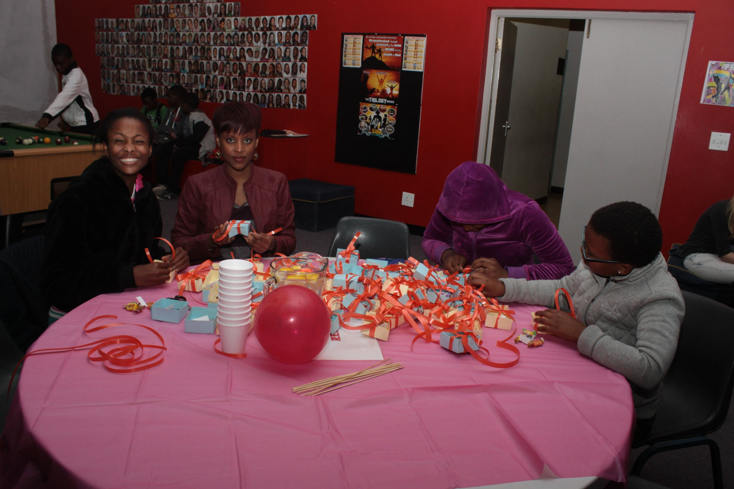
Notes:
Teens and adult leaders creating the gift boxes for the tables - they contained a few sweets and a Bible verse.

Slide 3
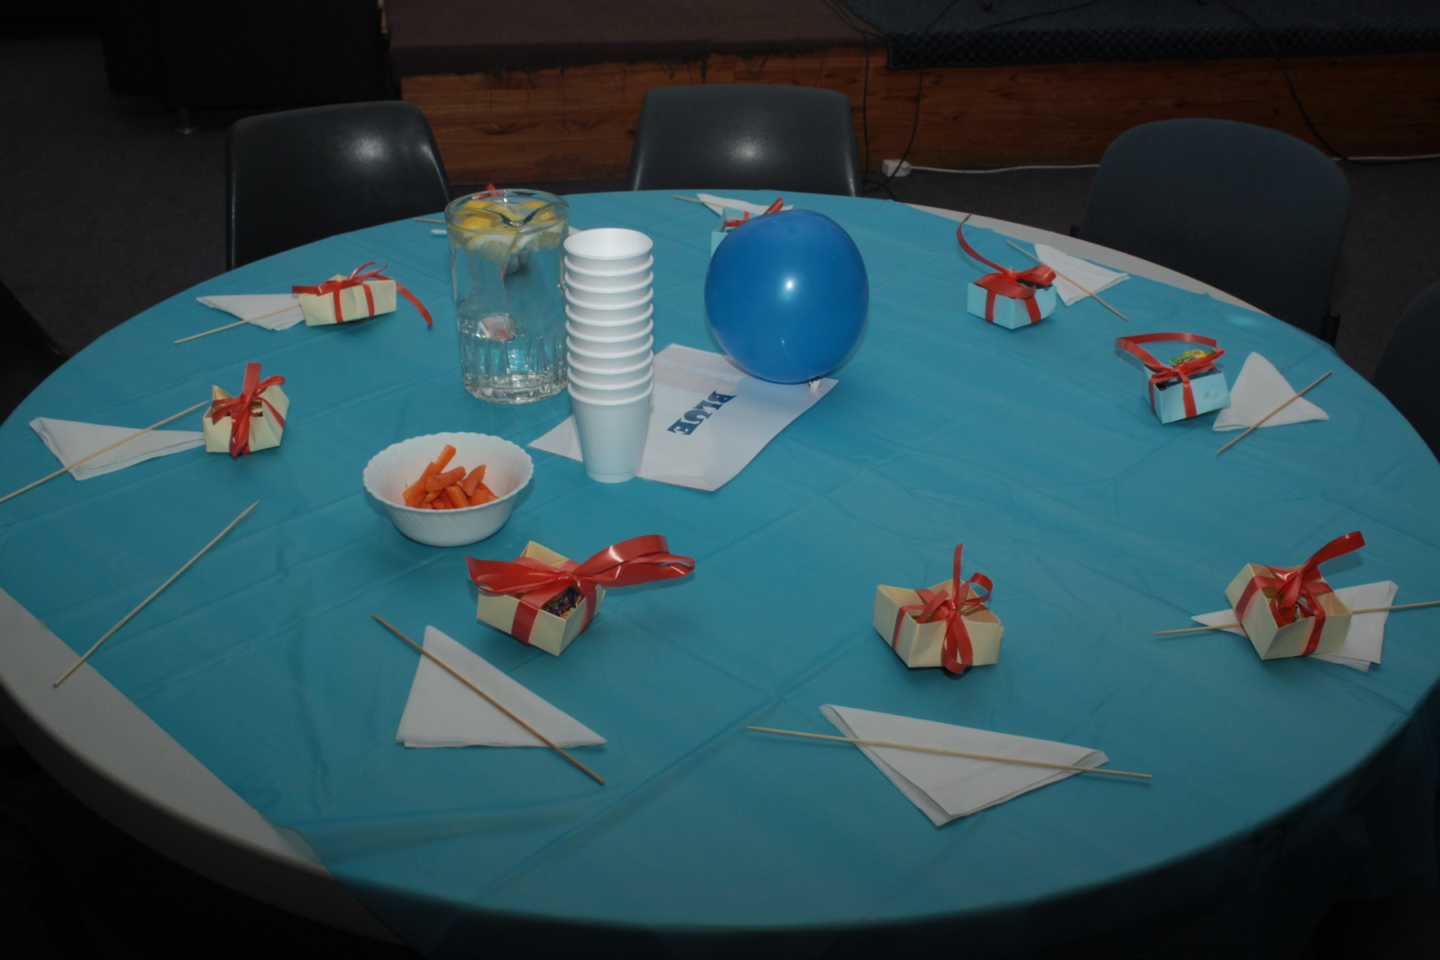
Notes:
One of the tables.

Slide 4
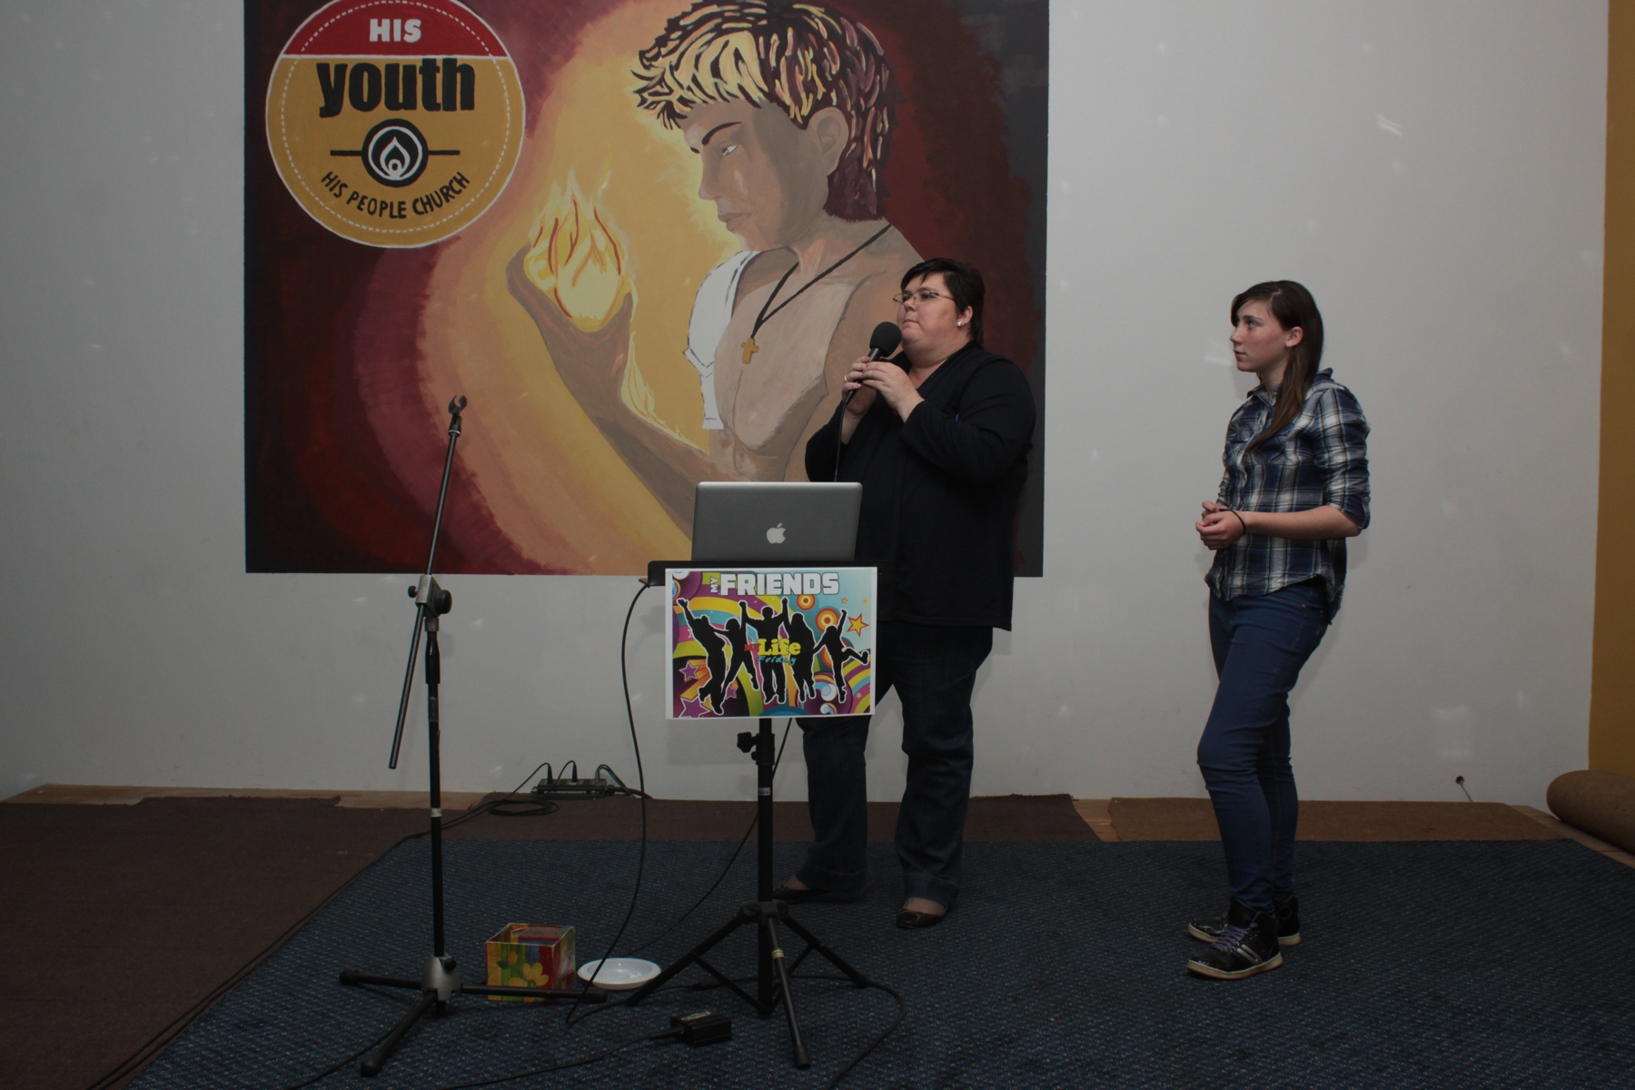
Notes:
The welcome

Slide 5
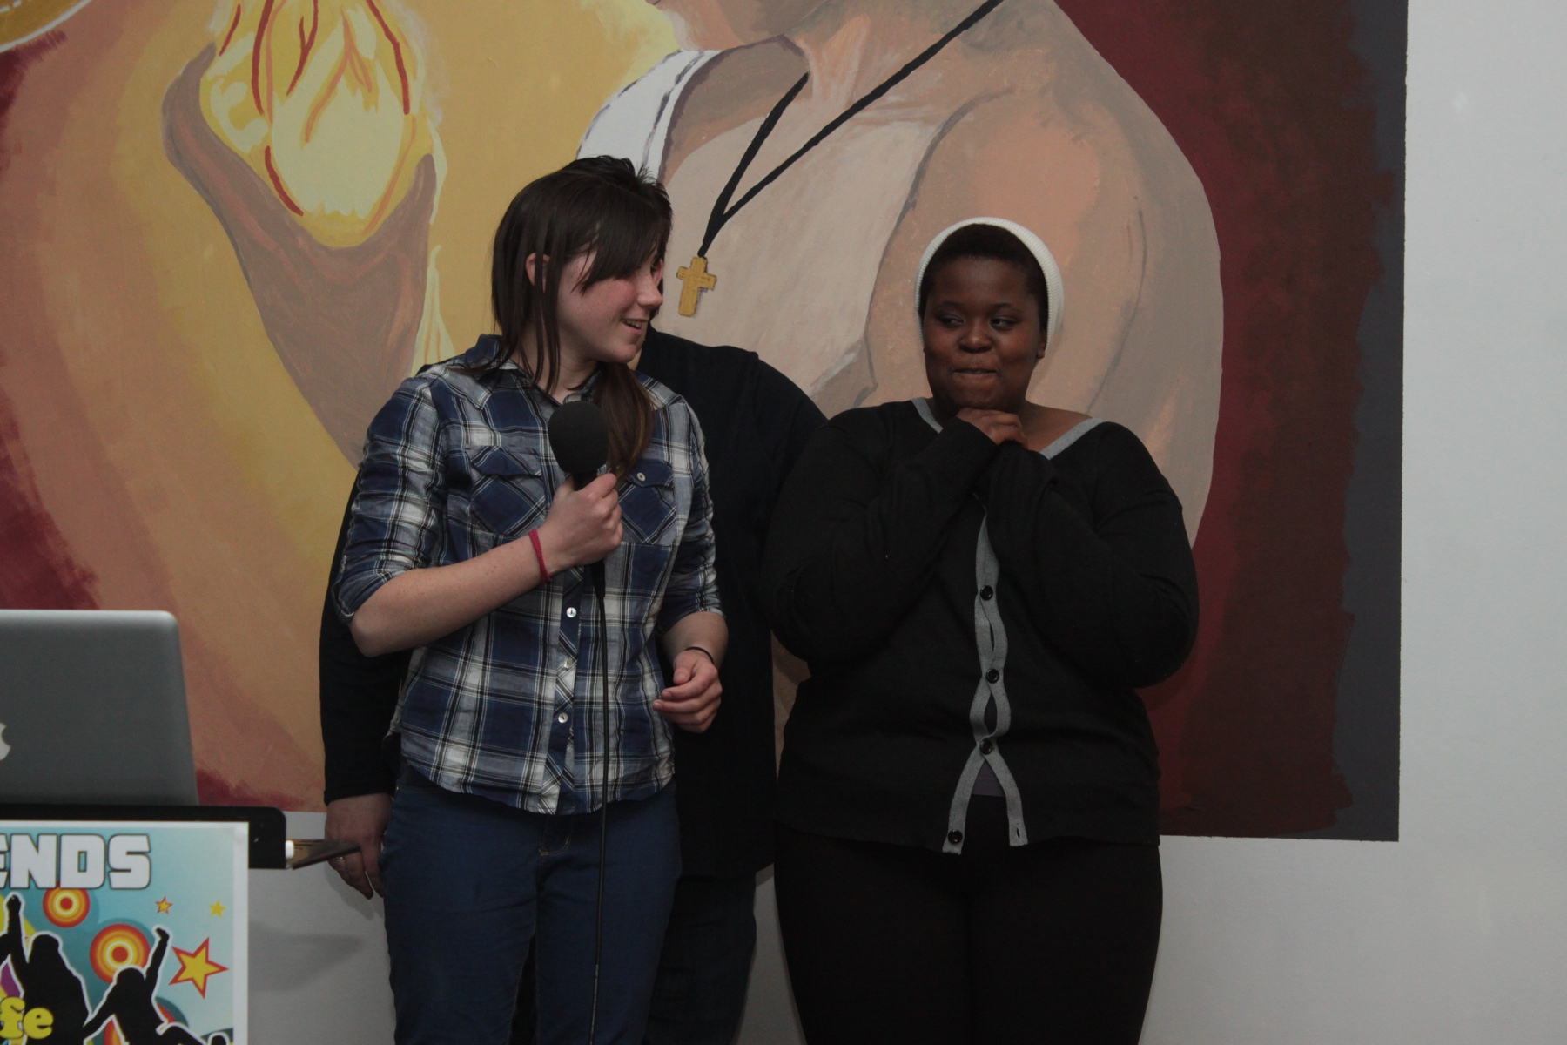
Notes:
Welcoming newcomers.

Slide 6
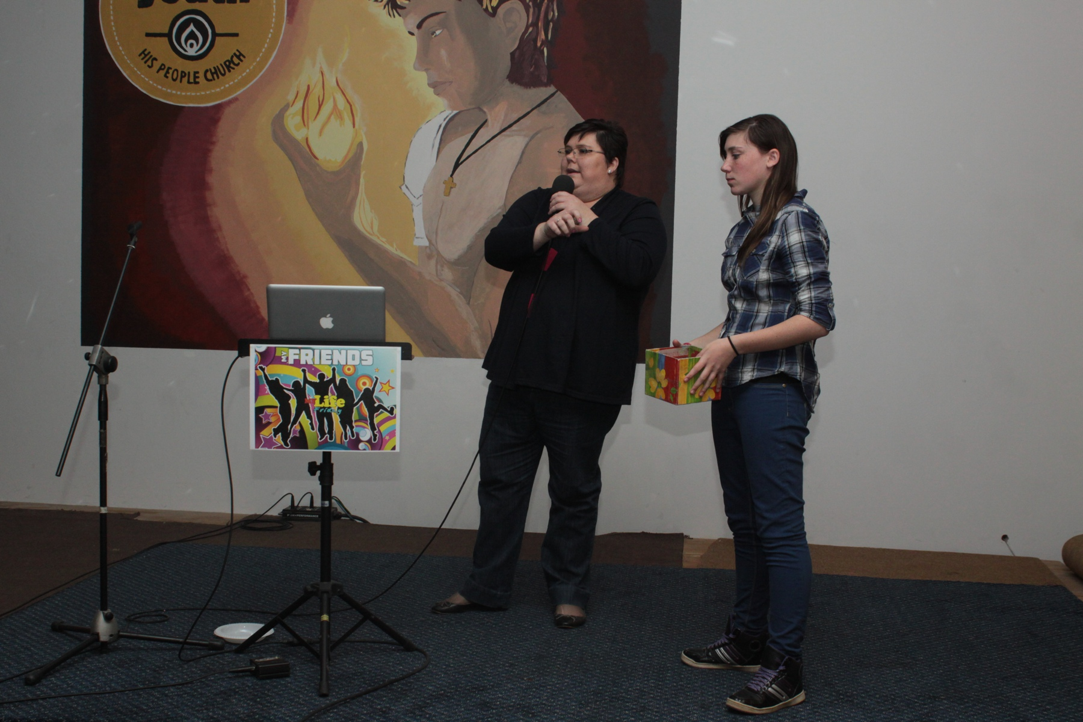
Notes:
Teens each took a slip of paper to allocate them to one of the 5 tables.

Slide 7
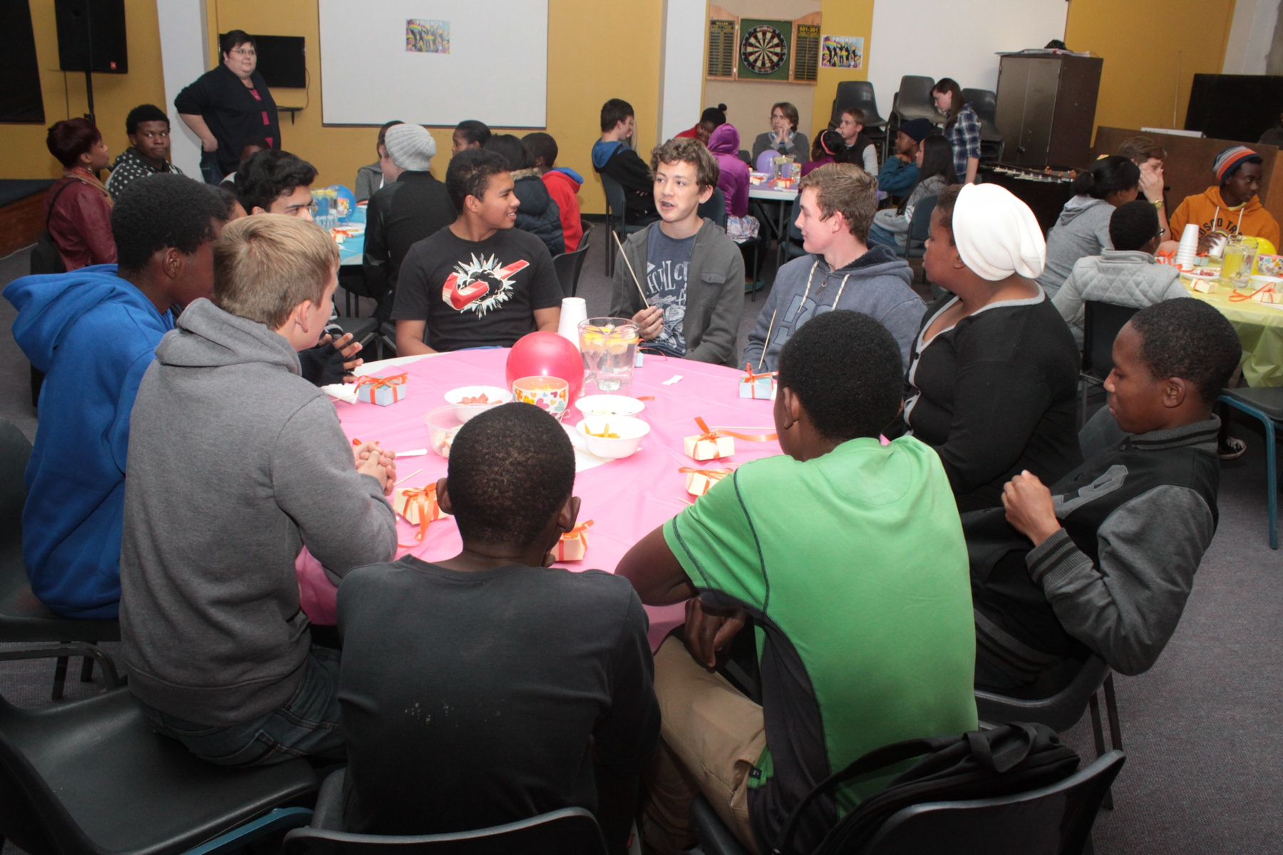
Notes:
Teens started off sharing two truths about themselves and a lie - group members had to figure out which was the lie.

Slide 8
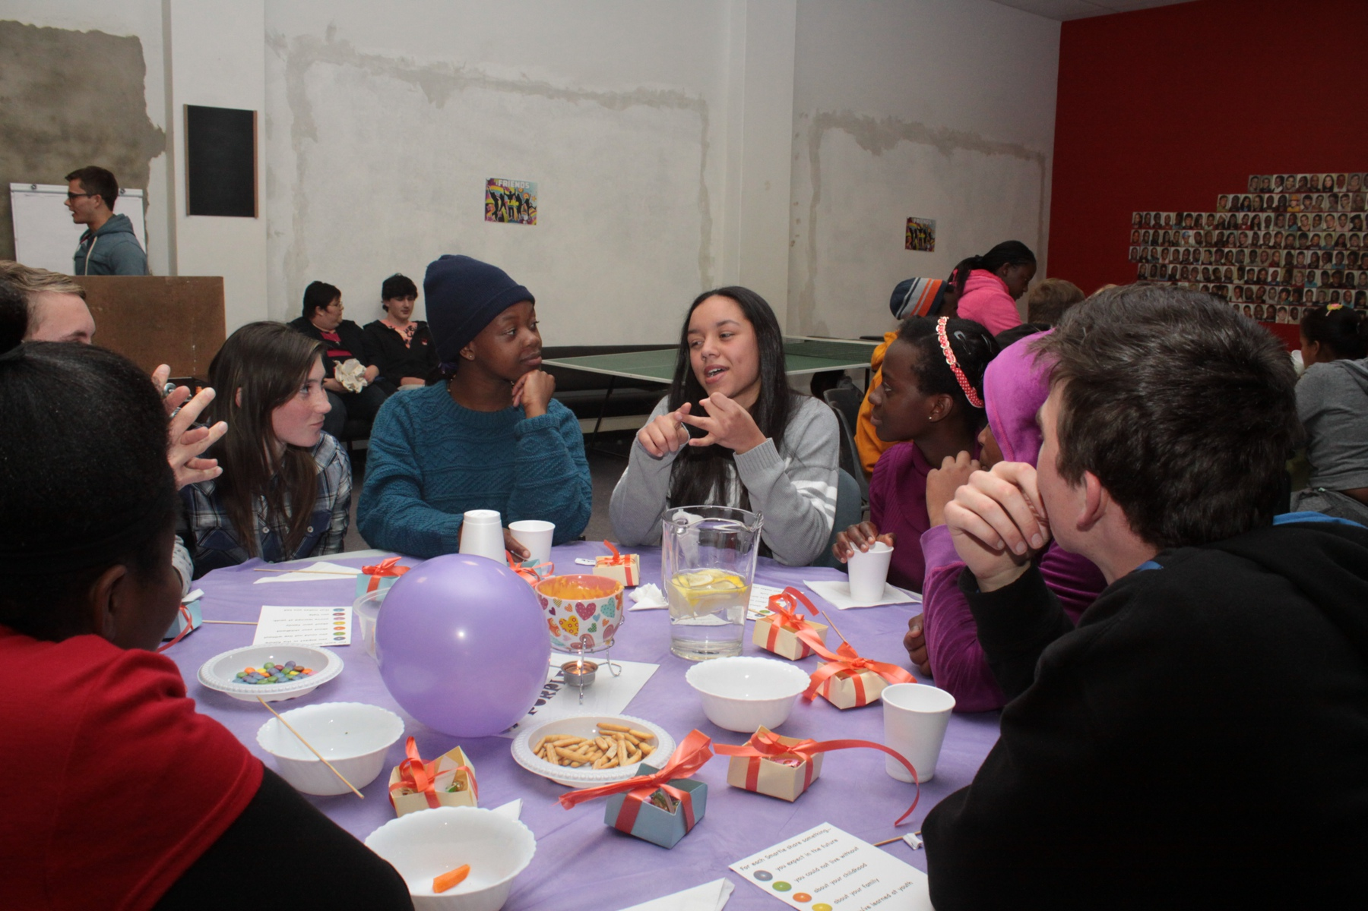

Slide 9
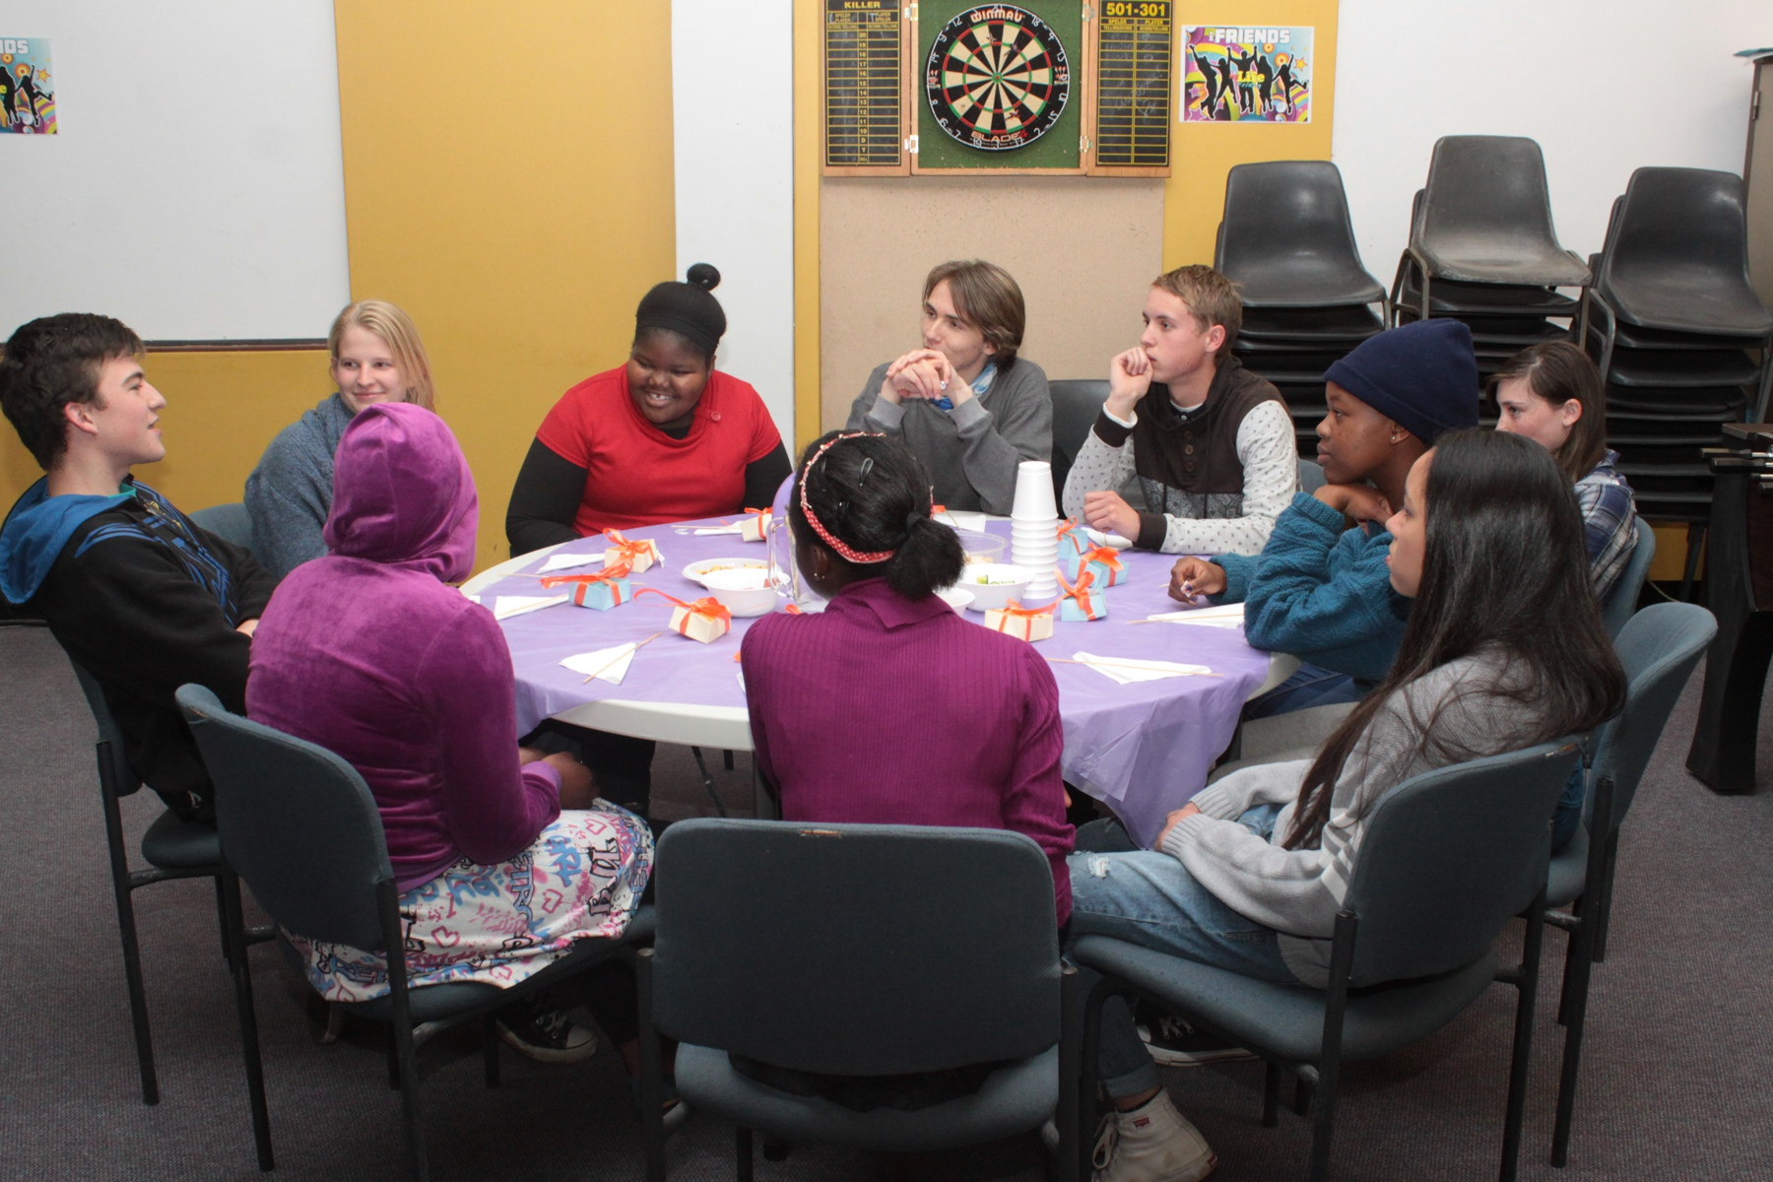

Slide 10
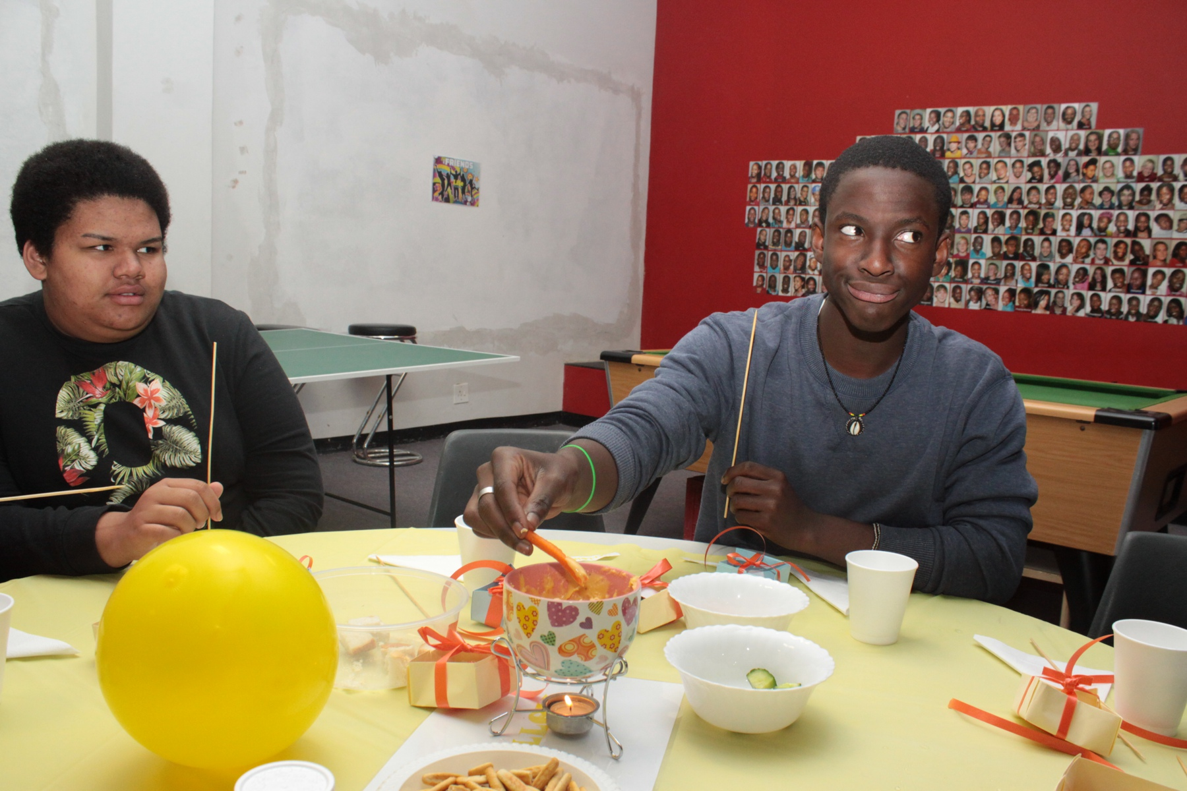
Notes:
The cheese fondue.

Slide 11
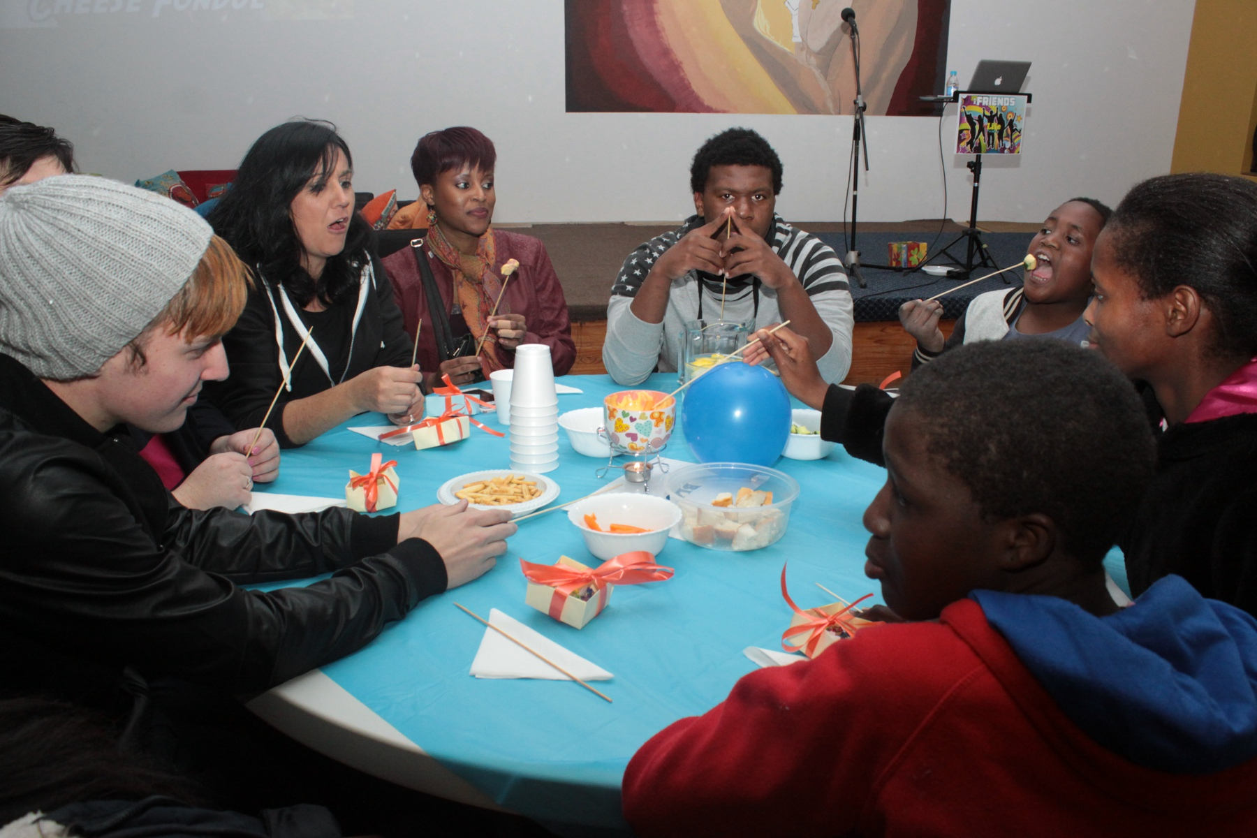

Slide 12
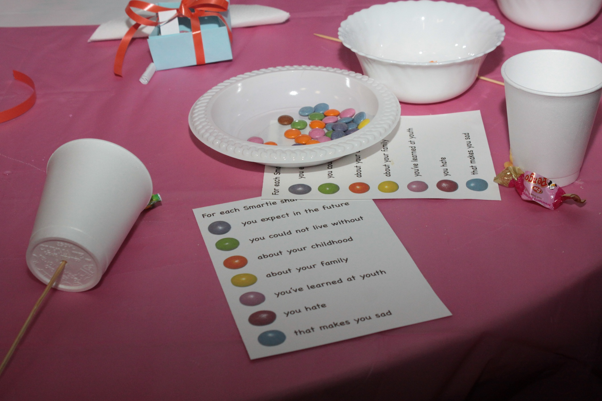
Notes:
The Smarties (or M&M game) designed to get teens connecting.

Slide 13
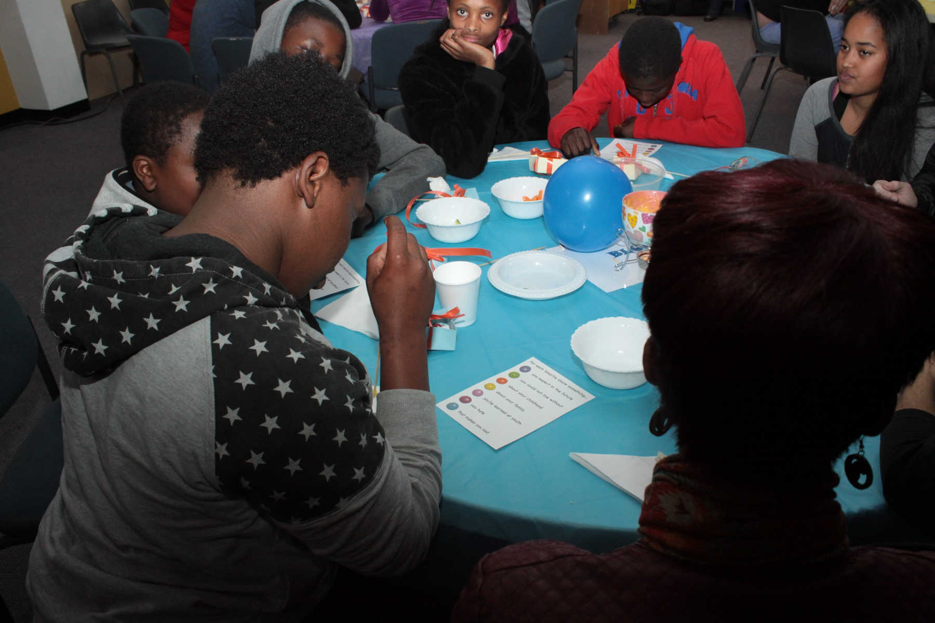

Slide 14
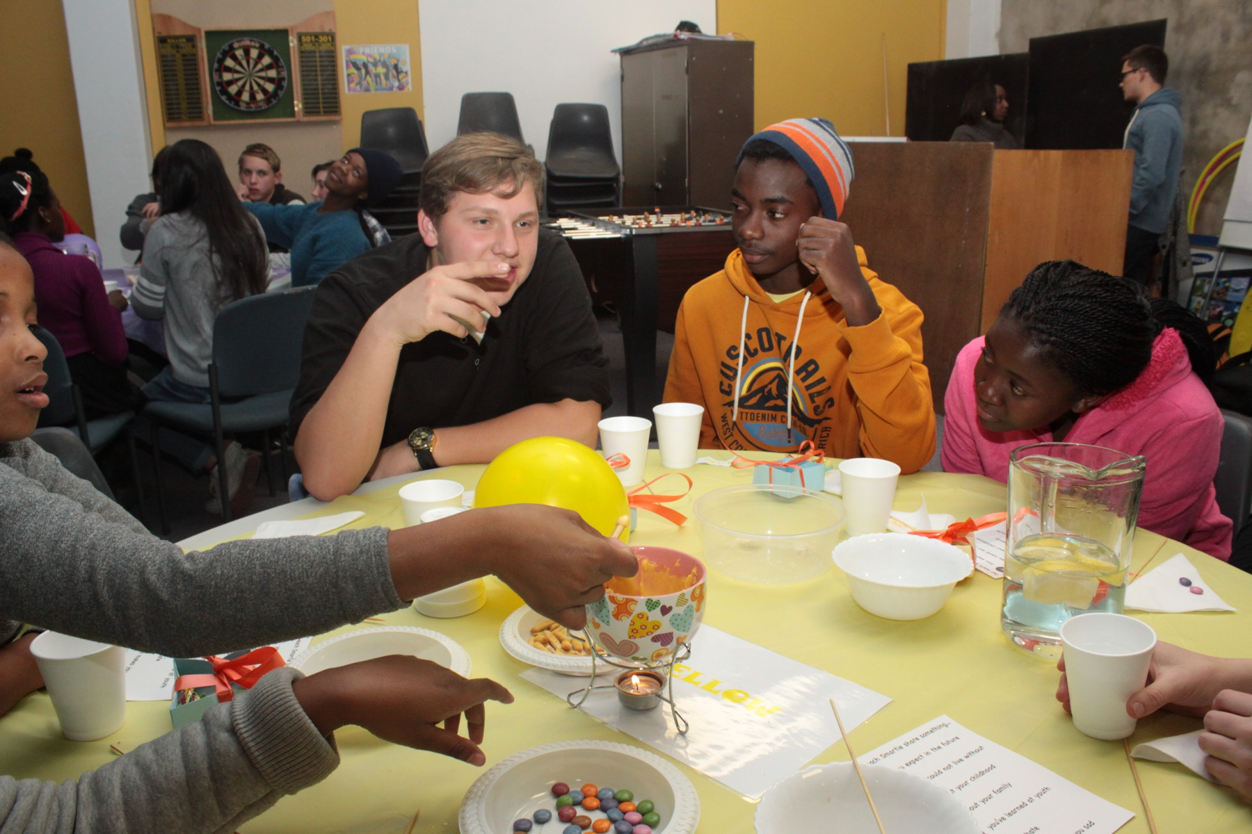

Slide 15
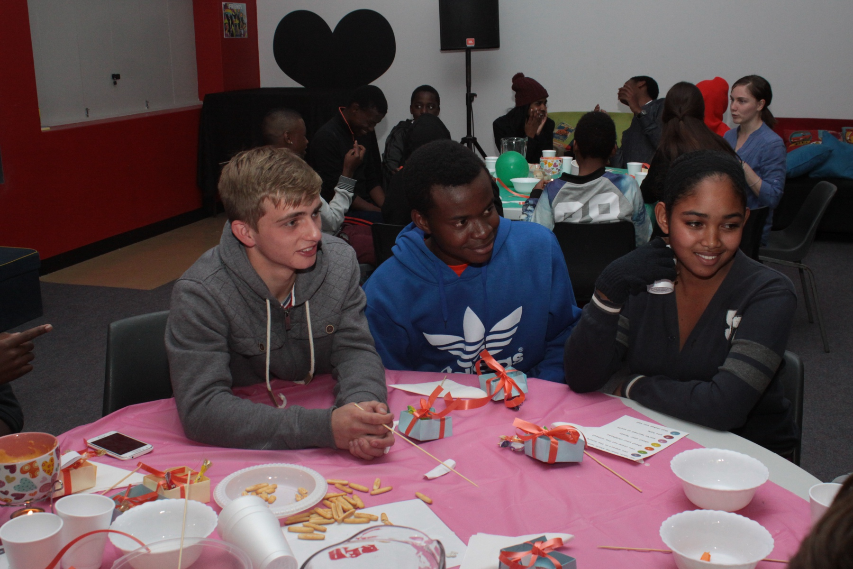

Slide 16
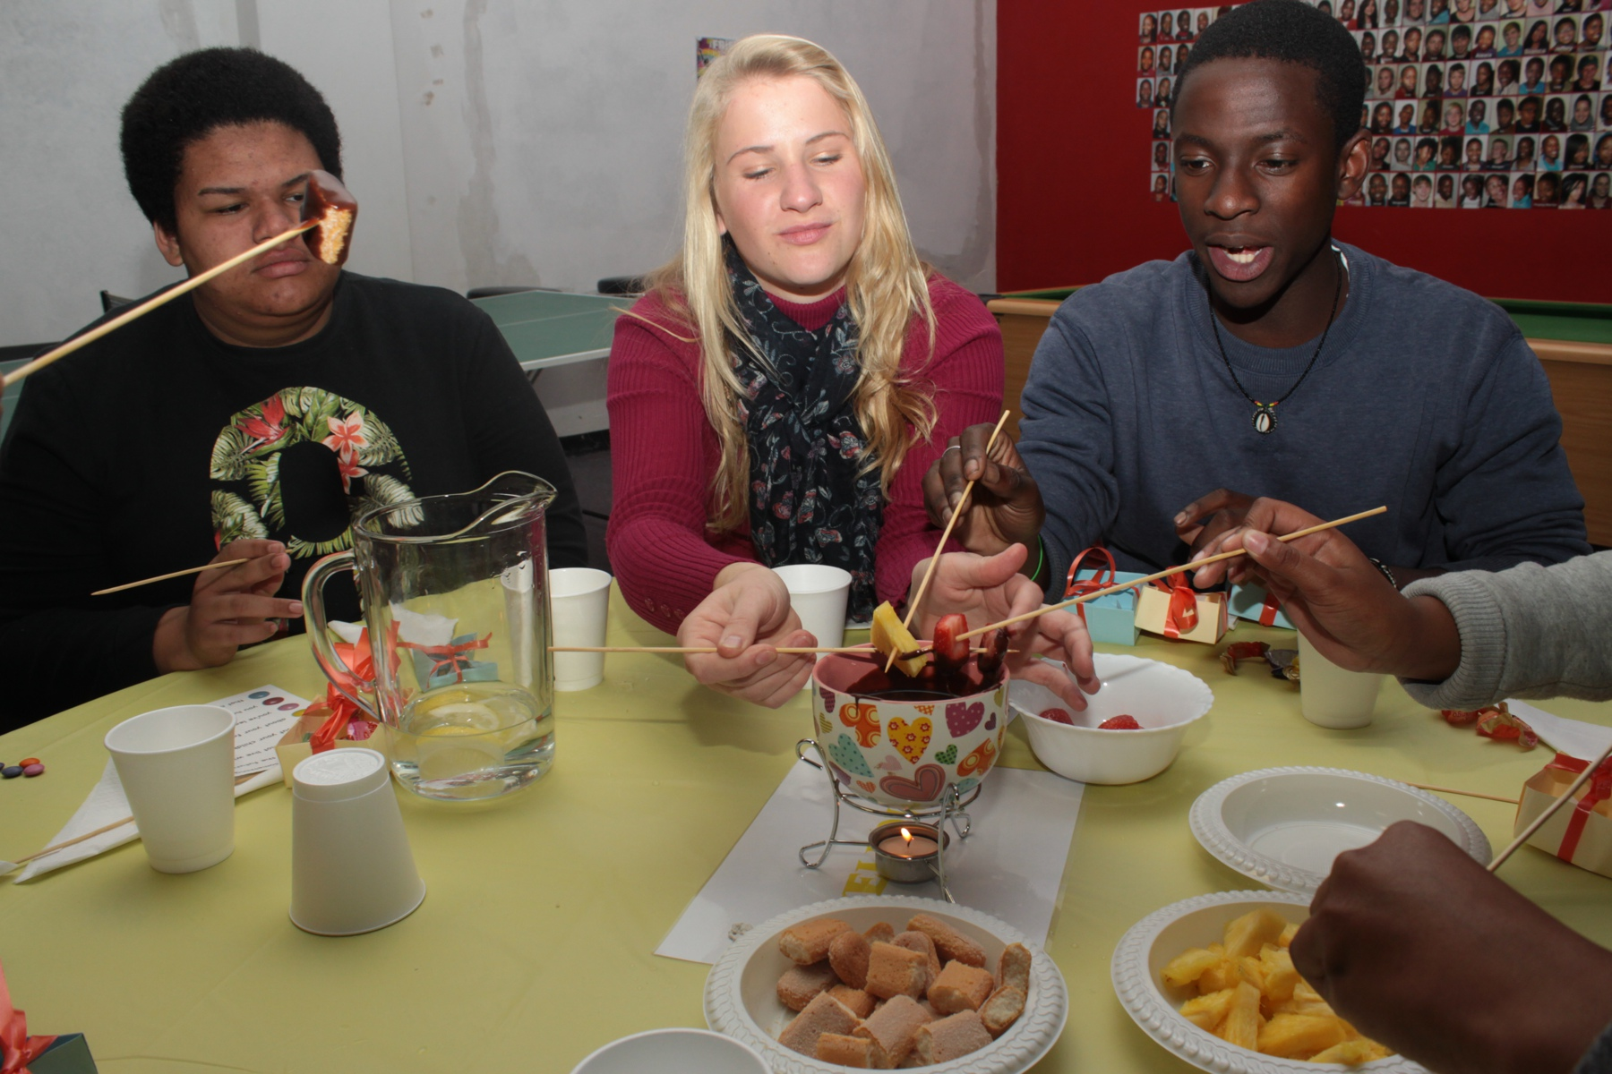
Notes:
The Chocolate Fondue.

Slide 17
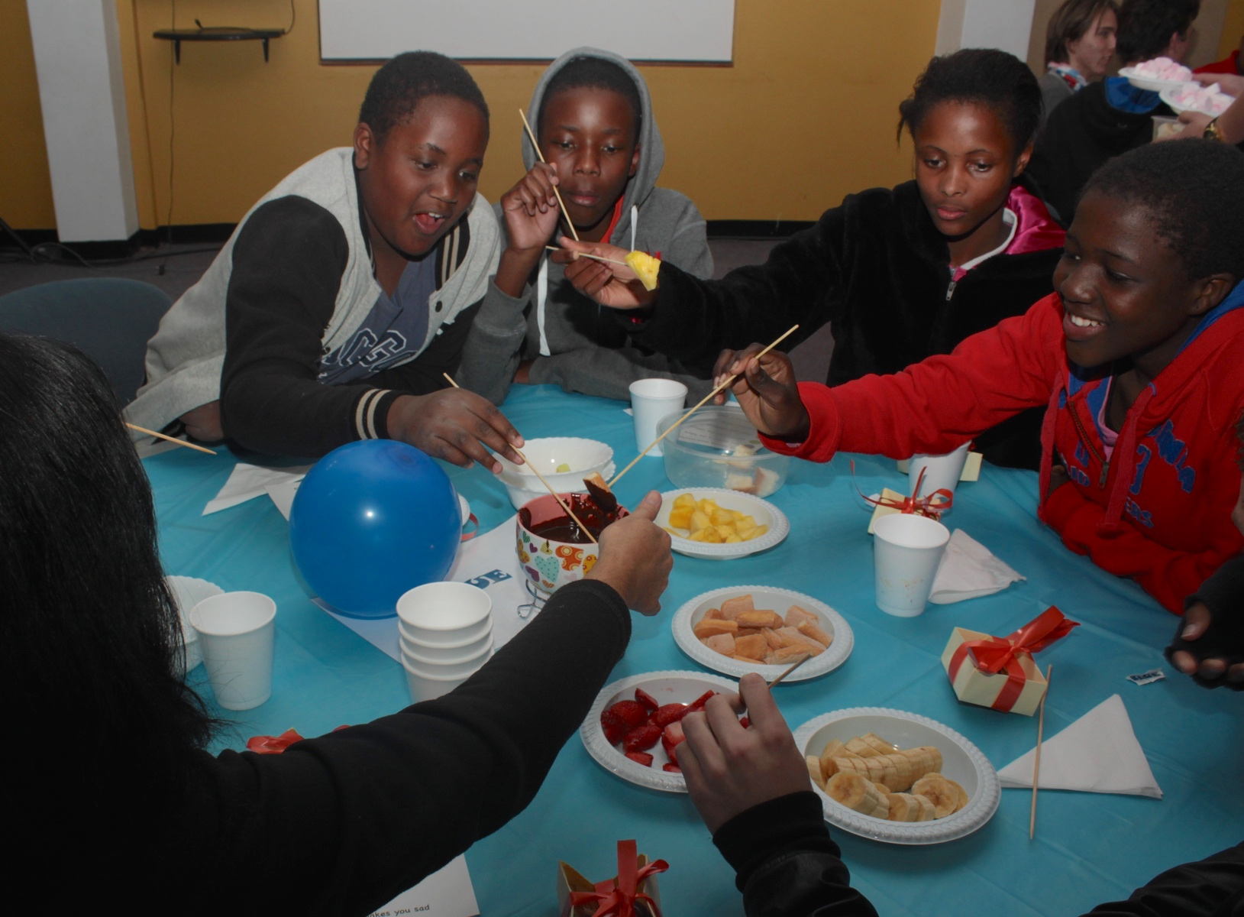

Slide 18
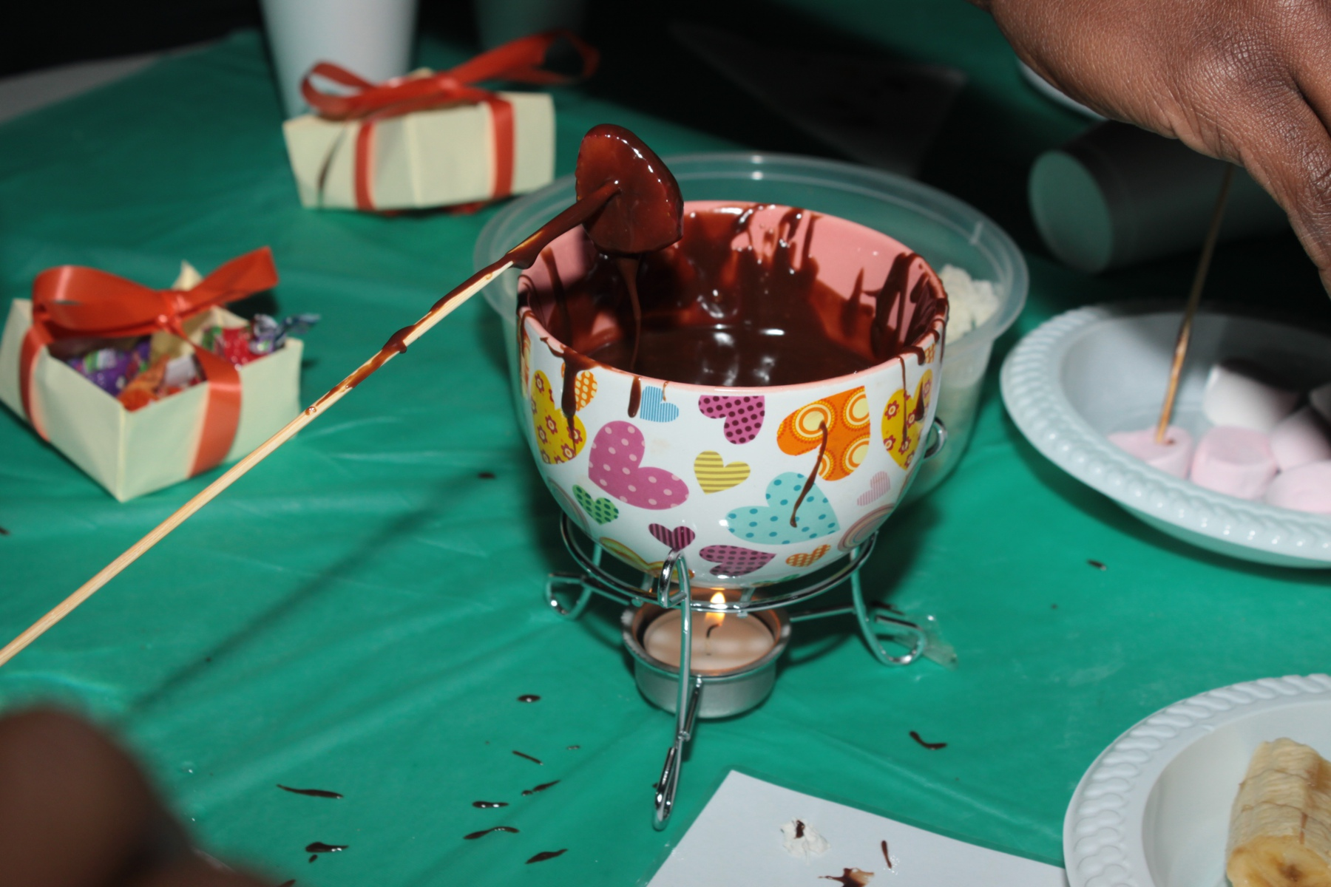

Slide 19
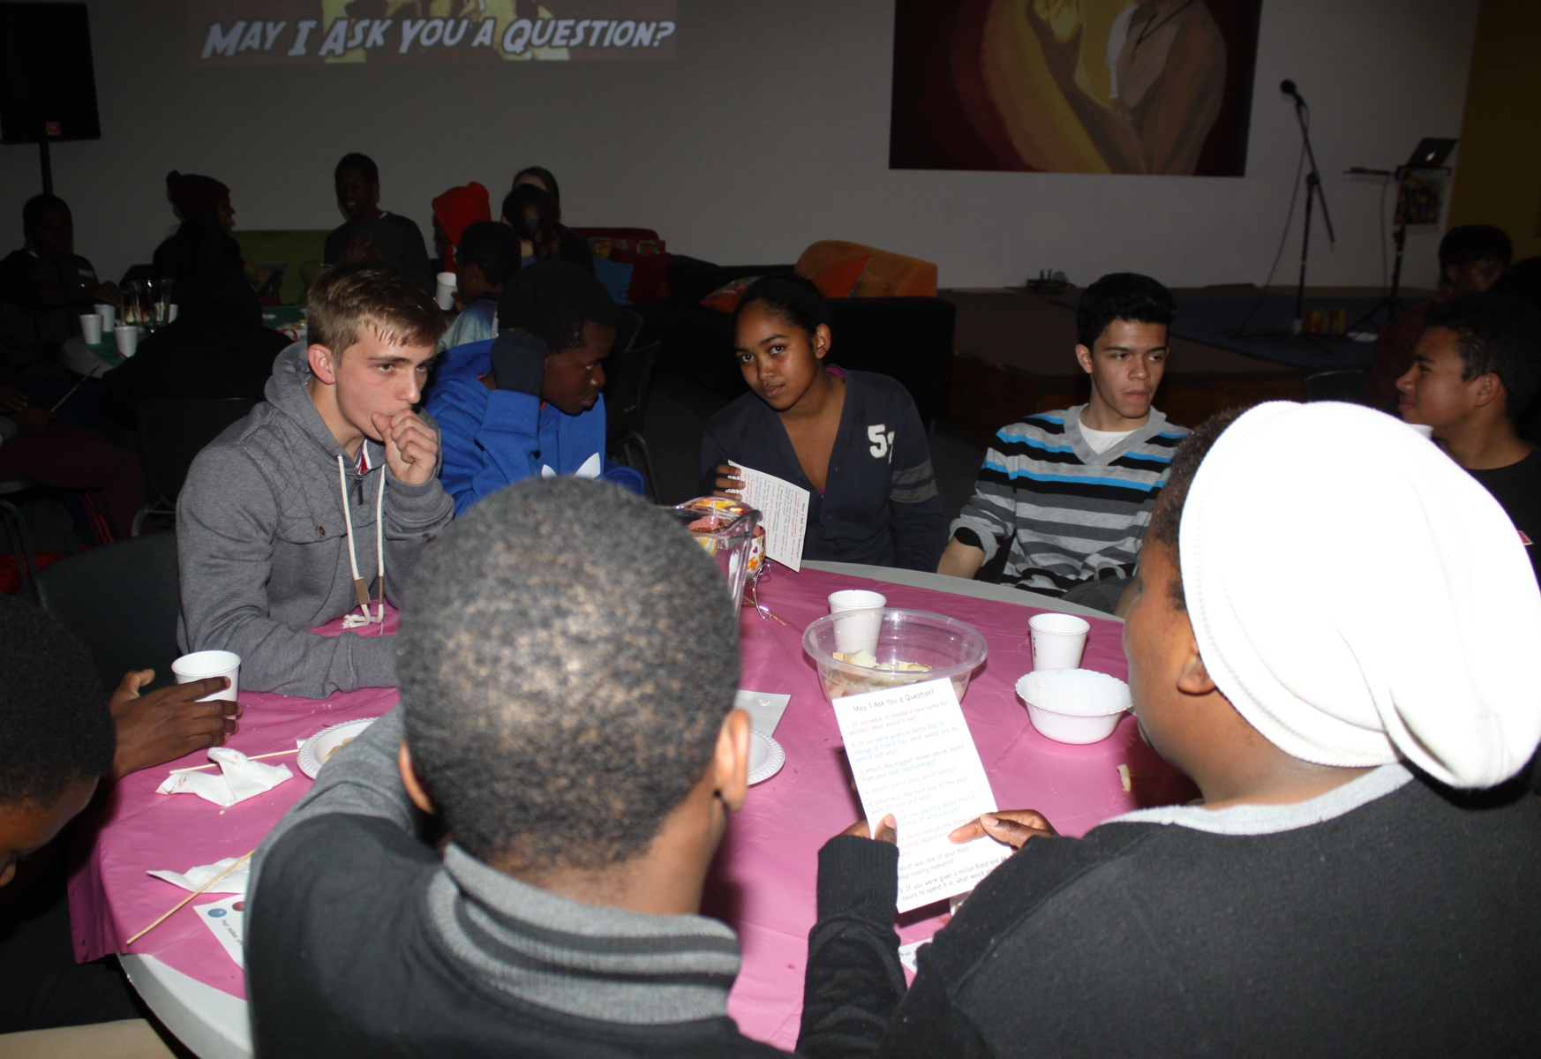
Notes:
The game called: “May I Ask You a Question?” Where you could ask anyone in the group a question from the card on the table.

Slide 20
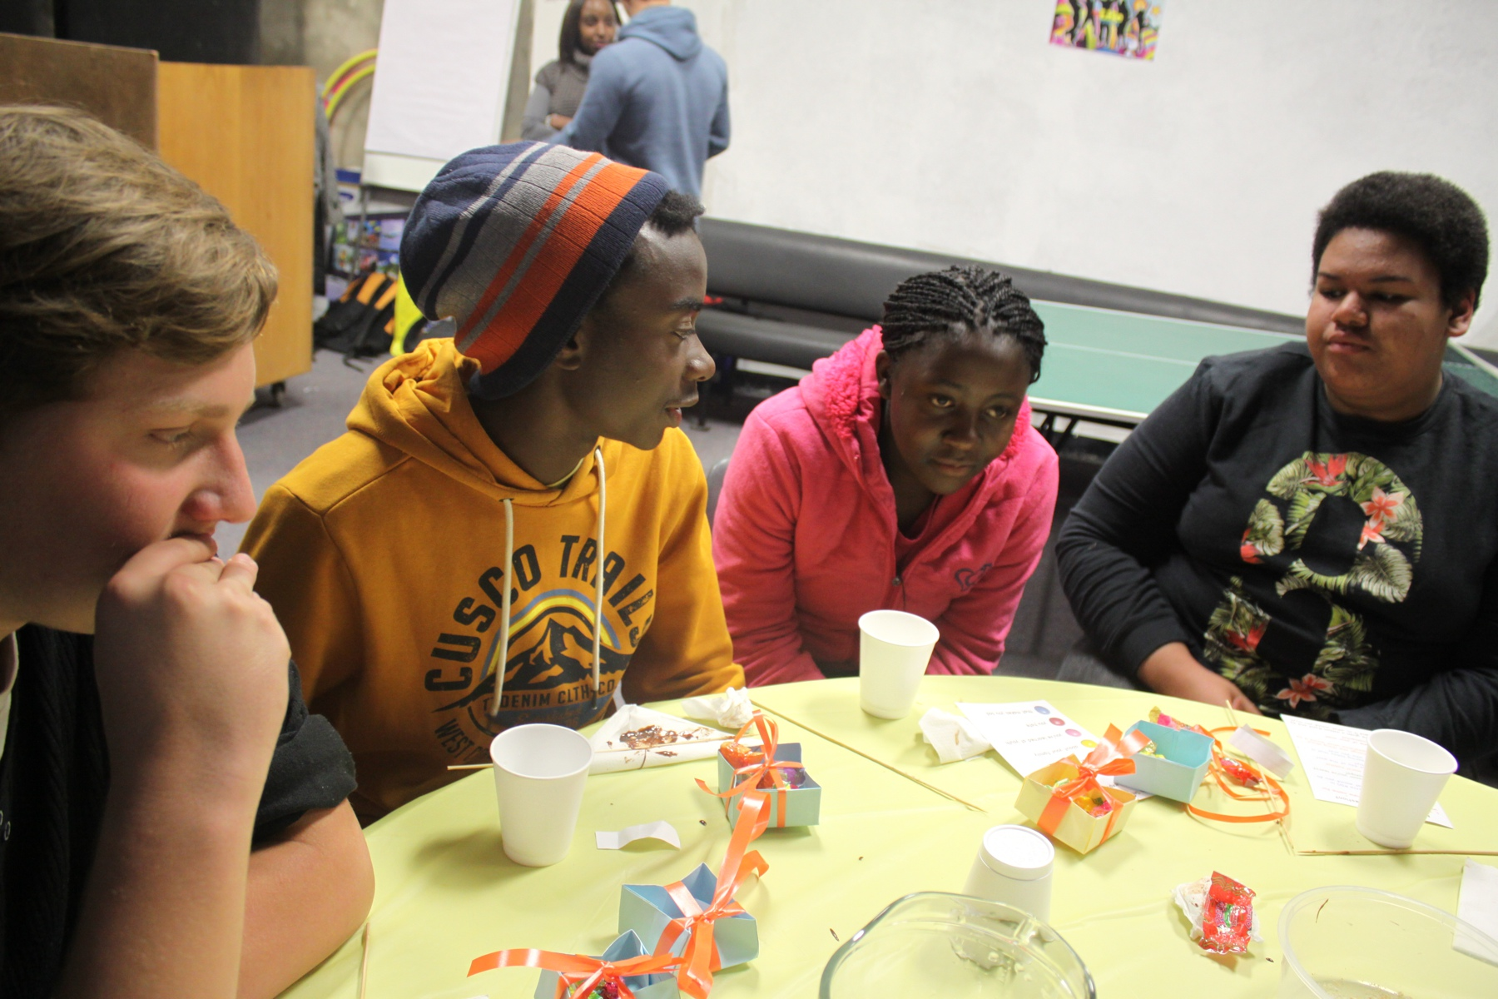

Slide 21
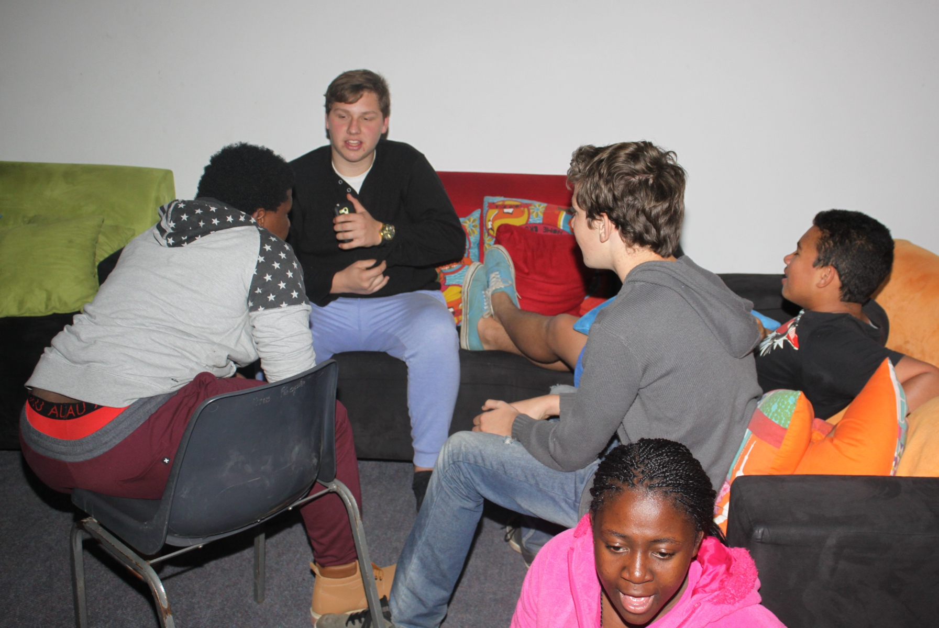
Notes:
Small group time.

Slide 22
