Slide 1

Notes:
My Health Night.

Slide 2
Notes:
Video: The Best Motivation Video 2015 - THE JOURNEY. Get it on YouTube at: https://www.youtube.com/watch?v=LPqXtfrJAUE
Video Length: 3:17

Slide 3

Notes:
Welcome to My Life Friday
Time: 7:40-7:50 - Welcome, Announcements and Instructions

Slide 4
Notes:
Tonight is My Health Night

Slide 5

Notes:
Welcome to all our regulars and if there are any newcomers – please come up onto stage so we can welcome you!

Slide 6

Notes:
On Sunday morning we continue with the Trilogy Series!

Slide 7

Notes:
Next Friday night is My Mind night.

Slide 8

Notes:
It’s Time to Get Fit! Time: 7:50-8:45

Slide 9

Notes:
Instructions: You will divide into two groups. You will spend 10 minutes at each of the 2 stations with a 5-minute break in between followed by refreshments.

Slide 10

Notes:
Station #1: Crossfit Workout. An instructor will lead a 10 minute Crossfit workout session.

Slide 11

Notes:
Activity #2: Dance Workout. The group will have 2 instructional videos to dance to.

Slide 12

Notes:
Get Ready for Video #1

Slide 13
Notes:
Video: Zumba Dance Easy For Beginners. Get it on YouTube at: https://www.youtube.com/watch?v=wZ8iYNfd1pE

Slide 14

Notes:
Get Ready for Video #2

Slide 15
Notes:
Video: Dance, Dance, Dance Zumba Fitness. Get it on YouTube at: https://www.youtube.com/watch?v=ra1kQED6S5w

Slide 16

Notes:
Drinks Break: We will serve fruit juice at this point.

Slide 17
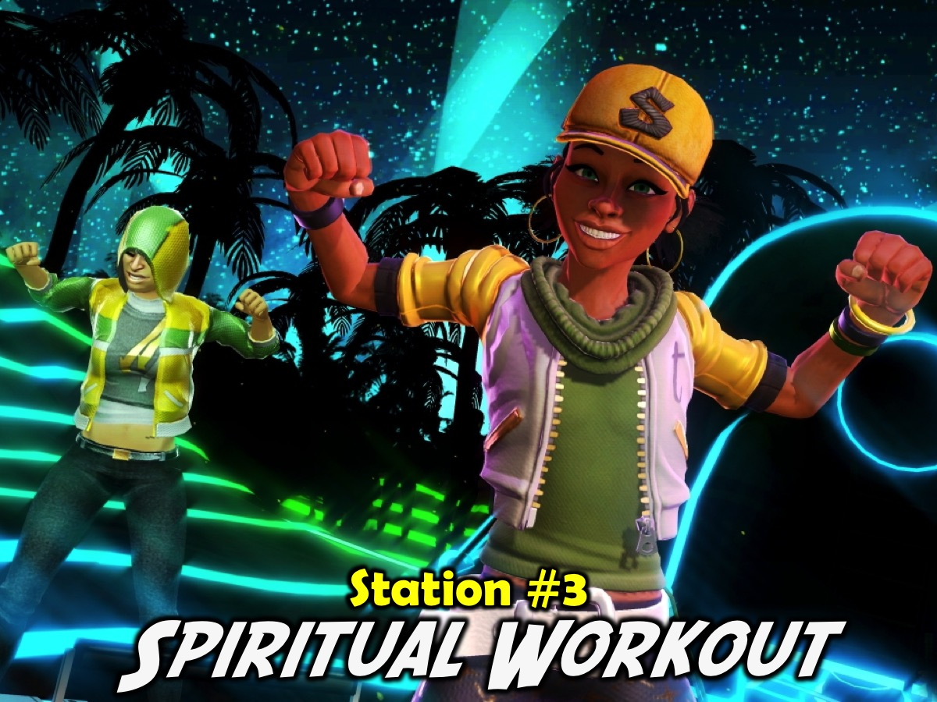
Notes:
Station #3: Spiritual Workout. Around the venue there are 9 stations that you can visit in any order - spend as much time at each place as you need to make use of the spiritual exercise that we have provided. You don’t have to visit all 9 stations.
The Stations:
1. Detox. Confess anything to God that you have done in the past week that he is not please about.
2. Jog. Jog your memory about God’s love by saying this verse 5 times: “For God so loved the world that he gave his one and only Son, that if I believe in him I will not perish but have eternal life.” Thank God for loving you!
3. Breathing. Say the Lord’s Prayer out loud - slowly line by line - actually say it as a prayer to God. “Our Father in heaven, hallowed be your name, your kingdom come, your will be done, on earth as it is in heaven. Give us today our daily bread. And forgive us our debts, as we also have forgiven our debtors. And lead us not into temptation, but deliver us from the evil one. For yours is the kingdom and the power and the glory forever. Amen.”
4. Reps. Say this verse over a few times until you can say it without looking: "This is how God showed his love among us: He sent his one and only Son into the world that we might live through him.” (1 John 4:9)
5. Cardio. Ask God to speak to you as you meditate on His Word. Say the verse over slowly at least 7 times - pausing between each time you repeat it. Pause and ask God what he wants to say to you. Thank God for having spoken to you. Verse: “Love the Lord your God with all your heart, and all your soul and all your mind, and love your neighbour as you love yourself.” (Luke 10:27)
6. Spot. Ask God to show you one person that you need to speak to about how much he loves them. Write their name down on the wall. (Use the heart shape on the wall)
7. Stretch. Which of these Fruit of the Spirit do you need to work on in your life? “But the fruit of the Spirit is love, joy, peace, patience, kindness, goodness, faith, gentleness, self-control.” (Galatians 5:22-23). What can you do to develop it in your life?
8. Pulse. Take your spiritual pulse by asking yourself whether you are more in love with God now than you were 6 months ago. If your answer is YES, then think of 3 reasons why you are in a better place. If your answer is NO, then ask God to show you what you need to do or stop doing to get into a better place in the next 6 months.
9. Gains. Think about something that you have learnt in the last month about God and write it on the page. God is…

Slide 18
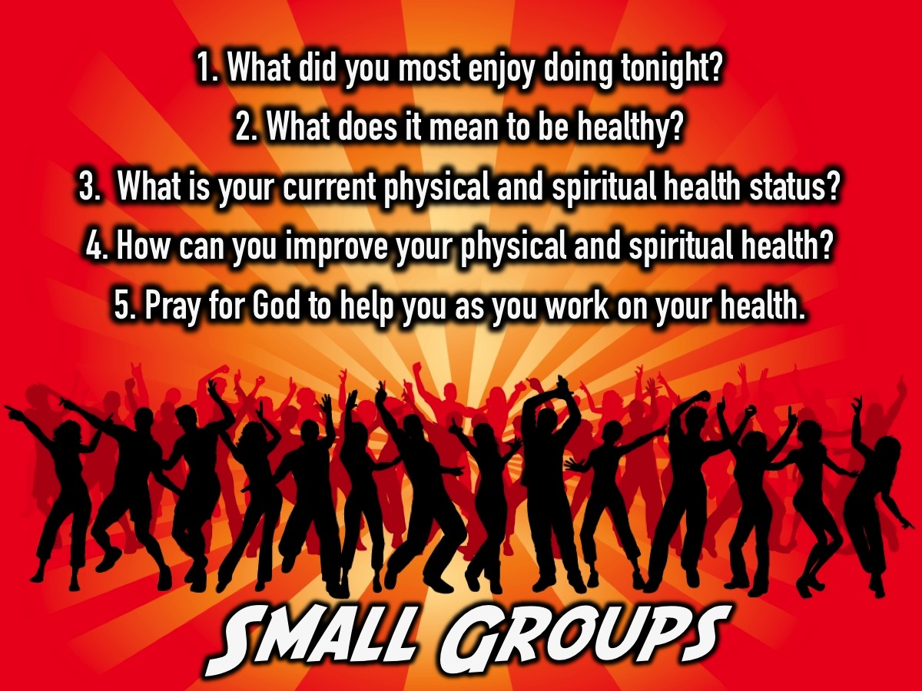
Notes:
Small Groups: Here are the questions: (1) What did you most enjoy doing tonight? (2) What does it mean to be healthy? (3) What is your current physical and spiritual health status? (4) How can you improve your physical and spiritual health? (5) Pray for God to help you as you work on your health.

Slide 19

Notes:
Refreshments. We will end with fruit salad and fresh fruit juice.
Refreshments Start at: 9:10

Slide 20
Notes:
Next Friday Night is My Mind Night (Warwick)

