Slide 1

Notes:
My Hobbies Night

Slide 2
Notes:
Video: The Crazy Frogs - The Ding Dong Song - New Full Length HD Video. Get it on YouTube at: https://www.youtube.com/watch?v=5fju_XcUhqo
Video length: 2:15

Slide 3
Notes:
Video: Bon Jovi – It’s My Life. Get it on YouTube at: https://www.youtube.com/watch?v=vx2u5uUu3DE
Video length: 4:30

Slide 4

Notes:
Welcome to My Life Friday

Slide 5

Notes:
Each Friday night of this term we are going to be focusing on a different part of our lives.

Slide 6

Notes:
Tonight is My Hobbies Night

Slide 7

Notes:
Welcome to all our regulars and if there are any newcomers – please come up onto stage so we can welcome you!
Time: 7:40-7:50 - Welcome, Announcements and Instructions

Slide 8

Notes:
Announcements: On Sunday morning we continue with the Trilogy Series!

Slide 9

Notes:
Next Friday night there is no youth do to Friday being a public holiday!

Slide 10

Notes:
Tonight is all about trying a new hobby - one you would possibly really enjoy but have not tried yet.

Slide 11

Notes:
Hobbies - what are hobbies? Things you do regularly for enjoyment. Things you love to do that you don't get tired of. Things you find fun to do that's not work!

Slide 12
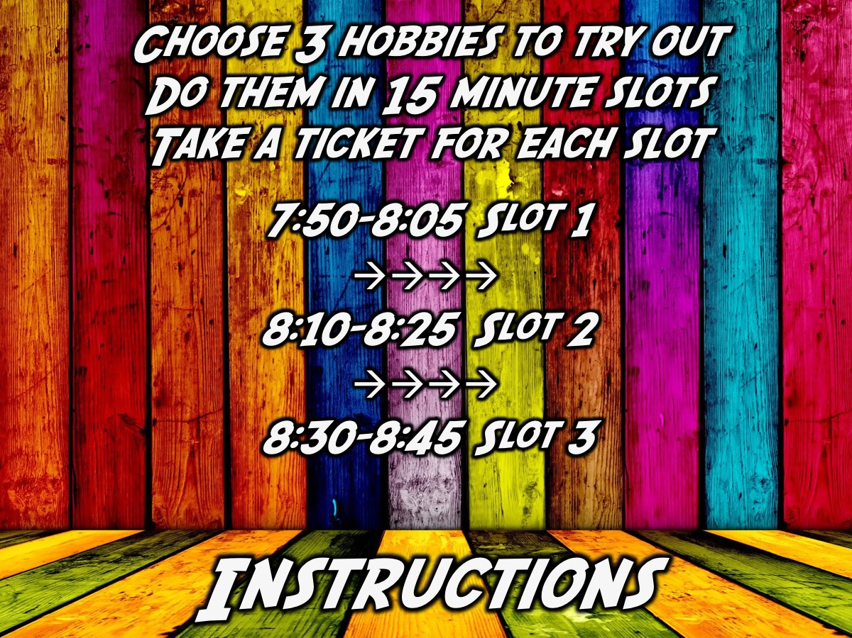
Notes:
Instructions: You will choose 3 hobbies to try out. You will do them in 15 minute slots. You will take a ticket for each slot. There is a 5 minute transition between each slot (a leader will be stationed at each of the stations to be the time keeper).
7:50 - 8:05 Slot 1
8:05 - 8:10 Transition
8:10 - 8:25 Slot 2
8:25 - 8:30 Transition
8:30 - 8:45 Slot 3
8:45 - 8:50 Transition
Tickets have the following information:
Hobby: Playing Chess
Time: 7:50-8:05
Venue: His Diz Room

Slide 13

Notes:
There are 6 hobbies for you to try out tonight:
(At each station the person leading it says: "Welcome to my hobby! This is what it is about… Okay, it is time for you to try it out!”)

Slide 14

Notes:
1. Geocashing - Shaun Pearce introduces his hobby of Geocaching by introducing what it is all about and then using a GPS enabled phone leads the group to find the treasure and record it. Venue: Youth Kitchen

Slide 15
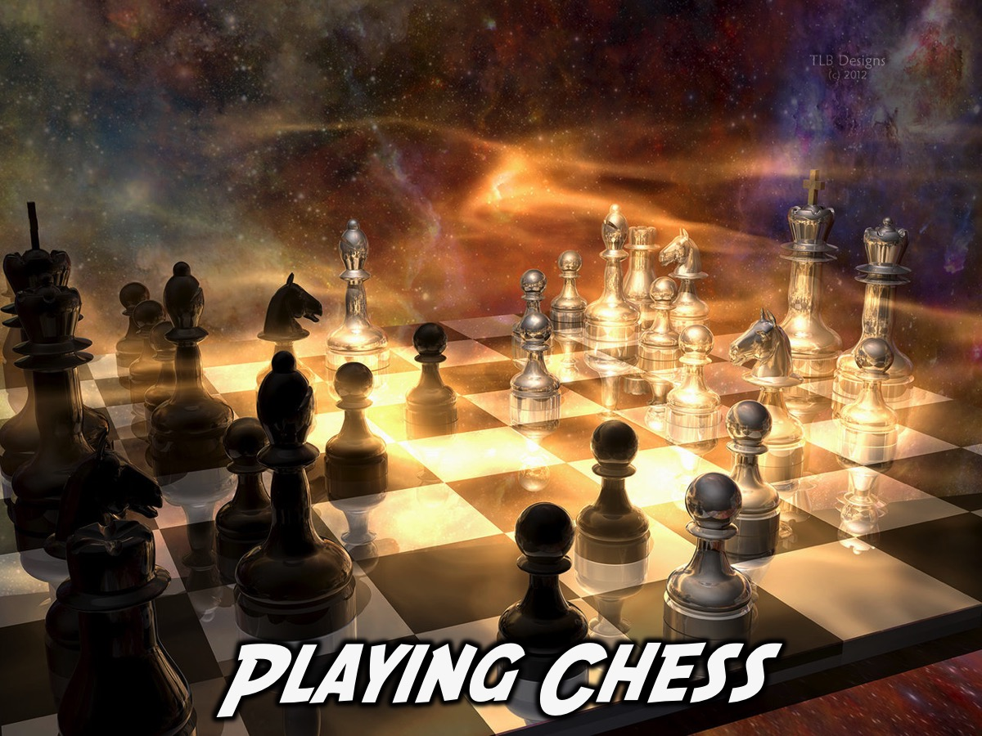
Notes:
2. Playing Chess - Tebogo Matomi introduces his hobby of chess – sharing a brief overview of the game of chess – explaining how each peace moves and the aim of the game - and then people get to try it out. Venue: His Kids

Slide 16

Notes:
3. Creating Art - Debbie introduces her hobby of painting and each person gets to paint a mask. Venue: His Kids

Slide 17

Notes:
4. Playing Guitar - Hannah Eccles introduces her hobby of guitar playing and teaches teens three basic chords and the basics of strumming. Venue: His Diz

Slide 18

Notes:
5. Dressmaking – Ashley Tittley introduces her hobby of dressmaking - shows what is involved and gets everyone to try out sewing two pieces of material together on a sewing machine. Venue: Youth Room

Slide 19

Notes:
6. Baking Cookies – Simone Woodhead introduces her hobby of baking and shares what is involved in making a batch of biscuits and each group gets to prepare a try of biscuits which are baked while the next group is being instructed - and these biscuits are served later as eats for our refreshment time. Venue: Tots House.

Slide 20
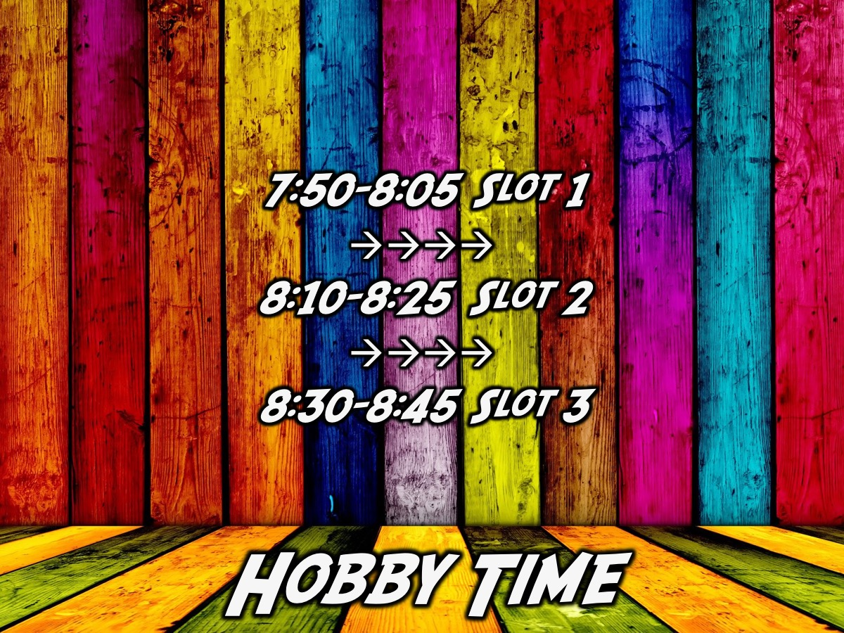
Notes:
It is Hobby Time. Visit the stations in the venues marked on your tickets.

Slide 21

Notes:
Small Group Questions: (1) What new hobbies did you get to try out tonight? (2) Which hobbies did you enjoy the most and the least? (3) What hobbies do you currently have in your life? (4) How could you involve God in your hobby? (5) How could you use your hobby to show God’s love, share the gospel or make the world a better place? (6) Pray for each other to find hobbies that are fun, help you connect with God and enrich others.
Time: 8:50 - 9:10

Slide 22

Notes:
Refreshments – we will end with cookies that were baked tonight and milk.
Time: 9:10 - 9:30

