Slide 1

Notes:
My Mind Night

Slide 2

Notes:
Welcome to My Life Friday
Time: 7:40-7:50 - Welcome, Announcements and Instructions

Slide 3
Notes:
Tonight is My Mind Night

Slide 4

Notes:
Welcome to all our regulars and if there are any newcomers – please come up onto stage so we can welcome you!

Slide 5

Notes:
On Sunday morning we continue with the Trilogy Series!

Slide 6

Notes:
Next Friday night is My School night.

Slide 7

Notes:
Rehearse: You are going to divide into six groups and will have to create an advert in 15 minutes (to introduce a new perfume to the market). Then you will perform the 1 minute advert on stage.
Behind the Scenes - we are appointing a teen leader for each group. They will be responsible to identify and record the names of the roles played by each team member according to these six roles:
1. Optimist (person who kept up morale)
2. Leader (drove the project, took charge)
3. Cautious (didn't do too much, kept quiet)
4. Organizer (got people to focus, detail-orientated)
5. Thinker (came up with ideas, suggestions)
6. Indifferent (just went with the flow)

Slide 8

Notes:
Release: It is time to release your advert. Each group has 1 minute to present their advert on stage.

Slide 9
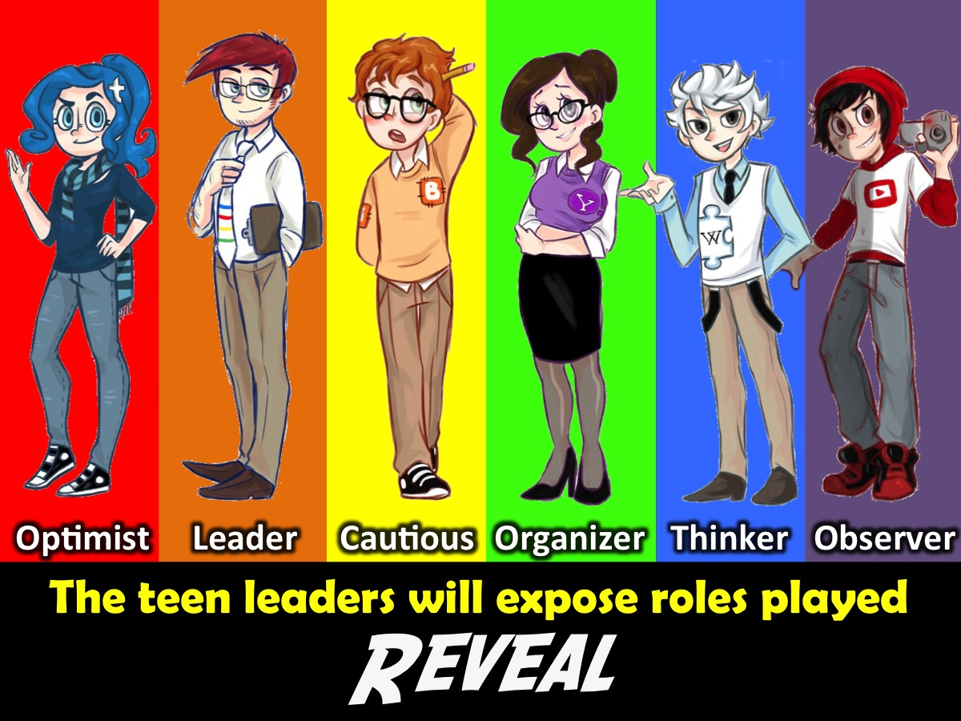
Notes:
Reveal: In each group there is teen leader who will reveal to the group the roles played by each member of the group during the creation and performance of the advert: the Optimist, Leader, Cautious, Organizer, Thinker and Observer.

Slide 10
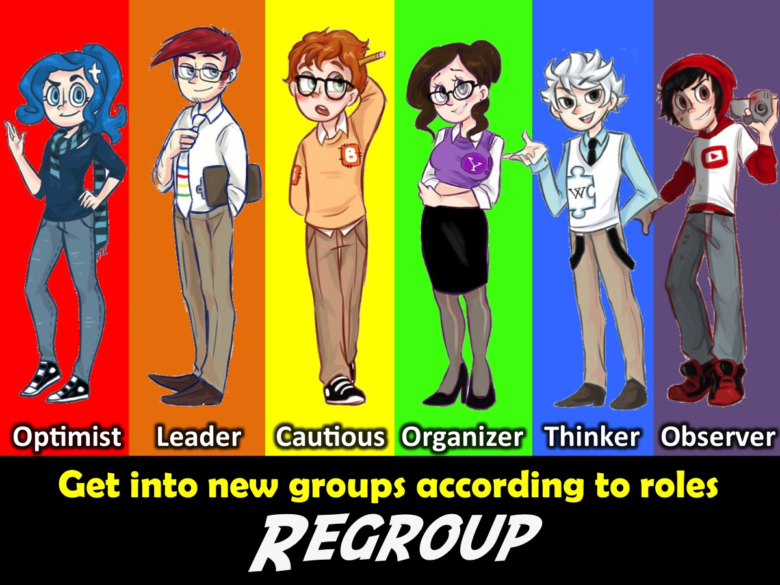
Notes:
Regroup: You will divide into six new groups based on the six different roles played during the rehearsal: the Optimist, Leader, Cautious, Organizer, Thinker and Observer.

Slide 11

Notes:
Rehearse: You will create your new advert - you have 10 minutes this time. This time you are creating an advert for a new car.

Slide 12

Notes:
Release: It is time to release your new advert. Each group has 1 minute to present their advert on stage.

Slide 13

Notes:
Reflect: The MC will now share some insights.

Slide 14
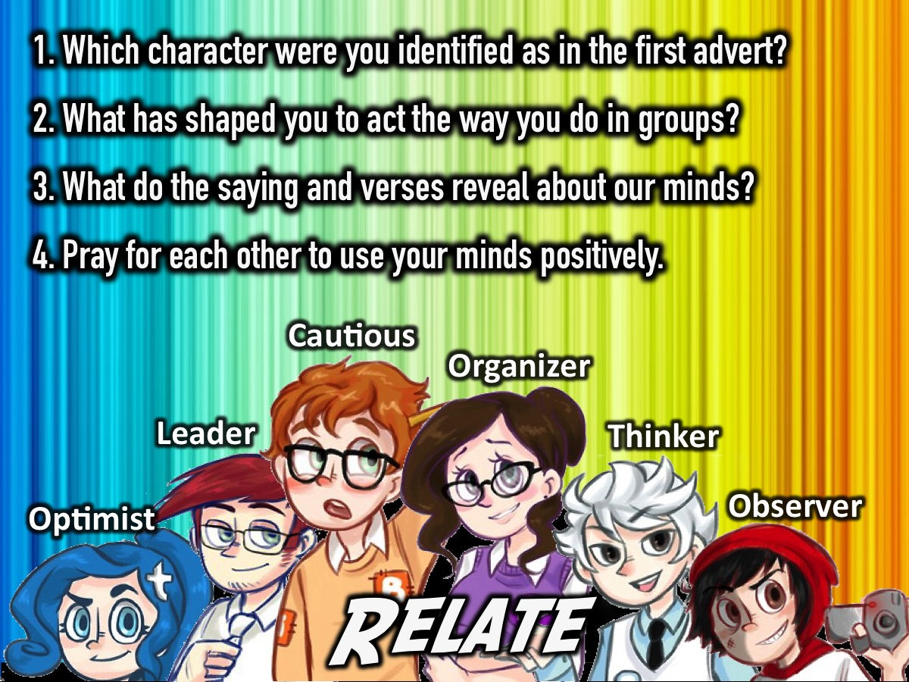
Notes:
Relate: Here are the small group questions: (1) Which character were you identified as in the first advert? (2) What has shaped you to act the way you do in groups? (3) What do the verses/sayings reveal about our minds? Watch your thoughts, they become words; watch your words, they become actions; watch your actions, they become habits; watch your habits, they become character; watch your character, for it becomes your destiny. (Anon). Love the Lord your God with all your heart and with all your soul and with all your strength and with all your mind. (Luke 10:27). Do not conform to the pattern of this world, but be transformed by the renewing of your mind. (Romans 12:1). Whatever is true, noble, right, pure, lovely, admirable - if anything is excellent or praiseworthy - think about such things. (Philippians 4:8). Set your minds on things above, not on earthly things. (Colossians 3:2). (4) Pray for each other to use your minds positively.

Slide 15

Notes:
Refreshments: We will serve hot chocolate and biscuits. Refreshments Start at: 9:10

Slide 16

Notes:
Next Friday Night is My School Night (Shaun)

