Slide 1

Notes:
Here are the photos from a creative Friday night in the My Life series developed by Warwick that helped teens identify the role they play in small groups and how they can grow.

Slide 2
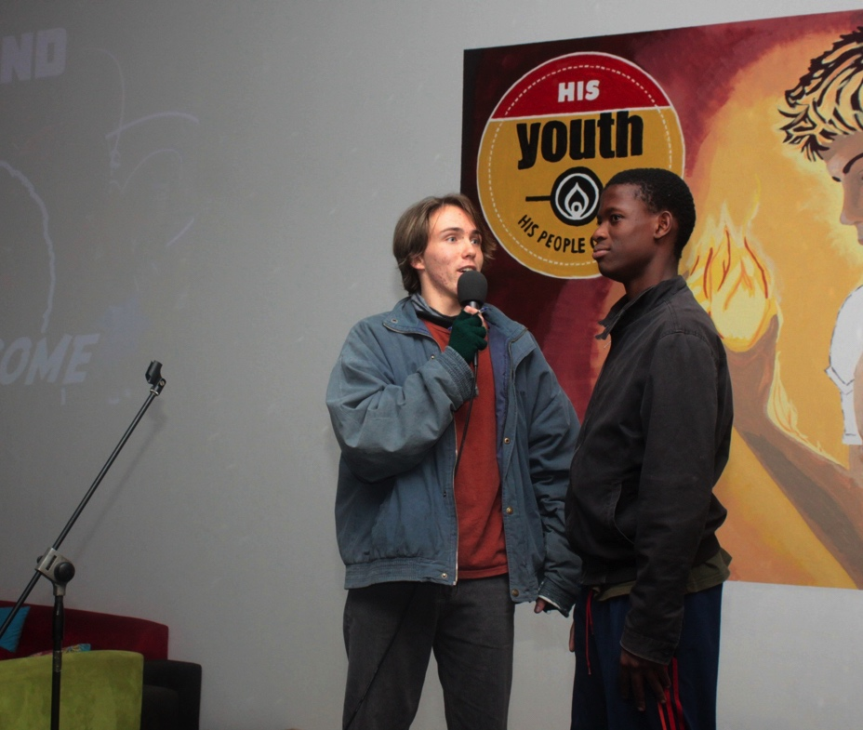
Notes:
Here are the photos from a creative Friday night in the My Life series developed by Warwick that helped teens identify the role they play in small groups and how they can grow.

Slide 3
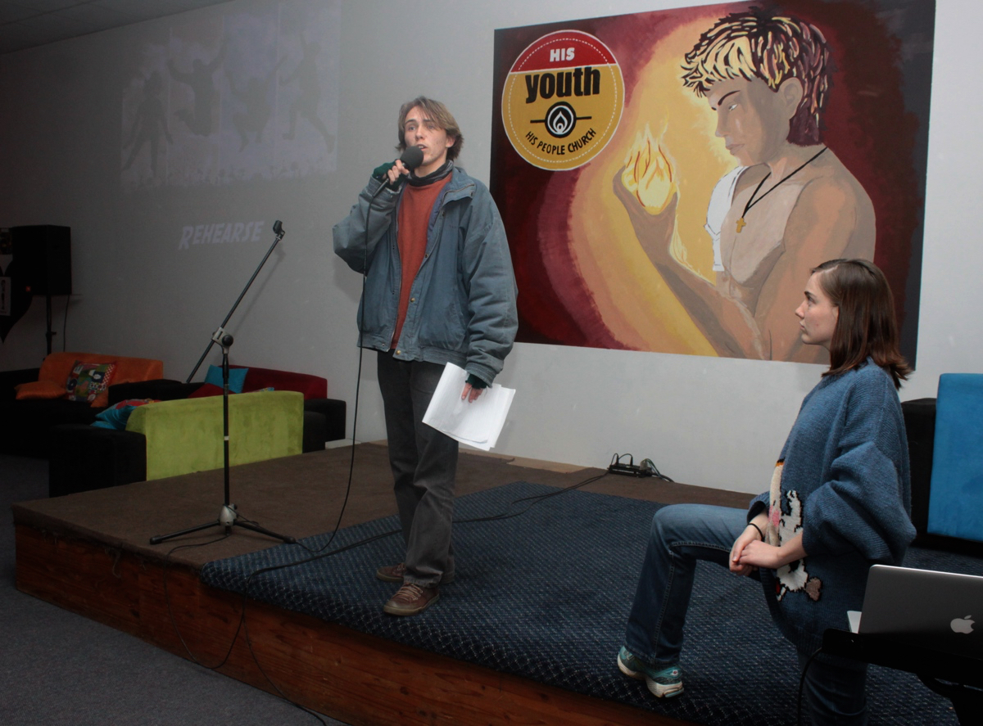
Notes:
Warwick the MC on the night ably assisted by his sister, Hannah.

Slide 4

Notes:
The group was divided randomly into 6 smaller groups and given the task of creating a commercial for a new perfume.

Slide 5
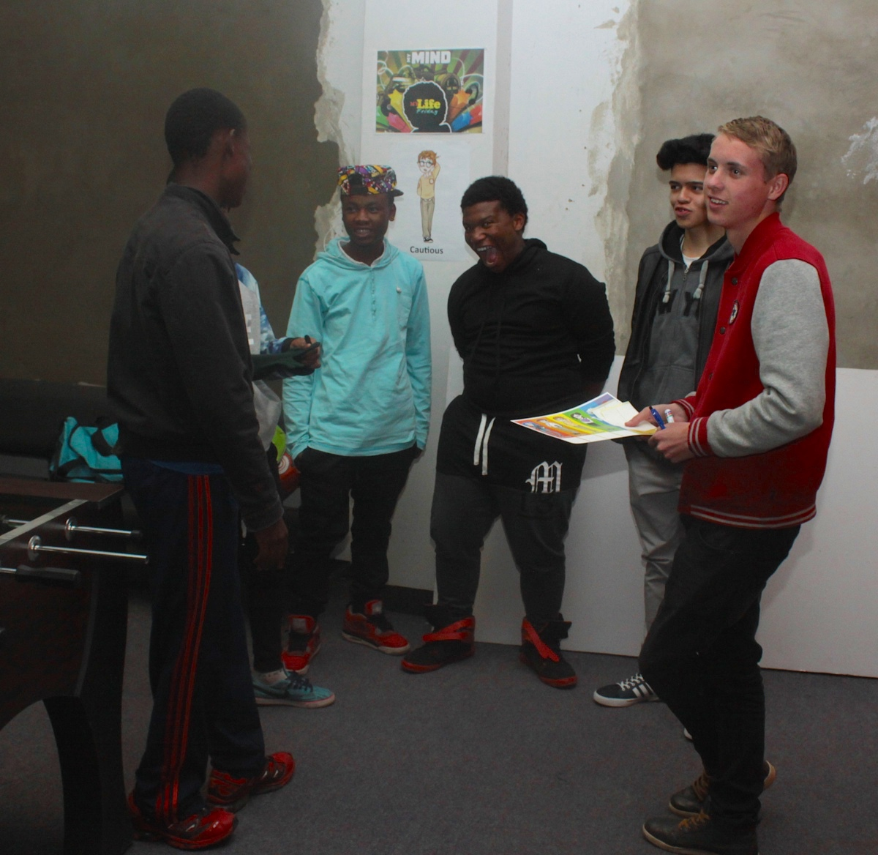

Slide 6
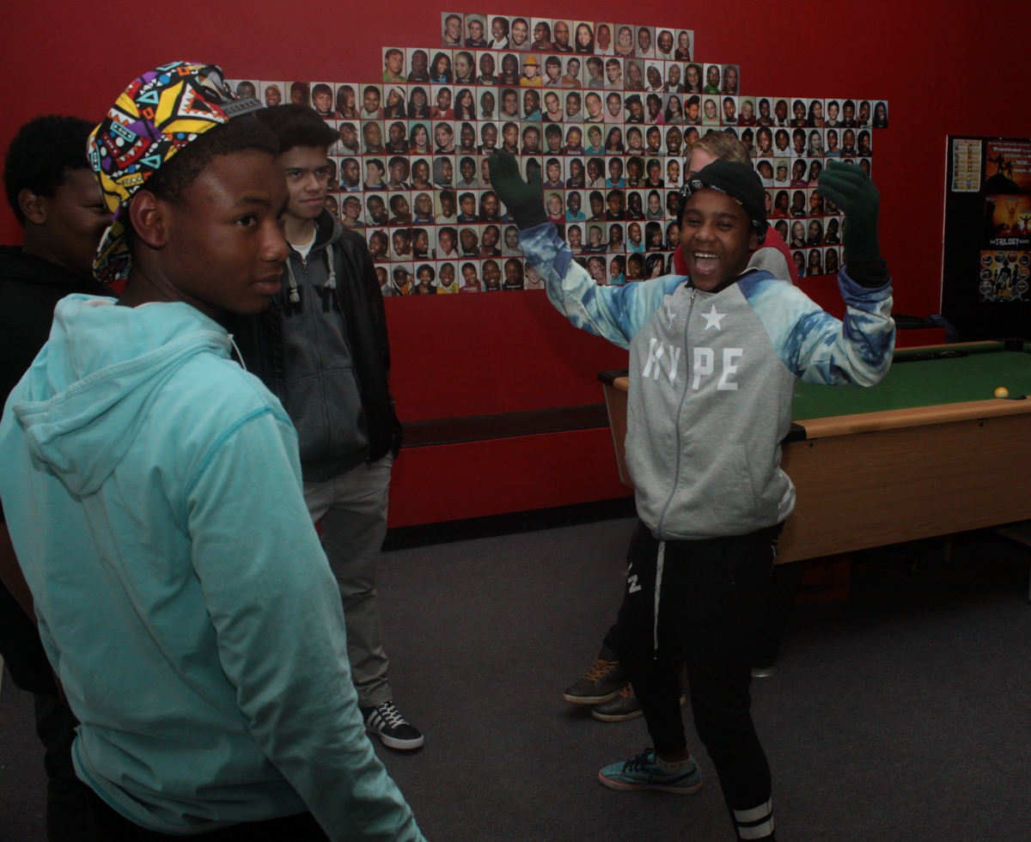
Notes:
Groups working on creating their commercial.

Slide 7
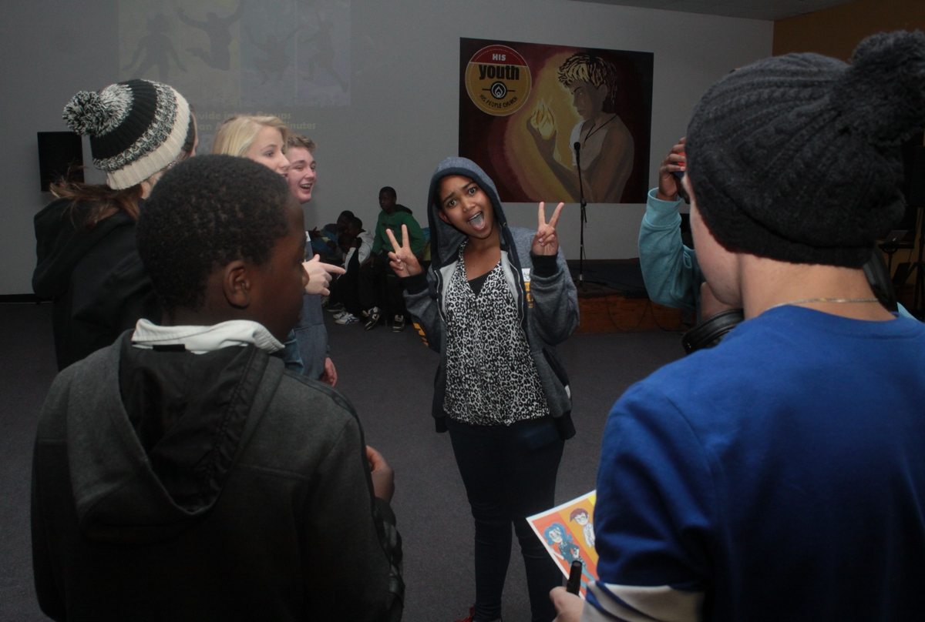
Notes:
Groups working on creating their commercial.

Slide 8
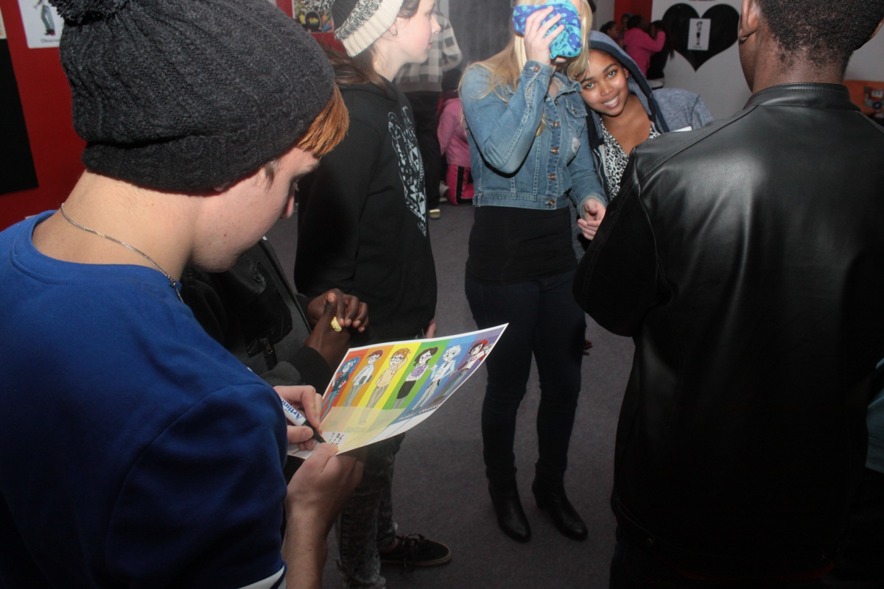
Notes:
During the group work phase we had teen leaders observing the group to identify six different roles that people play when they work in a small group.

Slide 9

Notes:
Each group had a minuute to present their commercial on stage.

Slide 10
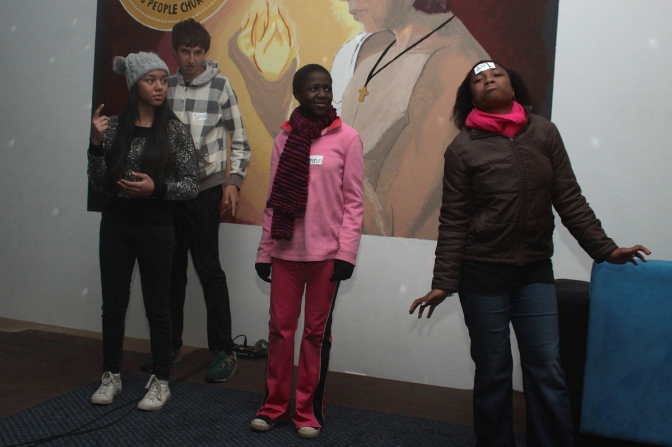
Notes:
Group 1: Danielle's group introduced their new perfume: Elizabeth Pardon. Alexia stands in the middle of the stage while Dominic stands behind her spraying the perfume and Hannah joins in, Abby sits on the side of the stage looking out at the audience but her head snaps up as she smells the peerfume. Sharon sprays a by-passer and says: “Why use your own perfume when you could use Elizabeth Pardon? This fragrance has a refreshing smell that will leave you energized and feeling like never before! With each sprits you’ll find new confidence and feel amazing!”

Slide 11
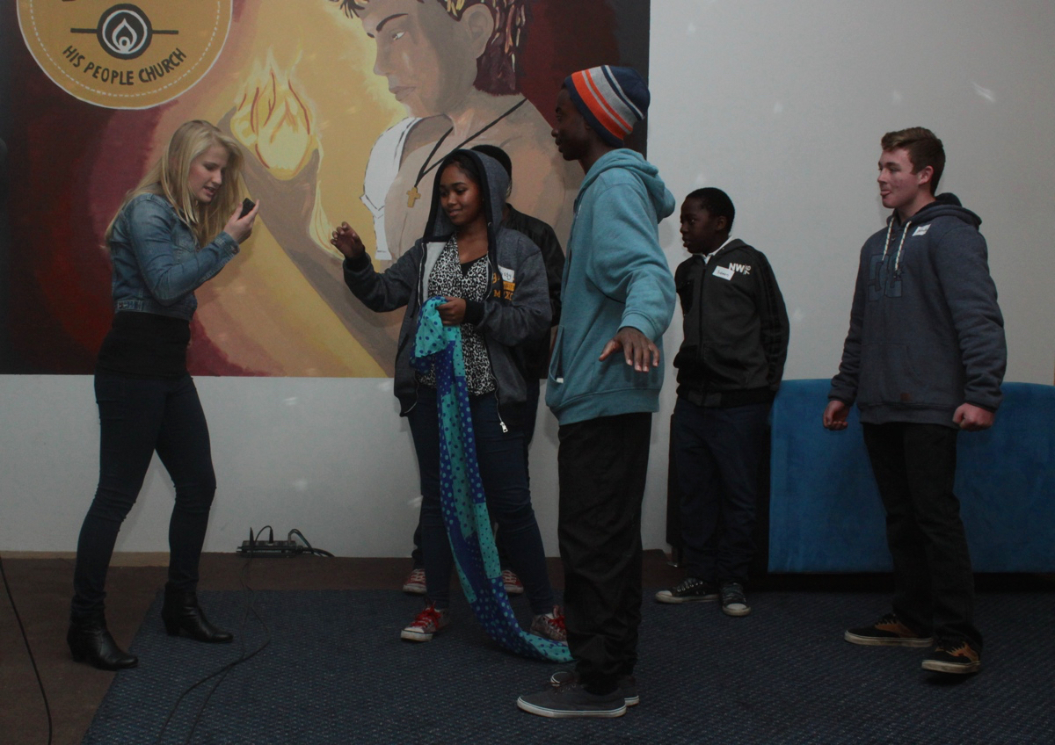
Notes:
Group 2: Asher's group introduce their new perfume: Winter Whispher. Sarah is stinking because the day is so hot. She takes the perfume, sprays herself and says: "You can use it when the day is hot!” Brendon is gymming and uses Winter Whispher to refresh himself. Ryan says: "Use it to refresh yourself but beware it is very expensive!"

Slide 12
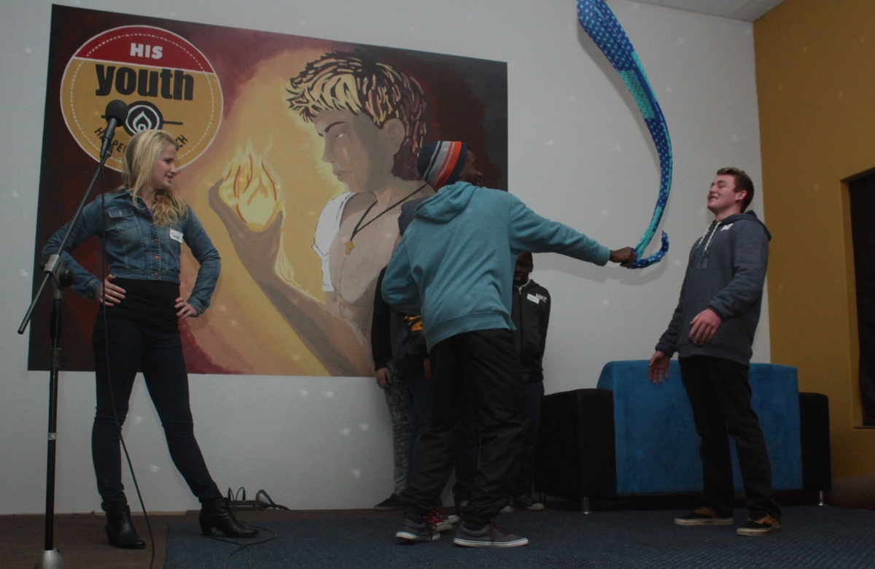
Notes:
Group 2: Asher's group introduce their new perfume: Winter Whispher. Sarah is stinking because the day is so hot. She takes the perfume, sprays herself and says: "You can use it when the day is hot!” Brendon is gymming and uses Winter Whispher to refresh himself. Ryan says: "Use it to refresh yourself but beware it is very expensive!"

Slide 13
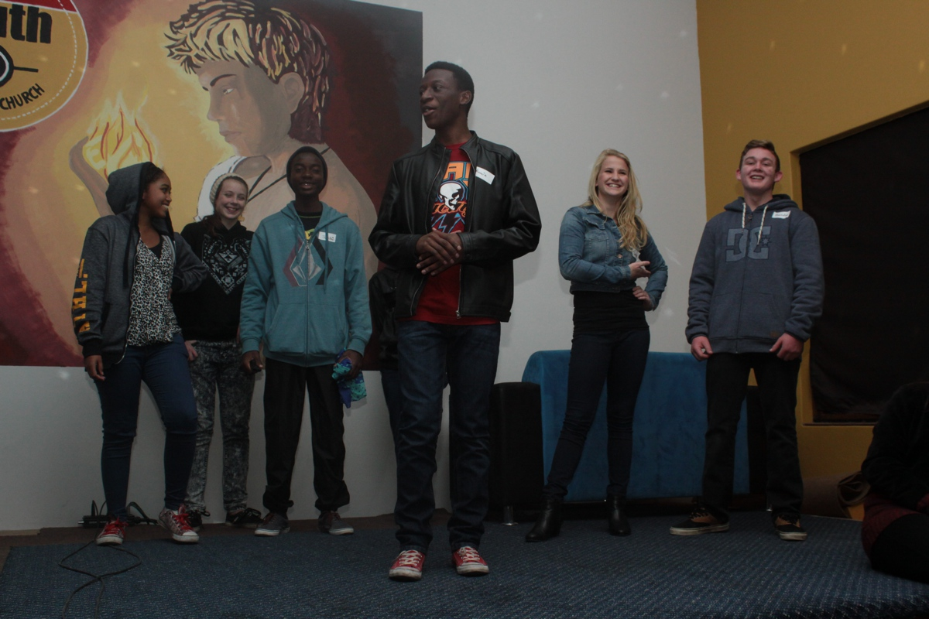
Notes:
Group 2: Asher's group introduce their new perfume: Winter Whisper. Sarah is stinking because the day is so hot. She takes the perfume, sprays herself and says: "You can use it when the day is hot!” Brendon is gymming and uses Winter Whisper to refresh himself. Ryan says: "Use it to refresh yourself but beware it is very expensive!"

Slide 14
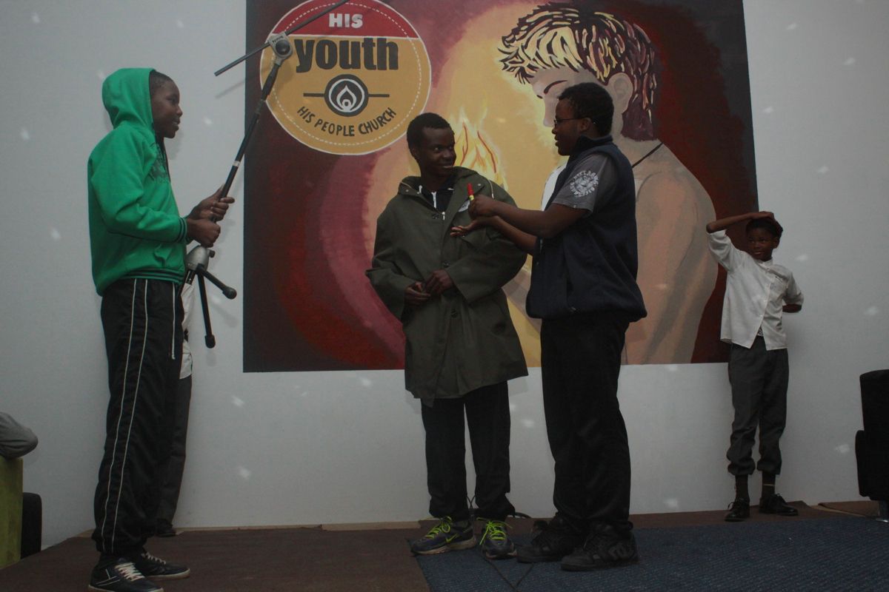
Notes:
Group 3: Danielle's group introduces their new perfume: Red Shirt. Micah stinks - everyone says so! A man offers him a new deo that makes him earn the respect of all his peers. Plus after using the deodorant he discovers that he is magically wearing a red shirt under his clothing. He says: “A deodorant that will make a Red Shirt appear under all those layers of winter clothes!”

Slide 15
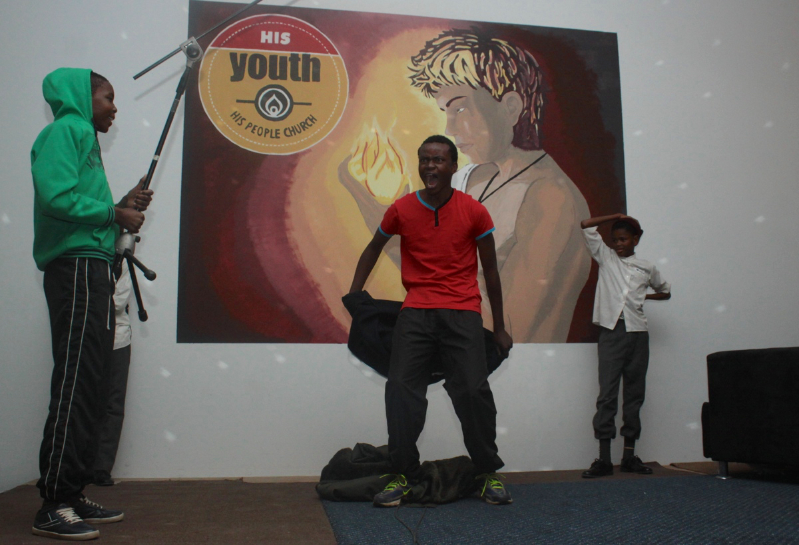
Notes:
Group 3: Danielle's group introduces their new perfume: Red Shirt. Micah stinks - everyone says so! A man offers him a new deo that makes him earn the respect of all his peers. Plus after using the deodorant he discovers that he is magically wearing a red shirt under his clothing. He says: “A deodorant that will make a Red Shirt appear under all those layers of winter clothes!”

Slide 16
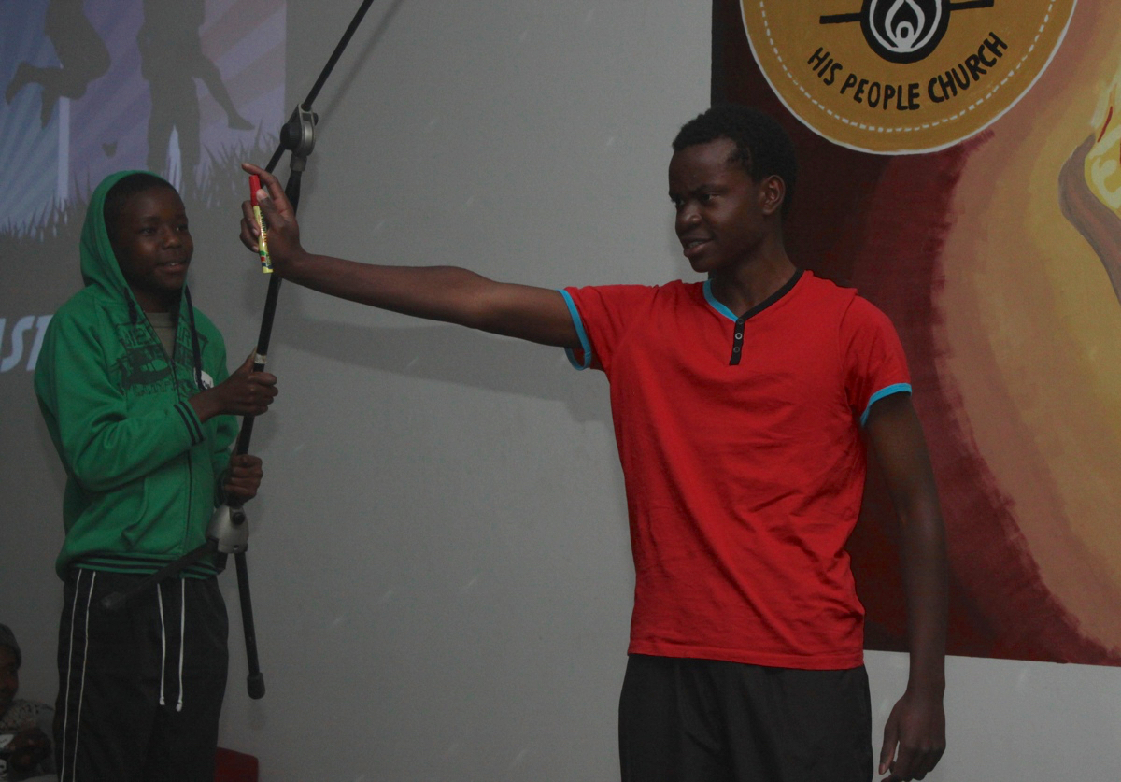
Notes:
Group 3: Danielle's group introduces their new perfume: Red Shirt. Micah stinks - everyone says so! A man offers him a new deo that makes him earn the respect of all his peers. Plus after using the deodorant he discovers that he is magically wearing a red shirt under his clothing. He says: “A deodorant that will make a Red Shirt appear under all those layers of winter clothes!”

Slide 17
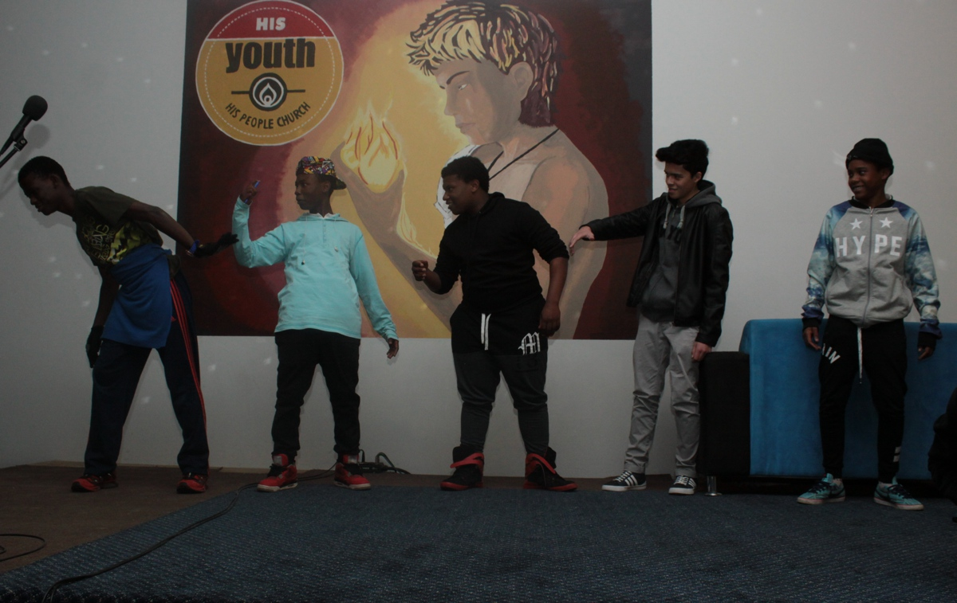
Notes:
Group 4: Kenan's group introduces their new perfume. As the guys spray the deodorant they begin to dance. At the end someone even flys through the air. Someone says: "Cow-flavoured spray gives you wings." Someone else says: "You can only get it at Spaza shops."

Slide 18
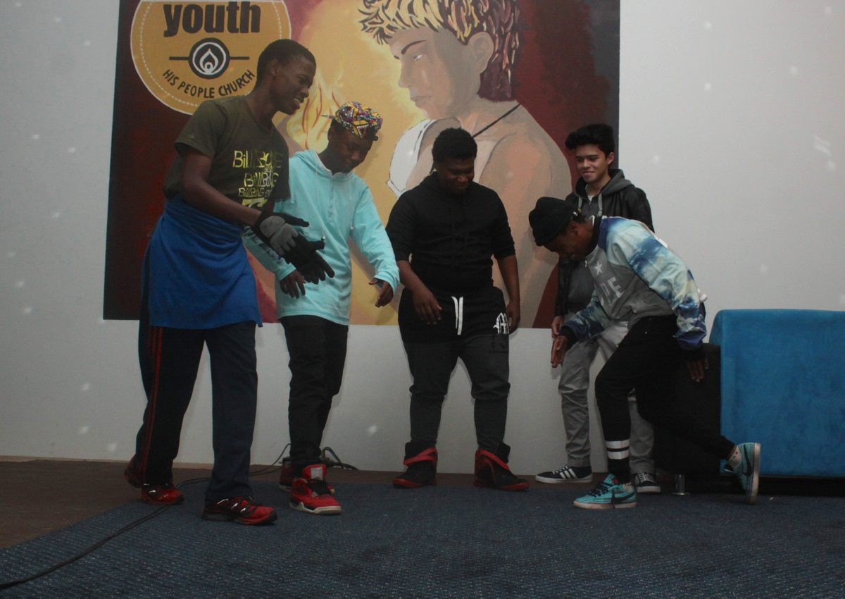
Notes:
Group 4: Kenan's group introduces their new perfume. As the guys spray the deodorant they begin to dance. At the end someone even flys through the air. Someone says: "Cow-flavoured spray gives you wings." Someone else says: "You can only get it at Spaza shops."

Slide 19
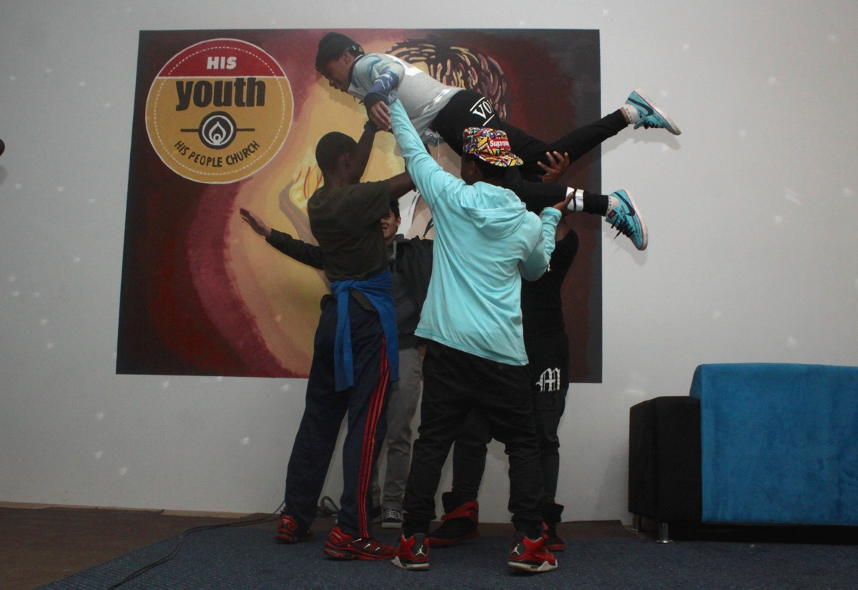
Notes:
Group 4: Kenan's group introduces their new perfume. As the guys spray the deodorant they begin to dance. At the end someone even flys through the air. Someone says: "Cow-flavoured spray gives you wings." Someone else says: "You can only get it at Spaza shops."

Slide 20
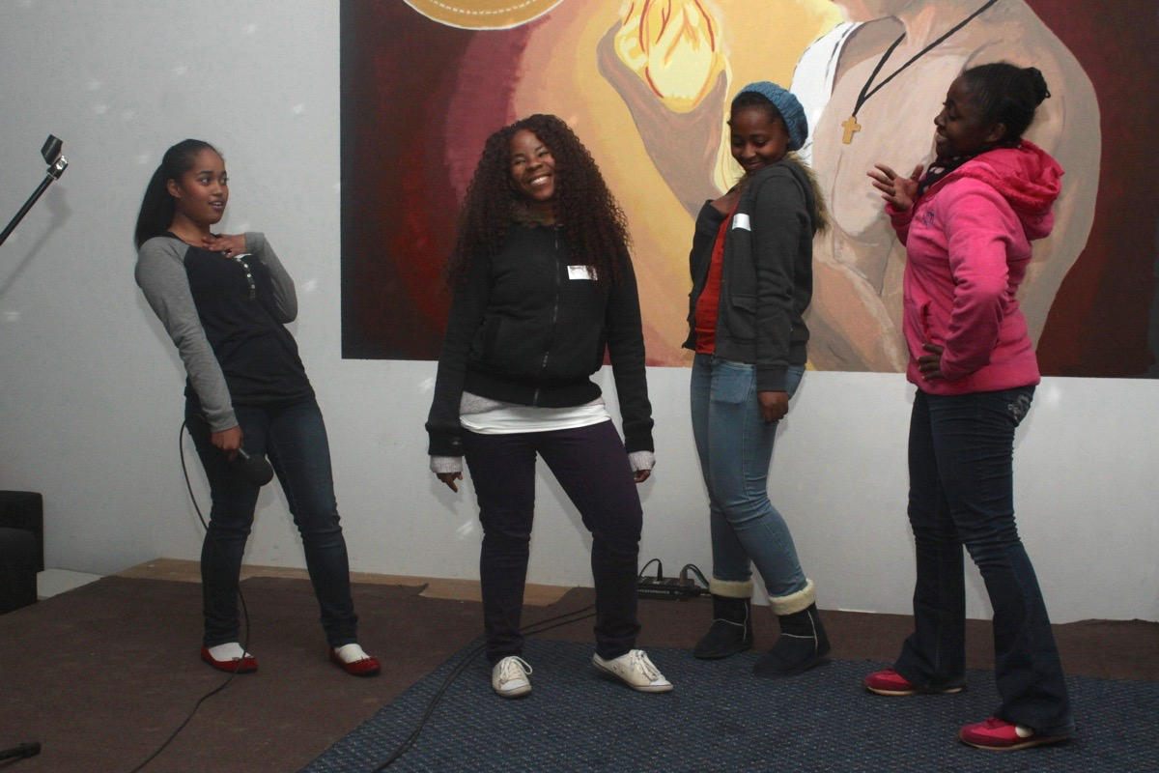
Notes:
Group 5: Tiague's group introduces their new perfume: Bonita Je’tem. The girls walk onto stage and when Ayanda sprays the perfume she says: "Because I have it everyone everyone looks at me!" Tama says: "I need to go get some!"

Slide 21
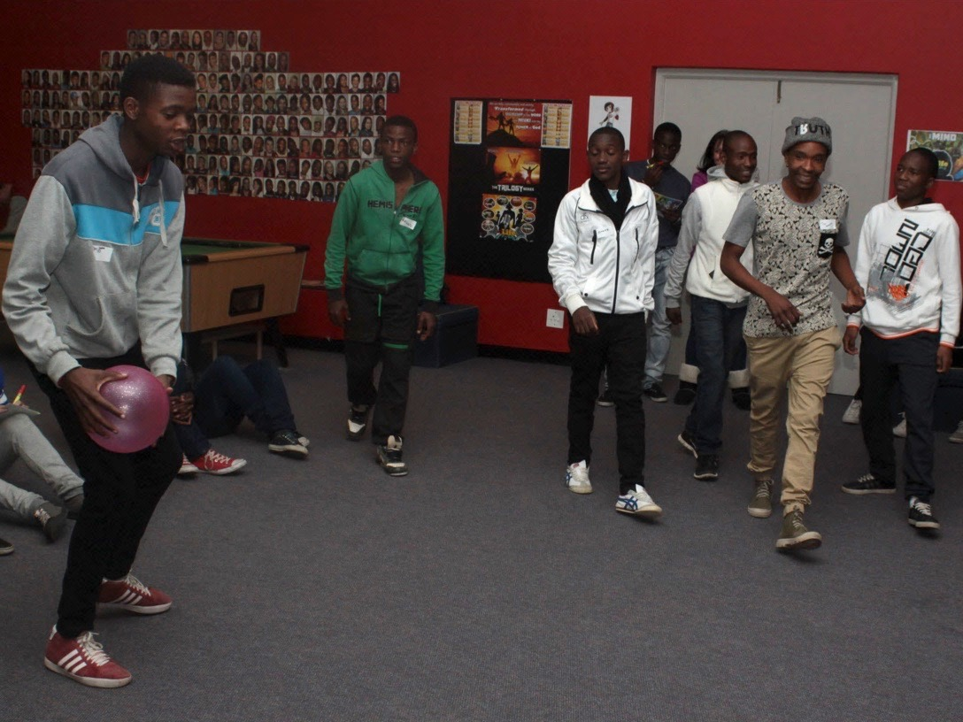
Notes:
Group 6: Godswill's group introduces their new perfume: Blue Note. After a game of basketball someone sprays the perfume and when everyone realises it is good someone says: "After sports, spray Blue Note and all the ladies will want you!"

Slide 22
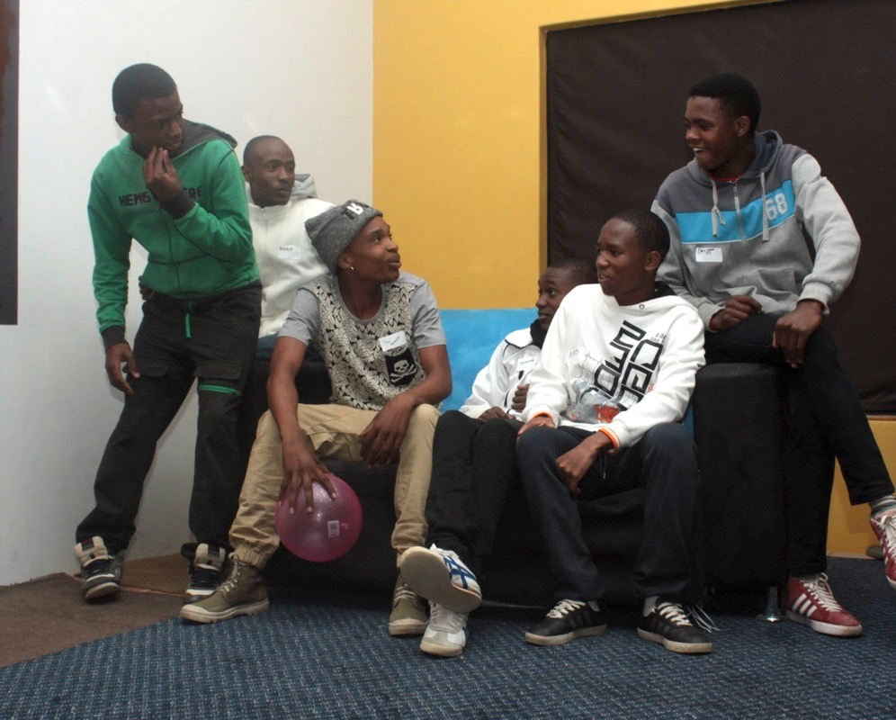
Notes:
Group 6: Godswill's group introduces their new perfume: Blue Note. After a game of basketball someone sprays the perfume and when everyone realises it is good someone says: "After sports, spray Blue Note and all the ladies will want you!"

Slide 23
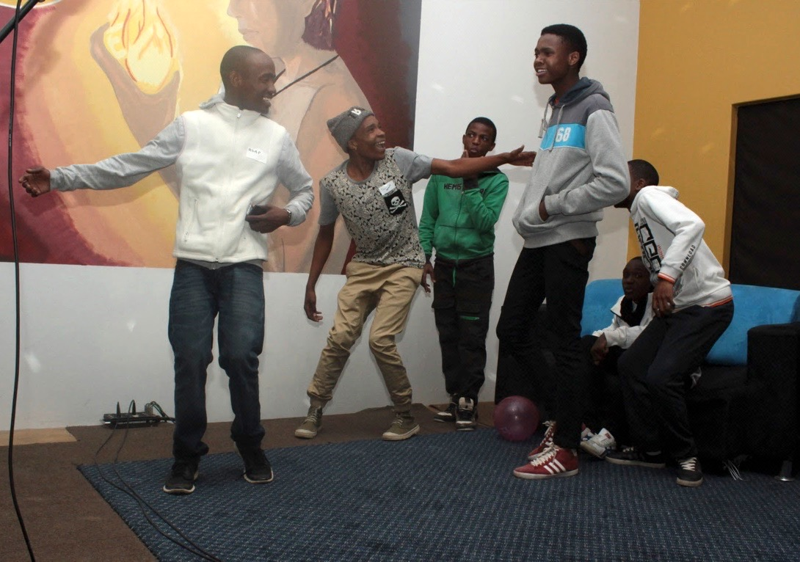
Notes:
Group 6: Godswill's group introduces their new perfume: Blue Note. After a game of basketball someone sprays the perfume and when everyone realises it is good someone says: "After sports, spray Blue Note and all the ladies will want you!"

Slide 24
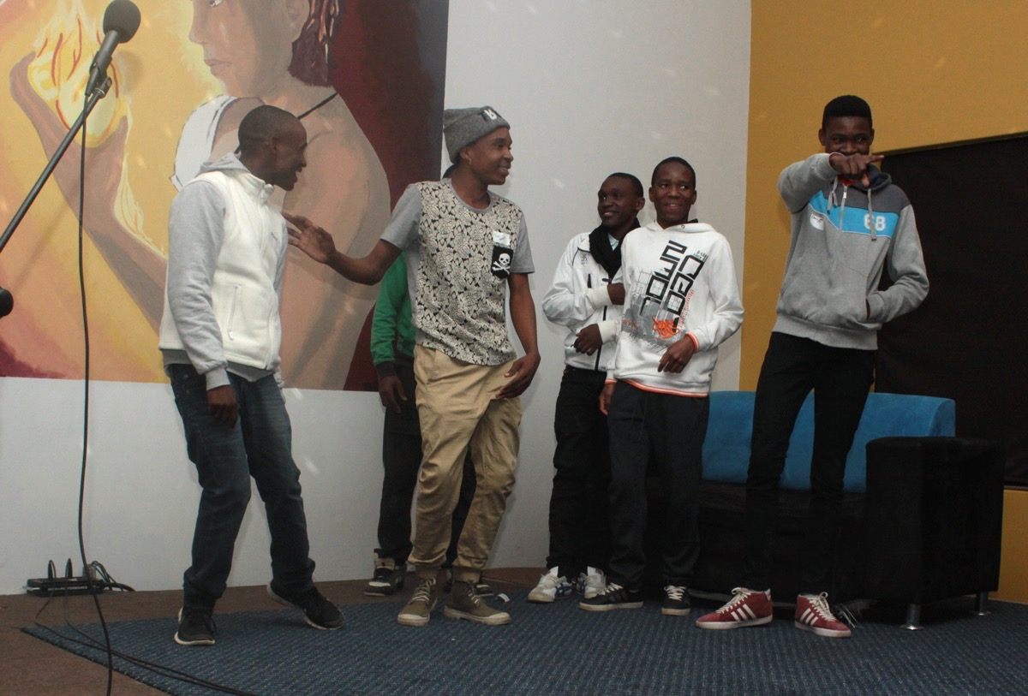
Notes:
Group 6: Godswill's group introduces their new perfume: Blue Note. After a game of basketball someone sprays the perfume and when everyone realises it is good someone says: "After sports, spray Blue Note and all the ladies will want you!"

Slide 25
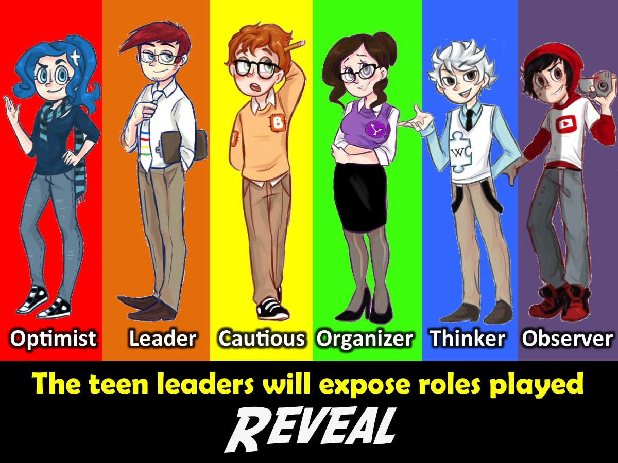
Notes:
At this point the leaders revealed to the group which roles they had played in their small group:
1. Optimist (person who kept up morale)
2. Leader (drove the project, took charge)
3. Cautious (didn't do too much, kept quiet)
4. Organizer (got people to focus, detail-orientated)
5. Thinker (came up with ideas, suggestions)
6. Observer (just went with the flow)

Slide 26
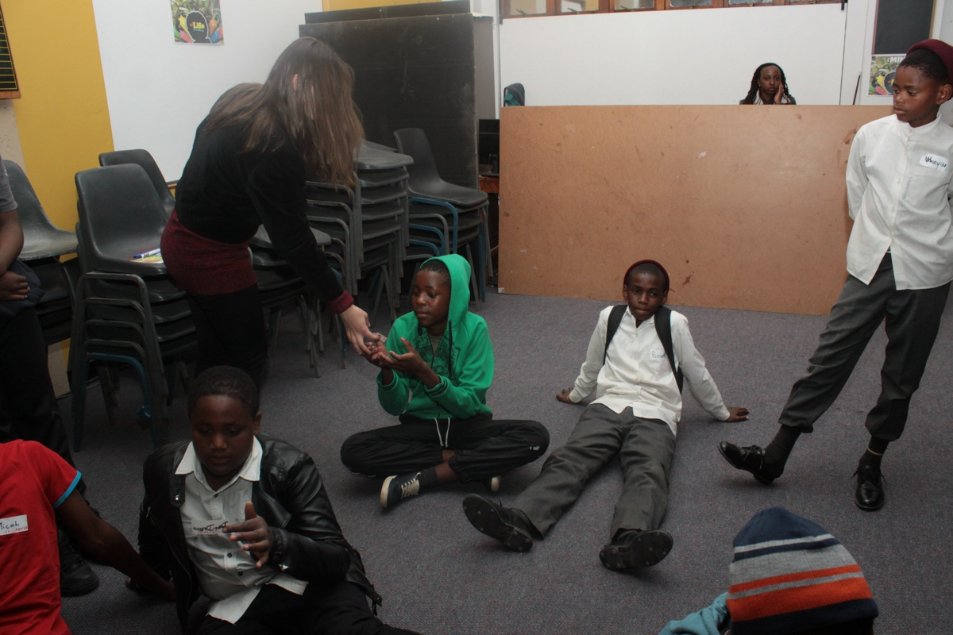
Notes:
Leaders identifying the roles played by writing it on the name tags.

Slide 27
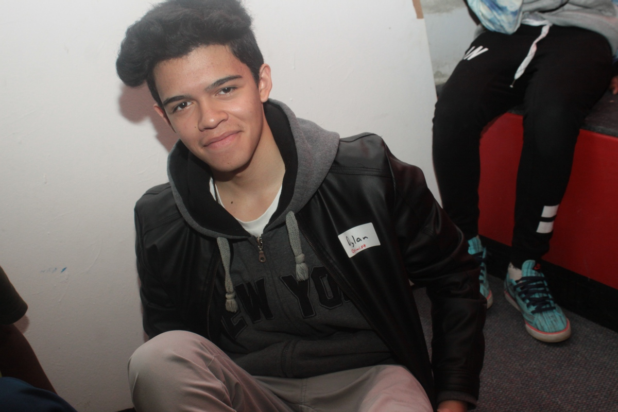
Notes:
Leaders identifying the roles played by writing it on the name tags.

Slide 28
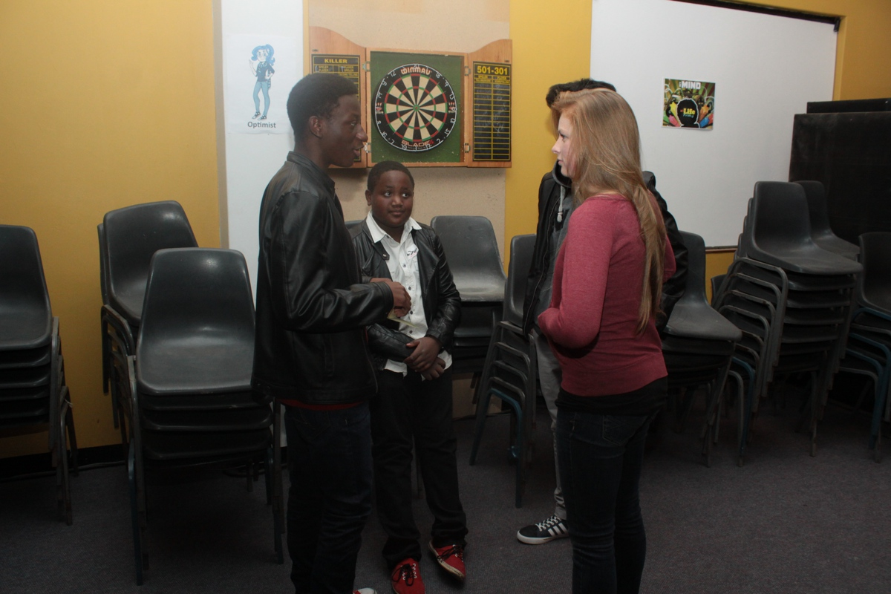
Notes:
The group of Optimists creating their commercial for a new car.

Slide 29
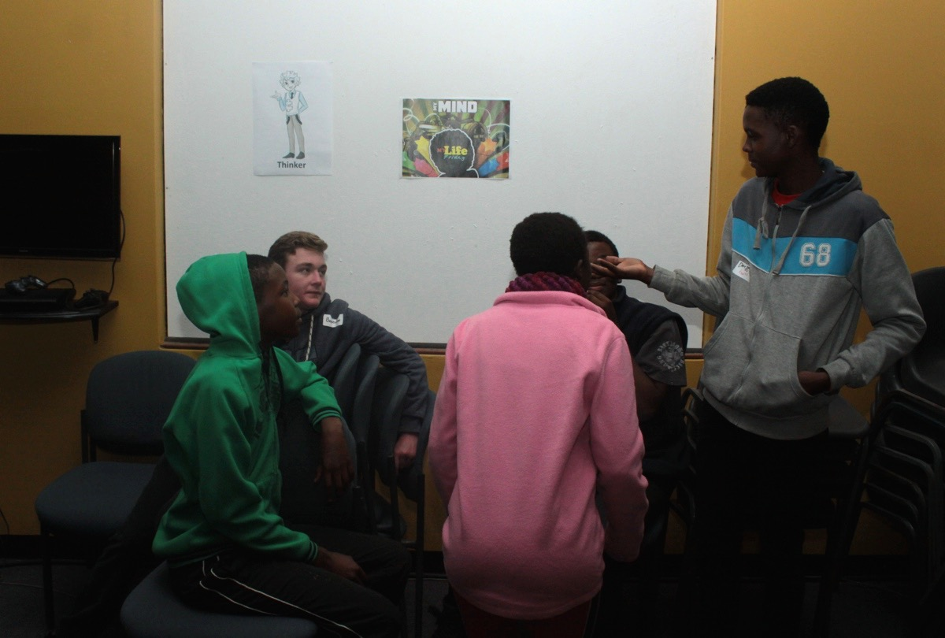
Notes:
The group of Thinkers creating their commercial for a new car.

Slide 30
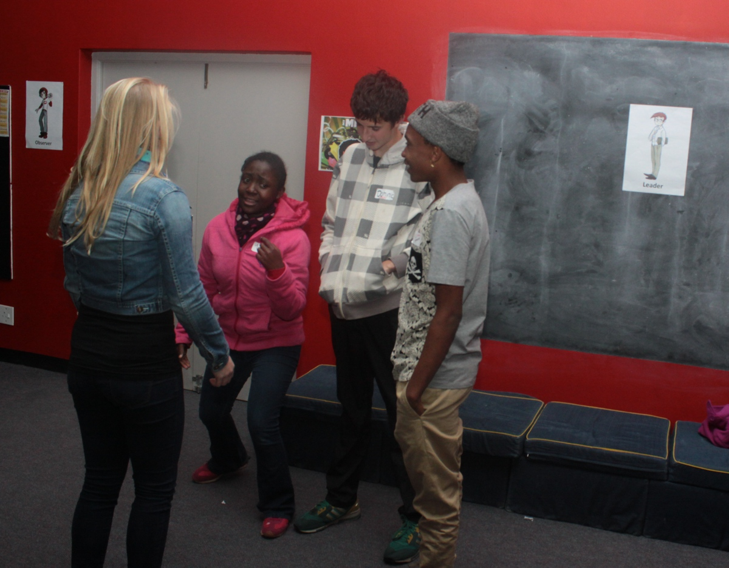
Notes:
The group of Leaders creating their commercial for a new car.

Slide 31
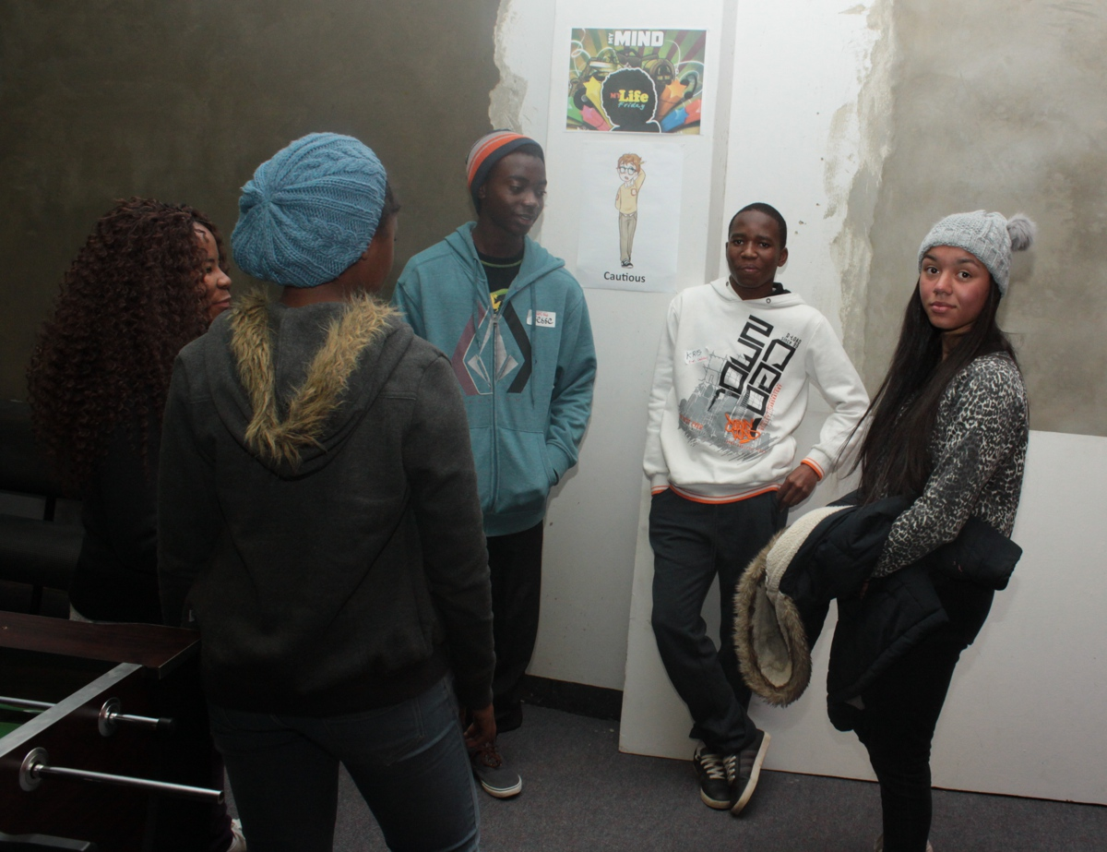
Notes:
The group of Cautious creating their commercial for a new car.

Slide 32
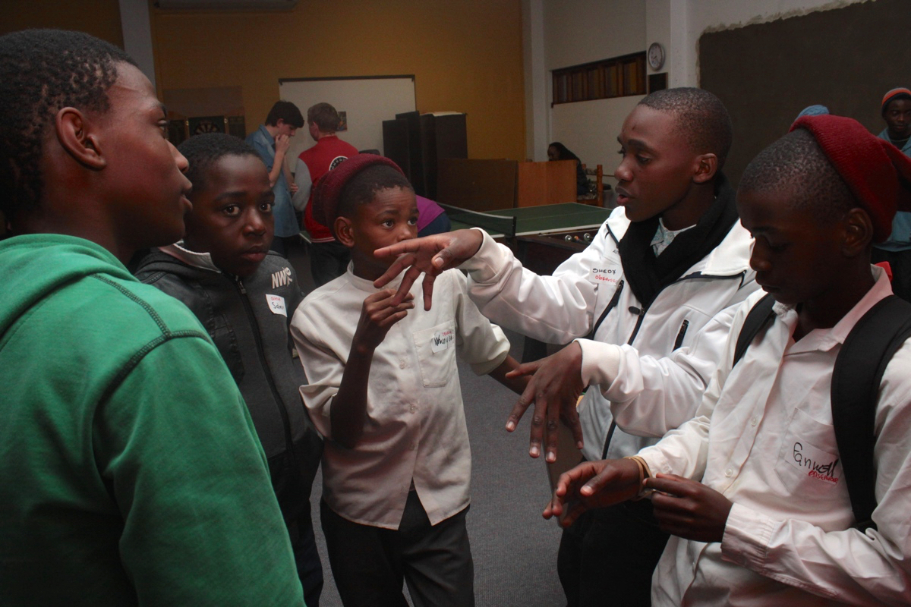
Notes:
The group of Observers creating their commercial for a new car.

Slide 33
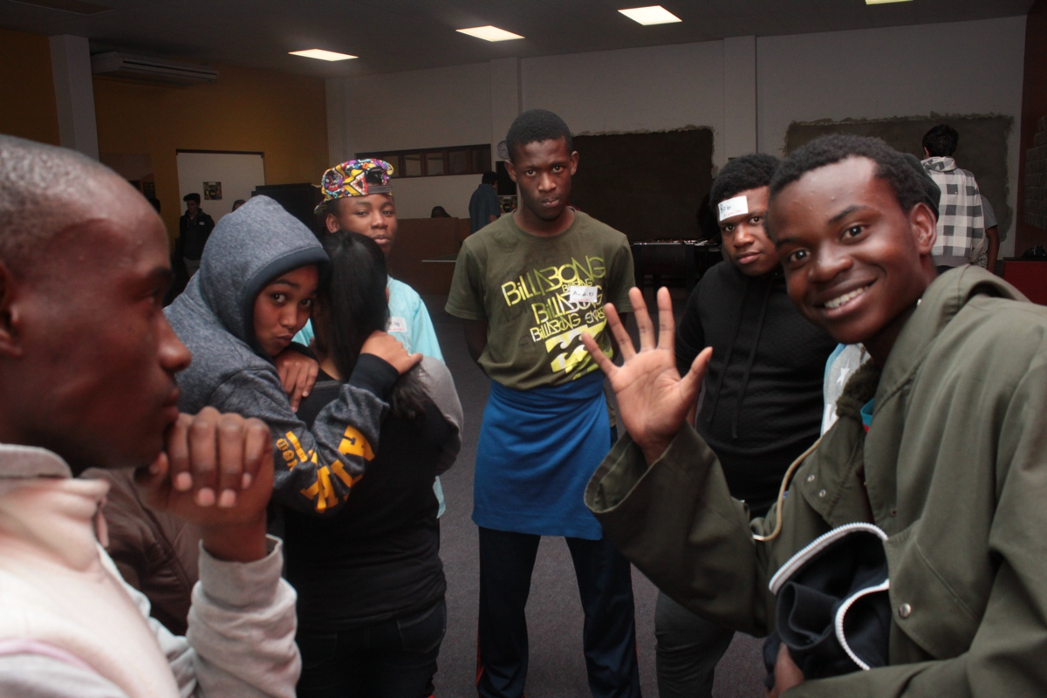
Notes:
The group of Organisers creating their commercial for a new car.

Slide 34

Notes:
The six groups got to present their commercial for a new car on stage.

Slide 35
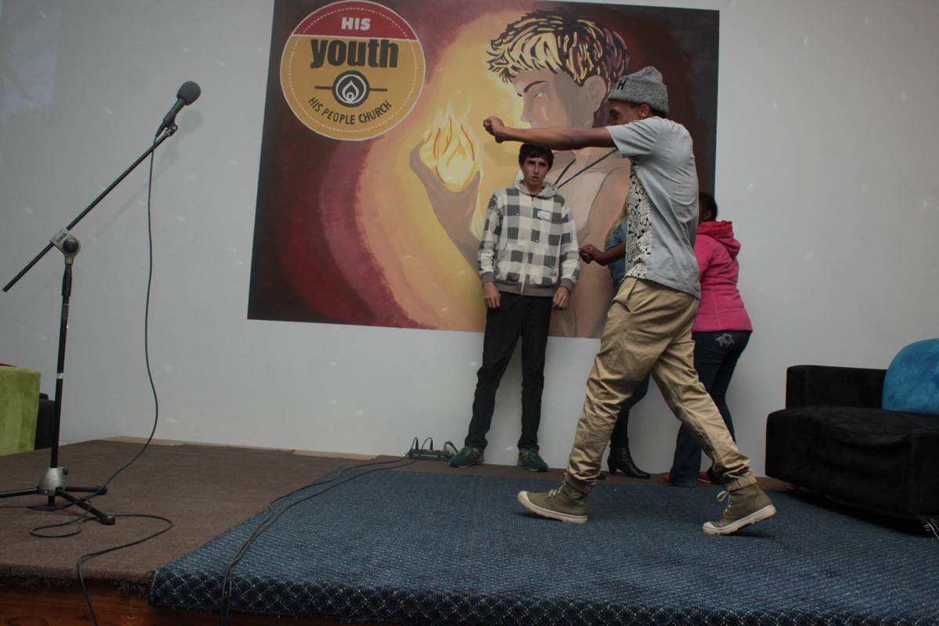
Notes:
The group of Leaders presenting their new car commercial.

Slide 36
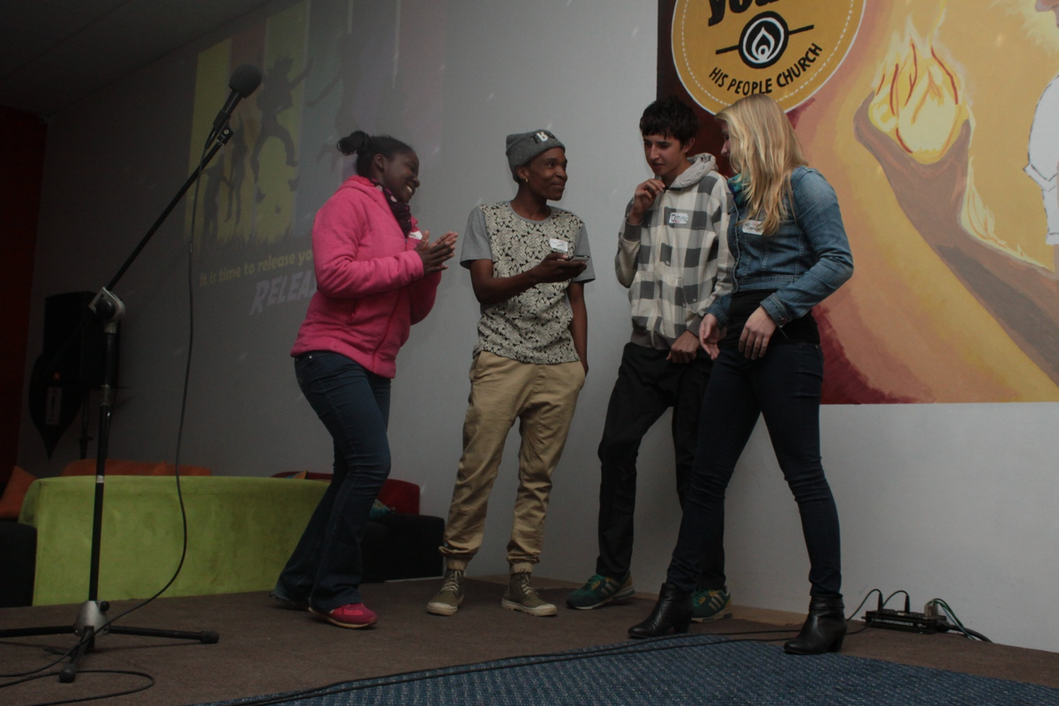
Notes:
The group of Leaders presenting their new car commercial.

Slide 37
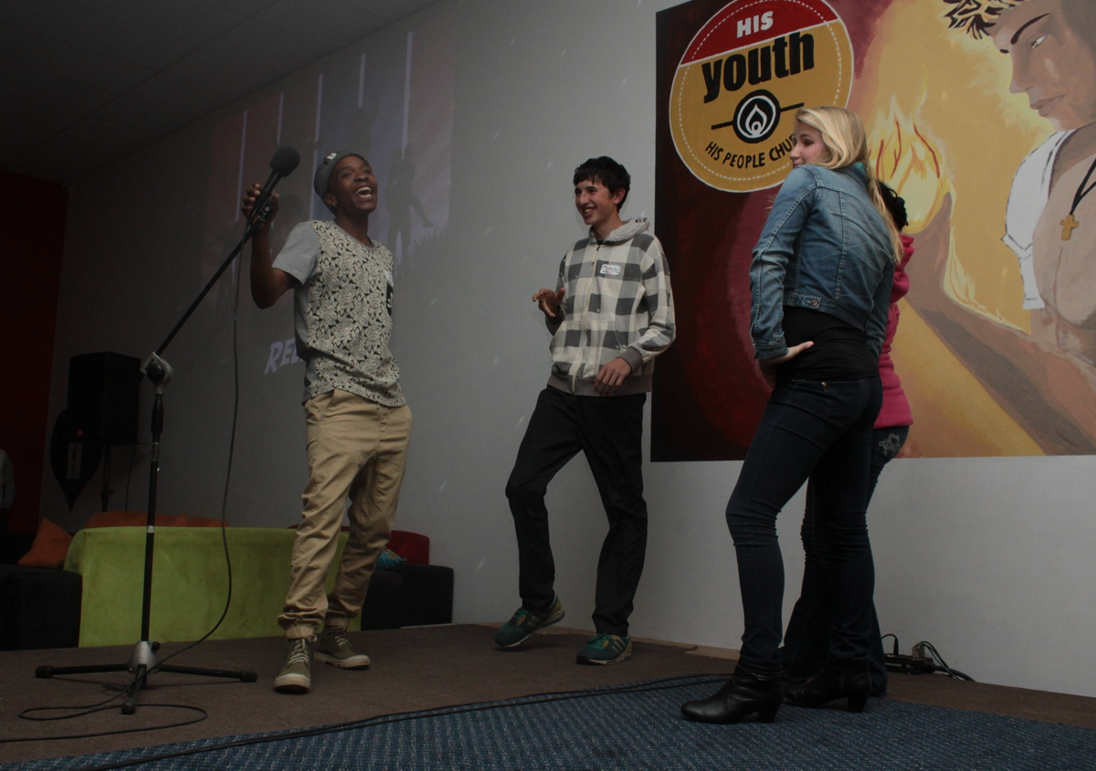
Notes:
The group of Leaders presenting their new car commercial.

Slide 38
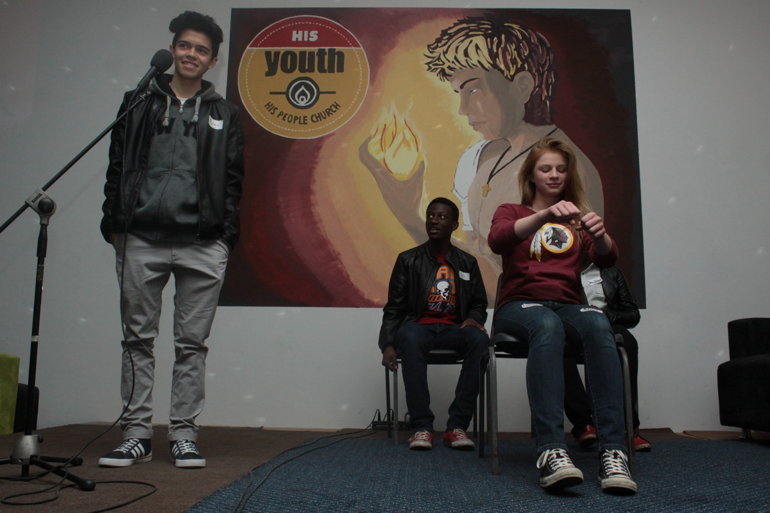
Notes:
The group of Optimists presenting their new car commercial.

Slide 39
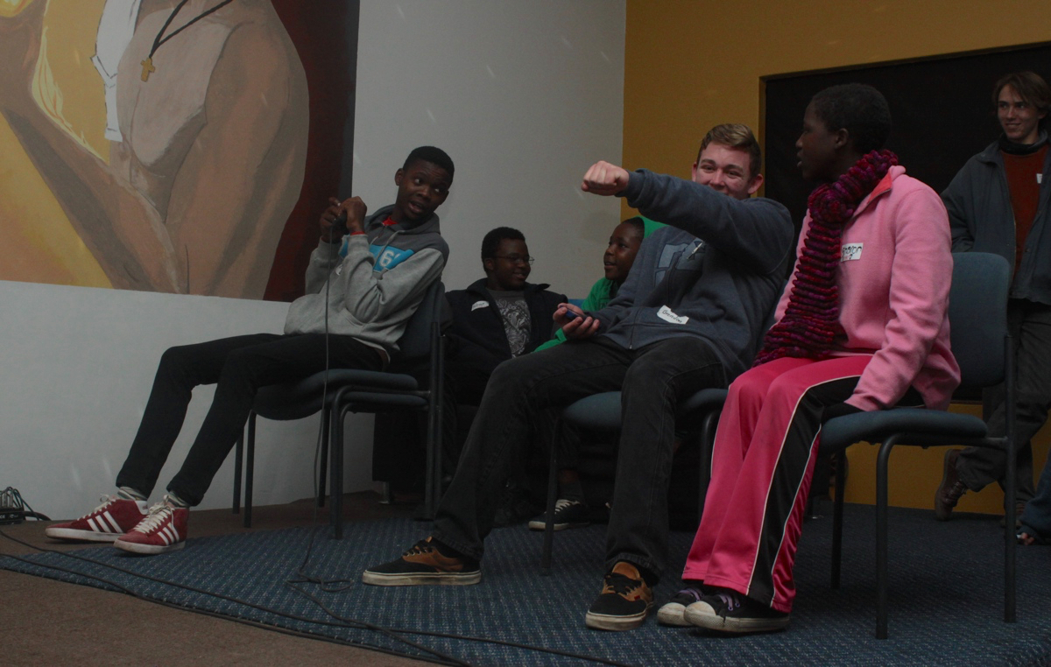
Notes:
The group of Thinkers presenting their new car commercial.

Slide 40
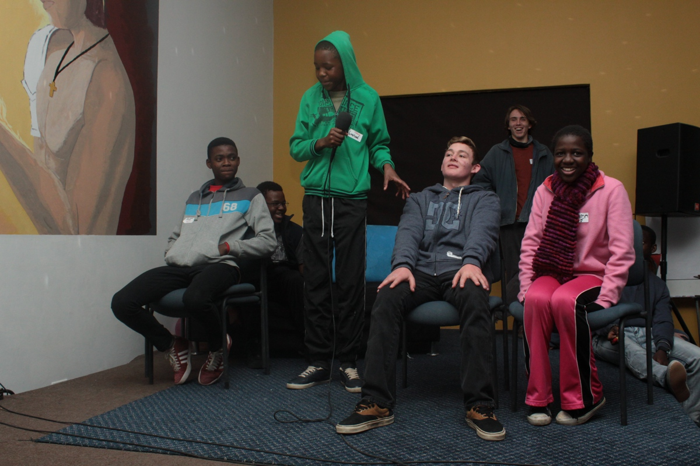
Notes:
The group of Thinkers presenting their new car commercial.

Slide 41
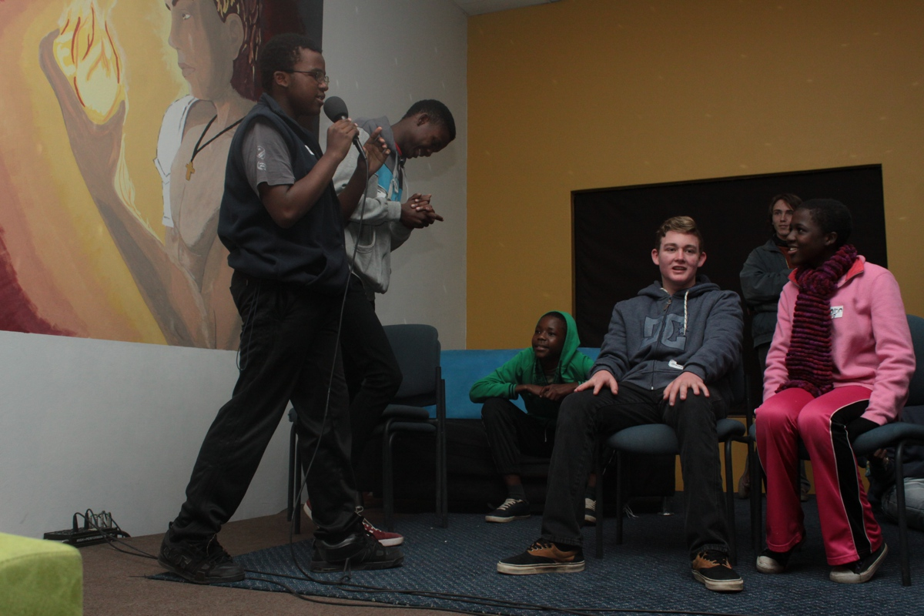
Notes:
The group of Thinkers presenting their new car commercial.

Slide 42
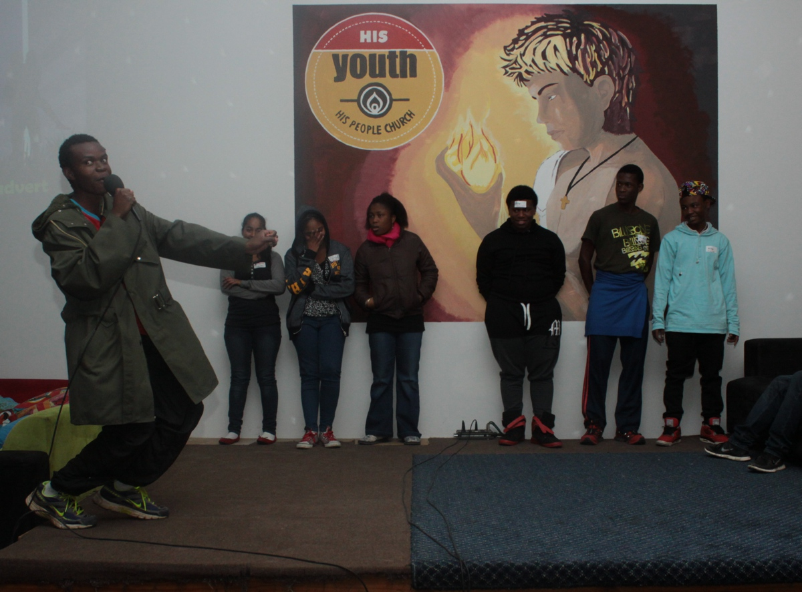
Notes:
The group of Organisers presenting their new car commercial.

Slide 43
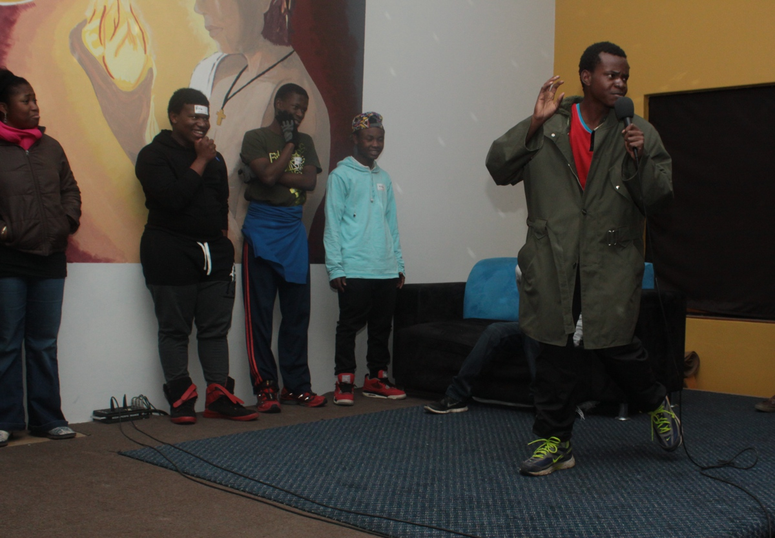
Notes:
The group of Organisers presenting their new car commercial.

Slide 44
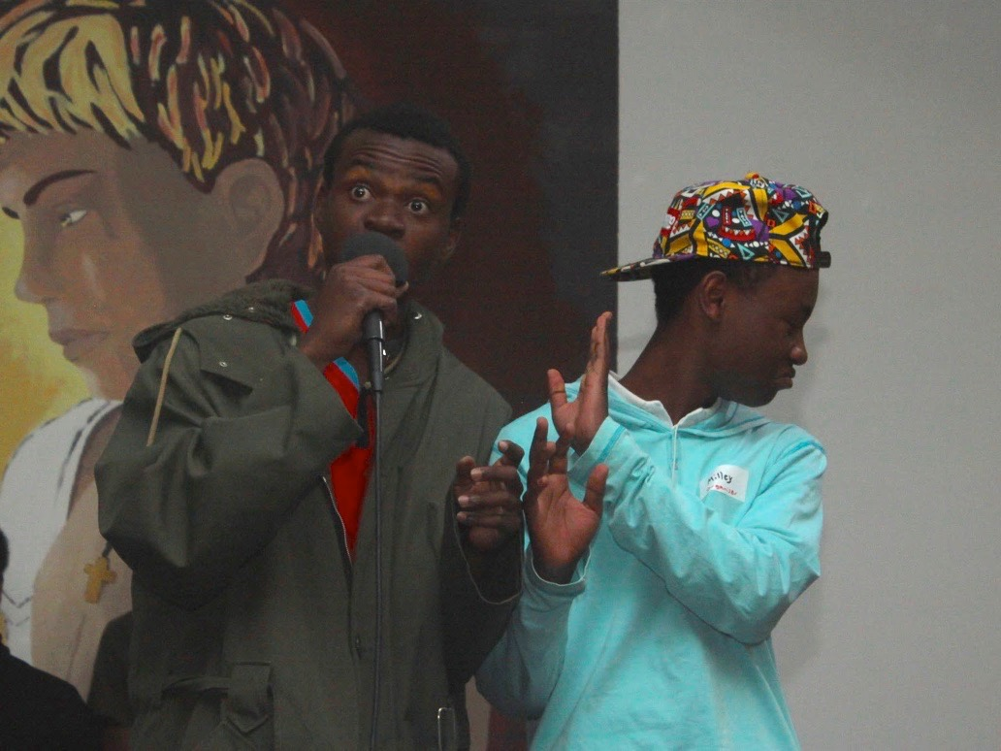
Notes:
The group of Organisers presenting their new car commercial.

Slide 45
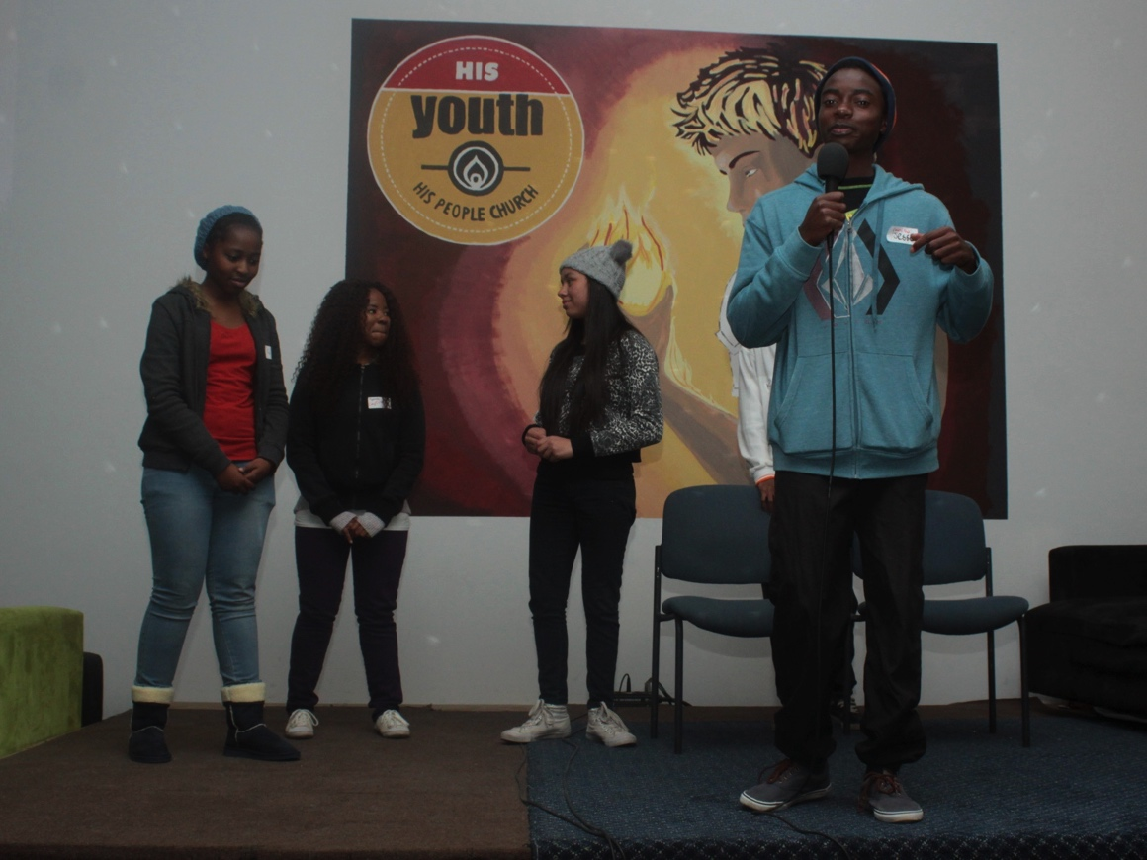
Notes:
The group of Cautious presenting their new car commercial.

Slide 46
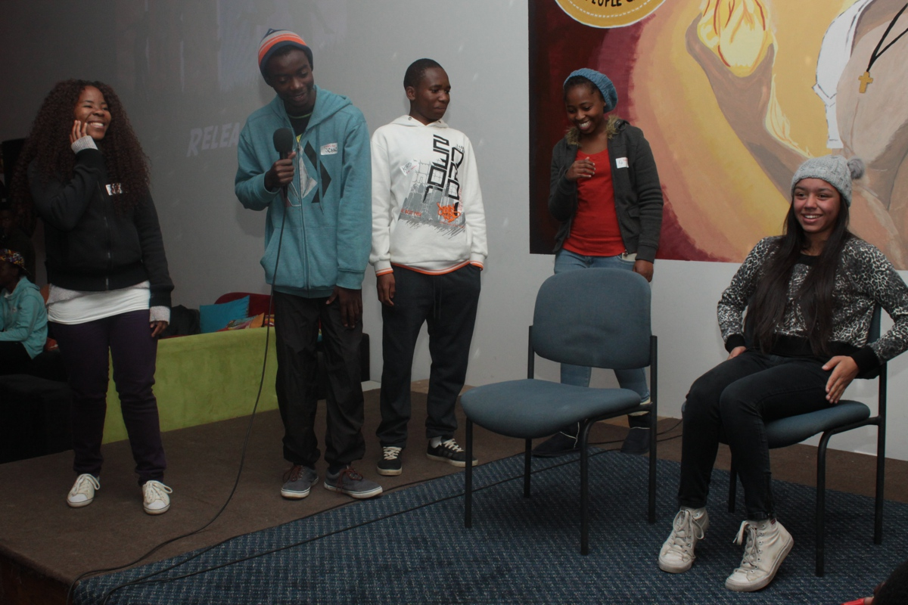
Notes:
The group of Cautious presenting their new car commercial.

Slide 47
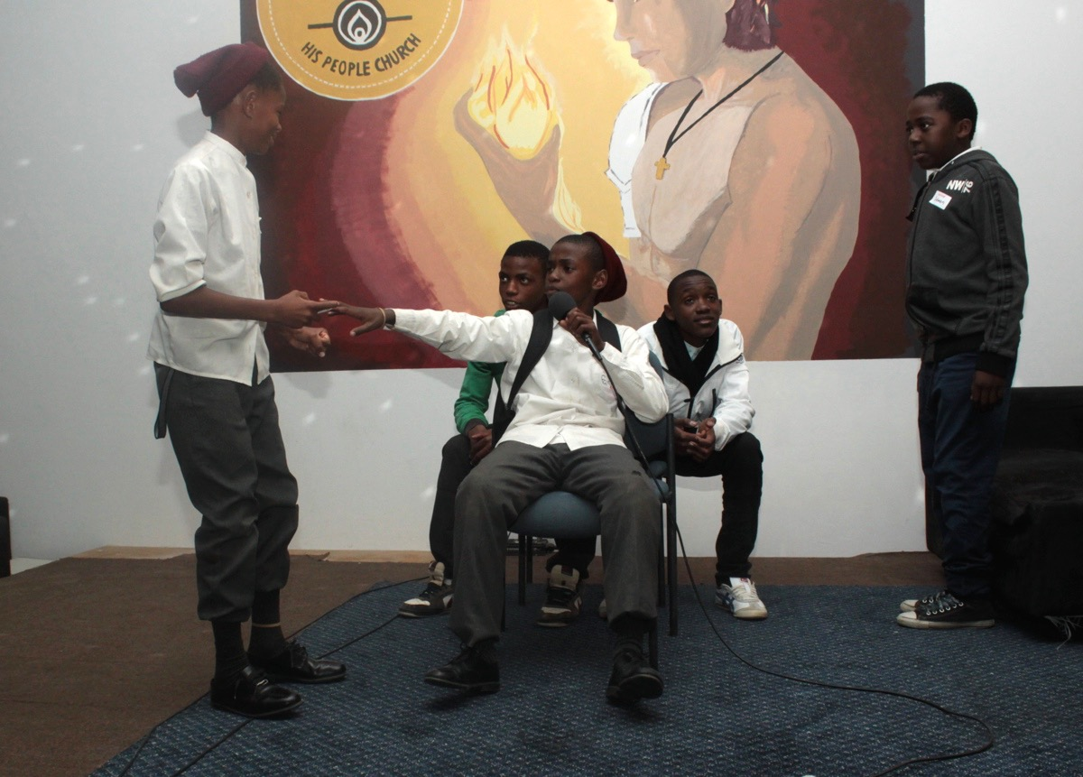
Notes:
The group of Observers presenting their new car commercial.

Slide 48
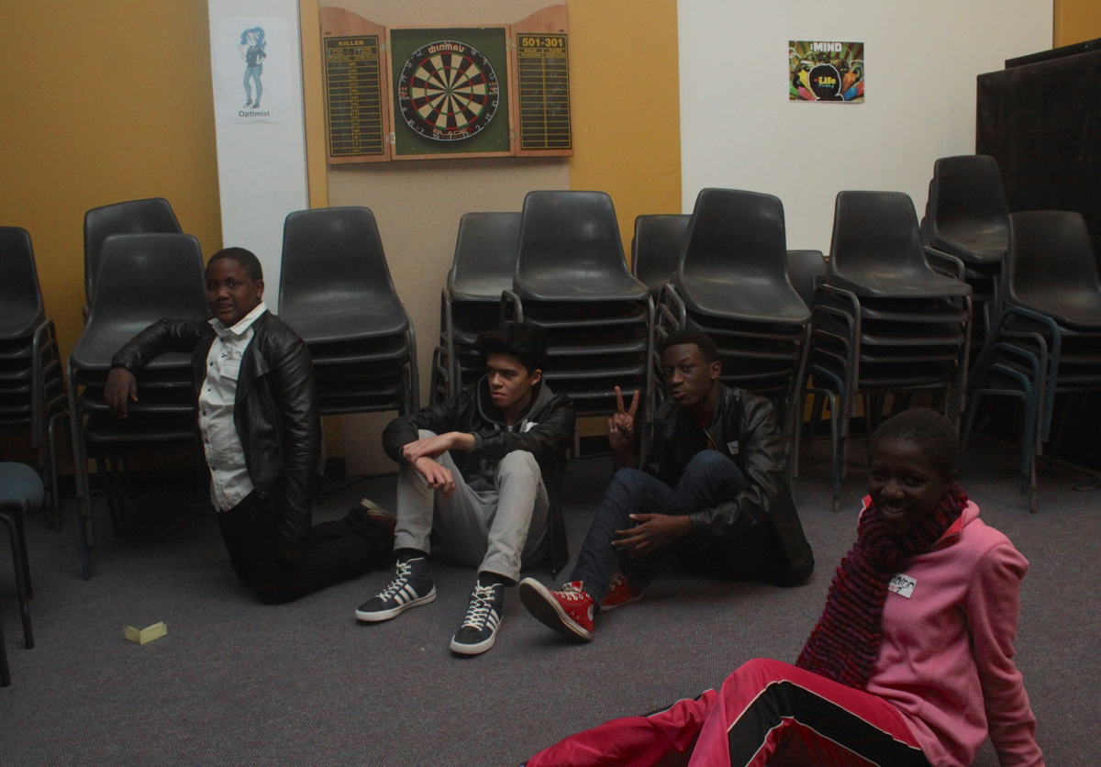
Notes:
Groups chilling during the message.

Slide 49
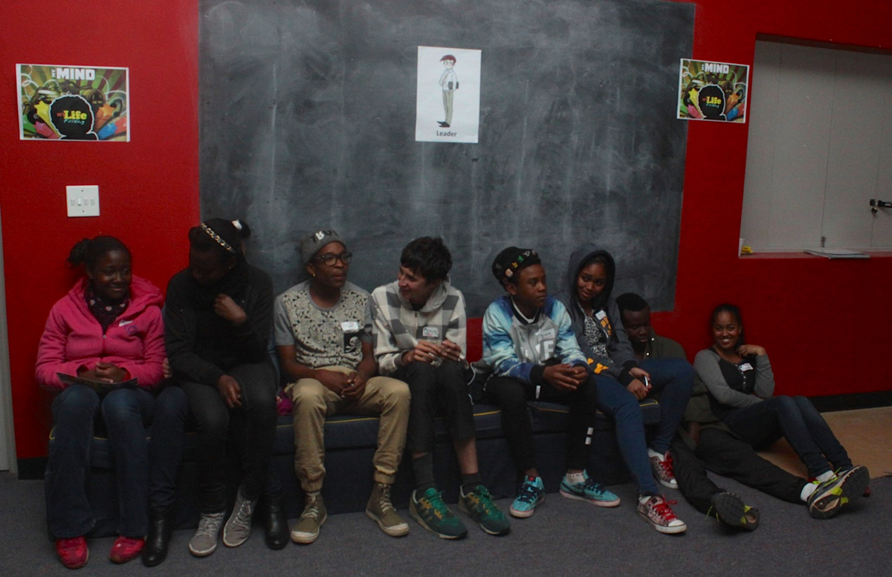
Notes:
Groups chilling during the message.

Slide 50
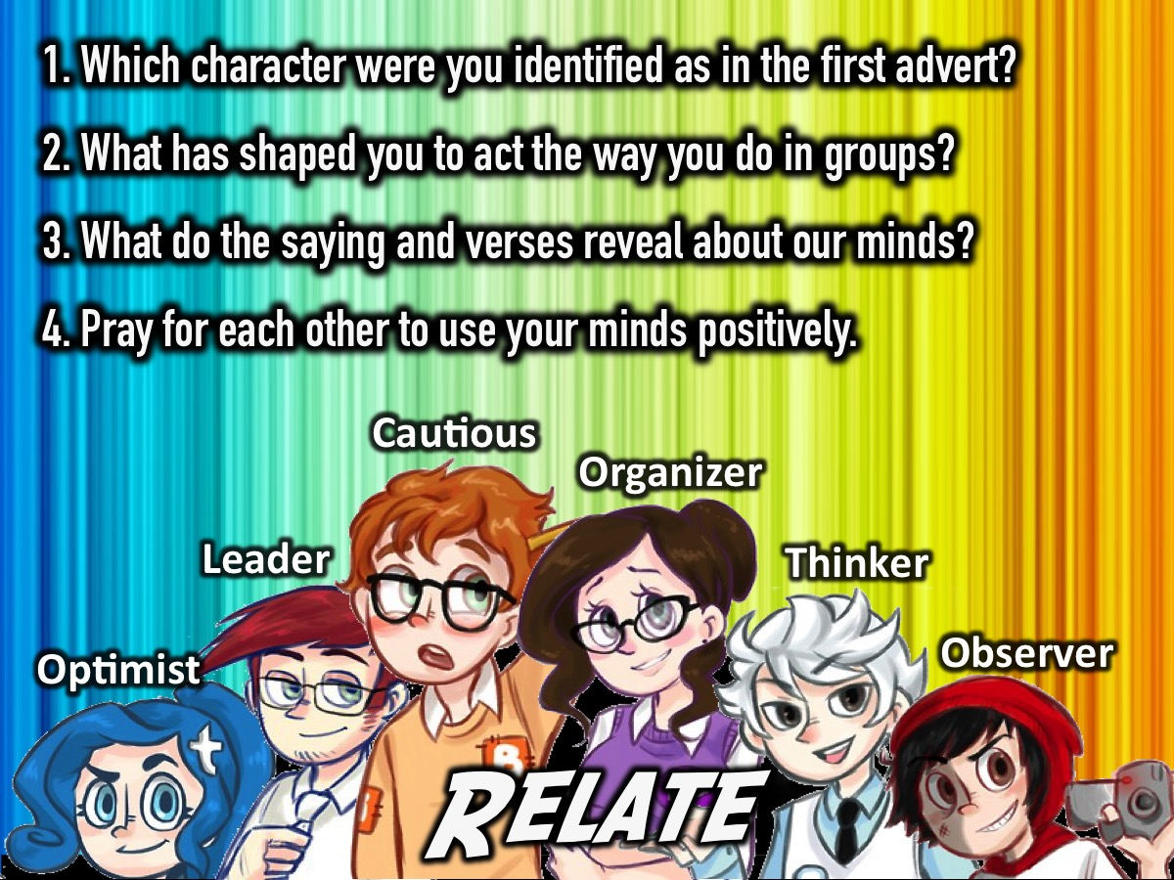
Notes:
Relate: Here are the small group questions: (1) Which character were you identified as in the first advert? (2) What has shaped you to act the way you do in groups? (3) What do the verses/sayings reveal about our minds? Watch your thoughts, they become words; watch your words, they become actions; watch your actions, they become habits; watch your habits, they become character; watch your character, for it becomes your destiny. (Anon). Love the Lord your God with all your heart and with all your soul and with all your strength and with all your mind. (Luke 10:27). Do not conform to the pattern of this world, but be transformed by the renewing of your mind. (Romans 12:1). Whatever is true, noble, right, pure, lovely, admirable - if anything is excellent or praiseworthy - think about such things. (Philippians 4:8). Set your minds on things above, not on earthly things. (Colossians 3:2). (4) Pray for each other to use your minds positively.

Slide 51
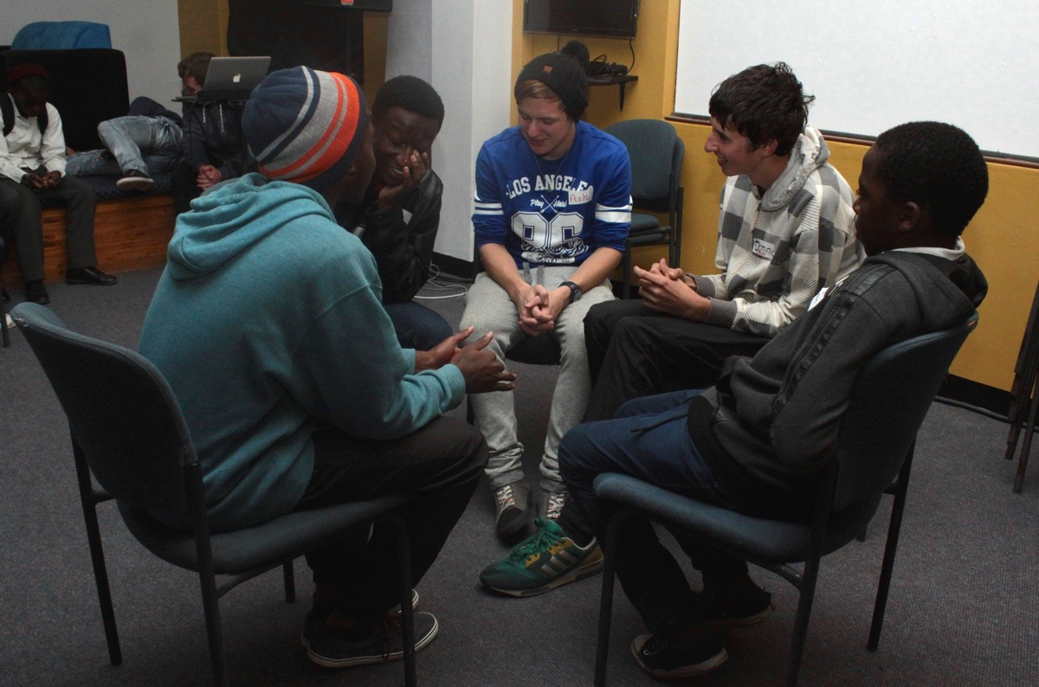
Notes:
Small group time.

Slide 52
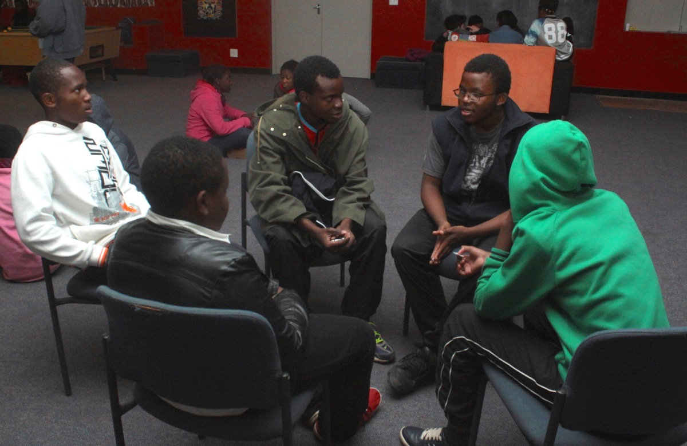
Notes:
Small group time.

Slide 53
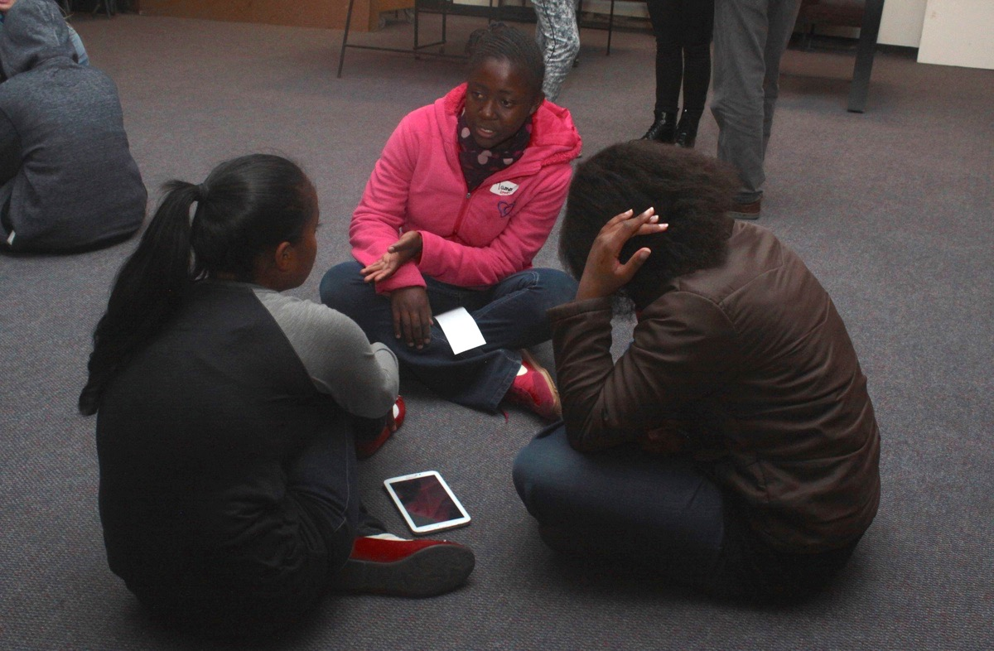
Notes:
Small group time.

Slide 54
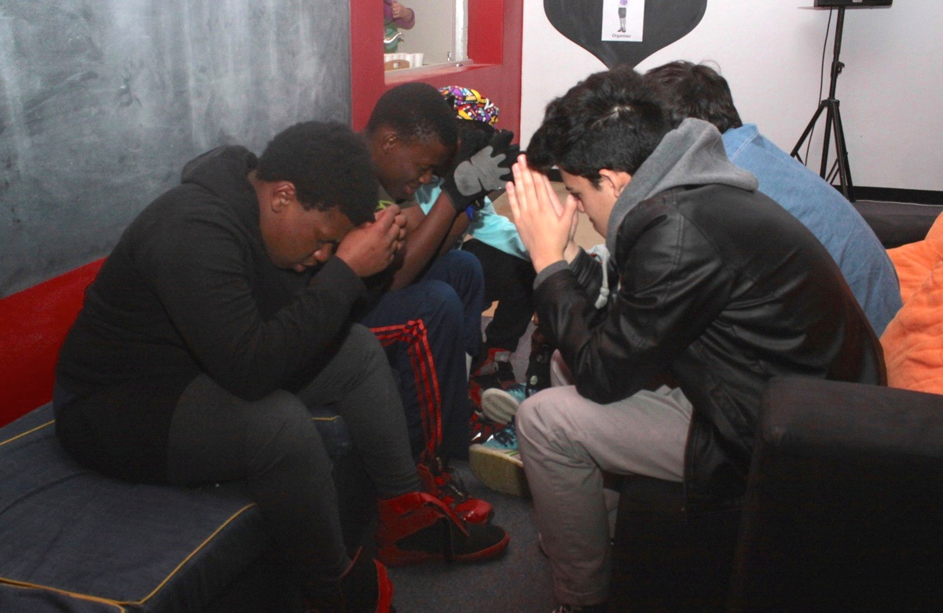
Notes:
Small group time.

Slide 55

Notes:
Leaders after a good night of work!

