Slide 1
Notes:
My Music Night.
Total Pre-Event Videos: 7:50.
Start playing videos at 7:30.

Slide 2
Notes:
Video: Jika by Mi Casa. Get it on YouTube at: https://www.youtube.com/watch?v=BaYV5bkRGIY
Video length: 4:00

Slide 3
Notes:
Video: Up by Olly Murs. Get it on YouTube at: https://www.youtube.com/watch?v=29GWMT0GB6s
Video length: 3:50

Slide 4
Notes:
Welcome to My Life Friday
Time: 7:40-7:50 - Welcome, Announcements and Instructions

Slide 5
Notes:
Tonight is My Music Night

Slide 6
Notes:
Welcome to all our regulars and if there are any newcomers – please come up onto stage so we can welcome you!

Slide 7
Notes:
Announcements: On Sunday morning we continue with the Trilogy Series!

Slide 8
Notes:
Next Friday night is My Passion Night.

Slide 9
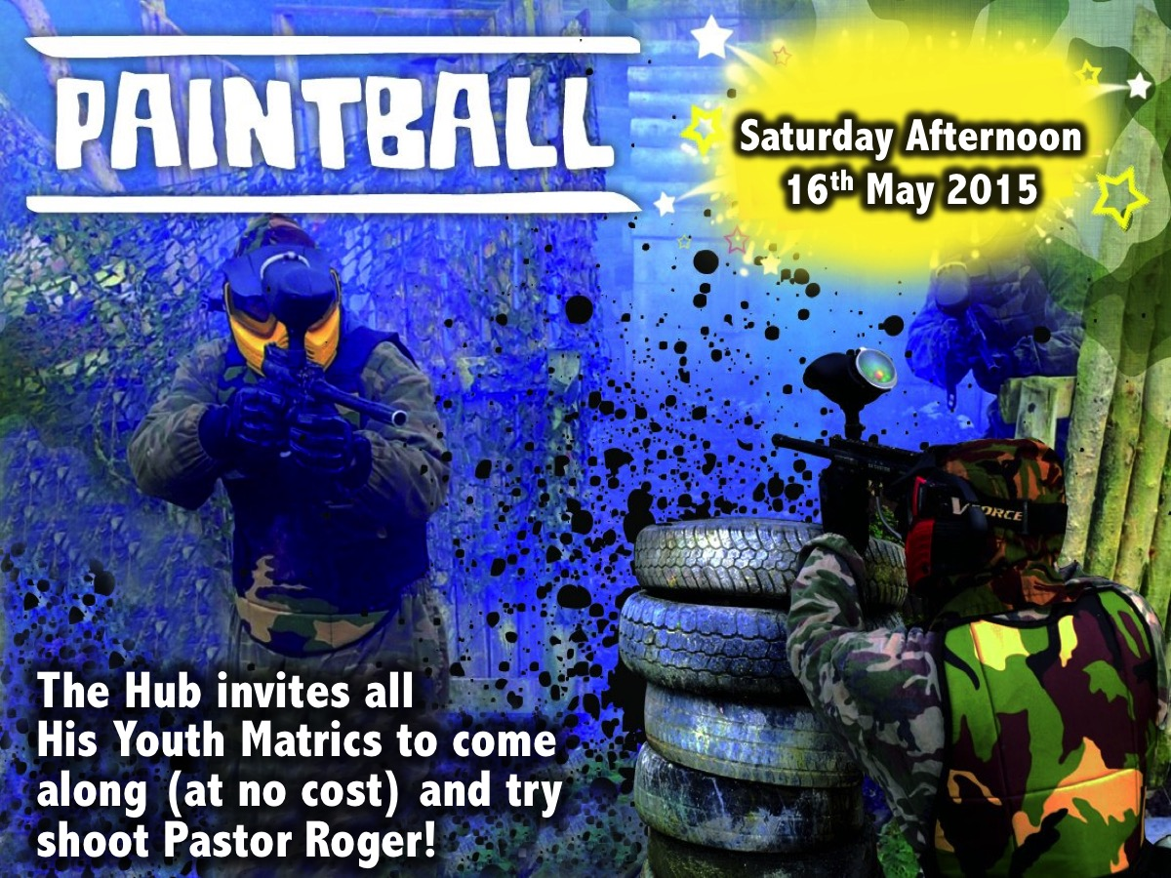
Notes:
The Hub (our Sunday night congregation) invites all His Youth Matrics to come along (at no cost) for an afternoon of Paintballing on Saturday the 16th May!

Slide 10
Notes:
It is time to Perform!
Time: 7:50-8:45

Slide 11
Notes:
Instructions: You will divide into 5 groups. Choose a musical name for your group. Compete in 3 rounds of challenges. Earn the most points to win prizes.

Slide 12
Notes:
1. Acapella. We have selected a song that each group will have to sing without music backing. You will sing the first verse and the chorus (which you can repeat twice). You have 5 minutes to rehearse and 1 minute to perform the song. Let’s listen to an original version of the song and then an acapella version…
Points: Two judges will judge each group and give them a score out of 10.
Round 1 Starts at 7:50

Slide 13
Notes:
Don’t You Worry Child original Version

Slide 14
Notes:
Video: Swedish House Mafia – Don’t You Worry Child ft John Martin. Get it on YouTube at: https://www.youtube.com/watch?v=1y6smkh6c-0
Video Length: 1:35

Slide 15
Notes:
(Here are a few acapella version of the song to give you some ideas)
Don’t You Worry Child Acapella Version

Slide 16
Notes:
Video: Acapella Version of Don’t You Worry. Get it on YouTube at: https://www.youtube.com/watch?v=fhwFEZKClrY
Video Length: 1:10

Slide 17
Notes:
Don’t You Worry Child Acapella Beatbox Version

Slide 18
Notes:
Video: Beatbox Version of Don’t You Worry. Get it on YouTube at: https://www.youtube.com/watch?v=AoepVgD0LE4
Video Length: 0:50

Slide 19
Notes:
Don’t You Worry Child Pentatonix Version

Slide 20
Notes:
Video: Pentatonix Version of Don’t You Worry. Get it on YouTube at: https://www.youtube.com/watch?v=7YAcMgoSpDE
Video Length: 0:55

Slide 21
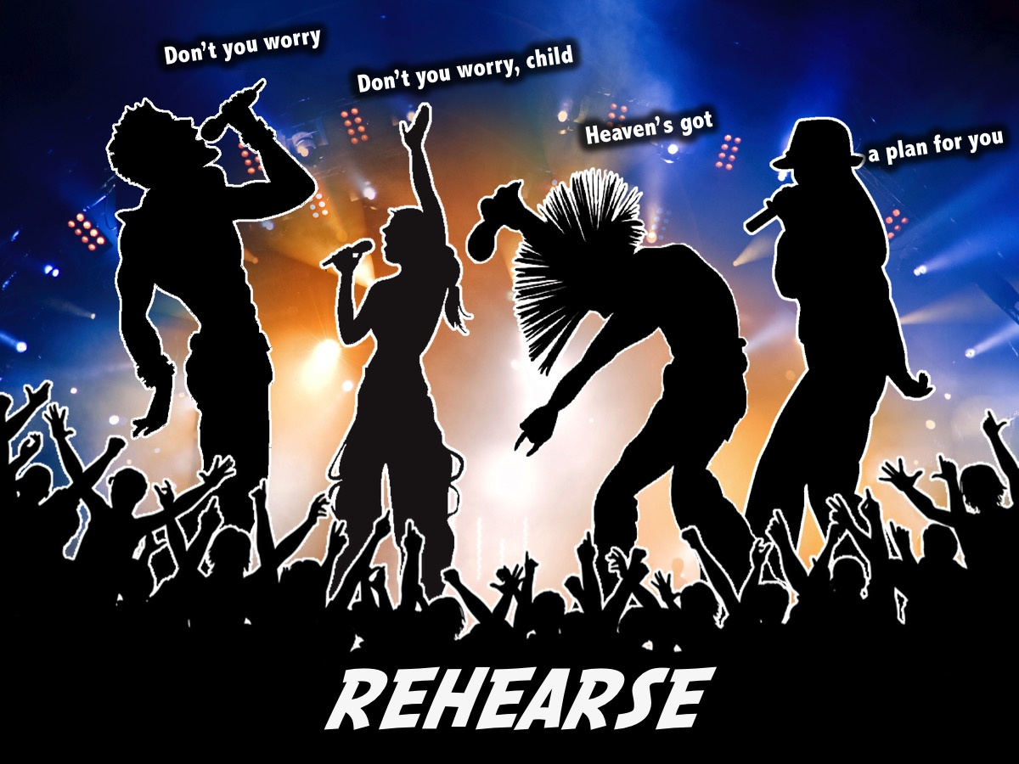
Notes:
Rehearse: You have 5 minutes to rehearse the song. There will be a timer counting down on the screen.
Time: 5:00

Slide 22
Notes:
Each group is going to perform your song for the judges.
Time: 2 minutes per group
Total time for Performance: 10:00
Total Time for Round 1 is 20:30

Slide 23
Notes:
2. Dance. We are going to watch a video and each group will create a dance for the song. You will have 5 minutes preparation time before presenting your dance.
Points: Two judges will judge each group and give them a score out of 10.
Round 2 Starts at 8:15

Slide 24
Notes:
Video: Uptown Funk. Get it on YouTube at: https://www.youtube.com/watch?v=OPf0YbXqDm0
Video Length: 1:30

Slide 25
Notes:
Rehearse: You have 5 minutes to rehearse your dance.
Time: 5:00

Slide 26
Notes:
Perform: You are going to perform your dance for the judges.
Time: Each group will take no more than 2 minutes
Total Time: 10 minutes

Slide 27
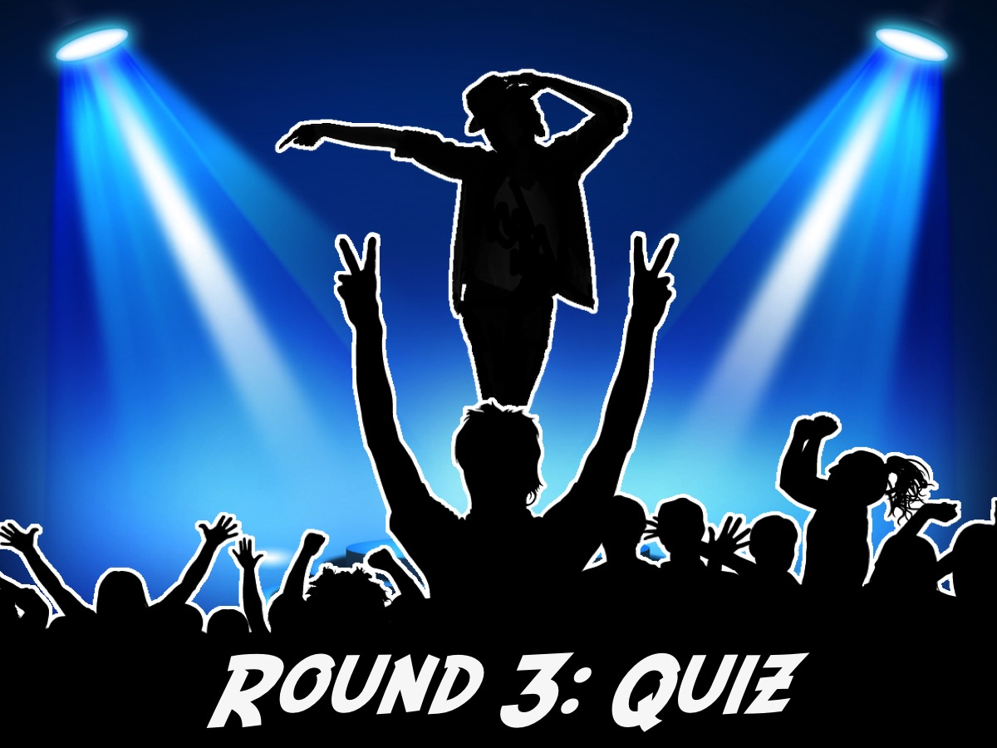
Notes:
3. Quiz. Groups will play "60 seconds" trying to guess artists. One group member will try give clues of the artists, the rest of the group must guess. Each group will have the same 10 questions at the same time at different places.
Points: A teen leader will be assigned to each group to score how many of the 10 names they managed to get in the 60 seconds allowed.
[Artists: Rihanna, Martin Garrix, ACDC, Dolly Parton, lil' Wayne, Taylor Swift, Mi Casa, Cassper Nyovest, Hillsong, Olly Murs]
Time to Introduce Quiz: 2mins
Round 3 Starts at: 8:35

Slide 28
Notes:
You have 60 seconds to guess the artists.
Time for Quiz (including Scoring): 2:00
Total Time for Round 3 is 4:00

Slide 29
Notes:
Prizes: The 3 sets of points will be added together for a score out of 30. The highest group will win.
Prize Giving Starts at 8:40

Slide 30
Notes:
Small Group Questions: (1) What did you most enjoy tonight: Acapella, Dance or Quiz. (2) What song means the most to you and why? (3) What role does music play in your life as a teenager? (4) What music draws you closer to God or away from God? (5) What can you do to connect with God more through music? (6) Pray for each other to get closer to God through music.
Small Groups start at 8:45 (until 9:05)

Slide 31
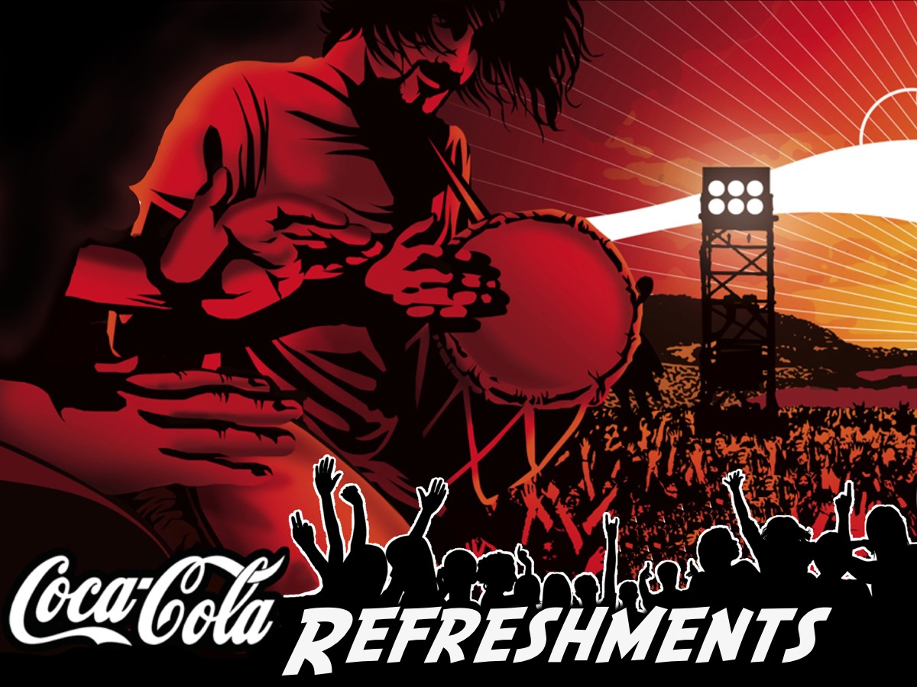
Notes:
Refreshments – we will end with coke and chips (NikNaks).
Refreshments Start at: 9:05

Slide 32
Notes:
Video: Koze Kuse by DJ Merlon ft. Mondli Ngcobo. Get it on YouTube at: https://www.youtube.com/watch?v=fbmd64-gToo
Video length: 4:00

Slide 33
Notes:
Video: Virus by Martin Garrix & Moti. Get it on YouTube at: https://www.youtube.com/watch?v=bH4YSVZOq-U
Video length: 3:20

Slide 34
Notes:
Next Friday night is My Passion Night.

