Slide 1

Notes:
PJs Movie Night.

Slide 2

Notes:
Welcome to PJs Movie Night.

Slide 3

Notes:
Accouncements: Due to the holiday break there will be no youth on Friday night for 3 weeks - until the last Friday night in July. On Sundays we will meet in the Sanctuary for the whole service.

Slide 4

Notes:
PJs Award - the best pajama outfits will receive a prize.

Slide 5
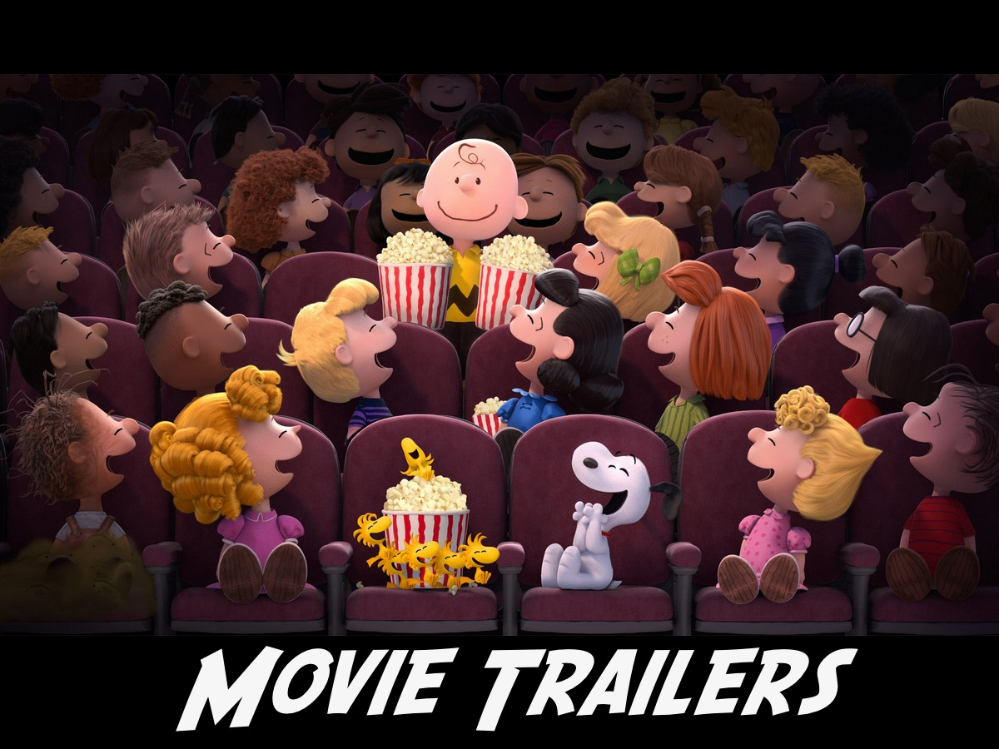
Notes:
First up we have some trailers for upcoming movies to show…

Slide 6

Notes:
Ant-Man Movie Trailer. Get it on YouTube at: https://www.youtube.com/watch?v=QfOZWGLT1JM

Slide 7

Notes:
Maze Runner Scorch Trials Trailer. Get it on YouTube at: https://www.youtube.com/watch?v=-44_igsZtgU

Slide 8

Notes:
Hunger Games Mockingjay Part 2. Get it on YouTube at: https://www.youtube.com/watch?v=cbd_s-486vQ

Slide 9
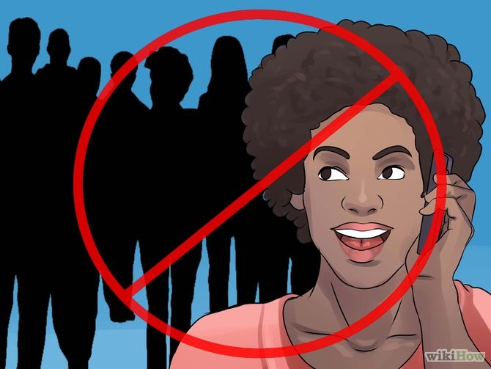
Notes:
Video: Turn off your cell phones. Get it on YouTube at: https://www.youtube.com/watch?v=Wr0vYfPVzH4

Slide 10

Notes:
Our Feature film tonight is Rise of the Guardians - sit back and enjoy the movie - popcorn and sweets will be served during the movie.

Slide 11
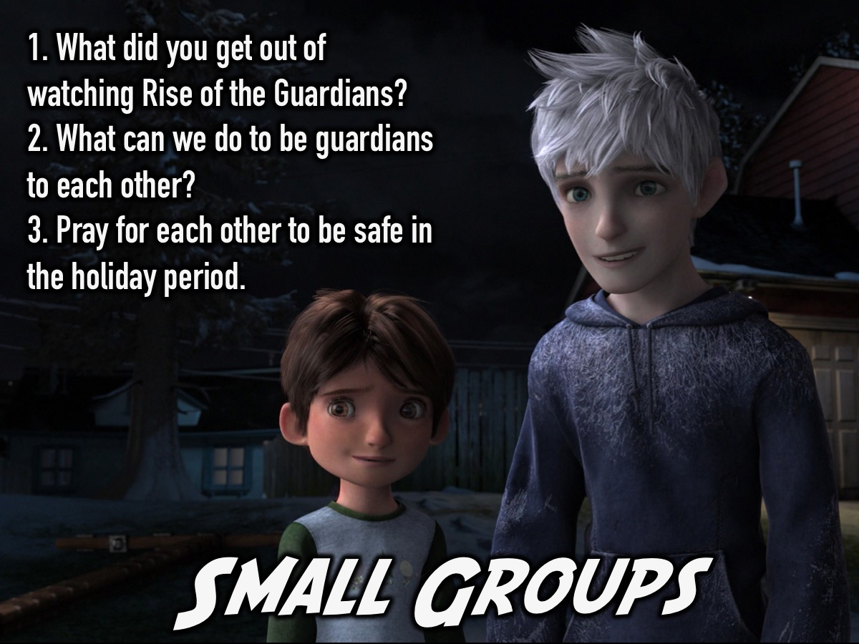
Notes:
Small Groups. Here are the questions for our small group time: (1) What did you get out of watching Rise of the Guardians? (2) What can we do to be guardians of each other? (3) Pray for each other to be safe in the holiday period.

Slide 12
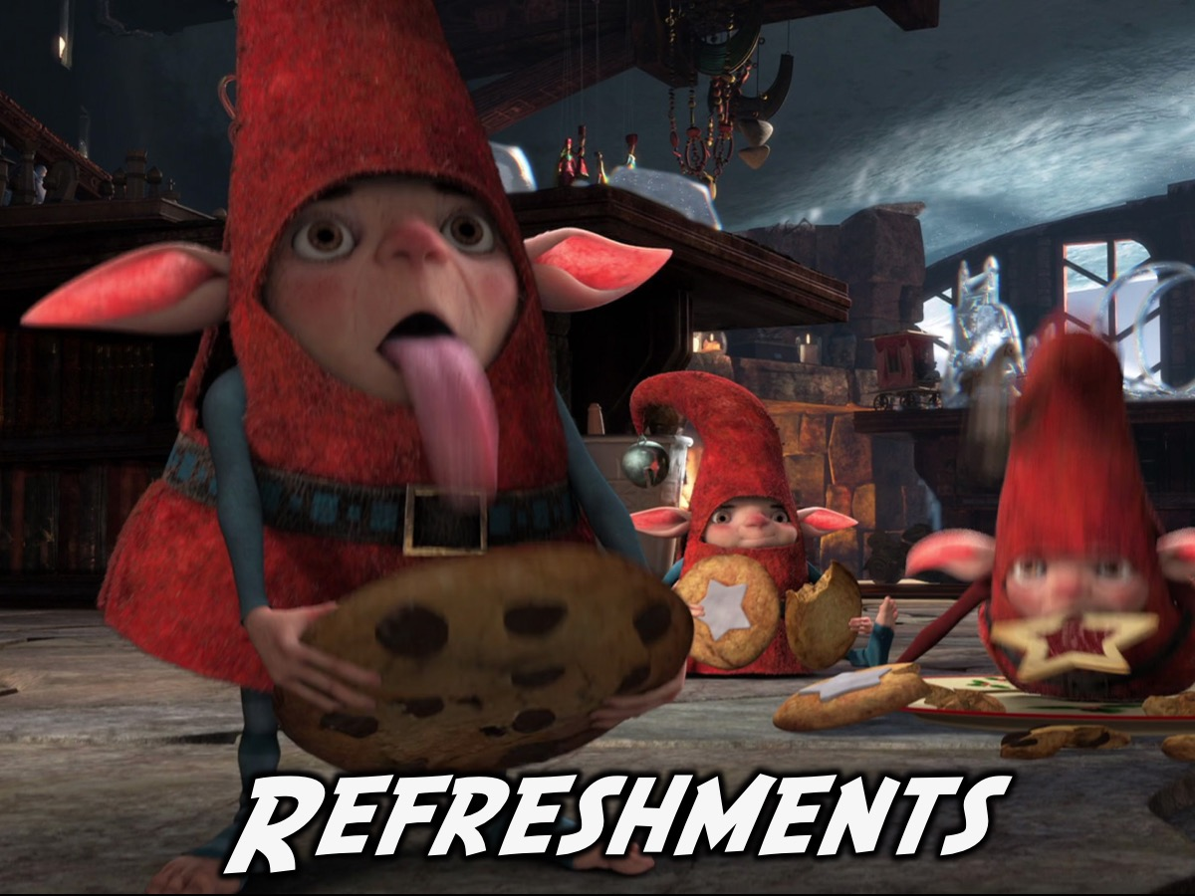
Notes:
Refreshments: It is time for Hot Chocolate and chips.

