Slide 1


Slide 2
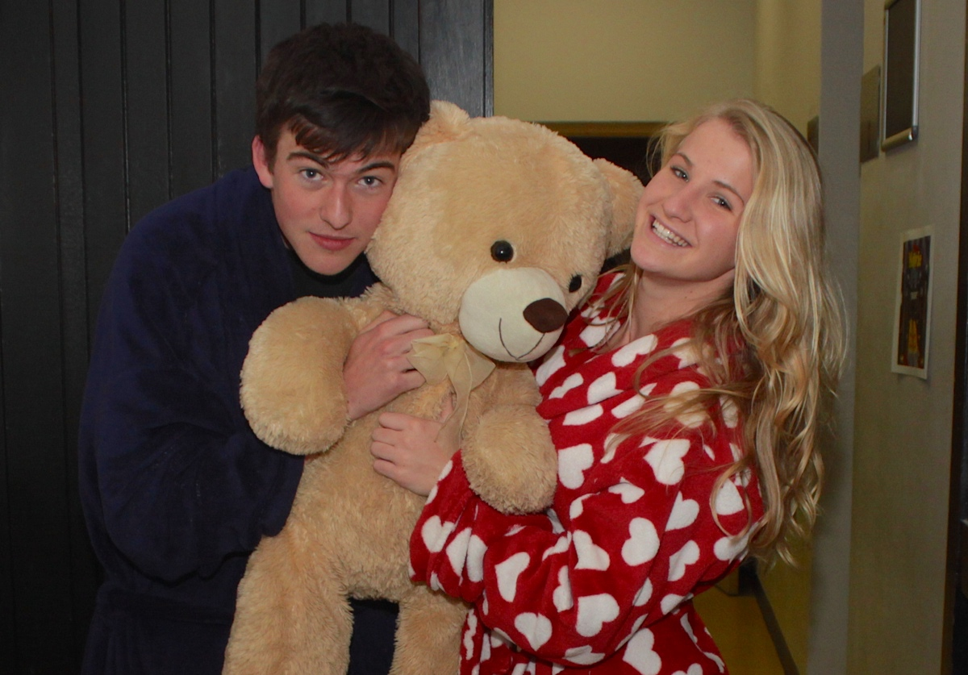

Slide 3
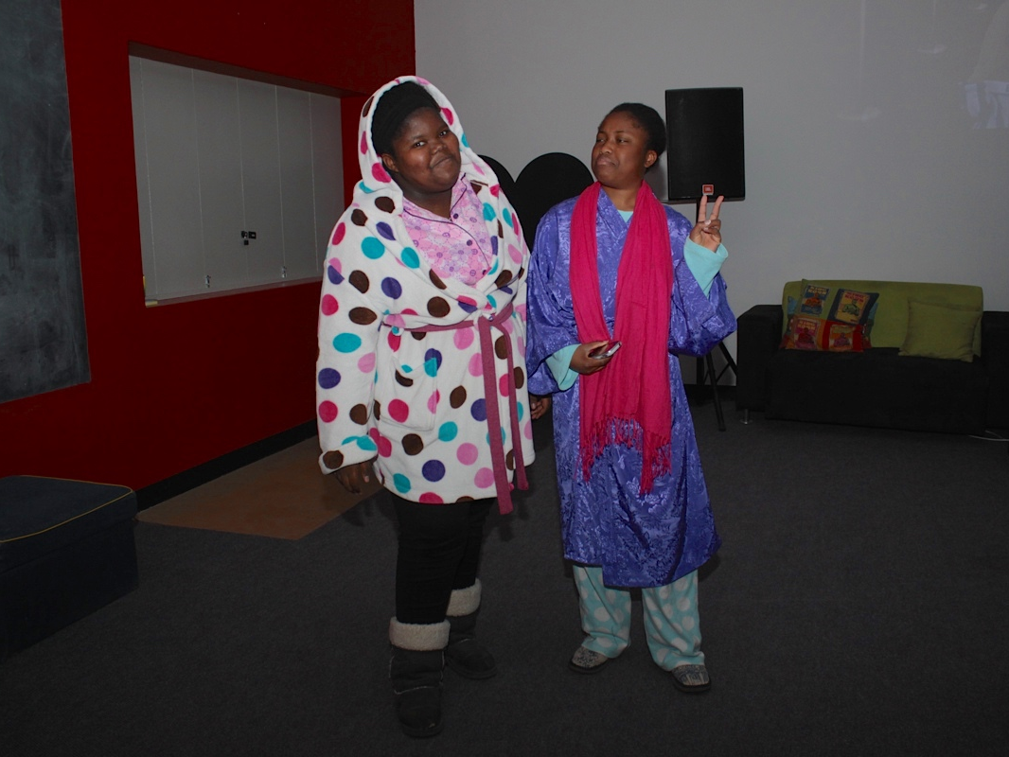

Slide 4
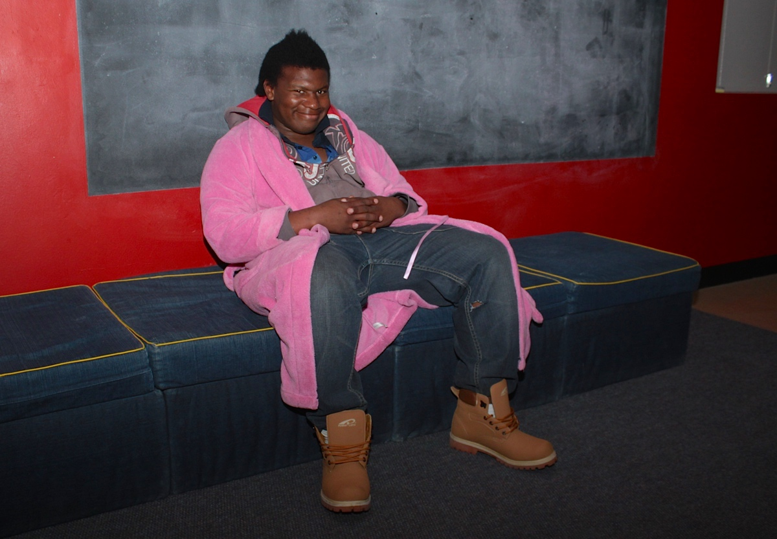

Slide 5
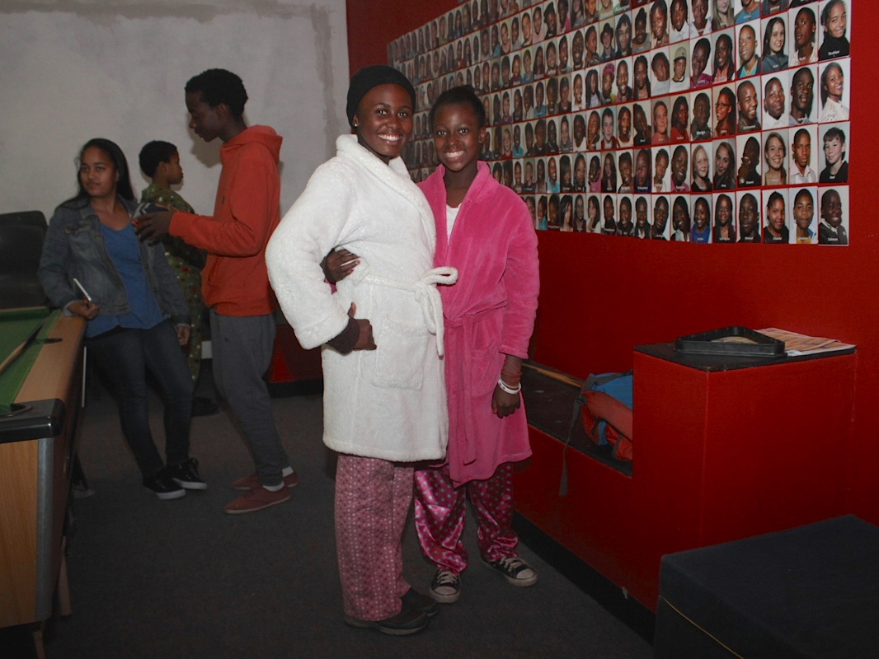

Slide 6
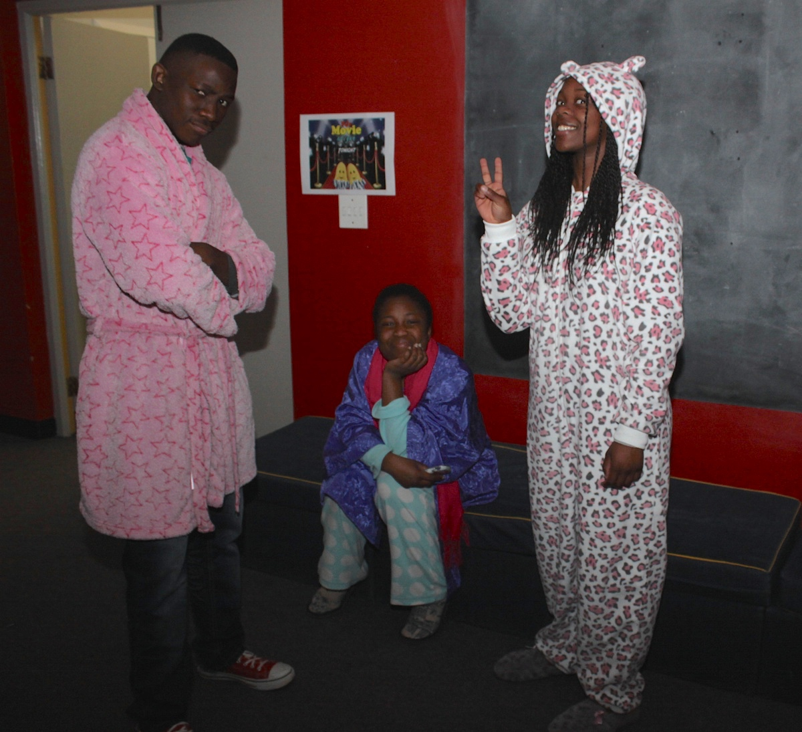

Slide 7
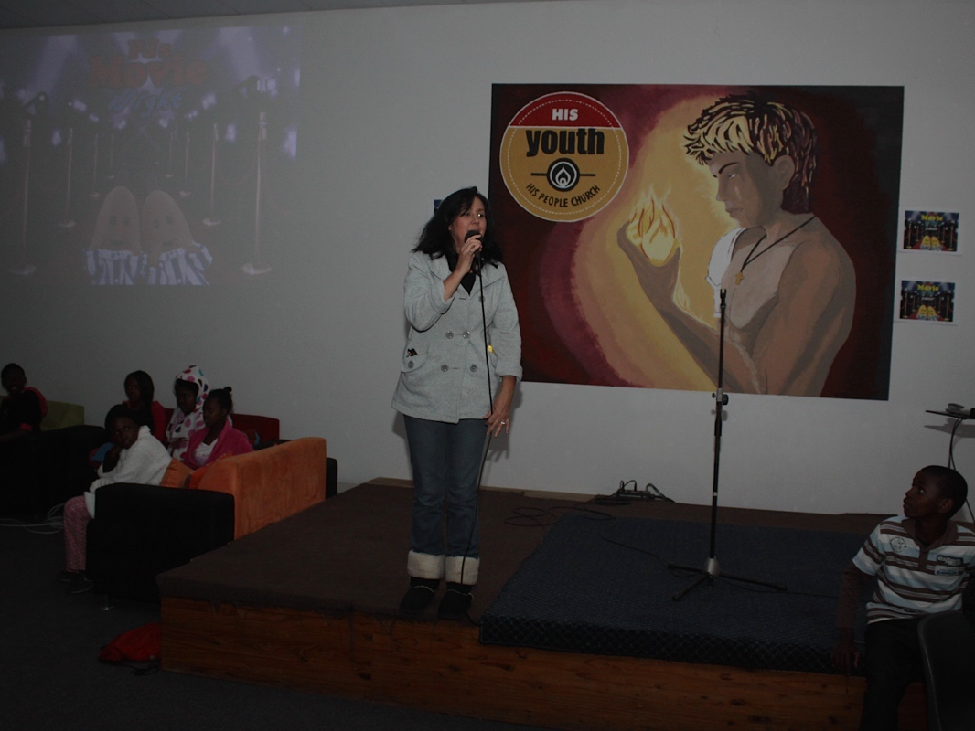

Slide 8


Slide 9
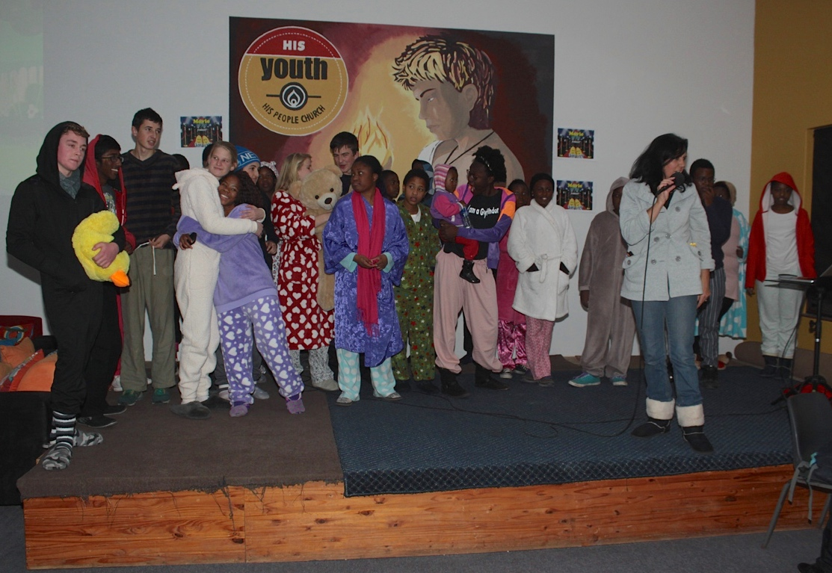

Slide 10
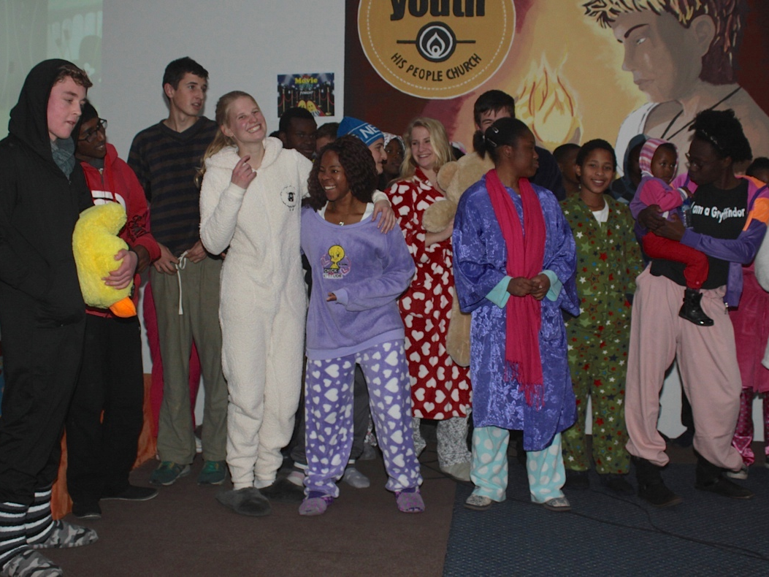

Slide 11
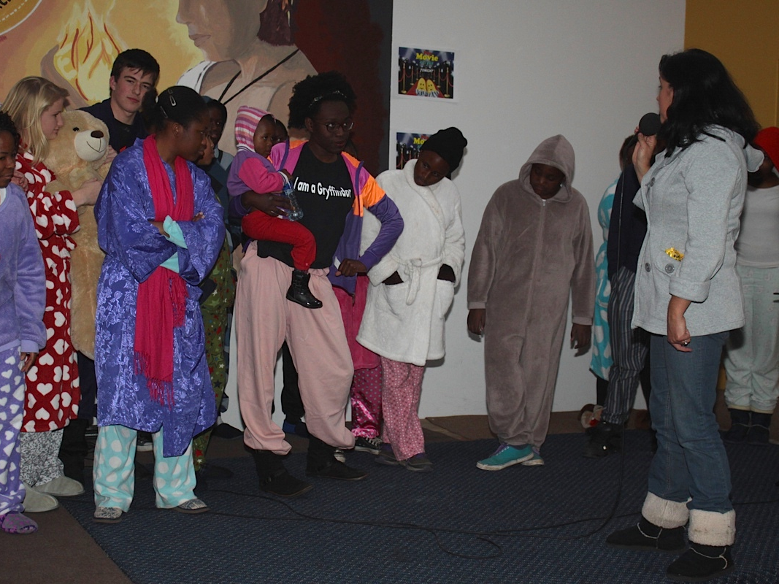

Slide 12
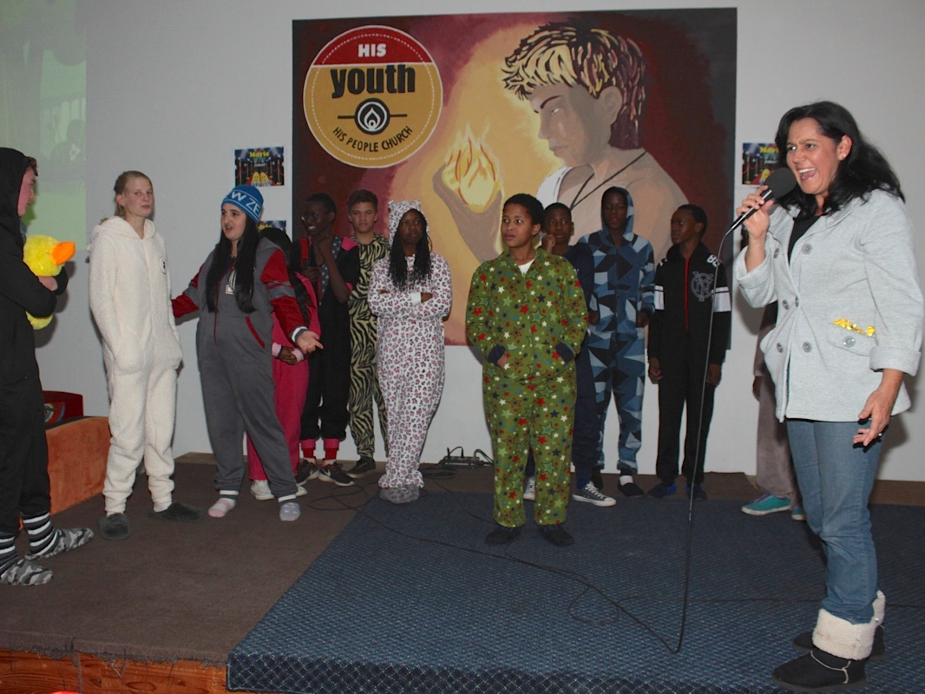

Slide 13
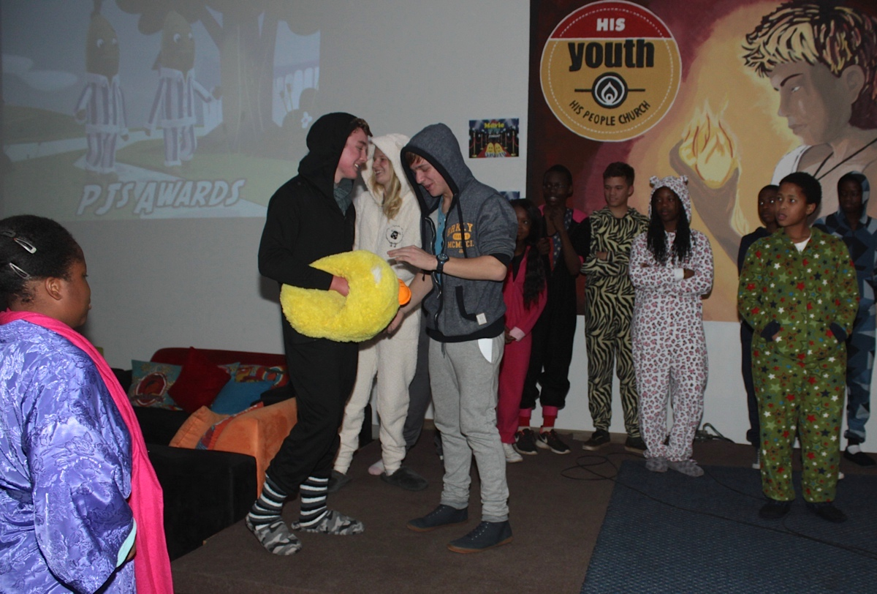

Slide 14
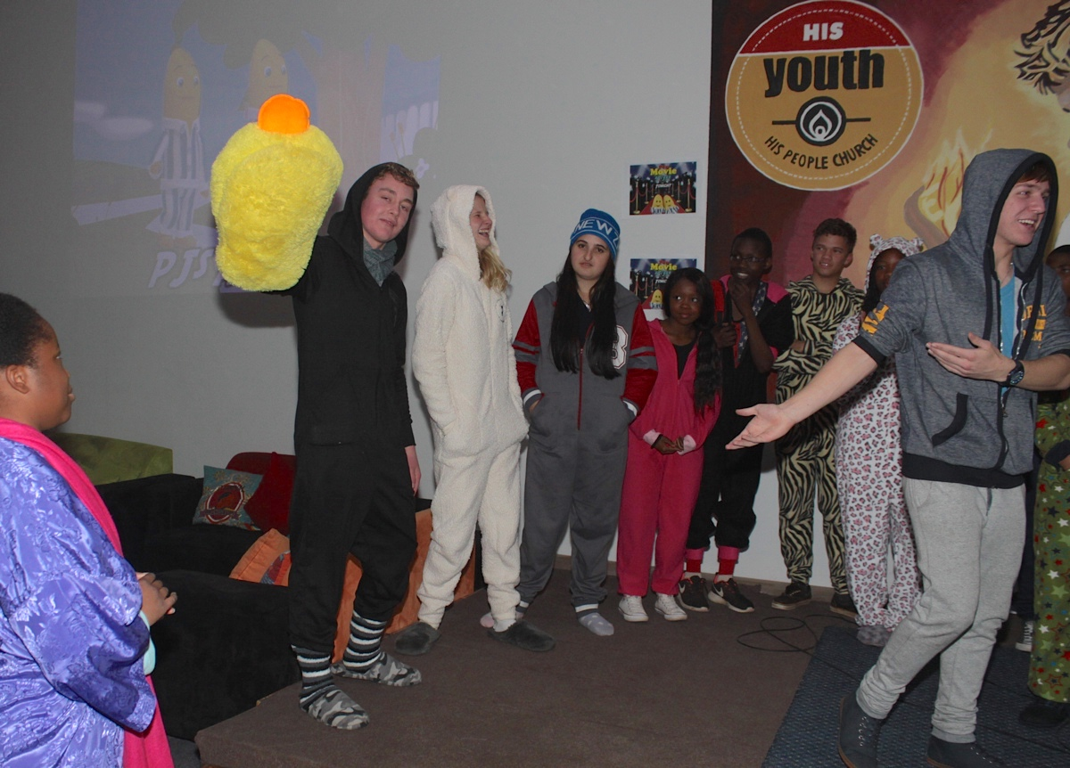

Slide 15
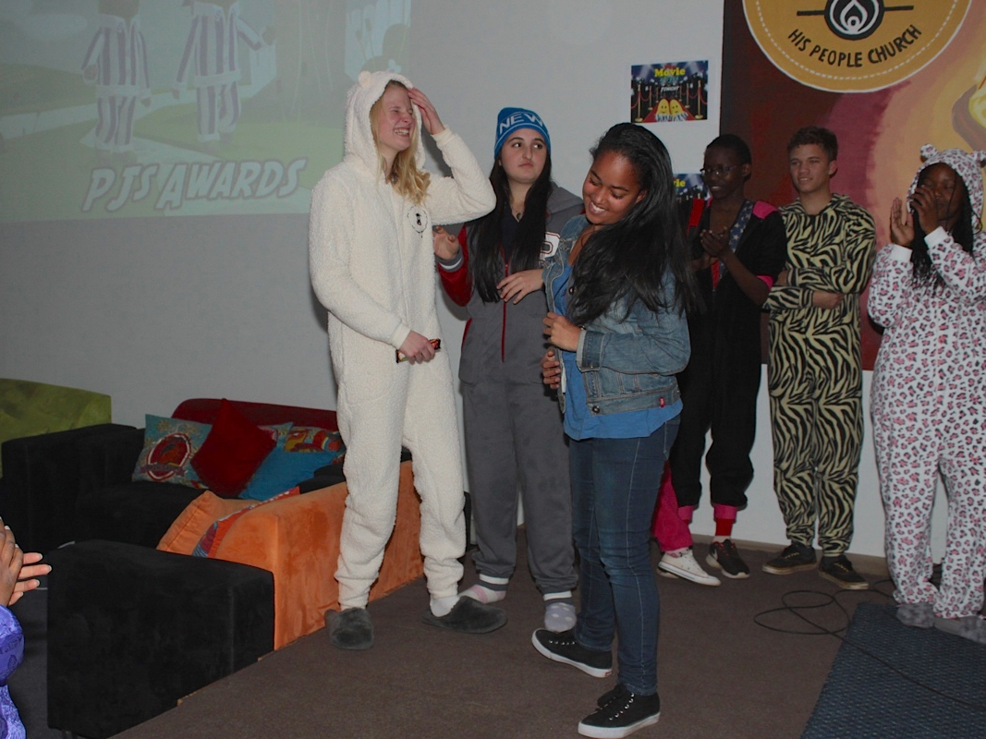

Slide 16
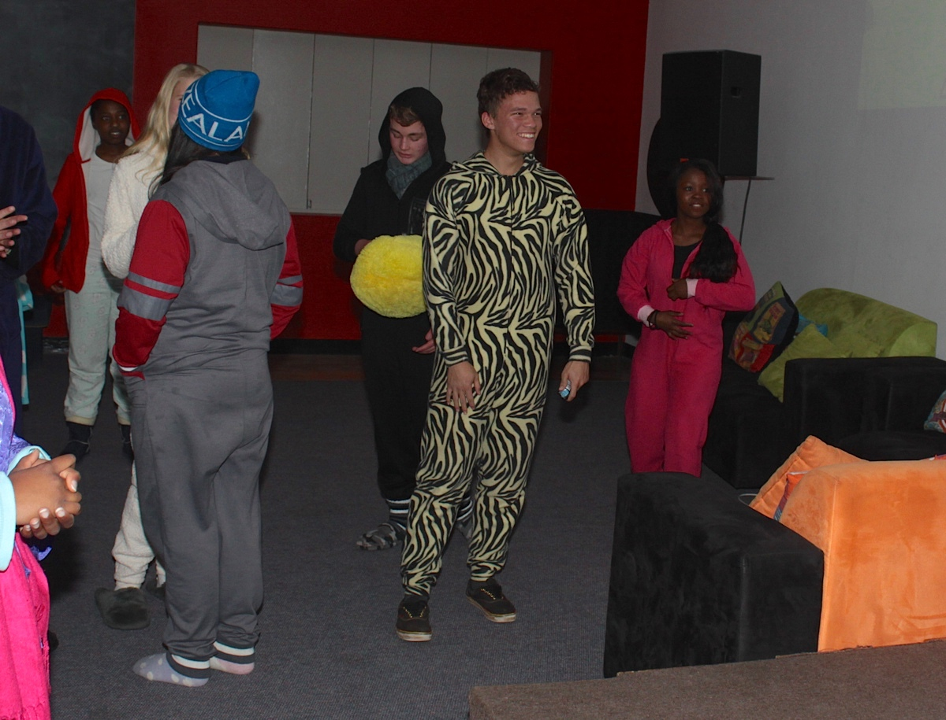

Slide 17
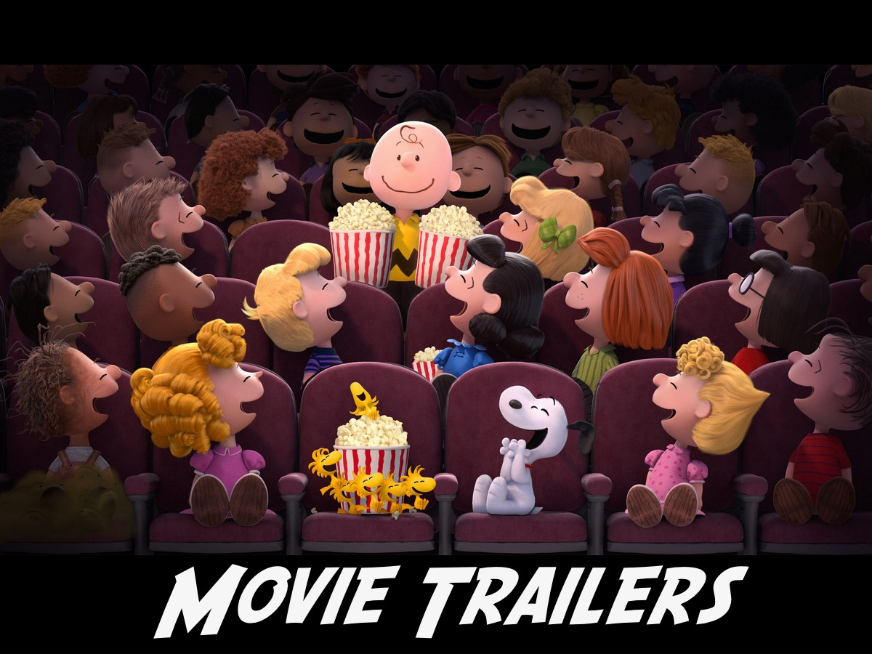
Notes:
First up we have some trailers for upcoming movies to show…

Slide 18
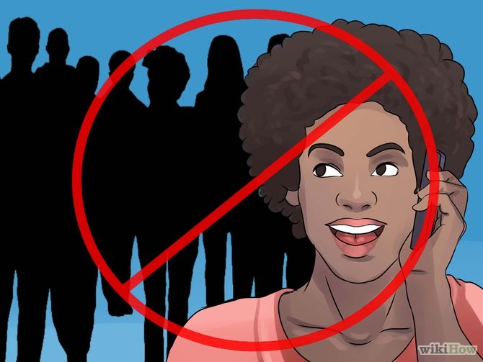
Notes:
Video: Turn off your cell phones. Get it on YouTube at: https://www.youtube.com/watch?v=Wr0vYfPVzH4

Slide 19

Notes:
Our Feature film tonight is Rise of the Guardians - sit back and enjoy the movie - popcorn and sweets will be served during the movie.

Slide 20
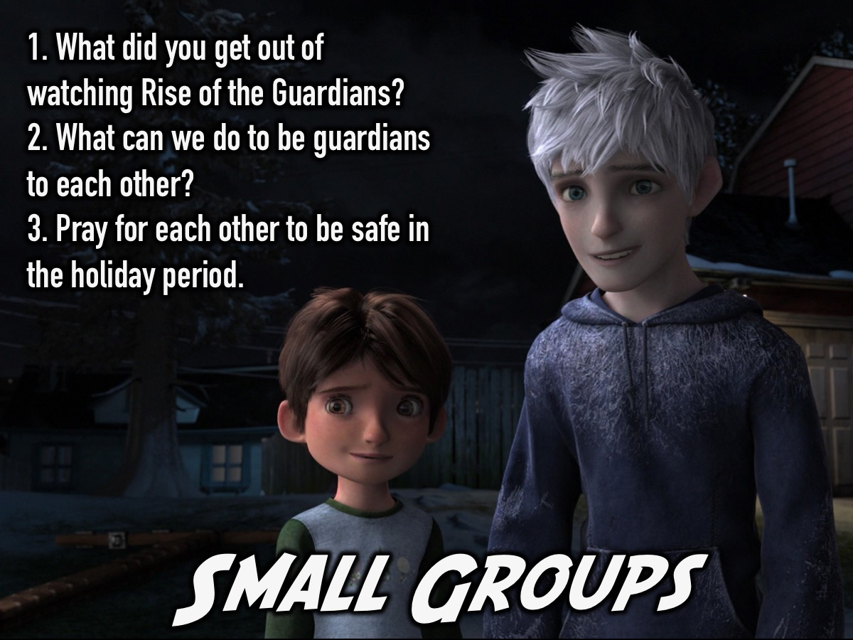
Notes:
Small Groups. Here are the questions for our small group time: (1) What did you get out of watching Rise of the Guardians? (2) What can we do to be guardians of each other? (3) Pray for each other to be safe in the holiday period.

Slide 21
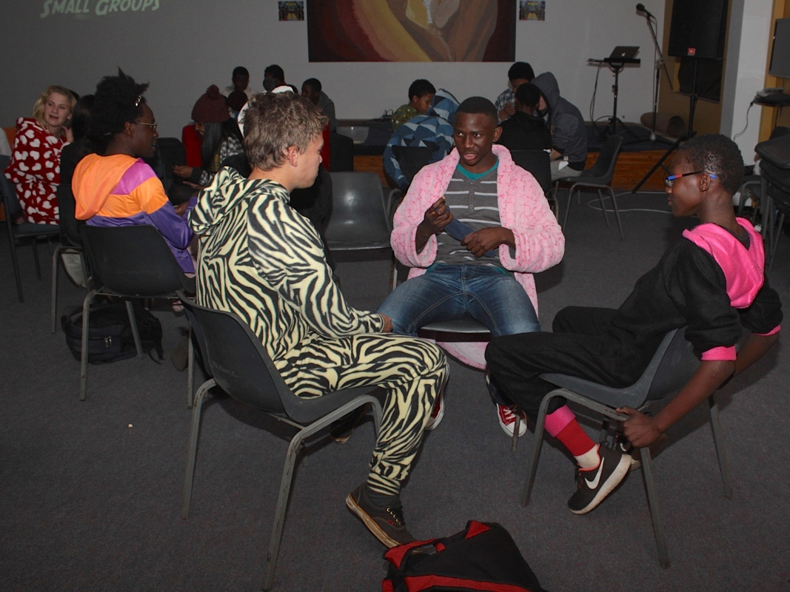

Slide 22
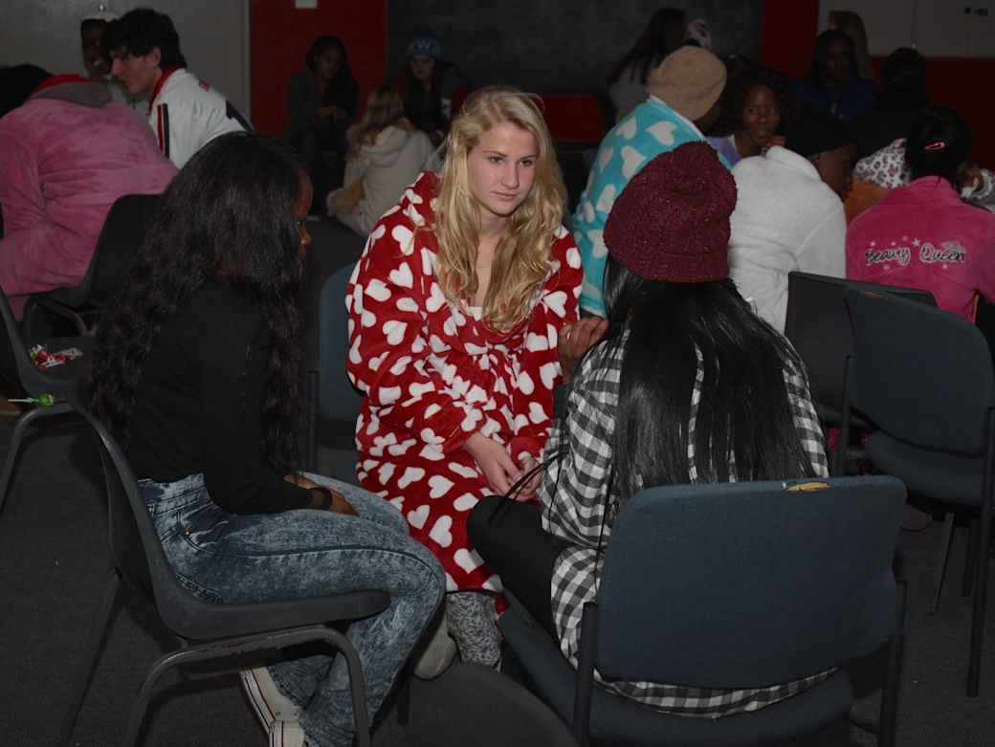

Slide 23
