Slide 1

Notes:
My Passion Night.
Total Pre-Event Videos: 3:00.
Start playing videos just after 7:35.

Slide 2
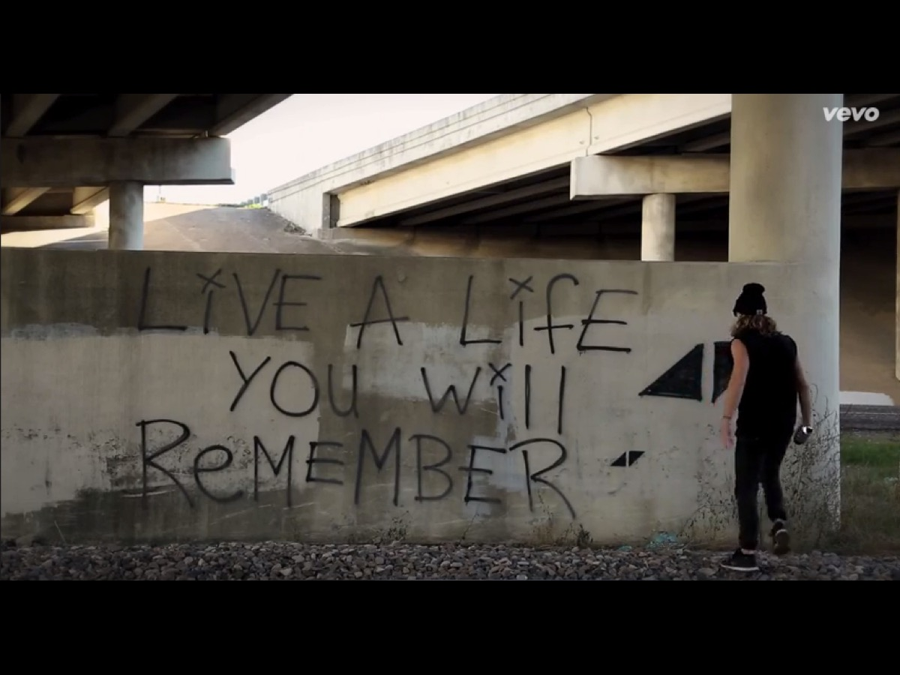
Notes:
Video: The Nights by Avicii. Get it on YouTube at: https://www.youtube.com/watch?v=UtF6Jej8yb4
Video Length: 3:00

Slide 3

Notes:
Welcome to My Life Friday
Time: 7:40-7:50 - Welcome, Announcements and Instructions

Slide 4
Notes:
Tonight is My Passion Night

Slide 5

Notes:
Welcome to all our regulars and if there are any newcomers – please come up onto stage so we can welcome you!

Slide 6

Notes:
Announcements: The Hub (our Sunday night congregation) invites all His Youth Matrics to come along (at no cost) for an afternoon of Paintballing on Saturday the 16th May!

Slide 7

Notes:
Announcements: On Sunday morning we continue with the Trilogy Series!

Slide 8

Notes:
Next Friday night is My Movie Night.

Slide 9

Notes:
It’s Passion Time! Time: 7:50-8:45

Slide 10

Notes:
The Passion Poem:
Swept away from the hand of time
The tick-tock sound is of little importance.
The world is forsaken.
When I began.
My heart beats faster
Awash with inspiration
Swept away from the troubles of the world
Endless effort
Empowered enthusiasm
Lives edified
God glorified.
Sing, dance, play soccer, create an artwork and be happy.
Passion; you sweep me away from the hand of time.
Create a canvas and colour the world with your passion.

Slide 11

Notes:
Instructions: You will visit four venues in the building - exploring four passions (Adventure, Competition, Creativity and Wisdom). You will spend 10 minutes at each venue. You will be given a sheet with the order for your group. Each group will be given a different coloured wristband to wear.

Slide 12

Notes:
1. Adventure
Venue: His Kids Room
Welcome the group to the station – tell them that this passion is all about exploration and travel.
We are going to play a game called: "Round the World”.
Put up the 10 country posters on the wall spread around the room.
Tell the group that they are going to “travel” to different countries as you call out a destination. They have to individually figure out in which country it is found and run to the country poster on the wall. Anyone who goes to the wrong country is eliminated.
The winner (the last person standing) will receive a prize.
If time allows (7 minutes) you will play 2 rounds of the game.
Then have the group discuss these 2 questions:
* What countries have you travelled to in real life?
* Where would you like to travel to and why?
Supplies Needed:
* A3 Posters with country names/flags
* A4 pages with names of attractions to call out.

Slide 13

Notes:
2. Competition
Venue: Youth Room
Welcome the group to the station – tell them that this passion is all about competing, teamwork and personal development.
Divide the group into two smaller groups and play the game of Chair Netball.
Rules: Put a chair as the goals on either side of the room – and have a member from each group stand on a chair in their opponents area. The ball is passed from person to person (you are not allowed to run with the ball) and finally thrown to the goalkeeper who has to catch the ball without falling off the chair (the goalkeeper cannot be touched by the defenders). Play until a group reaches 10 goals or until 7 minutes are up. Give each person on the winning team a prize.
When the game is over have the group discuss these questions (3 minutes):
* What sports are you passionate about?
* What do you like/dislike about sport?
Supplies Needed:
* Volleyball
* 2 chairs
* Whistle
* Score Keeper

Slide 14

Notes:
3. Creativity
Venue: His Diz Room
Welcome the group to the station – tell them that this passion is all about creativity and designing stuff.
Get the group to choose 1 person to be their sketch artist. They will choose 1 of 4 designs which the artist will not see. They have to describe what they see to the artist who will draw it. They have 7 minutes to complete the exercise.
When the artist is finished have the group discuss the following questions:
* What was it like trying to get the artist to draw what you had seen/heard?
* In what ways are you creative?
Supplies Needed:
* A3 Paper (1 sheet per round)
* Black marker pen
* Posters for the Artist to Draw

Slide 15

Notes:
4. Wisdom
Venue: His Kids Worship Room
Welcome the group to the station – tell them that this passion is all about knowledge, growth and serving others.
Show the group an example of a formula for happiness in life:
Life + Laughter x Love - Hate = Happiness.
The group then has to work together to create a formula for life that starts with “Life” and ends with “Best Life Ever". The following symbols must be used: + (plus), - (subtract), x (multiply) and = (equals). Symbols can be used more than once. They have 7 minutes to complete the exercise.
When they have finished creating their formula give each person the Mathematics for Life equation handout and tell them to spend 3 minutes reflecting on it.
The Mathematics for Life Equation:
SUBTRACT all your fears (1 Peter 5:7)
DIVIDE your blessings with others (2 Corinthians 9:11)
MULTIPLY your good deeds (2 Corinthians 10:8)
ADD Jesus to your life (Romans 10:9-10)
EQUALS a Wonderful Life (Psalm 16:11)
Supplies Needed:
* Posters of the Formula for happiness in life.
* A3 paper with “Life” and “Best Life Ever” on it.
* Black marker pens
* The Mathematics of Life equation handout.

Slide 16

Notes:
It is time to experience passion!

Slide 17

Notes:
Rewards: There is no competition between the groups, but everyone will receive a Chomp chocolate.

Slide 18

Notes:
Small Groups: Small groups are going to be a little different tonight. You are going to share your answers to four questions and fill in a worksheet along the way to identify your spiritual passion. Here are the questions:
1. What activities make you lose track of time?
2. What do you daydream about doing in life?
3. What activities leave you energised?
4. How do you want to make a difference in your world?
5. Now look for common words or phrases and finish the sentence: My Passion is…
6. Share your passion with each other.
7. Pray for each other’s passion to please God and encourage people.
Small Groups start at 8:45 (until 9:10)

Slide 19

Notes:
Refreshments. We will end with juice and biscuits! Refreshments Start at: 9:10

Slide 20

Notes:
Video: The Days by Avicii. Get it on YouTube at: https://www.youtube.com/watch?v=JDglMK9sgIQ
Video Length: 4:00

Slide 21

Notes:
Next Friday Night is My Movies Night (Asher Pardey’s Night)

