Slide 1

Notes:
My School Night
Pre-event Videos: 8 Minutes.
Buy for event: 4 Bags of Marbles; 4 Yo-Yos; 8 Apples; 8 Bananas; 1 Pkt Biscuits; 4 Sandwiches; 8 Fish; 4 Fizzers; 4 Cokes; 4 White T-Shirts; 4 School Lunch Boxes (that will contain all the Food Race items).
Organise: A Scoreboard; A3 Cardboard for School Names; Koki Pens

Slide 2
Notes:
Video: High School Dance Battle - Geeks vs. Cool Kids. Get it on YouTube at: https://www.youtube.com/watch?v=e5KeReQEUe8
File: My School Dance Battle.mp4
Video Length: 2:25

Slide 3
Notes:
Video: This Is How We Hoop (feat. Rachael Lust). Get it on YouTube at: https://www.youtube.com/watch?v=fIU20knDVnI
File: My School Hula-Hooper.mp4
Video Length: 2:00

Slide 4
Notes:
Video: BLACK My journey to yo-yo mastery. Get it on YouTube at: https://www.youtube.com/watch?v=gnuFrtTNUTc
File: My School Yo-Yo Champ.mp4
Video Length: 3:43

Slide 5

Notes:
Welcome to My Life Friday
Time: 7:40-7:50 - Welcome, Announcements and Instructions

Slide 6
Notes:
Tonight is My School Night

Slide 7

Notes:
Welcome to all our regulars and if there are any newcomers – please come up onto stage so we can welcome you!

Slide 8

Notes:
Announcements: On Sunday morning we conclude the Trilogy Series!

Slide 9

Notes:
Next Friday night is My School night.

Slide 10

Notes:
It is time to enroll!

Slide 11

Notes:
Gym Class. Ice Breaker - Teens answer questions about school related matters. Everyone starts by standing in the middle of the youth room and if they answer “Yes” they run to the one side and if “No” they run to the others side. Everyone returns to the middle after each question is answered.

Slide 12
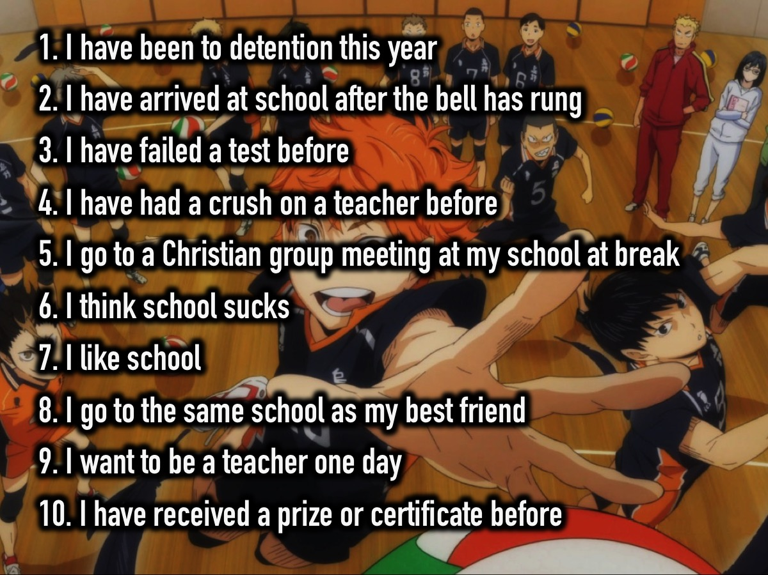
Notes:
The Questions:
1. I have been to detention this year
2. I have arrived at school after the bell has rung
3. I have failed a test before
4. I have had a crush on a teacher before
5. I go to a Christian group meeting at my school at break
6. I think school sucks
7. I like school
8. I go to the same school as my best friend
9. I want to be a teacher one day
10. I have received a prize or certificate before

Slide 13
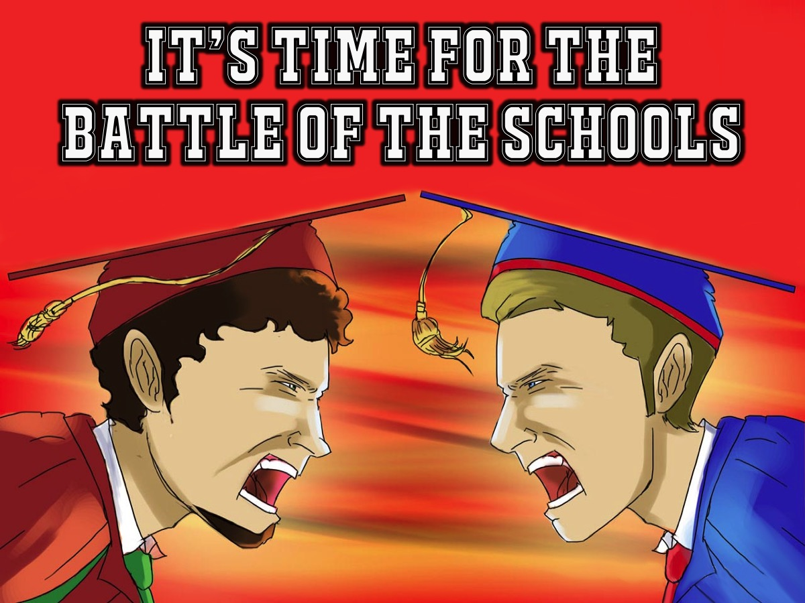
Notes:
It is time for the ultimate Battle of the School contest

Slide 14
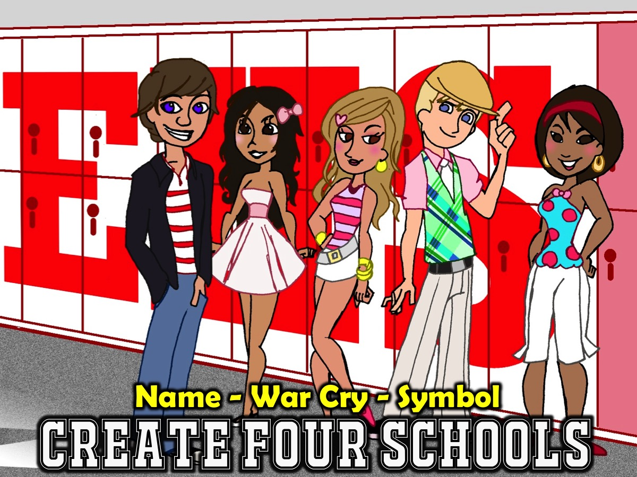
Notes:
Create Four Schools. Divide into four groups: Each group has to come up with a name for their school (only one word - ie. “Rosebank” High), a war cry and a uniform symbol drawn on their body with a Koki (possibly also drawing the symbol on a white T-Shirt that is to be worn). Each school then presents their name, war cry and symbol (including T-Shirt) on stage.

Slide 15
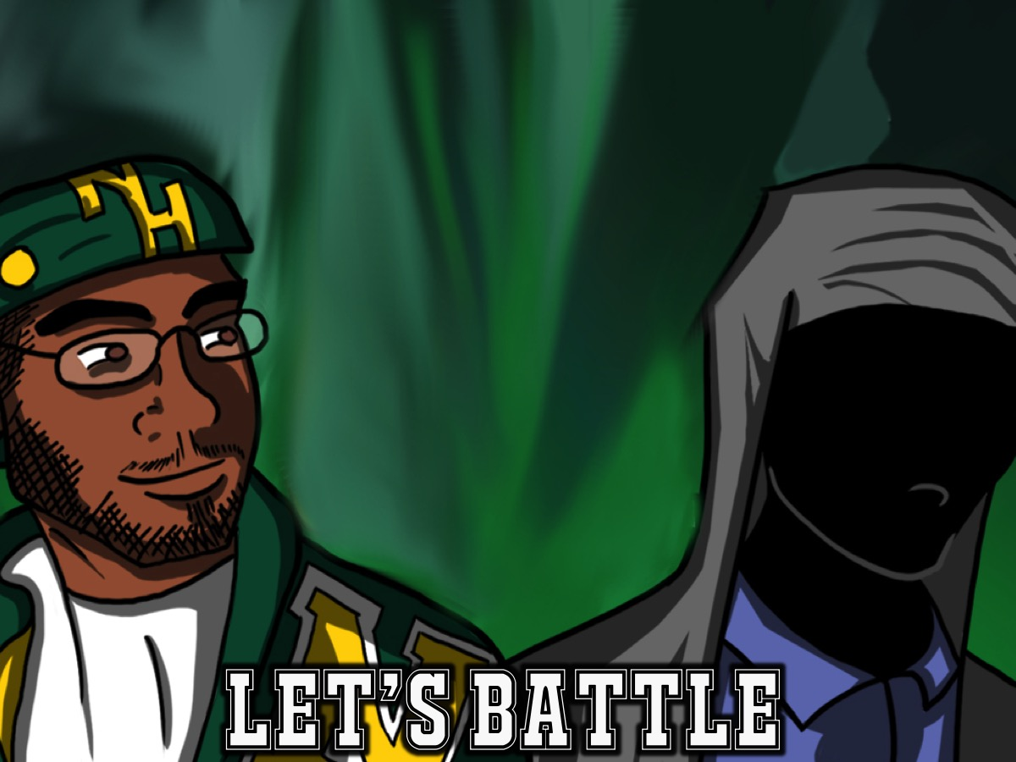
Notes:
Let’s Battle. You are going to compete as schools against each other - the winner will receive prizes. Points will be awarded and written onto the scoreboard.

Slide 16

Notes:
1. Marbles.

Slide 17
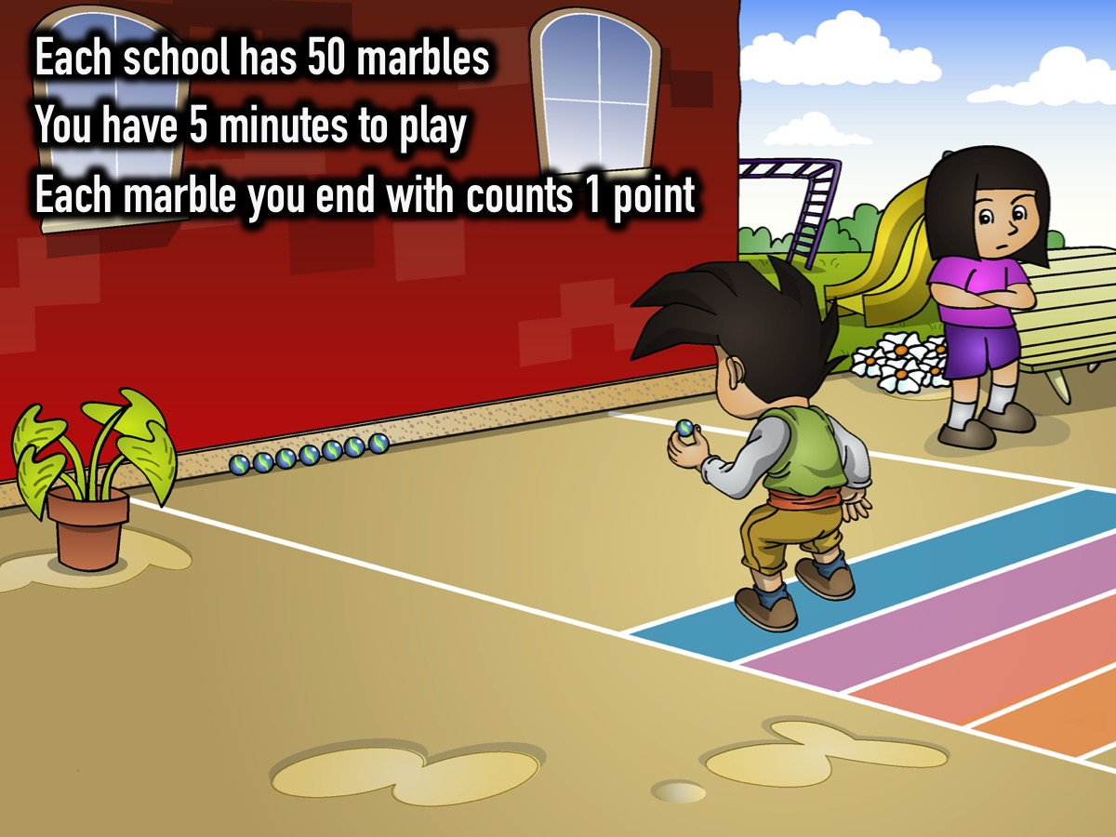
Notes:
1. Marbles. Each school is given a bag of 50 marbles and they have to play marbles against the other schools (individually or in groups as they choose) and after a certain amount of time each school will be awarded a point for ever marble they have in their possession.

Slide 18
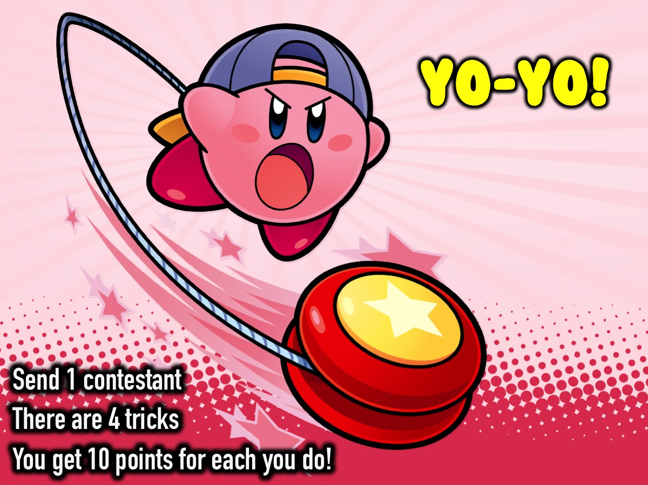
Notes:
2. Yo-Yo. Each school sends a representative who will get 10 points for each trick they are able to complete successfully.

Slide 19
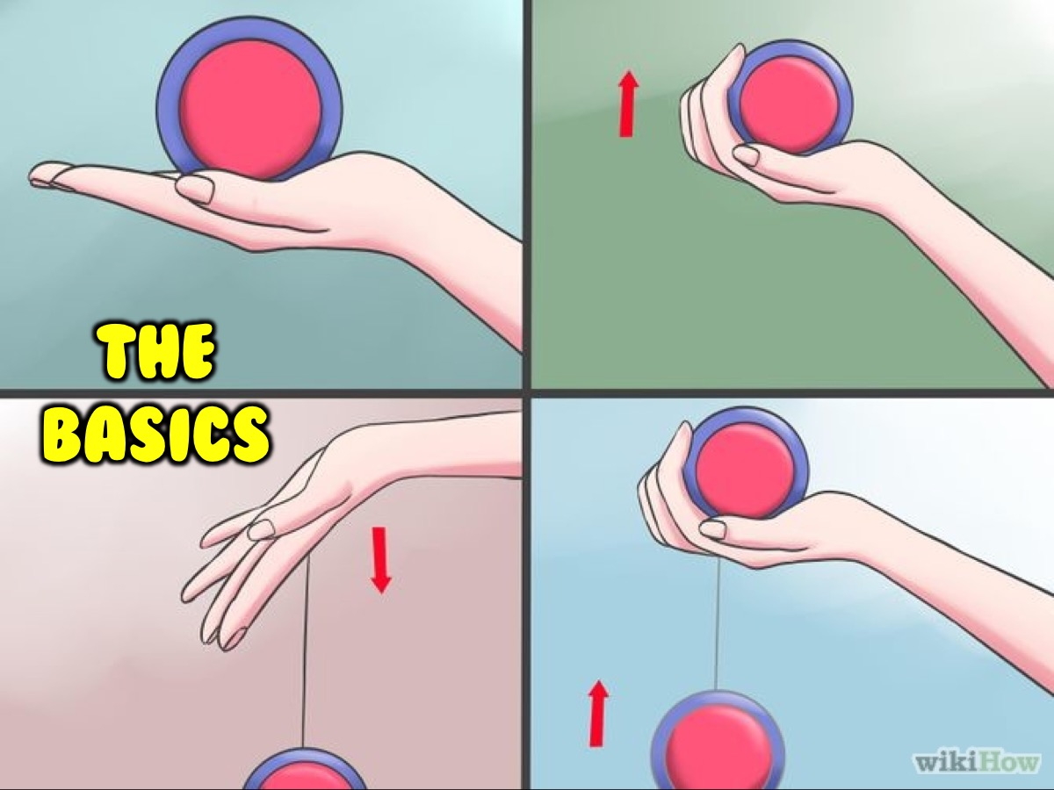
Notes:
(1) The Basics - throw the yo-yo down and bring it back up to your hand.

Slide 20
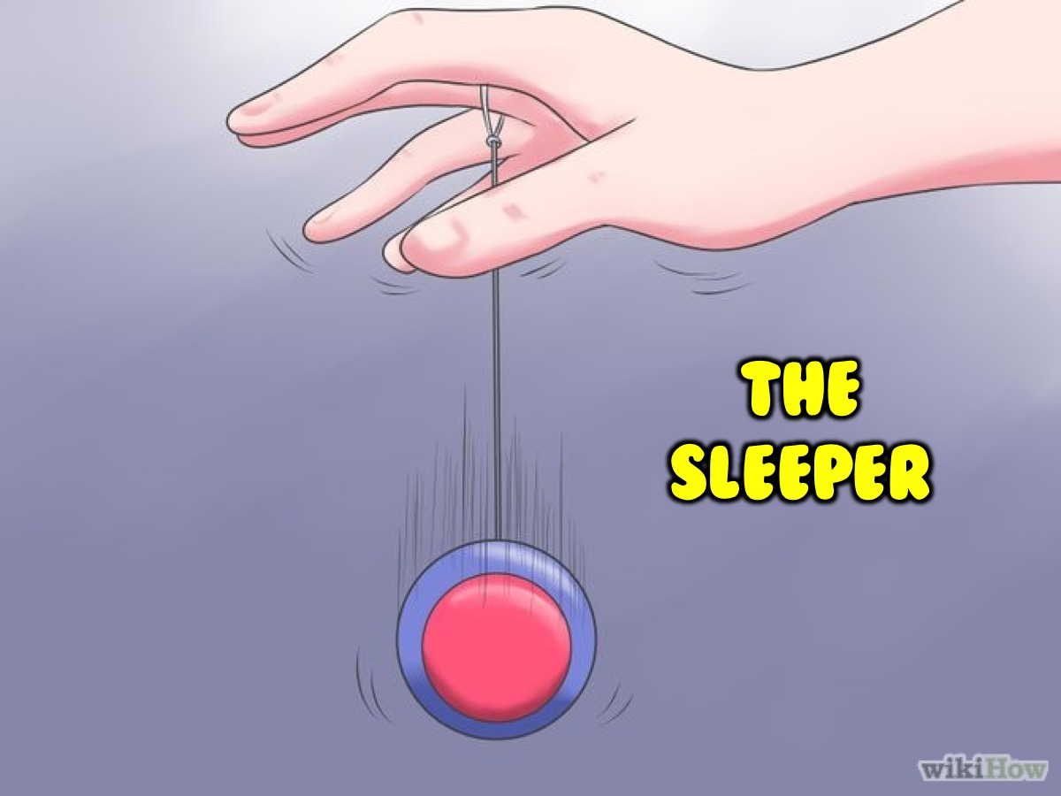
Notes:
(2) The Sleeper - throw the yo-yo down and let it spin at the end of the string for a few seconds before bringing it back to your hand.

Slide 21
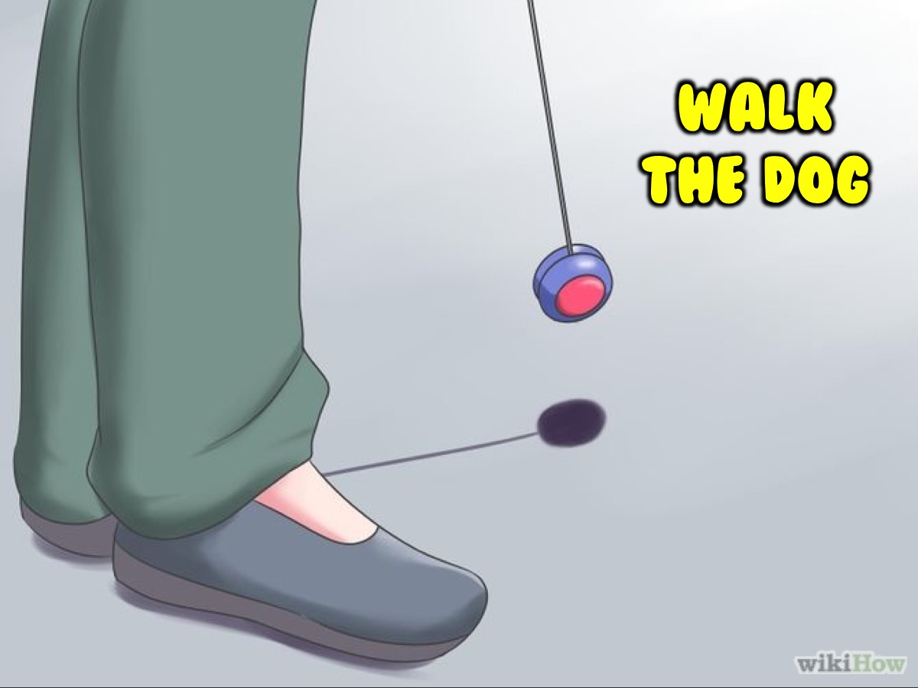
Notes:
(3) Walk the Dog - throw a sleeper and then let the yo-yo walk on the ground for about 30 centimeters before bringing it back to your hand.

Slide 22
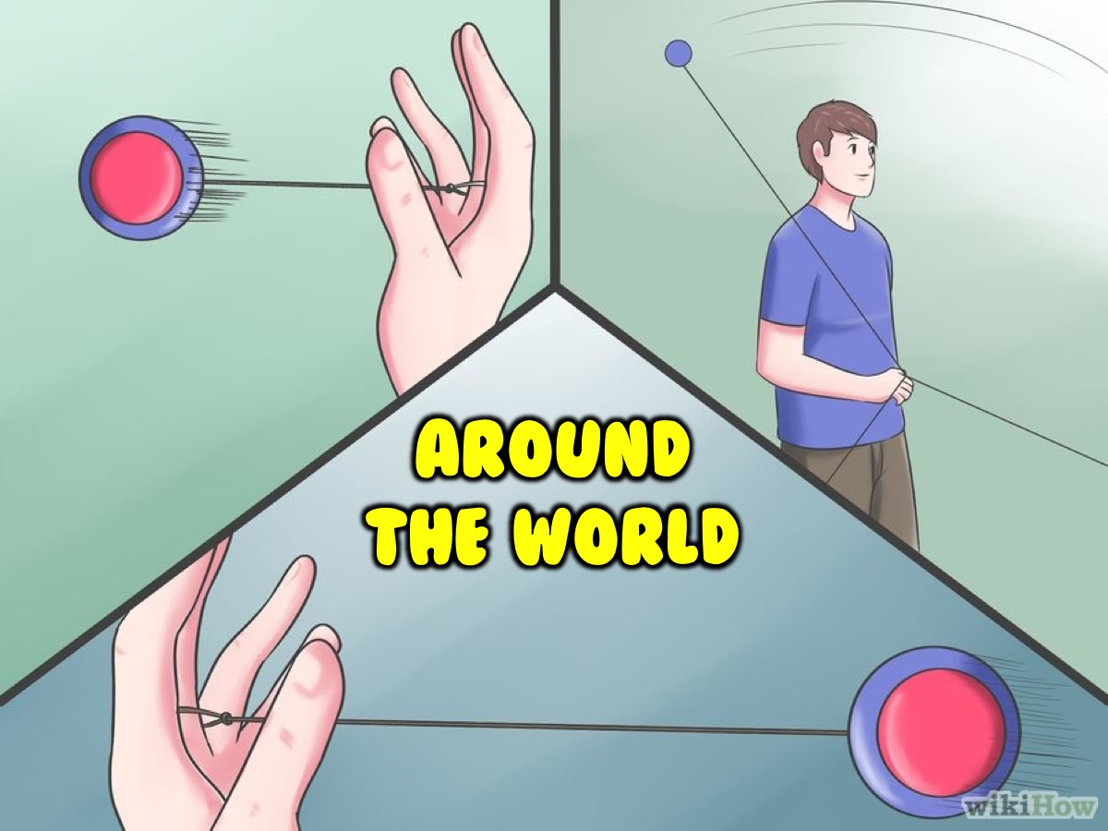
Notes:
(4) Around the World - throw the yo-yo out in front of you and let it go all the way around above your head until you bring it back into your hand.

Slide 23

Notes:
3. Rock-Paper-Scissors.

Slide 24
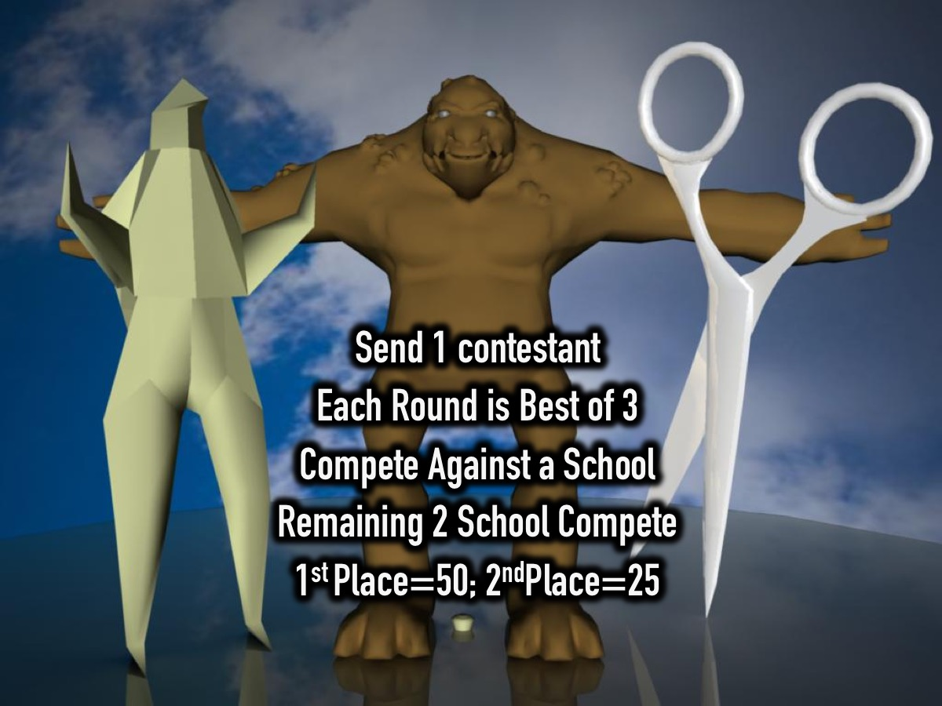
Notes:
Each school sends a contestant forward to compete in a round of Rock Paper Scissors. Each schools competes against another school and then the remaining two schools play for first place. The first place school wins 50 points and the second place schools wins 25 points.

Slide 25
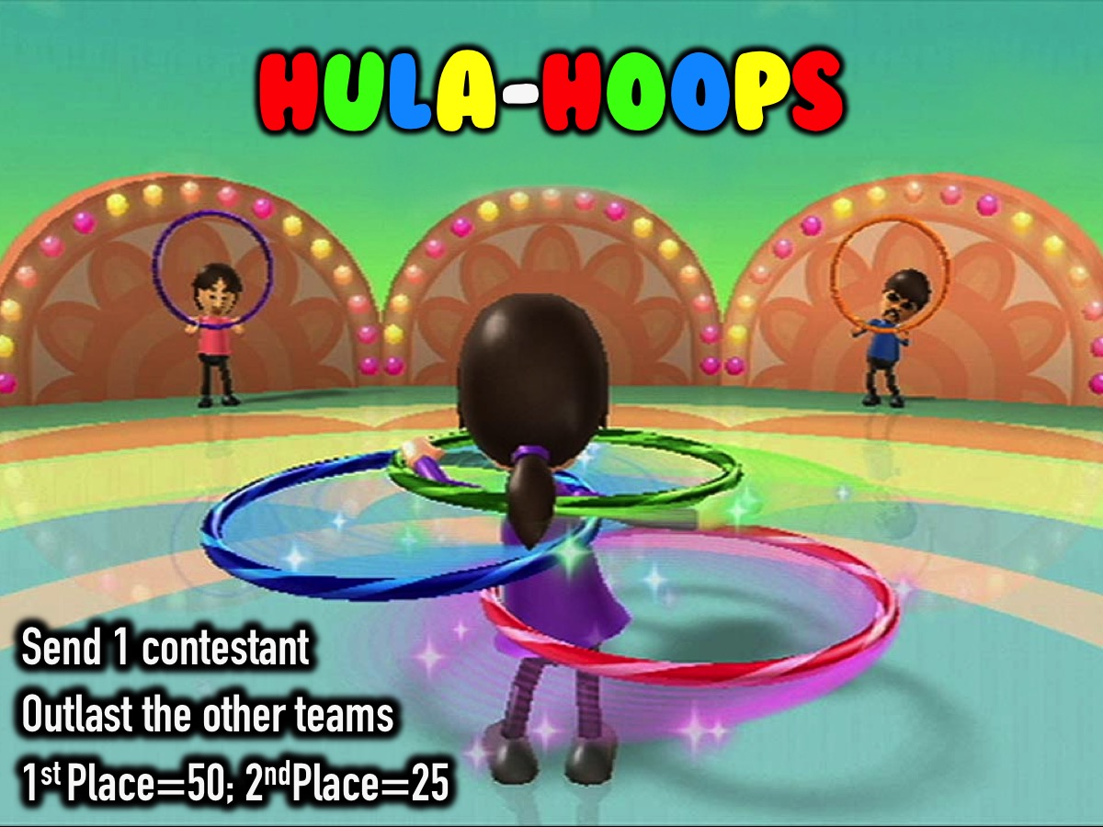
Notes:
4. Hula-Hoops. Each schools sends 1 person to compete in the hula-hoop contest. Everyone starts spinning the hoops at the same time and the person who keeps the hoop off the group the longest wins 50 points for their school and the second place person wins 25 points for their school.

Slide 26
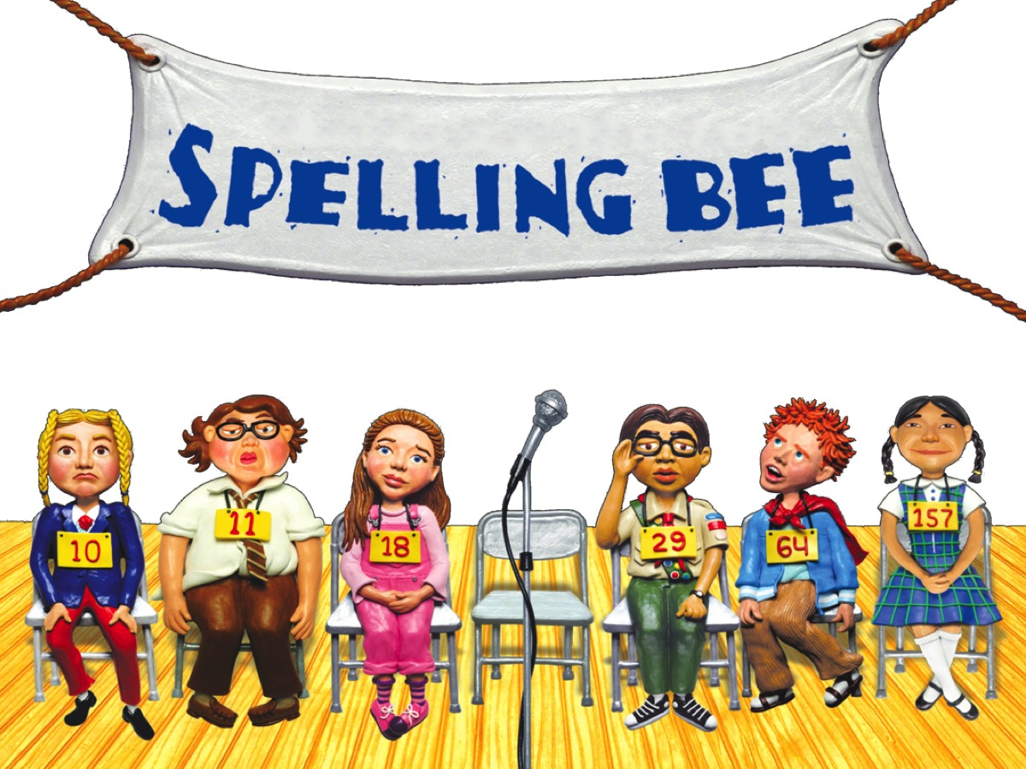
Notes:
5. Spelling-Bee.

Slide 27
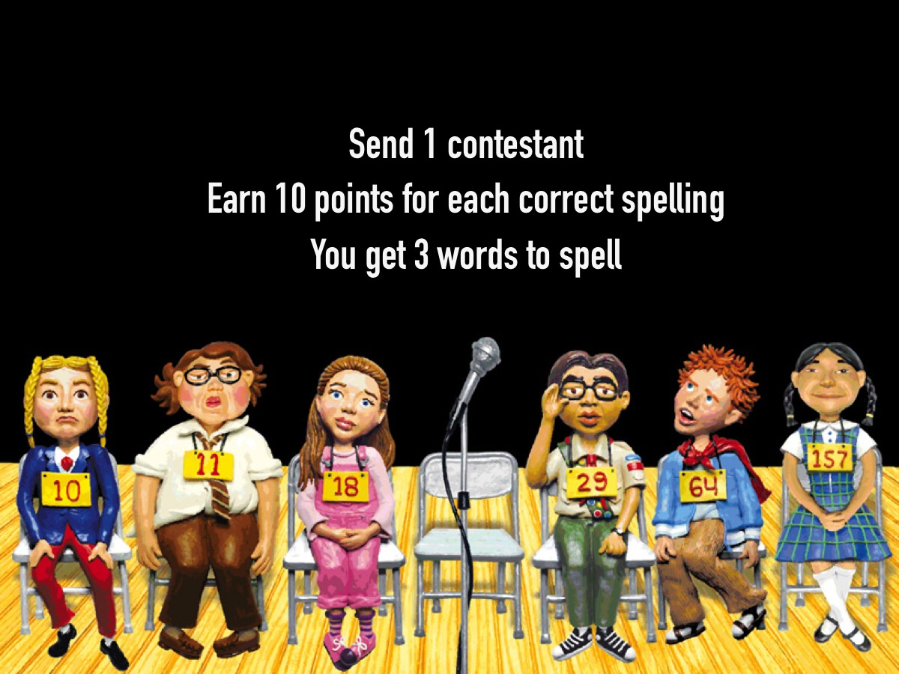
Notes:
Each school sends 1 person to compete and they get 10 points for every word they spell correctly. Each school is given 3 words to spell. The Words: Outrageous, Lucrative; Gruesome; Parliament; Pageant; Ominous; Permeate; Espionage; Occurred; Cappuccino; Honorary; Berserk.

Slide 28
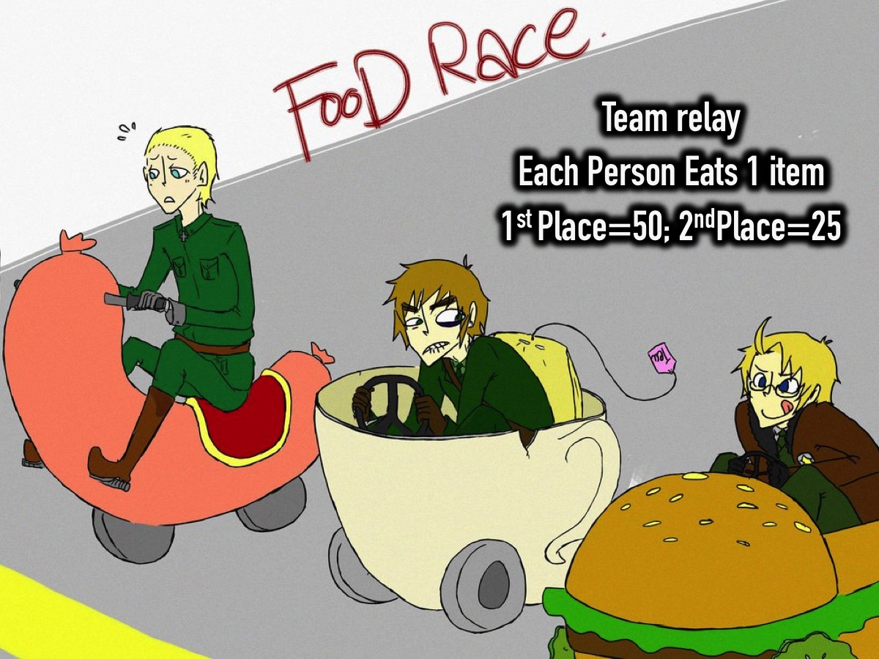

Slide 29

Notes:
And the prize for the top school goes to…

Slide 30
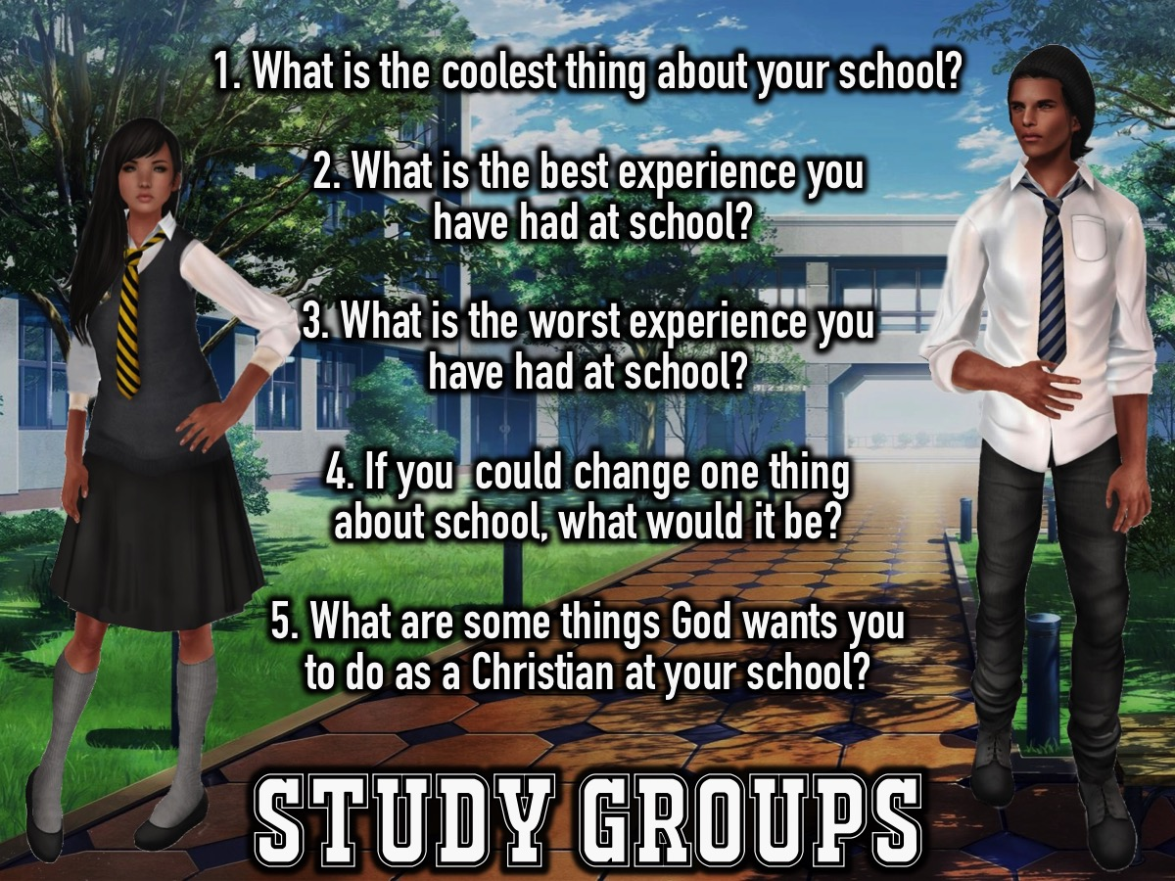
Notes:
Study Groups. Here are the questions for our small group time: (1) What is the coolest thing about your school? (2) What is the best experience you have had at school? (3) What is the worst experience you have had at school? (4) If you could change one thing about school, what would it be? (5) What are some things God wants you to do as a Christian at your school? Examples: Share your lunch with a hungry person. Invite a friend to youth. Run a small group at your school. Share the love of Jesus with someone. Pray for someone who is sick or injured. Share the Gospel with someone.

Slide 31
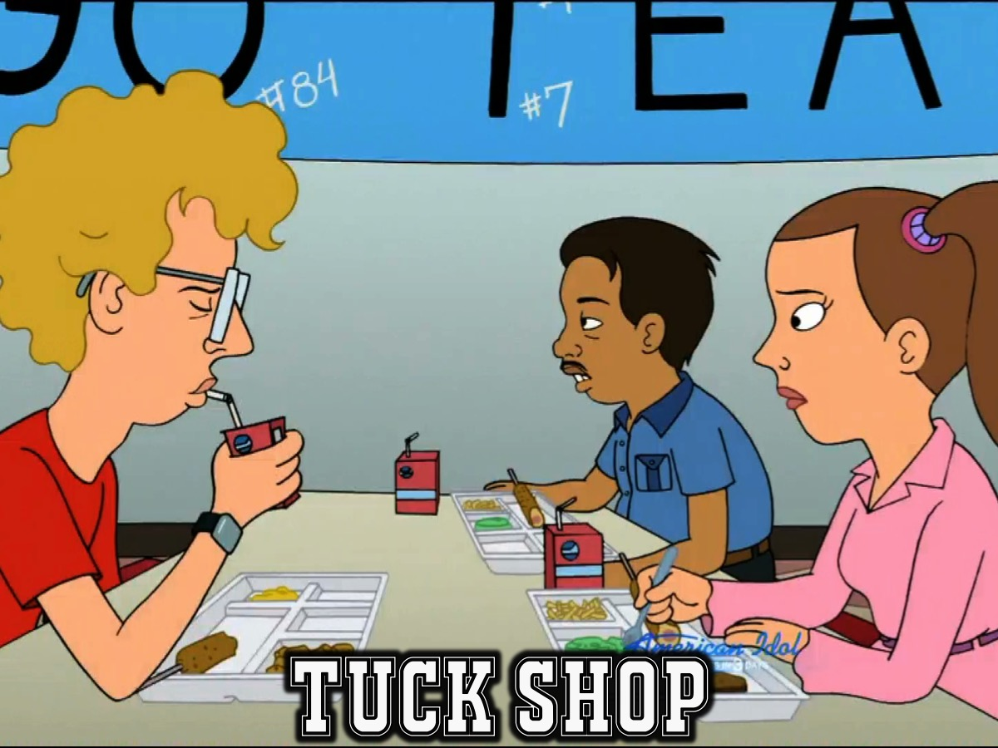
Notes:
Tuck Shop: We will serve hot chocolate and crisps. Refreshments Start at: 9:10

Slide 32

Notes:
Next Friday night is My Friends Night

