Slide 1

Notes:
This term we are exploring various seemingly paradoxical aspects of Christian living – it is all about the power of “AND” instead of “EITHER OR”.

Slide 2

Notes:
This term we are exploring various seemingly paradoxical aspects of Christian living – it is all about the power of “AND” instead of “EITHER OR”.

Slide 3
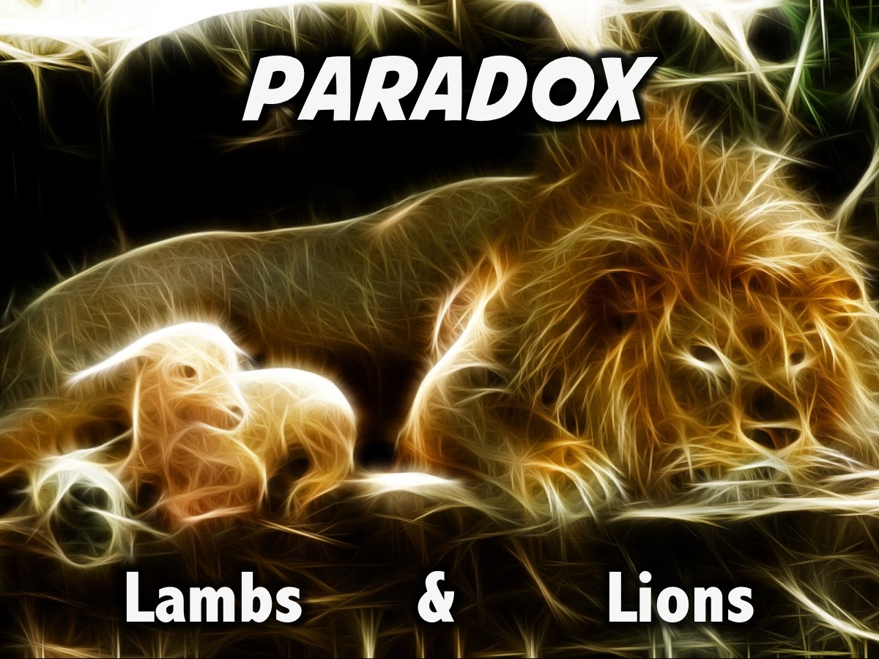
Notes:
We have been called to be Lambs AND Lions - or Gentle AND Strong.

Slide 4
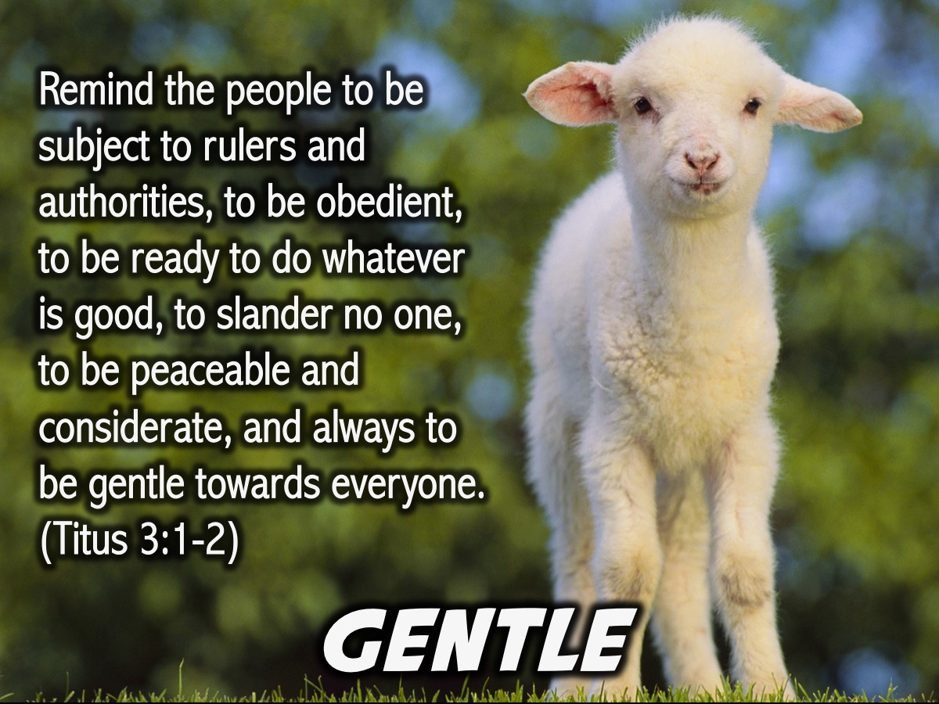
Notes:
Gentle: Remind the people to be subject to rulers and authorities, to be obedient, to be ready to do whatever is good, to slander no one, to be peaceable and considerate, and always to be gentle towards everyone. (Titus 3:1-2)

Slide 5
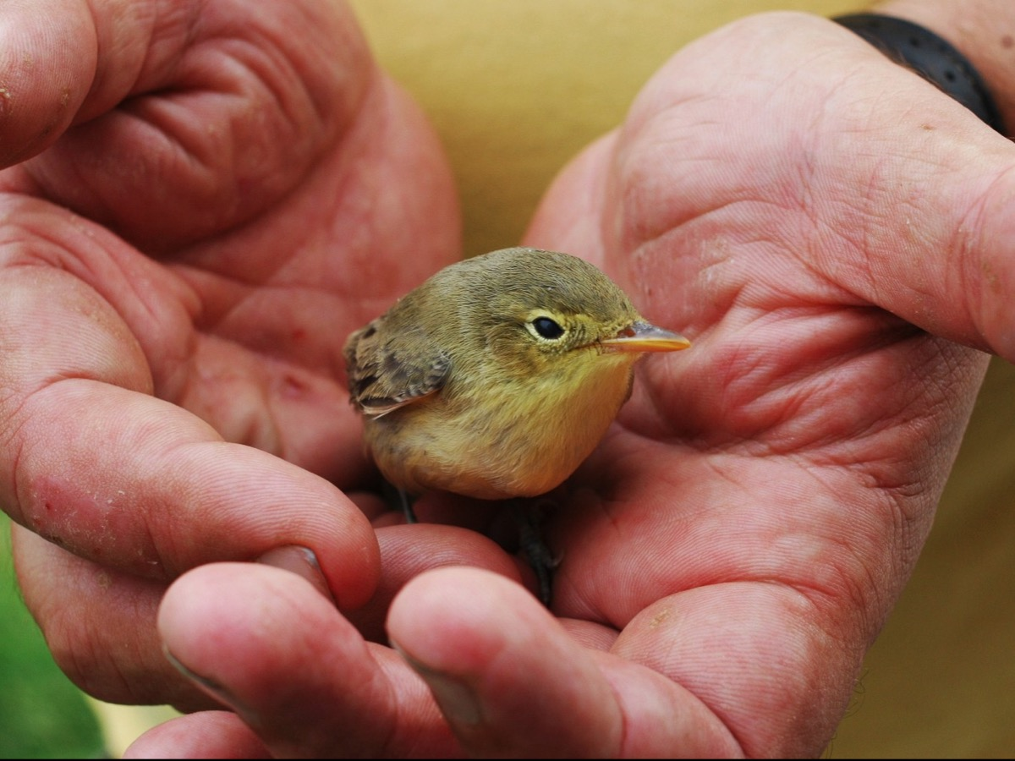
Notes:
Here is a great visual example of gentleness!

Slide 6

Notes:
Strong: Be strong and courageous. (Joshua 1:9)

Slide 7
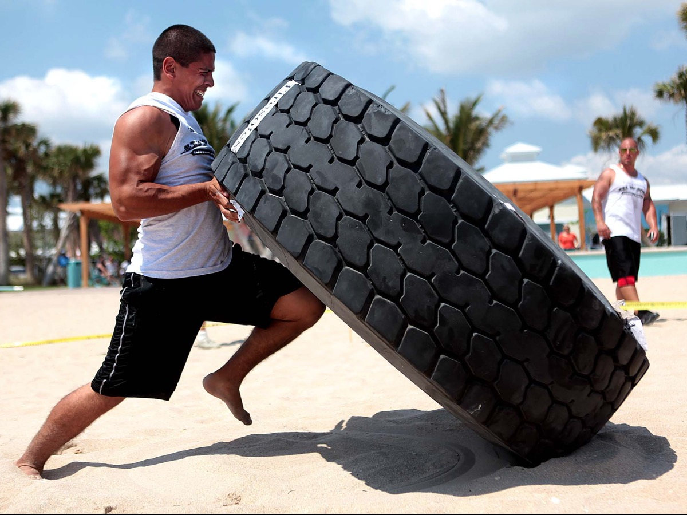
Notes:
Here is a great visual example of strength.

Slide 8

Notes:
The Gentle and Strong Debate: We are going to divide into two groups and your will have a change to debate either for us being Gentle or being Strong. Here are the scriptures you will have to work with – and of course you can add examples or stories or other insights to the debate.
Verses about being Gentle:
Remind the people to be subject to rulers and authorities, to be obedient, to be ready to do whatever is good, to slander no one, to be peaceable and considerate, and always to be gentle towards everyone. (Titus 3:1-2)
Always be prepared to give an answer to everyone who asks you to give the reason for the hope that you have. But do this with gentleness and respect. (1 Peter 3:15)
And the Lord’s servant must not be quarrelsome but must be kind to everyone, able to teach, not resentful. Opponents must be gently instructed, in the hope that God will grant them repentance leading them to a knowledge of the truth, and that they will come to their senses and escape from the trap of the devil, who has taken them captive to do his will. (2 Timothy 2:24-26)
But the fruit of the Spirit is love, joy, peace, patience, kindness, goodness, faithfulness, gentleness, self-control; against such things there is no law. (Galatians 5:22-23)
A gentle answer turns away wrath, but a harsh word stirs up anger. (Proverbs 15:1)
Let every person be quick to hear, slow to speak, slow to anger; for the anger of man does not produce the righteousness of God. (James 1:19-20)
Christ suffered for you, leaving you an example, that you should follow in his steps. He committed no sin, and no deceit was found in his mouth. When they hurled their insults at him, he did not retaliate; when he suffered, he made no threats. Instead, he entrusted himself to him who judges justly. (1 Peter 2:21-23)
Verses about being Strong:
Finally, be strong in the Lord and in his mighty power. Put on the full armor of God so that you can take your stand against the devil's schemes. For our struggle is not against flesh and blood, but against the rulers, against the authorities, against the powers of this dark world and against the spiritual forces of evil in the heavenly realms. Therefore put on the full armor of God, so that when the day of evil comes, you may be able to stand your ground, and after you have done everything, to stand. (Ephesians 6:10-13)
I pray that out of his glorious riches he may strengthen you with power through his Spirit in your inner being, (Ephesians 3:16)
The God who equipped me with strength and made my way blameless. He made my feet like the feet of a deer and set me secure on the heights. He trains my hands for war, so that my arms can bend a bow of bronze. (Psalm 18:32-34)
Have I not commanded you? Be strong and courageous. Do not be frightened, and do not be dismayed, for the LORD your God is with you wherever you go. (Joshua 1:9-11)
For God gave us a spirit not of fear but of power and love and self-control. (2 Timothy 1:7)
When it was almost time for the Jewish Passover, Jesus went up to Jerusalem. In the temple courts he found men selling cattle, sheep and doves, and others sitting at tables exchanging money. So he made a whip out of cords, and drove all from the temple area, both sheep and cattle; he scattered the coins of the money changers and overturned their tables. To those who sold doves he said, "Get these out of here! How dare you turn my Father's house into a market!" His disciples remembered that it is written: "Zeal for your house will consume me." (John 2:13-17)

Slide 9
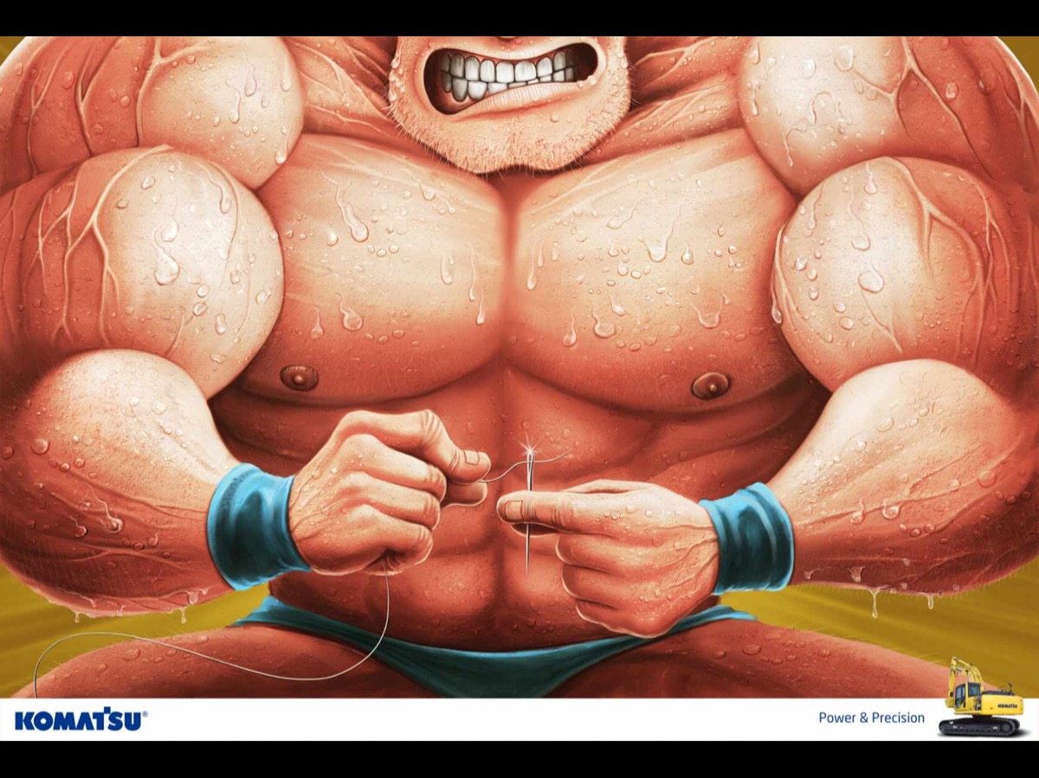
Notes:
Here is a great picture of gentle and strong.

Slide 10
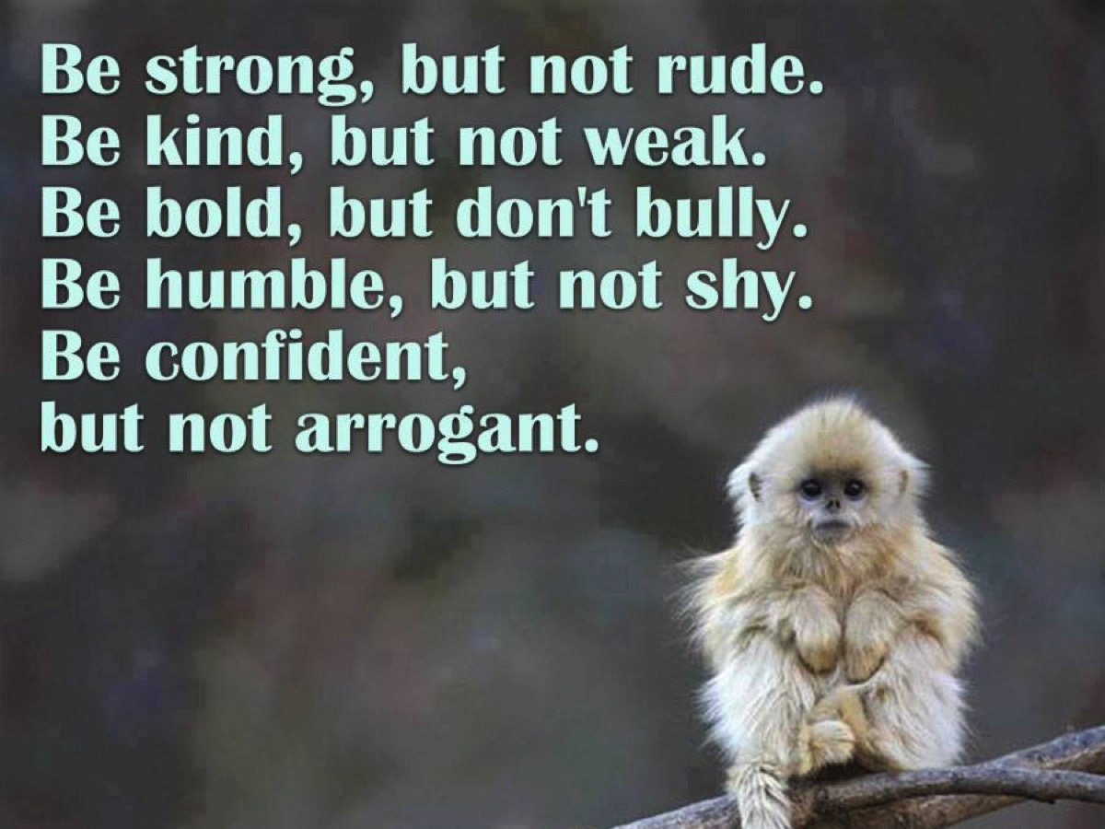
Notes:
Here are some profound words that mix gentle and strong. It is clearly a tension to manage.

Slide 11
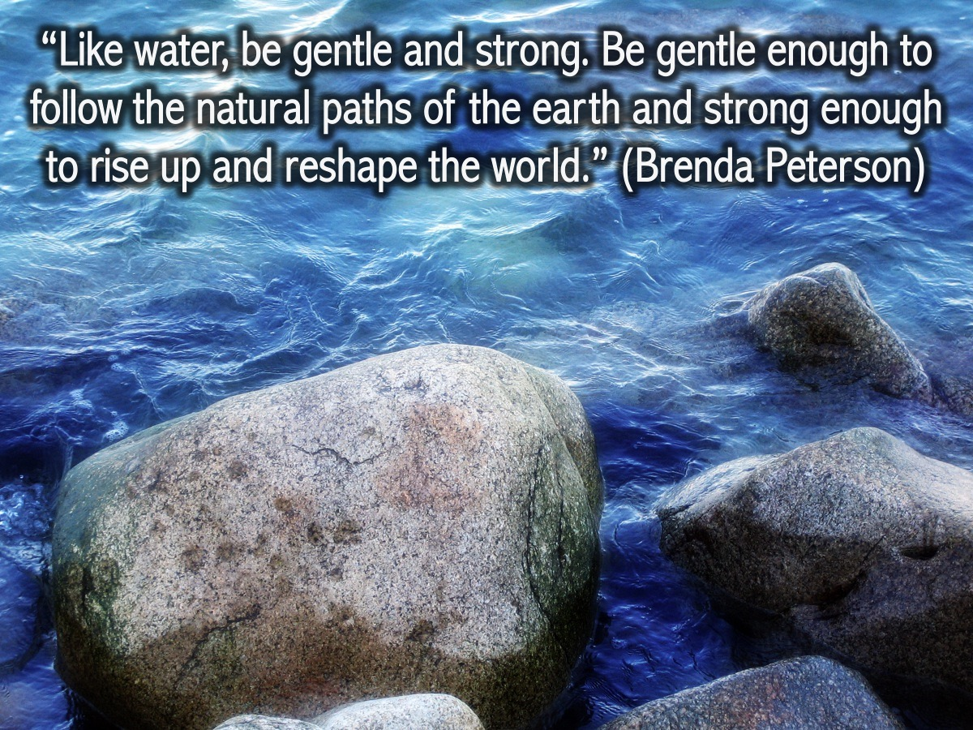
Notes:
“Like water, be gentle and strong. Be gentle enough to follow the natural paths of the earth and strong enough to rise up and reshape the world.” (Brenda Peterson)

Slide 12
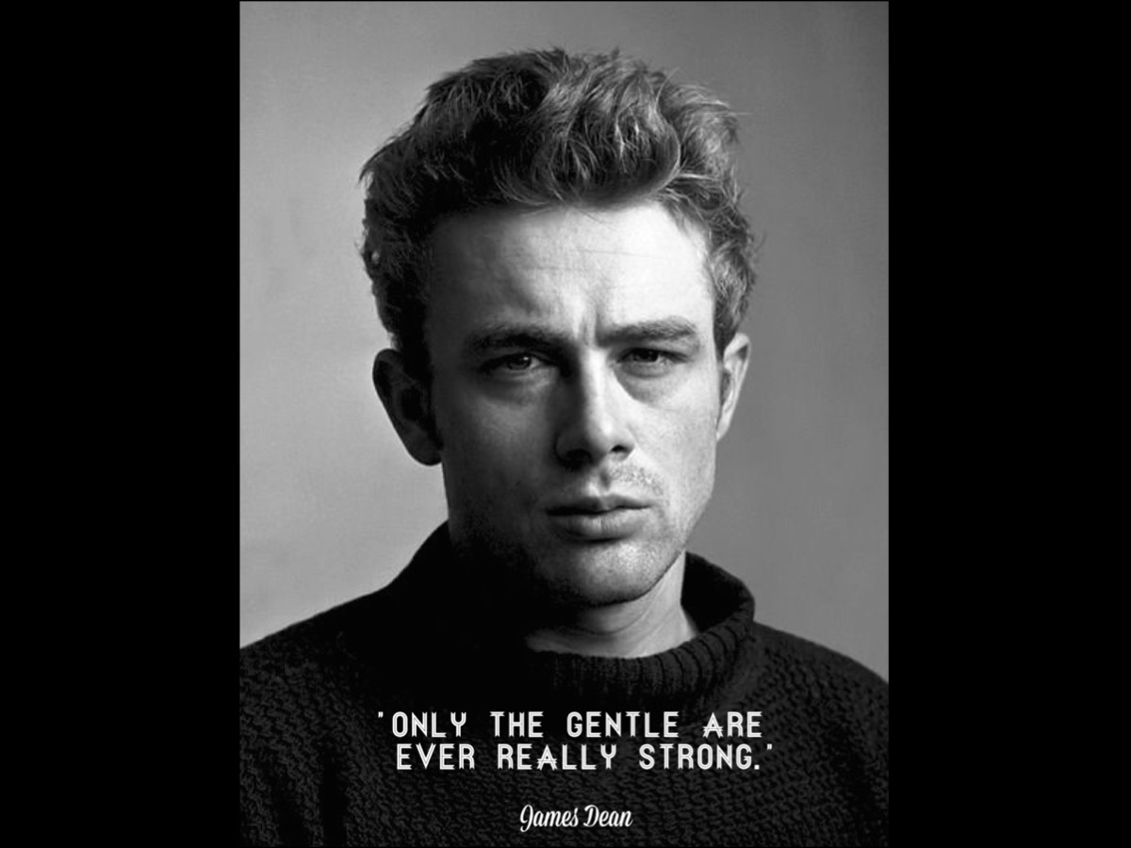
Notes:
James Dean once said: “Only the gentle are ever really strong”.

Slide 13
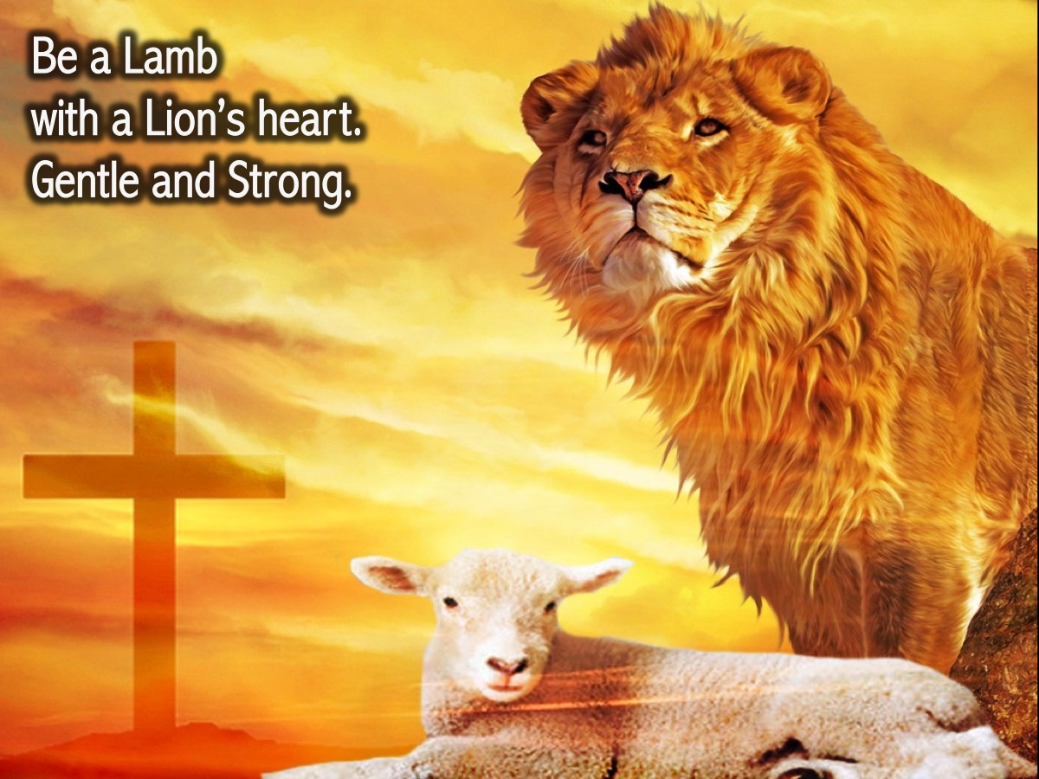
Notes:
Be a lamb with a lion’s heart. Gentle and strong.

Slide 14
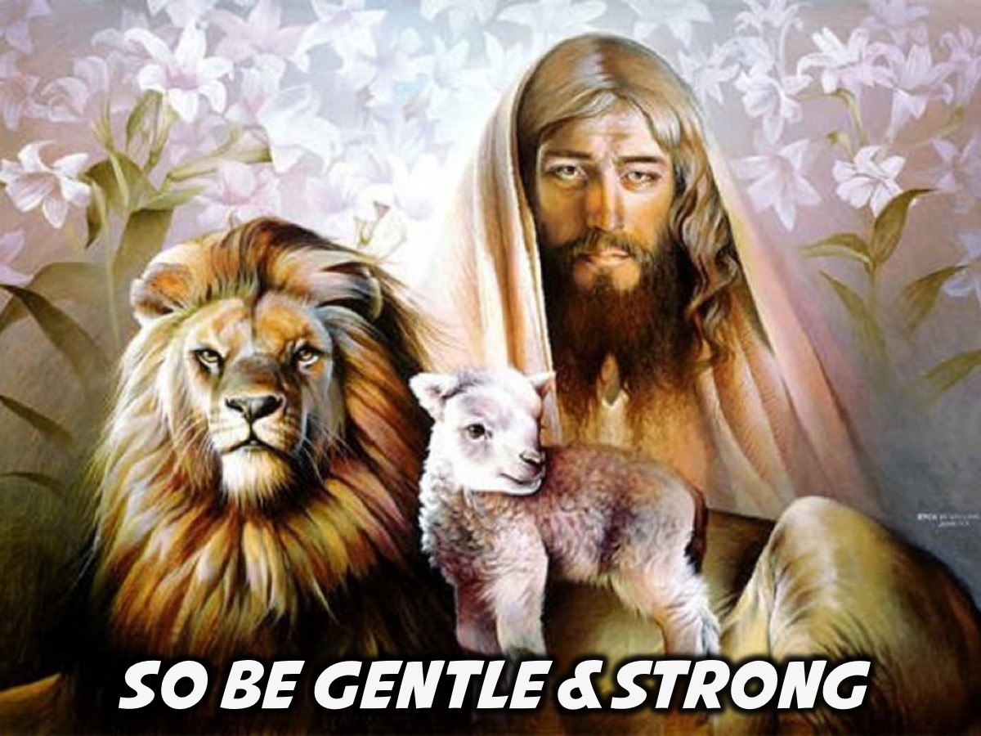
Notes:
So be Gentle and Strong! With Jesus’ help we can do it!

Slide 15
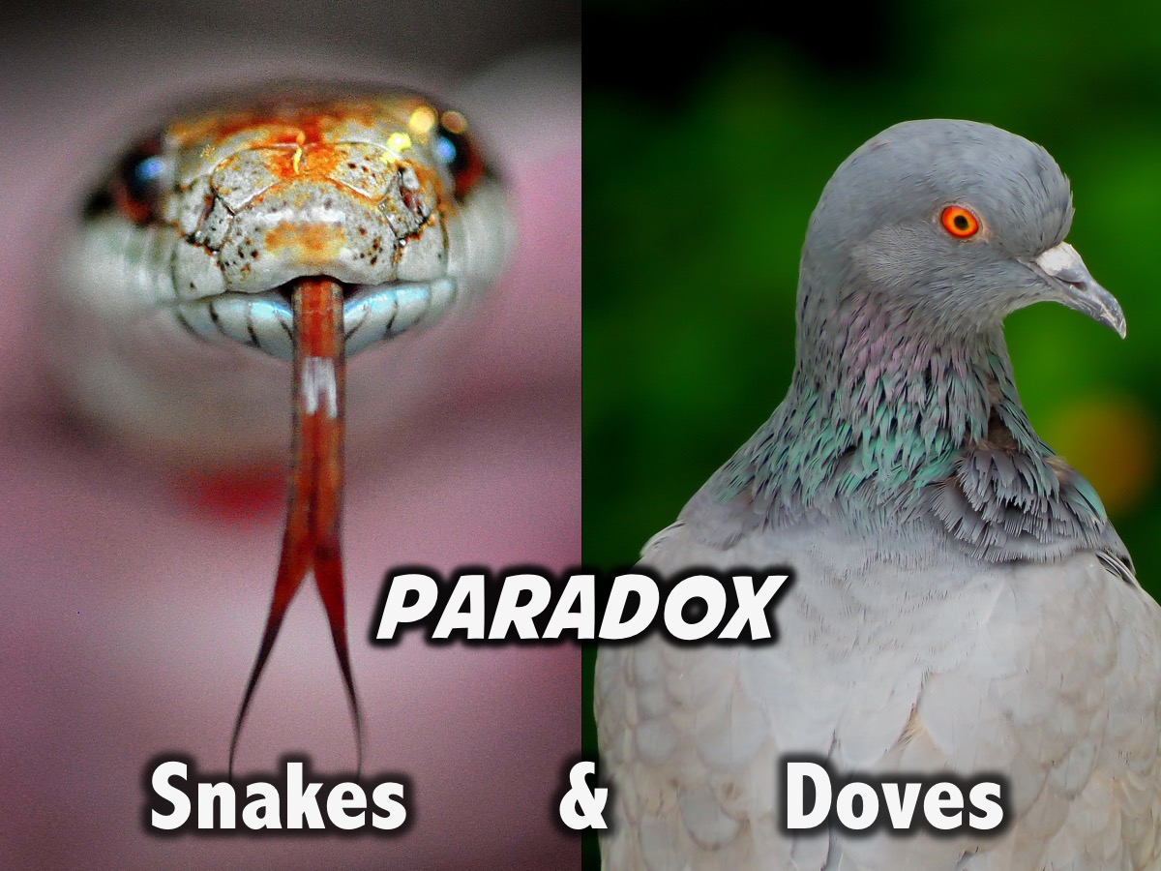
Notes:
Next week we will look at how we are called to be likes Snakes and Doves.

