Slide 1

Notes:
This term we are exploring various seemingly paradoxical aspects of Christian living – it is all about the power of “AND” instead of “EITHER OR”.

Slide 2

Notes:
Last week we started the series by looking at how we are called to be Lambs and Lions - or Gentle and Strong.

Slide 3
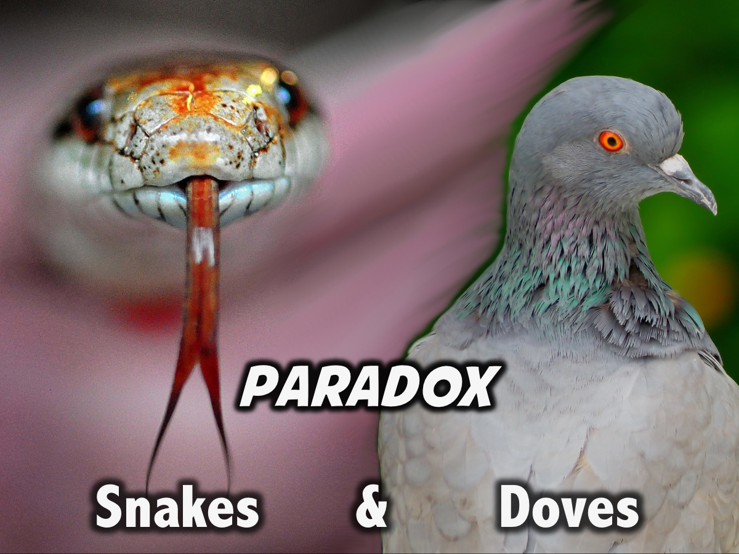
Notes:
This week we are look at how we are called to be likes Snakes and Doves.

Slide 4

Notes:
In Matthew 10:16 Jesus says that his followers must be wise as serpents and innocent as doves.

Slide 5
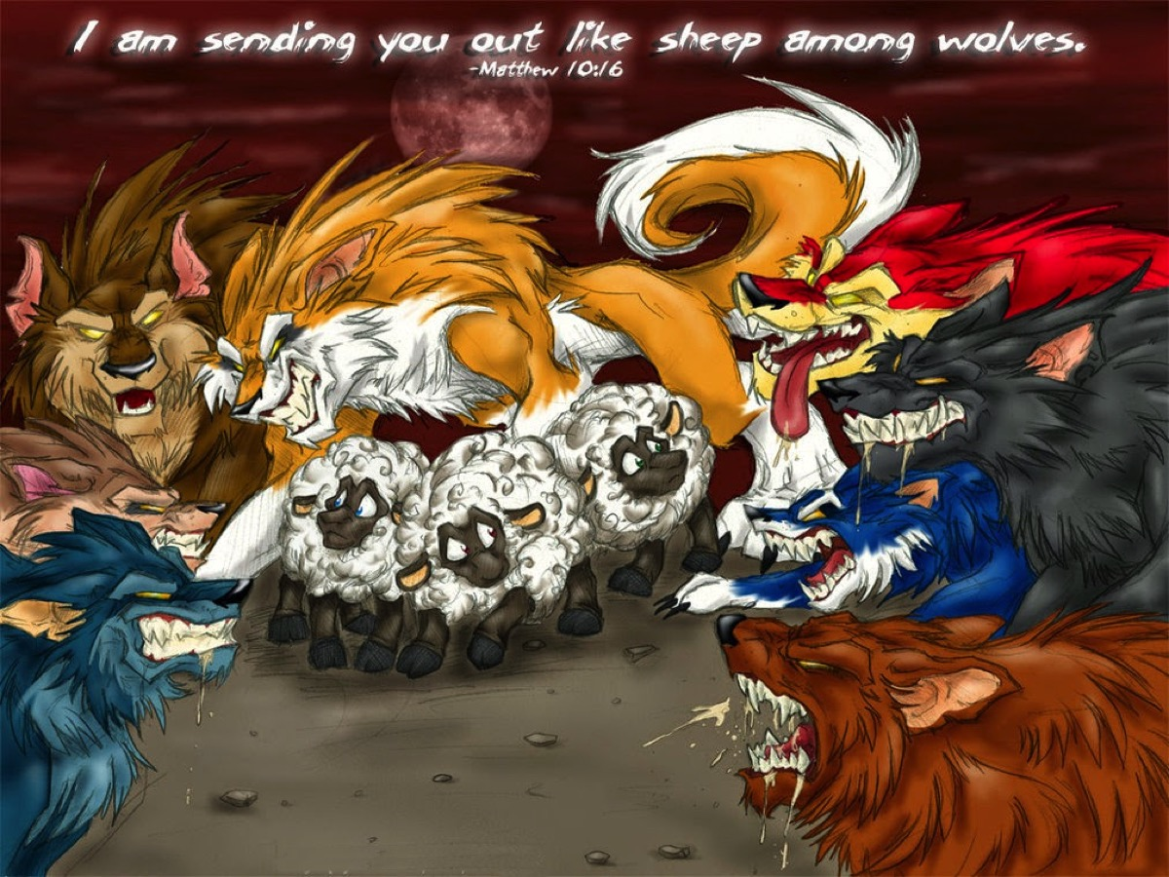
Notes:
But first we need to look at the context in which this analogy is given… In the immediate context we see that Jesus is sending his disciples out like sheep among wolves.

Slide 6
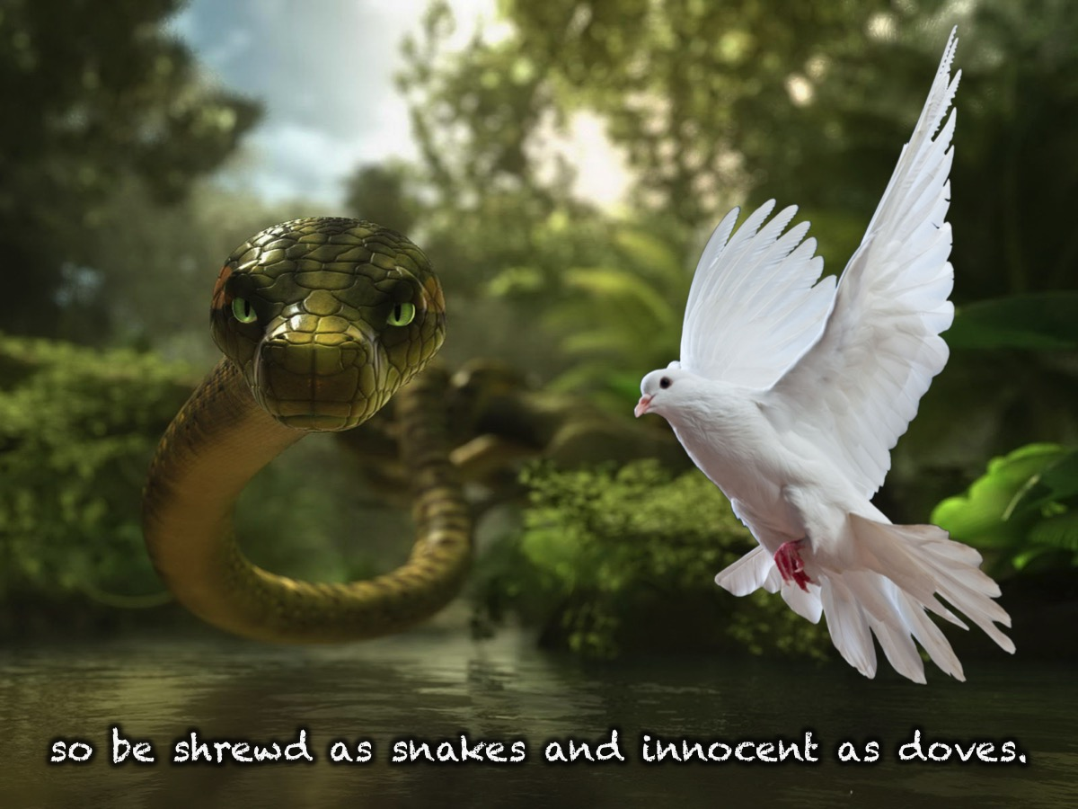
Notes:
So they need to be shrewd as snakes and innocent as doves. But why? For that we have to look at the wider context of the verse!

Slide 7
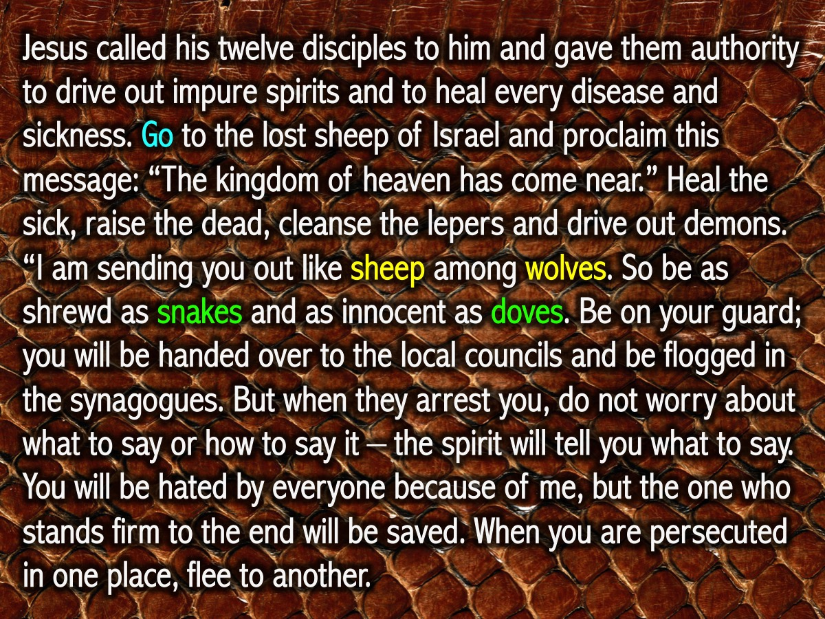
Notes:
Jesus called his twelve disciples to him and gave them authority to drive out impure spirits and to heal every disease and sickness. ² These are the names of the twelve apostles: first, Simon (who is called Peter) and his brother Andrew; James son of Zebedee, and his brother John; ³ Philip and Bartholomew; Thomas and Matthew the tax collector; James son of Alphaeus, and Thaddaeus; ⁴ Simon the Zealot and Judas Iscariot, who betrayed him. ⁵ These twelve Jesus sent out with the following instructions: “Do not go among the Gentiles or enter any town of the Samaritans. ⁶ Go rather to the lost sheep of Israel. ⁷ As you go, proclaim this message: ‘The kingdom of heaven has come near.’ ⁸ Heal the sick, raise the dead, cleanse those who have leprosy,^{[a]} drive out demons. Freely you have received; freely give. ⁹ “Do not get any gold or silver or copper to take with you in your belts— ¹⁰ no bag for the journey or extra shirt or sandals or a staff, for the worker is worth his keep. ¹¹ Whatever town or village you enter, search there for some worthy person and stay at their house until you leave. ¹² As you enter the home, give it your greeting. ¹³ If the home is deserving, let your peace rest on it; if it is not, let your peace return to you. ¹⁴ If anyone will not welcome you or listen to your words, leave that home or town and shake the dust off your feet. ¹⁵ Truly I tell you, it will be more bearable for Sodom and Gomorrah on the day of judgment than for that town. ¹⁶ “I am sending you out like sheep among wolves. Therefore be as shrewd as snakes and as innocent as doves. ¹⁷ Be on your guard; you will be handed over to the local councils and be flogged in the synagogues. ¹⁸ On my account you will be brought before governors and kings as witnesses to them and to the Gentiles. ¹⁹ But when they arrest you, do not worry about what to say or how to say it. At that time you will be given what to say, ²⁰ for it will not be you speaking, but the Spirit of your Father speaking through you. (Matthew 10)

Slide 8
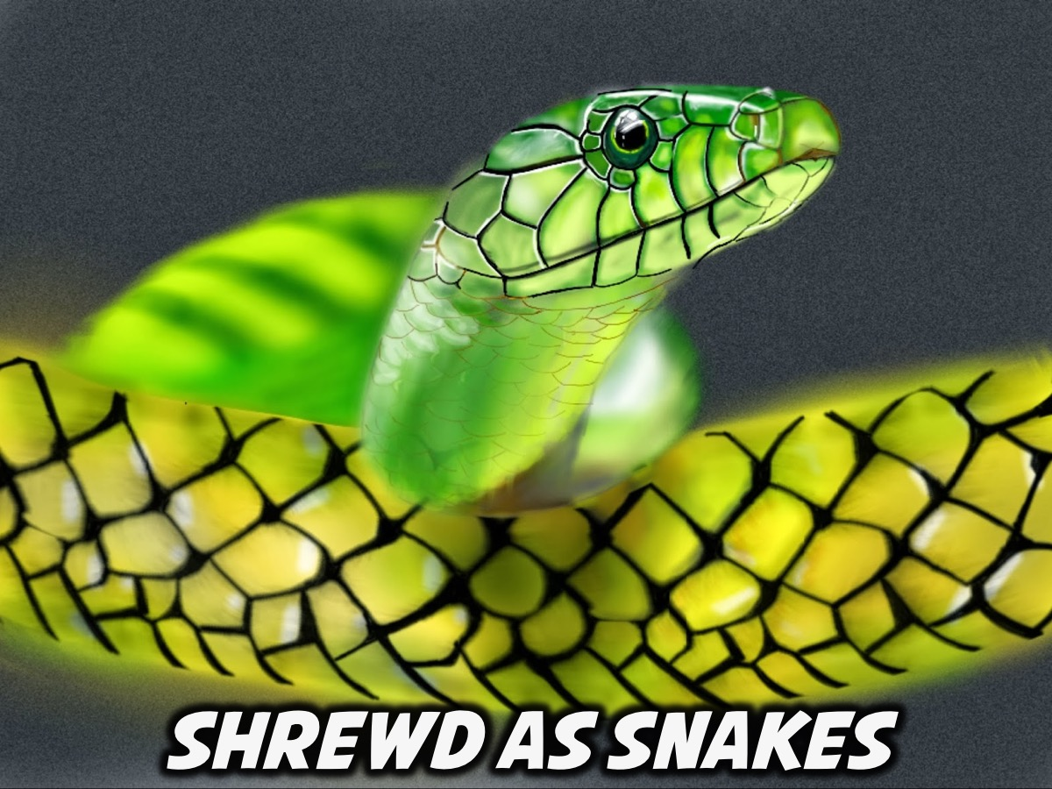
Notes:
Those of you on the left hand side of the room are going to think about what Jesus meant when he told his disciples to go on mission but to be as shrewd as snakes.

Slide 9
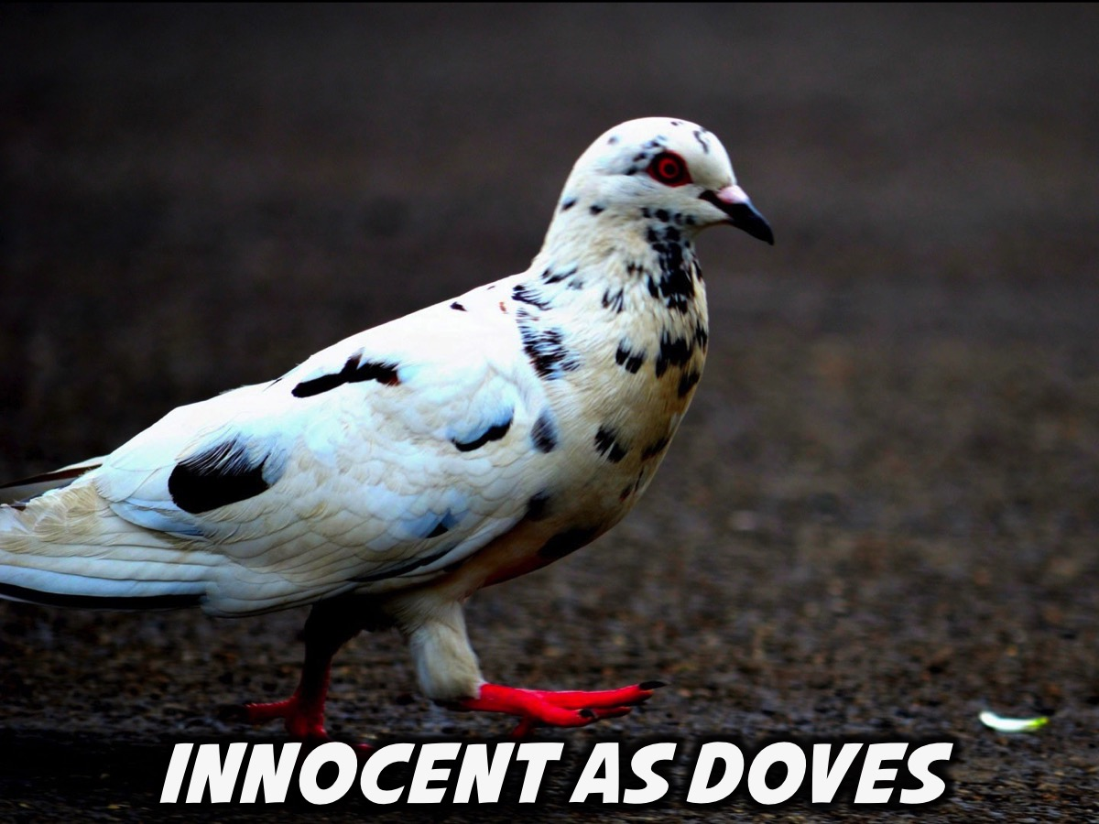
Notes:
And those of you on the right hand side of the room are going to think about what Jesus meant when he told his disciples to go on mission but to be as innocent as doves.

Slide 10
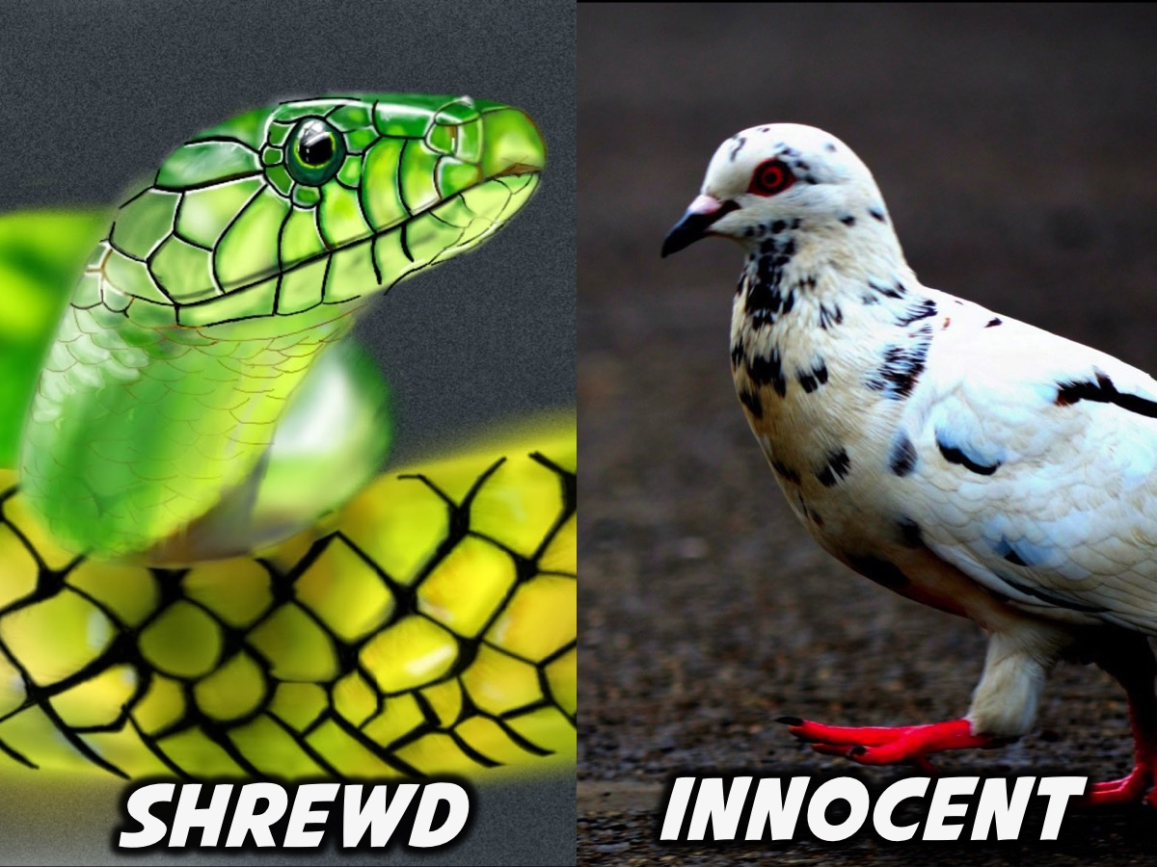
Notes:
Feedback from each small group.

Slide 11
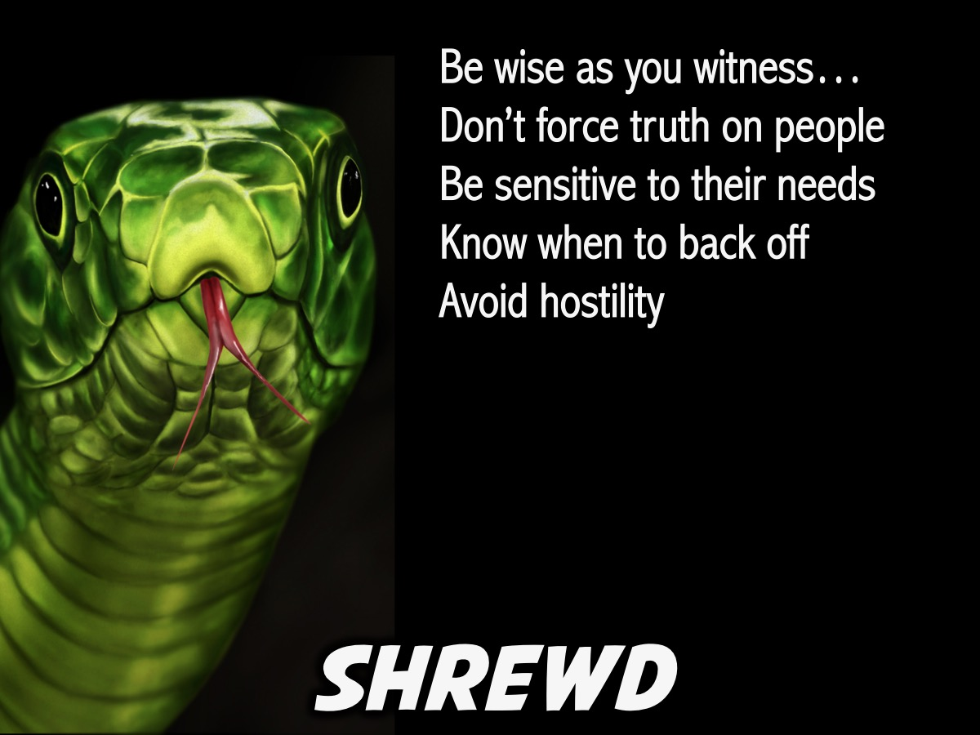
Notes:
1. Be Shrewd like Snakes. We are not to be dumb like sheep who wander obliviously into a pack of wolves, but we are to be wise like serpents. Serpents are known for their cleverness and craftiness in the Bible. The point is—be smart. Be evangelists (people who share the message of Jesus) but be wise evangelists. Don’t walk around arrogantly ramming gospel truths down people’s throats and, upon rejection, claim that now you and the Apostle Paul have a lot in common! Avoid all unnecessary hostility, think about your audience, love your audience, and carefully craft how you will lovingly communicate the good news to them—never changing the eternal message but its method of communication.

Slide 12

Notes:
2. Be Innocent like Doves. Don’t be so clever as to become deceptive. We can have such a low Christian profile that it becomes no profile at all. Be wise evangelists but still be evangelists. Be shrewd when you do it, but do it. The dove does have to take some risks if it will fly. It could be shot or attacked; it could stay in its nest to be safe—but the dove is born to fly. We should make Jesus known as much as we possibly can to whoever will listen. Yes, we must do it very carefully and well, but more importantly, we must do it. Too often we have inverted the demand and been as guilty as serpents and dumb as doves.

Slide 13
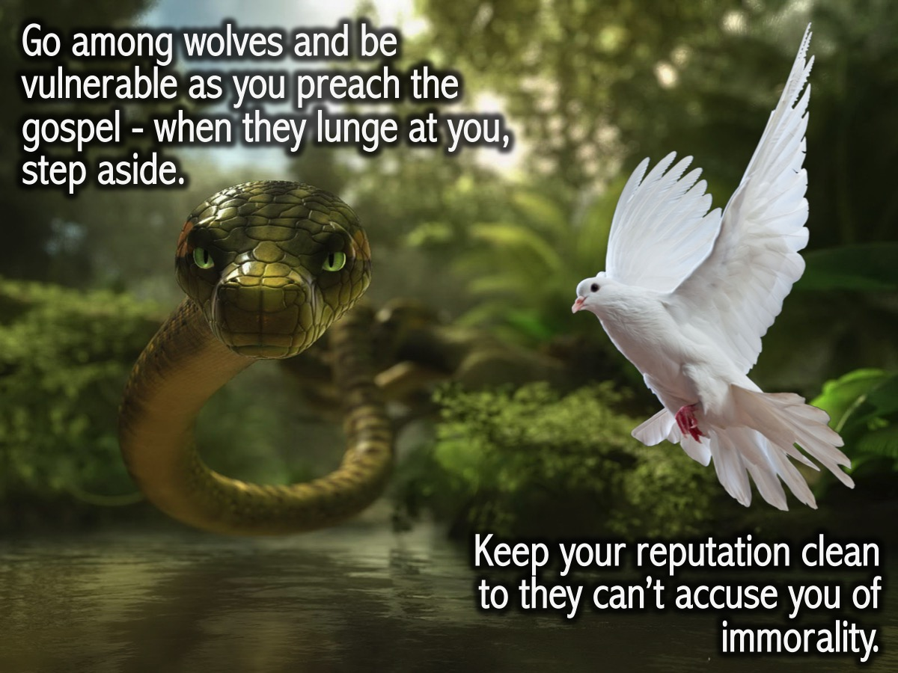
Notes:
So, yes, go among wolves and be vulnerable as you preach the gospel, but when they lunge at you, step aside. When they open their mouths, don’t jump in. And not only that, be as innocent as doves. That is, don’t give them any legitimate reason to accuse you of injustice or immorality. Keep your reputation as clean as you can.

Slide 14
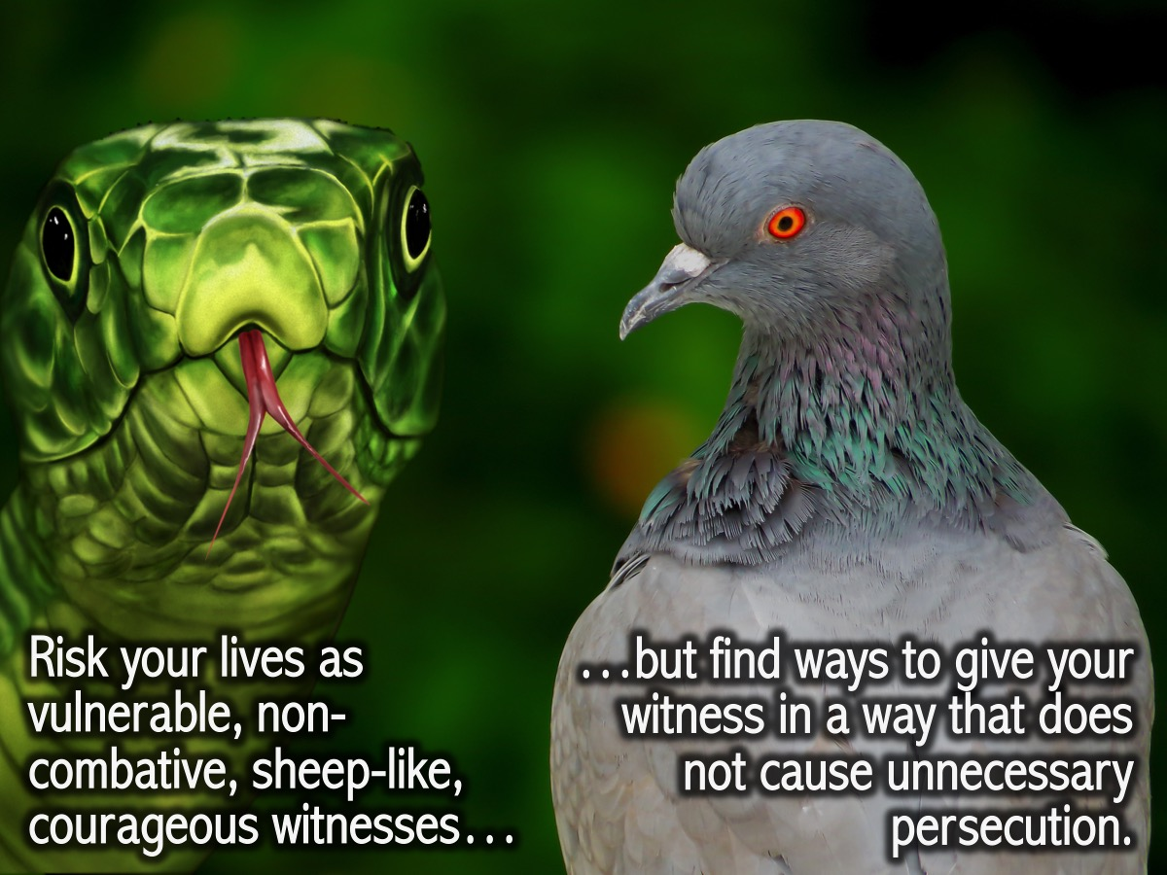
Notes:
So both the snake-intelligence and the dove-innocence are both designed to keep the sheep out of trouble. Jesus does not mean for us to get ourselves into as much difficulty as possible. He means: Risk your lives as vulnerable, non-combative, sheep-like, courageous witnesses, but try to find ways to give your witness in a way that does not bring down unnecessary persecution.

Slide 15
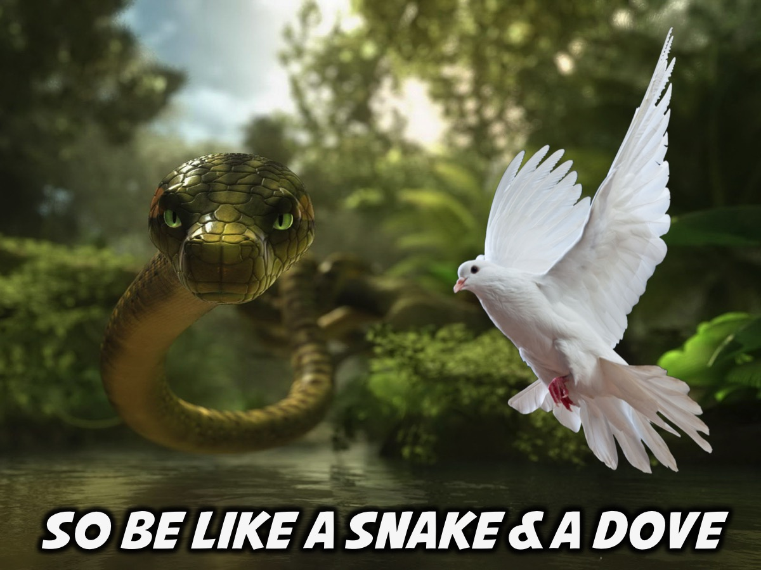
Notes:
So be like a SNAKE and a DOVE! With Jesus’ help we can do it!

Slide 16
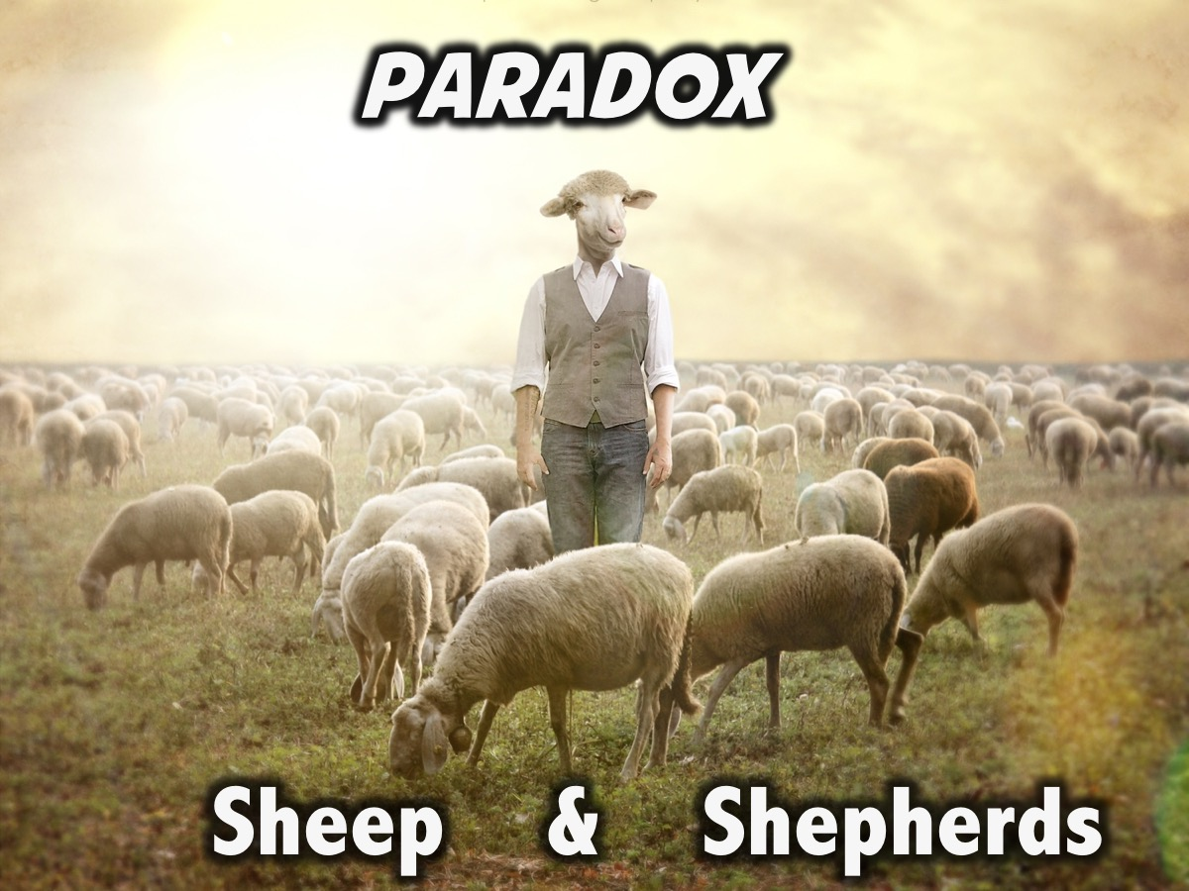
Notes:
Next week we will look at how we are called to be sheep and shepherds.

