Slide 1

Notes:
This term we are exploring various seemingly paradoxical aspects of Christian living – it is all about the power of “AND” instead of “EITHER OR”.

Slide 2

Notes:
In week 1 we started the series by looking at how we are called to be Lambs AND Lions - or Gentle AND Strong.

Slide 3
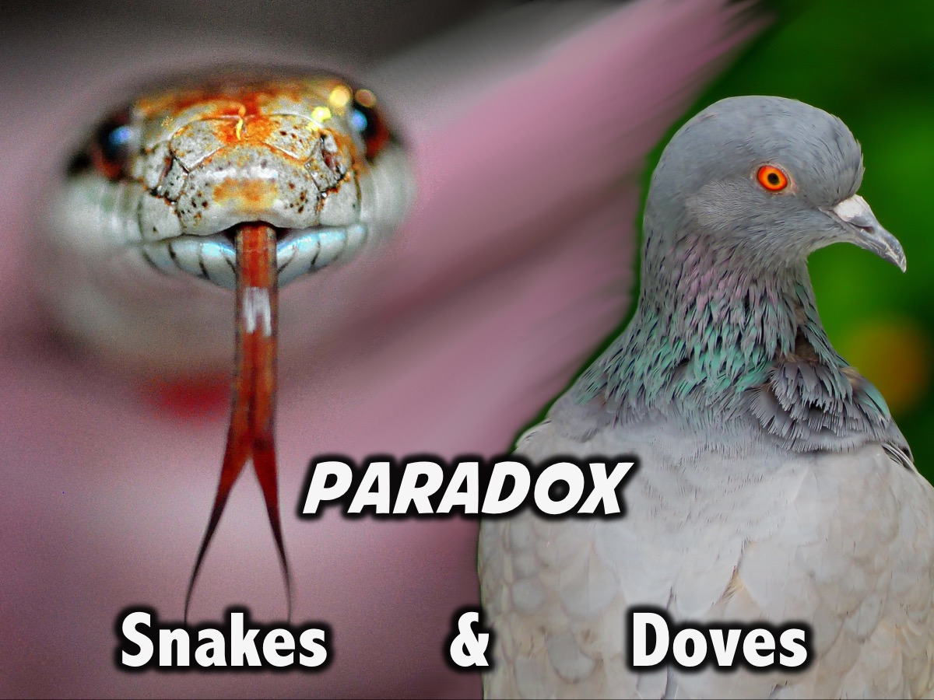
Notes:
In week 2 we are looked at how we are called to be like Snakes and Doves – or Shrewd AND Innocent.

Slide 4
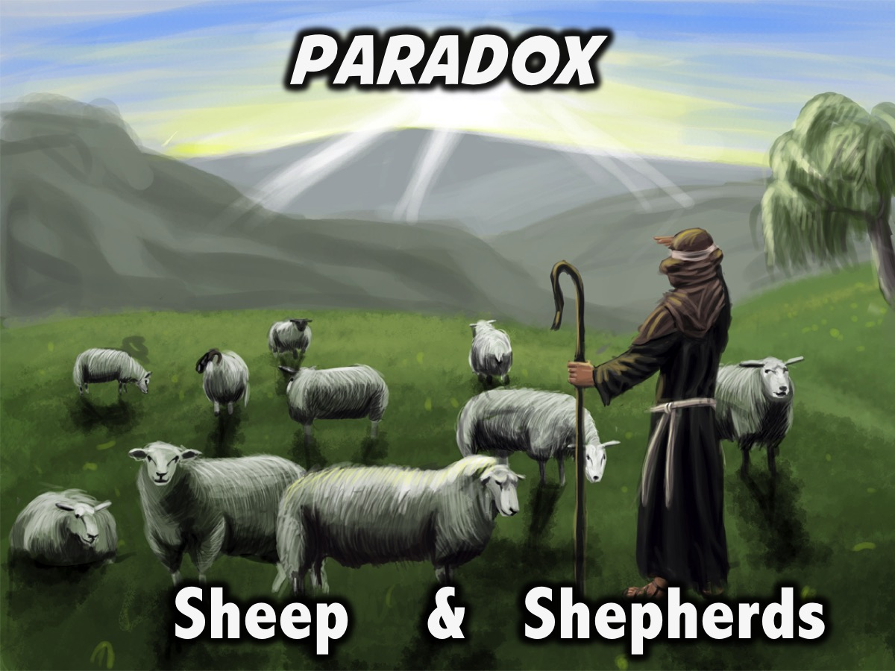
Notes:
This week we are going to look at how we are to be like both Sheep AND Shepherds.

Slide 5
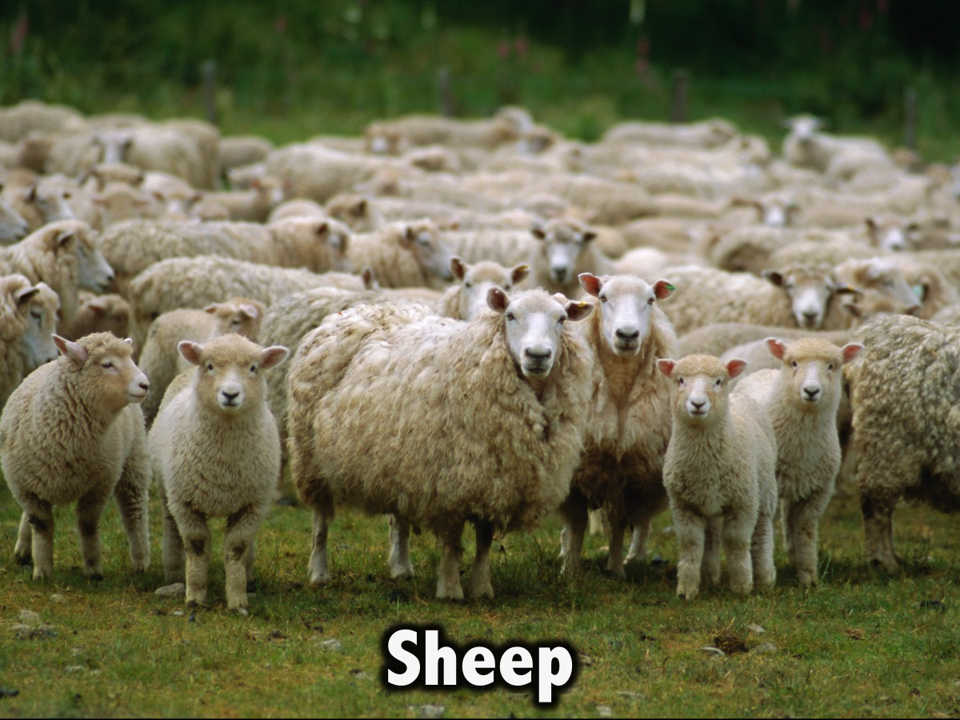
Notes:
We are called to be sheep!

Slide 6
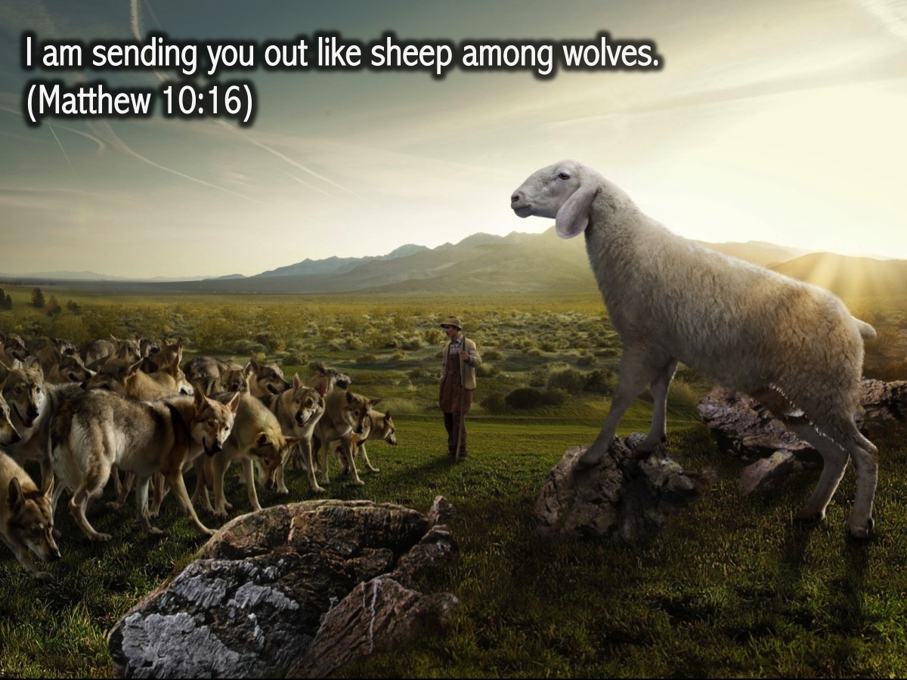
Notes:
Jesus said to his disciples: "I am sending you out like sheep among wolves." (Matthew 10:16)

Slide 7
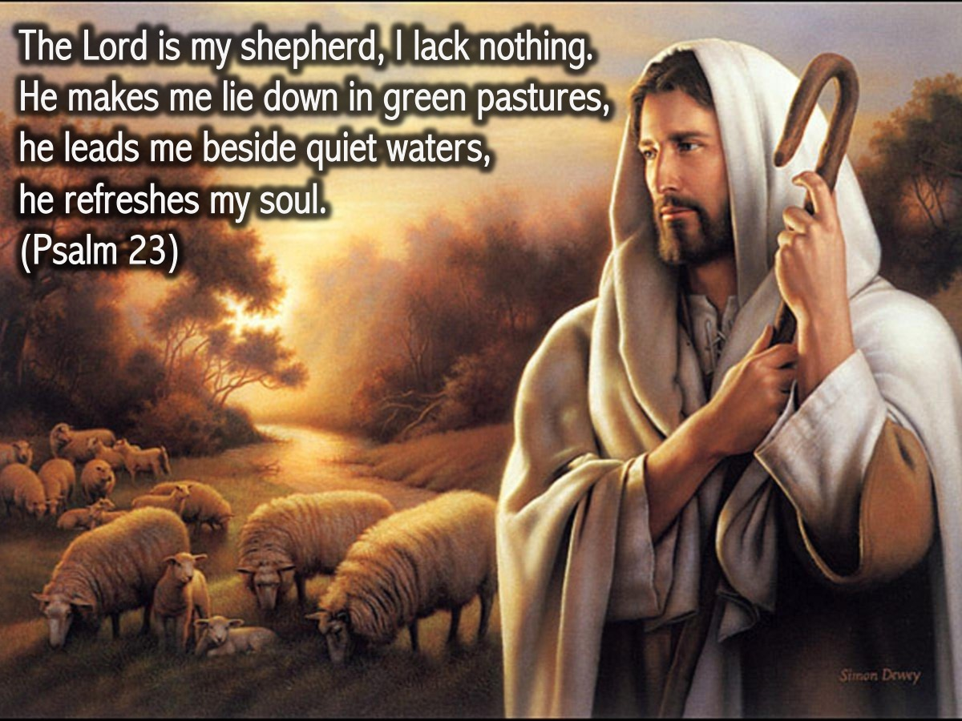
Notes:
The Lord is my shepherd, I lack nothing. He makes me lie down in green pastures, he leads me beside quiet waters, he refreshes my soul. He guides me along the right paths for his name’s sake. Even though I walk through the darkest valley, I will fear no evil, for you are with me; your rod and your staff, they comfort me. You prepare a table before me in the presence of my enemies. You anoint my head with oil; my cup overflows. Surely your goodness and love will follow me all the days of my life, and I will dwell in the house of the Lord for ever. (Psalm 23)

Slide 8
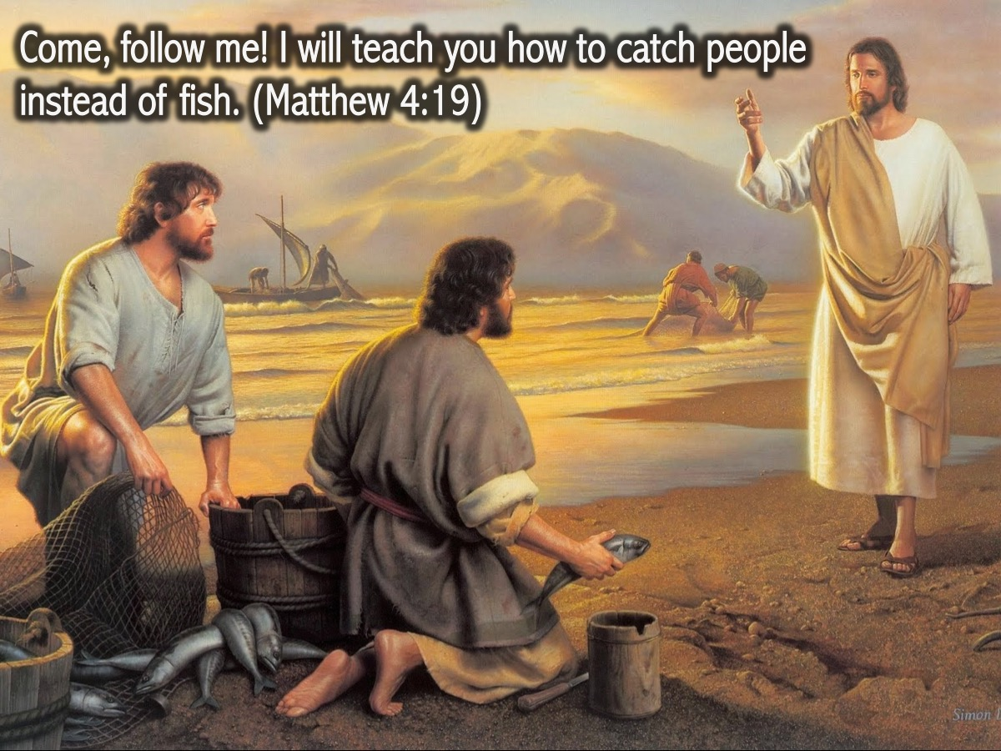
Notes:
Jesus said: “Come, follow me! I will teach you how to catch people instead of fish. (Matthew 4:19)

Slide 9
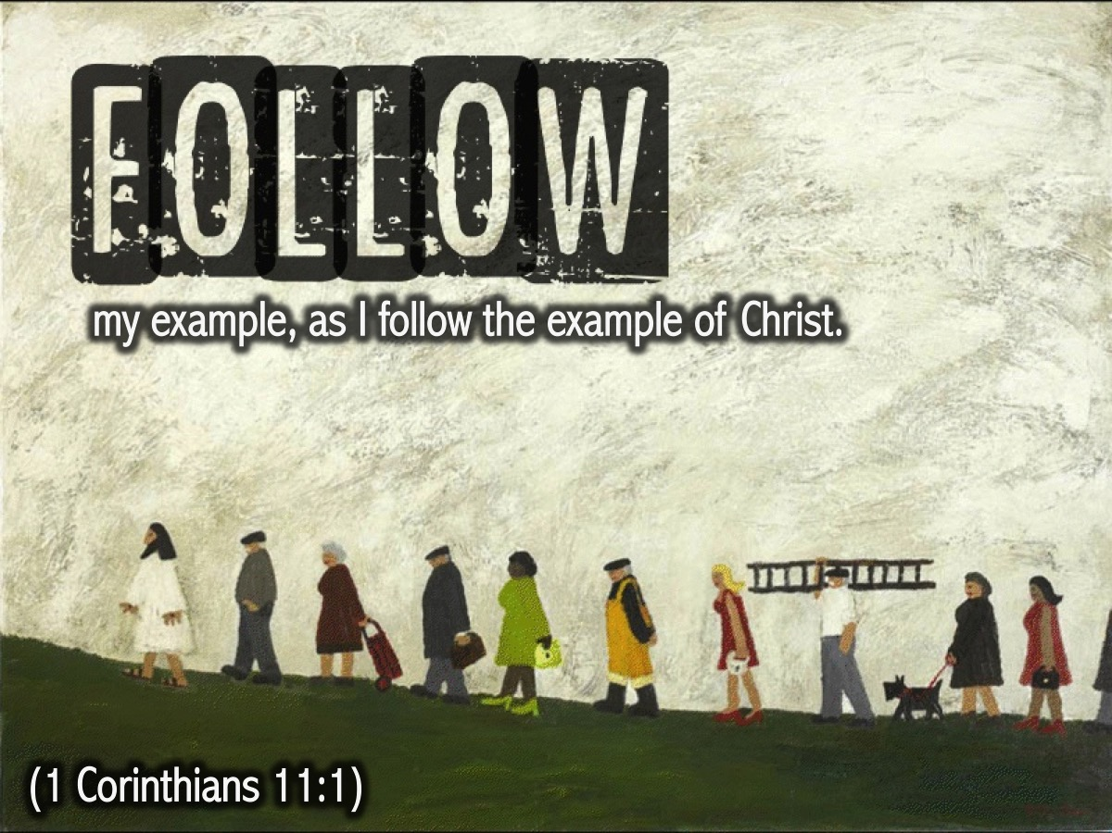
Notes:
Paul said: “Follow my example, as I follow the example of Christ”. (1 Corinthians 11:1)

Slide 10
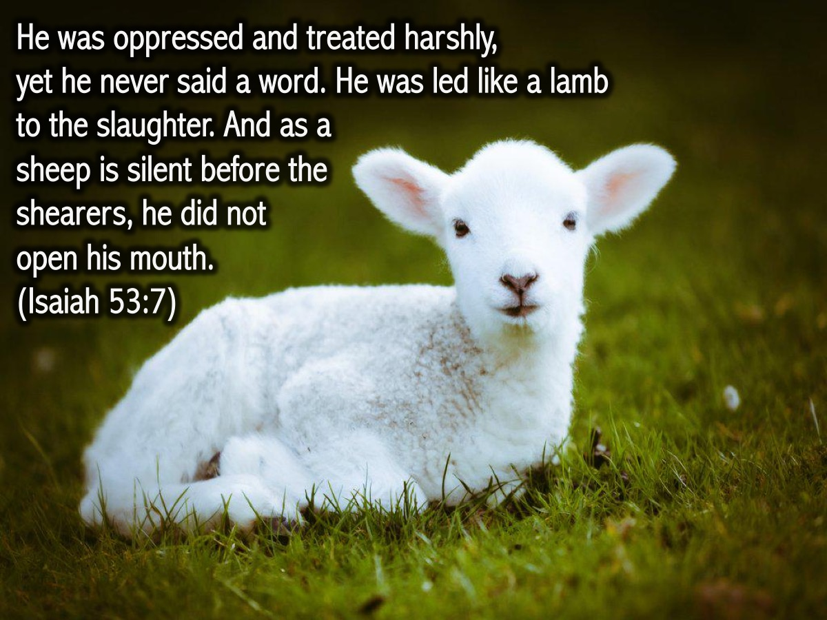
Notes:
We have a great example in the life of Jesus where, when it was necessary, he was like a sheep! He was oppressed and treated harshly, yet he never said a word. He was led like a lamb to the slaughter. And as a sheep is silent before the shearers, he did not open his mouth.(Isaiah 53:7)

Slide 11
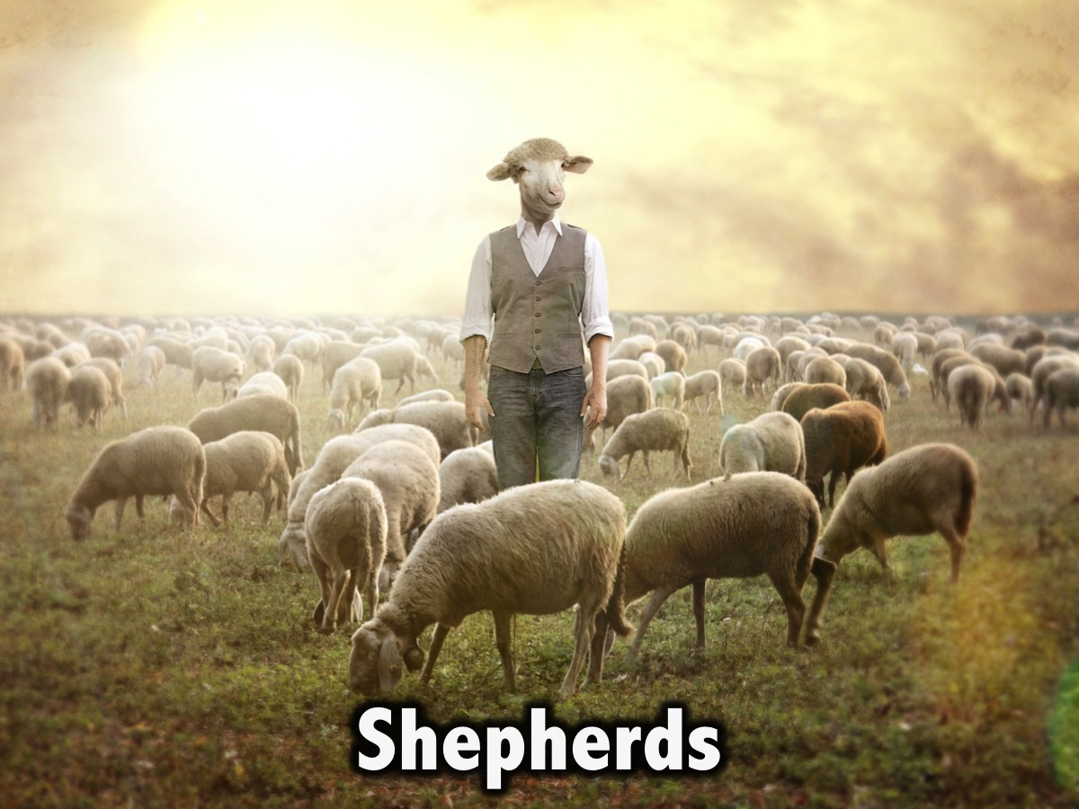
Notes:
We are called to be sheep!

Slide 12
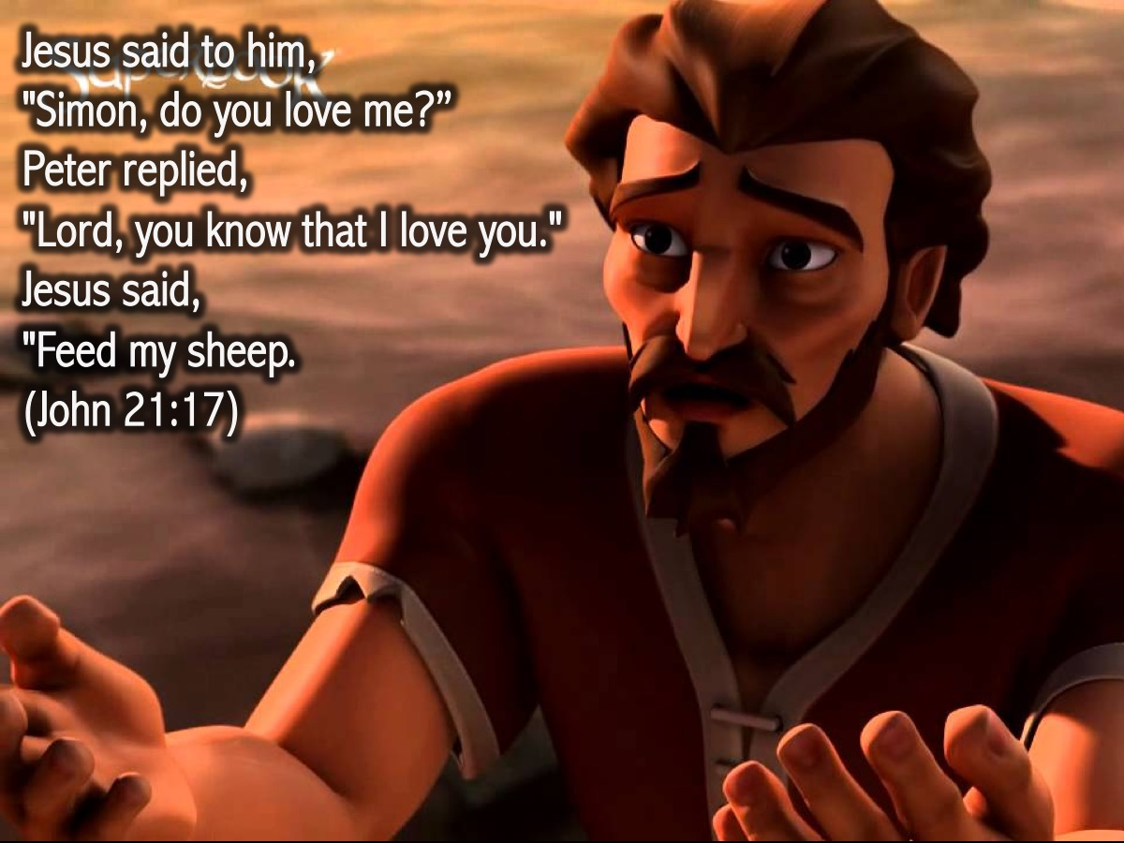
Notes:
Jesus said to one of his disciples, Peter, that he was to feed his sheep! “The third time he said to him, "Simon son of John, do you love me?" Peter was hurt because Jesus asked him the third time, "Do you love me?" He said, "Lord, you know all things; you know that I love you." Jesus said, "Feed my sheep.” (John 21:17)

Slide 13
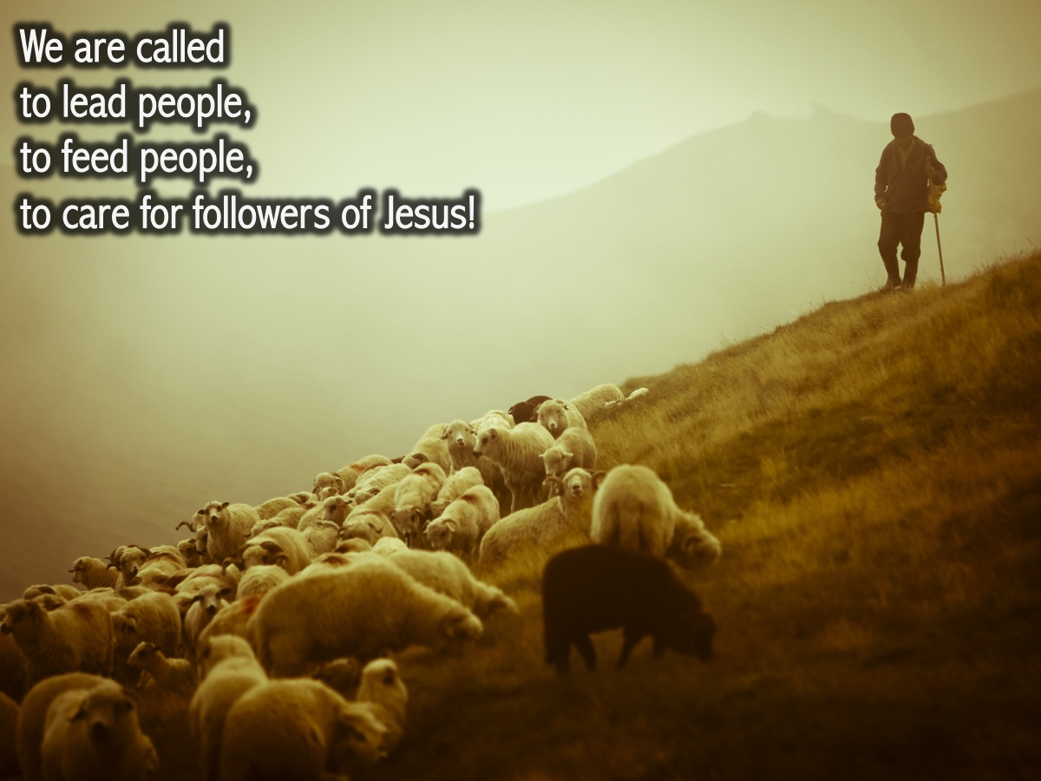
Notes:
We are called to lead people, to feed people, to care for followers of Jesus!

Slide 14
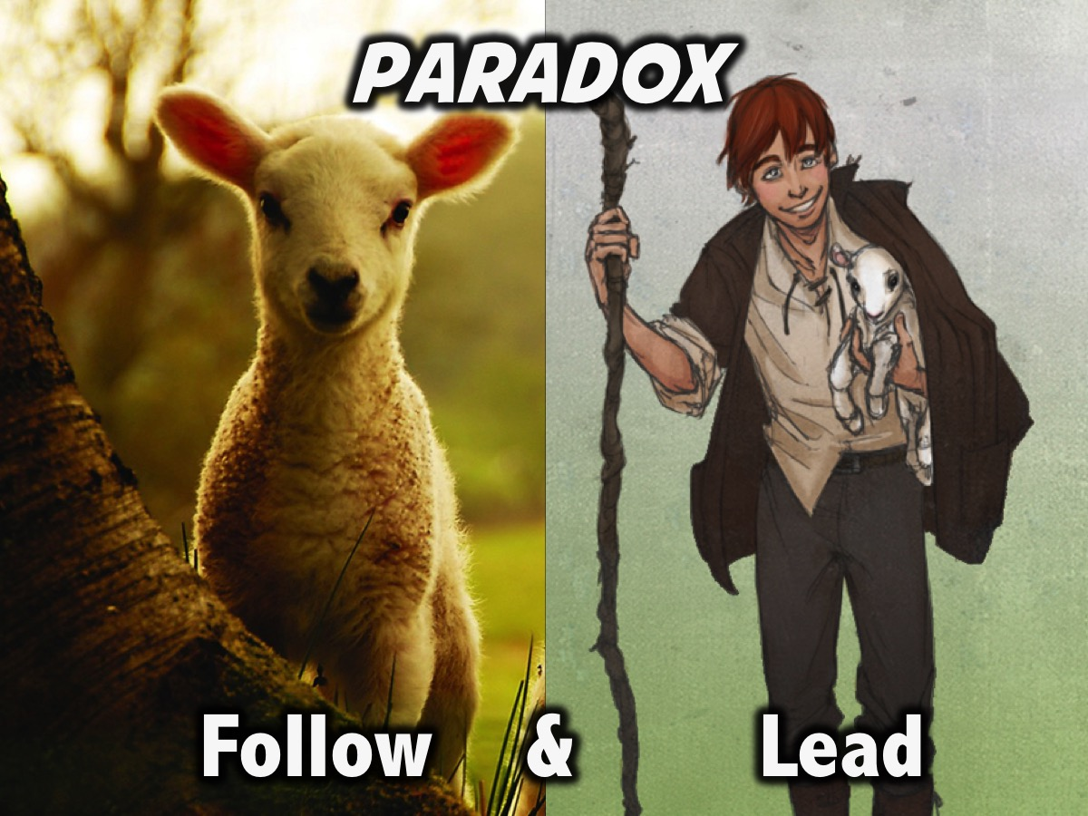
Notes:
So be sure to follow AND lead!!!

Slide 15

Notes:
Next week we will look at how we are both sinners and saints.

