Slide 1
Notes:
This term we are exploring various seemingly paradoxical aspects of Christian living – it is all about the power of “AND” instead of “EITHER OR”.

Slide 2
Notes:
Last week we looked at how we are both Earthly AND Heavenly.

Slide 3
Notes:
This week week we are going to look at how we are both Slaves AND Free.

Slide 4
Notes:
We are Free!

Slide 5
Notes:
He came to set the captives free and opening the prison to them that are bound. (Isaiah 61:1)

Slide 6
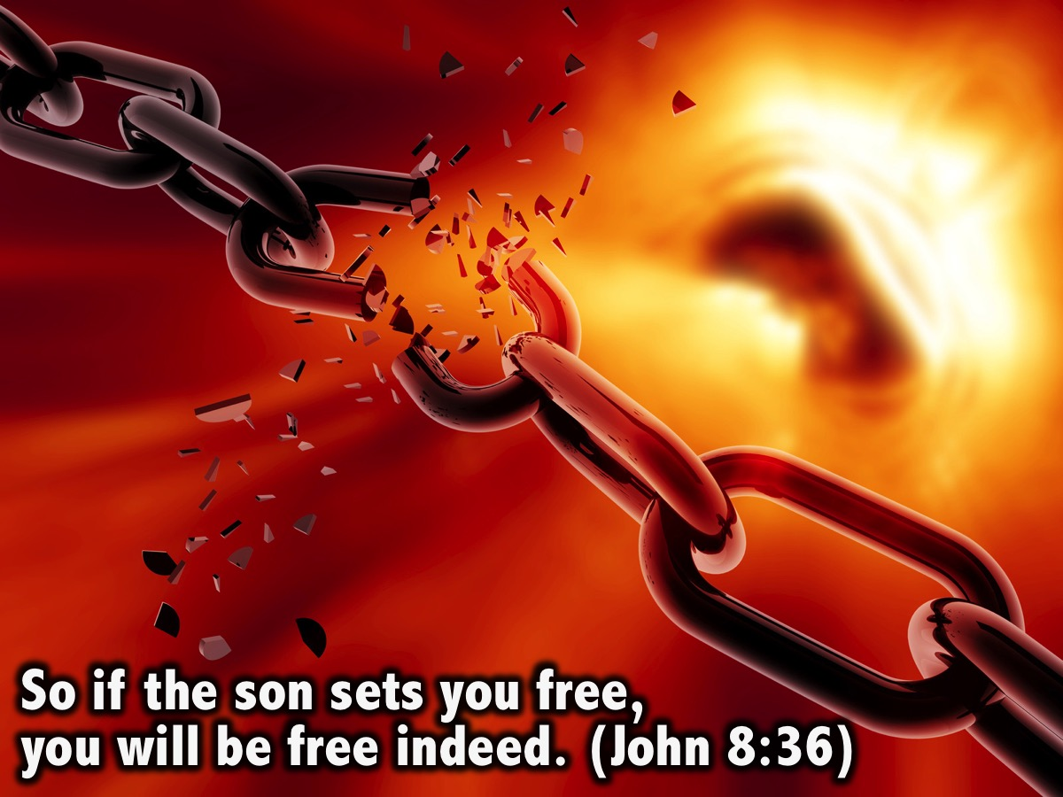
Notes:
Jesus breaks our chains: “So if the son sets you free, you will be free indeed.” (John 8:36)

Slide 7
Notes:
So you are no longer a slave, but a son, and if a son, then an heir through God. (Galatians 4:7)

Slide 8
Notes:
The Spirit of life has set you free in Christ Jesus from the law of sin and death. (Romans 8:1-2)

Slide 9
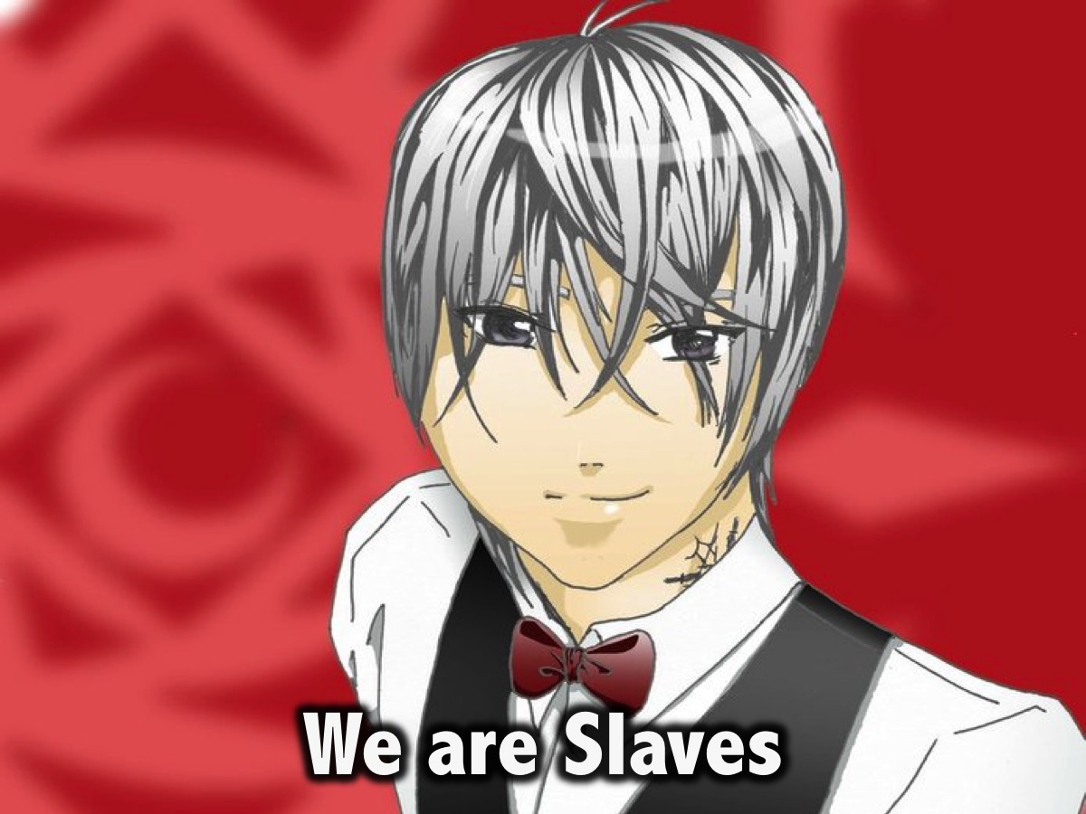
Notes:
We are Slaves!

Slide 10
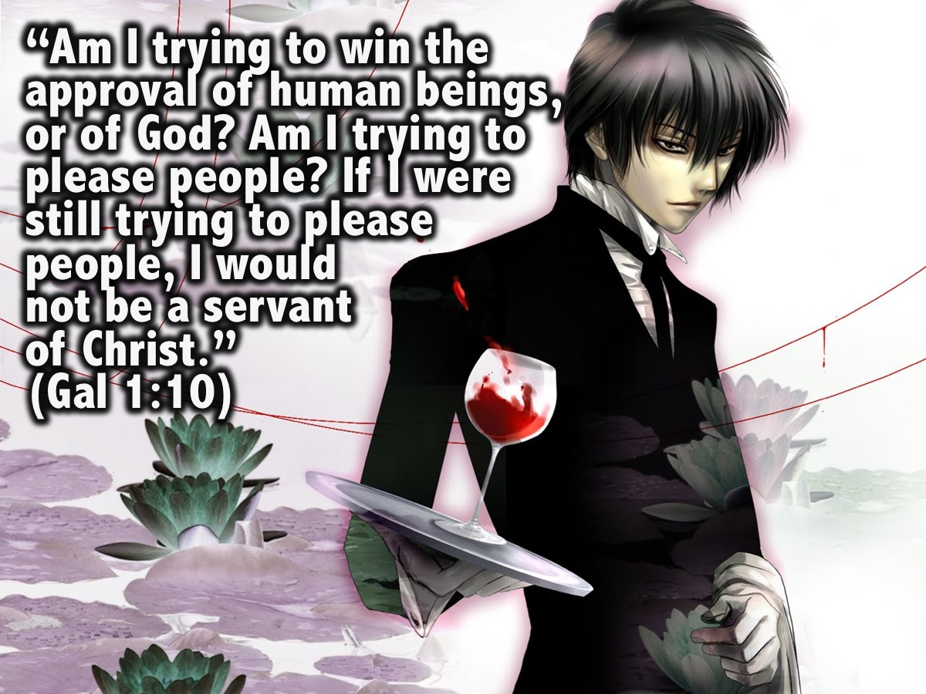
Notes:
“Am I now trying to win the approval of human beings, or of God? Or am I trying to please people? If I were still trying to please people, I would not be a servant of Christ.” (Galatians 1:10)

Slide 11
Notes:
For you were called to freedom, brothers. Only do not use your freedom as an opportunity for the flesh, but through love serve one another. (Galatians 5:13)

Slide 12
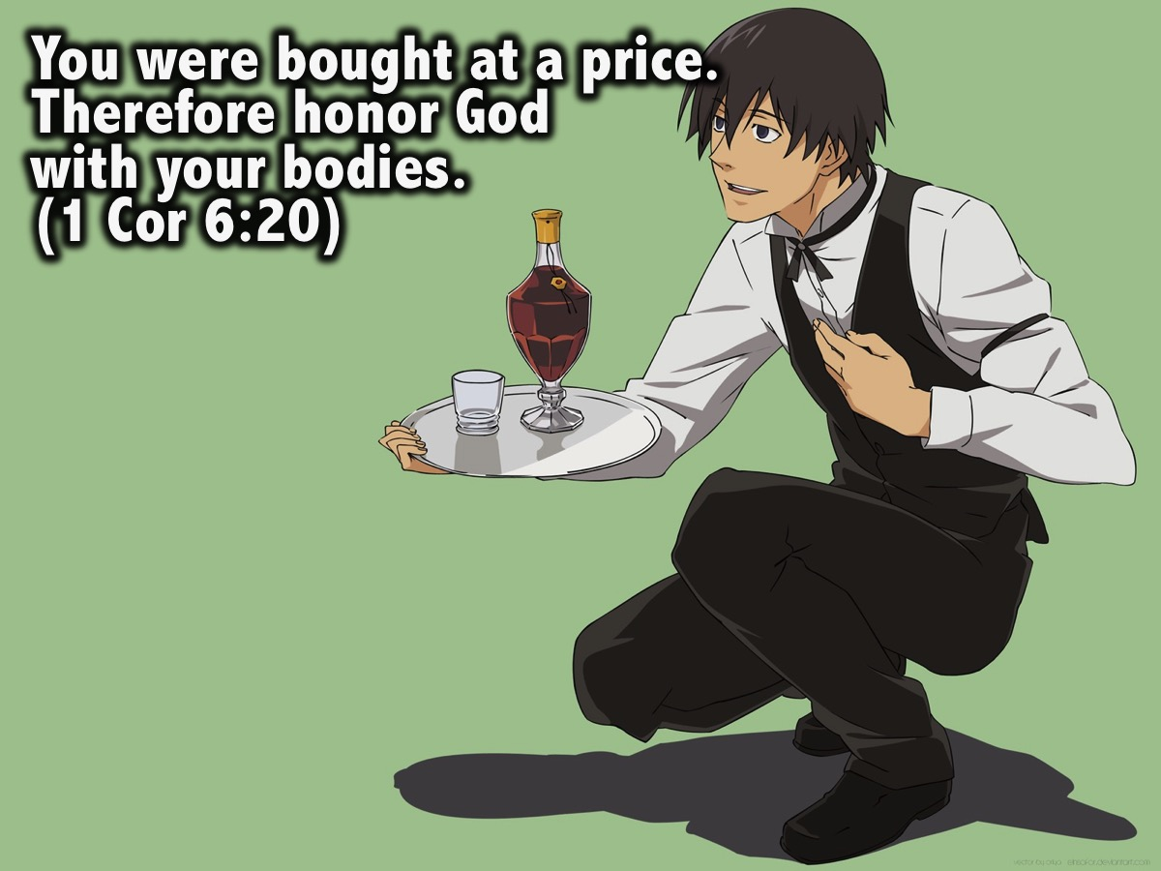
Notes:
You were bought at a price. Therefore honor God with your bodies. (1 Corinthians 6:20)

Slide 13
Notes:
“Well done, good and faithful servant! You have been faithful with a few things; I will put you in charge of many things. Come and share your master’s happiness!” (Matthew 25:21)

Slide 14
Notes:
But thanks be to God that, though you used to be slaves to sin, you have come to obey from your heart the pattern of teaching that has now claimed your allegiance. You have been set free from sin and have become slaves to righteousness. (Romans 6:17-18)

Slide 15
Notes:
You have been set free from sin and have become slaves to righteousness. (Romans 6:18)

Slide 16
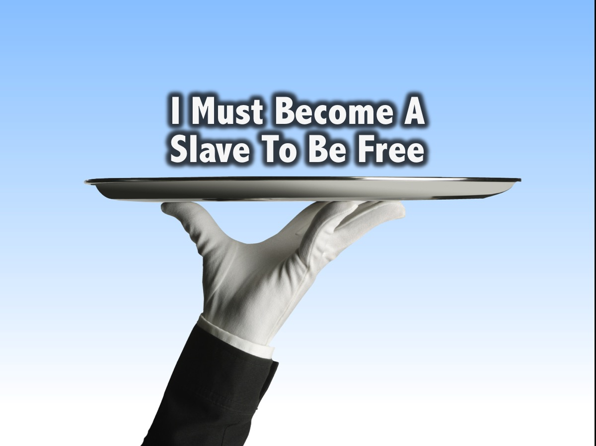
Notes:
I Must Become A Slave To Be Free

Slide 17
Notes:
Since the French Revolution, freedom has become the goal of many nations – freedom to do as we please, go where we want, and be whatever we wish. But for many this “freedom” has become another form of slavery – to sin, selfishness, and ultimately self-destruction.

Slide 18
Notes:
Paul said to believers, “You have been set free from sin, and have become slaves to righteousness, sffer your body in slavery to righteousness leading to holiness” (Rom. 6:16-22).

Slide 19
Notes:
Jesus told the people, “If you hold to My teaching, you are really My disciples. Then you will know the truth, and the truth will set you free” (Jn. 8:31-32).

Slide 20
Notes:
The reality is that we are all slaves to something or someone. We are not autonomous; we all serve some master. Ultimately there are only two masters – the Lord Jesus and the powers of evil. We must decide who we will serve.

Slide 21
Notes:
One important aspect of the Christian life is to recognize that we have been bought at a price, and therefore willingly offer ourselves as slaves to God. Only then will we become truly free.

Slide 22
Notes:
So be be aware of the paradox of being both Free AND Slaves. If you really want to go deeper into what the Bible says about us being slaves then read this article:
Slaves for Christ
http://www.gty.org/resources/sermons/80-321/slaves-for-christ
We’re going to turn to a subject in the New Testament that, as I think about it, is largely ignored and overlooked. And I’ve been made aware of that in recent months. It was not too many months ago that I was flying on one of those jumbo jets from Los Angeles to London, in the process reading a book that dealt with the issue of slavery in the New Testament time and in the New Testament text. It set me thinking in all kinds of directions. I actually finished the book on the flight I was so rapt in my attention to this particular theme.
Being a slave of Christ may be the best way to define a Christian. We are, as believers, slaves of Christ. You would never suspect that, however, from the language of Christianity. In contemporary Christianity the language is anything but slave language. It is about freedom. It is about liberation. It is about health, wealth, prosperity, finding your own fulfillment, fulfilling your own dream, finding your own purpose. We often hear that God loves you unconditionally and wants you to be all you want to be. He wants to fulfill every ambition, every desire, every hope, every dream. In fact, there are books being written about dreams as if they are gifts from God which God then having given them is bound to fulfill. Personal fulfillment, personal liberation, personal satisfaction, all bound up in an old term in evangelical Christianity, a personal relationship. How many times have we heard that the gospel offers people a personal relationship with Jesus Christ?
What exactly does that mean? Satan has a personal relationship with Jesus Christ and it’s not a very good one. Every living being has a personal relationship with the living God of one kind or another, leading to one end or another.
But what exactly is our relationship to God? What is our relationship to Christ? How are we best to understand it?
Well if you read the New Testament in its original text, you would come away stunned really by how different the original text is from any English version that you’ve ever read...whether King James, New King James, New American Standard, ESV, NIV and you can name all the rest. All of them virtually have found a way to mask something that is an absolutely critical element of truth. In fact, the word “slave” appears in the New Testament 130 times in the original text. You will find it once in the King James, once the Greek word “slave” is translated slave. You will find it translated “slave” a few other times in other texts, like the New King James text and even the New American Standard text, and it will be translated “slave” when, one, it refers to actual slavery, or two, it refers to some kind of bondage to an inanimate reality. But whenever it is personalized, the translators seem unwilling to translate it “slave.”
For example, in Matthew 6:24 Jesus said this, “No man can be a slave to two masters.” What does your Bible say? “No man can serve two masters.” The favorite word for slave is servant, favorite English word. Very often bondservant is used which tends to move in the right direction but is not exactly slave. You have a word used 130 times in the New Testament, you have other uses of that word with a preposition, sundoulos which means fellow slaves, used about a dozen times. You have the verb form used another approximately a dozen times. So you have at least 150 plus usages of just three of the words and there are others in the group with the root doul, d-o-u-l in English for doulos. There are about twenty established English translations of the New Testament, about twenty. Only one of them...only one of them always translates doulos slave, only one and it is a translation of the New Testament written by a formidable scholar in New Testament Greek who studied the original papyri, and things like that, by the name of E.J. Goodspeed. Have you ever heard of Goodspeed translation? Goodspeed is a well-known scholar. For fifteen years he was a pioneering professor of New Testament Greek at the University of Chicago. The Goodspeed translation always translates doulos as slave. And when you read it, it gives you an entire different sense of our relationship to Christ. You do have a personal relationship to Jesus Christ, you are His slave. That’s putting it as simply as I can put it.
There are six words, at least, for servant, doulos is not one of them. There is diakonos from which we get deacon, oiketes related to oikos, house, a house servant, heis, having to do with one who serves by instructing the young. Huperetes, a low-level, third level, under servant, literally an under-rower, the third level on a galley slave, someone who pulled an oar down at the bottom of a great ship; leitourgos, another kind of service, usually associated with religion; paidiske and maybe misthios that can be translated minister. There are plenty of words for servant, there’s only one word for slave, doulos and sundoulos. Yet in the history of the evangelical translation of the Greek into the English, all the translators consistently have avoided the use of the word.
Now you might suggest that therefore it’s disputed, that maybe doulos isn’t quite as clearly slave. But that’s not the case. But they avoid it nonetheless. Doulos is not at all an ambiguous term. They are trying to avoid something. It’s not about a lack of linguistic information, it might well be a lack of courage, conviction. As I said, they will use slave if it literally refers to a slave, a physical slave. Or if it refers to bondage to an inanimate object, like being a slave of sin, or a slave of righteousness.
But when it comes to being a personal relationship with God or Christ, they back away from the word slave inevitably and use some form of the word servant. This is a matter of preference in all cases to accommodate. And we ask...to accommodate what? Well I suppose to accommodate the stigmas attached to slavery.
I was...a couple of months ago I was at a pastors conference back in North Carolina and I had a Q & A session with some pastors and one very gracious pastor stood up, he was a black pastor and he said to me, “How am I to communicate to my congregation that they are slaves of Jesus Christ when slavery is such a distasteful part of our past?” And he really had put his finger on the issue. I would venture to say that slavery is part...is probably a distasteful part of everybody’s past. It’s no more distasteful to a black pastor who is three or four or five generations removed from actual slavery, than it is to me who am equally removed from slavery, but it is just as distasteful to me to buy and sell humanity in the fashion that slave traders did it. Nobody thinks very positively about slavery. But when you come to the New Testament, you can’t get around it.
Open your Bible, if you will, to Ephesians chapter 6...Ephesians chapter 6. And we’re not going to be able to unfold all of this, this is a huge subject and I’m not going to try to do too much. I kept you a little long this morning, so I’ll let you out a lot earlier tonight. But I just want you to catch a few insights into this. In the sixth chapter of Ephesians, you have an illustration where slave is used and it is used because the Apostle Paul in writing to the church at Ephesus and to all other believers who would read this, knows that he is addressing slaves. And so he addresses them in verse 5 of Ephesians 6 as he addresses their masters in verse 9. And here there is no reluctance on the translators of the New Testament to use the word slave because he’s talking to slaves. “Slaves, be obedient to those who are your masters according to the flesh with fear and trembling in the sincerity of your heart as to Christ, not by way of eye service, not just when they’re looking as men pleasers, but as slaves of Christ doing the will of God from the heart.” There you have the introduction of the phrase “slaves of Christ...slaves of Christ.”
This is not just true of actual slaves, this is true of all of us. And the translators of the NAS are comfortable to use the word “slaves of Christ” rather than servants of Christ because that metaphoric use is built upon the literal use of slaves who are being addressed in verse 5. So they can’t really get around it.
So here we have an honest translation of doulos, slaves of Christ...in a sense, forced by the obvious object of the statement that is actual slaves. Turn to 1 Corinthians chapter 7 and I’ll come back and reference other things in that text a little later. But in 1 Corinthians chapter 7, you have a very similar situation where in verse 22 Paul is regulating people’s human relationships once they’ve come to Christ, says a lot in this chapter about what do you do if you’re married to a non-believer, or what do you do if you’re a widow, what do you do if you’re a virgin, what do you do if your father has a virgin daughter? What do you do if you’ve lost your spouse, should you remarry and who should you remarry? It’s all about these relationships now that you’re in Christ. And he talks about those that are slaves, “He who is called in the Lord while a slave in a sense is the Lord’s freeman, likewise he who was called while free is Christ’s slave.” There you have the same phrase again, slaves of Christ. And again, there’s no reluctance on the part of the translator to say slave because he is talking about actual slaves. And in verse 23 it makes it very clear what constitutes slavery, “You were bought with a price.” There is no more defining expression in terms of what it means to be a slave. It means to be owned. It means to be owned.
This word doulos in the Greek should never be translated anything but slave...never. Do you remember these words, Matthew 25:21? “Well done, good and faithful......,” that’s what you’ve read all your life. That is not the word for servant. That is not any of the six words for servant, that is doulos, well done, good and faithful slave. And the NAS is true to that translation. “Well done, good and faithful slave.” Why? Because it’s drawn out of a parable taught by our Lord about a man who had slaves. So whenever, in a sense, the New Testament is forced sort of to acknowledge that the metaphor, the analogy or the object of the statement is in fact a slave, then they will maintain that slave language. But in other cases, they will change it as fast as they can.
Now the problem with this is that it shuts out the clarity and the power and the richness of this metaphor. You would understand that. When you give somebody the gospel, you are saying to them, “I would like to invite you to become a slave of Jesus Christ. I would like to invite you to give up your independence, give up your freedom, submit yourself to an alien will, abandon all your rights, be owned by, controlled by the Lord.” That’s really the gospel. We’re asking people to become slaves. I don’t hear a lot of that slave talk today, do you? We have by playing fast and loose with the word doulos, managed to obscure this precise significance and substantial foundation for understanding biblical theology.
Now lest you think again that I may be overemphasizing this narrow usage of the word doulos, I tracked it through all of the lexicons that are sources that analyze the original meaning of Greek words, the sum of all of that is best contained in a massive set of books written by Kittel, or pulled together by, edited by Kittel which is the last word, and more than the last word, enough and more than enough on anything you want to know. And in Kittel the article on doulos, this is what it tells us. All the words in the doulos root group describe the status of a slave, the meaning is unequivocal, the meaning is self-contained...and here’s something Kittel never says, “It is superfluous to give examples or trace history. It’s not even debatable.” It goes on to say, and this is a very technical source, it describes, this doulos, a kind of service which is not a matter of choice for the one who renders it, a kind of service which he has to perform whether he likes it or not. It describes one subject totally to an alien will, the will of the owner and in total and utter dependence on that owner. That’s what the word means. It is the word for slave.
Now let’s go into the Greek and Roman world of the New Testament. When we say slave, we have a rather distant somewhat detached historical revulsion to the word slave. If you think that’s a hard word for us to swallow, imagine how hard it was for those living in the midst of slavery to swallow that idea. When a pastor says to me, “How can I talk to my people about being slaves to Christ when they have in their past history the abuses of slavery?” Well if you think that’s hard, how can Jesus and the apostles of the New Testament talk to people living in the midst of a slave-dominated society, ten to twelve million slaves at that very time, about the fact that being a Christian was being a slave to Jesus Christ? There wouldn’t be any distant foggy idea of what that meant, they would know exactly what that meant, precisely what it meant.
Now remember, for Greeks, elevated people, the citizenry, freedom was the pinnacle of life. Personal dignity was attached to freedom, being a douloswas the worst, it was the opposite. Let me tell you about slaves in the Greek/Roman world. They had no freedom. They had no rights. They had no ownership of anything. They had no legal recourse in the courts. They could not give testimony as a witness in a law case. They had no citizenship. They had no possibility of doing what they wanted to do. They weren’t asked, “Say there, Mr. Slave, what would you like to do to be fulfilled?” They weren’t asked, “What do you think your purpose is? Can you dream your dream so I, your master, can fulfill it?” Bizarre. They had no choice about anything. They owned nothing. They couldn’t be citizens and they couldn’t be a part of the army, the military. They were totally dependent on whoever owned them. It doesn’t mean that it didn’t have some benefits. They were provided for, cared for, protected. In many cases, treated kindly, compassionately, loved within families. But to the Greek and the Roman philosophically and socially, freedom was the pinnacle of life. So free men had only scorn for slaves and slaves longed to be free.
By the way, we cannot find in Greek literature, and there’s a lot of religious Greek literature cause they were very religious, they had many gods as we know. Remember Mars Hill, Athens. They had statutes to gods that they didn’t even know, as well as the ones t hey thought they knew. Very, very religious, never in the religious language of that world can there be found the use of the word doulos to describe the relationship between a worshiper and his God. They used philos, friends. They were friends of God, they were not slaves of their deities. That was repugnant to them. That was repulsive to them. They loved freedom.
So the idea of coming along in that world and announcing to people that you must become a slave of Jesus Christ, was just another way to present the message to make it impossible to believe. Nobody is going to line up to become anybody’s slave. Slaves already had enough of slavery. Free men had nothing but disdain for slavery. And yet the New Testament holds back absolutely nothing. We’re called to be slaves. Now the difference between a slave and a servant is obvious...obvious. Servants were hired to work for wages. Servants were hired to work for wages and they could quit. They were paid a wage for a job. Slaves were owned and they could not quit. If they ran away, they were found, arrested, flogged and there’s all kinds of ancient writings about the flogging of slaves and worse, and sometimes...sometimes...many times, crucified publically as a demonstration to the rest of the slaves of what could happen to them if they ran away. One of the great stories of a runaway slave is the book of Philemon in the New Testament, right? In fact, the Apostle Paul encouraged Philemon when...encouraged Onesimus, the runaway slave when he met him, to go back home because that was the right thing to do and he encouraged Philemon to treat him with love, compassion, forgiveness and embrace him.
In spite of this reality of slavery, and because it is so distasteful and has been for so long, the translators of the New Testament have done everything they can to edit it out. I could only wish that if you get the opportunity, find a copy of Goodspeed’s translation. You might find one in a library, it’s not a very popular translation and obviously a translation done by one man lacks some of the richness of one that’s done by a collection of men who can kind of bounce off each other. But you’ll find it very interesting. The Apostle Paul, for example, did not see himself, as one writer puts it, as the great founder of Christianity. He did not see himself that way. He saw himself as the slave of God and he slave of Christ. Let me just help you to see this the best I can, and we’re limited because of the translation of the NAS, but look at Romans 1:1. It’s almost as if the translators choke on the word slave and they just do anything to replace it. So in Romans 1:1 it’s Paul, a bondservant of Christ Jesus. It’s actually the word doulos, a slave of Christ Jesus. That was his formal introduction, a slave of Christ Jesus. Happily so, Philippians chapter 1 verse 1, he includes Timothy, “Paul and Timothy,” and again the NAS is bondservants, the Greek is slaves of Christ Jesus. Back in Galatians chapter 1 and verse 10, Paul says it again, the end of the verse, he says, “If I was trying to please men, I would not be a slave of Christ.” Now he understood what slavery meant. “I only do what pleases my master.” This is the singular focus of being a slave. You don’t have to please a lot of people, you just please one. That metaphor is critical to understanding our relationship to the Lord. If we’re going to talk about a personal relationship to Christ and to God, then our personal relationship is we are slaves. That’s the best way to define that relationship. And Paul here tells us it means that we only please Him. He says to the Corinthians, “I have as my ambition to be pleasing to Him.”
It came down to this, do what He says and do what pleases Him. It’s that simple. That’s what a slave did. Really only two possibilities, where there was a direct command, you obeyed it. Where there was not a direct command, you found a way to do what would please the master. You obeyed him and you pleased him. In his letter to Titus, again introducing himself in Titus chapter 1, he says, “Paul, a slave of God.” He is a slave of God, he is a slave of Christ. He’s not alone, look at James...James, a slave of God...and I love this...and of the Lord Jesus Christ, and this is James, the half brother of Jesus. He’s not trying to elevate himself, he doesn’t say, “I’m James the half-brother of Jesus.” He says, “I am James, a slave of God and a slave of the Lord Jesus Christ.”
That, of course, is why over in chapter 4 and verse 13 he says these familiar words, “Come now, you who say today or tomorrow we’ll go in to such-a-such a city, spend a year there, engage in business, make a prophet, yet you do not know what your life will be like tomorrow, you’re just a vapor that appears for a little while and then vanishes away. Instead you ought to say, if the Lord wills we shall live and do this, or that.” That’s slave talk. That’s what it means to be subject to an alien will. Jude, the same thing. “Jude, a slave of Jesus Christ.”
Now, when you’re coming to James and Jude and the Apostle Paul and we could include our beloved Peter, 2 Peter 1, Simon Peter, a slave and an apostle of Jesus Christ, you’re talking about the elite. You’re talking about those at the top of the spiritual list and they happily and gladly and joyfully identified themselves as slaves of Christ and slaves of God.
Just a couple of other illustrations. Colossians 1:7 mentions Epaphras and then the NAS says, “Our beloved fellow bondservant.” It is in the Greek our sundoulos, our fellow slave, Epaphras. Further in chapter 4 verse 12, “Epaphras who is one of your number, a slave of Jesus Christ.” They not only were willing to take to themselves the title of being a slave, but they conferred it upon the most noble of other believers.
In 2 Timothy chapter 2 and verse 24, Paul is writing to Timothy and he’s writing about how pastors ought to conduct themselves and how they ought to minister in the church and serve in the church. And he says, in 2 timothy 2:24, “The Lord’s slave must not be quarrelsome, but be kind to all, able to teach, patient when wronged with gentleness, correcting those who are in opposition that perhaps God may grant them repentance, leading to the knowledge of the truth.” Here those who teach and lead the church are identified as slaves. This is not some reference to the low-level of believers. What I’m trying to tell you is, the Apostles took this identification to themselves. The most noble authors of the New Testament took this signification to themselves. They conferred it upon the noblest of their brotherhood and they so labeled those who following them would be the leaders of the church. We are slaves of God and slaves of Jesus Christ.
Several times in the book of Acts, believers are referred to as slaves. This is consistent all through the New Testament. Maybe there’s a remarkable usage of it, however, in the book of Revelation. Let me look with you at the book of Revelation. You might not think this triumphal book is a place to talk about slavery, but this here is another way and another location in the New Testament that the Spirit of God has deemed to let us in to this broad sweeping identification of slavery. The Revelation, verse 1, chapter 1 of Jesus Christ which God gave him to show to His slaves. This extends it beyond the New Testament era, beyond the Apostles, beyond those upon whom the Apostles conferred high honor, beyond those who followed the Apostles. Now we are extending this to the great body of people who will come and will read this great glorious revelation of the glory of Christ contained in this book. It is to His bondservants that this truth is to be communicated, as the NAS says, but the word is slaves.
If you go to chapter 7 for a moment, and we won’t keep doing this too long, but you see in chapter 7 how God pronounces protection upon His people during the time of the Tribulation. Verse 3, “Do not harm the earth or the sea or the trees until we have sealed the slaves of our God on their foreheads.” This is the 144 thousand in the future during the time of the Tribulation who are still called slaves. Chapter 10 of this book of Revelation, verse 7, “In the days of the voice of the seventh angel when he is about to sound, then the mystery of God is finished as He preached to His slaves, the prophets.” The prophets were His slaves in the past. People of the future are also His slaves. And it just continues to go on like that through the book of Revelation. The people of God are identified as slaves. In fact, look at chapter 19 for a moment. This is the chapter in which the Lord returns, this is the great culmination. “A great voice...verse 1...says, “Hallelujah, salvation and glory and power belong to our God because His judgments are true and righteous. He has judged the great harlot, the false religious system of the Tribulation who was corrupting the earth with her immorality and He has avenged the blood of His slaves.” Slaves...they will still be slaves of Christ in the future. And He, that is our Lord Himself, will avenge the blood of His slaves.
Let’s go to heaven in Revelation 22. Revelation 22 we get a glimpse of heaven and in verse 3 part of it is there no longer will be any curse there and the throne of God and of the Lamb that shall be in it and His...here’s the word again...slaves shall serve Him and they shall see His face and His name shall be on their foreheads. If a slave tried to get away, one of the punishments that they did to a slave was to put “FUG” fugitivus, marking him as a fugitive.
Well, as slaves, we’re going to have something on our foreheads, it won’t be fugitive, it will be His own name whom we serve. Verse 6, “He said to me, These words are faithful and true and the Lord, the God of the spirits of the prophets, sent His angels to show His slaves the things which must shortly take place.” They were slaves in the past, they’ll be slaves in the future, slaves in heaven, we’re His slaves now who are being taught by the book of Revelation that these things will come to pass. We will never stop being slaves...never.
Now having said that by way of introduction, and that’s all that is...what characterized a slave? And I’m going to pull it together for you here, I hope. Let me give you five things to think about, okay? One, exclusive ownership...exclusive ownership. A servant could be hired and quit. A slave was owned. That means exclusive ownership because he was bought with a price. Does that sound like New Testament talk? Two, complete and constant availability and obedience..complete and constant availability and obedience. Three, subject to one alien will. No man can be a slave to two masters, right? Impossible. You could have two employers, you could have a day job and a night job. But you can’t have two masters who have total control over you because they both own you and everybody knew that. That’s why that statement is self-evident. No man can be a slave to two masters. So, exclusive ownership by one master, complete, constant availability and obedience to that one master, and simple in the sense that it is singular, let’s call it singular devotion to that one master. That’s New Testament talk, too, isn’t it? Love the Lord your God with...what?...all your heart, soul, mind and strength, have no other god. Do all that you do to please Him, to honor Christ.
Fourth, the slave had complete dependence on his master for everything...for everything, absolutely everything. And fifth, all discipline and reward came from that one master. That’s what it was to be a slave. You were owned by one person. You were completely and constantly to be available and obedient to that one master. You had one consuming raison d’etat, reason to live and that was to please that master. You were dependent on that master for absolutely everything. And all discipline and reward came at the discretion of that master. All of that is directly connected to what it means to be a slave of Jesus Christ. We are owned by Him because we’ve been bought with a price. We are in a position of complete and constant availability and obedience to that one master to the degree that we can say, “Not my will but Thine be done,” all the time. We are singular in our devotion and that means we have no other master to obey and no other master to serve, and that’s why the New Testament says you cannot...these are the words of Jesus...serve God and money. You can’t serve God and anything else.
Fourthly, as believers we are totally dependent upon our one master for everything...protection, provision now and in the future...totally dependent on Him. That too is what it means to be a Christian. We only have the spiritual resources that are provided for us by our master. And all discipline and reward comes from that master. That’s what it means to be a Christian.
I can’t tell you how many years I have gone through discussions with people about the lordship of Christ. Let me tell you something real simple. Kurios and doulos are two words that describe both sides of a relationship. If there is a slave, let me tell you something, there is a lord. If there is a lord, there is a master. If there’s a master, there’s a slave. You don’t call yourself a master if you don’t have a slave and you’re not a slave if you don’t have a master. That’s why the New Testament never even bothers to defend the idea, as it were, of whether or not when you come to Christ He is your Lord. That is patently obvious. When you confess Jesus as Lord, you are at the same time confessing yourself as slave. There’s no other way to view it. Kurios and doulos are the two sides of the relationship. A slave is someone whose life belongs totally to someone else, absolute ownership, absolute control, absolute subjection, absolute obedience, absolute loyalty, absolute dependence. Slavery then was a social relationship between two persons where one had nothing, willed nothing and received nothing but what the master authorized, desired and provided.
Now if you don’t grasp that idea of slavery and a lot of us, we miss it because it’s been hidden from our English text, it’s hard for us to really understand the essence of what it is to be a Christian. You are a slave of Jesus Christ. You are owned. You have been purchased by His blood, Acts 20. You have been bought, not with silver and gold, but with...what?...1 Peter 1:18 and 19, the precious blood of Jesus Christ. You have been purchased, Revelation 5:9. You have no independent rights. Slaves had no rights. Slaves owned nothing. They could not own their own property. In the eyes of the law they were not citizens, they could hold no public office. They were completely under the discretion and the provision and the protection and the care and the abuse in an earthly sense of their owner. The New Testament, listen, does not condemn slavery, doesn’t. The New Testament does not condone slavery...just recognizes that it exists. Look, the New Testament does regulate it, tells slaves how to act if they’re Christians. And it tells masters how to act if they’re Christians. The slaves are to serve as if they are serving Christ. Didn’t I read you that in Ephesians 6:5 and 6? And the masters are to conduct themselves with their slaves in a way that honors Christ. And that plays out in the wonderful little book of Philemon. Colossians 3 says the same thing. Look at Colossians 3:22...Colossians 3, “Slaves,” and he’s talking to those who actually are slaves, “Slaves, in all things obey those who are your masters on earth.” That’s the way the system works, do it. Here you have it very clearly indicated that the New Testament does not call for the abolishing of slavery. It doesn’t condemn it, it doesn’t condone it. “Slaves, in all things obey those who are your masters on earth, not with external service as those who merely please men, but with sincerity of heart, fearing the Lord. Whatever you do, do your work heartily as far as for the Lord rather than for men, knowing that from the Lord you will receive the reward of the inheritance.”
Then I love this, “It is the Lord Christ whom you serve.” That’s not what it says. “It is the Lord Christ to whom you are enslaved.” Enslaved. In other words, because of your slavery to Christ, you conduct your earthly slavery in a way that honors Christ. If you’re a master, you conduct your care of the slaves in a Christ-honoring way. If you’re a slave, you conduct your life in a Christ-honoring way. The New Testament doesn’t condemn it, doesn’t condone it, but it regulates it by calling for the highest kind of Christ-honoring conduct. And therefore the New Testament condemns all abuses on both sides.
There was a great upside to being a slave of a benevolent, gracious, generous, kind, compassionate master. I can’t think of a better life. In the church slaves and masters blended. By the way, you couldn’t tell them by their dress. And if they hadn’t been a fugitive and got stamped, you wouldn’t know who was a slave and who wasn’t. And in the church, Galatians 3:28, “In Christ there’s neither bond nor free, all are one.” But Christianity doesn’t overthrow the social structure. Christianity was not a social reconstruction movement. By the way, if Christianity exists to abolish slavery, then Jesus and the Apostles failed miserably. They’re guilty of a massive failure. They didn’t abolish slavery. Rather than abolish slavery, this is amazing, the Spirit of God took the slave metaphor because it was the best metaphor to describe our personal relationship to Christ. He bought us, He owns us. We are devoted to Him and to Him alone. To be obedient to Him at all times, we have no will but His will. He is our Lord, we confess Him as Lord. That’s exactly what He demanded. You remember the words of Luke 9:23? We’ve repeated them so many times. “If any man will come after Me, let him deny himself.” That’s slave talk. That’s slave talk. “Take up his cross and follow Me.” It’s the end of you...the end of your life, you’re finished, it’s over, you’re done. You are now the slave of Jesus Christ. And it’s not burdensome. Jesus said, “Take My yoke because My yoke is...what?...easy and My burden is light and you’ll find rest.”
A slave could have some status, but the status the slave had was related to who his master was. That’s why it was an honor to be part of Caesar’s household even though you were a slave. You were a slave at the highest level. And we have no honor for ourselves other than that honor that comes to us because of who our master is, right? And that’s why the apostles could say, “I’m a slave of God, I’m a slave of Jesus Christ.” That’s where the honor came from. And I submit to Him for all my needs, I’m dependent on Him as my protector and my provider and I submit to all His discipline of my failures and my disobedience that He might conform me more to His will and I submit to Him some day for that reward which He determines is suitable to give to me when I come before Him and hear, “Well done, good and faithful slave.” Let Him give me what He will.
And by the way, you’re going to be a slave to someone. Being a slave to Jesus Christ is beyond any kind of slavery that anybody ever knew because this master, listen to this one, makes us sons and gives us all the rights of His own sons. He adopts us into His family, calls us joint-heirs with Christ, takes us to heaven where we rule and reign from His own throne and pours out all the lavish riches in His possession forever and ever and ever for our own unmitigated joy and His own glory. Who wouldn’t want to be a slave under that master? What a joy to be a slave of Jesus Christ.
Father, we thank You tonight for helping us to see something that maybe we haven’t seen so clearly in the past. We are slaves, happily so, gladly so, who have been bought out of another slavery, the slavery to sin and death and hell. We have been bought, redeemed from the slave market of souls under the power and authority of the devil himself. We have become Your own purchased possession. We want to obey You as our Lord, our Master. We want to please You in all that we do. We will never have another Master. We will not have duplicity. We will not try to serve You and the world. But we will only serve You knowing that You will provide everything we need and more, that You have given us precious promises to do that now and forever and that You have made us not just slaves but sons, not just sons but joint heirs, not just joint heirs but rulers who will reign with You forever and upon whom all the glories of eternity will be showered. We are slaves who are loved. We are slaves who are beloved by our master. We love You in return, O Lord, and desire to serve You and to please You with all our hearts in single-minded, undistracted devotion. And we pledge ourselves again to that because we love You and because it honors You and pleases You. Thank You for the privilege and all that You give us of which we are so unworthy. In the name of Christ, amen.

Slide 23
Notes:
Here is one more Paradox that we were going to teach on but ran out of weeks in the school term as exams started.
I Must Give To Receive A baby knows that when it cries it gets what it wants. We all start out self-centered. We want our desires to be satisfied. The problem is that as adults we still operate in this childish mode. Solomon pointed out: “One gives freely and gains even more, another withholds and comes to poverty … a generous man will prosper … he who refreshes others will himself be refreshed” (Prov. 11:24-25). The Lord said: “It is more blessed to give than to receive” (Acts 20:35). God is a giver, and He wishes us to be givers also. Paul told us how to give: “Whoever sows sparingly will also reap sparingly, and whoever sows generously will also reap generously … God loves a cheerful giver” (2 Cor. 9:6-8). God gives graciously so that we may give to others. But if we try to hang on to things, they slip though our fingers. We have received life from God. If we give it back to Him, we receive abundant life. Missionary martyr Jim Elliot said: “He is no fool who gives up what he cannot keep, in order to obtain what he cannot loose.” Are we willing to trust God’s paradox: when we most give we most receive?

