Slide 1
Notes:
Parenting: Lessons from Jesus and Life. We will be focusing on the Gospel of John this evening to explore some themes from Jesus’ life and ministry that have shaped how we parent our kids.

Slide 2
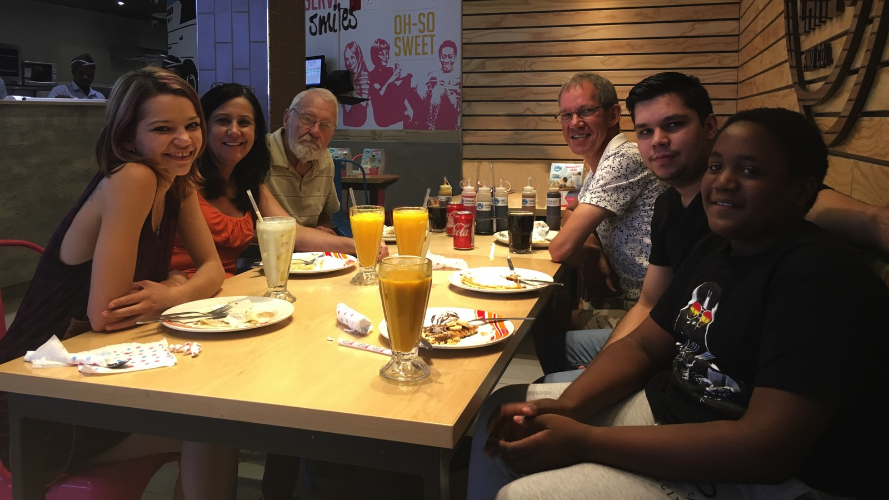
Notes:
Here is a photo taken of our family a few months back: From left to right: Ashley (22), Debbie, My Dad, Mark, Keegan (24) and Drew (12).

Slide 3
Notes:
1. Incarnate: “The Word became flesh and made his dwelling among us.” (John 1:14) - the Word was with God, but he left glory to enter into our world!
Enter into the world of your kids - don’t wait for them to enter your world. Find out what interests them and use it as away to spend time with them.

Slide 4
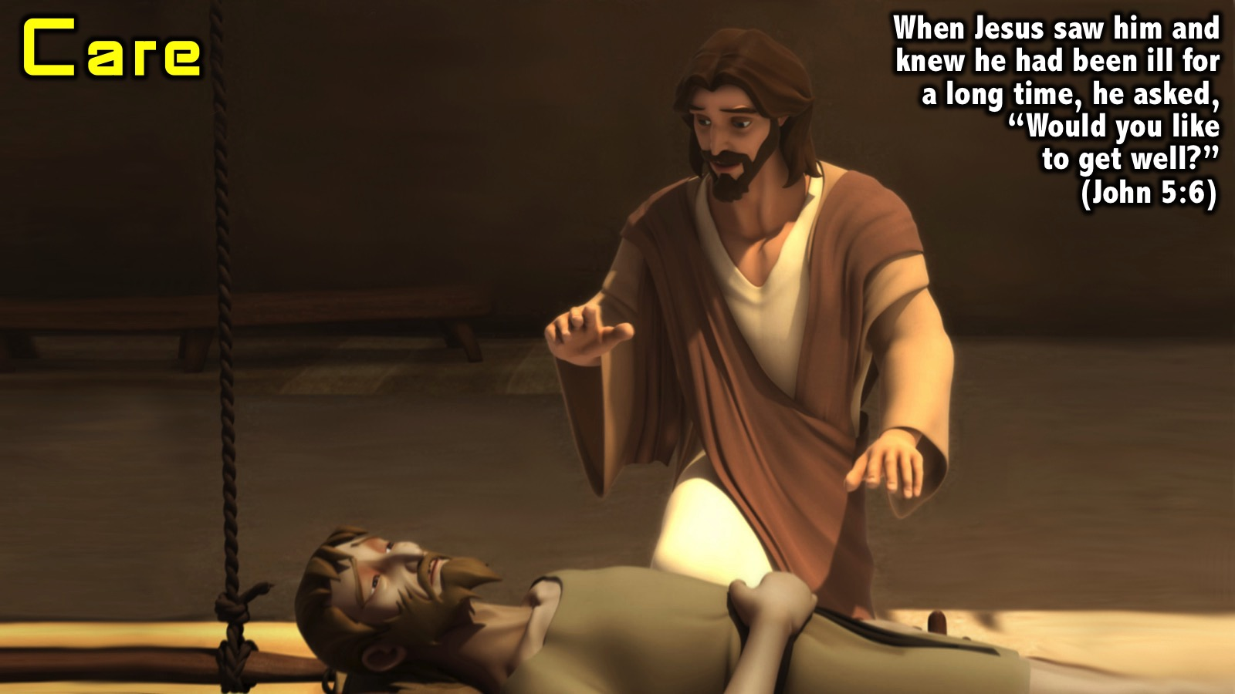
Notes:
2. Care: “When Jesus saw him and knew he had been ill for a long time, he asked, “Would you like to get well?” (John 5:6). In John 5 Jesus healed a lame man and in John 9 Jesus healed the man born blind.
See illness and needs as an opportunity to demonstrate love and care to our kids.

Slide 5
Notes:
3. Teach: “Midway through the festival Jesus went up to the Temple and began to teach.” (John 7:14). See also John 14-16 and the parables of Jesus.
Make time to formally teach your kids to build foundations in their lives and equip them with skills for life. Don’t outsource it all to school and church.

Slide 6
Notes:
4. Forgive: “Where are your accusers? Go and sin no more.” (John 8:10-11). In John 8 Jesus forgave the woman caught in adultery and in John 21 Jesus restored Peter who betrayed him.
Forgive and restore your kids when they fall or make mistakes - keep the relationship open at all costs.

Slide 7
Notes:
5. Serve: “So he got up from the table, took off his robe, wrapped a towel around his waist, and poured water into a basin. Then he began to wash the disciples’ feet, drying them with the towel he had around him”. (John 13)
Meet the needs of your kids or at the least work with them so their needs are taken care of. They may not show appreciation at the time, but they will remember it in time.

Slide 8
Notes:
6. Pray: “Holy Father, protect them by the power of your name, the name you gave me, so that they may be one as we are one.” (John 17:11)
Pray for your kids to find and live their God-given destiny, to come to know Jesus and grow to maturity, to be kept safe from the evil one’s snares.

Slide 9
Notes:
7. Die: “Unless a kernel of wheat falls to the ground and dies, it remains only a single seed. But if it dies, it produces many seeds.” (John 12:24). See also John 18-19.
Die to your agenda, be available to your kids - stop what you are doing and engage with them the moment your paths cross.
The book More: How to Move From Activity For God to Intimacy With God has a chapter on the need for us to Die to our own agenda and to be available for God to use us in people’s lives by becoming a channel through which God can work in their lives.

Slide 10
Notes:
Video: Wimpy’s Make Time advert. Get it on YouTube at: https://youtu.be/yARpEOc3DMI

Slide 11
Notes:
Summary: Here are some of the themes we have explored this evening: Incarnate, Care, Teach, Forgive, Serve, Pray and Die.
Challenge: In the next 3 months make your way through the Gospel of John and ask God to give you insights into parenting from the story of Jesus’ life and ministry.
Themes to Explore:
* Miracles (John 2): Do miracles with what you have.
* Gospelize (John 3): Share the gospel with your kids and equip them to share the GOSPEL with their peers.
* Disciple (John 4): Disciple your kids like Jesus developed his disciples to take over from him.
* Feed (John 6): Find any excuse to eat and drink together or celebrate special events.
* Shepherd (John 10): Watch over your flock like a shepherd.
* Prepare (John 12:20-36): Prepare your kids for the day when you won’t be around.
* Resurrect (John 20-21): Even when things go wrong there will still be resurrection because life comes from death.

