Slide 1

Notes:
The First Part of Our Planning Session was PRAY:
We started our time with guided devotions and prayer using these five lessons we learnt from Nehemiah in chapter 1:
(1) Get The Facts (Nehemiah 1:1-3) - we spent time in prayer reflecting on the state of our lives, ministries and organisation.
(2) Go to God (Nehemiah 1:4-6a) - we spent time giving God the praise He deserves deserves for who he is and all he does.
(3) Confess your Sins (Nehemiah 1:6b-7) - we spent time confessing any personal or corporate sins that God brought to our attention.
(4) Remember the Past (Nehemiah 1:8-10) - we spent time remembering all that God has done in the past in and through us or your ministries.
(5) Ask for Help (Nehemiah 1:11) - we spent time asking God help us experience success and favour in the coming months.

Slide 2
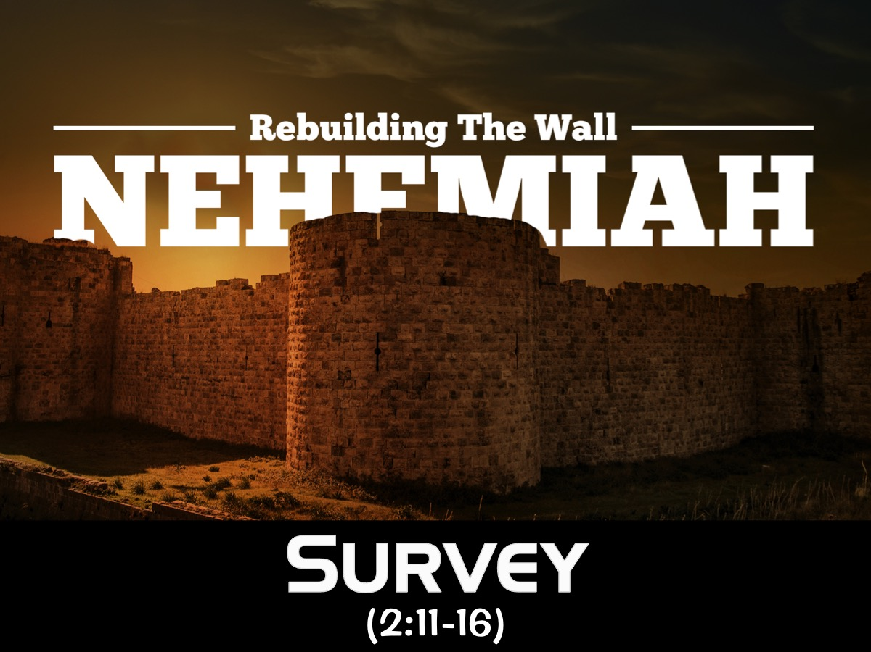
Notes:
The Second Part of our Planning Session was SURVEY:​
Using the example of Nehemiah who went out to survey the situation (Nehemiah 2:11-16) we went on a prayer journey for 30 minutes where leaders listened to what God was saying to them about the organisation as they contemplated the following things: Buildings, Grass, Trees, Mountains, Sky and anything else they encountered. All the insights were captured on a flipchart and then each delegate reflected on the top three insights they received and they were used to create a list of key insights from the group.

Slide 3

Notes:
The Third Part of our Planning Session was Build
Nehemiah 3 describes the building process that was started and we were guided by the Patrick Lencioni book, The Advantage, that describes 4 disciples of a healthy organisation.

