Slide 1

Notes:
Project Runway Night.
Length of pre-event videos: 4:40

Slide 2
Notes:
Pre-Event Video: Mercedes Benz Fashion Week Spring 2015. Get it on YouTube at: https://www.youtube.com/watch?v=ZTvGcHMV7As
Length: 2:00

Slide 3
Notes:
Pre-Event Video: Project Runway All-Stars 2012 Trailer. Get it on YouTube at: https://www.youtube.com/watch?v=OJqr4lhVVaY
Length: 1:20

Slide 4
Notes:
Pre-Event Video: Project Runway Season 1 Trailer. Get it on YouTube at: https://www.youtube.com/watch?v=OJqr4lhVVaY
Length: 1:20

Slide 5

Notes:
The Welcome: Welcome to Project Runway Night – are there any newcomers?

Slide 6
Notes:
Video: A Project Runway Trailer.

Slide 7
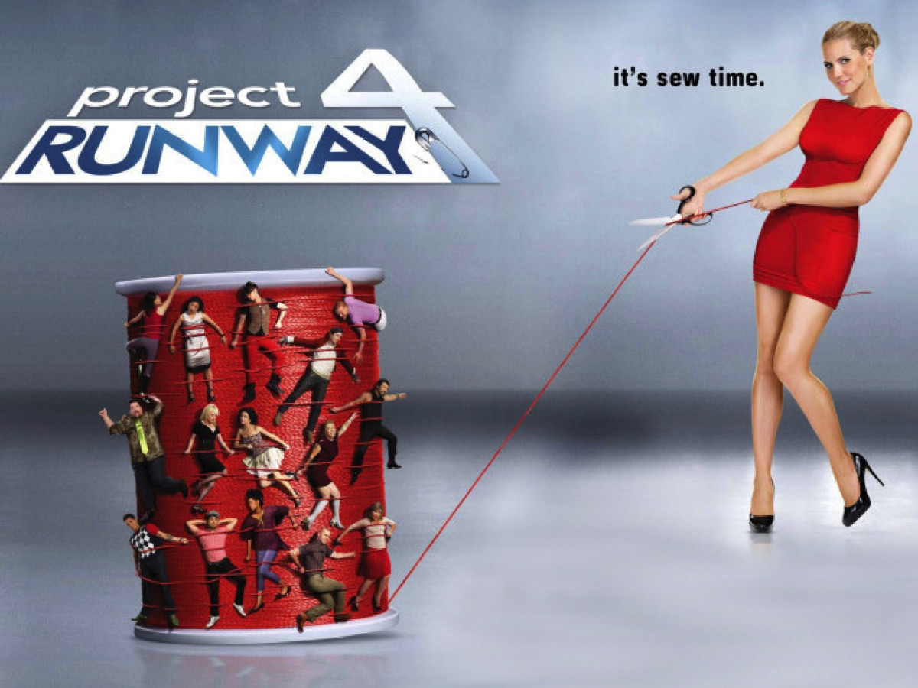
Notes:
It’s sew time!

Slide 8
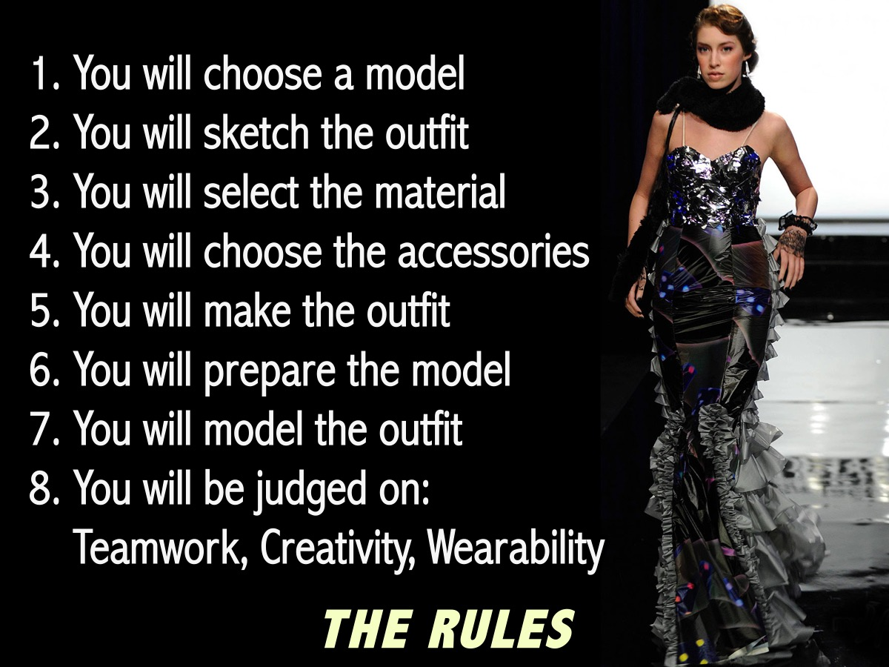
Notes:
The Rules: (1) You will choose a model, (2) You will sketch the outfit, (3) You will select the material, (4) You will choose the accessories, (5) You will make the outfit, (6) You will prepare the model, (7) You will model the outfit, (8) You will be judged on Teamwork, Creativity and Wearability.

Slide 9

Notes:
The Prizes: The first prize tonight will go to the team that produces the best design!

Slide 10
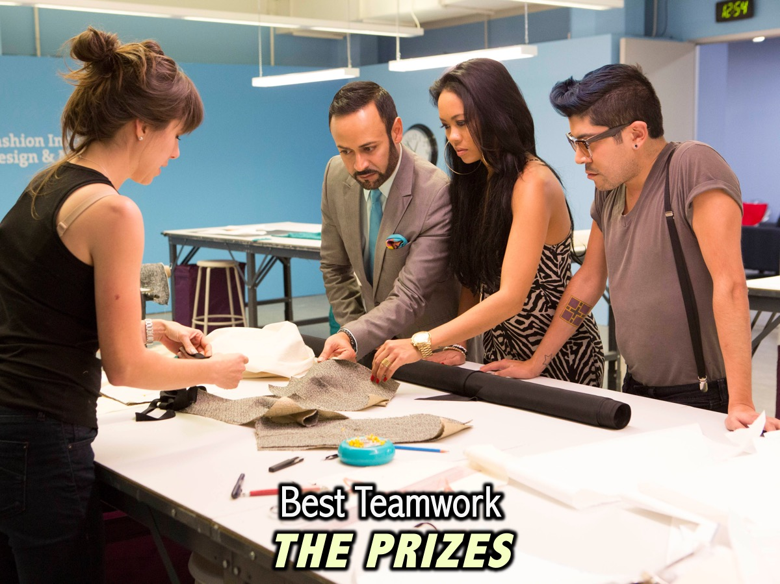
Notes:
The Prizes: The second prize tonight goes to the team that participates the best and works together – even if their design does not take first place.

Slide 11
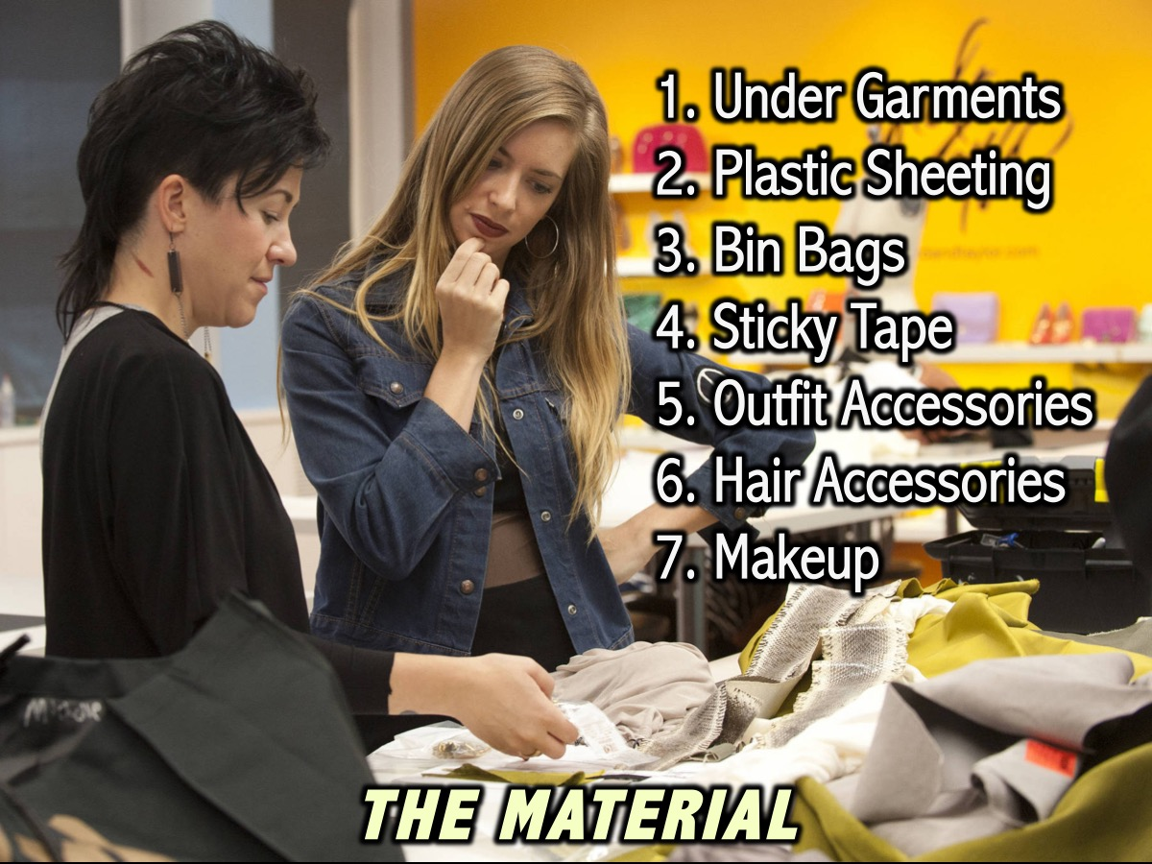
Notes:
The Materials: You will have the following items to use in your project: Under Garments, Plastic Sheeting, Bin Bags, Sticky Tape, Outfit Accessories, Hair Accessories and Makeup.

Slide 12

Notes:
The Teams: You are going to divide into guys and girls teams and then divide again to make 4 teams

Slide 13
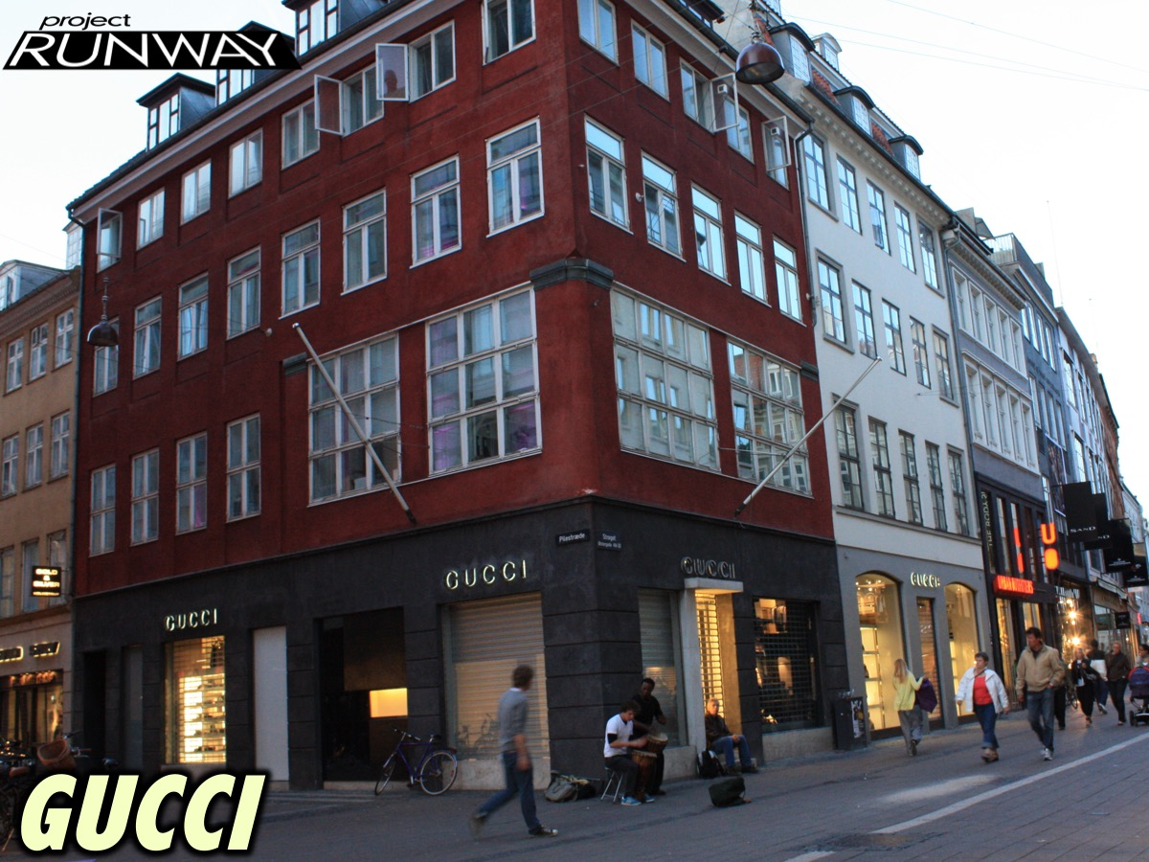
Notes:
Team #1 is Gucci

Slide 14

Notes:
Team #2 is Prada

Slide 15

Notes:
Team #3 is Versace

Slide 16
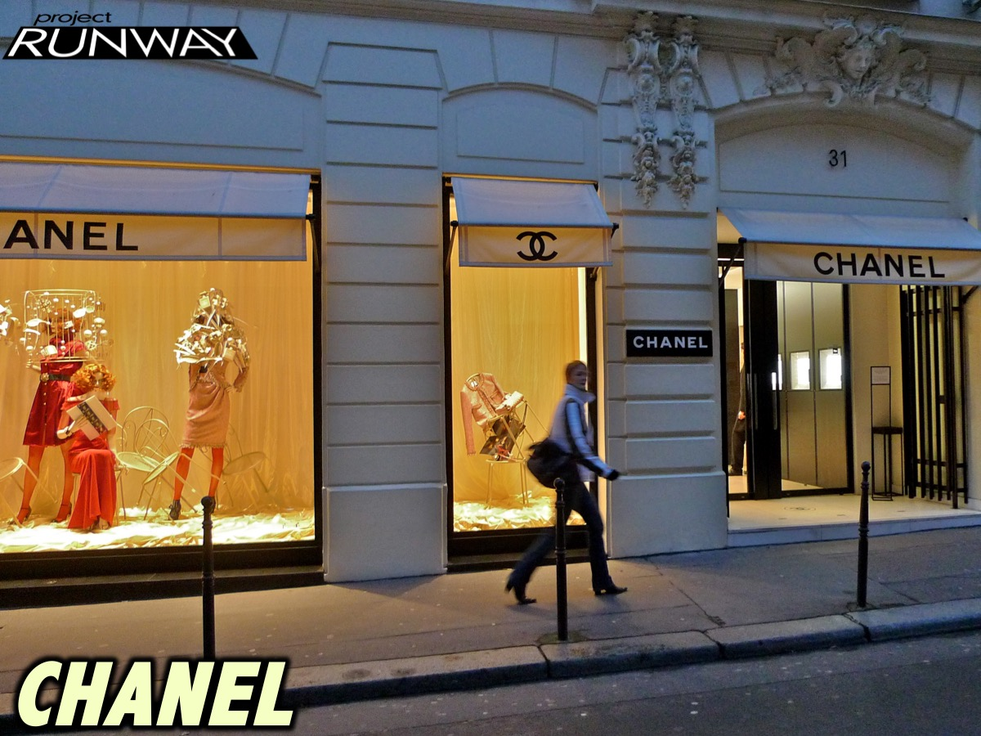
Notes:
Team #4 is Chanel

Slide 17
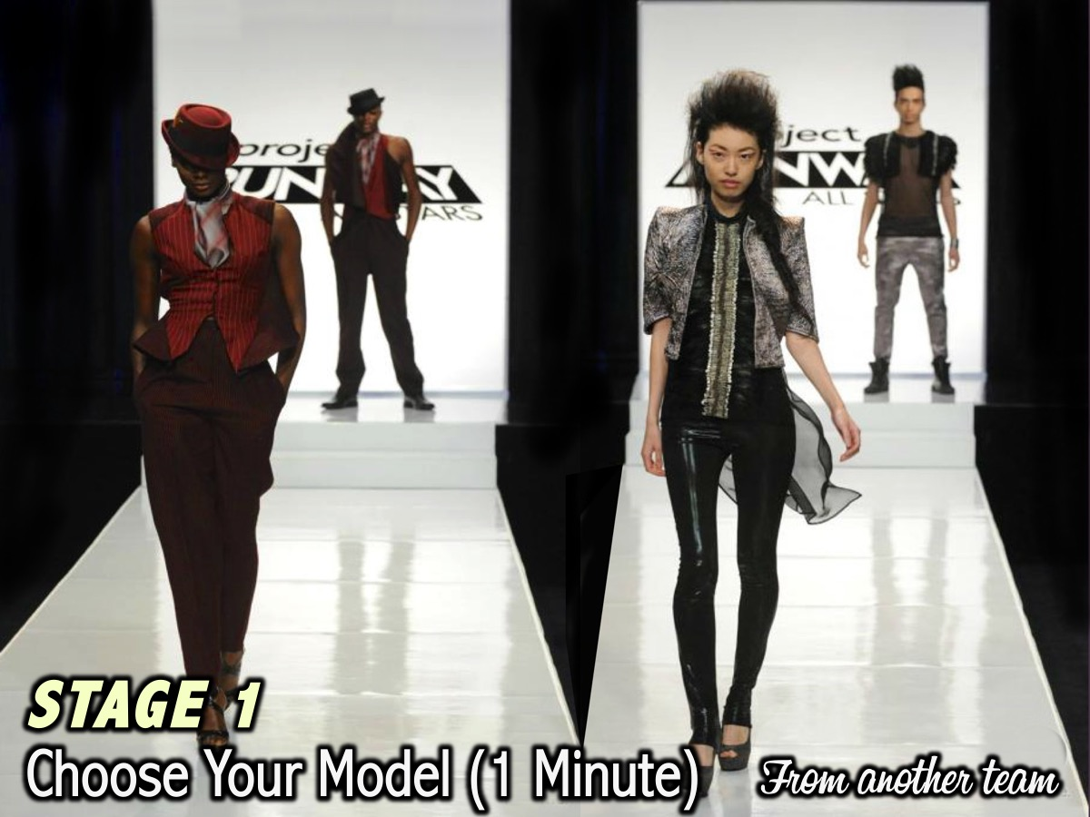
Notes:
Stage 1: Choose Your Model – you have 1 minute to choose one person from any of the other teams to be your model tonight. The gender of your model has been pre-determined – check your table for instructions!

Slide 18
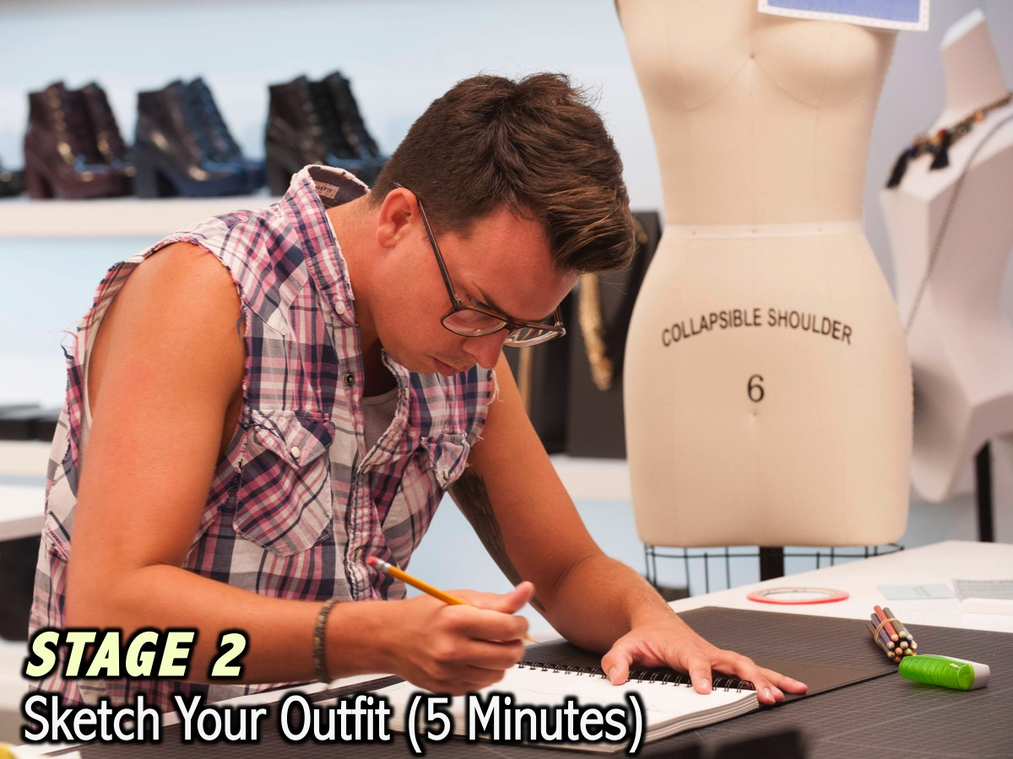
Notes:
Stage 2: Sketch Your Outfit. You have 5 minute to design your outfit on paper with pastels. The design cannot change after the 5 minutes are up and your design will be seen by the judges to help them decide who is the winner on the night. To help you in your creativity and to give you some focus and a story for your design we are going to show you a poster from the movie Epic.

Slide 19
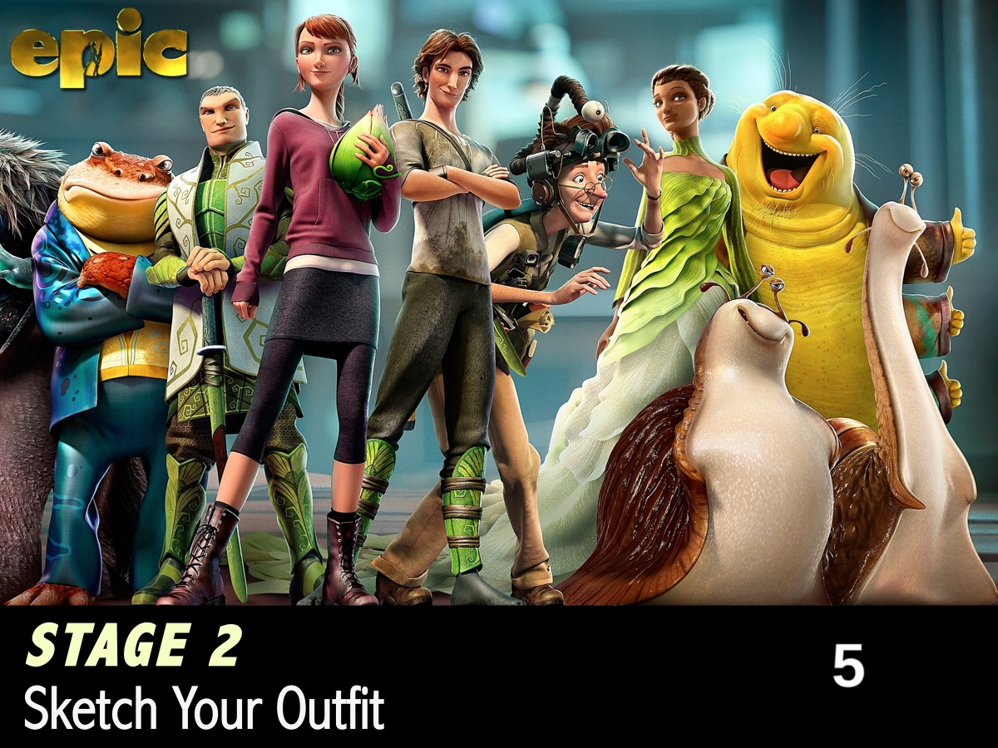
Notes:
You have 5 minutes – Starting Now!

Slide 20
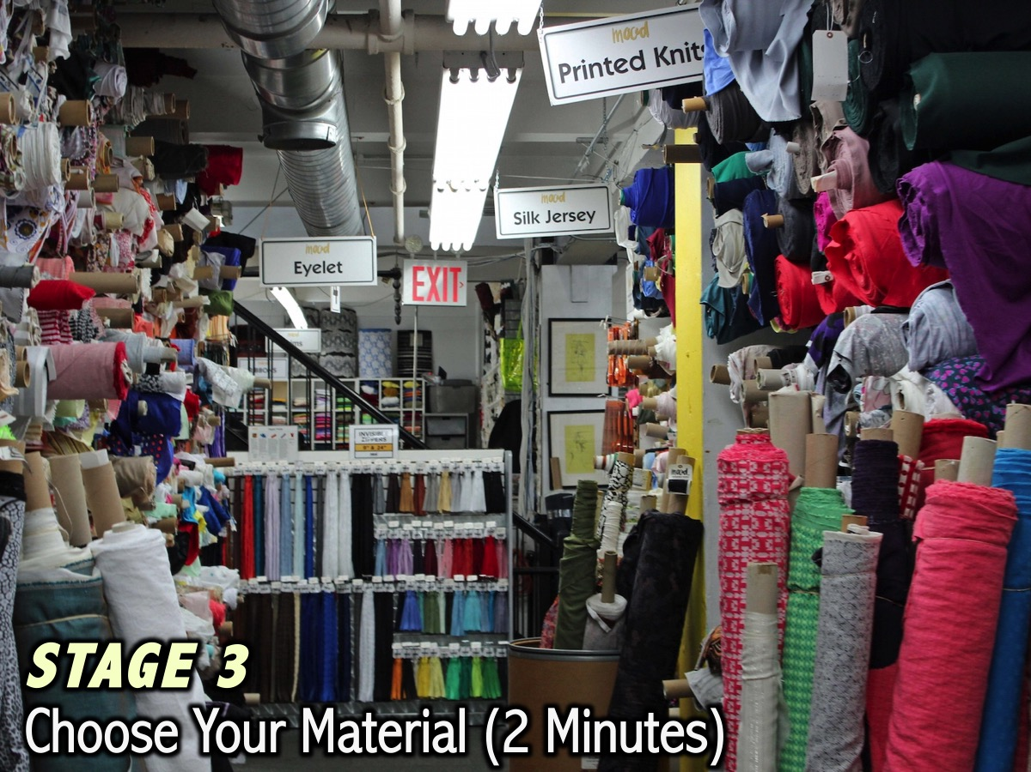
Notes:
Stage 3: Choose Your Material. You have 2 minutes to choose the material to make your outfit.

Slide 21
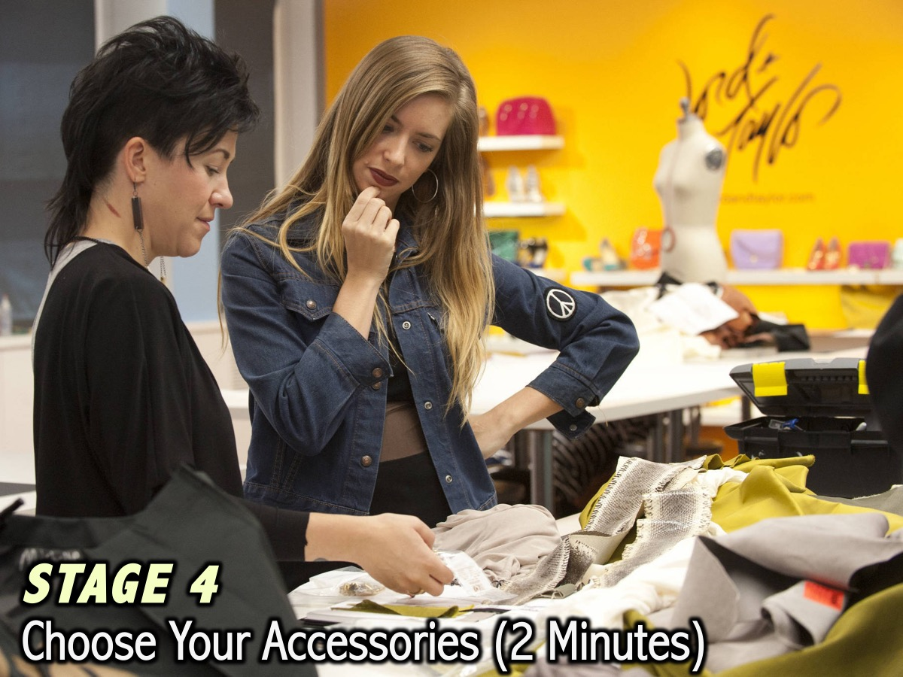
Notes:
Stage 4: Choose Your Accessories. You have 2 minutes to choose hair and makeup accessories to go with your outfit.

Slide 22
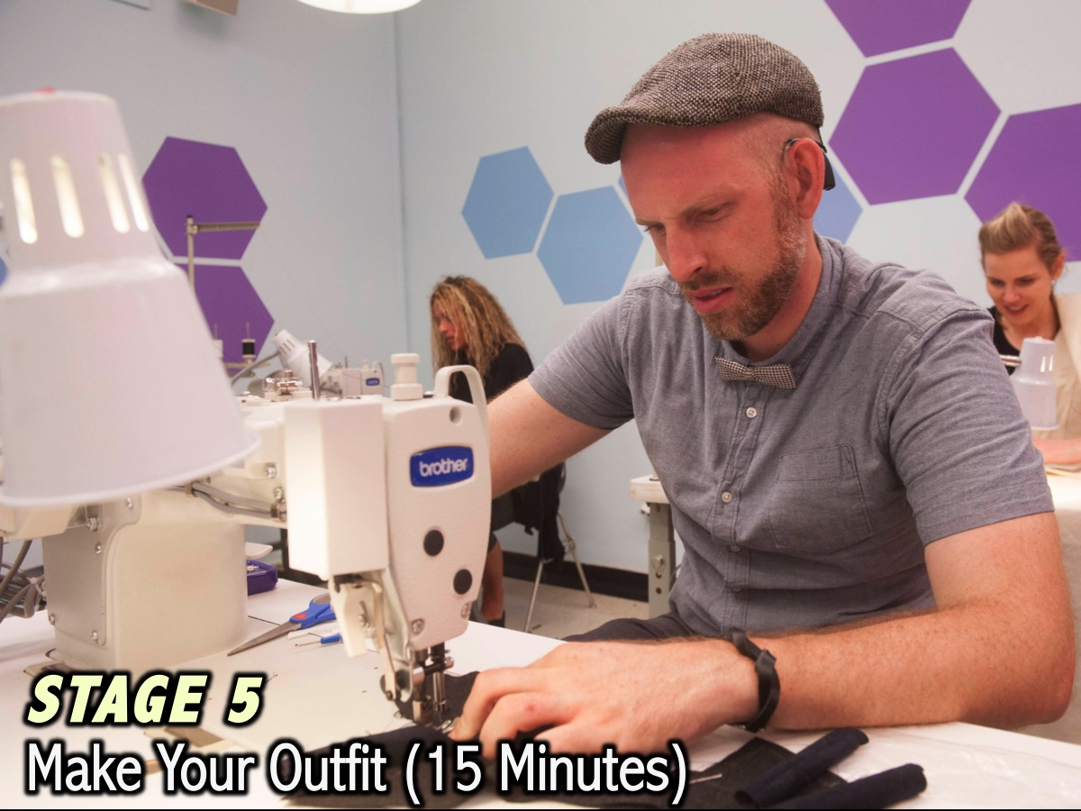
Notes:
Stage 5: Make Your Outfit. You have 15 minutes to make your outfit using the material

Slide 23
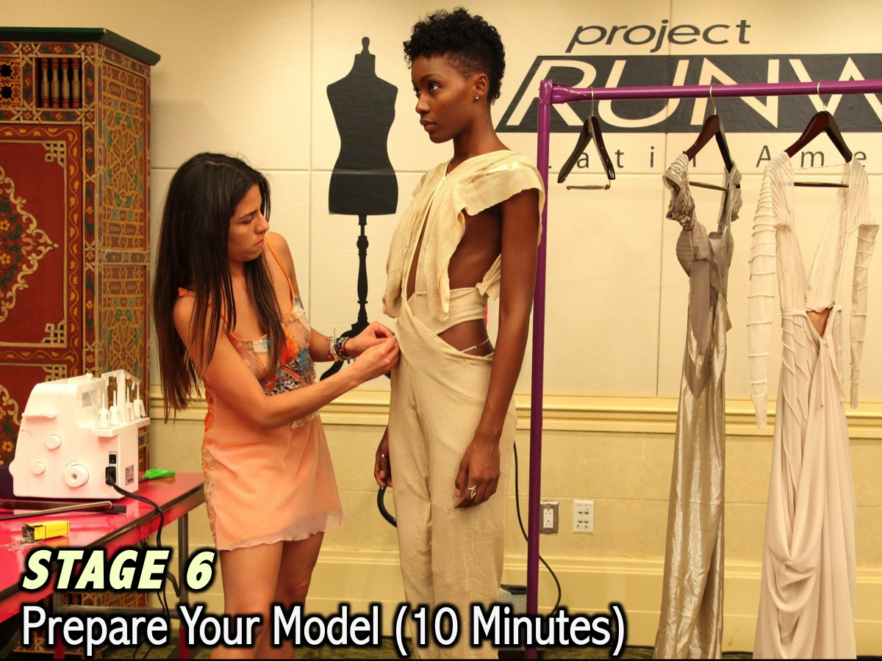
Notes:
Stage 6: Prepare Your Model. You have 10 minutes to make up your model.

Slide 24

Notes:
Stage 7: Model Your Outfit. Each group will send their lead designer to the stage to briefly introduce their outfit and the model will walk the runway. An audio track will play as soon as this slide is activated – to help groups finish off their model preparation (it is 40 seconds long and taken from the Project Runway show).

Slide 25

Notes:
Team GUCCI. The tracks to be used for Team Gucci walking the runway is on YouTube at: https://www.youtube.com/watch?v=VkcCiKwjQFQ

Slide 26

Notes:
Team PRADA. The tracks to be used for Team Prada walking the runway is on YouTube at: https://www.youtube.com/watch?v=1qBjqInKKzM

Slide 27

Notes:
Team VERSACE. The tracks to be used for Team Versace walking the runway is on YouTube at: https://www.youtube.com/watch?v=XZWVycmZkkM

Slide 28

Notes:
Team CHANEL. The tracks to be used for Team Chanel walking the runway is on YouTube at: https://www.youtube.com/watch?v=Kw8xXlbehKE

Slide 29
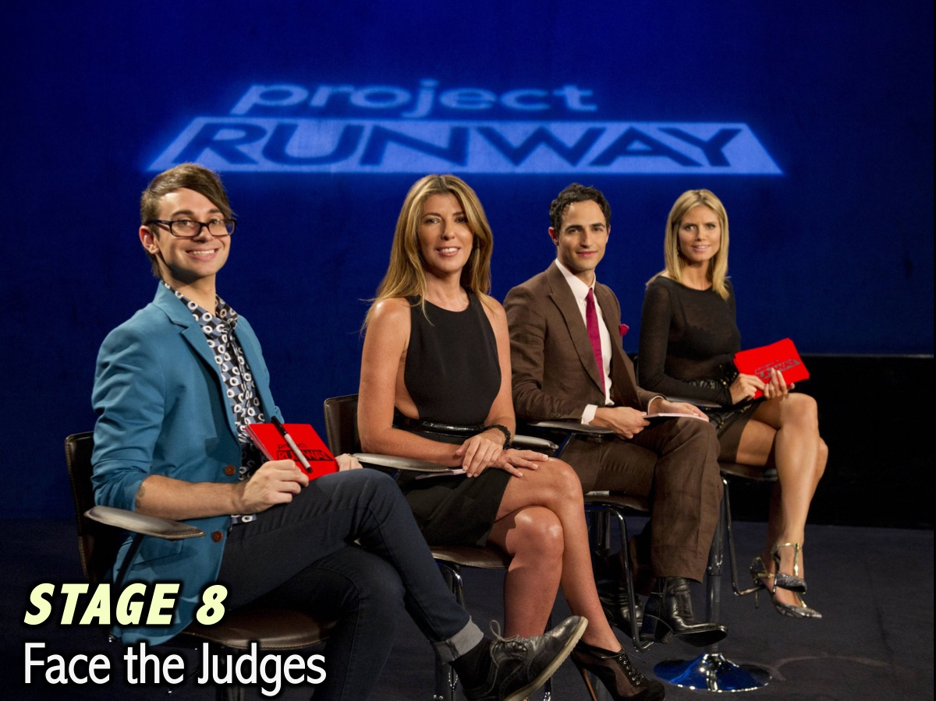
Notes:
Stage 8: Face the Judges: The judges will judge the creations, the paper designs and the team participation on the night and present the results from 4th place to 1st place. The top team and the team with the best team participation on the night will receive prizes.

Slide 30

Notes:
The award for Best Design tonight goes to: Team __________

Slide 31
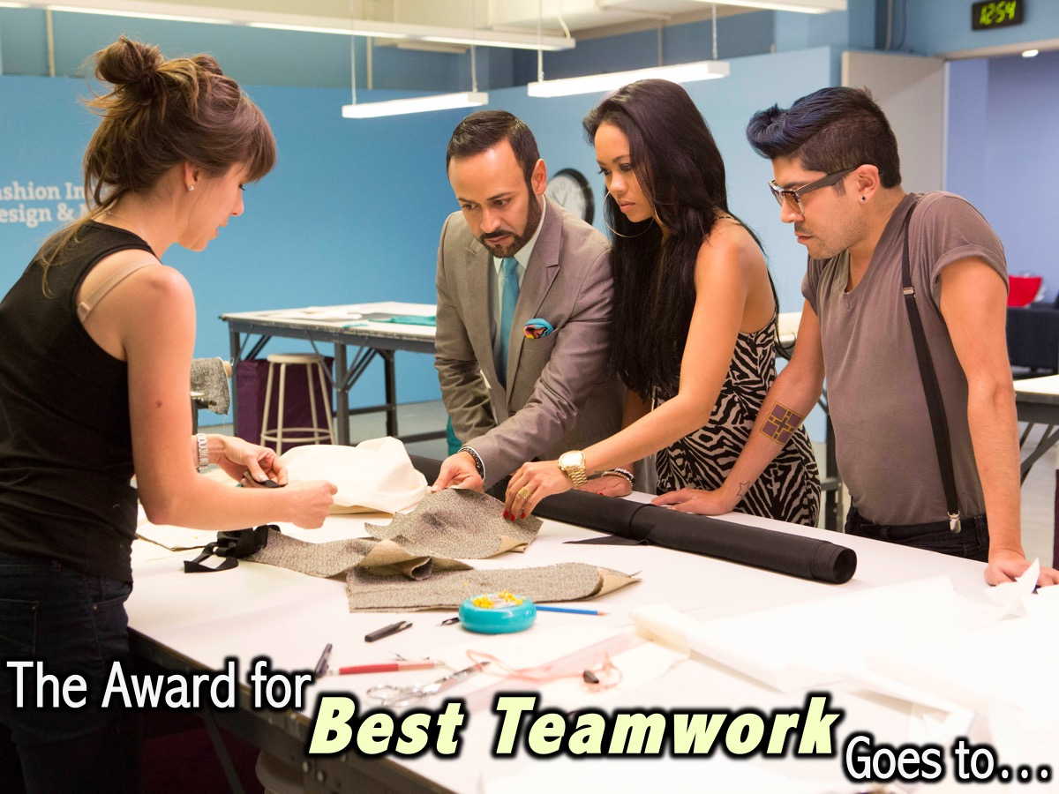
Notes:
The award for Best Teamwork tonight goes to: Team ____________

Slide 32
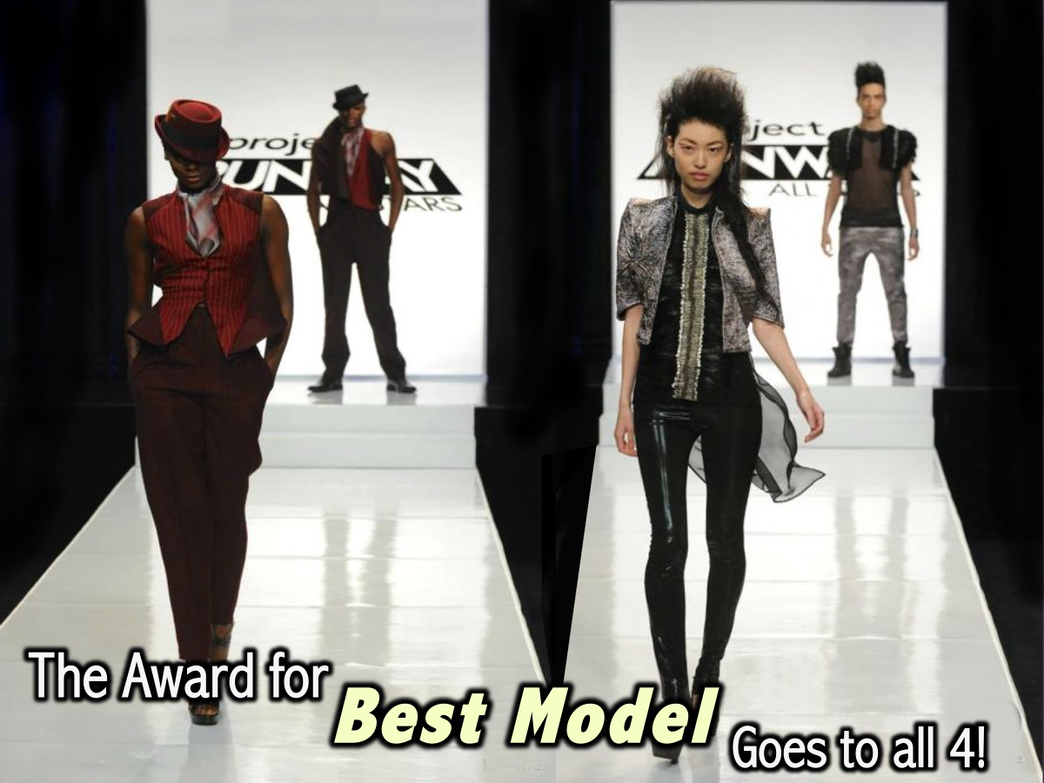
Notes:
The award for Best Model goes to all four of our Models!

Slide 33
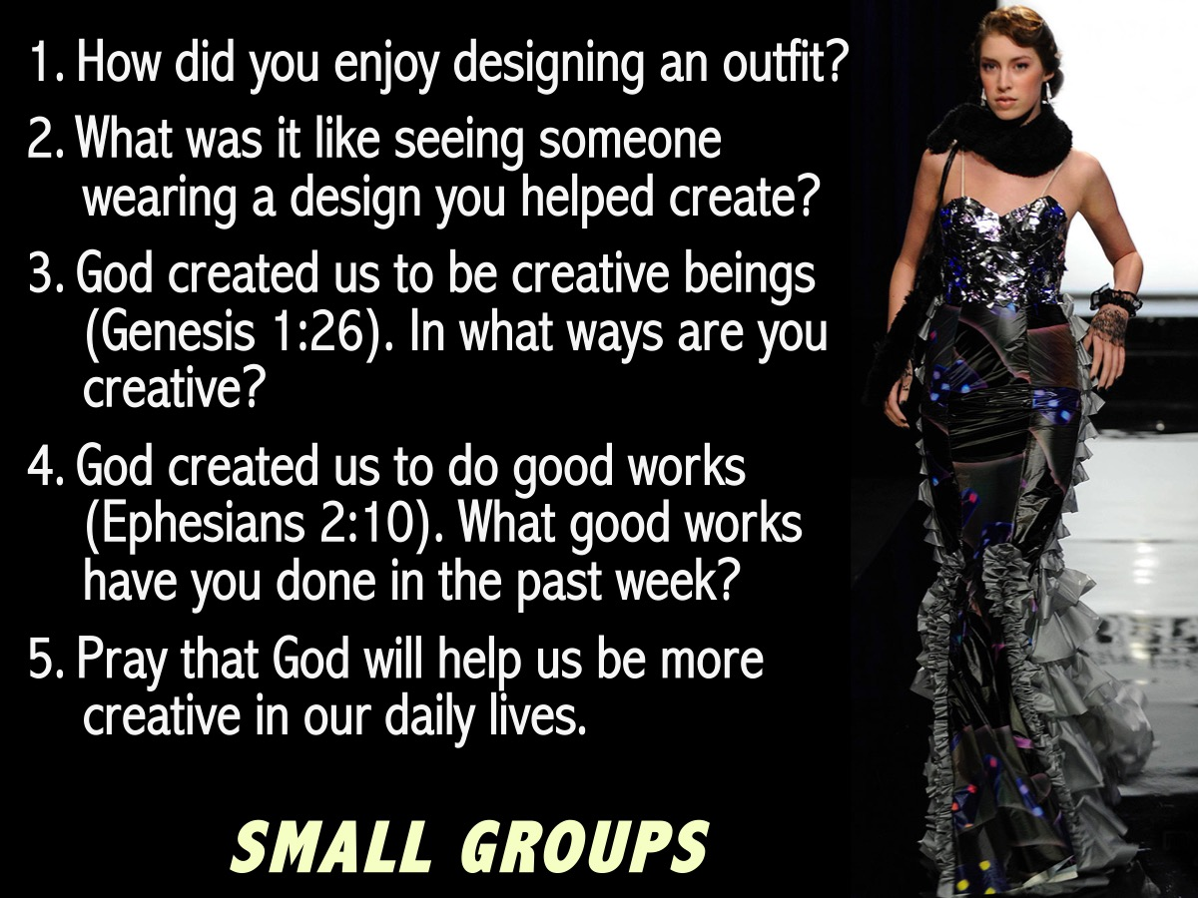
Notes:
The Small Groups: Here are the questions for our small group time: (1) How did you enjoy designing an outfit? (2) What was it like seeing someone wearing a design you helped create? (3) God created us to be creative beings (Genesis 1:26). In what ways are you creative? (4) God created us to do good works (Ephesians 2:10). What good works have you done in the past week? (5) Pray that God will help us be more creative in our daily lives.

Slide 34

Notes:
Next Friday night is our Amazing Improv Race night.

Slide 35

Notes:
On Sunday morning it is the Heroes Series and we will be looking at the life of Jonah.

Slide 36

Notes:
Refreshments

