Slide 1
Notes:
Tonight is Chow Night. We will start with a prayer, welcome and notices in then teens will choose a country to explore and more to their respective tables. The leader of the country is responsible to decorate their table and cook a meal for 12 people (teens will be seated at tables with 12 people). The leader must find interesting information about that country they are representing. They will have 20 minutes. Then they will have South African dessert and they will reflect on what they learnt about the country, watch an Africa Day video and pray for South Africa before heading into small groups.

Slide 2
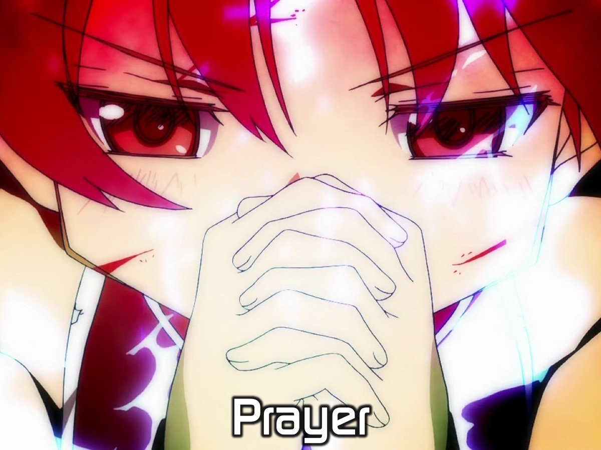
Notes:
Let’s open our meeting in prayer.

Slide 3
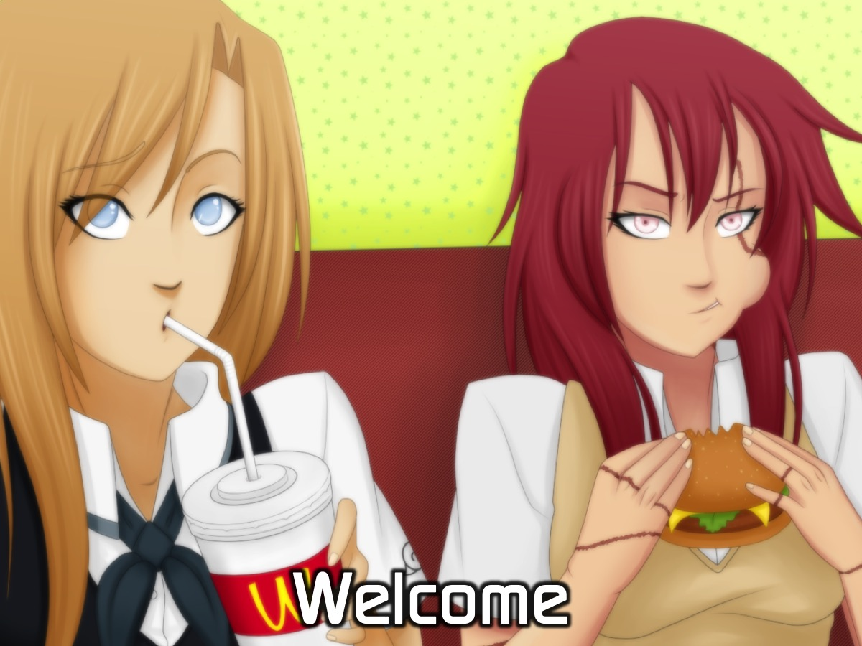
Notes:
Welcome to newcomers and regulars.

Slide 4
Notes:
On Sunday morning it is the Word-On series and we will be exploring what the Bible says about Lifestyle.

Slide 5
Notes:
Next Friday night is our Talent Night. You can bring any talent that you have along with you - whether it is a hobby or a skill that you have - if you can bring something with you to show and tell you will be entered into our talent night. You can also perform on stage if it is singing or dancing. There will be prizes up for grabs.

Slide 6
Notes:
Tonight is Chow Night.

Slide 7
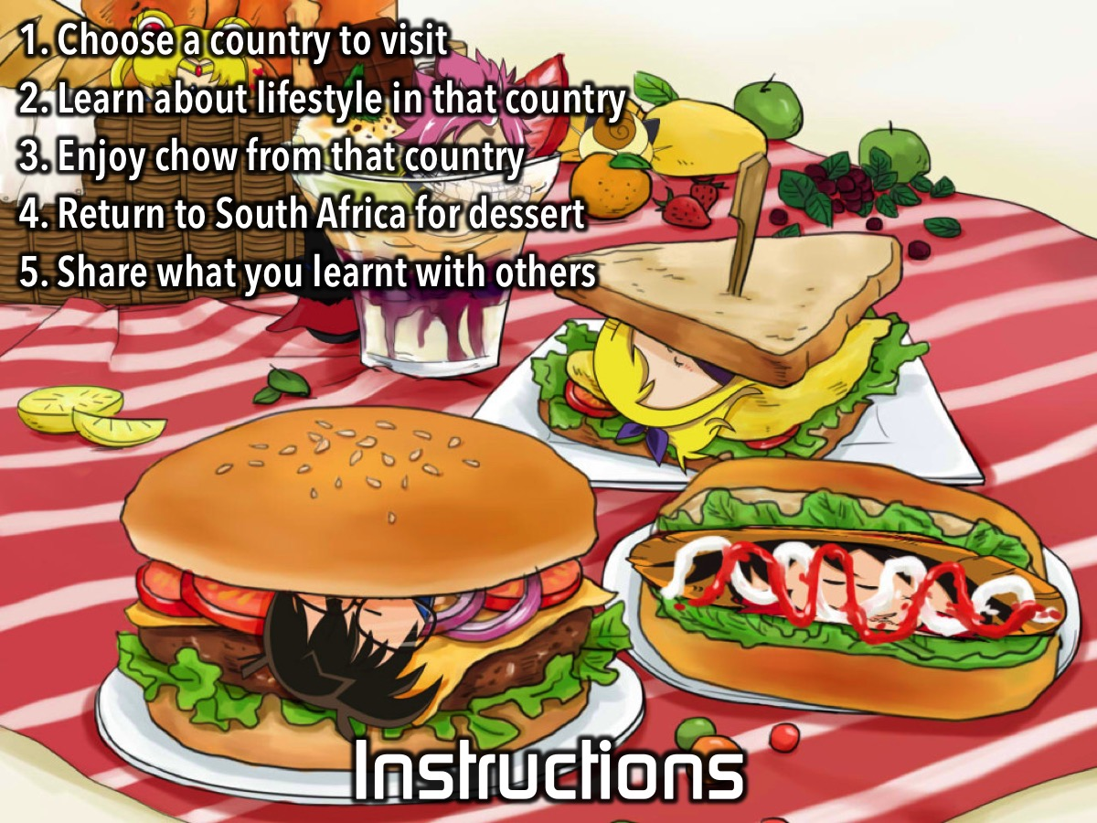
Notes:
Instructions: You are going to choose a country to visit. There you will learn about lifestyle in that country and also get to chow some of their food. You will return to South Africa for dessert and share what you learnt around tables.

Slide 8
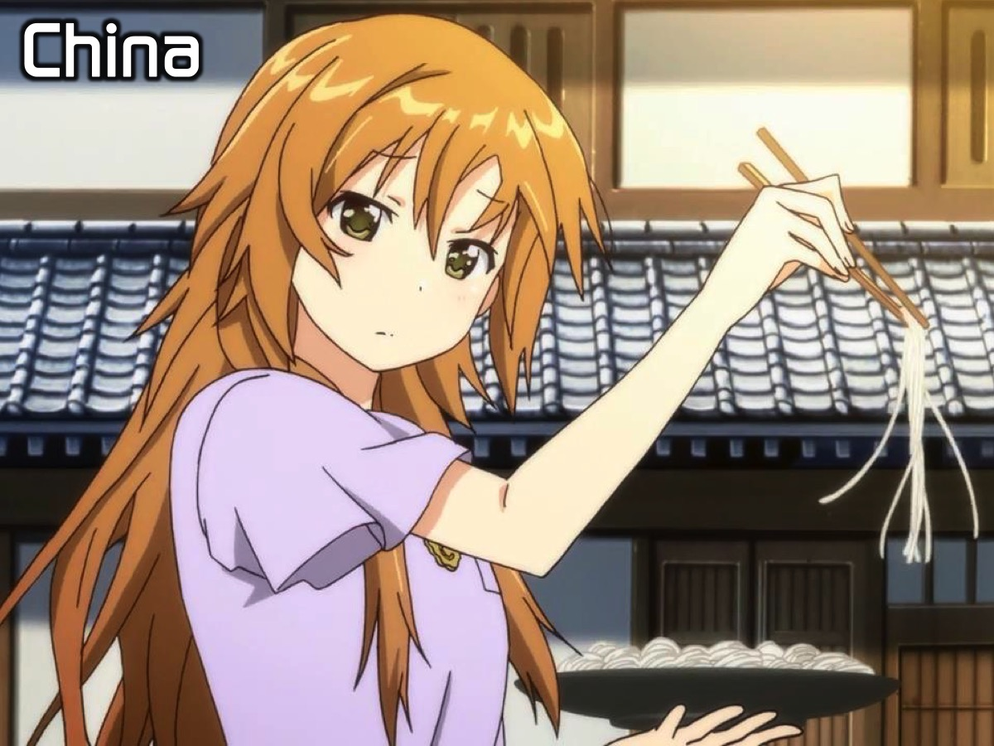
Notes:
China: Stir-Fry and Noodles will be served.

Slide 9
Notes:
Italy: Pizza will be served.

Slide 10
Notes:
USA: Hot dogs and crisps will be served.

Slide 11
Notes:
India: Curry and rice will be served.

Slide 12
Notes:
Choose Your Country: So we need equal numbers to go to each of the venues for their meal. There is a country poster in each corner of the room - go and stand next to one of the posters before we send you to your tables.

Slide 13
Notes:
Enjoy SA Dessert: Traditional South African dessert will be served in the youth room and teens will sit at round tables - 8 at a table.

Slide 14
Notes:
Video: MTN Celebrates Africa Day. Get it on YouTube at: https://www.youtube.com/watch?v=JXo3OvSYhOE

Slide 15
Notes:
Pray for SA: At your tables spend 10 minutes praying for South Africa using this outline: Praise, Request, Admit, Yield

Slide 16
Notes:
Small Groups. Here are the questions for our small group time: (1) What did you most enjoy about tonight? (2) What do you most love about living in SA? (3) How does your lifestyle benefit others? (4) How does following Jesus impact your lifestyle? (5) Pray for each other to make the world a better place.

Slide 17
Notes:
On Sunday morning it is the Word-On series and we will be exploring what the Bible says about Lifestyle.

Slide 18
Notes:
Next Friday night is our Talent Night. You can bring any talent that you have along with you - whether it is a hobby or a skill that you have - if you can bring something with you to show and tell you will be entered into our talent night. You can also perform on stage if it is singing or dancing. There will be prizes up for grabs.

Slide 19
Notes:
It is time for Refreshments.

