Slide 1

Notes:
This Friday is CrossFit Night.
[Note: Advertise a week in advance that teens should bring: Short pants, t-shirts, comfortable athletic shoes, a sweat towel, water bottle, clean shirt for afterwards and deodorant.}

Slide 2

Notes:
Let’s open our meeting in prayer.

Slide 3

Notes:
Welcome to newcomers and regulars.

Slide 4

Notes:
On Sunday morning it is the Word-On series and we will be exploring what the Bible says about Suffering.

Slide 5

Notes:
Next Friday night is our Power Night.

Slide 6

Notes:
Tonight is CrossFit Night.

Slide 7

Notes:
Put your hands together for our CrossFit instructors!
Hi guys and girls, it is awesome to be with you this evening. Thank you for having us and thank you to Mark and Debs for inviting us to join you. So my name is Simon…

Slide 8
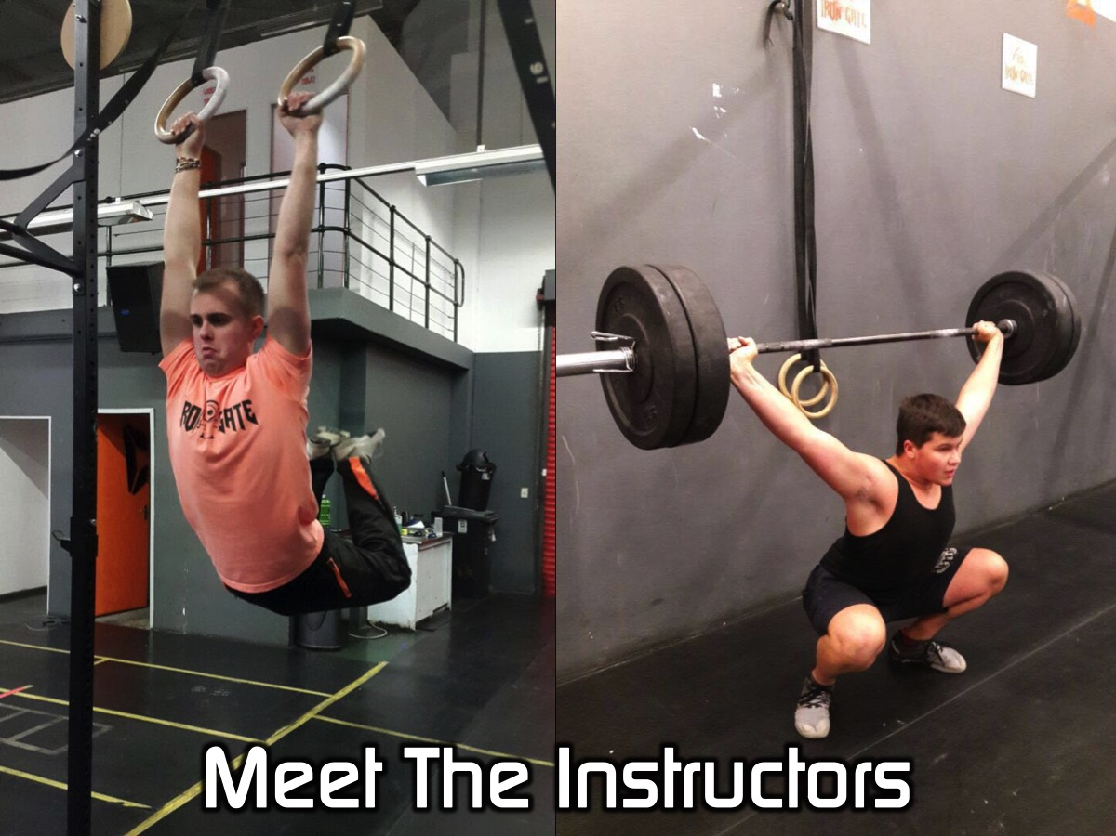
Notes:
…and these are two of my friends, Josh and Isaac. We mess around with a little sport you might of heard of before called CrossFit.

Slide 9

Notes:
So who of you here have ever done CrossFit before?
And what can you tell us about CrossFit?
So when people think about CrossFit, what are some of the things which come to mind?

Slide 10

Notes:
So tonight we are going to be having some fun. We have three WODs planned so I hope you've brought your A game. A WOD stands for Workout Of the Day. With each WOD we will put you into teams, we will then demonstrate to you the movements and the rules.

Slide 11

Notes:
WOD1: Complete 120 burpees (share reps as needed)
Burpees: Start from a standing position. Bend over and place both hands firmly on the ground in front of the feet. Kick (or step) both feet back into a push-up position and lower the entire body to the ground. This is not a push-up. The chest and thighs need to make full contact with the ground. Then extend the arms, lifting the chest and jump (or step) both feet in towards the chest. Stand, jump (opening the hips fully) and clap hands behind the head while in the air. Instruction Video: https://www.youtube.com/watch?v=TX60BcsO_wE

Slide 12
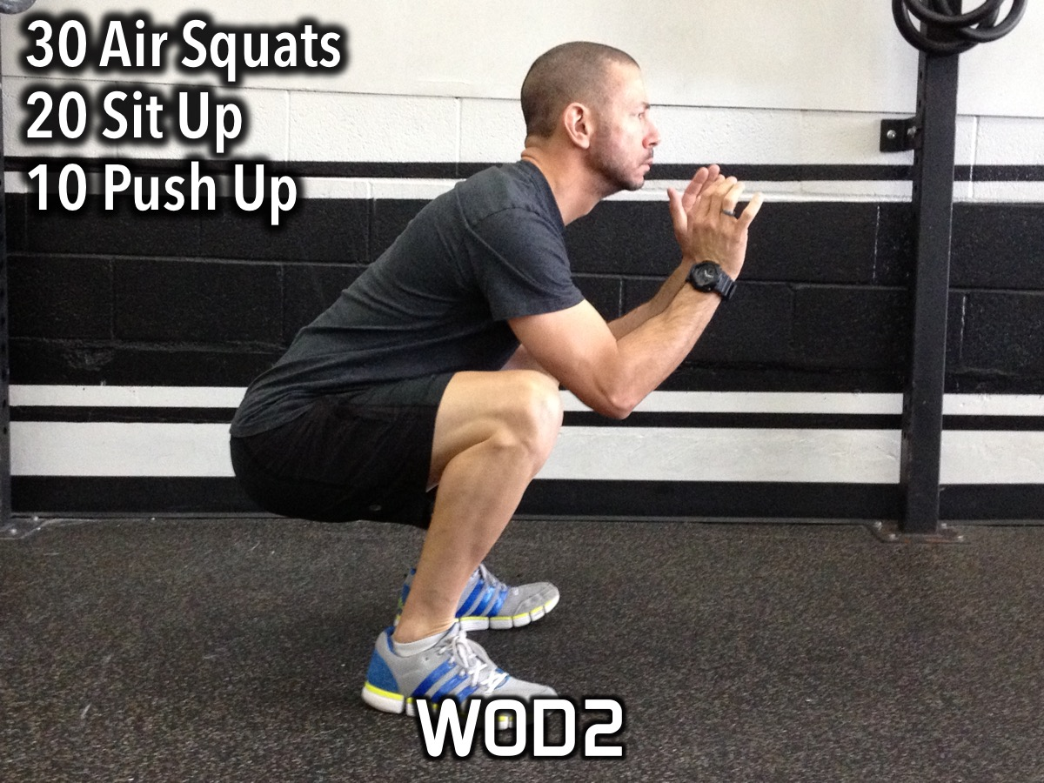
Notes:
WOD2: 5min AMRAP in pairs: 30 Air Squats/20 Sit Up/10 Push Up (Alt as needed).
Air Squats: Feet shoulder width apart (heels directly under shoulders) with toes slightly turned out. Weight should be distributed between the heel and mid-foot (heels). Maintaining a neutral spine (flat back), push the hips back then down. While pushing the hips back and down, make sure the knees stay inline with the toes (tracking). At no point should the knees roll inside of the ankle (collapse). Continue to descend until the crease of the hip is below the knee cap (full depth). After achieving full depth, stand to full extension in the hips and knees by driving through the heels.
Instruction Video: https://www.youtube.com/watch?v=JKtOS-xIbhg

Slide 13

Notes:
WOD3: 5min AMRAP in pairs: 30 Mountain Climbers/20m Bear Crawl (Alt as needed)
Mountain Climber: Start with your hands directly under your shoulders in the top of the push up position, arms locked out. Bring your left knee to your left elbow, then alternate to bring your left leg back to set up position and bring your right knee to your right elbow. All while maintaining a tight belly and back with arms locked out. Instruction Video: https://www.youtube.com/watch?v=1J4hRICVjRo
Bear Crawl: Start with hands and feet on the ground. Walk forward with hips and shoulders square with the ground. Instruction Video: https://www.youtube.com/watch?v=2yAWjVCT1VQ

Slide 14

Notes:
WOD4: 5min AMRAP in pairs: 20 Slam Ball/20 Alt Lunge holding the Slam Ball (Alt as needed)
Setup in a wide stance
Pick ball up and bring it to a full overhead position
From here you will slam the ball down pulling your hips back and finishing in a full squat
Be sure to catch the ball on it’s first hop.
From this position you bring the ball back over head driving it back down, pulling your hips to a full squat catching the ball on it’s first hop.
Instruction Video: https://www.youtube.com/watch?v=7gLEmS4nwi0

Slide 15

Notes:
Small Groups. Here are the questions for our small group time: (1) How did you feel during the WODs? (tough, out of breath, suffering, in pain). (2) In what ways can experiencing suffering be a good thing for us? (3) Think about a time in your life when you were experiencing suffering in your life. Did you feel it drew you closer to God or pushed you further from Him? (4) 2 Corinthians 4:16-17 says: "That is why we never give up. Though our bodies are dying, our spirits are being renewed every day. For our present troubles are small and won't last very long. Yet they will produce for us a glory that vastly outweighs them and will last forever." How does this Scripture make you think differently about suffering? (5) Pray for each other to experience God when suffering.

Slide 16
Notes:
On Sunday morning it is the Word-On series and we will be exploring what the Bible says about Suffering.

Slide 17
Notes:
Next Friday night is our Power Night.

Slide 18

Notes:
It is time for Refreshments.

