Slide 1

Notes:
Encounter Night is a journey through the GOSPEL story and we will start in the youth room where we will have dramatic readings by a Narrator and God that will cover the first three chapters of Genesis including creation (God created us to be with him) where they will sculpt a creature with clay and read a love letter from God and then we will explore the fall of Adam and Eve with eating of the forbidden followed by a grafitti wall exercise where teens will write sins they have committed and teens will be banished from the youth room (Our sins separate us from God). When they enter the next venue (in the kids zone) they will experience a courtroom scene where they will be sentenced to death for their sin (Sins cannot be removed by good deeds). Thankfully a Jesus figure will appear and lead teens into another venue to experience his death and resurrection in video format (Paying the price for sin, Jesus died and rose again). They will then be able to collect an eternal life voucher from Jesus (Everyone who trusts in Him alone has eternal life) before heading back to the youth room where they will experience the reality of eternity through a rope illustration (Life with Jesus starts now and lasts forever). The narrator will has speaking parts to guide the jouney along the way will give a small talk to wrap things before we watch the Life in 6 Words video and then head into small group using these questions: (1) What was you favourite line from the video? (2) What do each of the letters in G.O.S.P.E.L. stand for? (3) Why do you think that the Gospel is important? (4) How have you responded to the Gospel message? (5) Pray for each other to embrace or share the message.

Slide 2
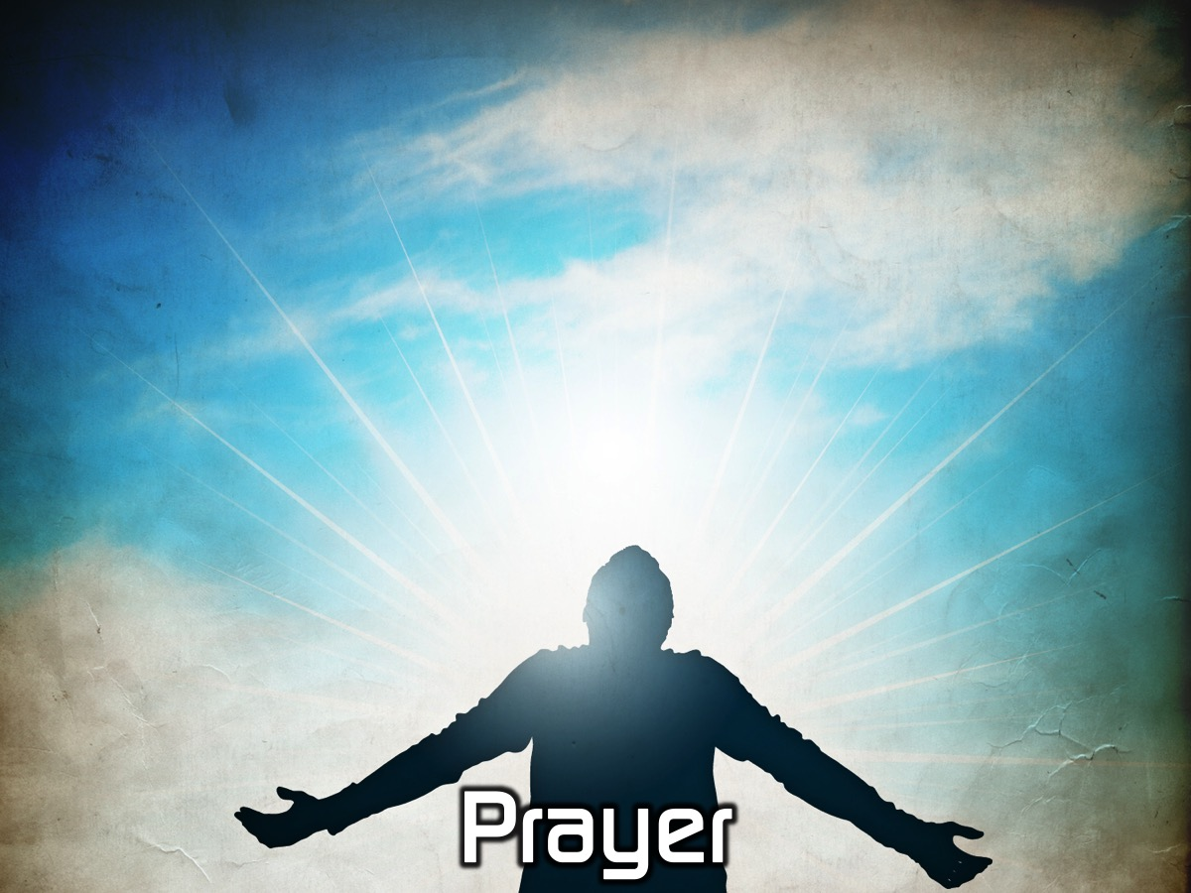
Notes:
Let’s open our meeting in prayer.

Slide 3
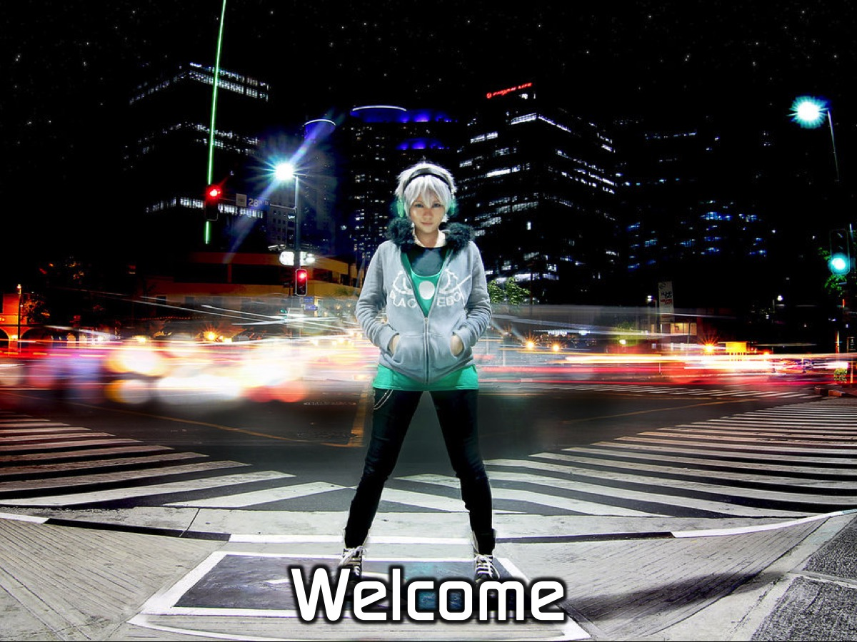
Notes:
Welcome to newcomers and regulars.

Slide 4
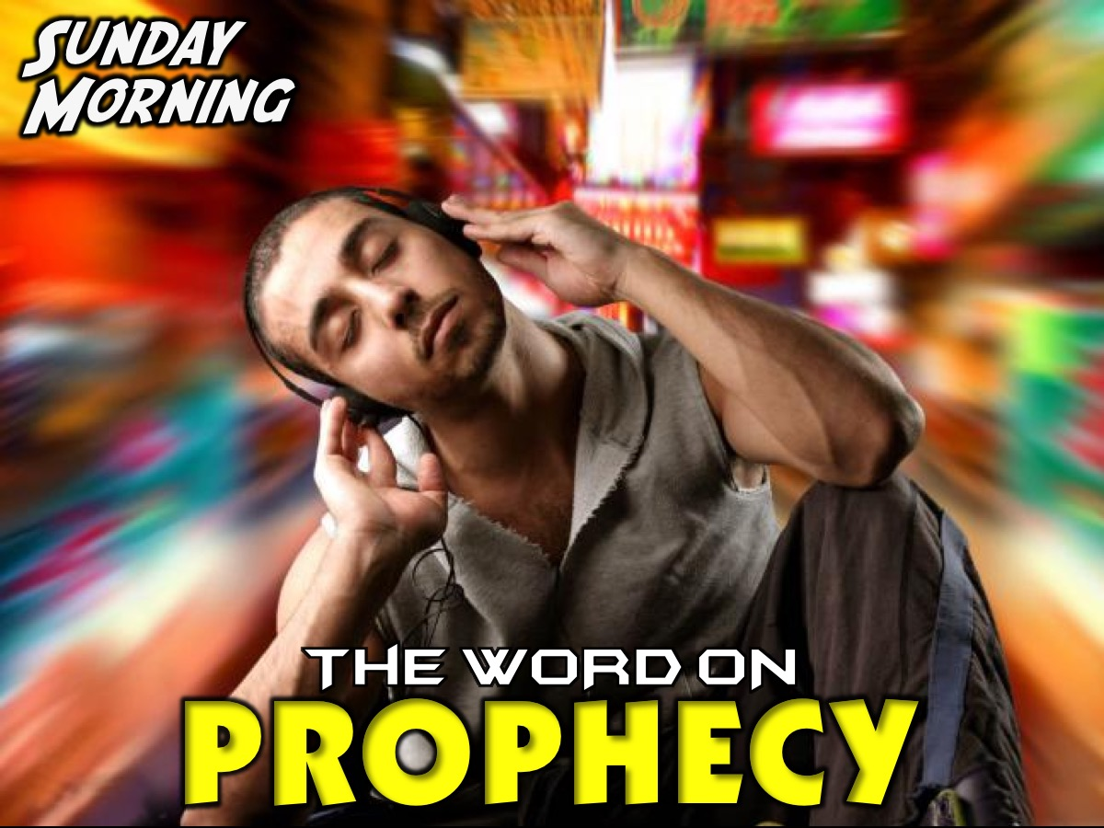
Notes:
On Sunday morning it is The Word-On series and we will be exploring what the Bible says about Prophecy.

Slide 5
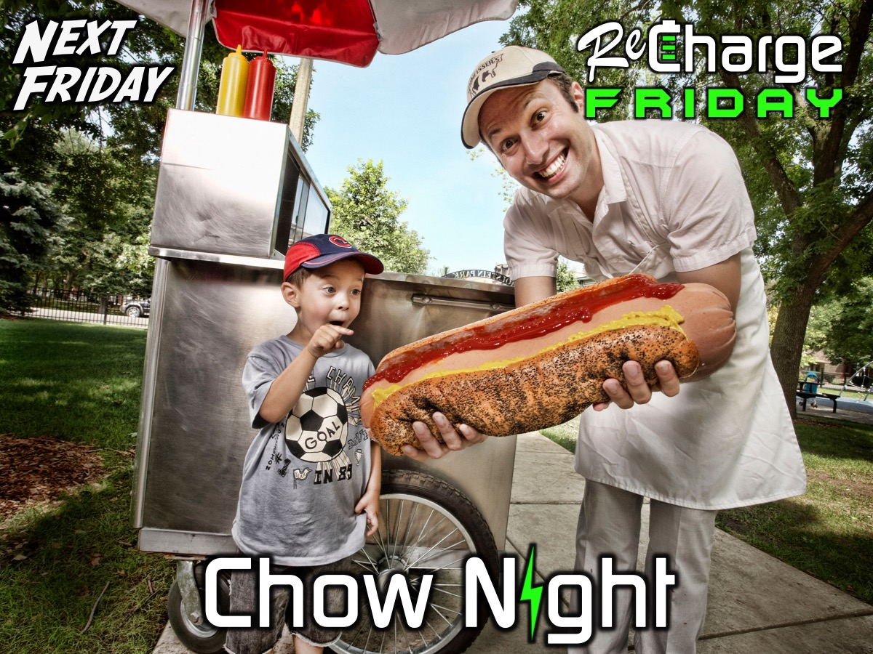
Notes:
Next Friday night is our Chow Night.

Slide 6

Notes:
Tonight is Encounter Night.

Slide 7
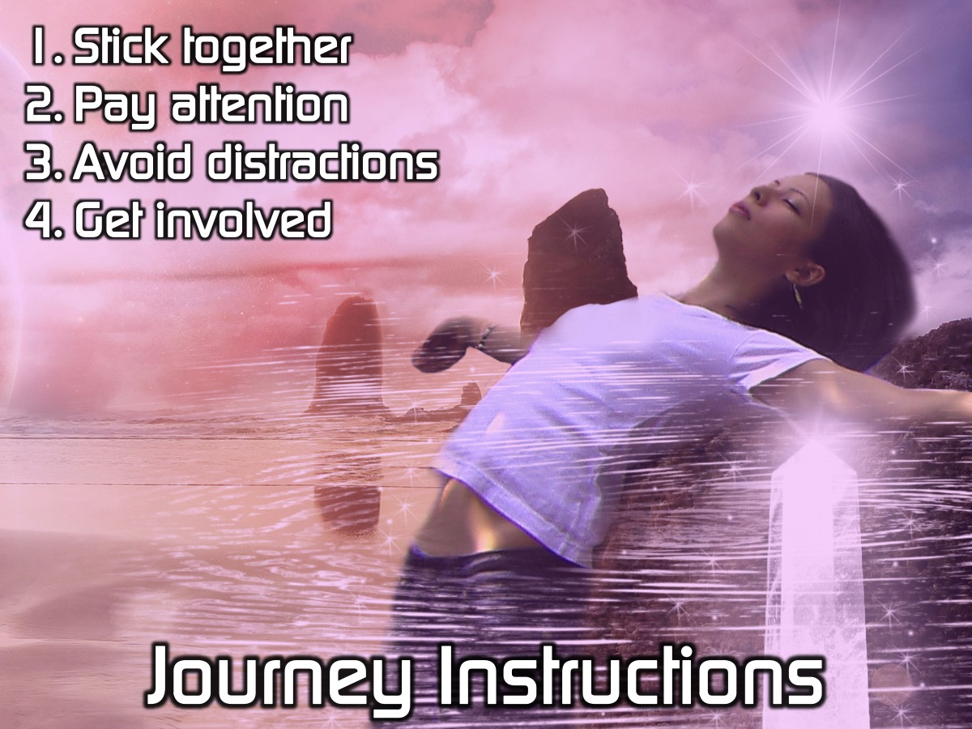
Notes:
Here are some instructions for our journey tonight: (1) Stick together. (2) Pay attention. (3) Avoid distractions. (4) Get involved.

Slide 8
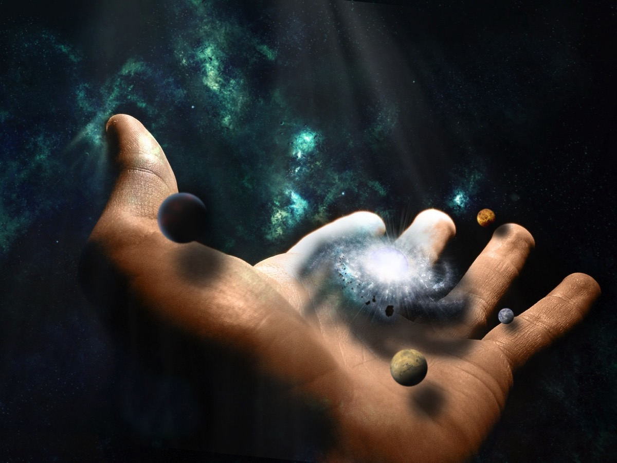
Notes:
[Scene: The audience is seated on chairs around tables in darkness. On stage there are 2 seats - the Narrator and God - and they read the story of the creation of the world and humans using this script and slides with images]
Narrator: In the beginning God created heaven and earth! (Genesis 1:1)

Slide 9
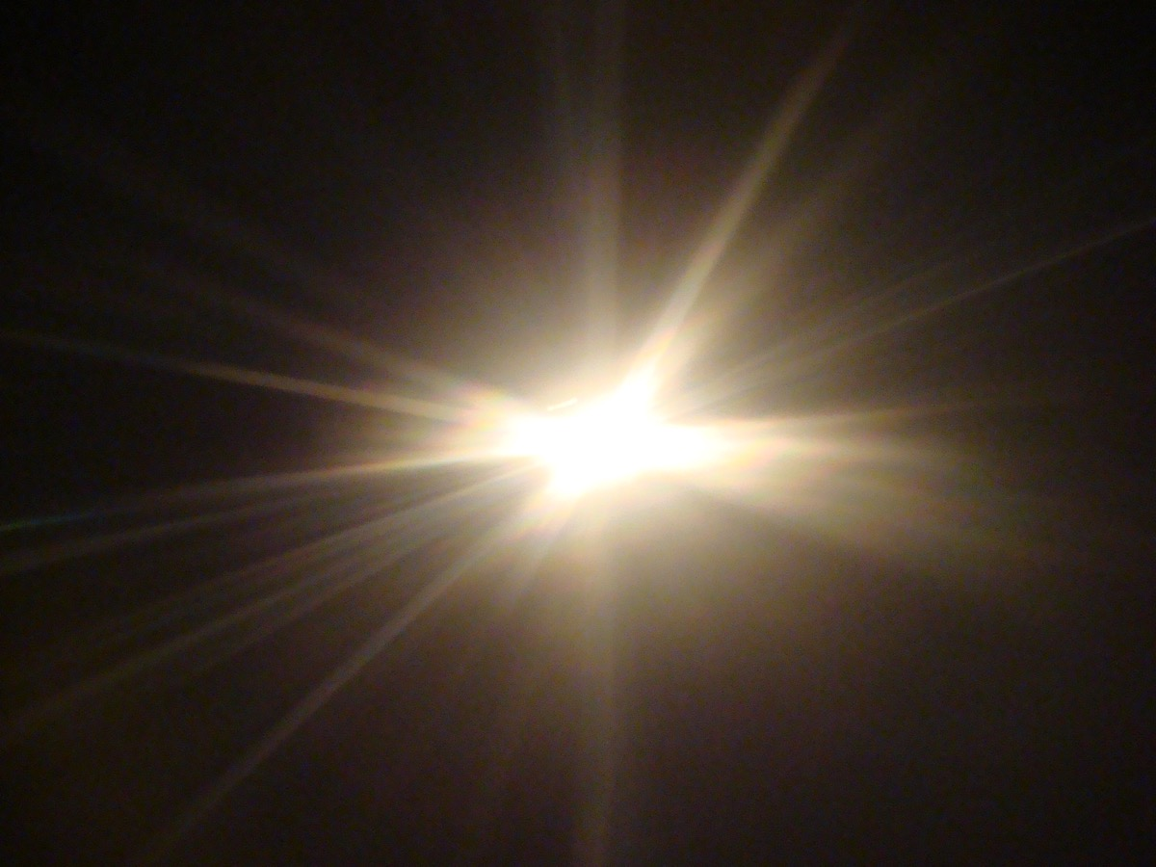
Notes:
[The stage lights are turned on when God says: “Let there be light!”]
Narrator: Then God said,
God: “Let there be light!”
Narrator: So there was light. God saw the light was good. So God separated the light from the darkness. God named the light day, and the darkness he named night. (Genesis 1:3-5)

Slide 10

Notes:
Narrator: Then God said,
God: “Let there be a horizon in the middle of the water in order to separate the water.”
Narrator: So God made the horizon and separated the water above and below the horizon. And so it was. God named what was above the horizon sky. (Genesis 1:6-8)

Slide 11
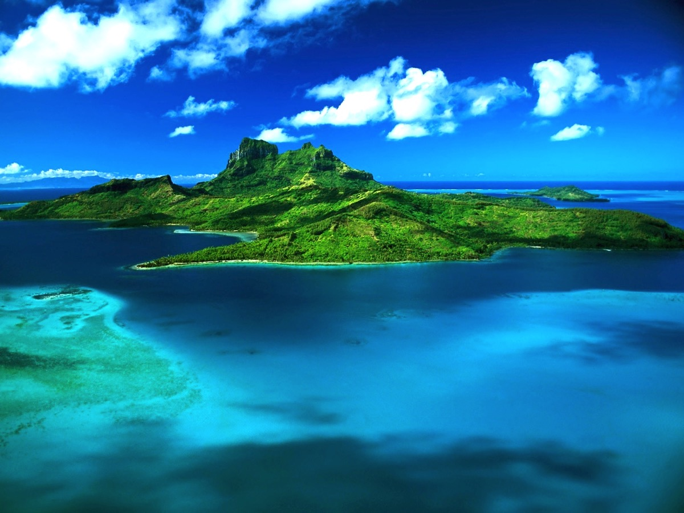
Notes:
Narrator: Then God said,
God: “Let the water under the sky come together in one area, and let the dry land appear.”
Narrator: And so it was. God named the dry land earth. The water which came together he named sea. God saw that it was good. (Genesis 1:9-10)

Slide 12
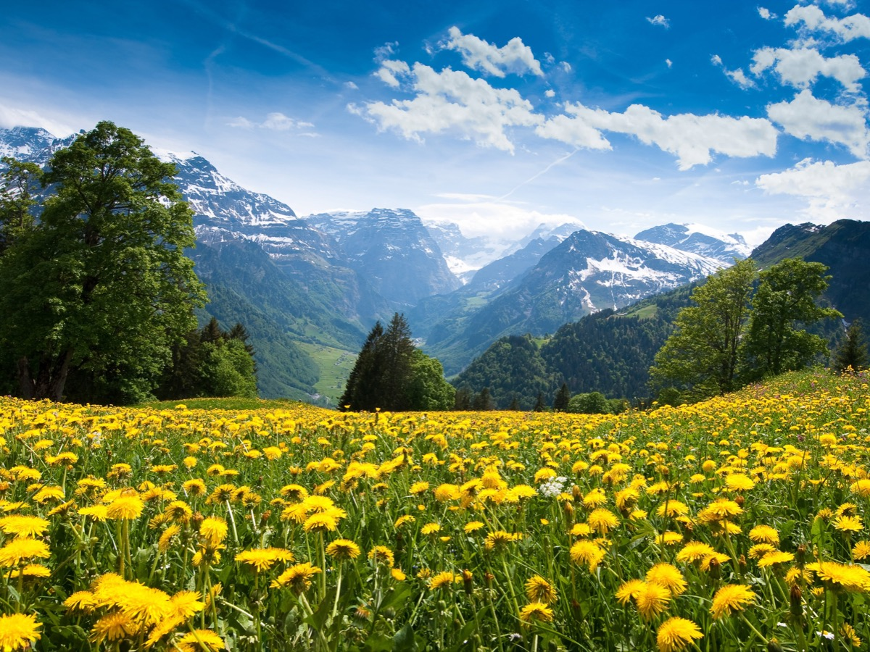
Notes:
Narrator: Then God said,
God: “Let the earth produce vegetation: plants bearing seeds, each according to its own type, and fruit trees bearing fruit with seeds, each according to its own type.”
Narrator: And so it was. (Genesis 1:11)

Slide 13
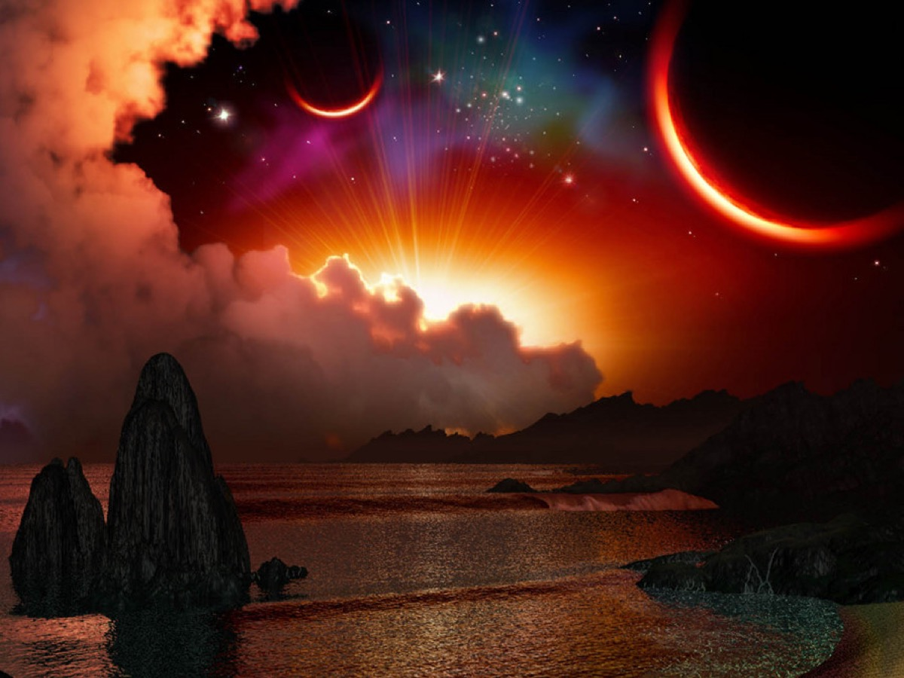
Notes:
[More room lights are turned on when God speaks]
Narrator: Then God said,
God: “Let there be lights in the sky to separate the day from the night. They will be signs and will mark religious festivals, days, and years. They will be lights in the sky to shine on the earth.”
Narrator: And so it was. God made the two bright lights: the sun to rule the day and the moon to rule the night. He also made the stars. (Genesis 1:14-16)

Slide 14
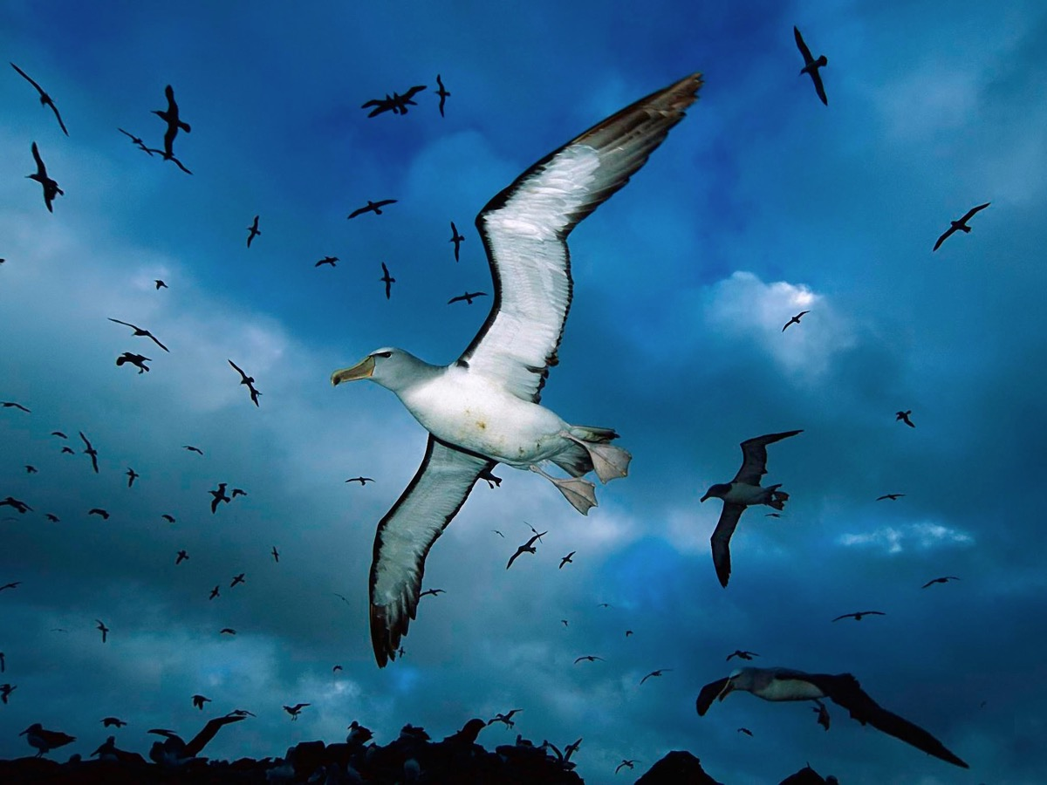
Notes:
Narrator: Then God said,
God: “Let birds fly through the sky over the earth.” (Genesis 1:20)

Slide 15
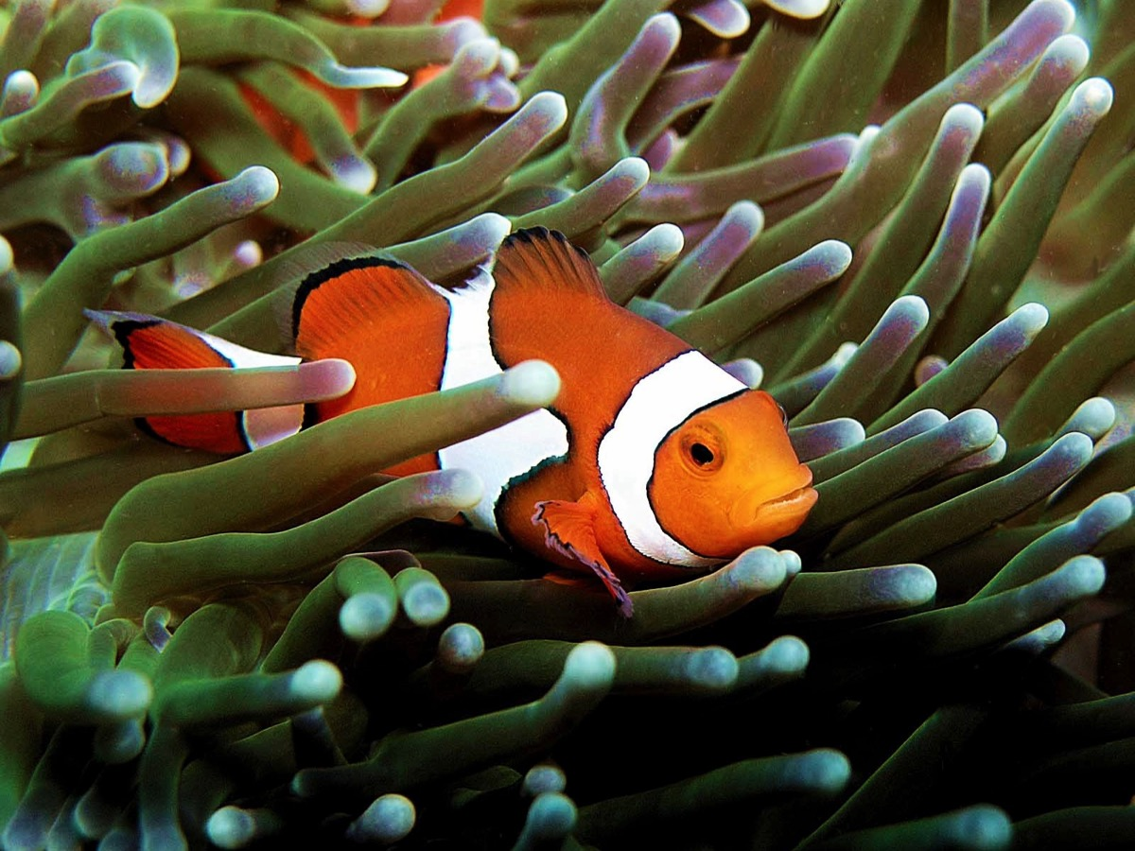
Notes:
Narrator: Then God said,
God: “Let the water swarm with swimming creatures.”
Narrator: And God saw that they were good.” (Genesis 1:21)

Slide 16
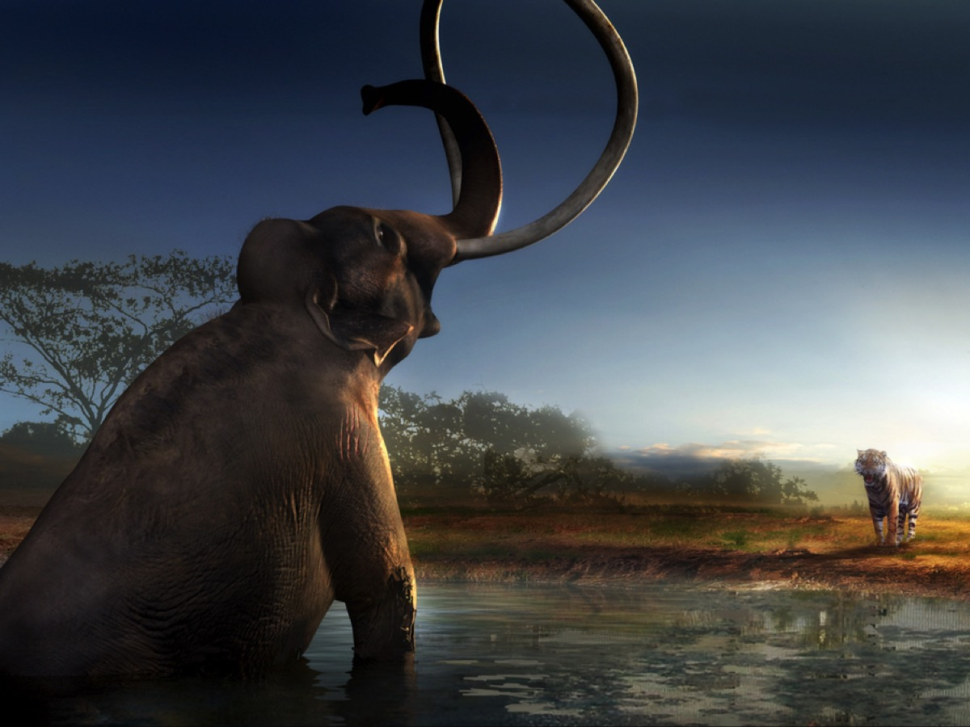
Notes:
Narrator: Then God said,
God: “Let the earth produce every type of living creature: every type of domestic animal, crawling animal, and wild animal.”
Narrator: And so it was. (Genesis 1:24)

Slide 17
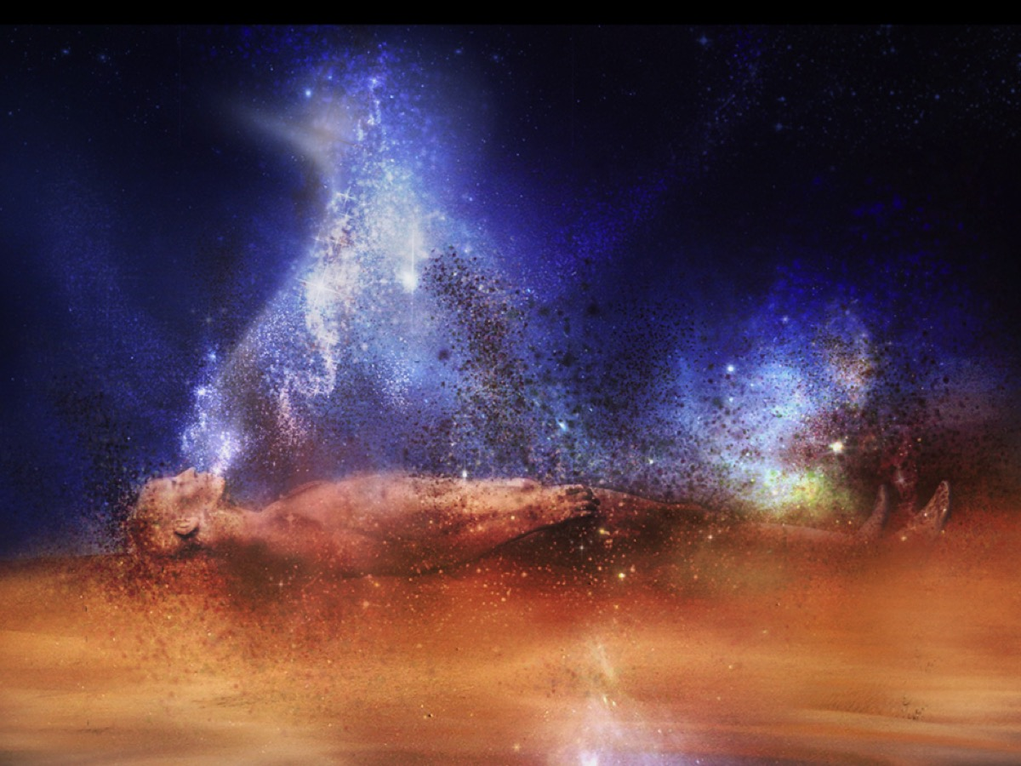
Notes:
Narrator: Then God said,
God: “Let us make humans in our image, in our likeness” (Genesis 1:26)

Slide 18
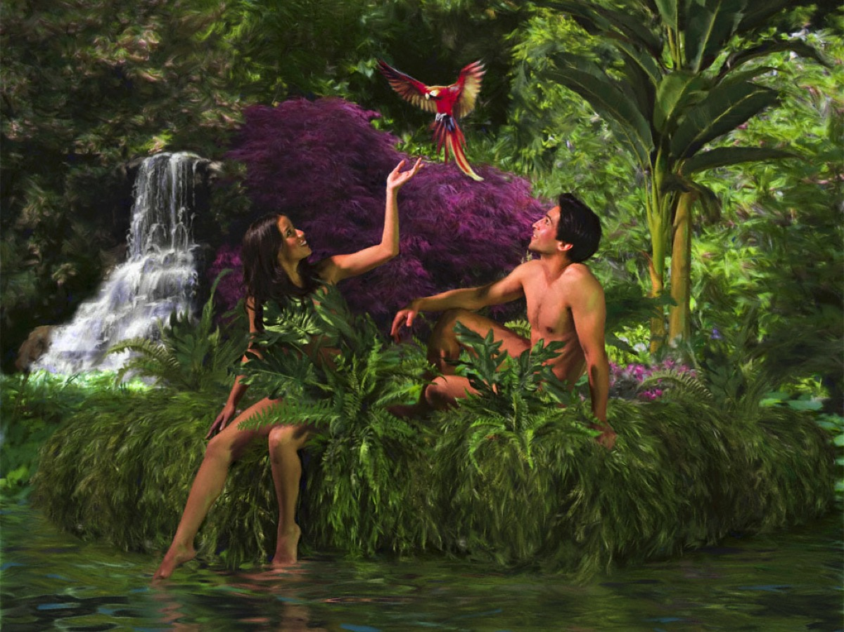
Notes:
Narrator: So God created mankind in his own image, male and female he created them. (Genesis 1:27)

Slide 19
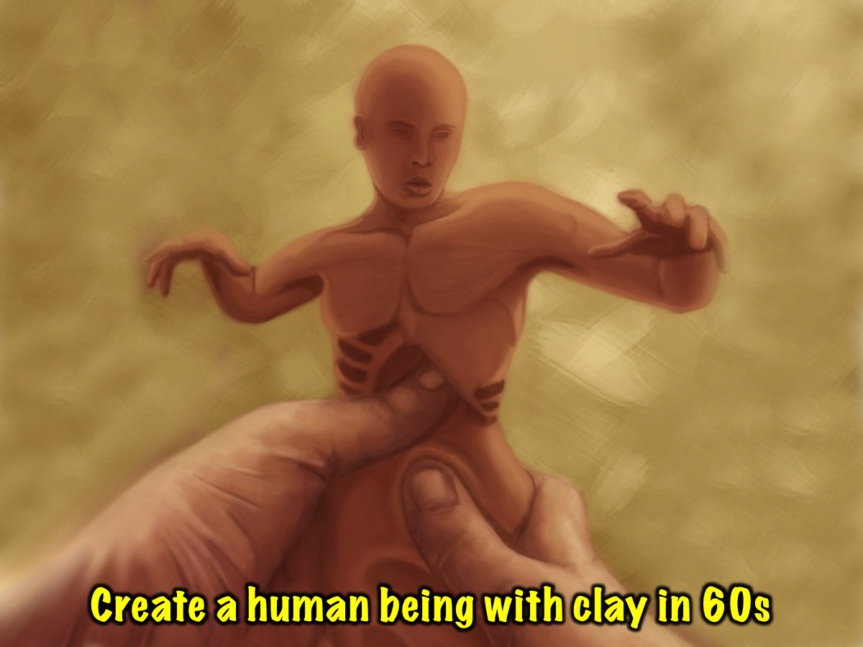
Notes:
Activity: Clay Moulding.
Narrator: On your tables there are pieces of clay. Take two pieces and create a human being.

Slide 20
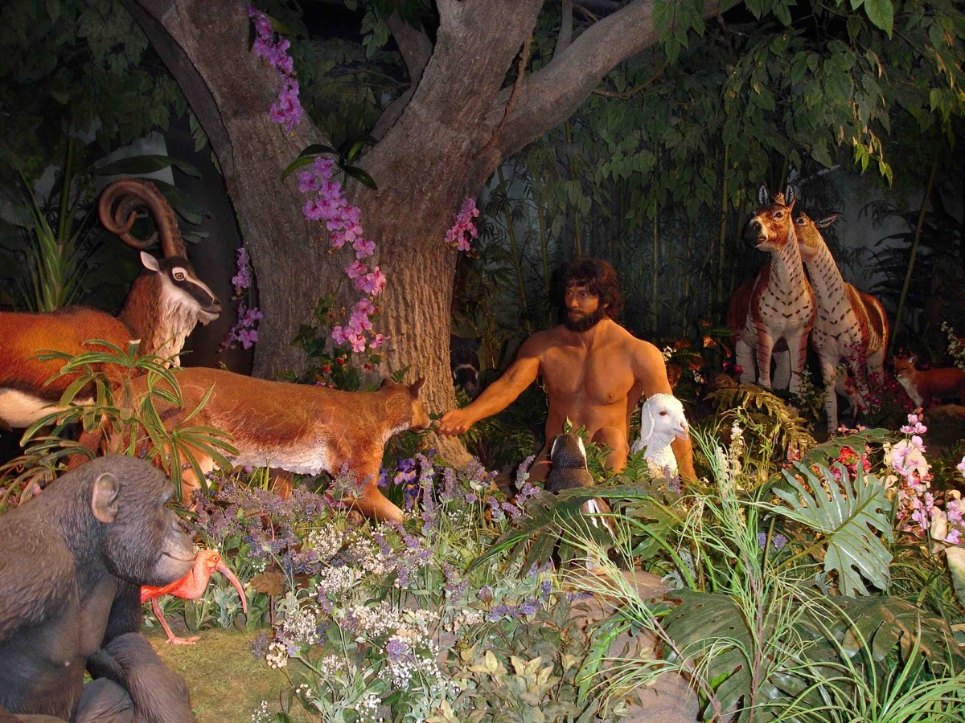
Notes:
Narrator: God blessed them and said,
God: “Be fertile, increase in number, fill the earth, and be its master. Rule the fish in the sea, the birds in the sky, and all the animals that crawl on the earth.” (Genesis 1:28)

Slide 21
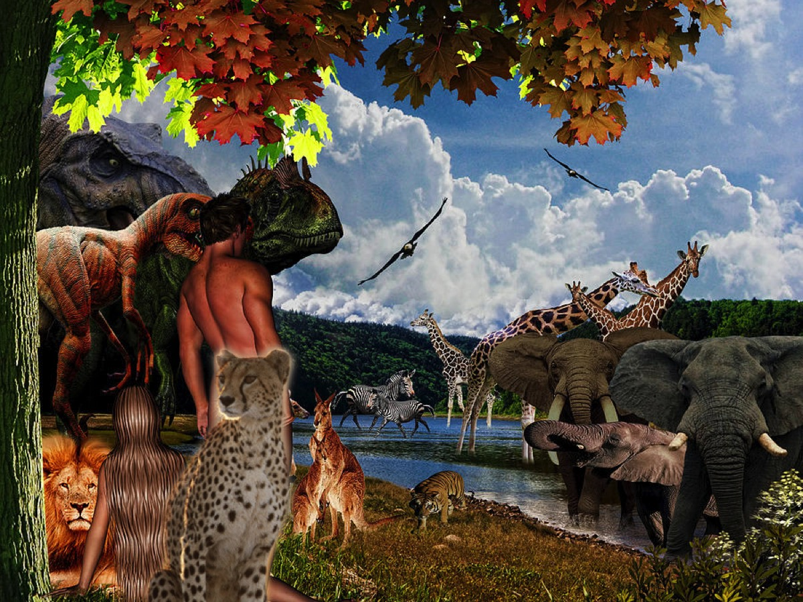
Notes:
Narrator: And God saw everything that he had made and that it was very good. (Genesis 1:31)

Slide 22
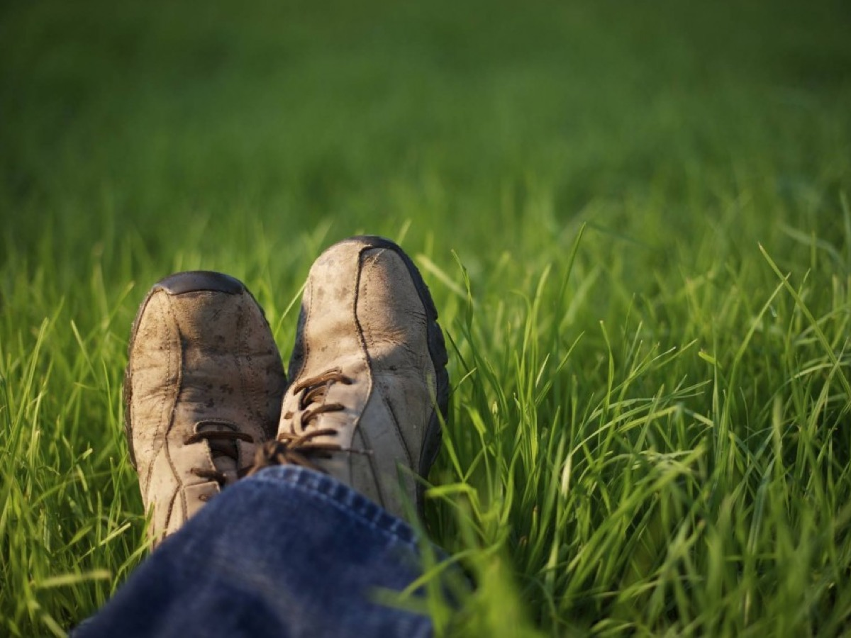
Notes:
Narrator: On the seventh day God stopped the work he had been doing. (Genesis 2:2)

Slide 23
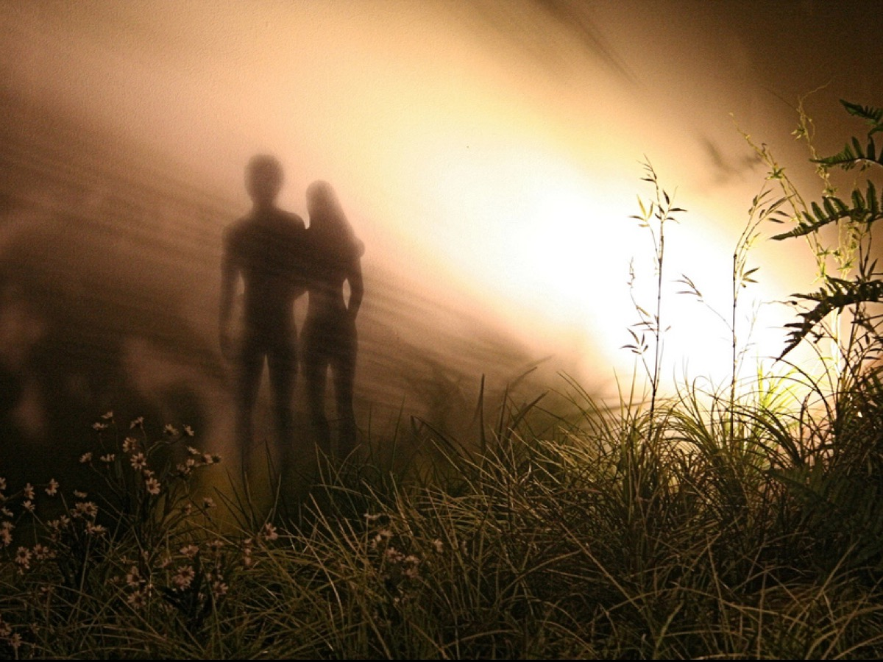
Notes:
Narrator: God used to walk with Adam and Even in the garden in the cool of the day (based on Genesis 3:8). Just imagine how awesome it must have been to have your creator walking around with you - he told them how much he loved them and had created them to be with him forever and they were able to respond with love and devotion.

Slide 24
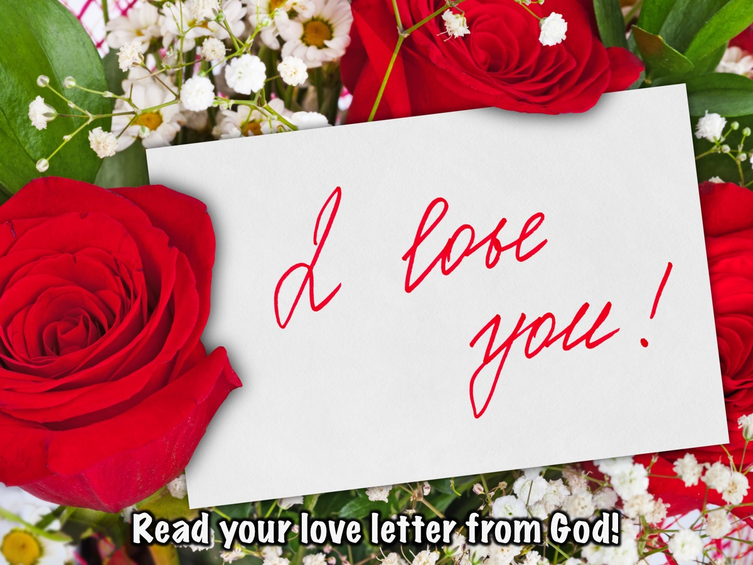
Notes:
Activity: The Love Letter From God:
Narrator: You are invited to come forward and receive a personal love letter from God. [“My dearest child. You are my unique and special creation. I crafted you in my own image, forming you out of the dust of the ground and breathing into you the breath of my spirit so you became a living being. I created you to enjoy the most intimate of relationships humans could ever experience - the ability to hear my voice and know that I hear your every word. I promise to walk with you and protect you from all harm. I will always love you because I made you and you are precious and honoured in my sight! With all my love, your father, God.”]

Slide 25
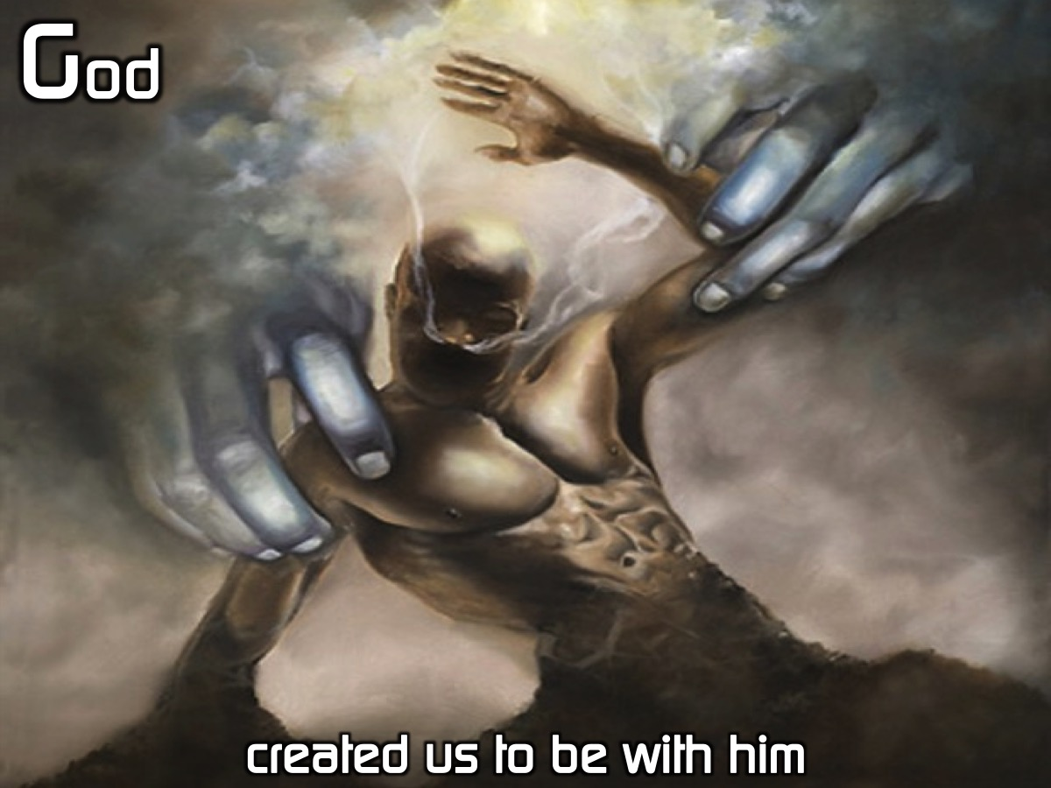
Notes:
Narrator: God created us to be with him. (1) We are a special creation of God handcrafted by God himself. (2) We were made in the very image of God. (3) We were created to connect with God on the deepest most intimate level.

Slide 26
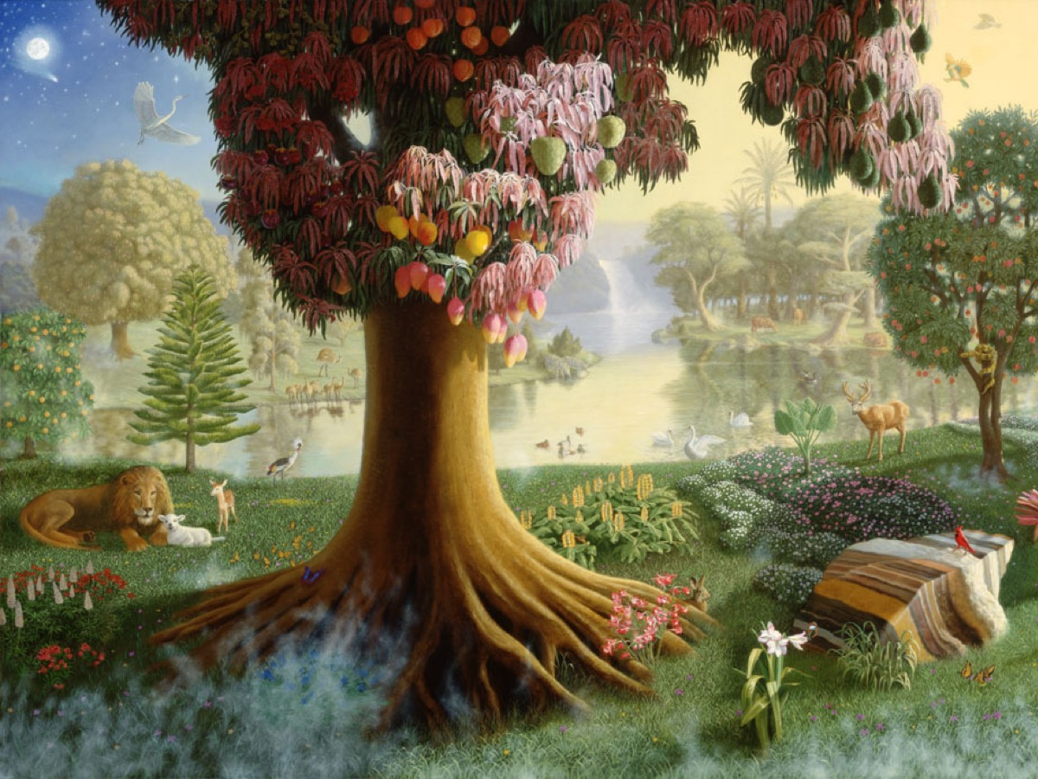
Notes:
Narrator: The Lord God took the man and put him in the Garden of Eden to work it and take care of it and told him,
God: “You are free to eat from any tree in the garden; but you must not eat from the tree of the knowledge of good and evil, for when you eat from it you will certainly die.” (Genesis 2:15-17)

Slide 27
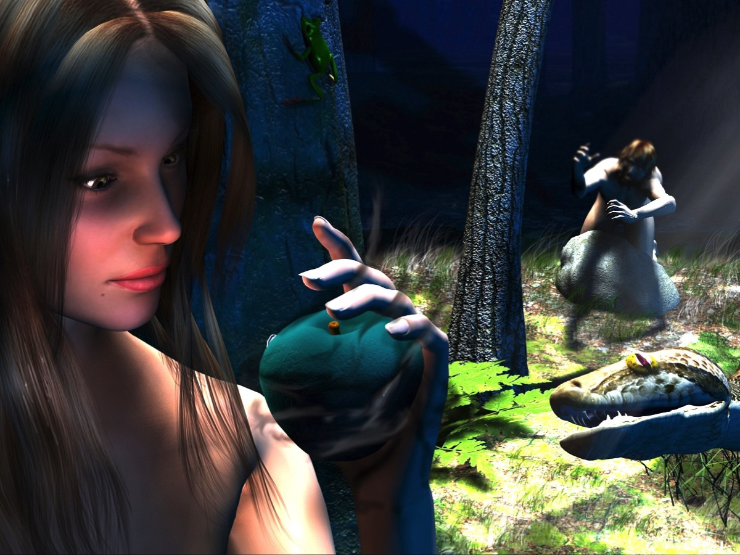
Notes:
Narrator: When the woman saw that the fruit of the tree was good for food and pleasing to the eye, and also desirable for gaining wisdom, she took some and ate it. She also gave some to her husband, who was with her, and he ate it. (Genesis 3:6)

Slide 28
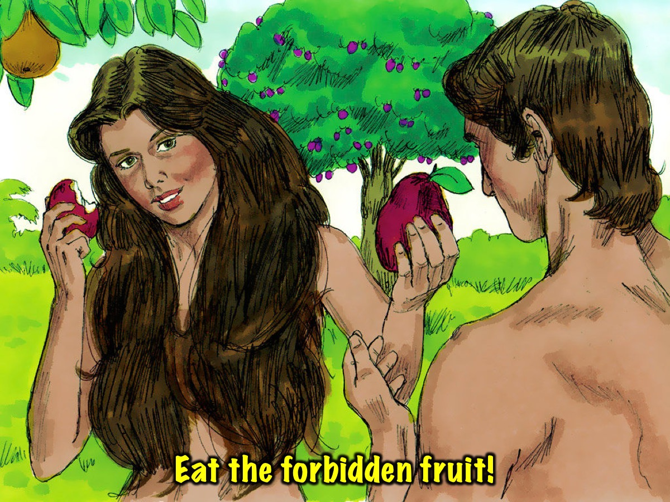
Notes:
Narrator: There is a bowl of forbidden fruit - you will now come forward and eat a piece.

Slide 29
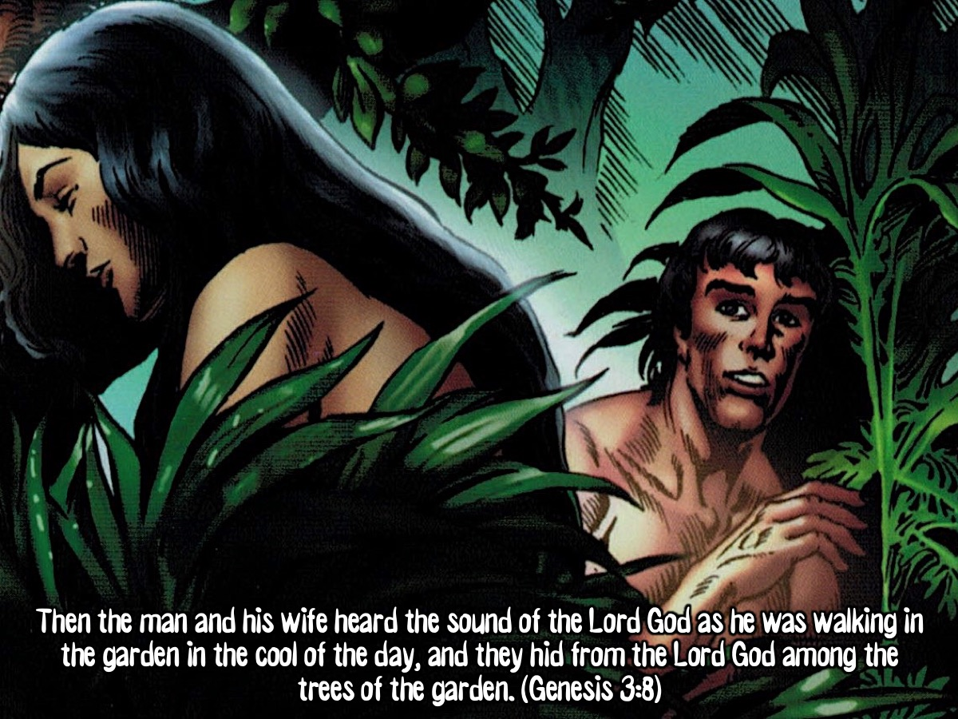
Notes:
Narrator: Then the man and his wife heard the sound of the Lord God as he was walking in the garden in the cool of the day, and they hid from the Lord God among the trees of the garden. (Genesis 3:8)

Slide 30
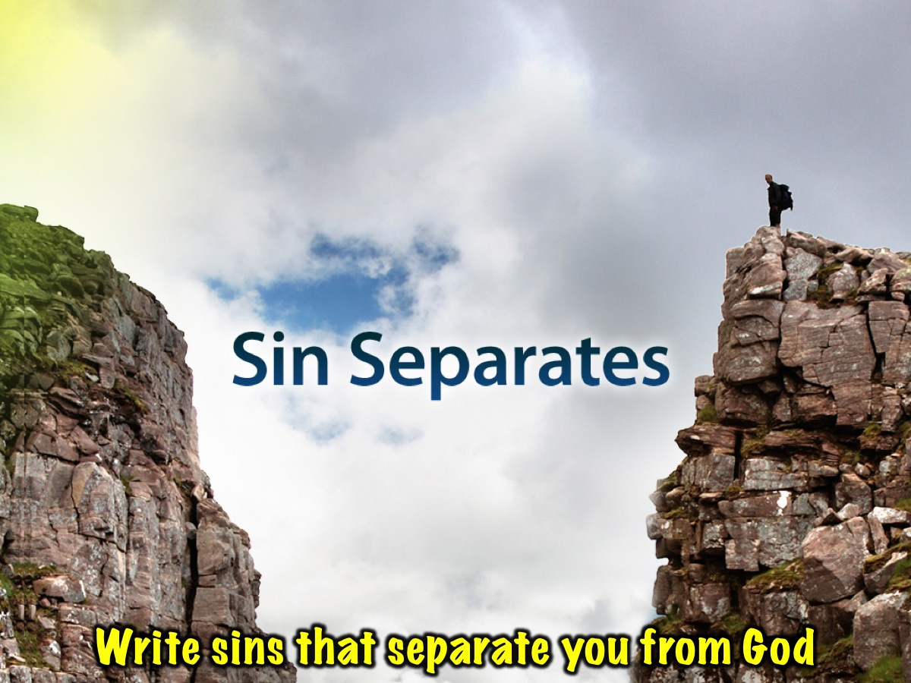
Notes:
Activity: The Graffiti Wall.
Narrator: Each of you must go to the graffiti wall and write down at least one sin that you have committed.

Slide 31
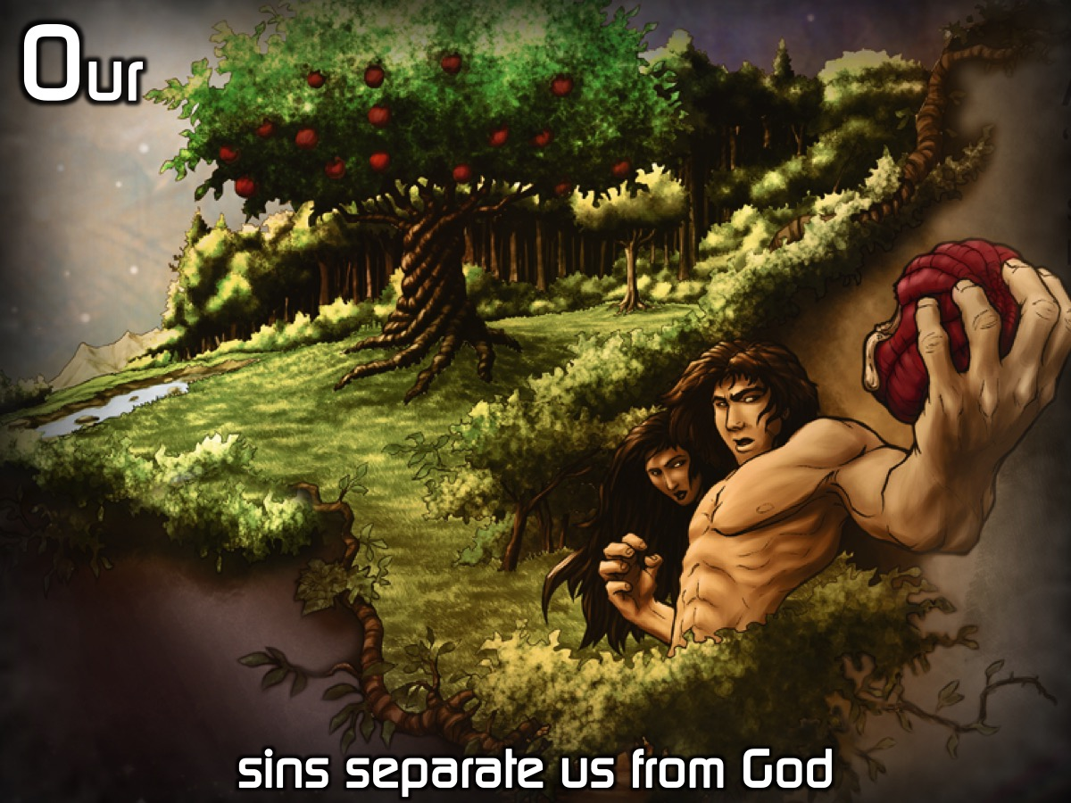
Notes:
Narrator: Our sins separate us from God. (1) Sin is breaking God’s commands, violating God’s character and missing God’s mark. (2) When Adam and Eve sinned everything changed: Their eyes were opened their doom was sealed and their descendants were condemned. They lost the intimate relationship they had with God and instead of running towards him they found themselves hiding from him.

Slide 32
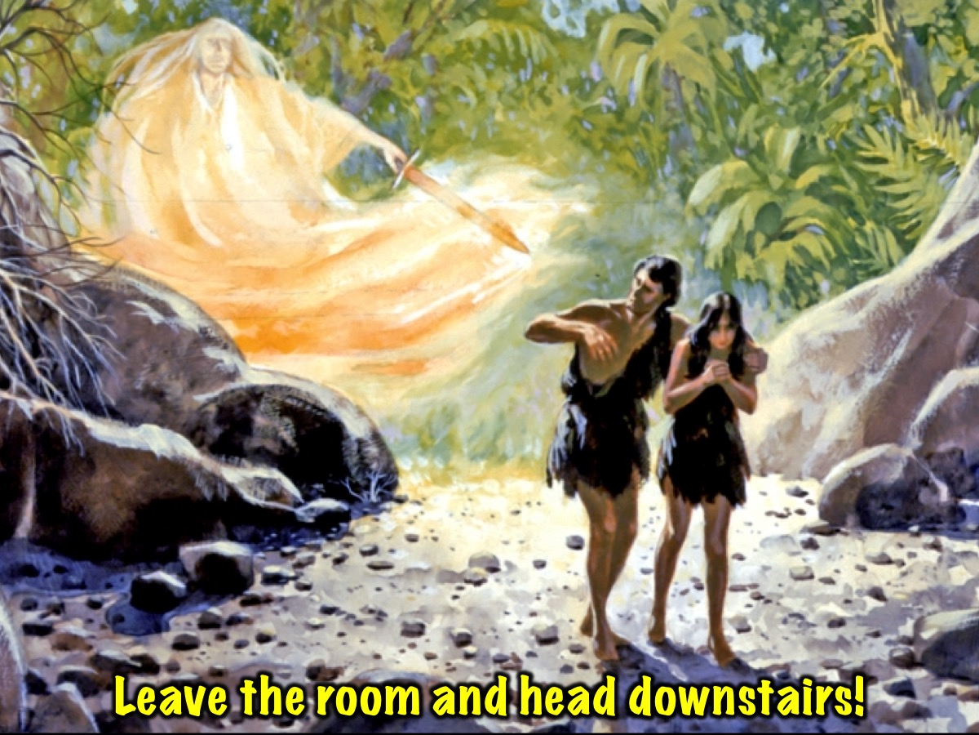
Notes:
Narrator: So the Lord God banished him from the Garden of Eden to work the ground from which he had been taken. (Genesis 3:23). You are no longer allowed to remain in God’s presence – make your way out of the room.
Activity: Leave The Room. Teens leave the youth room and make their way down to the next venue.

Slide 33
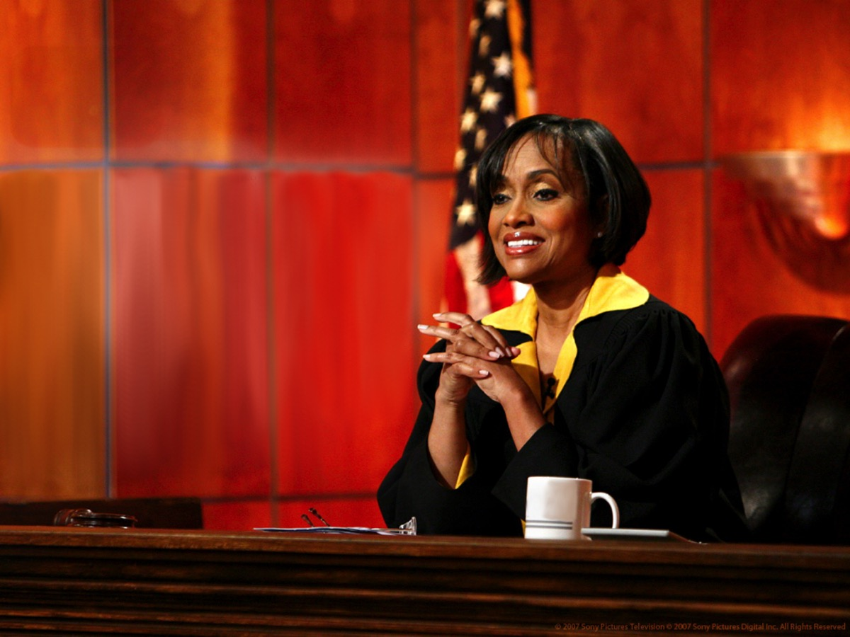
Notes:
Activity: The Courtroom Drama. Teens enter the room and take their seats, but a bailiff stands and says: “All rise” as the judge makes her way to the front. The judge addresses the audience: “If you wrote a sin on the graffiti wall at the last station you will not be allowed to leave this room until you have paid for your sins - an amount of R100 for every sin you have ever committed. You could try and work off your debit but it would require washing dishes at a local restaurant and it would be a year for every sin you have ever committed. You could do jail time if you choose that, but it would require doing a year for every sin. Sadly it seems that you would die in prison as your life would run out before your debt has been paid.”

Slide 34
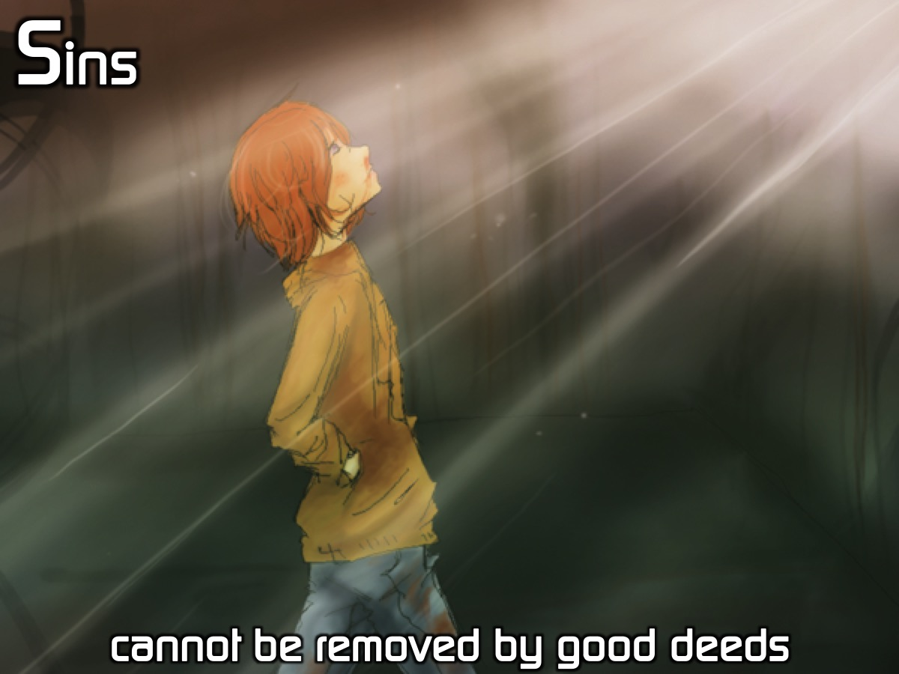
Notes:
Narrator: Sins cannot be removed by good deeds. (1) Because we could never be good enough (Matthew 5:48 says we must be perfect). (2) Because the Law is a mirror to show us our sin and not a ladder to get us to heaven. (3) Because even our good deeds come from selfish motives (Isaiah 64:6 says that even our righteous acts are like filthy rags).

Slide 35
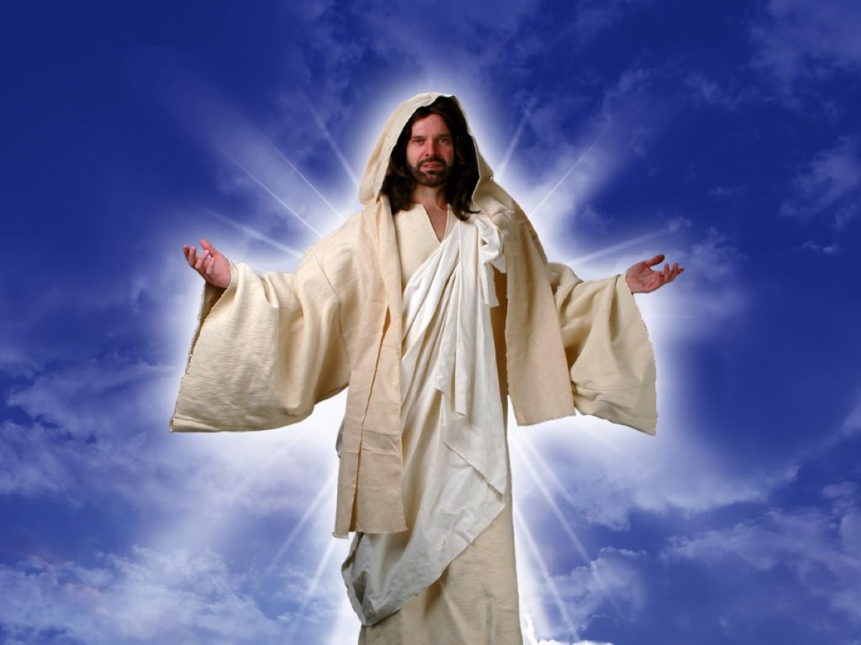
Notes:
Narrator: Just when you think that all is lost and you will never leave the room, a person enters - it is Jesus - and he offers to give his life to pay the debt that we owe and the Judge agrees and we are invited to follow Jesus out of the venue into the next venue.

Slide 36
Notes:
Video: Third Day - Carry My Cross. Get it on YouTube: https://www.youtube.com/watch?v=G8RVYjfgsto
[Wait a few minutes in darkness before playing the next video]

Slide 37
Notes:
Video: The Passion: Jesus Resurrection. Get it on YouTube at: https://www.youtube.com/watch?v=j2Mnsxj2N7Y

Slide 38
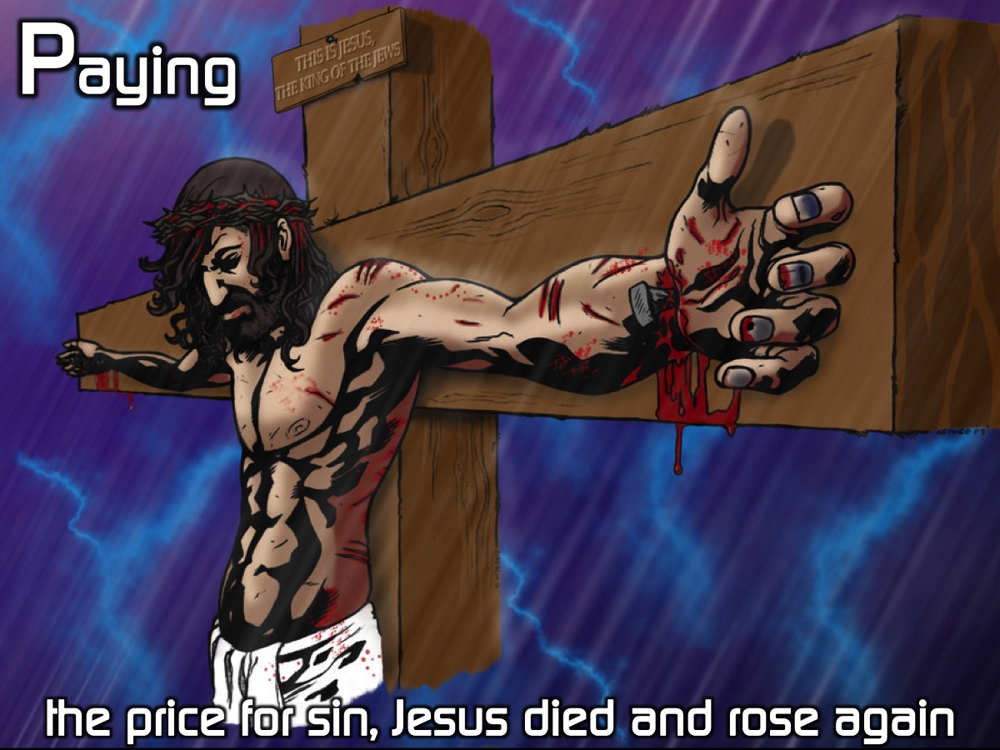
Notes:
Narrator: Paying the price for sin, Jesus died and rose again. (1) Jesus died in our place for our sins. (2) His resurrection demonstrated that He was who He claimed to be - the Son of God, our Saviour.

Slide 39

Notes:
Activity: The Eternal Life Gift Voucher.
Narrator: Jesus is offering you eternal life – if you are interested then he has vouchers that you can collect from him. [Create gift vouchers that teens can collect from the person playing the role of Jesus – the voucher speaks of how when you trust in Jesus for salvation you will be saved because he exchanges our sin for his righteousness.]

Slide 40
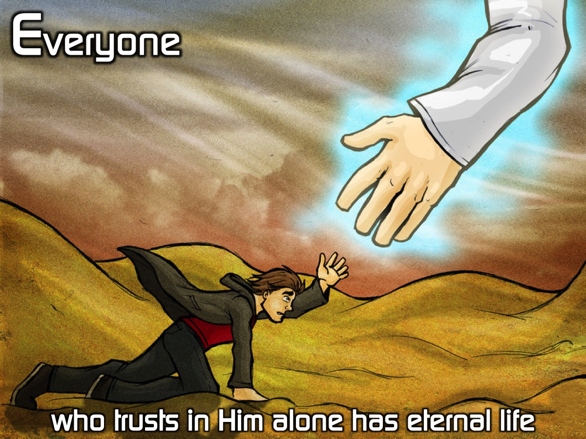
Notes:
Narrator: Everyone who trusts in Him alone has eternal life. (1) We are saved by grace through faith, not by good works. (2) We are justified by God the Father through faith in Jesus alone). (3) When we trust in Jesus as our savior he exchanges our sin for his righteousness.

Slide 41

Notes:
Narrator: Make your way back to the youth room.

Slide 42

Notes:
Narrator: Welcome back to the place of intimacy with Father God - where you started.
Activity: The Eternity Rope. Use a long rope as an illustration of eternity but then show that on one end there is a small coloured section that represents our life on earth. Show how that our live with Jesus starts here on earth but that is only a fraction of that time that we will spend forever in the presence of Jesus. It is not just a long time but an awesome time in Gods presence - with our Creator.

Slide 43
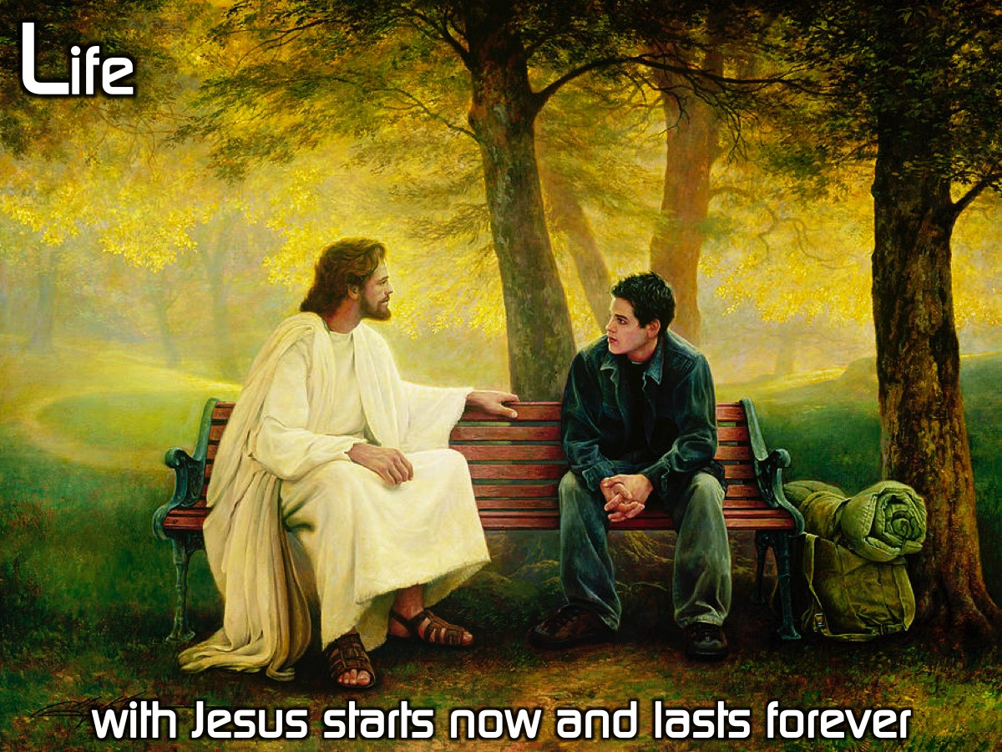
Notes:
Narrator: Life with Jesus starts now and lasts forever. (1) Eternal life begins as soon as you believe in Jesus it is not something you get when you die. (2) Eternal life is eternal - it will never end!. (3) Eternal life is not just about the quantity, but the quality of life with Jesus!

Slide 44
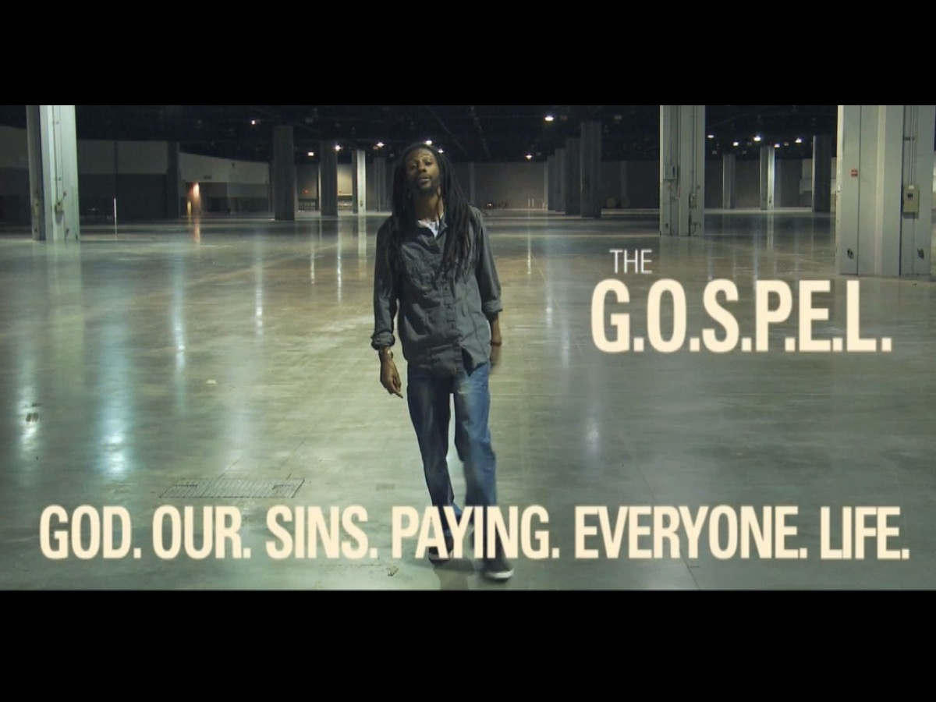
Notes:
Video: We are going to watch a video called: Life in 6 Words.

Slide 45
Notes:
Video: Life in 6 Words. Get it on YouTube at: https://www.youtube.com/watch?v=jyYFxp7apl4

Slide 46
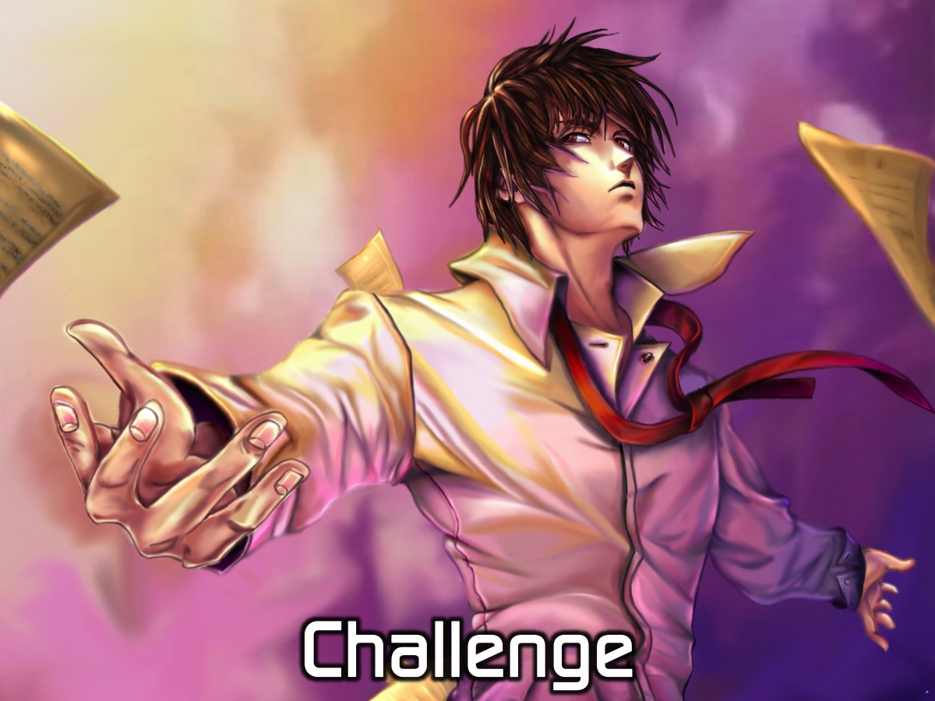
Notes:
Challenge: Tonight we got a front row seat to one of the coolest renditions of the Gospel on the planet. We listened to a man pour out his heart about what the Gospel means to him. We heard how the Gospel changed him, and what it means to us. Do YOU understand the Gospel? Do you really believe that the Gospel of Jesus Christ is about Him saving you…not you trying to save yourself? Do you really believe that Christ that came into the world to save sinners? No matter how wicked they were? Do you really believe that the Gospel of Jesus Christ is true and that it can save you? God. Our. Sins. Paying. Everyone. Life. Every word is important. God is perfect. We are sinful. God paid the debt that resulted from our sin. We are given life instead of death. Do you truly believe this? If so, great! You’ve got the biggest part of life figured out! If not, then know that God is calling out to you right now to come into a relationship with Him that is perfect. But you can only do this through Jesus, the Son of God who paid our debt on sin by dying on a cross and rising to life three days later. Right now, I invite you to put your trust in this Gospel, in this Savior. You can do so right where you are. We’re going to say a prayer, but if you would like to talk about this further, there will be time in your small groups.

Slide 47
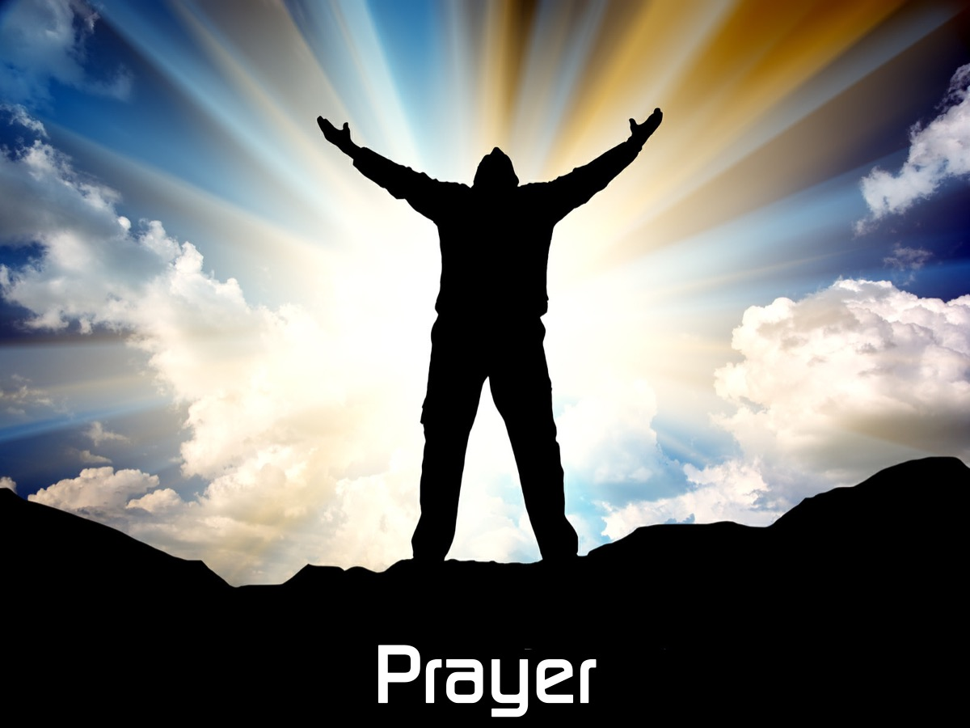
Notes:
Prayer:
Narrator: Dear Lord, thank you for tonight, for reminding us that you created us to enjoy a close relationship with you. We realize that our sins separated us from you and that we cannot remove our sins through good deeds. We understand that Jesus died and rose again to pay for our sins and right now we put our trust in you and receive the free gift of eternal life. We are so excited about getting to start eternal life right now and know that it will never end. Amen.

Slide 48
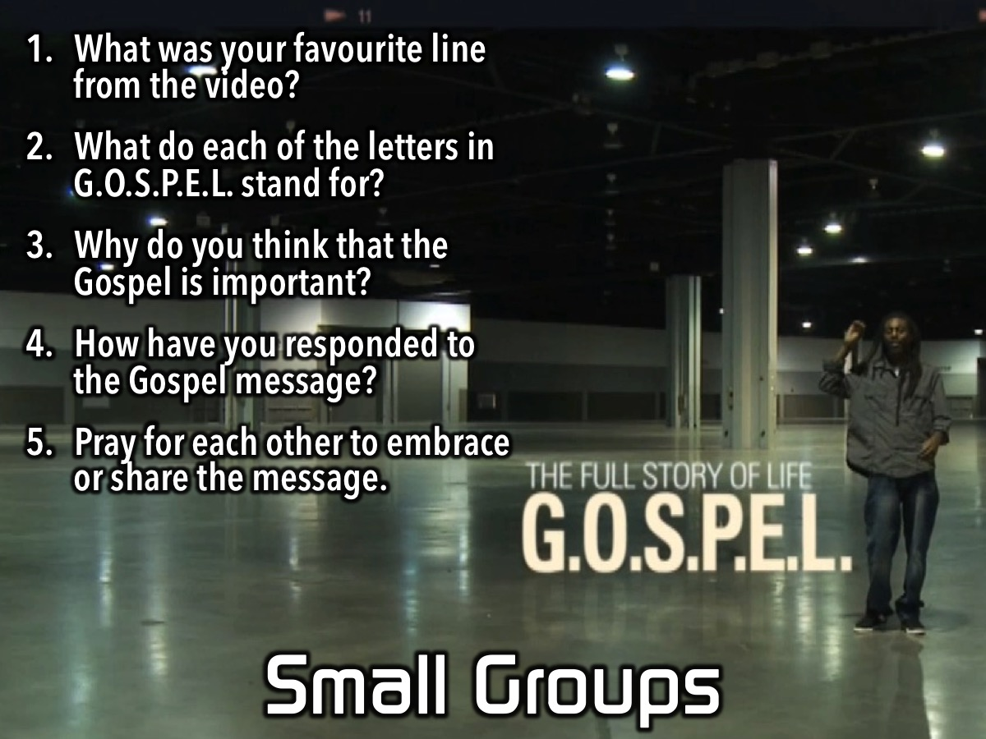
Notes:
Small Groups. Here are the questions for our small group time: (1) What was your favourite line from the video? (2) What do each of the letters in G.O.S.P.E.L. stand for? (3) Why do you think that the Gospel is important? (4) How have you responded to the Gospel message? (5) Pray for each other to embrace or share the message.

Slide 49
Notes:
On Sunday morning it is The Word-On series and we will be exploring what the Bible says about Prophecy.

Slide 50
Notes:
Next Friday night is our Chow Night.

Slide 51

Notes:
It is time for Refreshments.

